Slide 1
2017 Hurricane Model Implementations Briefing to NCEP Director: Much improved operational forecast guidance for global tropical cyclones
Avichal Mehra
(on behalf of the EMC Hurricane Team)
Environmental Modeling Center,
NCEP/NOAA/NWS, NCWCP, College Park, MD 20740.
in collaboration with
NHC, DTC, JTWC, GFDL, ESRL, HRD and URI
Briefing to NCEP Director, April 28, 2017
Notes:
1
1

Slide 2
FY17 NCEP Operational Hurricane Models (proposed) 2017 HMON V1.0.0
Briefing to NCEP Director, April 28, 2017
Notes:
2
2

Slide 3
2017 HMON V1.0.0 (A new Operational Hurricane Model at NCEP)
Notes:
3
3

Slide 4
HMON: Hurricanes in a Multi-scale Ocean coupled Non-hydrostatic model
HMON: Advanced Hurricane Model using NMMB (Non-hydrostatic Multi-scale Model on a B grid) dynamic core which is currently being used in NCEP’s operational NAM and SREF systems.
Shared infrastructure with unified model development in NEMS. A step closer towards NEMS/FV3 Unified Modeling System for hurricanes
Much faster, scalable and uses CCPP style physics package
Development supported by NGGPS, HFIP and HIWPP programs
Provides high-resolution intensity forecast guidance to NHC along with HWRF (replacing the legacy GFDL hurricane model)
27

Slide 5
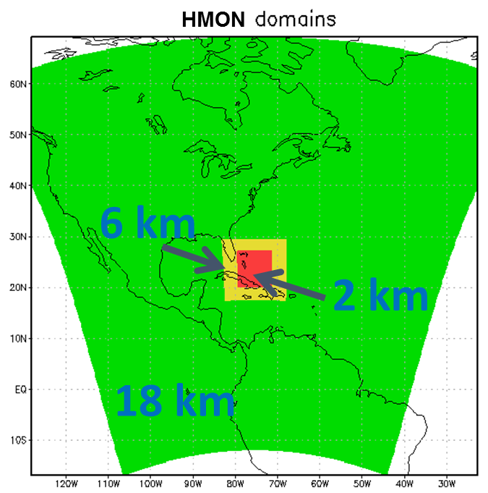
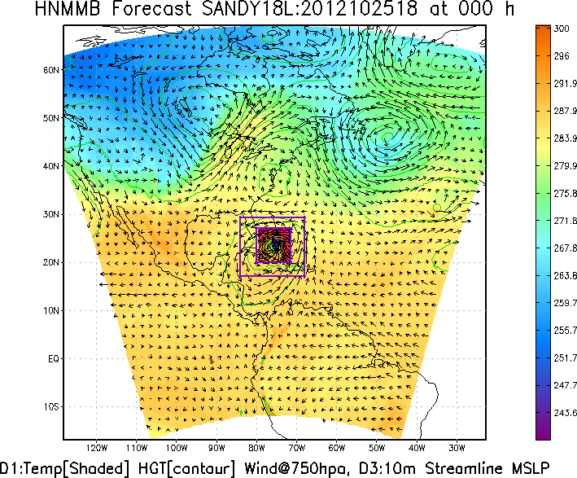
HMON: A New Operational Hurricane Model at NCEP
HMON
HMON: Hurricanes in a Multi-scale
Ocean coupled
Non-hydrostatic model
HMON: Implements a long-term strategy at NCEP/EMC for multiple static and moving nests globally, with one- and two-way interaction and coupled to other (ocean, wave, land, surge, inundation, etc.) models using NEMS-NUOPC infrastructure.
28

Slide 6
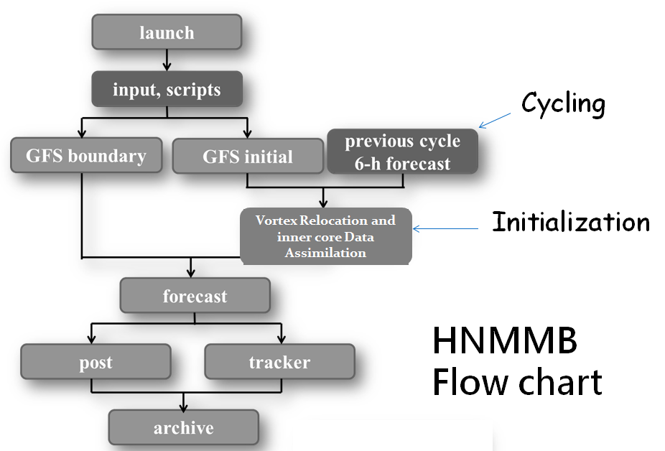
Design of HMON Workflow
HYCOM
Coupler
29

Slide 7
HWRF vs GFDL vs HMON
(Maintain Diversity of Hurricane Numerical Guidance)
 | 2017 HWRF | 2016 GFDL | 2017 HMON
Dycore | Non-hydrostatic, NMM-E | Hydrostatic | Non-hydrostatic, NMM-B
Nesting | 18/6/2 kms; 75°/25°/8.3°, Full two-way moving | ½.°,1/6°,1/18°; 75°/11°/5°, Two-way moving with bc | 18/6/2 kms; 75°/12°/8°, Full two-way moving
Data Assimilation and Initialization | Self-cycled two-way HWRF EnKF-GSI with inner core DA (TDR); Vortex relocation & adjustment | Spin-up using idealized axisymmetric vortex | Vortex relocation & adjustment
Physics | Updated surface (GFDL),GFS-EDMF PBL, Scale-aware SAS, NOAH LSM, RRTM, Ferrier | Surface (GFDL), GFS PBL(2014), SAS, GFDL LSM, RRTM, Ferrier | Surface (GFDL), GFS PBL (2015), SAS, NOAH LSM, RRTM, Ferrier
Coupling | MPIPOM/HYCOM, RTOFS/GDEM, Wavewatch-III | MPIPOM, RTOFS/GDEM, No waves | HYCOM, RTOFS/NCODA, No waves
Post-processing | NHC interpolation method, Updated GFDL tracker | NHC interpolation Method, In-line tracker | NHC interpolation method, GFDL tracker
NEMS/NUOPC | No | No | Yes with moving nests
30

Slide 8
HMON Verification for Atlantic Storms
(2014-2016)
Configuration: HWRF physics + vortex initialization + no data assimilation + no ocean coupling

Slide 9
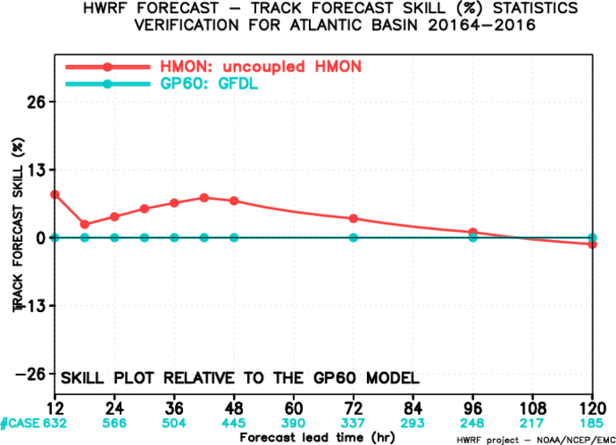
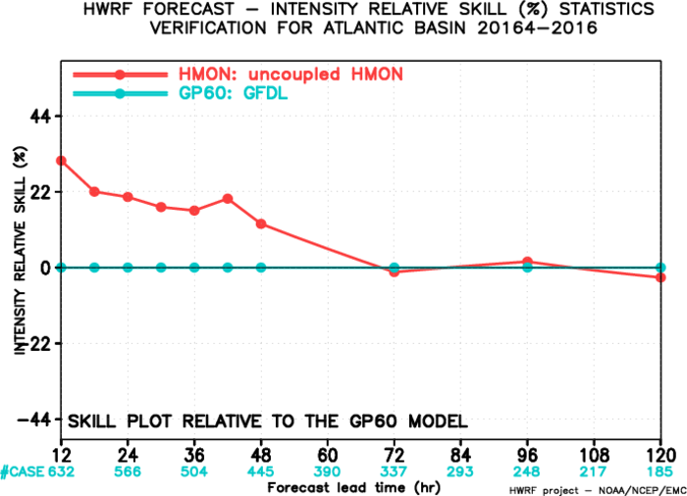
2014-16 Atlantic Basin: Relative to GFDL
(Late model)
HMON has improved track skills as compared to GFDL at all lead times except for Day 5. The positive skill goes down by Day 4 for tracks and Day 3 for Intensity.
32

Slide 10
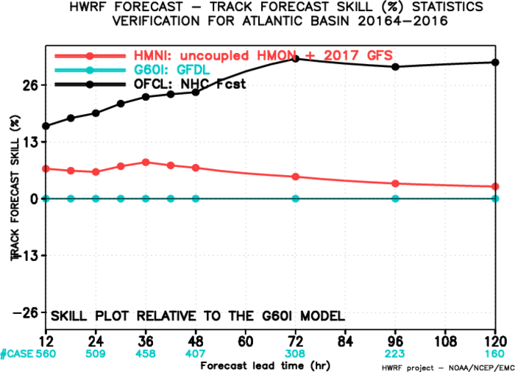
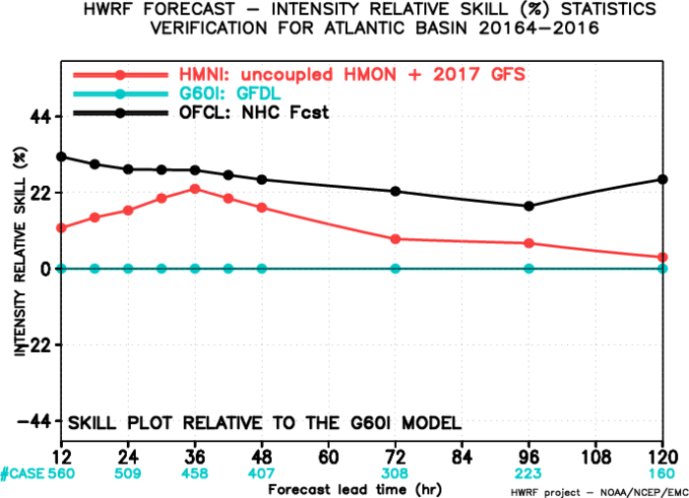
2014-16 Atlantic Basin: Relative to GFDL
(Interpolated)
HMON has improved track skills as compared to GFDL at all lead times with an average improvement of more than 5%. It also has improved intensity skills with a mean improvement of >10%. Both tracks and intensity need to close gap with the official skill.
33

Slide 11
HMON Verification for East Pacific Storms
(2014-2016)
Configuration: HWRF physics + vortex initialization + no data assimilation + ocean coupling with HYCOM

Slide 12
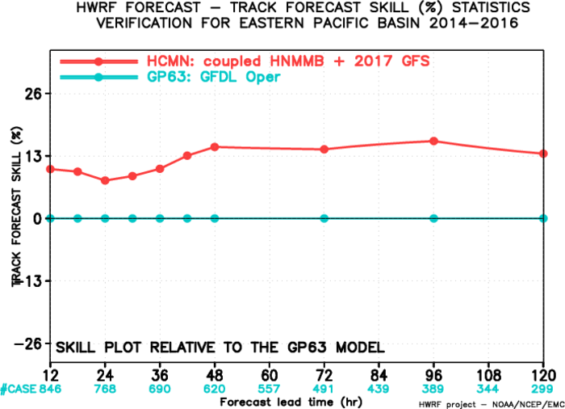
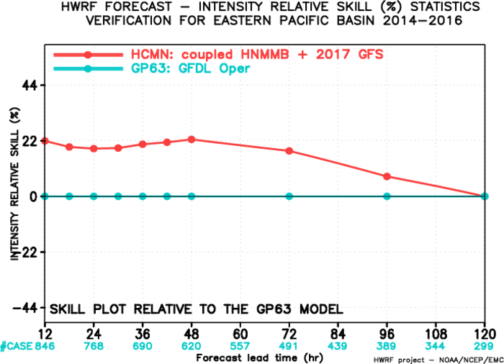
2014-16 East Pacific Basin: Relative to GFDL
(Late model)
HMON has improved track skills as compared to GFDL with an average improvement of more than 12%. It also has significantly improved intensity skills with a mean improvement of > 10%.
35

Slide 13
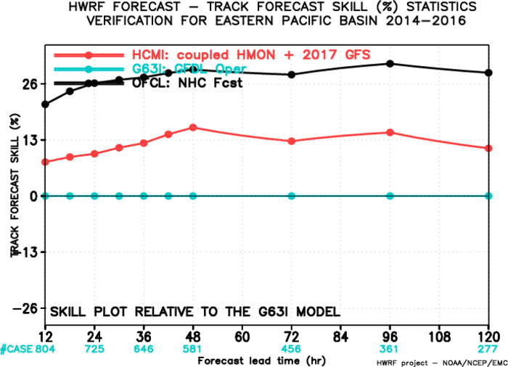
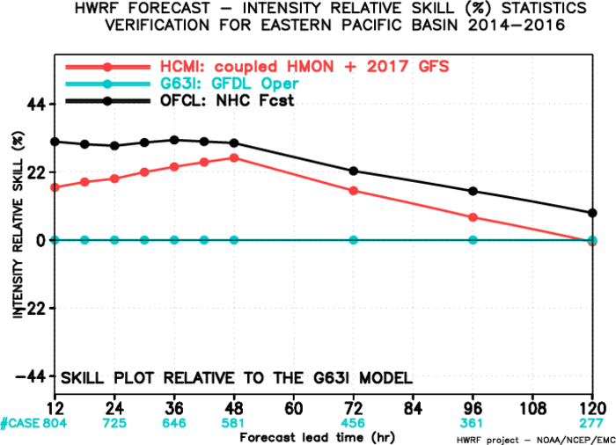
2014-16 East Pacific Basin: Relative to GFDL
(Interpolated)
HMON has improved track and intensity skills as compared to GFDL but still needs to close gap with official skill especially for longer lead times for intensity.
36

Slide 14
HMON Verification for Central Pacific Storms
(2014-2016)
Configuration: HWRF physics + vortex initialization + no data assimilation + ocean coupling with HYCOM

Slide 15
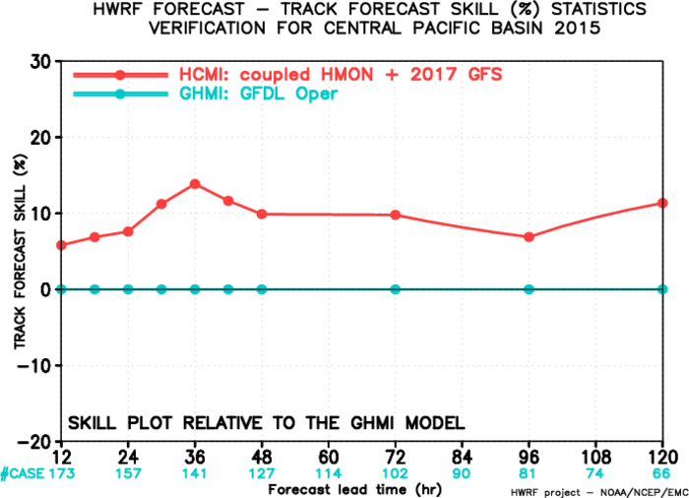
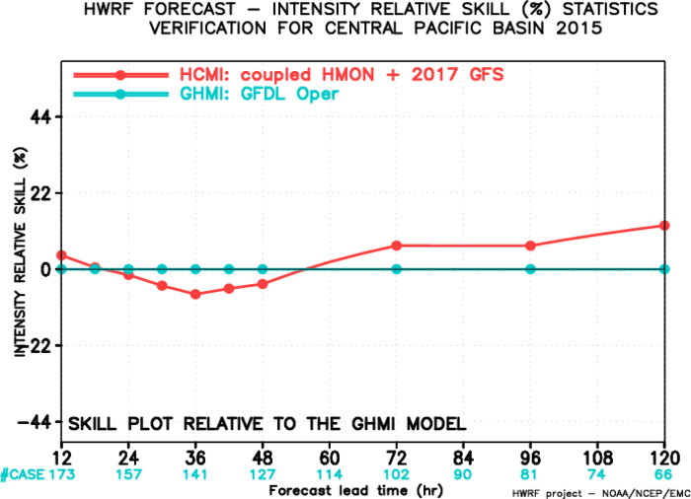
2014-16 Central Pacific Basin: Relative to GFDL
(Interpolated)
HMON has improved track skills as compared to GFDL of more than 10% while intensity skills are neutral to positive for longer lead times.
38

Slide 16
HMON verification Statistics: Summary
Compared with GFDL, HMON consistently shows improved performance for track and intensity skill for the North Atlantic basin (based on 2014-16 seasons)
Compared with GFDL, it also consistently shows improved performance for track and intensity skill for the North East Pacific basin (based on 2014-16 seasons)
Compared with GFDL, track skills are much improved while intensity skill are neutral for the Central Pacific basin (based on 2014-16 seasons)
Results are different from HWRF and usually exhibit large errors in comparison especially at longer lead-times where improvement is needed.
39

Slide 17
Targeted Resources for Hurricane Modeling
(maximum per storm forecast)
Operational System | 2016 (nodes) | 2017 (nodes) | Max Storms | Comments
HWRF (plus WW3) | 63 | 63 | 8 | Max # of storms increased by 1
WW3-multi2 | 7 | 0 | 0 | WW3 subsumed in HWRF
GFDL | 5 | 0 | 0 | Discontinued
HMON | 0 | 26* | 5 | Uses much less resources than HWRF
TOTAL | 75 | 89 | -- | 18.7% resource increase*
* Initial implementation is targeted for only 5 storms serving NHC areas of responsibility (NATL, EPAC & CPAC)
40

Slide 18
NHC Recommendation
Based on the mostly improved TC track and intensity predictions for a large 3-year sample of cases for the Atlantic and eastern North Pacific basins, the National Hurricane Center endorses the operational implementation of the 2017 HWRF, and accepts the introduction of HMON into operations.
Dr. Richard J. Pasch
Senior Hurricane Specialist
National Hurricane Center
41

Slide 19
JTWC Recommendation
The improvements in the forecast guidance provided by HWRF in the western North Pacific, arguably one of the most difficult basins to forecast, especially the 20+ percent improvement in intensity skill at days 4 and 5, is truly impressive and we look forward to the implementation.
Robert J. Falvey Director, Joint Typhoon Warning Center
42

Slide 20
Next Steps for Fy17 HWRF v11.0.0
Retrospective T&E at EMC: April 10, 2017 --- Completed
Briefing to NHC: April 13, 2017 ----- Completed
NHC Evaluation and Recommendations: April 24, 2017 -- Completed
Briefing to EMC Director and CCB: April 25, 2017 --- Completed
Briefing to NCEP Director's Office: April 28, 2017 --- Now Completed
Submission of Codes to NCO: April 28, 2017 --- Code hand-off, submission of RFC forms, release notes and flow diagram
TIN for 2017 HWRF : May 3, 2017
NCO IT Testing : ????
Briefing to NCEP Director's Office: ????
Implementation by NCO: **
** Recommend H217 be implemented after 2017 GFS

Slide 21
Next Steps for FY17 HMON v1.0.0
Retrospective T&E at EMC: April 07, 2017 --- Completed
Briefing to NHC: April 07, 2017 ----- Completed
NHC Evaluation and Recommendations: April 24, 2017 -- Completed
Briefing to EMC Director and CCB: April 25, 2017 --- Now Completed
Briefing to NCEP Director's Office: April 28, 2017 (scheduled)
Submission of Codes to NCO: April 28, 2017 --- Code hand-off, submission of RFC forms, release notes and flow diagram
TIN for 2017 HMON : May 3, 2017
NCO IT Testing : ????
Briefing to NCEP Director's Office: ????
Implementation by NCO: **
** Recommend HMON be implemented with 2017 GFS

Slide 22
Request approval from NCEP OD for operational implementation of the following Hurricane model configurations: II. 2017 HMON V1.0.0

Slide 23
Supplementary Slides

Slide 24
Successful R2O in FY17 HWRF Upgrades
This upgrade is a result of multi-agency R2O efforts supported by HFIP/NGGPS
EMC: Key model physics upgrades, increase in vertical levels, data assimilation upgrades, and pre-implementation T&E;
DTC/NCAR: code management and repository, physics upgrades;
NHC/CPHC/JTWC: Diagnostics and evaluation of the HWRF pre-implementation tests and real-time guidance
HRD/AOML: Data Assimilation and Physics upgrades;
GFDL: New Tracker;
ESRL: Physics upgrades;
URI: Ocean coupling

Slide 25
HWRF/HMON Long-Term Plans
2016
2017
2018
2019
2020
HWRF Operational Model Continues Followed by Ensembles
GFDL –—–— HMON
10-member HWRF/ HMON Ensembles
NEMS Global Nests (NGGPS)
Basin-Scale HWRF/NMMB/FV3—–— Global/Tropical Domains
Hurricane Models take over Hurricane Wave Forecasts
Development, T&E and Implementation Plans for HWRF & HMON
2016 Nov: Configuration ready
2016 Dec- 2017 March: Pre-implementation retrospective testing
2017 April: EMC CCB and code hand-off
2017 June: Operational Implementation

Slide 26
HMON Version 1.0
Status as of 04/25/17
G
G
Project Information & Highlights
G
Schedule
Leads: Avichal Mehra & Tom Black, EMC and Steven Earle, NCO
Scope: Replace GFDL hurricane model with Hurricane NMMB (H-NMMB). Initial operating capability for NHC basins (ATL, EPAC and CPAC) with maximum 5 storms per cycle.Transition and tune HWRF physics, initialization, and ocean coupling for H-NMMB
Expected benefits: Improved track & intensity forecast skill compared to GFDL. Improved forecast guidance to NHC to fulfill their mission. Explore high-resolution hurricane ensemble products
Dependencies: N/A.
Milestones & Deliverables | Date | Status
Freeze system code; deliver to NCO if applicable | 1/10/17 | N/A
Complete full retrospective/real time runs and evaluation | 4/07/17 | In progress
Deliver final system code to NCO and conduct CCB | 4/2517 | On track
Issue Technical Information Notice | 5/03/17 | On track
Complete 30-day evaluation and IT testing | 6/12/17 | On track
Operational Implementation | 6/27/17 | On track
EMC | NCO | Red text indicates change from previous quarter
G
G
Resources
Issues/Risks
Staff: 0.75 Fed FTEs + 4 contractor FTEs; including Dev (Vortex Initialization, Coupler and Physics)
Funding Source: STI
Compute: parallels: 150 nodes for 3 months (devmax/devonprod);; EMC Dev: 100 nodes for 3 months (devhigh); Ops: Delta = 26 nodes per storm
Archive: 0.3 PB (Delta = 0.3 PB)
Issue: Complex T&E due to dependency on NEMS/GSM and RTOFS upstream requirements; Resolution: Use 2016 versions.
Risk: Implementation dates are dependent on completion of T&E; Ongoing disruptive Cray upgrades and maintenance
Mitigation: Conduct T&E as soon as retrospective data are available. Use white space on production machine.
Management Attention Required | Potential Management Attention Needed | On Target
R
Y
G

