Slide 1
Impacts of the separate hydrometeors advection on hurricane structure and intensity: an evaluation using satellite data
Shaowu Bao and DTC HWRF group (Ligia, Kathryn, Evan, Biswas)
September 21 2017
Environmental Modeling Center

Slide 2
FA vs. FA-ADV
CWM
Advection
(CWM)
Other physics
CWM
F_ice
F_rain
F_Rimef
Micro
physics
New
CWM
F_ice
F_rain
F_Rimef
FA:
F_ice
F_rain
F_Rimef
same
Advection
(Qc Qi Qr, Qrimef)
New Qc
Qr Qi Qrimef
Other physics
Qc
Qr Qi Qrimef
Qc
Qr Qi Qrimef
CWM
F_ice
F_Rain
F_Rimef
Micro
physics
FA-ADV

Slide 3
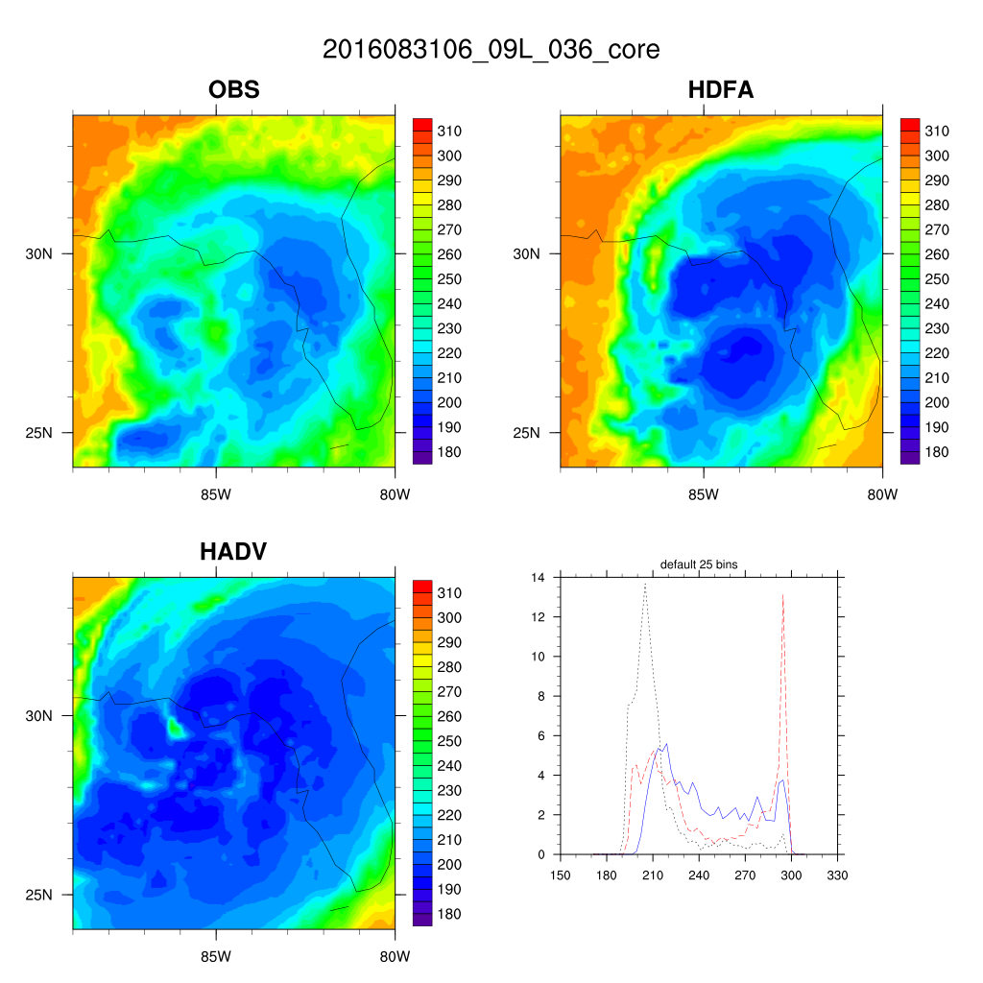
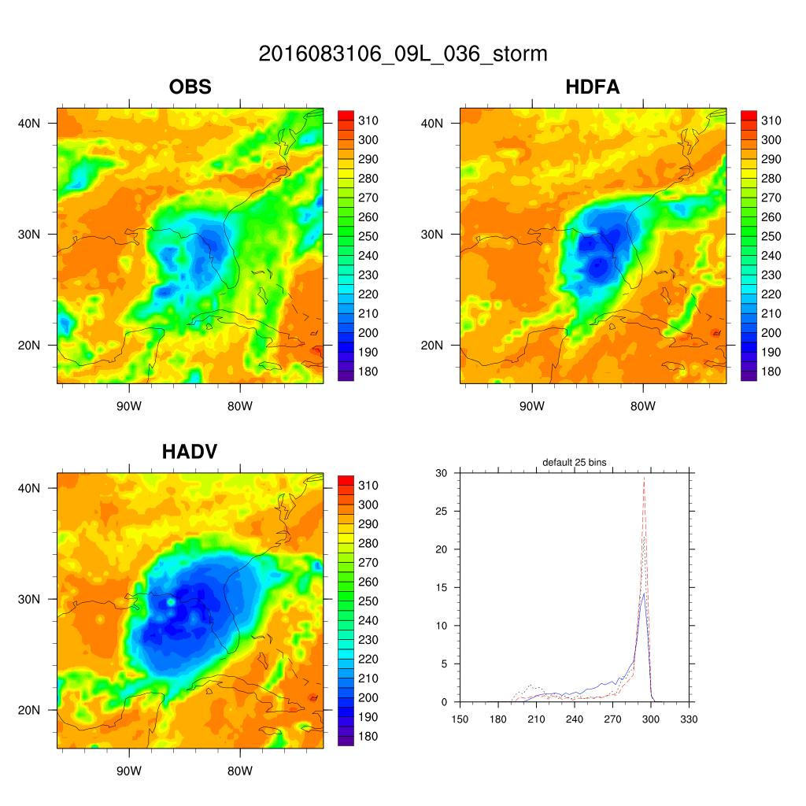
observational vs. synthetic satellite images: Hurricane Hermine (2016)
core scale
storm scale
FA-ADV (HADV) generates larger storms

Slide 4
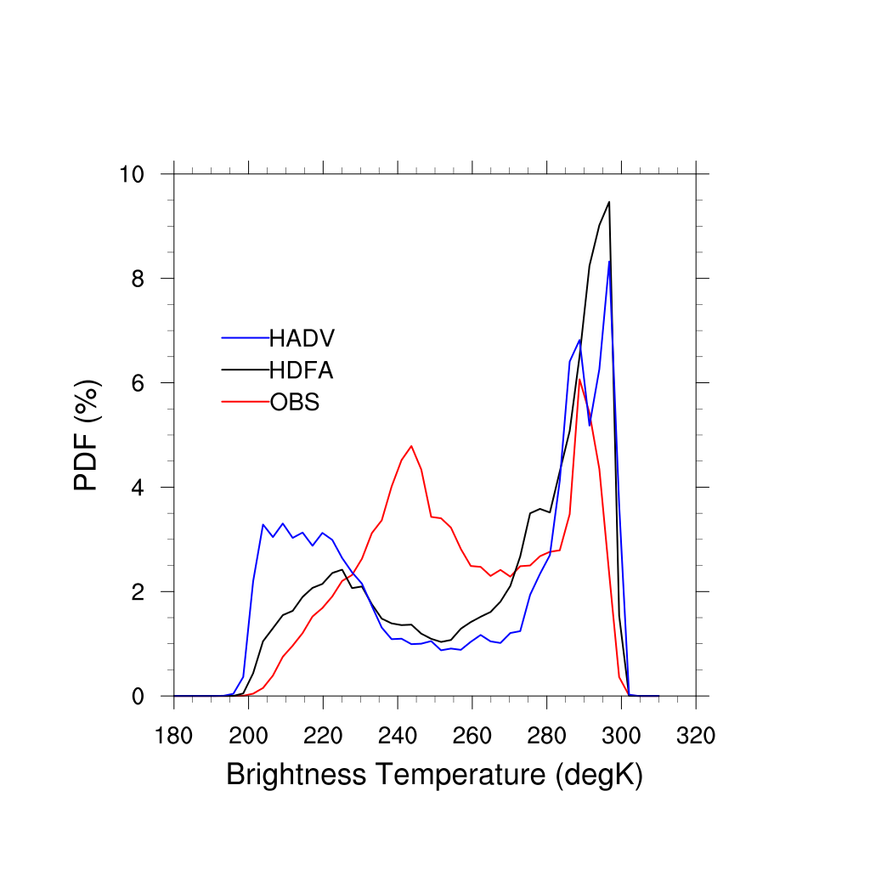
Composite PDF : Hurricane Hermine 2016
Larger cold BT
FA-ADV (HADV) generates larger storms

Slide 5
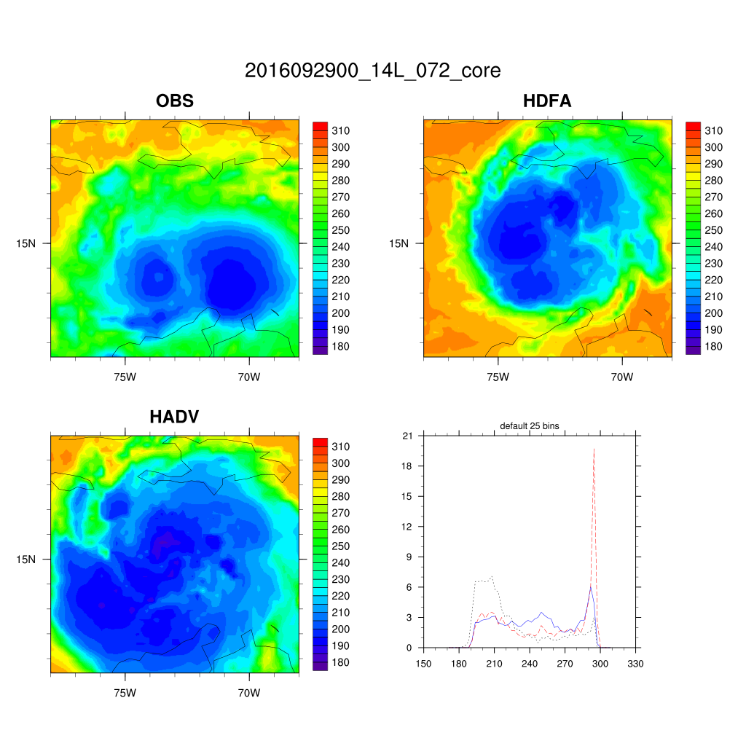
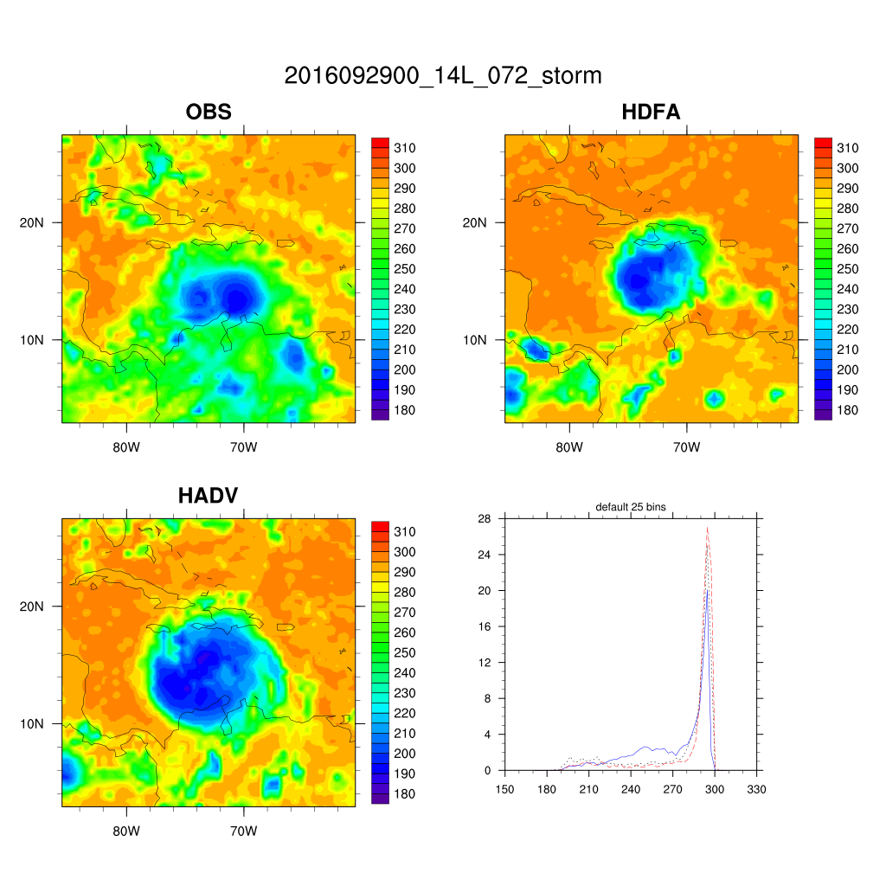
observational vs. synthetic satellite images: Hurricane Matthew(2016)
FA-ADV (HADV) generates larger storms

Slide 6
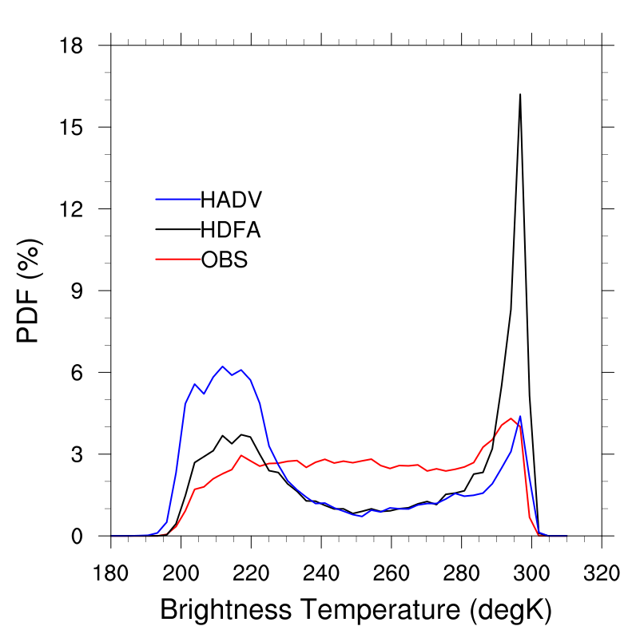
Composite PDF : Hurricane Matthew 2016
Larger vortex
FA-ADV (HADV) generates larger storms

Slide 7
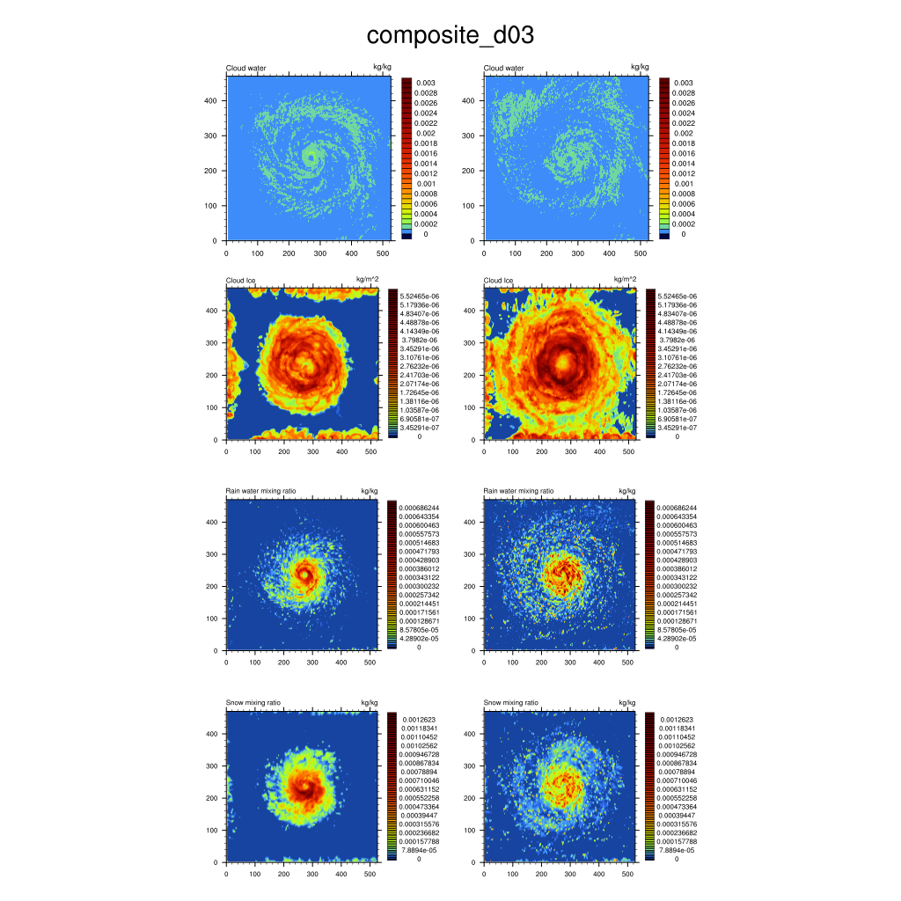
Idealized HWRF 5-day run
FA
FA-ADV
Cloud
Ice
Rain
Snow
Idealized HWRF run mixing ratio also showed that FA-ADV generates larger storms than FA
Notes:
Maximum value level

Slide 8
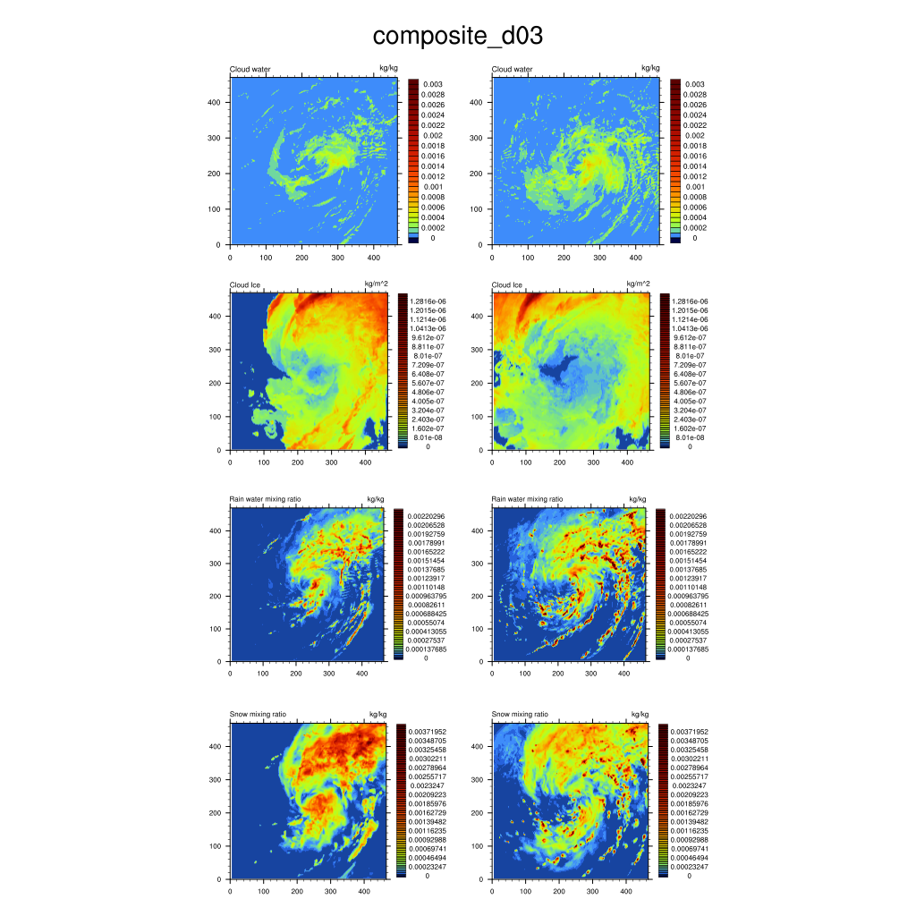
Real case Hurricane Hermine 2016
FA
FA-ADV
Cloud
Ice
Rain
Snow
Cloud
Ice
Rain
Snow
Real-case HWRF run mixing ratio also showed that FA-ADV generates larger storms than FA

Slide 9
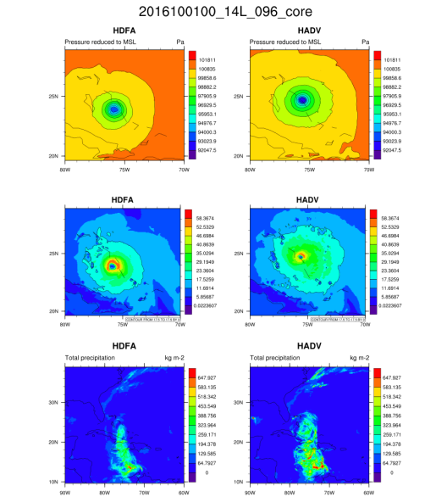
MSLP, 10m wind, accumulated rainfall fields
MSLP
10m winds
34 kt
34 kt
FA-ADV generates:
lower P_{min} and larger low MSLP coverage
larger 34kt 10m wind contour area
weaker Vmax
heavier rainfall
Accumulated
rainfall

Slide 10
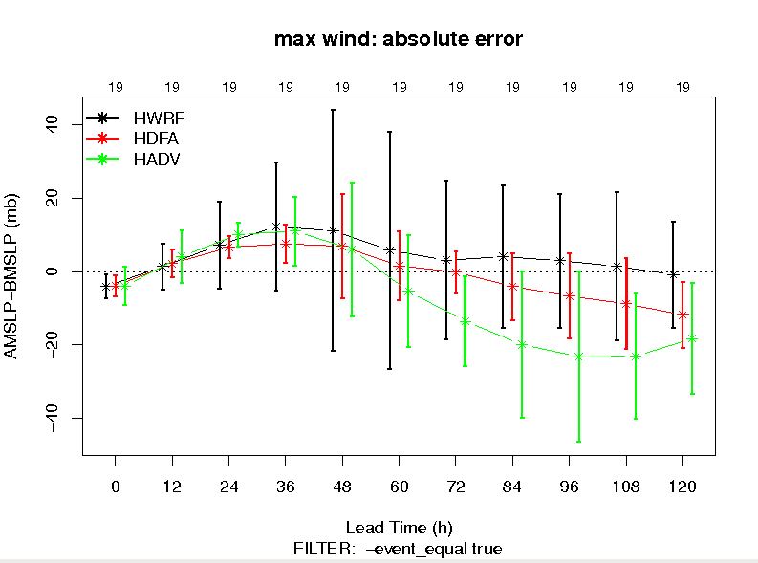
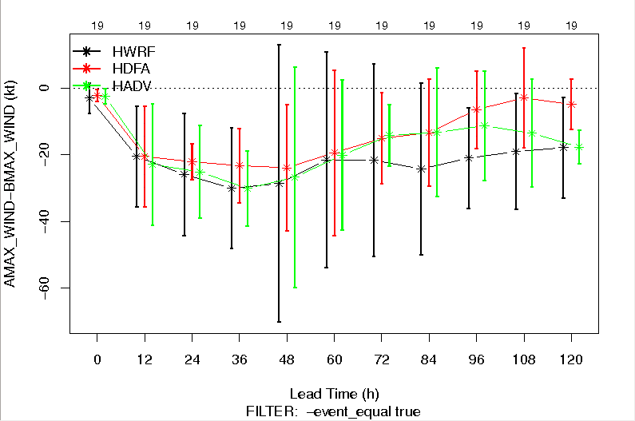
Bias: MSLP and Vmax
FA-ADV MSLP deeper than FA
FA-ADV Vmax weaker than FA
MSLP. BIAS (0 is best track)
Vmax BIAS (0 is best track)
FA-ADV has a negative bias in MSLP and negative bias in Vmax

Slide 11
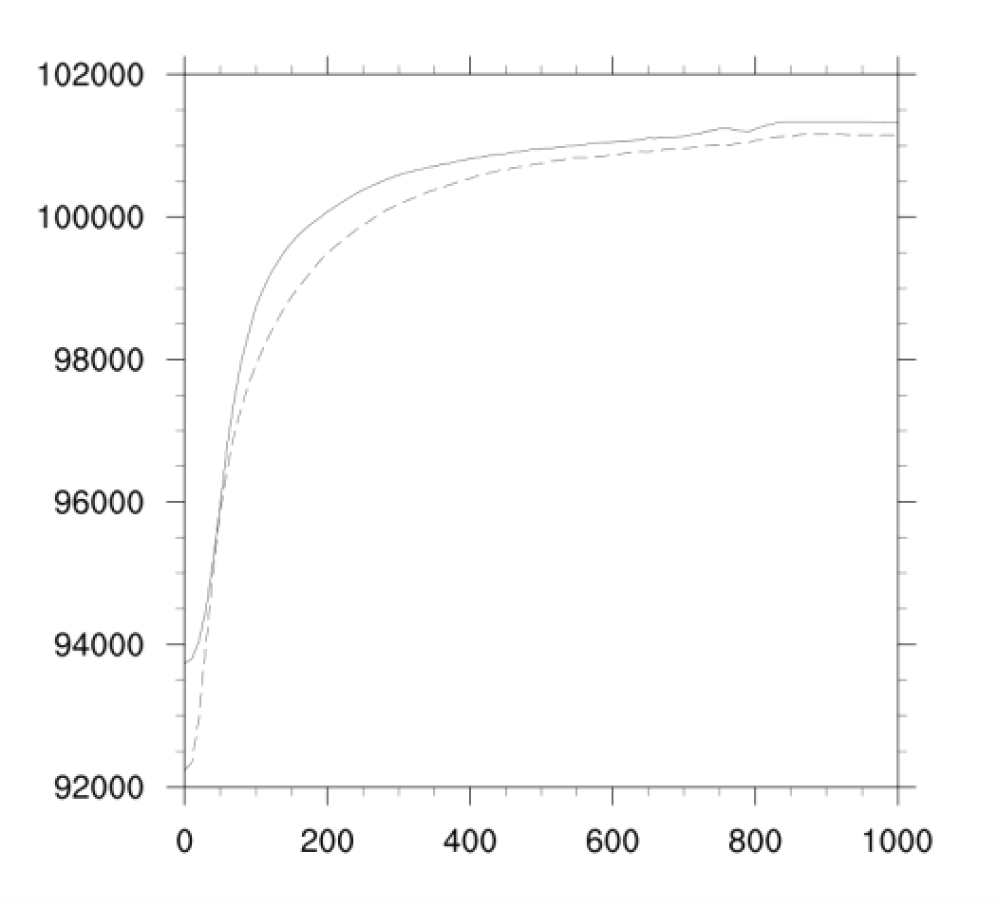
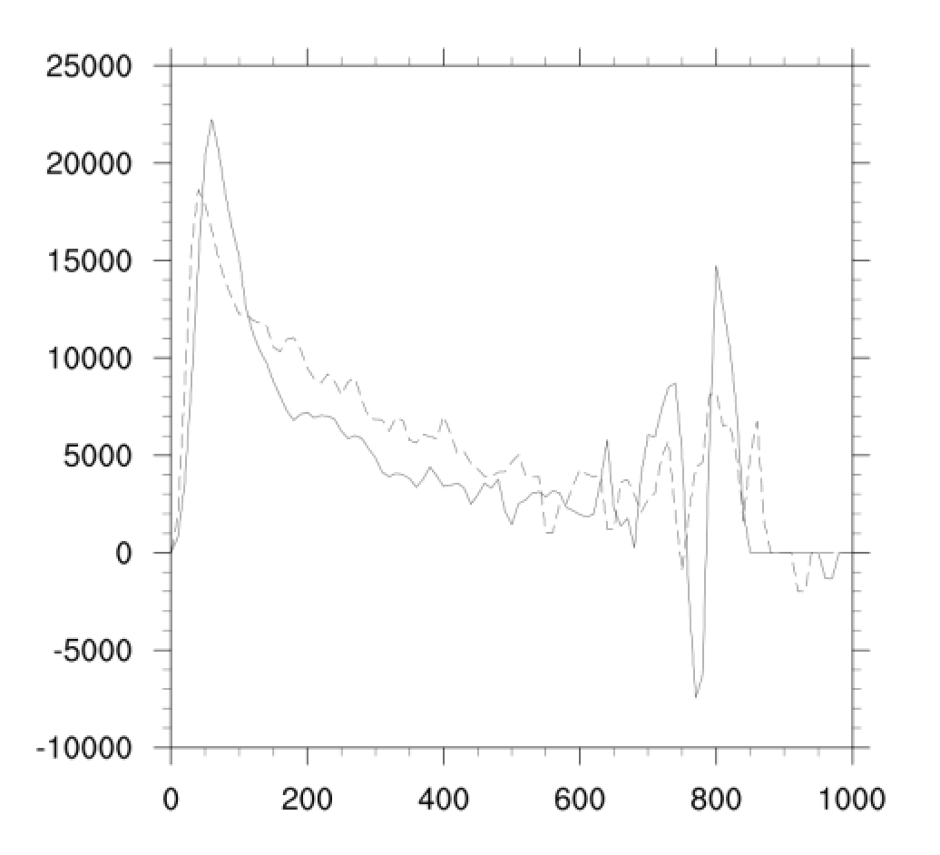
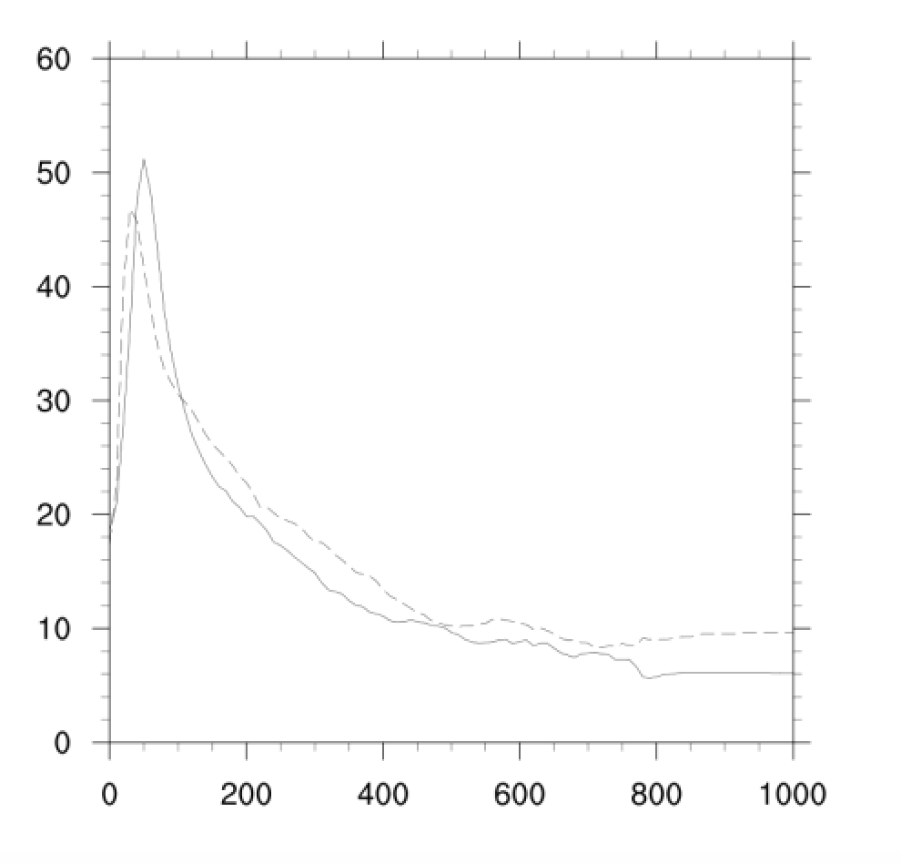
MSLP, 10m wind and Pressure Gradient (azimuthal-averaged) FA: solid line; FA-adv: dashed line
$$\frac{∂P}{∂r}×r$$
Model 10m wind
MSLP
FA
FA-ADV
Radius (km)
Radius (km)
Radius (km)
$$\frac{V^{2}}{r}=−\frac{1}{ρ}\frac{∂P}{∂r}$$
Consider cyclostrophic balance:
$\frac{∂P}{∂r}×r$
FA-ADV: MSLP deeper than FA, both inner core and outer core, and its peak is weaker than FA,
so its Vmax is weaker than FA

Slide 12
Idealized high-frequency output diagnostic
FA-20min run
Output per minute
“tendency”
Idealized HWRF
4-day spin-up run
Restart files
FA-ADV 20min run
Output per minute
“tendency”

Slide 13
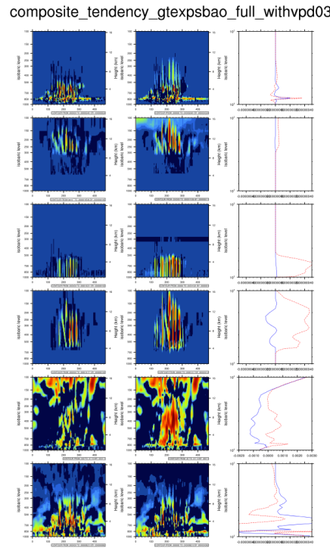
Idealized high frequency run Tendencies
FA (blue) vs. FA-ADV (red)
FA FA-ADV mixing ratio tendency
Cloud
Ice
Rain
Snow
Temp
Vapor
A significant diabatic heating in FA-ADV

Slide 14
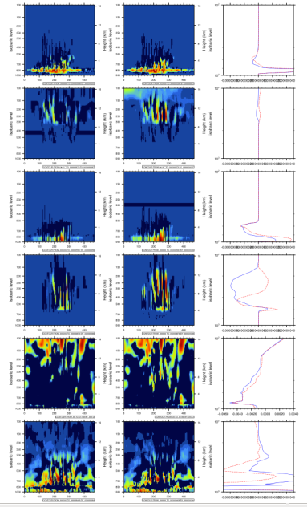
With all diabatic heating
Except heating related to PCOND=0
(no heating due to cloud condensation)
Idealized high frequency run Tendencies
FA (blue) vs. FA-ADV (red)
With all diabatic heating
Cloud
Ice
Rain
Snow
Temp
Vapor
Cloud
Ice
Rain
Snow
Temp
Vapor
The more diabatic heating in FA-ADV is gone when heating due to condensation is turned off

Slide 15
Summary
Separate advection of hydrometeor species generates larger-sized storms than if the total condensate is advected, as shown in the GOES-13 satellite evaluation
A possible reason might be the total condensate advection underestimates the diabatic heating caused by the water vapor condensation to cloud [BUT IT IS NOT CLEAR WHY SEPARATE ADVECTION CAUSED MORE CONDENSATION]
More diabatic heating in FA-ADV causes more angular momentum input into hurricane vortex and therefore larger sizes.
MSLP is deeper in FA-ADV than FA both near inner core and outer core, due to the diabatic heating, and required by hydrostatic adjustment
The Vmax closely followed the cyclostrophic relationship and can be used to explain why FA-ADV Vmax is weaker than FA.

Slide 16
Next steps:
Check the impact of the separate advection on the rime factors distributions
Check the upward wind velocity
Conduct a one-domain run to eliminate the possibility of nesting problems

Slide 17
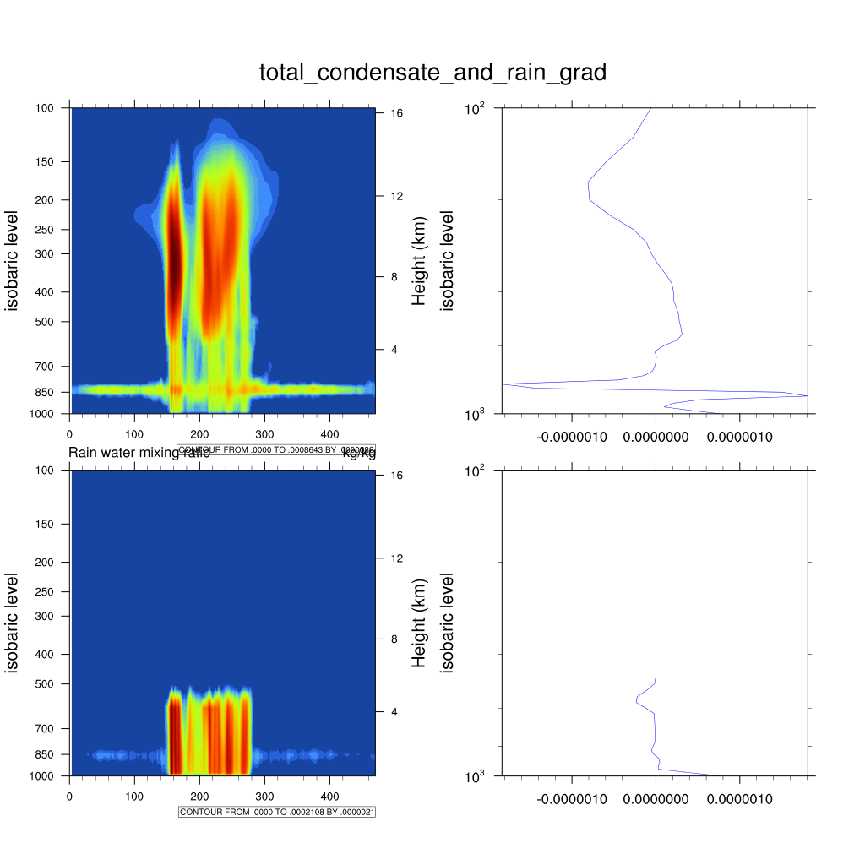
Total condensate profile
Total condensate gradient
Positive gradient
no upward advection
Rain water profile
Rain water gradient
Negative gradient upward advection

Slide 18
FA
FA-ADV
Total condensate
snow
Total condensate
+Qr
Freeze
heating
-Qs
+ heating
rain

