Slide 1
HFIP real-time demo: HWRF Ensemble Prediction System, 2016 Hurricane Season
Zhan Zhang
EMC/NCEP/NWS/NOAA, College Park, MD 20740
Notes:
1
1

Slide 2
Background
Two jet real time reservations;
HWRF EPS real time parallel for one AL storms;
Multi-Model Combined Ensemble Prediction;
80-member HWRF EPS for SHOUT, intensity change guidance for Global Hwak

Slide 3
Scope of FY16 HWRF Upgrades
System & Resolution Enhancements
T&E with new 2016 4D-Hybrid GDAS/GFS IC/BC
Upgrade dynamic core from WRF3.6a to WRF3.7.1a (with bug fixes)
Smaller time step (dt=30 s vs. 38 4/7 s)
Increase the size of nested domains (details on next slide)
More products: MAG and AWIPS2
Initialization/Data Assimilation Improvements
GSI upgrades; new data sets for GSI (CrIS, SSMI/S, METOP-B changes)
Turn on Data Assimilation for all storms in East Pacific and use of ROTFS initialization
Physics Advancements
Implement new GFS PBL (2015 version)
Upgrade to new scale-aware SAS convection scheme for all domains
Update momentum and enthalpy exchange coefficients(Cd/Ch)
Improved vertical wind profile in the surface and boundary layer
First time in 2016….
Implementation on WCOSS Cray
Ocean coupling for CPAC, WPAC and NIO (all NH basins)
One-way coupling to wave model (Hurricane Wave Model)
Use of dev-ecflow for accelerated T2O

Slide 4
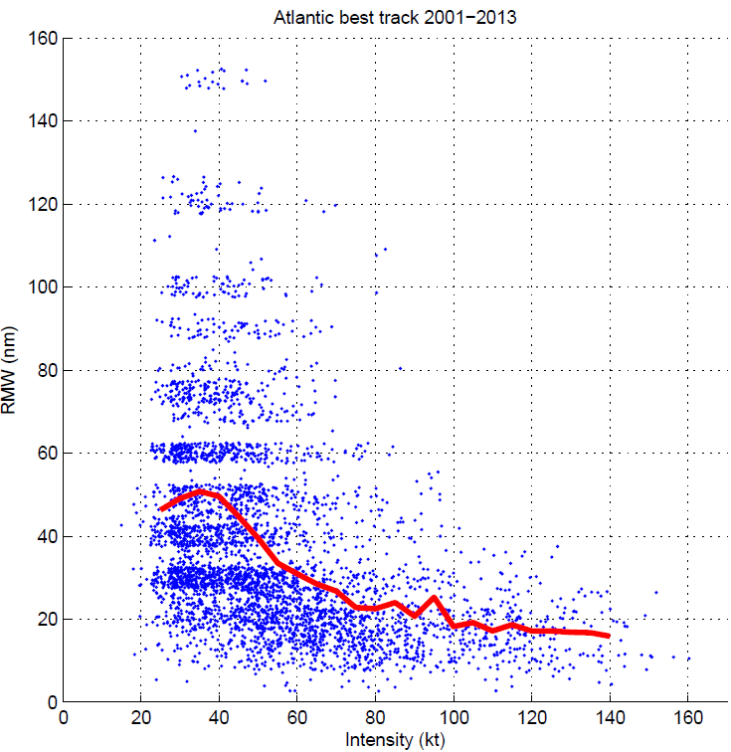
2016 HWRF ensemble Configuration
Use 2016 operational deterministic HWRF model except for
Less horizontal resolution: 27/9/3km vs. 18/6/2km
Less vertical resolution: L43 vs. L61;
No GSI due to lack of GDAS data;
IC/BC Perturbations (large scale): 20 member GEFS.
Model Physics Perturbations (vortex scale):
Stochastic Convective Trigger Perturbations in SAS: -50hPa to + 50hPa white noise ;
Stochastic boundary layer height perturbations in PBL scheme, -20% to +20%;
Stochastic Cd perturbation;
Stochastic initial wind speed and position (TCVital) perturbations considering best track uncertainty.
Difference from 2015 HWRFES:
Larger D02 and D03;
Scale-aware convection scheme turned on for all domains.

Slide 5
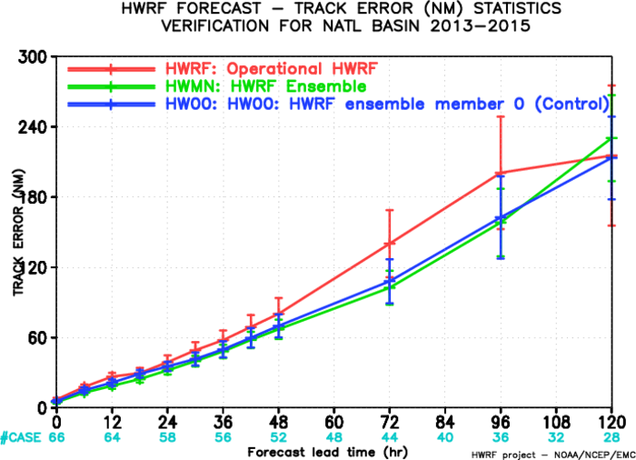
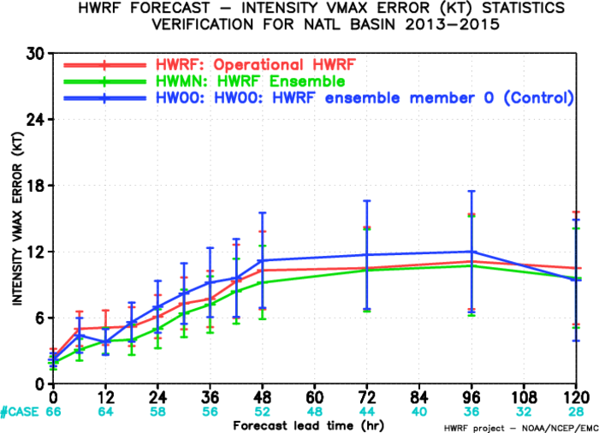
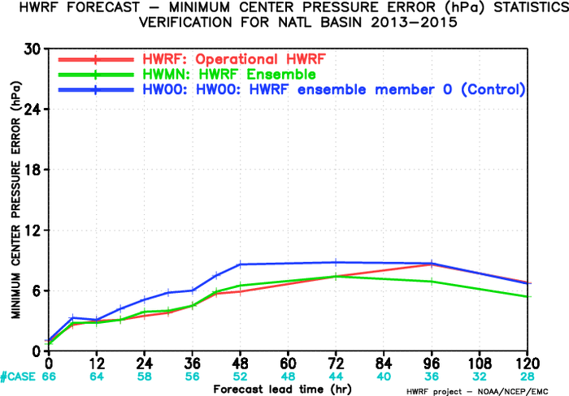
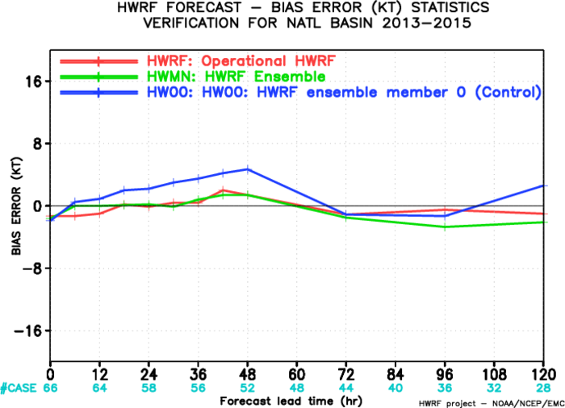
Verification: HWRF-EPS vs Deterministic HWRF

Slide 6
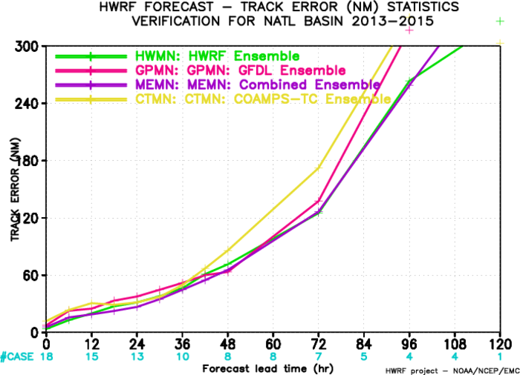
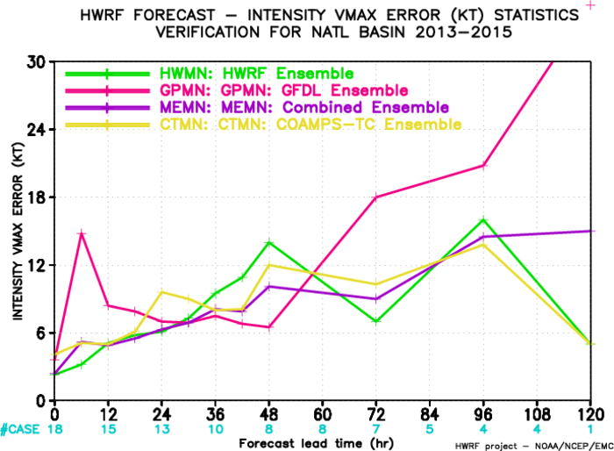
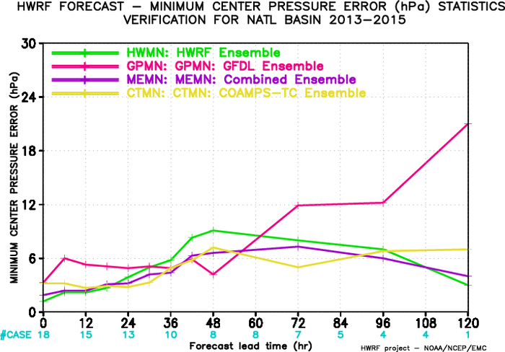
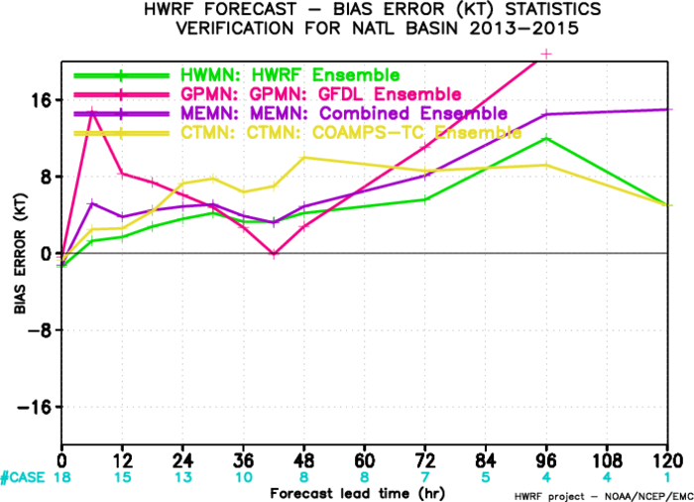
Verification: Multi-Model EPS

Slide 7
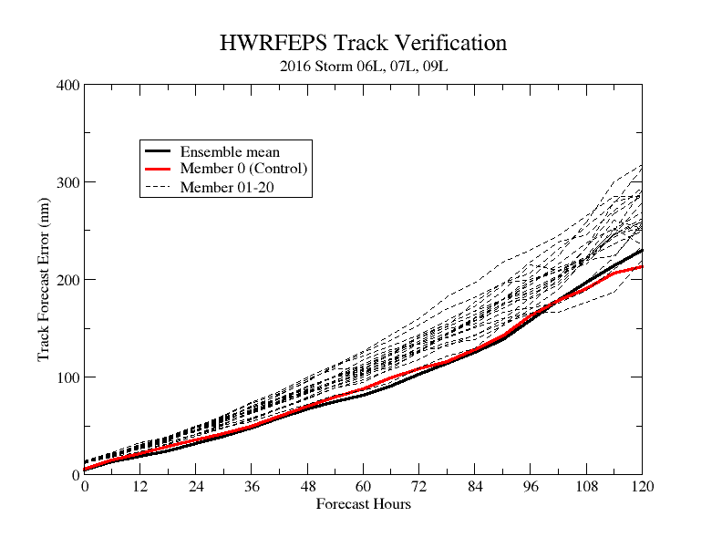
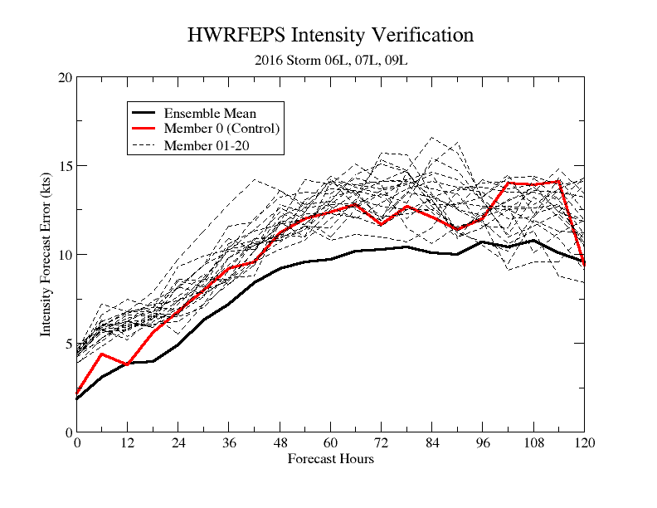
Verification: Individual Members vs Ensemble mean
1. HWRF EPS outperforms both the operational HWRF and its control (HW00) in terms of track and intensity;
2. HWRF ensemble mean has the smallest forecast errors compared to its individual ensemble members.

Slide 8
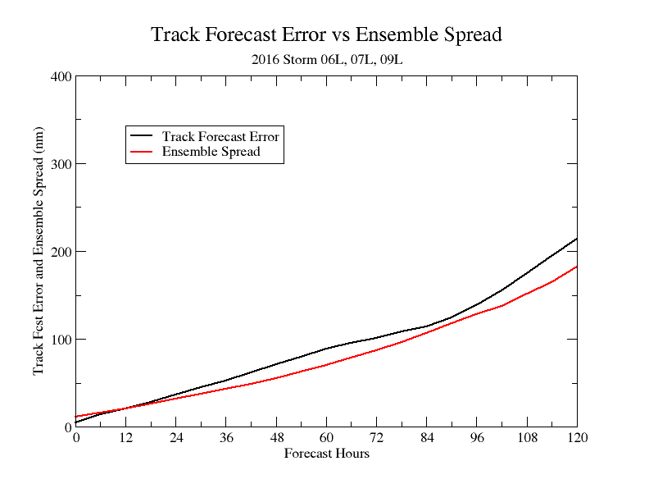
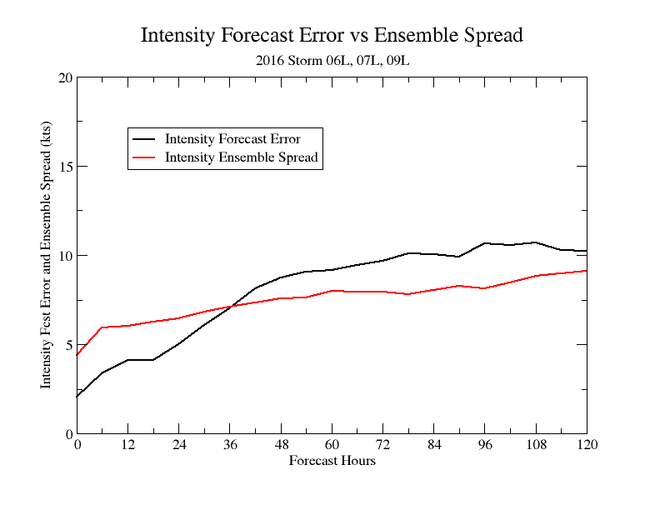
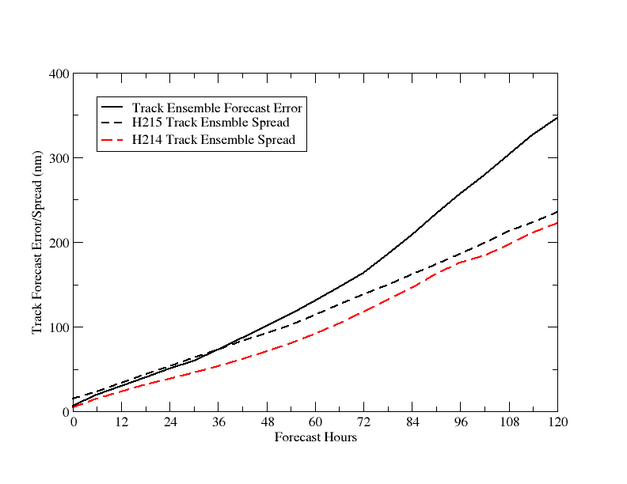
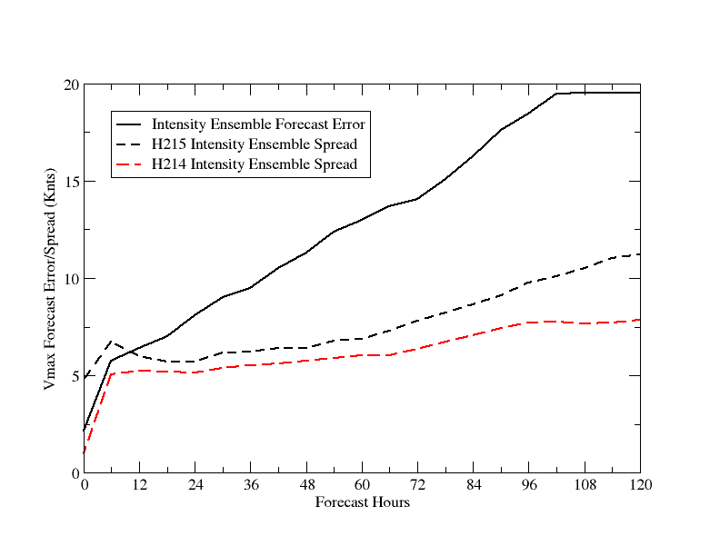
Forecast Error vs Ensemble Spread
2016-Track
2016-Intensity
2015/2014
2015/2014

Slide 9
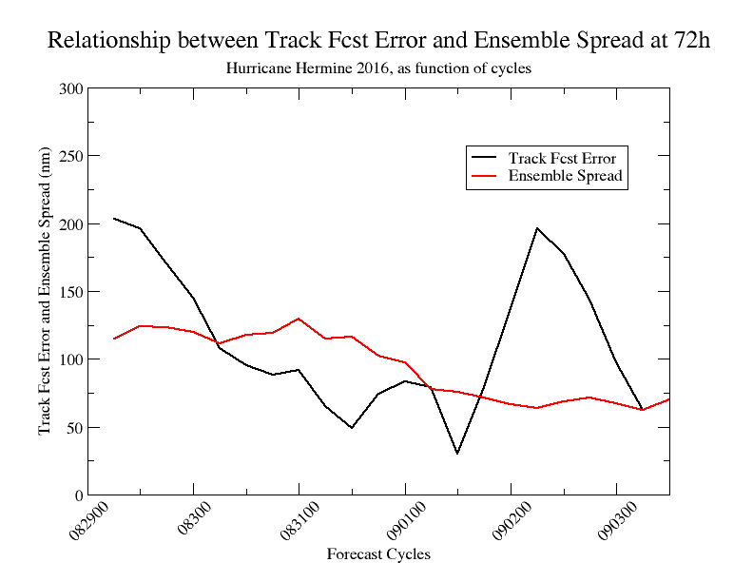
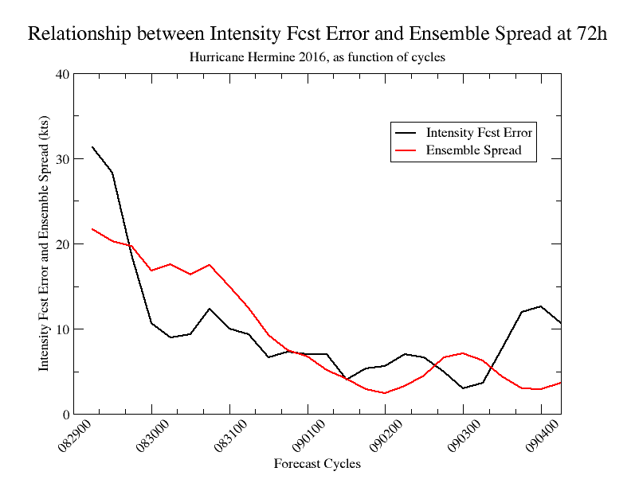
Forecast Error and Ensemble Spread as Function of Cycles
Hurricane Hermine, (2016083000-2016090400) at 72h
Larger intensity ensemble spread corresponds to larger intensity forecast errors. The track forecast error and spread doesn’t seem clearly correlated.

