Slide 1
FY16 HWRF final version and tracker
Chun-Sil Jin

Slide 2
Contents
FY16 final version issue
TC-trackers in TC forecast models
Impact of new tracker/L63/damping in FY16 retrospectives
New tracker and L63 test in the track and intensity degraded cases (in process)

Slide 3
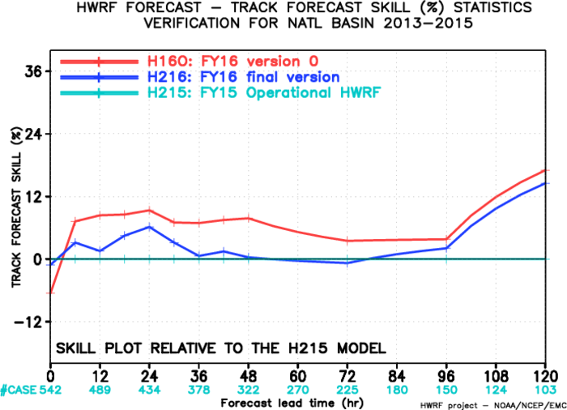
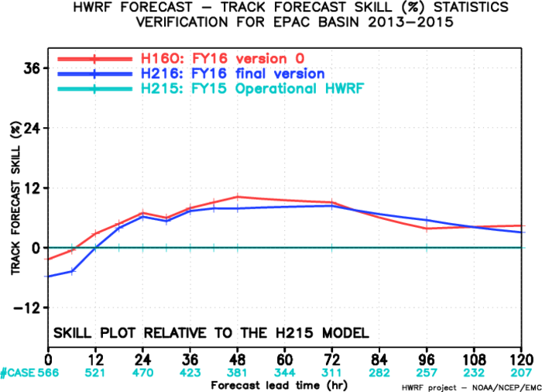
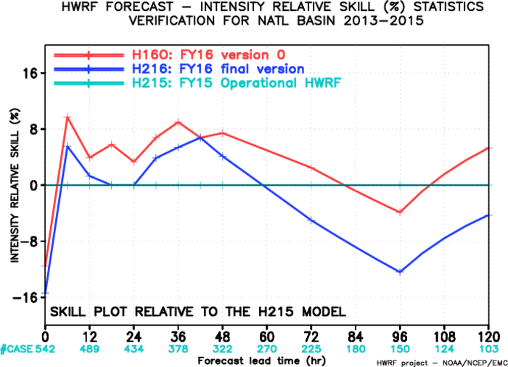
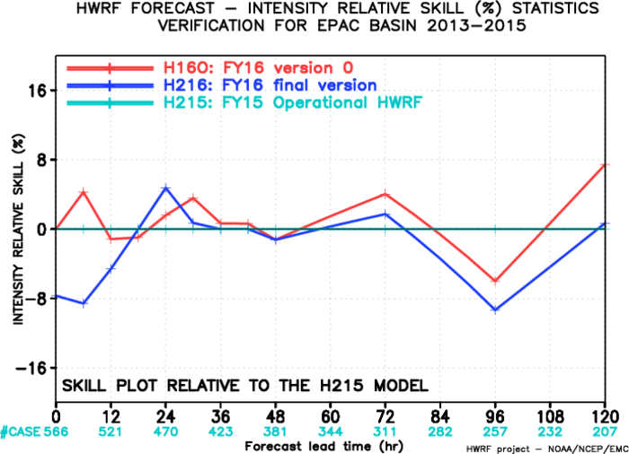
FY16 final version issue
Base | Exp | Tracker | Lev | Damp
FY16 baseline + Upgrades | H16O | Old | 61 | No
 | H216 (A216) | New | 63 | Yes
Zhang (2016)

Slide 4
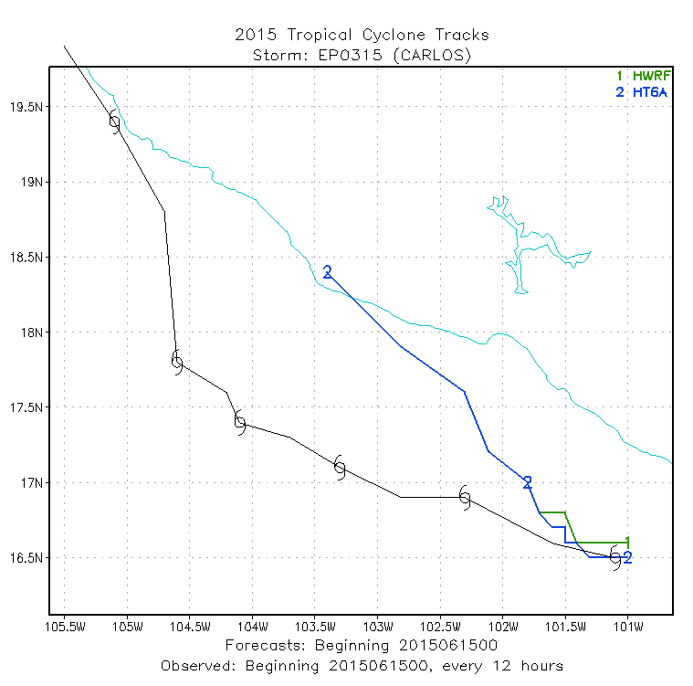
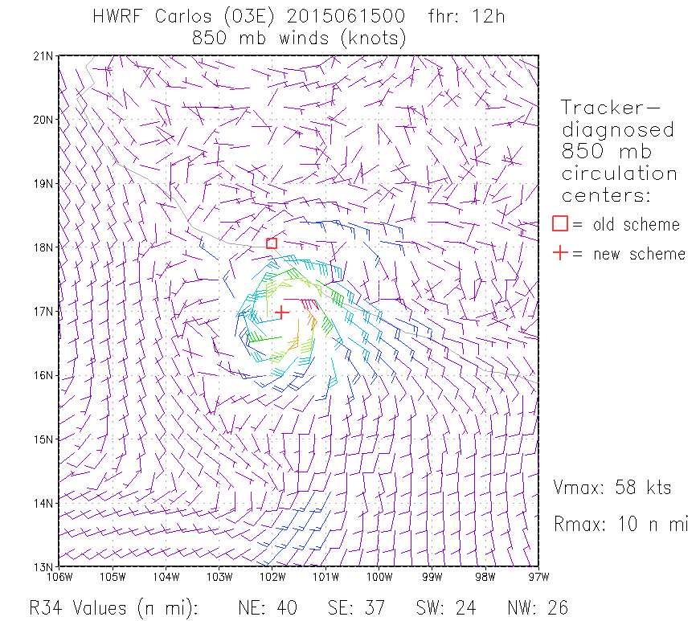
Updated GFDL vortex tracker
Near-core circulation issue in H215
Old scheme (green)
  Interpolate data to fine scale, then find the minimum wind speed
New scheme (blue)
  Compute circulation minus Vmax at center
  Subtracting the Vmax at the center helps to more accurately refine the center fix.
Difference: Extension of tracks beyond early dissipation.
List of updates
Most significant upgrade
Replacement of scheme to track the near-core circulation
Tracking of 200-850 mb thickness
Expansion of domain for tracker files for moveable grids
Option to use land-sea mask for genesis detection
Use of azimuthally averaged values for sfc wind structure diagnostics
GRIB2 issues…
Marchok (2016)
Notes:
Old tracker (green) dropped Carlos (2015061500) at 12h, even if it was very small circulation but a 58-kt storm in HWRF and the 850 mb winds clearly showed. Diagnosing an accurate fix for the circulation center is critical. In the new scheme, subtracting the Vmax at the center helps to more accurately refine the center fix. The differences are seen in the extension of tracks beyond early dissipation.

Slide 5
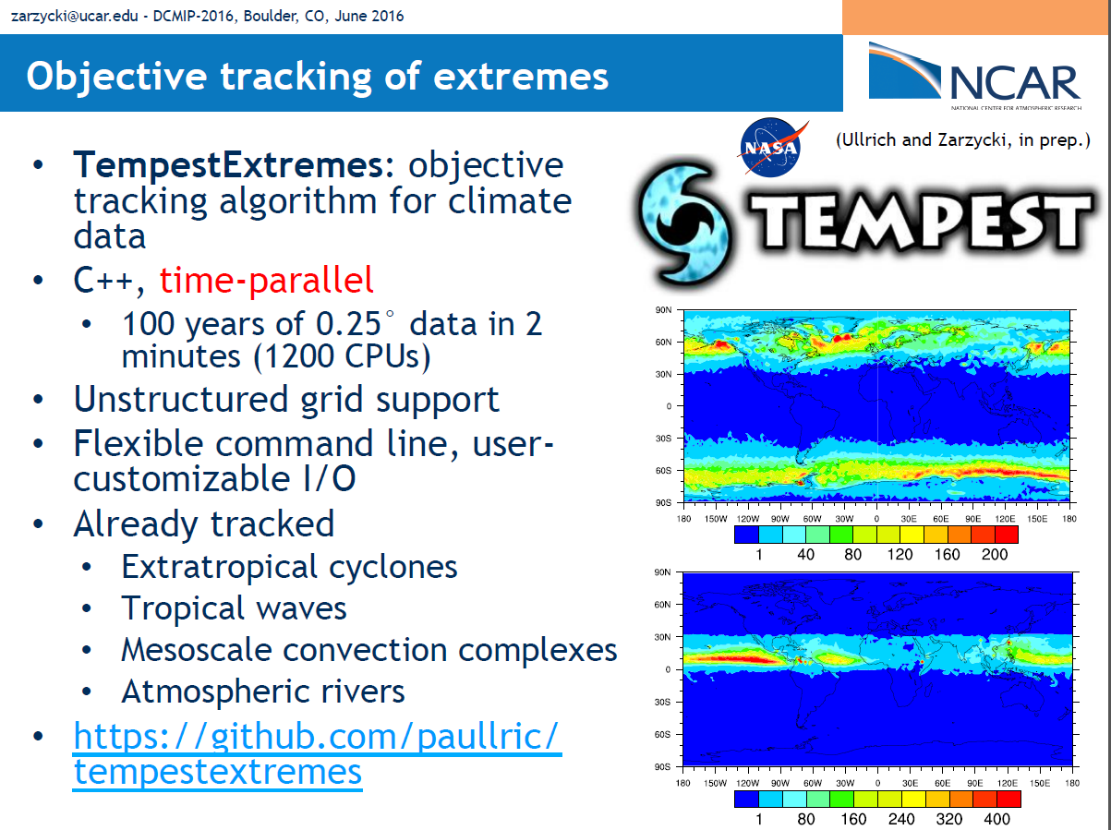
Ullrich and Zarzycki (2016)

Slide 6
Trackers in short- and long-term prediction of TC
 | Short-term prediction | Long-term prediction
Resolution and prediction period | 10⁰ – 10¹ km, 0 – 120 hr | 10¹ – 10² km, 1 mon – 100 yr
Purpose | tracking single storm (track) at the specified location and time (e.g., TC Vital) in high-resolution model | Detecting and tracking multiple storms (genesis and track) which occur anywhere, anytime in low-resolution model
Issues and requirements | Track not well-defined storm with center locations | Eliminate false alarms (i.e., extratropical storms and tropical depressions)
Parameter | - Storm intensity (VORT, GPH, MSLP, Wind) | - Storm intensity (VORT, MSLP, Wind) - Storm/thermal structure (Wind, TEMP)
Issues | In the forecasting system including numerical models, DA, and tracker (e.g., HWRF), tracking results affect the forecast skill. | Detect and tracking results (especially storm number) are very sensitive to thresholds and basin.
Institutes (developer) | GFDL (Marchok), NCAR (Wang), NRL (Liou), ECMWF (Hodges) | NCAR (Suzuki-Parker), NCEP/IRI (Camargo), CSIRO (Walsh), MRI (Murakami), BOM (Tory), UC-Davis (Ullrich), Princeton (Vitart), GFDL (Knutson)

Slide 7
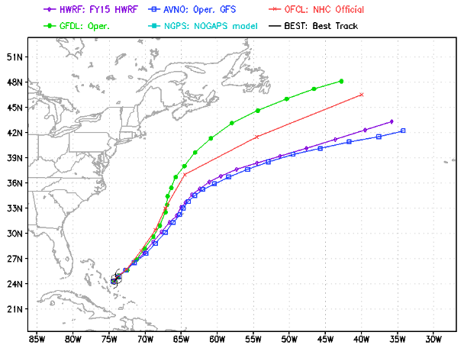
Simplified tracking flowcharts
Short-term prediction (GFDL)
Long-term prediction (General)
Start
Start
Seasonal forecast (JJA, 2012)
WRF
Read TC Vitals and model data
Read model data
Search and compute storm center
near observed location
using Barnes analysis
Search and analyze potential storm
in the model domain
Using Barnes analysis (weight-averaged centers (RV, GPH, SLP) at the finer grid than model grid), GFDL vortex tracker is more accurate compared to other trackers.
As increased interests in forecasting longer lead times and cyclone genesis, it has been updated to detect and track other storms after storm with TC Vitals (since 2011 version).
Potential storm identification
A local minimum MSLP
Maximum 850-hPa vorticity and surface wind speed exceeds those thresholds.
Maximum 850-hPa wind speed > maximum 300-hPa wind speed
Vertically averaged warm-core temperature is warmer than the surrounding.
Realistic storm?
No
Tracking to next lead time
Yes
Tracking to next time
Write output
Write output
Stop
Stop

Slide 8
Trackers in short-term prediction
Domain | Name | Resolution | Tracker | Method
Global | GFS | ~35 km | Marchok (2002)
 | ECMWF (15-day) | ~25 km | Hodges (1994), Hodges and Emerton (2015) | - Averaged vorticity between 850 and 600 mb - Spectrally filtered to reduce high-frequency spatial noise - Off-grid vorticity maxima to provide a better approximation - TC center is fixed to the nearest local minimum SLP
 | UKMET | ~40 km | Heming (2016) | Adopted ECMWF tracker
 | NOGAPS | ~55 km
Regional | HWRF | 18-6-2 km | Marchok (2002)
 | GFDL | 30-10-5 km | Marchok (2002)
 | COAMPS-TC | 27-9-3 km | Liou and Jin (2004) | - Averaged vorticity between 100 to 1500 m - 9-point smoother to avoid picking up small-scale center - Dynamically tracking TC during the forecast run (i.e., internal tracker) - Circulation center (calm and circular) is located nearby a local SLP minimum and vorticity maximum
NOAA models use GFDL vortex tracker.
Other models may use their own vortex tracker (e.g., ECMWF, UK Met Office).

Slide 9
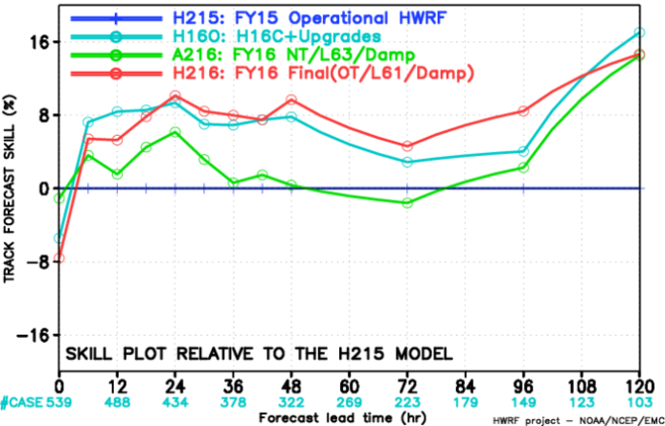
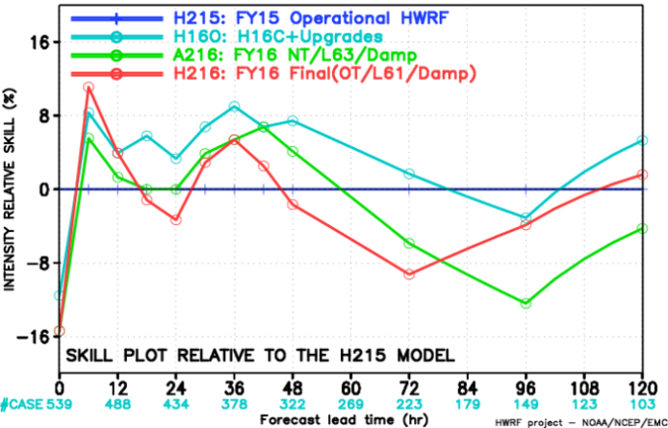
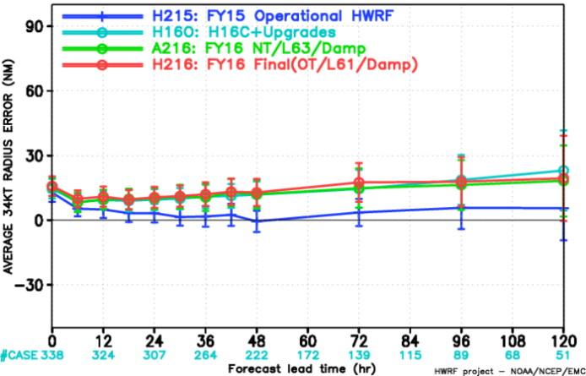
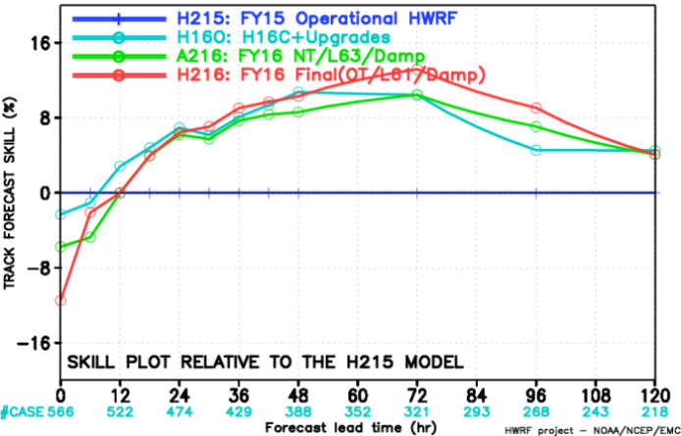
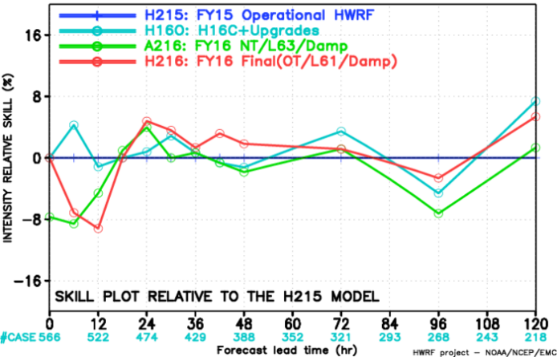
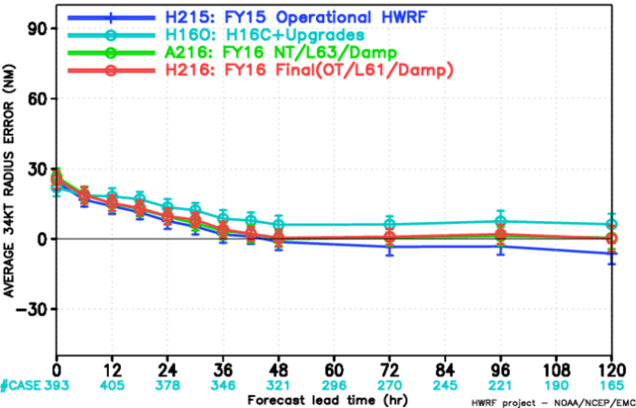
Impact of new tracker/L63/damping
Track skill
Intensity skill
R34 Error
NATL
EPAC
In the NATL,
Base | Exp | Tracker | Lev | Damp | Trk skill (D1-3) | Int skill (D1-3)
FY16 baseline + Upgrades | H16O | Old | 61 | No | +10% | +5-10%
 | A216 | New | 63 | Yes | 0 ~ +5% | -5% ~ 5%
 | H216 | Old | 61 | Yes | +10% | -10% ~ +5%
 | 6ONT | New | 61 | No | in process
 | 6O63 | Old | 63 | No
H16O vs. H216: Impact of damping
intensity degradation
H16O vs. 6ONT: Impact of new tracker (in process)
H16O vs. 6O63: Impact of L63 (in process)
A216 vs. H216: Impact of both new tracker and L63
track degradation

Slide 10
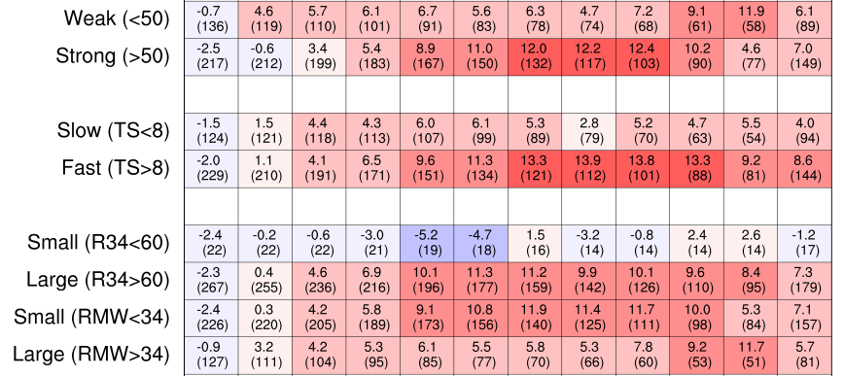
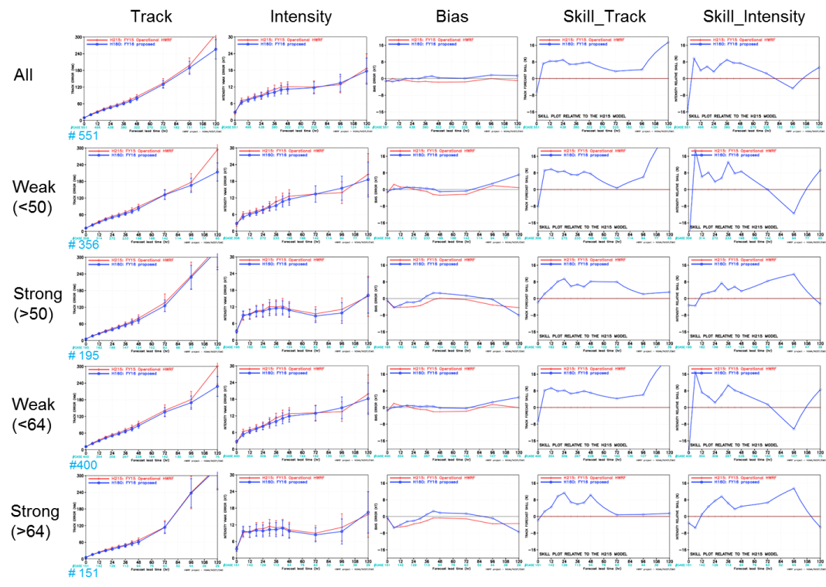
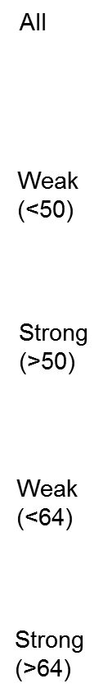
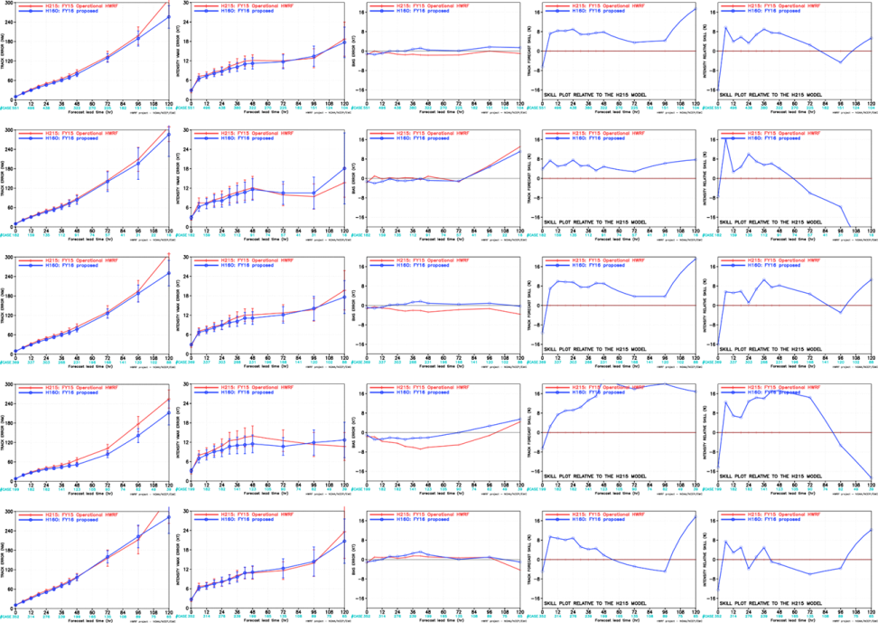
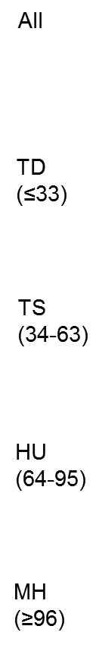
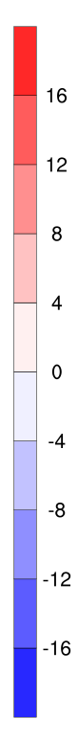
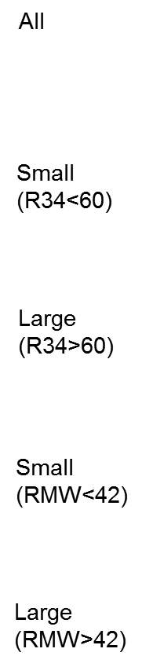
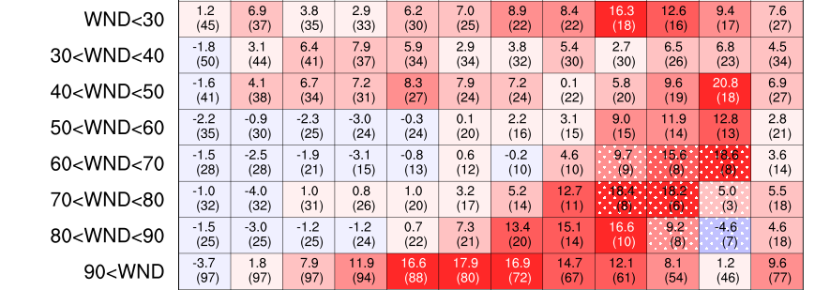
Portrait diagram for efficient and detailed cluster analysis
Previous cluster analysis
Portrait diagram
(e.g., H215 Bias WPAC)
Statistics
(cycles)
Intensity
(wind)
Translation speed
Compre-
hensive
Size
Detailed
(e.g., wind)
Complicated analysis
Non-significant
: less cycles < 10
Previous cluster analysis results are too complicated to analyze because of too many 1-d time series figures. Portrait diagram provide more efficient and detailed analysis.
Efficient and detailed analysis

Slide 11
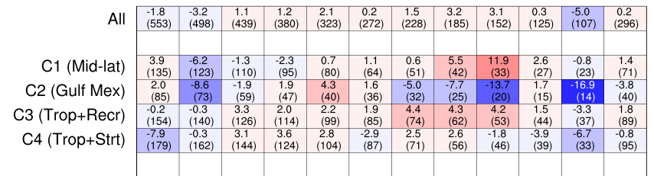
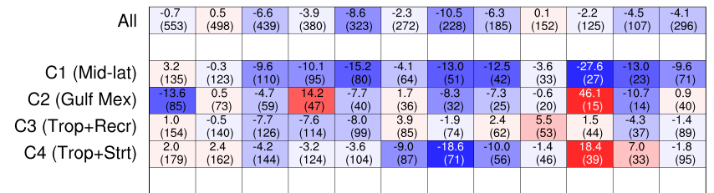
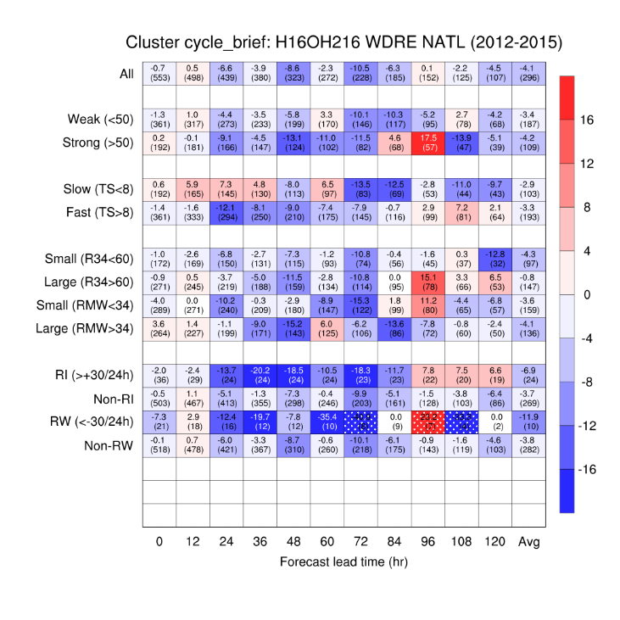
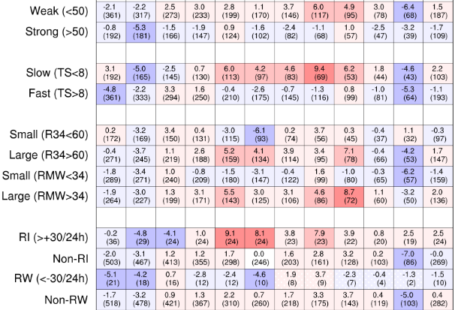
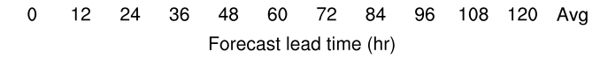
Impact of damping (H216 minus H16O)
Base | Exp | Tracker | Lev | Damp
FY16 baseline + Upgrades | H16O | Old | 61 | No
 | A216 | New | 63 | Yes
 | H216 | Old | 61 | Yes
Track skill
Intensity skill
Cluster
storm
Cluster
cycles
Due to add damping in H216, C1 storms had significant intensity degradation.

Slide 12
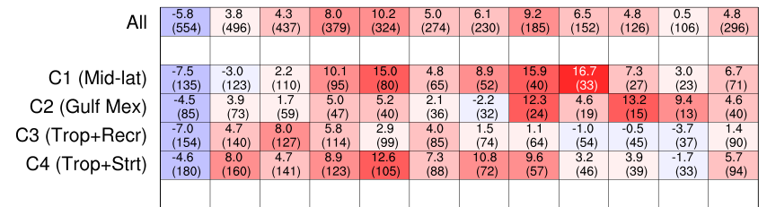
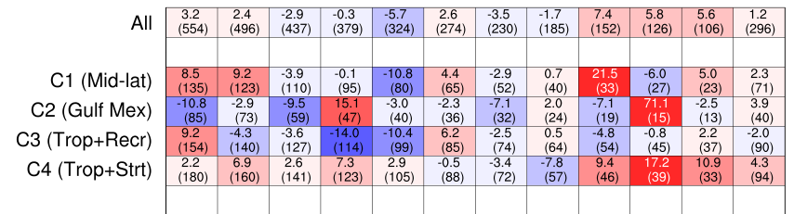
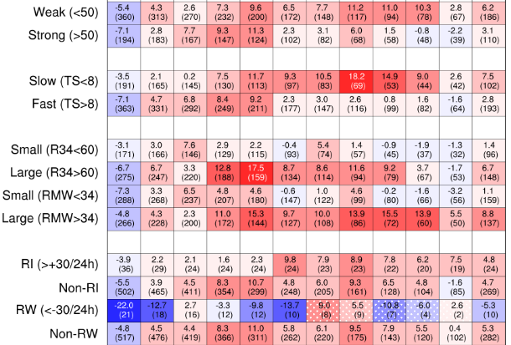
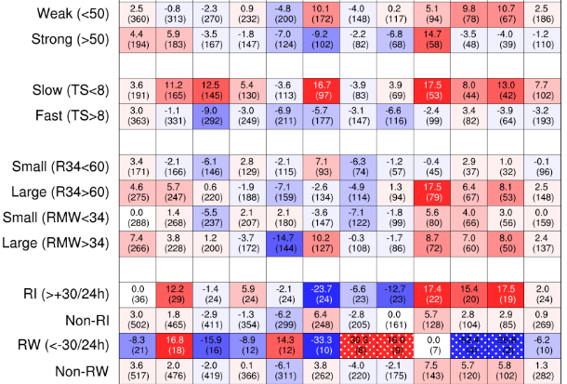
Impact of NT and L63 (H216 minus A216)
Base | Exp | Tracker | Lev | Damp
FY16 baseline + Upgrades | H16O | Old | 61 | No
 | A216 | New | 63 | Yes
 | H216 | Old | 61 | Yes
Track skill
Intensity skill
Cluster
storm
Cluster
cycles
Due to NT and L63 in A216, slow and large cycles had significant track degradation.

Slide 14
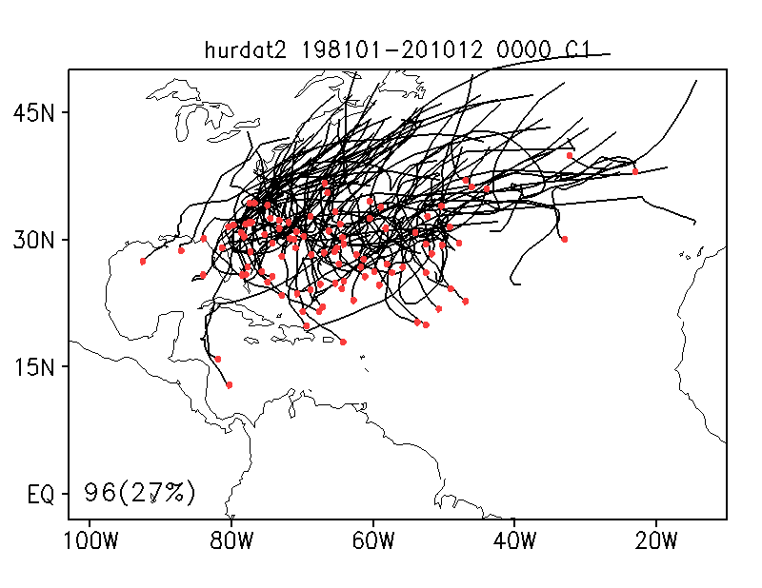
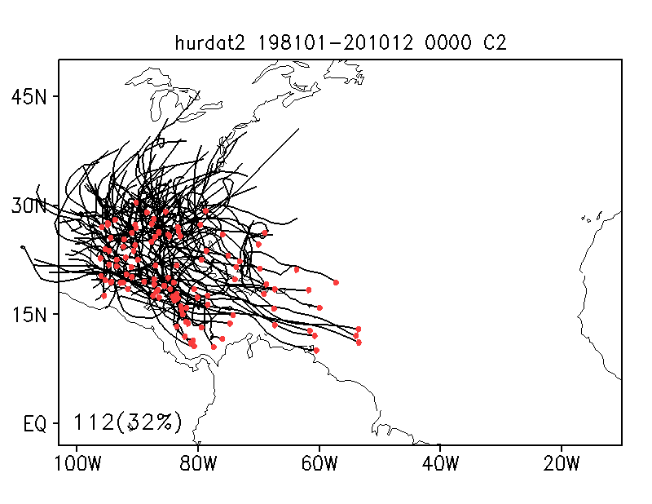
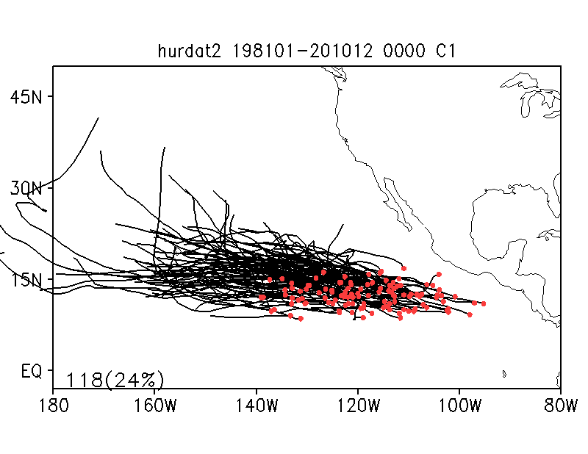
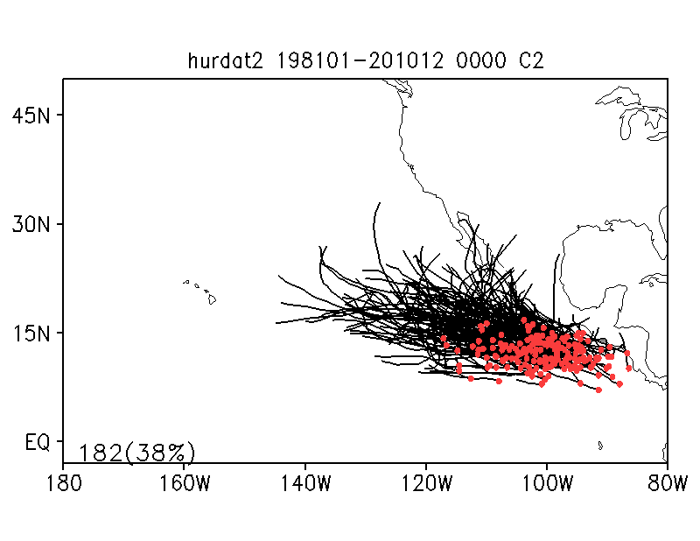
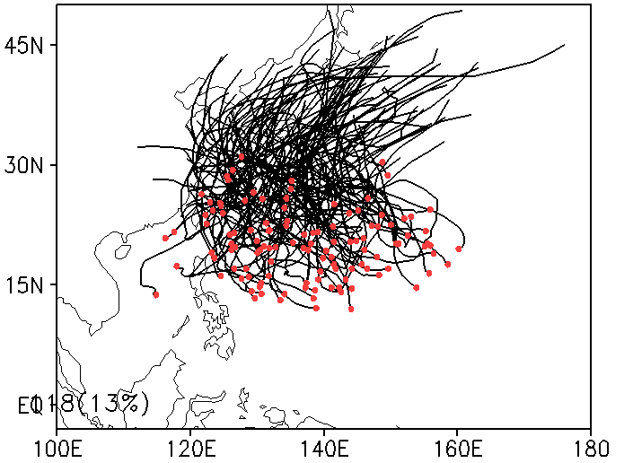
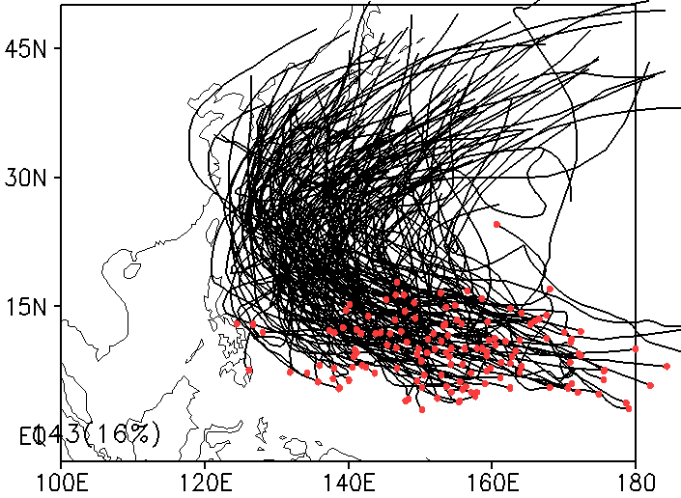
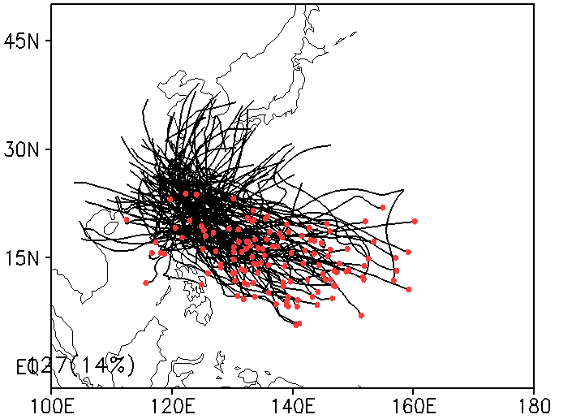
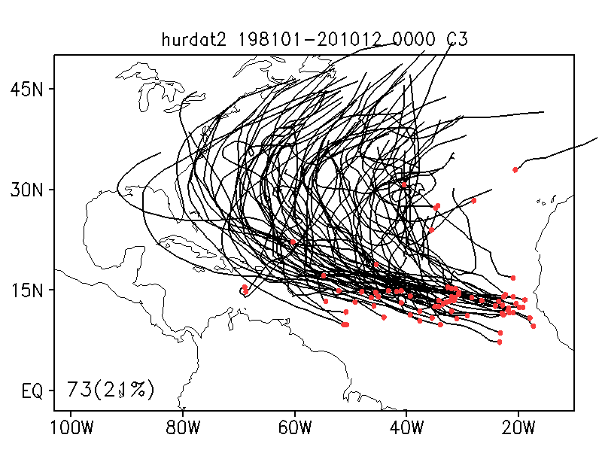
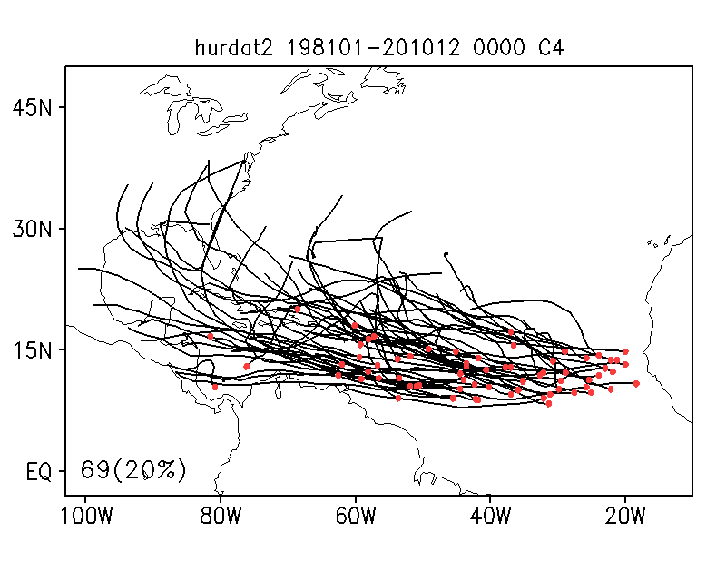
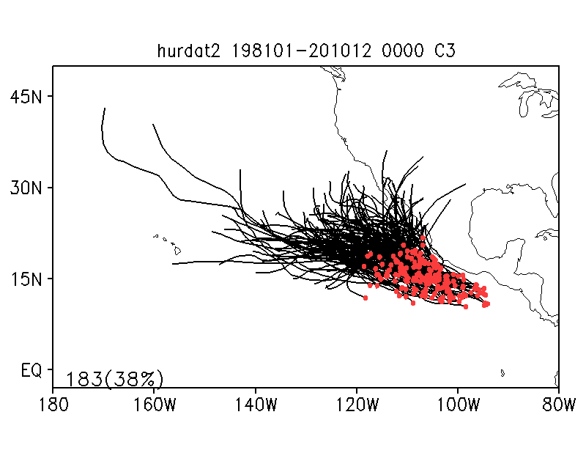
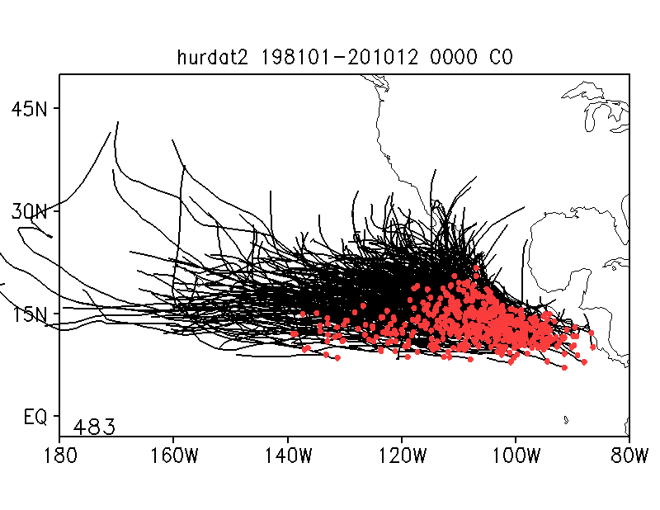
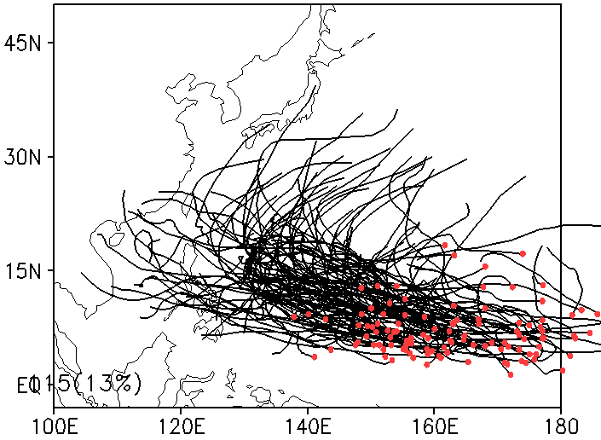
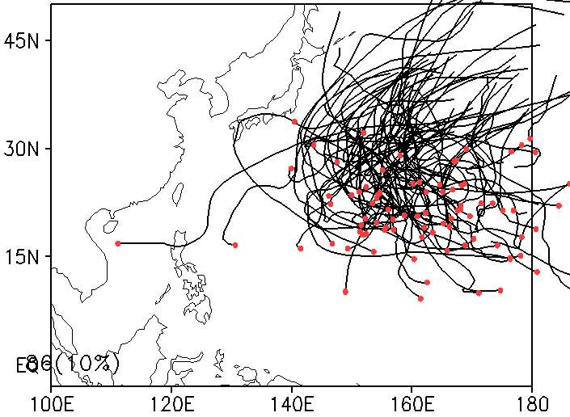
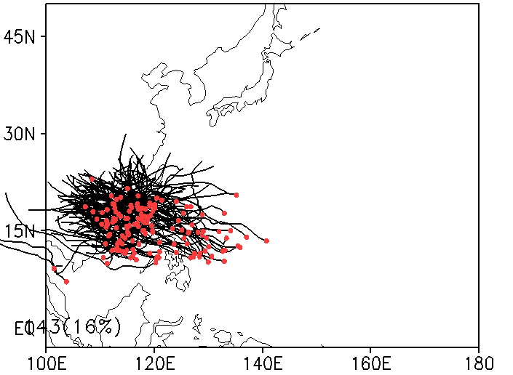
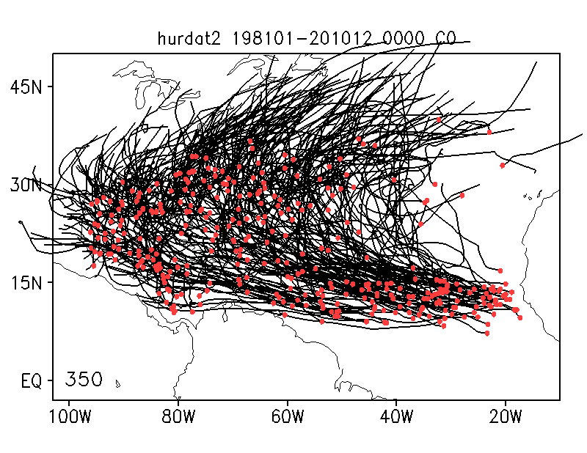
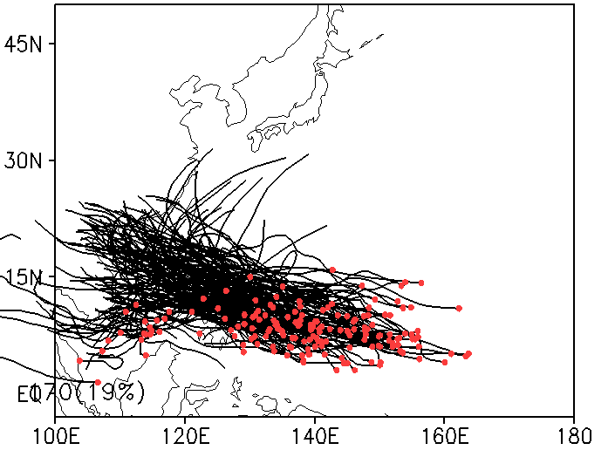
TC pattern clustering (based period: 1981-2010)
NATL
EPAC
WPAC
C1: Mid-lat + northward
C2: Gulf of Mexico
C1: Westward (ENSO)
C2: Cost of Mex, low-lat
C1: KO+JP
C2: Trop+Recur
C3: Taiwan
C3: Tropics + recurve
C4: Tropics + straight
C3: Cost of Mexico
ALL
C4: Trop+Strai
C5: Open ocean
C6: SCS
ALL
ALL
Since TC characteristics vary according to track patterns (e.g., Harr and Elsberry 1991), TC pattern clustering is useful in measuring model performance.
According to Kossin et al. (2010) and Camargo et al. (2007, 2008), the optimum number of clusters are 4, 3, and 7 for NATL, EPAC, and WPAC, respectively.
Here, the fuzzy clustering method is used (Kim et al. 2011).

Slide 15
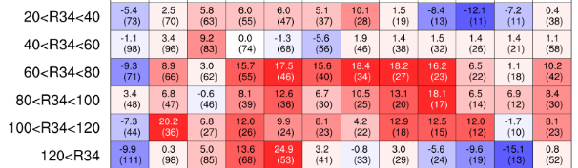
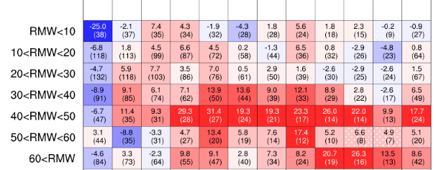
Impact of NT and L63 (H216 minus A216)
Base | Exp | Tracker | Lev | Damp
FY16 baseline + Upgrades | H16O | Old | 61 | No
 | A216 | New | 63 | Yes
 | H216 | Old | 61 | Yes
Track skill
Cluster
cycles

