Slide 1
Evaluation of Thompson and Ferrier Microphysics Schemes with GOES Satellite
Shaowu Bao, Ligia Bernardet, Greg Thompson, Christina Holt, Mrinal Biswas
September 2015

Slide 2
Background
Thompson scheme: advanced features and successful applications in mid-latitude.
HWRF using Thompson scheme: track/intensity degradation in EP.
To solve this problem, need a systematic evaluation of Thompson scheme’s performance of modeling clouds.
EP track error
EP intensity
error
2014 test
Operational (red) vs T/R (black)
No partial cloudiness

Slide 3
Goal
Thompson vs. operational (Ferrier) on their performance of modeling clouds.
Methods
Use NOAA GOES satellite long-wave infrared band (ch4)
Metrics: cloud-top brightness temperature
Compare Thompson and Ferrier synthetic images with the observed ones
Large number of samples (> 2000 images)
Creation of model synthetic brightness temperature images:
Ferrier: UPP (choice of the radiative effective size)
Thompson: Jason Otkin’s code
Statistical methods: PDF and FSS

Slide 4
2015 tests:
 | Radiation | Microphysics | Synthetic Satellite image
HDGF (DTC) | GFDL | Ferrier | UPP
HDRF (DTC) | RRTMG+ partial cloudiness | Ferrier | UPP
HDRT(~160 cycles) | RRTMG+ partial cloudiness | Thompson | Jason’s code
09e 2011 (HILARY)
09l 2011 (IRENE)
12l 2011 (KATIA)
16l 2011 (OPHELIA)
03l 2012 (CHRIS)
04e 2012 (DANIEL)
05e 2012 (EMILIA)
07e 2012 (GILMA)
12l 2012 (LESLIE)
18l 2012 (SANDY)
03l 2013 (CHANTAL)
17e 2013 (RAYMOND)
18e 2013 (SANIA)
06l 2014 (EDOUARD)
08l 2014 (GONZALO)
13e 2014 (MARIE)
14e 2014 (NORBERT)
15e 2014 (ODILE)
Notes:
Gonzalo

Slide 5
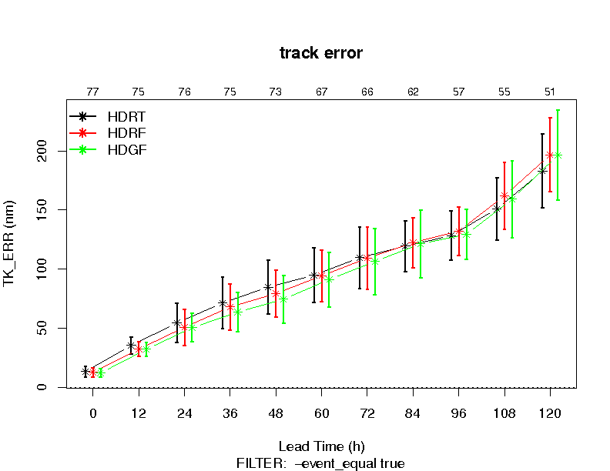
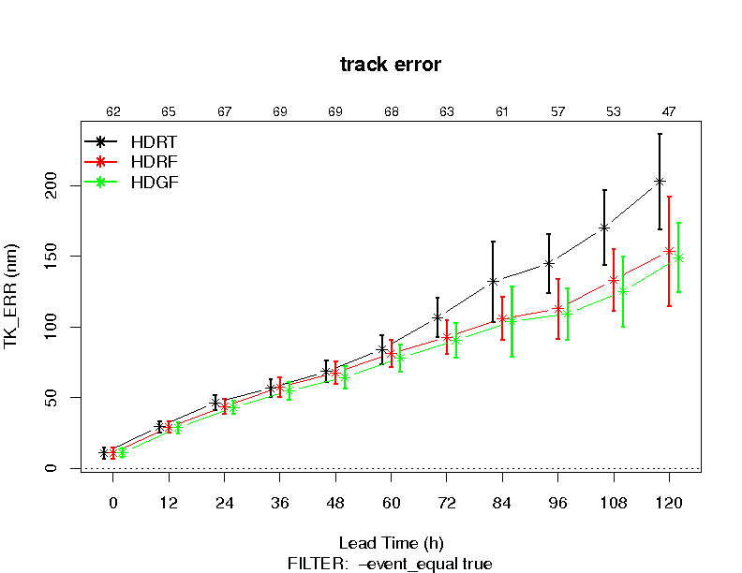
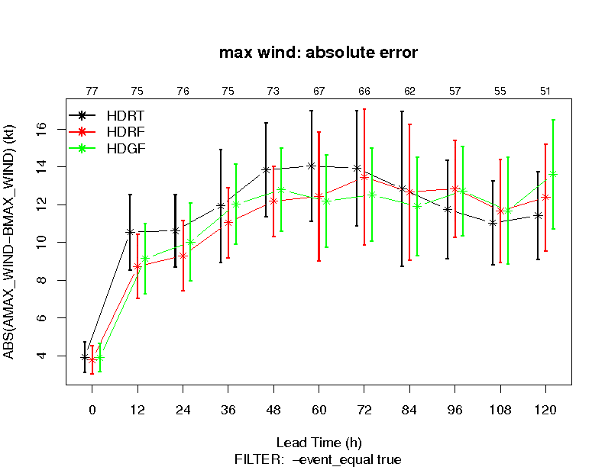
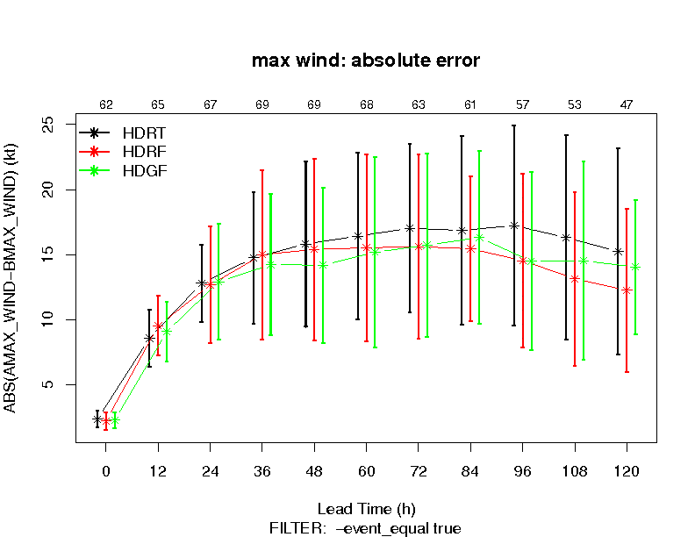
2015 test Track/intensity verification
mixed results for AL
Degraded track/intensity for EP;
Similar with the 2014 HC35 vs HDTR tests
Track error
AL
Track error
EP
intensity error
AL
intensity error
EP

Slide 6
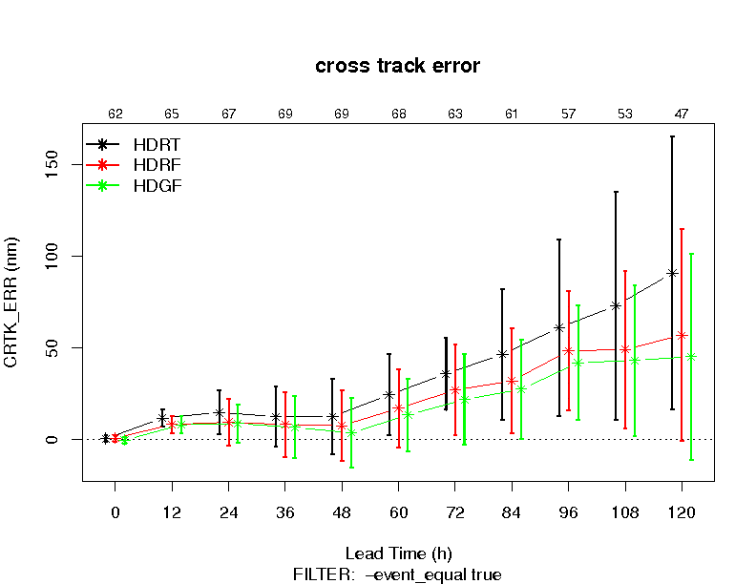
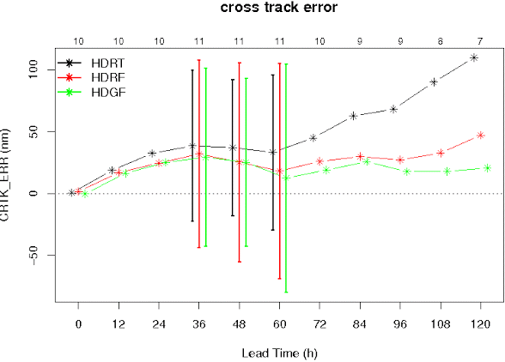
Cross-track error in EP
HDRT tends to go North
All
EP
cases
Daniel
2012

Slide 7
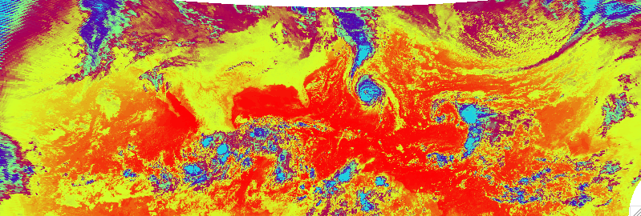
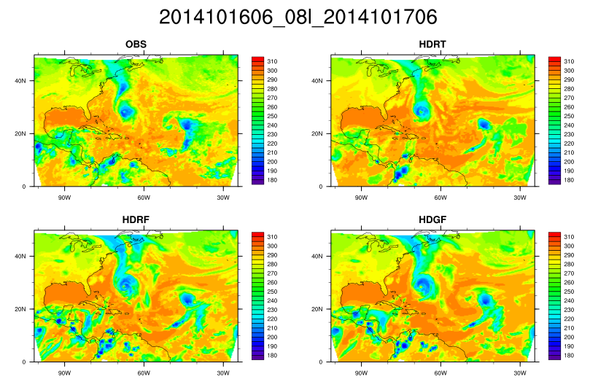
Satellite GOES data
> 2000 images were used
Notes:
No clouds: brown : 290K and above
Low clouds (stratocumulus): yellow+green (240-285)
High clouds (convective): blue (< 230)

Slide 8
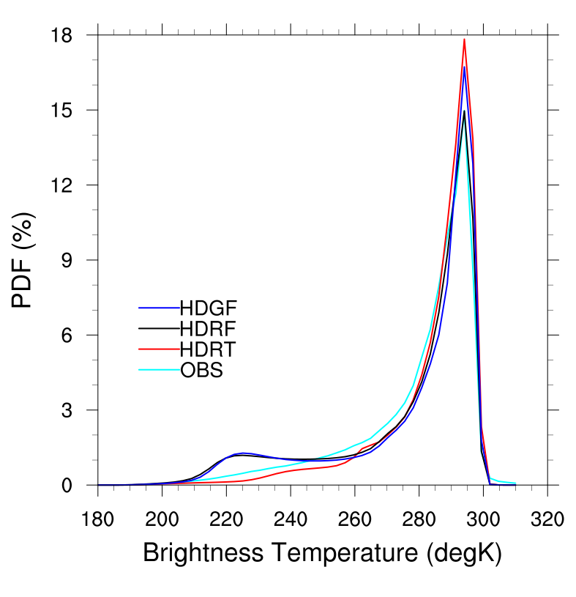
AL
high
clouds
low clouds
Low clouds coverage:
Both T and F results have less coverage.
High clouds coverage:
Ferrier has too much; Thompson has less but closer to obs.
Notes:
Temperature from 180-310 were divided into 50 bins.
Low clouds: diff not to large

Slide 9
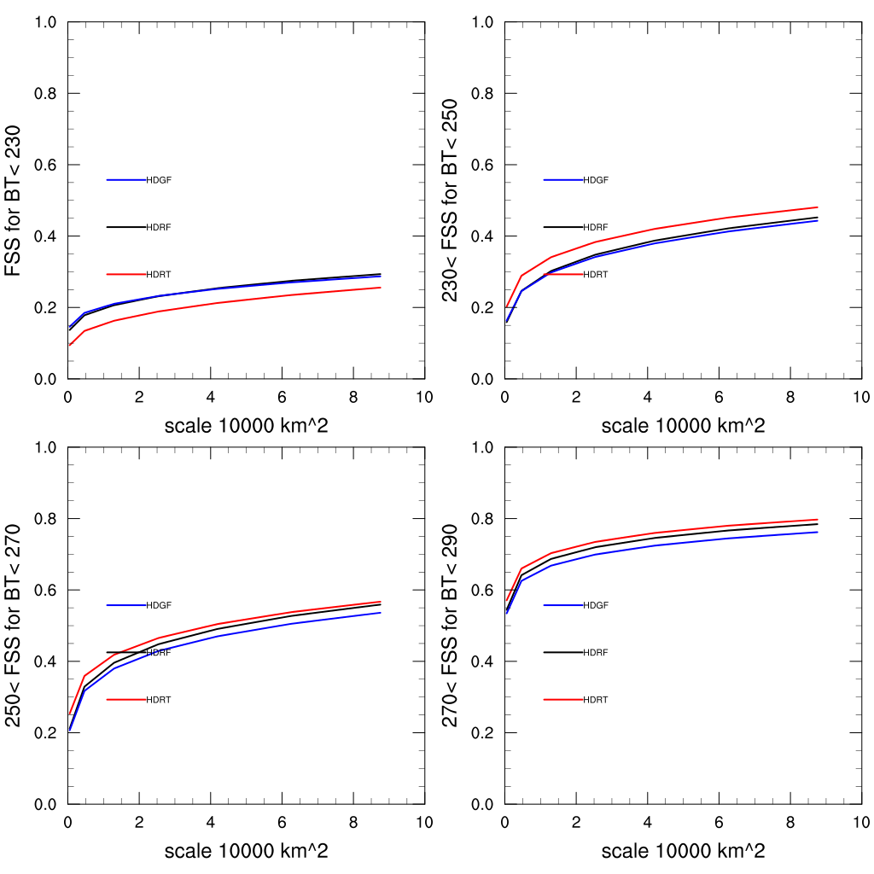
AL
Fraction Skill Scores (FSS)
higher is better
High clouds
Low clouds
T has higher scores for low clouds
F has higher score for high clouds due to better track forecast.
Low clouds
Low clouds

Slide 10
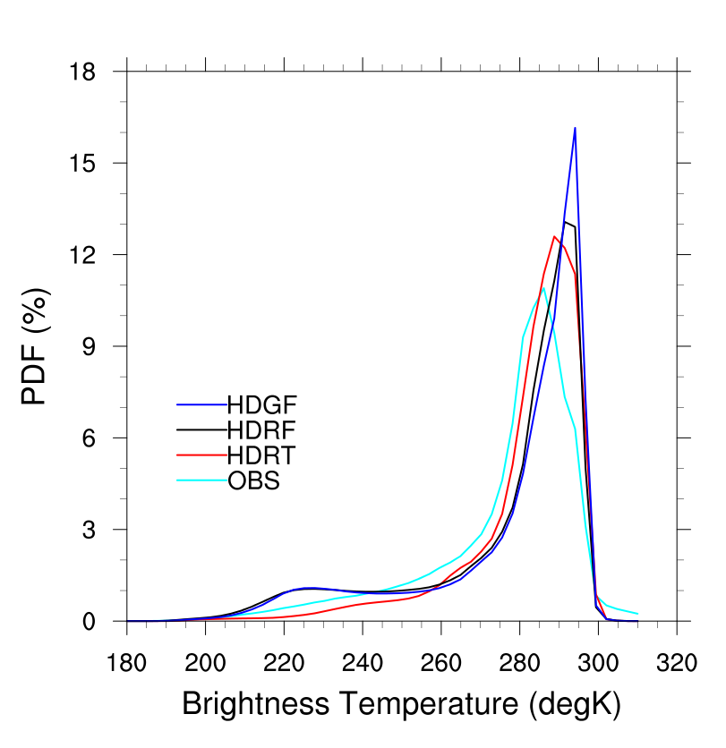
EP
High clouds
Low clouds
Low clouds coverage:
Both T and F results have less coverage.
T is closer to obs.
High clouds coverage:
Ferrier has too much; Thompson has less but closer to obs.

Slide 11
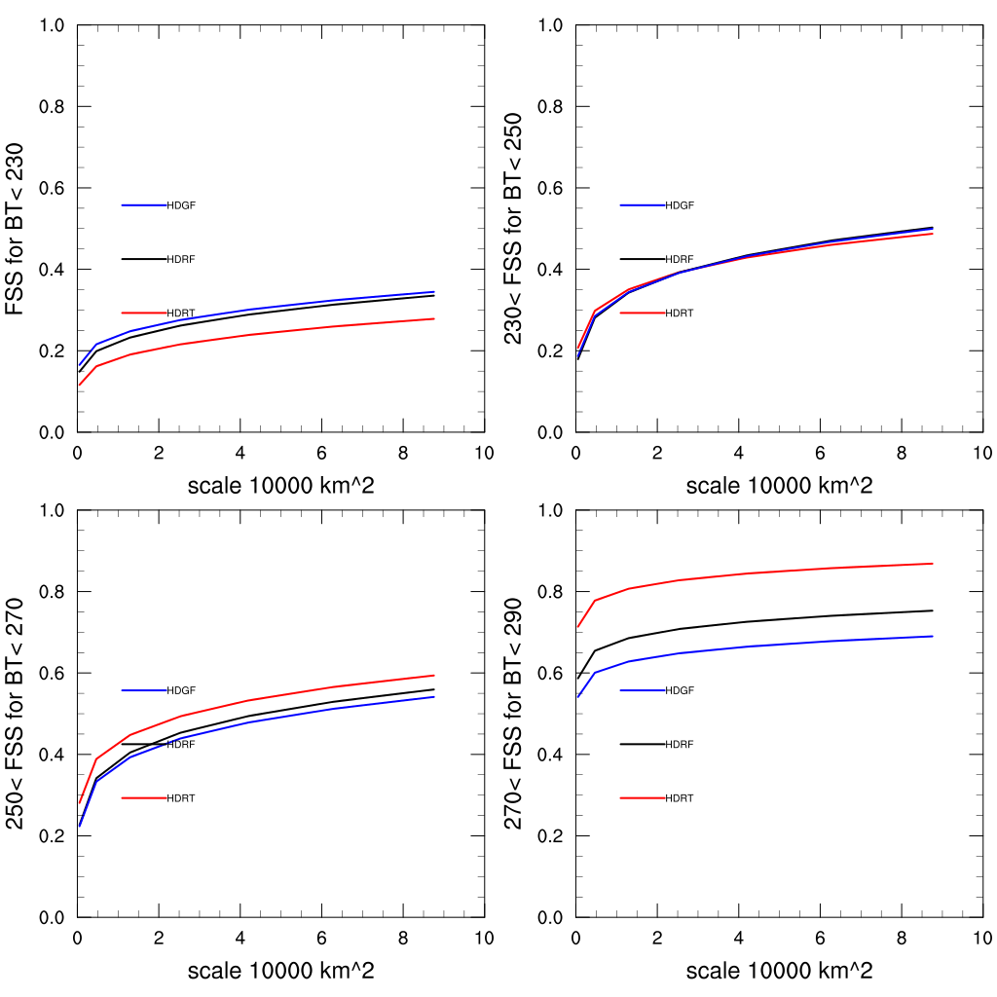
EP
Fraction Skill Scores (FSS)
Higher is better
High clouds
Low clouds
T has higher scores for low clouds
F has higher score for high clouds due to better track forecast.
Low clouds
Low clouds

Slide 12
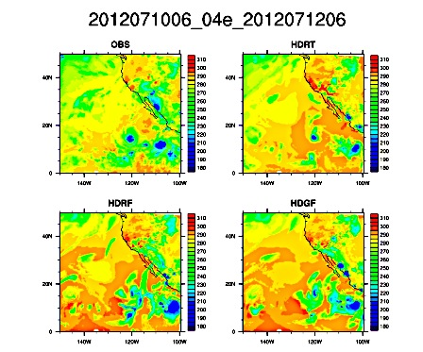
An
image example for EP
Daniel 04e 2012

Slide 13
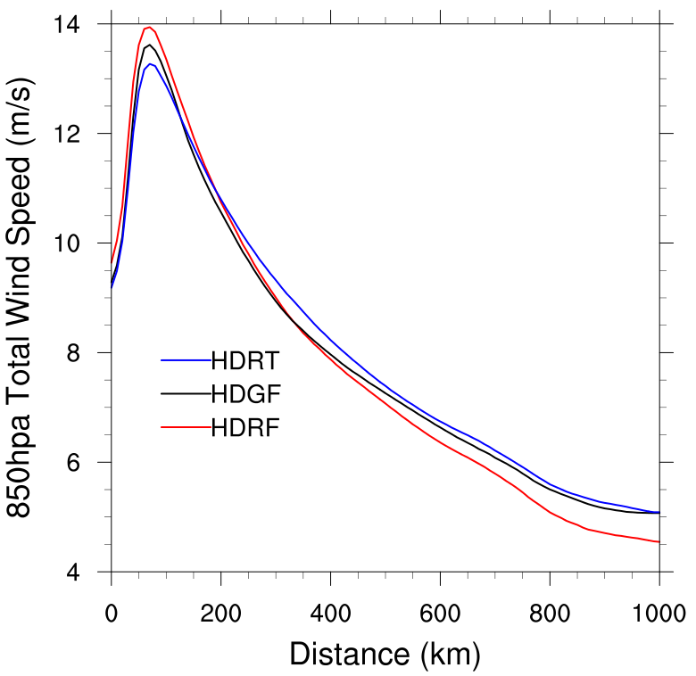
Daniel (2012) 850 hPa wind profile / total condensate
HDRT 850 hPa wind weaker in vortex but stronger outside.
Total condensate
Cross section
HDRT total condensate
thicker and wider

Slide 14
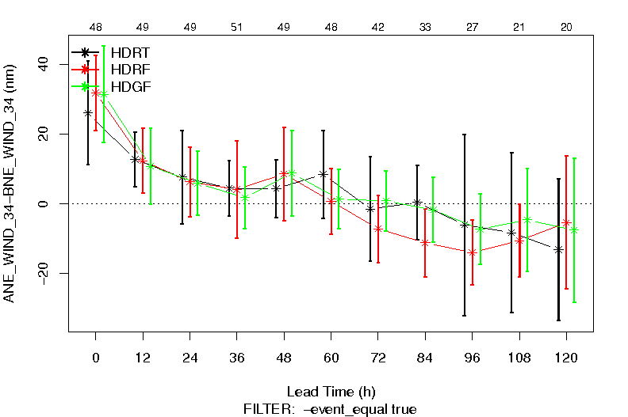
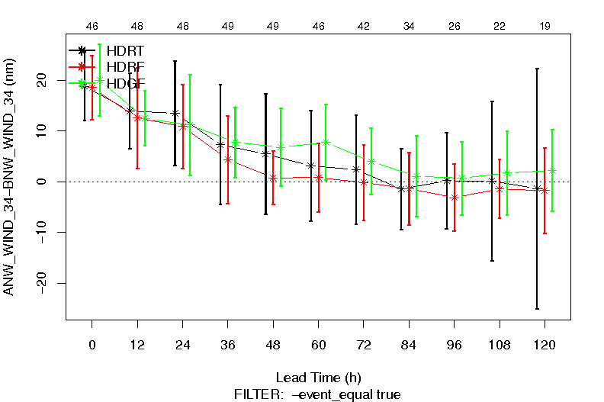
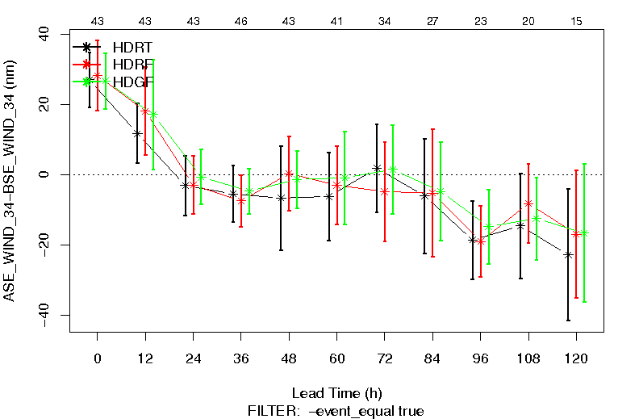
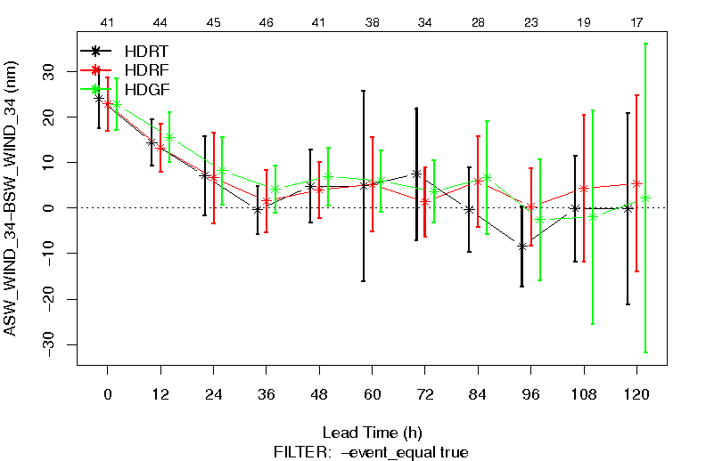
EP storms: structure Vx (MET-tc) 34Kt Radius (model-besttrack)
NE
NW
SE
SW

Slide 15
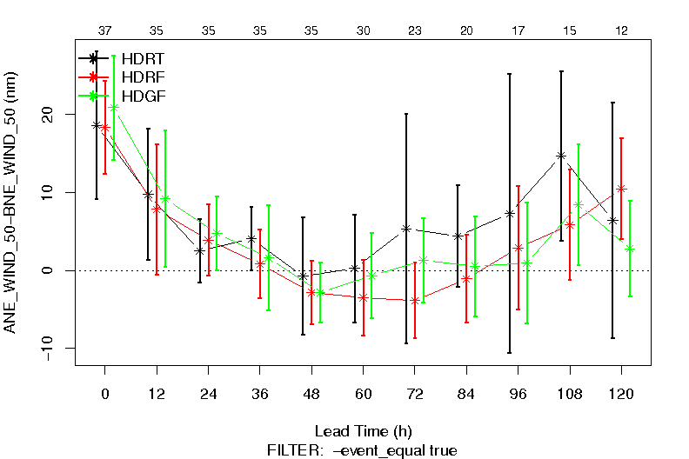
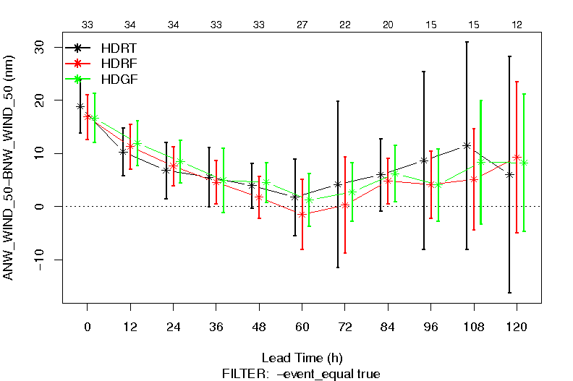
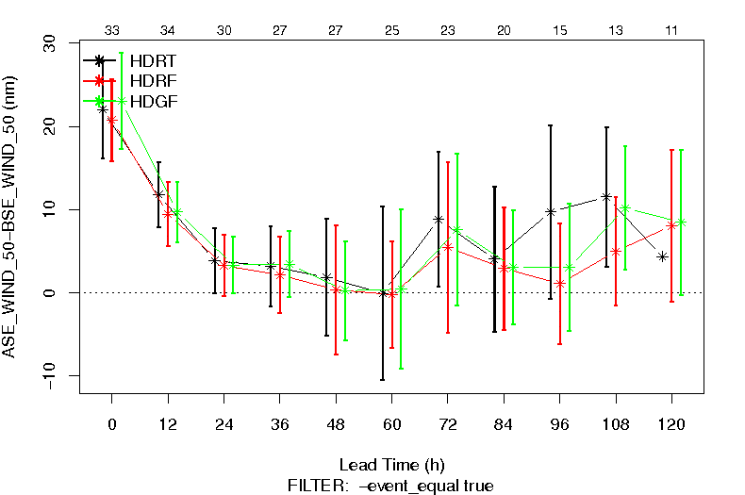
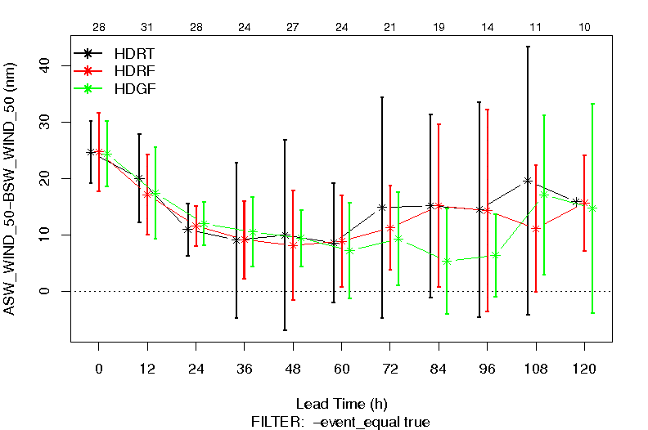
EP storms: structure Vx (MET-TC) 50Kt Radius (model-besttrack)
NE
NW
SE
SW
HDRT 50kt radius larger than HDRF HDGF at T>48 hr

Slide 16
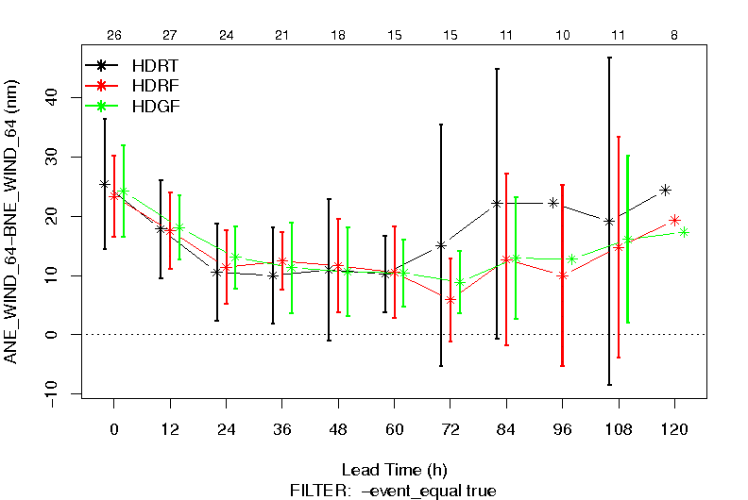
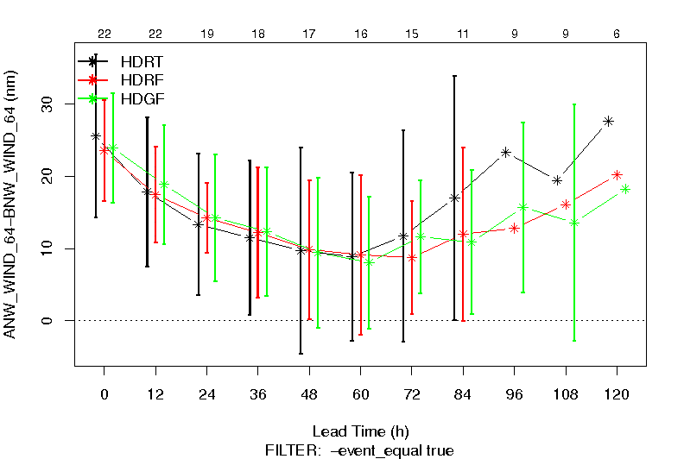
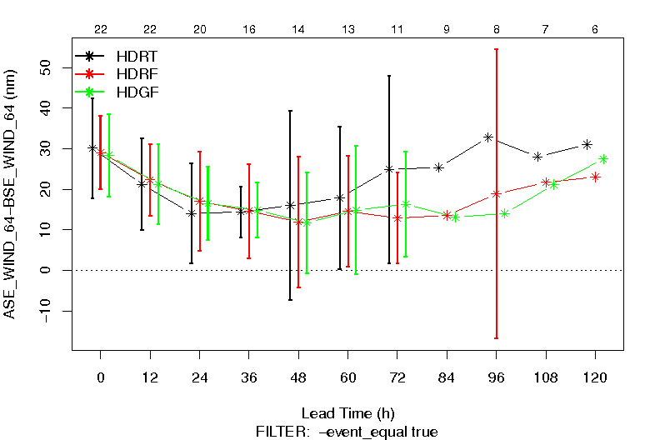
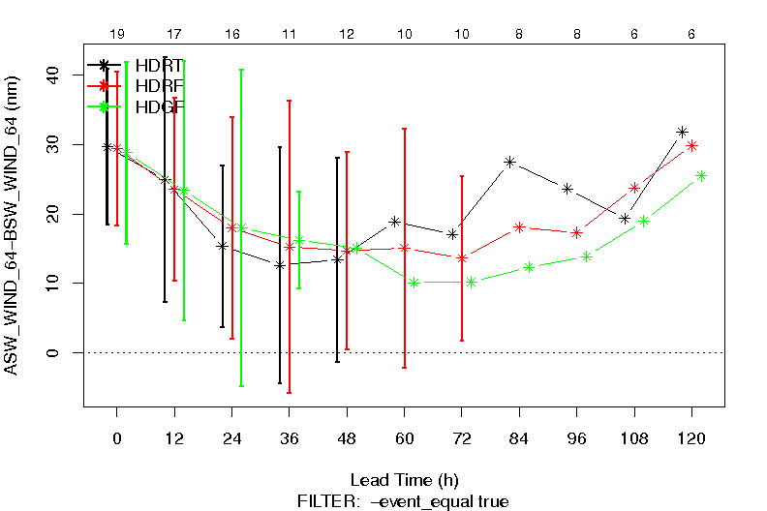
EP storms: structure Vx (MET-TC) 64Kt Radius (model-besttrack)
NE
NW
SE
SW
HDRT 64kt radius larger than HDRF HDGF at T>48 hr

Slide 17
Summary
Model generated synthetic GOES ch4 images from HWRF runs with Thompson and Ferrier schemes were compared against the observed images.
Both schemes generate less stratocumulus coverage than the observed; but Thompson scheme agrees with observation better.
Ferrier generates more high cloud (T<240K) than the observation, Thompson generates less, but closer to the observation.
Thompson scheme generated larger storm size and wider total condensate profiles.
The better simulation of cloud-top temperature did not lead to better track/intensity simulation. The reason will be investigated.

Slide 18
Mid-nest result AL

