Slide 1
Hurricane Maximum Potential Intensity Equilibrium
Chanh Kieu
IMSG, NOAA/NCEP/EMC
Dedicated to the EMC HWRF team. September 2014

Slide 2
Outline
Motivation
Objectives
Hurricane-scale model
Stability analysis
Intensity error growth
Role of radiative cooling
Concluding remarks

Slide 3
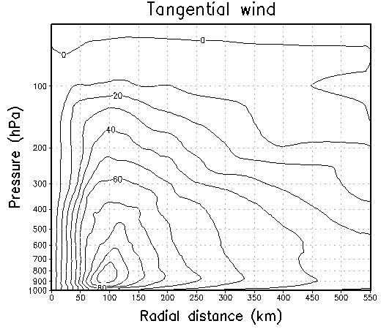
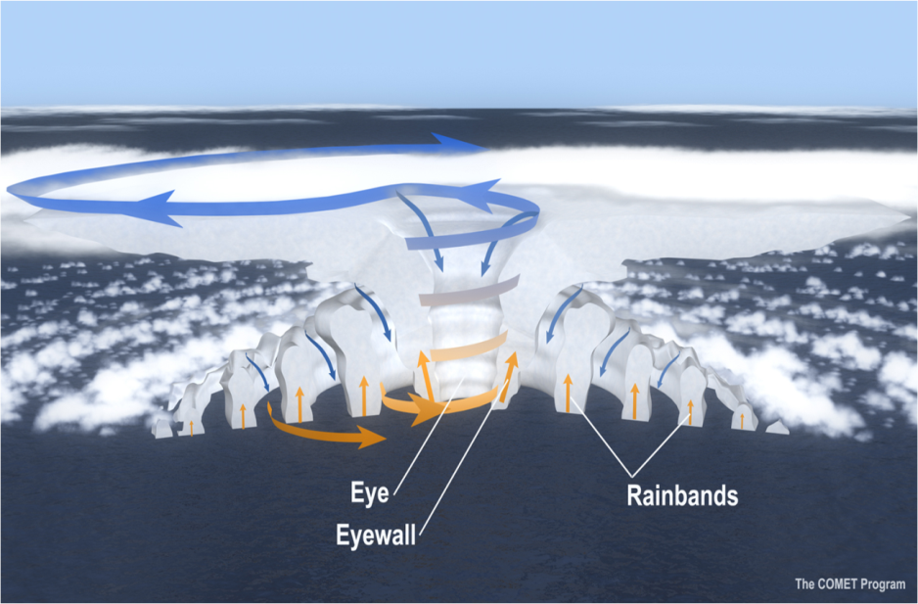
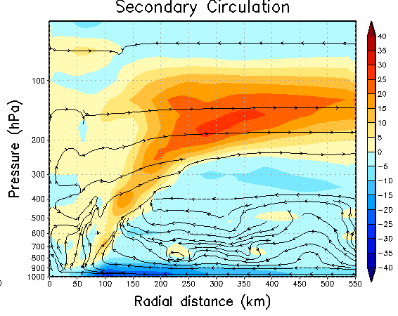
Motivation
Hurricanes are in general multi-scale systems;
Hurricanes however possess a “soliton” structure in time;
Quasi-balance models have been used extensively, based on the soliton of gradient quasi-balance.

Slide 4
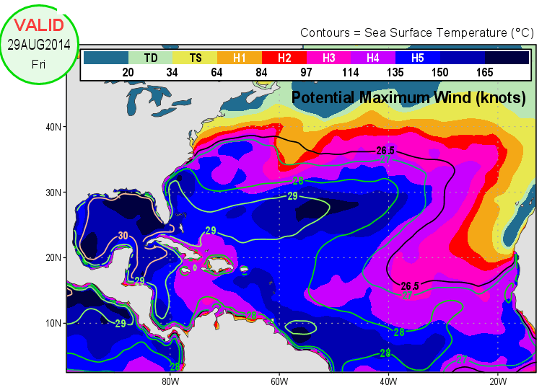
Motivation
Under neutral slantwise convection and gradient balance, (Emanuel 1986,2003) obtained
Questions:
Is the MPI equilibrium achievable? i.e., is it a stable or unstable? What is the attractor and corresponding basin of attraction?
Is the WISHE hypothesis consistent with MPI ?

Slide 5
Objectives
Explore the stability of the MPI equilibrium;
Examine the consistency of the WISHE feedback and the MPI limit;
Examine the dependence of initial intensity error growth on the storm intensity;

Slide 6
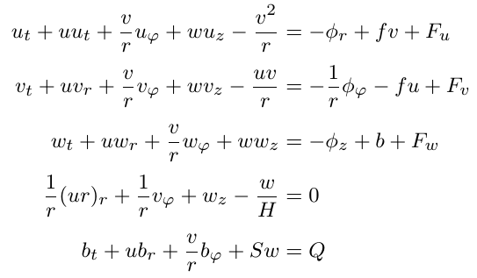
Formulation
We start from the non-hydrostatic, anelastic primitive, equations in the log-pressure (p) cylindrical coordinates (r,φ,z), z= -H ln(p/p_{s})

Slide 7
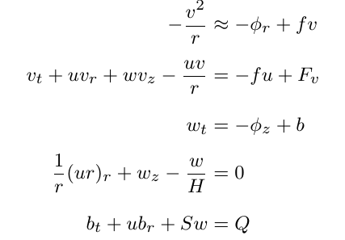
Formulation
Quasi-dynamics system can be approximated as
Can we have a set of equations for the “macro” variables including VMAX, PMIN, RMW, W, dT?

Slide 8
Growth rate of tropical depression
The earliest model for TC development was due to Charney and Eliassen (1964), based on a 3-level gradient wind balance model
The TC growth rate decreases with the storm size (a);
The larger the moist conversion to diabatic heating (μ) , the larger the growth rate would be;
But then is the TC growth rate the same for all scales < 100 km ???
Ψ’ ~ e^{σt}
vortex in gradient and thermal wind balances
Kieu and Zhang (2009): Is the growth of SC the same as growth by PC?
Assume: w ~ e^{σt} , then v ~ exp[e^{σt}] -> PC grows much faster than SC
Top-hat profile for W
U -> V -> φ -> B -> Q

Slide 9
Hurricane-scale model
Let us start with the scale of vertical motion W, which can be regarded as the maximum vertical motion wihtin the eyewall
Continuity equation then gives:
$$U≈−\frac{1}{H}WR≡−αWR$$
Tangential equation then gives:
$β≡\frac{C_{d}}{h}$, Rossby #>>1
Radial momentum equation then gives:
$$ΔΦ≈{−V}^{2}$$

Slide 10
Hurricane-scale model (Cont’d)
Vertical momentum equation then gives:
(W<<V):
Thermodynamic equation is:
Let us now introduce 2 mechanisms: 1) WISHE feedback. 2) Newtonian cooling relaxation process such that
Then we finally have under neutral slantwise convection

Slide 11
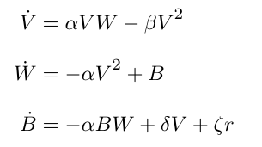
Hurricane-scale model(Cont’d)
In summary, we have a system of equation for hurricane scale dynamics (HSD system)
Note:
This system consist of 3 variables, and contains highly nonlinear terms
This is the system for dynamics of hurricane scale, not for individual pulses of convection
The system is autonomous. In reality, TCs move and the so some can be non-autonomous (higher dimension)
V>0 means cyclonic. V<0 anomalous low in NH. For SH, should flip the sign

Slide 12
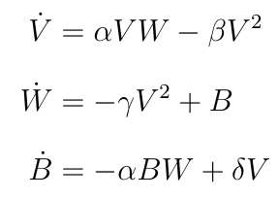
HSD system: absence of radiative cooling
In the absence of the radiative cooling, we have:
Notes:
The flows are unbounded. So no chaos seems to be possible;
Plane V =0 is a null-surface, separating the flow from cyclonic to anticyclonic
Flows are dissipative in V>0, but expanding for V < 0
Three CPs:

Slide 13
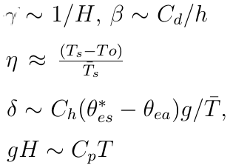
Linear stability analysis: unstable node
Consider first the critical point (0,0,0). Linearization gives degenerate three eigenvalues with all = 0 -> Linearization is no longer feasible
(0,0,0) is unstable. Any point move into V>0 will grow as B ~ t, and W ~ t². Similar to V<0 domain.
How about the other two CPs?
Where is MPI?
So, does WISHE lead to MPI equilibrium?
Not quite yet!!!

Slide 14
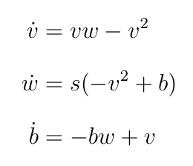
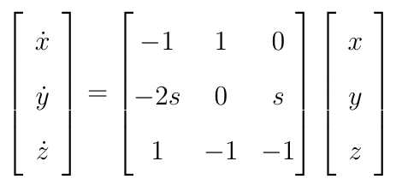
Linear stability analysis: MPI equilibrium
Let us nondimensionalize the HSD system, using V = V_{c}v, B= B_{c}b, W=W_{c}w, and t = Tτ, T = 1/βV_{c} and s = αγ/β², we have
Linearization at MPI equilibrium
v = 1+x, w = 1+y, b = 1+z
Note:
Characteristics equations has 1 real root < 0, and 2 complex root with Re<0 -> spiral points. It is also attracting -> asymptotically sable. What a relieve!
MPI equilibrium is “structurally stable” around (1,1,1). So change of parameter will not effect the stability. No need to special balance.
Linearization is good only around (0,0,0). Numerical exps appear to show that basin of attraction is (v>0,b>0). As long as v>0,b>0, it will grow!!! (is that familiar to you by now).
The remaining CP (-1,-1,1) is living in anomalous low, and unstable.

Slide 15
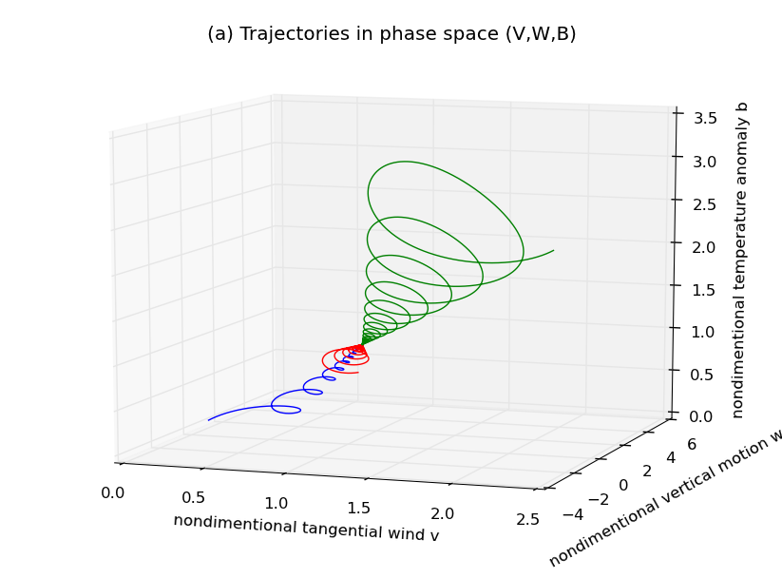
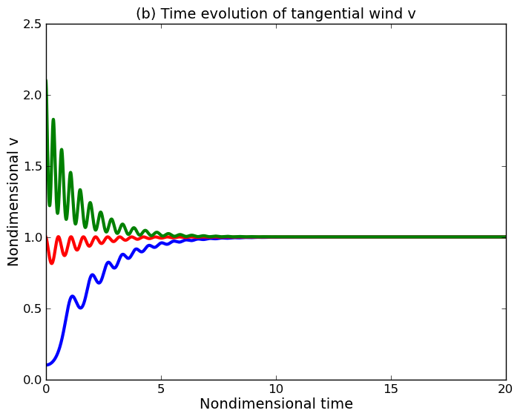
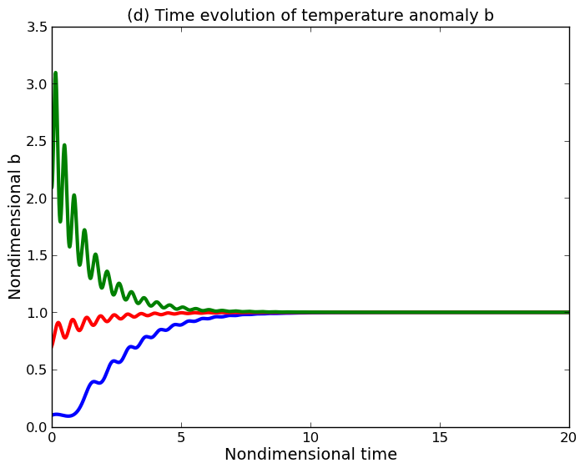
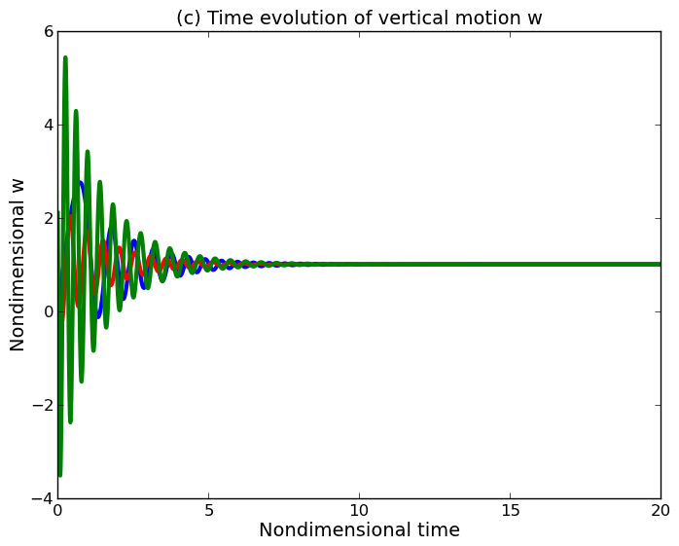
Linear stability analysis: MPI equilibrium
Note:
MPI based on v only is not sufficient; v=1 but if other dimensions are not right, it could lead to strong oscillation.
Growth of flow is in episodes, not monotonically with time. So, previous models forTC growth have to be re-visited;
Two different time scales for the flow
WISHE is so far the only model that could capture i) MPI, 2) reasonable evolution of flow (finally!!!);

Slide 16
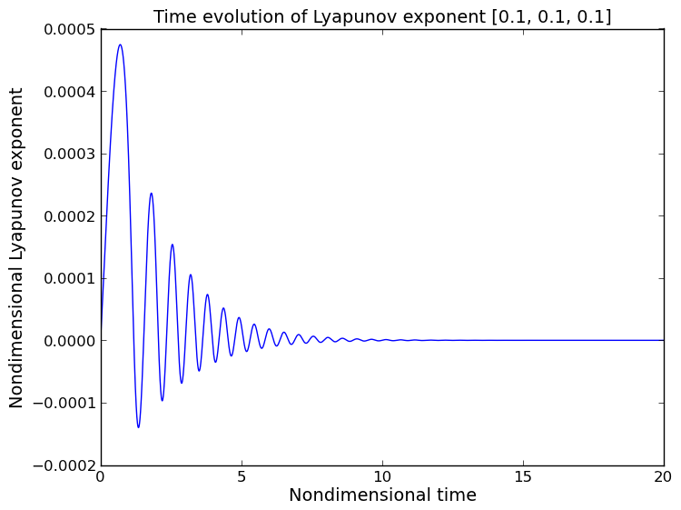
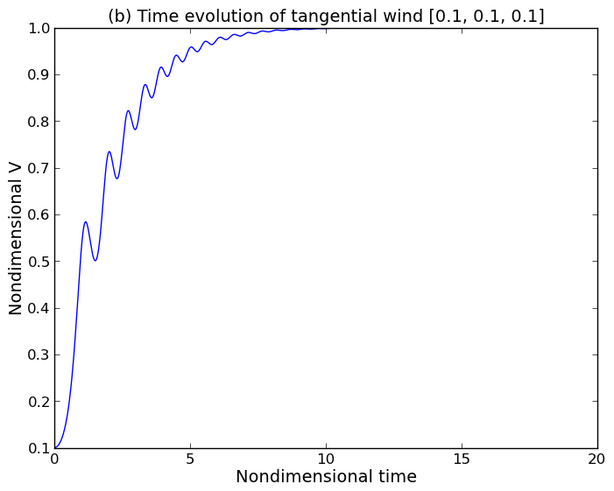
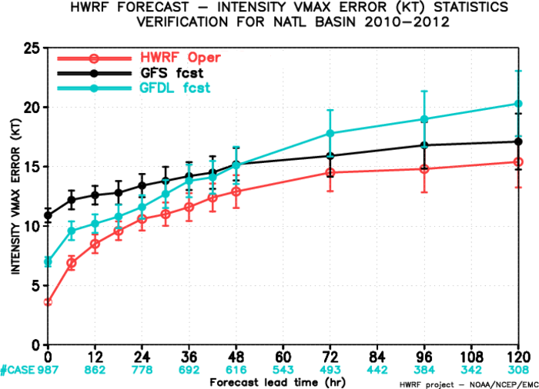
Linear stability analysis: initial error growth
Error growth is much larger during weak intensity stage, and then weaken as storm get stronger -> initial errors during the weak period will be hard to control;
Although the errors growth for strong storms will be easier to control, the error growth depends on how reasonable the (V,W,B). Too little warm core or too weak vertical motion can lead to rapid errors growth;
The faster error growth at early time seems to consistent with statistics. Other source of error (model/boundary) is not here;
Vortex flow seems to be more predictable at strong intensity (longer lead time) than during the short lead time.
$$λ=\frac{1}{T}\ln{\frac{\left|y\left(T\right)−x\left(T\right)\right|}{\left|y\left(0\right)−x\left(0\right)\right|}}$$

Slide 17
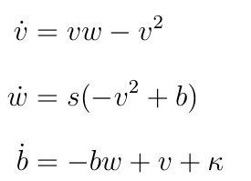
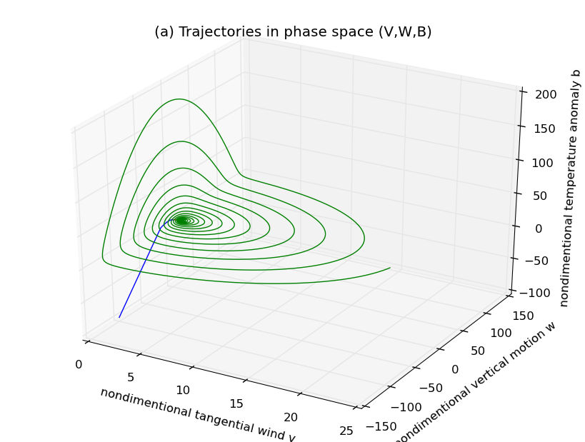
HSD system: presence of radiative cooling
In the presence of the radiative cooling, we have:
κ = -r ~ -0.2 (~ radiative cooling 1-2 K/day)
Notes:
Inclusion of the radiative cooling reduces the MPI value!;
The MPI equilibrium is still structural stable;
v=0 plane is still a null-surface, but basin of attraction is shifted because of the CP at origin is shifted.

Slide 18
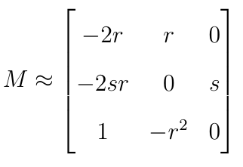
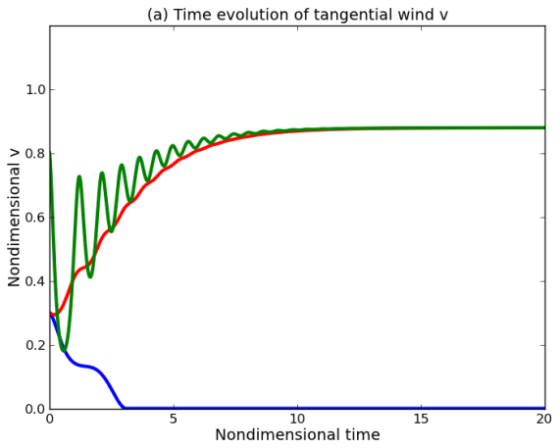
HSD system: presence of radiative cooling
Around the CP y_{o}, linearization gives
b
Notes:
The CP point at the origin is shifted, and a new non-developing domain appears!!. A vortex can decay if its initial condition is within the domain;
The non-developing domain is associated with the constant radiative cooling.
Replacing the constant cooling by Newtonian cooling relaxation with a fixed cap will shift y_{o} back to origin but produce a trap in which vortex may never grow.
n
w
v

Slide 19
Conclusion
WISHE feedback could lead to 1) a stable MPI equilibrium; and 2) an expected evolution of tangential flow;
MPI equilibrium is structurally stable, and it is the only sink of the hurricane-scale system. In the absence of radiative forcing, all (v>0,b>0) vortex will approach the MPI;
Vortex intensification takes place in episodes with 2 different timescales; the fast timescale is ~ 3 h, and slower timescale is ~ 1-2 days. Previous growth models based on monotonic function are not valid;
Intensity error growth depends strongly on the vortex initial intensity; initially weaker vortex will have larger error growth;
Radiative cooling decreases the MPI limit, but the MPI equilibrium is still stable.
Radiative cooling modify the basin of attraction of the MPI equilibrium and create a domain in the phase space that a vortex would not develop if its initial condition is within this domain.
Potential bifurcation could happen if radiative forcing is sufficiently strong.

Slide 20
Thank you!!!

Slide 21
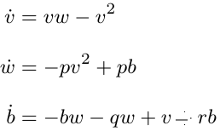
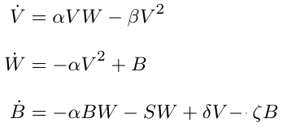
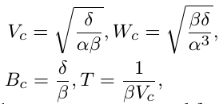
Appendix
The CPs are now$\left(v_{c},w_{c},b_{c}\right)$, where $v_{c}=\left(0, \frac{−r±\sqrt{r^{2}+4−4q}}{2}\right), b_{C}=v_{c}^{2},w_{c}=v_{c}$.
Condition for existence of CPs are $q<1+\frac{r^{2}}{4}$. Too stable stratification (i.e. large q) will lead to collapse of the MPI equilibrium with the origin point., and eventually no other CPS could exist except for the origin unstable node.
Stability of the MPI equilibrium will also be greatly modified once stratification becomes significant since it is no longer structurally stable away from (1,1,1).
More investigation is under way.

Slide 22
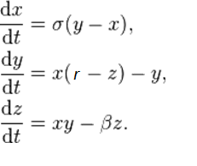
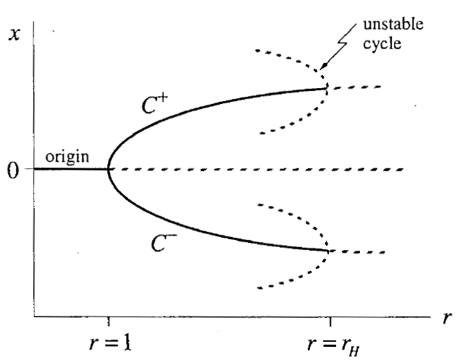
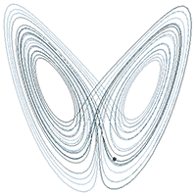
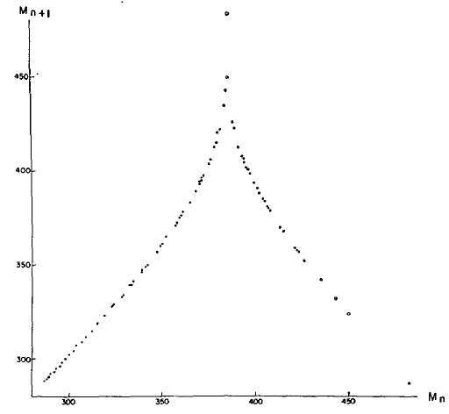
Lorenz-63 model
Lorenz-63 model for chaotic flow of 3 variables x convective intensity, y temp. difference between descending and ascending, z difference in vertical temp.
Chaos happened when r > Rayleigh number -> pitchfork/Hopf bifurcation happens at some threshold of r;
CPs are unstable, and a new stranger attractor appears with fractal dimension ~2.06 (both limit cycles are now stable);
Bounded and dissipative system, positive Lyapunov exponent on attractor. Predict range ~ ln(1/initial_error) -> 10 times initial error reduction can only double the predictability range.

