Slide 1
HWRF high resolution physics experiment HFIP Tiger physics team
Chanh Kieu, Young Kwon, Vijay Tallapragada (NCEP/EMC), and
Jian-Wen Bao (ESRL)

Slide 2
Outline
Objective
Idealized experiments
Retrospective experiments
Real-time experiments
Summary & Future Plans

Slide 3
Objective
HFIP Milestones/Objectives FY2013
2. Model Physics Strategic Planning and Tiger Teams
Physics package testing for the operational HWRF models
Test and evaluate proposed improvements in the PBL scheme used in the operational HWRF and GFDL models. Stream 2, 2.1.1 Mar 15, 2014 ;
Couple the operational HWRF model to NOAH LSM. Test, evaluate and calibrate its performance. Stream 2, 2.1.2, Mar 15, 2014;
Optimize the operational HWRF and GFDL physics packages for the 2014 season. Conduct HWRF Testing and Evaluation on new model capabilities. Test Plan TBD with EMC. Stream 2, 2.1.3, Mar 15, 2014;

Slide 4
New physics package proposal
for FY2014 HWRF
 | PBL | Surface layer | Cumulus | Radiation | Micro-physics | Land surface
Current HWRF | GFS scheme (bl_pbl_physics=3) | GFDL sfc layer scheme (sf_sfclay_physics=88) | SAS scheme (cu_physics=84) | GFDL radiation scheme (ra_lw_physics=98) | Ferrier scheme (mp_physics=85) | GFDL slab scheme (sf_surface_physics=88)
Proposed scheme | MYJ scheme (bl_pbl_physics=2) | MYJ-GFDL sfc layer scheme (sf_sfclay_physics=22) | Meso-SAS scheme (cu_physics=85) | RRTMG radiation scheme (ra_lw_physics=4) | Thompson scheme (mp_physics=8) | Noah LSM scheme (sf_surface_physics=2)

Slide 5
High-resolution physics: Idealized experiments

Slide 6
Idealized configuration
A prescribed axisymmetric vortex on f-plane located at 12.5⁰N;
Maximum surface tangential wind ~ 16 m s⁻¹;
Radius of surface maximum wind is 90 km;
Quiescent environment corresponding to the Jordan sounding;
Constant sea surface temperature of 29⁰C;
The initial mass and wind fields associated with the weak vortex disturbance are obtained by solving the nonlinear balance equation;
Triple-nested domains of 27/9/3km;
43 stretched hybrid levels in the vertical direction with the top level set to 50 hPa.
More details can be found in Gopalakrishna et al. (2012); Bao et al. (2012)

Slide 7
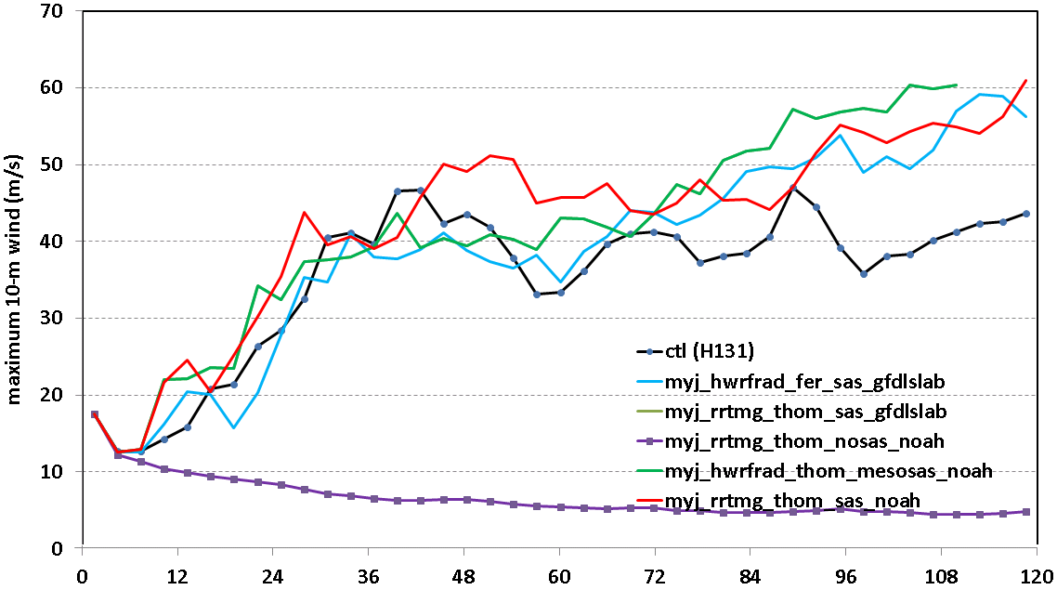
Time series of VMAX
MYJ and its combination with RRTMG/Thompson physics appear to produce stronger intensity than the control (FY13 HWRF)
Exp with mesosas failed near the end of simulation (Qingfu’s upgrade fixes this)
Model vortex cannot grow with cumulus parameterization turned off

Slide 8
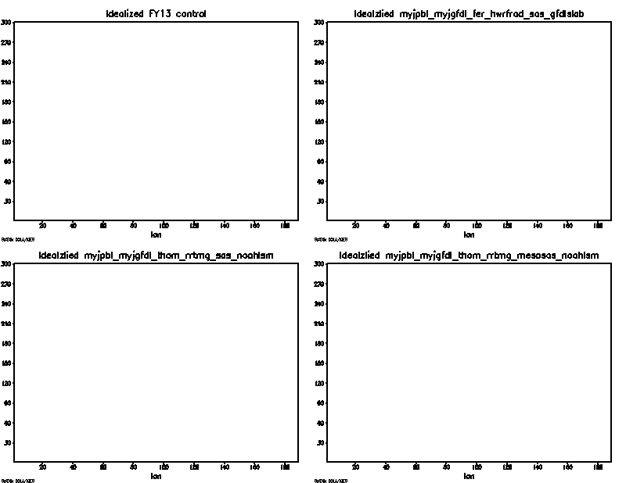
Plane view of w at z = 5 for d03
control
MYJ
Wave propagation is very active in all exps with regular radiation of vortex-rossby/gravity waves from the core outward ~ every 36 h, which gives wave speed ~ 3 m s⁻¹;
The wave propagations are observed in all fields and at all levels.
RRTMG exps appear to possess more confined vortex core with stronger ring of convection as the waves propagate outward;
RRTMG exps have a small vortex core (RMW) at the end of simulation;
Rrtmg+thompson+sas
Rrtmg+thompson+mesosas

Slide 9
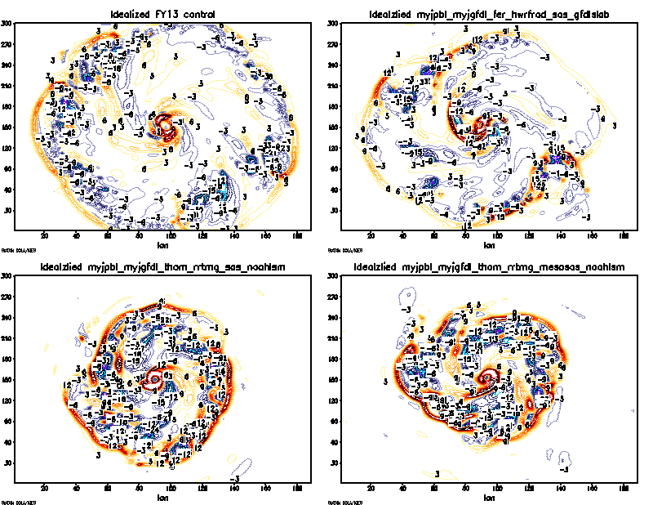
Plane view of w at z = 5 for d03
control
MYJ
Wave propagation is very active in all exps with regular radiation of vortex-rossby/gravity waves from the core outward ~ every 36 h, which gives wave speed ~ 3 m s⁻¹;
The wave propagations are observed in all fields and at all levels.
RRTMG exps appear to possess more confined vortex core with stronger ring of convection as the waves propagate outward;
RRTMG exps have a small vortex core (RMW) at the end of simulation;
Rrtmg+thompson+sas
Rrtmg+thompson+mesosas
T = 27 h

Slide 10
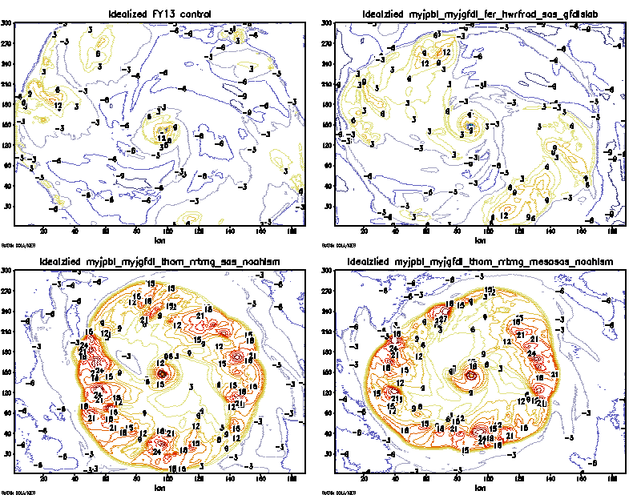
Longwave temperature tendency at z = 1
control
MYJ
Control exp tends to have much broader but weaker longwave tendency level 1 as compared to RRTMG/Thompson scheme
RRTMG/Thompson exp shows consistently more compact core with larger longwave warming at all levels
Rrtmg+thompson+sas
Rrtmg+thompson+mesosas
T = 27 h

Slide 11
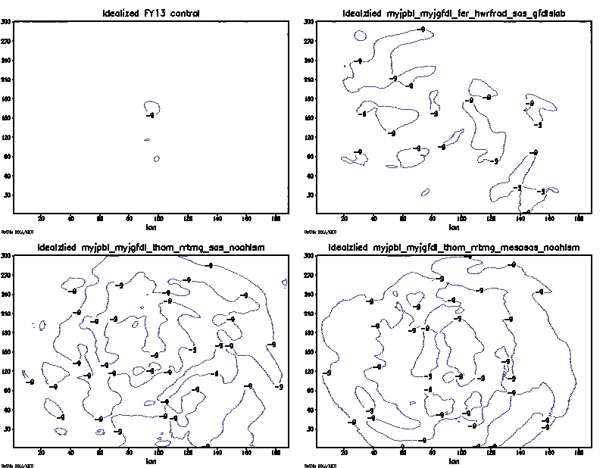
Longwave temperature tendency at z = 42
control
MYJ
RRTMG/Thompson gives stronger cooling at upper levels;
Surprising that MYJ PBL can enhance some of upper level cooling even with the GFDL radiation scheme
Control configuration lacks radiative cooling at upper level as reported preciously by Rob Fovell
Rrtmg+thompson+sas
Rrtmg+thompson+mesosas
T = 27 h

Slide 12
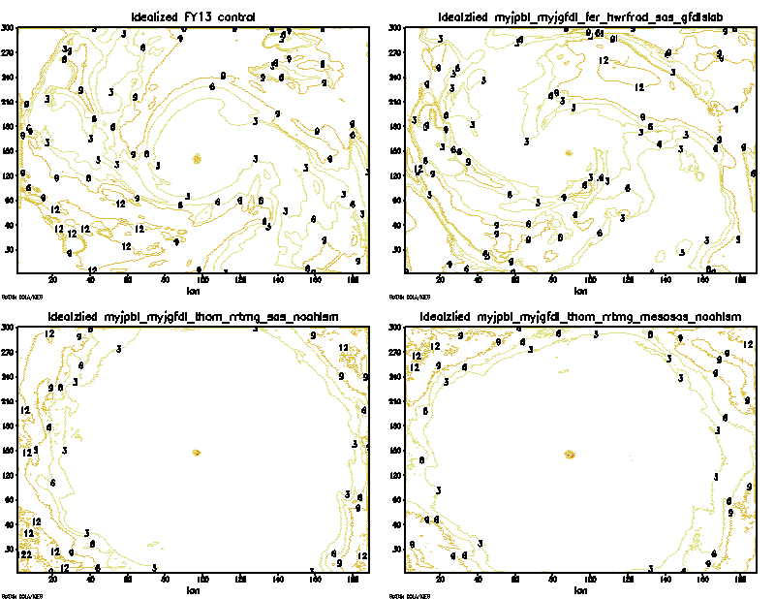
Shortwave temperature tendency at z = 1
control
MYJ
Control exp tends to have larger shortwave tendency because of less cloud and thus receive more shortwave incoming;
RRTMG/Thompson has weaker shortwave tendency as denser cloud appears to block the incoming shortwave
Rrtmg+thompson+sas
Rrtmg+thompson+mesosas
T = 27 h

Slide 13
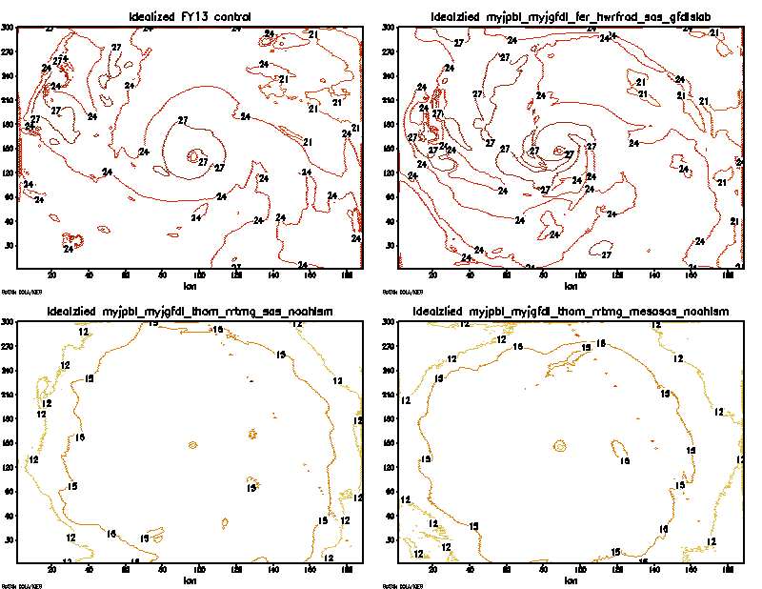
Shortwave temperature tendency at z = 42
control
MYJ
At higher level, shortwave fluxes in CTL or MYJ both larger than the RRTMG due to the larger transmittance of the atmosphere layer (less cloud !)
SAS or meso-SAS does not show much changes in the shortwave tendency!
Rrtmg+thompson+sas
Rrtmg+thompson+mesosas
T = 27 h

Slide 14
Lessons learned from idealized exps:
RRTMG and Thompson schemes produce stronger storms, more cloud content at upper levels, but more compact storm structure;
MYJ gives a stronger storm despite larger horizontal diffusion?
MYJ impacts to radiation appear to be more profound as it can reach at upper levels via cloud types/coverage?
Notes:
Vijay’s question about MYJ? Let see what next for retro runs

Slide 15
High-resolution physics: retrospective experiments

Slide 16
Retrospective configuration
FY2013 configuration (checked out on 21 June 2013);
Test with 2 storms; one is an ocean-storm only (Leslie 2012) and the other is a landfalling storm (Issac 2012);
Four experiments were conducted
1. HTG1: all new physics options included (no meso-sas)
2. HTG2: all new physics options included except MYJ
3. HTG3: all new physics options included except
RRTMG
4. HTG3: all new physics options included except
Thompson
Note that since meso-SAS failed in idealized exps, no meoso SAS is used in all 4 experiments;
HTG2 failed after few cycles for Leslie. Other configures were successful for both storms.

Slide 17
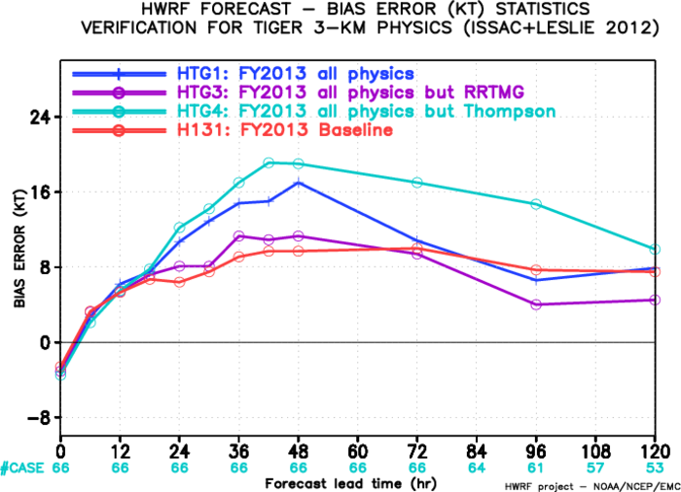
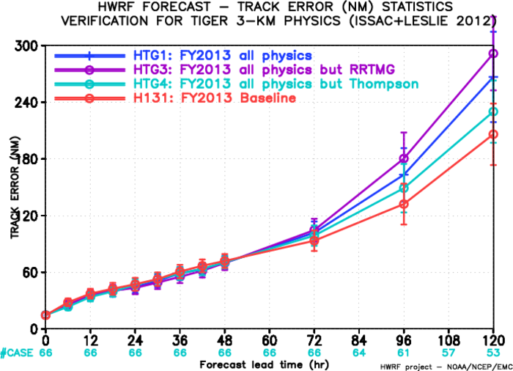
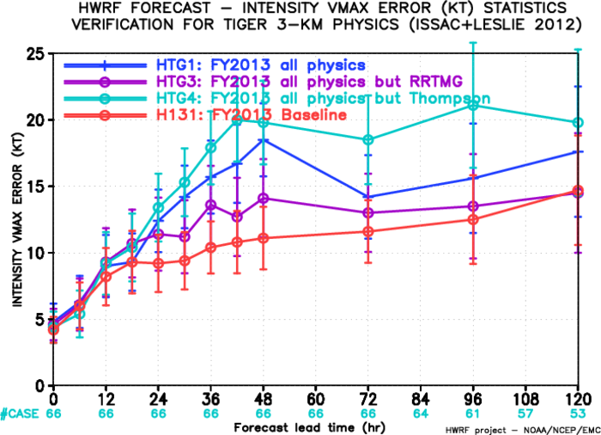
Verification

Slide 18
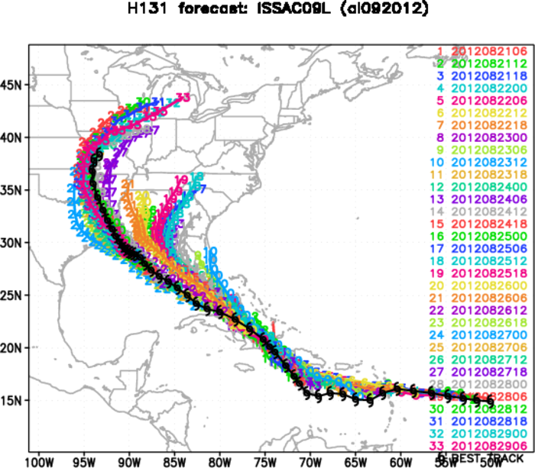
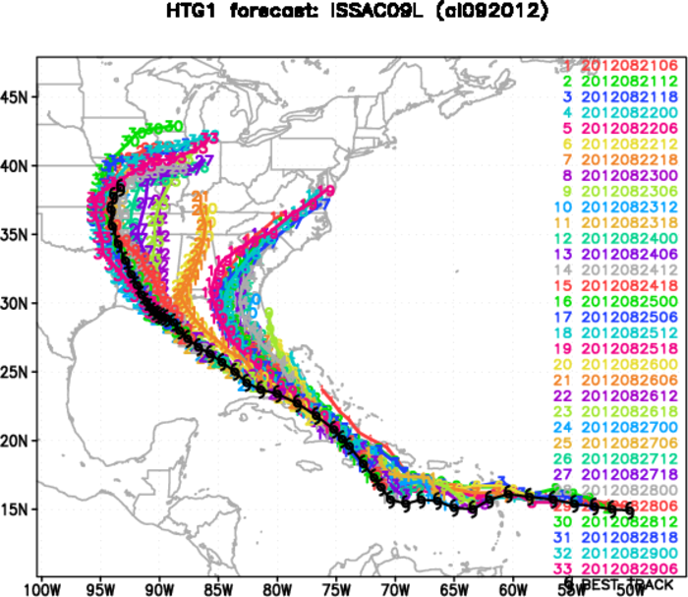
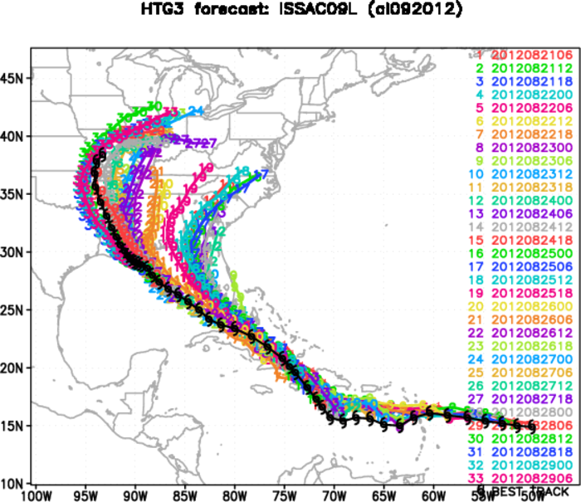
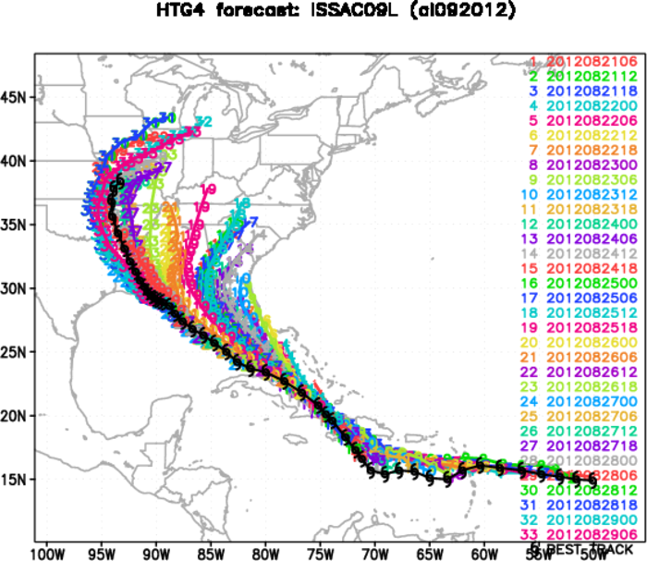

Slide 19
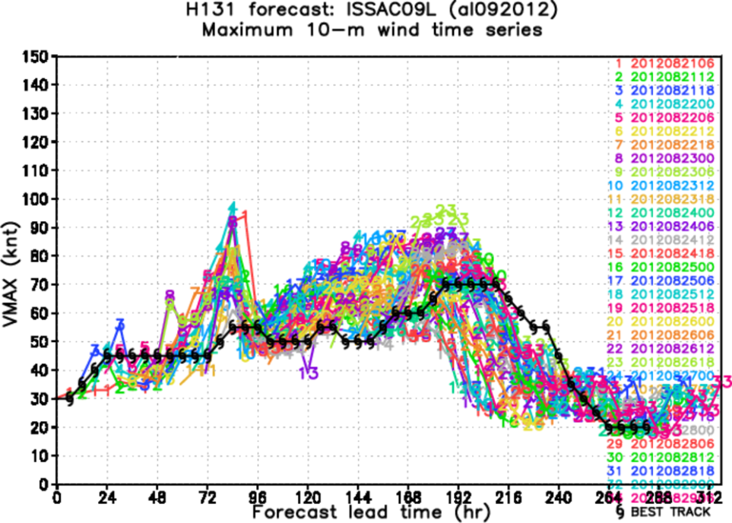
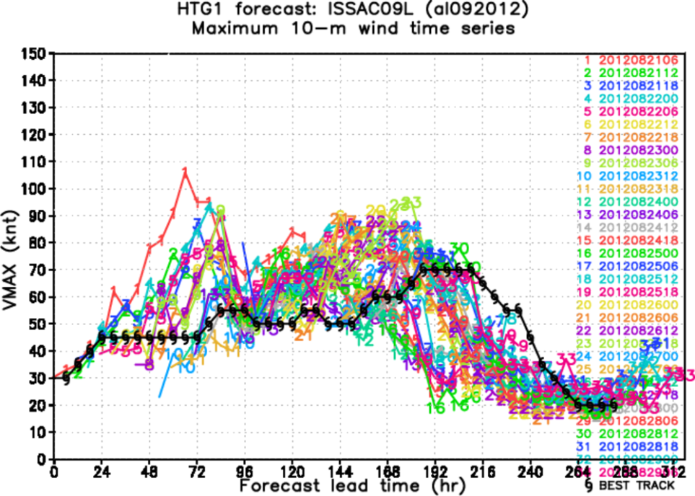
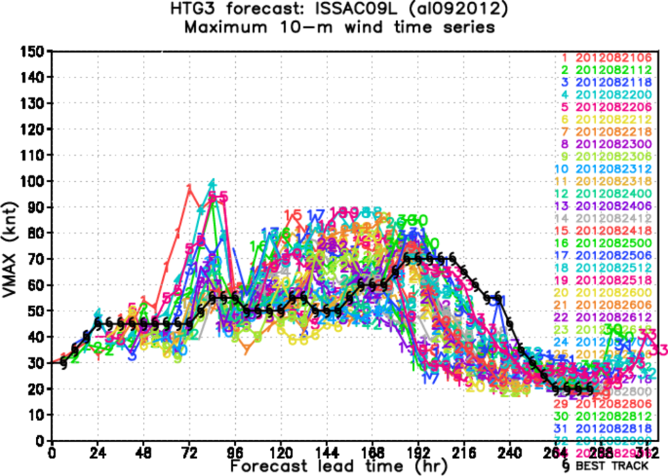
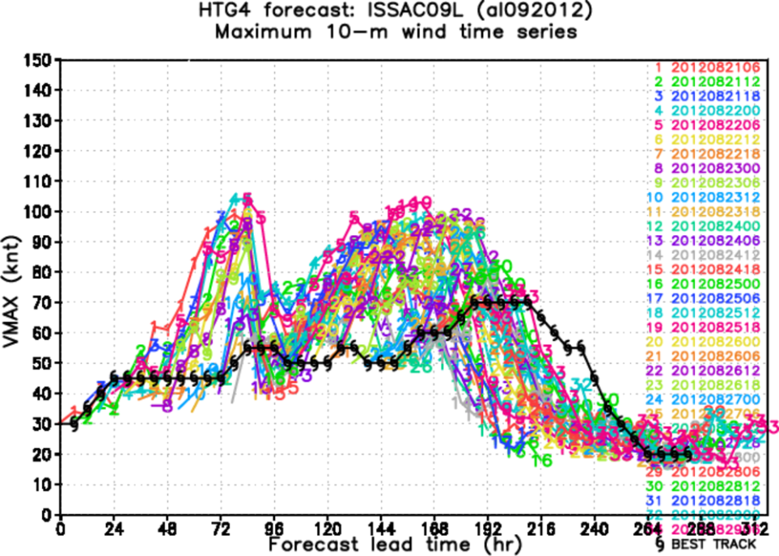

Slide 20
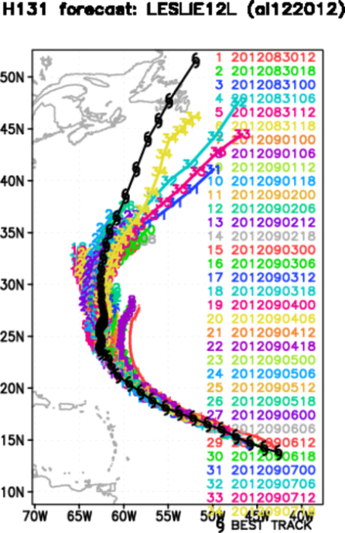
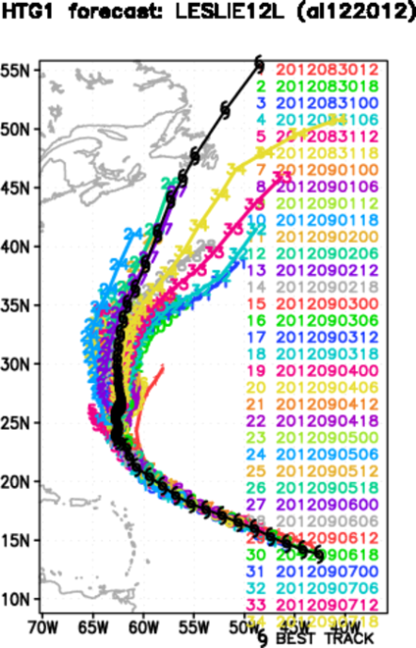
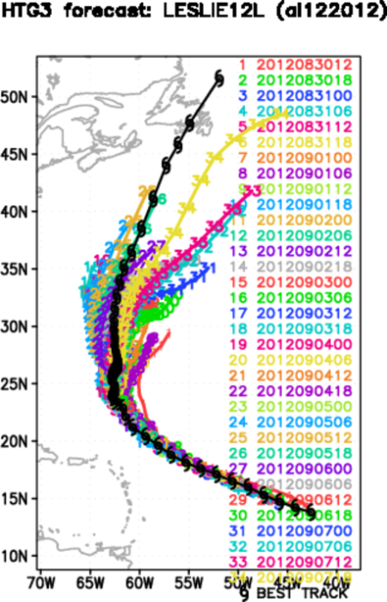
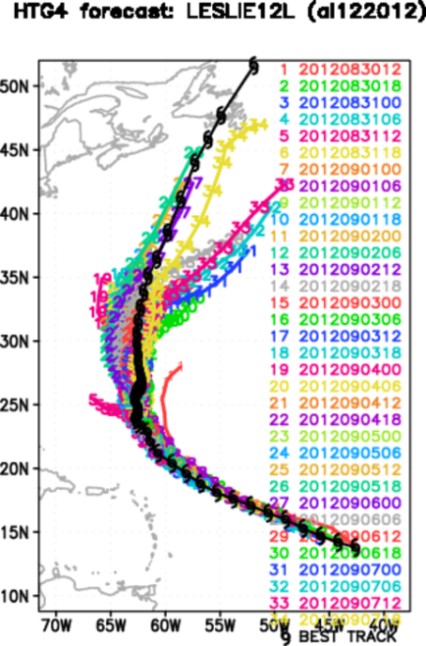

Slide 21
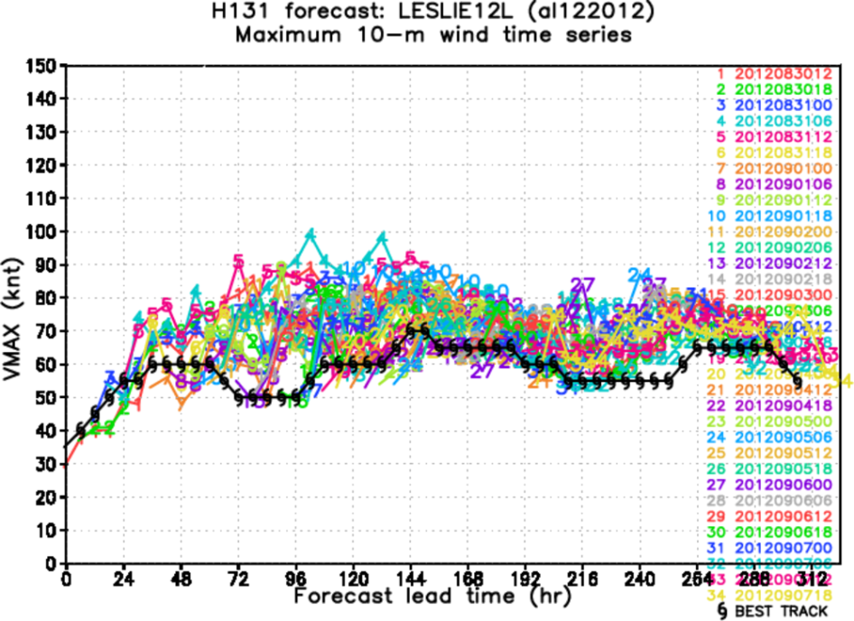
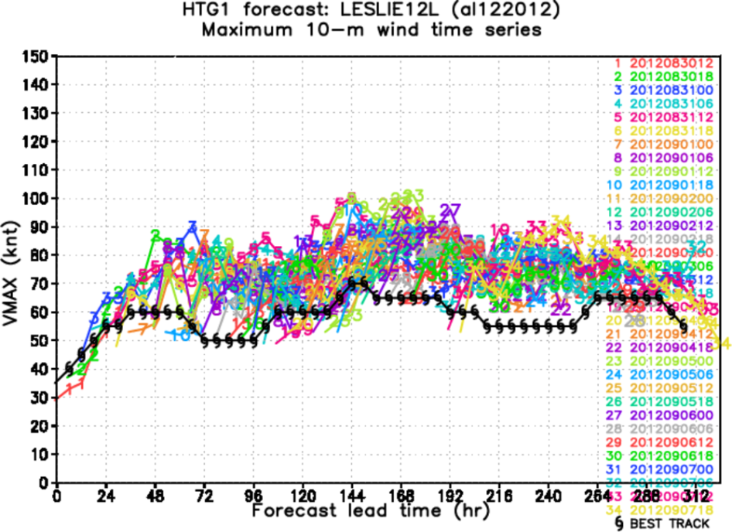
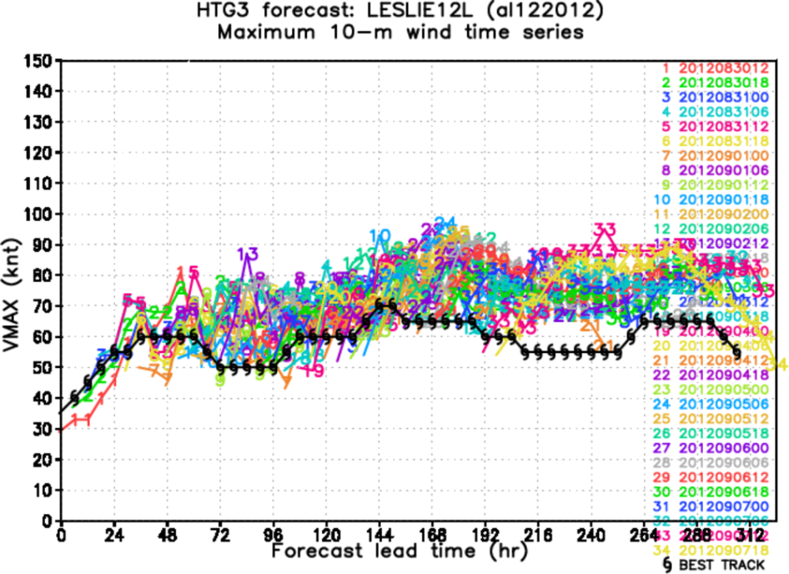
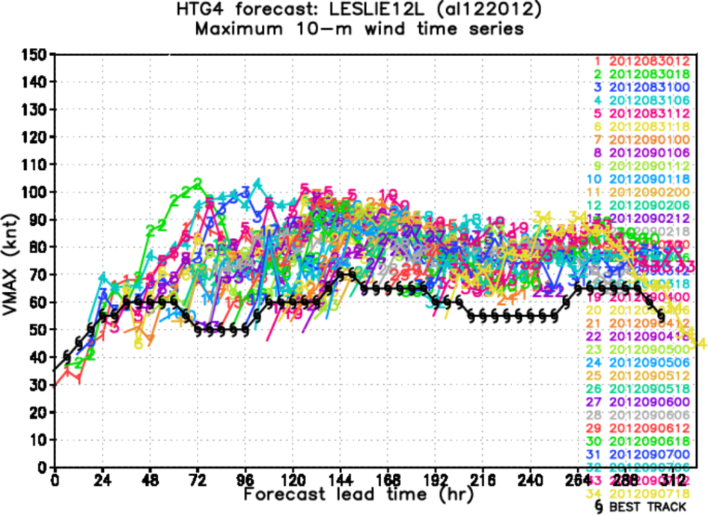

Slide 22
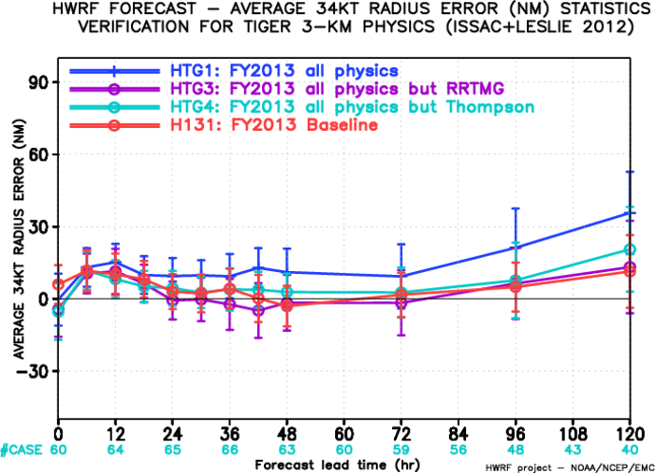
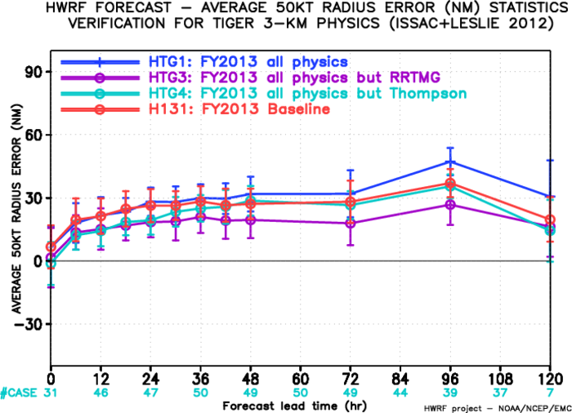
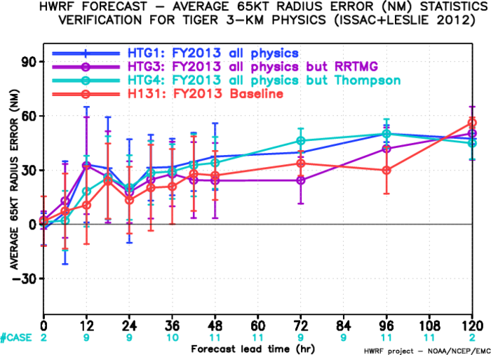
Structure Verification
New physics package gives largest 34-kt and 50-kt radii errors. Storm tends to be larger than the CTL storm;
65-kt errors have too small sample size

Slide 23
Lessons learned from retro exps:
RRTMG helps track and degrades intensity?
Thompson degrades tracks but helps intensity?
Combination of all schemes helps neutralize the negative impacts of each individual scheme;
Model crash with RRTMG+Thompson+Noah LSM?
Given that, we decided to go with all combination for real-time stream 2 demo.
Notes:
Let see what next for real-time runs

Slide 24
High-resolution physics: real-time experiments

Slide 25
Real-time configuration
FY2013 configuration (updated on 17 July 2013);
HTG1 configuration is selected, which includes RRTMG, NOA LSM, Thompson microphysics, and MYJ PBL/surface layer scheme;
The real-time experiment is under stream 2, and currently run on Jet (maximum 3 reservations);
No Invest run, only named/numbered storms;
Forecast time ~ 12 minutes longer than the current operational version
Real-time products are updated at: http://www.emc.ncep.noaa.gov/gc_wmb/vxt/PARA/HTG1/index.html (password protected)
Notes:
HTG1 can neutralize the negative impacts of Thompson and RRTMG scheme.

Slide 26
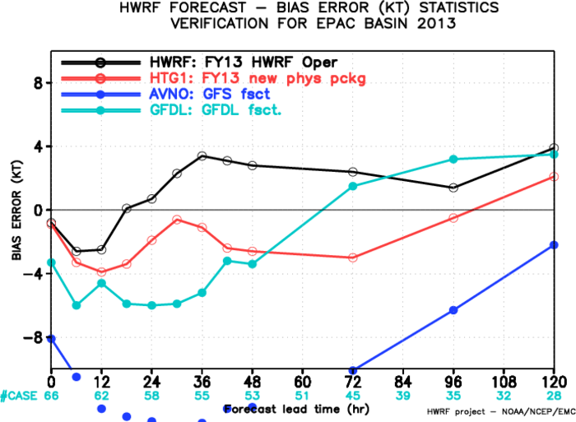
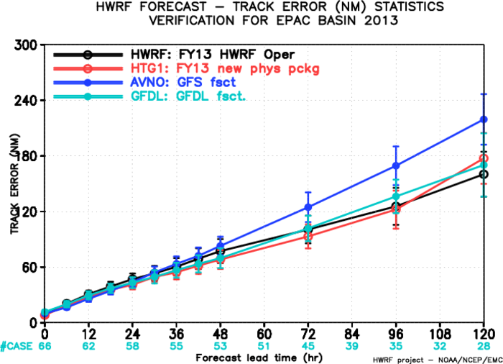
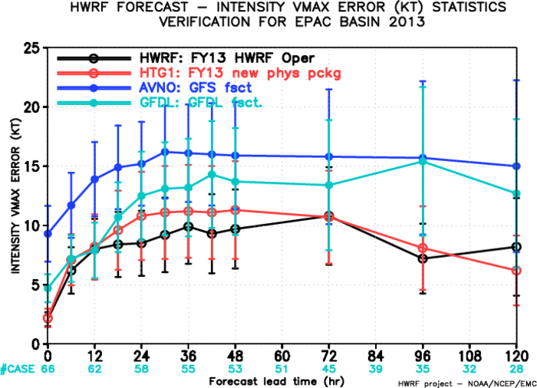
Verification: East Pacific (4 storms 06E-10E)
Surprisingly, HTG1 has negative bias as compared to HWRF, which is opposite to retrospective/idealized exp;
Appears to outperform the operational version up to 96-h in terms of track errors;
Intensity errors are comparable to HWRF.

Slide 27
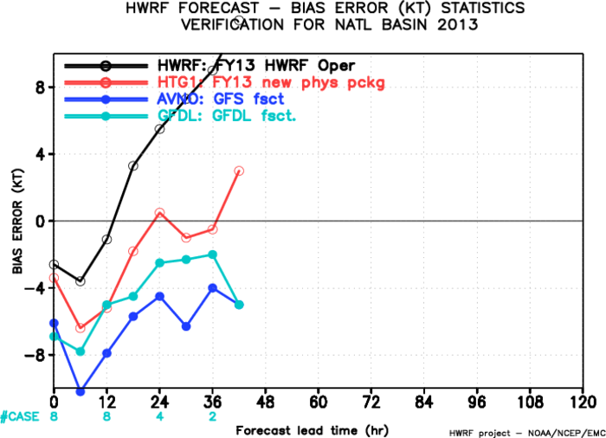
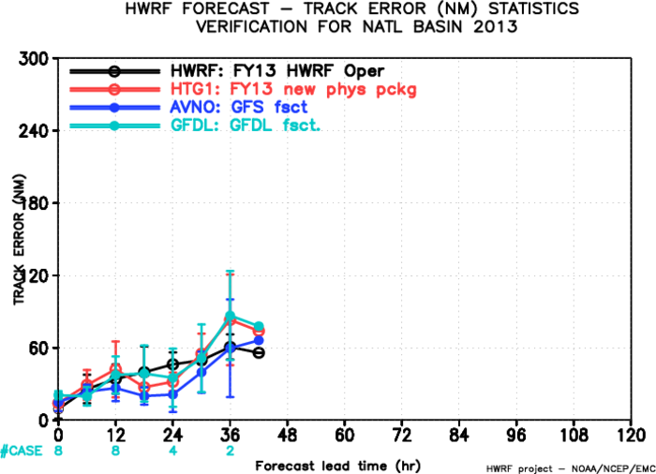
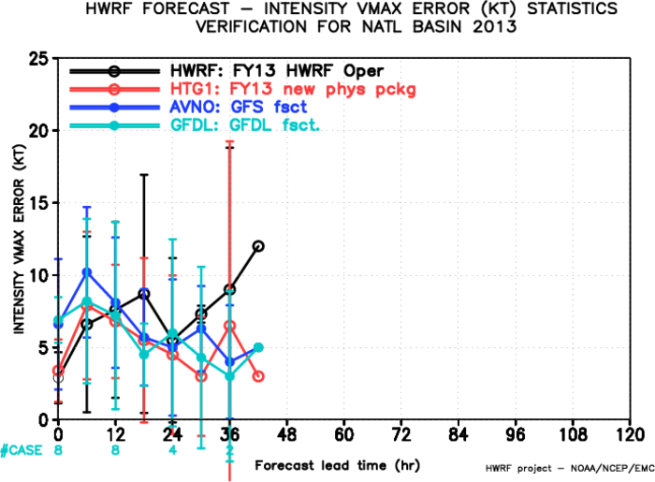
Verification: Atlantic (2 storms 05L-06L)
Sample size is too small to say anything;
Negative bias however appears to be also observed in the AT basin;

Slide 28
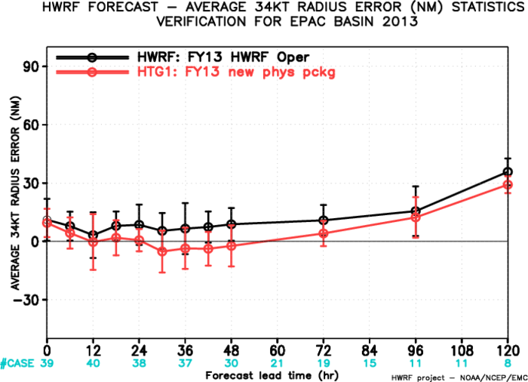
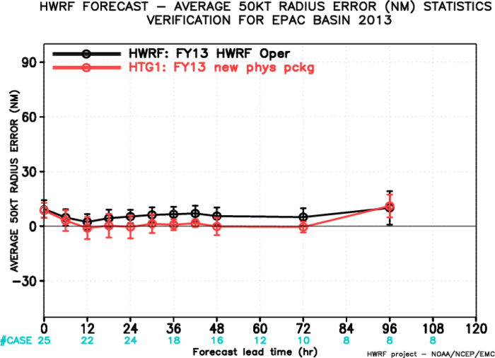
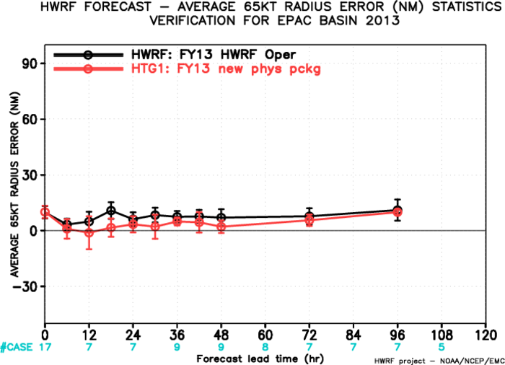
Structure Verification: EP (4 storms 06E-10E)
New physics package gives more reasonable storm size both in the outer and in the inner region!

Slide 29
Summary
Idealized and retrospective experiments show a consistent result that RRMTG, Thompson and MYJ tend to produce stronger intensity and positive bias;
Testing of new physics package (meso-SAS excluded) showed the new physics degraded track/intensity scheme in retrospective runs;
RRTMG and Thompson schemes somehow provide opposite impacts to the track /intensity errors in retrospective runs;
Real-time experiment shows however very promising track/intensity forecast skill so far. Need more monitoring and extended diagnostics.
Notes:
Have a lot more scientific questions and issues need to be addressed. Have only 30’ to present

Slide 30
Appendix

Slide 31
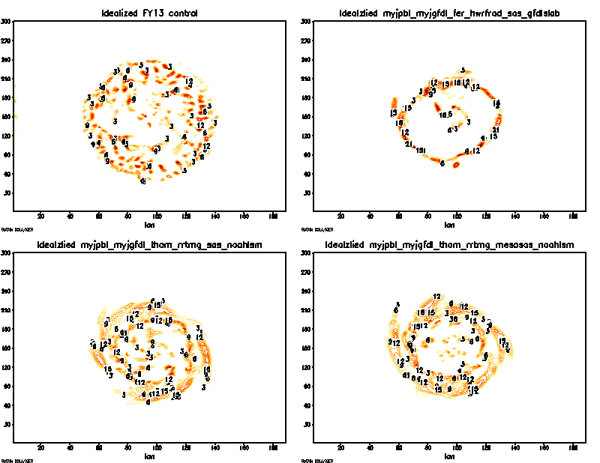
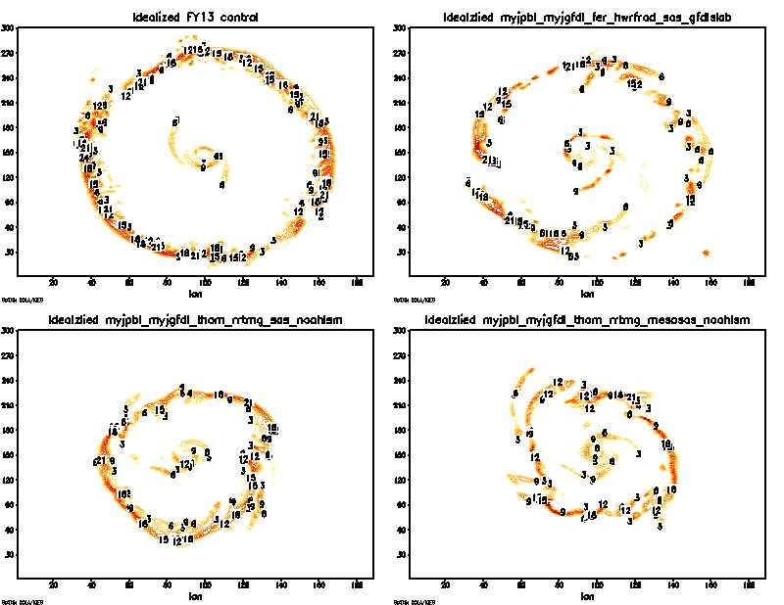
Plane view of qc at lev = 10 for d03
control
MYJ
Rrtmg+thompson
Rrtmg+mesosas
T = 18 h
T = 27 h
Control exp seems to develop a random disk of convection (cloud), while RRTMG/Thompson exps show development a quick ring of cloud that is also more confined to the storm center.
The outward propagation of cloud ring is consistent with the those since in vertical motion. Note that faster outward wave propagation in the control exp as compared to the combination of RRTMG/Thompson;

Slide 32
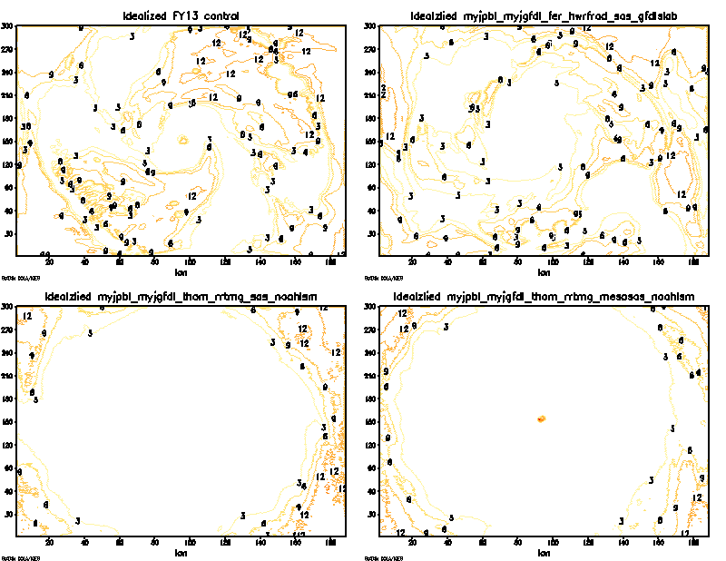
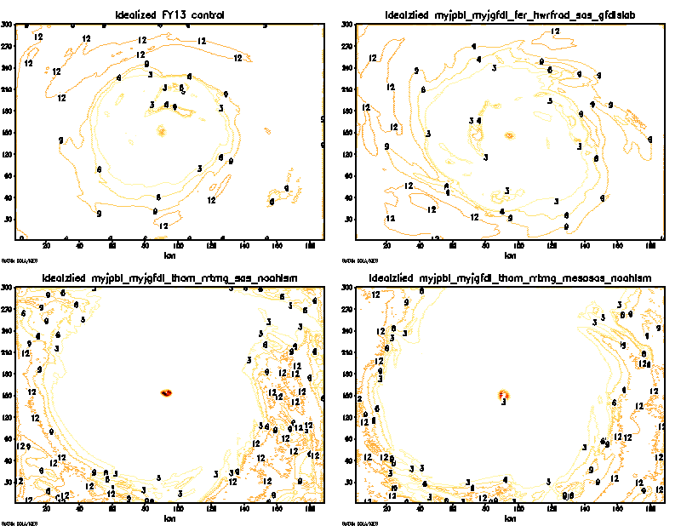
Plane view of d03 shortwave Temp tendency at z = 1
control
MYJ
Rrtmg+thompson
Rrtmg+mesosas
T = 12 h
T = 54 h
Short wave tendency is less within the entire storm area in RRTMG/Thompson scheme as compared to control exp due to the cloud coverage
The difference is consistent at all levels.
At the higher level, the shortwave temperature tendency in control is much larger than the RRTMG/Thompson combination
Where is shortwave cooling?

Slide 33
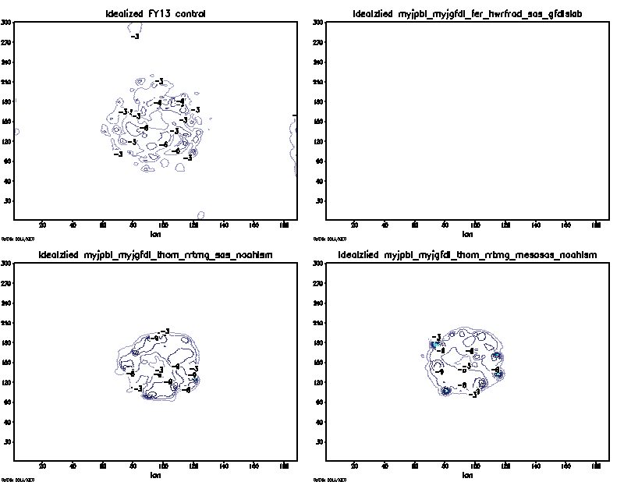
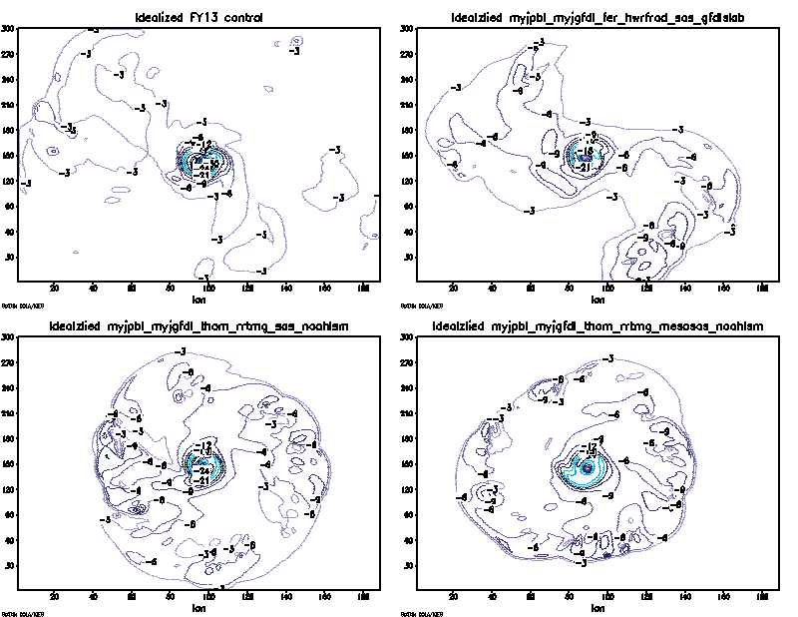
Plane view of d03 sensible heat flux at surface
control
MYJ
Rrtmg+thompson
Rrtmg+mesosas
T = 18 h
T = 27 h
RRTMG/Thompson scheme appears to have more symmetric and broader area of sensible heat flux exchange from the surface.
Surface latent heat flux appears to have issue as it is randomly not seen in all exps. Could be due to model or the plot contours. Need to double check
Sensible heat flux is negative and maximum within the core region. Note sure what is the definition of the sensible heat flux is but it does not seem to make sense to see negative values (flux from atmosphere into the ocean surface…downdraft is cool, why is it negative?)

Slide 34
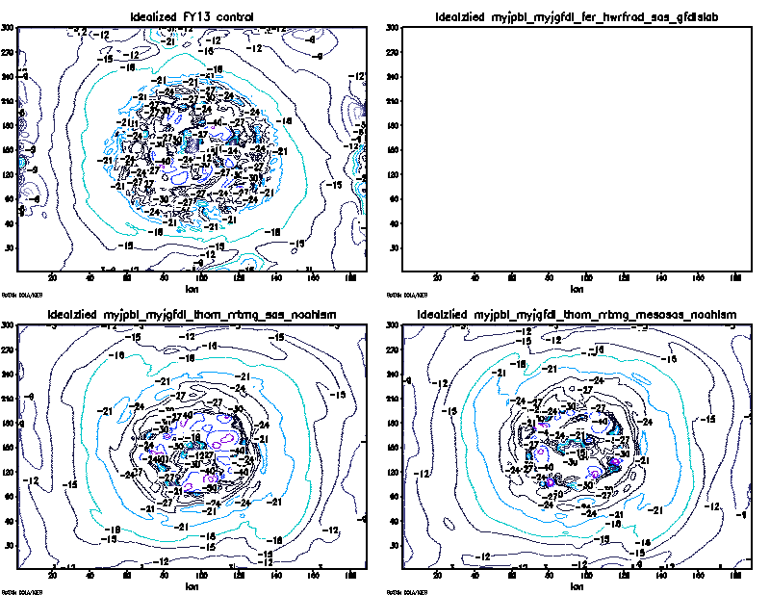
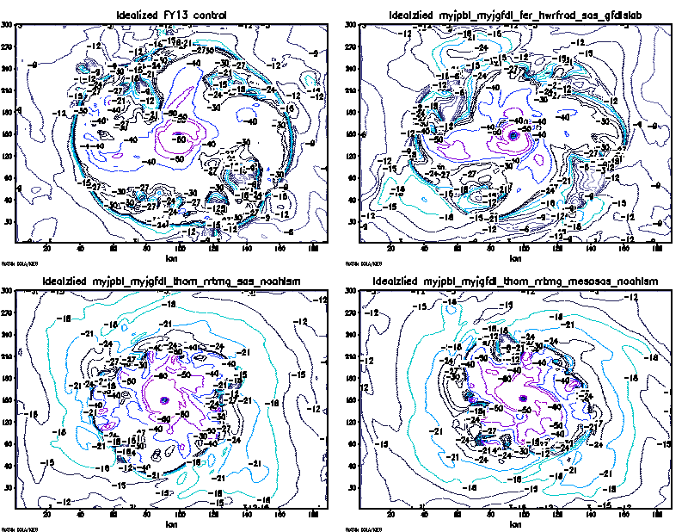
Plane view of d03 latent heat flux at surface
control
MYJ
Rrtmg+thompson
Rrtmg+mesosas
T = 27 h
T = 36 h
RRTMG/Thompson scheme appears to have larger flux but confined within a smaller area of latent heat flux exchange from the surface.
Similar to the sensible heat flux, the latent heat flux is randomly not seen in all exps. Need to double check!
Again, latent heat flux is negative and maximum within the core region. Note sure what is the definition of the latent heat flux is but it does not seem to make sense to see negative values (flux into the ocean surface?)

