Slide 1
Application of the meso-SAS scheme to HWRF model: Preliminary Results
Qingfu Liu
Hua-Lu Pan
Sept. 17-18, 2012
HFIP Phyiscs Meeting

Slide 2
Outline
Problems in current HWRF model
What the meso-SAS scheme can do in HWRF model?
Preliminary results
Discussions and future work

Slide 3
Problems in current HWRF model
Small weak storms have large negative intensity bias
The intensification of small weak storms are slow, and may even fall apart in some cases. These small weak storms are mainly confined to the third nest, and are dominated by the explicit microphysics. At 3km, the vertical velocity is small (max. vertical velocity rarely exceed 10m/s in HWRF model), and the boundary layer moisture convergence does not generate enough CAPE to sustain the convection.
Strong storms have large positive intensity bias
This intensity bias is connected to the grid-scale convection. Generally speaking, explicit microphysics is prone to grid-scale convection, and the grid scale convection can produce very strong small size storms. In HWRF model, the grid-scale convection is enhanced due to the moisture convergence from the second nest (where SAS scheme is used, and the storm size is larger compared to the third nest).

Slide 4
What the meso-SAS scheme can do in HWRF model?
Increase the intensity of weak storms
Decrease the intensity of strong storms (reduce the intensity overshoot)
Compare to observation, we have the following problems:
Explicit microphysics used at 3km model resolution
Storm size is small (may be related to grid scale convection)
Intensification is slow (may be caused by small vertical velocity)
If intensified, storm tends to have significant overshoot (related to grid scale convection)
Operational SAS scheme (Not designed to use at high model resolution)
Storm size is reasonable (may be too large in HWRF, need further verification)
Intensification is too fast
If intensified, weak storms tend to have too much intensification
Meso-SAS (designed to use at all model resolutions)
Storm size will fall within the two limits (explicit vs operational SAS)
Intensification rate will fall within the two limits
Weak storms are easier to intensify. Strong storms have less overshoot

Slide 5
Preliminary results:
Use 2012 operational HWRF configuration, only replace the SAS scheme with the meso-SAS, and turn on the meso-SAS scheme in the third nest
Storms tested: 2011 hurricane season
Atlantic: IRENE(09L) and KATIA (12L) (strong storms)
East Pac: DORA(04E), EUGENE (05E), HILARY (09E) and JOVA (10E)
Experiments:
H719 (or P719): meso-SAS
H212: Baseline (2012 operational version)
HOPS: 2011 operational HWRF

Slide 6
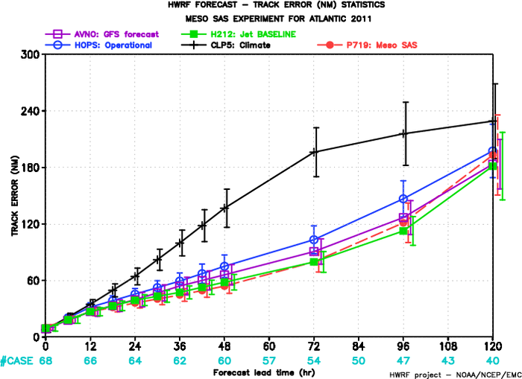
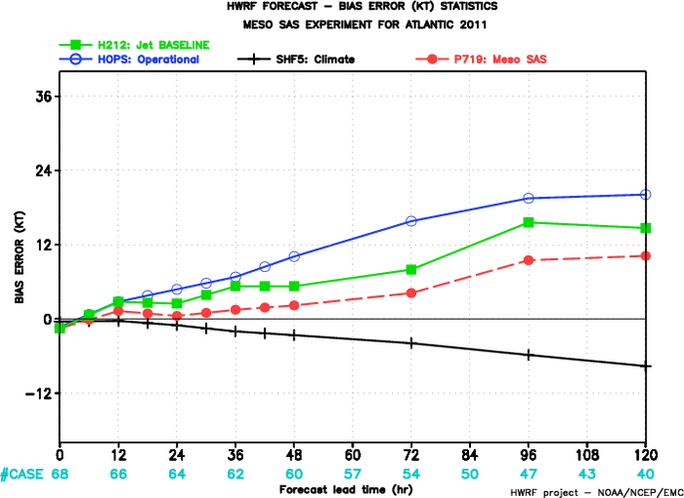
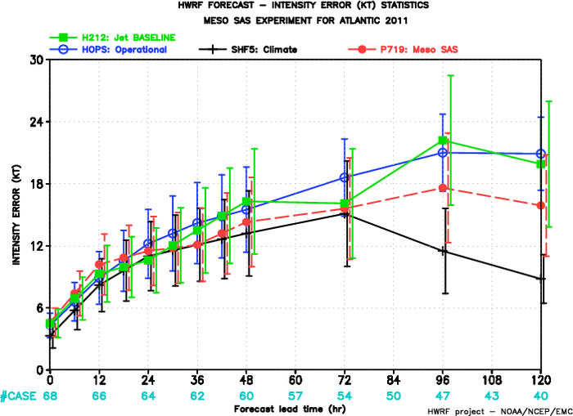
Atlantic Storms: 09L and 12L
Track slightly degraded after 72h
Intensity improved after 30h
Positive intensity bias reduced

Slide 7
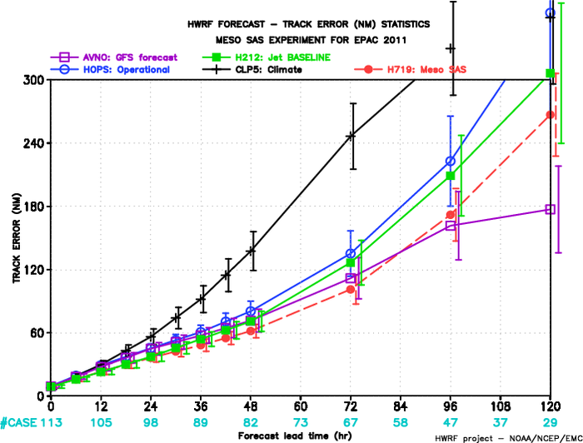
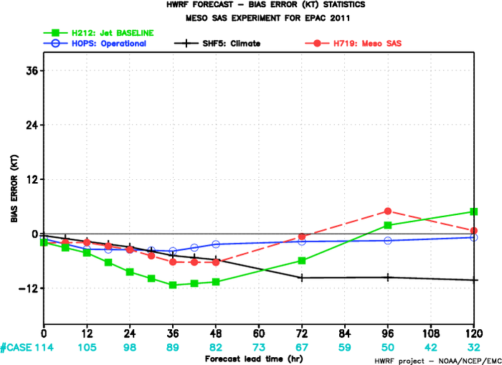
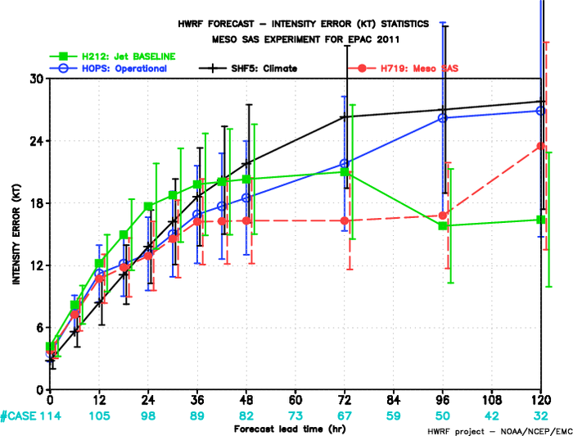
JOVA landfall
East Pac Storms: 04E, 05E, 09E and 10E
Track improved
Intensity improved except at 120h
(caused by the wrong timing of
hurricane JOVA landfall)
Storms become stronger
JOVA landfall

Slide 8
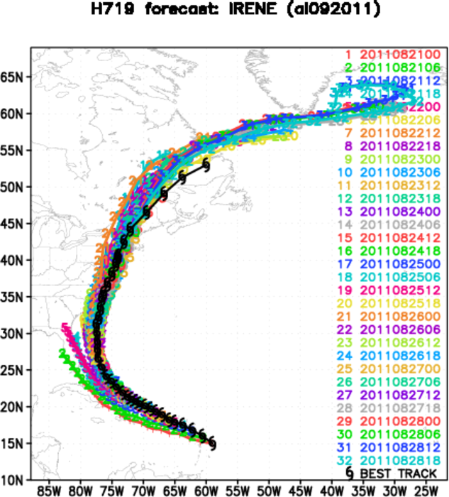
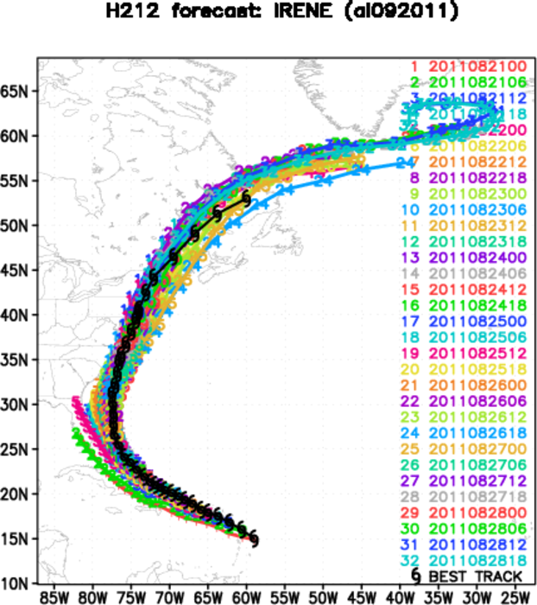
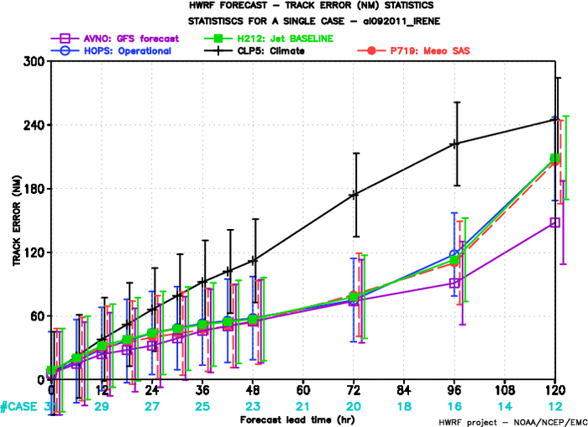
Hurricane IRENE (09L)
Track basically same
Intensity improved (page 9)

Slide 9
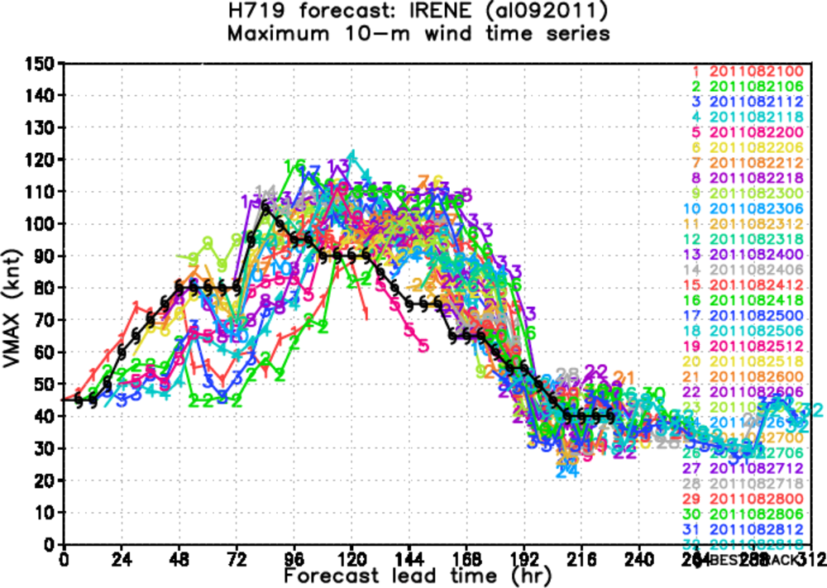
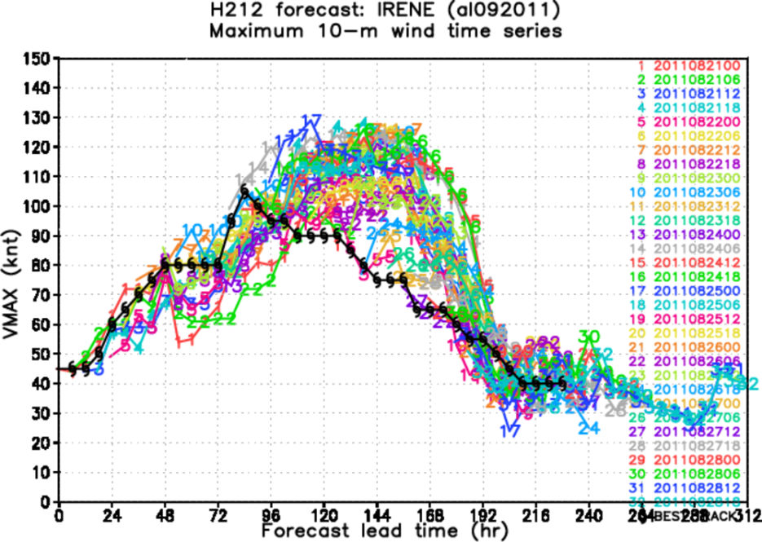
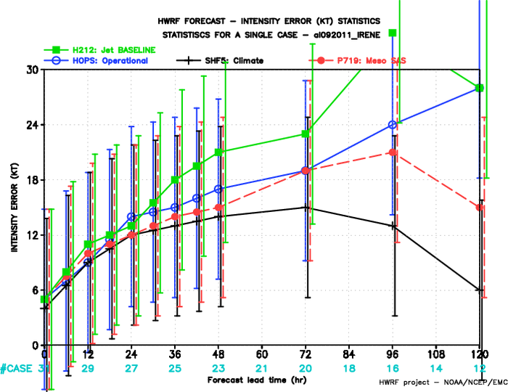
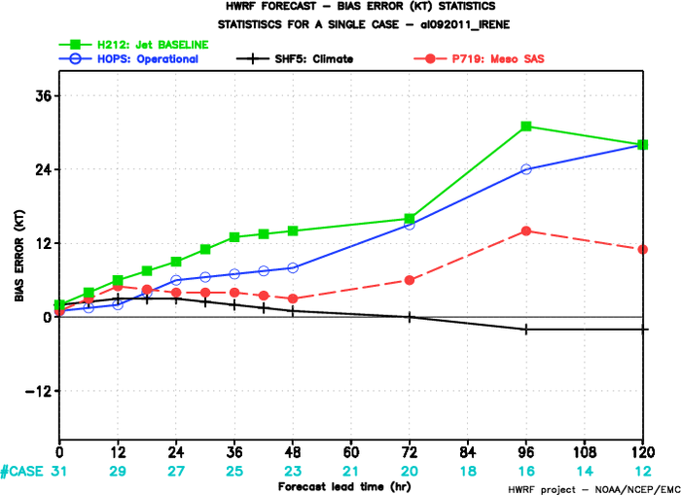
Less overshoot
Land interaction

Slide 10
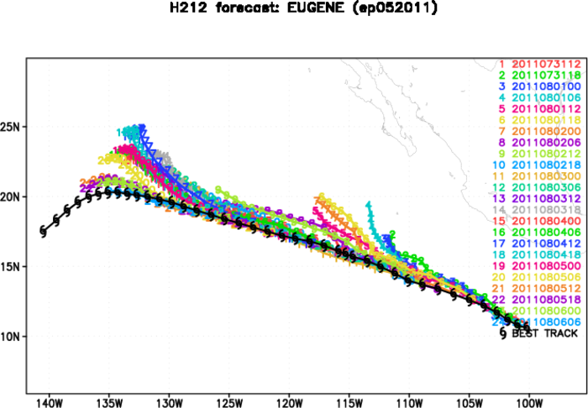
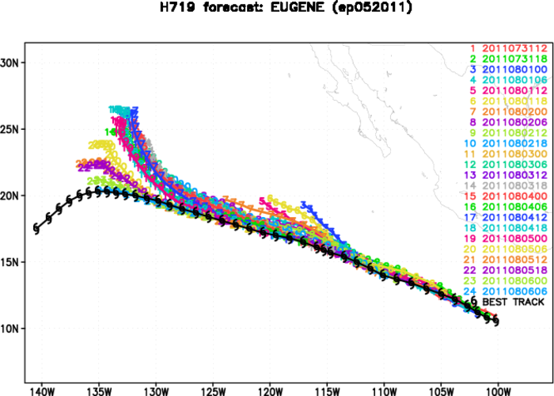
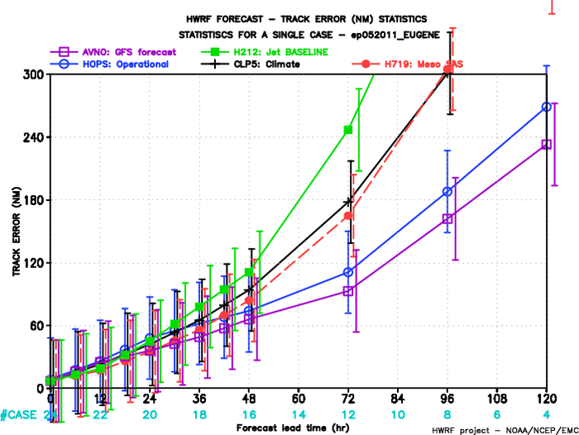
Hurricane EUGENE (05E)
Track slightly improved
Intensity improved (page 11)

Slide 11
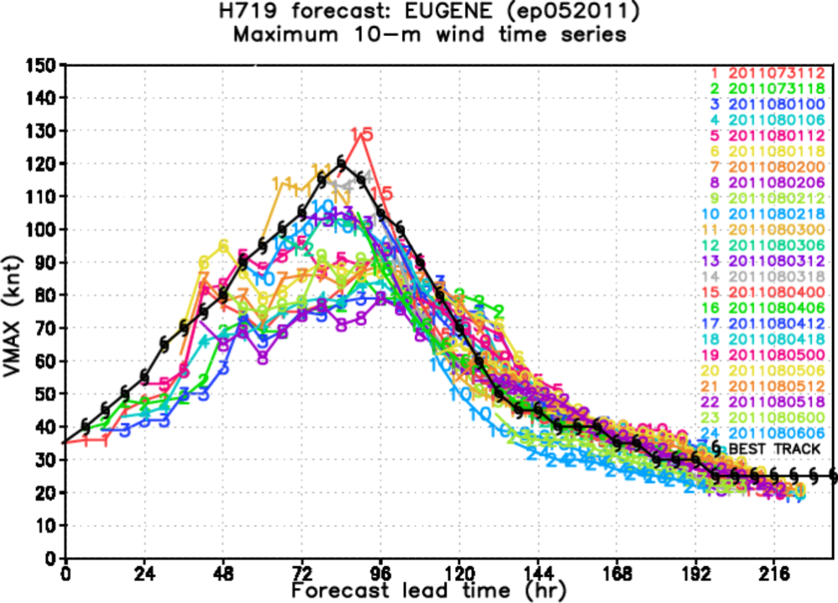
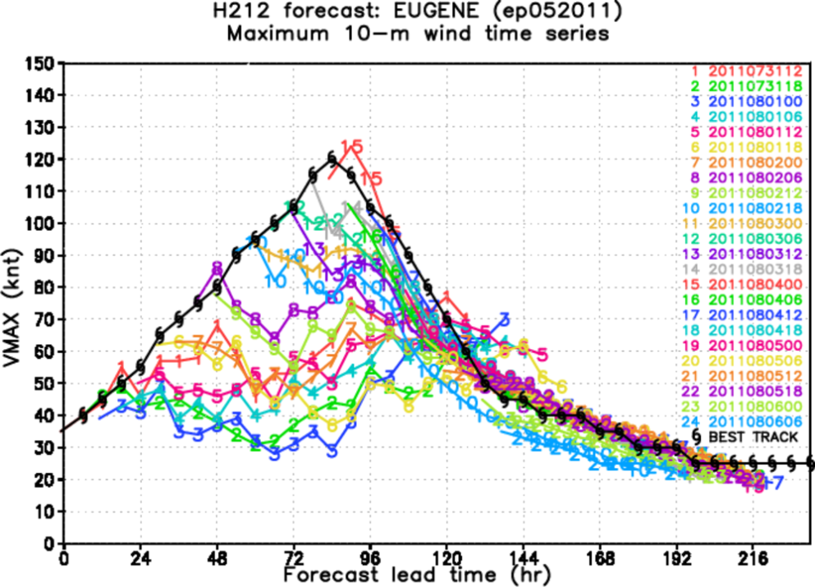
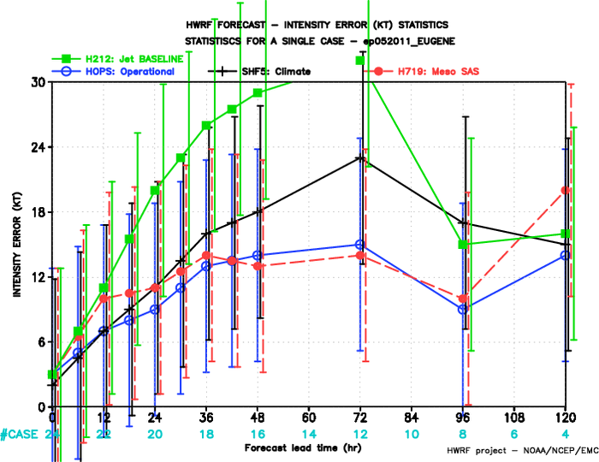
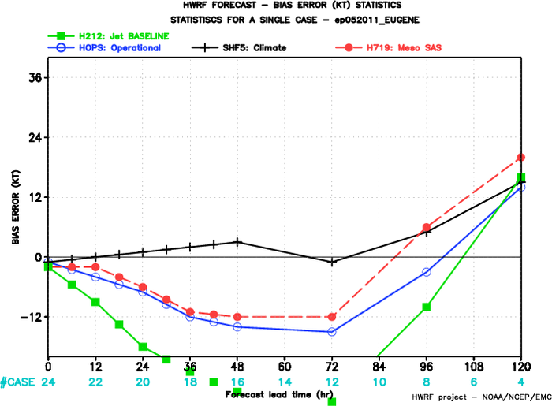
Slow intensification

Slide 12
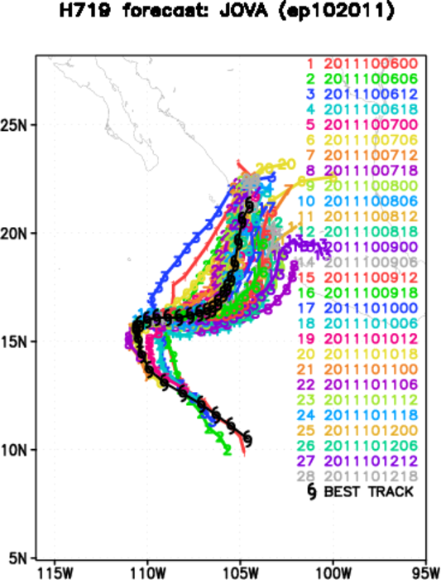
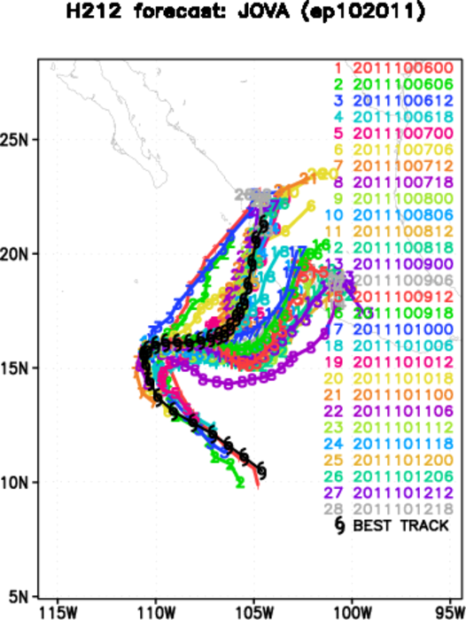
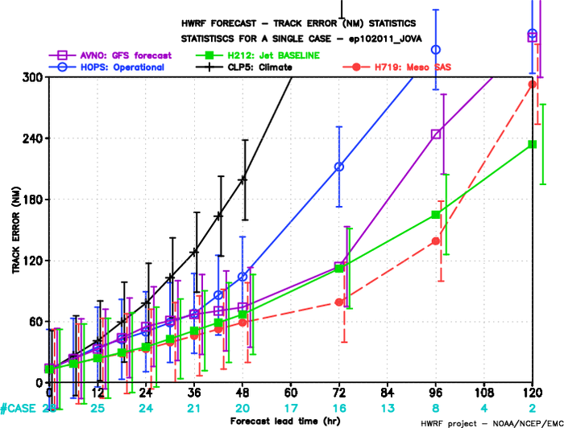
Hurricane JOVA (10E)
Track improved before 96h
and degraded at 120h
Intensity degraded at 120h
due to the wrong timing of
landfall (page 13)

Slide 13
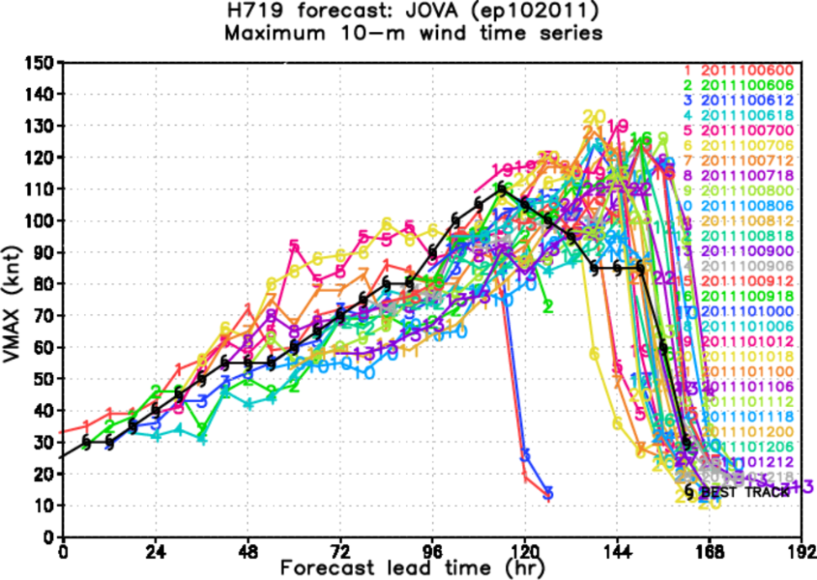
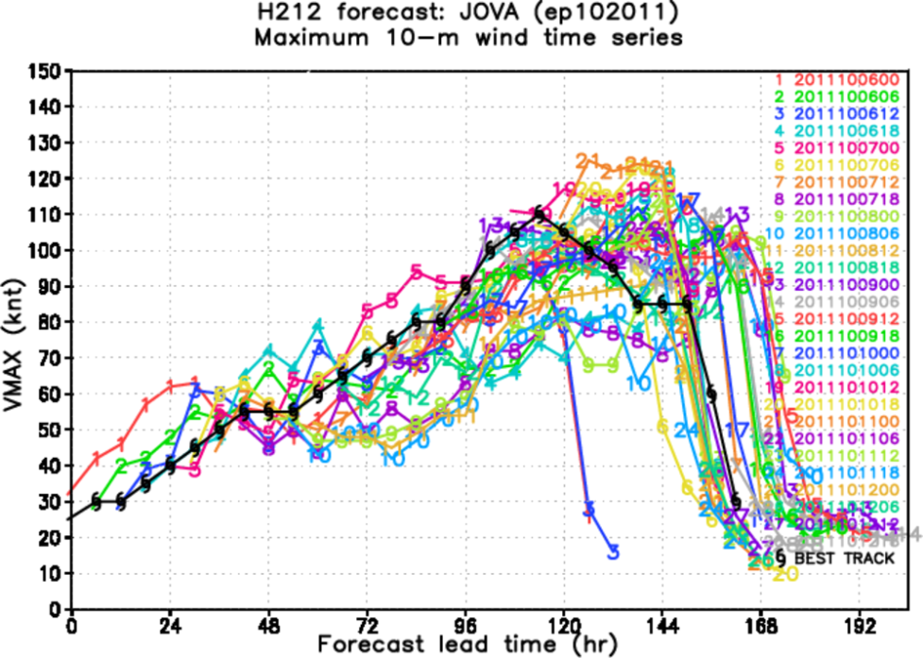
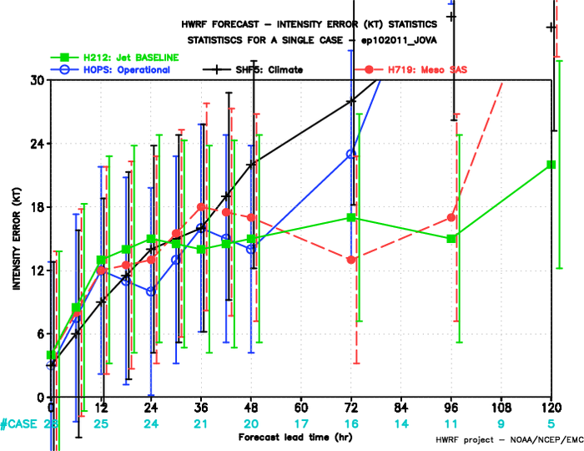
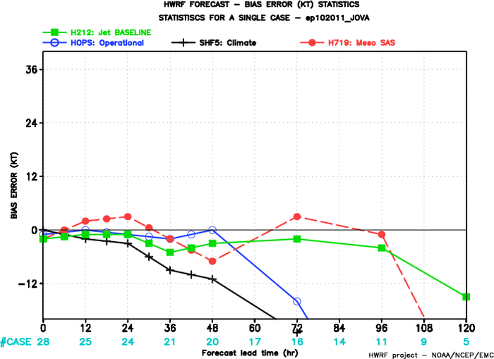
Landfall at wrong time

Slide 14
Discussions and future work
The meso-SAS scheme is developed not just for hurricane models, it is for all numerical models.
The meso-SAS scheme, if used in course grid (>10km), produces the same results as the current operational SAS scheme. If it is used in high resolution models, the impact of the subgrid scale convection will be reduced. As sigma (fraction of the updraft area in model grid) approaches 1.0, the meso-SAS scheme will be automatically turned off, and the model will use explicit microphysics
In current HWRF model, sigma is small (due to small vertical velocity), and the meso-SAS scheme behaves similar to the current operational SAS. Three major problems identified: 1) some of the weak storms become too strong. 2) track and intensity forecasts are degraded for some strong storms. 3) current meso-SAS code may have computational problem when sigma is large
We need to adjust some parameters and do more tests. There is a potential that the meso-SAS scheme can produce much better intensity forecast (without degrading the track forecast) in HWRF model.

