Slide 1
2012 Hurricane Season HWRF Data Assimilation Real Time Parallel Experiment – NOAA P3 TDR Data Assimilation
Mingjing Tong
Acknowledgement: EMC HWRF team and DA team
HWRF weekly meeting
2012-09-06

Slide 2
Assimilation System
HWRF model
27-9-3 HWRF V3.4a (FY2012)
43 vertical levels with 50 hPa top
Data assimilation performed on outer domain (27km, 80x80 degree) and new ghost domain (3km, 30x30 degree).
Domains redefined to be centered at TC center at each analysis time
Data assimilation scheme
One-way GSI-ensemble hybrid using ensemble from global hybrid system
Cold start from GDAS (Global Data Assimilation System) forecast with relocation
Observations assimilated every 6 hours

Slide 3
GSI Hybrid Ensemble-Var System
HWRF one way
hybrid system
HWRF
forecast
vortex
initialization
GSI
Hybrid Ens/Var
analysis
recenter analysis ensemble
member 1
forecast
member 1
analysis
Global hybrid EnKF/Var system
member 2
forecast
EnKF
member update
member 2
analysis
member 3
forecast
member 3
analysis
high res
forecast
GSI
Hybrid Ens/Var
high res
analysis

Slide 4
Assimilation System
Observational data
Radiosonde, aircraft reports (AIREP/PIREP, RECCO , MDCRS-ACARS, TAMDAR , AMDAR), surface ship and buoy observation, surface land observations, pibal winds, wind profilers, Dropsondes, scatterometer wind data
Dropsonde wind within radius=max(111km, 3*RMW) are flagged (not assimilated).
Surface pressure data within vortex area are flagged.
Satellite wind estimates not assimilated, because negative impact was found. Quality control of satellite winds need to be carefully investigated.
Satellite radiance data not assimilated due to model top and bias correction issues.
NOAA P3 Tail Doppler Radar radial wind (TDR) data assimilated in ghost domain

Slide 5
Assimilation System
Other detail of data assimilation
Since observations in vortex area are often sparse, assimilating those inner/outer core data after vortex initialization either hurt storm structure or balance. Therefore, when TDR data are not available, data assimilation only performed on outer domain before vortex initialization
TDR data assimilation
Modified cross error check, so that data with innovation (o-f) greater than 20 m/s are rejected
Retuned observation error, so that the error gradually increases as o-f increases
To deal with asynchronism of TDR data, FGAT* (First Guess at Appreciated Time) is used
Assimilation time window – analysis time ±3 hours
Data thinned at 9 km resolution
Full vortex initialization before data assimilation
* FGAT - compares observations with the background at the observation time; In traditional 3DVAR scheme, observation is assumed to be valid at the analysis time and is used to compute the innovation

Slide 6
Assimilation System
Hybrid data assimilation
80 ensemble member at T254L64
β₁⁻¹=0.25 (25% weight given to static B)
β₁⁻¹ gradually increase to 1.0 from 850 hPa downward for outer domain
Horizontal localization: outer domain – 600 km; ghost domain – 150 km
Vertical localization: outer(ghost) domain 10(20) vertical model levels
Parallel vs. operational configurations
DA scheme: Hybrid Ens/Var vs. 3DVAR
First guess: GDAS forecast vs. GFS hybrid analysis
GSI analysis: on domain one only if no TDR data vs. on two domains
Observations: observations within 1200 km from vortex center are removed for operational setup. TDR data are not assimilated in operational HWRF
Observation error: 3 times larger for operational setup (minimize the impact of data)

Slide 7
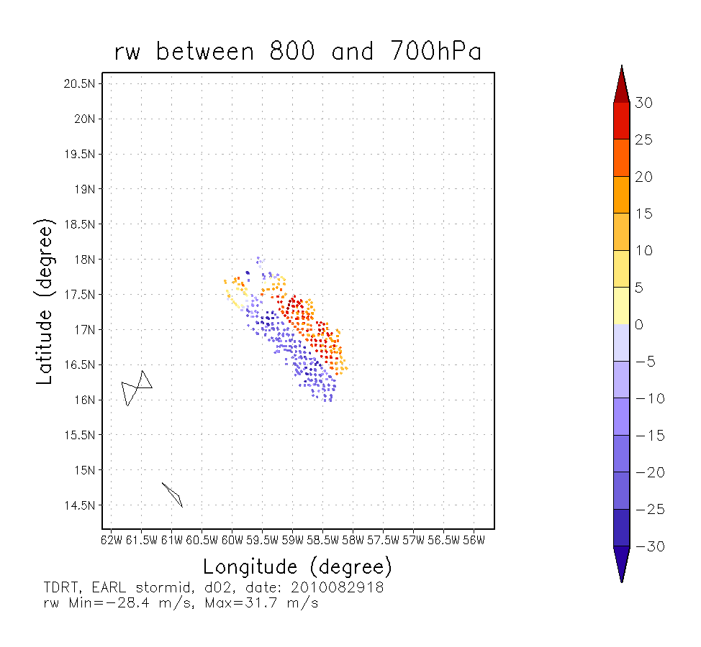
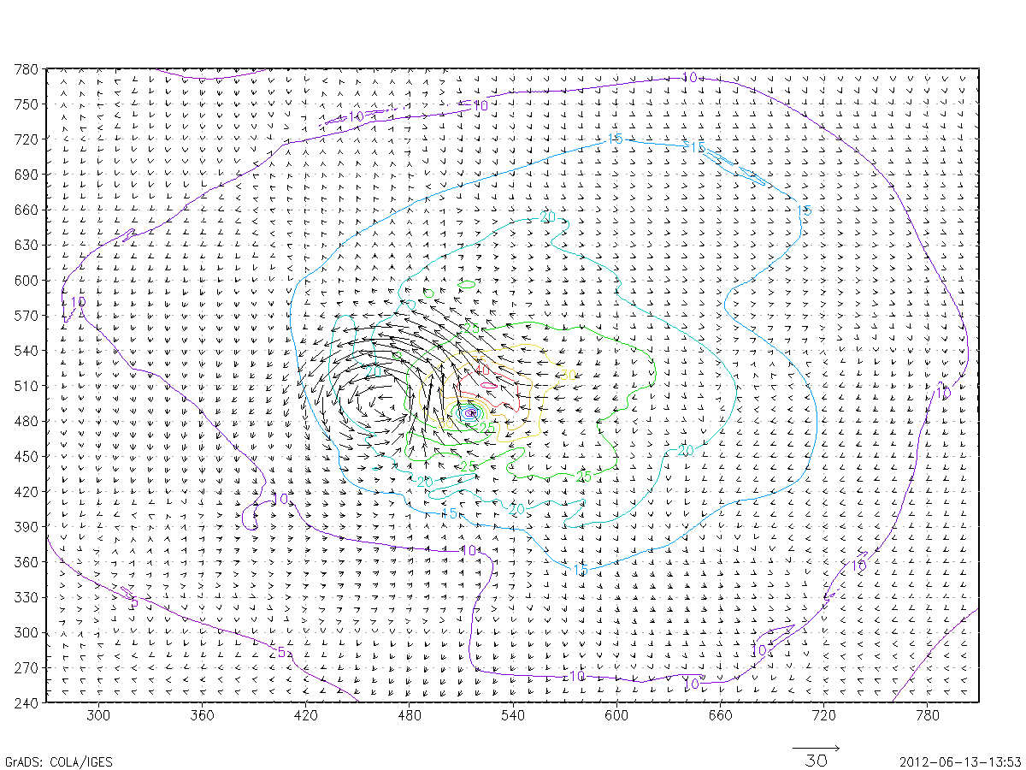
Data coverage issue
analysis
obs
Wind increment (vectors)
Data dump located at the end of the assimilation wind

Slide 8
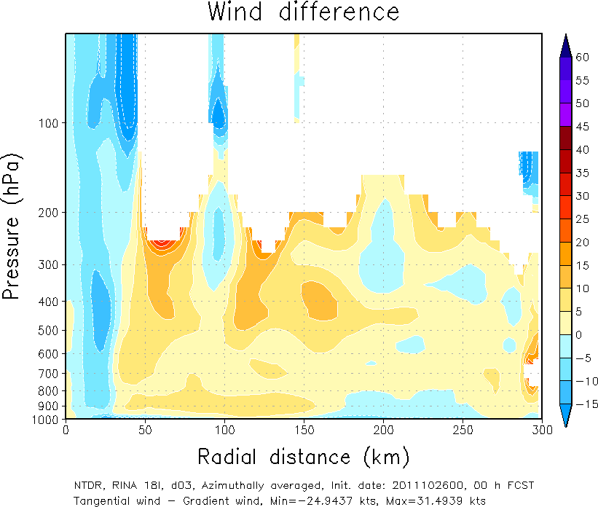
Balance issue
with TDR
without TDR
Assimilation of TDR data can introduce mass-wind imbalance, even with hybrid method

Slide 9
TDR assimilation – latest update
Average scores for Earl (2010 07l), Irene (2011, 09l), Rina (2011, 18l)
TDRN compared with TDRP
Reject data dump at the ends of assimilation window
Horizontal localization length scale for outer domain gradually increase from 600 km to 900 km from the 26th model level to model top
Vertical localization is in the units of lnP (0.5 for outer domain and 1.2 for ghost domain) not measured by vertical levels

Slide 10
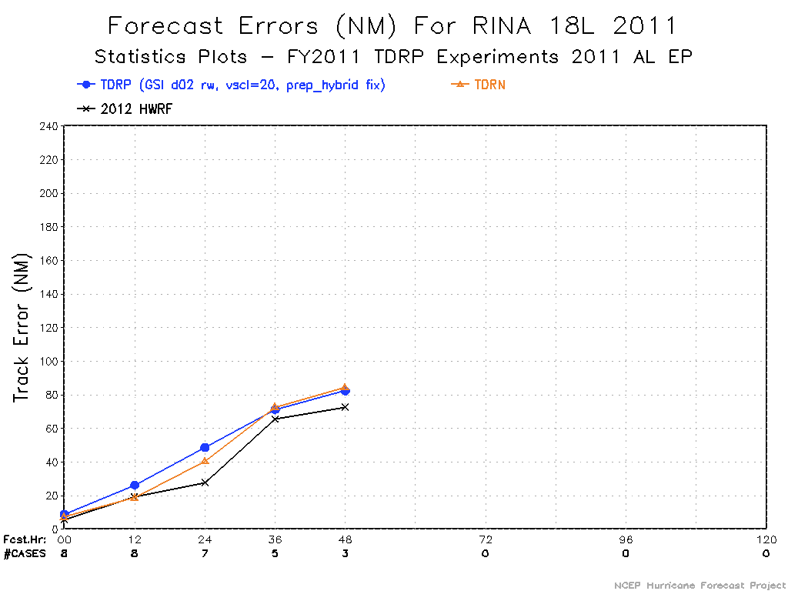
Impact is case dependent

Slide 11
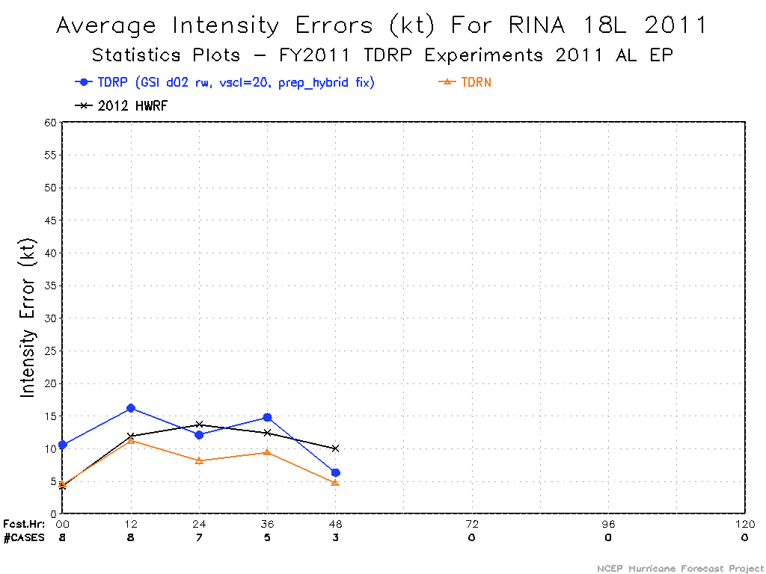
Impact is case dependent

Slide 12
TDR assimilation results of Isaac

Slide 13
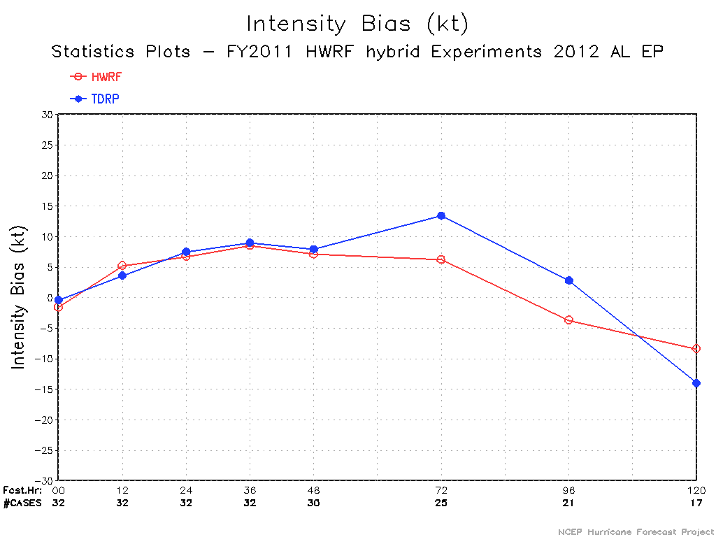
All cycles of Isaac

Slide 14
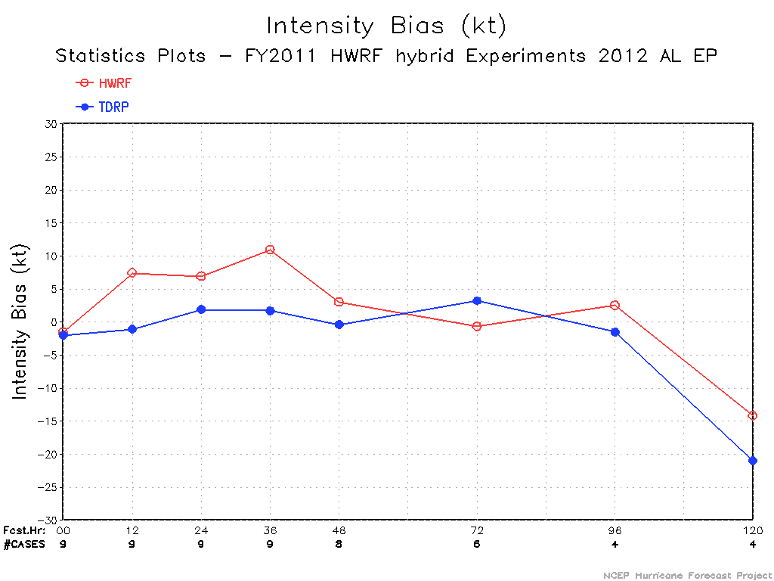
Cycles with TDR data

Slide 15
worse track and intensity forecast with TDR data

Slide 16
worse track and intensity forecast with TDR data

Slide 17
better Intensity forecast, worse track forecast after day 2

Slide 18
better track and intensity forecast with TDR data

Slide 19
better track and intensity forecast with TDR data

Slide 21
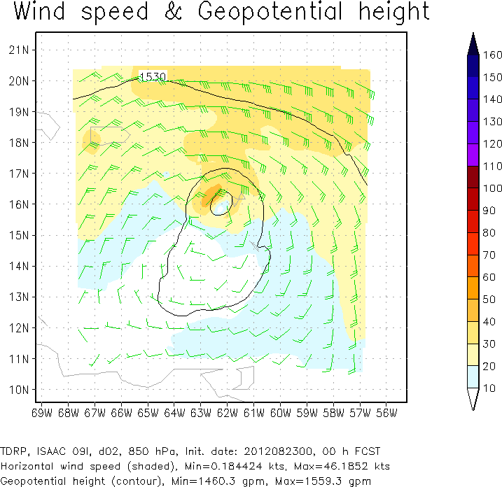
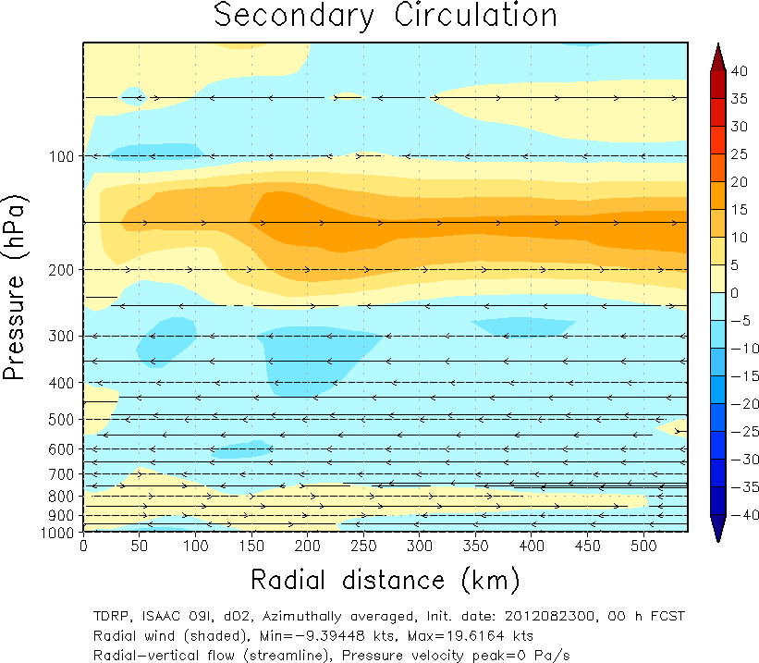
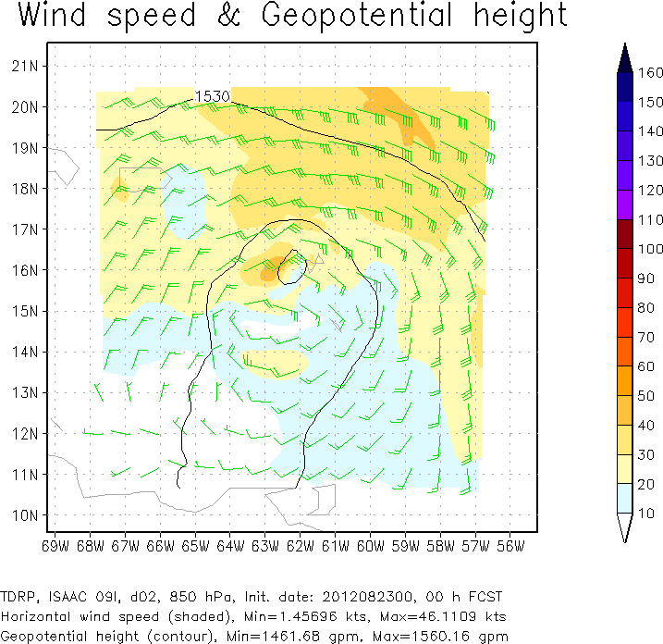
2012082300 – worse performance than operational HWRF
first guess
analysis

Slide 22
Analysis increment of 2012082300

Slide 23
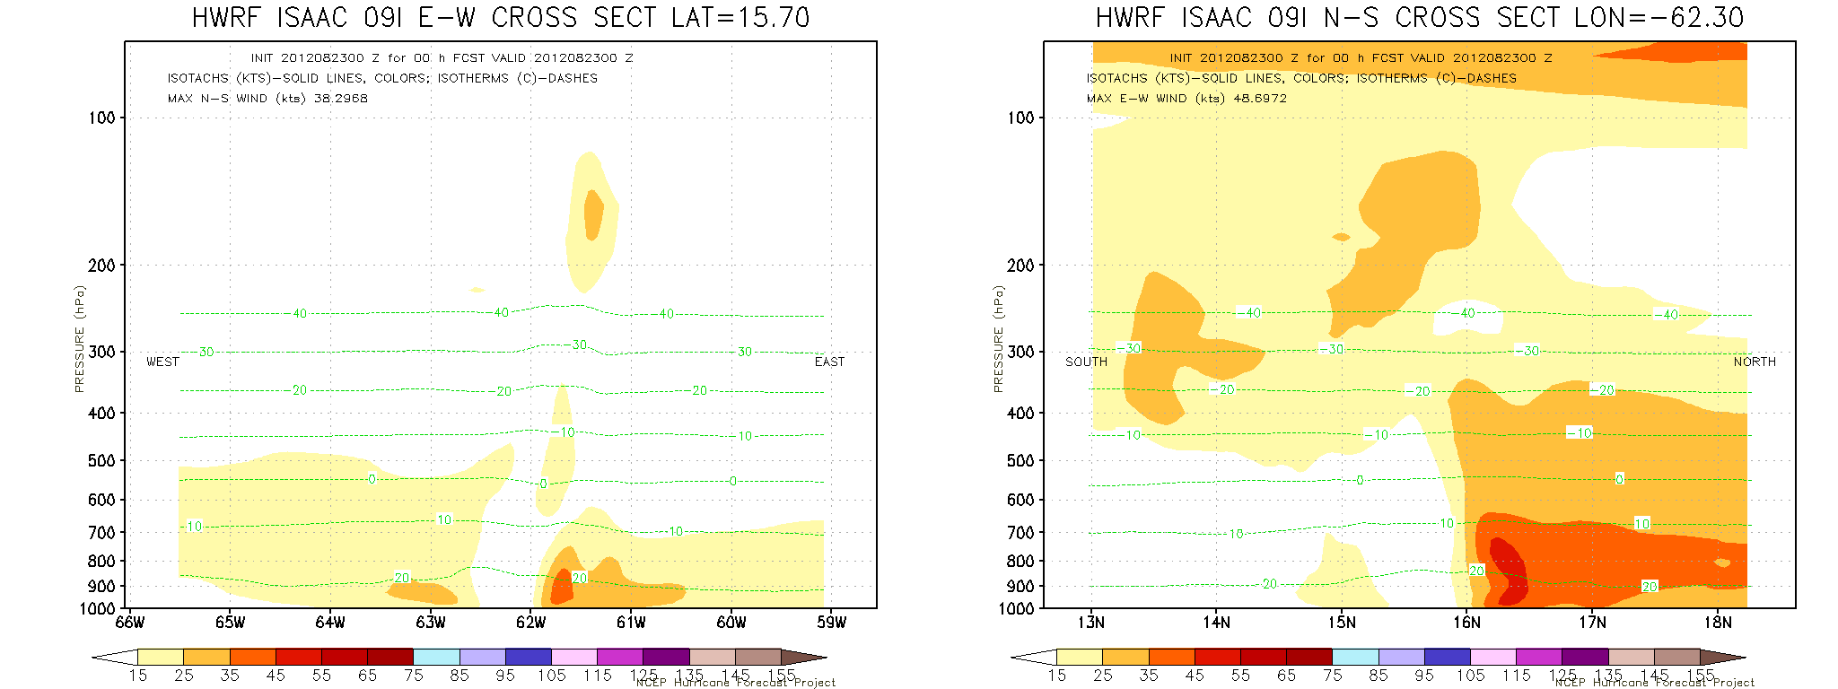
2012082300 – worse performance than operational HWRF
TDRP
operational
HWRF

Slide 24
three cases showing better intensity forecast
first guess
analysis
2012082700
2012082712
2012082800

Slide 25
three cases showing better intensity forecast
TDRP
HWRF
2012082700
2012082712
2012082800

Slide 26
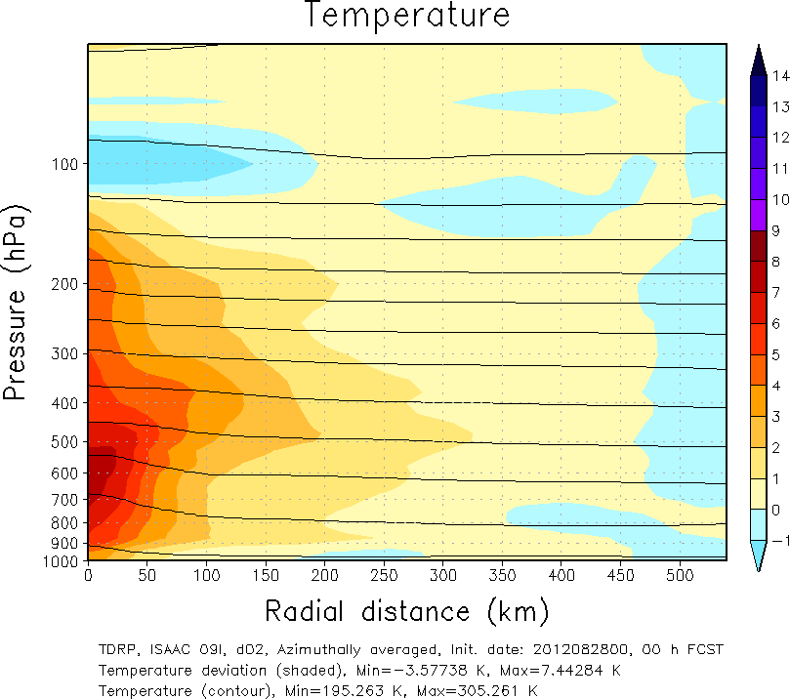
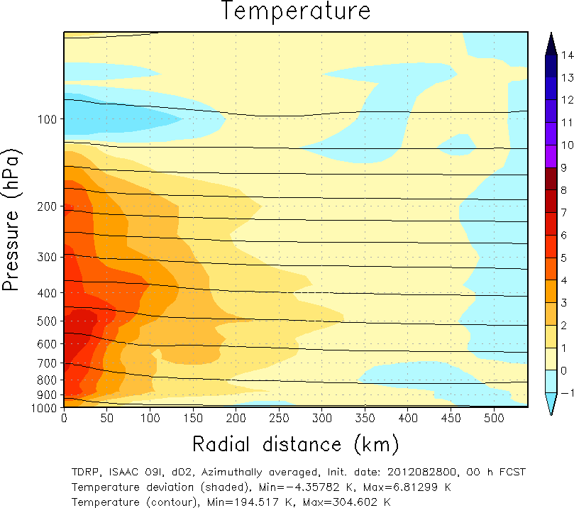
three cases showing better intensity forecast
first guess
analysis
2012082700
2012082712
2012082800

Slide 27
three cases showing better intensity forecast
TDRP
HWRF
2012082700
2012082712
2012082800

Slide 28
TDR assimilation results of Leslie

Slide 29
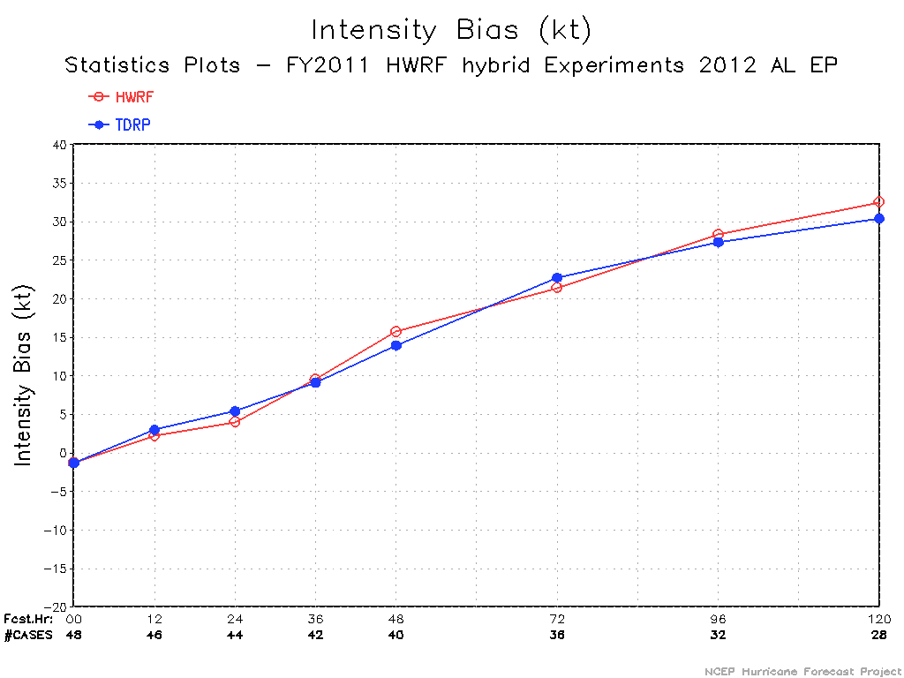
All cycles of Leslie 12l

Slide 30
Track and intensity errors of TDR cases of Leslie 12l

Slide 34
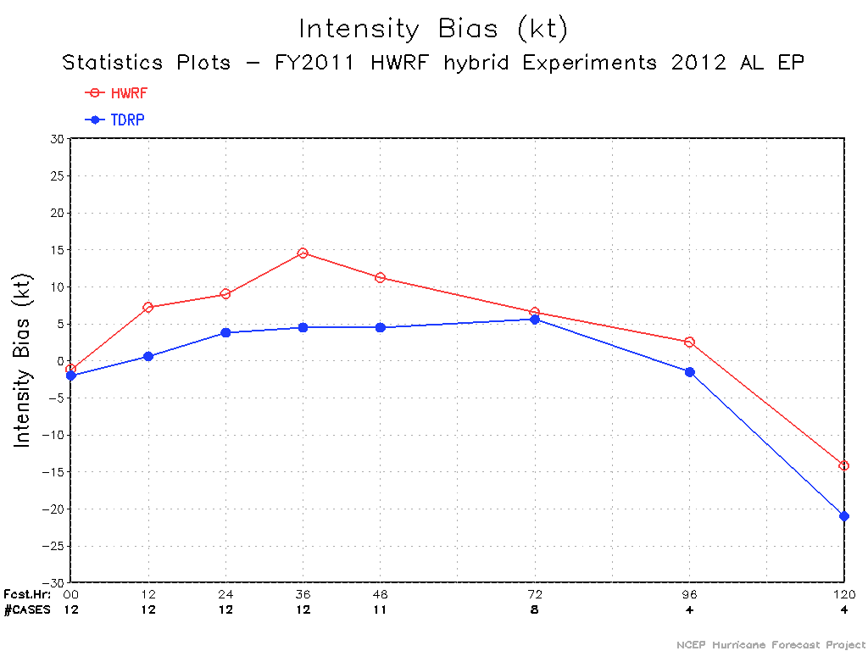
TDR cases of 2012 (Isaac 09l and Leslie 12l)

Slide 35
Summary
Data assimilation system has been upgraded to one-way hybrid Ens/Var system for 2012 hurricane season TDR parallel.
Added more QC and retuned observation error for TDR data
The impact of assimilating TDR data is case dependent. Positive impact can be seen in some cases.
For hurricane Isaac, there are 3 cases that TDR parallel shows clear better performance than operational HWRF.
Intensity forecast of TDR parallel has smaller bias than operational HWRF.
More diagnoses are need to understand the 2 cases that showing worse performance.
Need to evaluate analysis for large scale storm environment.
Compare TDR analysis with HRD’s TDR composite.

