Slide 1
HWRF with a hybrid EDMF PBL scheme
-- Preliminary test runs
Presented by Weiguo Wang
2015/10/22
EMC GFS: Jongil Han
EMC HWRF: Lin Zhu, Zhan Zhang, Weiguo Wang et al
HRD: Jun Zhang
Thanks to Morris for sharing experience of the application of the scheme in GFDL model.

Slide 2
Outline
GFSPBL scheme (Han et al 2015)
HWRF idealized case
- Experiment configurations
- H215: Variable alpha vs constant alpha
- H215: oldGFSPBL vs NewGFSPBL(edmf)
HWRF real case
- Katrina experiment
- Retrospective runs
Summary

Slide 3
Compared with old gfs PBL scheme (in hwrf), the new version differs mainly in three aspects :
 | OLD | NEW
Treatment of large nonlocal eddies | Counter-gradient method all unstable conditions | Mass flux method very unstable conditions Counter-gradient method weakly unstable conditions
Critical Ri# estimating PBL H | Variable Ri # all conditions | Variable Ri# only under stable conditions
Dissipation Heating Enhanced K due to instability PBL cloud layer | Somewhat Outside the scheme None | In the scheme. TKE budget eqn. Yes

Slide 4




Formulations
PBL scheme is designed for estimating
+ K γ
Old PBL scheme
Counter-gradient term
Updated PBL scheme
Mass flux term

Slide 5




Turbulent eddy diffusivity , K
Stable conditions
Unstable conditions
PBL height, h
Calculate Ri# between surface and a level, till Ri=Rbcr
Critical Ri #

Slide 6

Dissipation heating
Buoyance Wind shear
Cloud-top driven diffusion
If the condition for cloud-top instability is met, increase entrainment flux at cloud top
Total K = PBL mixing K + Cld K

Slide 7
Application to hurricane simulations
Issues:
Compared with obs-derived, it has been found that regular GFS PBL scheme gives,
- K is too big
- PBL Height is too high
Treatments:
- Introduced a fixed alpha to limit K based on obs
- Adjust K so that max K is not larger than U/0.6 at ~ 500 meter.
- Variable critical Ri# method to determine PBL height under all conditions

Slide 8
Idealized Runs

Slide 9
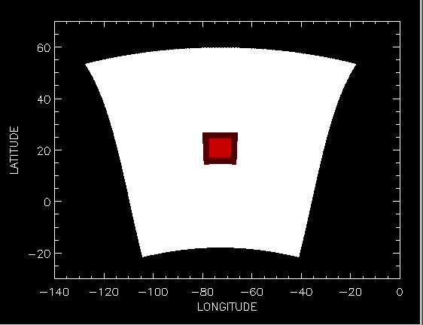
Idealized run configuration
Nz = 61
Ptop = 2 hpa
D01:
NxNy=288×576
Dx = 18 km
Dt = 38+4/7s
D02:
NxNy=142×272
Dx = 6 km
Dt = 12+6/7s
D03:
NxNy=265×472
Dx = 2 km
Dt = 4+2/7s
FA mp
RRTMG, …etc
D01
D02
D03

Slide 10
Experiments:
 | Legend | What
(1) | H215 | 2015 Operational HWRF, variable alpha adjust K OLD
(2) | H215 alpha=0.75 | Same as (1), constant alpha OLD
(3) | NewPBL alpha=1 | GFS-EDMF PBL scheme NEW
(4) | NewPBL alpha=-1 | As (3), with variable alpha NEW
(5) | NewPBL alpha=-1 No cloud | As (3), with variable alpha, disable cloud impacts NEW

Slide 11
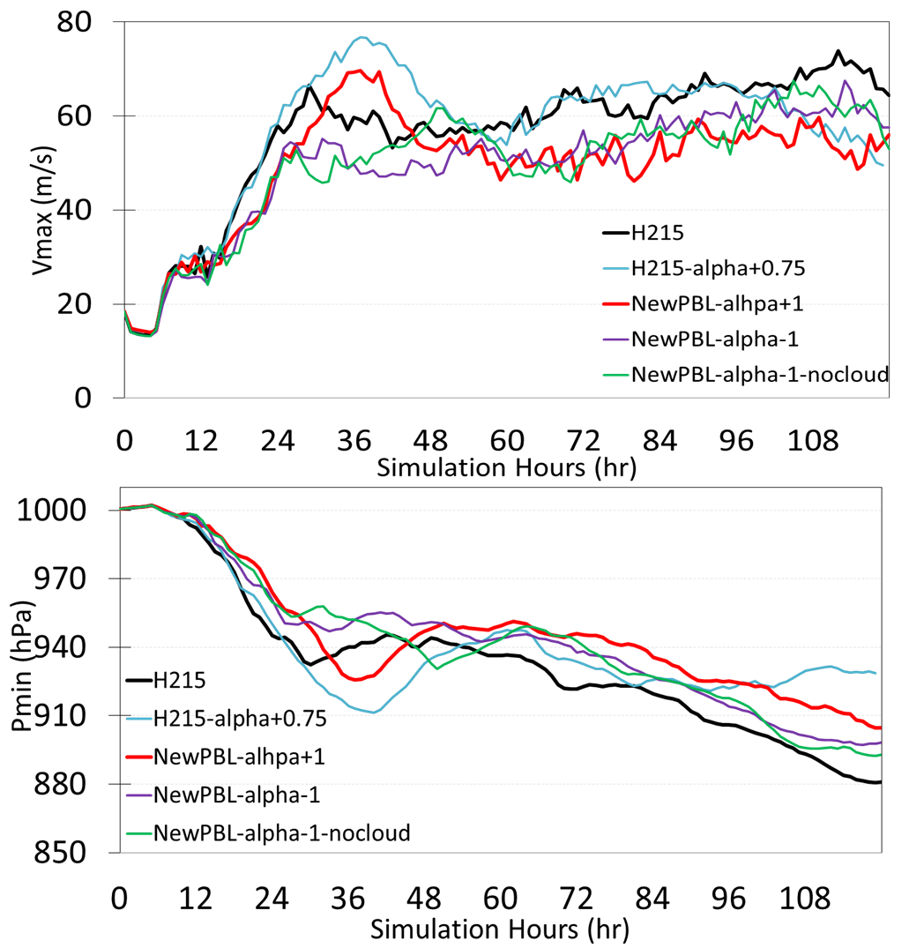
H215:
OLD
Variable alpha
Fixed alpha=0.75
Similar Vmax; after 96hr, alpha=0.75 weaker
NewPBL:
With alpha adjustment, stronger Vmax, lower P.
Spin-up
Spin-up

Slide 12
H215
H215 – alpha=0.75
H215 H215
Variable alpha constant alpha .75

Slide 13
H215
H215 – alpha=0.75
T=60 hr
Ku
Wup
Vt(contour)
Vr(shaded)

Slide 14
H215
H215 – alpha=0.75
T=108 hr
Ku
Wup
Vt(contour)
Vr(shaded)

Slide 15
H215 H215
old GFS PBL vs New GFS PBL

Slide 16
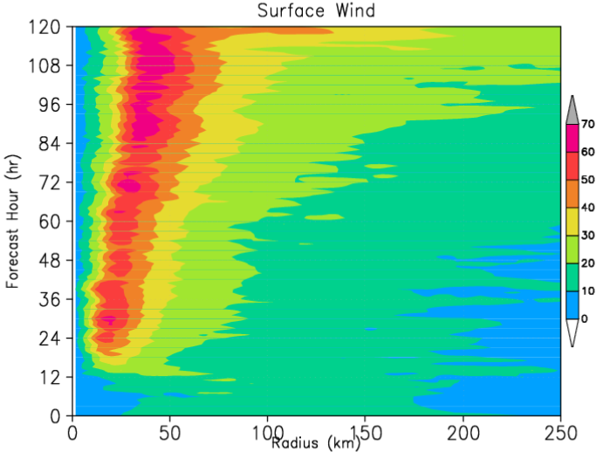
H215
New GFS EDMF
New GFS EDMF + variable alpha
New GFS EDMF + variable alpha + Nocld

Slide 17
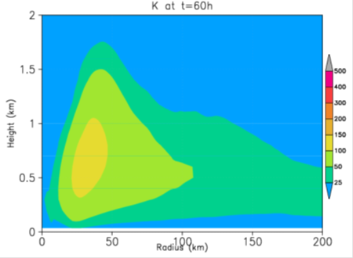
T=60h
Ku
H215
New GFS EDMF
New GFS EDMF + variable alpha
New GFS EDMF + variable alpha + Nocld

Slide 18
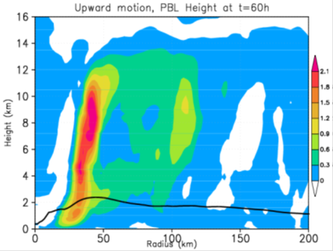
T=60h
Wup
H215
New GFS EDMF
New GFS EDMF + variable alpha
New GFS EDMF + variable alpha + Nocld

Slide 19
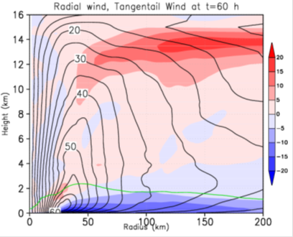
T=60h
Vt
Vr
H215
New GFS EDMF
New GFS EDMF + variable alpha
New GFS EDMF + variable alpha + Nocld

Slide 20
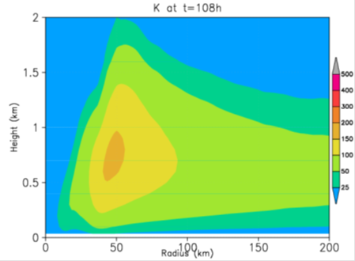
T=108h
Ku
H215
New GFS EDMF
New GFS EDMF + variable alpha
New GFS EDMF + variable alpha + Nocld

Slide 21
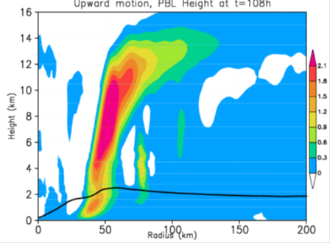
T=108h
Wup
H215
New GFS EDMF
New GFS EDMF + variable alpha
New GFS EDMF + variable alpha + Nocld

Slide 22
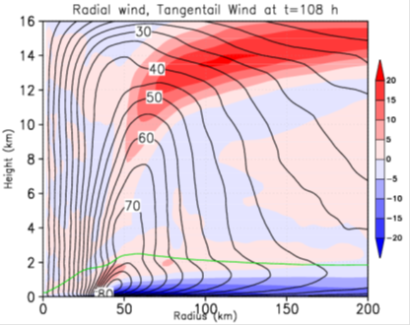
T=108h
Vt
Vr
H215
New GFS EDMF
New GFS EDMF + variable alpha
New GFS EDMF + variable alpha + Nocld

Slide 23
Summary for idealized case
Run with New PBL scheme tends to give weak intensity
Run with New PBL scheme + adjustment of K, intensity gets stronger
Run with New PBL scheme shows multiple bands of Wup more clearly
Need to look at more about indirect impacts, e.g., precipitation, latent heating,….

Slide 24
Real case

Slide 25
Katrina experiment
 | Legend | what
(1) | H215 | 2015 Operational HWRF system
(2) | H215-edmf | As (1), but use gfs edmf pbl scheme(50% dissipation heating )
(3) | H215-edmf-0.7dis | As (1), but use gfs edmf pbl scheme(70% dissipation heating )
(4) | H215-edmf-alpha | As (2) but use variable alpha to adjust K

Slide 26
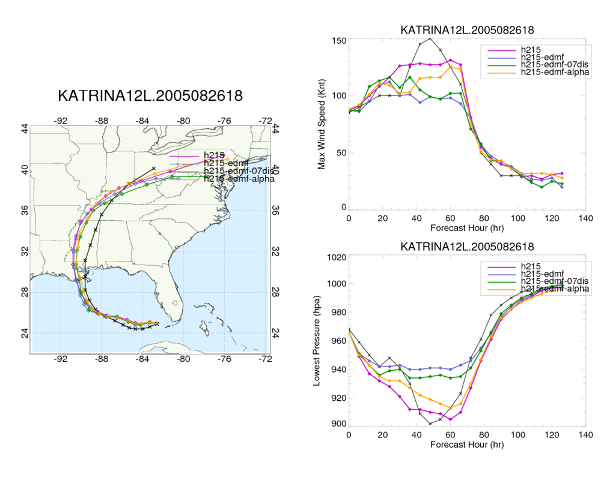

Slide 27
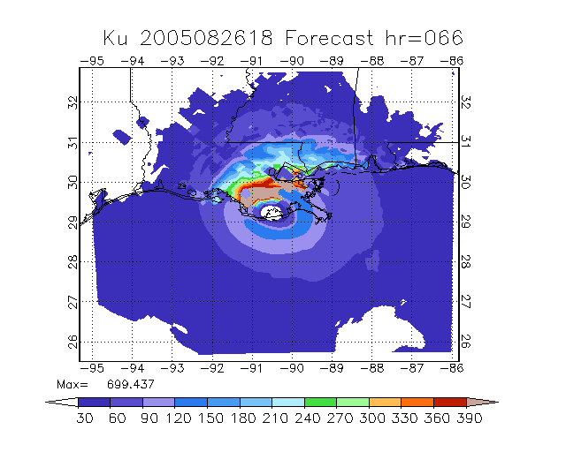
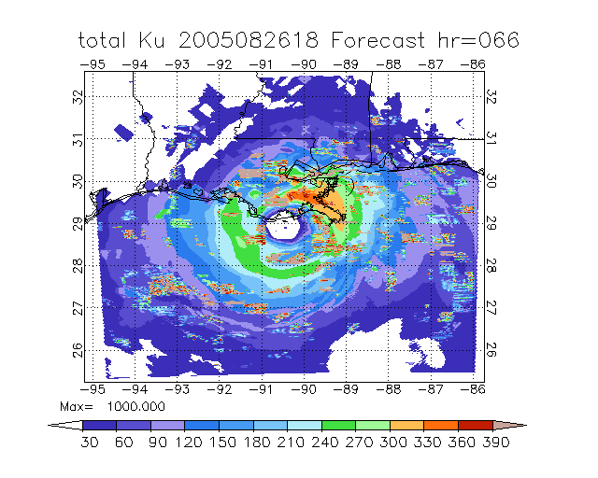
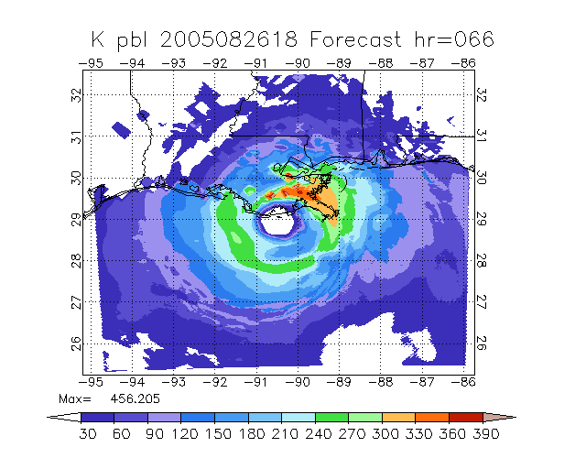
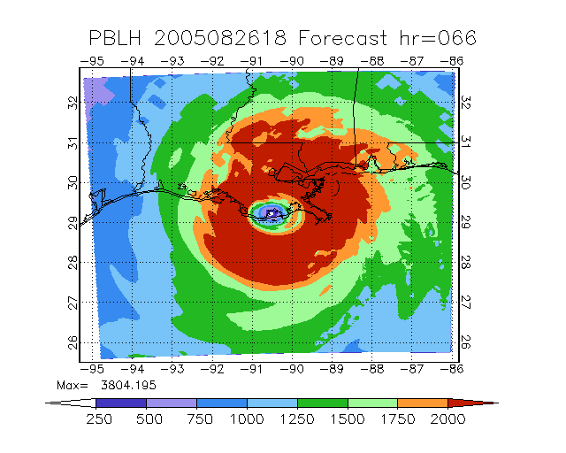
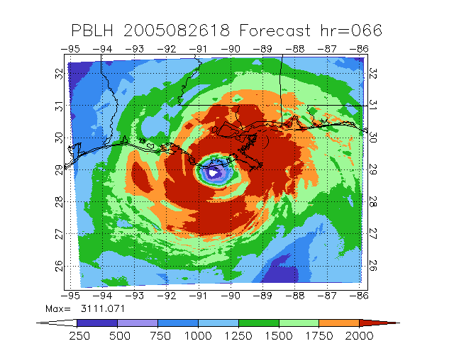
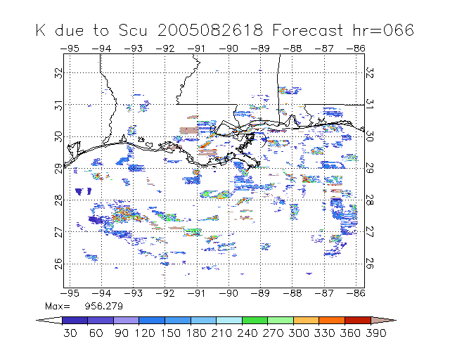
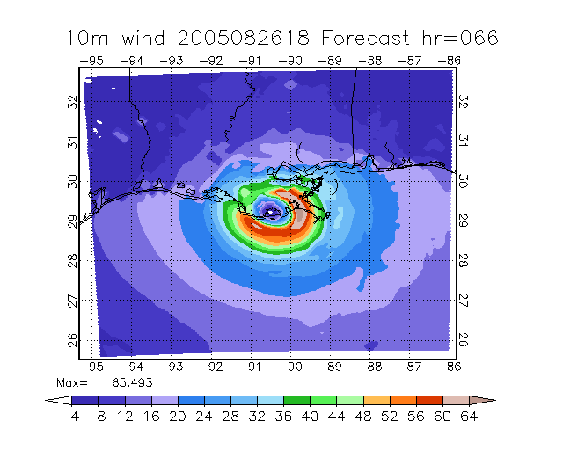
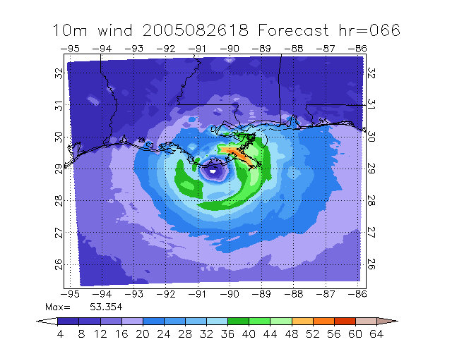
H215
H215-edmf
PBL mixing K
Total Ku
PBLH
Scu mixing K
10m wind

Slide 28
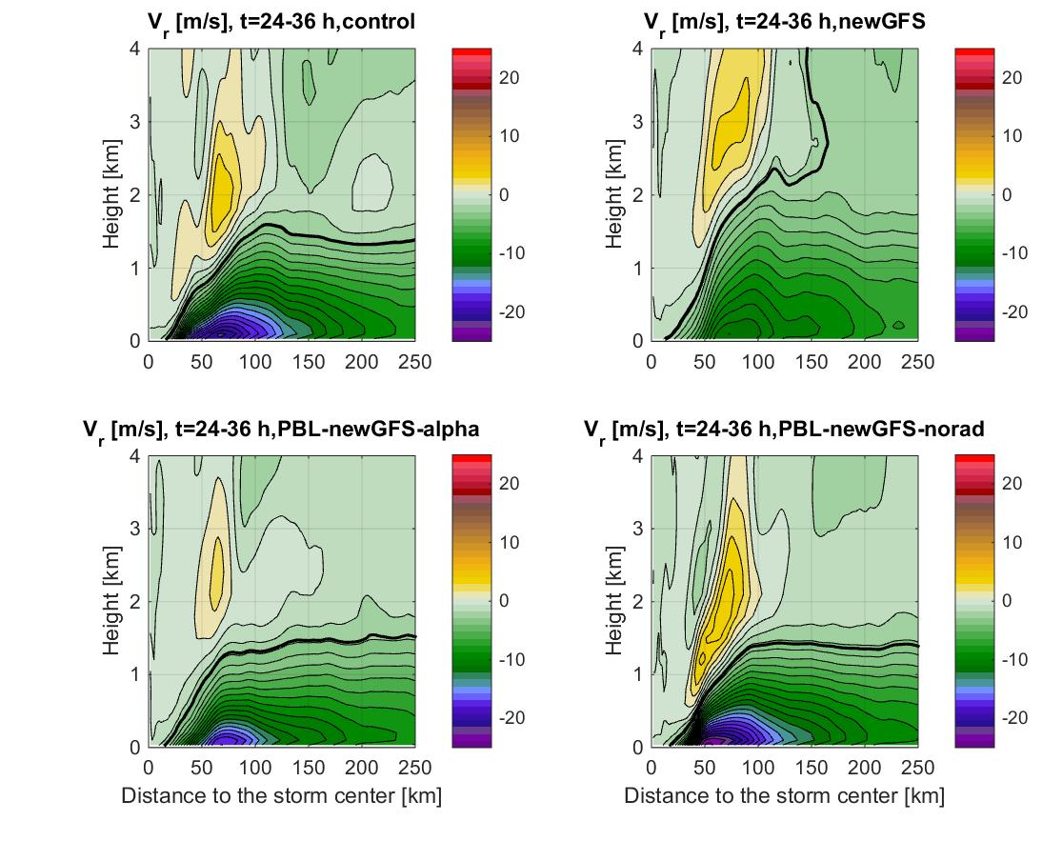
H215
H215 -edmf
Radial
Wind
PBL H
H215 –edmf-alpha
H215 –edmf-alpha-Nocld
HRD, J Zhang

Slide 29
Retrospective runs
Storms
2014: 6L, 7L, 8L, 9L
2015: 4L, 5L, 6L, 7L, 8L, 9L
2E, 3E, 4E, 5E, 9E, 10E,…
 | Legend | What
(1) | HY15 | Operational HWRF system
(2) | EDMF | As (1), but use GFS EDMF PBL scheme
(3) | EDM1 | As (2), but use variable alpha over D03, D02, No alpha over D01

Slide 30
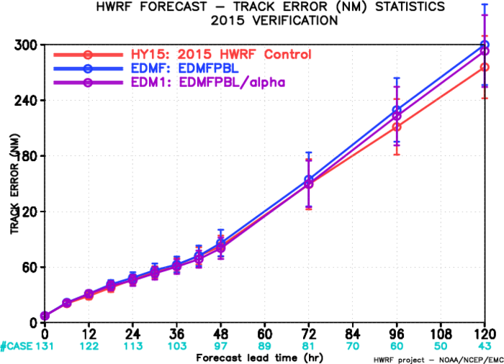
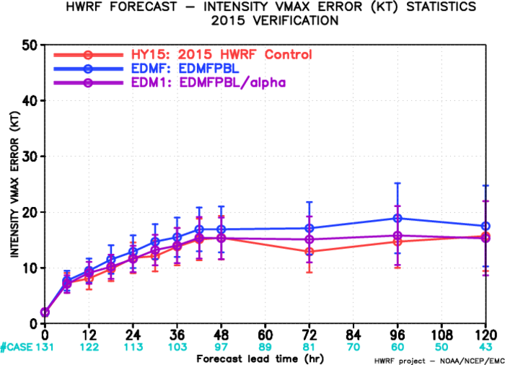
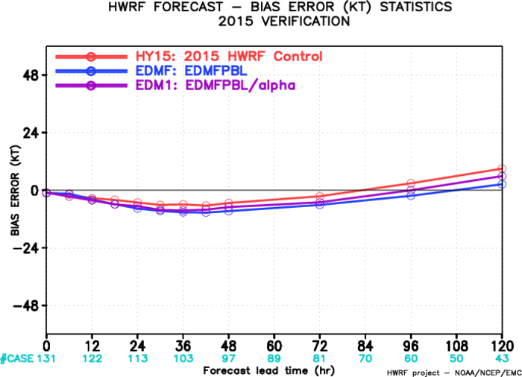
ATL verification
Track: similar < 48hr
EDMF/1 degrade d > 72hr
Intensity: EDM1 better than EDMF
Similar to HY15 < 48hr

Slide 31
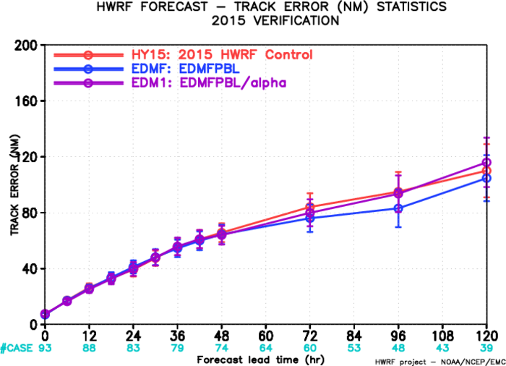
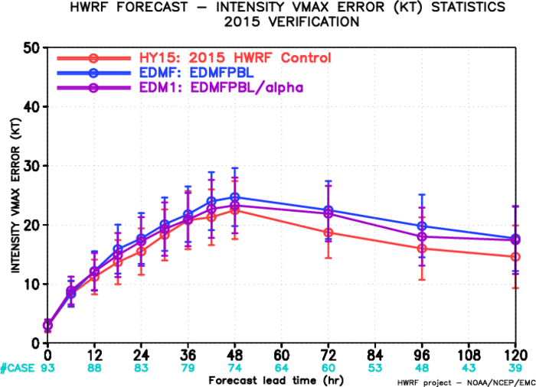
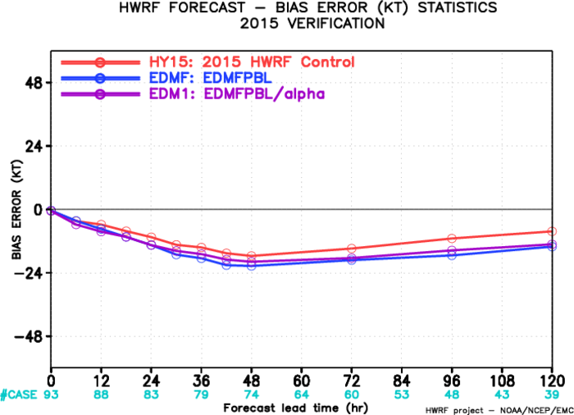
EP verification
Track: similar < 48hr
better afterwards
Intensity: EDM1 better than EDMF
Weaker than HY15

Slide 32
AL Strong storm
Strong Storm
V worse
Alpha helps

Slide 33
AL Strong storm
Strong Storm
Neutral track, maybe slightly better<48hr

Slide 34
AL Weak storm
Weak AL Storm
Better Vmax

Slide 35
AL Weak storm
Weak AL Storm
Better track

Slide 36
EP Strong storm
Strong Storm
Weak V
Alpha helps

Slide 37
EP Strong storm
Strong EP Storm
Better track

Slide 38
EP Weak storm
Weak EP Storm
Neutral Vmax

Slide 39
EP weak storm
Weak EP Storm
Neutral track

Slide 40
Summary
HWRF with new GFS PBL tends to give weaker intensity, particularly for strong storm.
May give better results for weak storms. Track is slightly better.
It is necessary to introduce K or PBLH adjustment based on observations
With alpha adjustment, the new scheme can give similar results to H215.
HWRF with new PBL scheme+K adjustment tends to give multiple bands of Wup.
Need to look at other variables (e.g., precipitation, …clouds..) to see indirect impacts.

Slide 42
