Slide 1
Impact of microphysical processes on eyewall replacement cycle in HWRF simulations
1
Ping Zhu, Zhenduo Zhu
Department of Earth & Environment
Florida International University
Sundararaman Gopalakrishnan, Robert Black, Frank Marks
Hurricane Research Division, AOML, NOAA
Vijay Tallapragada
Environmental Modeling Center, NCEP, NOAA
Jun Zhang, Xujing Zhang
CIMAS, University of Miami

Slide 2
2
Outline
How do miscrophysical processes affect eyewall replacement cycle in two idealized HWRF simulations that use different sets of model physics?
Why no eyewall replacement is seen in the idealized simulation that uses operational HWRF model physics?
Key microphysical parameters affecting ERC in HWRF simulations.
ERC in HWRF real case simulations
Notes:
As reviewed in the previous section, SEF and ERC are the outcome of a complicated internal interaction among TC vortex, diabatic heating associated with eyewall and rain-band convection, and boundary layer processes. However, the details of this interaction in governing the occurrence and course of SEF and ERC are still not well understood.
Therefore, the objectives of this study are to advance our understanding of underlying mechanisms that control SEF and ERC by investigating the role of outer rainband convection in the SEF and the physical mechanism behind formation and development of secondary wind maximum; reexamining the mechanisms that governs the demise of the primary eyewall in 3d full physics numerical simulations.
To achieve these research goals, we used WRF to perform a series of idealized TC simulation. Tangential wind budget analysis and Sawyer-Eliassen Equation were used to analyze the mechanisms behind the formation of secondary wind maximum and the interaction between inner and outer eyewalls during the simulated ERC.

Slide 3
Motivation
ERC in HWRF idealized simulations
3
Advancing our understanding of the impact of model physics, in particular microphysics, on ERC in HWRF simulations.
Since ERC in real TCs can be affected by TC asymmetries and environmental conditions such as wind shear, the problem is relatively easy to approach in an idealized framework. For this reason, as a first step idealized HWRF simulations are used to investigate how microphysics interact with other sub-grid scale and resolved processes to affect ERC in HWRF simulations.
Notes:
This is a summary of the model configuration used for the control simulation. We use WRF3.3.1 to simulate a category-1 hurricane-like vortex on f-plane with flat water surface and 29c SST. This figure shows the radial profiles of tangential wind and vorticity. Dunion moist sounding is used to prescribe the background environment with no background wind. The simulation is 8 days long and the output interval is 10 minutes. We use 3 two-way nested domains with the highest horizontal resolution being 2km. 47 vertical levels are used with 10 below 1.5 km and lowest half-level being 60m. We use RRTM long wave scheme, Dudhia short wave scheme and Thompson microphysics scheme. Kain-Fritch cumulus scheme is activated on the outermost domain only. We use MYJ PBL and surface scheme with Davis’s formula for surface roughness for vertical turbulent mixing and Smagorinsky shceme for Horizontal turbulent mixing. lateral boundary values are periodic on west and east boudaries, symmetric on south and north boundaries.

Slide 4
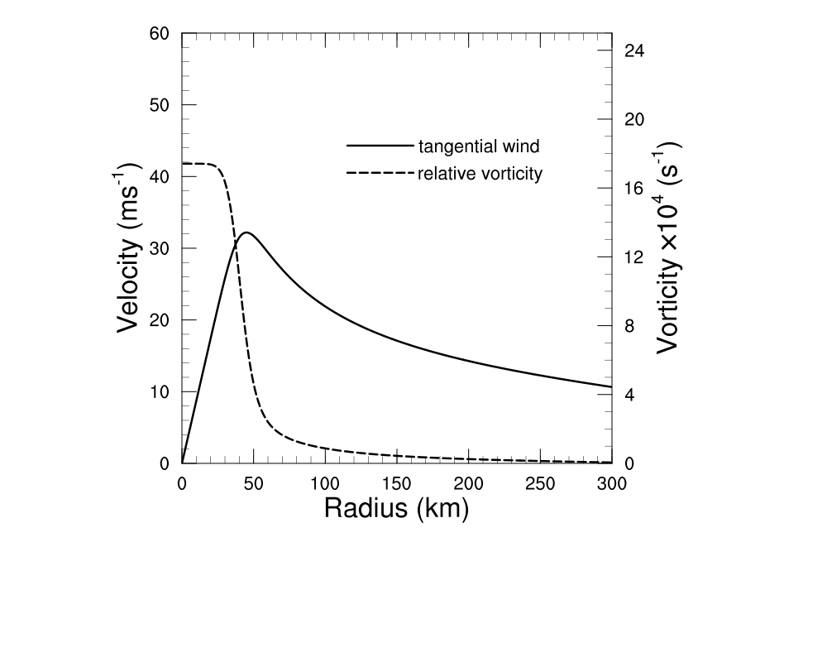
Initial vortex
4
1. A Cat-1 vortex with V_{max}=36.0 ms⁻¹ at r=45.0 km embedded in a quiescent background determined by the non-SAL sounding of Dunion and Marron [2008].
2. Tangential wind profile at the surface is determined by Wood and White [2011]’s formula.
3. The surface profile is extended
into the vertical using Nolan and
Montgomery [2002]’s formula.
4. The pressure and temperature
fields that hold the vortex wind
field are in hydrostatic and
gradient wind balance.
5. A water surface with a uniform
temperature of 29 ⁰C is set on an
f-plane at 20⁰N.
Initial vortex structure
After Zhu and Zhu 2014 and 2015
Notes:
This is a summary of the model configuration used for the control simulation. We use WRF3.3.1 to simulate a category-1 hurricane-like vortex on f-plane with flat water surface and 29c SST. This figure shows the radial profiles of tangential wind and vorticity. Dunion moist sounding is used to prescribe the background environment with no background wind. The simulation is 8 days long and the output interval is 10 minutes. We use 3 two-way nested domains with the highest horizontal resolution being 2km. 47 vertical levels are used with 10 below 1.5 km and lowest half-level being 60m. We use RRTM long wave scheme, Dudhia short wave scheme and Thompson microphysics scheme. Kain-Fritch cumulus scheme is activated on the outermost domain only. We use MYJ PBL and surface scheme with Davis’s formula for surface roughness for vertical turbulent mixing and Smagorinsky shceme for Horizontal turbulent mixing. lateral boundary values are periodic on west and east boudaries, symmetric on south and north boundaries.

Slide 5
Configuration of HWRF
5
HWRF v3.6a
HWRF operational triple nests, 0.18⁰/0.06⁰/0.02⁰ ; 47 vertical levels; performed in the HWRF real case simulation framework.
HWRF1: operational model physics: Ferrier microphysics; modified GFDL radiation; simplified Arakawa-Schubert cumulus (outmost domain); modified GFDL surface layer scheme; and modified NCEP GFS PBL.
HWRF2: Thompson microphysics; RRTM(LW)/Dudhia(SW) radiation; Kain-Fritch cumulus (outmost domain); modified GFDL surface layer scheme; and modified NCEP GFS PBL.
10-day simulation.
Notes:
This is a summary of the model configuration used for the control simulation. We use WRF3.3.1 to simulate a category-1 hurricane-like vortex on f-plane with flat water surface and 29c SST. This figure shows the radial profiles of tangential wind and vorticity. Dunion moist sounding is used to prescribe the background environment with no background wind. The simulation is 8 days long and the output interval is 10 minutes. We use 3 two-way nested domains with the highest horizontal resolution being 2km. 47 vertical levels are used with 10 below 1.5 km and lowest half-level being 60m. We use RRTM long wave scheme, Dudhia short wave scheme and Thompson microphysics scheme. Kain-Fritch cumulus scheme is activated on the outermost domain only. We use MYJ PBL and surface scheme with Davis’s formula for surface roughness for vertical turbulent mixing and Smagorinsky shceme for Horizontal turbulent mixing. lateral boundary values are periodic on west and east boudaries, symmetric on south and north boundaries.

Slide 6
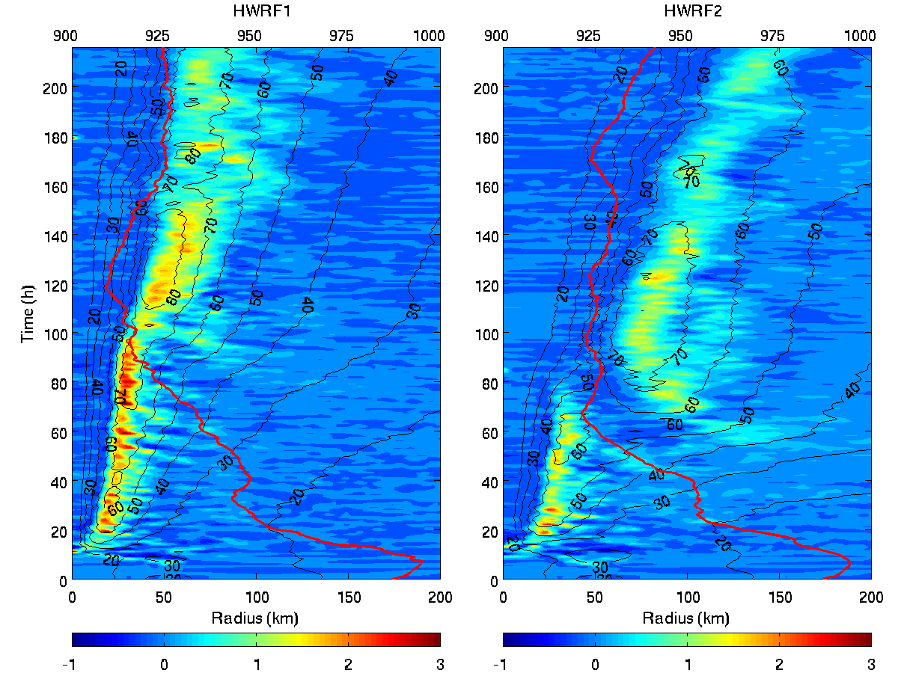
6
Eyewall
replacement
Vertical velocity at 5 km (m/s, color shades); tangential wind at 1 km (m/s, black contours); minimum sea-level pressure (MSLP, hPa, red curve scaled to the upper axis)
Notes:
This slide shows the evolution of storm intensity, radius of maximum wind and snaphots of reflectivity at 1 km level. As you can see, the secondary eyewall forms around 76 h. The simulated ERC captures the major features of observed ERC which I showed before, the storm weakens as the secondary eyewall forms and reintensifies later, the Radius of maximum wind suddenly increases and a secondary wind maximum forms after the SEF, which will be shown in the next slide. I will focus on the period from 60 to 94 h that covers the ERC shaded by the pink color.

Slide 7
7
Double eyewalls
Azimuthal-mean tangential wind (color shades, ms⁻¹), relative vorticity (white, green, blue: 0.5x10⁻³, 1.0x10⁻³, 2.0x10⁻³ s⁻¹), updrafts (dotted black: 0.3, 0.5, 0.7, 0.9, 1.1 ms⁻¹) at the 66th h.
Tangential wind at 1 km (color shades, ms⁻¹), relative vorticity at 1 km (green, blue : 1.0x10⁻³ s⁻¹, 2.00x10⁻³ s⁻¹), updraft at 5 km (dotted black: 1.0 ms⁻¹) at the 66th h.
Notes:
These two figures show the evolution of azimuthal-mean tangential wind at 1km and vertical velocity at 5km. The vertical axis is time, the horizontal axis is radius. We can see a secondary wind maximum forms around 78 h, about 2 hours after the secondary eyewall forms. The scattered outer convections are more and more organized with time and eventually became the secondary eyewall. This figure suggests a close relationship between the development of outer rainbands and secondary eyewall formation.

Slide 8
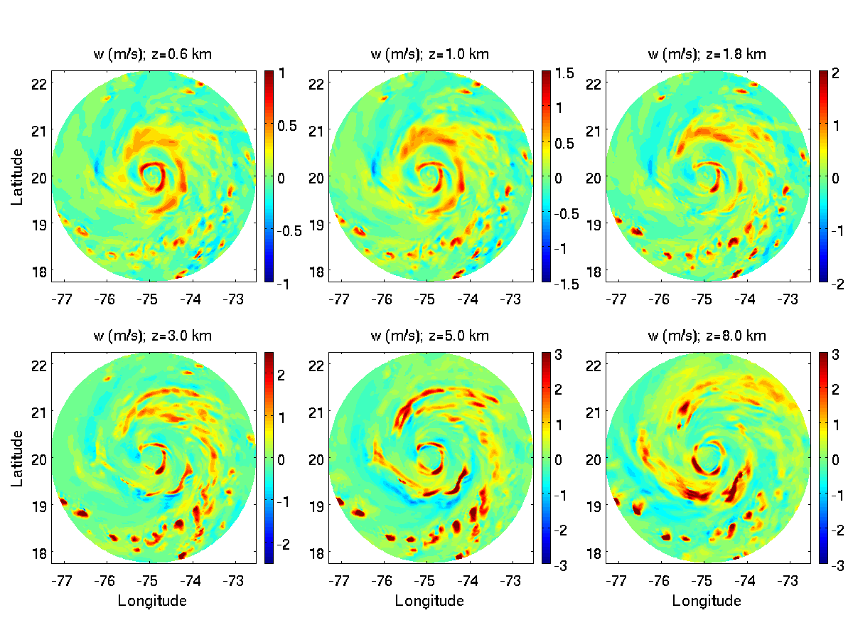
Vertical velocity (m/s) at different heights at the 66th h
8
Notes:
Shapiro and Willoughby 1982 first showed that the evolution for a balanced symmetric TC-like vortex may be understood from the transverse circulation induced by the heat and momentum sources via Sawyer-Eliassen equation. Here we are going to use this method to demonstrate that SEF and ERC in 3d full physics simulations can be well understood from a balanced symmetric perspective. This figure compares the vertical velocities directly simulated by WRF and those diagnosed by Sawyer-Eliassen equation before and during the ERC. There is a very good agreement between them. To provide a quantitative evaluation of how well the Sawyer-Eliassen diagnoses can represent the WRF simulated transverse circulation, we computed the correlation coefficients between the WRF simulations and Sawyer-Eliassen diagnoses for the ERC period from 50 h to 90 h. As you can see, below 16km and above the boundary layer, the correlation coefficients exceed 0.8. Even in the boundary layer, the correlation coefficients are still greater than 0.6. Similar good correlations are also found in radial flow. This gives us the confidence that the Sawyer-Eliassen equation provides a useful analytical tool for investigating ERC in realistic 3d full physics simulations.

Slide 9
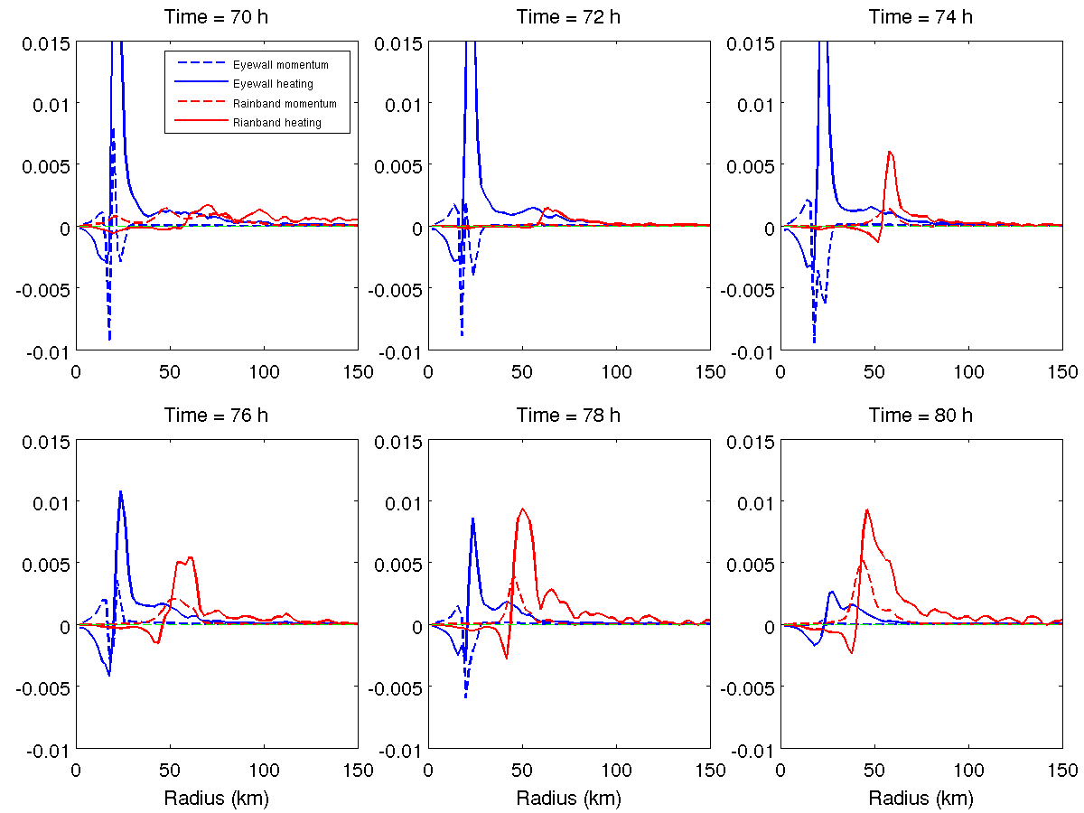
Sawyer-Eliassen (SEE) diagnoses of tangential wind tendency associated with mean flow advection induced by eyewall and outer rainband heating and momentum forcing in WRF-ARW
9
Double ring structure
Notes:
This slide shows a detailed tangential wind budget analysis averaged between 79 and 81 h. The budget equation basically tells us that the net tendency is the sum of the resolved advection terms by axisymmetric mean flow, advection terms by asymmetric eddy processes and subgrid scale terms parameterized by SGS schemes. The first plot is the net tangential wind tendency. We can see the positive and negative tendencies correspond well with the development of the secondary eyewall and the decay of the primary eyewall. The resolved tendency is positive in the boundary layer whereas the SGS tendency is negative. The net tendency is a small residual between the two large tendencies induced by the resolved and subgird scale processes. Note that the net tendency is multiplied by a factor of 10. Since the broadening of tangential wind and development of secondary wind maximum require a positive tendency, this result indicates that the resolved processes are the driving force for SEF and the SGS processes may be considered as a response to the changes induced by the resolved processes. Therefore, the resolved process is the key here. However, since the SGS tendency has a magnitude comparable to that of resolved tendency, which mainly comes from SGS vertical mixing, the SGS parameterizations can have a profound impact on the occurrence and course and ERC. More importantly, this figure shows the resolved positive tendency mainly comes from the advection by mean flow. The contribution from asymmetric eddy processes is small, note that it has been multiplied by a factor of 4, and it is generally negative in the boundary layer. This budget analysis simply tells us that advection term by axisymmetric mean flow is the key to understand the simulated ERC. This enable us to use the Sawyer-Eliassen equation to analyze the physical processes determining the wind tendency, because Sawyer-Eliassen equation is based on balanced axisymmetric framework and it can only be used to understand the symmetric processes.

Slide 10
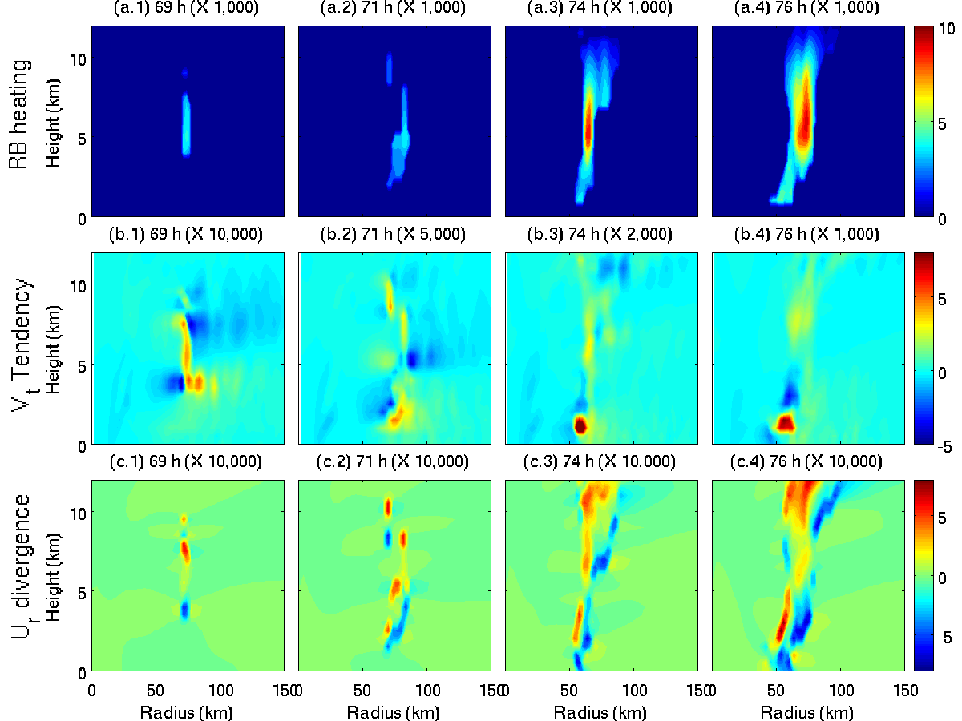
A positive feedback mechanism for outer rainband development and SEF
10
The sporadic outer rainband convection induces the convergence of radial inflow and accelerates the tangential wind at the base of the convection, which can cause the increase of moisture in the lower troposphere. The increased moist instability favors the development of low-level convection, which further enhances convergence of radial inflow and acceleration of tangential wind in the upper BL. Both can promote surface evaporation and effective transport of moisture. This can cause a runaway interaction leading to SEF.

Slide 11
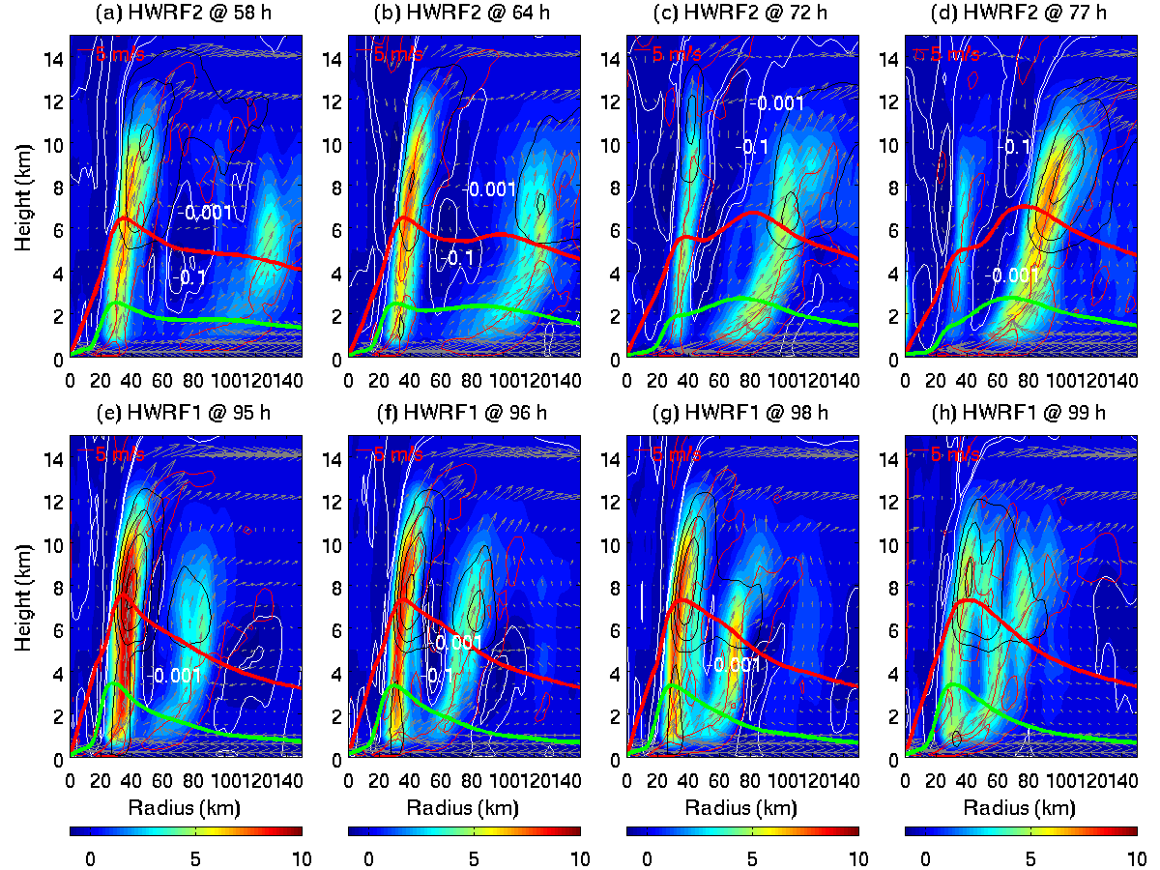
11
Diabatic heating (X1000 Ks^{-1,} color shades), hydrometeor mixing ratio (black, 2, 3, 4, 5gkg⁻¹), downdraft (white: -0.001, -0.1 ms⁻¹), transverse circulations (arrows), convergence of radial flow (red, -0.1X10⁻³,-0.5X10⁻³) during the ERC in HWRF2 and a convection episode in HWRF1. Thick red: 1 km tangential wind/10 (ms⁻¹). Thick green: surface buoyancy fluxes/100 (Wm⁻²).
Notes:
This slide shows a detailed tangential wind budget analysis averaged between 79 and 81 h. The budget equation basically tells us that the net tendency is the sum of the resolved advection terms by axisymmetric mean flow, advection terms by asymmetric eddy processes and subgrid scale terms parameterized by SGS schemes. The first plot is the net tangential wind tendency. We can see the positive and negative tendencies correspond well with the development of the secondary eyewall and the decay of the primary eyewall. The resolved tendency is positive in the boundary layer whereas the SGS tendency is negative. The net tendency is a small residual between the two large tendencies induced by the resolved and subgird scale processes. Note that the net tendency is multiplied by a factor of 10. Since the broadening of tangential wind and development of secondary wind maximum require a positive tendency, this result indicates that the resolved processes are the driving force for SEF and the SGS processes may be considered as a response to the changes induced by the resolved processes. Therefore, the resolved process is the key here. However, since the SGS tendency has a magnitude comparable to that of resolved tendency, which mainly comes from SGS vertical mixing, the SGS parameterizations can have a profound impact on the occurrence and course and ERC. More importantly, this figure shows the resolved positive tendency mainly comes from the advection by mean flow. The contribution from asymmetric eddy processes is small, note that it has been multiplied by a factor of 4, and it is generally negative in the boundary layer. This budget analysis simply tells us that advection term by axisymmetric mean flow is the key to understand the simulated ERC. This enable us to use the Sawyer-Eliassen equation to analyze the physical processes determining the wind tendency, because Sawyer-Eliassen equation is based on balanced axisymmetric framework and it can only be used to understand the symmetric processes.

Slide 12
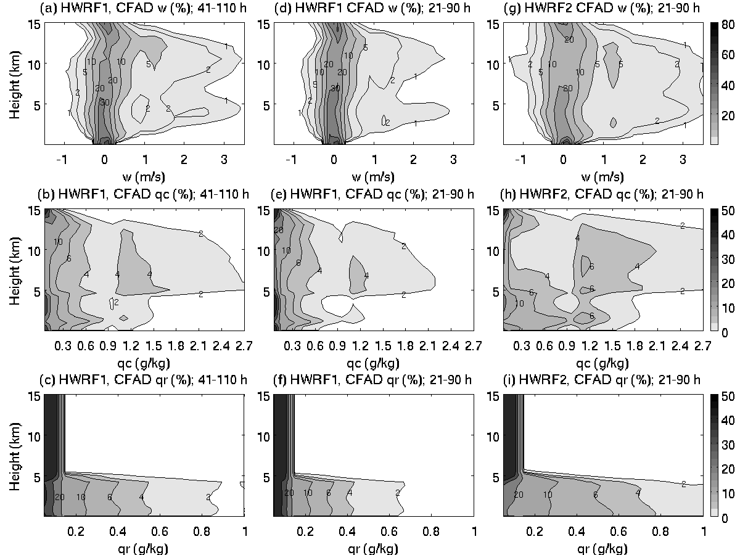
12
CFAD (%) of vertical velocity (w); total hydrometeor mixing ratio (q_{c}); rain water mixing ratio (q_{r}) from HWRF1 and HWRF2 in the outer rainband region (50-200 km in radius) averaged over the period from the 21st to 90th h, a period before and during the ERC of HWRF2, and from the 41st to 110th h, a period before and during a convective episode in HWRF1.
Notes:
This slide shows a detailed tangential wind budget analysis averaged between 79 and 81 h. The budget equation basically tells us that the net tendency is the sum of the resolved advection terms by axisymmetric mean flow, advection terms by asymmetric eddy processes and subgrid scale terms parameterized by SGS schemes. The first plot is the net tangential wind tendency. We can see the positive and negative tendencies correspond well with the development of the secondary eyewall and the decay of the primary eyewall. The resolved tendency is positive in the boundary layer whereas the SGS tendency is negative. The net tendency is a small residual between the two large tendencies induced by the resolved and subgird scale processes. Note that the net tendency is multiplied by a factor of 10. Since the broadening of tangential wind and development of secondary wind maximum require a positive tendency, this result indicates that the resolved processes are the driving force for SEF and the SGS processes may be considered as a response to the changes induced by the resolved processes. Therefore, the resolved process is the key here. However, since the SGS tendency has a magnitude comparable to that of resolved tendency, which mainly comes from SGS vertical mixing, the SGS parameterizations can have a profound impact on the occurrence and course and ERC. More importantly, this figure shows the resolved positive tendency mainly comes from the advection by mean flow. The contribution from asymmetric eddy processes is small, note that it has been multiplied by a factor of 4, and it is generally negative in the boundary layer. This budget analysis simply tells us that advection term by axisymmetric mean flow is the key to understand the simulated ERC. This enable us to use the Sawyer-Eliassen equation to analyze the physical processes determining the wind tendency, because Sawyer-Eliassen equation is based on balanced axisymmetric framework and it can only be used to understand the symmetric processes.

Slide 13
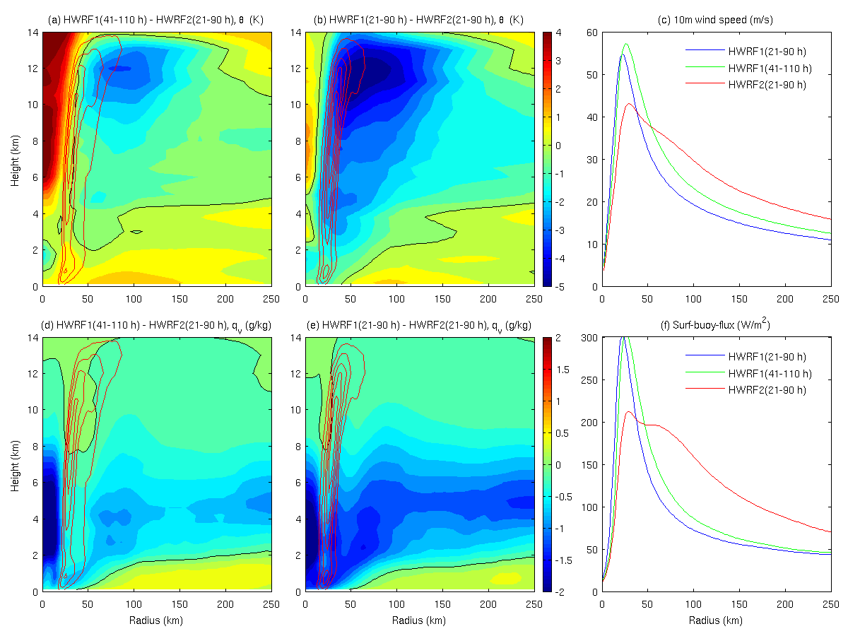
13
Left and mid panels: Difference of azimuthal-mean θ (K) and q_{v} (gkg⁻¹) between HWRF1 and HWRF2 based on the same time period (21st – 90thh) and based on convective events (21st – 90thh, ERC in HWRF2, and 41st – 110th h, convective episode in HWRF1, color shades, black: zero). Red contours: updraft difference between HWRF1 and HWRF2 (0.2, 0.4, 0.6, 0.8, and 1.0 m s⁻¹). Right panels: Radial profiles of 10-m wind and surface buoyancy fluxes .

Slide 14
14
HWRF1 and HWRF2 involve changes in three major physics parameterizations, microphysics, radiation, and cumulus scheme. It is, thus, unclear if the resultant difference between HWRF1 and HWRF2 is due mainly to the change in specific parts of individual schemes or the combined effect of changes in all three schemes.
Can operational HWRF produce ERC by changing model physics?
Key microphysical parameters affecting ERC in HWRF simulations.

Slide 15
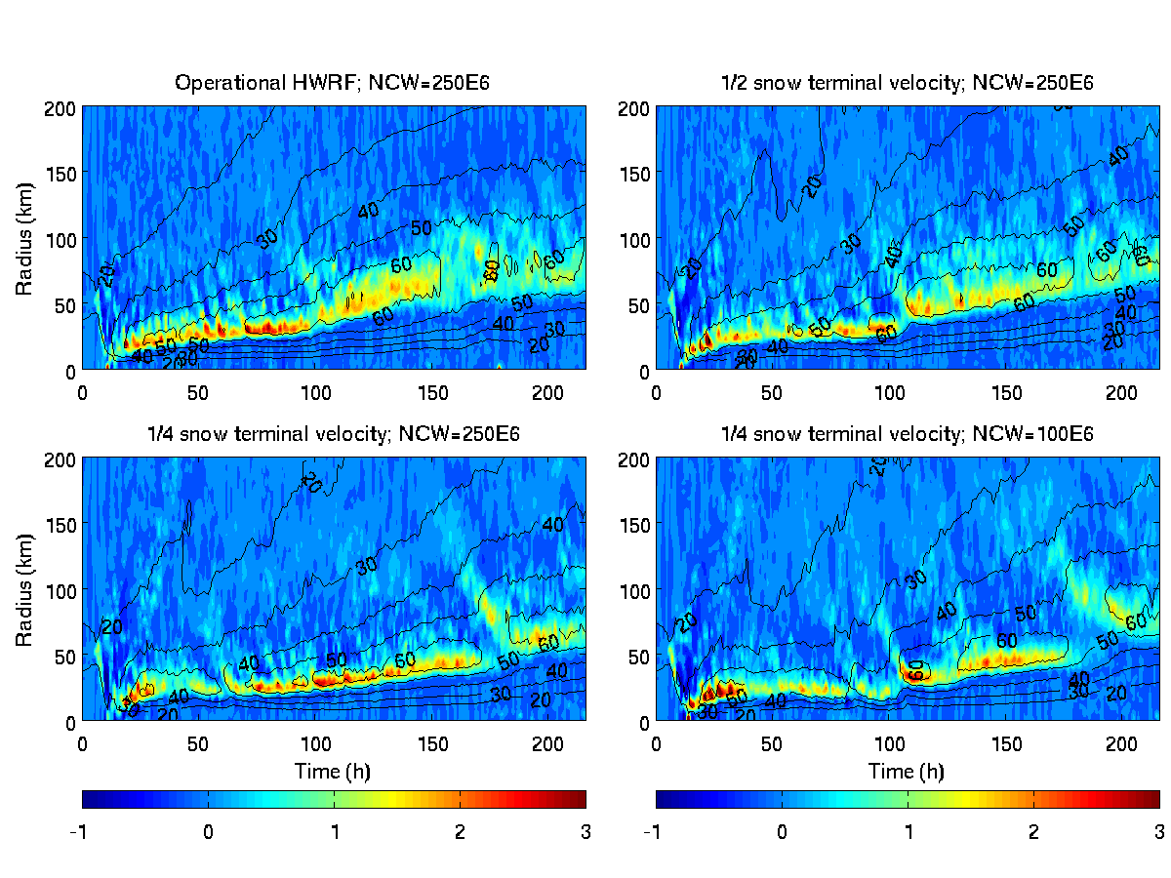
Sensitivity on snow terminal velocity and number of concentration of cloud droplet
15
Vertical velocity at 5 km (m/s, color shades); tangential wind at 1 km (m/s, black contours) in numerical experiments with different values of STV and NCW
Notes:
This slide shows a detailed tangential wind budget analysis averaged between 79 and 81 h. The budget equation basically tells us that the net tendency is the sum of the resolved advection terms by axisymmetric mean flow, advection terms by asymmetric eddy processes and subgrid scale terms parameterized by SGS schemes. The first plot is the net tangential wind tendency. We can see the positive and negative tendencies correspond well with the development of the secondary eyewall and the decay of the primary eyewall. The resolved tendency is positive in the boundary layer whereas the SGS tendency is negative. The net tendency is a small residual between the two large tendencies induced by the resolved and subgird scale processes. Note that the net tendency is multiplied by a factor of 10. Since the broadening of tangential wind and development of secondary wind maximum require a positive tendency, this result indicates that the resolved processes are the driving force for SEF and the SGS processes may be considered as a response to the changes induced by the resolved processes. Therefore, the resolved process is the key here. However, since the SGS tendency has a magnitude comparable to that of resolved tendency, which mainly comes from SGS vertical mixing, the SGS parameterizations can have a profound impact on the occurrence and course and ERC. More importantly, this figure shows the resolved positive tendency mainly comes from the advection by mean flow. The contribution from asymmetric eddy processes is small, note that it has been multiplied by a factor of 4, and it is generally negative in the boundary layer. This budget analysis simply tells us that advection term by axisymmetric mean flow is the key to understand the simulated ERC. This enable us to use the Sawyer-Eliassen equation to analyze the physical processes determining the wind tendency, because Sawyer-Eliassen equation is based on balanced axisymmetric framework and it can only be used to understand the symmetric processes.

Slide 16
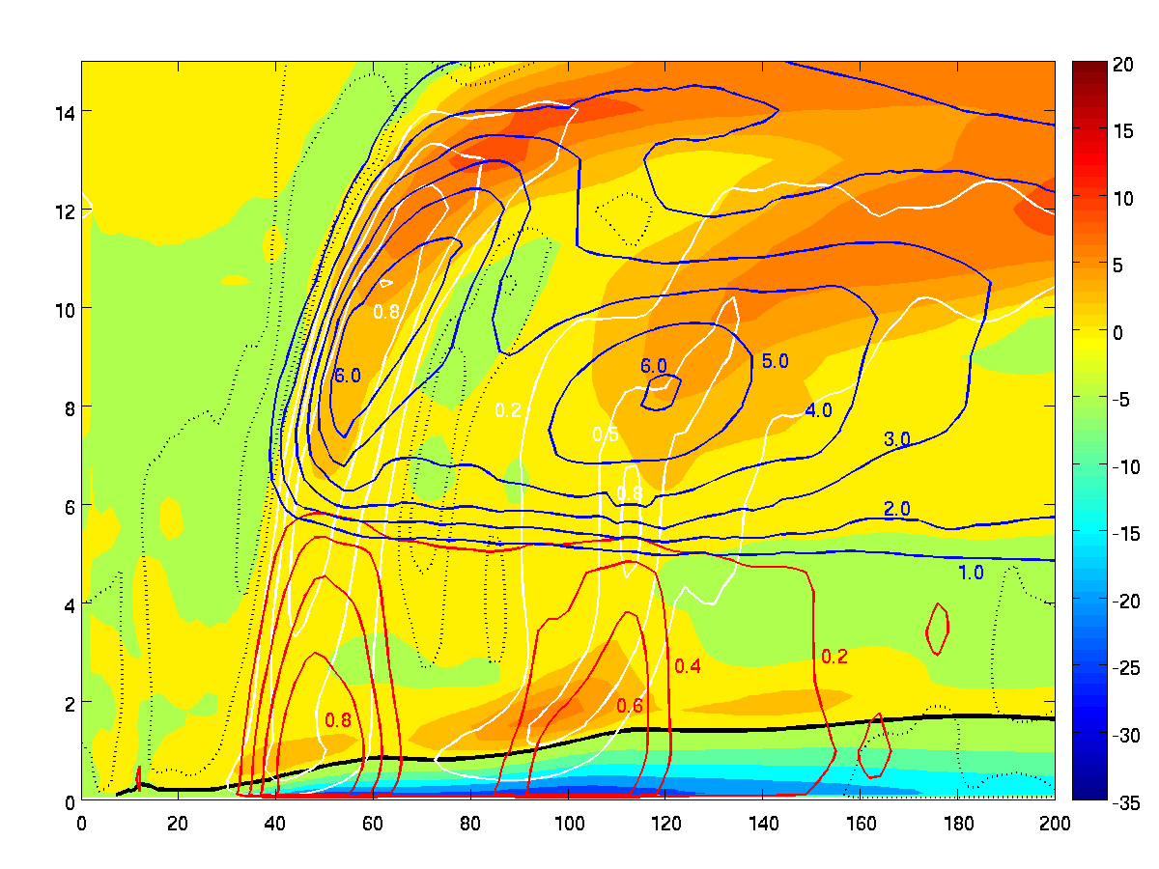
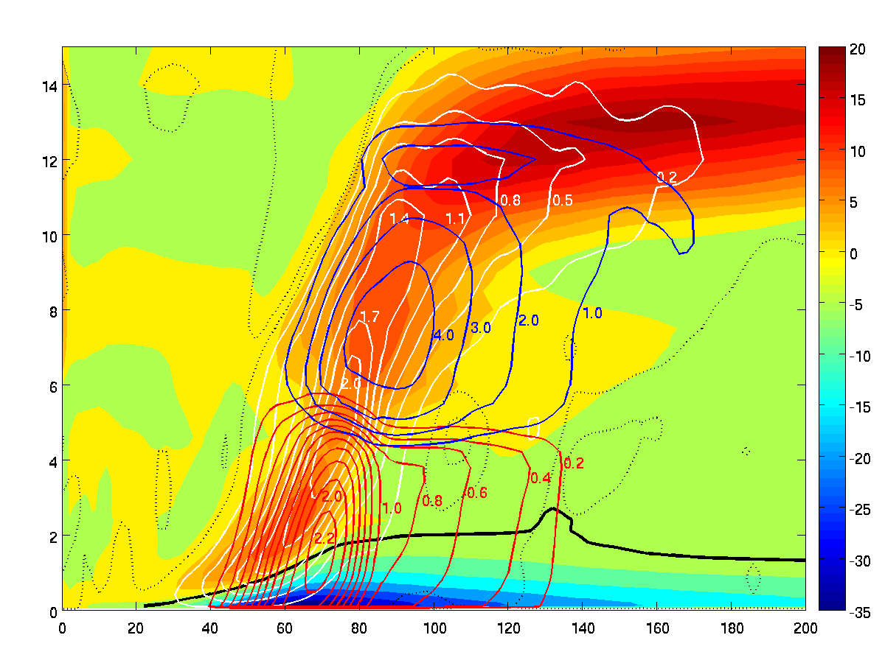
¼ STV; NCW=100E6 at 177th h
16
Height (km)
-0.1
Operational HWRF at 177th h
-0.001
Radius (km)
Height (km)
Radial velocity (m/s, color shades; black: zero); updraft (m/s, white contours); downdraft (m/s, dotted black); solid hydrometeor mixing ratio (g/kg, blue contours); rain water mixing ratio (g/kg, red contours) in experiments with HWRF operational microphysics and with ¼ STV and NCW=100E6.
-0.001
-0.001
-0.1
Radius (km)
Notes:
This slide shows a detailed tangential wind budget analysis averaged between 79 and 81 h. The budget equation basically tells us that the net tendency is the sum of the resolved advection terms by axisymmetric mean flow, advection terms by asymmetric eddy processes and subgrid scale terms parameterized by SGS schemes. The first plot is the net tangential wind tendency. We can see the positive and negative tendencies correspond well with the development of the secondary eyewall and the decay of the primary eyewall. The resolved tendency is positive in the boundary layer whereas the SGS tendency is negative. The net tendency is a small residual between the two large tendencies induced by the resolved and subgird scale processes. Note that the net tendency is multiplied by a factor of 10. Since the broadening of tangential wind and development of secondary wind maximum require a positive tendency, this result indicates that the resolved processes are the driving force for SEF and the SGS processes may be considered as a response to the changes induced by the resolved processes. Therefore, the resolved process is the key here. However, since the SGS tendency has a magnitude comparable to that of resolved tendency, which mainly comes from SGS vertical mixing, the SGS parameterizations can have a profound impact on the occurrence and course and ERC. More importantly, this figure shows the resolved positive tendency mainly comes from the advection by mean flow. The contribution from asymmetric eddy processes is small, note that it has been multiplied by a factor of 4, and it is generally negative in the boundary layer. This budget analysis simply tells us that advection term by axisymmetric mean flow is the key to understand the simulated ERC. This enable us to use the Sawyer-Eliassen equation to analyze the physical processes determining the wind tendency, because Sawyer-Eliassen equation is based on balanced axisymmetric framework and it can only be used to understand the symmetric processes.

Slide 17
17
Instantaneous cross-section of vertical velocity (ms^{-1,} color shades, black: zero), ice mixing ratio (red, 0.1, 2, 5gkg⁻¹), rain mixing ratio (white: 0.2, 2 ms⁻¹) at the 66th h in HWRF1.
Notes:
This slide shows a detailed tangential wind budget analysis averaged between 79 and 81 h. The budget equation basically tells us that the net tendency is the sum of the resolved advection terms by axisymmetric mean flow, advection terms by asymmetric eddy processes and subgrid scale terms parameterized by SGS schemes. The first plot is the net tangential wind tendency. We can see the positive and negative tendencies correspond well with the development of the secondary eyewall and the decay of the primary eyewall. The resolved tendency is positive in the boundary layer whereas the SGS tendency is negative. The net tendency is a small residual between the two large tendencies induced by the resolved and subgird scale processes. Note that the net tendency is multiplied by a factor of 10. Since the broadening of tangential wind and development of secondary wind maximum require a positive tendency, this result indicates that the resolved processes are the driving force for SEF and the SGS processes may be considered as a response to the changes induced by the resolved processes. Therefore, the resolved process is the key here. However, since the SGS tendency has a magnitude comparable to that of resolved tendency, which mainly comes from SGS vertical mixing, the SGS parameterizations can have a profound impact on the occurrence and course and ERC. More importantly, this figure shows the resolved positive tendency mainly comes from the advection by mean flow. The contribution from asymmetric eddy processes is small, note that it has been multiplied by a factor of 4, and it is generally negative in the boundary layer. This budget analysis simply tells us that advection term by axisymmetric mean flow is the key to understand the simulated ERC. This enable us to use the Sawyer-Eliassen equation to analyze the physical processes determining the wind tendency, because Sawyer-Eliassen equation is based on balanced axisymmetric framework and it can only be used to understand the symmetric processes.

Slide 18
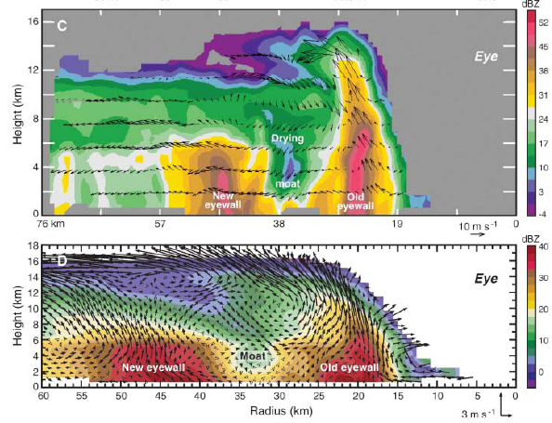
The idealized simulations show that the ice-phase microphysics and precipitation parameterization can have a profound impact on the processes governing SEF and ERC. However, the idealized simulation itself cannot answer if ERC should be or should not be generated for this particular initial setting of vortex.
18
ERC in Hurricane Rita (2005)
(a) Rita best track
(b)
7Z, 24
0Z, 24
Latitude
0Z, 23
18Z, 22
(c)
0Z, 22
0Z, 21
0Z, 20
Longitude
Reflectivity and transverse circulation at 1800-1820UTC, 22 Sept. (C): northwest cross-section. (D): comprehensive mean adopted from Houze et al. (2007)
Notes:
Here I am going to provide you with more evidence o support this positive feedback mechanism of SEF. This figure shows the time evolution of cloud water , rain water, relative humidity, equivalent potential temperature, low troposphere stability and surface buoyancy flux averaged over the radii of 50-80 km. As indicated by cloud water, mid-tropospheric convection existed long time before SEF. At about 60 h, weak shallow convection starts to develop possibly due to the convergence of radial inflow induced by the midtropospheric convection. Once sufficient shallow convection is initiated, its induced convergence of radial inflow and acceleration of tangential wind in the boundary layer can enhance surface evaporation to result in the increase of relative humidity and equivalent potential temperature, which favors the further development of convection. Note that in this particular case, the low tropospheric stability measured by the difference of potential temperature between 3km and 2km does not change much, indicating that the enhanced moist instability leading to SEF is mainly due to the increased low level moisture through the proposed positive feedback.

Slide 19
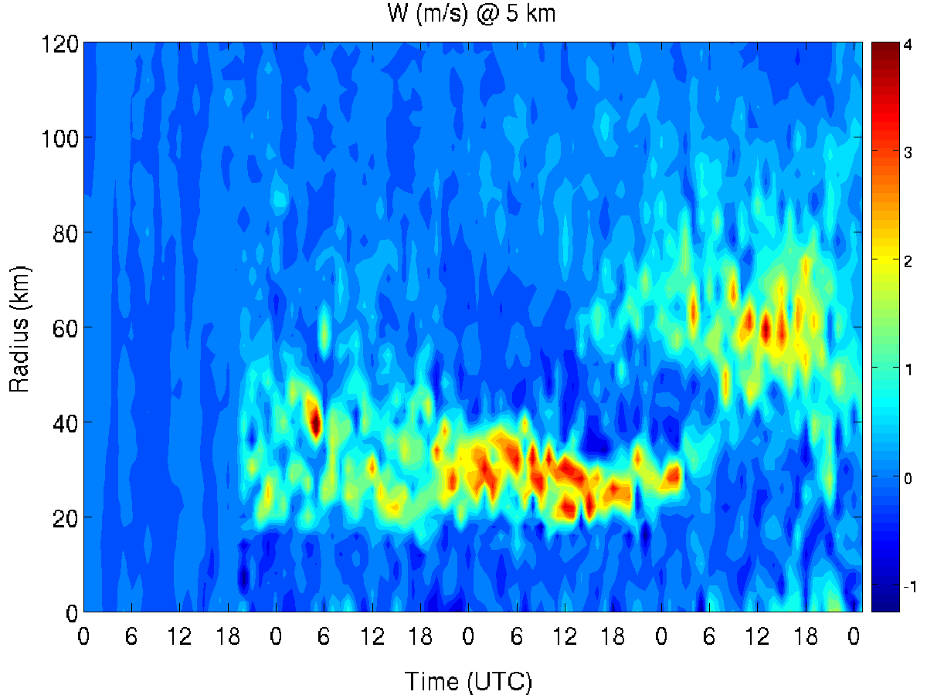
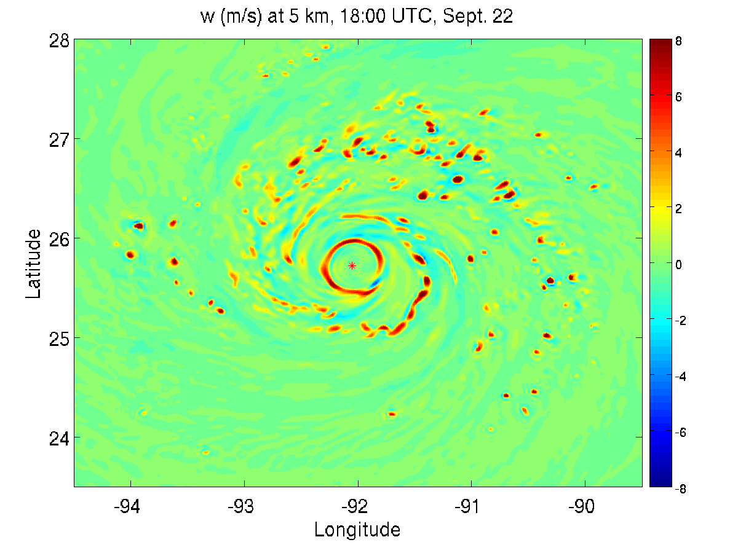
ERC of Rita simulated by WRF-ARW
19
Simulation starting at 00 Z, 20 Sept.
Grid-spacing: 18/6/2 km
Grid-mesh: 310, 184, 310
Vertical level: 47
GFS data
20
21
22
23
24
Thompson microphysics; RRTM(LW)/Dudhia(SW) radiation;
Kain-Fritch cumulus;
MYJ PBL and the associated surface layer parameterization.
Notes:
In summary, analyses using the tangential wind budget and Sawyer-Eliassen equation are performed to investigate the mechanisms underlying ERC. Tangential wind budget analysis indicates that the net tendency of tangential wind is a small residual resultant from a large cancellation between the tendencies induced by the resolved and sub-grid scale (SGS) processes. The broadening of tangential wind and development of secondary wind maximum is mainly due to axisymmetric advection by mean flow.
Sawyer-Eliassen equation is a powerful tool for studying ERC. The azimuthal-mean transverse circulation directly simulated by WRF can be well represented by the Sawyer-Eliassen diagnoses, and many aspects of SEF and ERC can be well explained in the balanced symmetric framework. The outer rainband heating plays a crucial role in governing the formation and the development of the secondary tangential wind maximum. The strength of outer rainband heating must reach a certain level relative to the eyewall heating to initiate and drive SEF and ERC. The study reveals a positive feedback among shallow convection, acceleration of tangential winds, and convergence of radial inflow in the boundary layer that leads to SEF and a mechanism for the demise of inner eyewall that involves the interaction between the transverse circulations induced by eyewall and outer rainband convection.

Slide 20
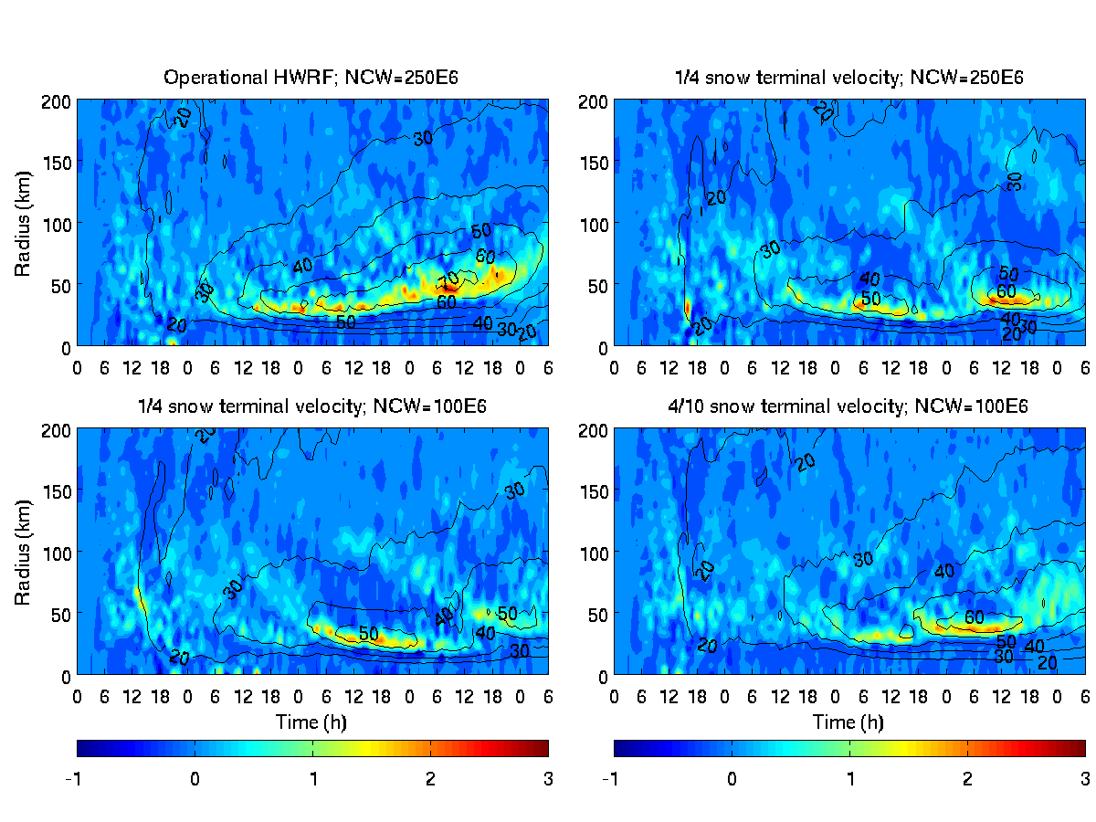
ERC of Rita simulated by HWRF
20
20
21
22
23
20
21
22
23
20
21
22
23
20
21
22
23
Time (UTC)
Time (UTC)
Vertical velocity at 5 km (m/s, color shades); tangential wind at 1 km (m/s, black contours) in numerical experiments with different values of STV and NCW
Notes:
To show the importance of low level convection, we removed the heating below 3 km and then examined the response of transverse circulation to such a change in forcing. The upper panel is for total rainband heating and the lower panel is for rainband heating only above 3 km. As you can see without low level convection the large positive tendency of tangential wind and convergence of radial inflow in the boundary layer nearly disappear. Therefore, low level convection plays a key role in SEF.

Slide 21
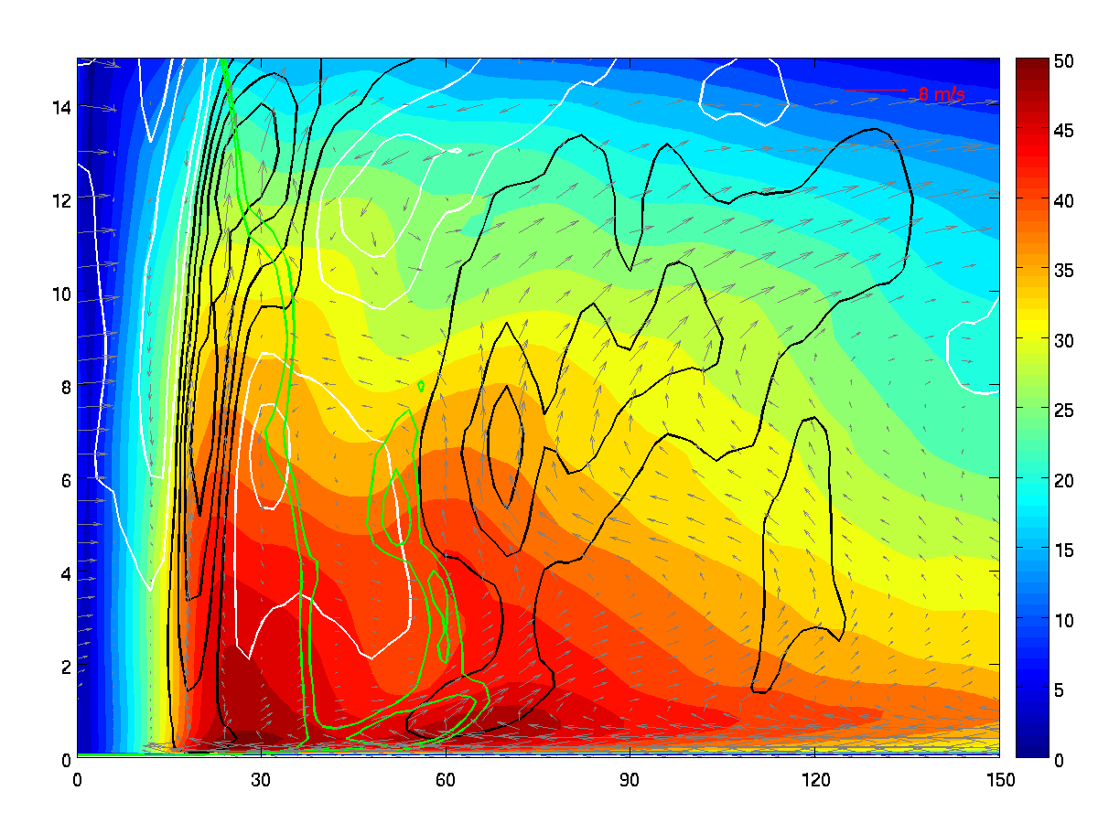
R-Z structure @ 10UTC August 23 (1/4 STV; NCCD=100E6)
21
Z-R structure of Rita double eyewalls in the HWRF experiment of ¼ STV and NCW=100E6
0.8
-0.2
0.2
-0.01
0.4
Height (km)
-0.01
0.6
0.8
1.0e-3
-0.2
0.2
0.6
1.0e-3
0.4
0.9e-3
0.2
Radius (km)
Azimuthal-mean tangential wind (color shades, ms⁻¹), relative vorticity (green, s⁻¹), updrafts (black, ms⁻¹), downdrafts (white, ms⁻¹) at 5:00 UTC 23 Sept.
Notes:
To understand the mechanism behind the demise of the primary eyewall, we use Sawyer-Eliassen diagnoses to examine the interaction between eyewall and rainband. The white contours in the upper panel are the subsidence induced by the outer rainband heating. As we can see, there is non-negligible subsidence right over the inner eyewall updraft. This confirms the findings of Willoughby et al. 1982. The inner eyewall starts to weaken well before the outer concentric eyewall forms. Apparently, the rainband induced subsidence is one cause for the weakeing of inner eyewall. The bottom panel shows the susbsidence induced by the inner eyewall heating. It is the leading cause for the formation of moat. The eyewall heating also induces fairly strong subsidence over the outer rainband. The question is why the outer rainband induced subsidence can inhibit the development of inner eyewall whereas the inner eyewall induced subsidence does not appear to have a significant impact on the development of outer rainbands. The answer lies in the radial flow induced by the heating.

Slide 22
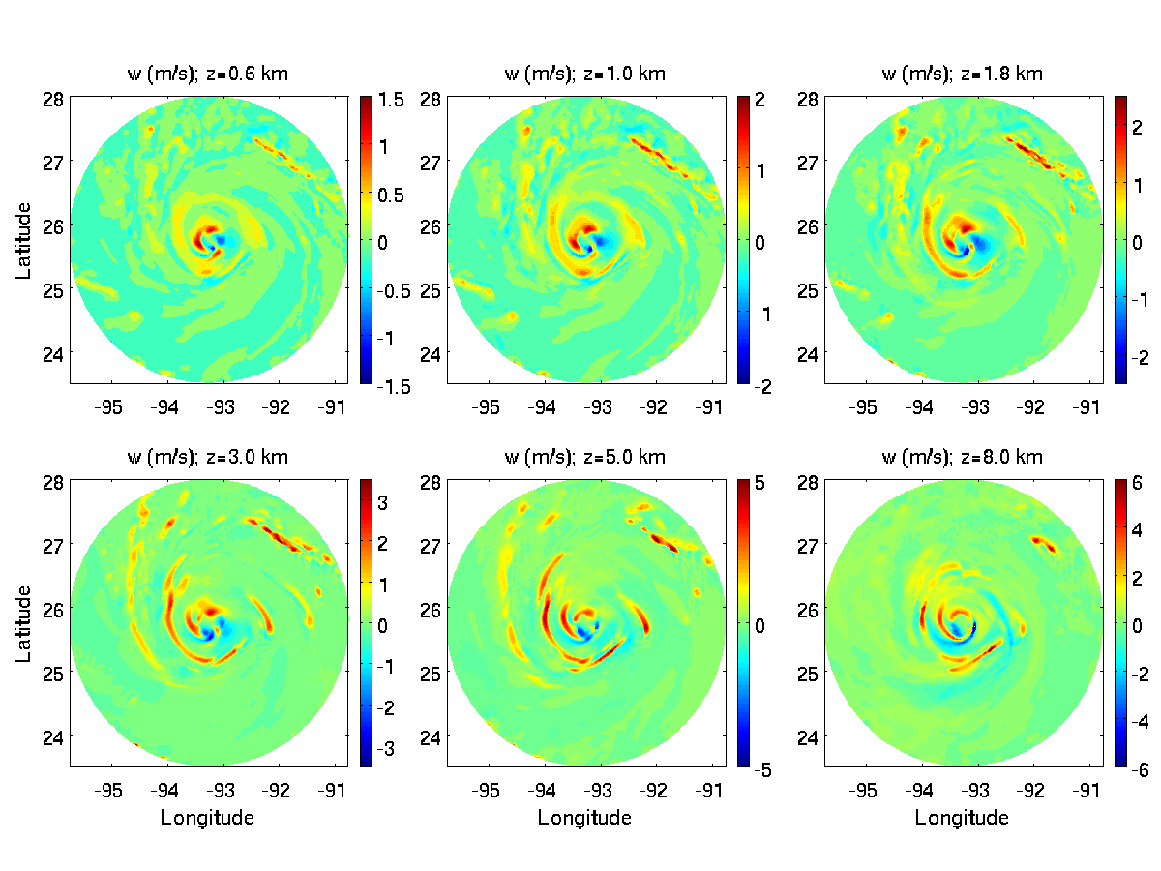
Vertical velocity (m/s) at different heights at 5:00UTC 23 Sept.
22
Notes:
In summary, analyses using the tangential wind budget and Sawyer-Eliassen equation are performed to investigate the mechanisms underlying ERC. Tangential wind budget analysis indicates that the net tendency of tangential wind is a small residual resultant from a large cancellation between the tendencies induced by the resolved and sub-grid scale (SGS) processes. The broadening of tangential wind and development of secondary wind maximum is mainly due to axisymmetric advection by mean flow.
Sawyer-Eliassen equation is a powerful tool for studying ERC. The azimuthal-mean transverse circulation directly simulated by WRF can be well represented by the Sawyer-Eliassen diagnoses, and many aspects of SEF and ERC can be well explained in the balanced symmetric framework. The outer rainband heating plays a crucial role in governing the formation and the development of the secondary tangential wind maximum. The strength of outer rainband heating must reach a certain level relative to the eyewall heating to initiate and drive SEF and ERC. The study reveals a positive feedback among shallow convection, acceleration of tangential winds, and convergence of radial inflow in the boundary layer that leads to SEF and a mechanism for the demise of inner eyewall that involves the interaction between the transverse circulations induced by eyewall and outer rainband convection.

Slide 23
Conclusion
23
1. Several reasons are responsible for HWRF with operational model physics not to generate eyewall replacement in the idealized simulations. These include (a) lack of outer rainband convection at the far radii from the eyewall, (b) excessive ice-phase hydrometeors in the eyewall, and (c) enhanced shallow convection between eyewall and outer rainbands, which all tend to prevent the formation of a persistent moat in-between eyewall and outer rainbands. Less evaporative cooling from precipitation in the outer rainband region is a likely reason for producing a more stable and dryer environment that inhibits the development of systematic convection at the far radii from the eyewall.
2. ERC in HWRF shows a substantial sensitivity to ice-phase microphysics and precipitation parameterization. Snow terminal velocity and number of concentration of cloud droplet pose a great impact on the occurrence and structure of concentric eyewalls. Large snow terminal velocity causes snow to fall quickly and melt in the low level, and hence, enhances the inner eyewall diabatic heating to result in a strong radial inflow in the BL. The persistent fuel supply into the eyewall by the strengthened BL inflow leads to a long-lived eyewall. On the other hand, small snow terminal velocity and small number of concentration of cloud droplet appear to favor the development of outer rainband convection leading to the formation of concentric outer eyewall.
Notes:
In summary, analyses using the tangential wind budget and Sawyer-Eliassen equation are performed to investigate the mechanisms underlying ERC. Tangential wind budget analysis indicates that the net tendency of tangential wind is a small residual resultant from a large cancellation between the tendencies induced by the resolved and sub-grid scale (SGS) processes. The broadening of tangential wind and development of secondary wind maximum is mainly due to axisymmetric advection by mean flow.
Sawyer-Eliassen equation is a powerful tool for studying ERC. The azimuthal-mean transverse circulation directly simulated by WRF can be well represented by the Sawyer-Eliassen diagnoses, and many aspects of SEF and ERC can be well explained in the balanced symmetric framework. The outer rainband heating plays a crucial role in governing the formation and the development of the secondary tangential wind maximum. The strength of outer rainband heating must reach a certain level relative to the eyewall heating to initiate and drive SEF and ERC. The study reveals a positive feedback among shallow convection, acceleration of tangential winds, and convergence of radial inflow in the boundary layer that leads to SEF and a mechanism for the demise of inner eyewall that involves the interaction between the transverse circulations induced by eyewall and outer rainband convection.

Slide 24
24
3. The challenge for operationally predicting ERC stems from the fact that SEF and ERC depend strongly on how SGS processes are parameterized and how they interact with each other and with the resolved processes. Changes in model physics are sufficient in kicking off and driving the feedback in different directions, leading the storm to evolve along a totally different pathway.
Remark
1. All parameterization schemes tested in this study are widely used in numerical simulations and some of them have been extensively evaluated in different conditions as individual schemes. However, the complicated sensitivity of ERC to these schemes suggests that the interaction between schemes and the feedback between resolved and parameterized processes are far from well understood.
2. The modification of STV and NCW in our experiments is only for the purpose of demonstrating the importance of microphysics to ERC simulations in HWRF. It should not be interpreted as a way of tuning parameterizations. However, it suggests that ice-phase microphysics and autoconversion/accretion parameterization are important to ERC simulations in HWRF.
Notes:
In summary, analyses using the tangential wind budget and Sawyer-Eliassen equation are performed to investigate the mechanisms underlying ERC. Tangential wind budget analysis indicates that the net tendency of tangential wind is a small residual resultant from a large cancellation between the tendencies induced by the resolved and sub-grid scale (SGS) processes. The broadening of tangential wind and development of secondary wind maximum is mainly due to axisymmetric advection by mean flow.
Sawyer-Eliassen equation is a powerful tool for studying ERC. The azimuthal-mean transverse circulation directly simulated by WRF can be well represented by the Sawyer-Eliassen diagnoses, and many aspects of SEF and ERC can be well explained in the balanced symmetric framework. The outer rainband heating plays a crucial role in governing the formation and the development of the secondary tangential wind maximum. The strength of outer rainband heating must reach a certain level relative to the eyewall heating to initiate and drive SEF and ERC. The study reveals a positive feedback among shallow convection, acceleration of tangential winds, and convergence of radial inflow in the boundary layer that leads to SEF and a mechanism for the demise of inner eyewall that involves the interaction between the transverse circulations induced by eyewall and outer rainband convection.

