Slide 1
Issues with ICLOUD3
DTC
Code used: https://svn-dtc-hwrf.cgd.ucar.edu/tags/HWRF_DTC_physbaseline2015 with Updated Thompson and radiation driver code.

Slide 2
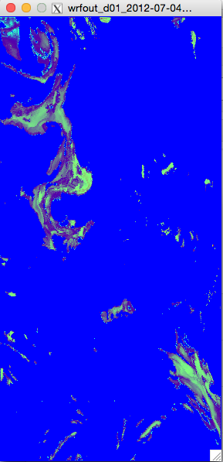
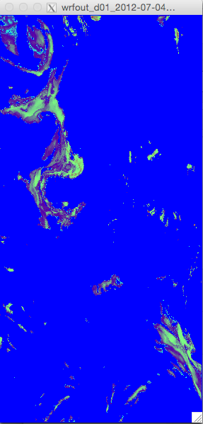
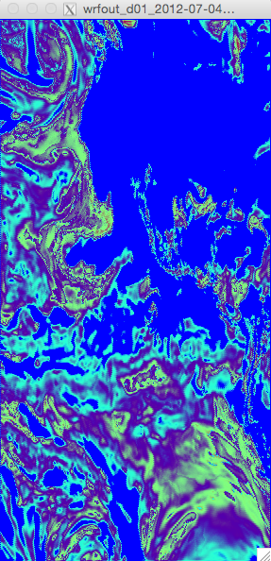
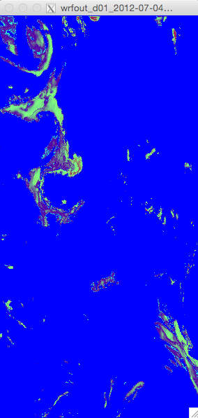
Ferrier-Aligo 6 min output QCLOUD Level 17 ICLOUD=3
T=6 min
T=12 min
T=18 min
T=24 min
Notes:
the temporary value of QC (and QI) was overwriting the actual microphysics value - just filling in the partial cloudiness areas at the times of the radiation calls. Non-radiation timesteps didn't see the problem

Slide 3
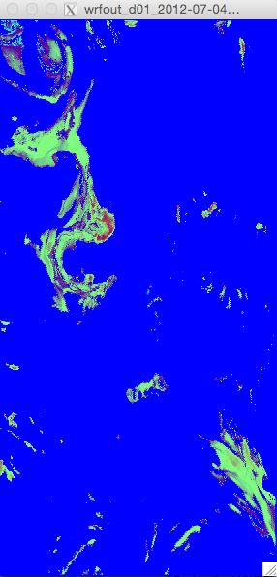
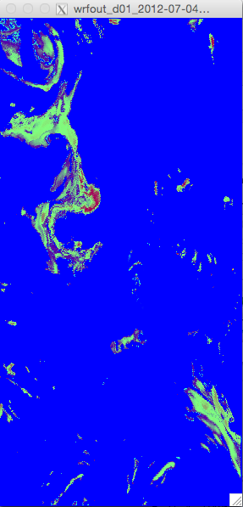
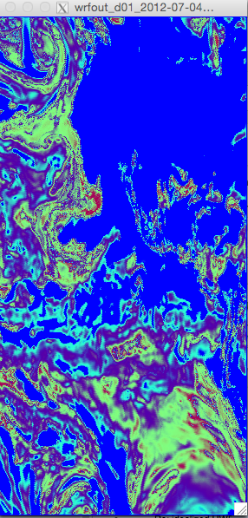
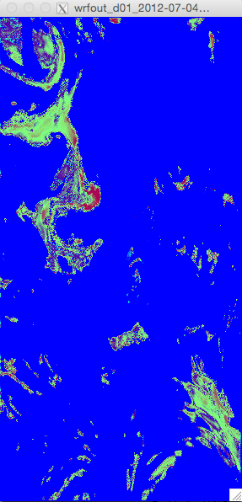
Thompson 6 min output QCLOUD Level 17 ICLOUD=3
T=6 min
T=12 min
T=18 min
T=24 min
Notes:
Same issues with Thompson

Slide 4
Ferrier-Aligo 6 min output QCLOUD Level 17 ICLOUD=1
T=6 min
T=12 min
T=18 min
T=24 min

Slide 5
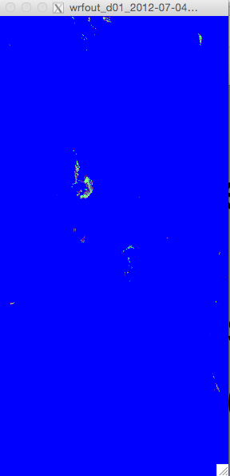
Thompson 6 min output QCLOUD Level 17 ICLOUD=1
T=6 min
T=12 min
T=18 min
T=24 min

Slide 6
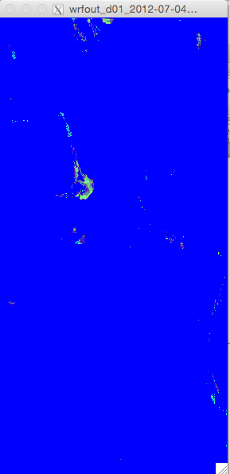
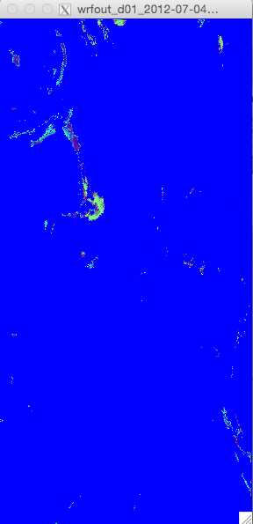
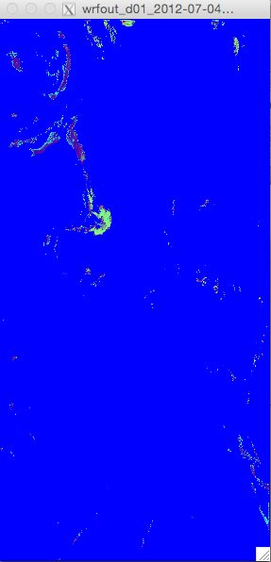
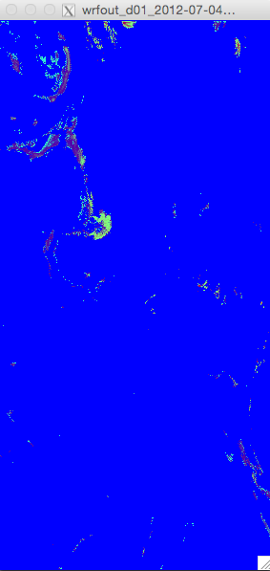
Ferrier-Aligo 6 min output QCLOUD Level 17 ICLOUD=3 BUG FIX
T=6 min
T=12 min
T=18 min
T=24 min
Notes:
Added logic responsible for resetting the cloud water (and ice) back to their prior values

Slide 7
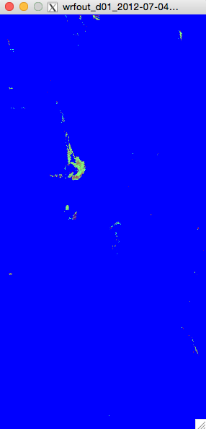
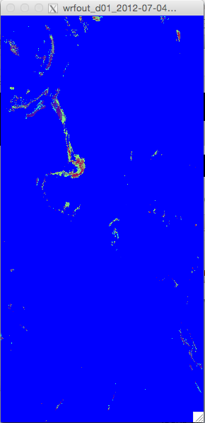
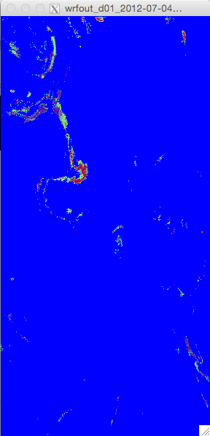
Thompson 6 min output QCLOUD Level 17 ICLOUD=3 BUG FIX
T=6 min
T=12 min
T=18 min
T=24 min
Notes:
Added logic responsible for resetting the cloud water (and ice) back to their prior values

Slide 8
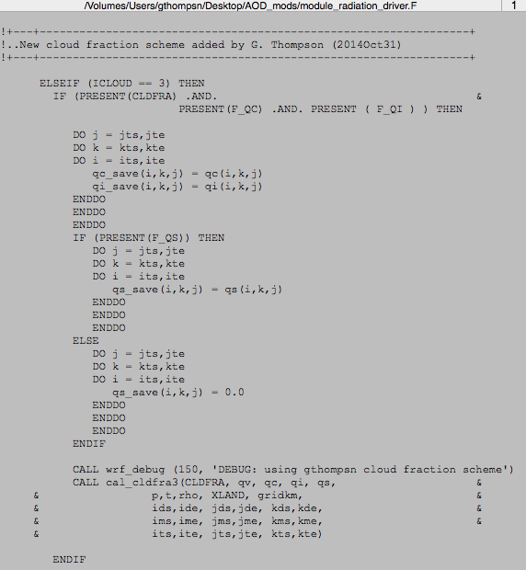
New icloud=3 option
Before calling fractional cloudiness scheme, grab a copy of the microphysics-only data values, because the actual Qc, Qi, and Qs will be modified internally by the Cal_CldFra3 subroutine.

Slide 9
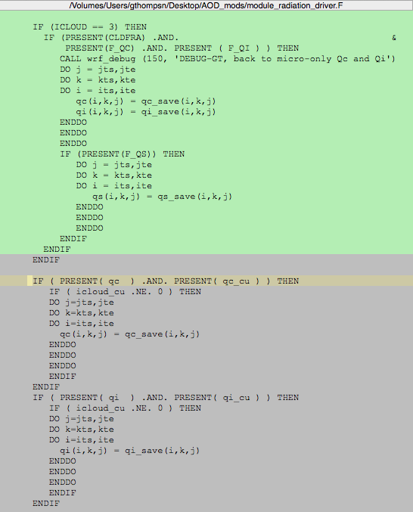
BUG FIX …
The resetting back to microphysics-only values was not occurring with icloud=3 option (unless shallow cumulus scheme was also enabled)

