Slide 1
Challenges and Benefits of Assimilating Global-Hawk-based Data from Tropical Cyclones
Jason Sippel
NASA GSFC / GESTAR / MSU

Slide 2
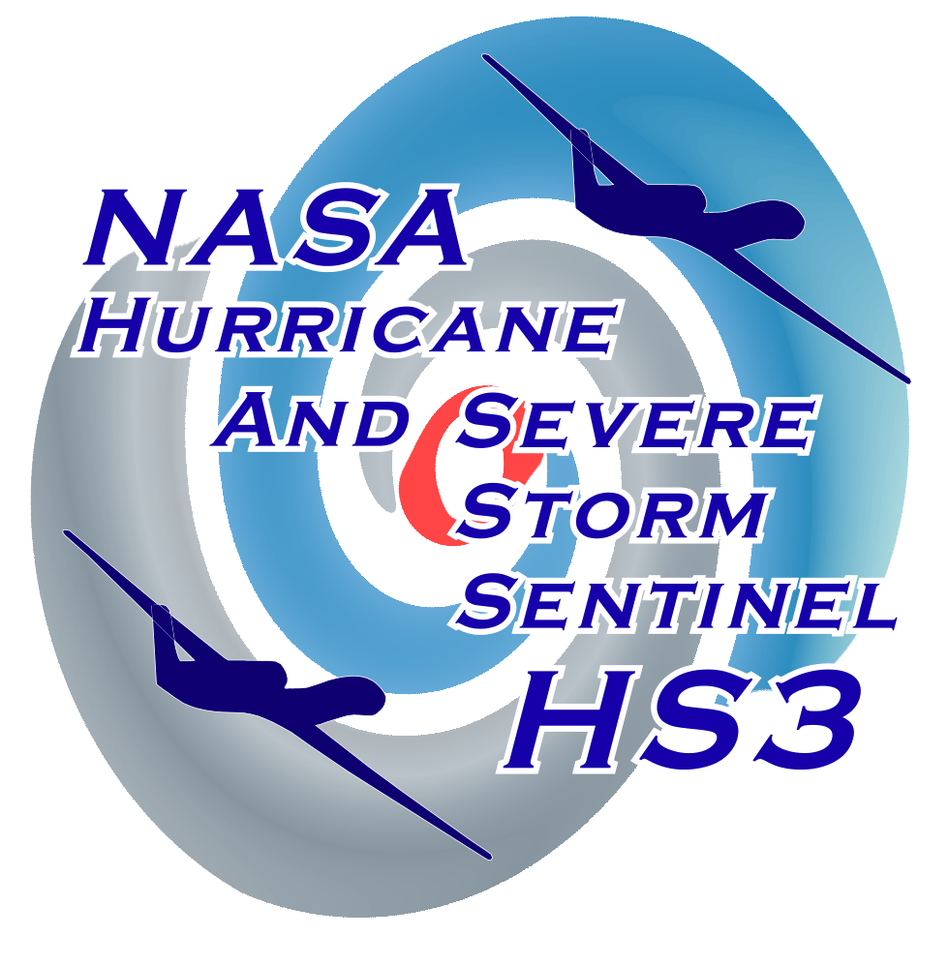
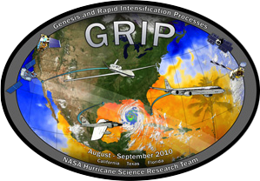
Motivating Question:
To what extent can unmanned aircraft systems (UAS) be used to improve analyses and forecasts of tropical cyclones?
An answer (or beginning of one) is now possible thanks to two recent NASA experiments.

Slide 3
Outline
Genesis and Rapid Intensification Processes (GRIP) experiment
Hurricane and Severe Storm Sentinel (HS3) experiment
Single-instrument OSSE experiments
Single-instrument real-data experiments
Multi-instrument real-data experiments

Slide 4
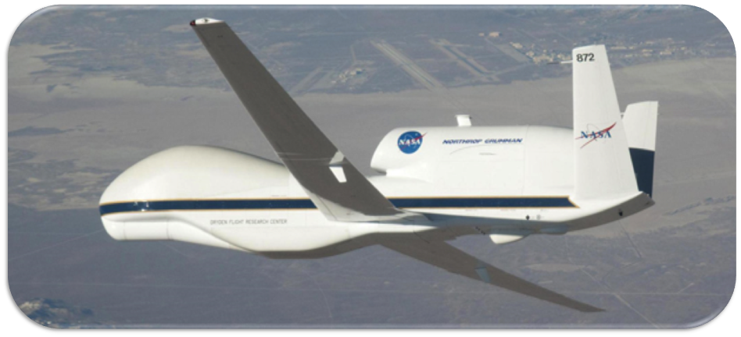
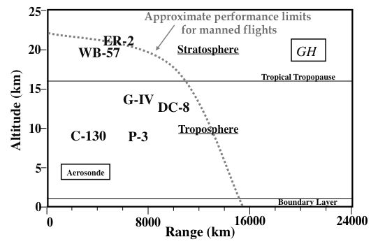
Genesis and Rapid Intensification Processes Experiment (GRIP): 2010
Goal: Understand TC formation & intensity change
Focus: Apply new technologies
  First use of the Global Hawk for hurricanes
  Several new instruments
Bonus: Coordination with PREDICT (NSF) and IFEX (NOAA) experiments
Global Hawk

Slide 5
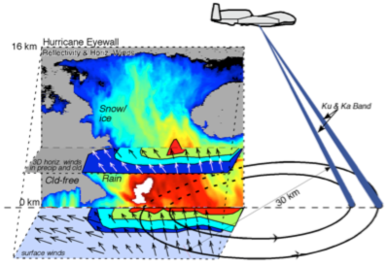
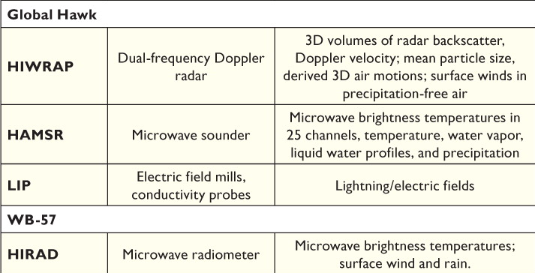
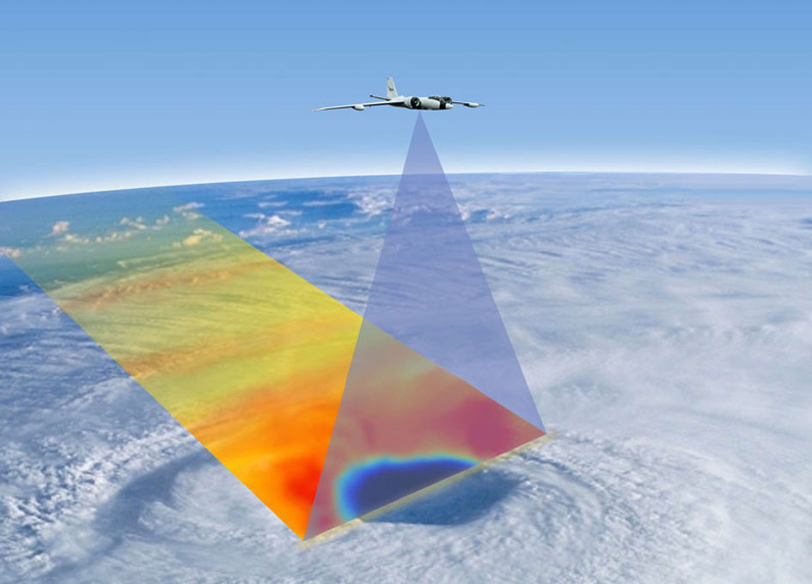
Genesis and Rapid Intensification Processes Experiment (GRIP): 2010
Above: GRIP high-altitude aircraft and instruments
Right: (top) HIWRAP and (bottom) HIRAD are potentially most useful for hurricane data assimilation

Slide 6
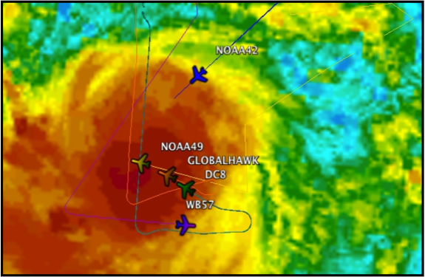
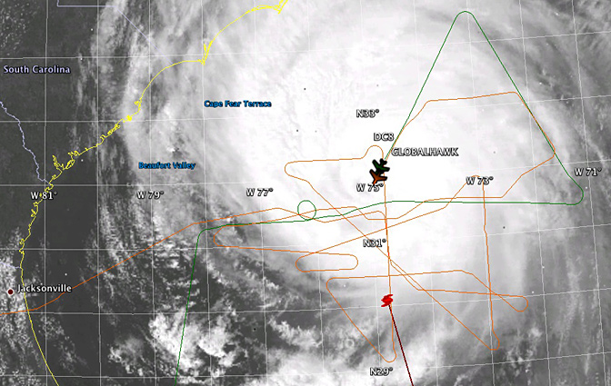
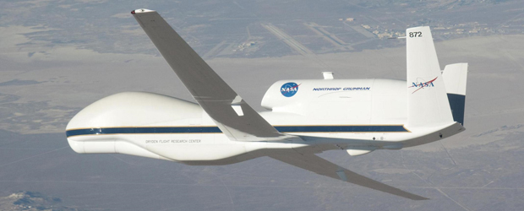
Genesis and Rapid Intensification Processes Experiment (GRIP): 2010
Hurricane Karl
  Global Hawk made 20 eye overpasses during RI
  Five aircraft took observations simultaneously
  Unprecedented multi-day observations in coordination with PREDICT and IFEX
Successful missions with Hurricane Earl and TS Matthew
Karl: NASA RTMM feed

Slide 7
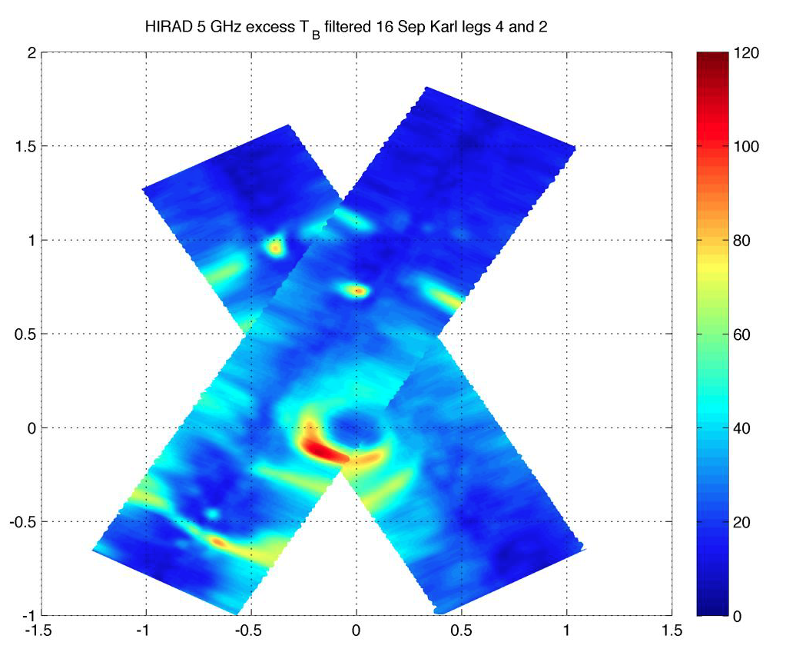
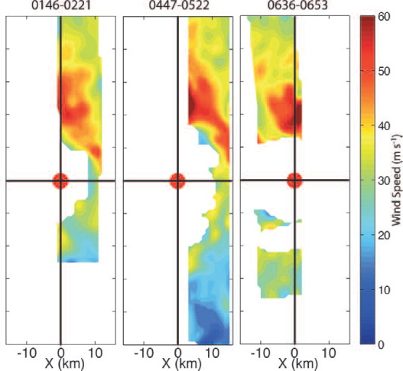
Genesis and Rapid Intensification Processes Experiment (GRIP): 2010
HIRAD Tb from Hurricane Karl, used for retrieving wind speeds
HIWRAP-derived 3-km wind speeds from Karl
Some data from GRIP (Braun et al 2013)

Slide 8
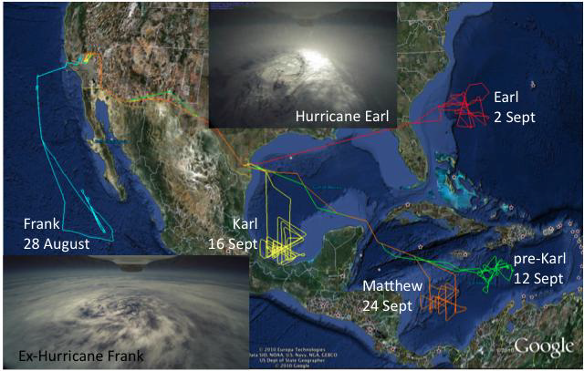
Genesis and Rapid Intensification Processes Experiment (GRIP): 2010
Global Hawk flight tracks during GRIP: Braun et al. (2013)

Slide 9
Outline
Genesis and Rapid Intensification Processes (GRIP) experiment
Hurricane and Severe Storm Sentinel (HS3) experiment
Single-instrument OSSE experiments
Single-instrument real-data experiments
Multi-instrument real-data experiments

Slide 10
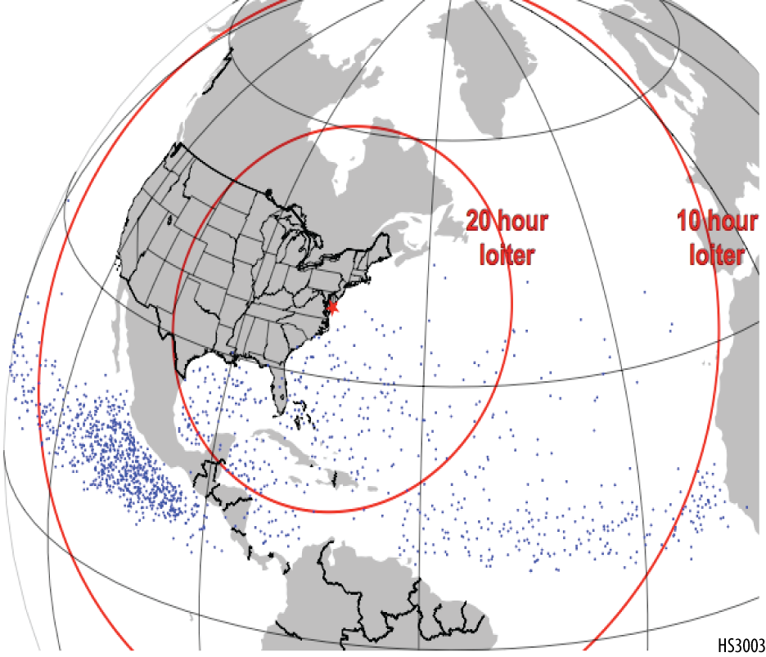
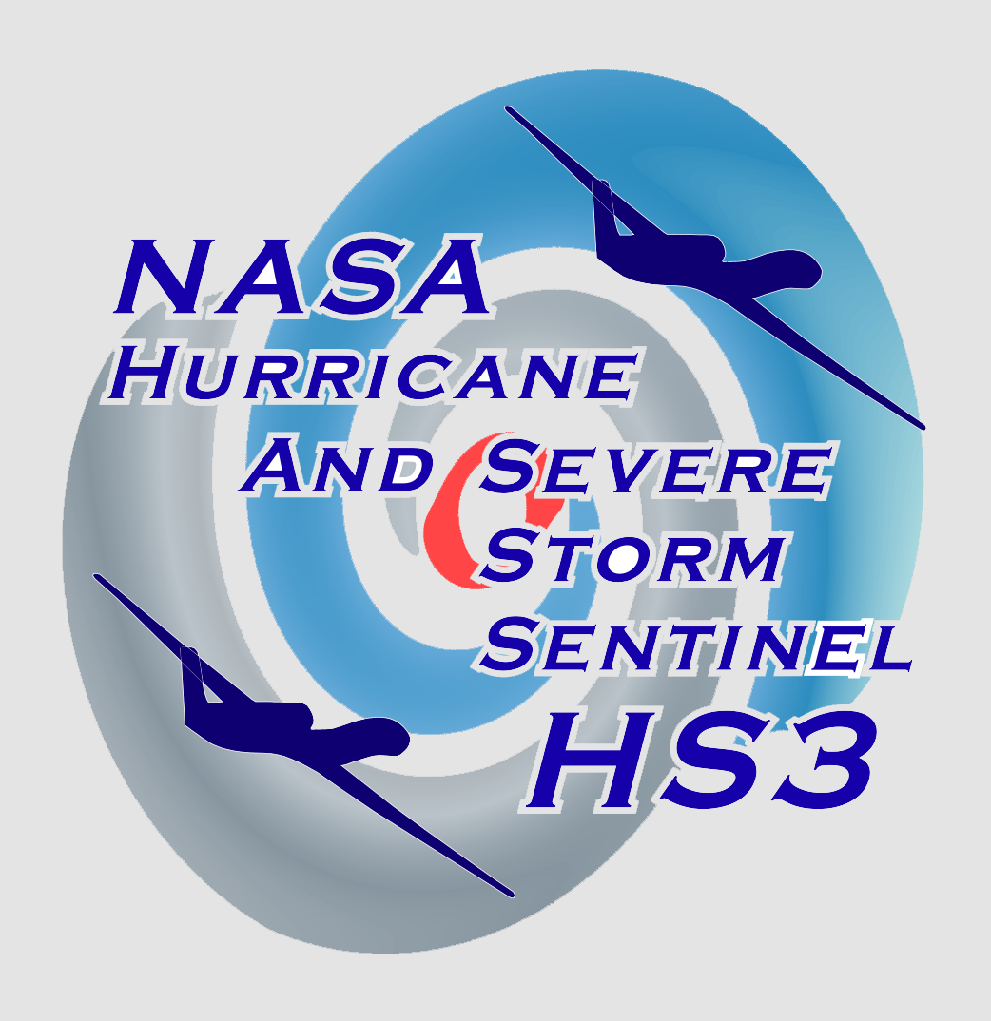
Hurricane and Severe Storm Sentinel Experiment (HS3): 2012-2014
Goal: Better understand TC formation and intensity change
Focus: Use ‘Environmental’ and ‘Over-Storm’ Global Hawks with new instruments flying from US East Coast
16 h
loiter
6 h
loiter
Genesis locations and range rings (assuming 26-h flights)

Slide 11
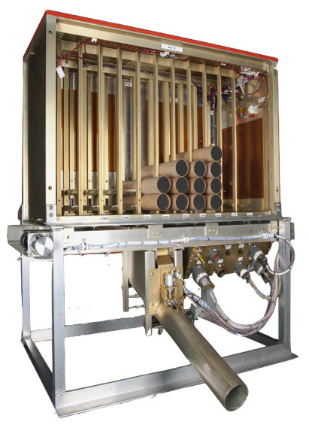
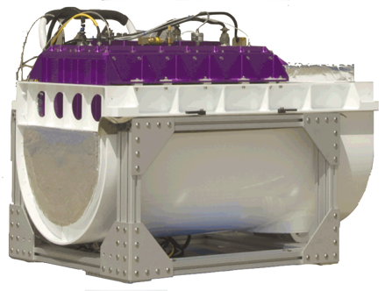
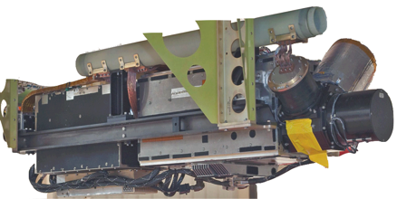
Hurricane and Severe Storm Sentinel Experiment (HS3): 2012-2014
“Environmental” Global Hawk Payload
Scanning High Resolution Infrared Sounder (S-HIS)
Measurements: Microwave retrieval of temperature, water vapor vertical profiles
Airborne Vertical Atmospheric Profiling System (AVAPS)
Measurements: Up to 89 dropsondes measuring temperature, pressure, wind, and humidity.
Cloud Physics Lidar (CPL)
Measurements: Cloud structure and depth

Slide 12
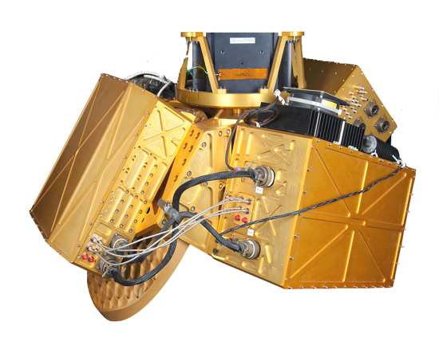
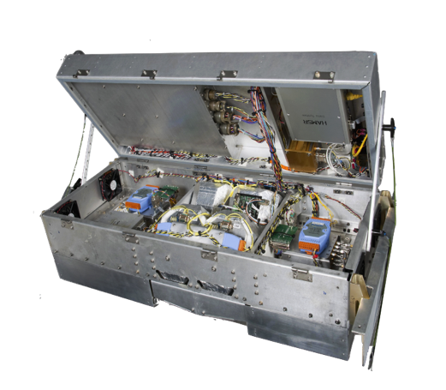
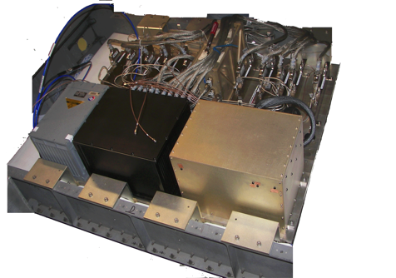
Hurricane and Severe Storm Sentinel Experiment (HS3): 2012-2014
“Over-Storm” Global Hawk Payload
Hurricane Imaging Radiometer (HIRAD)
Measurements: Microwave retrieval of wind speed and rain-rate retrievals over 60-km wide swaths
High Altitude Imaging Wind and Rain Airborne Profiler (HIWRAP)
Measurements: Doppler velocity and reflectivity
High Altitude Monolithic Microwave integrated Circuit Sounding Radiometer (HAMSR)
Measurements: Microwave retrieval of temperature, water vapor, and cloud liquid water

Slide 13
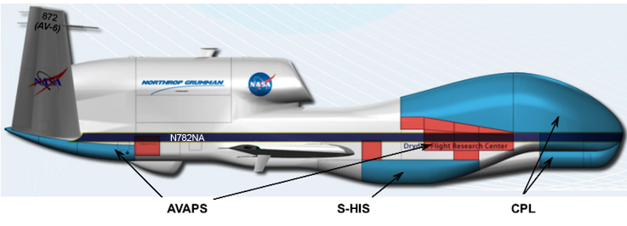
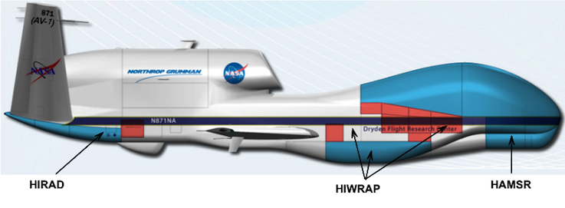
Hurricane and Severe Storm Sentinel Experiment (HS3): 2012-2014
The “Environmental” GH
The “Over-Storm” GH

Slide 14
Hurricane and Severe Storm Sentinel Experiment (HS3): 2012-2014
The “Environmental” GH
Challenge: Unfortunately, technical issues generally prevented the over-storm Global Hawk from flying during HS3. Thus, any experimentation for “over-storm” data assimilation purposes must rely on available GRIP data.

Slide 15
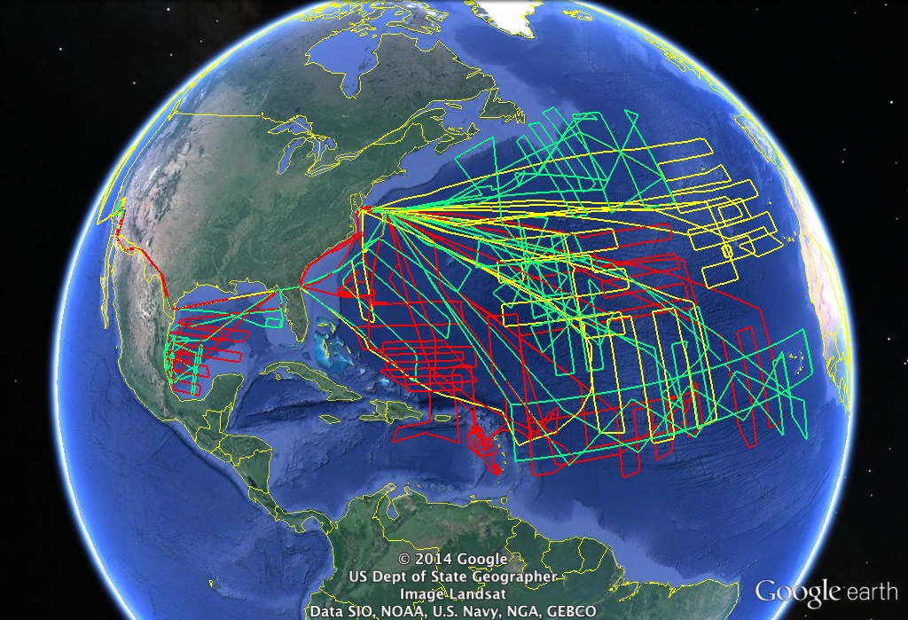
Hurricane and Severe Storm Sentinel Experiment (HS3): 2012-2014
Despite aircraft issues, good data was to be had…

Slide 16
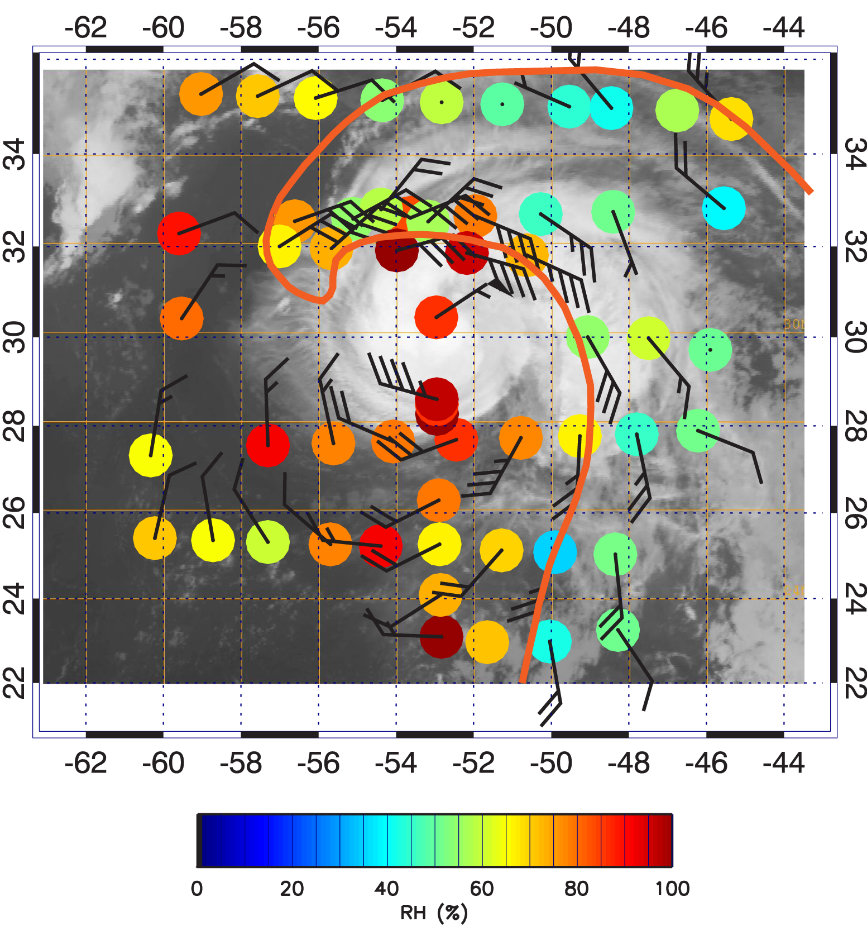
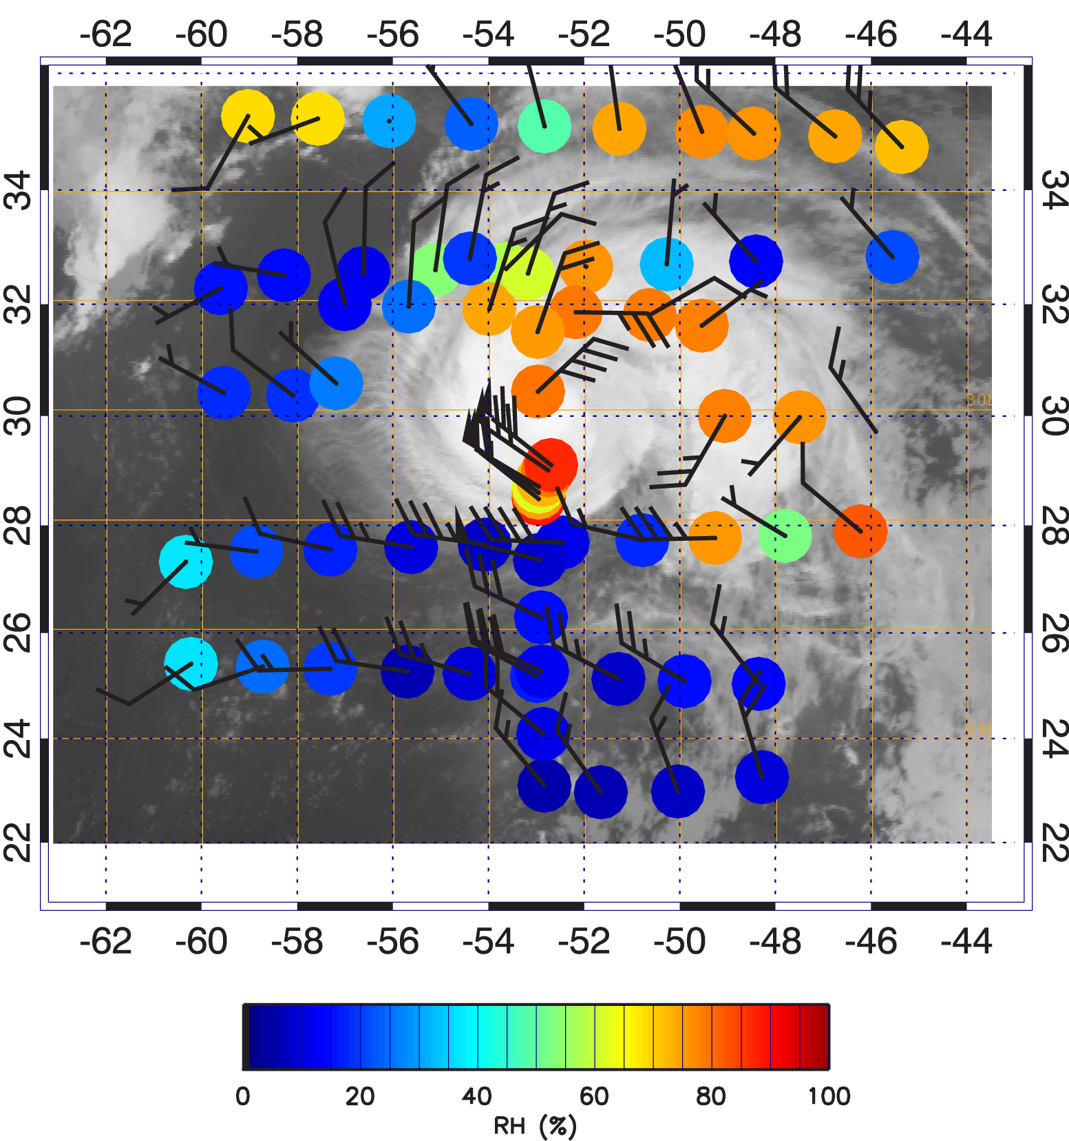
Hurricane and Severe Storm Sentinel Experiment (HS3): 2012-2014
SAL boundary
800-hPa RH
400-hPa RH
Example HS3 dropsonde data from Hurricane Nadine ( Sept. 14-15 2012)
Notes:
This slide shows results from the second Nadine flight. Both images show dropsonde derived relative humidity and winds for lower (left image) and middle (right image) levels. Warmer colors indicate moist air while colder colors represent drier air. At low levels, the approximate boundary of Saharan air is indicated by the dark orange line. The image shows that Saharan air was located to the east and north of the rain bands within Nadine but did not extend into its inner-core region. At higher levels, very dry air was found encroaching on the storm on its western and southern sides and appeared to be impacting the storm's ability to intensify as a result of strong vertical wind shear.

Slide 17
Summary of Experiments and Data
Recent NASA HS3 and GRIP Experiments offer a unique opportunity to explore the impact upon hurricane forecasts of assimilating data from new sources
Data from high-altitude and/or unmanned aircraft include Doppler velocity, microwave retrievals of surface wind speeds, temperature, and moisture, and dropsonde data
Unmanned aircraft offer unprecedented sampling capabilities, though challenges remain

Slide 18
Outline
Genesis and Rapid Intensification Processes (GRIP) experiment
Hurricane and Severe Storm Sentinel (HS3) experiment
Single-instrument OSSE experiments
Single-instrument real-data experiments
Multi-instrument real-data experiments

Slide 19
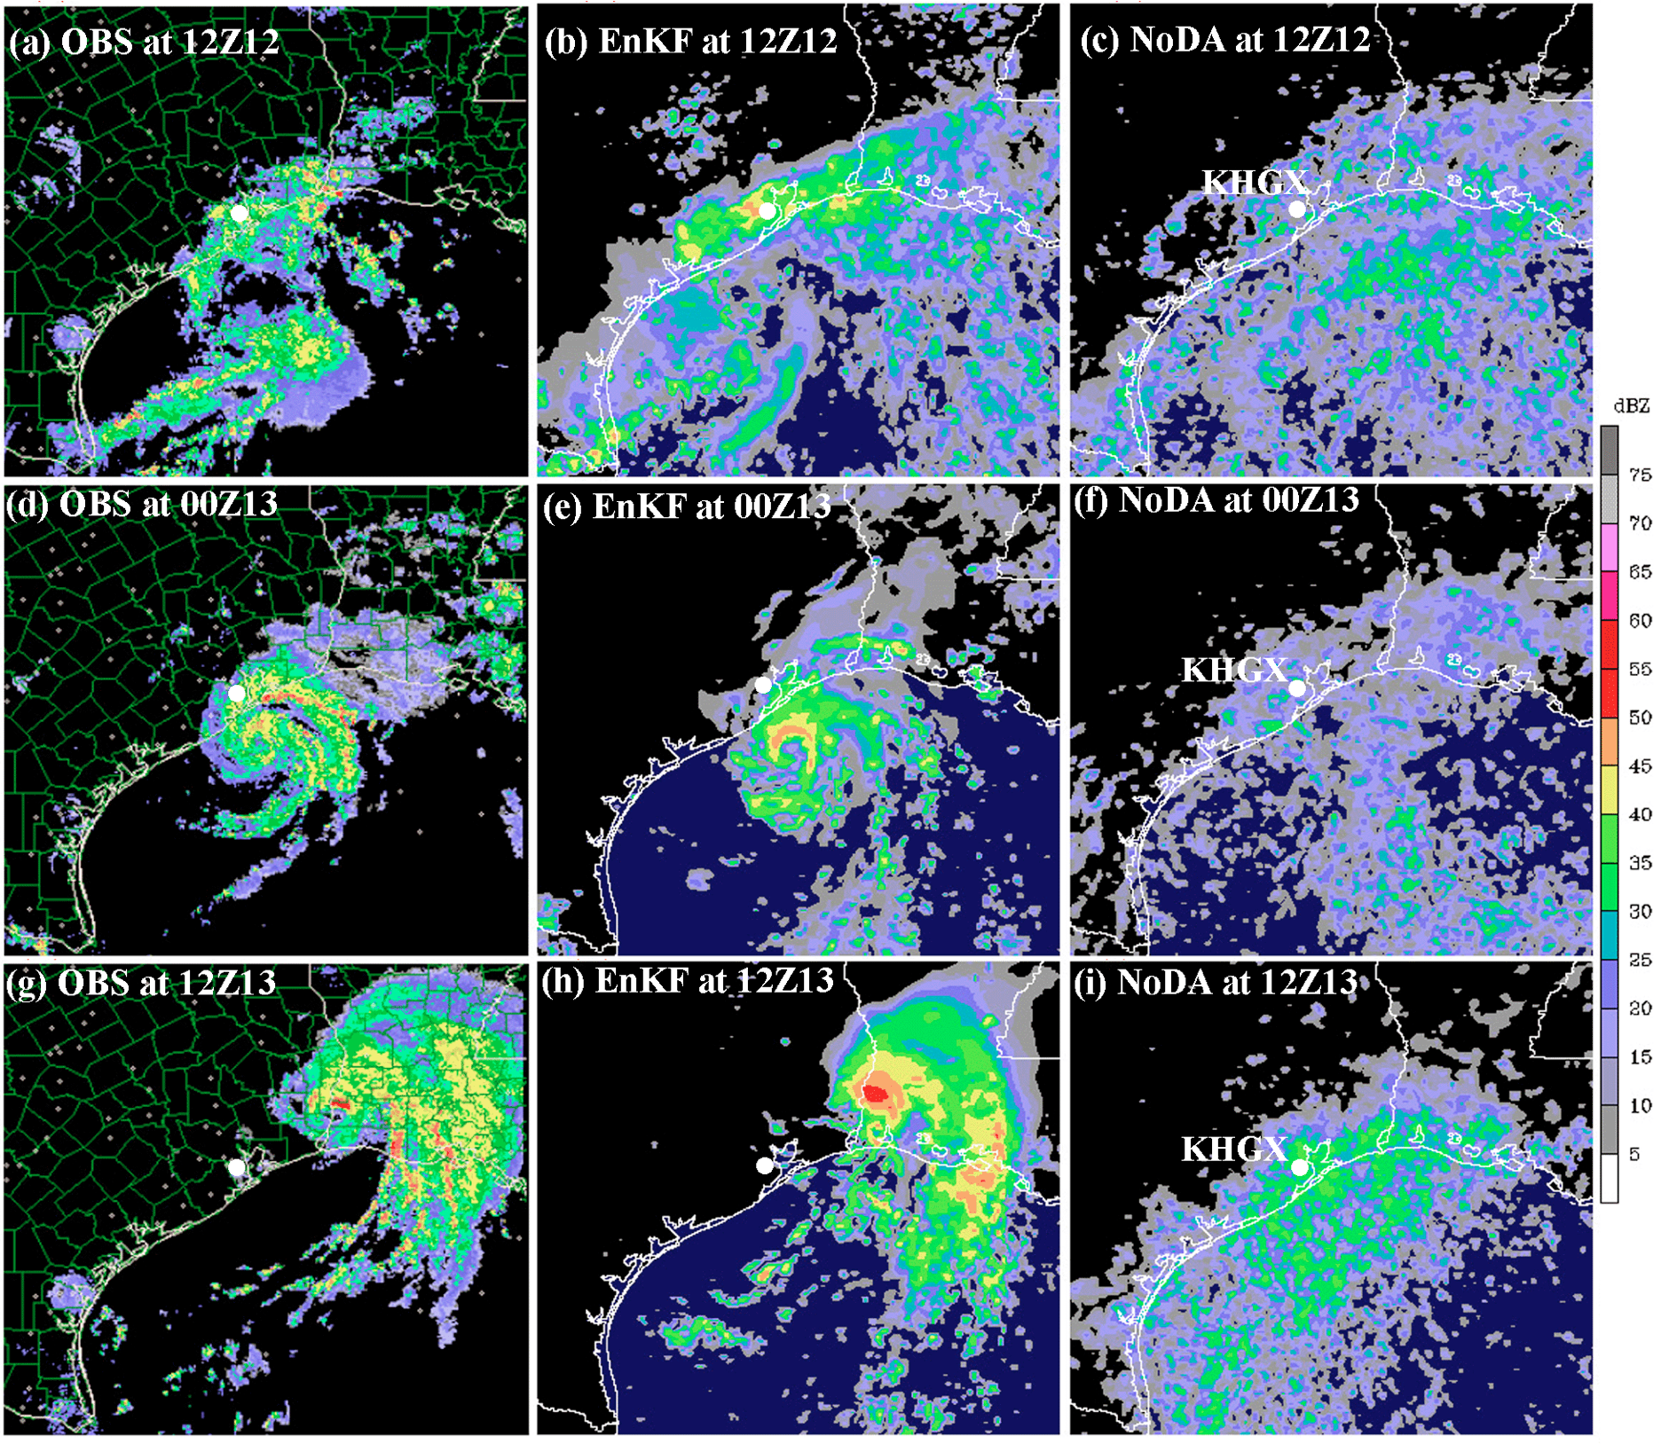
Single-instrument OSSE: Hurricane Karl
Past success with Vr DA (e.g., with 88-D and P-3 data) makes HIWRAP Vr very interesting
Look at Hurricane Karl from GRIP
OSSE results can give guidance on what to expect from real DA
Observed dBZ
Analyzed dBZ
Observed and EnKF-analyzed reflectivity in Hurricane Humberto after assimilating WSR-88D Vr

Slide 20
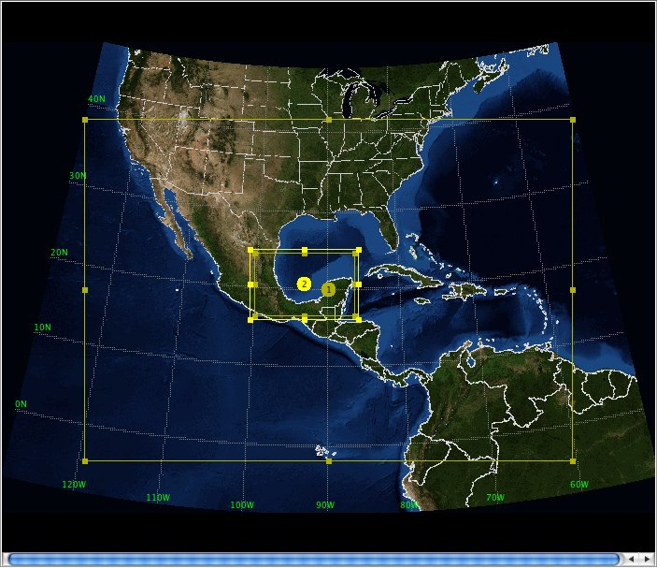
Single-instrument OSSE: Hurricane Karl
WRF-EnKF from Zhang et al. (2009) with covariance relaxation
WRF-ARW V3.1.1, 27/9/3 km
30-member ensemble, IC/BCs from WRF-VAR + GFS
Ensemble integrated 12 h to generate mesoscale covariance
Model domains

Slide 21
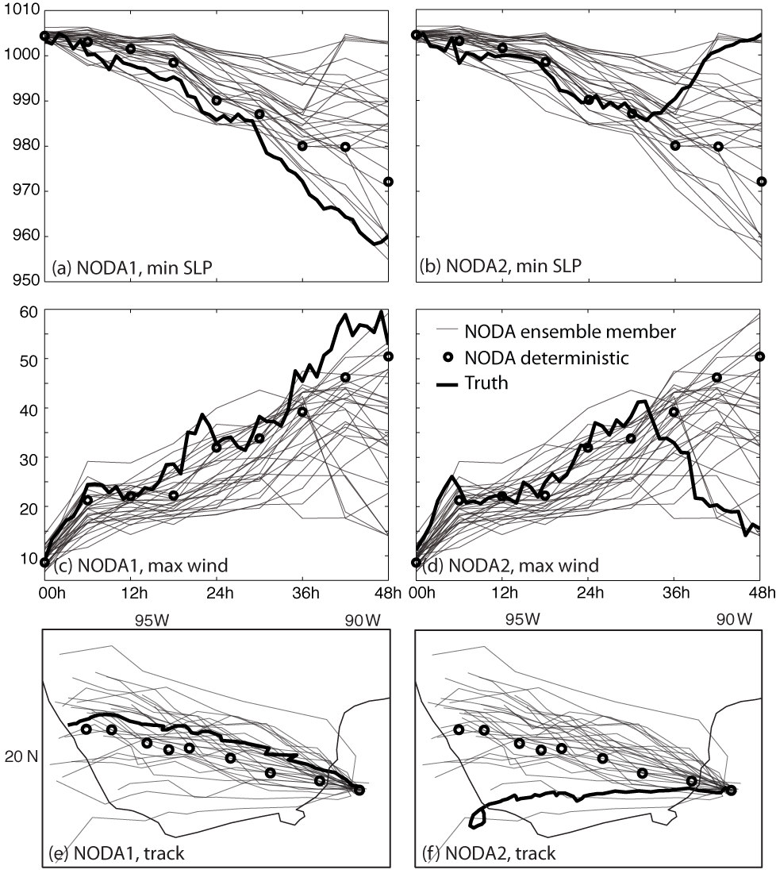
Single-instrument OSSE: Hurricane Karl
‘Truth’ realizations selected to test EnKF performance in face of:
Small error of the prior: How much improvement does the EnKF offer when the forecast is already pretty good? (NODA1)
Large error of the prior: How well can the EnKF correct when the truth is unlike most of the prior? (NODA2)
‘Truth’ realizations and NODA forecasts

Slide 22
Single-instrument OSSE: Hurricane Karl
Generation of ‘Truth’ data:
Instantaneous scans taken every ~28 km; observation cones slightly overlap at surface
Data grouped into 1-h flight segments from same output time; ~1900 obs/hr
Add 3 m/s random error, only assimilate when attenuated dBZ > 10
Observations every ~3 km on cone surface
50°
19.0 km
~ 3 km
~ 3 km

Slide 23
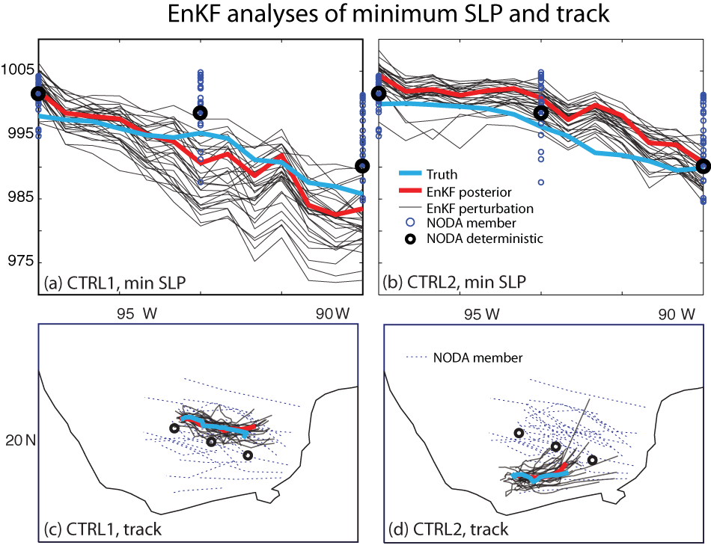
Single-instrument OSSE: Hurricane Karl
Intensity metrics: Generally small corrections due to small initial error in NODA
Position: more noticeable correction, particularly for CTRL2

Slide 24
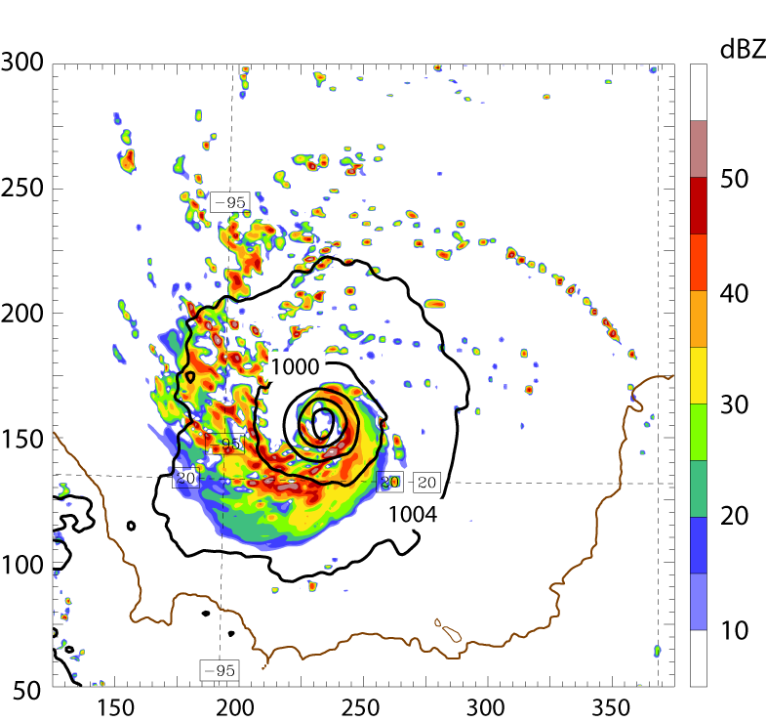
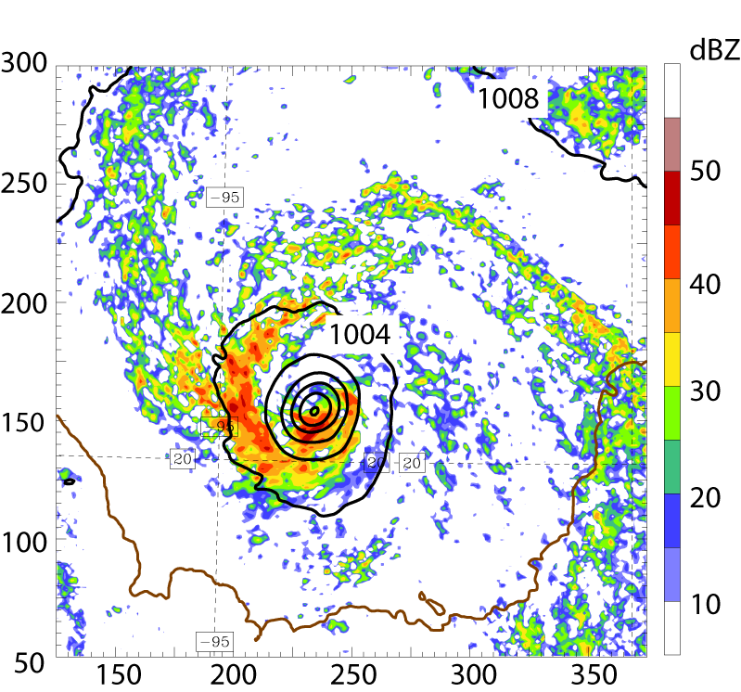
Single-instrument OSSE: Hurricane Karl
(a) Truth1 reflectivity
(b) EnKF reflectivity (13 cycles)
EnKF is able to produce good analysis of storm structure after 13 cycles

Slide 25
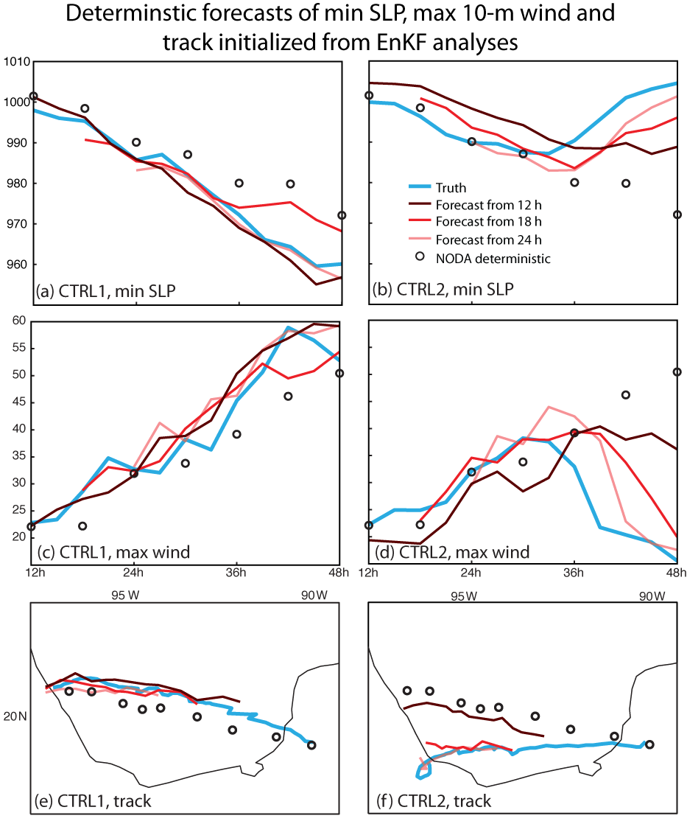
Single-instrument OSSE: Hurricane Karl
Forecast error is reduced relative to NODA in both cases, particularly from 36-48 h
CTRL2 needs more time to produce better analyses (i.e., that produce ‘good’ forecasts)

Slide 26
Outline
Genesis and Rapid Intensification Processes (GRIP) experiment and data available
Hurricane and Severe Storm Sentinel experiment (HS3) and data available
Single-instrument OSSE experiments
Single-instrument real-data experiments
Multi-instrument real-data experiments

Slide 27
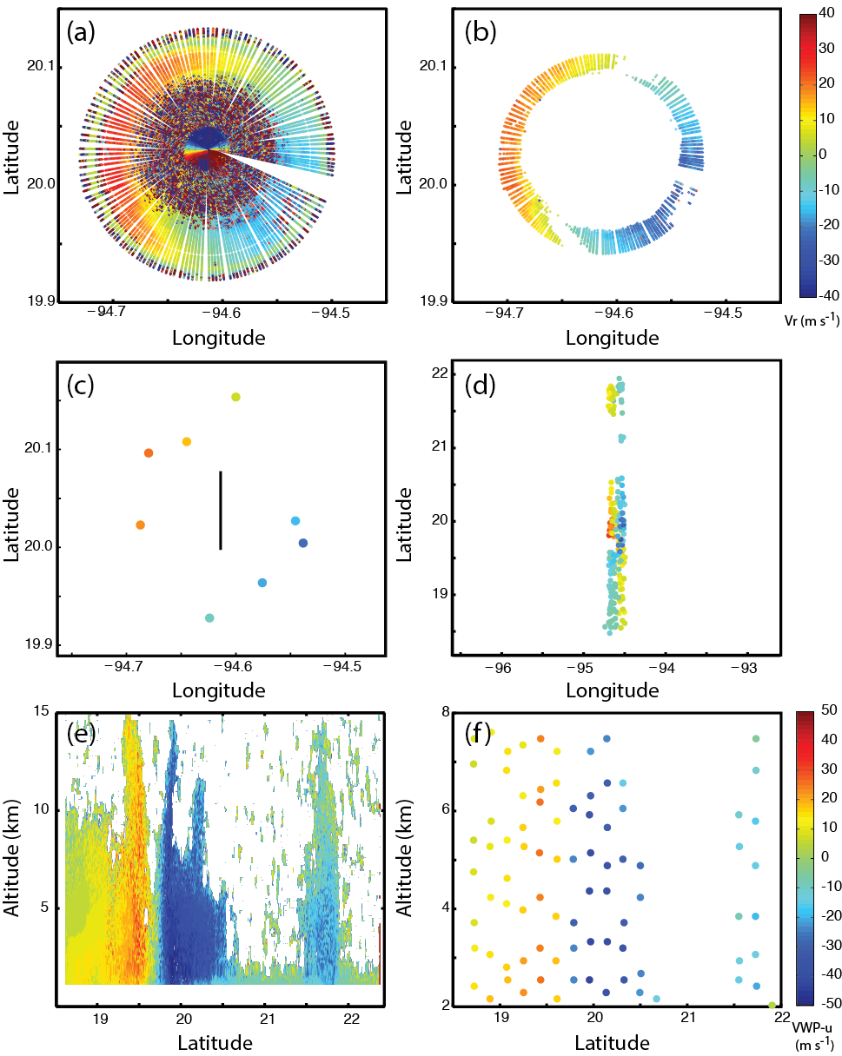
Real-data, single-instrument experiments: Hurricane Karl
Challenges with real data:
Outer beam unavailable, so inner-beam used
  OSSE assumed outer beam
  Noisier covariance due to stronger w component
  Smaller footprint (less coverage)
Some data missing due to unfolding problems
Heavy QC required to remove noisy or bad data
A single, unedited Vr volume near the northern eyewall

Slide 28
Real-data, single-instrument experiments: Hurricane Karl
Challenges with real data:
Outer beam unavailable, so inner-beam used
  OSSE assumed outer beam
  Noisier covariance due to stronger w component
  Smaller footprint (less coverage)
Some data missing due to unfolding problems
Heavy QC required to remove noisy or bad data
Vr removed for dBZ < 25, z < 2 km, and z > 8 km

Slide 29
Real-data, single-instrument experiments: Hurricane Karl
Vr SO generation:
After initial QC, an SO procedure performs additional QC and significant thinning
Analyses overfit data unless spacing between SOs > ~15 km
This yields about 100-250 SOs/h
All Vr SOs from a single 1-h cycle during a north-south transect over the storm center

Slide 30
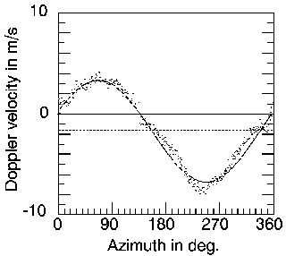
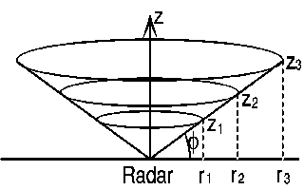
Real-data, single-instrument experiments: Hurricane Karl
VWP: An alternative to Vr
Assimilating HIWRAP-derived VAD wind profiles (VWPs) is a possible alternative
VWPs have the benefit of being a fit, so they avoid some noise issues
VWPs also avoid noisy vertical velocity error covariance
VWP Methodology

Slide 31
Real-data, single-instrument experiments: Hurricane Karl
VWP SO generation:
VWP product is already clean, so SO procedure mostly only thins to keep data independent
Profiles require 20-km separation for independence; this yields 100-200 SOs/h
VWP u-component SOs along same north-south transect as shown for Vr

Slide 32
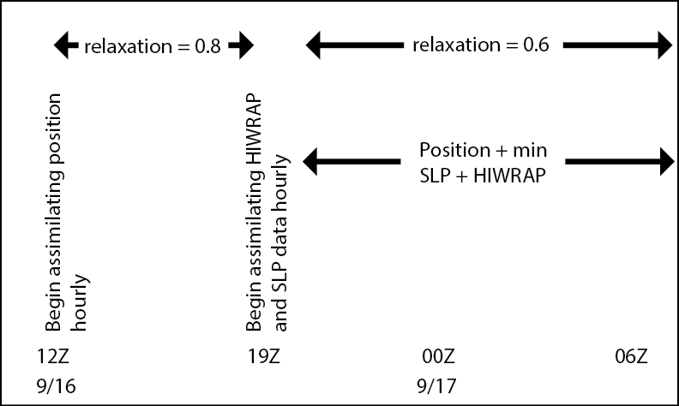
Real-data, single-instrument experiments: Hurricane Karl
Experiment Setup:
Assimilate position beforehand to help with bad first guess
Assimilate position and intensity concurrently with Vr/VWP to help when no data is available
Try different values of observation error (2-4 m/s)
Lower relaxation coefficient with time to to control unrealistic perturbations (most important for Vr)

Slide 33
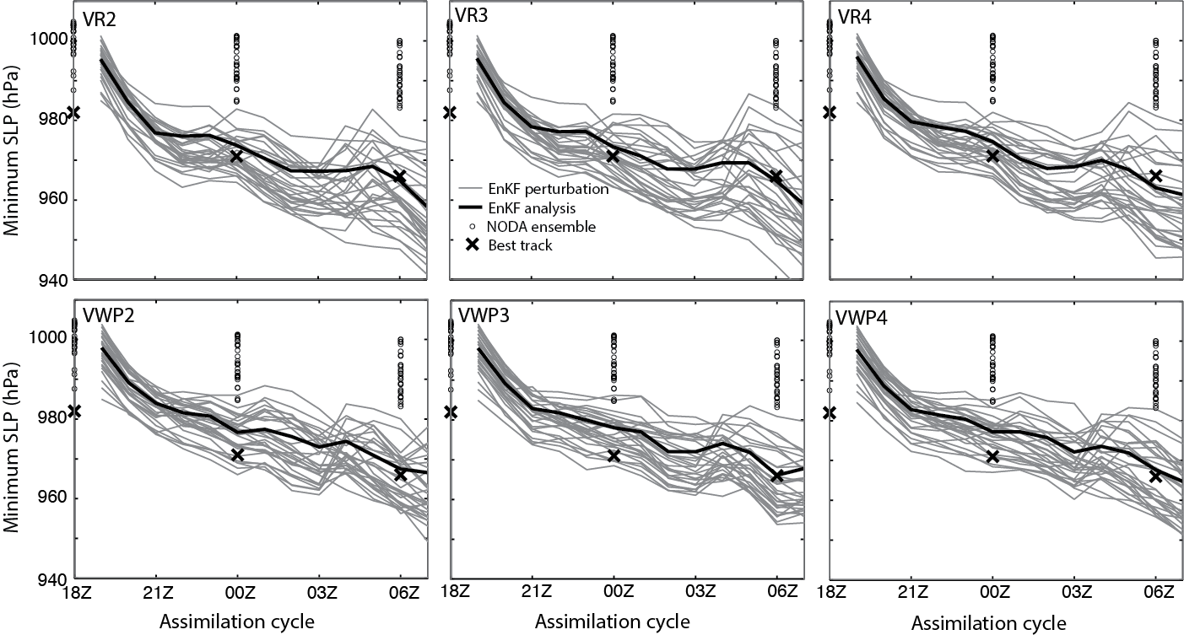
Real-data, single-instrument experiments: Hurricane Karl
Analysis minimum SLP for 6 VWP and Vr experiments

Slide 34
Real-data, single-instrument experiments: Hurricane Karl
VR mean provides a slightly better fit than does VWP
Both VR and VWP do much better than NODA
VWP perturbations have less spread than do VR perturbations
Analysis minimum SLP for 6 VWP and Vr experiments

Slide 35
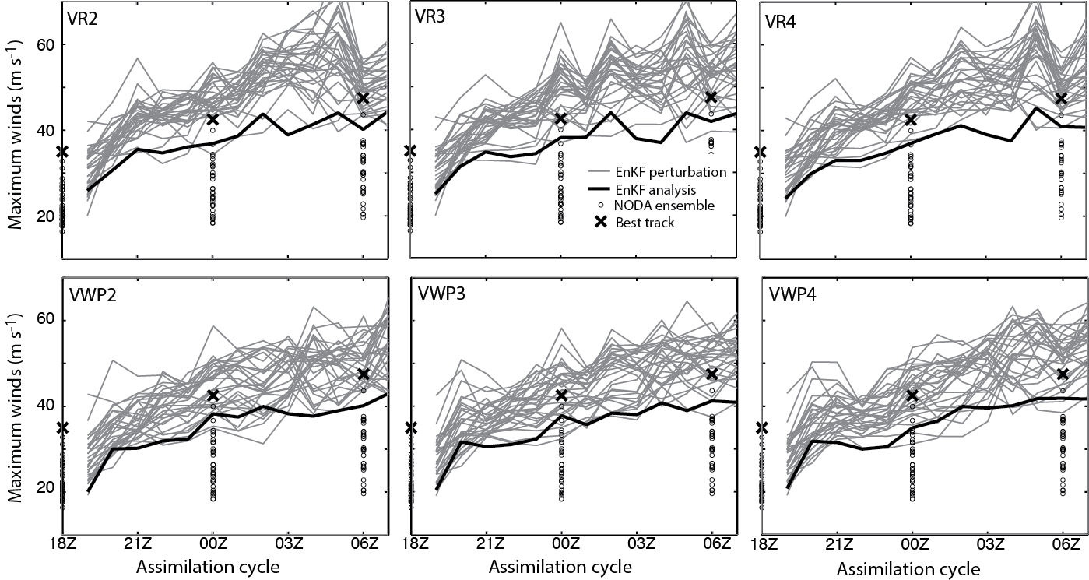
Real-data, single-instrument experiments: Hurricane Karl
Analysis minimum SLP for 6 VWP and Vr experiments

Slide 36
Real-data, single-instrument experiments: Hurricane Karl
VR mean provides a slightly better fit than does VWP
Both VR and VWP do much better than NODA
VWP perturbations are less erratic than VR perturbations
Analysis maximum winds for 6 VWP and Vr experiments

Slide 37
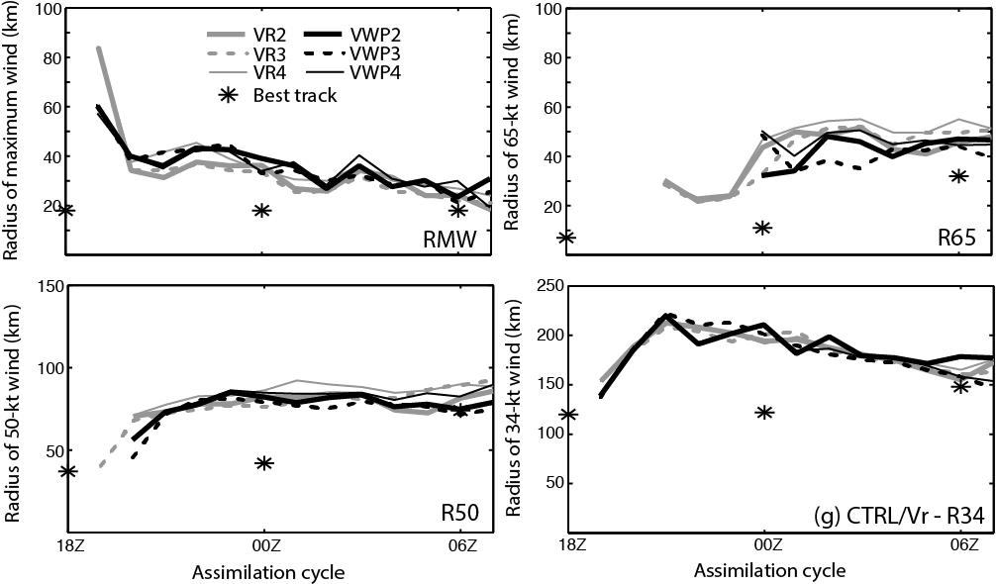
Real-data, single-instrument experiments: Hurricane Karl
Analysis wind radii for 6 VWP and Vr experiments

Slide 38
Real-data, single-instrument experiments: Hurricane Karl
Both VR and VWP are similar and agree with observations
Analysis wind radii for 6 VWP and Vr experiments

Slide 39
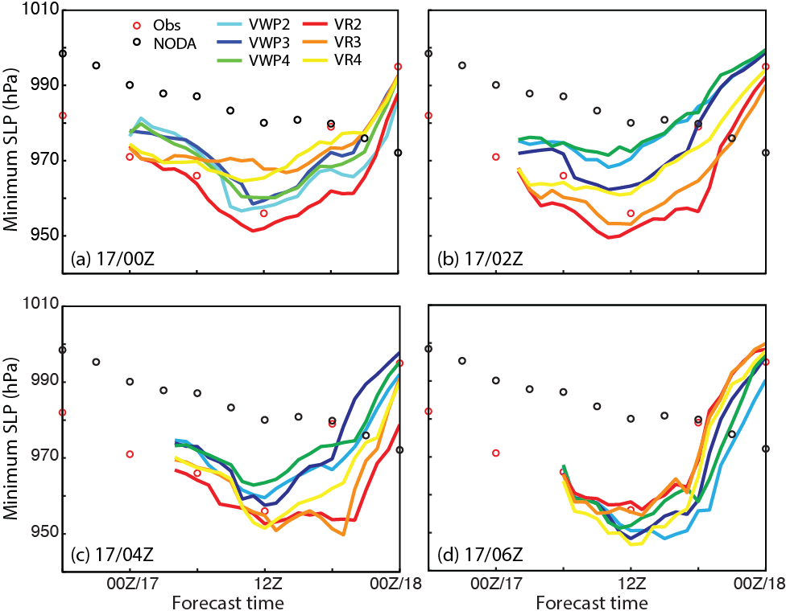
Real-data, single-instrument experiments: Hurricane Karl
Benefits: Improved deterministic forecasts of minimum SLP
All EnKF-initialized forecasts are far superior to NODA
Mean error from VWP experiments is slightly lower than that from VR experiments
VWP experiments have more forecast consistency
Observed min SLP compared with a deterministic forecast without DA and EnKF-initialized forecasts

Slide 40
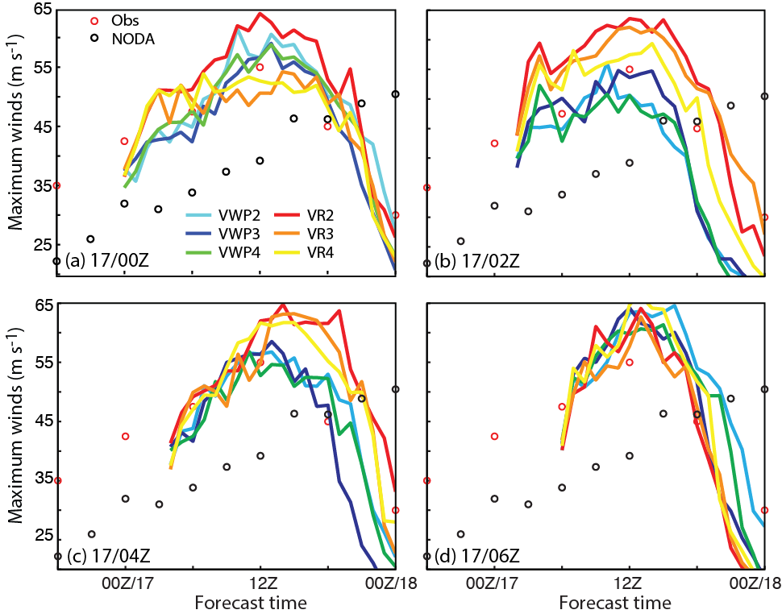
Real-data, single-instrument experiments: Hurricane Karl
Benefits: Improved deterministic forecasts of maximum winds
All EnKF-initialized forecasts are far superior to NODA
Mean error from VWP experiments is slightly lower than that from VR experiments
VWP experiments have more forecast consistency
Observed max winds compared with a deterministic forecast without DA and EnKF-initialized forecasts

Slide 41
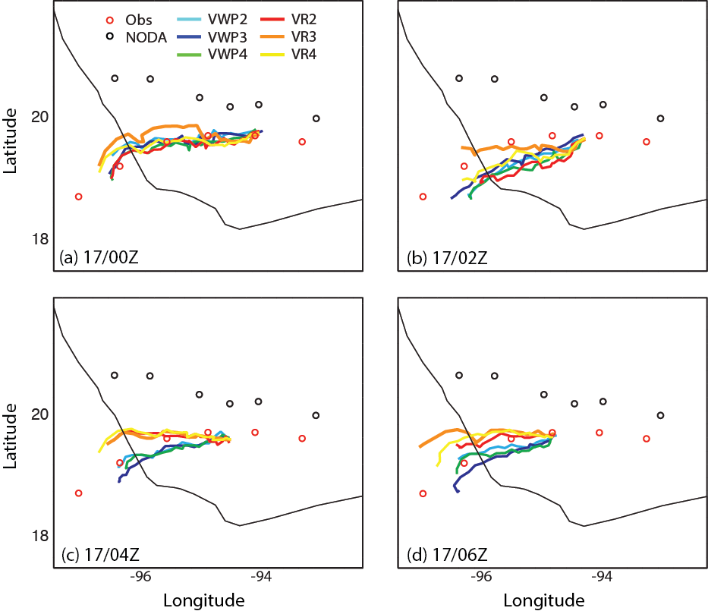
Real-data, single-instrument experiments: Hurricane Karl
Benefits: Improved deterministic forecasts of track
All EnKF-initialized forecasts are far superior to NODA
Mean error from VWP experiments is slightly lower than that from VR experiments
VWP experiments have more forecast consistency
Observed track compared with a deterministic forecast without DA and EnKF-initialized forecasts

Slide 42
Real-data, single-instrument summary
Issues with early HIWRAP data posed significant challenges for DA
An alternate approach to assimilating Vr is to use Vr-derived VWP
Despite challenges, analyses assimilating either Vr or VWP accurately portray storm intensity and size, resulting in improved forecasts
VR analyses do slightly better with intensity, but VWP-initialized forecasts are superior

Slide 43
Outline
Genesis and Rapid Intensification Processes (GRIP) experiment and data available
Hurricane and Severe Storm Sentinel experiment (HS3) and data available
Single-instrument OSSE experiments
Single-instrument real-data experiments
Multi-instrument real-data experiments

Slide 44
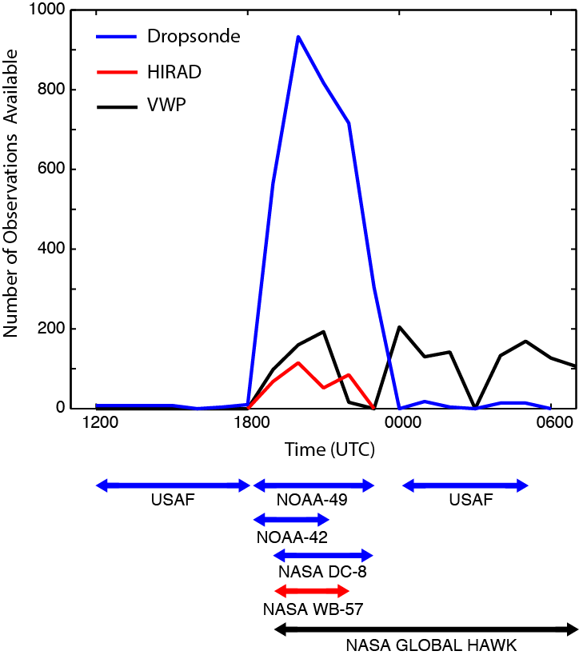
Real-data, multi-instrument experiments: Hurricane Karl
Assimilate data from:
HIWRAP VWP
Dropsondes (USAF C130, NOAA43, NOAA49, NASA DC8)
HIRAD (GRIP – NASA WB57)

Slide 45
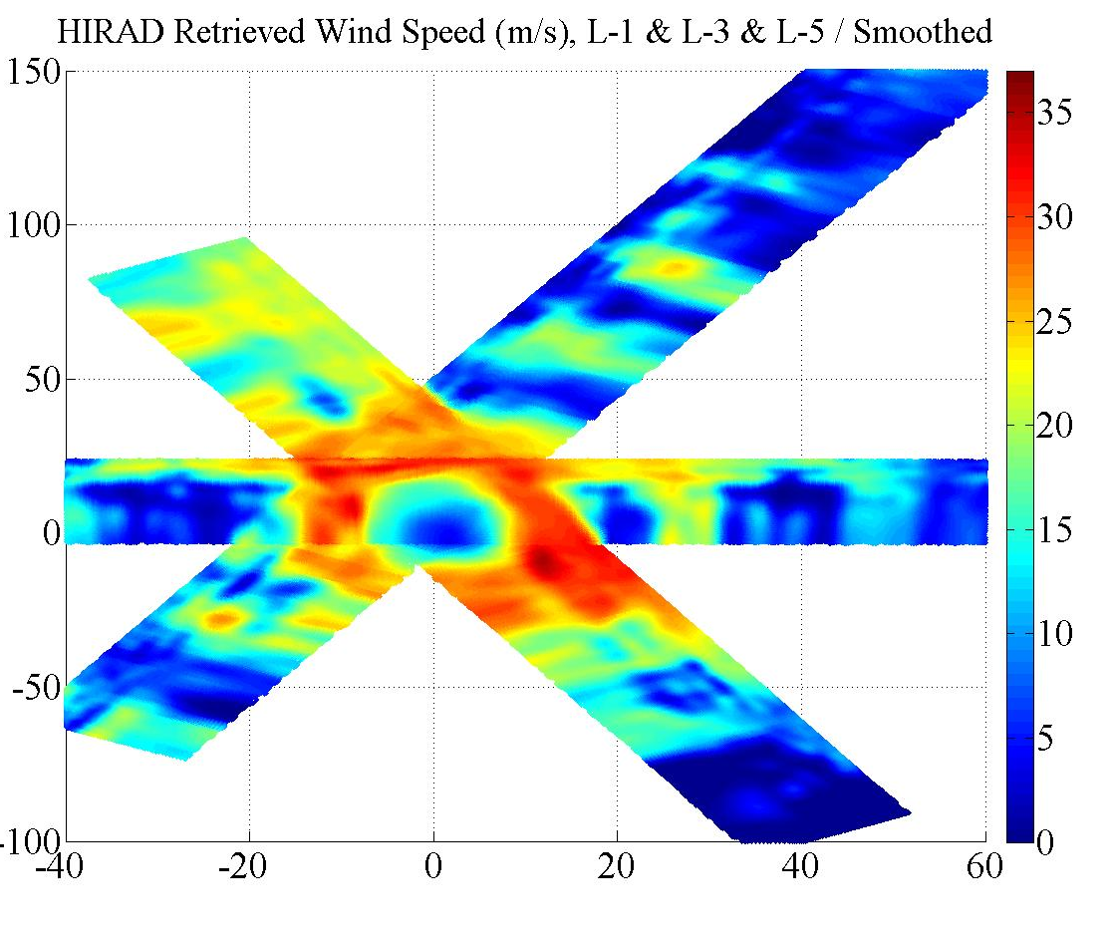
Real-data, multi-instrument experiments: Hurricane Karl
More Challenges with real data:
HIRAD data from Karl is worse than HIWRAP data, so significant manual QC was required
Only speeds from half of HIRAD swath are used – the other half is likely unretrievable
Fortunately, new HIRAD data is much, much better
HIRAD-retrieved wind speeds from Hurricane Karl

Slide 46
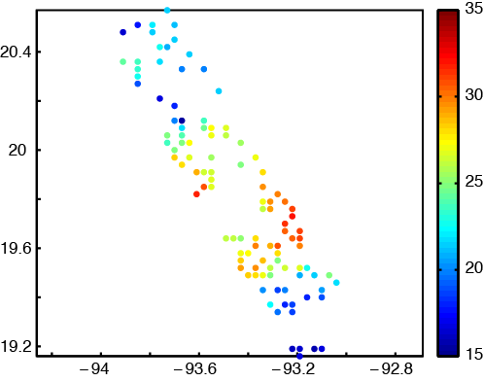
Real-data, multi-instrument experiments: Hurricane Karl
HIRAD SOs:
Data gridded to 3-km grid, then randomly thinned to achieve ~6-km separation between obs
Upon recommendation of HIRAD team, all speeds
< 15 m/s rejected
HIRAD SOs from second pass over Hurricane Karl

Slide 47
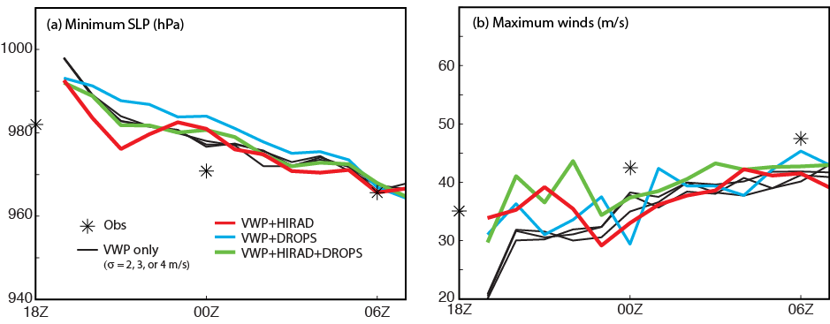
Real-data, multi-instrument experiments: Hurricane Karl
Quicker spinup of analysis winds with multiple sources
Best results when all three sources assimilated

Slide 48
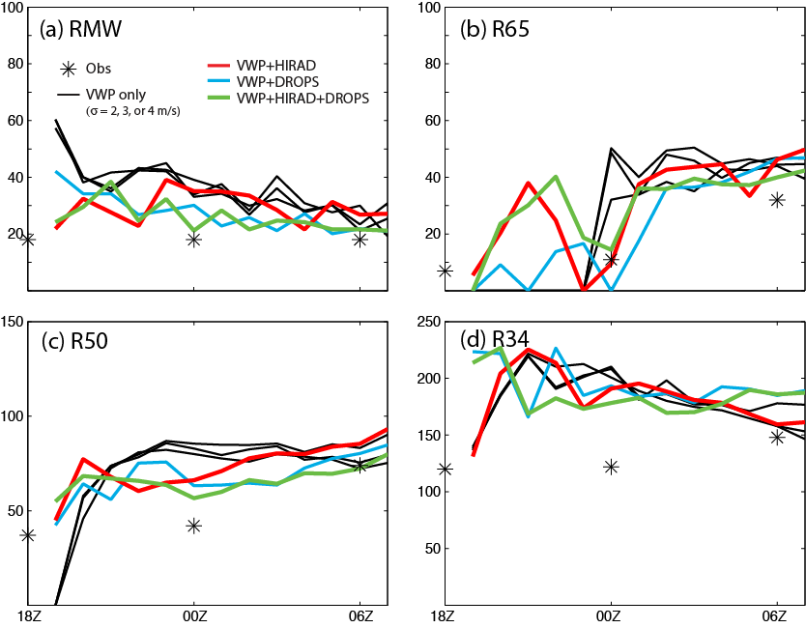
Real-data, multi-instrument experiments: Hurricane Karl
Quicker spinup of analysis winds with multiple data sources
Best results when all three sources assimilated

Slide 49
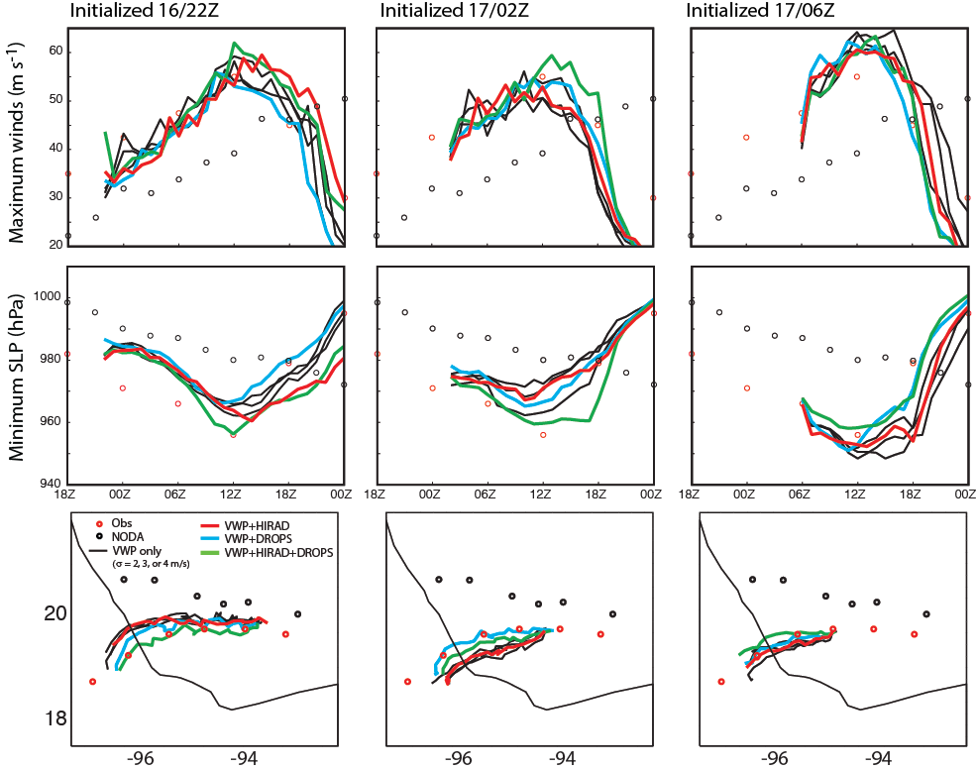
Real-data, multi-instrument experiments: Hurricane Karl

Slide 50
Real-data, multi-instrument experiments: Hurricane Karl
VWP+HIRAD+drops produces most consistent forecasts
Forecasts of SLP from VWP+HIRAD+drops are best, but forecast max winds are slightly biased
VWP+HIRAD doesn’t change forecast much
Adding drops improves forecast track

Slide 51
Summary
Two recent NASA experiments, GRIP and HS3, provide excellent opportunities to test hurricane DA with new data sources and platforms
OSSE and real-data experiments show that assimilating wind data from a high-altitude Doppler radar can be very helpful for improving hurricane analyses and forecasts
Additional experiments show that assimilating data from different platforms further improves analyses and forecasts

