Slide 1
Idealized 18/6/2 HWRF Physics experiments in preparation for 2015 implementation
Lin Zhu
October 29, 2014

Slide 2
Outline
Experiments configuration
Storm intensity
Storm structure

Slide 3
Experiment Configurations
2014 Operational HWRF
Grid Points (x,y) | Grid size (km) | Vertical levels | Time step | Model top | Feedback
D01: 216 × 432 D02: 106 × 204 D03: 198×354 | D01: 27 km D02: 9 Km D03: 3 km | 61 levels | D01: 45 s D02:15 s D03: 5 s | 2 hPa | Yes
Radiation scheme | PBL scheme | Micro-Physics scheme
GFDL | 2014 GFS | Ferrier

Slide 4
Experiment Configurations
Domain Set up (domain size is the same as 2014 Operational HWRF)
Experiment | Grid Points (x,y) | Grid size (km) | Vertical levels | Time step | Model top | Feedback
CTL (2014 HWRF phys) | D01: 288 × 576 D02: 142 × 272 D03: 265×472 | D01: 18 km D02: 6 Km D03: 2 km | 61 levels | D01: 38+4/7 s D02: 12+6/7 s D03: 4+2/7 s | 2 hPa | Yes Yes
RRTMG Radiation
Wind Speed dependent α in GFS PBL
Ferrier-Aligo MP

Slide 5
Experiment Configurations
Physics Schemes
Experiment | Radiation scheme | PBL scheme | Micro-Physics scheme
CTL | GFDL | 2014 GFS | Ferrier
RRTMG | RRTMG | 2014 GFS | Ferrier
Variable α in GFS PBL | GFDL scheme | 2014 GFS with Wind Speed dependent α (UCLA) | Ferrier
Ferrier-Aligo | GFDL scheme | 2014 GFS | New Ferrier-Aligo

Slide 6
Storm intensity

Slide 7
Storm Intensity
Experiment | Storm intensity (Lowest P_{min} Highest V_{max}) | Storm intensity change for first 36 hours (ΔP, ΔV)
CTL | P_{min} = 949 hPa V_{max} = 50 m s⁻¹ | ΔP = - 47 hPa ΔV = 31 m s⁻¹
RRTMG | P_{min} = 928 hPa V_{max} = 55 m s⁻¹ | ΔP = - 56 hPa ΔV = 38 m s⁻¹
Variable α in GFS PBL | P_{min} = 929 hPa V_{max} = 61 m s⁻¹ | ΔP = - 54 hPa ΔV = 32 m s⁻¹
Ferrier-Aligo (strongest) | P_{min} = 908 hPa V_{max} = 73 m s⁻¹ | ΔP = - 79 hPa ΔV = 45 m s⁻¹

Slide 8
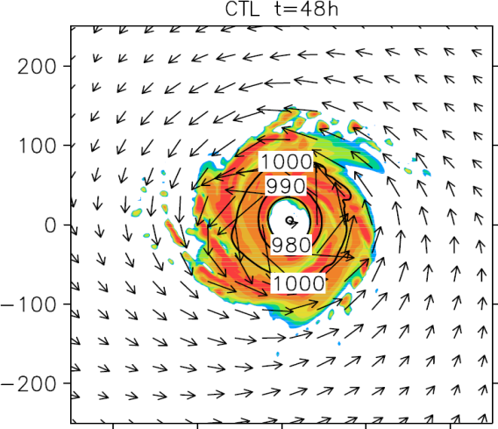
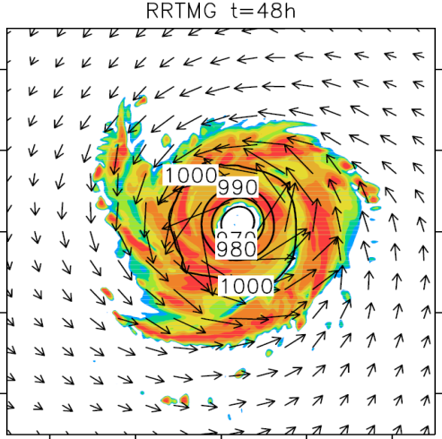
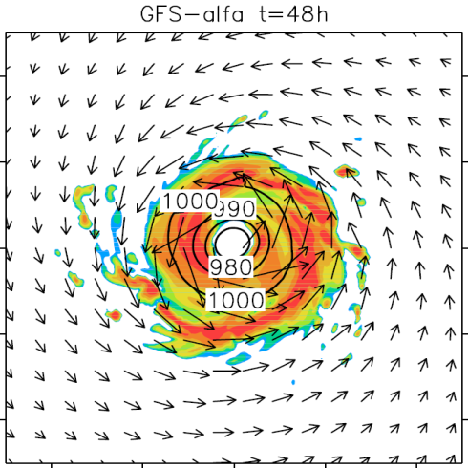
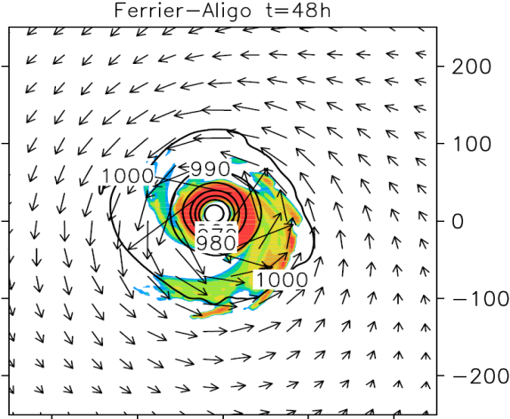
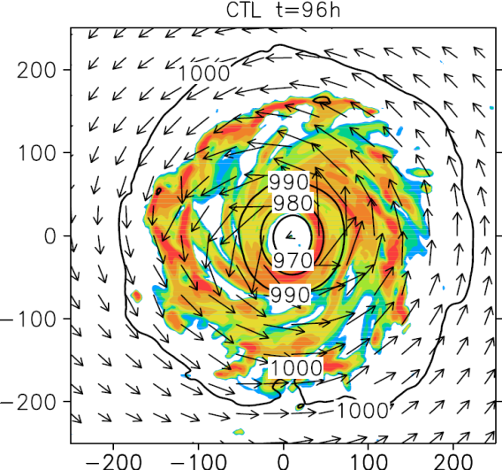
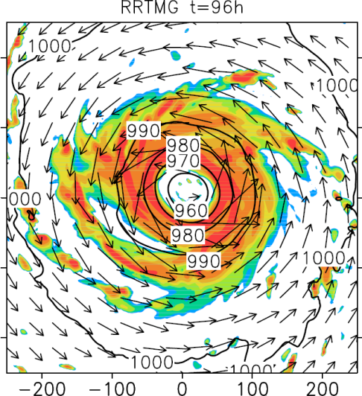
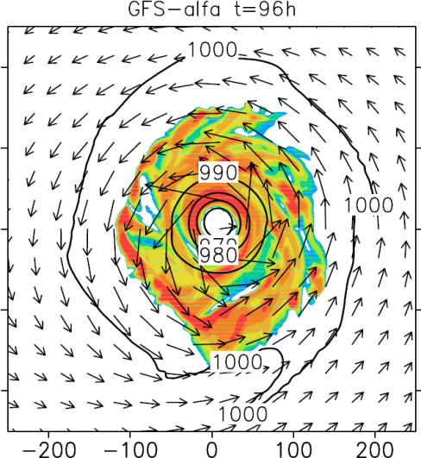
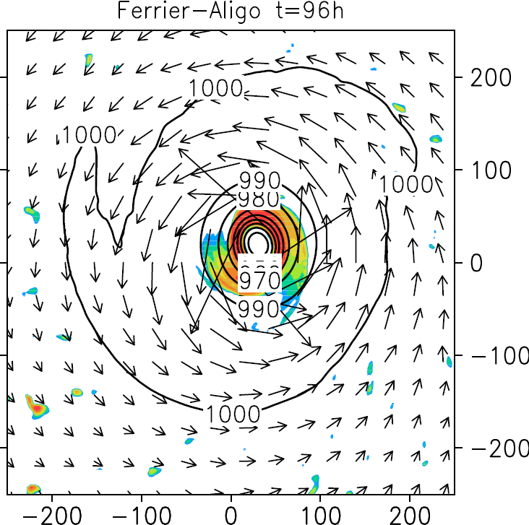
Storm structure
Radar Reflectivity (shaded) at 850 hPa MSLP (contoured)

Slide 9
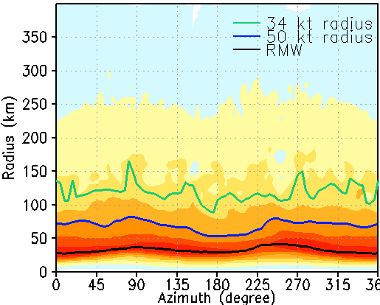
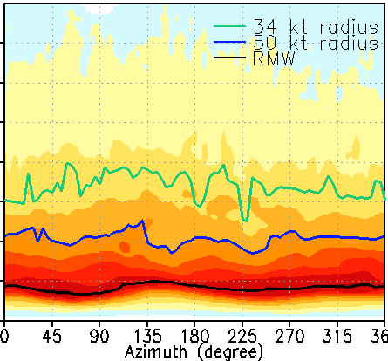
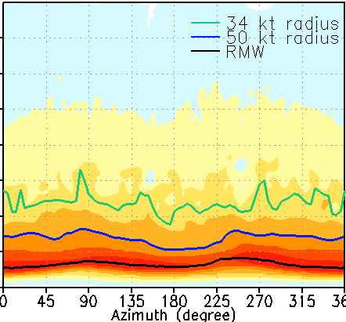
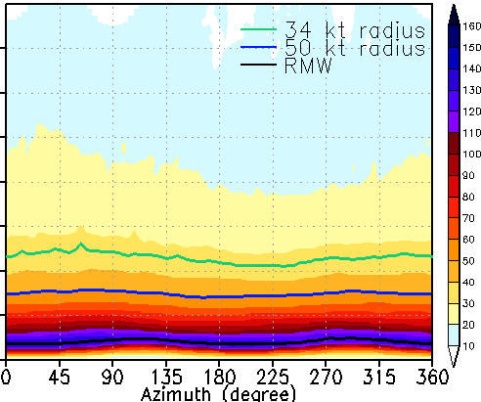
10m Wind Speed (shaded), RMW (black curve), 50 Kt radius (blue curve), 34 Kt radius (green curve)
CTL t=96h
RRTMG t=96h
GFS-α t=96h
Ferrier-Aligo t=96h
Experiment | CTL | RRTMG | Wind speed dependent GFS α | Ferrier Aligo (smallest)
Storm size (RMW) | 30 km | 50 km | 33 km | 25 km

Slide 10
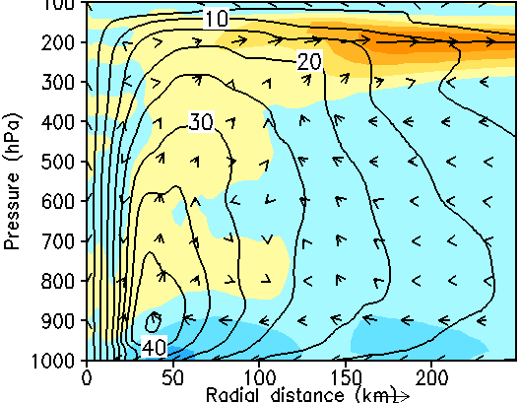
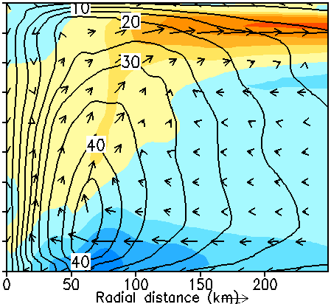
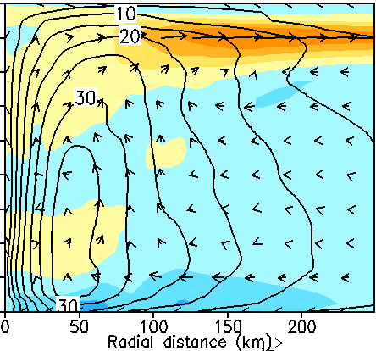
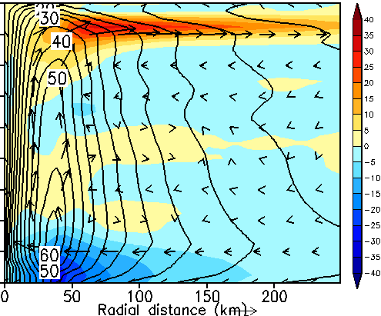
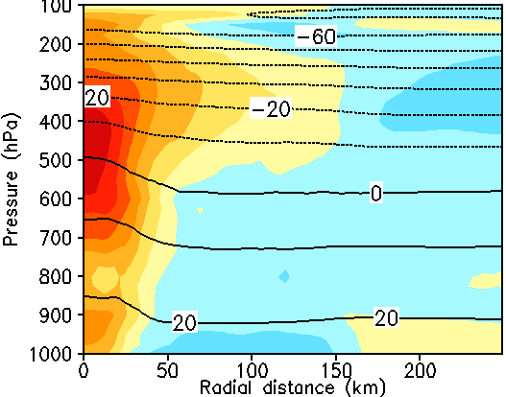
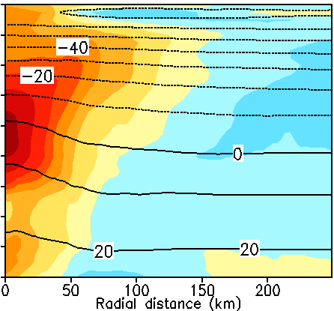
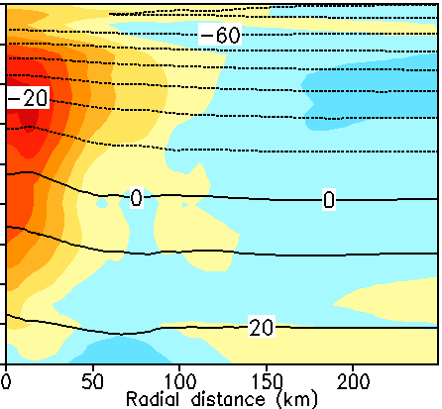
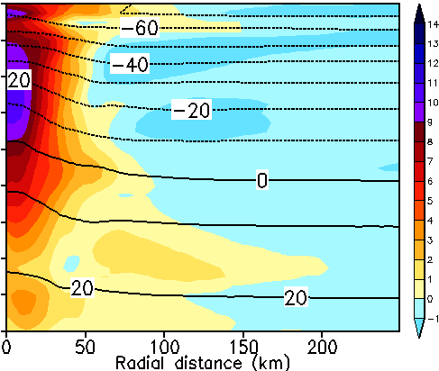
Radial wind (shaded), tangential wind (contoured)
CTL t=96h
RRTMG t=96h
GFS-α t=96h
Ferrier-Aligo t=96h
Temperature anomaly (shaded), temperature(contoured)
CTL t=96h
RRTMG t=96h
GFS-α t=96h
Ferrier-Aligo t=96h

Slide 11
Things to do:
Combine RRTMG+Variable α+Ferrier-Aligo
Get more understanding of the modified physics schemes, e.g. the details of the changing the schemes and why it changes
Do more diagnostics of the storm structure: analysis of how the physics impact of the storm intensity and structure, especially first 36 hours.

Slide 12
Questions ?

