Slide 1
2015 HWRF Implementation Plan Presented by Zhan Zhang

Slide 2
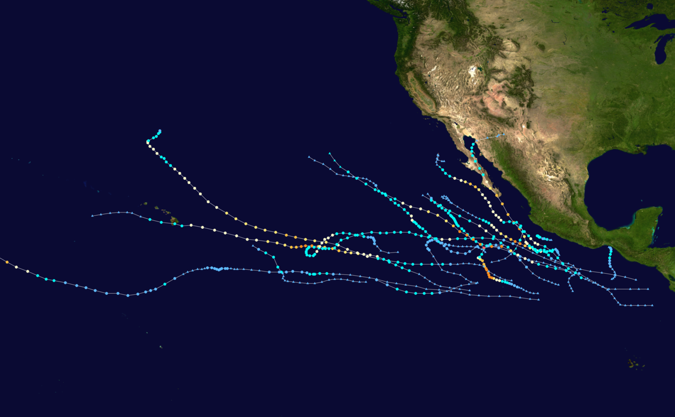
2014 HWRF Forecast Performance for Eastern Pacific Basin (Amanda 01E – Trudy 20E)

Slide 3
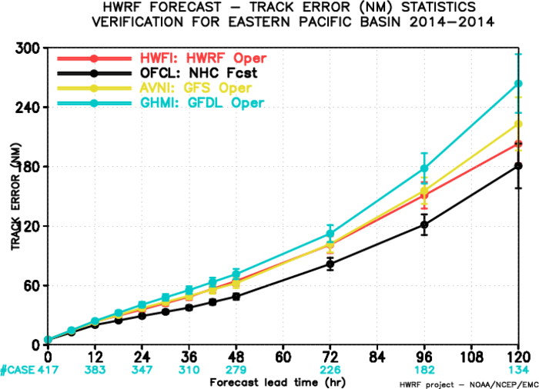
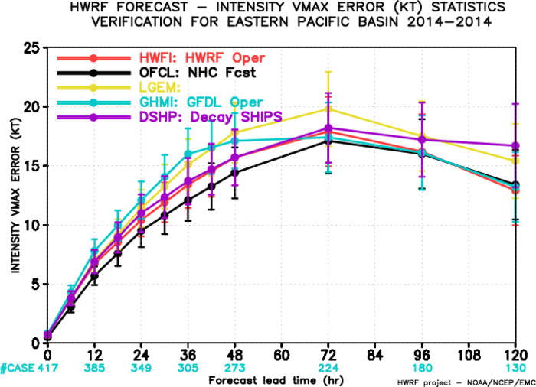
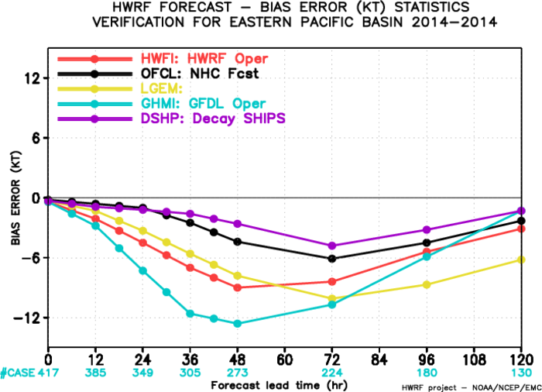

Slide 4
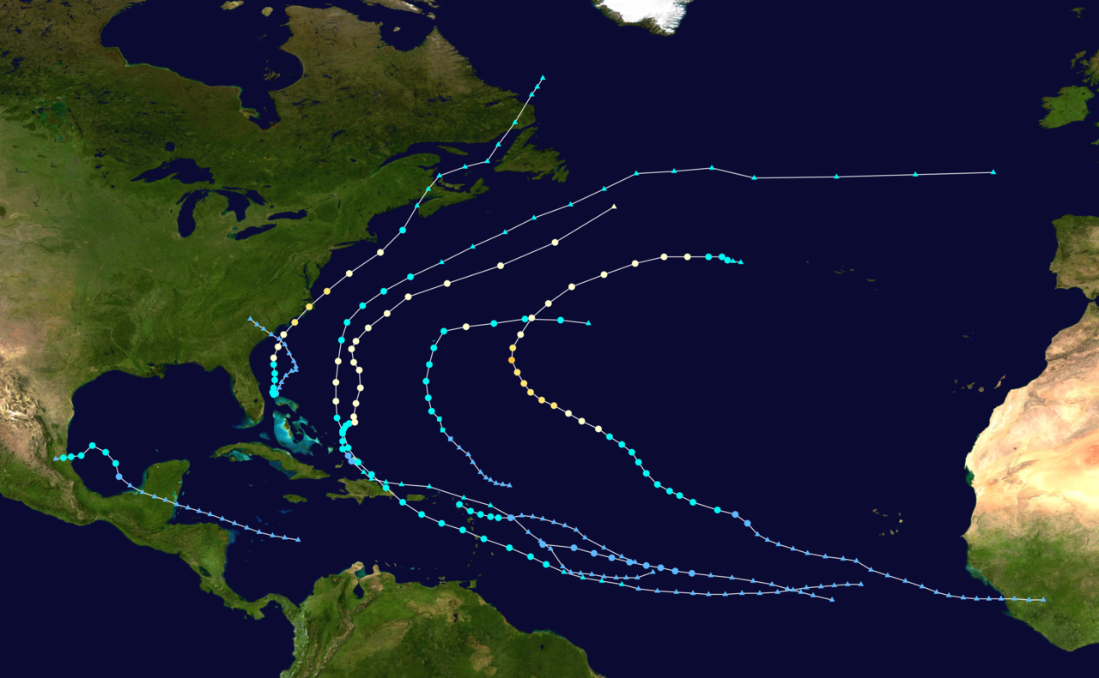
2014 HWRF Forecast Performance for
Atlantic Basin (Arthur 01L – Gonzalo 08L)

Slide 5
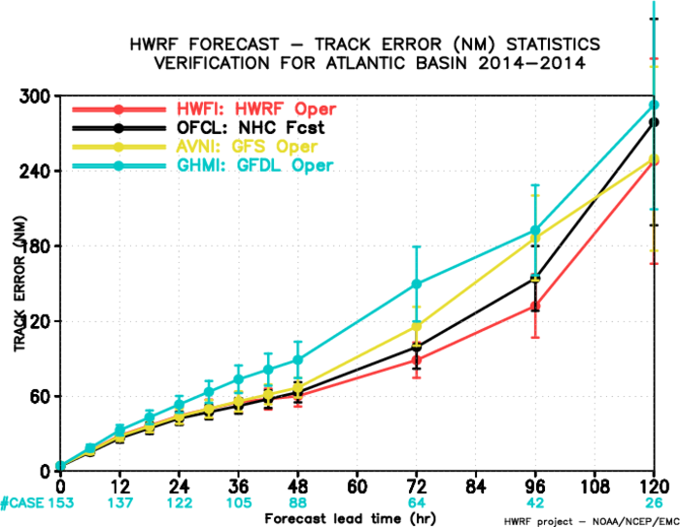
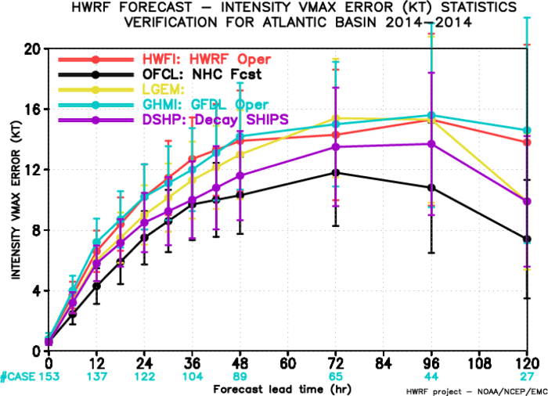
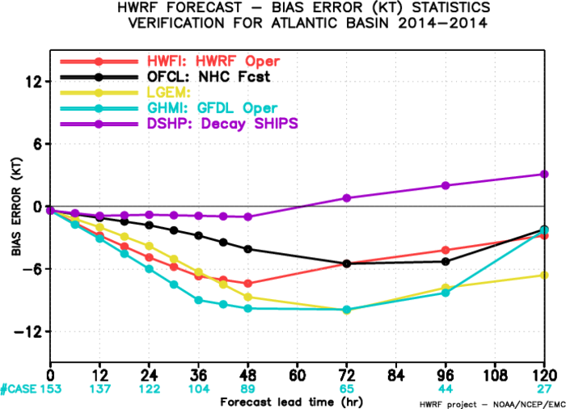

Slide 6
2015 HWRF Implementation Plans
Priorities:
Datasets:
GFS T1534 spectral analysis for initial conditions (current T574)
GFS 0.25 degree master GRIB2 forecast files for generating lateral boundary conditions (26 levels for 2012/2013/2014; 47 levels for 2011)
GDAS T574 (current T256) spectral forecasts for relocation, FGAT and data assimilation
GFS T574 EnKF spectral forecasts for generating HWRF ensembles (for regional hybrid data assimilation (inner core DA only)
Observational data same as 2014 HWRF (TDR, dropsondes, satellite and conventional)
Resolution:
Increase horizontal resolution to ~18/6/2 km, (dt~38sec)
Increase the nest domain sizes (if affordable)
Vertical resolution and model top same as 2014 HWRF (61 levels, 2 hPa top)
Bug fixes: Coupler related issues/bugs, nest shifting problem, etc.
Timing:
With the same computer nodes, the run time for forecast job takes about 150min (compared to 87min with current operational HWRF)

Slide 7
2015 HWRF Implementation Plans
Vortex initialization
Modifications needed for increased resolution
Lower limit for ROCI set to 250 km
Modifications to filter domain and strength of the filter
Unified domain specification for all basins (no hardwired basin-specific assumptions)
MPI based optimization and stream-lined modular software infrastructure (remove redundant i/o, namelist driven options for size/structure corrections)
Data Assimilation
Improve ensemble background-error covariance from new T1534 GFS EnKF ensemble
GFS EnKF based 40-member HWRF ensemble for inner-core regional hybrid DA (aircraft data only)
Improve background vortex: re-evaluate the use of vortex initialization to generate background vortex for inner-core DA for strong storms. Possibly use hourly FGAT for inner-core DA
Improve use of TDR data: delay TDR data dumping and processing to allow more data to be assimilated
Assimilate MSLP and HS3 dropsonde data

Slide 8
2015 HWRF Implementation Plans
Physics
Address the NOAH LSM issues (NOAA-NSF Visiting Scientist Program)
Improved cloud-radiative feedback (by switching to RRTMG radiation)
Implementation of Ferrier-Aligo Microphysics
Improved GFS PBL based on Rob Fovell’s wind-speed dependent α
Revisit physics at the air-sea interaction (adding impact of currents, modification of exchange coefficients for heat and momentum)
Use of idealized HWRF runs and observations based composite diagnostic metrics for physics evaluation
Ocean
No changes planned for the Atlantic basin
NCODA based initialization for the East Pac basin (replacing GDEM climatology)
Use inputs from OMITT experiments and diagnostic evaluation

Slide 9
2015 HWRF Implementation Plans
Additional Products
Experimental tornado genesis parameters to become operational
Products for downstream applications (Hurricane Wave and RTMA)
Experimental products for hydrology and river routing models
Test plan
Outlier analysis based evaluation (NHC methods)
Choice of priority cases based on input/feedback from NHC
Focus on track/intensity/size/structure/rainfall/RI/RW metrics (Jun Zhang)
Additional diagnostics for spatial distribution of errors (Chun-Sil Jin)
Conditional verification and diagnostics (Ryan Torn, DTC, Kate Musgrave, Dave Zelinsky)
Technical details
https://svn-dtc-hwrf.cgd.ucar.edu/branches/py2km branch as baseline
Python+Rocoto automation for HWRF T&E
Improved visualization and web interface for experimental results (Keqin Wu)
Extensive use of Jet/Zeus/WCOSS for pre-implementation tests

Slide 10
Outlier Analysis: ATL

Slide 11
Outlier Analysis: EPAC

Slide 12
Intensity Error Analysis for H214 for 2011-2013 AL Storms
48h
2011,, 16L,17L

Slide 13
Intensity Error Analysis for H214 for 2011-2013 EP Storms
48h

Slide 14
Outlier Analysis
Focus on storms with high magnitude of track and intensity errors:
(Use cumulative distribution of forecast errors)
calculate all intensity errors ( fcst-obs ) from H214 at different forecast hours;
rank the errors from weaker to stronger biases;
take 5% at both ends;
find storms that occur more than 5 times in weaker/stronger bias ends.
relate the intensity errors to geographical locations, relationship to track errors and size errors
Target physics/initialization/DA improvements for the outliers
Examples: 2011: Ophelia/Philippe; 2012: Isaac/Kirk/Michael; 2013: Gabrielle/Jerry
Repeat the procedure for low magnitude of track and intensity errors
Ensure substantial improvements to storms with high magnitude of errors
Retain the forecast performance for storms with low magnitude of errors

Slide 15
2011 | Storm | Error | 2012 | Storm | Error
2011092806 | 16L | -41 | 2012090406 | 13L | -67
2011093000 | 16L | -39 | 2012090412 | 13L | -65
2011092812 | 16L | -36 | 2012090418 | 13L | -54
2011092818 | 16L | -35 | 2012090400 | 13L | -47
2011092900 | 16L | -35 | 2012090318 | 13L | -37
2011092918 | 16L | -33 | 2012090500 | 13L | -37
2011092906 | 16L | -32 | 2012090506 | 13L | -34
2011092912 | 16L | -31 | 2012090312 | 13L | -20
2011100200 | 17L | -37 | 2012090406 | 13L | -67
2011100300 | 17L | -37 | 2012081706 | 09L | 26
2011100218 | 17L | -34 | 2012082118 | 09L | 26
2011100306 | 17L | -33 | 2012082206 | 09L | 26
2011100118 | 17L | -32 | 2012081718 | 09L | 27
2011100418 | 17L | -32 | 2012082200 | 09L | 27
2011092806 | 16L | -41 | 2012081800 | 09L | 31
 |  |  | 2012082218 | 09L | 33
 |  |  | 2012081806 | 09L | 58
2012 | Storm | Error
2012083018 | 11L | 27
2012083100 | 11L | 34
2012083112 | 11L | 35
2012083106 | 11L | 36
2010092012 | 11L | 62
2013091218 | 10L | -36
2013091412 | 10L | -36
2013091306 | 10L | -33
2013091400 | 10L | -33
2013091406 | 10L | -29
2013091318 | 10L | -25
2013091300 | 10L | -23
2013090406 | 07L | 19
2013090206 | 07L | 22
2013090218 | 07L | 26
2013090506 | 07L | 29
2013090500 | 07L | 38

Slide 16
HWRF Upgrade Plan for 2015 Implementation
Multi-season Pre-Implementation
 | Model upgrades | Physics and DA upgrades |  |  |  | Combined
 | Baseline (H150) | NOAH LSM (H151) | Upgraded Ferrier –Aligo (H152) | RRTMG (H153) | Data Assimilation* | H215
Descriptions | 1.Resolution increase: 18/6/2km w/ same domain size; 2. Python scripts 3. New GFS T1534 4. Init improvement, GFS vortex filter 5. NCODA based ocean init for EPAC | NOAH LSM (w/ Ch cap over land) | Separate species, w/o advection | 1.Radiation 2. gfs_alpha test | Hybrid GSI/HWRF-EPS based DA | Baseline + NOAH/LSM +newMP+RRTMG
Cases | Four-season 2011-2014 simulations in ATL/EPAC, cases (~3000) | Priority cases (TBD) | Priority cases (TBD) | Priority cases (TBD) | Only Aircraft DA cases for 2011-2014 | Four-season 2011-2014 retrospectives ~3000 simulations in ATL/EPAC
Platform | WCOSS | Zeus | Jet | Jet/Zeus | Jet | Jet/WCOSS/Zeus
The plan is based on the assumption that 2015 operational HWRF system will have 3x computer resources as current system on WCOSS within HWRF operational time windows.
* DA experiment requires additional computer resources outside current operational time window.

Slide 17
Q3FY15 Hurricane WRF V9.0.0
Project Status as of 10/21/2014
G
G
Project Information and Highlights
Scheduling
Lead: Vijay Tallapragada, EMC and Chris Magee, NCO
Scope:
Replace current partial HWRF python based scripts with complete Python based scripts for a unified system.
Increase the horizontal resolution of atmospheric model for all domains from 27/9/3 to 18/6/2 km.
Upgrade and improve HWRF vortex initialization scheme in response to both GFS and HWRF resolution increases.
Upgrade Data Assimilation System with hybrid HWRF-based EnKF and GSI system.
Upgrade model physics to accommodate model resolution increase, including micro-physics process, radiation, surface physics and PBL.
Upgrade current GFDL slab model to NOAH LSM.
Upgrade ocean initialization for MPIPOM
Add namelist controlled ensemble capability.
Expected Benefits:
Improved track & intensity forecast skill and additional model output for
downstream applications
Milestone (NCEP) | Date | Status
EMC testing complete/ EMC CCB approval | 3/31/15/ 4/15/15
Code Delivered to NCO | 3/28 → 4/09
PNS/Technical Information Notice Issued | 3/17 → 4/29
Initial Test Complete | 4/30 → 5/15
CCB approve parallel data feed | NA
Test with specific cases | 4/17 → 4/24
Testing Ends | 4/24 → 5/04
IT testing begins | 4/24 → 5/05
IT testing ends | 5/05 → 5/15
Management Briefing | 5/09 → 5/25
Implementation | 5/25 → 5/26
G
Issues/Risks
G
Finances
Issues: See detailed resource requirement table (attached separately)
Risks:
Mitigation:
Associated Costs:
Funding Sources: EMC Base: T2O 18 Man-months (3 FTE full time for 6 months). NCO Base: 2 man-months for implementation, 1 man-month annually for maintenance
Management Attention Required | Potential Management Attention Needed | On Target
R
Y
G
v1.0 09/14//07

Slide 18
Computer Resource Requirement Comparison
HWRF V9.0.0, Q3FY15
J-job name | Job Description | Current Resource requirement (w/ T1534 GFS) | New Resource requirement (estimate)
JHWRF_ENSEMBLE | HWRF Ensemble 6h forecast from T-6 Global EnKF analysis (no DA, no INIT, no relocate, no GSI) 40-member 2-nest domain(18/6) | N/A | Pre-HWRF (before HWRF starts) 320 core(1) in 2-hour window
JHWRF_OCEAN_INIT | Ocean model initialization | 9 core(1) ~30min | 9 core(1) ~30min
JHWRF_INIT (GFS) | Atmospheric model IC and BC pre-process, 1IC job + 1 BC job | 32 core(1) ~59min | IC: 96 core(1) ~9 min BC: 32 core(1) ~50min
JHWRF_INIT (GDAS) | GDAS pre-process, 3 parallel jobs | 3x32 core(1), ~8min | 3x96 core(1), ~8min
JHWRF_RELOCATE | Vortex relocation, 3 parallel jobs | 3x16 core(1), ~20min | 3x48 core(1), ~20min
JHWRF_GSI | Data Assimilation | 2x112 core(1) or14 nodes ~18min | 256 core(1), 30 nodes ~20min
JHWRF_MERGE | Create final HWRF input files | 32 core(1) ~5min | 64 core(1) ~5min
JHWRF_FORECAST | 126h model integration | 208 core(1) ~88min | 624 core(1) ~88min
JHWRF_POST | Post-process model output, run parallel with forecast job | 16 core(1) ~fcst+5min | 32 core(1) ~fcst+5min
JWRF_PRODUCT | Produce GRIB2 output and track files, run parallel with forecast job | 5 core(1), ~fcst+10min | 10 core(1) ~fcst+10min

