Slide 1
New WRF-NMM
Interpolation Schemes
Sam Trahan
October 25, 2012

Slide 2
New WRF-NMM Interpolation Schemes Summary
New NMM Interpolation
Adding New Variables
Alternative Microphysics

Slide 3
New NMM Interpolation Overview
WRF-NMM Nest-Parent interpolation has issues
does not support non-Ferrier microphysics
zero condensate advected at boundary
slow
hard to add new variables
Now rewritten to fix those problems.
Retain support for:
different terrain in different domains
pressure space interpolation

Slide 4
New NMM Interpolation
Old Method: Two Step Interpolation
Source Domain
Pressure
Target Domain
Hybrid Coordinates
Hybrid Coordinates
Space
1030 mbar
New Method: Single Step
Source Domain
Target Domain
log(P)
Space
Interp.
Hybrid Coordinates
Hybrid Coordinates

Slide 5
New NMM Interpolation Weights and Indices
Source P(k)
Target P(k)
Generate interpolation weights, indices
for each target i,j,k, store source k and weight
changes with time
Reuse for all variables
Horizontal interpolation is separate

Slide 6
New NMM Interpolation Extrapolation
Source P(k)
Target P(k)
Different Psfc
(exaggerated)
Different Psfc: must extrapolate
Three options:
Constant preset value
Copy ground value below ground
Extrapolate to constant preset value at 1030mbar
Configurable via Registry on per-variable basis

Slide 7
New NMM Interpolation Additional Changes
Up feedback of temperature and water vapor adjusted for different pressure
Previous implementation could not due this because it would require parent values while up-interpolating
Better conservation of mass
Numerous other framework changes for speed
10% faster so far
10% more after all commits
New nest motion based on smoothed PDYN

Slide 8
Alternate Microphysics Overview
Old method:
zero condensate at nest boundary
no forcing or feedback
causes highly non-physical results with severe turbulence in ~100km region near nest boundary
New method:
log(P) interpolation of MOIST, SCALAR
correct two-way feedback of microphysics

Slide 9
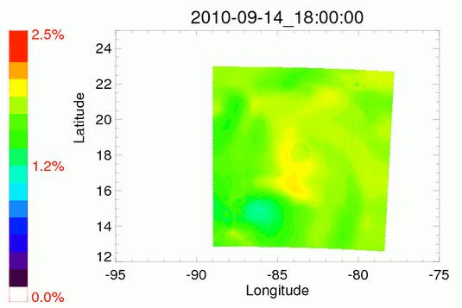
Alternate Microphysics Old Method

Slide 10
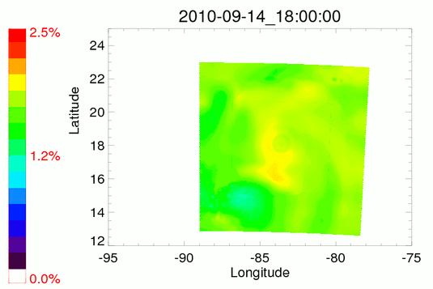
Alternate Microphysics New Method

Slide 11
Implementation Overview
Old Registry:
state real cwm ijkb dyn_nmm 1 - rhu=(nmm_feedback:IIH,JJH,HBWGT1,HBWGT2,HBWGT3,HBWGT4)d=(interp_h_nmm:IIH,JJH,HBWGT1,HBWGT2,HBWGT3,HBWGT4)f=(nmm_bdy_hinterp:cwmnest_b,cwmnest_bt,IIH,JJH,HBWGT1,HBWGT2,HBWGT3,HBWGT4) "CWM" "Total condensate" "kg kg-1"
New Registry:
state real cwm ijkb dyn_nmm 1 - rhu=(UpMass:@ECopy,0.)d=(DownMass:@ECopy,0.)f=(BdyMass:@ECopy,0.) "CWM" "Total condensate" "kg kg-1"

Slide 12
Implementation Decide Interpolation Method
log(P) in vertical + horizontal interp:
copy lowest model level
extrapolate to preset value at 1030mbar
preset below-ground value
Horizontal interp, no vertical: H or V grid
Nearest neighbor, no vertical interp: H grid only
2D fields: horizontal interp, nearest neighbor
IKJ fields

Slide 13
Implementation Special Cases
Critical mass field variables handled specially:
PD - recomputed during down interp, not up or bdy
same as original implementation
T - lapse rate atmosphere below ground
same as original implementation
Q - constant RH below ground
suggested by Greg Thompson

Slide 14
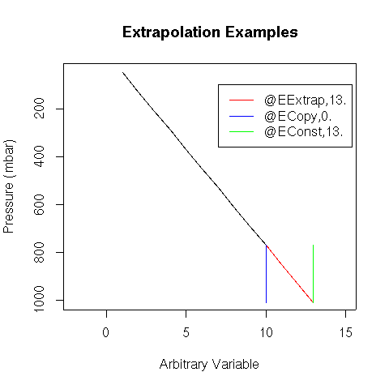
Implementation Log(P) Interpolation
Interp. in log(P) on H points, extrap. below ground
u=(UpMass:stuff),d=(DownMass:stuff)f=(BdyMass:stuff)
Source P(k)
Target P(k)
Different Psfc

Slide 15
Implementation Log(P) Interpolation: @EConst
Interpolate in log(P) on H points,
Preset below-ground value:
u=(UpMass:@EConst,3.14)
d=(DownMass:@EConst,3.14)
b=(BdyMass:@EConst,3.14)

Slide 16
Implementation Log(P) Interpolation: @EExtrap
Interpolate in log(P) on H points,
Extrapolate to preset value at 1030mbar
u=(UpMass:@EExtrap,3.14)
d=(DownMass:@EExtrap,3.14)
b=(BdyMass:@EExtrap,3.14)

Slide 17
Implementation Log(P) Interpolation: @ECopy
Interpolate in log(P) on H points,
Copy lowest model level value:
u=(UpMass:@ECopy,0.)
d=(DownMass:@ECopy,0.)
b=(BdyMass:@ECopy,0.)
The “0.” has no meaning, but is required for framework-related reasons

Slide 18
Implementation Level-by-Level Copy
Source P(k)
Target P(k)
Can add variables without log(P) interp.:
level-by-level copy on H points, horiz. interp.:
u=(UpCopy)d=(DownCopy)b=(BdyCopy)
on V points:
u=(UpVel)d=(DownVel)b=(BdyVel)
Used by both old and new interpolation schemes for velocity (no good way to extrapolate velocity).

Slide 19
Implementation Other 3D IJK, 2D Cases
Horiz. nearest neighbor, vert. level-by-level:
Real valued fields:
u=(UpNear)d=(DownNear)b=(BdyNear)
Integer fields:
u=(UpINear)d=(DownINear)b=(BdyINear)
2D IJK fields: can use any of the 3D methods:
u=(UpCopy)d=(DownCopy)b=(BdyCopy)
u=(UpNear)d=(DownNear)b=(BdyNear)
u=(UpINear)d=(DownINear)b=(BdyINear)
Will automatically detect 2D (kds=kde)

Slide 20
Implementation IKJ Fields
Just soil and Ferrier fractions
Log(P) interp. up and down, but not bdy:
u=(UpMass:@ECopy,0.)
d=(DownMass:@ECopy,0.)
Can also use @EExtrap or @ECopy
Use for F_ice, F_rimeF, F_rain if desired
Down interpolate nearest neighbor (soil fields)
d=(DownNearIKJ)

Slide 21
Implementation Issues (Tuning Needed)
Velocity inconsistent with mass field, TKE
no good way to extrapolate velocity
Tuning
What is the best way to extrapolate microphysics, T, Q, etc.?
Two-way feedback of Ferrier fractions? Of CWM?
Other fields
SST - still nearest neighbor, cannot handle new lakes
interp_land_mask_field - still in use, does not correctly handle the E grid

Slide 22
Skill So Far (Without Tuning)
79 Cases: Leslie, Isaac, Eugine
Slight track improvement
Radius closer to correct (larger storms)
Higher intensity bias
Leads to increase in intensity error

Slide 23
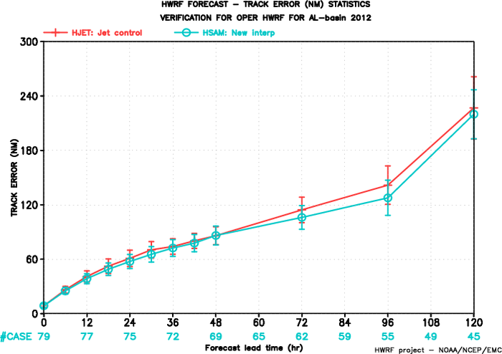
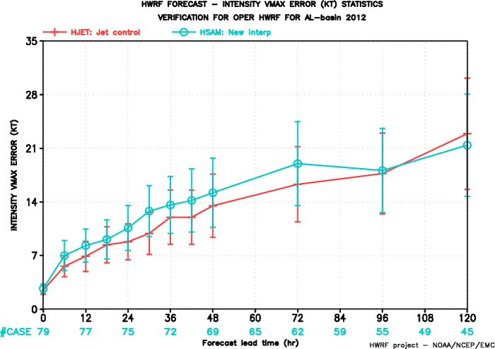
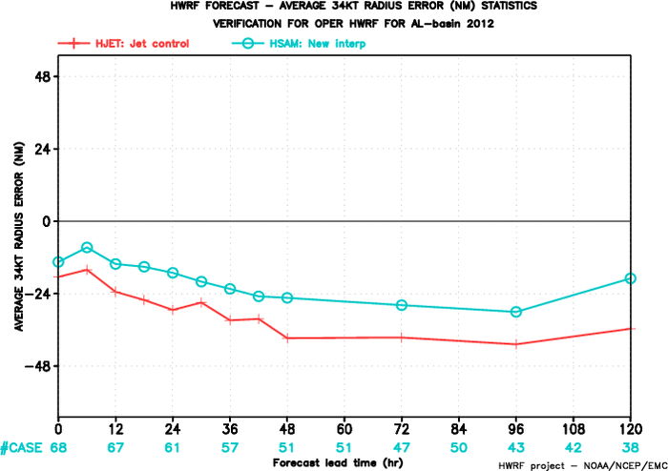
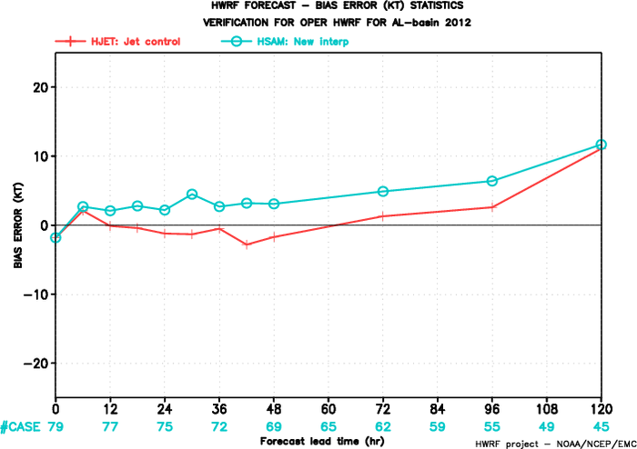
Skill So Far (Without Tuning)

