Slide 1
Dependence of the RI on initial vortex structure with HWRFx
Chanh Kieu

Slide 2
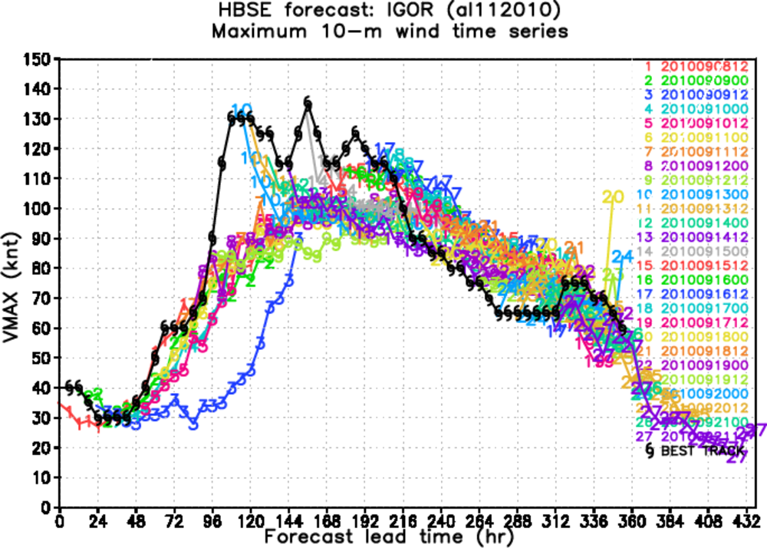
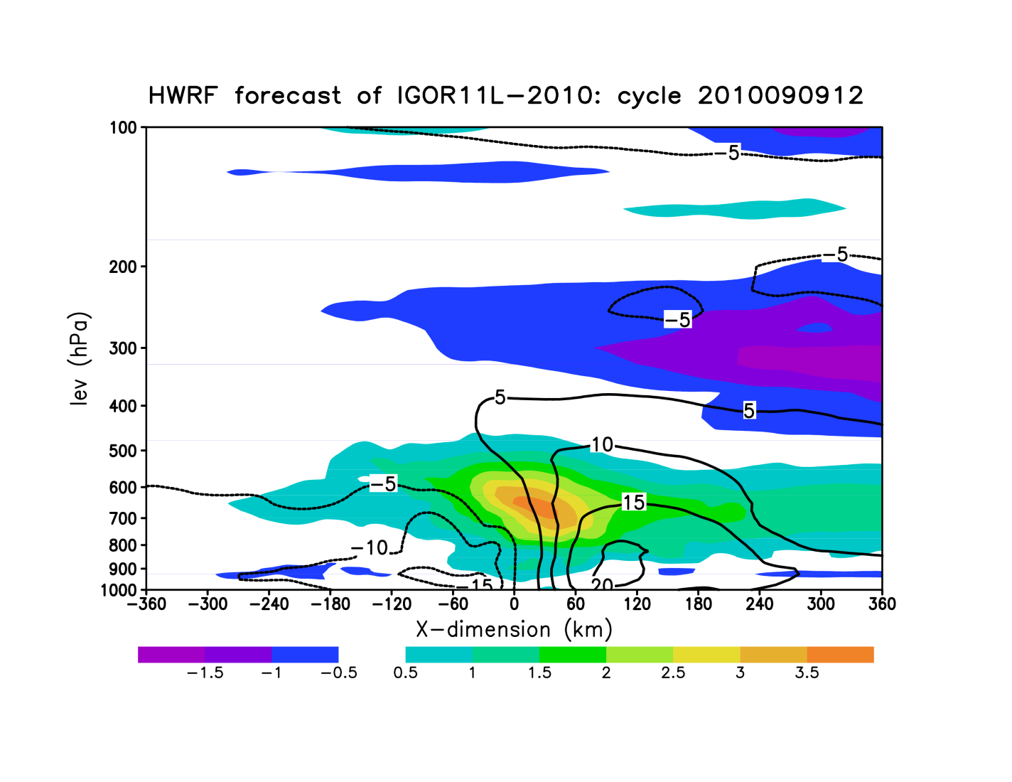
Motivation

Slide 3
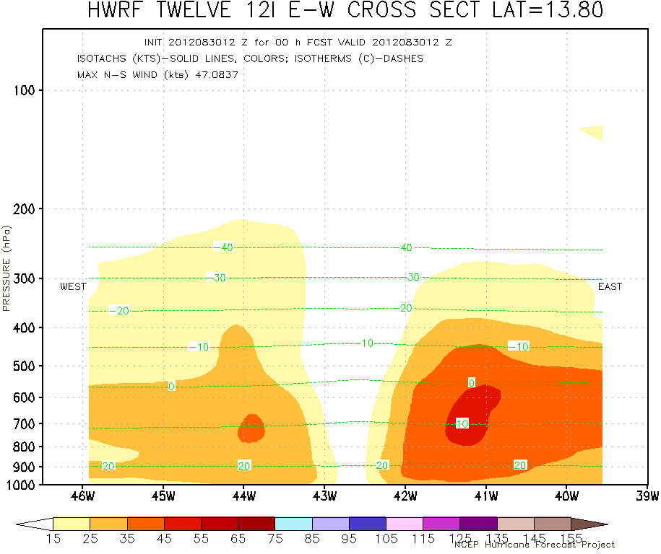
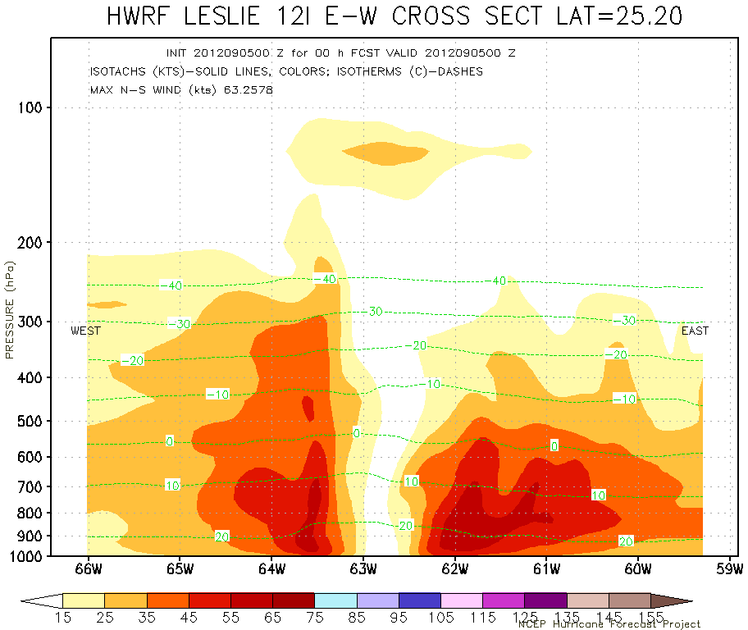
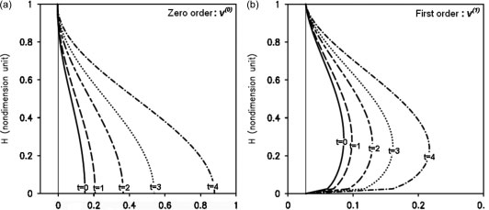
Motivation
Kieu and Zhang, QJ 2009

Slide 4
Questions
How does the storm development depend on the initial vortex structure in the HWRF model?
What factors determine the rapid intensification of the model vortex?

Slide 5
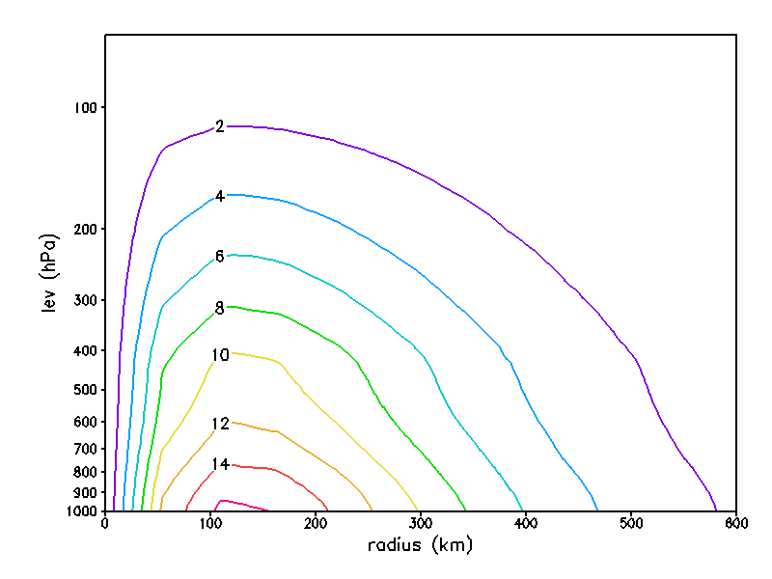
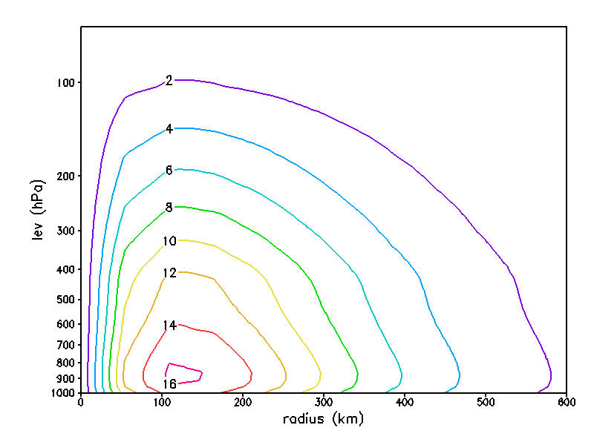
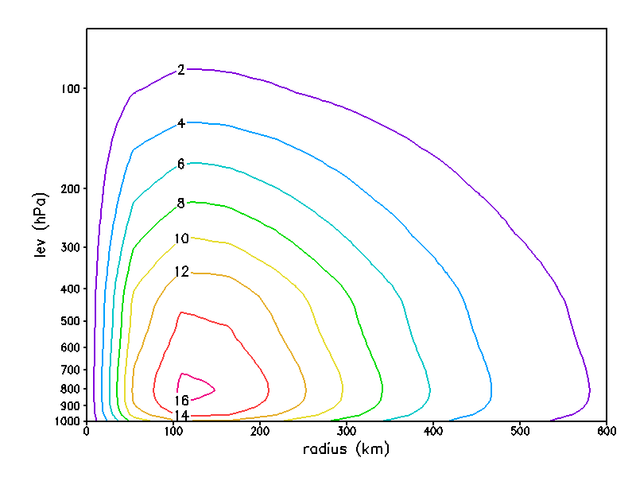
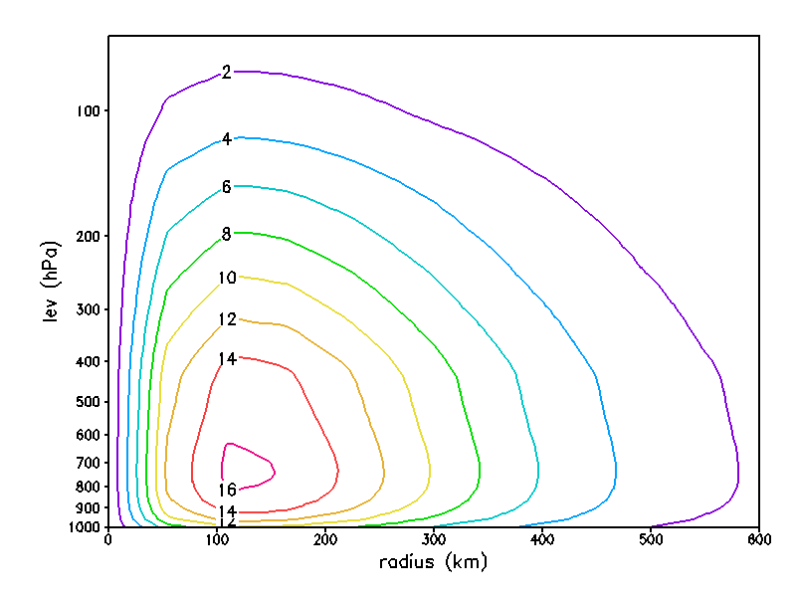
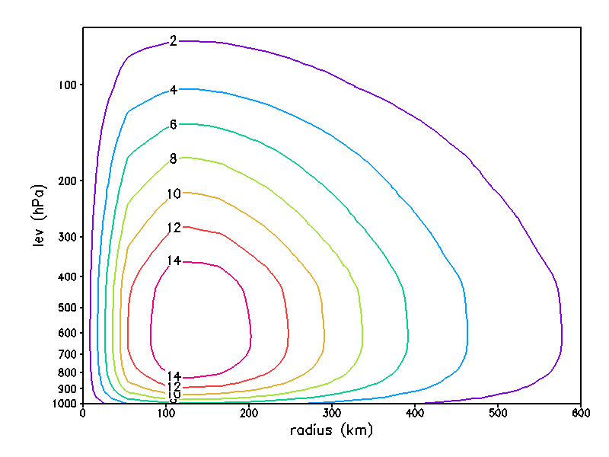
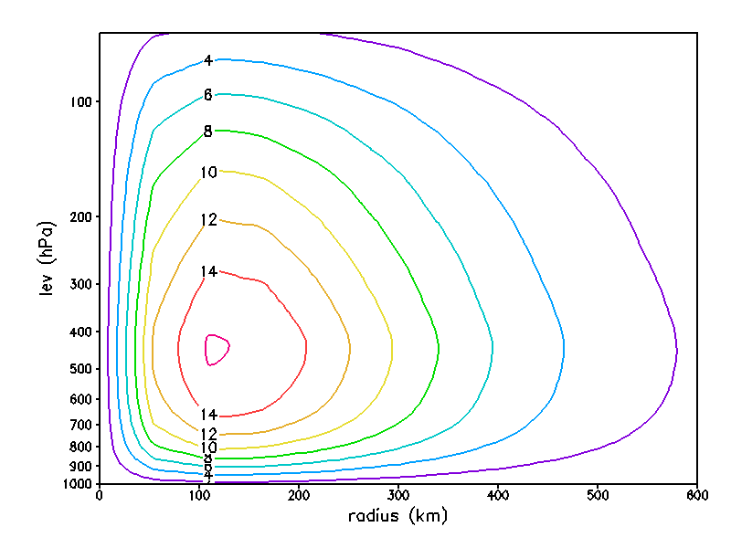
Experiment design
Use HWRF idealized configuration (Gopal et al);
Modify the bogus initial structure to allow for changing the level of the VMAX
δ ∈ [0,1]
δ =0
δ =0.1
δ =0.2
δ =0.4
δ =0.6
δ =1.0

Slide 6
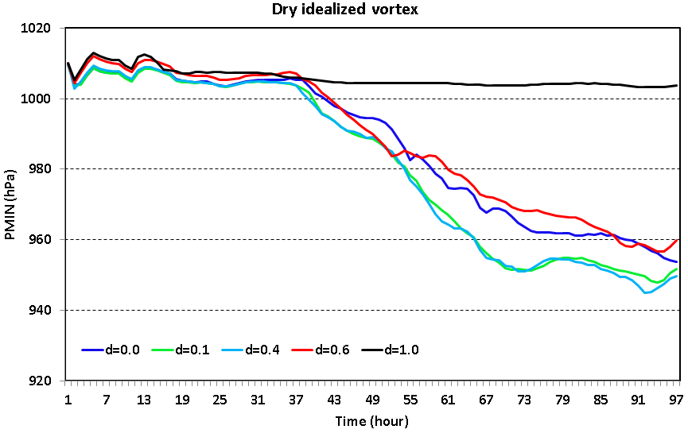
Results: dry environment
Lower Z_{VMAX} allows for larger radial momentum flux, thus intensifying storm
Lower Z_{VMAX} allows for large surface fluxes, thus intensifying storm
Lower Z_{VMAX} however has larger frictional forcing, thus decelerating the storm
whether a storm will grow will depends on which mechanisms dominate. But what is going on during the first 2 days.

Slide 7
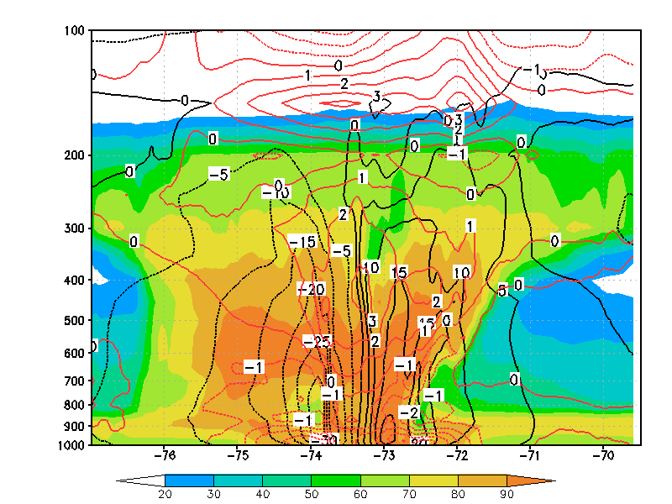
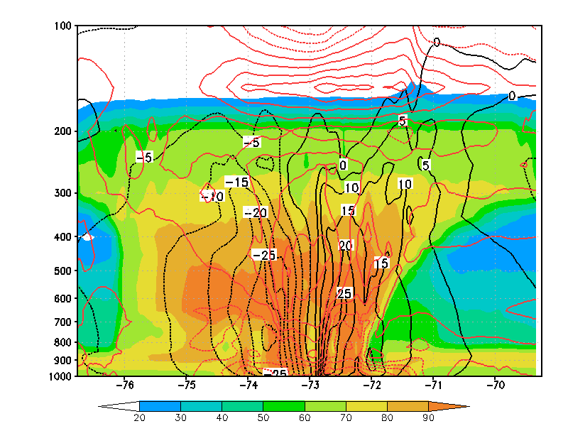
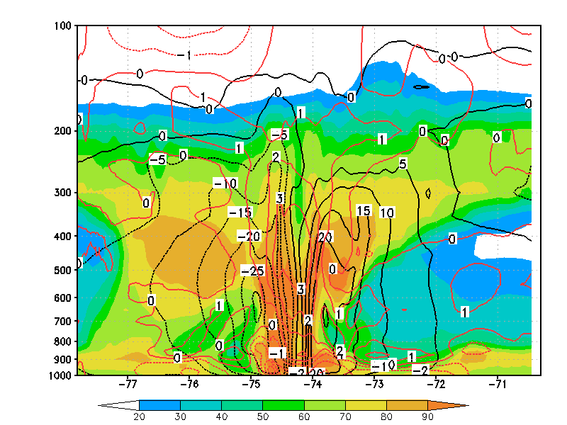
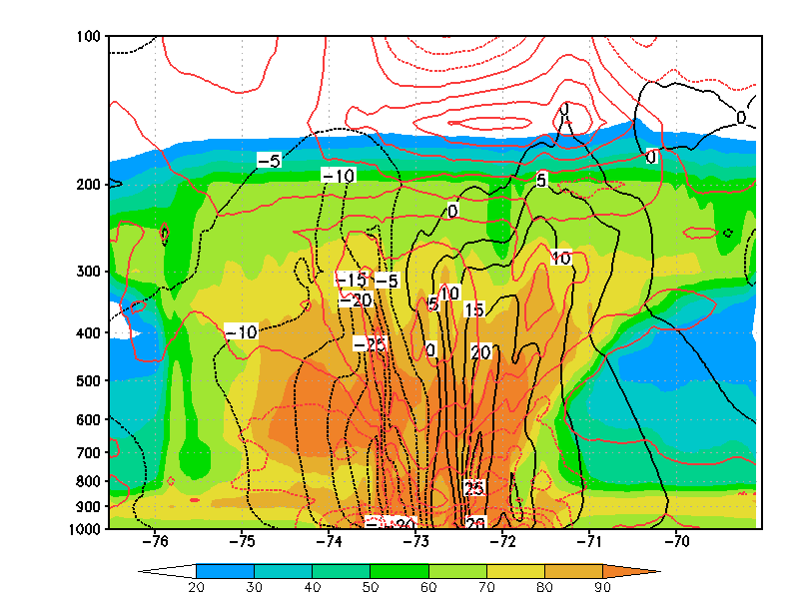
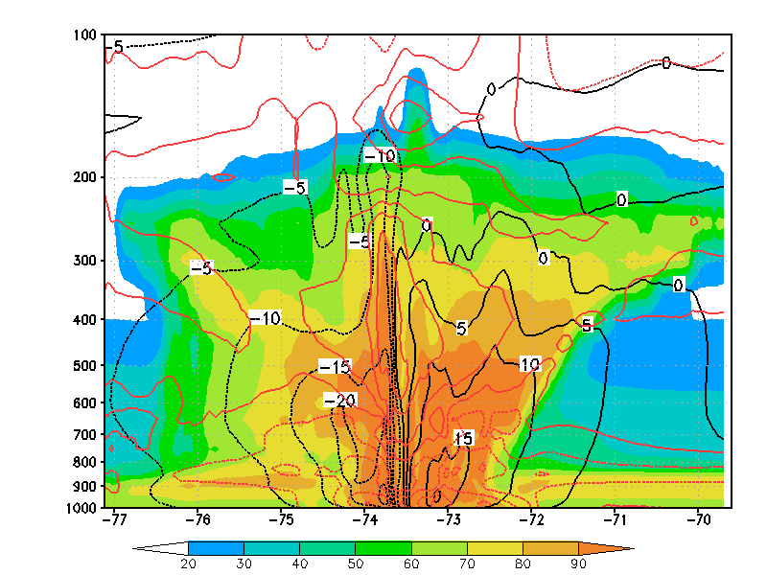
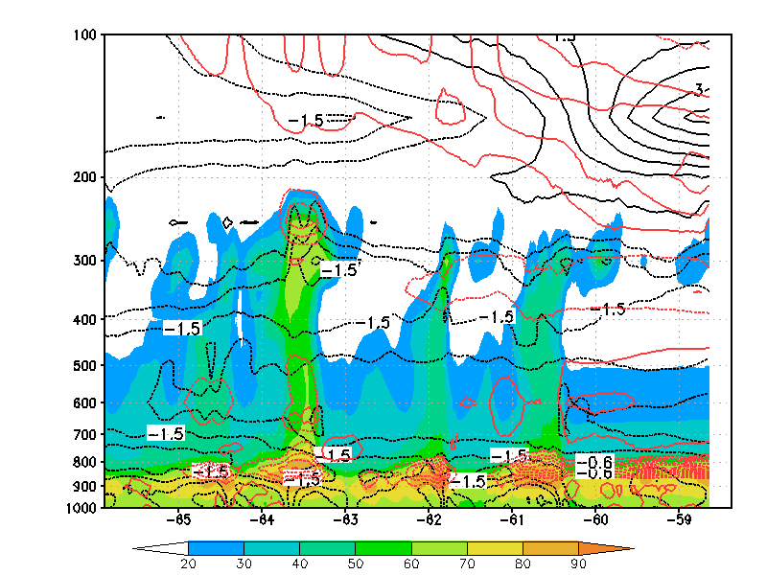
Results: dry environment
δ =0
δ =0.1
δ =0.2
δ =0.4
δ =0.6
δ =1.0
the storm will grow only if the moist structure is ‘phase-locked’ with wind structure and a warm core aloft
high RH core is much needed as it allows for latent heating released within the core
Too low moist content at midlevel for reaching saturation, while lower Z_{VMAX} vortex can bring more moist to up level.

Slide 8
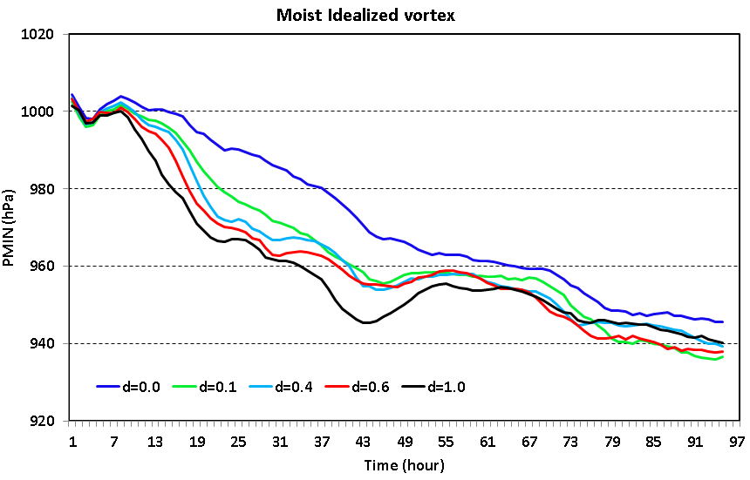
Results: moist environment
Vortex with higher Z_{VMAX} now grows faster
Time to start the RI is shorter

Slide 9
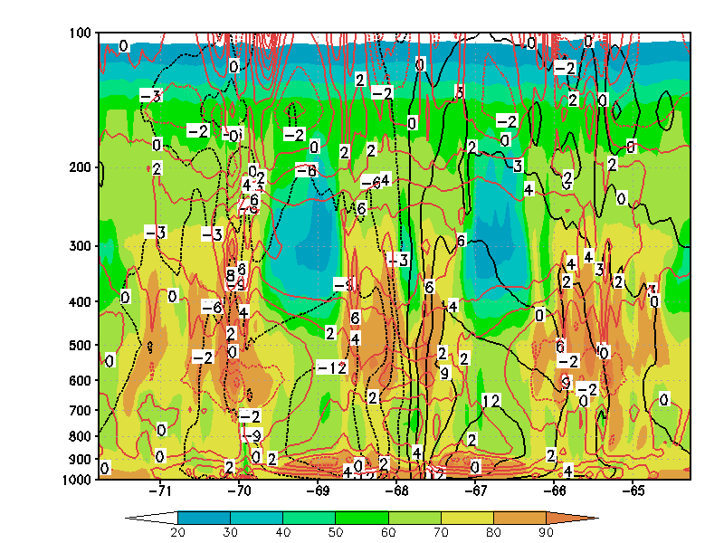
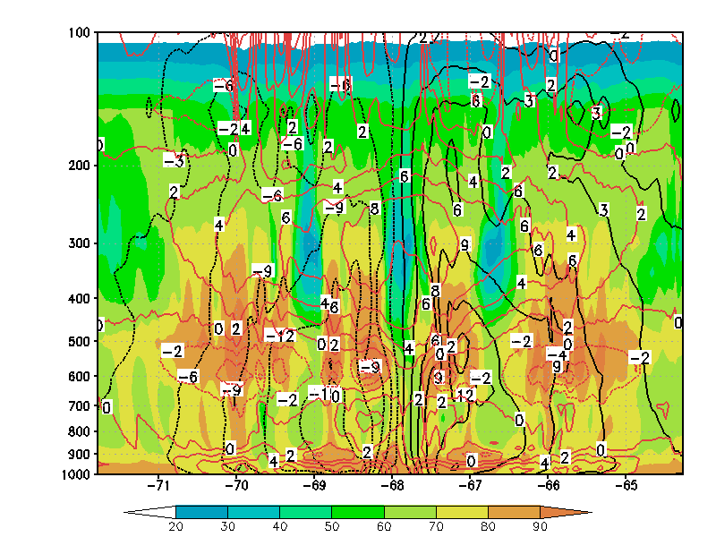
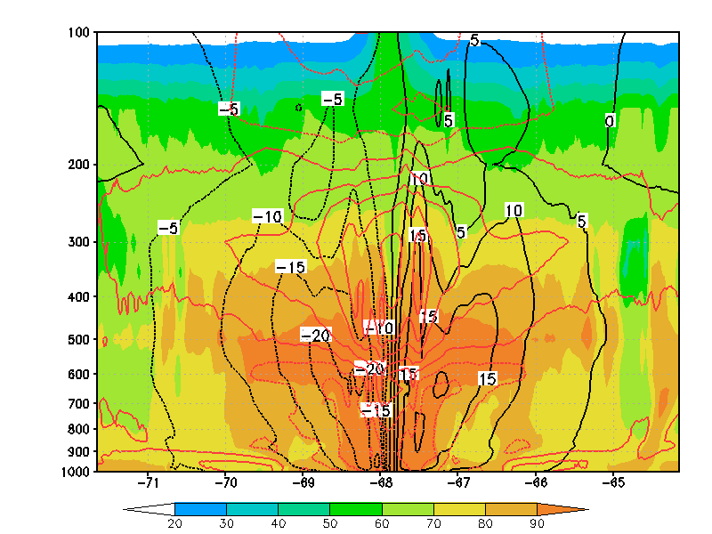
Results: moist environment
δ =0, t= 10h
δ =0.1, t =10h
δ =1.0, t = 10h
The phase-lock of a saturated warm core and organized circulation determines the trigger of the RI;
Mid-level vortex somehow can organize saturated core quickly in moist environment . Need to understand why?

Slide 10
Conclusions
Correct vertical structure is important for the vortex initialization;
Moist initialization has to be properly accounted for in addition to the traditional wind structure;
Moist process is critical to ensure a correct capture of the RI.

