Slide 1
Hybrid variational-ensemble data assimilation system for HWRF
Mingjing Tong
Collaborator: David Perish, Daryl Kleist, Russ Treadon, John Derber
Xuyang Ge (UCAR), Fuqing Zhang (PSU)
HWRF team

Slide 2
Current Hybrid DA system for HWRF (1 way coupling)
Global EnKF ensemble forecast member 1
Global EnKF ensemble forecast member 2
Global EnKF ensemble forecast member 3
Data assimilation
HWRF initialization
Interpolated to HWRF domains
Global EnKF-GSI hybrid system control forecast
global forecast environment
control first guess
GSI
control analysis
control forecast
Hwrf forecast
Relocated vortex
w or w/o size and intensity correction
observation
2 way coupling hybrid system includes running EnKF. The control hybrid analysis will be feedbacked to the ensemble members by recentering the EnKF analysis to the control analysis

Slide 3
GSI (3DVAR) cost function
Ensemble-3DVAR hybrid formula
Additional term associated with
extended control variable ( α )
equivalent
(Wang et al. 2007)
* Equations from Wang et al. 2008 and 2010
Ensemble covariance is incorporated as part of the background error covariance though augmentation of control variables (Lorenc 2003; Buehner 2005; Wang et al. 2007)

Slide 4
TDR real time parallel (TDRP) configurations
 | HWRF | TDRP
Storm environment | GFS analysis | GDAS forecast
Vortex initialization | Full vortex initialization | Relocation only if TDR data are available
Use of GSI | Only for deep storms Isotropic static B | All storms Use FGAT Anisotropic B (some flow Dependency) in ghost domain
Data assimilated | Data time window [-1.5,1.5] hr Exclude inner core (150 km from TC center) SYNOP, METAR or sfc marine, ATLAS buoy, Sfc mesonet, synthetic t.c. wind data | Data time window [-3,3] hr Assimilate all data Assimilate TDR data
All hybrid experiments follow TDRP configuration, except B is a combination of static B and ensemble B

Slide 5
A real time run with hybrid DA

Slide 6
Hybrid DA test with Adrian 01e

Slide 7
Pseudo-ensemble hybrid for HWRF
Poterjoy and Zhang (2011): Wavenumber 0 storm structures have the largest influence on both ground- and storm-relative forecast uncertainty for TCs with category 1 or higher intensity.
Back ground error covariance is dominated by wavenumber 0 component.
Flow-dependent forecast covariance can be approximated from a sample of near-axisymmetric TC vortices
TC vortices are created by running idealized 3 km resolution HWRF simulations and grouped by intensity
More information about TC vortices library can be found in Xuyang Ge’s Sept. 8th presentation.

Slide 8
Realization of Pseudo-ensemble hybrid in GSI
Global ensemble members are first interpolated to HWRF d01 and ghost domain
Calculate ensemble perturbations from global ensemble
TC library vortices are mapped to the background vortex region (300 km from background TC center) in ghost domain
Calculate ensemble perturbations from TC library
Replace global ensemble perturbations with TC library perturbations within 150 km from background TC center
TC library perturbations are gradually blended with global ensemble perturbations from 150 km to 300 km from background TC center
Perform hybrid analysis following algorithm in slide 3
T perturbations from member 1

Slide 9
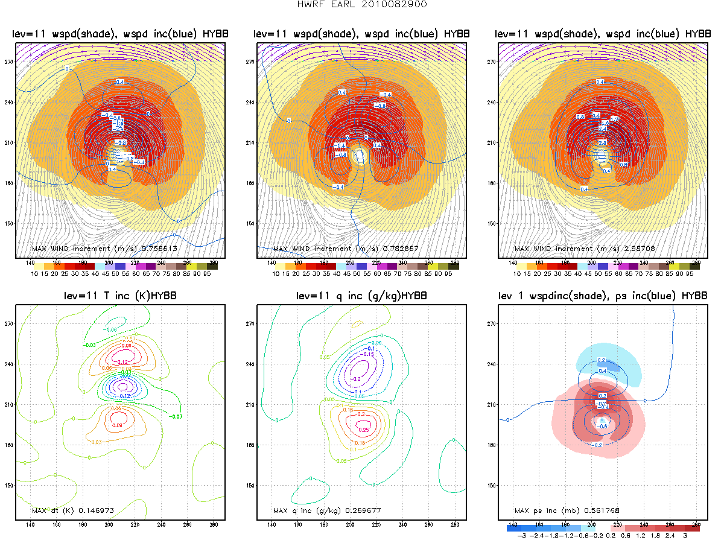
Analysis increment from single obs test u obs at 0.5 degree north of storm center at 850 level
PEDA
HYBB
PEDA – hybrid DA with pseudo-ensemble HYBB – hybrid DA with pure global ensemble

Slide 10
Analysis increment from single obs test u obs at 0.5 degree north of storm center at 850 level
PEDA
HYBB
PEDA – hybrid DA with pseudo-ensemble HYBB – hybrid DA with pure global ensemble

Slide 11
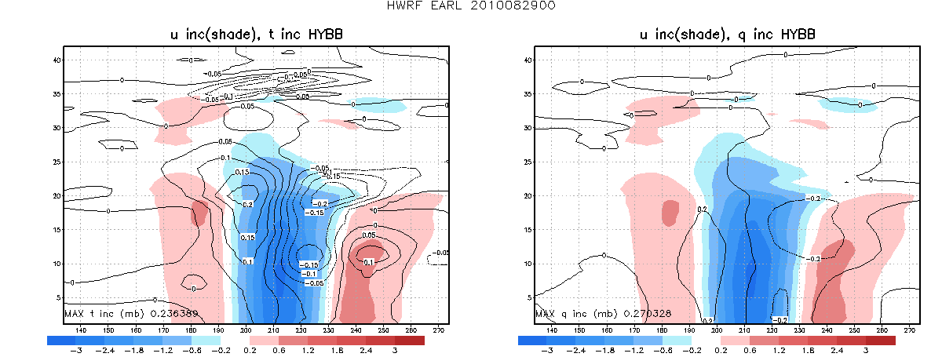
Analysis increment from single obs test u obs at 0.5 degree north of storm center at 850 level
PEDA
HYBB
PEDA – hybrid DA with pseudo-ensemble HYBB – hybrid DA with pure global ensemble

Slide 12
Hybrid TDR test with Hurricane EARL

Slide 13
Hybrid TDR test with Hurricane EARL

Slide 14
Hybrid TDR test with Hurricane EARL

Slide 15
First TDR DA cycle

Slide 16
Hybrid TDR test with Hurricane EARL
PEDA
Dual-Doppler analysis plot by Xuyang

Slide 18
Conclusion and plans
The initial results of hybrid data assimilation experiments are neutral. The analysis of individual cycles of EARL case is ongoing.
No much more computational cost is added by using PEDA. No need to worry about moving nest.
Intensive hybrid test will be done with the ensemble data from the new global parallel run (prd12q3k)
More test and analysis with PEDA will be done by Xuyang Ge. Xuyang will also work on improve the TC library and deal with the issue of lack of size variability in the TC library and taking into account weak storms.
Move on to 27-9-3 HWRF. May take more advantage of PEDA by running higher resolution of HWRF.
Move on the 2 way coupling hybrid by collaborating with AOML/HRD and Jeff Whitaker

