Slide 1
The NOAH LSM in HWRF 2010 vs 2011 (preliminary)
Bob Tuleya

Slide 2
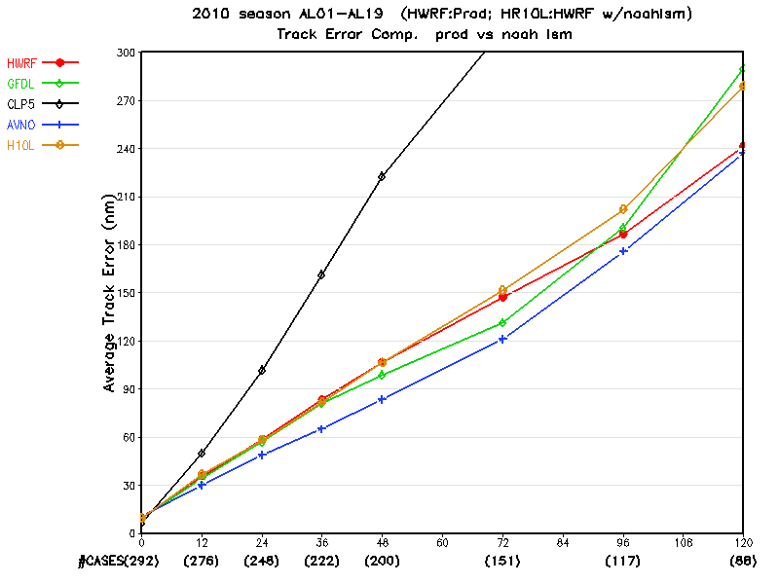
Track NOAH LSM test cases 2010 AL01-AL19
Noah lsm worse
Why???

Slide 3
Example of Alex (2010) two problems areas
Hot spots in LST in parent & nest
Apparent lateral BC problems

Slide 4
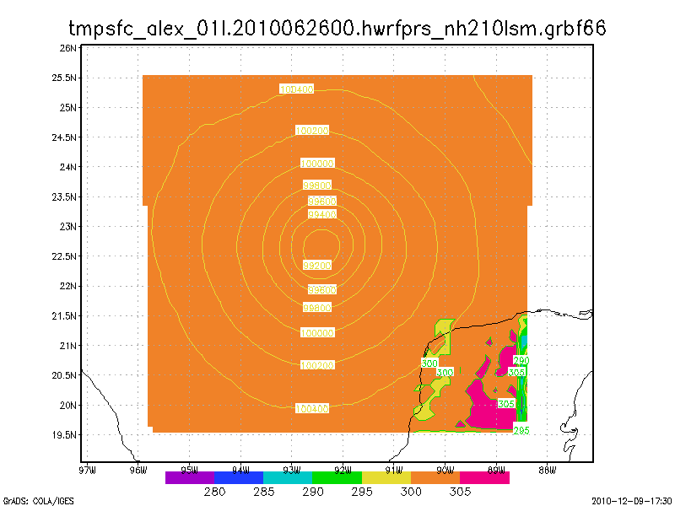
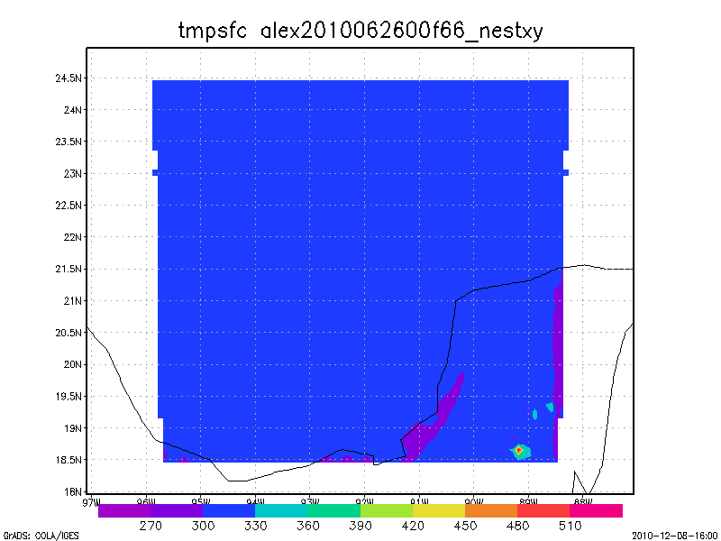
R2 makes problems worse R2 blows up in nest with very hot LST
H210 NOAH LSM
R2 NOAH LSM
LST hot spot >500K

Slide 5
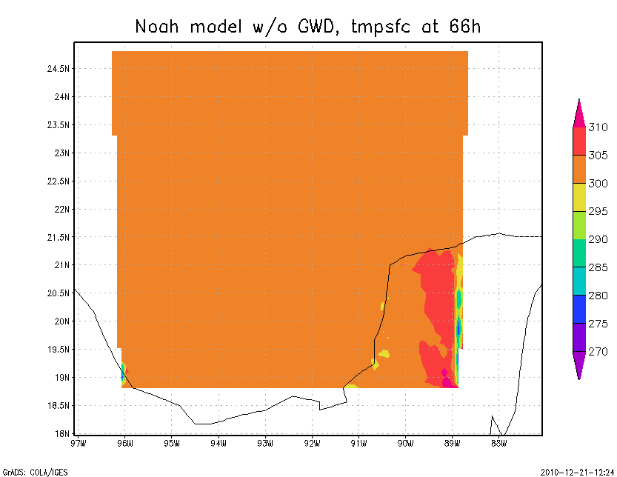
Apparent sensitivity to GWD?? BC problems remain, very hot spots removed

Slide 6
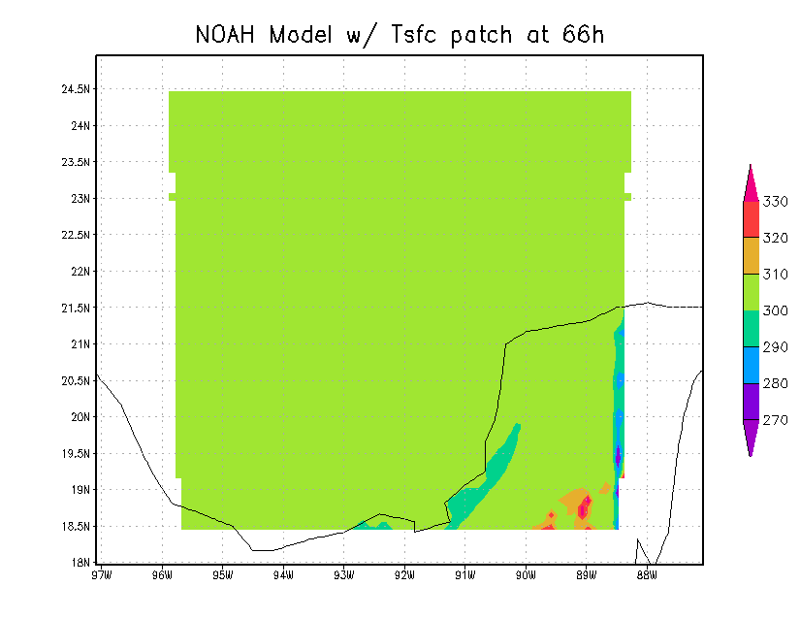
Apply patch to fix Tsfc values along perimeter after LSM call, hot spots reduced/removed

Slide 7
2011 HWRF LSM
Atlantic season only 283 cases al05-al17
Run with netcdf option ????

Slide 8
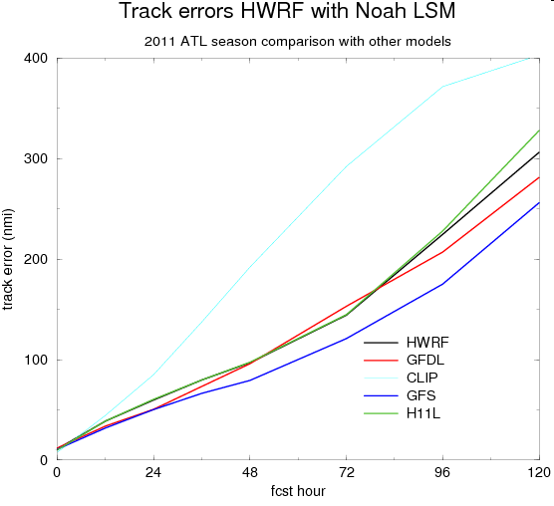
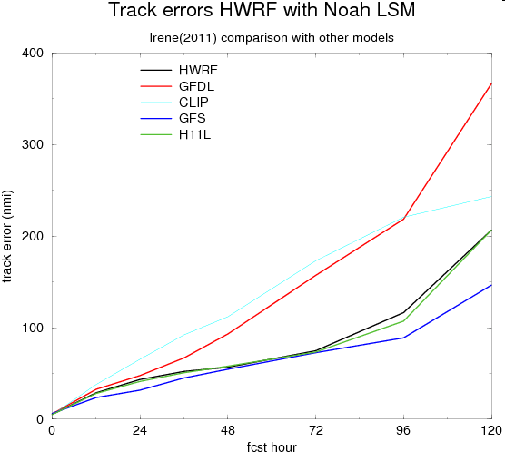
Atlantic season…Irene

Slide 9
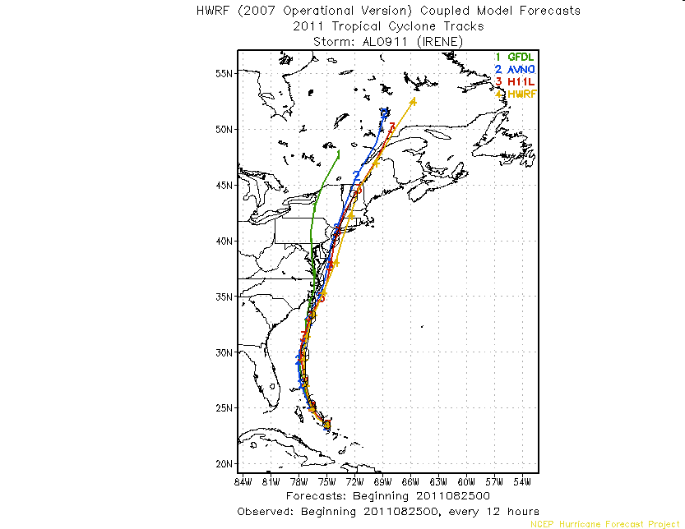

Slide 10
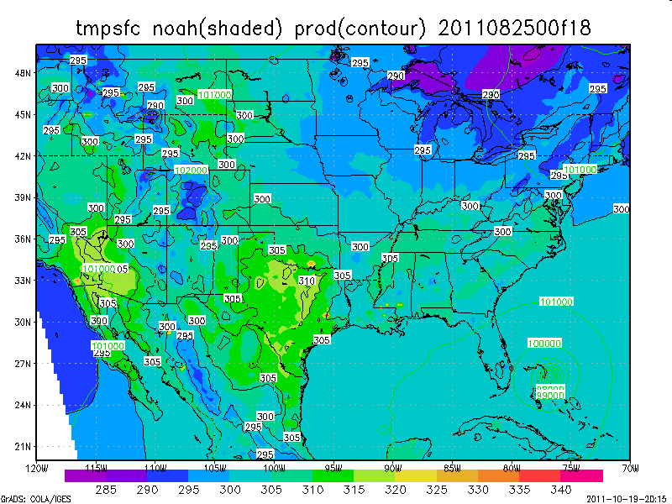

Slide 11
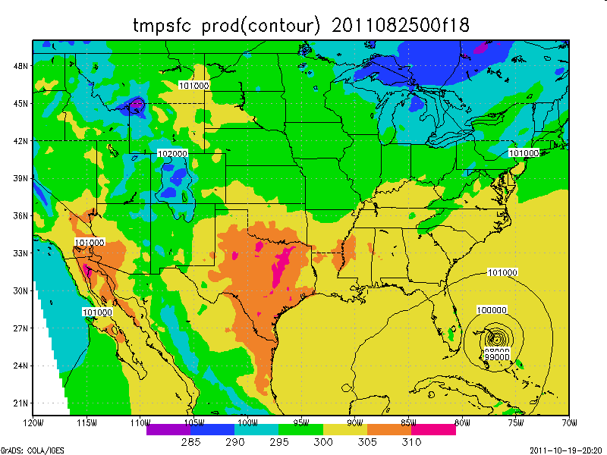

Slide 12
Preliminary Results 2011 HWRF with NOAH LSM
Track error very close to operational HWRF small degradation at 120h ???
Intensity error almost the same as operational
More realistic variability in land surface temperature
Investigate noise at boundaries
Investigate netcdf vs binary
Rainfall verificatio
Stream routing….

