Slide 1
Stability of Hurricane Intensity Equilibrium
Chanh Kieu
Department of Earth and Atmospheric Sciences
Indiana University, Bloomington
College Park, May 2017

Slide 2

Outline
Motivation
Hurricane-scale dynamics
MPI equilibrium and stability
Role of tropospheric stratification
Upcoming plans
Concluding remarks

Slide 3

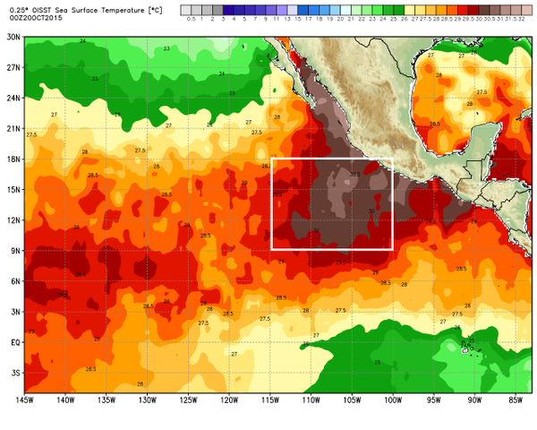
Motivation
Emanuel’s MPI
Patricia rapidly developed on 18-24 Oct 2015
Invest 96E struggled from 10-15 Oct 2015
There must be something else beyond the SST control !!!

Slide 4
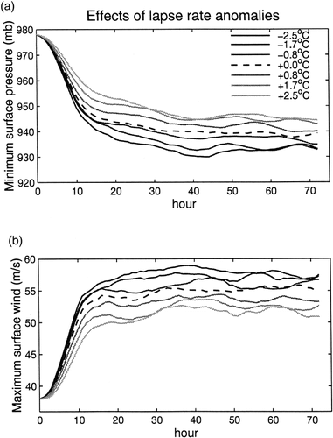
Motivation
Emanuel (2005)
Studies by Shen et al. (2000), Hill and Lackmann (1998), and Lin and Chan (2015) point out somethings beyond the SST;
Less stable atmosphere produces a stronger storm at MPI equilibrium, even under the same SST/outflow → the tropospheric stratification is likely an important factor;
Shen et al. 2000
Notes:
To put this in more systematical framework, let take a look at E05 vs. S00
Important results but not realized in Emanuel’s MPI formula -> revisit the MPI problem to see how to incorporate the stratification
http://journals.ametsoc.org/doi/full/10.1175/1520-0442%282000%29013%3C0109%3AASSOTT%3E2.0.CO%3B2

Slide 5
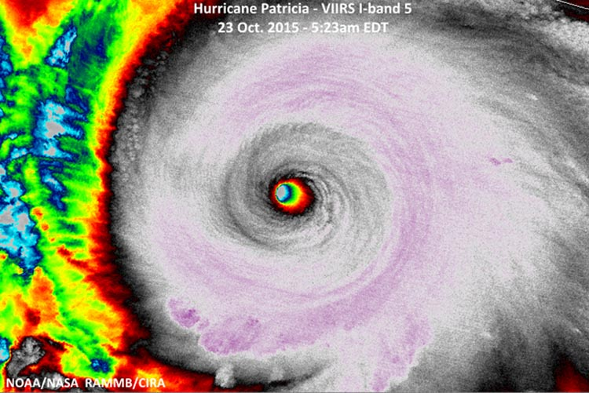
Hurricane-scale dynamics
Cloud top temp
RMW/eye
VMAX
Storm size
PMIN
Notes:
The question we have here is that is there anyway that could elucidate this result beyond the numerical method.

Slide 6
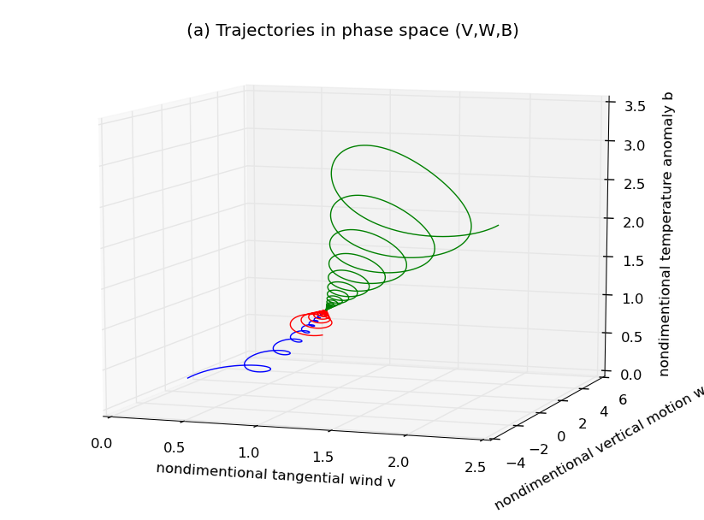
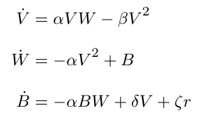
Hurricane-scale dynamics
Kieu (2015, QJ) proposed a low-order model that represents the hurricane development by a set of scales in a reduced phase space under the WISHE feedback:
V: maximum surface wind
W: maximum vertical motion in the eyewall
B: buoyancy anomaly at the center (warm core)
U: maximum surface radial wind
ΔP: surface pressure deficit
The MPI is structurally stable and unique;
The MPI is characterized by (V,W,B);
The WISHE hypothesis is consistent with the MPI’s stability ;

Slide 7
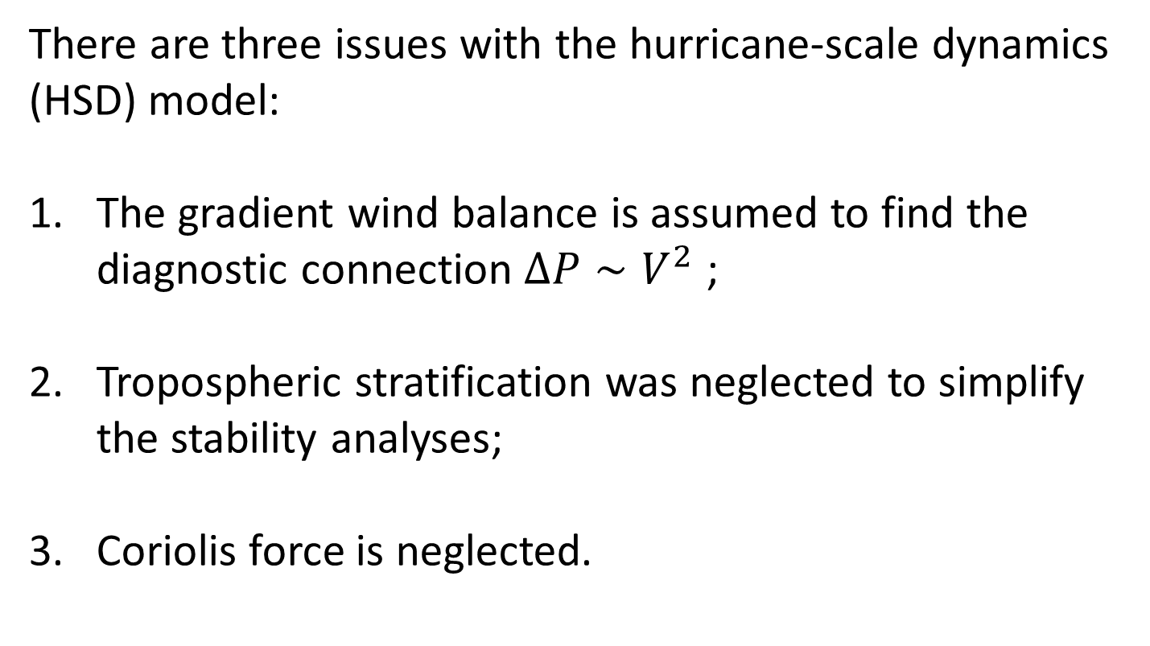
Hurricane-scale dynamics
There are three issues with the hurricane-scale dynamics (HSD) model:
The gradient wind balance is assumed to find the diagnostic connection $ΔP∼V^{2}$ ;
Tropospheric stratification was neglected to simplify the stability analyses;
Coriolis force is neglected.

Slide 8
Modified hurricane-scale dynamics
Kieu and Wang (2017a,b) revisited the HSD model and proposed a modified version (MSD) for the hurricane scales as follows:
V: maximum surface wind
W: maximum vertical motion
B: buoyancy anomaly at the center
U: maximum surface radial wind
ΔP: surface pressure deficit

Slide 9
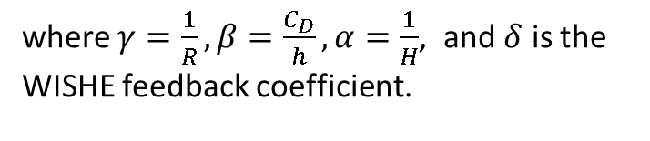
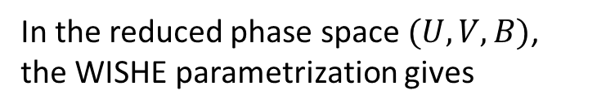
Modified hurricane-scale dynamics
In the reduced phase space $(U,V,B)$, the WISHE parametrization gives
where $γ=\frac{1}{R}, β=\frac{C_{D}}{h}, α=\frac{1}{H}$, and $δ$ is the WISHE feedback coefficient.
The same structurally stable and unique MPI equilibrium;
The WISHE hypothesis is again consistent with the MPI’s stability ;

Slide 10
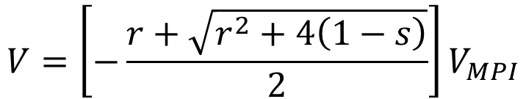

Modified hurricane-scale dynamics
In the presence of the tropospheric stratification and gradient wind imbalance, the MPI equilibrium is however quite different
$$V=\left[−\frac{r+\sqrt{r^{2}+4\left(1−s\right)}}{2}\right]V_{MPI}$$
$r$: nondimensional radiative cooling parameter
$s$: nondimensional stratification parameter
Larger radiative cooling leads to a weaker MPI

Slide 11
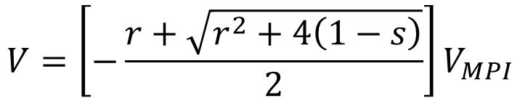

Modified hurricane-scale dynamics
The tropospheric stratification has a much larger control on the MPI, even with the same SST and outflow temperature
$$V=\left[−\frac{r+\sqrt{r^{2}+4\left(1−s\right)}}{2}\right]V_{MPI}$$
$r$: nondimensional radiative cooling parameter
$s$: nondimensional stratification parameter
More stable troposphere leads to a rapidly weaker MPI

Slide 12
Modified hurricane-scale dynamics
The tropospheric stratification has a larger control on the MPI than previously thought

Slide 13
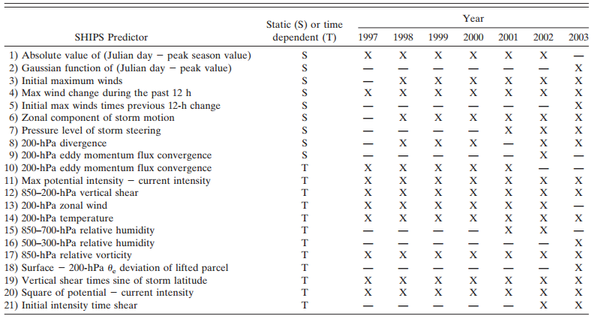
Implications
The role of tropospheric stratification on the MPI has very significant implications for practical purposes.
TC-climate variability: Shen et al. (2002), Hill and Lackmann (2005), Li and Chan (2015), Wang et al. (2012)…. SST is not the only proxy for TC variability
SHIP intensity forecasts (DeMaria et al. 2005):
Notes:
SHIPS: http://rammb.cira.colostate.edu/research/tropical_cyclones/ships/docs/2005_WAF_DeMaria_SHIPS.pdf

Slide 14
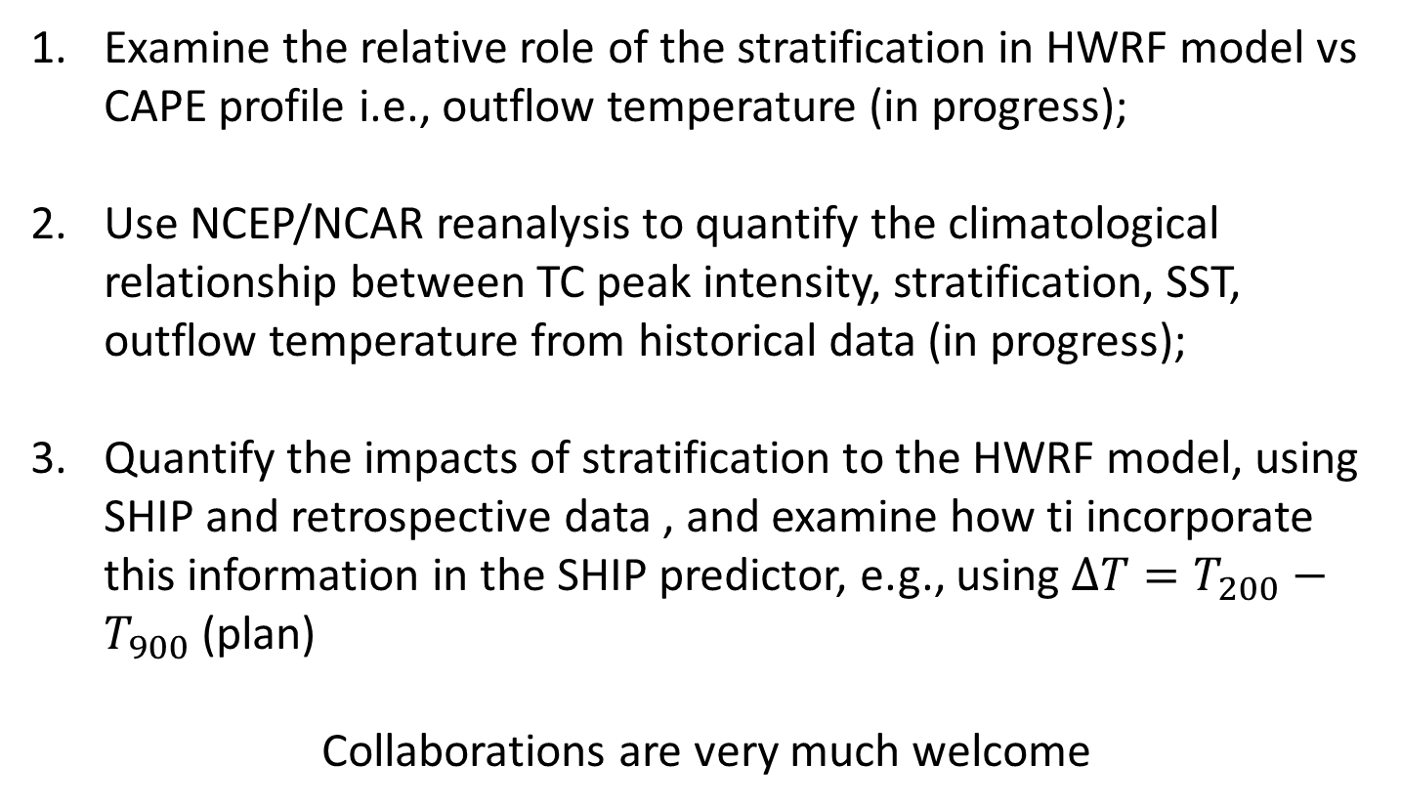
What next?
Examine the relative role of the stratification in HWRF model vs CAPE profile i.e., outflow temperature (in progress);
Use NCEP/NCAR reanalysis to quantify the climatological relationship between TC peak intensity, stratification, SST, outflow temperature from historical data (in progress);
Quantify the impacts of stratification to the HWRF model, using SHIP and retrospective data , and examine how ti incorporate this information in the SHIP predictor, e.g., using ${ΔT=T}_{200}−T_{900}$ (plan)
Collaborations are very much welcome

Slide 15
Conclusions
Tropospheric stratification plays a more important role to the MPI equilibrium than previously thought, which needs to be taken into account in future studies of TC development/variability;
The WISHE feedback provides not only a consistent MPI equilibrium, but also a structurally stable MPI equilibrium;
Gradient wind imbalance has minimum impacts to the stability of the MPI equilibrium;

Slide 16
Appendix

