Slide 1
Acronym:
H215: 2015 Operational HWRF, no ocean coupling;
HW61: L61, Ocean coupled;
H61A: HW61, but without;
HW43: L43, Ocean coupled

Slide 2
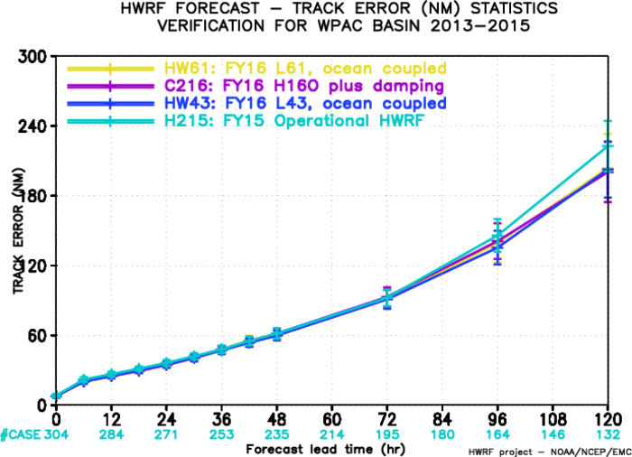
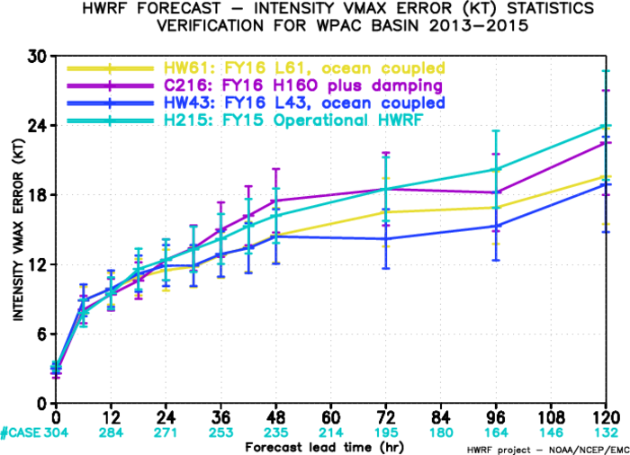
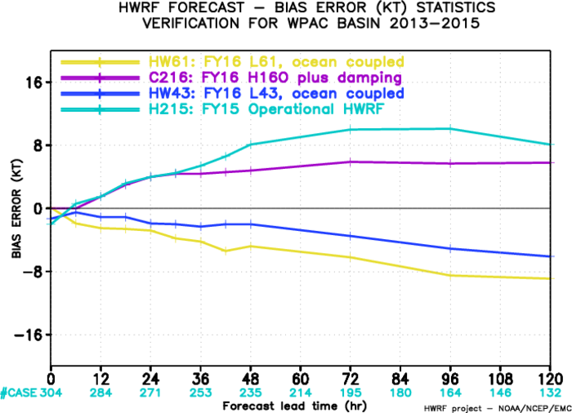
Verification for All 2015 WP Storms
------- HW61: L61, Coupled
------- H61A: L61, un-coupled
------- HW43: L43, Coupled
------- H215: FY15, Operational HWRF
------- HW61: L61, Coupled
------- H61A: L61, un-coupled
------- HW43: L43, Coupled
------- H215: FY15, Operational HWRF
------- HW61: L61, Coupled
------- H61A: L61, un-coupled
------- HW43: L43, Coupled
------- H215: FY15, Operational HWRF

Slide 3
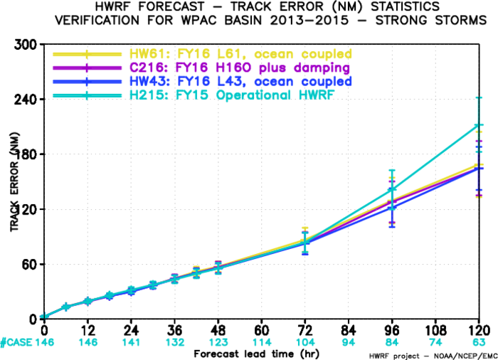
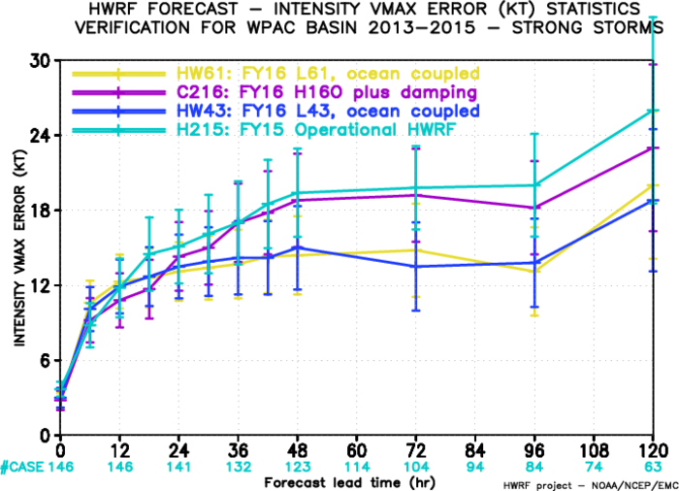
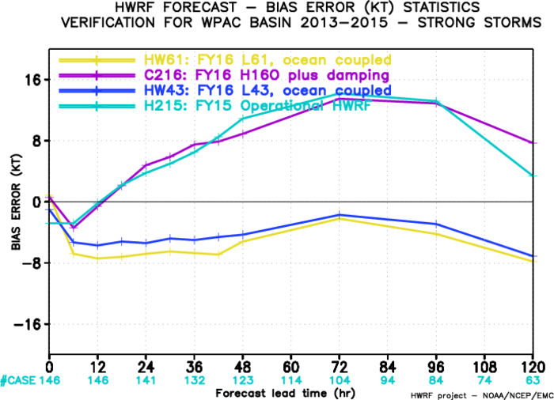
Verification for Initially Stronger 2015 WP Storms
------- HW61: L61, Coupled
------- H61A: L61, un-coupled
------- HW43: L43, Coupled
------- H215: FY15, Operational HWRF
------- HW61: L61, Coupled
------- H61A: L61, un-coupled
------- HW43: L43, Coupled
------- H215: FY15, Operational HWRF

Slide 4
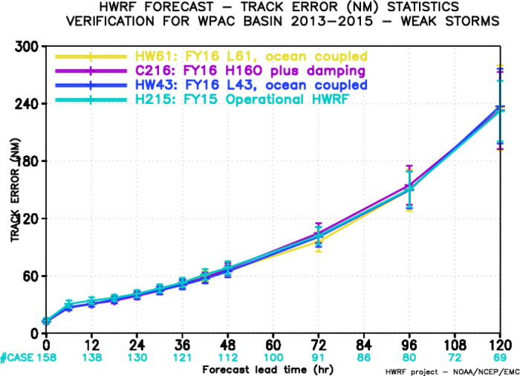
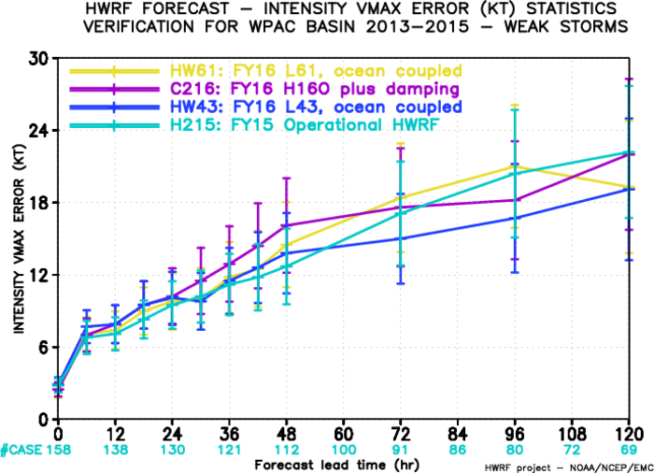
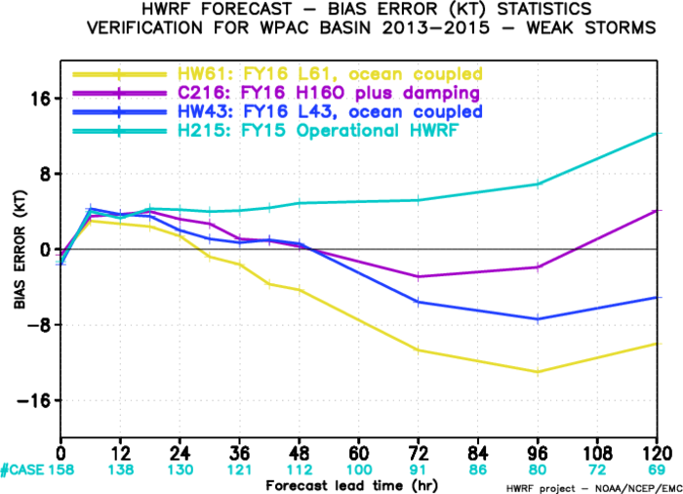
Verification for Initially Weaker 2015 WP Storms
------- HW61: L61, Coupled
------- H61A: L61, un-coupled
------- HW43: L43, Coupled
------- H215: FY15, Operational HWRF
------- HW61: L61, Coupled
------- H61A: L61, un-coupled
------- HW43: L43, Coupled
------- H215: FY15, Operational HWRF
------- HW61: L61, Coupled
------- H61A: L61, un-coupled
------- HW43: L43, Coupled
------- H215: FY15, Operational HWRF

Slide 5
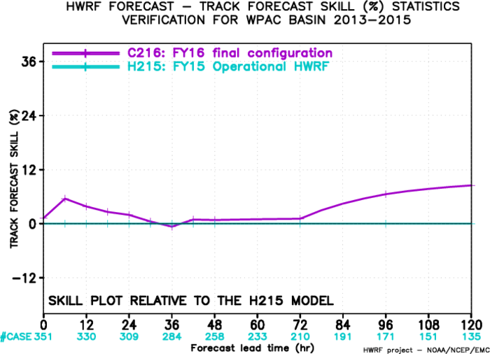
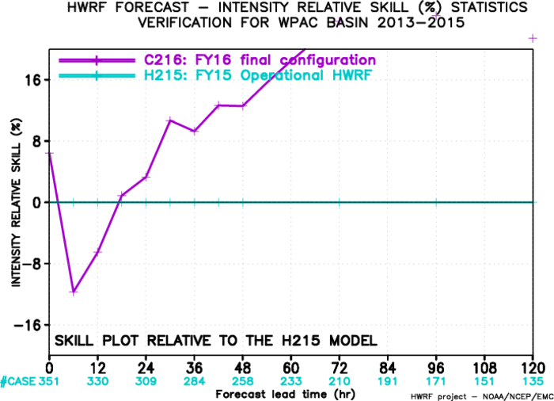
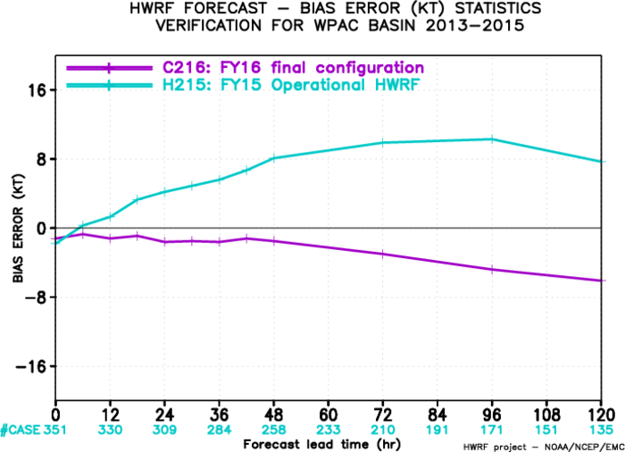
C216 Forecast Skills against H215 for WP Storms

