Slide 1
Outlier analysis H215/C216 (WPAC)
H215: FY15 Operational HWRF
C216: FY16 Final (WPAC)
(#Case WP:351)

Slide 2
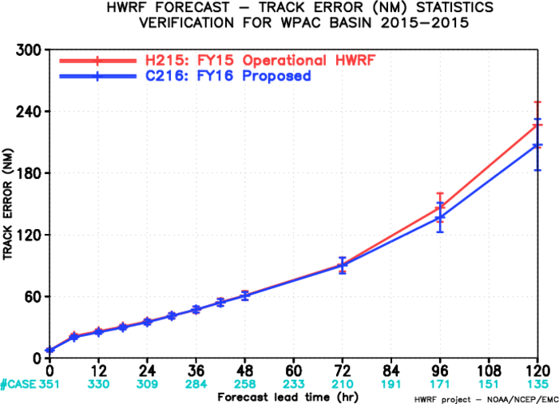
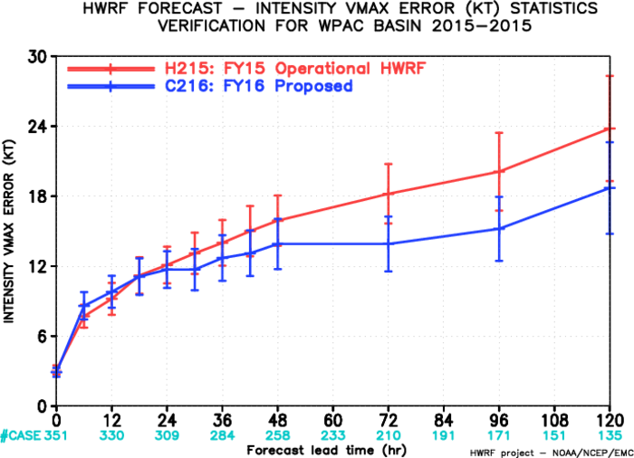
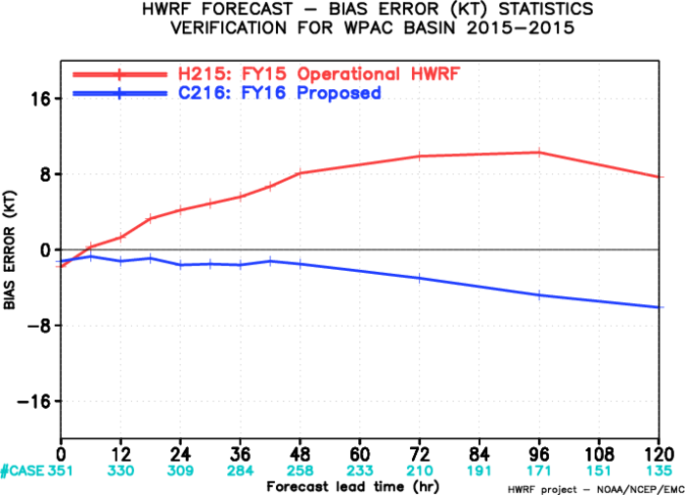
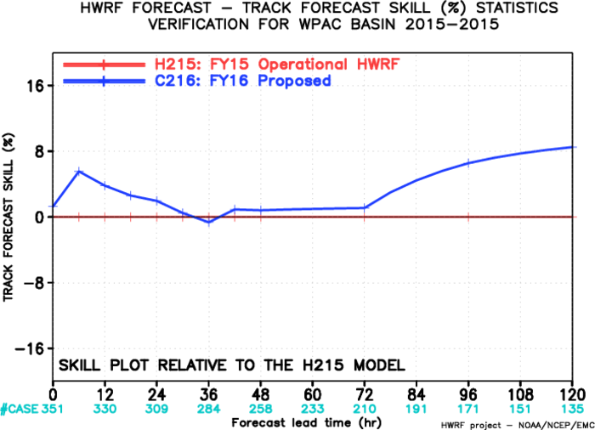
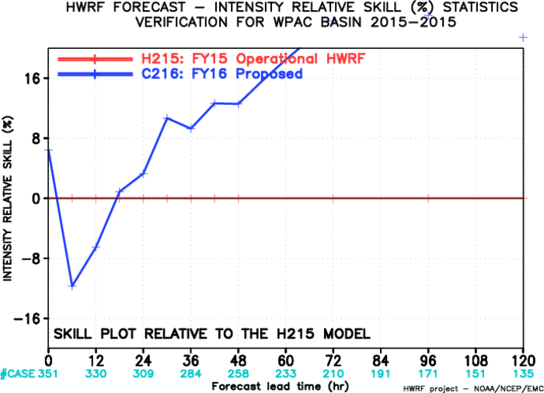
H215/C216, WPAC, 2015-2015
Improvement

Slide 3
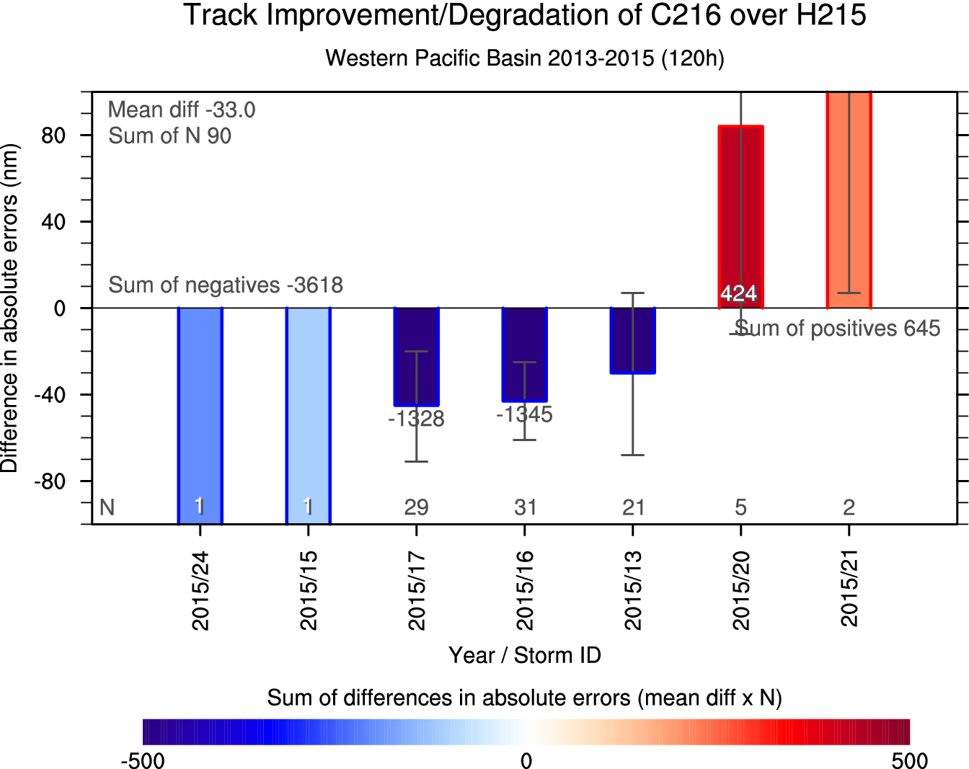
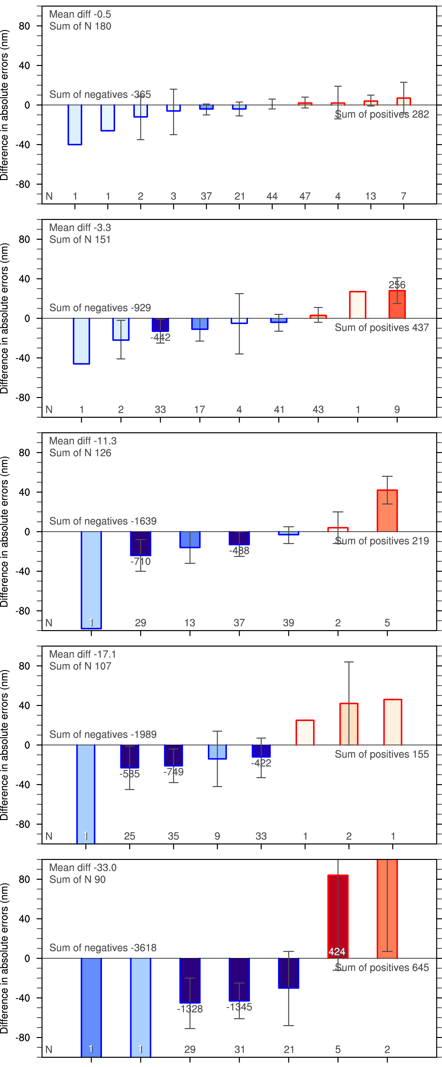
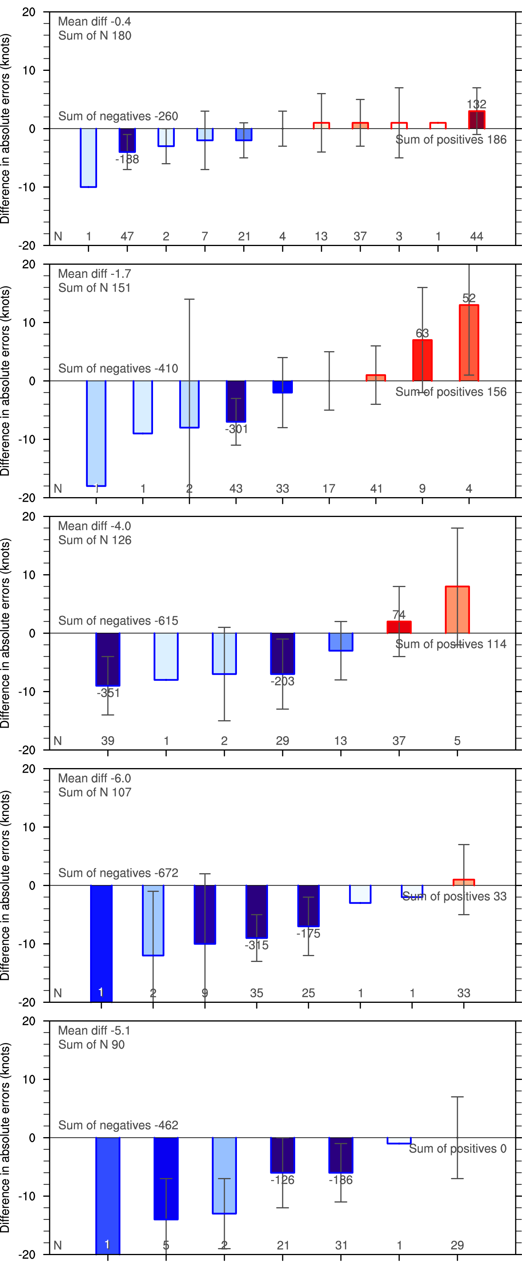
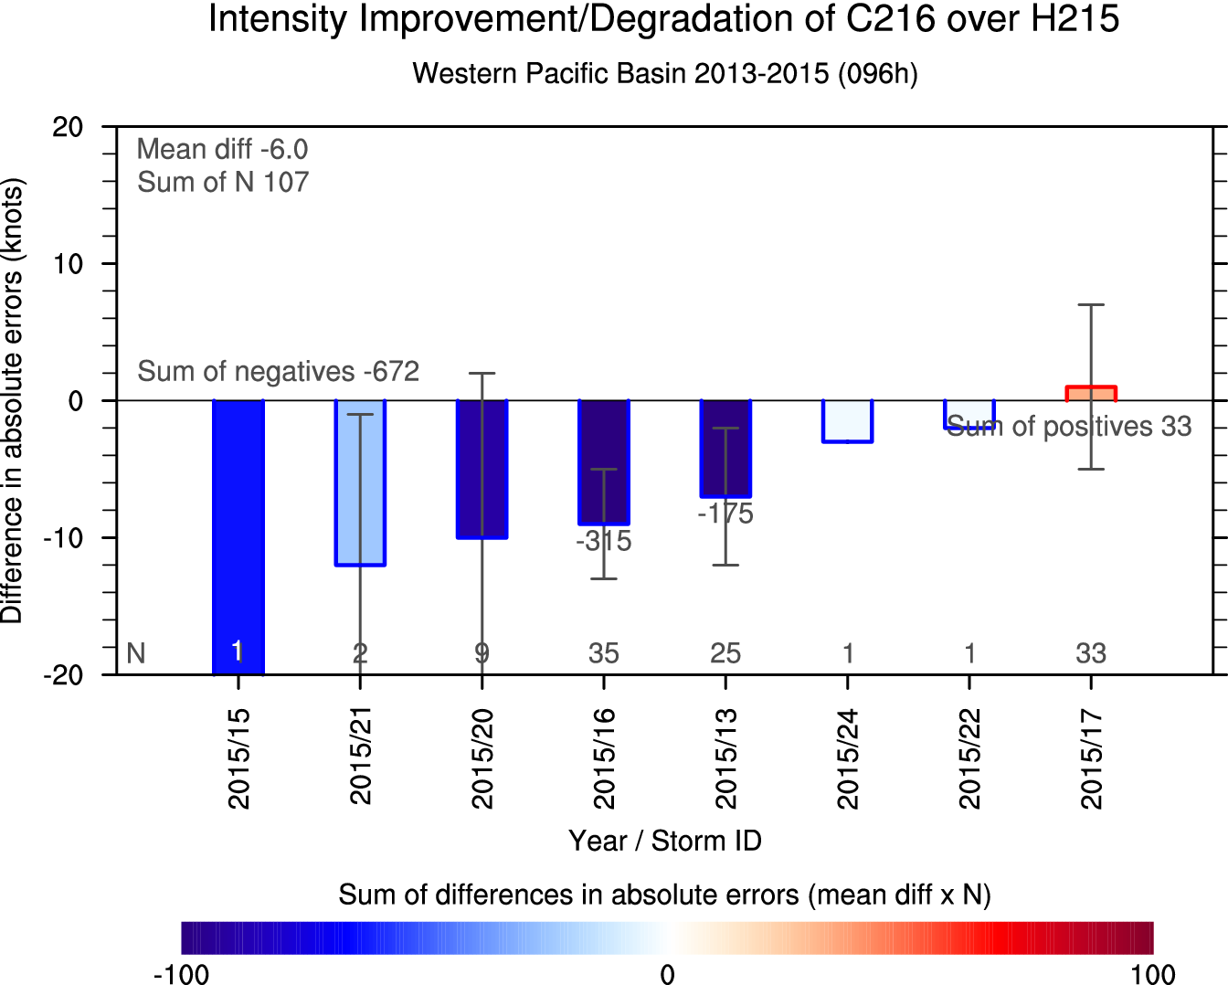
Imprv/Degrd of C216 over H215
Track
Intensity
24h
2015/16
24h
2015/17
48h
2015/13
2015/16
48h
2015/22
72h
2015/13
2015/17
2015/16
2015/13
72h
2015/22
2015/13
2015/16
2015/17
2015/16
2015/13
96h
96h
2015/13
2015/16
2015/17
2015/16
2015/13
120h
120h
2015/20
2015/21

Slide 4
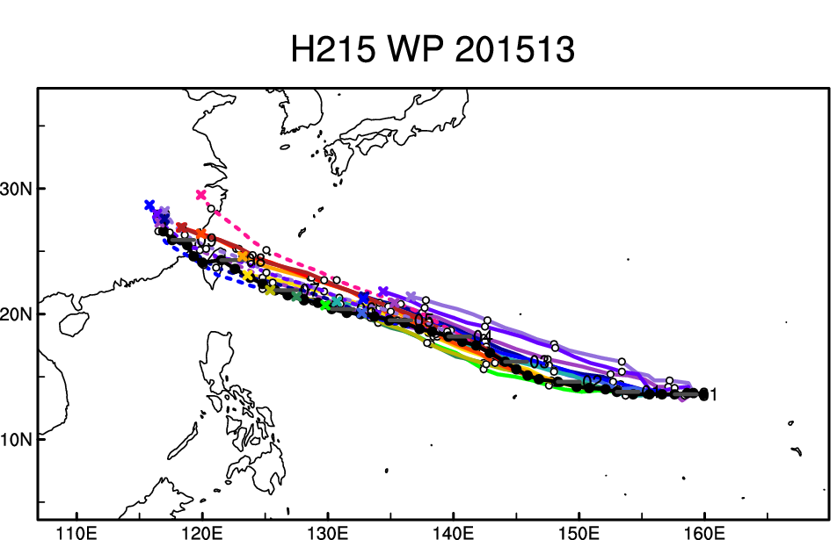
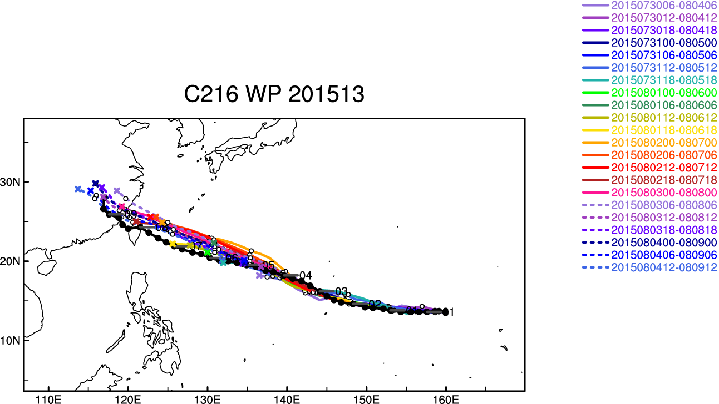
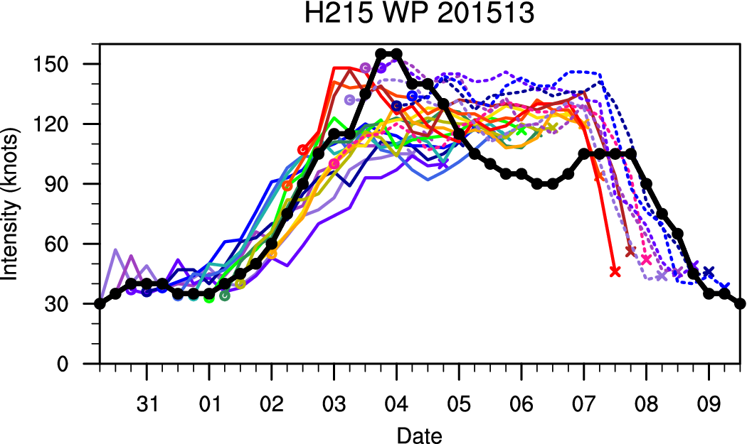
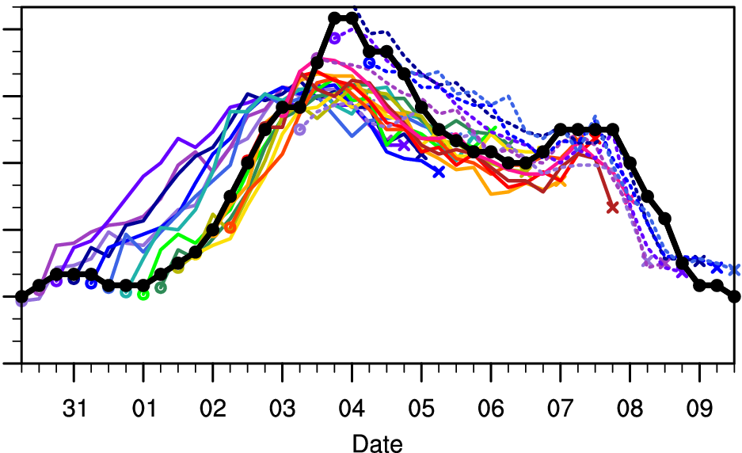
Case: 2015 13W Soudelor

Slide 5
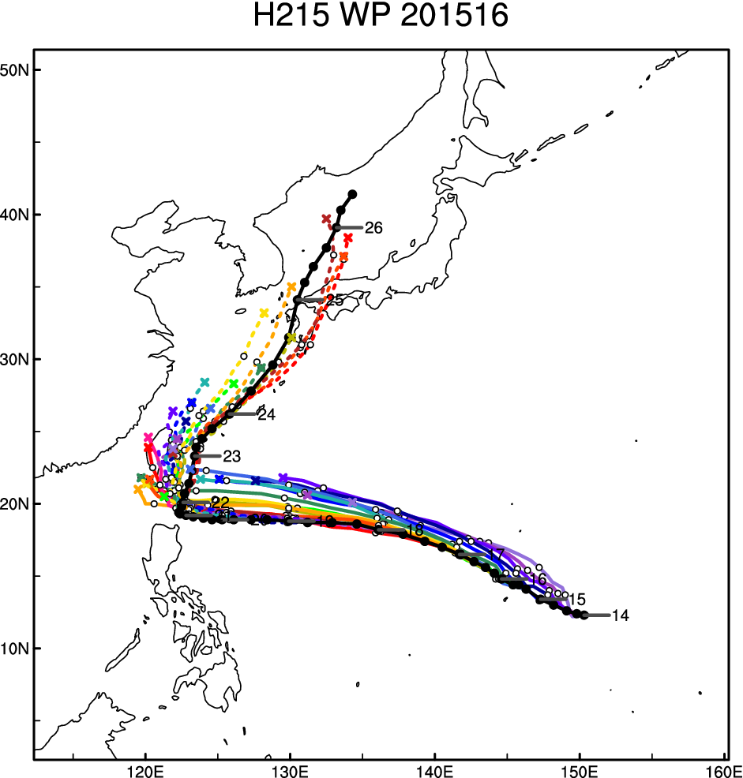
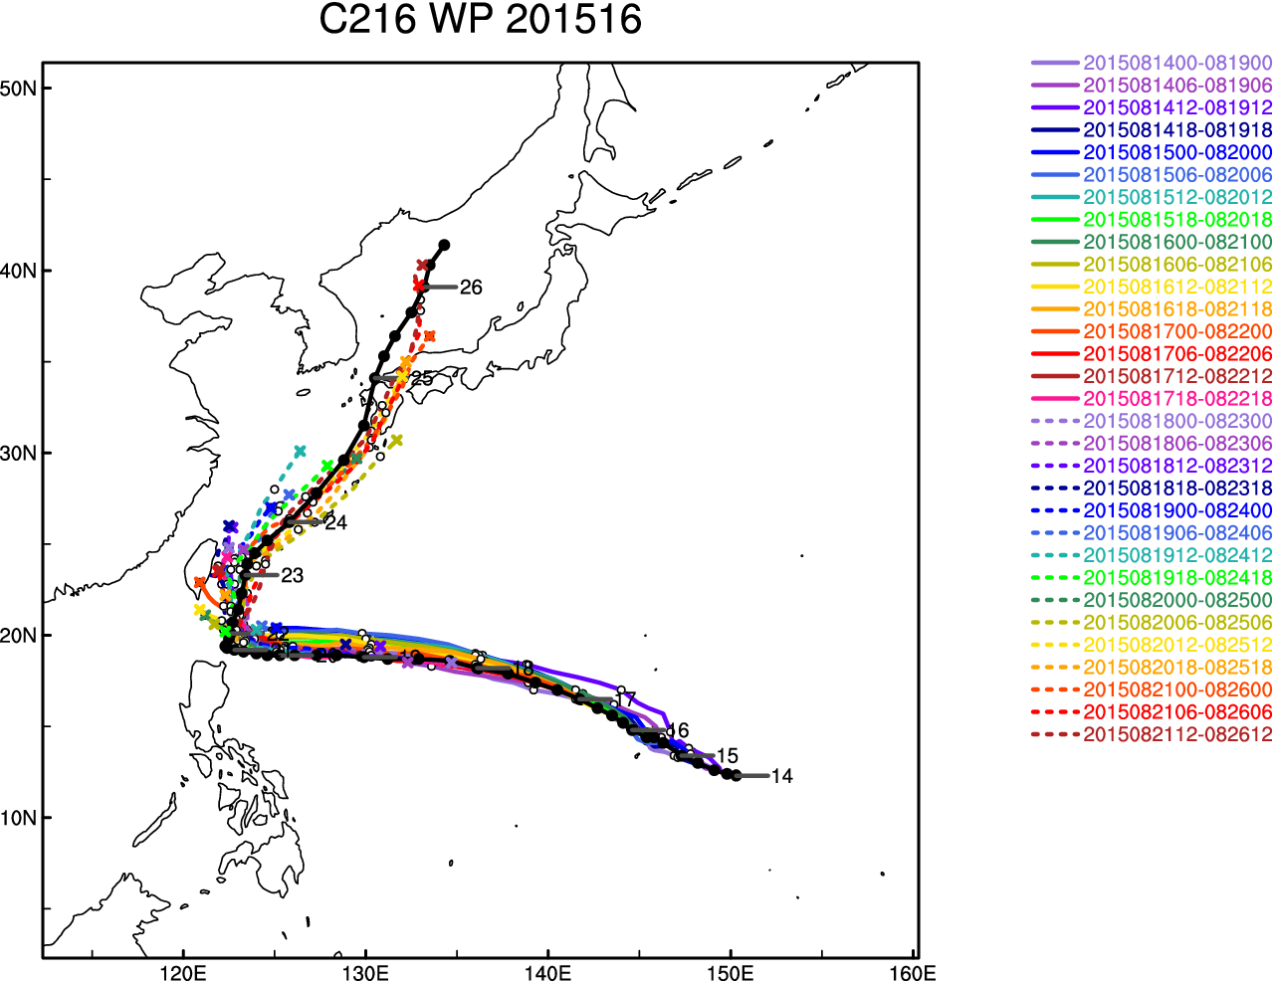
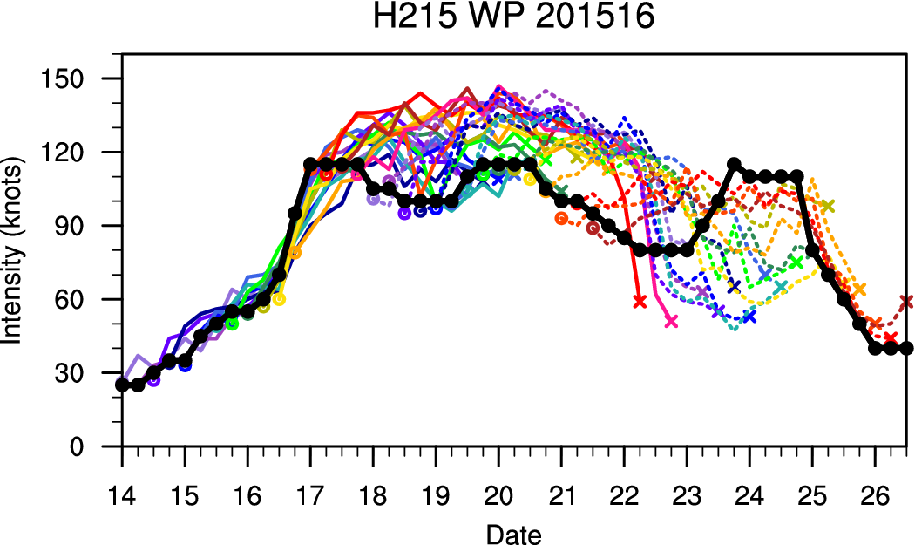
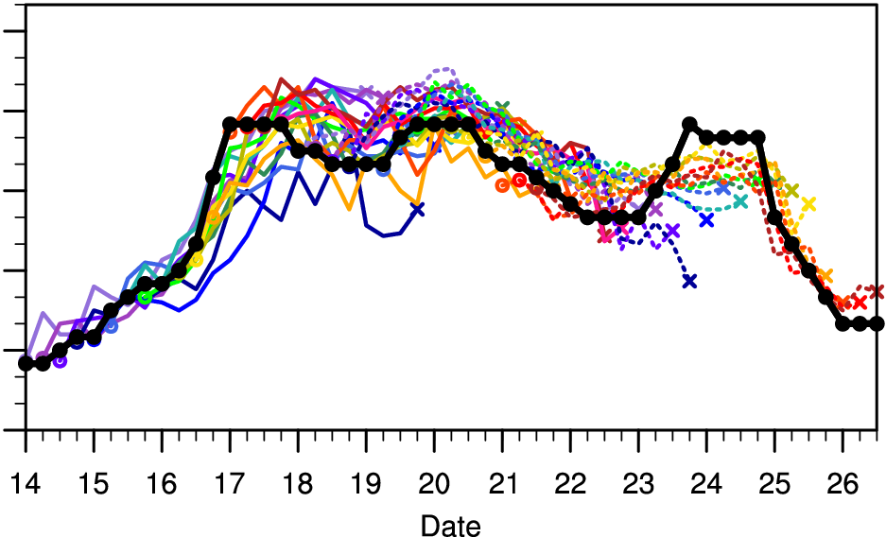
Case: 2015 16W Goni

Slide 6
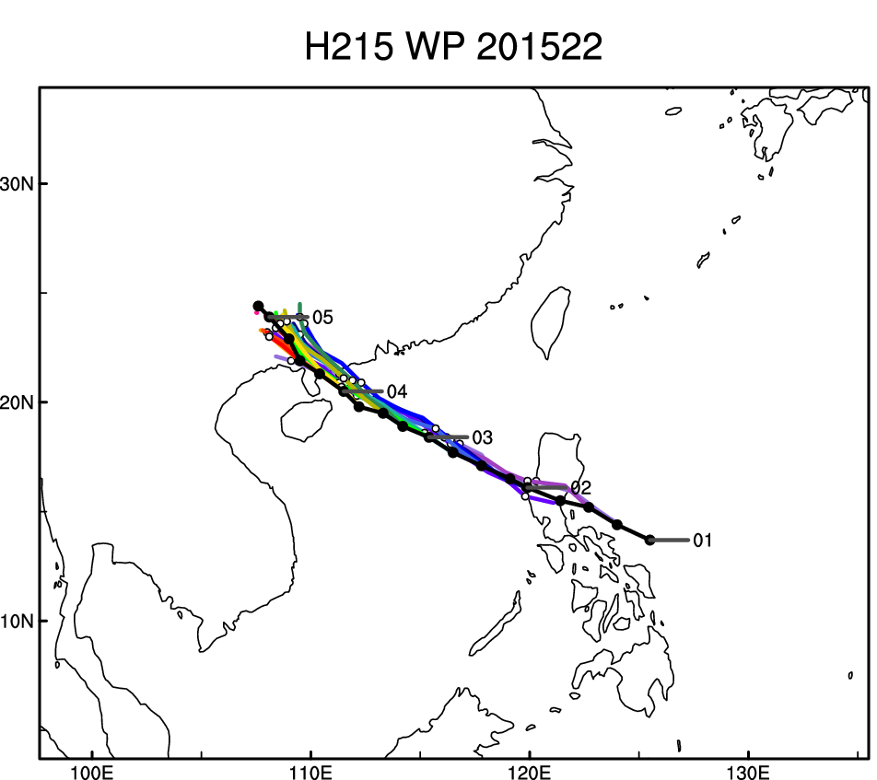
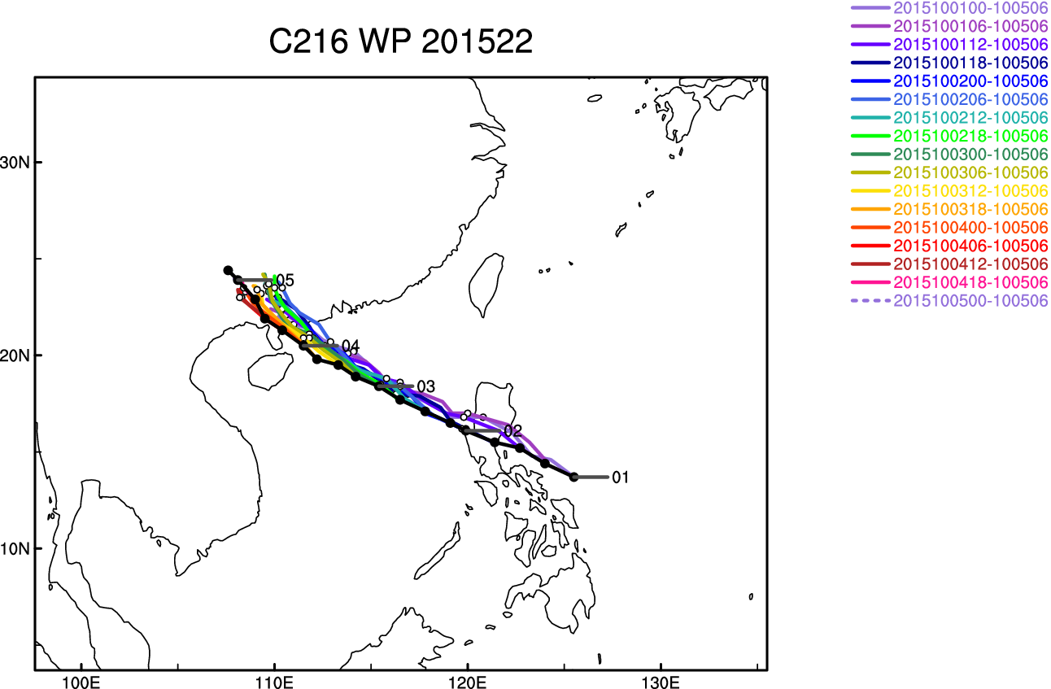
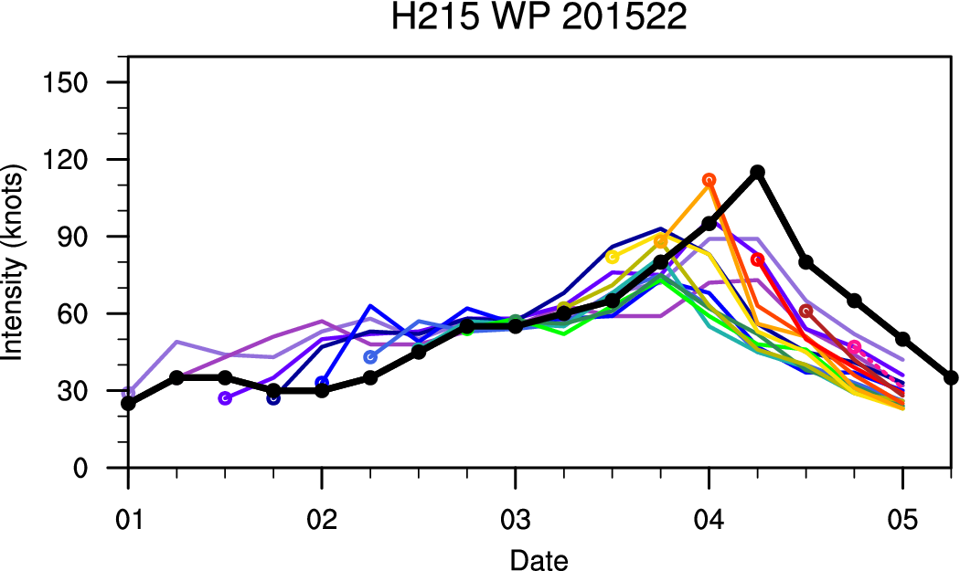
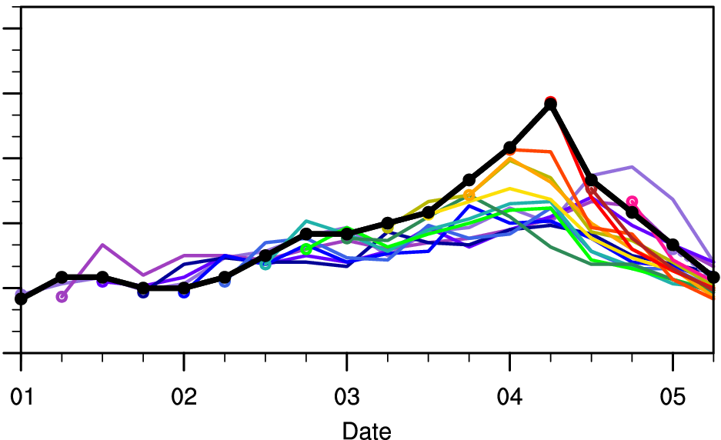
Case: 2015 22W Mujigae

Slide 7
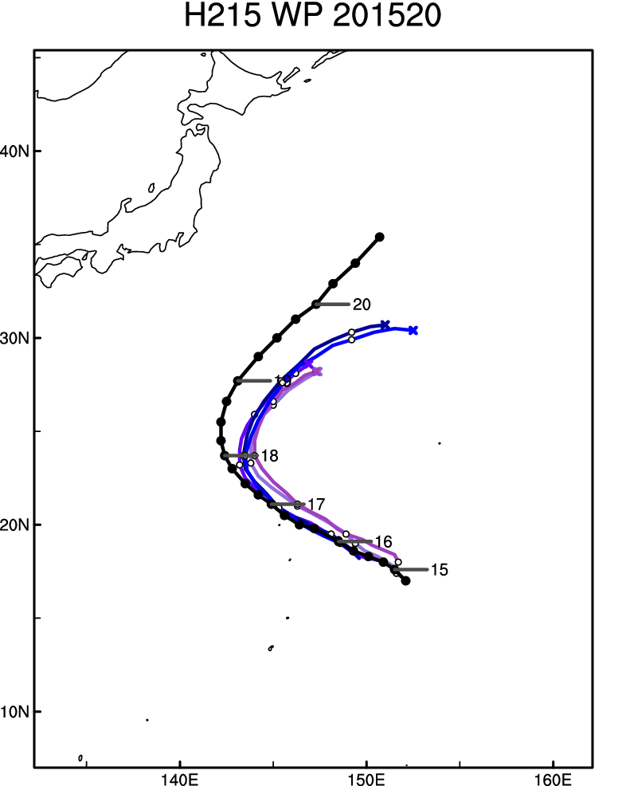
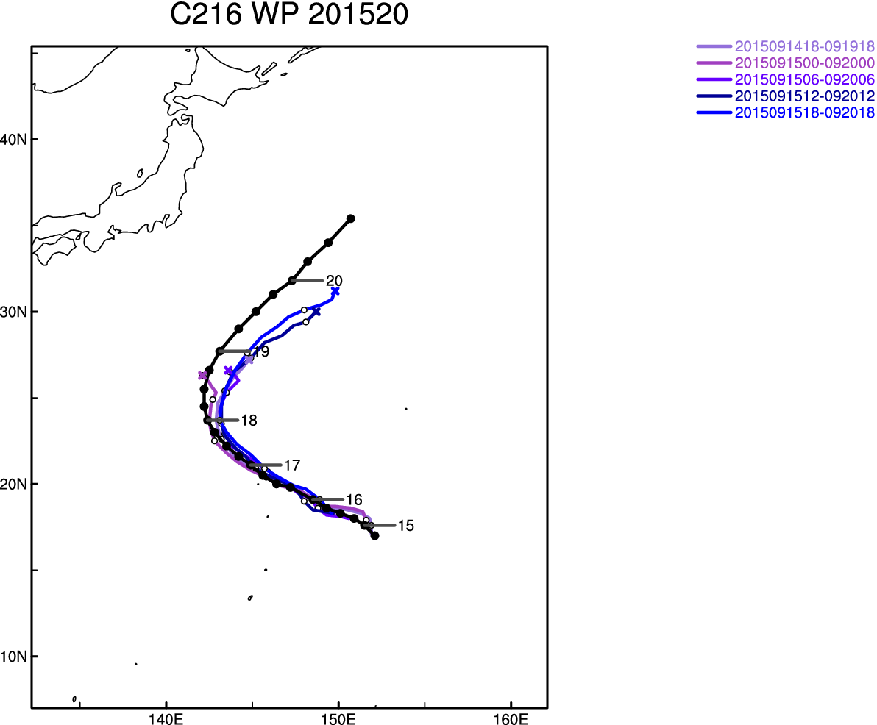
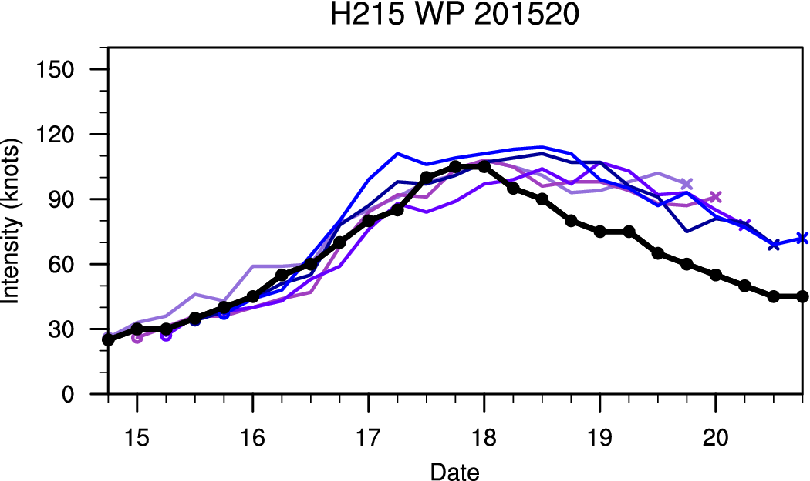
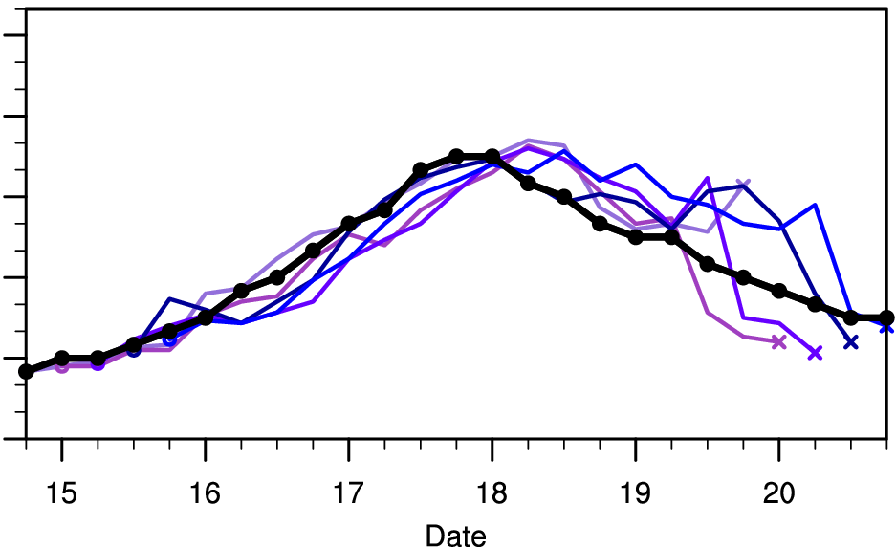
Case: 2015 20W Krovanh

Slide 8
Summary: most improved/degraded storms (sum of 0-120h fcst)
 | Track |  | Intensity
 | Improve | Degrade | Improve | Degrade
NATL H16O-H215 | 2015/11 2014/06 2015/04 2015/12 2014/08 2015/06 | 2014/04 2015/10 2013/11 2013/10 2012/18 2014/03 | 2015/11 2014/08 2015/10 2014/06 2015/12 2012/18 | 2013/09 2014/04 2014/03 2014/01 2013/12 2013/11
EPAC H16O-H215 | 2014/11 2014/10 2015/13 2015/12 2015/19 2015/09 | 2014/21 2014/15 2014/04 2014/03 2014/07 2013/08 | 2015/19 2014/10 2013/08 2014/09 2015/10 2015/13 | 2014/11 2014/17 2015/18 2014/19 2013/05 2014/21
WPAC C216-H215 | 2015/13 2015/17 2015/16 2015/24 2015/20 | 2015/22 2015/21 2015/23 | 2015/16 2015/13 2015/20 2015/21 2015/15 | 2015/17 2015/22
*storm ID: notable storms (6 or fewer storms)

