Slide 1
Potential Impacts of the Lower Stratosphere on Structure and Distribution of Intense Tropical Cyclones
Chanh Kieu
Indiana University, Bloomington
Collaborator: Vijay Tallapragada (NCEP), Da-Lin Zhang (Univ. of Maryland, College Park), Zachary Moon (Indiana University)
HFIP meeting, May 20, 2015

Slide 2

Outline
Motivation
Case study of STY Francisco
Idealized experiments
Implications
Conclusions

Slide 3
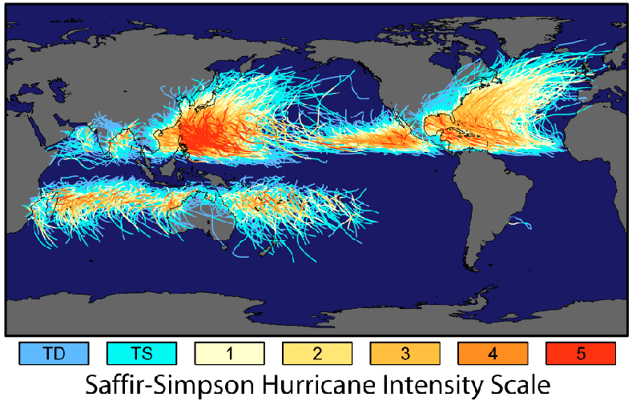
Motivation: TC global distribution
1. Do we have Cat 7+ hurricanes?
2. Why does WPAC have more intense TCs?

Slide 4

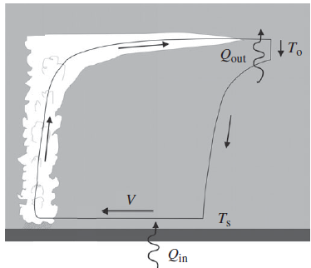
Motivation: Hurricane MPI
Emanuel’s MPI limit:
Limiting factors:
SST (direct vs. indirect via disequilibrium of enthalpy at surface);
Outflow temperature;
Mid-tropospheric moisture;
out
up
Applications:
Hurricane-climate projection;
Intensity outlook;
in

Slide 5
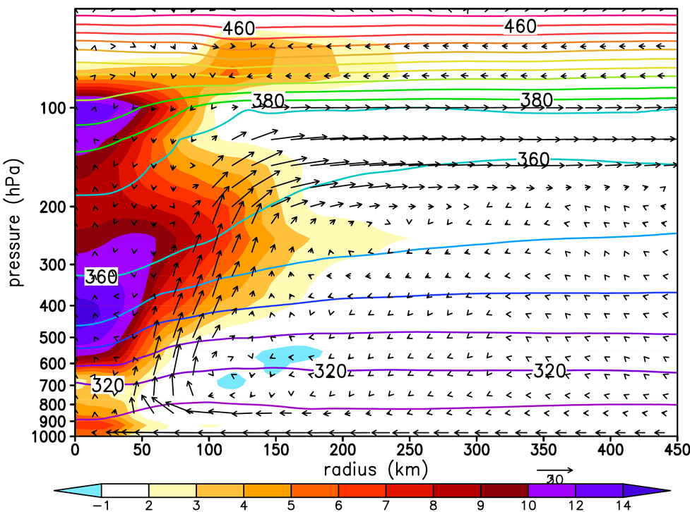
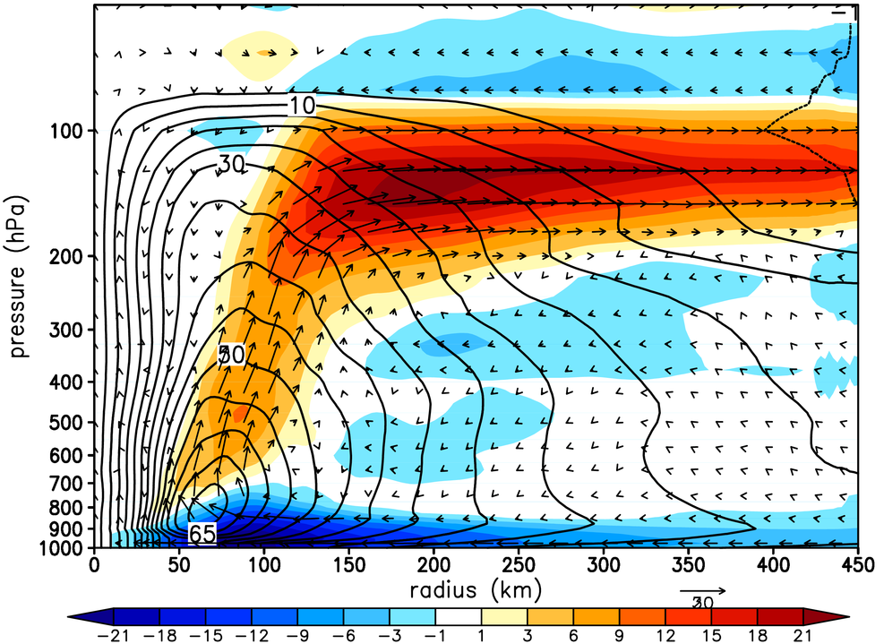
Motivation: HWRF double-warm core structure
Temperature anomaly (shaded, K), potential temp (contours)
Strong upper-level inflow above the typical outflow layer
Radial wind inflow (shaded, ms⁻¹), tangential wind (contours)
Persistent double warm core structure for all STY cases during 2012-2014 seasons

Slide 6
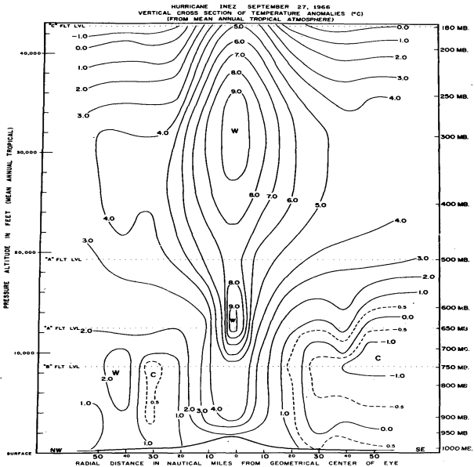
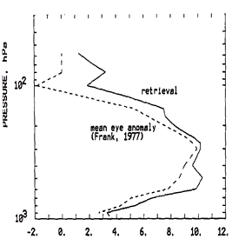
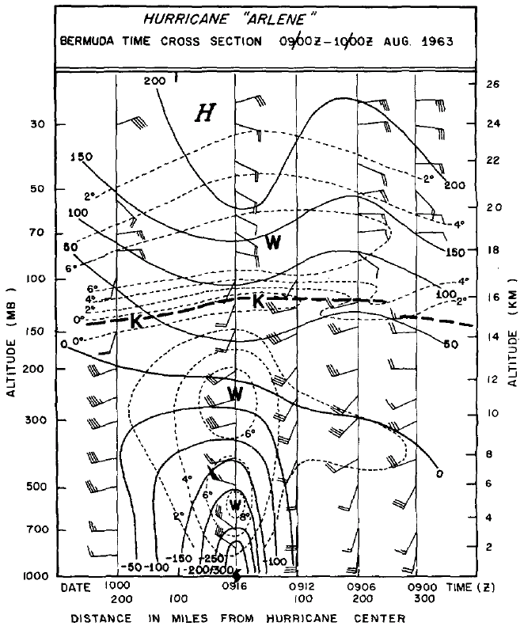
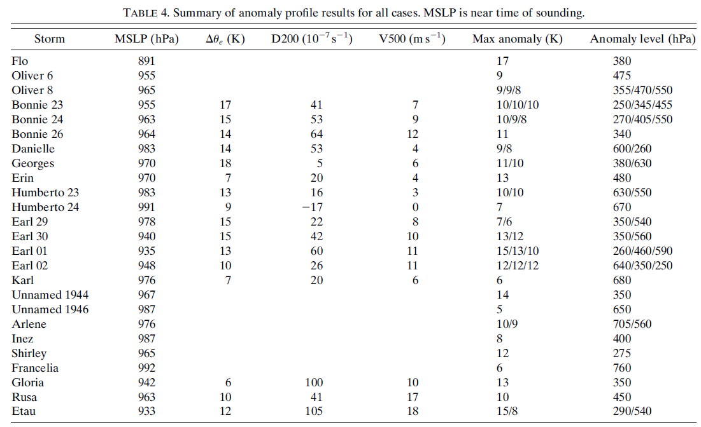
Motivation: observed DWC structure
Inez’s (1966) (Hawkins and Imbembo 1976)
Frank (1977) (Schwartz et al. 1996)
Arlene (1963) (Koteswaram 1967)
Durden (2013)
Observations of the DWC are rare due to lack of flight data for intense TCs.

Slide 7
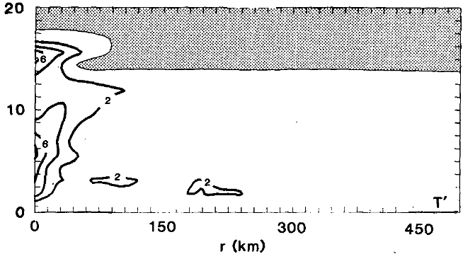
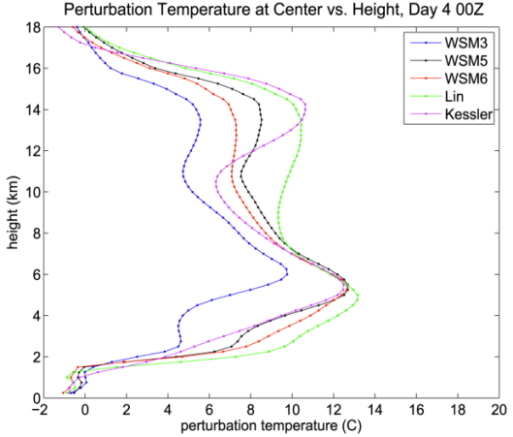
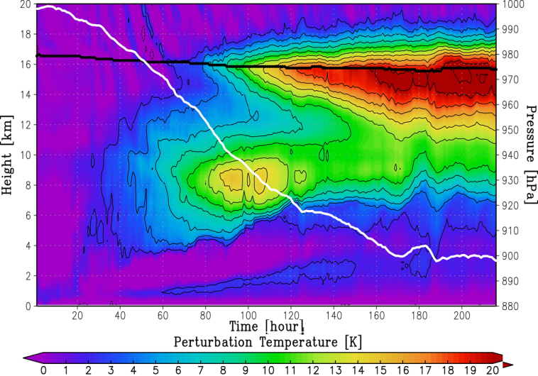
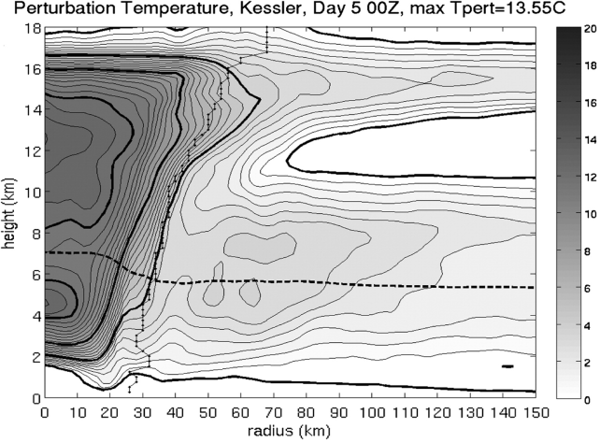

Motivation: simulated DWC structure
Rotunno and Emanuel (1987)
Stern and Zhang (2013)
Amber evidence of the DWC from previous modeling studies
Ohno and Satoh (2015)
Stern and Nolan (2012)
HWRF real-time forecast of Francisco (2013)

Slide 8
Hypotheses
Hypothesis 1: At high intensity (Vmax > 65 ms⁻¹), the lower stratosphere can interact with TCs and produce a DWC structure, allowing TCs to further strengthen and maintain their high intensity.
Hypothesis 2: The lower stratosphere can moderate the distribution of intense TCs and thus play a significant role in the TC-climate relationship.

Slide 9
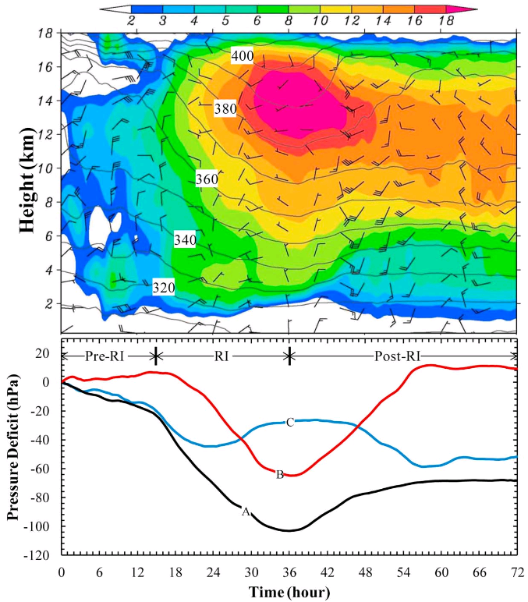
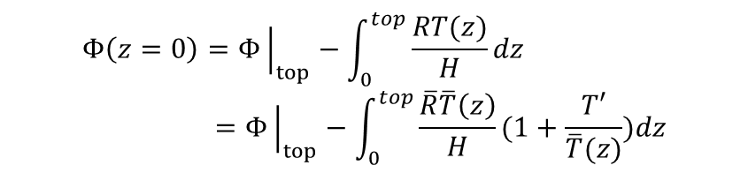
Justification for the upper warm core
Statement 1: Given the same T’, the higher the warm core, the deeper the pressure drop at the surface.
The effectiveness of upper warm core contribution to PMIN can be seen from the hydrostatic equation
$$Φ\left(z=0\right)=Φ{\left.​\right|}_{top}−\int_{0}^{top}{\frac{RT(z)}{H}dz}=Φ{\left.​\right|}_{top}−\int_{0}^{top}{\frac{\overline{R}\overline{T}\left(z\right)}{H}(1+\frac{T′}{\overline{T}(z)})dz}$$
Note: No causal implication (assuming a mechanism that could help build the upper warm core)
Upper warm core contribution to 50% the pressure drop at the surface (red curve) from simulation of Hurricane Wilma (2005, courtesy of Chen and Zhang (GRL, 2012)

Slide 10
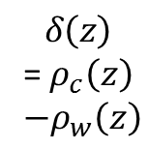


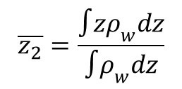
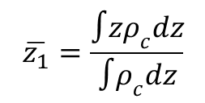
Justification for the upper warm core
Statement 2: the warmer the upper core is, the lower the center of mass, and so the more PE will be converted to KE.
$$\overline{z_{1}}=\frac{∫zρ_{c}dz}{∫ρ_{c}dz}$$
$$δ\left(z\right)$$
= $ρ_{c}\left(z\right)$
$$−ρ_{w}\left(z\right)$$
$\overline{z_{1}}−\overline{z_{2}}=\frac{∫\left(z−\overline{z_{1}}\right)δ\left(z\right)dz}{\overline{z_{c}}∫ρ_{c}dz}$ > 0
$$ρ_{c}$$
$$\overline{z_{2}}=\frac{∫zρ_{w}dz}{∫ρ_{w}dz}$$
1
2

Slide 11
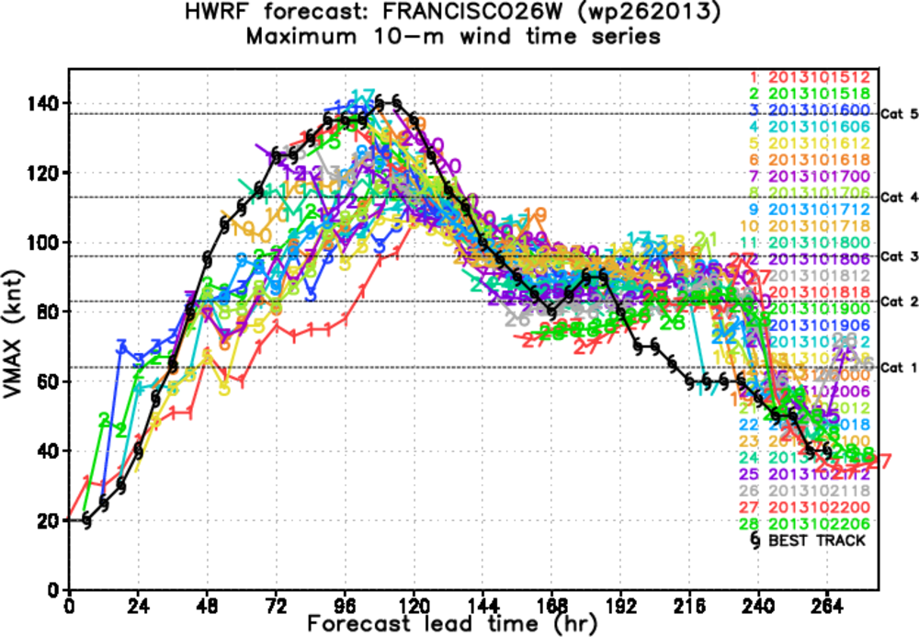
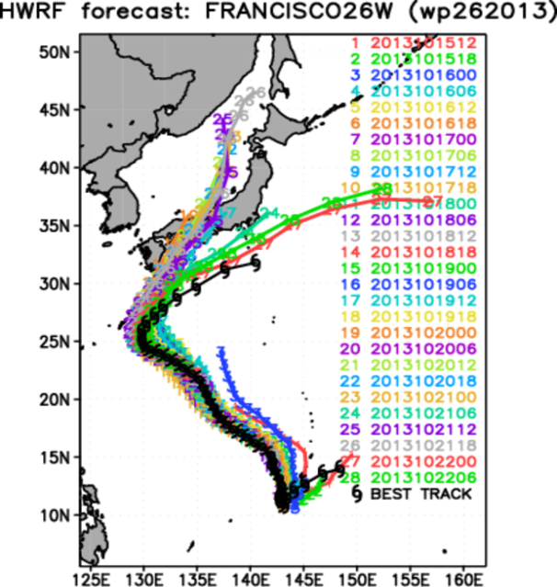
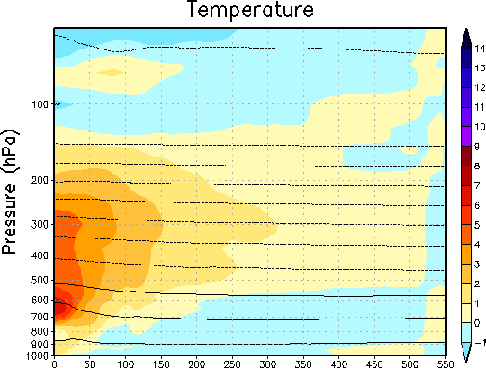
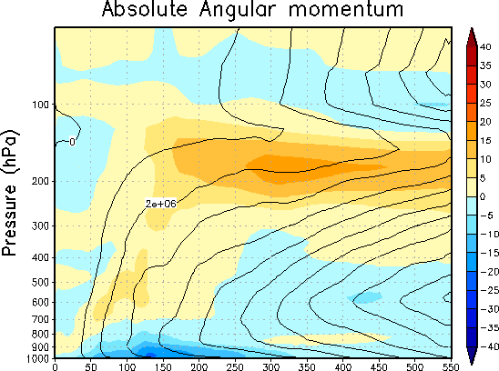
Case study: Francisco (2013)
Animation of DWC after 72h into integration…. Not artifact of model I.C.

Slide 12
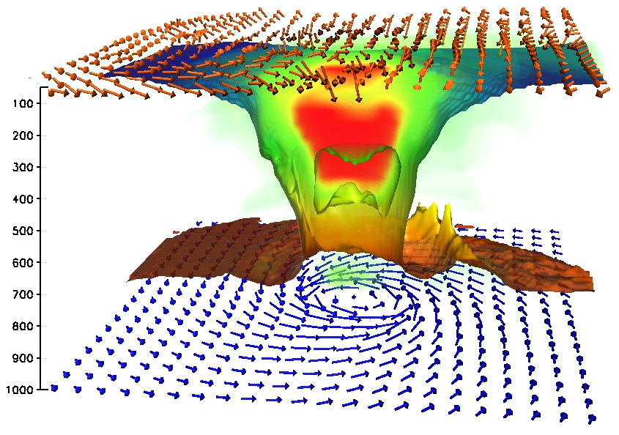
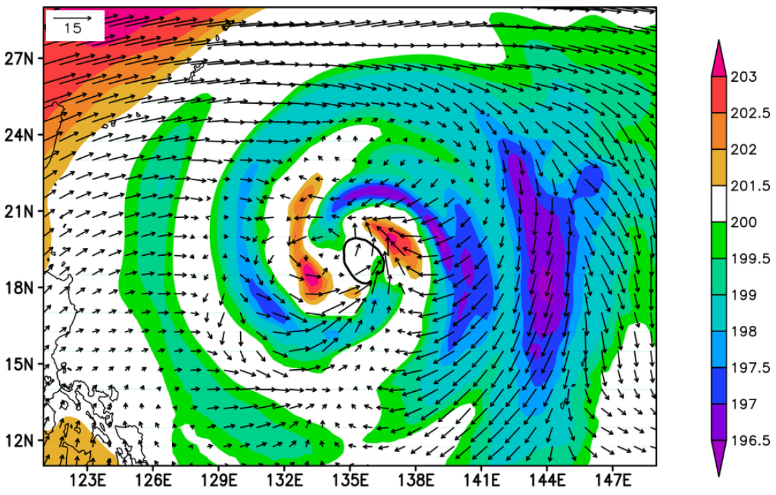
Case study: DWC structure
3D cross section at 72-h of Francisco initialized at 1200 UTC 17 July 2013,
Upper level inflow (UIL) is wide spread and is above the outflow (at 75hPa)

Slide 13
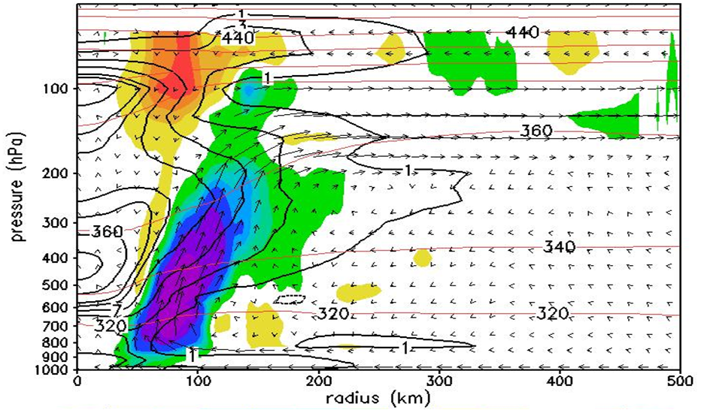
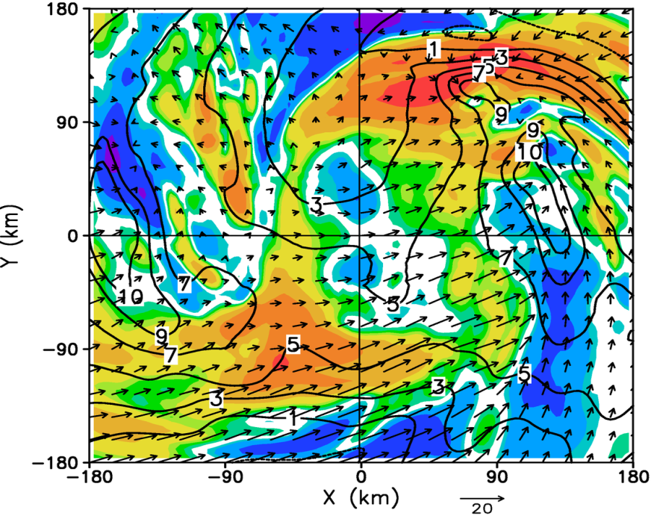

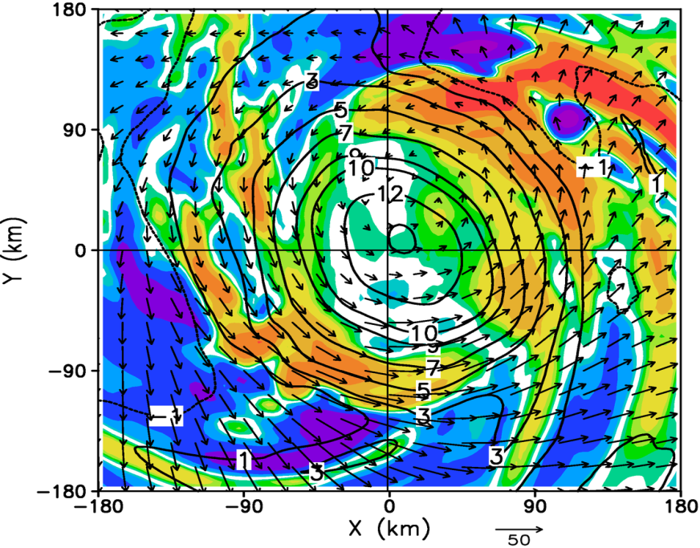

Case study: UIL-induced warming tendency
75 mb
$$adv=−(u\frac{∂θ}{∂r}+ω\frac{∂θ}{∂p})$$
100 mb
UIL could induce a substantial amount of warm advection from the lower stratosphere toward storm center;

Slide 14
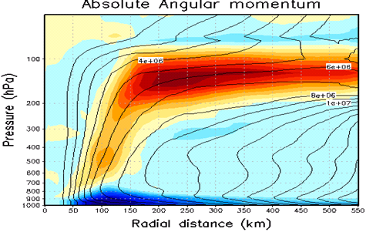

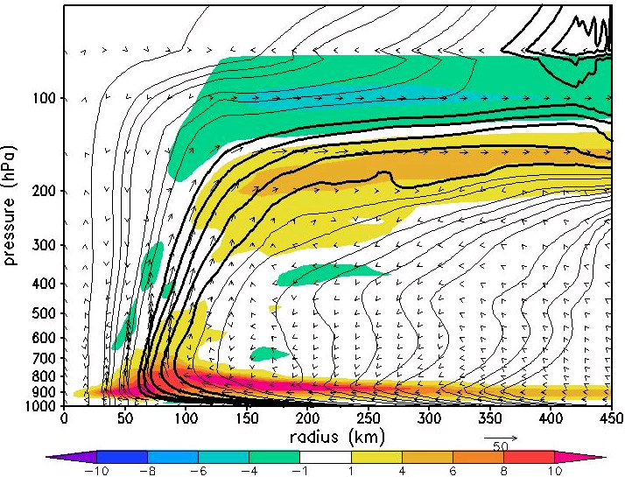
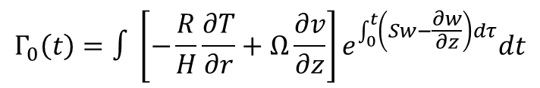
Case study: condition for UIL formation (1)
Given such impact of the UIL to DWC development, next question is under what conditions such UIL will develop?
Consistent development of UIL in all DWC cases in intense TCs (120 kt +);
UIL develops from a radius 50-500 km, confined within a thin layer above the outflow layer, extend from outside all the way to the eye;
Introduce Γ ≡ ∂u/∂z, a Lagrangian parcel along an M-surface will have
$$Γ_{0}\left(t\right)=∫\left[−\frac{R}{H}\frac{∂T}{∂r}+Ω\frac{∂v}{∂z}\right]e^{\int_{0}^{t}{\left(Sw−\frac{∂w}{∂z}\right)dτ}}dt$$
Result 1: A balance warm core must exist below the outflow level.

Slide 15
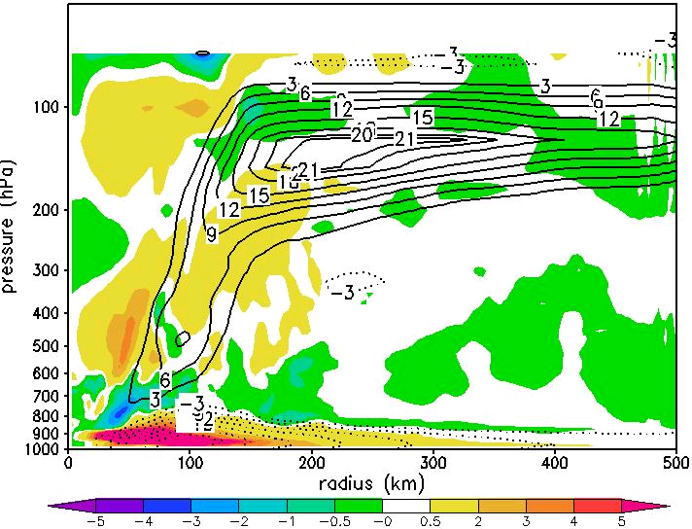
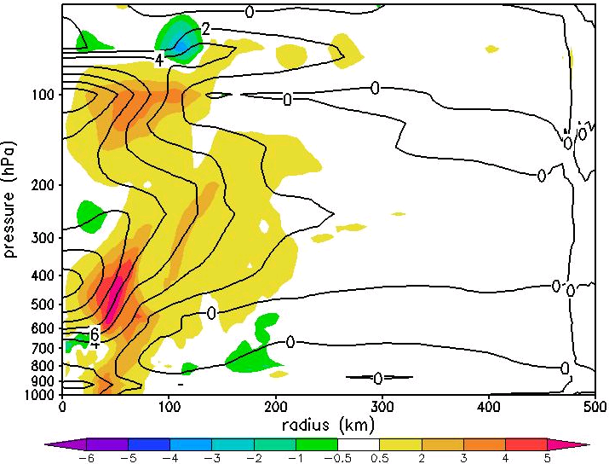
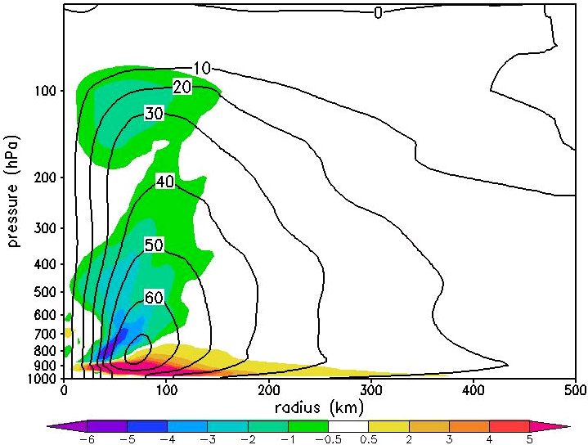



Case study: condition for UIL formation (2)
Result 2: For UIL to develop, an outer-core cold annulus or an inner-core warm ring must exist at the upper level.
A(z)=(- $\frac{R}{H}\frac{∂T}{∂r}+Ω\frac{∂v}{∂z})$
Radial temp gradient (- $\frac{R}{H}\frac{∂T}{∂r})$
Vertical derivative of V $(Ω\frac{∂v}{∂z})$

Slide 16
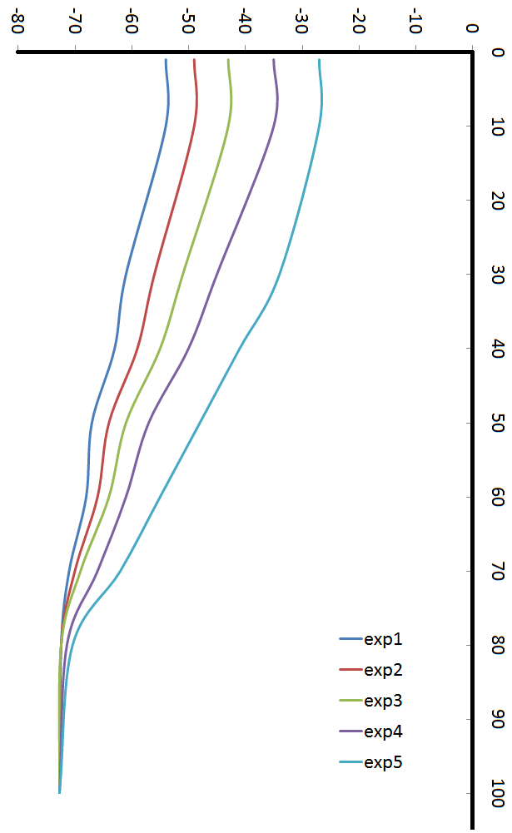
HWRF idealized experiments
~ 900-m resolution (dx = 0.063/0.021/0.007);
61 vertical levels;
2 hPa model top;
288 x 576 grid points for the outermost domain, 298 x 606 for intermediate domain, 540 x 990 for the innermost domain;
Time step 18 s;
Operational physics packages except RRTMG radiation scheme;
Jordan sounding with SST = 302⁰K
Rest environment with no shear;
Initial vortex with RMW = 90 km, and VMAX = 18 m/s;
Stratosphere stratification varies according to:
pressure (hPa) | exp1 | exp2 | exp3 | exp4 | CTL
1 | -54 | -49 | -43 | -43 | -27
10 | -54 | -49 | -43 | -43 | -27
30 | -61 | -56 | -51 | -51 | -34
40 | -63 | -59 | -55 | -55 | -41
50 | -67 | -64 | -61 | -61 | -48
60 | -68 | -66 | -64 | -64 | -55
70 | -71 | -70 | -69 | -69 | -62
80 | -72.4 | -72.4 | -72.4 | -72.4 | -70.4

Slide 17
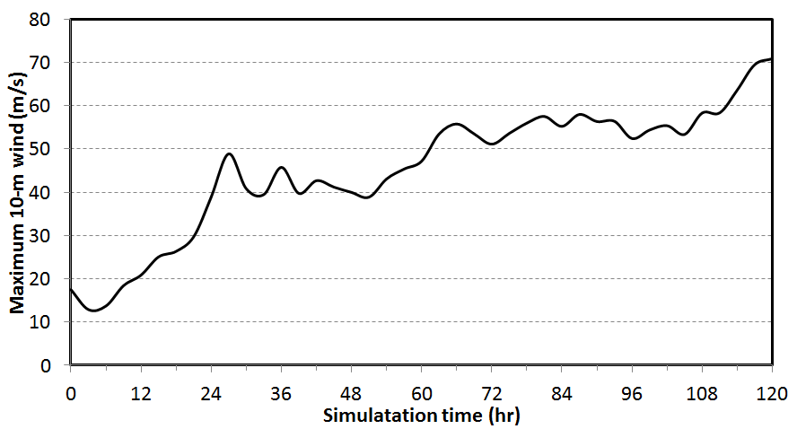
CTL Exp: Development of DWC
Hovmoller diagram of T’
vmax = 70 m/s
The vortex strengthens when an upper warm core is build

Slide 18
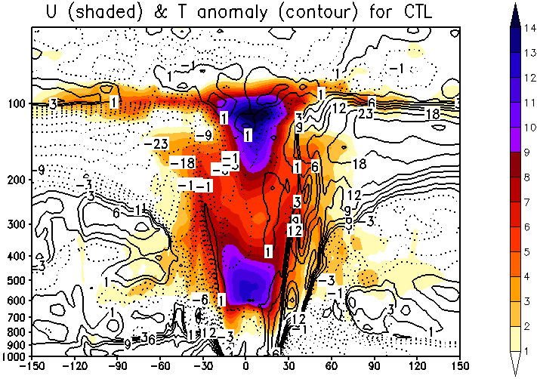
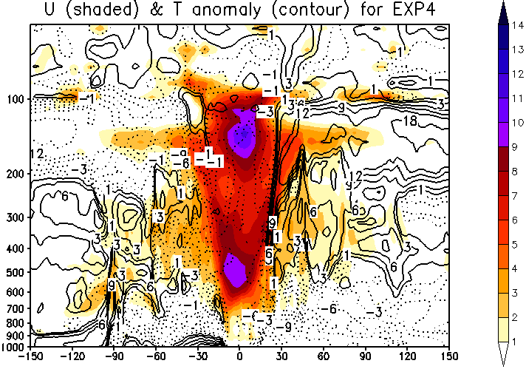
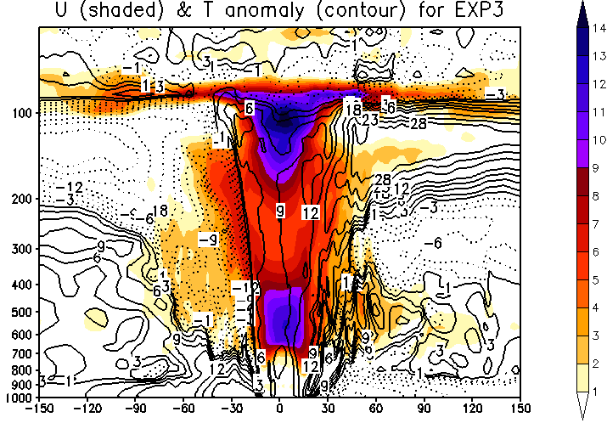
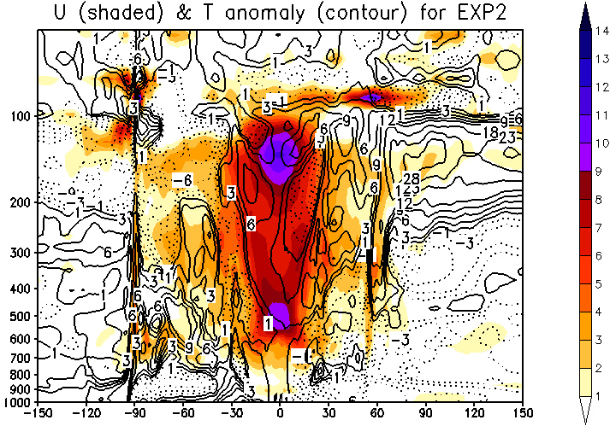
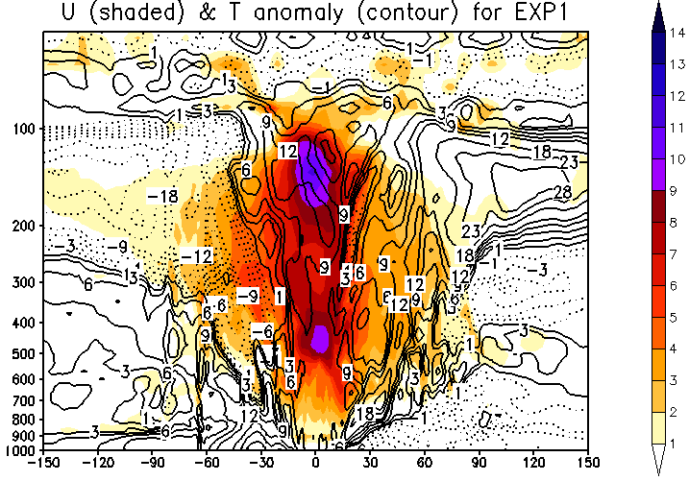
Sensitivity Exps
Weaker stratification (colder lower stratosphere) seems to produce a weaker DWC/storm;
CTL: vmax = 70 m/s
EXP4: vmax = 64 m/s
EXP3: vmax = 69 m/s
EXP2: vmax = 58 m/s
EXP1: vmax = 56 m/s
colder lower stratosphere (weaker stratification)

Slide 19
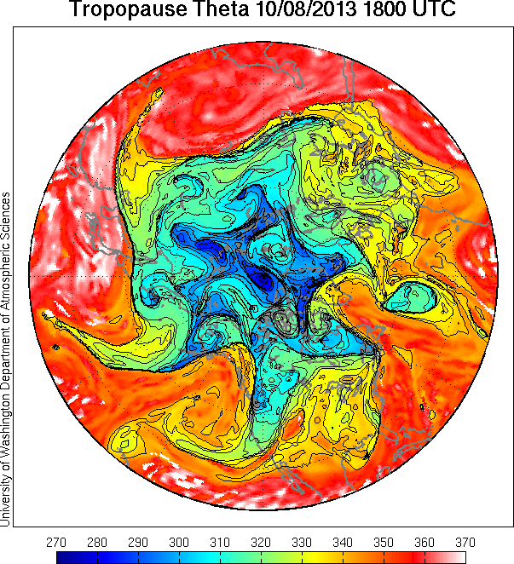
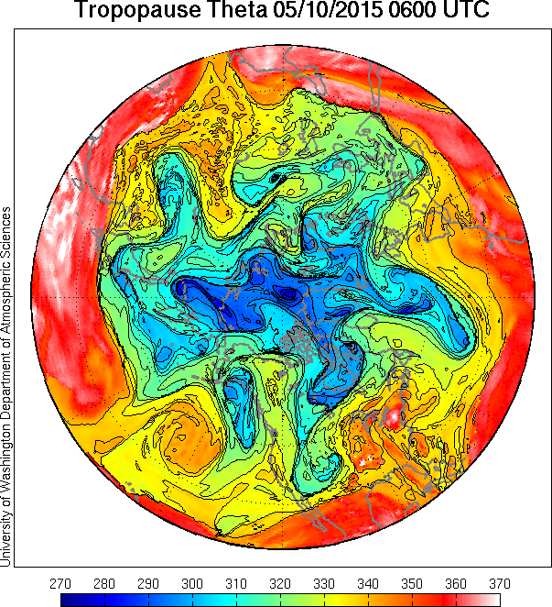
Low stratosphere: NATL/WPAC 2013
WPAC: more TCs with double warm core??? How about the higher MPI with colder outflow temperature?
NATL: less TCs with no double warm core

Slide 20
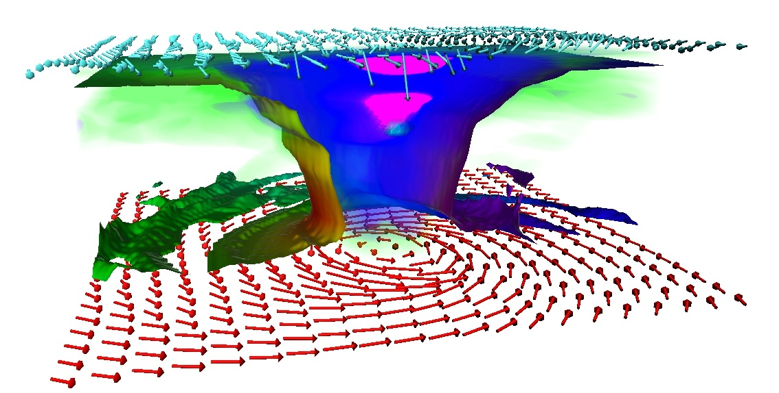
Paradox: DWC vs outflow
Warmer outflow temperature -> a weaker MPI
HWRF idealized exp
Tropopause temperature is not outflow temperature?
Outflow temperature is only for the traditional MPI with single in-up-out. Maybe different for the DWC structure?
Outflow concerns more with the ambient temperature, whereas the DWC structure concerns more the local impacts?

Slide 21
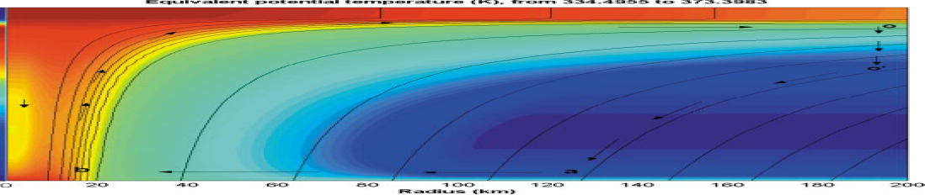
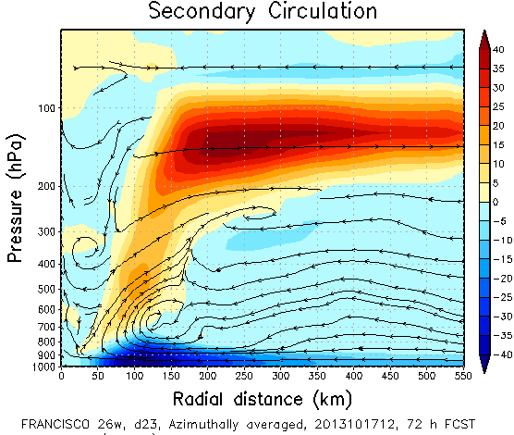
Implications
The DWC structure may go outside the traditional framework of a TC with a single warm core.
“… In real storms, air flowing out near the storm top usually experiences strong exchanges with the environment, so the energy cycle is in fact open. But numerically simulated axisymmetric storms have closed cycles and behave very much like real storms, so we can idealize the cycle as closed…” (Emanuel 2003)
Distribution of intense TCs should take into account the lower stratosphere beyond the outflow temperature;

Slide 22
Conclusions
Need more observational studies to better understand DWC and related UIL in intense TCs. The least area in TC observational study;
The DWC structure at high intensity is beyond the traditional MPI framework → need to further understand the conditions for the DWC formation and related MPI framework;
Need to take into account the lower stratosphere in future studies of distribution of extreme TCs in response to large-scale changes; and
HWRF captures persistently DWC structure for intense TCs → need to have higher resolution near the tropopause in numerical models for extreme TCs;

Slide 23
Thank you!

Slide 24
?

Slide 25
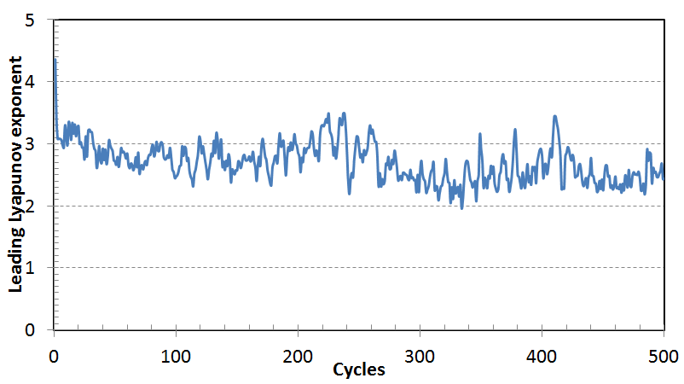
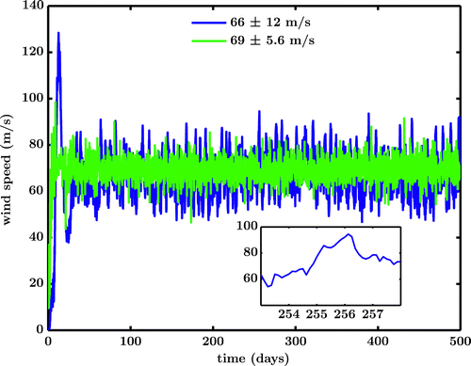
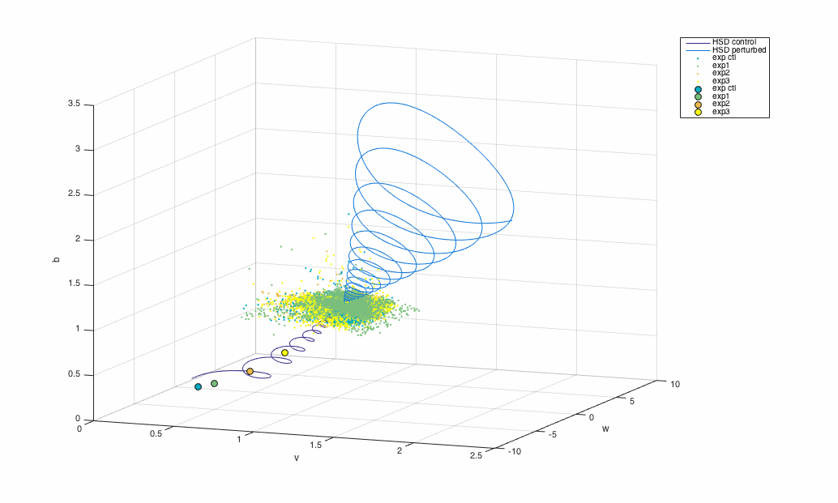

TC intensity predictability
$λ_{m}=\lim_{t_{m}→T_{∞}}{\lim_{ε→ε_{∞}}{\frac{\left|\left|v^{ε}\left(t_{m}+τ\right)−v\left(t_{m}+τ\right)\right|\right|}{\left|\left|ε\right|\right|}}}$
Maximum wind speed (m s⁻¹) (blue) and E-PI estimate (green) for the control simulation, using axisymemtric model. The legend shows the time-mean values. Hakim (2011)
Can we reduce intensity forecast errors at 4-5 day lead times below 18 kt ???
Note:
ω-limit set of a bounded model is guaranteed to be non-empty → existence of an MPI chaotic attractor ???
1000-day animation of flow orbits in the phase space using the 2D axisymmetric model to shows the MPI chaotic attractor (courtesy of Zach Moon, IU).

Slide 26
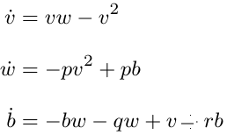
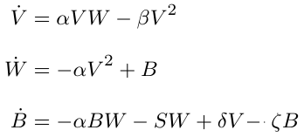
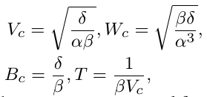

MPI equilibrium stability
The CPs are now$\left(v_{c},w_{c},b_{c}\right)$, where $v_{c}=\left(0, \frac{−r±\sqrt{r^{2}+4−4q}}{2}\right), b_{C}=v_{c}^{2},w_{c}=v_{c}$.
Condition for existence of CPs are $q<1+\frac{r^{2}}{4}$. Too stable stratification (i.e. large q) will lead to collapse of the MPI equilibrium with the origin point, and eventually no other CPs could exist except for the origin unstable node. Hopf bifurcation???
Stability of the MPI equilibrium will be greatly modified once stratification becomes significant since it is no longer structurally stable away from (1,1,1).

Slide 27





Lorenz-63 model
Lorenz-63 model for chaotic flow of 3 variables x convective intensity, y temp. difference between descending and ascending, z difference in vertical temp.
Chaos happened when r > Rayleigh number -> pitchfork/Hopf bifurcation happens at some threshold of r;
CPs are unstable, and a new stranger attractor appears with fractal dimension ~2.06 (both limit cycles are now stable);
Bounded and dissipative system, positive Lyapunov exponent on attractor. Predict range ~ ln(1/initial_error) -> 10 times initial error reduction can only double the predictability range.

Slide 28


A typical warm core
The tropical cyclone (TC) warm core is a characteristic of the TC balance dynamics to ensure the thermal wind balance;
Location of TC warm core varies largely from 500 – 100 mb, but the thermal wind balance would imply that TC warm core should be around 500-400 hPa for a typical TC (Stern and Nolan 2011)
Observation of Erin’s (2001) warm core (contours, Halverson et al. 2006)
HWRF real-time forecast of Yagi’s (2013) warm core (shaded, courtesy of EMC HWRF)

Slide 29

Scientific questions
Are there particular constrains or conditions for the development of the upper level warm core?
What are the implications of the upper warm core development?
How is the upper level warm core formed and what are the roles of the high level inflow layer? Note a significant portion of M- surfaces protruding the stratosphere.

Slide 30
Condition for DWC structure
Lower warm core is a balanced feature, whereas existence of upper warm core depends much on HIL and ability to reach the warm air in the lower stratosphere
Condition for DWC configuration:
Check in a layer between 100-50 hPa for the potential development of HIL:
Convergence flow with cyclonic circulation;
An annulus of low pressure anomaly between 200 -500 km radius;
A ring of deep vertical motion surrounding the eye;
The tropopause locates at low altitude .
A warmer tropopause at lower altitude would be ideal for TCs to access warm air in the lower stratosphere

