Slide 1
VORTEX SE and Hurricane
Landfalling Tornadoes
Hua Chen
Frank Marks
Ghassan Alaka
Sundararaman Gopalakrishnan
AOML/HRD

Slide 2
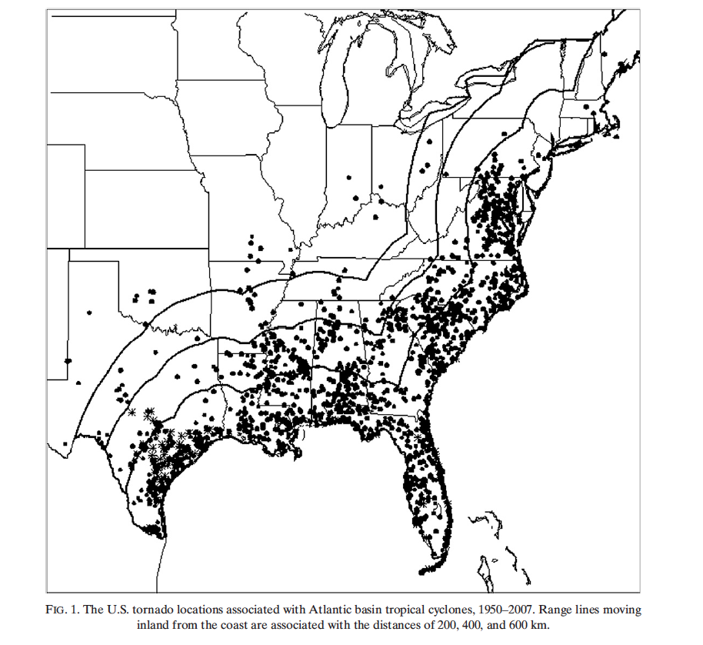
Goal
Combine AOML expertise in collecting observations and modeling of TCs to understand and improve tornadic prediction in landfalling storms.
  Advance diagnostic tool (HPOST) for tornadic predictions using HWRF,
  Run ensemble forecast of Hurricane Isaac to evaluate HWRF, and
  Develop field program module to collect dropsonde and Doppler radar observations in a landfalling storm to evaluate HWRF..
Background
Tornadoes spawned by landfalling TCs have been reported as far back as 1773
U.S. TC-spawned tornadoes within 400 km of the coast from TX to MD. In 2005 alone, TC tornado damage estimates totaled over $100 million.
In 2014 operational HWRF model and HWRF ensemble produced diagnostics for SPC guidance on the potential for TC-spawned severe weather & tornadoes

Slide 3
Two most important ingredients of Tornado formation
Low level wind shear
Convective Available Potential Energy (CAPE)
Great Plains tornados | TC-spawned tornados
Larger CAPE | Smaller CAPE
Smaller wind shear | Larger wind shear
TC-spawned tornados are weaker (F0-F1)

Slide 4
inner- and outer-region tornadoes
Outer-region tornadoes (beyond 200 km from the TC center): have a stronger diurnal signal, commonly occurring during the afternoon.
Inner-region tornadoes: typically occur within 12 h of TC
landfall, with no strong preference for a particular time of
day.
Outer-region tornadoes are stronger than inner-region
tornadoes

Slide 5
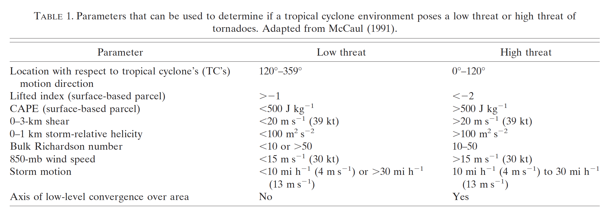
Tornado genesis diagnostics
Supercell Composite Parameter (Thompson et al. 2003)
SCP=(MUCAPE/1000 J kg⁻¹) × [(0-3 km SRH)/100 m² s⁻²] × (BRN shear/40 m² s⁻²)
Significant Tornado Parameter (Thompson et al. 2003)
STP=[(0-6 km shear)/20 m s⁻¹] × [(0-1 km SRH)/100 m² s⁻²] × (MLCAPE/1000 J kg⁻¹) × [(2000 – MLLCL)/1500m]

Slide 6
HWRF initialized at
20120826 12Z
H=57
20120828 21Z
Hurricane Isaac
H=57
20120828 21Z

Slide 7
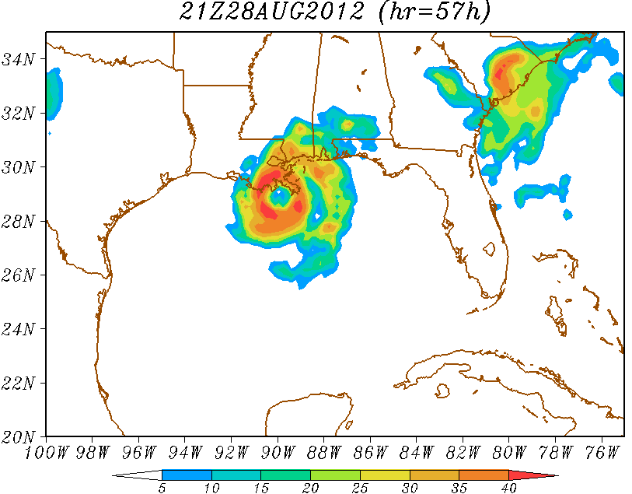
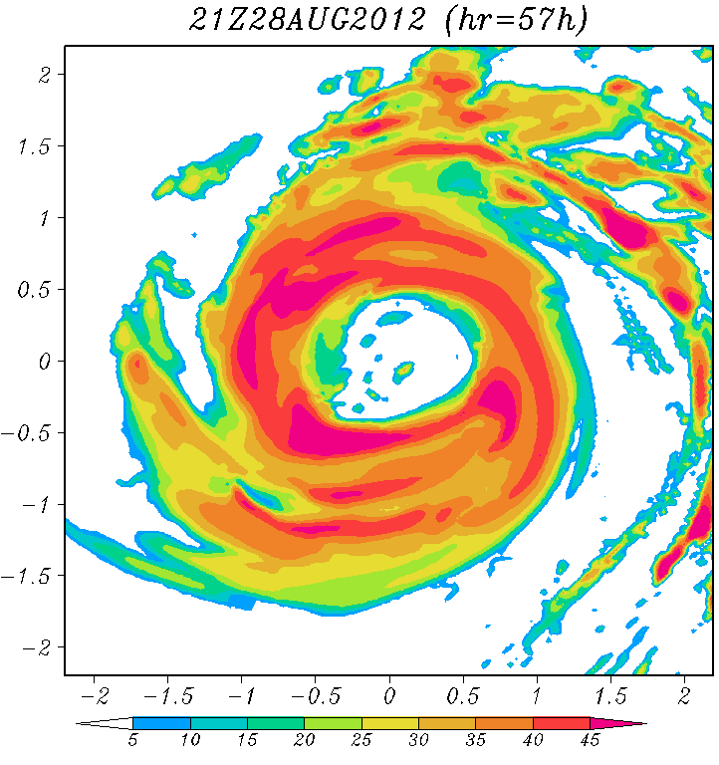
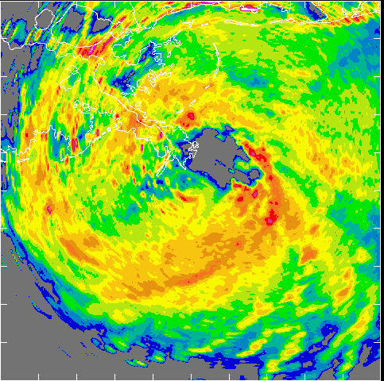
D1
Hurricane Isaac
HWRF
21Z 28 AUG 2012
HWRF reflectivity
D3
20120828H
2205Z
LF radar
HWRF reflectivity

Slide 8
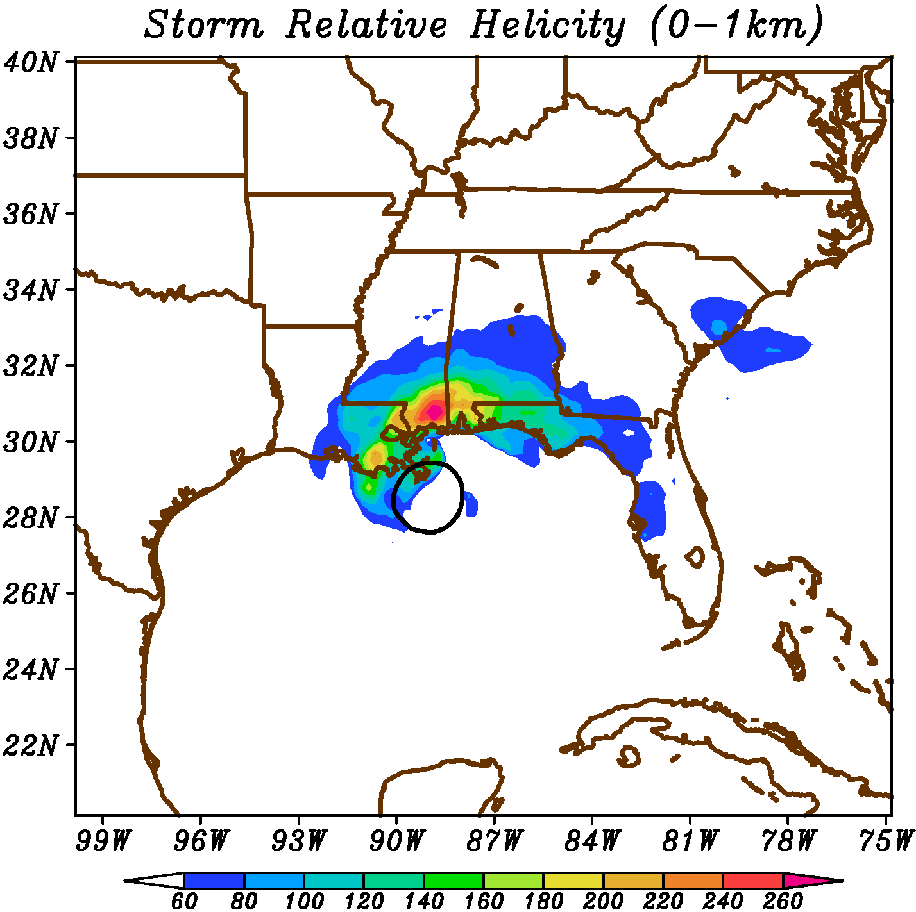
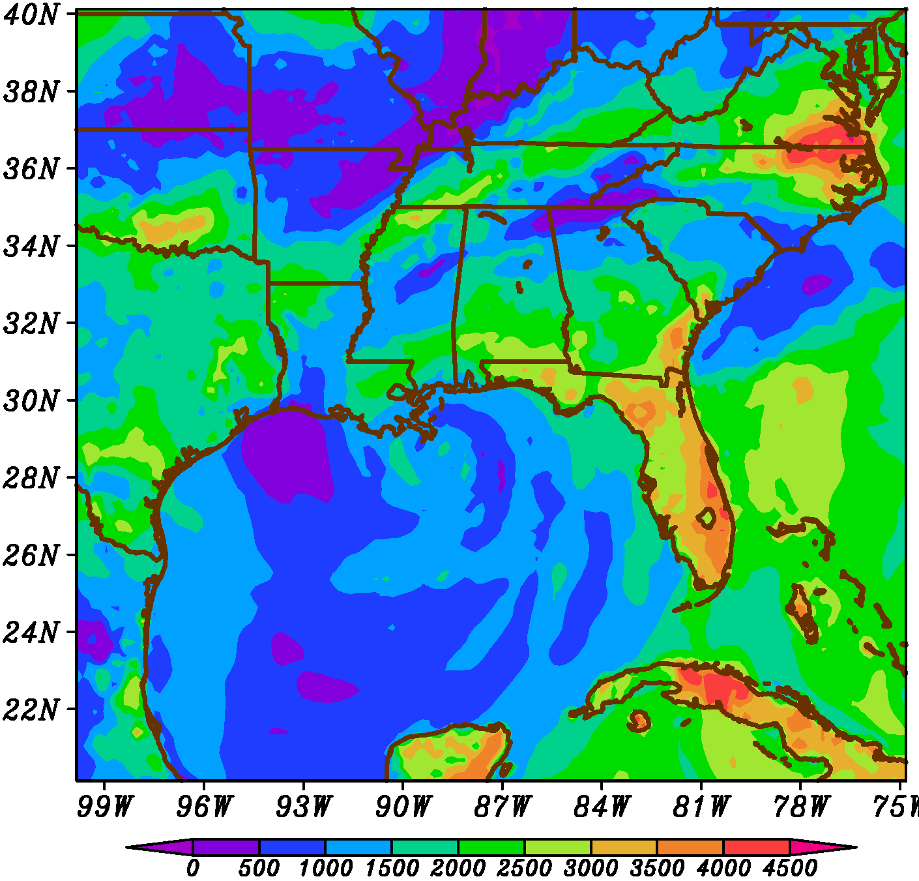
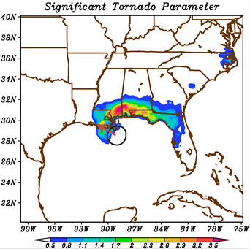
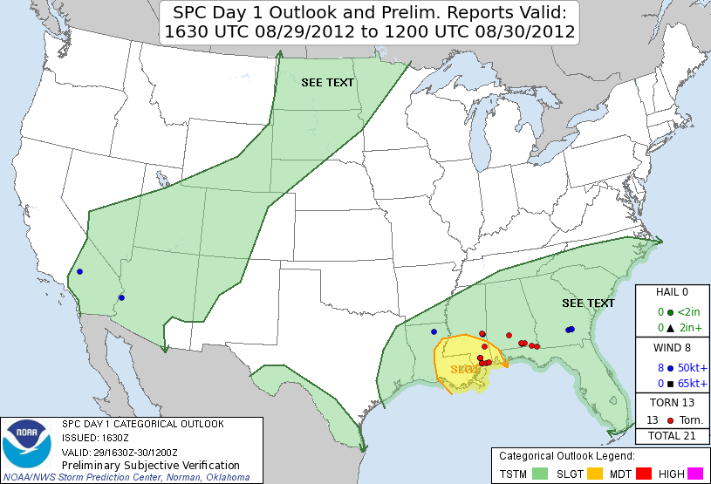
Hurricane Isaac
Surface CAPE
HWRF
21Z 28 AUG 2012
H=57

Slide 9
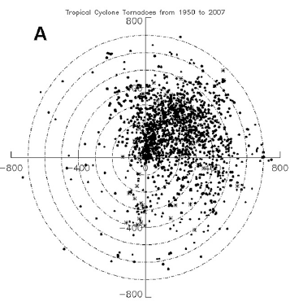
Storm Track
100 km range rings
LF
RF
LR
RR
Hurricane Landfall tornado climatology
Schultz & Cecil (2009)

Slide 10
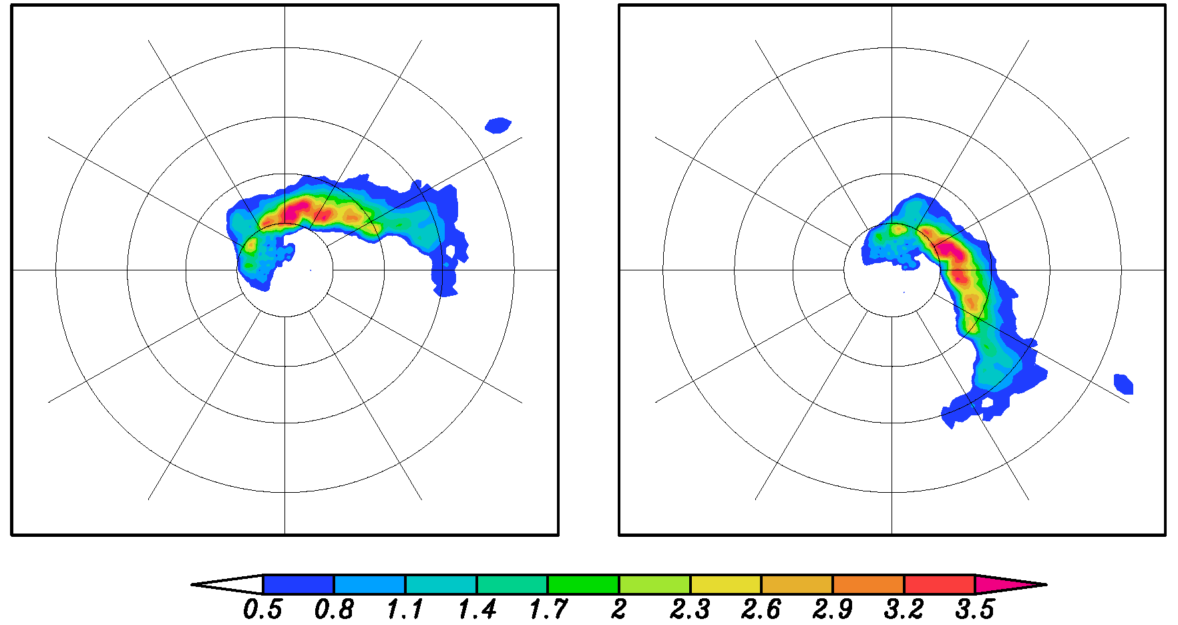
Hurricane Isaac
HWRF
21Z 28 AUGUST 2012
H=57
Original Significant Tornado Parameter
Rotated Significant Tornado Parameter
100 km range rings
100 km range rings
LF
Storm Track
RF
Storm Track
LR
RR

Slide 11
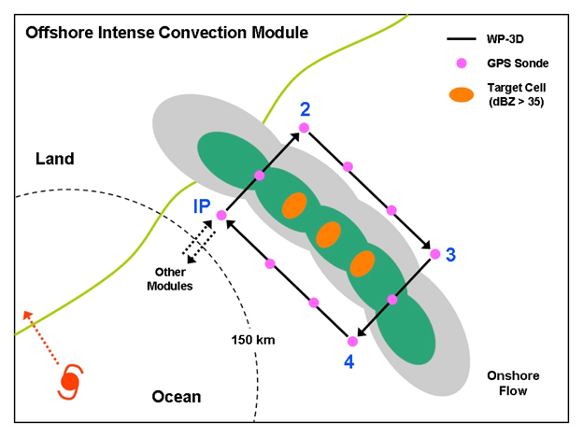
Tropical Cyclone Landfall Experiment
Module focuses on collection of dual-Doppler radar and vertical profiles of lower atmosphere near intense convective cells located in an offshore outer rain band (>150 km from the storm center) but embedded within the onshore flow.
This module can be easily incorporated during operational TD-R flights or the other two landfall modules when a suitable outer rain band is encountered.

