Slide 1
LSM impacts on TCs

Slide 2
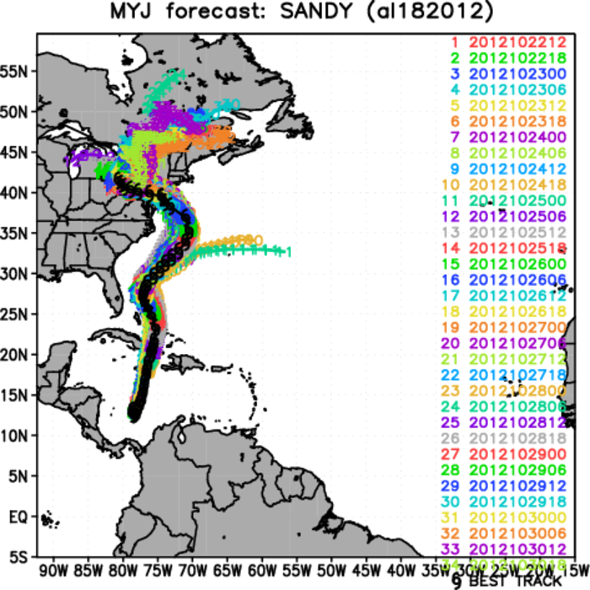
Sandy – 2012102212 - 2012103018
Notes:
The previous version of HWRF which was using the old GFS and doesn’t include physics upgrades, when run with NOAH lsm showed significant improvements in simulating track when compared to the default SLAB – gfdl surface layer combo. With physics upgrades and improved GFS, SLAB runs are similar to NOAH runs. NOAH runs does show slight improvement in predicting track and intensity. (2012102400, 2012102518, 2012102706)
However, replacing gfdl surface layer with MYJ surface layer and changing the PBL scheme accordingly, the simulated tracks tightly follows the best track. Much tighter spread.
Upon debugging, CHS and QGH are the values that differ and used by NOAH LSM.

Slide 3
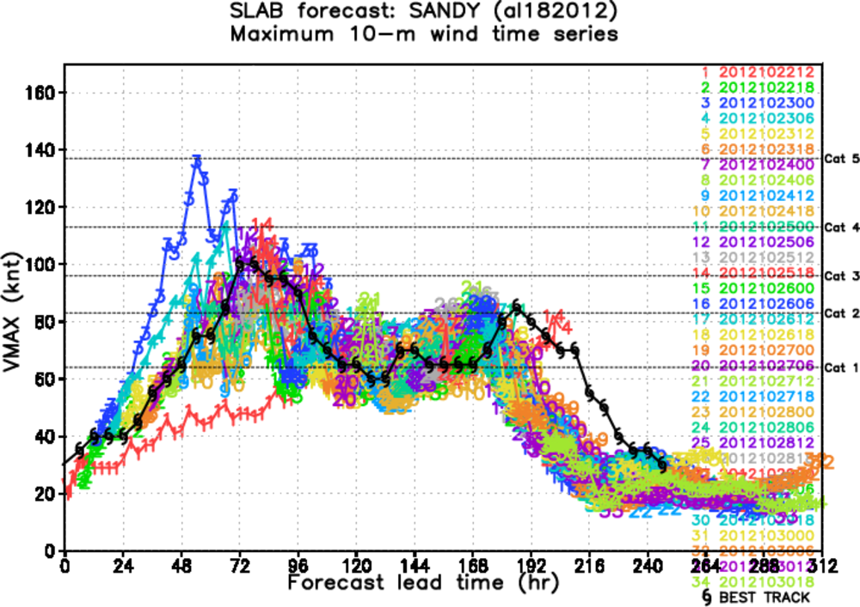
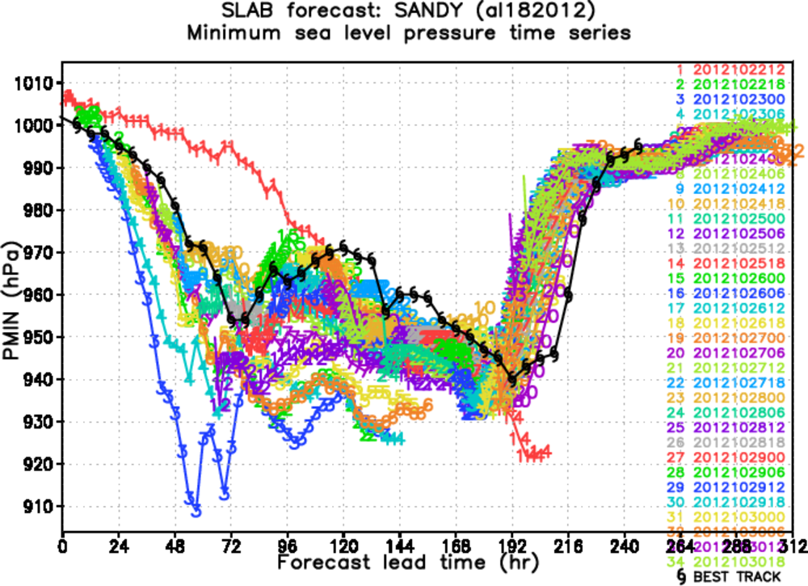
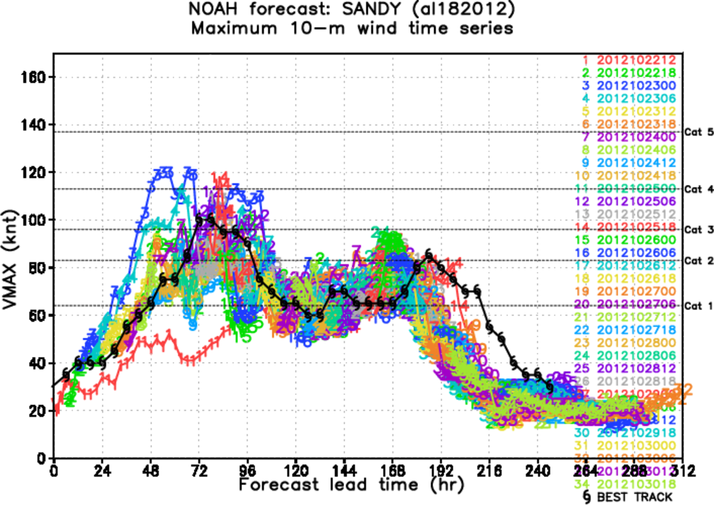
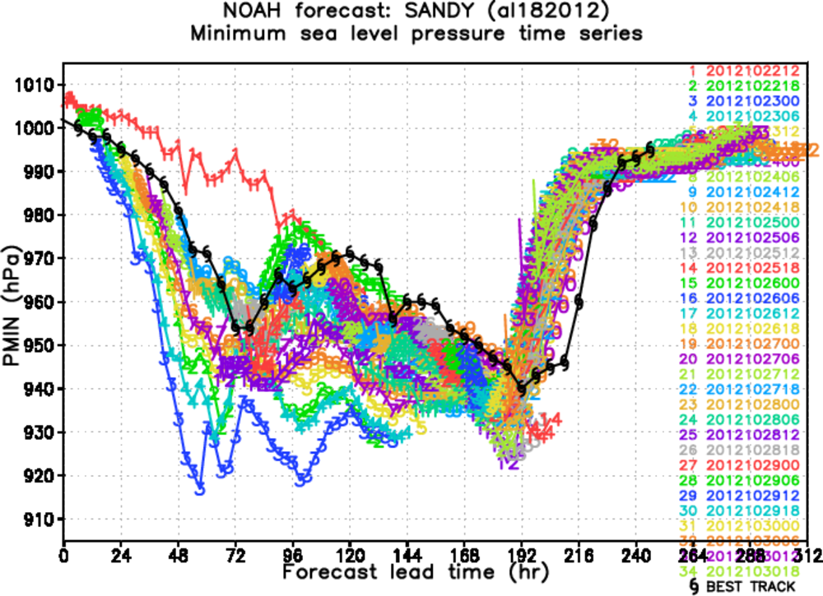
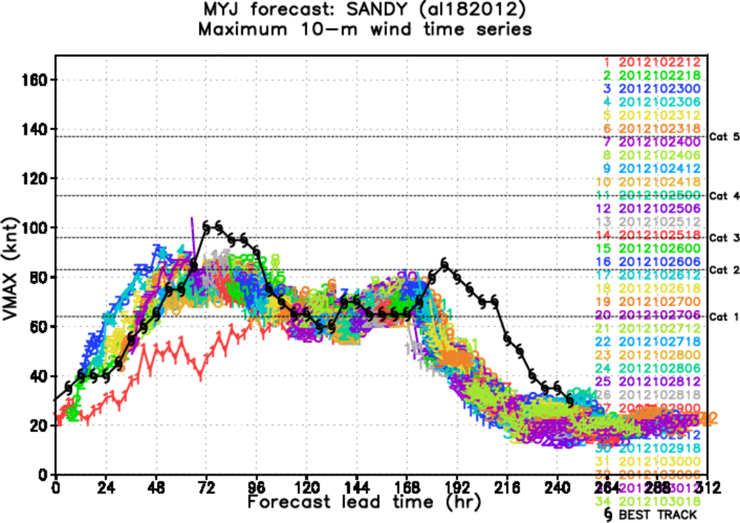
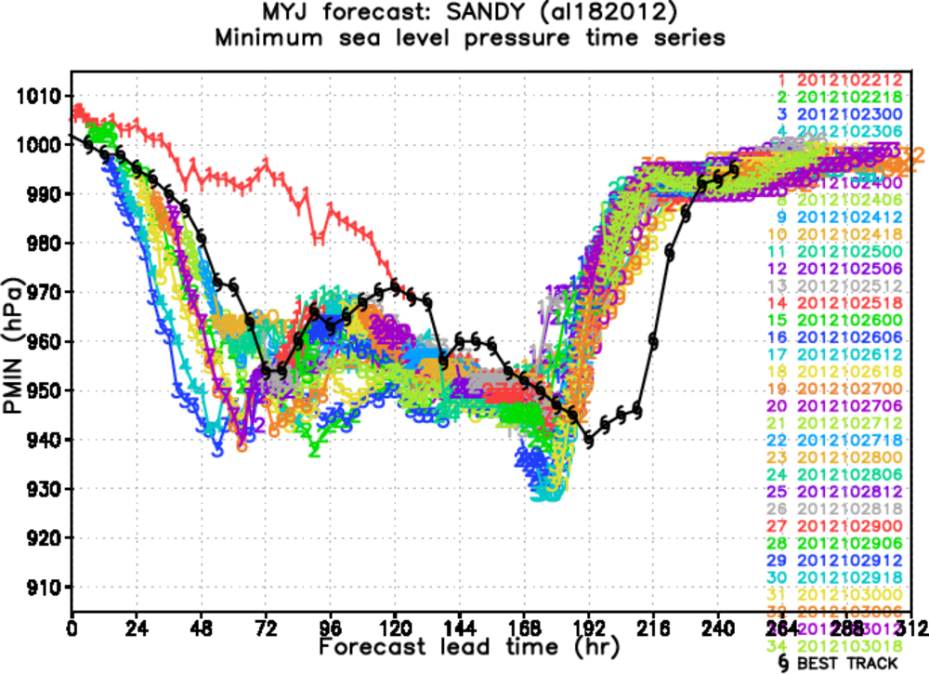

Slide 4
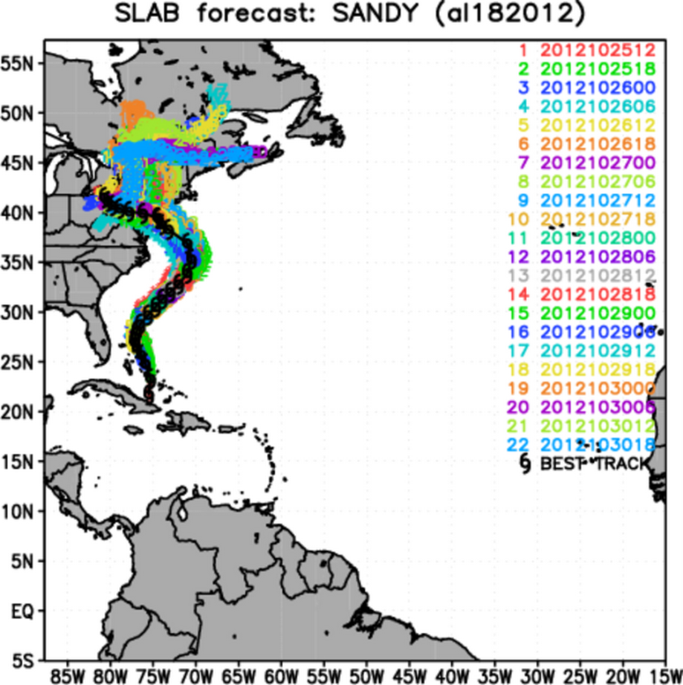
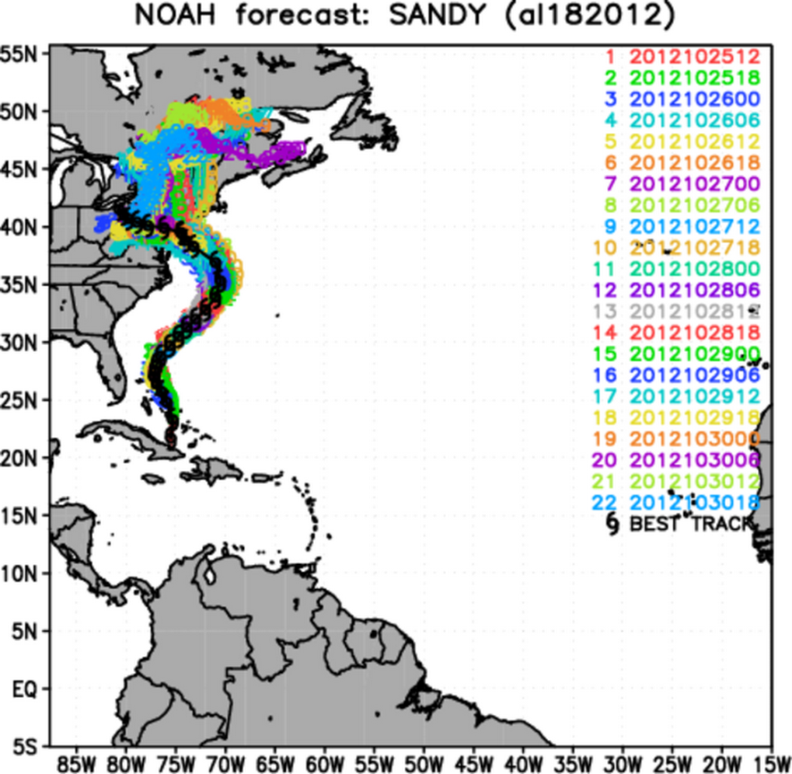
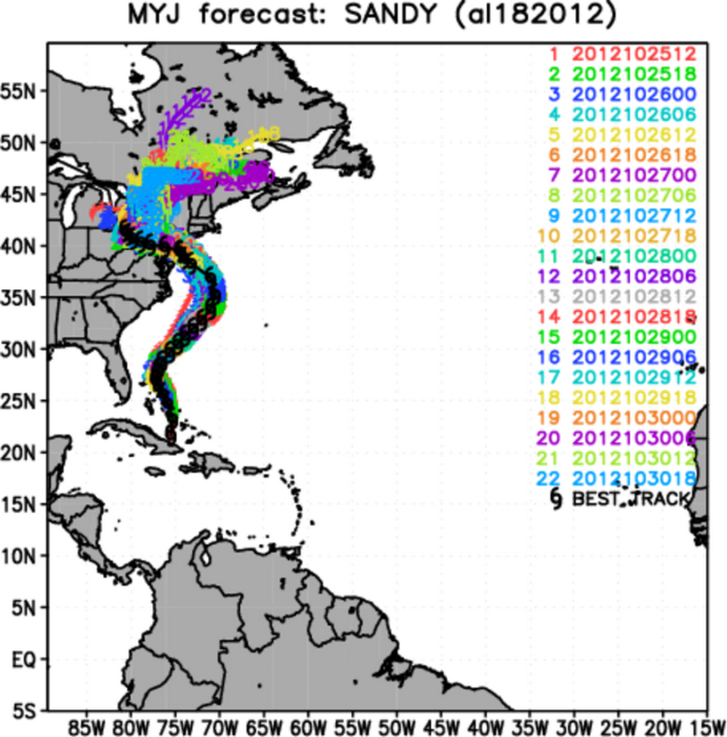
Only landfalling cases

Slide 5
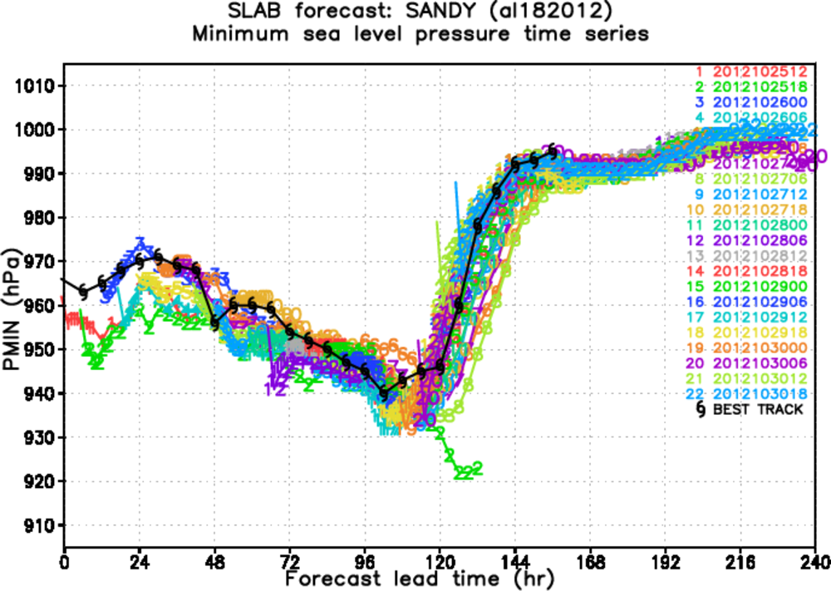
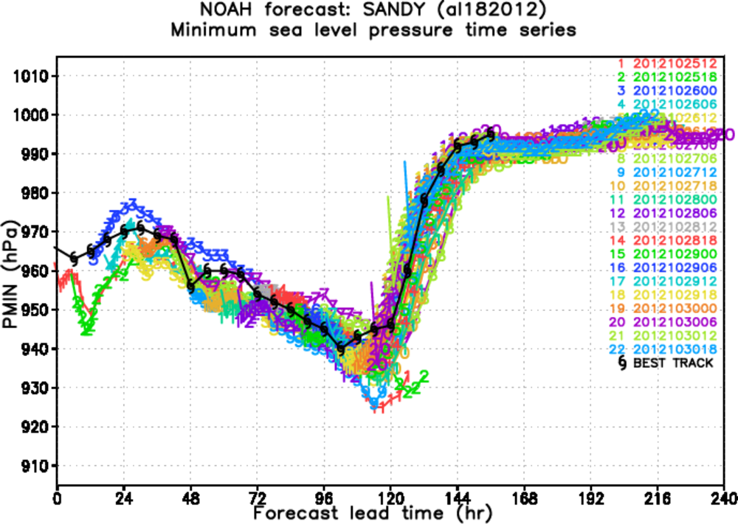
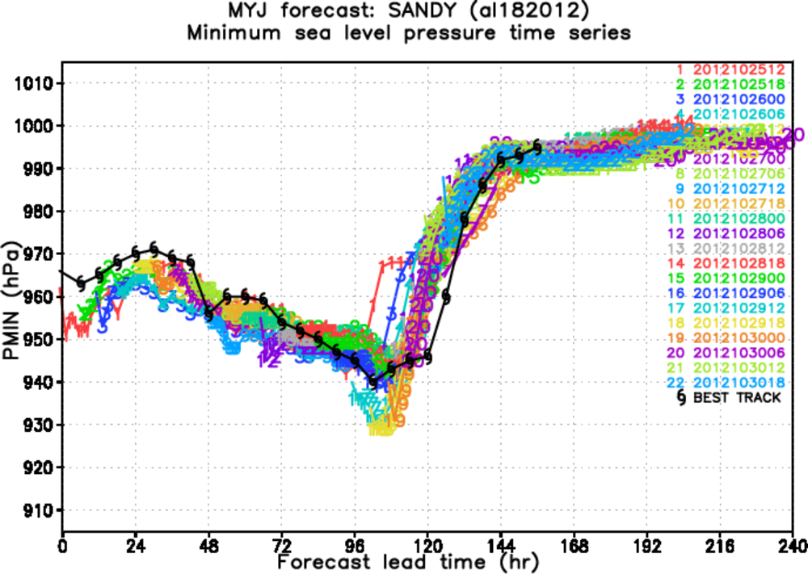

Slide 6
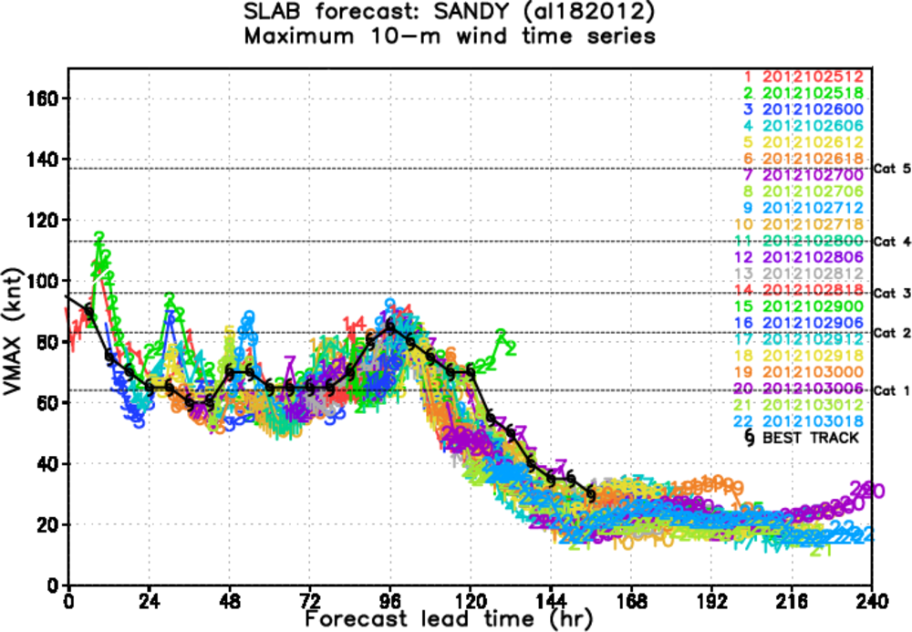
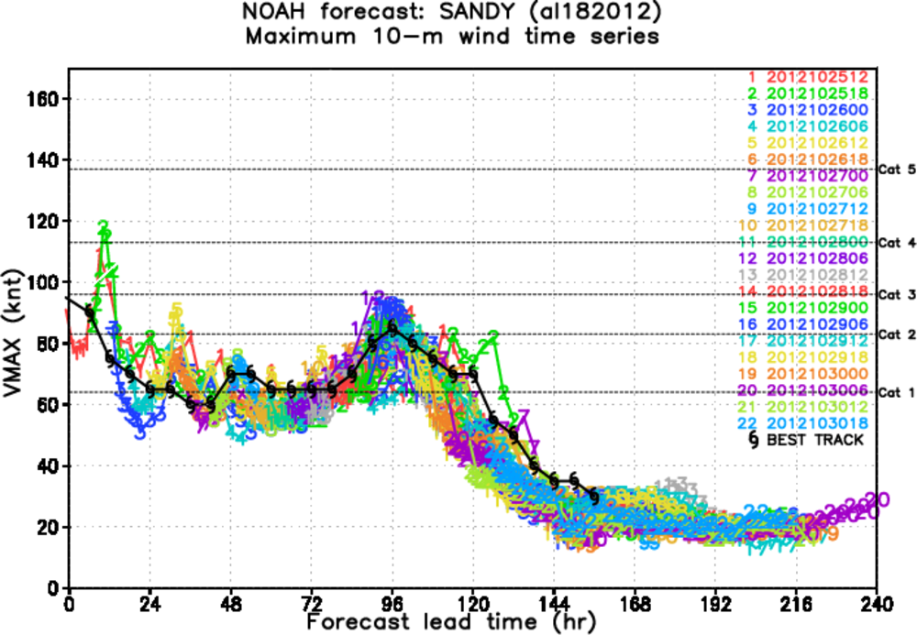
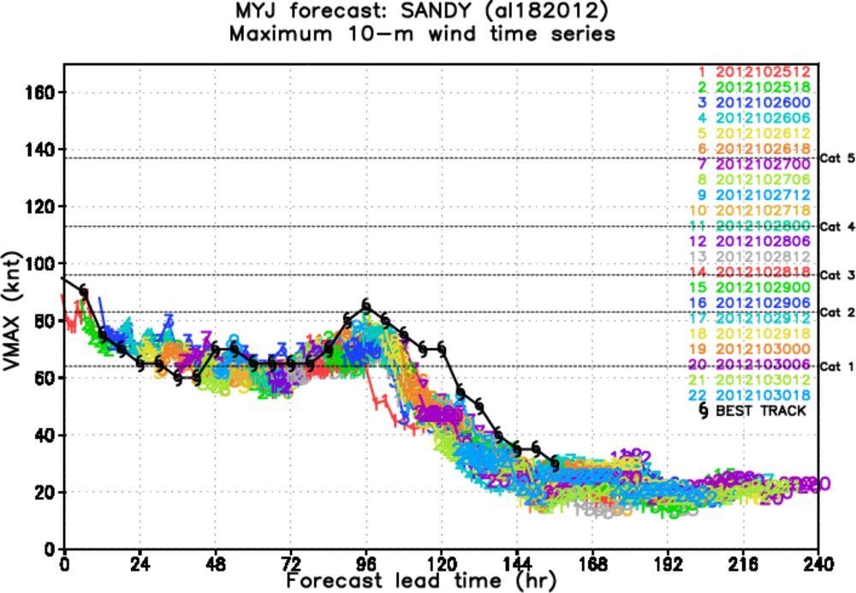

Slide 7
TSFC

Slide 8
Surface LHF

Slide 9
Surface SHF

Slide 10
Why?
New cd ch over ocean in gfdl surface layer
New lsm – noah vs. slab
New pbl – eta myj vs. GFS pbl
How to separate LS feedback from that of the ocean?
Perturb tsfc, soil moisture?
2 separate physics for land and ocean?

Slide 11
NOAH LSM ‐ GFDL surface layer scheme in HWRF model

Slide 12
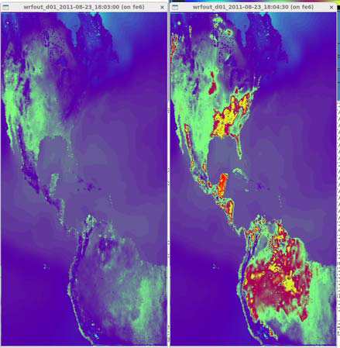
Background
Using NOAH land surface model coupled with GFSL surface layer physics in HWRF improves the track predictions considerably.
However, few cycles either failed or abnormal temperature fluctuations were seen in HWRF simulations.
C_{h} (surface exchange coefficient for heat and moisture) and related variables (HFX, QFX,) are causing the problem.
Typical CHS value over land = 0.012 – 0.015. But model computed CHS are very high and not physical at all.
Temporary fix suggested was to cap CHS at 0.1 and the model did not fail but the temperature fluctuations still exists (40-60 deg)
GFDL – SLAB sfc
NOAH – GFDL sfc

Slide 13
HCAP
Temporary fix suggested was to cap CHS at 0.1 and the model did not fail but the temperature fluctuations still exists (40-60 deg)

Slide 14
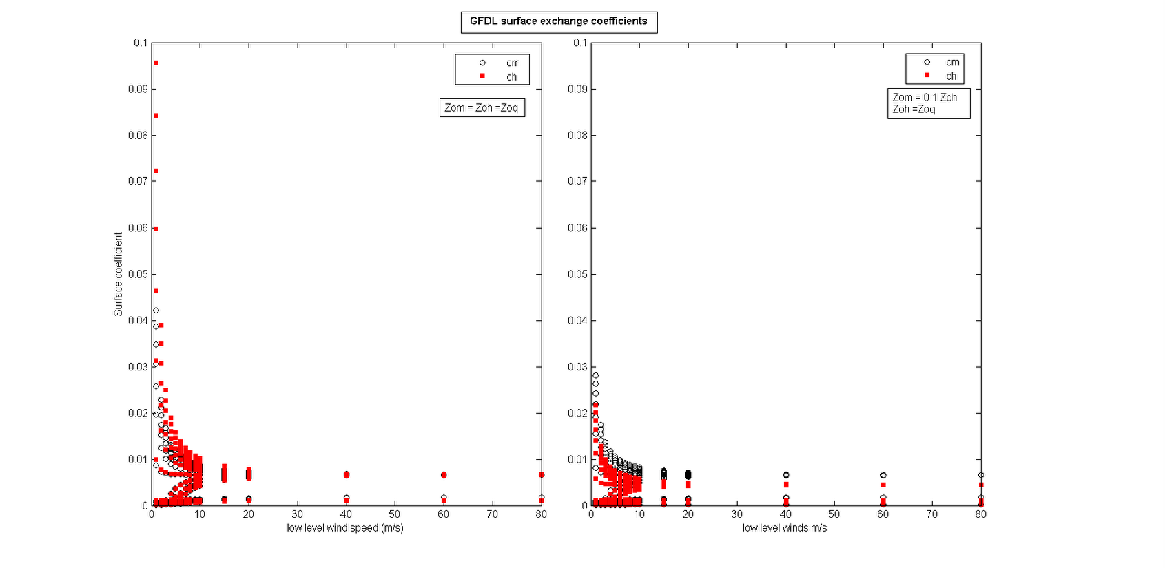
NOAH land surface with GFDL surface layer & MODZOT
Using Tuleya’s offline surface layer code, it was found that at really low wind speeds, CHS was as high as 0.1 when typical values are of the order of 10⁻².
GFDL surface layer code assumes zom = zoh and CHS is calculated using this assumption.
A new formulation for zoh = 0.1 zom (MODZOT) was tested and the offline code considerable reduced the chs values (0.03). The same formulation was tried in the HWRF

Slide 15
Max tsfc = 363 K
Max tsfc = 336 K
Noah gfdl with zoh=0.1zom
Noah_gfdl

Slide 16
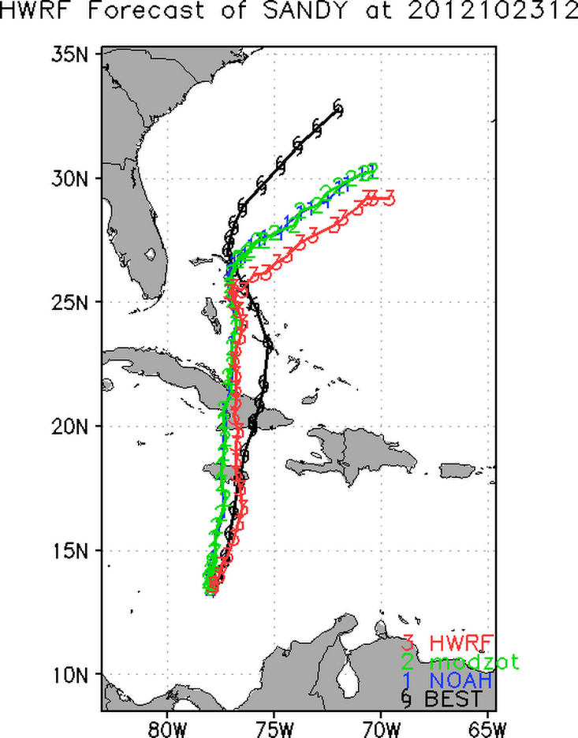
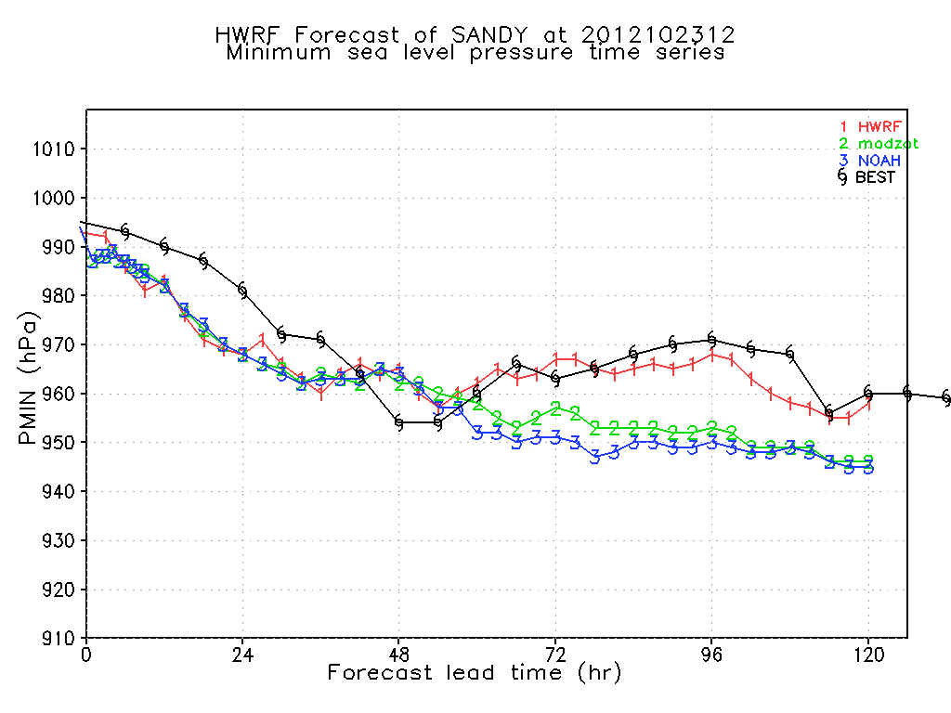
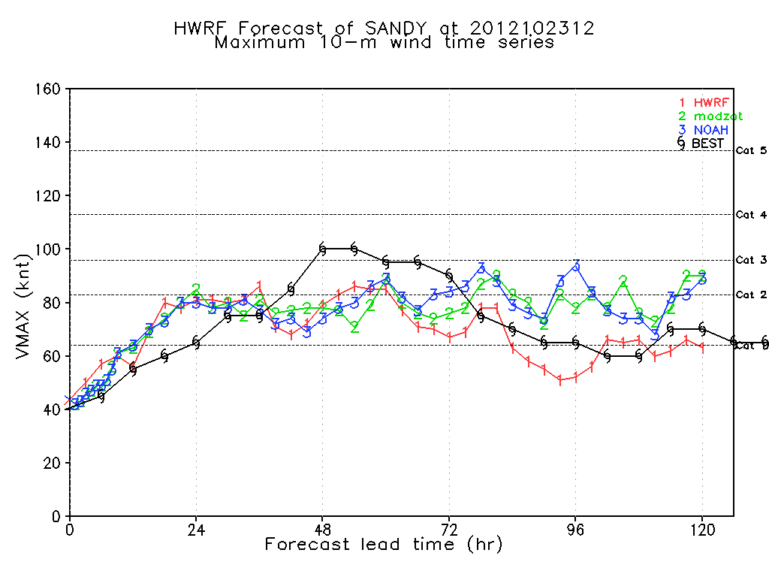

Slide 17
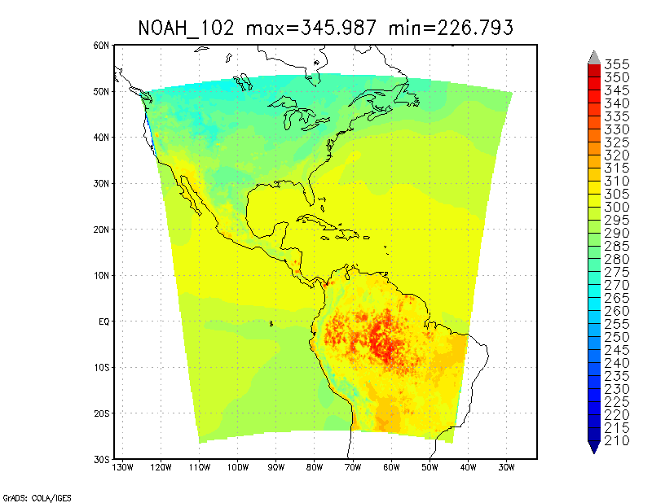
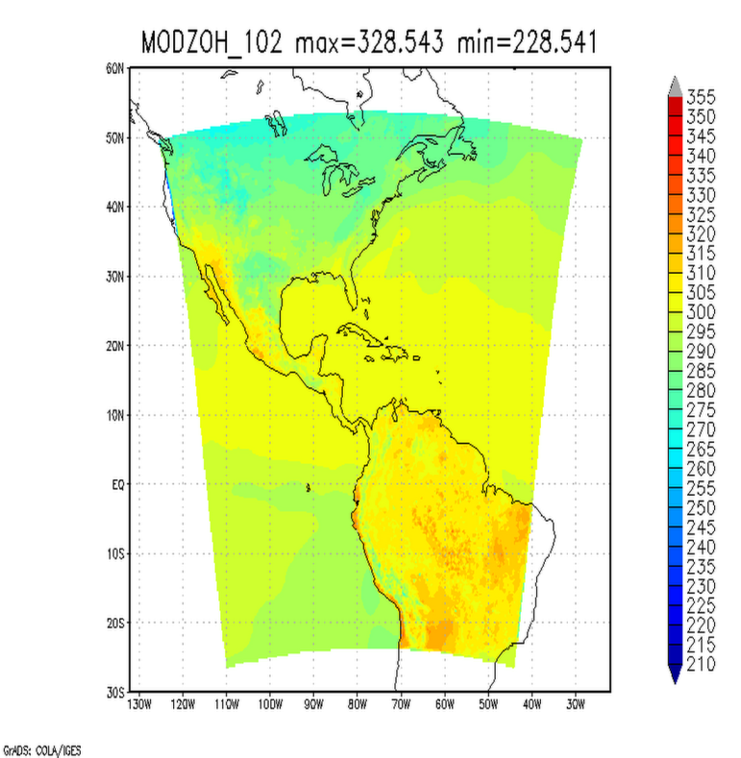
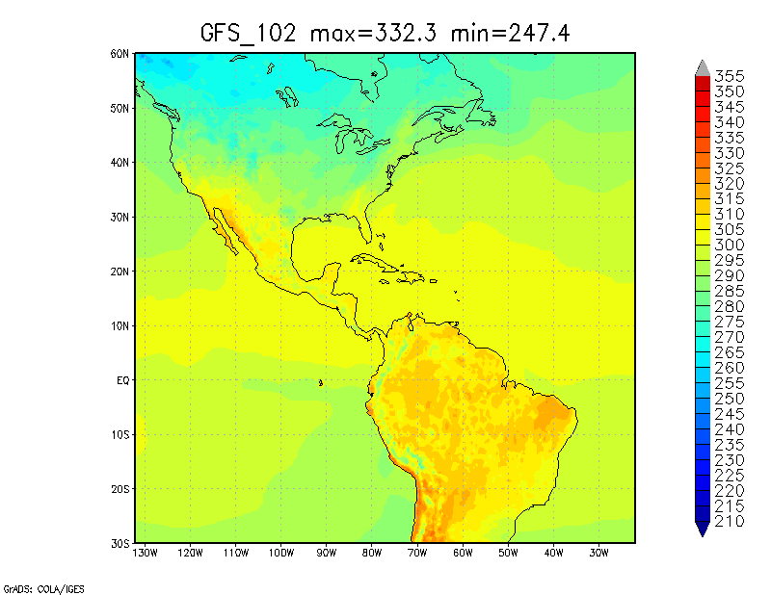
MODZOT performs better than HCAP. Max tsfc observed was 336 K compared to 352 K in HCAP run.

Slide 18
Sample point time series. MODZOT very closely follows GFS surface temperature.

Slide 19
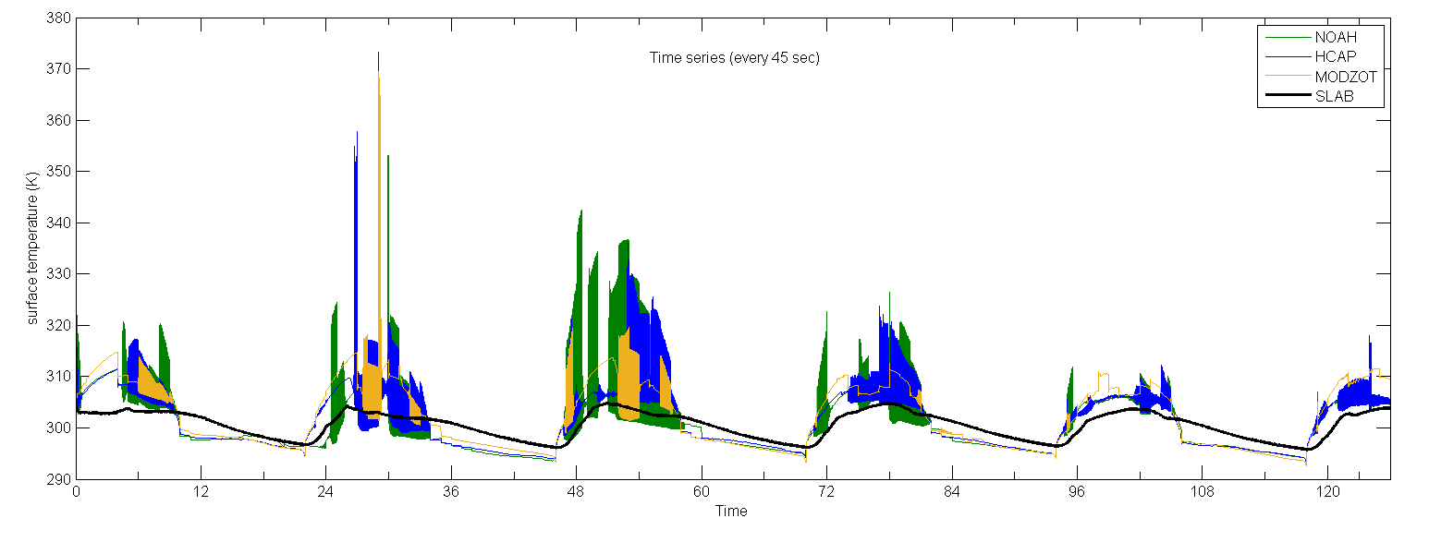
All the previous figures were using the 3 hrly outputs from HWRF. When surface temperature at every time step was plotted..
Temperature fluctuation still exist but it is not captured in the 3 hrly outputs and are as high as 370K.
The oscillations die down over time.

Slide 20
Debugging and physics of GFDL surface layer
Used Totalview to setup the debugging platform.
The GFDL – SLAB code is a one code and NOAH when coupled with GFDL surface layer switches off temperature prediction in the code using a flag.
CHS and QGH – variables from surface layer into LSM different
QGH reset to zero after GFDL surface layer.
CDM and CHS – surface layer exchange coefficients for momentum and heat are computed through the surface layer subroutine that differentiates between stable and unstable points based on Zeta (stability parameter).
The points of temperature fluctuations fall into the unstable points stack and the coefficients to calculated CHS are iterated within a loop.

