Slide 1
Advancements in Data Assimilation for NCEP Operational High-Resolution Triple-Nested HWRF
Vijay Tallapragada
Environmental Modeling Center,
NCEP/NOAA/NWS, Camp Springs, MD 20746.
JPSS Proving Ground and GOES-R3 risk reduction projects Kick-Off Meeting, May 18, 2012
Notes:
1
1

Slide 2
Outline
Operational HWRF for 2012 season
Unification of operational and research versions of HWRF in the community modeling framework (EMC/HRD/DTC)
Development and evaluation of Hybrid EnKF-3DVAR DA for Regional Modeling (EMC/HRD/ESRL/DTC)
Ongoing HWRF DA efforts at EMC
Future developments 2012 and beyond

Slide 3
FY12 HWRF Implementation at NCEP
A major accomplishment was the development of a third nest, at 3 km resolution, to cover the inner core and most of surrounding circulation of the storm. This would make the HWRF model the highest resolution hurricane model ever implemented for operations in the National Weather Service…. Richard Pasch, NHC
This presentation outlines the unprecedented efforts by the EMC HWRF team in collaboration with and support from several partners to accomplish this goal.
Major priorities for this implementation:
Upgrades to WRF NMM core and infrastructure (WPS, UPP and GSI)
Focus areas for FY12 Implementation:
a) Increase model resolution to 3 km near the hurricane core
Introduction of storm following third nest in 27/9/3 framework
Operational challenges to fit into available resources
Re-design Vortex Initialization applicable for 3km
b) Improve track, intensity and structure forecast skills and w-p relationship
Explicit convection in 3km domain, New GFS Shallow Convection
Modified surface physics, PBL, microphysics and convection
1-D POM coupling for the Eastern Pacific basin
Upgrade HWRF-GSI to V3.5 and reduce the impact of assimilation of observations in hurricane environment

Slide 4
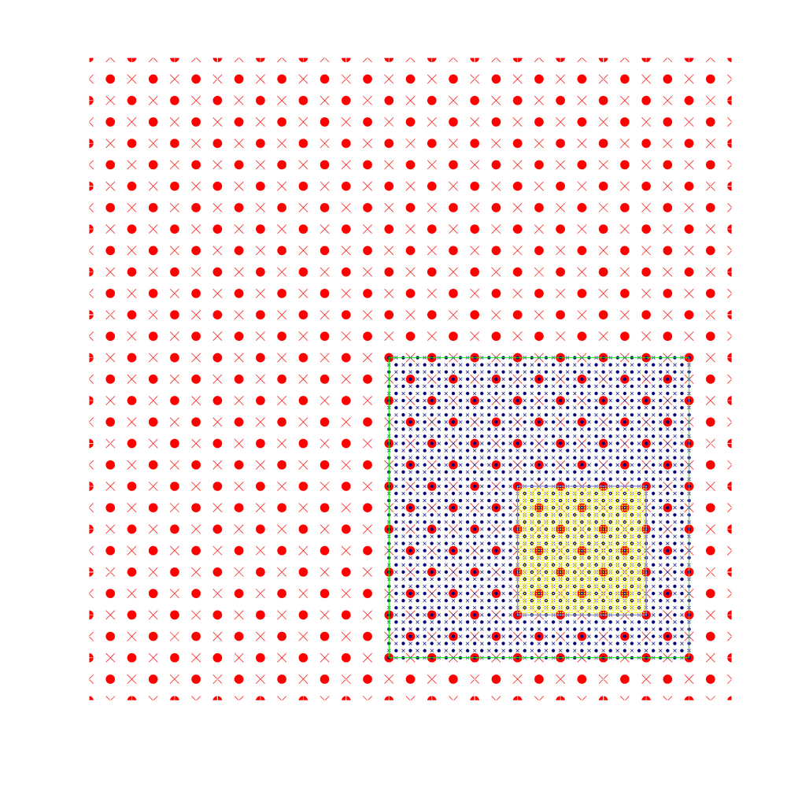
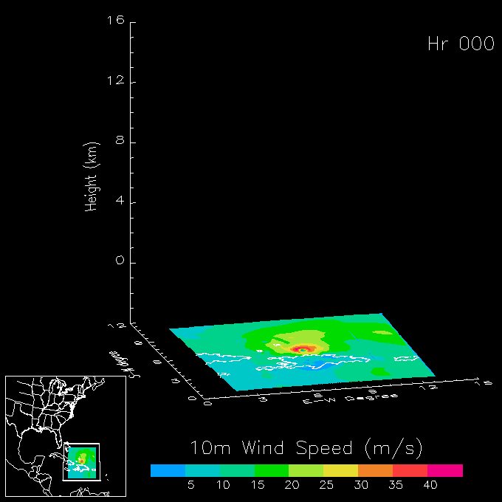
Highlights of the 2012 HWRF upgrades
For the first time, a high-resolution hurricane model operating at cloud-permitting 3km resolution is being implemented into NCEP operational system
This upgrade is a result of multi-agency efforts supported by HFIP
EMC: Computational efficiency, nest motion algorithm, physics improvements, 3km initialization and pre-implementation T&E
HRD/AOML: nest motion algorithm, multiple moving nests, PBL upgrades, interpolation for initialization, Stream 1.5
DTC/NCAR: code management and repository, MPI profiling
ESRL: Physics sensitivity tests and idealized capability
URI: 1D ocean coupling in East Pac basin
GFDL: Knowledge sharing, joint T&E
NHC: Diagnostics and evaluation of the HWRF pre-implementation tests
Three telescoping domains:
27km: 75x75º; 9km ~11x10º 3km inner-most nest ~6x6º
Notes:
4

Slide 5
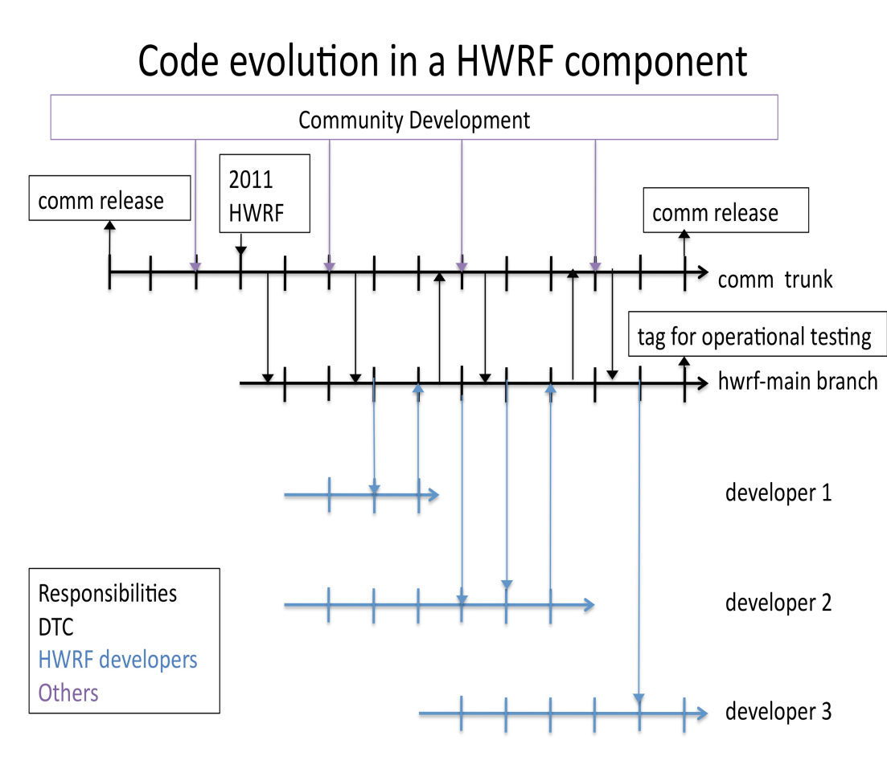
Integrated developmental path and unified code management
NCEP Operational HWRF (2.0) 2007
AOML/HRD Research HWRF (V3.0.1) 2008
High Resolution Research version of the HWRF system geared to compliment operations
Improved resolution and improved understanding of forecast at about 1-3 km resolution
Incorporate observations on vortex scale for improved model initialization
Incorporate appropriate representation of physical processes in tropics for 1-3 km resolution
Code management and community support through unified repository supported by DTC
HWRF Vortex
Assimilation & GSI
WRF pre-processing system Flexibility for testing initial
Conditions for research
Hurricane EnKF Data
Assimilation System (HEDAS)
NMM dynamics with
one moving nest
NMM dynamics with
multiple moving nests
Operating resolution 27:9
Operating resolution
27:9, 9:3 and 27:9:3
Ocean Coupled
GFDL/GFS Physics/
Slab LSM
GFDL/GFS Physics/
NOAH LSM Consistent w/ 3 km res.
Framework also
Includes Idealized
Cases/ 1-D HYCOM
HWRF post-processor
& HPLOT
Diapost: High Res. Hurricane Post-Processing system
Release Version HWRF V3.2
HFIP Stream 1.5 Real-Time Configuration in 2011
Tropical Prediction System
(HWRF-GEN) Basin-Scale &
Multiple-Movable Nests and Hybrid/Ensemble DA
Operational HWRF (2011)
Proposed 2012 operational HWRF
Coupling to HYCOM, Waves, NOAH LSM, Storm Surge and Inundation models, Hybrid DA, HWRF Ensembles, Other TC basins

Slide 6
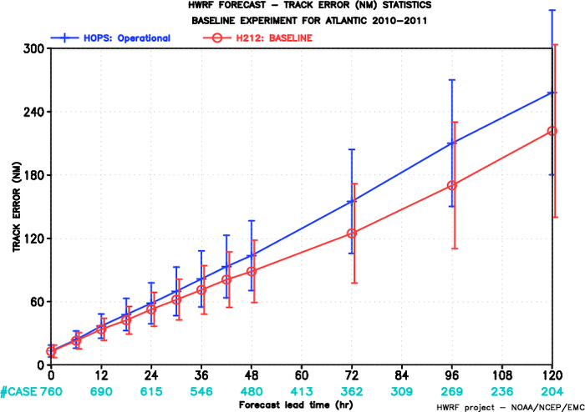
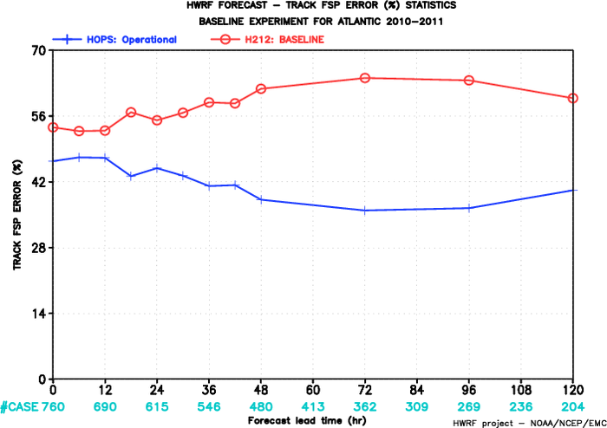
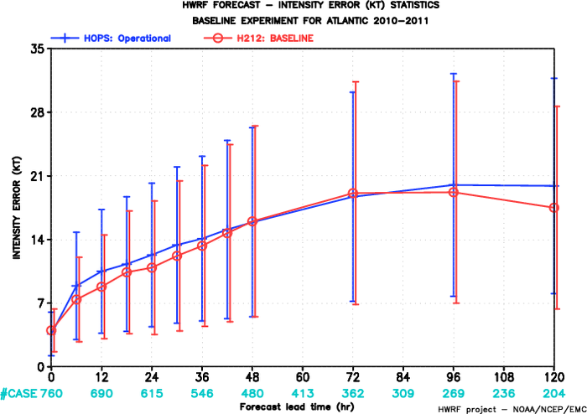
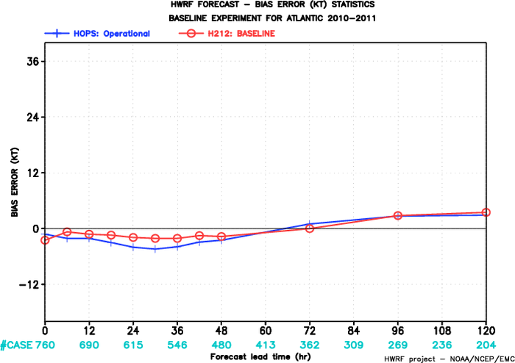
FY2012 HWRF
FY2012 HWRF
2010-2011 Atlantic Track Verification
~20% improvement
Track errors
Superior Track FSP
FY2012 HWRF
FY2012 HWRF
Intensity errors
HOPS: operational HWRF
H212: 2012 HWRF
~10% improvement
Improved Intensity Bias

Slide 7
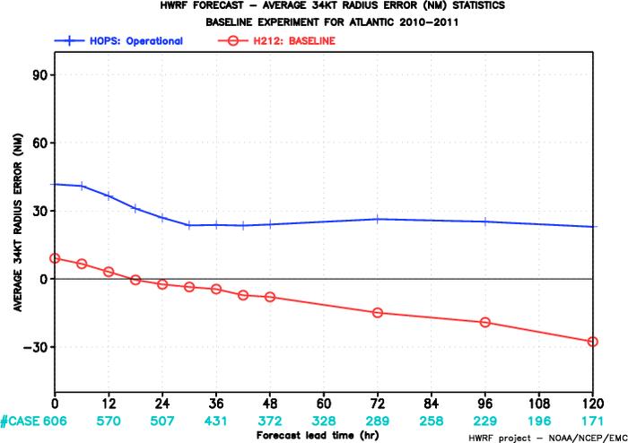
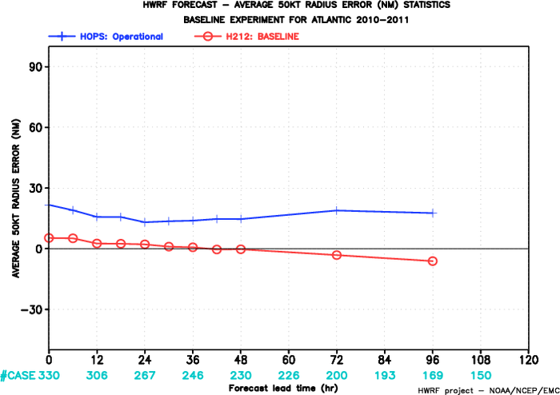
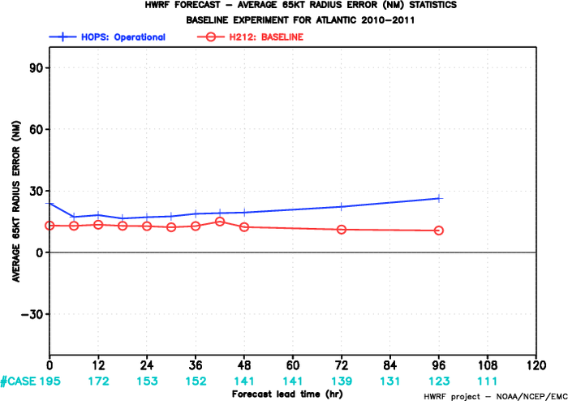
FY2012 HWRF
FY2012 HWRF
HOPS: operational HWRF
H212: 2012 HWRF
Mean 34-kt Radius Error
Mean 50-kt Radius Error
FY2012 HWRF
Mean 65-kt Radius Error
2010-2011 Atlantic
Radii Verification
Significant improvements in storm size and structure

Slide 8
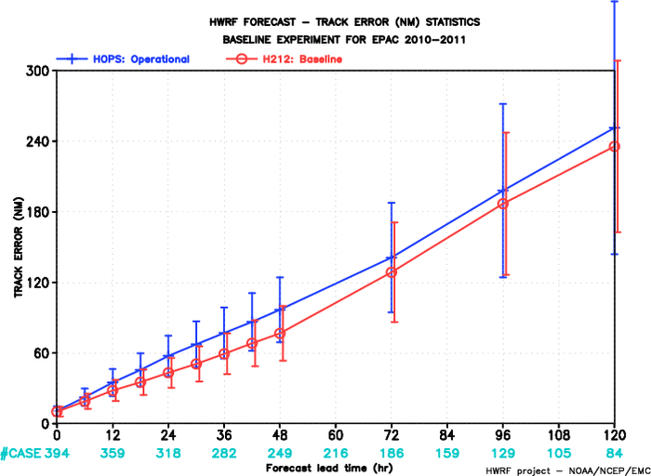
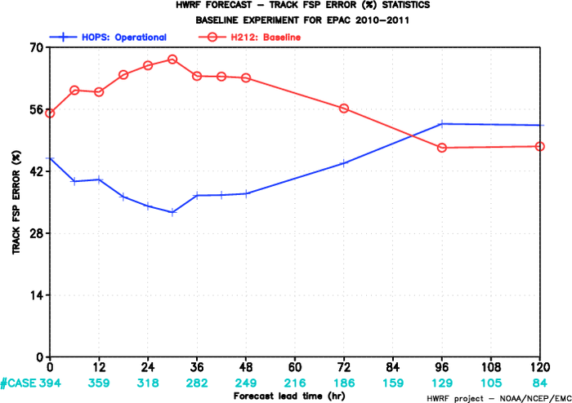
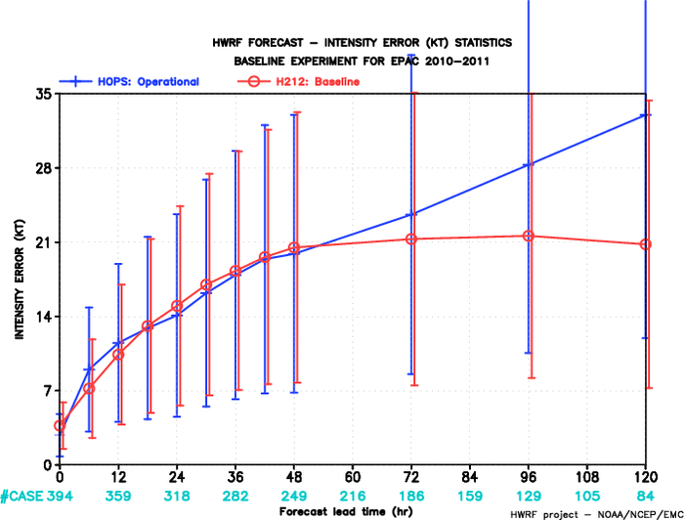
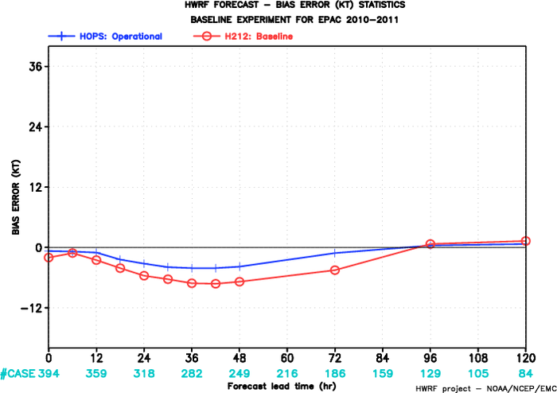
FY2012 HWRF
FY2012 HWRF
2010-2011 E-PAC
Track Verification
~20% improvement
Track errors
Improved Track FSP
FY2012 HWRF
FY2012 HWRF
HOPS: operational HWRF
H212: 2012 HWRF
~35% improvement
Intensity errors
Intensity Bias

Slide 9
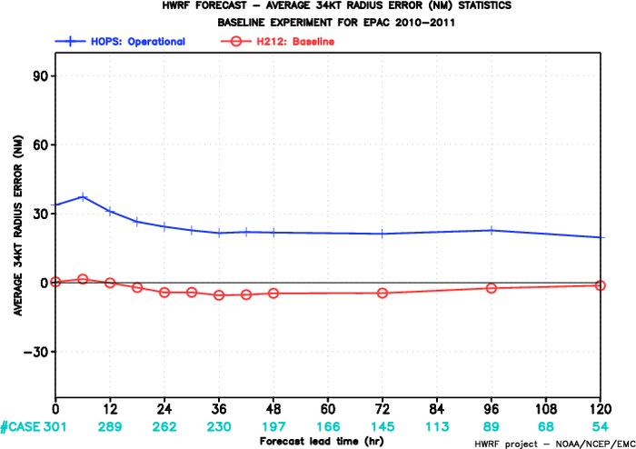
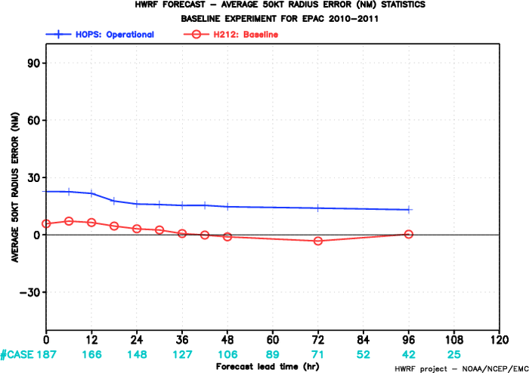
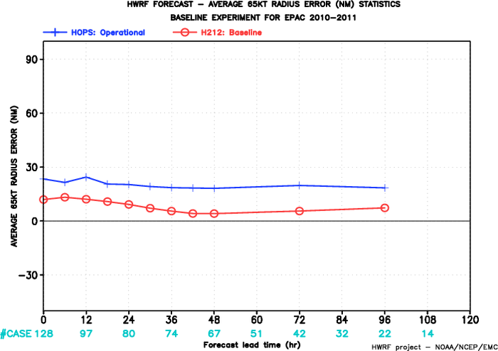
FY2012 HWRF
FY2012 HWRF
Mean 34-kt Radius Error
Mean 50-kt Radius Error
HOPS: operational HWRF
H212: 2012 HWRF
FY2012 HWRF
FY2012 HWRF
Mean 65-kt Radius Error
2010-2011 E-PAC
Radii Verification

Slide 10
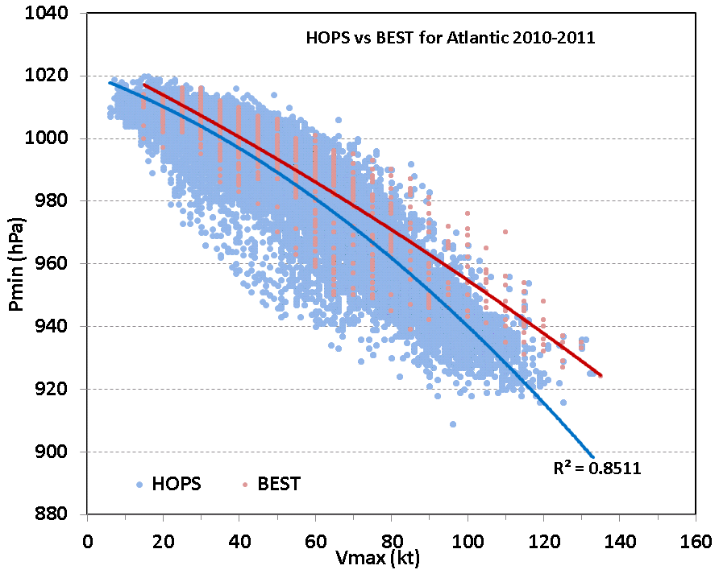
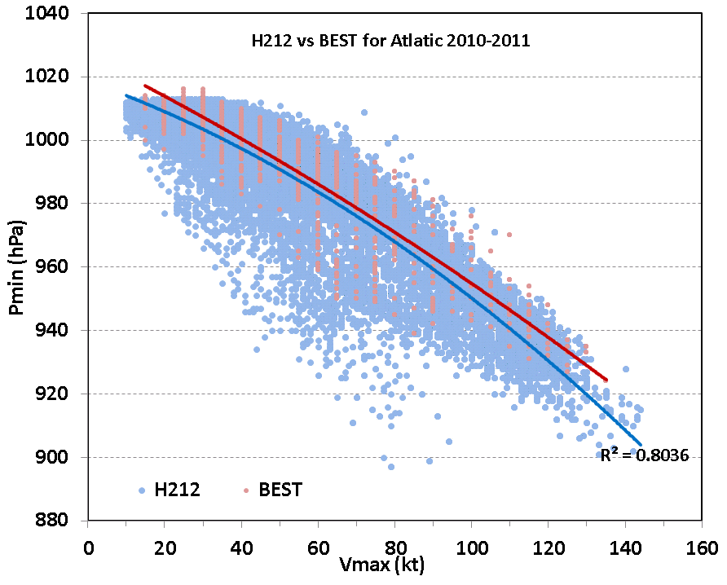
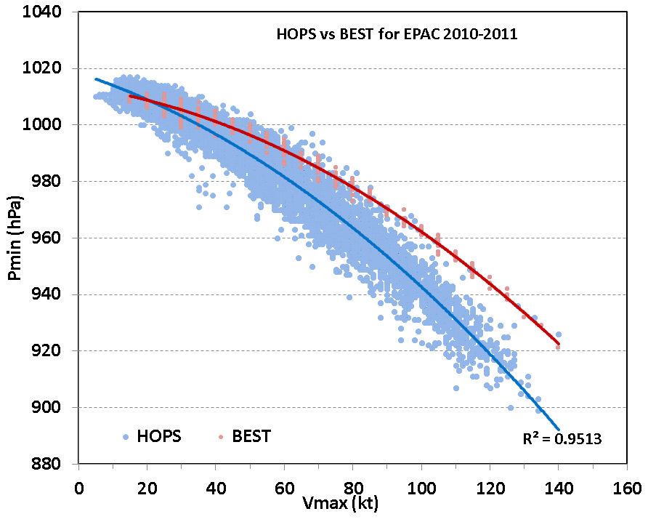
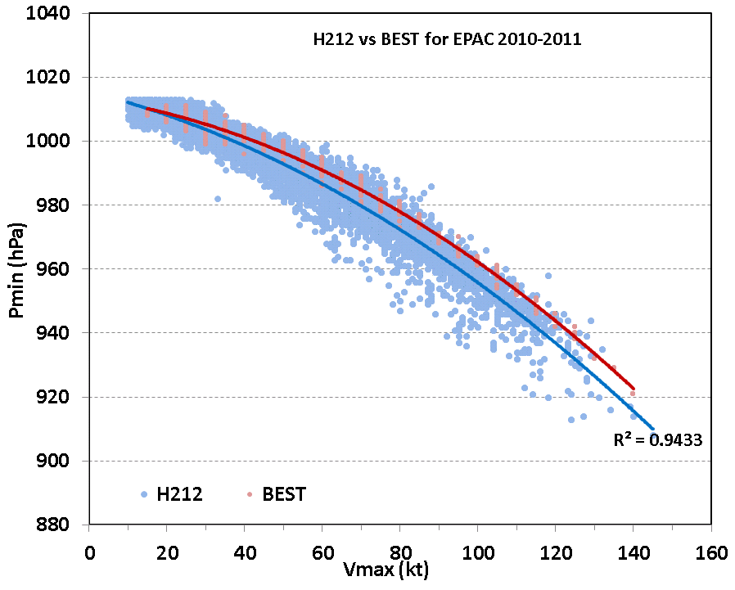
HOPS vs. H212 P-W relationship
ATLANTIC
E-PAC

Slide 11
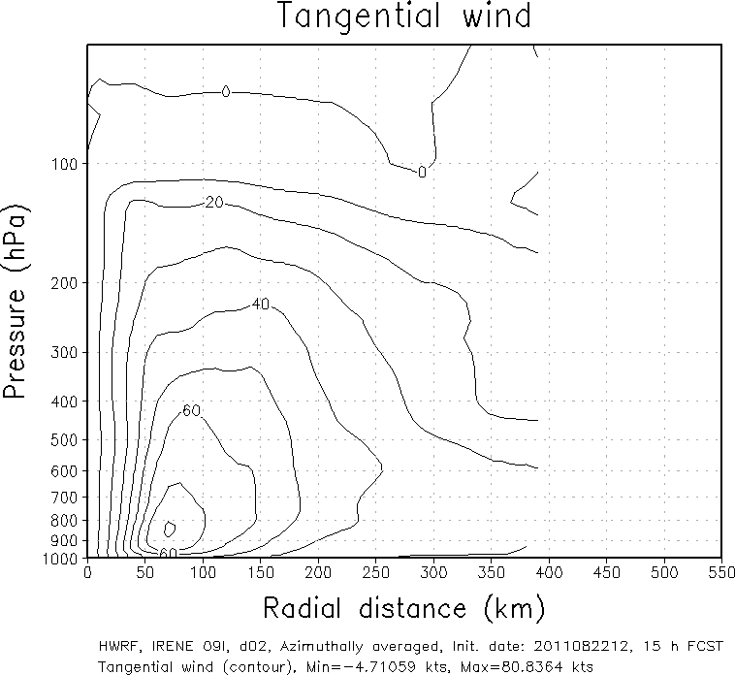
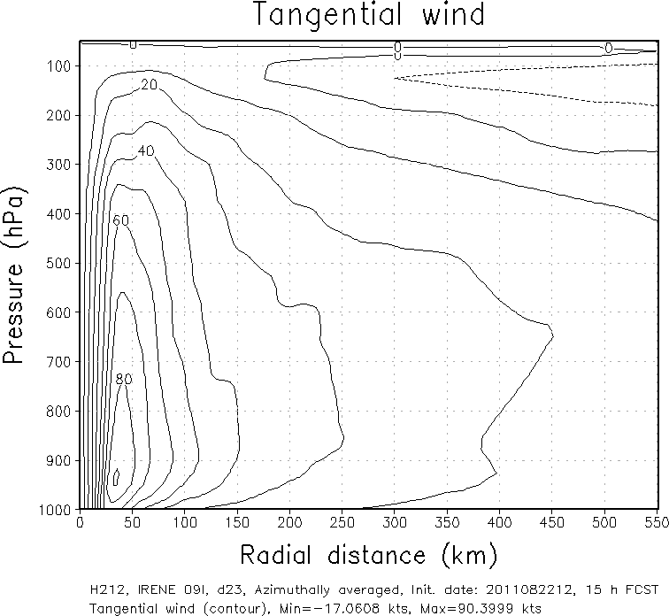
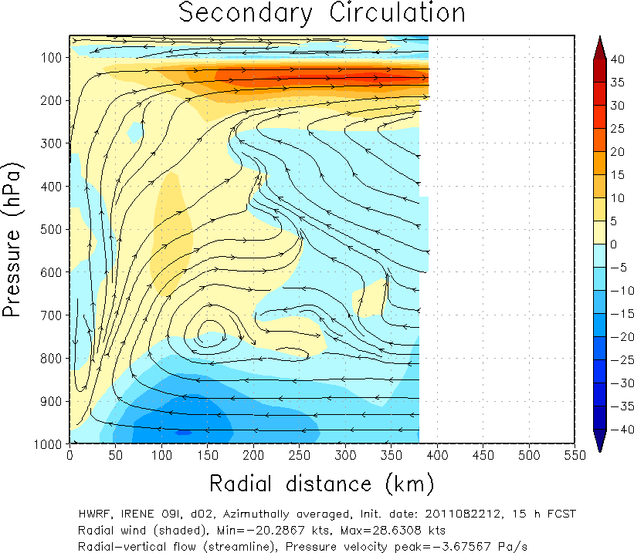
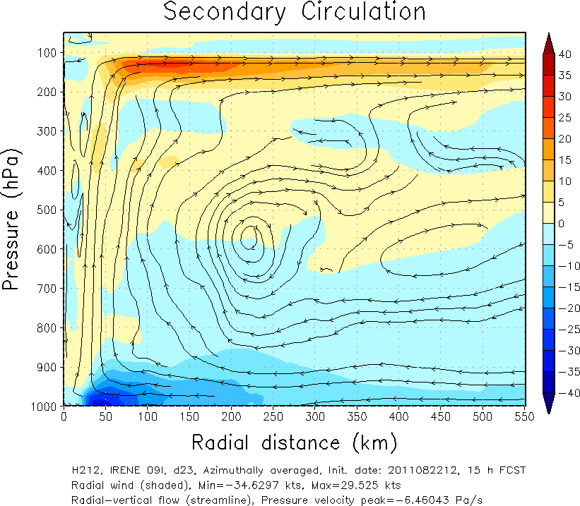
Advanced Vortex Scale Diagnostics
HOPS
H212
- Wind structure -
Smaller Size of vortex
Vertical structure comparison (Irene09L.2011082212 15h forecast)
Lower PBL height
- PBL height-

Slide 12
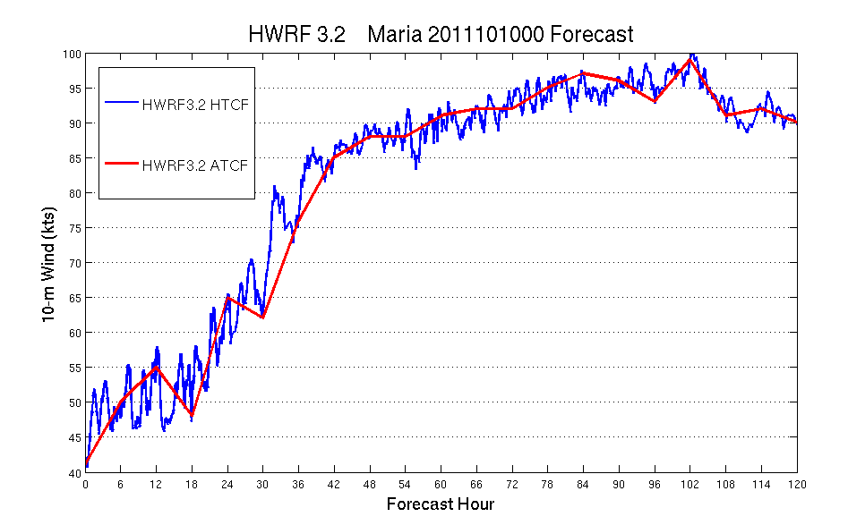
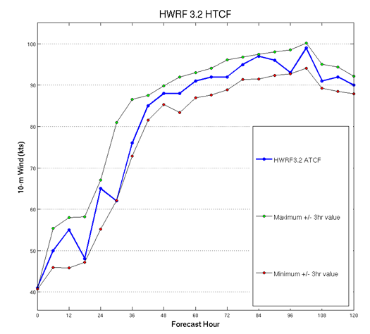
High Temporal Resolution (5sec. Interval) ATCF style Model Output
New experimental products from operational HWRF
Intensity variability could impact verification statistics
Evaluation of High-resolution structure now possible

Slide 13
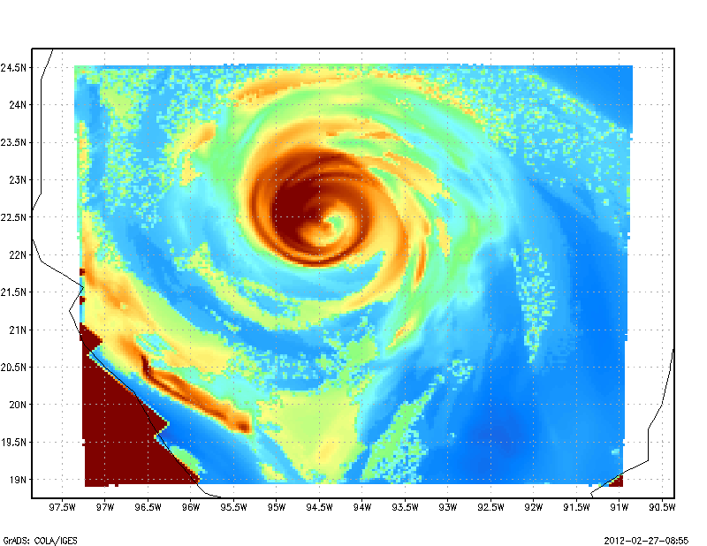
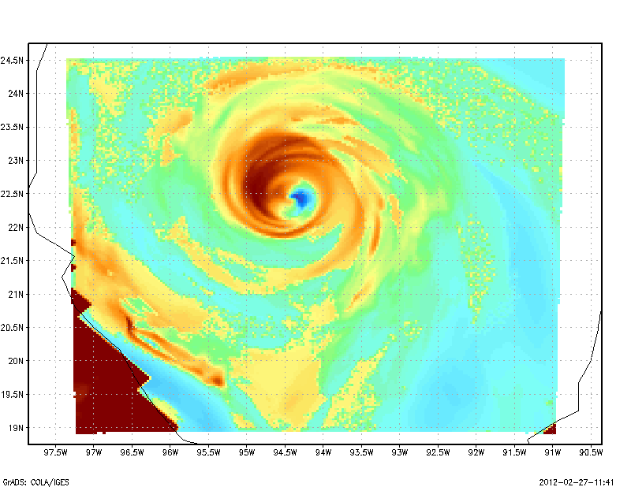
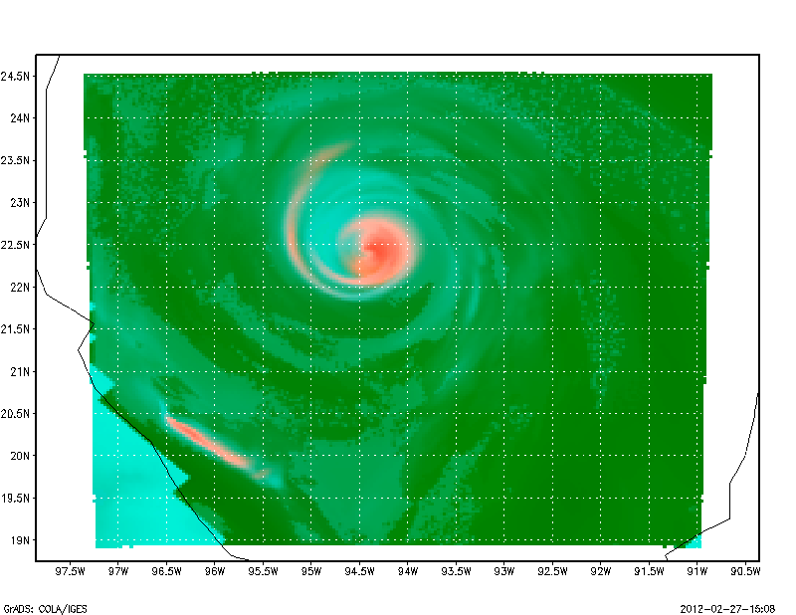
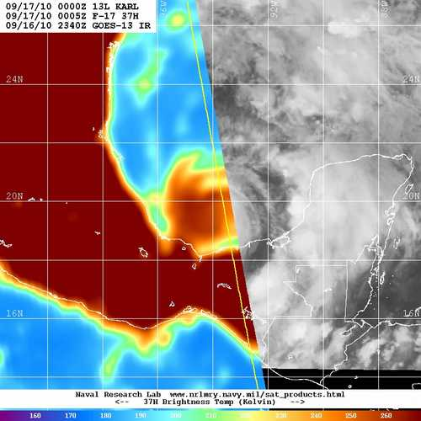
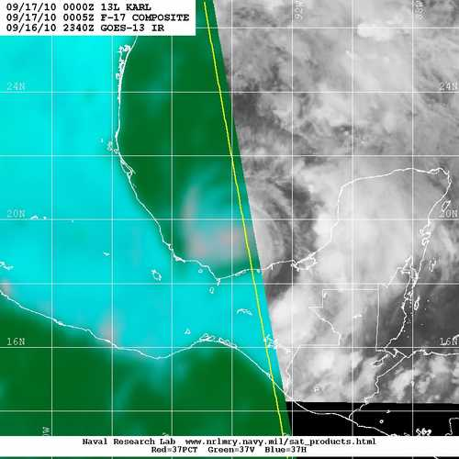
SSMI/S 37 GHz-H
SSMI/S 37 GHz-V
SSMI/S 37 GHz-Color Composite
Synthetic satellite imagery using a uniform RTM:
GOES-13 and GOES-11 Channel 2,3,4,6
SSM/I Microwave 37 GHz and 85 GHz V&H
HWRF Generated SSM/I S Microwave Imagery (new operational product)
-- Courtesy: Dave Zelinsky, NHC

Slide 14
Summary
Track forecast skills of H212 improved significantly over both 2011/2010 seasons on Atlantic basin with about 20-25% improvement against HOPS
Track forecast skills of H212 of Eastern Pacific basin also improved maximum 25% over the HOPS in 2010/2011 seasons
Intensity forecast show overall improvement. The biggest improvement of intensity is 2011 EP basin with over 40% to HOPS. Significant improvements in intensity bias is noted for both Atlantic and Eastern Pacific, for both 2010-2011 seasons.
On top of track and intensity skill, the storm size and structure of H212 improve as well, in terms of radii verification and evaluation of PBL height
The problem of wind-pressure relationship in high wind speed regime also significantly improved in H212
With high resolution and improved physics, we are laying foundation for improved intensity predictions through improved storm structure.

Slide 15
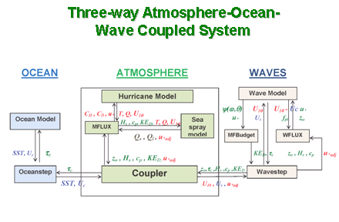
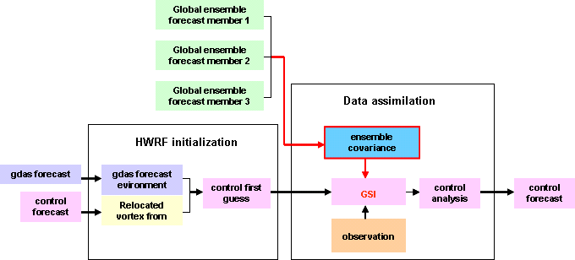
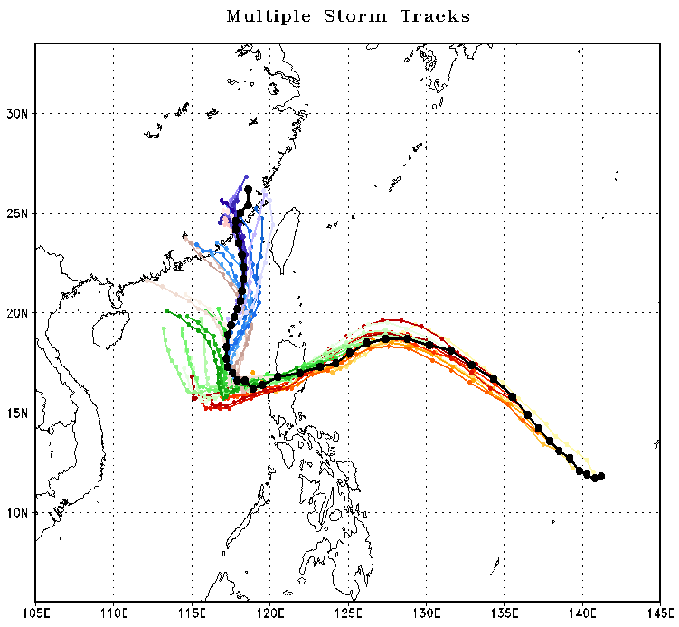
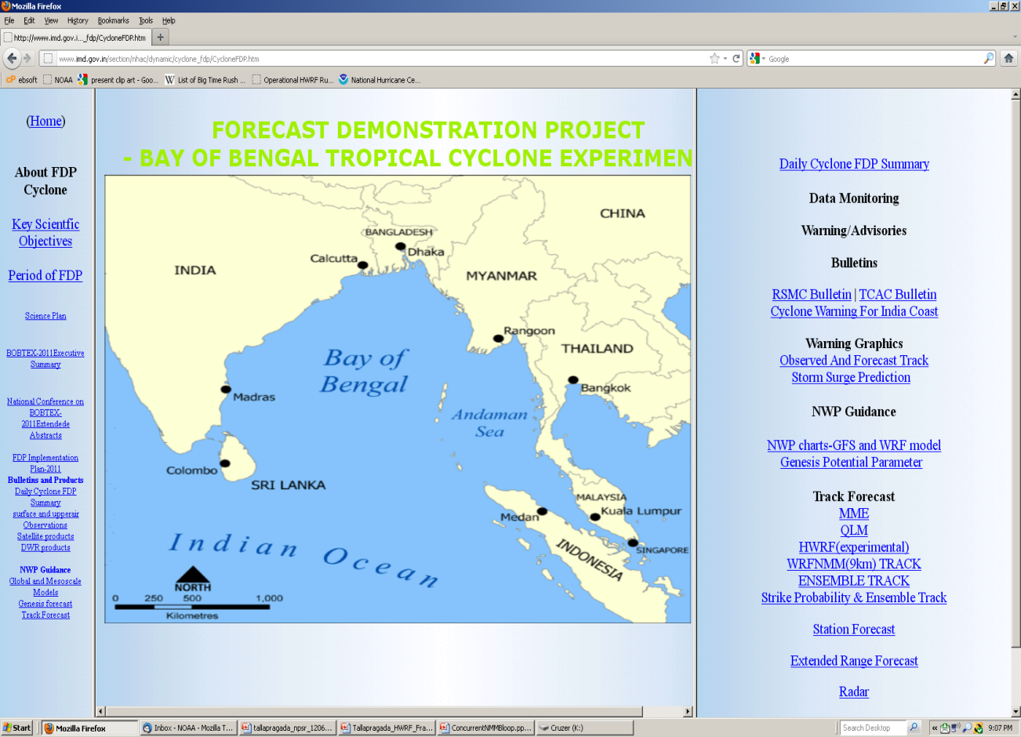
FY2012 and beyond…
HWRF Model (EMC, HRD)
Multiple moving nests within a basin scale domain & improved multi-scale interactions
HWRF Physics (URI, GFDL, ESRL,HRD)
Surface fluxes, sea spray and wave coupling, Physics for high-resolution (convection, micro physics, PBL, LSM )
HWRF Diagnostics (HFIP, EMC, NHC, FSU, CIRA, HRD, UMBC/UMD)
Hurricane model diagnostics, evaluation and verification, Develop a common and comprehensive diagnostics framework and tools to integrate model output with available observations for verification, Enhanced real-time product display and navigation
HWRF Ensembles
Large Scale Flow, Structure and Physics Perturbations; EnKF based perturbations in support of DA
Hybrid EnKF-GSI Data Assimilation for HWRF
Real-time transmission of the P3 TDR data flow from aircraft to NCO/TOC/AOC and assimilation using advanced GSI and improved vortex initialization (model consistent 3-D balanced vortex); Ensemble data assimilation - hybrid EnKF (Planned Demo for 2012 hurricane season (HFIP Stream 2); Improved use of satellite radiance datasets, Model vertical levels and top consistent with NAM
HWRF for World Oceans
Real-time testing of 27/9/3 HWRF for Western Pacific region (in support of JTWC)
Operational implementation of HWRF in India and advanced workshop in July 2012
Typhoon Megi
15
Notes:
15

Slide 16
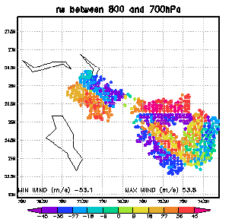
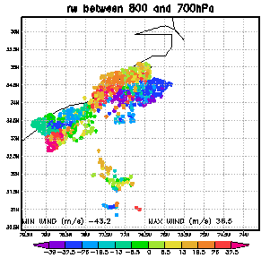
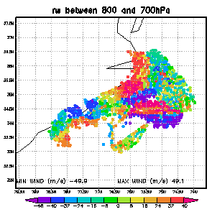
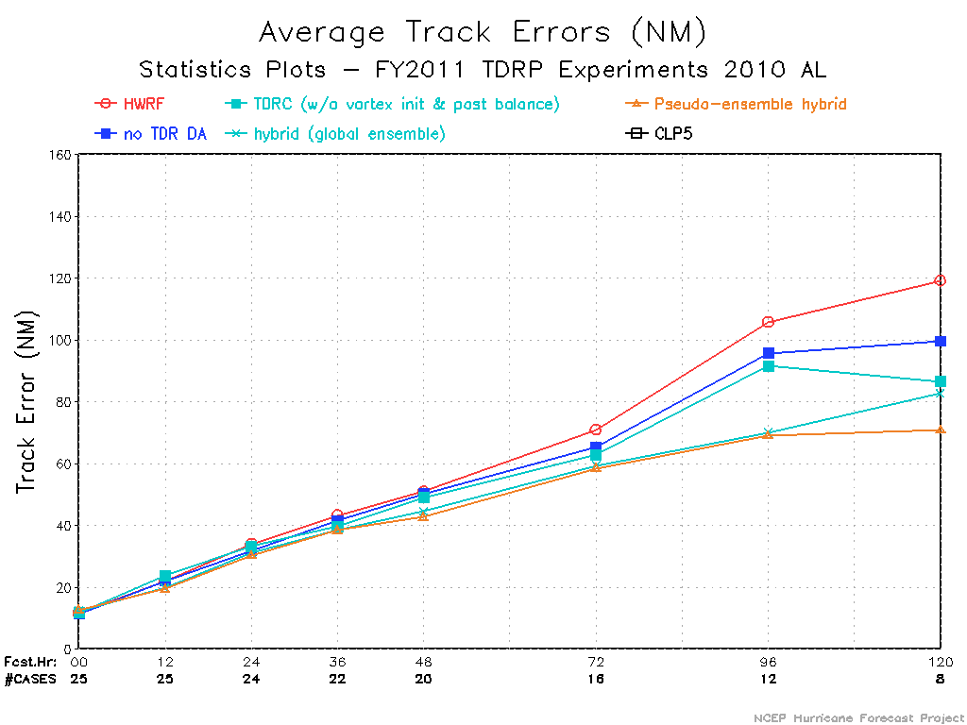
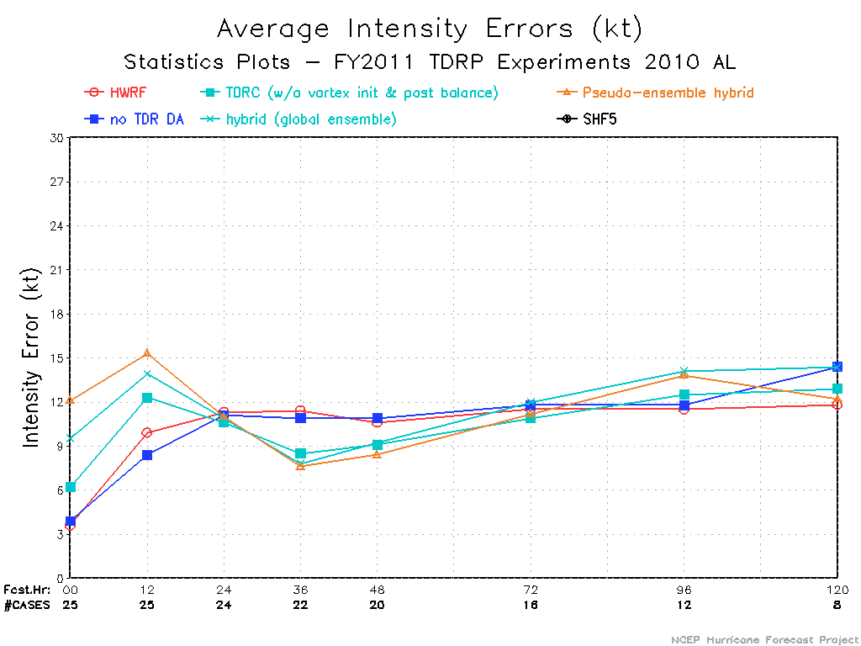
Real-Time TDR radial velocity data assimilated in inner analysis domain
2011.08.24 00Z
2011.08.24 12Z
2011.08.25 12Z
2011.08.27 00Z
2011.08.27 12Z
Positive improvements in track and intensity forecast skill using TDR data

Slide 17
2012 Hurricane Season Data Assimilation Real-time Parallel Experiments
DA Method | Analysis | Vortex Area | Data | Comments
One-way coupled Hybrid | Global T574 Hybrid EnKF-3DVAR system | 300 km from storm center | Prepbufr TDR* No satellite data | Background/First Guess from GDAS, HWRF Vortex initialization Use FGAT and 6-hrly analysis w/TDR, else 3hrly analysis
Basin-scale GSI/3DVAR System | 18 h run of HWRF using GSI (sequence of 6 h HWRF forecast and 3 GSI analyses) | No vortex scale DA | Prepbufr and clear-sky radiance | Test the impact of partial cycling/full cycling and radiance bias corrections Consistent with regional hybrid DA
Regional Hybrid DA | Dual-res (80 member HWRF ensembles) | No vortex scale DA | Prepbufr and satellite radiance | Collaborative effort supported by HFIP

Slide 18
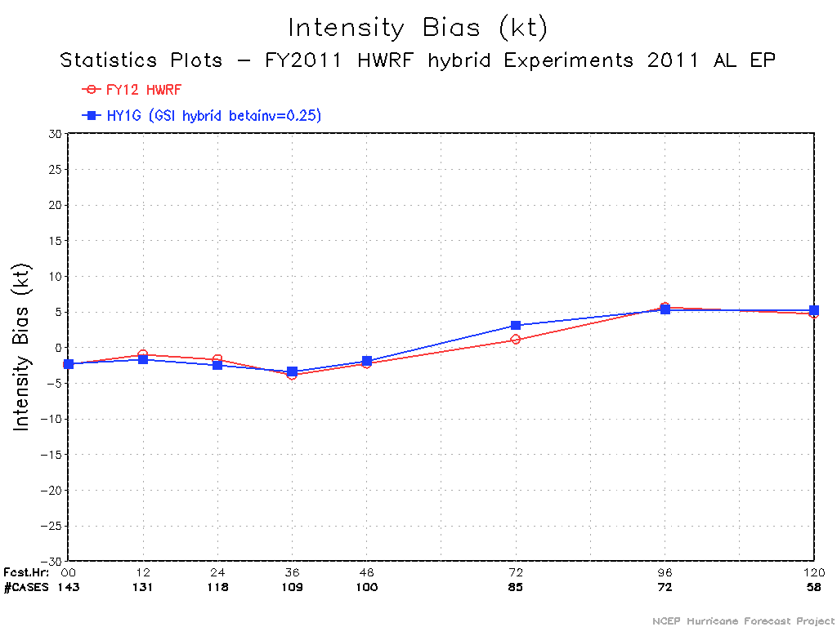
Results from One-Way Hybrid Experiments
FY12 (H212): initialized from GFS hybrid analysis and minimized the impact of GSI.
HY1G: HWRF GSI hybrid analysis on domain one using GDAS forecast as the first guess before HWRF vortex initialization. Ensemble perturbations obtained from ensemble forecast of global hybrid system. The weight given to ensemble B is 75%.
Four major hurricanes: Maria (AL), Ophelia (AL), HILARY (EP) and JOVA (EP)

Slide 19
Experiments assimilating satellite winds
HYBG (red) an earlier version of GSI hybrid analysis.
HYSW (green) same as HYBG, but with satellite winds assimilated

Slide 20
A case with radiance data assimilated

Slide 21
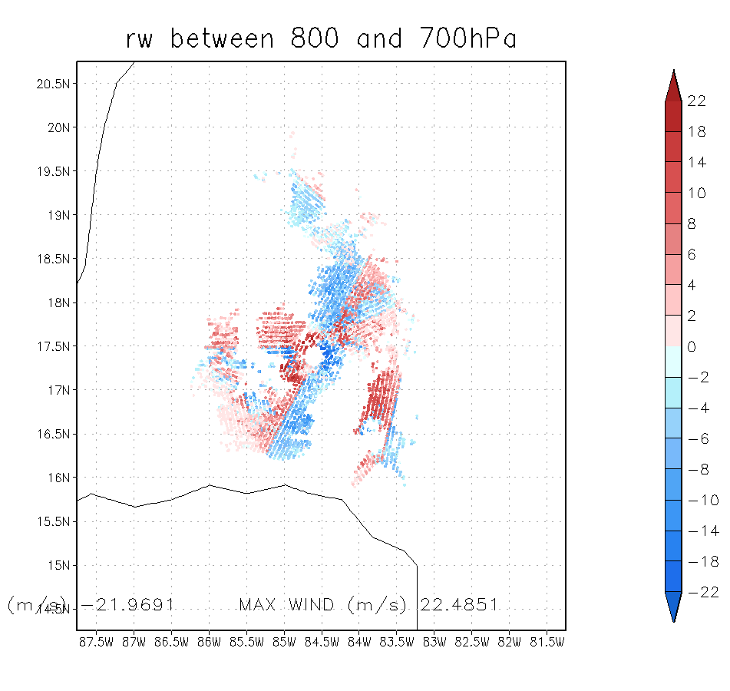
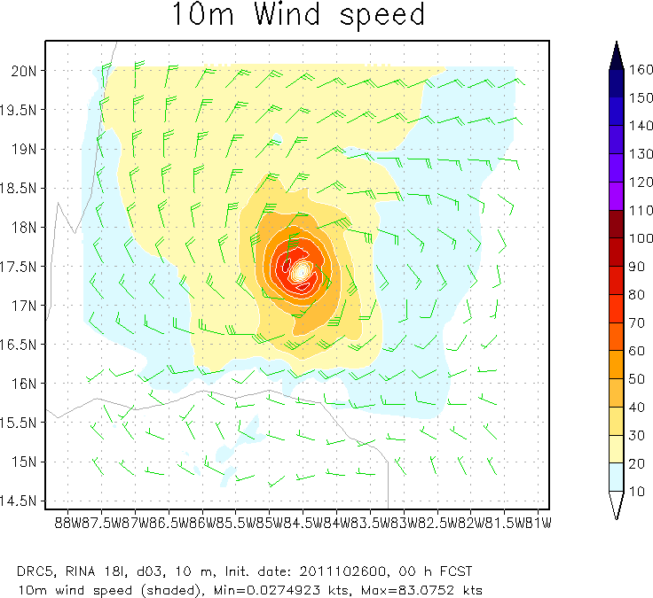
NTDR: w/o TDR data. This is the first guess for TDR assimilation
TDRP: with TDR data assimilated
DRC5: same as TDRP, but an extreme case with data (o-f > 5 m/s) rejected
obs-first guess

Slide 22
Focus areas for Data Assimilation in HWRF
Vortex DA
Improved warm-core structure through assimilation of ATMS water vapor and temperature soundings
Improved SST assimilation under storm conditions using AMSR2
Direct application of ATMS/AMSR2 data in vortex initialization
Hybrid EnKF/3DVAR DA for assimilation of aircraft observations and cloudy radiances
Environment DA
Hybrid EnKF/3DVAR DA for assimilation of cloudy and clear-sky radiances
Evaluate the impact of cycling the analysis for regional domain with higher vertical levels and higher model top
Determine optimum strategies for regional DA

Slide 23
Advancing the HWRF System FY2012 & Beyond
 | 2012 |  | 2013 | 2014* |  | 2015* | 2016*
Resolution/ Infrastructure | Triple nested HWRF (27/9/3 km) |  | Increased vertical resolution, higher model top | community R2O efforts (HFIP) |  | Upgrades to WRF infrastructure, Multiple moving domains, NEMS/ESMF/NMM-B, Other oceanic basins
Physics | PBL, Shallow Convection & Microphysics |  | Microphysics, Radiation, Surface Physics, Coupling to Waves and Land Surface, Physics for high-resolution
DA/ Vortex Initialization | Storm size correction, dynamic mass-wind consistency |  | Inner core DA (Doppler Radar, satellite) |  | Hybrid-EnKF DA, advanced vortex relocation procedure, improved GSI
Ocean | HYCOM Coupling |  | Improved ocean data assimilation, physics and resolution, unified coupled system for ATL & EPAC
Waves | One-way Wave Coupling |  |  | Two-way wave coupling, multi-grid surf zone physics, effects of sea spray
Diagnostics and Product Development |  | HWRF Ensembles, Coupling to Hydrological/ Surge/ Inundation models, diagnostics, product development
.
Ongoing Work
2012 upgrades
Planned developments
*Computer upgrade

Slide 24
Thanks for your attention
Real-time and pre-implementation T&E
HWRF products:
http://www.emc.ncep.noaa.gov/gc_wmb/vxt/index.html
Questions?
Acknowledgements:
HWRF team at EMC
EMC and HFIP Management
Collaborations with NHC, DTC, HRD, GFDL, URI, CIRA and other HFIP partners
Notes:
24

