Slide 1
HWRF sensitivity to cumulus schemes Preliminary Results
M. Biswas, L. Bernardet, S. Bao
EMC Telecon, May 10, 2012
Motivation
Configuration
Cases
Preliminary results
Conclusions and next steps

Slide 2
Motivation I
Documented Sensitivity of TC NWP to cumulus
Ma and Tan, 2009. Atmospheric Research.
Three Pacific storms, ARW, 15 km, large sensitivity to trigger functions.
Li and Pu, 2009. J. Meteor. Soc. Japan.
Emily (2005) ARW runs very sensitive to cu parm.
Torn and Davis, 2011. Manuscript submitted to MWR.
Sensitivity of AHW to cu parm.
Spencer and Shaw, 2012. AMS – Krish symposium.
More sensitivity to Cu Parm than MP or PBL for Typhoon Parma (ARW 3 km).
Krishnamurti, 2012. Tech Report to UCAR.
Errors in cu heating in (old) HWRF are substantial compared to other physics.
Zhan, Tallapragada, and Tuleya, 2012. AMS – Krish.
HWRF ensemble forecasting using various cumulus schemes for diversity.
HWRF 2012 Operational Test Plan
Changes in convection, addition of shallow convection.

Slide 3
Motivation II
HFIP Regional Model Team Physics Workshop (Aug ‘11): Foci: Scientific issues on PBL and MP
Follow-up Telecon (September 2011): -Decision to test some schemes for composing a suite to run in 2012 HFIP Demo
PBL (HRD/EMC): YSU, MYJ, MRF; Cumulus (DTC): KF, SAS, Grell, Tiedke
Microphysics (DTC/group): WSM6, Ferrier, Thompson, WDM6
Follow-up Telecon (October 2011): - Schemes for composing a suite to run in 2012 HFIP Demo should be evaluated by April 1
- Tests should be conducted in idealized and real configurations
Process
- Implement scheme
- Test individual scheme
- Test physics suite

Slide 4
Follow-up work conducted at DTC I
Idealized capability
Partnered with J-W Bao (ESRL) to add idealized capability to WRF
Preliminary capability added an currently undergoing testing at EMC
To do: collect README and datasets to create doc and case studies
Microphysics
Collected preliminary information on how to expand interoperability
Performed tests of WSM5, WSM6, and Thompson on NMM single domain
G. Thompson to start at DTC in July/2012 to connect his microphysics

Slide 5
Follow-up work conducted at DTC II
Cumulus Parameterization
Partnered with J. Dudhia (NCAR) to expanded HWRF interoperability (for DTC and general community)
NSAS, Tiedke, Grell (uncoupled) are now available
Performed HWRF 27/9 sensitivity experiments for Irene using various cumulus schemes (Presented HFIP Telecon Feb/2012)
Expanded test to 27/9/3 (Test Plan prepared jointly with EMC).
This is one of two comprehensive tests by DTC in AOP 2012
Main goal is to provide input for EMC physics-diversity ensemble

Slide 6
HWRF Configuration
https://svn-dtc-hwrf.cgd.ucar.edu/tags/hwrf-baseline-20120216-2300
In order for results to be ready to inform ensemble configuration, did not wait until final operational configuration but used
Three domain 27/9/3 (no cumulus on domain 3)
Initialized with GFS + vortex relocation; no GSI
Ocean model used in the Atlantic only

Slide 7
Physics Configuration
H212 | HPHY | HNSA | HTDK | HKF1
2012 implementation SAS | February tag SAS (pre-implementation) | New SAS (YSU implementation) | Tiedke | Kain Fritsch
Some differences between HPHY and H212
H212 has shallow convection and HPHY does not
H212 has additional bug fixes
H212 has additional microphysics tuning
H212 run by EMC on CCS, HPHY run by DTC on jet
H212 shown here for reference
Comparison between H212 and HPHY is not the goal
Goal is to intercompare HPHY, HNSA, HTDK, and HKF1

Slide 8
Selected cases: planned and completed
Storm | Start | End | Cycles | Done (x4)
Harvey | 2011081900 | 2011082206 | 14 | 10
Irene | 2011082100 | 2011082818 | 32 | 6
Katia | 2011082906 | 2011091012 | 49 | 11
Maria | 2011090618 | 2011091612 | 40 | 0
Ophelia | 2011090618 | 2011100306 | 50 | 8
Rina | 2011102318 | 2011102812 | 20 | 5
Atlantic |  |  | 205 | 40
Dora | 2011071812 | 2011072418 | 26 | 8
Eugene | 2011073112 | 2011080606 | 24 | 4
Fernanda | 2011081600 | 2011082000 | 20 | 2
Pacific |  |  | 70 | 14
Runs are slow due to heavy jet queues and relatively small DTC allocation
These are preliminary results
Depending on interpretations, may eliminate certain schemes or storms

Slide 9
Aggregated Atlantic track errors
Beginning: little difference
Later: HPHY best, HTDK worse
HNSA, HKF1 intermediate errors
HTDK has larger x-track errors
HTDK has larger x-track errors than other configurations

Slide 10
Aggregated Atlantic intensity errors
Abs errors depend strongly on lead time
No clear winners or losers
Suggest sample size not enough to resolve differences among schemes
40 37 36 34 34 30 28 25 23 23
24: HPHY worse, HNSA/HFK1 intermediate, HTDK best
48: HPHY best, others similar
72: HPHY best, HNSA/HFK1 intermediate, HTDK worse
96: HPHY/HNSA/HKF1 similar, HTDK worse
120 h: same ranking as 24 h
40 37 36 34 34 30 28 25 23 23
Bias differs among configurations
HPHY low bias up to 72 h, then high bias
HNSA similar, but curve shifts down
HKF1 and HTDK low bias throughout
HTDK very low bias at 84 h

Slide 11
Aggregated Atlantic 34 kt structure
Large variability in quadrants and lead times
Suggests sample too small to find differences
HPHY never worst, often best
HNSA often worst by large amount
HTDK, HKF1 intermediate

Slide 12
Aggregated Atlantic 50 kt structure
15 17 21 20 17 16 14 13 16
Large variability in quadrants and lead times
Suggests sample too small to find differences
HPHY rarely worst, often best
HNSA often worst by large amount
HTDK, HKF1 intermediate

Slide 13
Aggregated Pacific tracks
HPHY best
HNSA, HTDK intermediate
HKF1 worse
14 14 14 14 14 12 12 12 12 10

Slide 14
Aggregated Pacific intensity
Large errors at 2-3 day suggest small sample size
HPHY often best
HNSA, HFK1 intermediate
HTDK worse
14 14 14 14 14 12 12 12 12 10
Intensity bias pattern similar
HPHY has smallest low bias, but high bias at 120 h
Others have consistent low bias

Slide 15
Aggregated Pacific 34 kt structure
13 12 13 12 10 10 8 8 6 4
Unlike Atlantic, HPHY sometimes worse
Errors smaller at longer lead times
Large variability in quadrants and lead times
Suggests sample too small to find differences

Slide 16
Aggregated Pacific 50 kt structure
7 7 9 8 8 8 6 4 2
Large variability in quadrants and lead times
Suggests sample too small to find differences

Slide 17
Conclusions
Small sample size (especially on Pacific) to resolve large variability in results
No clear winner or losers
On Atlantic…
Track: HPHY best, HTDK worse, HNSA and HKF1 intermediate
Absolute errors: inconclusive
Bias: HTDK too low, HNSA and HFK1 have different characteristics than HPHY (low bias throughout the forecast)
34-kt radii: HPHY best, HNSA worse, HKF1 and HTDK intermediate
HFK1 provides an alternative to HPHY for an ensemble composition

Slide 18
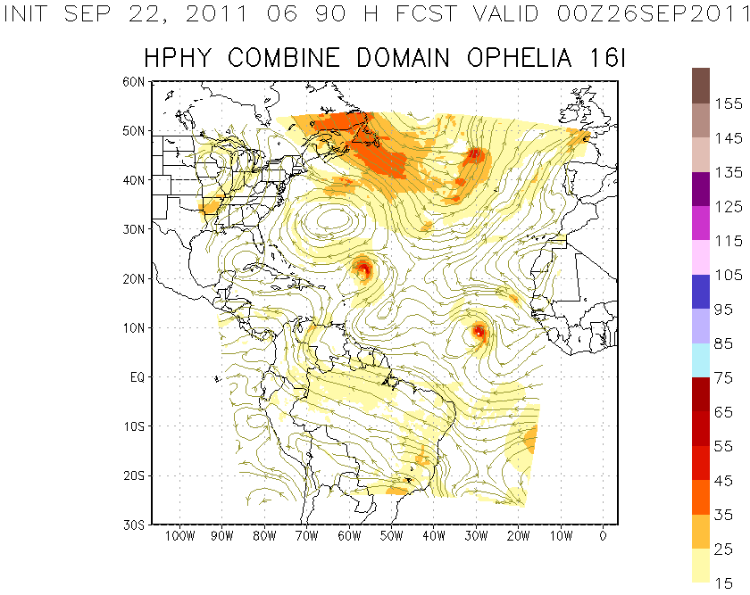
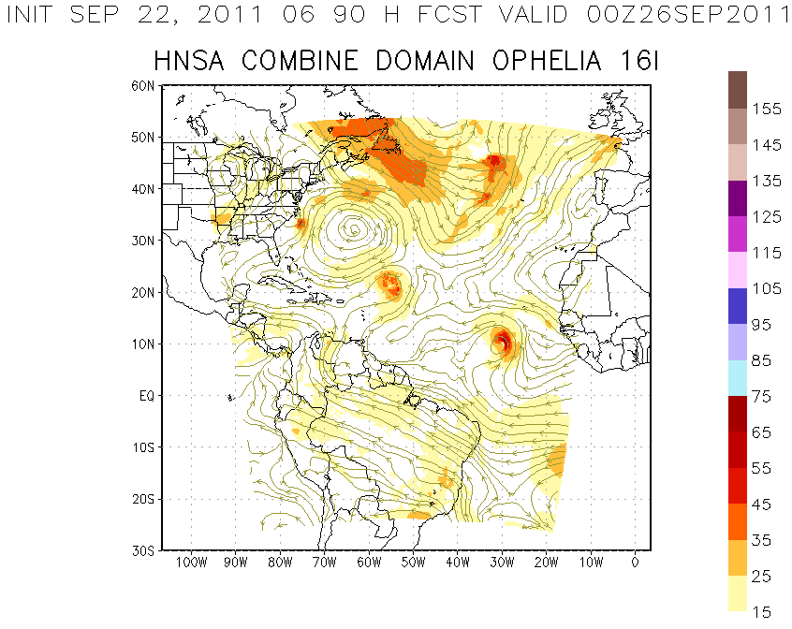
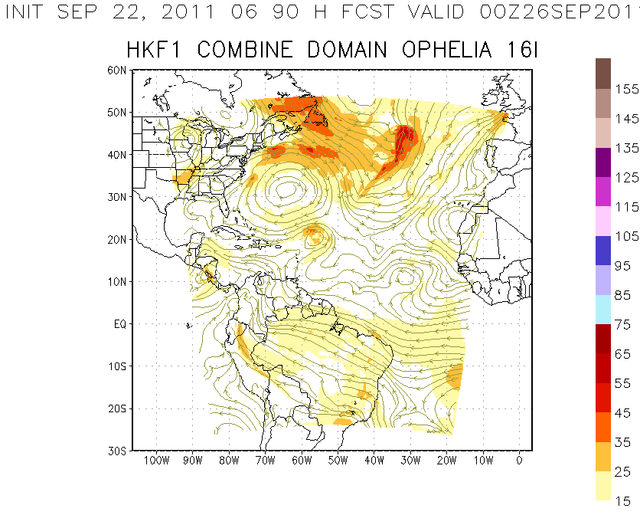
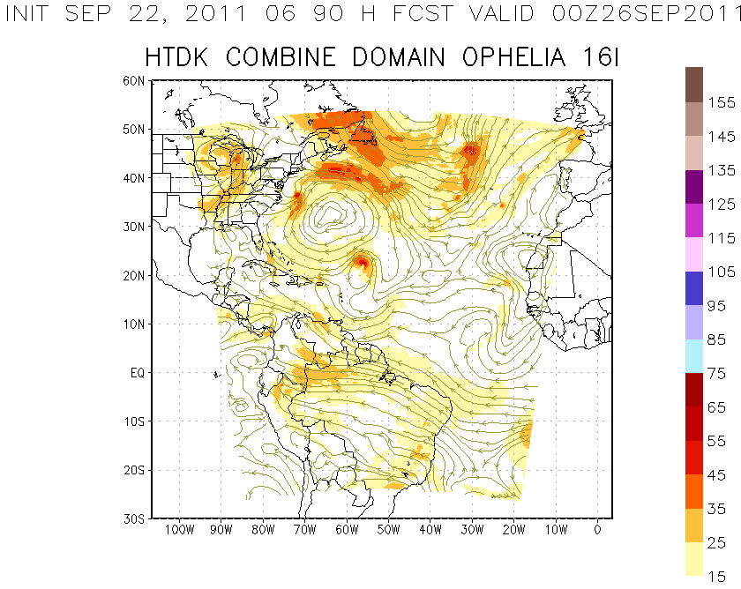
Next steps
Get feedback from this audience
Touch base on preparations for multi-physics ensemble
Follow up on Z. Zhang’s presentation on March in HFIP Ensemble telecon
Increase sample size
Make graphics available

Slide 19
Additional material

Slide 20
Harvey
10 7 6 4 4 3 1

Slide 21
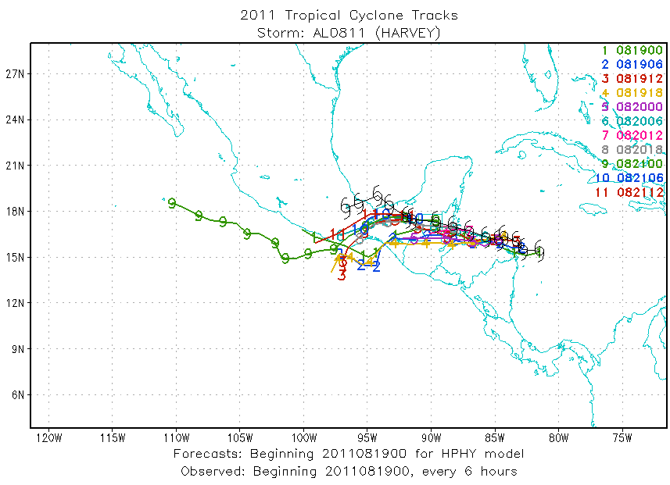
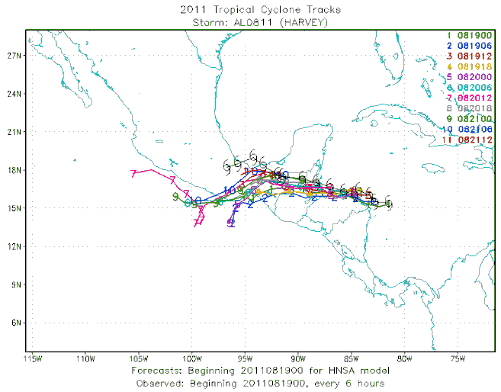
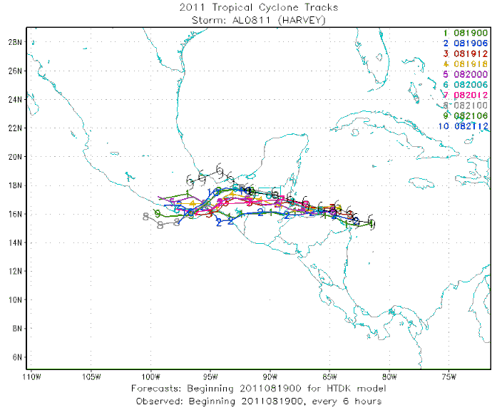
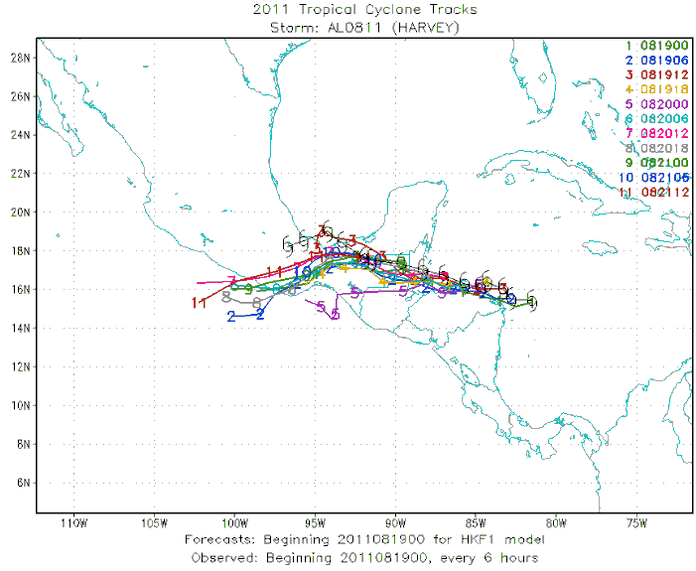
Harvey tracks

Slide 22
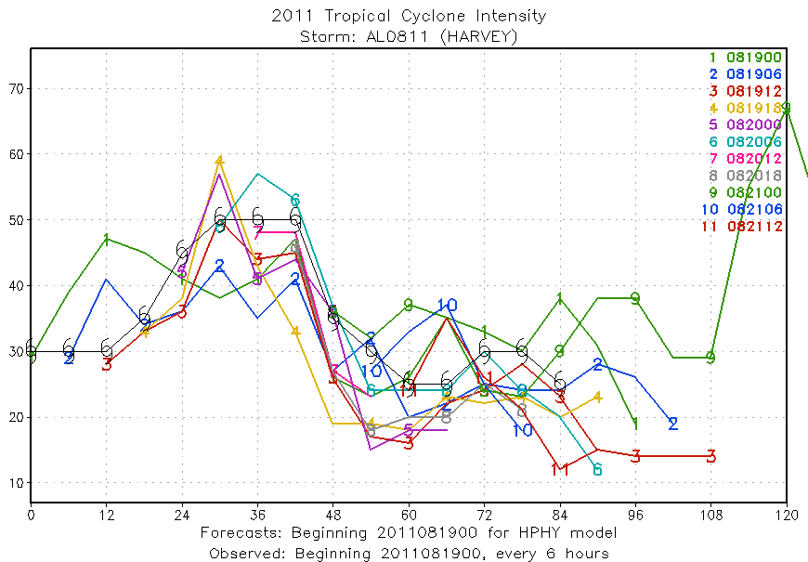
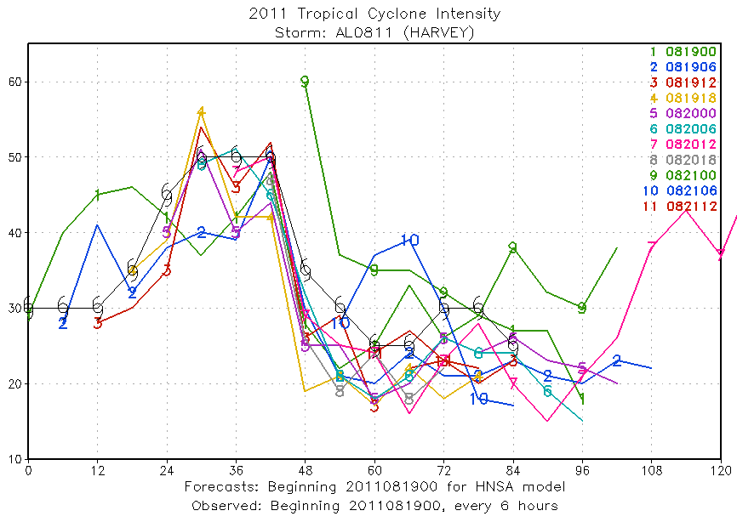
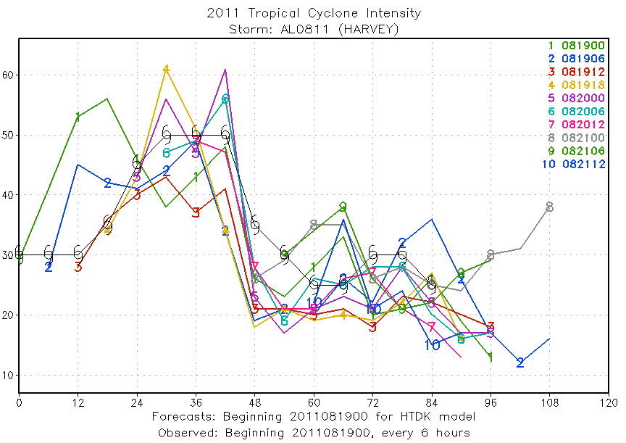
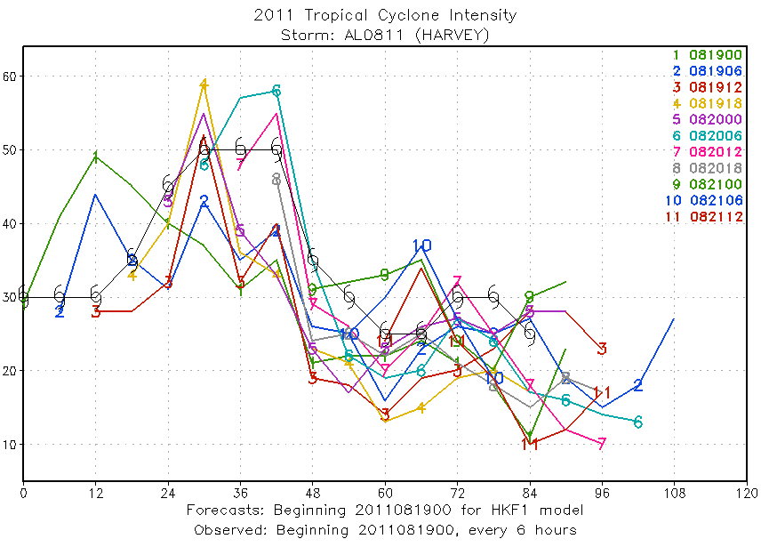
Harvey intensity

Slide 23
Irene
6 6 6 6 6 6 6 6 6 6
6 6 6 6 6 6 6 6 6 6

Slide 24
Irene tracks

Slide 25
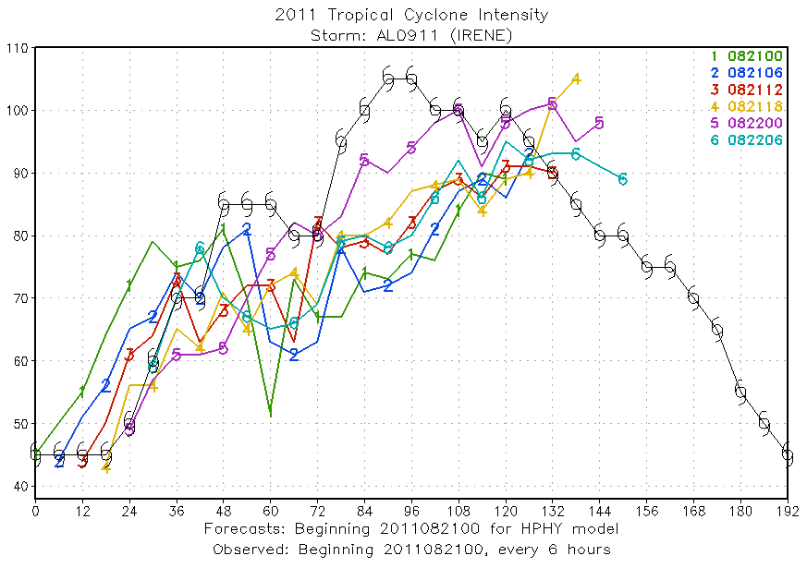
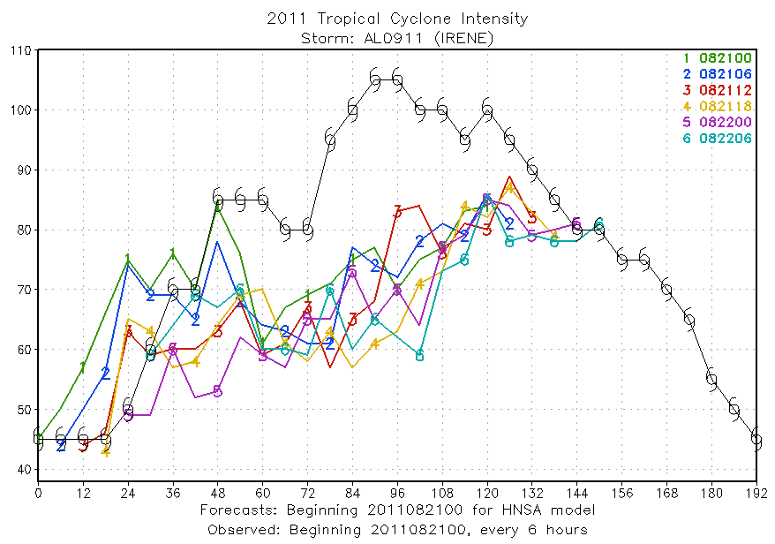
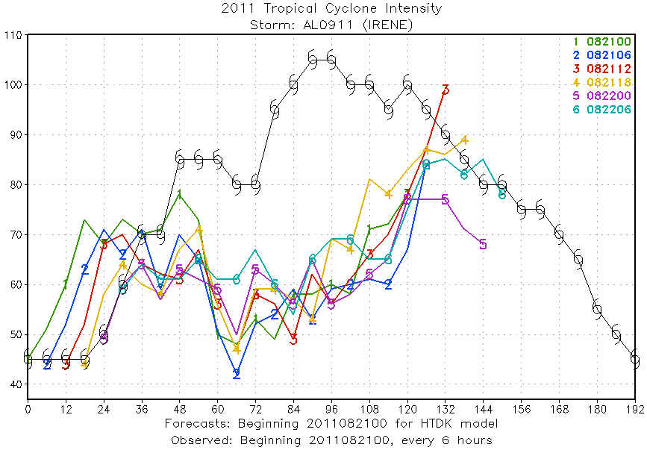
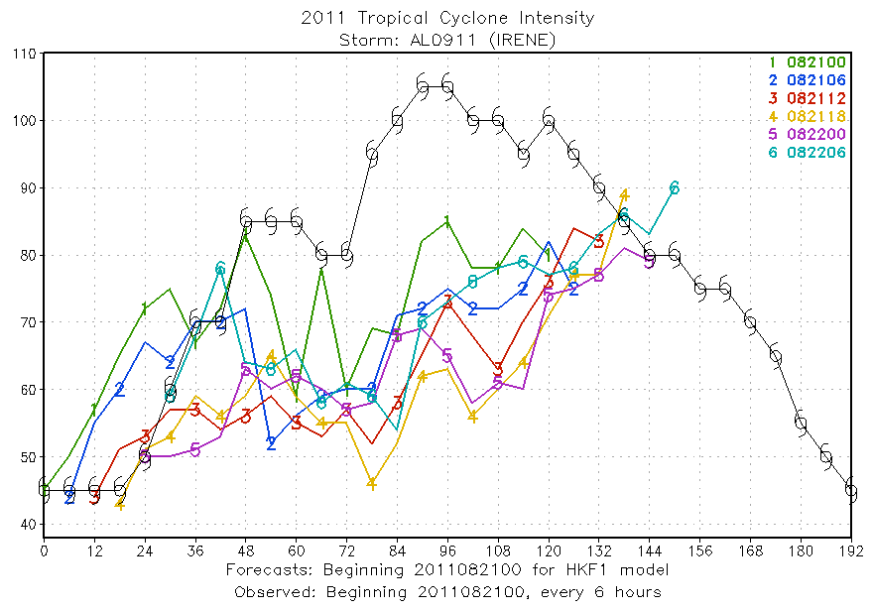
Irene intensity

Slide 26
Katia
11 11 11 11 11 10 10 10 10 10
Runs did not reach RI stage yet
11 11 11 11 11 10 10 10 10 10

Slide 27
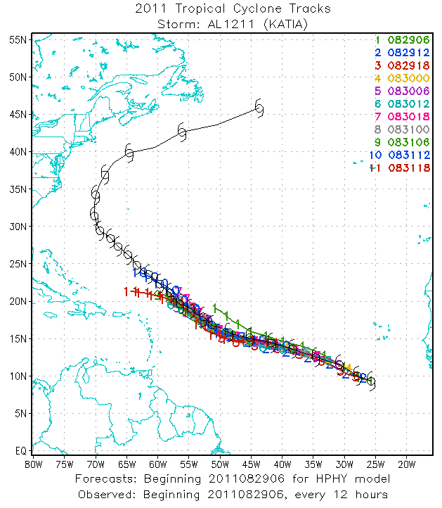
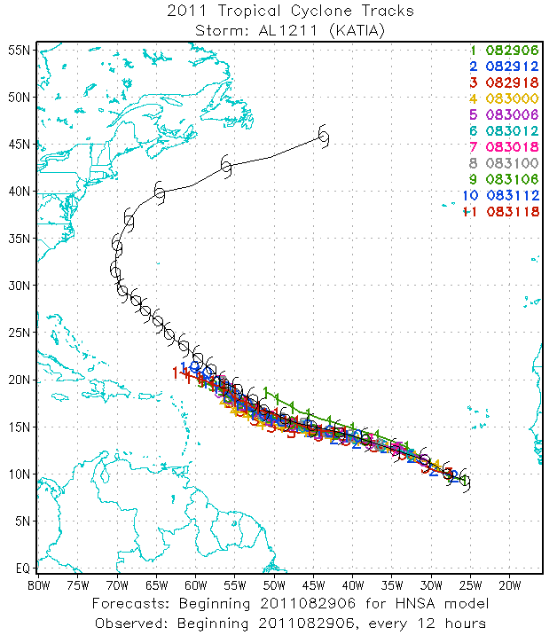
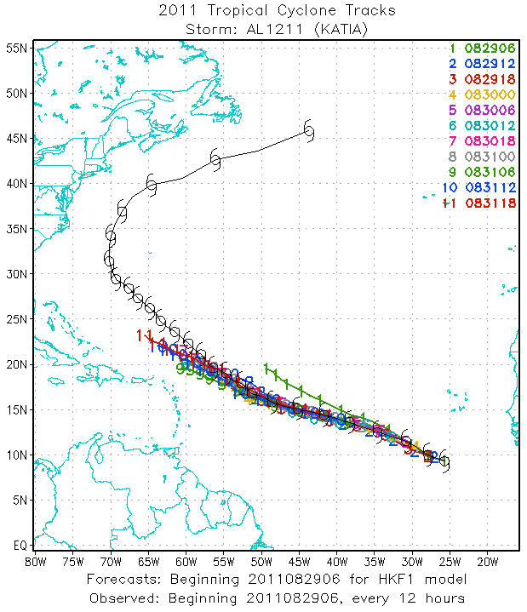
Katia tracks

Slide 28
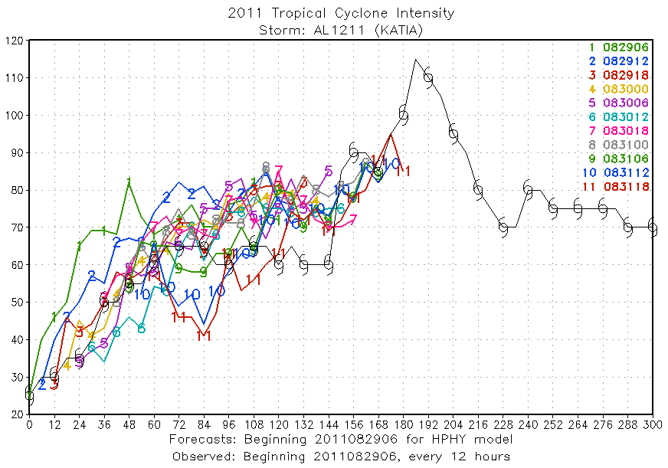
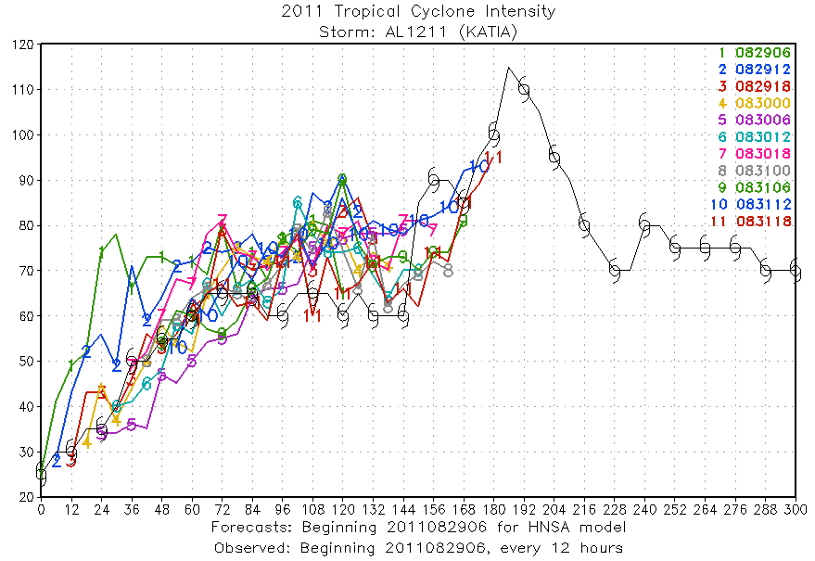
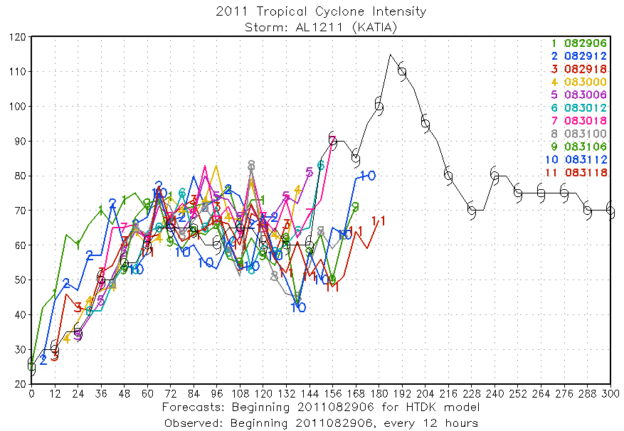
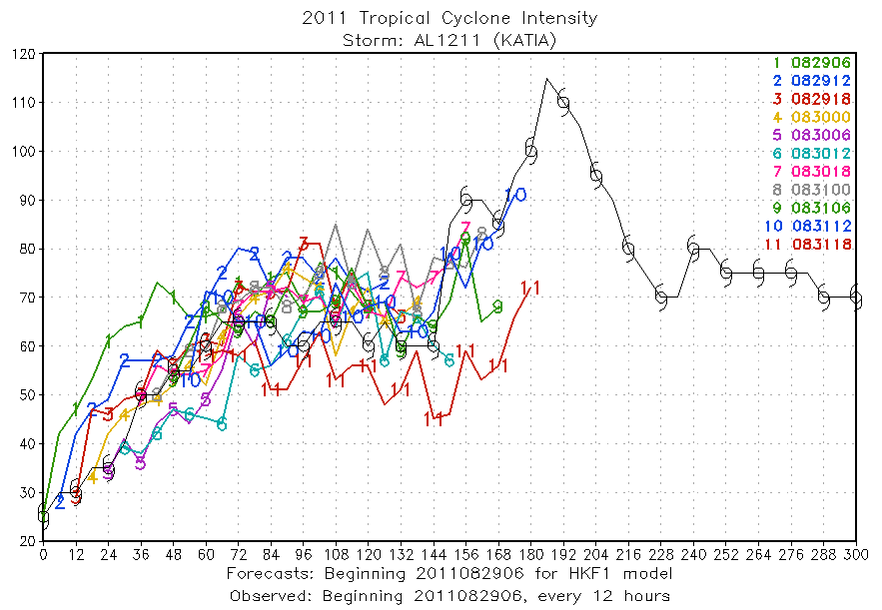
Katia intensity

Slide 29
Ophelia
8 8 8 8 8 6 6 6 6 6
Runs did not reach RI stage yet
8 8 8 8 8 6 6 6 6 6

Slide 30
Katia tracks

Slide 31
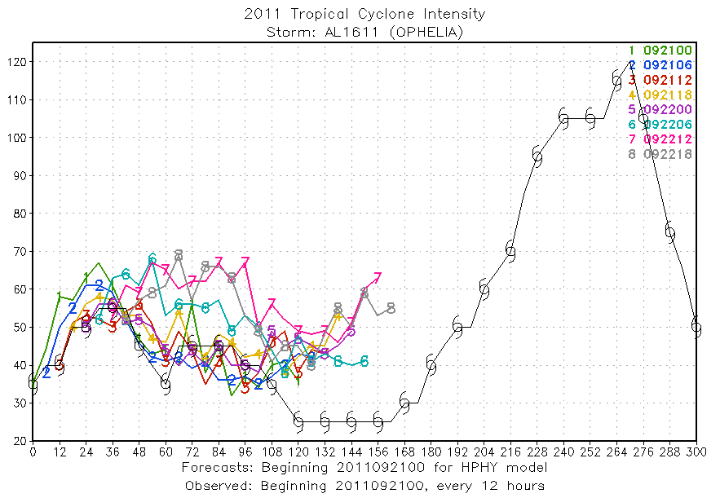
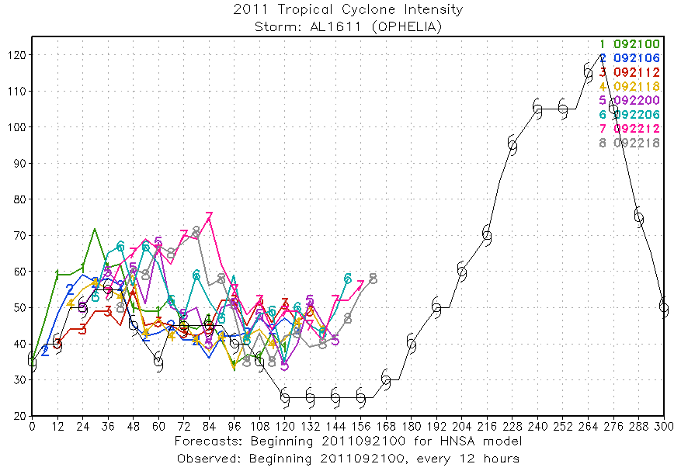
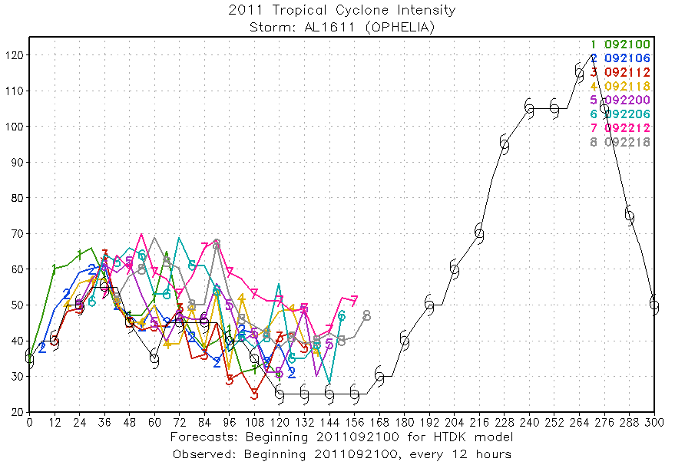
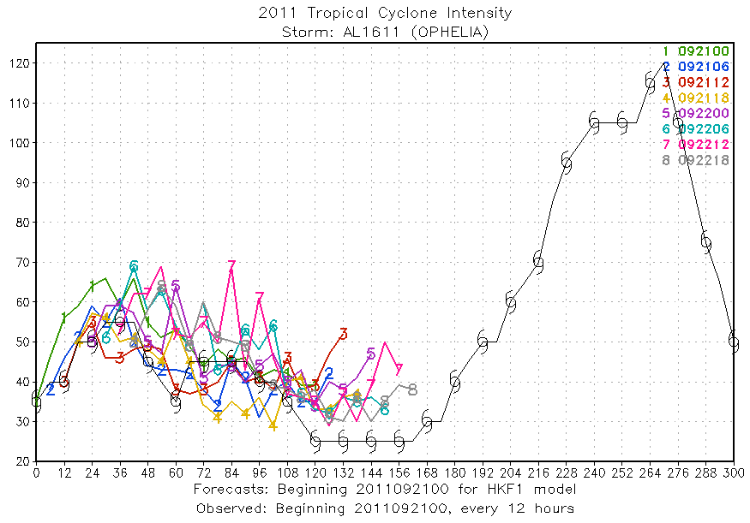
Katia intensity

Slide 32
Rina
5 5 5 5 5 5 5 3 1
5 5 5 5 5 5 5 3 1

Slide 33
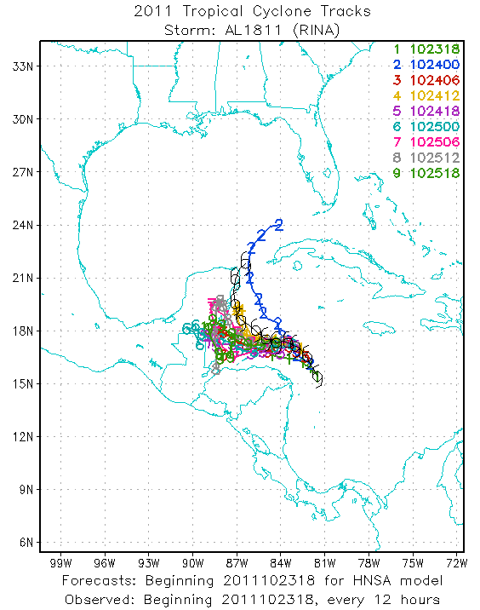

Slide 34
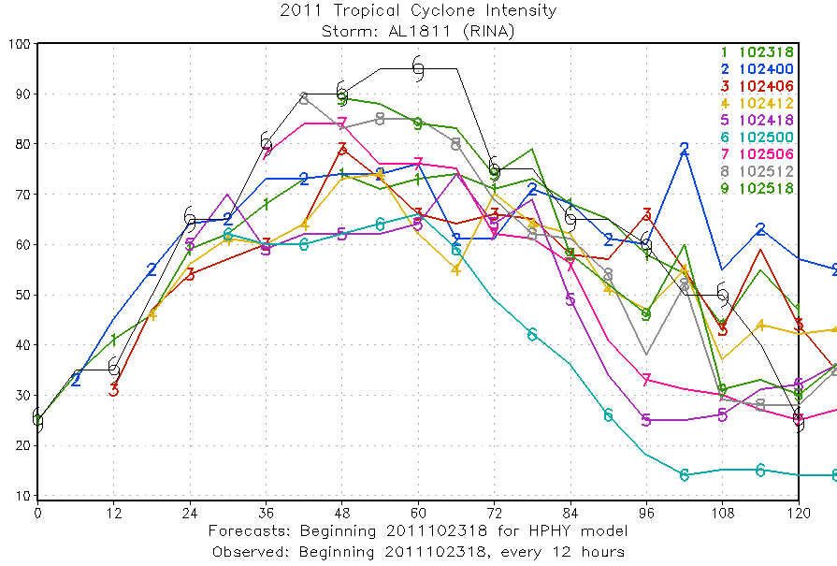
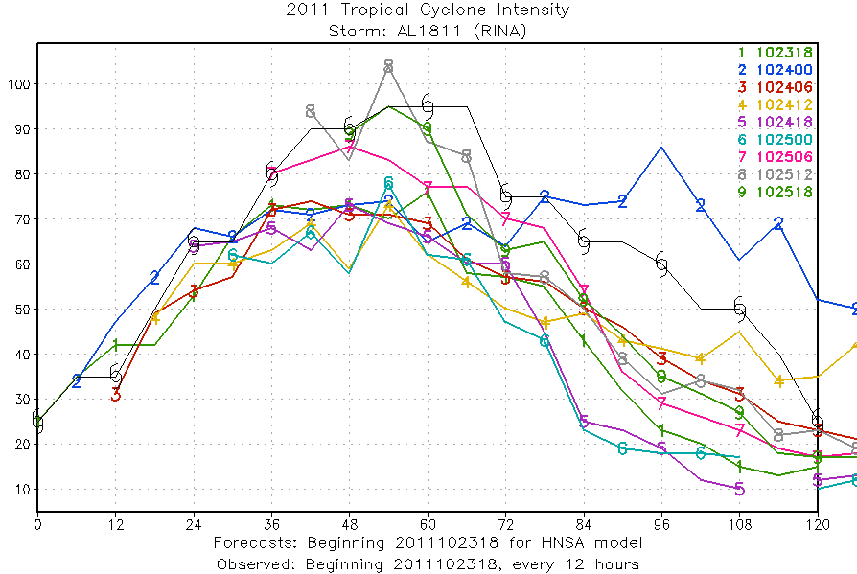
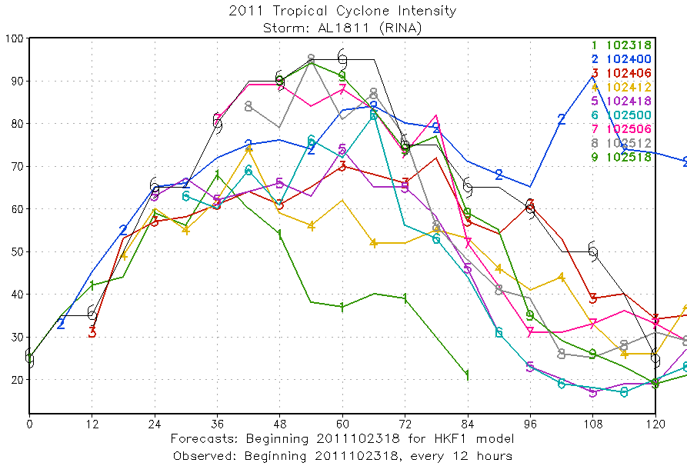
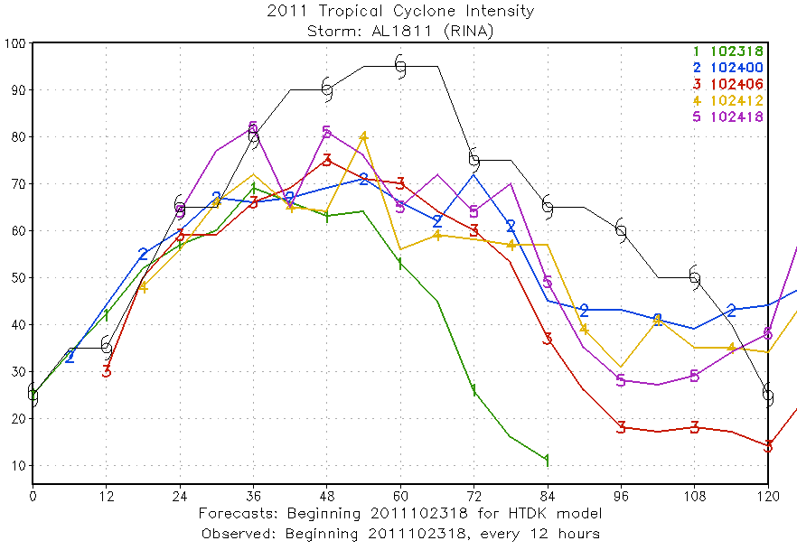

Slide 35
Dora
8 8 8 8 8 8 8 8 8 6
8 8 8 8 8 8 8 8 8 6

Slide 36
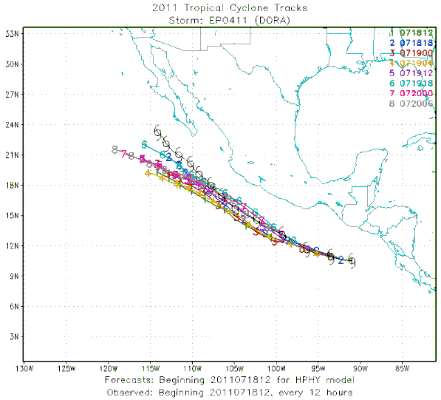
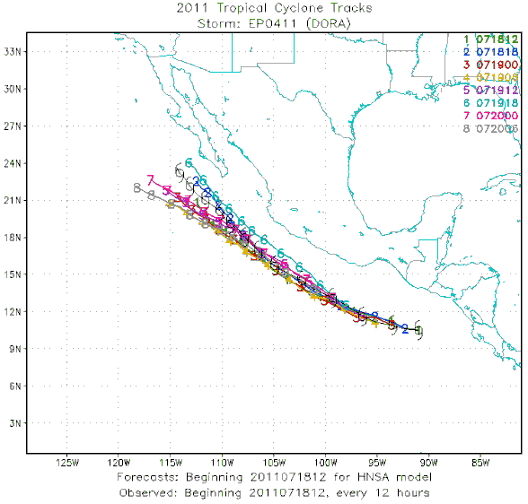
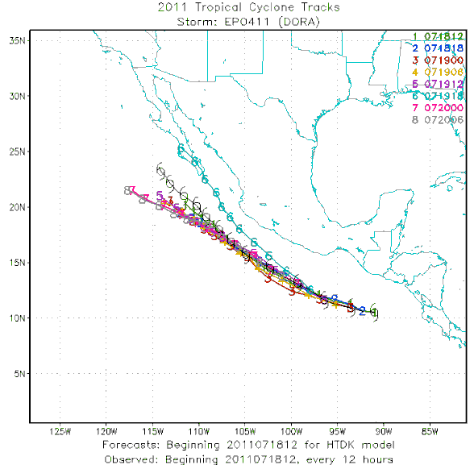
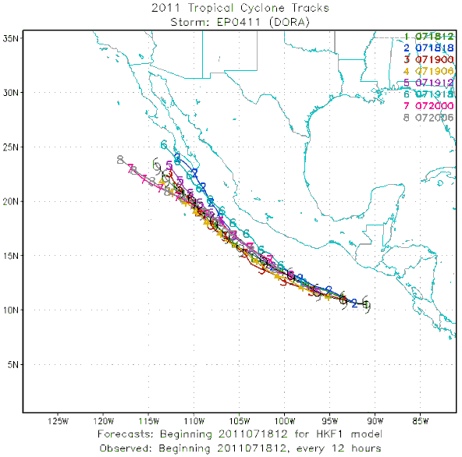
Dora tracks

Slide 37
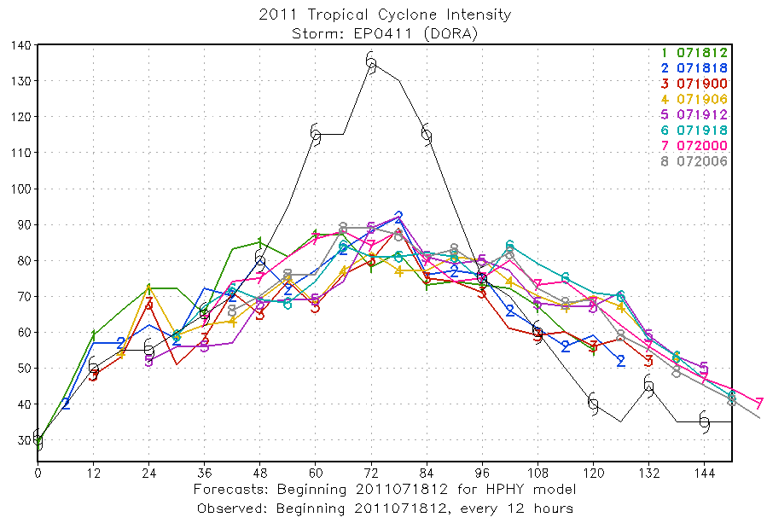
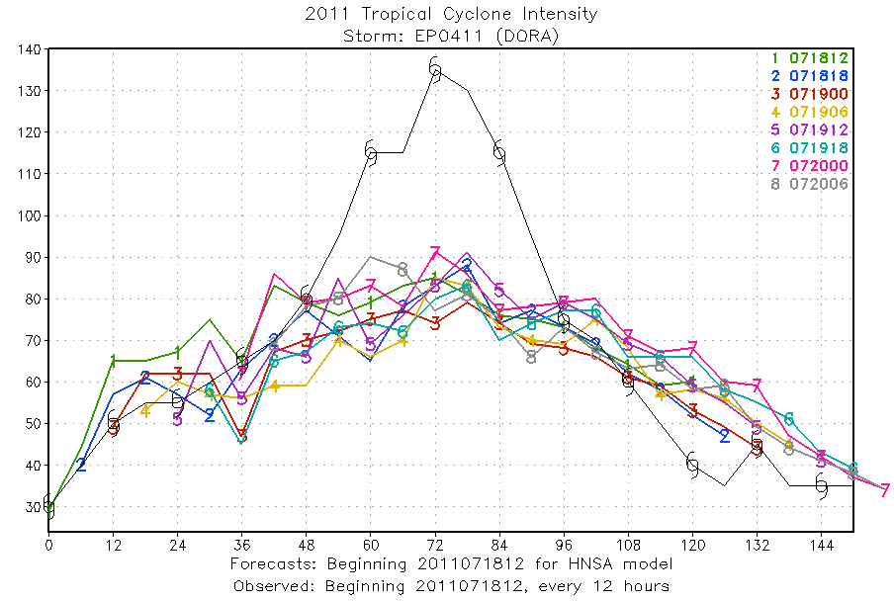
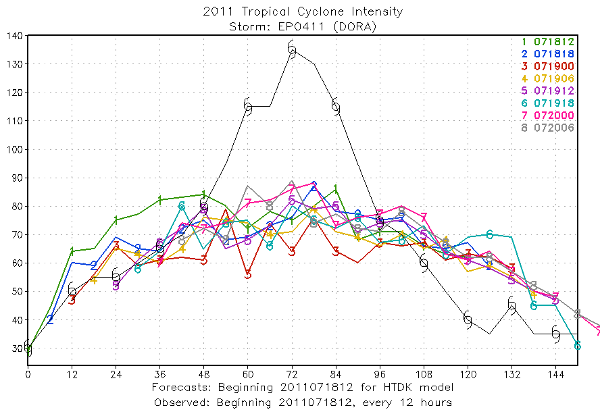
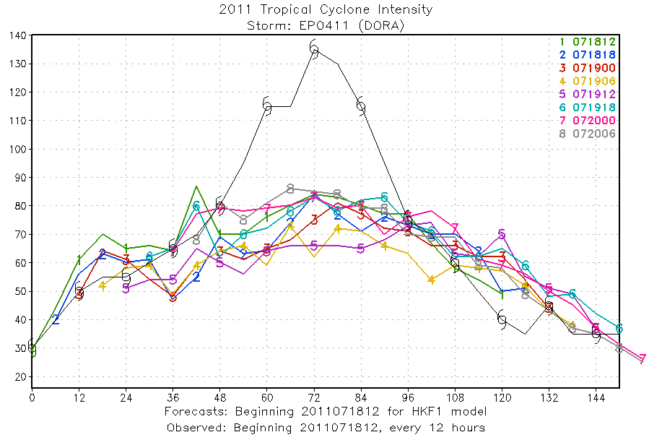
Dora intensity

Slide 38
Eugene
4 4 4 4 4 4 4 4 4 4
No configurations captured RI
4 4 4 4 4 4 4 4 4 4

Slide 39
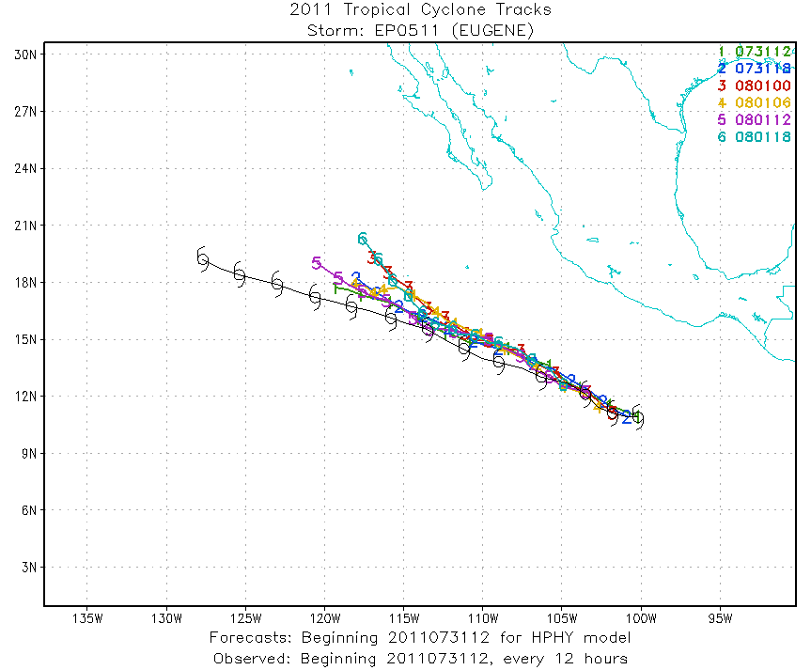
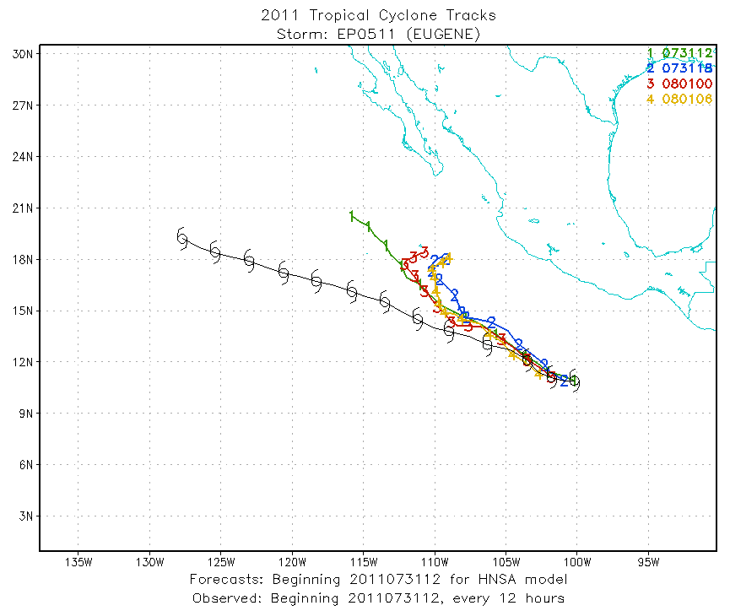
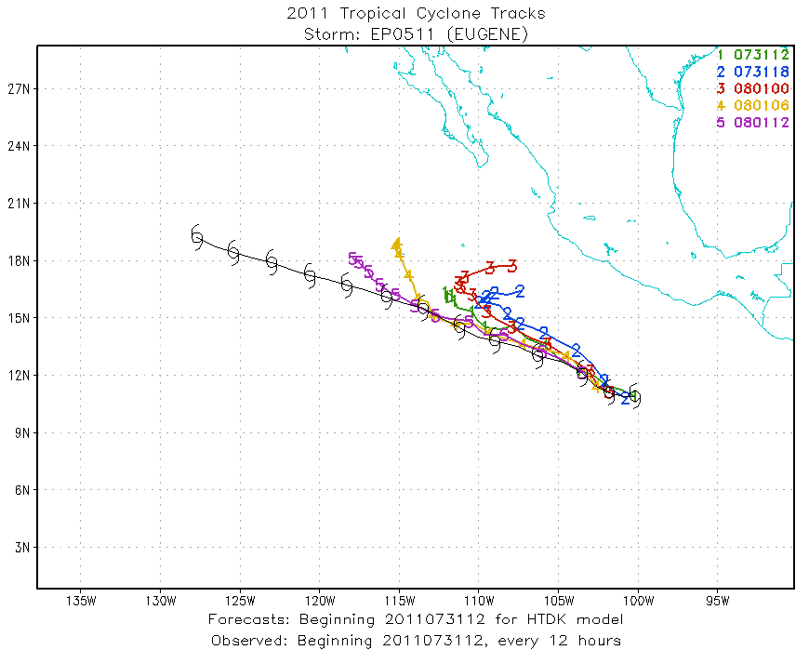
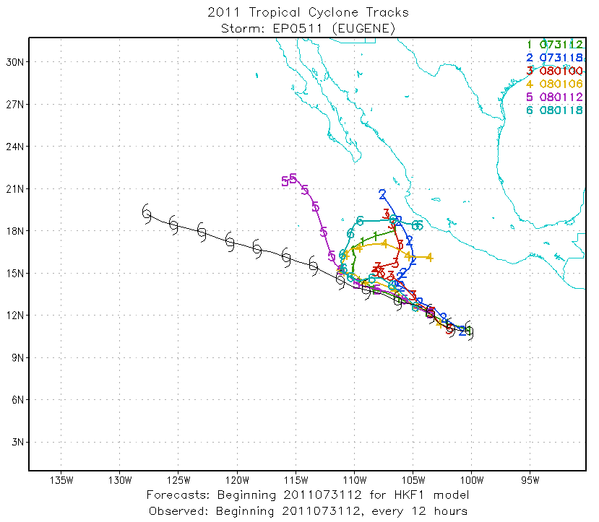

Slide 40
