Slide 1


Using OSEs/OSSEs to Evaluate Various Aspects of Hurricane Prediction Systems
Kelly Ryan
NOAA / Atlantic Oceanic and Meteorological Laboratory
Hurricane Research Division
Cooperative Institute for Marine and Atmospheric Studies
University of Miami
HWRF/HMON Meeting
March 29, 2018

Slide 2
What are OSEs/OSSEs?
Observing System Experiments and
Observing System Simulation Experiments
aim to assess the impact of changing various aspects of prediction systems on forecasting ability
Observations
Data Assimilation
Forecast Model
OSE: measurements collected in atmosphere
OSSE: synthetic data obtained from a nature run
OSE: any existing or future DA system
OSSE: any existing or future DA system
OSE: any existing or future model
OSSE: any existing or future model

Slide 3
How can we use OSEs/OSSEs?
Observing System Experiments and
Observing System Simulation Experiments
aim to assess the impact of changing various aspects of prediction systems on forecasting ability
Observations
Data Assimilation
Forecast Model
Optimize existing observing system data
Optimize existing observing strategies
Evaluate potential impact of new data
Evaluate capabilities of existing DA
Evaluate potential impact of new DA
Evaluate changes to parameterizations
Compare impact in variety of models

Slide 4
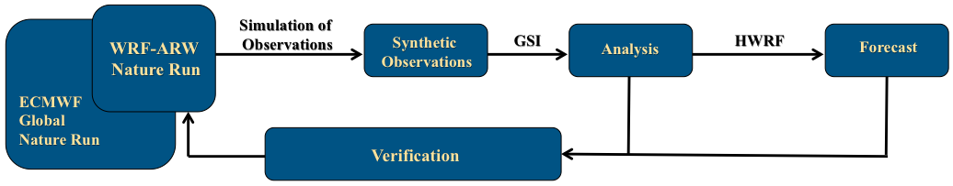
AOML’s OSE/OSSE Framework

Slide 5
AOML’s OSE/OSSE Framework
Truth
Hurricane Nature Runs
Past Hurricanes

Slide 6
AOML’s OSE/OSSE Framework
Observations
Control data:
Radiosondes, aircraft, buoy, ship, pibal winds, wind profilers, radar-derived Velocity Azimuth Display (VAD) wind, WindSat scatterometer winds, GPS-derived precipitable water, land surface observations
AND
IR radiances from HIRS, AIRS, IASI, GOES
MW radiances from AMSU-A, MHS, ATMS
Satellite derived winds
Control Data
Test Data
Existing aircraft test data:
Flight Level
Dropsonde
SFMR
Radars (TDR, LFR)
New data (DWL, UAS)

Slide 7
AOML’s OSE/OSSE Framework
Analysis
GSI
Performs analysis over 9 km parent domain
6-hour cycling
6-hour spin-up
3D-var and EnKF

Slide 8
AOML’s OSE/OSSE Framework
Forecast
Uses newest version of HWRF model
61 vertical levels
9 km parent domain
3 km vortex-following nest
  → Only active during forecasts
Fully-cycled; GFS is only used for BC’s
No vortex relocation
No vortex initialization
No ocean coupling
HWRF

Slide 9
AOML’s OSE/OSSE Framework
Verification
Verify results using OSE
→ Working on upgrade that allows this system to be used for more than data impact studies

Slide 10
“Research-Friendly” Framework
Truth
Flexibility to perform OSEs/OSSEs that evaluate data assimilation techniques and model physics/parameterizations in addition to data impacts
→ Allows for smooth transition of new DA techniques and changes to model physics
→ Can be applied to any forecast model with a similar configuration by omitting model-specific add-hoc approaches
Observations
Analysis
Forecast
Verification

Slide 11
“Research-Friendly” Framework
Truth
Vary cycling frequency & spin-up time easily
Observations
Easy integration and evaluation of new DA systems
Analysis
Test vortex relocation/initialization
Forecast
Verification
Evaluation of model physics schemes

Slide 12
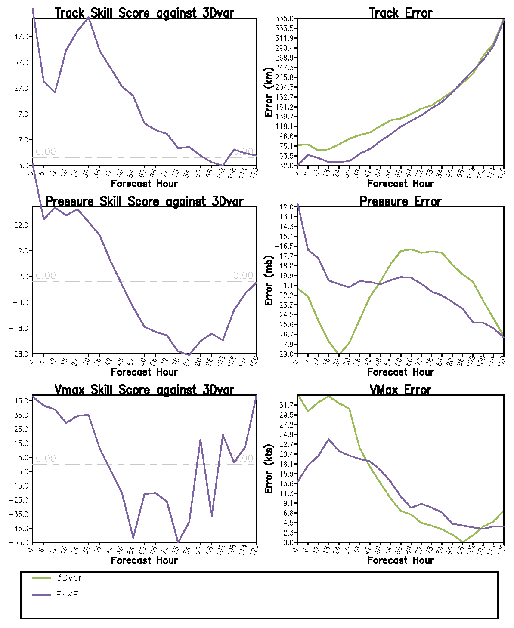
Comparison of DA Systems
Set up:
Assimilate Control Data
6-hour spin-up
6-hourly cycling for 3 days
Compare 3D-var vs. EnKF

Slide 13
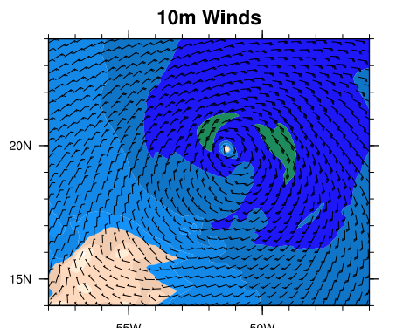
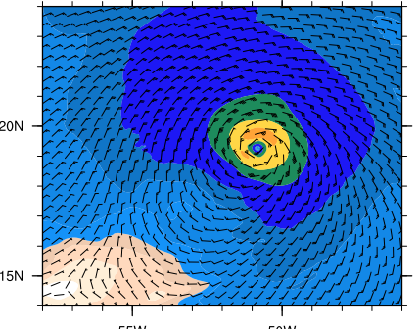
Comparison of DA Systems
3Dvar
Nature Run
EnKF
At time: 0 UTC on 2005-08-04

Slide 14
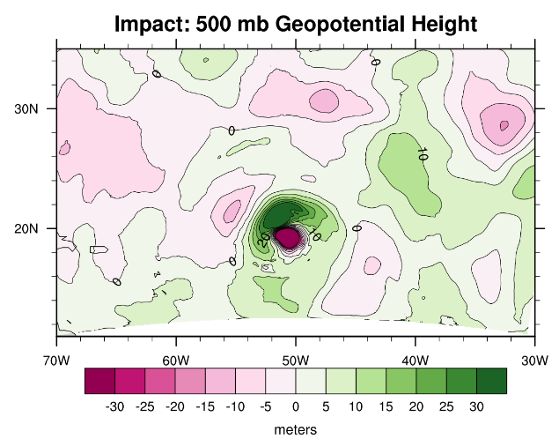
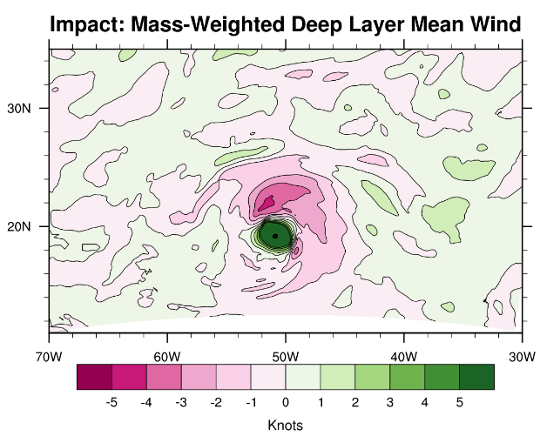
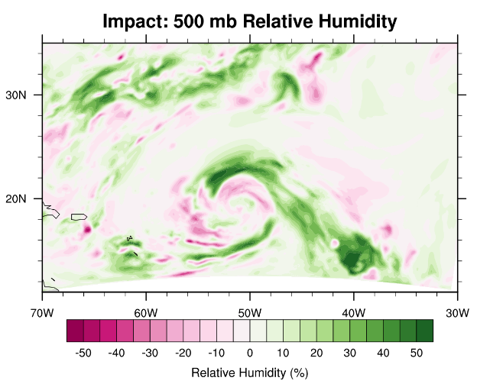
Comparison of DA Systems
Impact plots of environment: green = EnKF is closer to NR pink = 3Dvar is closer to NR

Slide 15
Evaluation of Model Physics
Boundary layer comparisons using Coyote UAS
  Direct comparison: will the data be used in D.A.?
  OSSE: how well does our D.A. system make use of these data?
  OSE: how do changes in parameterization schemes affect analyses and forecasts?

Slide 16
Progress of Next Generation Framework
Ability to change cycling frequency & physics schemes
Completed the addition of fully-tuned EnKF DA system
  Found and fixed a bug: radiances were not being assimilated because heights were not assigned
  → required us to add parameter to GSI namelist: “lwrite_peakwt=.true.” in gsiparm.anl
Next Steps:
Configure 3D-var EnKF hybrid DA
Add option to include vortex relocation/initialization

Slide 17
Getting the most out of our models by optimizing observation coverage

Slide 18
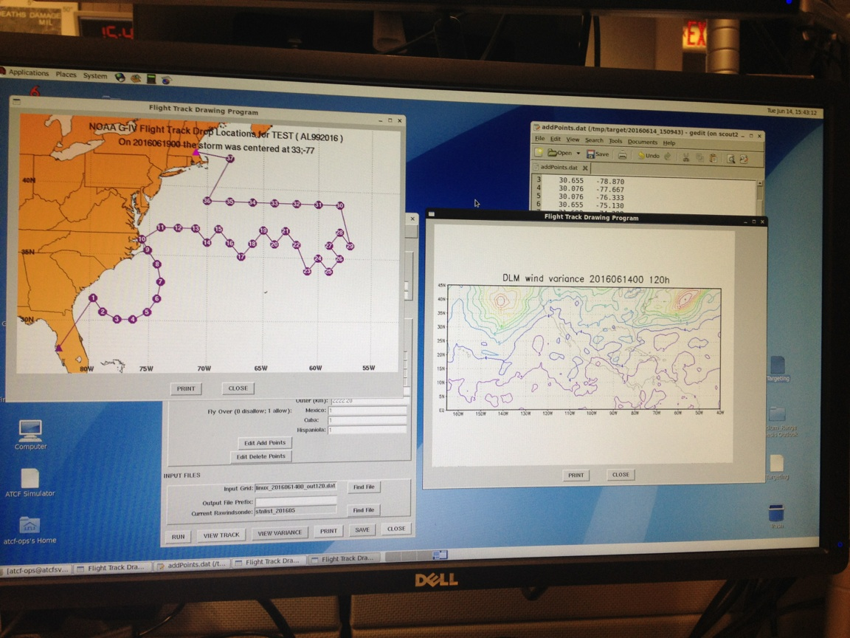
G-IV Synoptic Surveillance Targeting
Motivation:
Investigate targeting procedure for synoptic surveillance sampling using NOAA G-IV (NHC)
  Near-hurricane environment
  Synoptic scale features

Slide 19
G-IV Synoptic Surveillance Targeting
Current Procedure:
Use generic circumnavigation pattern around hurricane
Sample regions of highest variance in GEFS deep layer mean wind within 20 degrees of hurricane center location
Deploy dropsondes every 1-1.5 degrees
Performed 2-3 days before expected landfall
Subjective!!

Slide 20
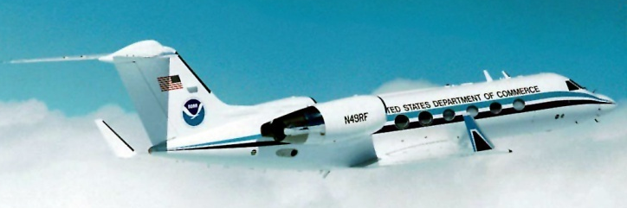
Objectives:
Near-storm environment:
Sensitivity to
  Storm relative location
  Pattern shape
Synoptic features
Sensitivity to
  Targeting techniques using ensemble forecasts
  Dropsonde distribution
Evaluate using both regional and global forecast models
HWRF and GFS
Altitude ~45,000 feet

Slide 21
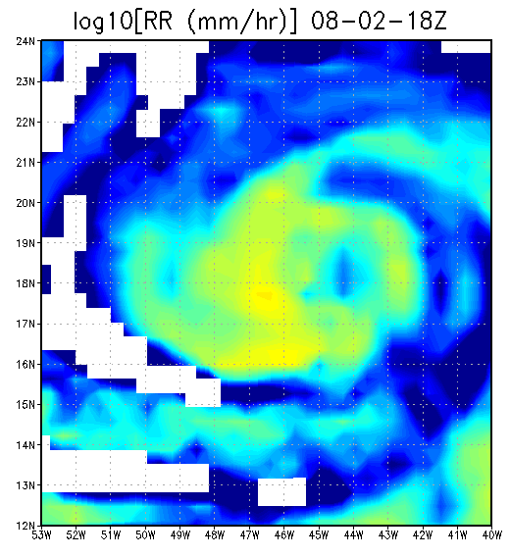
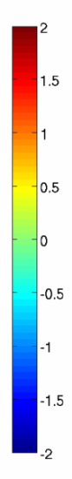
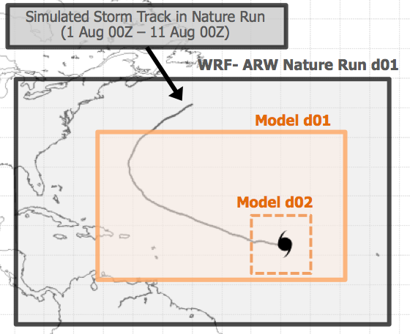
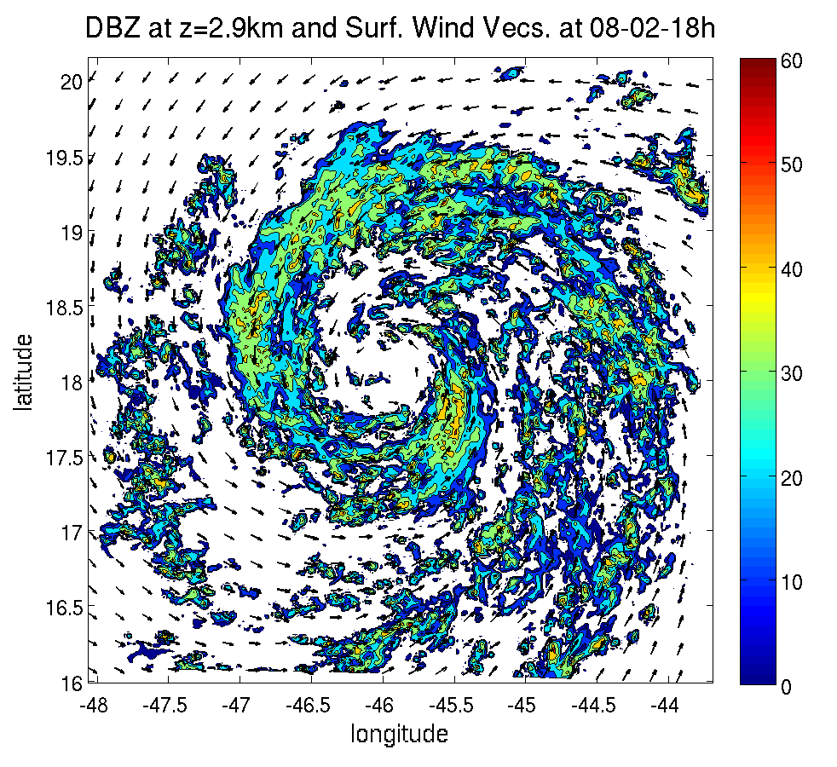
Notes:
13 day lifecycle of a rapidly intensifying N. Atlantic Hurricane

Slide 22
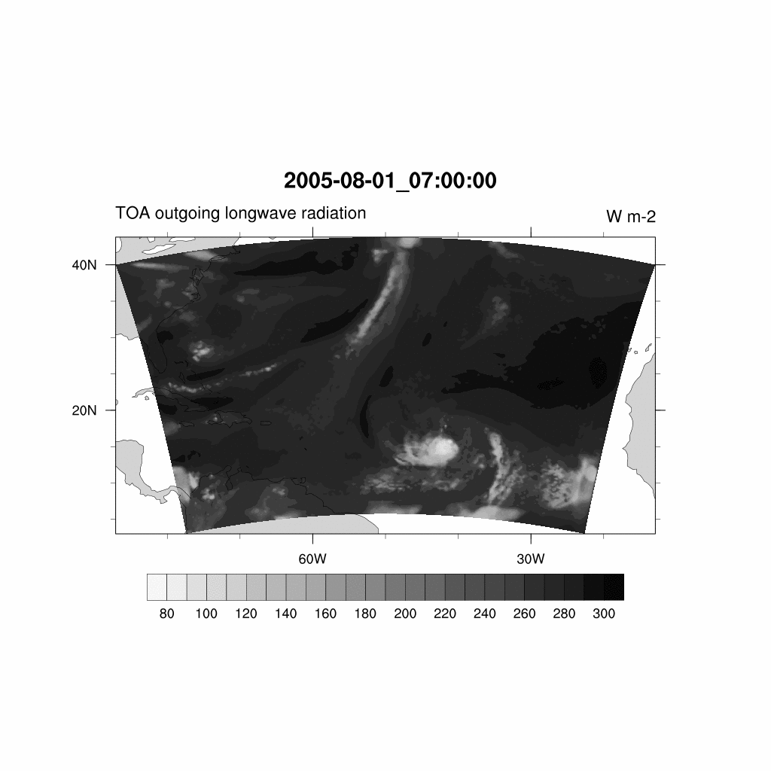
video
Notes:
13 day lifecycle of a rapidly intensifying N. Atlantic Hurricane

Slide 23
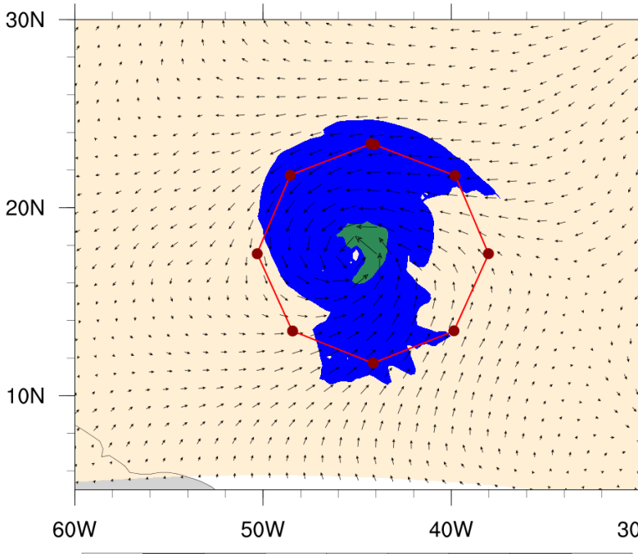
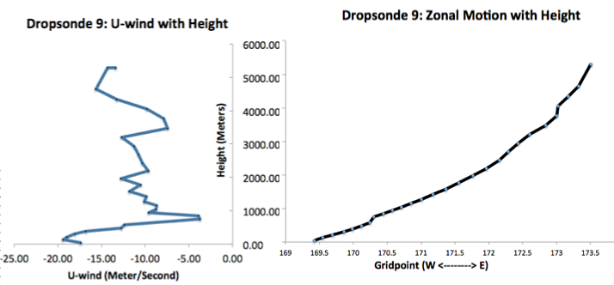

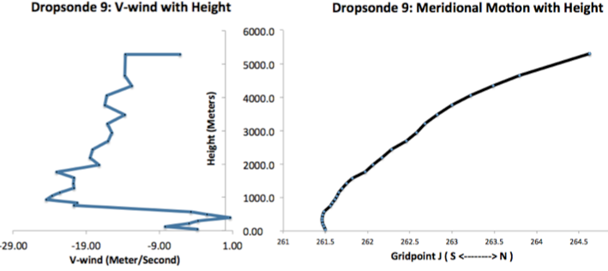
Dropsonde Simulation
Dropsonde 9
10-m Wind (knots)
Collects T, Q, U, V, W at standard pressure levels
Accounts for horizontal drift
Adjusts vertical speed based on updrafts/downdrafts and atmospheric pressure
Notes:
Aug 01, 2005 Nature Run time!
What are standard pressure levels (double check)

Slide 24
Data Assimilation:
3D-var system
6 hour spin-up
6 hourly cycling
Forecast Model:
Modified HWRF
→ domain configuration (9km parent, 3km nest)
→ no vortex relocation or initialization
→ no ocean coupling
Experiments:
Control experiment
Control + data experiments
  Current procedure
  Changes to procedure
Notes:
13 day lifecycle of a rapidly intensifying N. Atlantic Hurricane

Slide 25
Objectives:
Near-storm environment:
Sensitivity to
  Storm relative location
  Pattern shape
Synoptic features
Sensitivity to
  Targeting techniques using ensemble forecasts
  Dropsonde distribution
Evaluate using both regional and global forecast models
HWRF and GFS
φ
R

Slide 26
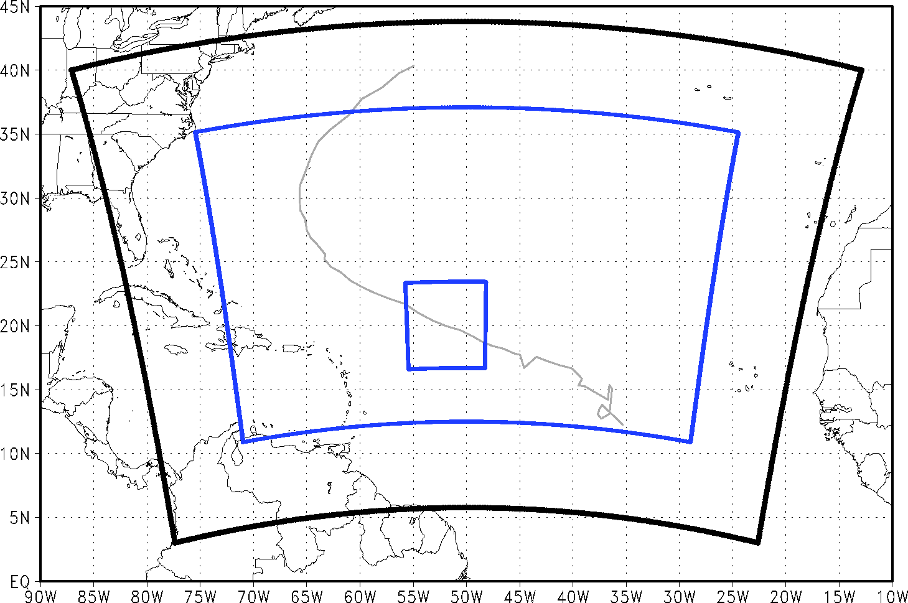
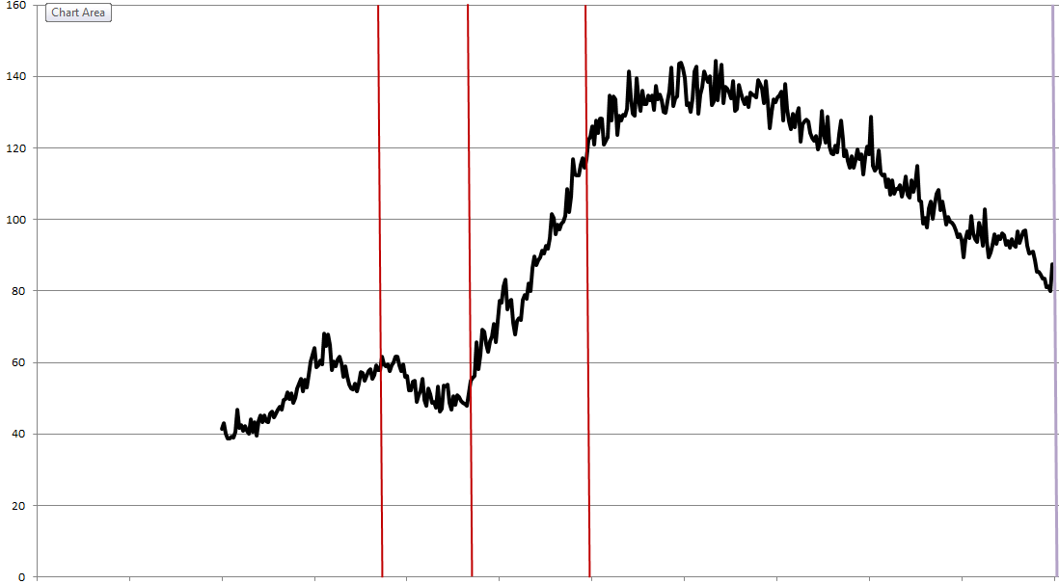
Distance from storm center:
At 2-3 degrees -> 150 nautical miles
(277 km)
Dropsonde coverage:
Every 1-2 degree -> 60 nautical miles
(111 km)
Radii Tested:
100, 150, 200, 250, 300, 350, 400 (naut. mi.)
August 4 @ 0 Z
Onset of RI
August 2 @ 0 Z
Intensity (knots)
120 hours
Time
Notes:
3

Slide 27
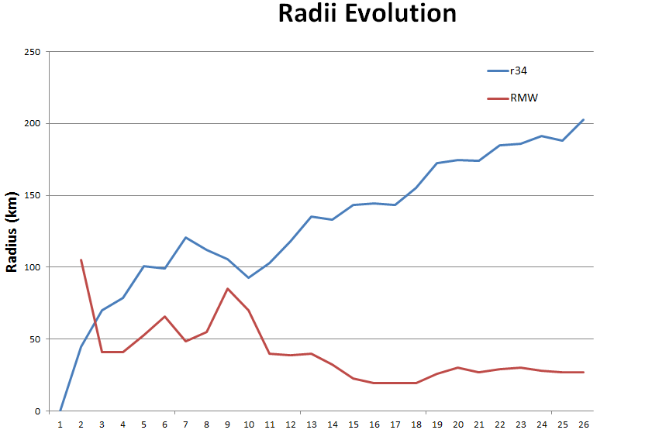
Aug 02 0Z
Aug 03 0Z
Aug 04 0Z
150 nautical mile radius
Sampling different regions as TC evolves with time
153.4 naut mi
No r34 detected
Radius (nautical miles)
131.8 naut mi
96.2 naut mi
Hours since initialization of HNR
Aug 02 0Z
Aug 03 0Z
Aug 04 0Z

Slide 28
Dropsonde coverage:
every 40 degrees (storm relative)
Total Dropsondes: 60
In each mission:
# observations assimilated in experiment:
~ 27200
# observations assimilated in control:
~ 26200
Radii Tested (in units of r34):
0.5, 1.0, 1.5, 2.0, 2.5, 3.0
August 4 @ 0 Z
Onset of RI
August 2 @ 0 Z
Intensity (knots)
120 hours
Time
Notes:
3

Slide 29
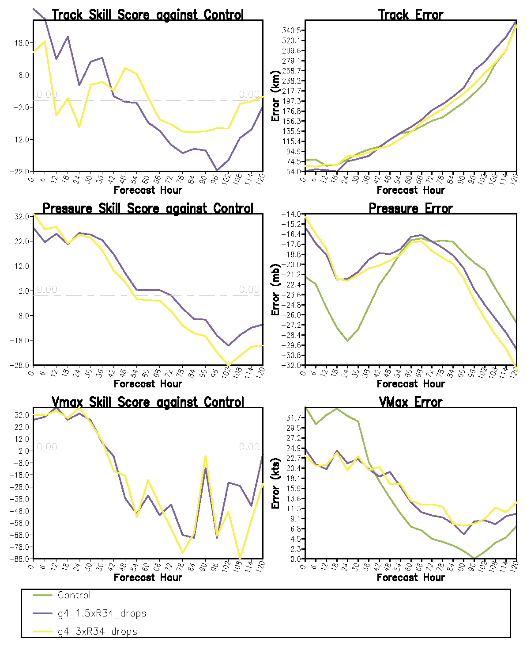
Positive impact on track forecast out to
  42 hours for 1.5 x R34
  9 hours for 3 x R34
Positive impact on intensity forecast out to 42-60 hours
  Little difference between regions
  Does not mitigate “spin down”
  Does not capture rapid intensification

Slide 30
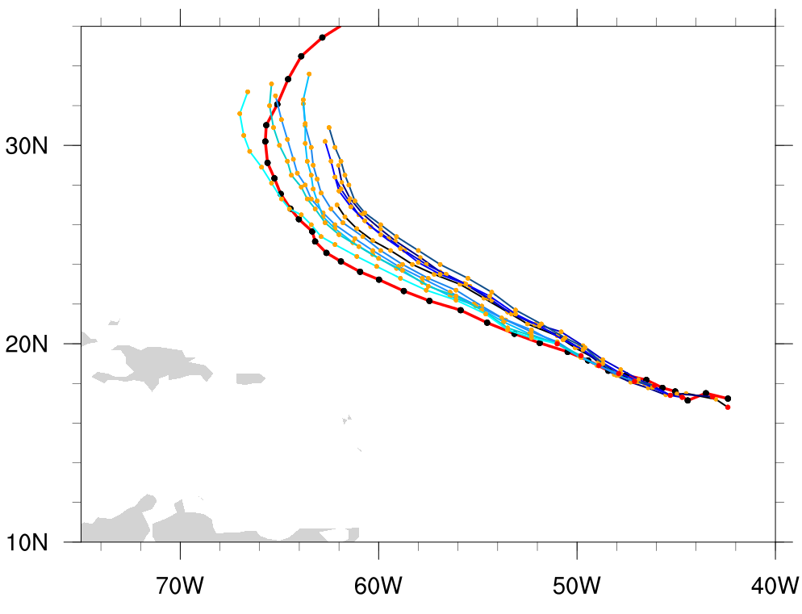
1.5 R34-unit Experiment
Forecast tracks diverge August 04 00Z
Notes:
5

Slide 31
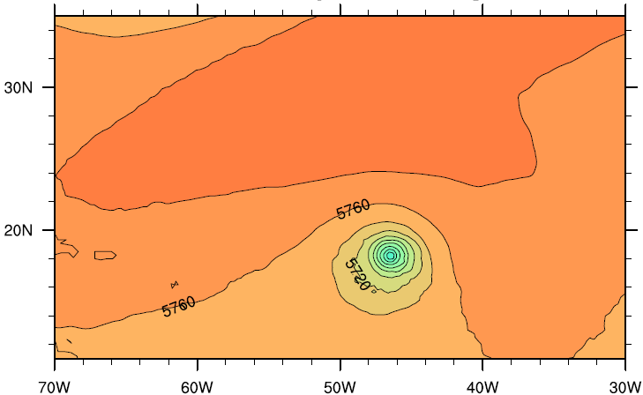
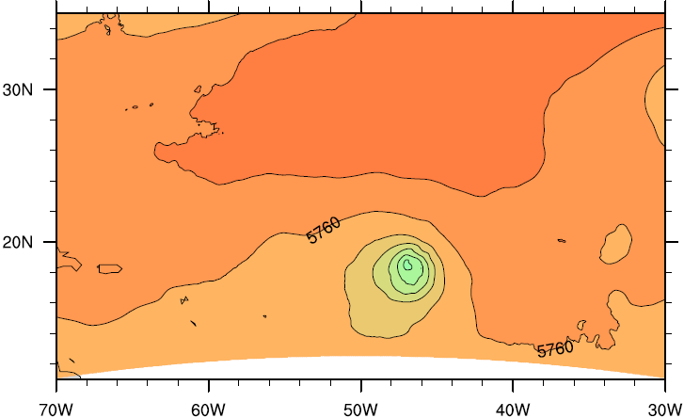
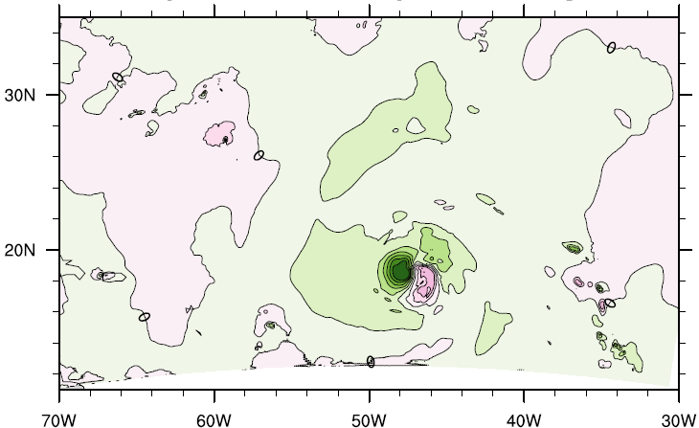
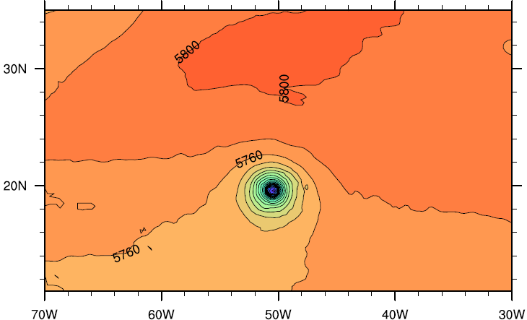
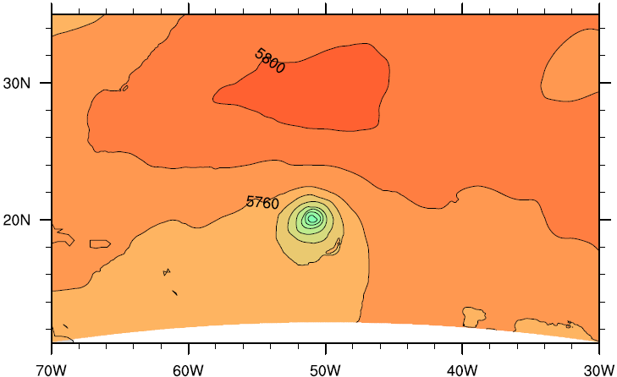
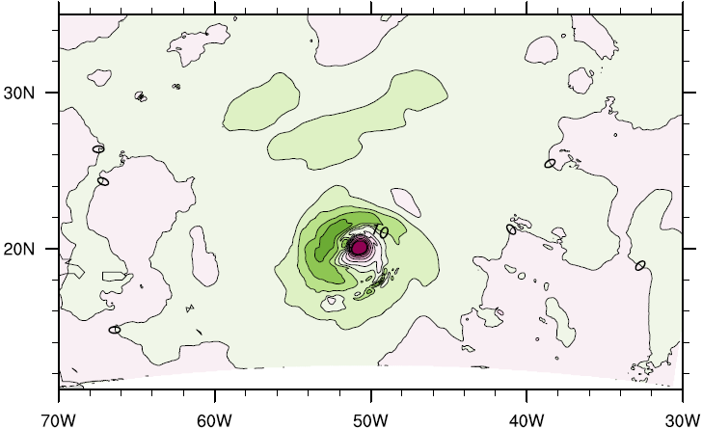


Nature Run
Analysis
Analysis Impact
Time 1
Time 2
Notes:
6

Slide 32
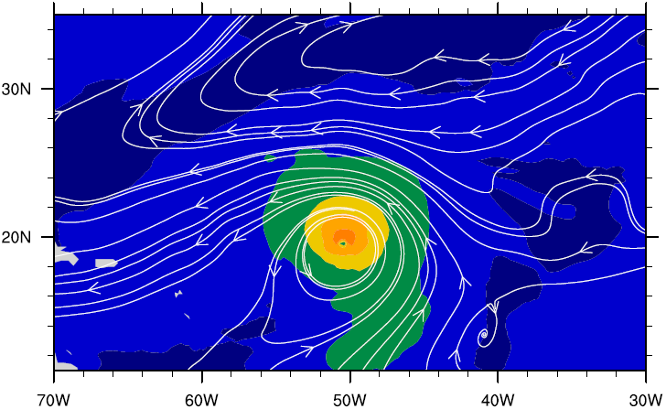
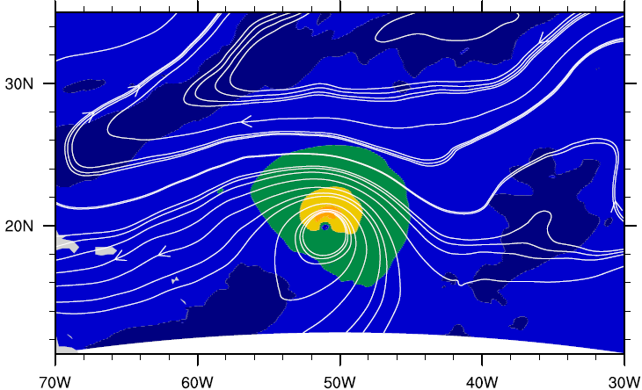

Deep Layer Mean Wind Field
Nature Run Experiment
Notes:
7

Slide 33
Objectives:
Near-storm environment:
Sensitivity to
  Storm relative location
  Pattern shape
Synoptic features
Sensitivity to
  Targeting techniques using ensemble forecasts
  Dropsonde distribution
Evaluate using both regional and global forecast models
HWRF and GFS

Slide 34
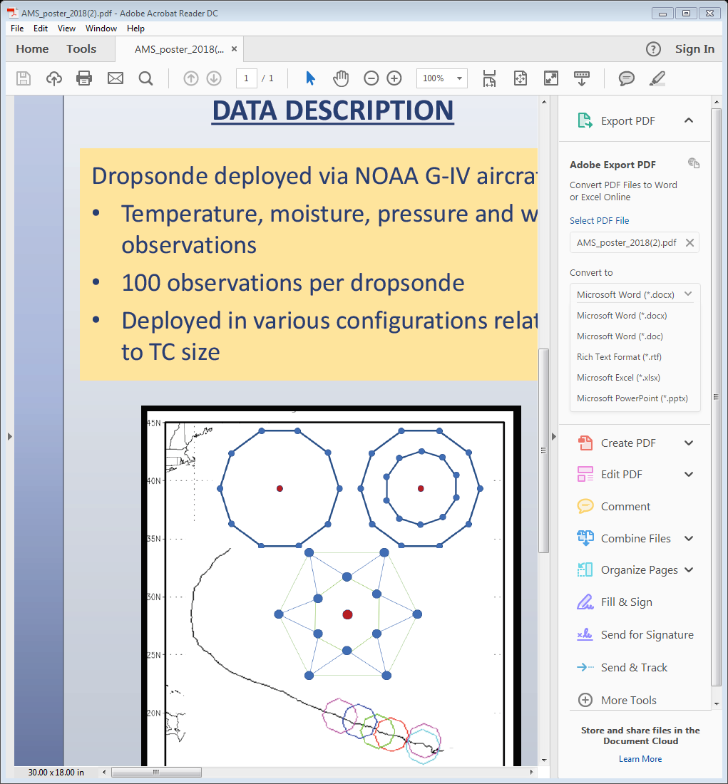
12 Dropsondes
Which pattern is best?
In each mission:
# observations assimilated in experiments:
~ 27200
# observations assimilated in control:
~ 26200
Patterns to test:
Inner Circumnavigation
Outer Circumnavigation
Concentric Circumnavigation
Experiments:
control control + inner (1.5xR34) control + outer (3xR34) control + concentric

Slide 35
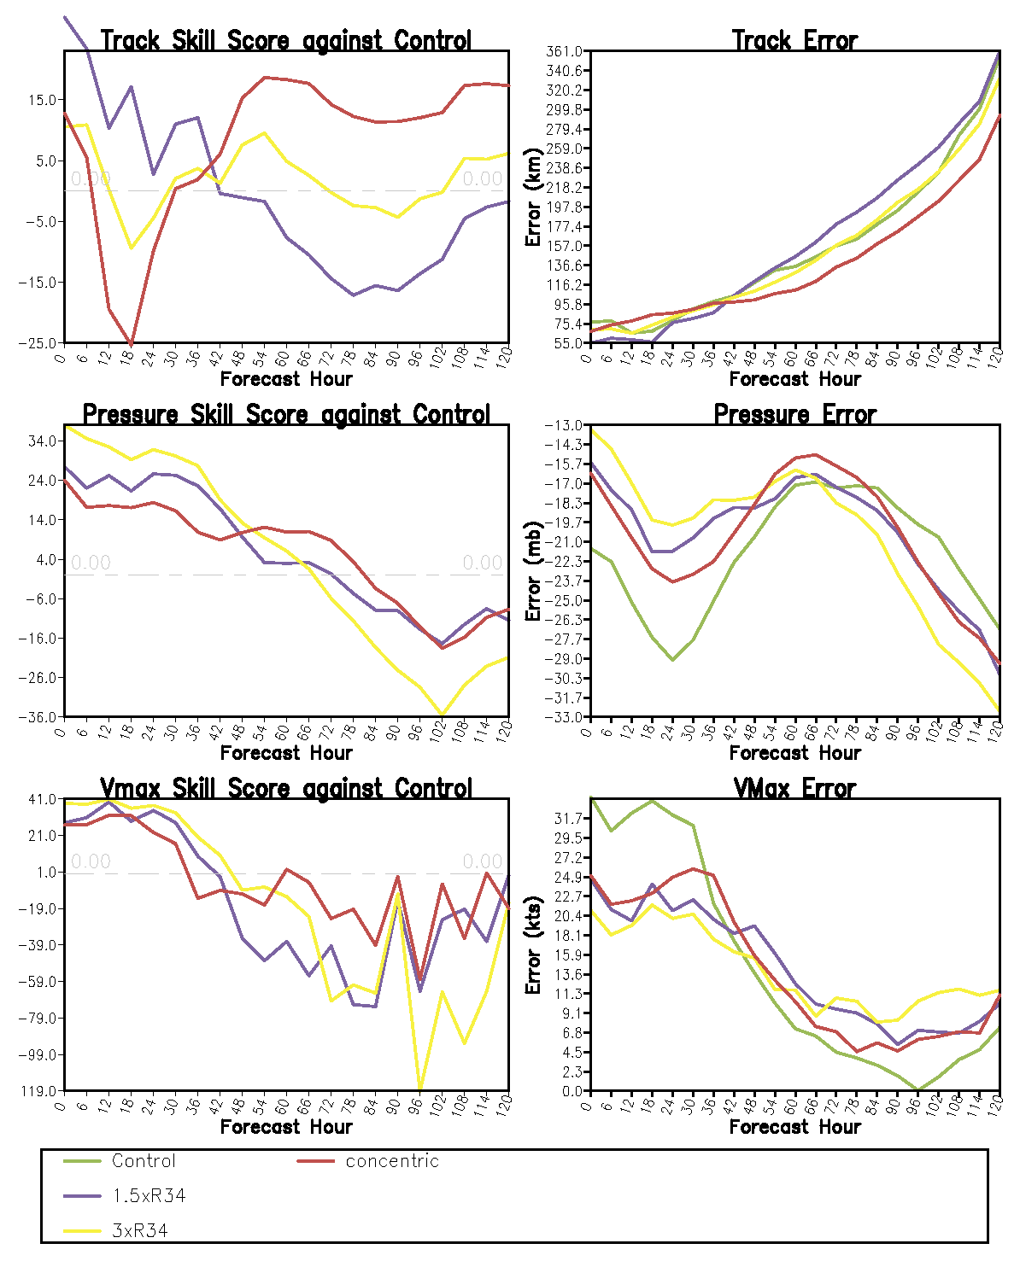
Experiments:
control control + inner (1.5xR34) control + outer (3xR34) control + concentric
For same # of dropsondes, multiple concentric circumnavigations provide more information about the radial gradient in atmospheric fields (i.e. the interaction of the core with the environment) which improves 2-5 day forecast by 15%-20%

Slide 36
Sensitivity to G-IV Dropsondes
Initial OSSE conclusions:
  Dropsondes deployed near interface between vortex and environment provide positive impact on track and intensity forecasts
  Dropsondes deployed closest to vortex provide greatest impact
  Given same # dropsondes, releasing at multiple radii provides a 2-5 day track forecast improvement over releasing dropsondes at 1 radial distance (equidistant distribution)

Slide 37
Sensitivity to G-IV Dropsondes
Next steps:
  Repeat these OSSEs using operational HWRF D.A. system, full operational HWRF model, with and without vortex relocation, varied cycling frequency, varied dropsonde density, etc…
  Continue with OSSEs on synoptic scale environment testing sensitivity targeting methods and dropsonde distribution
  Repeat all experiments with multiple Nature Runs to obtain more robust results

Slide 38
Sensitivity to G-IV Dropsondes
Proof-of-concept provides support for use of more expensive DA systems to determine what changes should be made operationally
Data impact OSSEs can be useful for defining systematic changes to operational procedures based on quantitative evidence and an understanding of why those changes improve prediction

Slide 39
Additional Future OSE/OSSE Studies
Similar experimental setup can be used for optimizing P-3 observations
  Tail Doppler Radar (See my talk at AMS Tropical Meeting titled “Impact of P-3 Tail Doppler Radar Observations on Hurricane Analyses and Forecasts using a Regional OSSE Framework” on April 17, 2018)
  Dropsondes
  SFMR
  New data (i.e. Coyote UAS)
Similar experiment setup can be used to optimize operational use of any aircraft

