Slide 1
HWRF idealized boundary issue
Chanh Kieu
Indiana University
Acknowledgement: Thank Gopal, Zhan Zhang, and Lin Zhu for help with the new HWRF upgrade.

Slide 2
Outline
Introduction
Methodology
Implementation
Preliminary experiments
Remarks

Slide 3
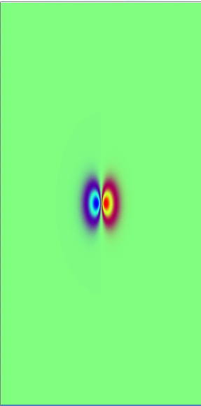
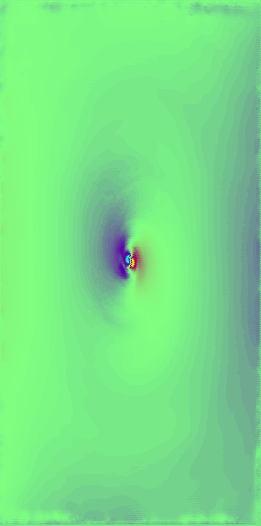
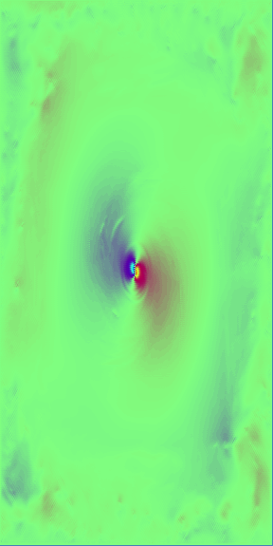
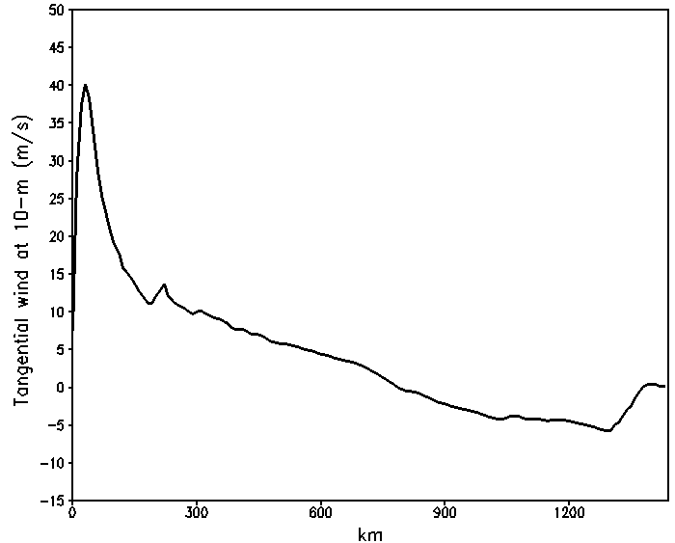
Introduction
Idealized configuration is an important component of any TC model as it allows for isolations of various factor in TC development
Regional TC models, however, suffer from boundary condition issues
t = 0
t = 48 hrs
t = 120 hrs
HWRF idealized 5-day simulation (V3.7)
Boundary issues create an unrealistic profile

Slide 4


Methodology
Implement Neumann-type boundary condition or radiative lateral boundary;
Reduce the boundary noises by assuming the far-field noises to be damped out by Reynolds molecular viscosity (dissipation via downscale cascades);
Our approach: choose the viscosity dissipation over the radiative boundary condition because 1) avoid complication of the boundary with E-grids, 2) maintain the imposed shear at lateral boundary for shear experiments, and 3) this is a ultimate goal of radiative boundary
$$E\left(k\right)\sim ε^{2/3}k^{−5/3}$$
forcing
transfer
Energy
$$k_{ν}\sim {\left(\frac{ε}{ν^{3}}\right)}^{\frac{1}{4}}$$
dissipation
Vallis, 2005
Wavenumber

Slide 5
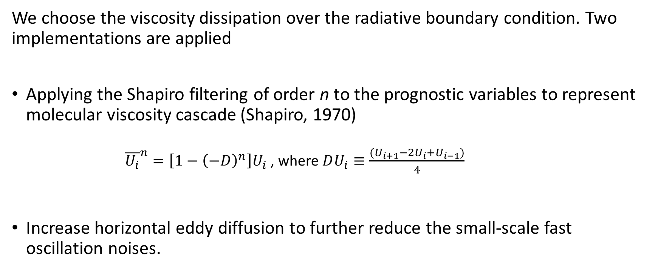
Methodology: Shapiro filtering and diffusion
We choose the viscosity dissipation over the radiative boundary condition. Two implementations are applied
Applying the Shapiro filtering of order n to the prognostic variables to represent molecular viscosity cascade (Shapiro, 1970)
${\overline{U_{i}}}^{n}=\left[1−{\left(−D\right)}^{n}\right]U_{i}$ , where $DU_{i}≡\frac{{(U}_{i+1}−2U_{i}+U_{i−1})}{4}$
Increase horizontal eddy diffusion to further reduce the small-scale fast oscillation noises.

Slide 6
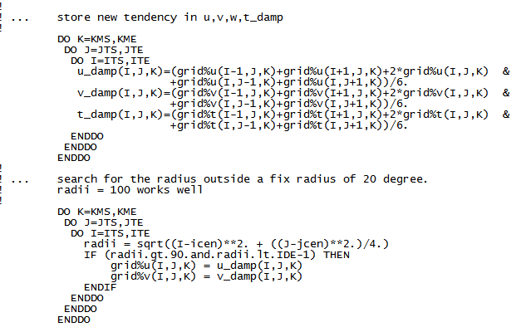
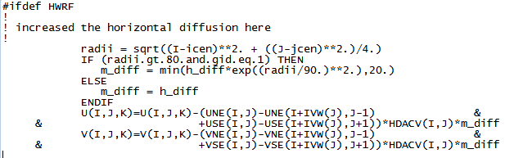
Preliminary implementation
Modify solve_nnm.F:
Modify module_DIFFUSION_NMM.F:
Remark 1: the following modifications are only for HWRF idealized configuration (V3.6). Currently hard-coded for specific domain of 288x576 grid points at 9/3/1 km resolution.
Remark 2: Idealized configuration V3.7 has a bug in domain tracking. Segment fault if max_dom=2 !!!

Slide 7
Preliminary experiments
HWRF V3.6:
  9/3/1 km resolution
  Domain setting: 288x576, 298x606, and 540x990
  61 vertical levels
  5-day simulation
HWRF V3.7:
  18/6/2 km resolution
  Domain setting: 288x576, 288x576, and 288x576
  61 vertical levels
  5-day simulation
  Not well-tested at this point due to the bug

Slide 8
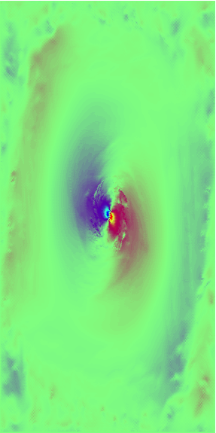
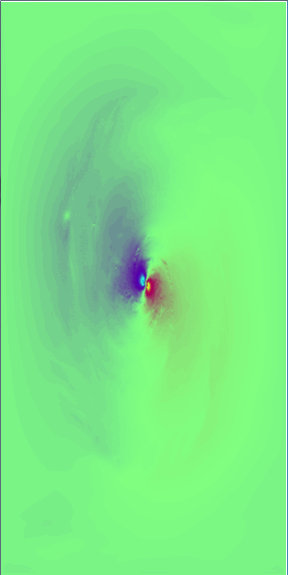
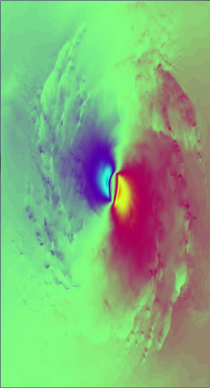
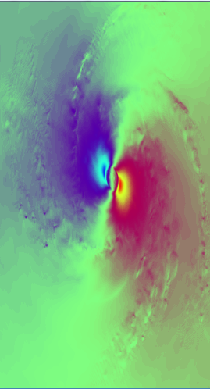
Result: large-scale structure (V3.6)
Outermost domain (~9 km)
Innermost domain (~900 m)
CTL
Far-field damping
CTL
Far-field damping
Significant reduction in the noises near the boundary towards the end of 5-day simulation;
Storm inner-core structure does seem to feel the impacts of boundary, albeit the overall structure is the same

Slide 9
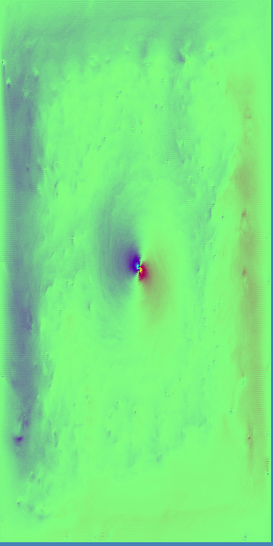
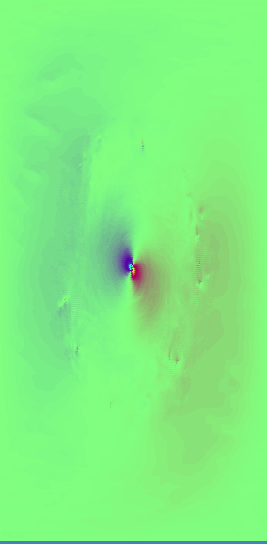
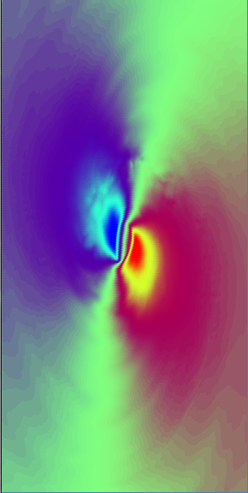
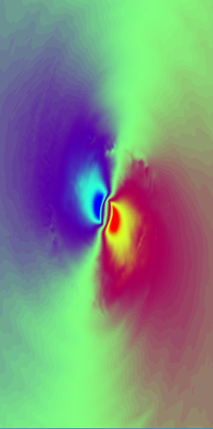
Result: large-scale structure (V3.7)
Outermost domain (~18 km)
Innermost domain (~2 km)
CTL
Far-field damping
CTL
Far-field damping
Similar reduction in the noises near the boundary towards but there appears to have some remnants
The far-field damping appears to be dependent on the resolution.

Slide 10
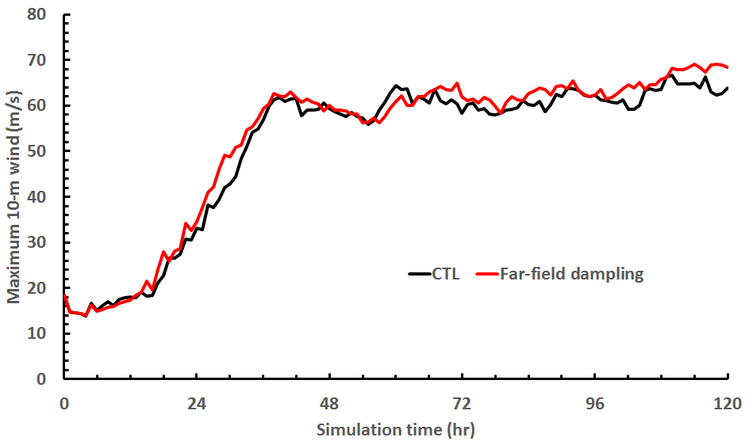
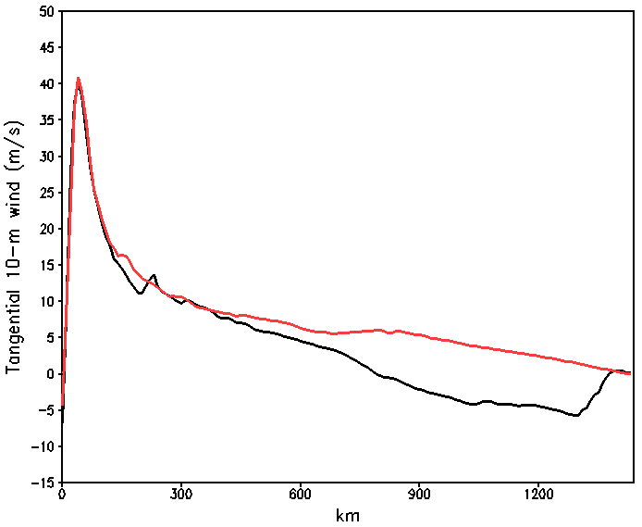
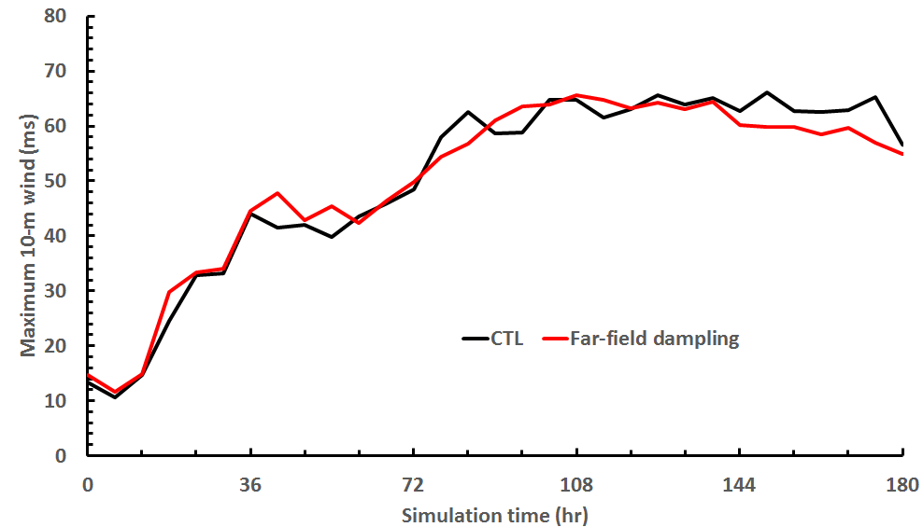
Result: radial profiles vs time series
Consistent with the 2D distribution, the radial profile of the 10-m wind shows that the anticyclonic wind go away near the boundary;
No significant change in the Vmax time series; both show similar rapid intensification and saturation after 72 hours (slightly higher for far-field damping exp)
HWRF V3.6
Far-field damping
HWRF V3.7
CTL

Slide 11
Result: inner-core structure
Both show DWC, but CTL exp has a weaker upper-level warm core
CTL exp
Far-field damping
Similar Vmax, but quite different vertical structure; CTL exp has a shallower depth

Slide 12
Result: inner-core structure
Stronger eyewall convection in far-field damping exp
CTL exp
Far-field damping
No outer eyewall development

Slide 13
Remarks
Boundary noises for HWRF can be reduced by using a simple far-field damping operator to represent the viscosity dissipation, with more reasonable radial wind profile;
The filter seems to however depend on the model resolution;
Quite similar Vmax time series between CTL and FFD experiments. However the vortex vertical structures are quite different -> boundary has realizable impacts on inner-core after 5-day into integration;

