Slide 1




Proposed vertical level and air-sea surface exchange coefficient upgrades for FY2017 HWRF implementation
Bin Liu, Lin Zhu, Banglin Zhang, Weiguo Wang, Sergio Abarca, Jason Sippel, Mingjing Tong, Qingfu Liu, Hyun-Sook Kim, Zhan Zhang, and Avichal Mehra
Acknowledgements: EMC Hurricane Group
Notes:
1
1

Slide 2
Outline
Proposed vertical level upgrade
Proposed air-sea surface exchange coefficient updates
Retrospective test results
Summary and recommendations for FY2017 HWRF upgrades

Slide 3
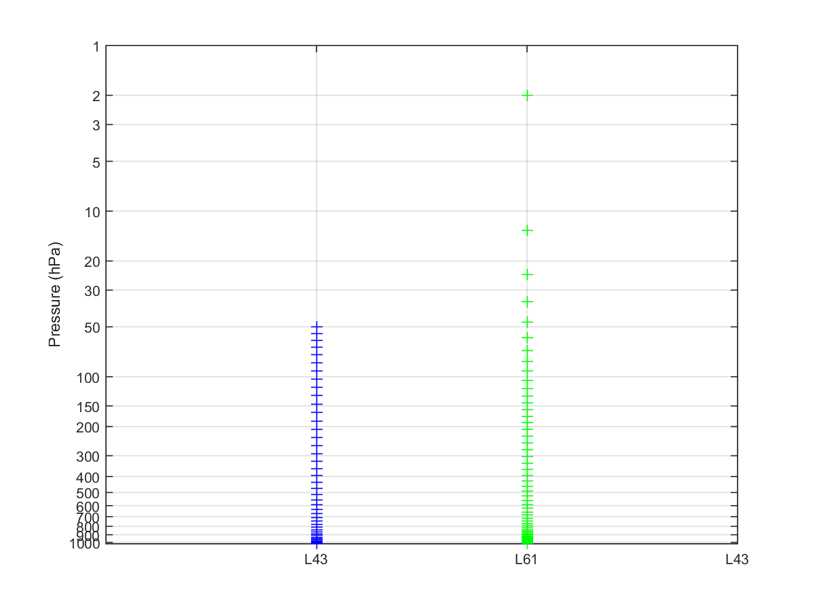
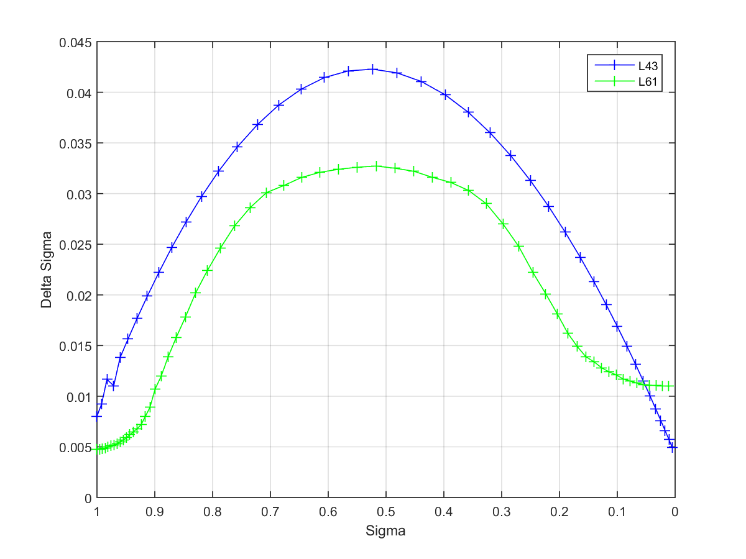
Current HWRF vertical levels
NATL, EPAC, CPAC: 61 levels with a 2-hPa model top
  Lowest half sigma level height: ~20 m
All other basins: 43 levels with a 50-hPa model top
  Lowest half sigma level height: ~34 m

Slide 4
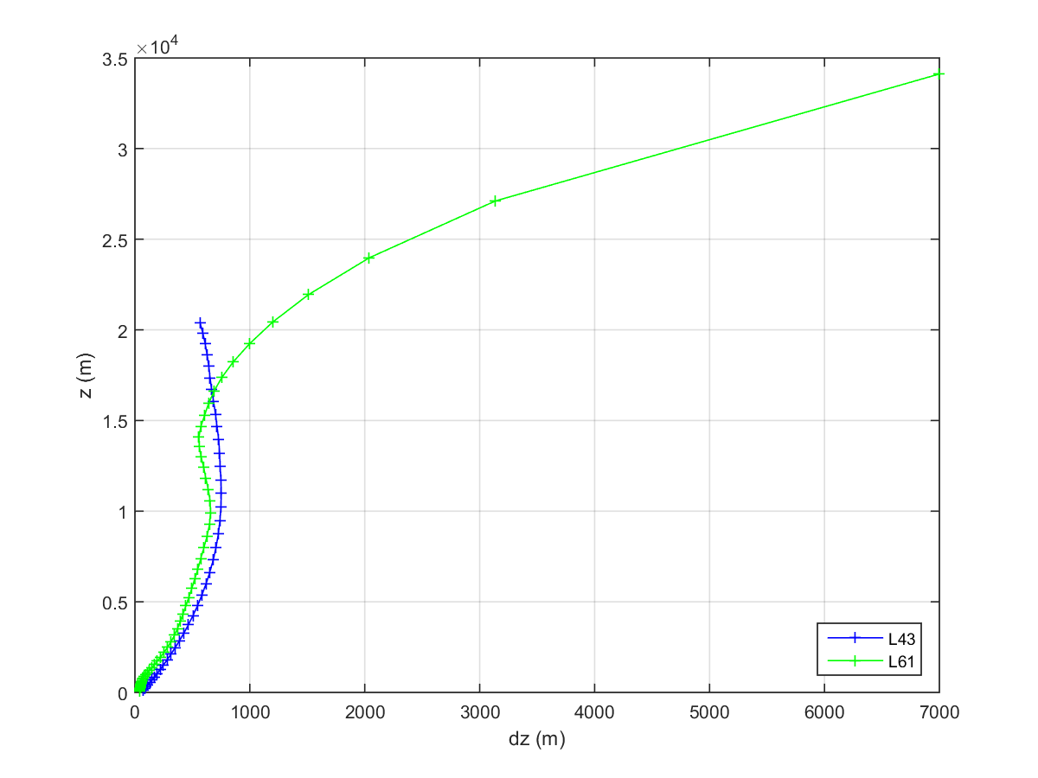
HWRF vertical levels
Sparse vertical levels near model top for L61
  dz > dx
Lowest model level height
  Lowest half sigma level height of ~20m (L61) and 34m (L43)
Relatively low vertical resolution in mid and upper troposphere

Slide 5
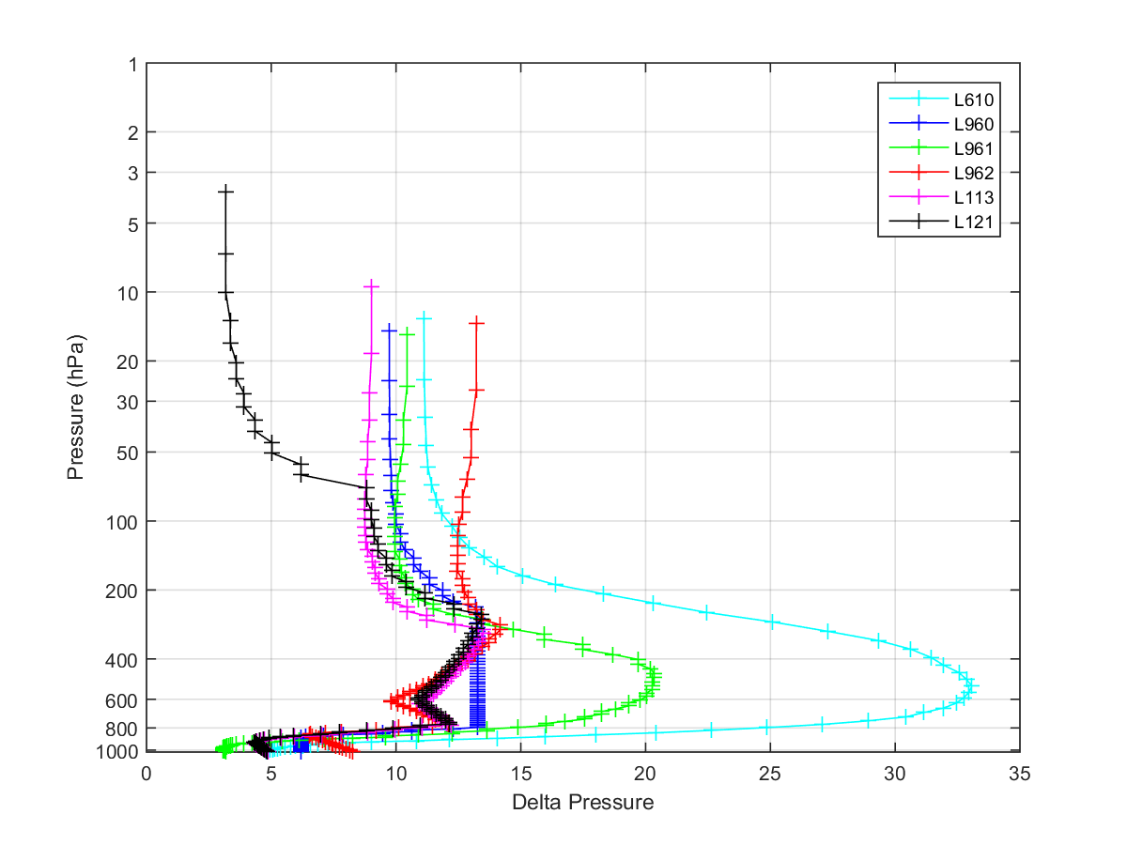
Hurricane track and vertical resolution
From B. Zhang et al. (2016), which shows that the track forecasts of
Hurricane Joaquin (2015) were greatly improved by increasing
the vertical resolution of HWRF.

Slide 6
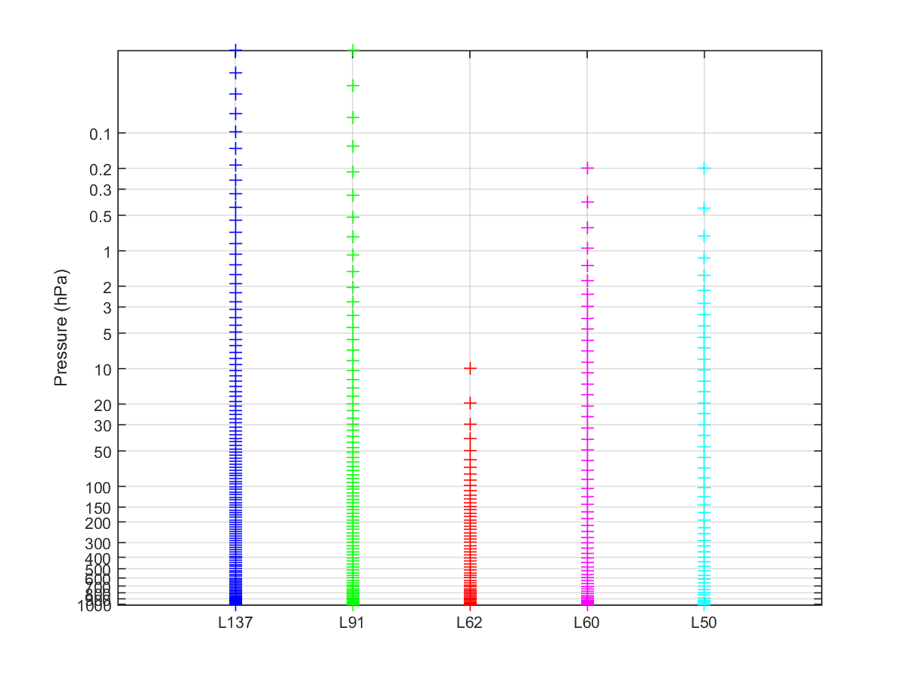
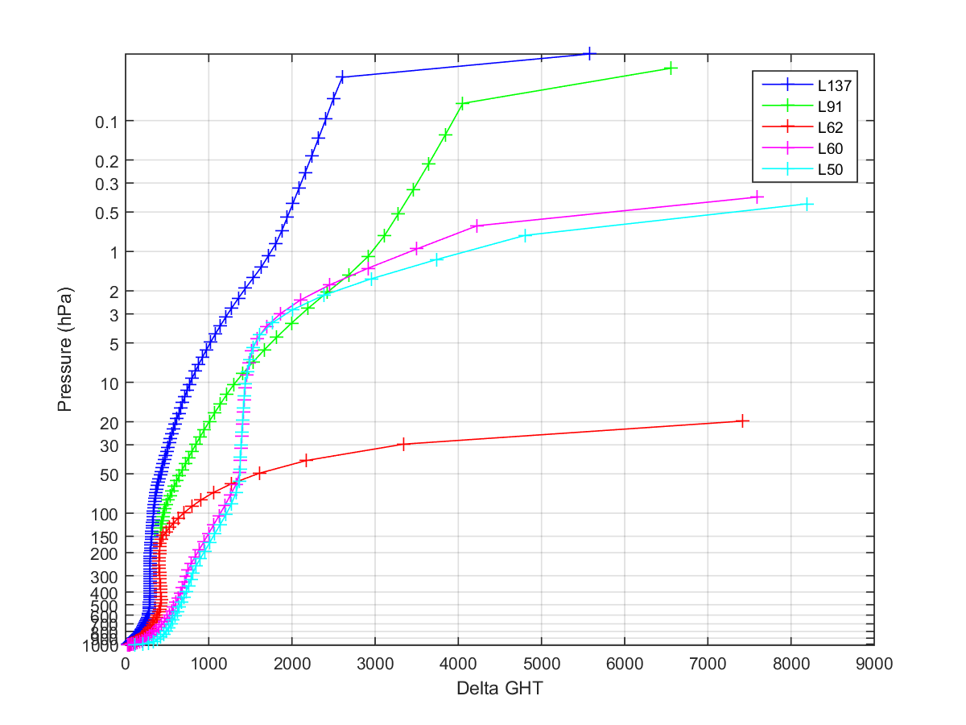
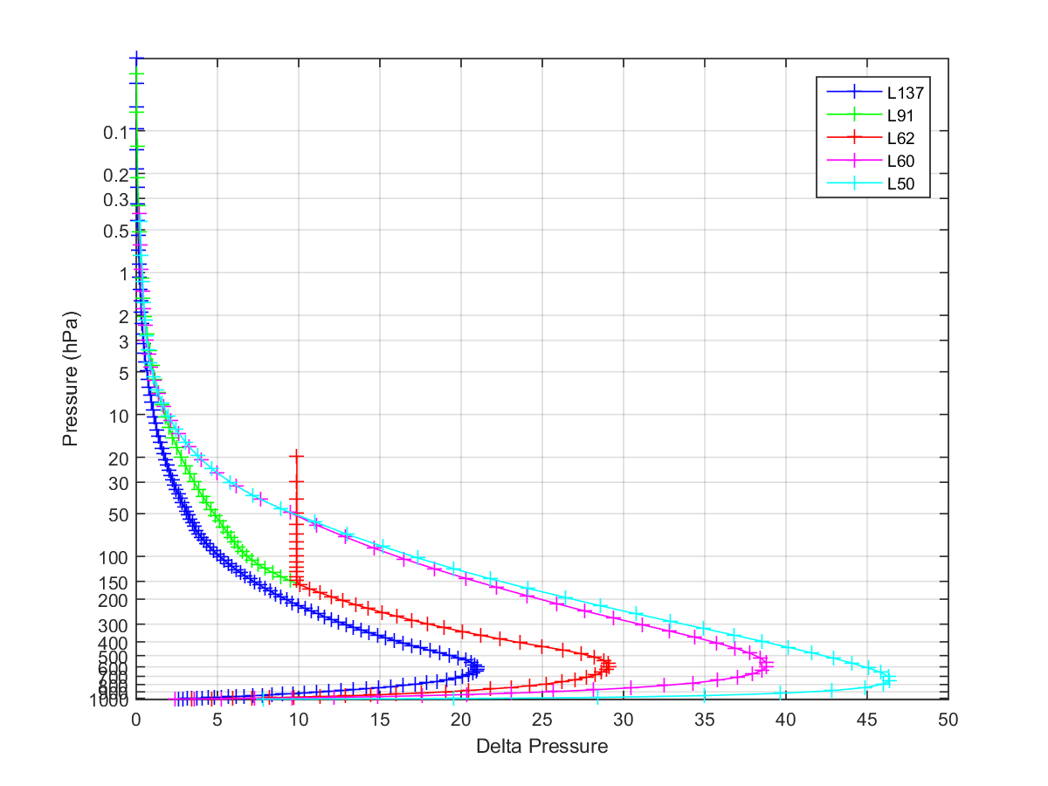
ECMWF IFS vertical levels
2013
2006

Slide 7
Expected features for new vertical level configuration
Increase HWRF vertical resolution and make it more consistent with model horizontal resolution
Optimize vertical level distribution
Fit in operational time window
Improve HWRF track and intensity forecasting
Unify the model vertical level setting for all the TC basins

Slide 8
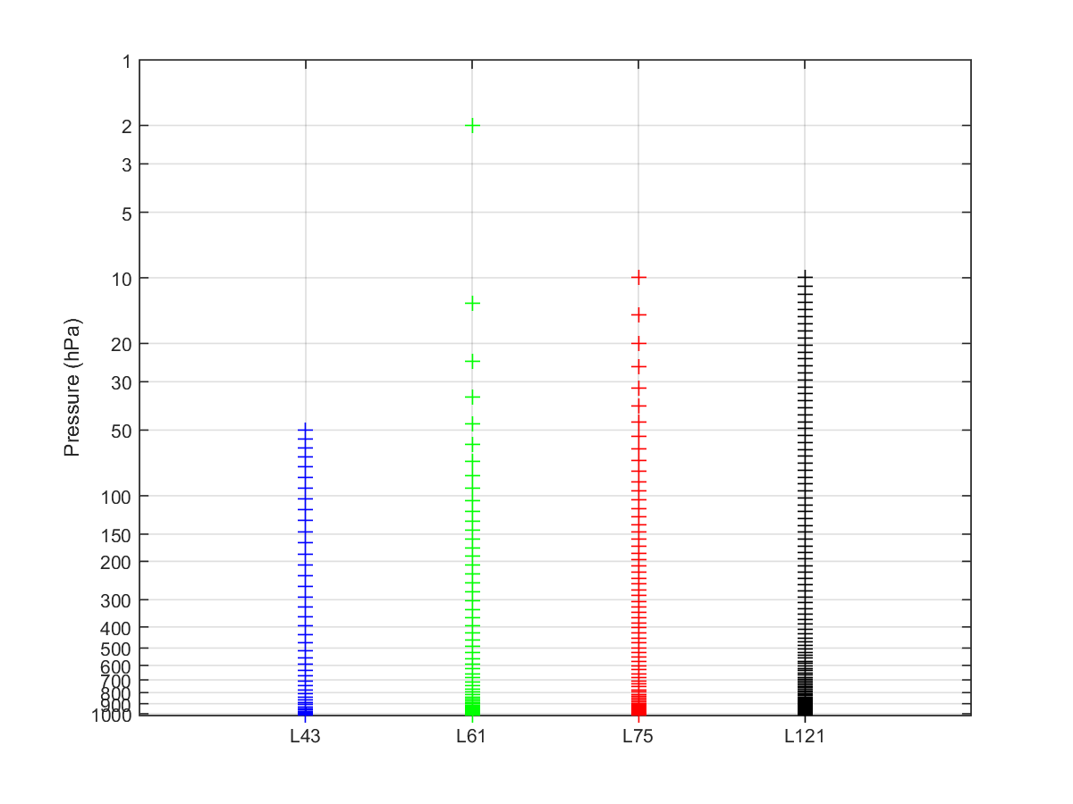
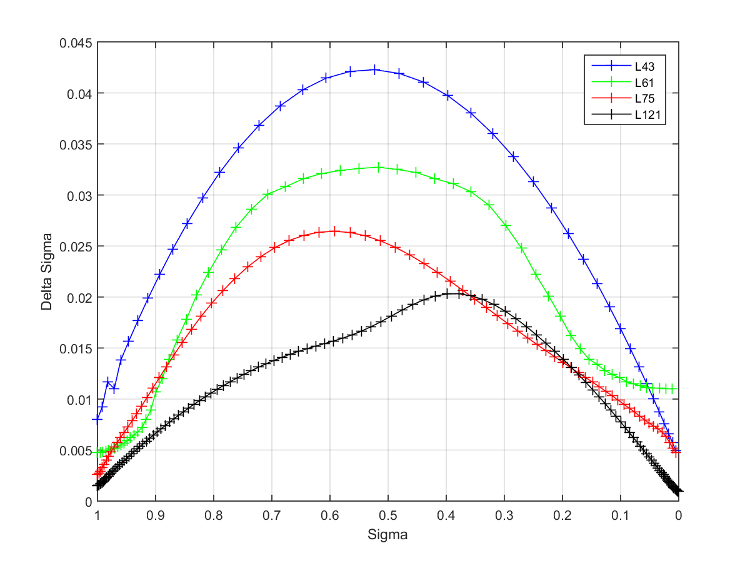
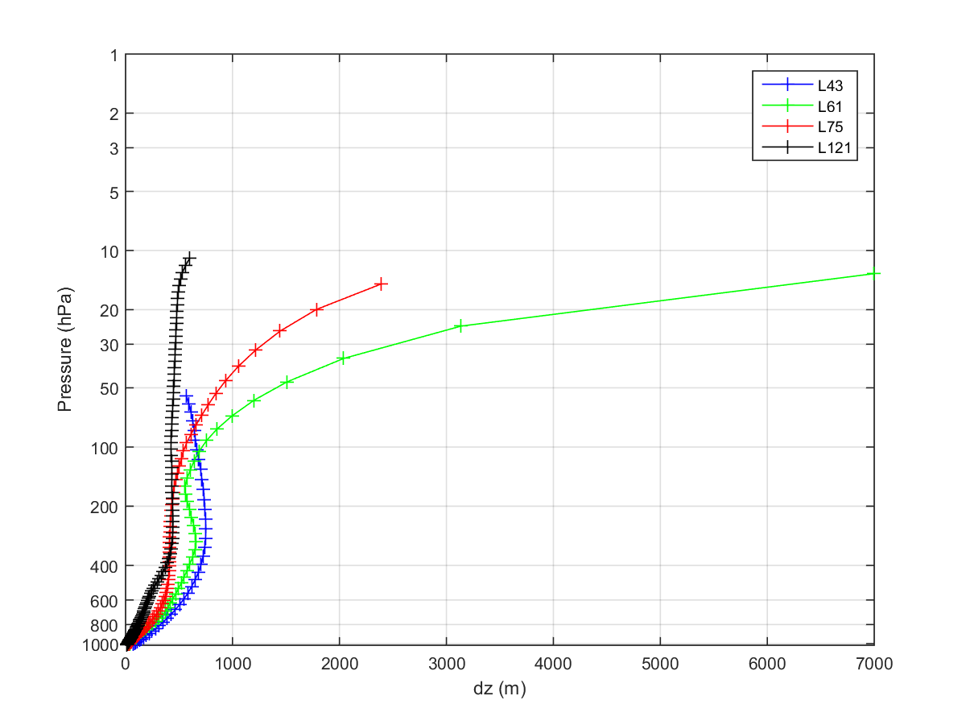
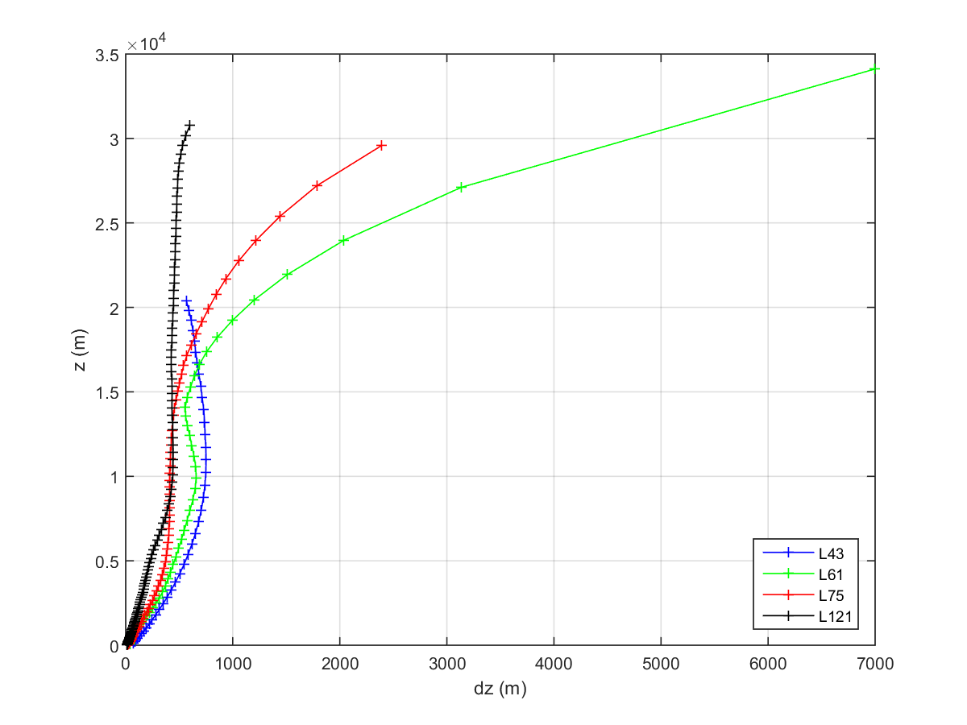
The proposed 75 vertical level/distribution

Slide 9
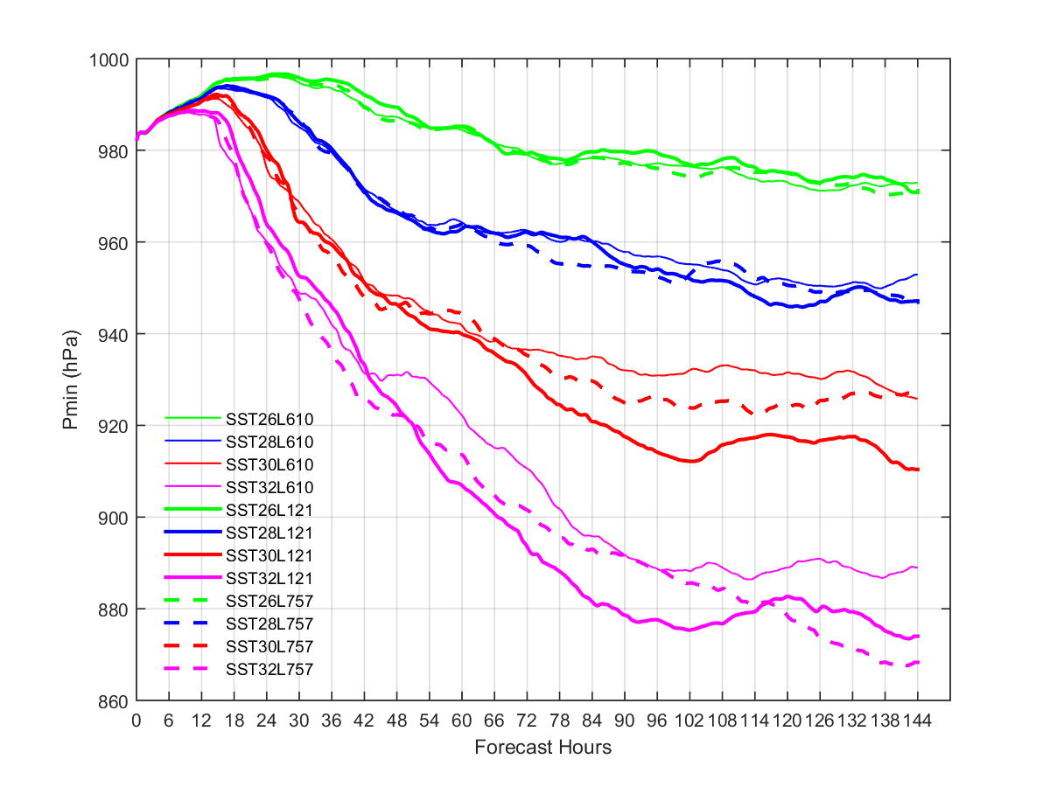
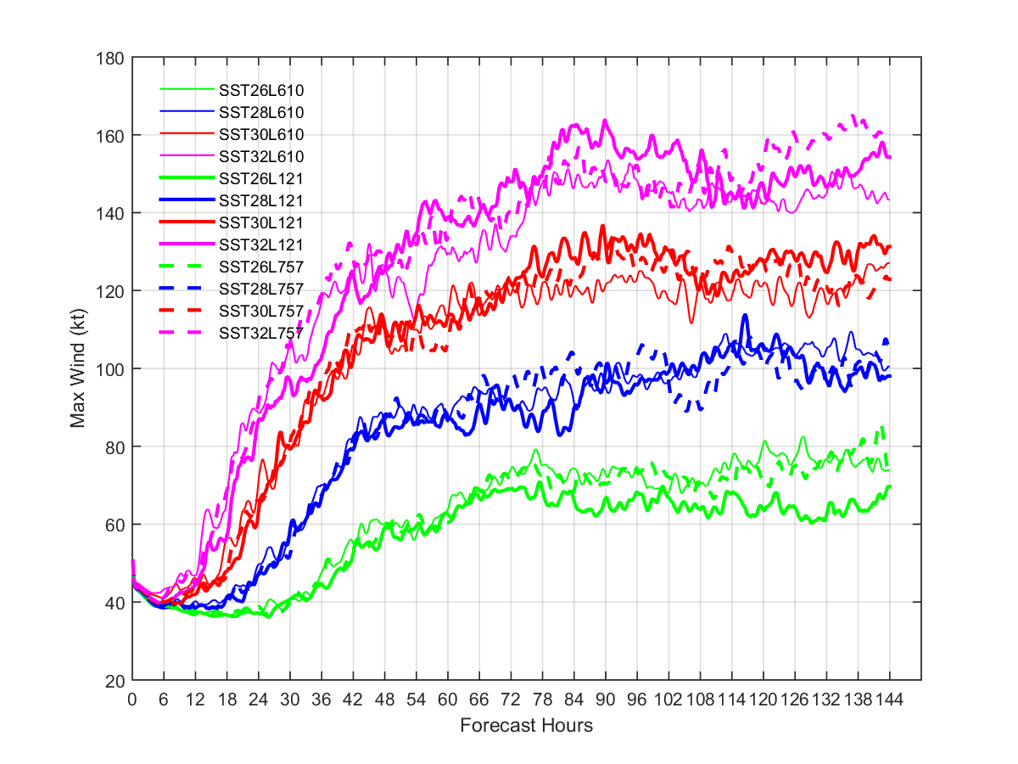
Intensity evolution with different vertical levels from idealized HWRF simulations

Slide 10
Outline
Proposed vertical level upgrade
Proposed air-sea surface exchange coefficient updates
Retrospective test results
Summary and recommendations for FY2017 HWRF upgrades

Slide 11
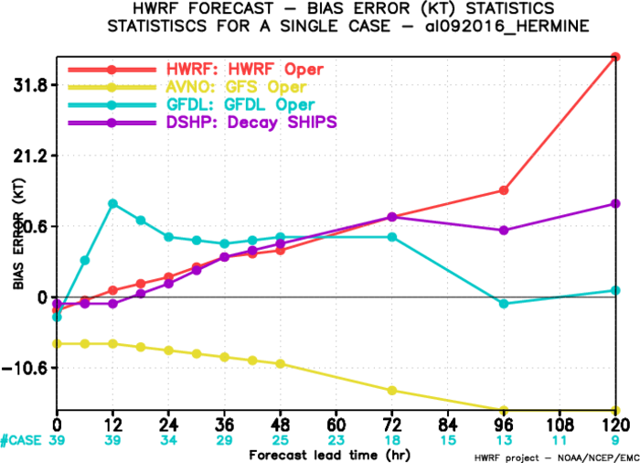
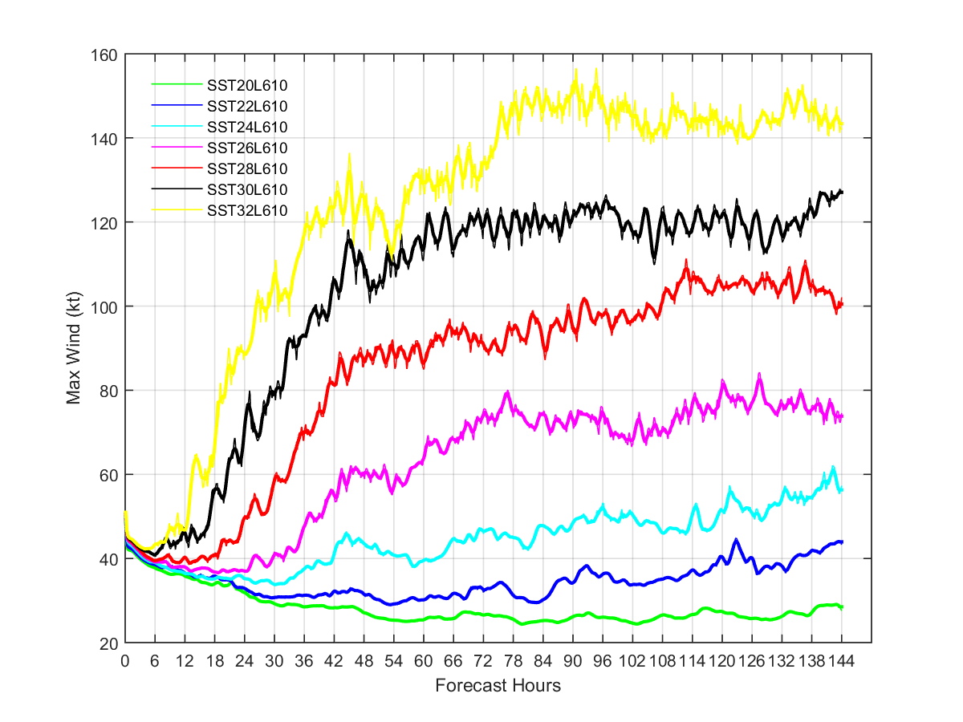
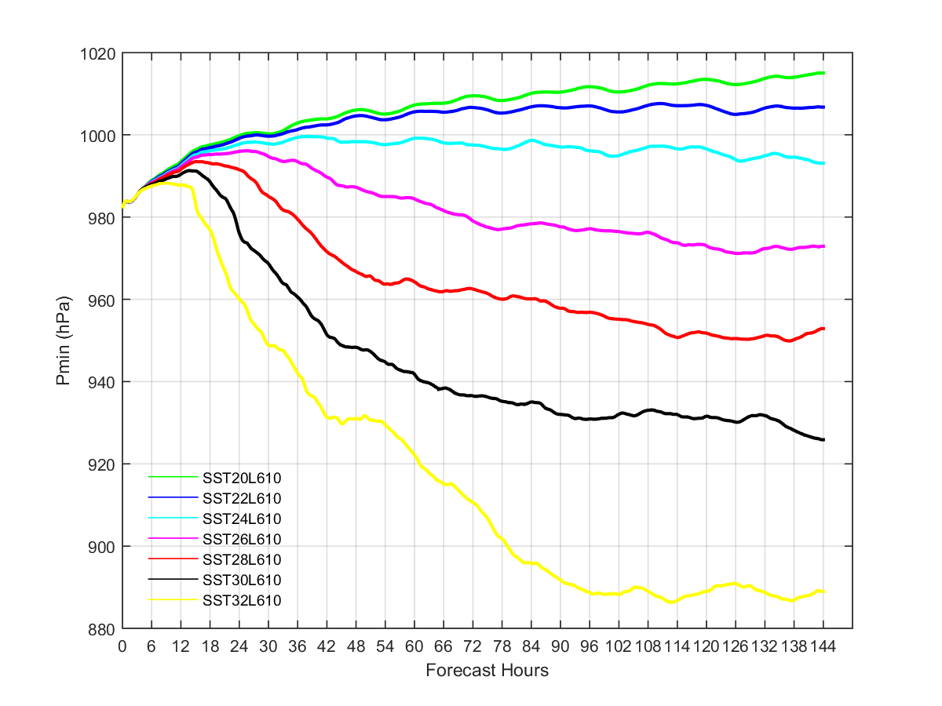
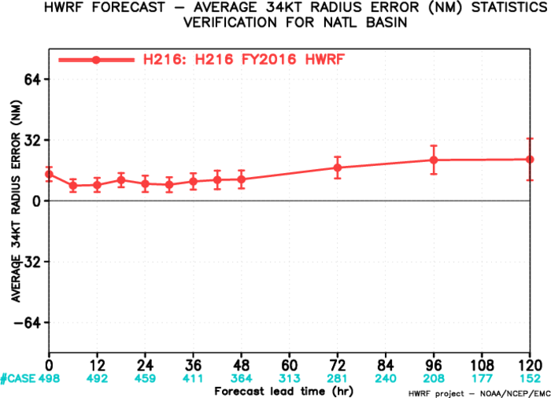
Weak storm over-intensification and large size error
FY2016 HWRF 09L intensity bias
Idealized Experiments with H216 for different SSTs: 22 to 32 degC

Slide 12
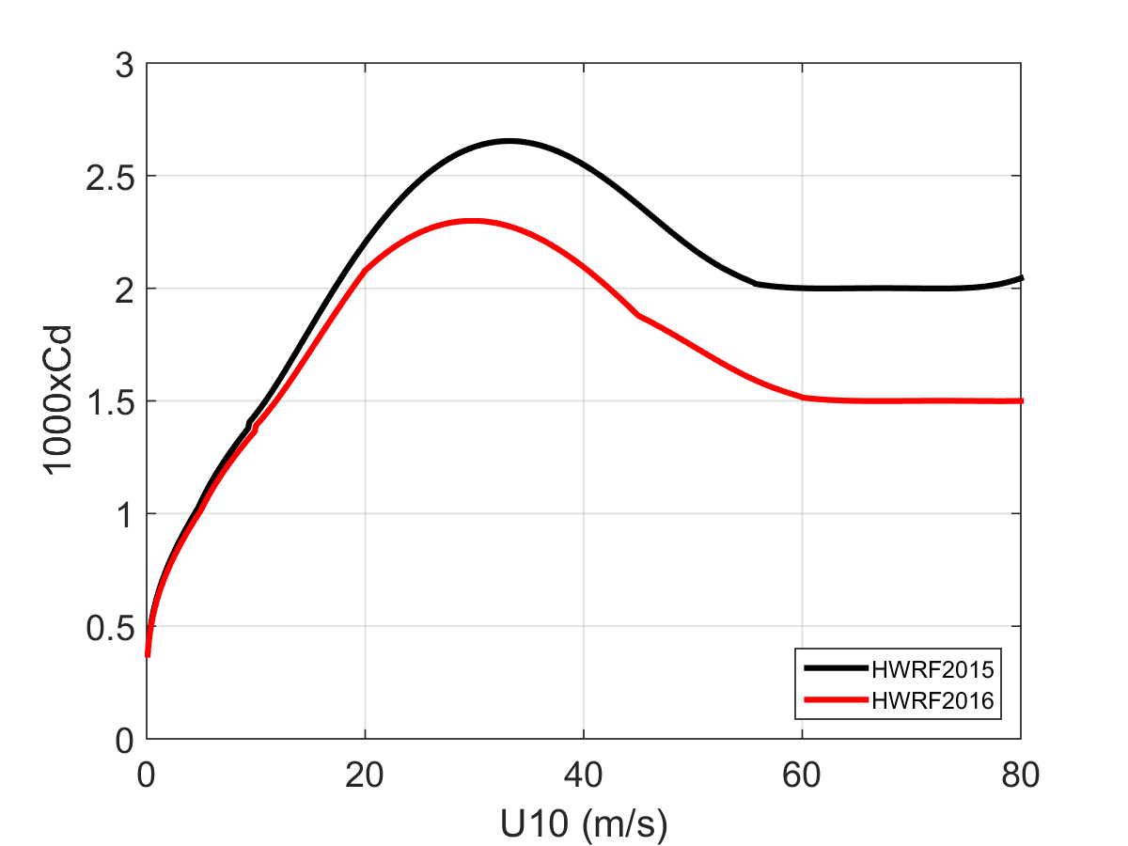
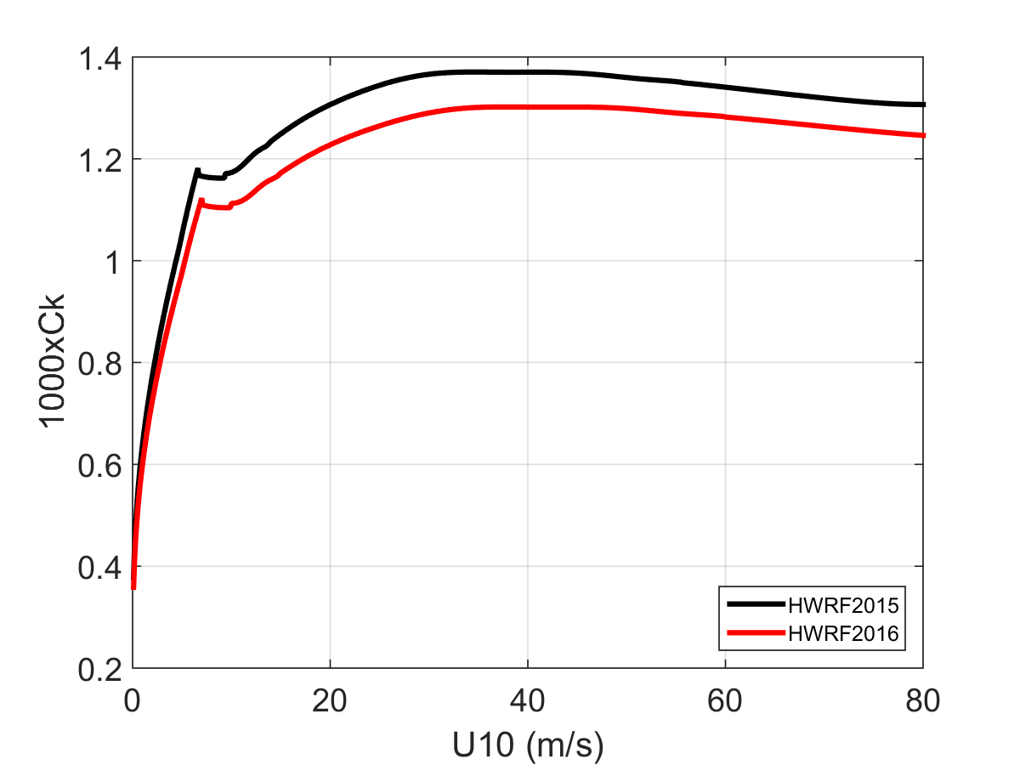
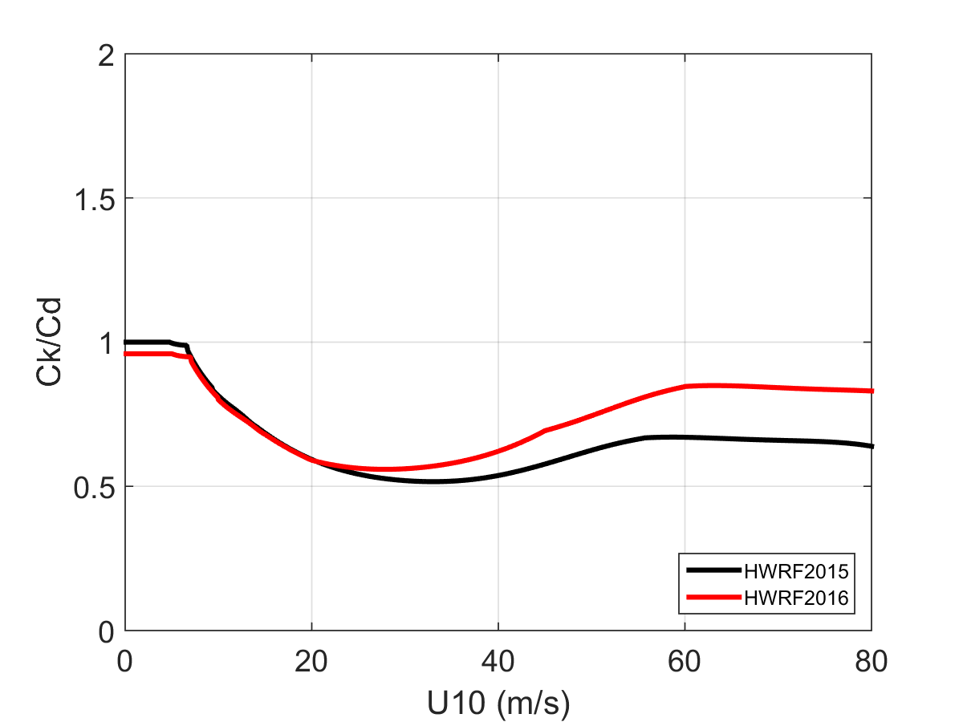
HWRF surface exchange coefficients

Slide 13
Cd under low-to-moderate winds
COARE algorithm
Areodynamical roughness:
COARE V3.5 (Edson et al. 2013)
m=0.0017, b=-0.005

Slide 14
Ck under low-to-moderate winds
COARE algorithm
Scalar roughness:
COARE V3.0 (Fairall et al. 2003)

Slide 15
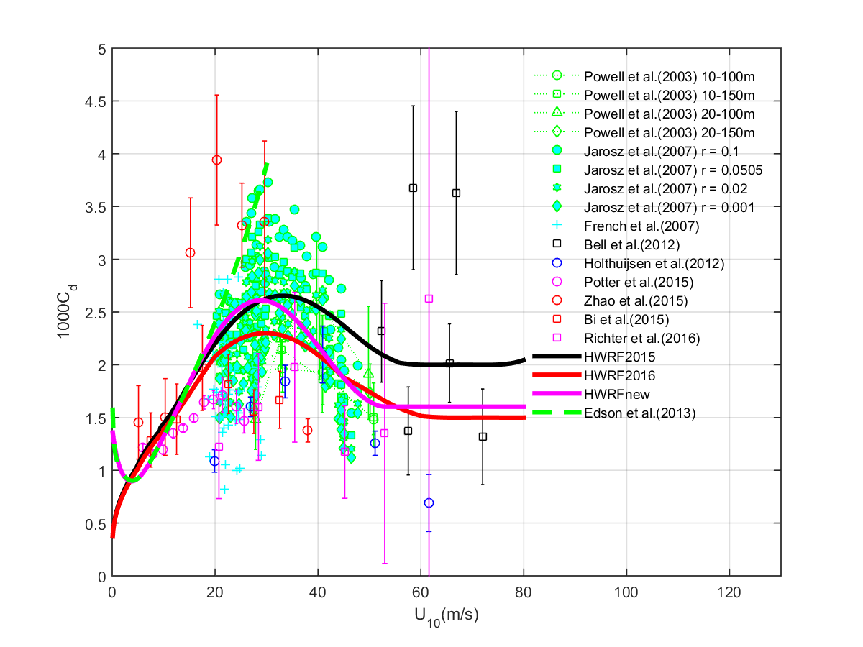
Cd under high winds

Slide 16
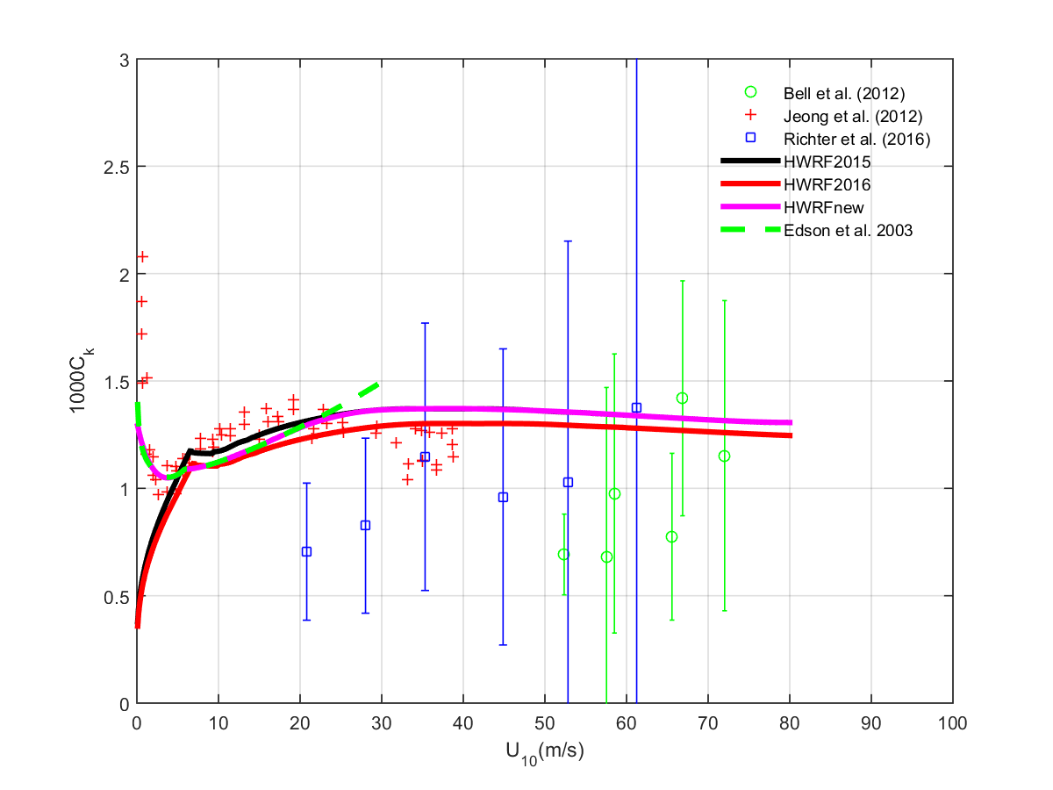
Ck under high winds

Slide 17
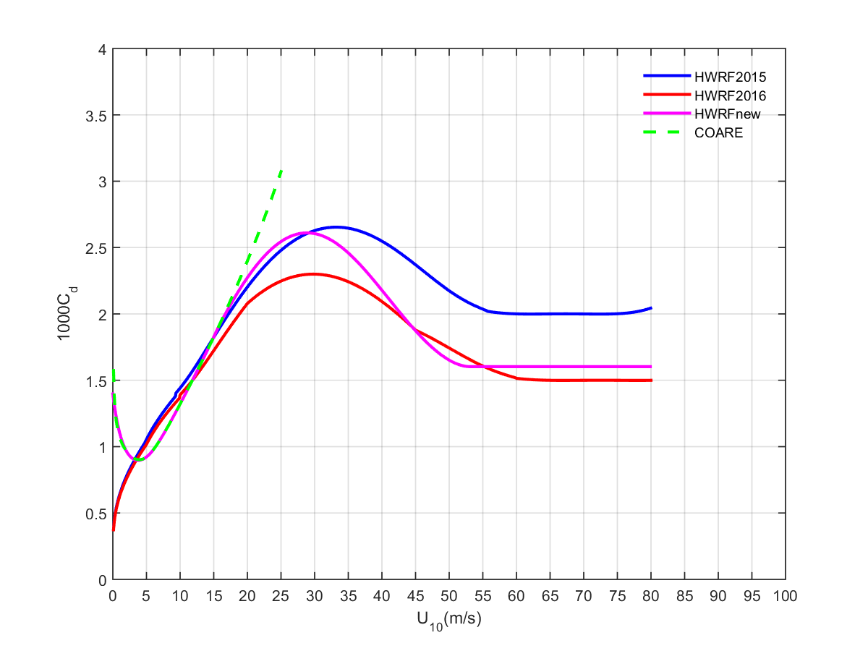
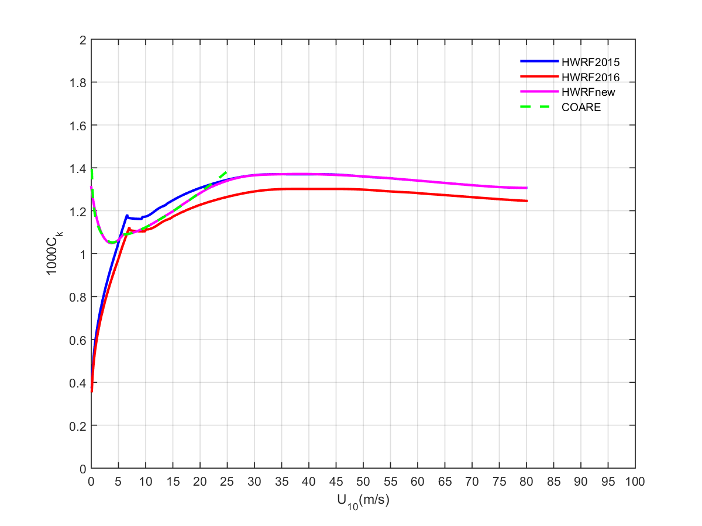
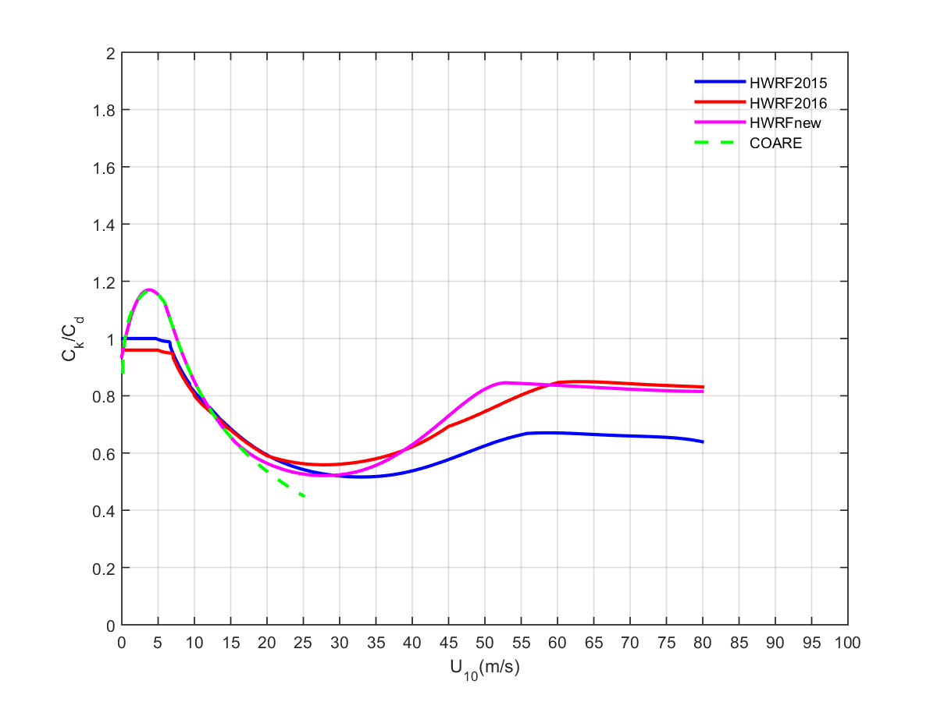
New Cd and Ck

Slide 18
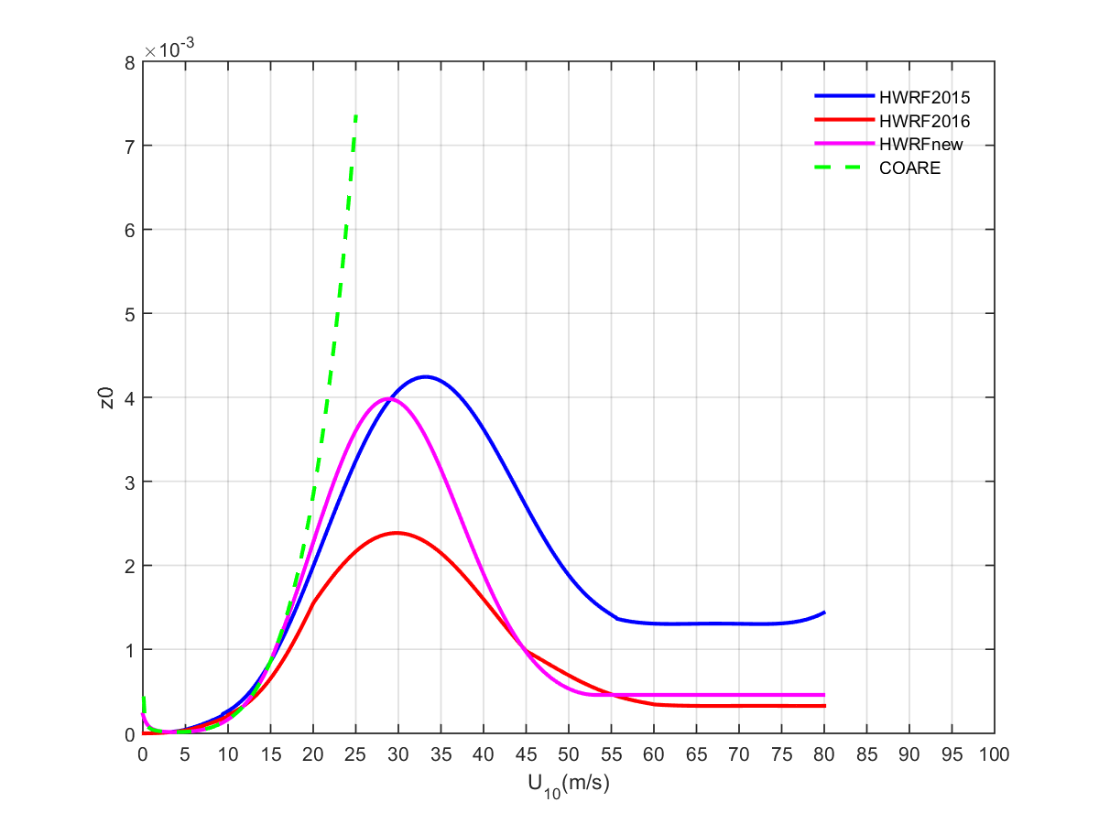
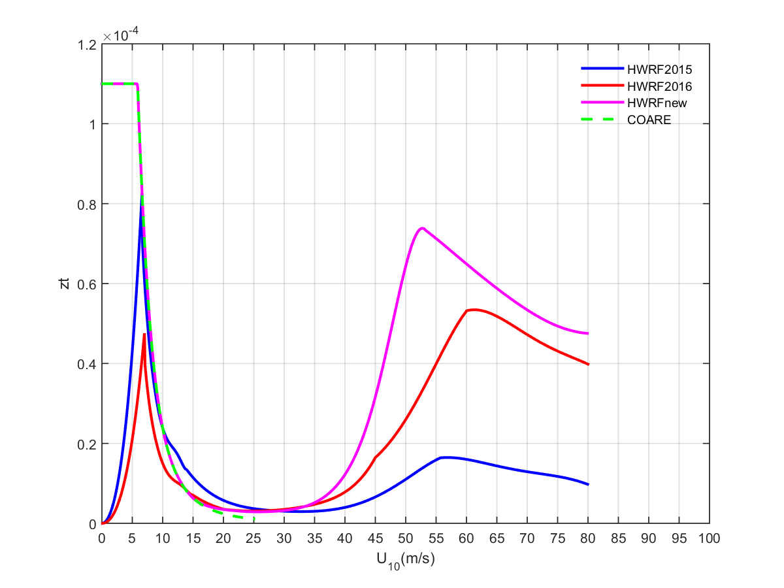
New z0 and zt

Slide 19
Outline
Proposed vertical level upgrade
Proposed air-sea surface exchange coefficient updates
Retrospective test results
Summary and recommendations for FY2017 HWRF upgrades

Slide 20
Experiments
H216: FY2016 HWRF
  2016 GFS
H17B: baseline experiment
  Framework upgrades plus 2017 GFS
H17P: H17B + physics upgrades
  Updated scale-aware SAS scheme
  Updated microphysics scheme
  Partial cloudiness modification in RRTMG
H17F: Combined physics, vertical level, and DA experiment
  H17P + 75 vertical levels + new Cd/Ck + DA advancements

Slide 21
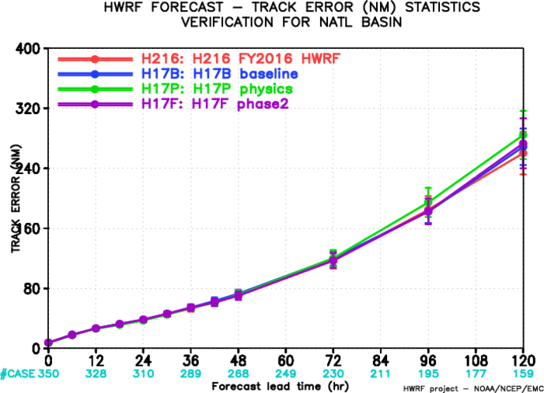
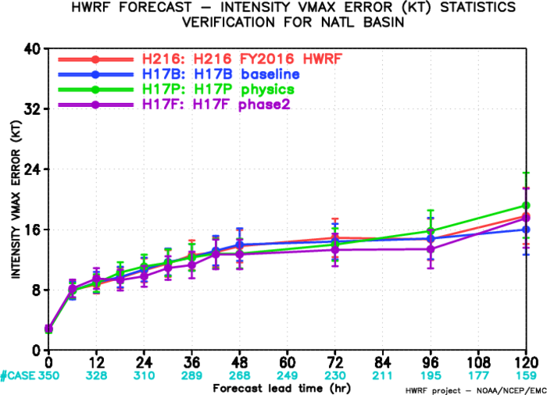
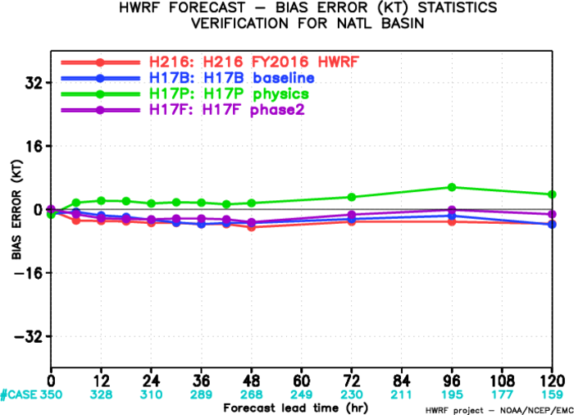
Track and intensity errors for NATL storms comparisons among H17BPF

Slide 22
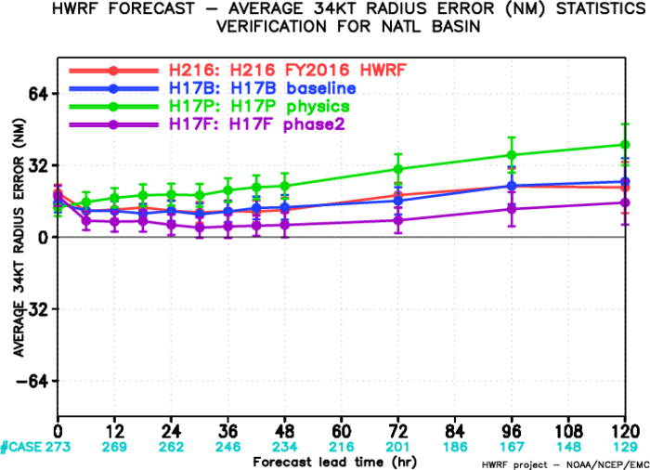
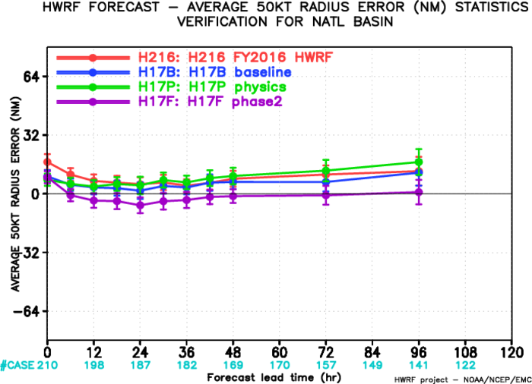
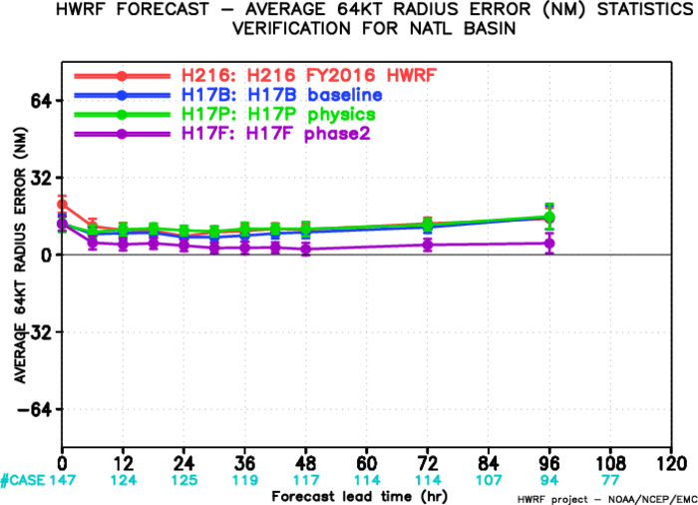
Track and intensity errors for NATL storms comparisons among H17BPF

Slide 23
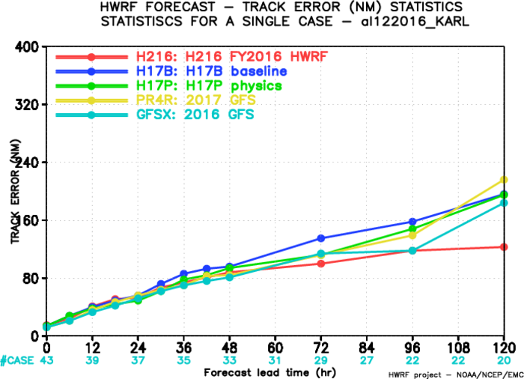
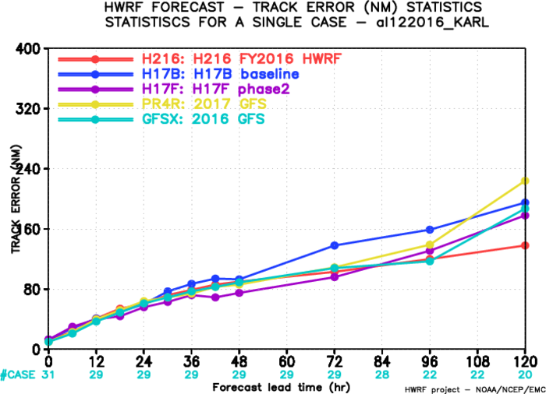
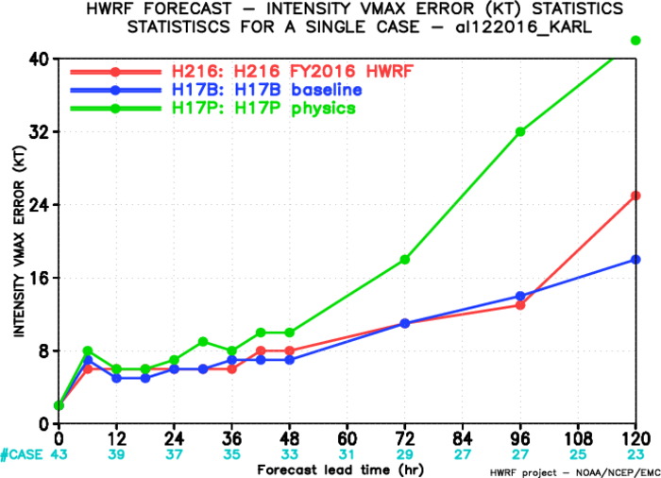
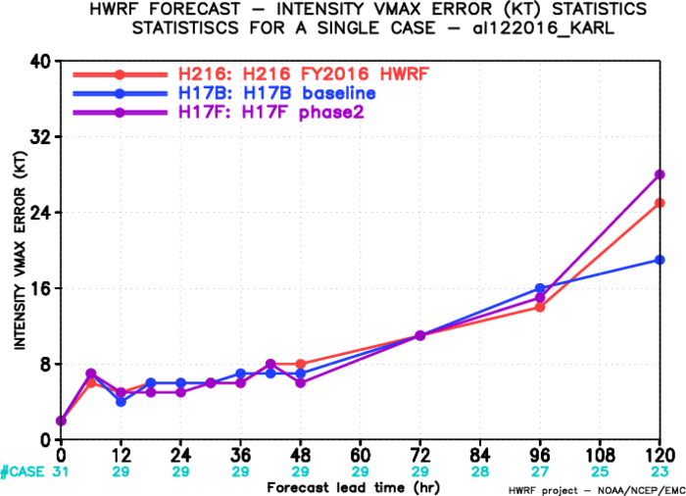
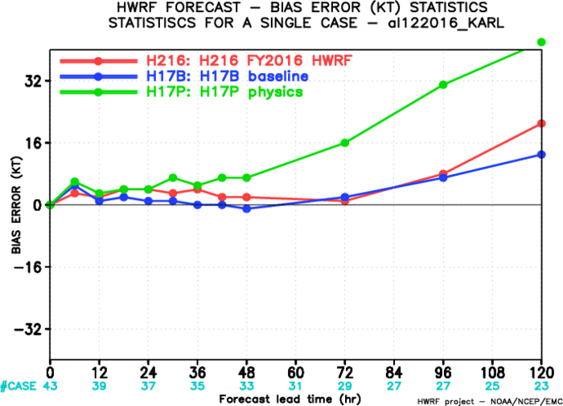
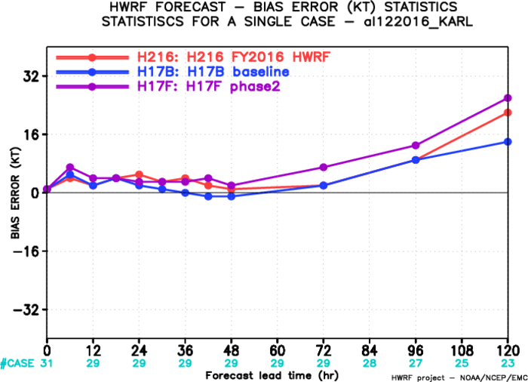
Karl
12L2016
H17P
H17F

Slide 24
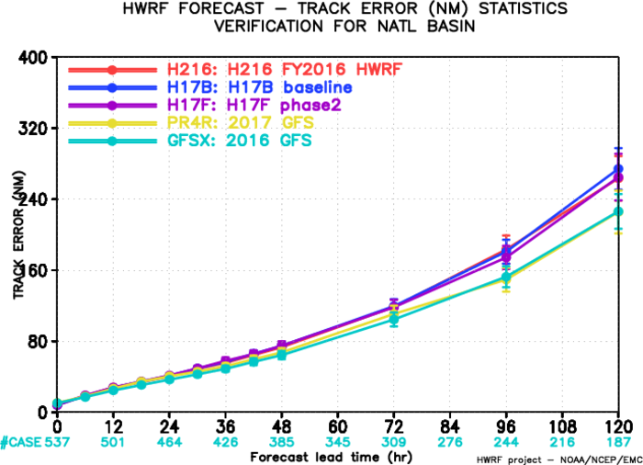
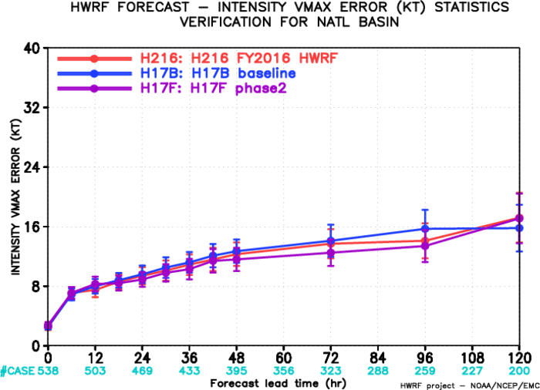
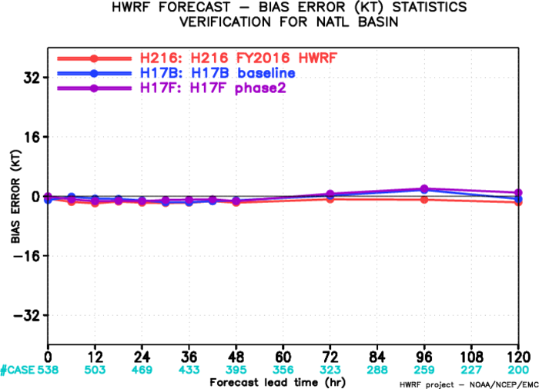
Track and intensity errors for NATL storms

Slide 25
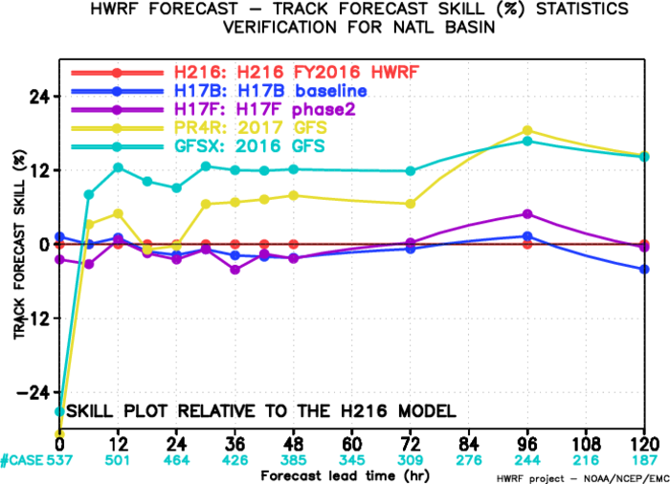
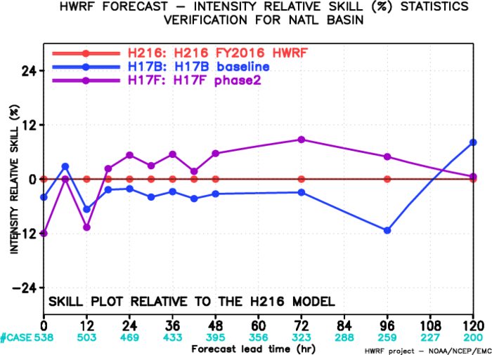
Track and intensity skills for NATL storms

Slide 26
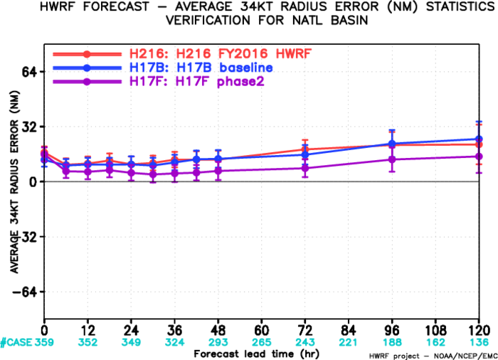
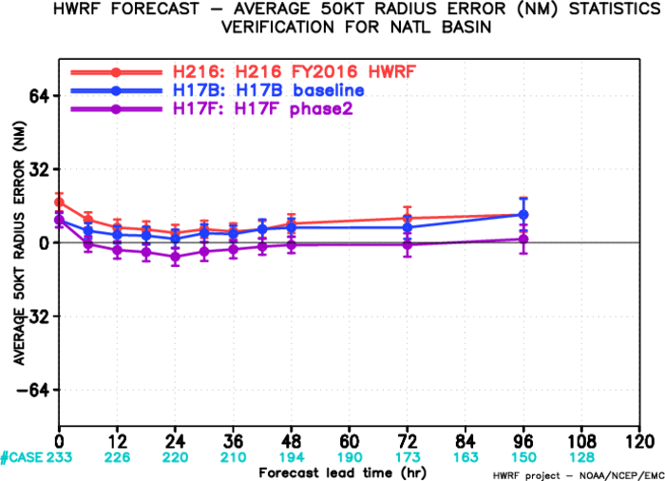
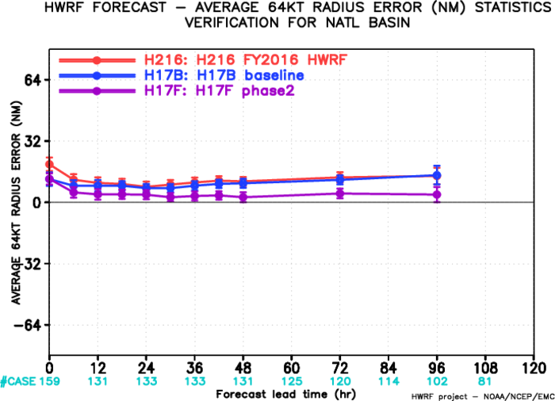
Size errors for NATL storms

Slide 27
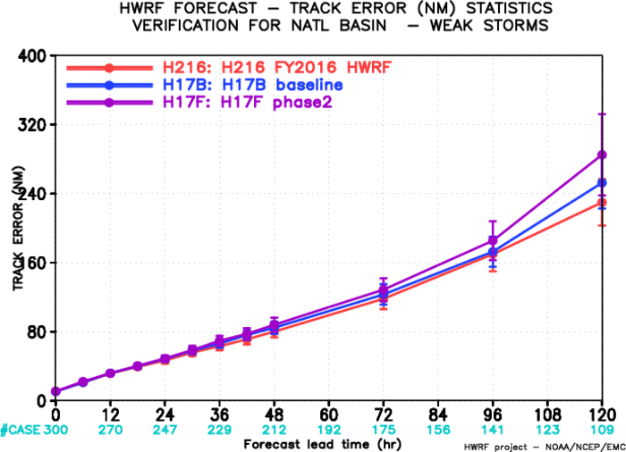
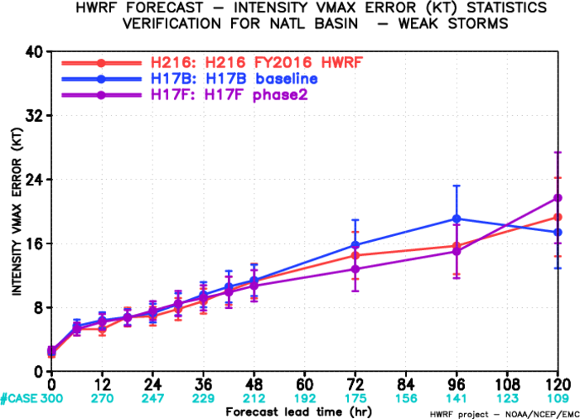
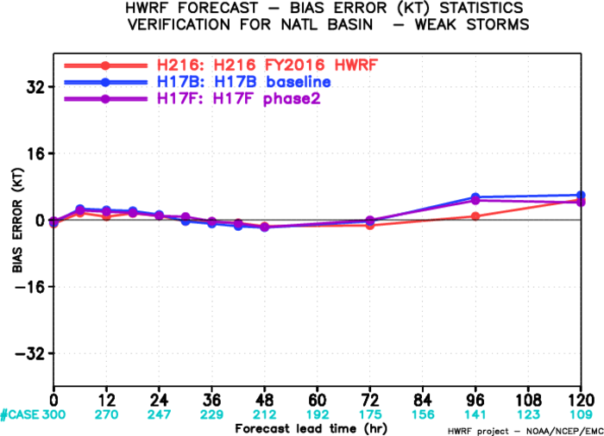
Track and intensity errors for NATL storms
Weak cycles (initial intensity<50kts)

Slide 28



Track and intensity errors for NATL storms
Strong cycles (initial intensity>50kts)

Slide 29



Track and intensity errors for Matthew

Slide 30



Track and intensity errors for EPAC storms

Slide 31


Track and intensity skills for EPAC storms

Slide 32



Size errors for EPAC storms

Slide 33
Summary and proposed H217 configuration
The proposed 75 vertical levels, new air-sea surface exchange coefficients, together with the physics and DA upgrades, provide promising improvements in terms of track/intensity/size forecasts.
Configuration for our H217 (proposed FY2017 HWRF test) will include:
  H17F: Baseline + physics upgrades (including new Cd/Ck) + 75 vertical levels + DA advancements
  Fully self-cycled EnKF DA system for TDR storms
  New vortex tracker

Slide 34
Thanks!

Slide 35
Sensitivity tests through idealized HWRF simulations
Sensitivity of simulated TC intensity to:
  model tops
  vertical level distributions in low/mid/up atmosphere
  number of vertical levels
Specified environment
  U=-5 m/s
  VWS = 0
  Typical tropical vertical T, RH profile
  All ocean with specified constant SSTs
Bogused vortex
  vmax=30 m/s
  rmw=50 km

