Slide 1
H16N Analyses and Diagnoses

Slide 2
H16N vs H16C
H215: FY2015 HWRF
H16C: Baseline experiment for FY2016 HWRF
H16N: H16C with RTOFS initialization for POM
Temp and Salinity fields from RTOFS
Phase 1 spin-up only
Ocean domain moved 10 degrees westward
One-way coupling to WW3

Slide 3
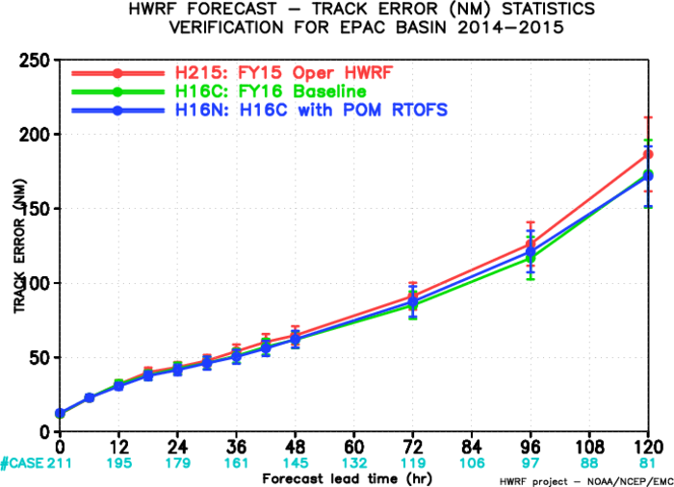
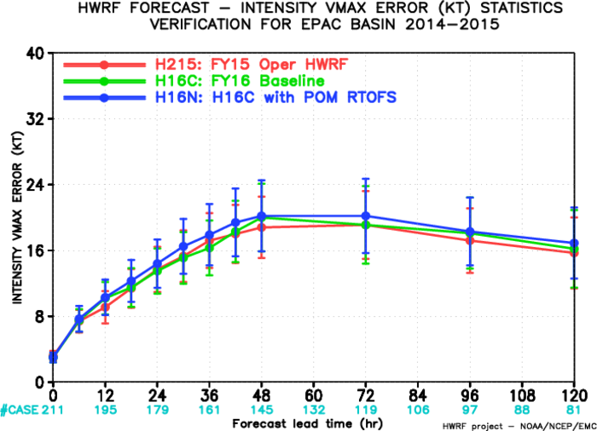
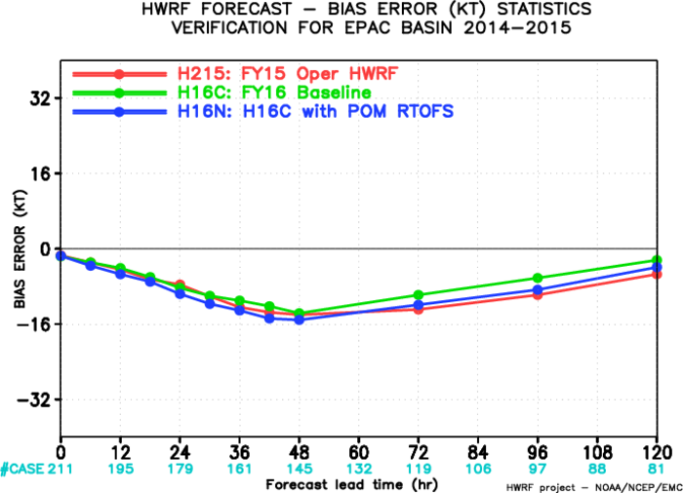
H16N EPAC

Slide 4
Sensitivity to Running on Different HPCs
H16C: Baseline experiment for FY2016 HWRF
H16E: H16C on jet

Slide 5
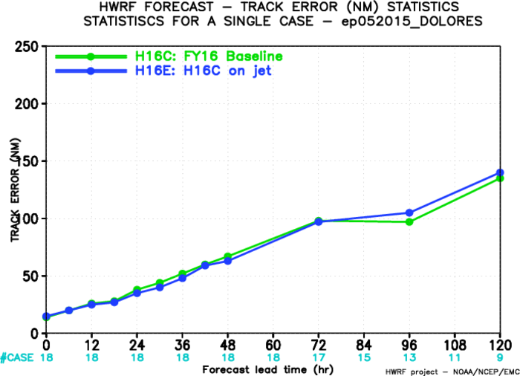
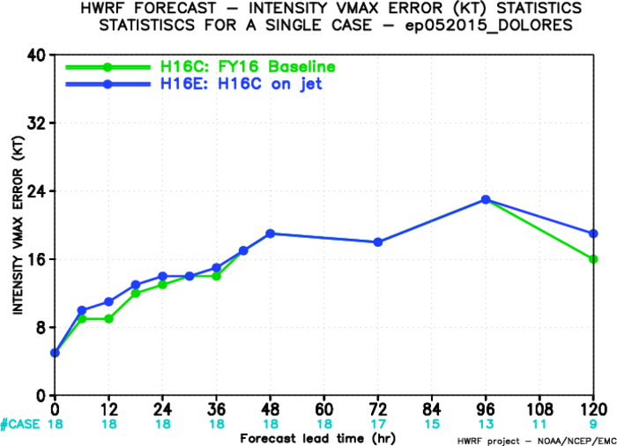
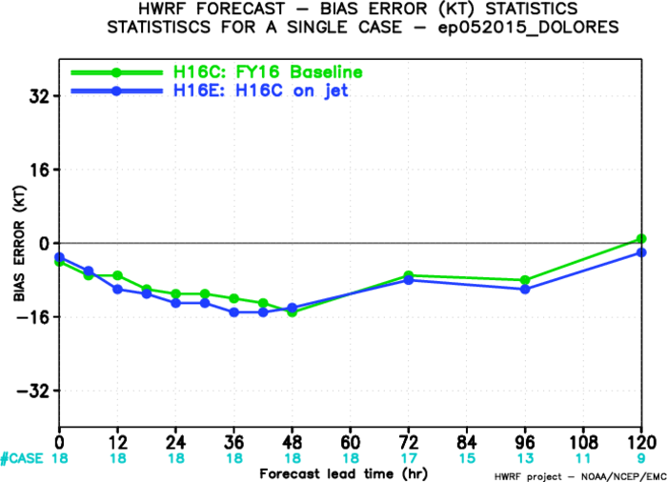
H16C on Cray and Jet

Slide 6
Sensitivity to POM Domain Shift
H16C: Baseline experiment for FY2016 HWRF
H16N_GDEM(H16G)
Same as H16N but uses GDEM climatology for POM initialization
Comparing to H16C, the change is POM domain shift

Slide 7
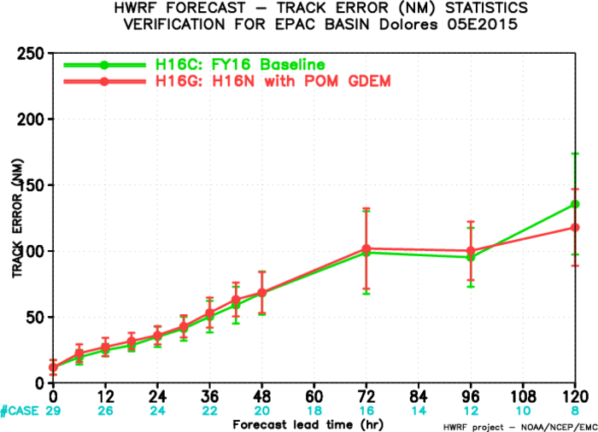
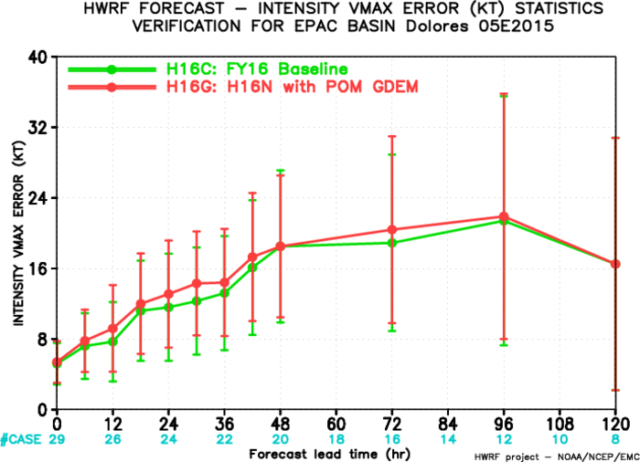
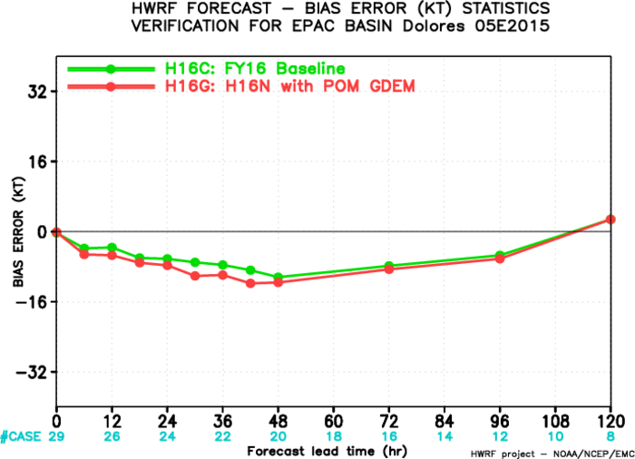
Sensitivity to POM Domain Shift

Slide 8
Sensitivity to RTOFS Sampling Levels
H16C: Baseline experiment for FY2016 HWRF
H16N: H16C with RTOFS initialization for POM
Temp and Salinity fields from RTOFS
Phase 1 spin-up only
H16N_vint(H16U)
Same as H16N, but use 40 zlevels (instead of 23 zlevels) to sampling RTOFS data

Slide 9
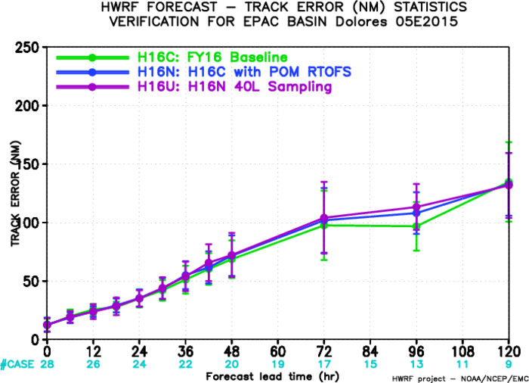
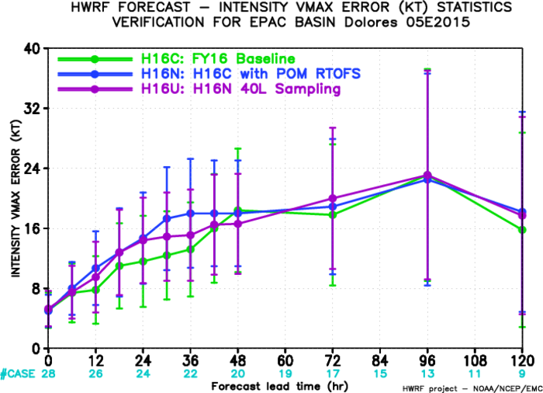
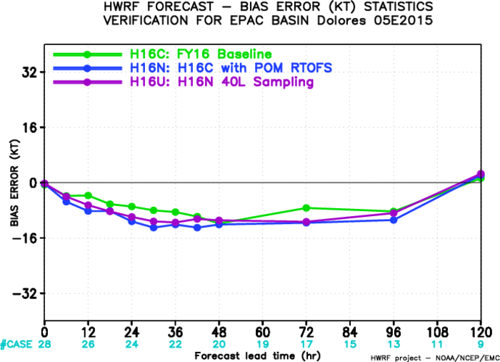
Sensitivity to RTOFS Sampling Levels

Slide 10
Discussion
Use 40 zlevels when sampling RTOFS data
Moving back to the old POM domain location?
Using RTOFS 00Z only?
Using more vertical POM model levels?

