Slide 1
H16N Analyses and Diagnoses

Slide 2
H16N vs H16C
H16C: Baseline experiment for FY2016 HWRF
H16N: H16C with RTOFS initialization for POM
Temp and Salinity fields from RTOFS
Phase 1 spin-up only
Ocean domain moved 10 degrees westward
One-way coupling to WW3

Slide 3
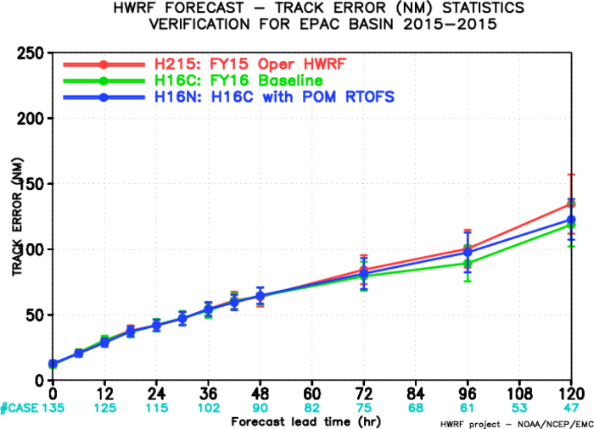
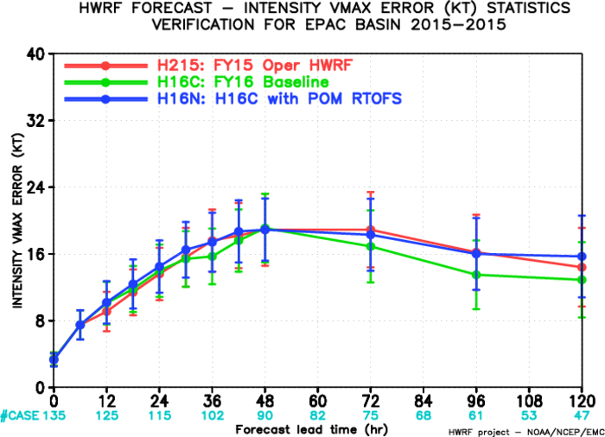
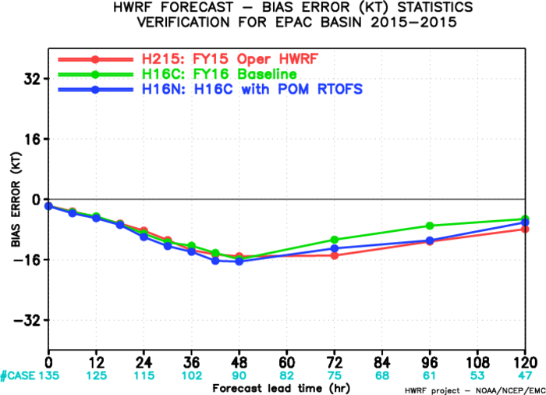
H16N EPAC

Slide 4
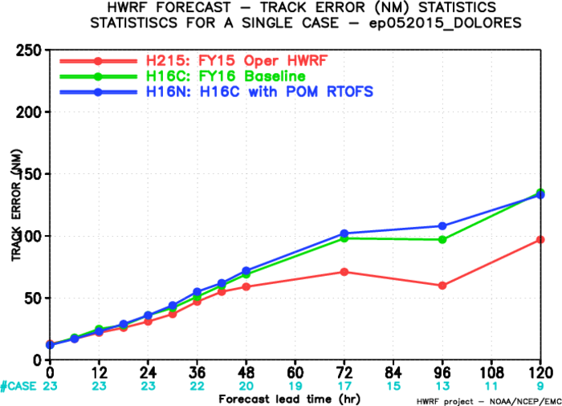
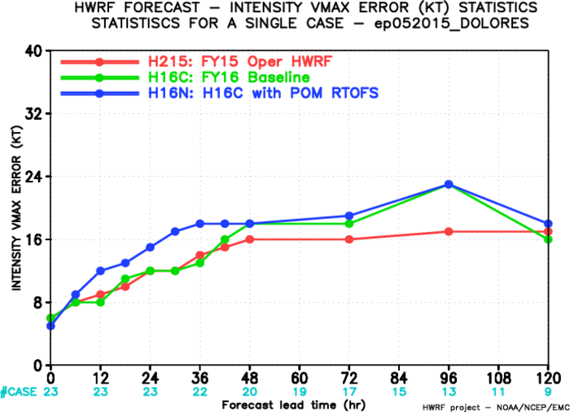
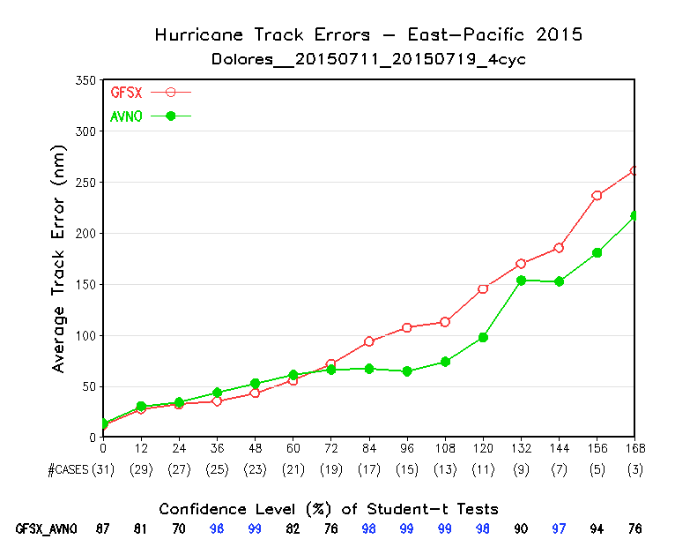
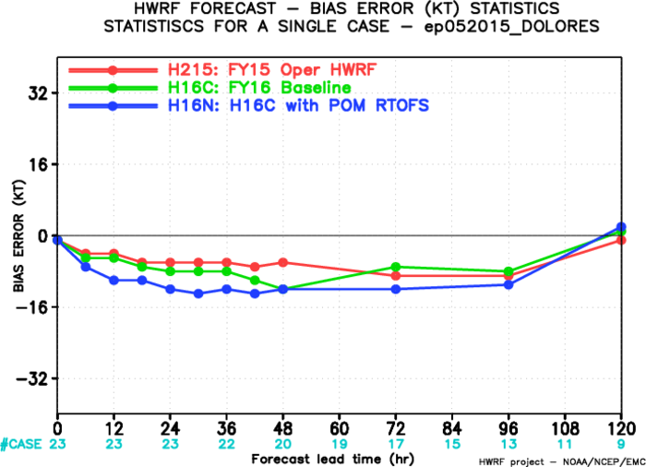
Dolores (05E2015)

Slide 5
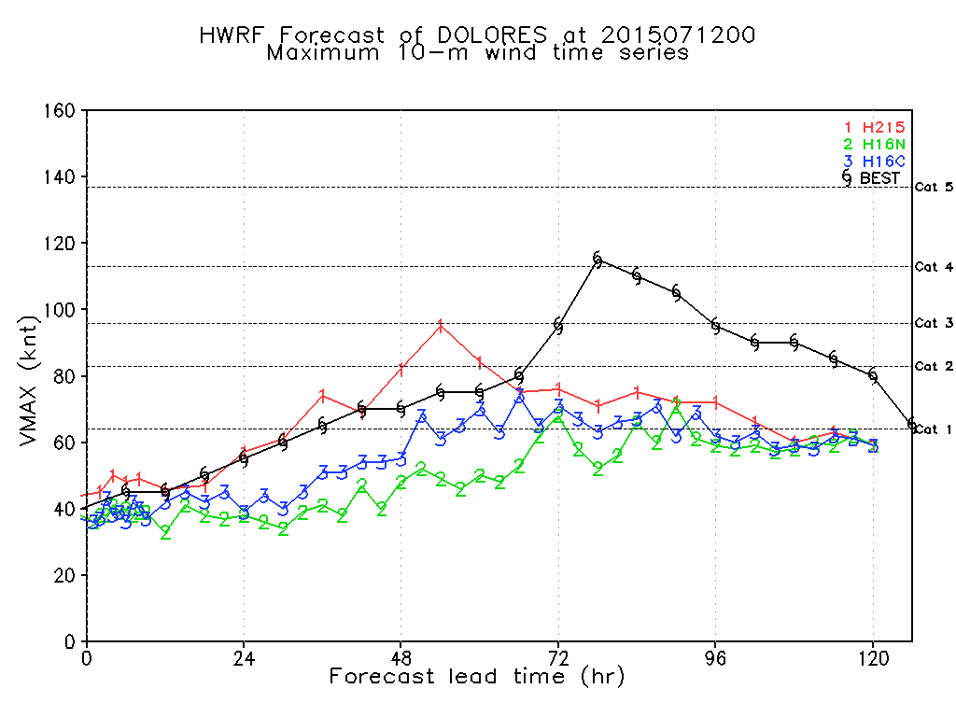
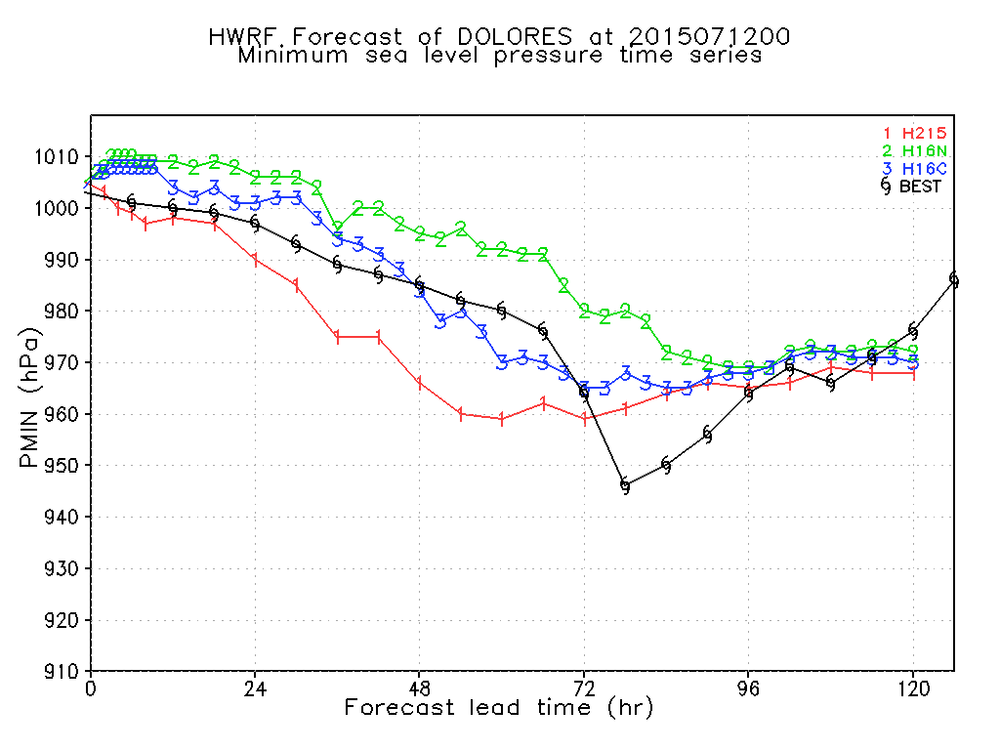
Track and Intensity (Dolores 05E2015) 2015071200Z

Slide 6
RTOFS and H16N SST 2015071200Z
At RTOFS first model level, ~0.5m depth
At POM first half-sigma model level, varying from ~0.1 to ~5 m depth

Slide 7
GFS and H16C SST 2015071200Z
At POM first half-sigma model level, varying from ~0.1 to ~5 m depth

Slide 8
SST Difference 2015071200Z
Why H16N SST < RTOFS SST?
Difference at the first model levels

Slide 9
SST difference at z = 0

Slide 10
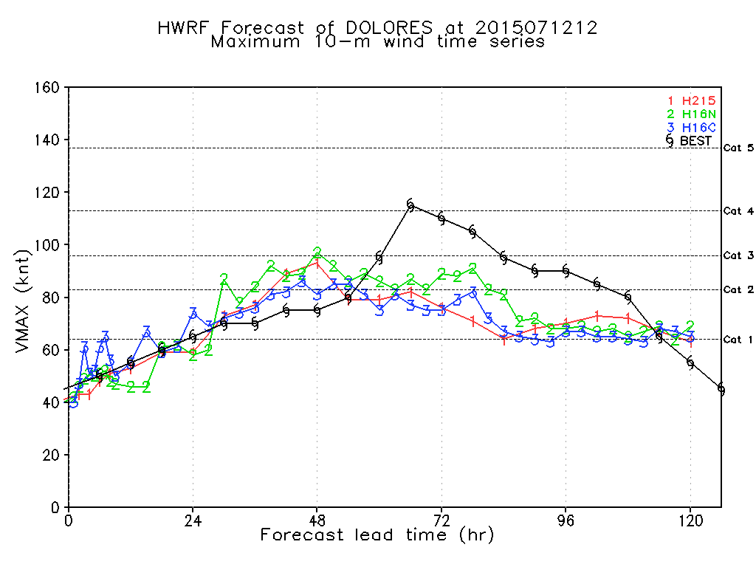
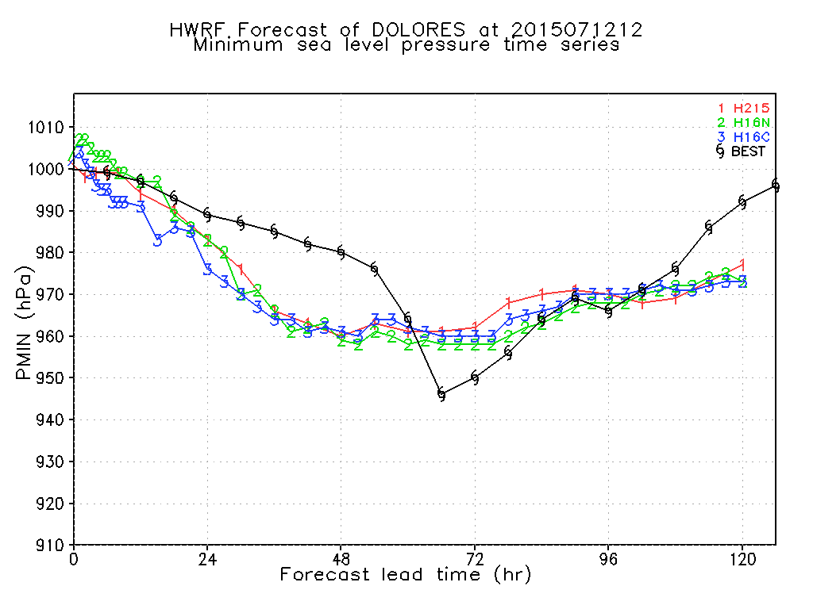
Track and Intensity (Dolores 05E2015) 2015071212Z

Slide 11
RTOFS and H16N SST 2015071212Z
At RTOFS first model level, ~0.5m depth
At POM first half-sigma model level, varying from ~0.1 to ~5 m depth

Slide 12
GFS and H16C SST 2015071212Z
At POM first half-sigma model level, varying from ~0.1 to ~5 m depth

Slide 13
SST Difference 2015071212Z
Difference at the first model levels

Slide 14
POM Init RTOFS vs GDEM

Slide 15
Differences between H16C and H16N
POM domain was moved westward in H16N
For 2015 EPAC, H16N did get warmer upper ocean (with higher OHC) as expected, though intensity forecast did not show much improvement so far for the cycles we have.
Might due to different initial SST between H16N and H16C
In H16N, POM initial first half sigma level temperature is slightly different from RTOFS SST, which might due to
Vertical interpolation through different vertical coordinate systems
And RTOFS first level is at about 0.5 m; while POM first half-sigma level is ~5 m
Suggestions from our previous internal and tele-con discussions and from URI
Use more zlevels in the upper ocean when interpolating from RTOFS to zlevels and then from zlevels to POM
Alternatively, increase POM model levels and put more levels in the upper ocean
Assuming first model levels representing SST during the interpolation between RTOFS and POM
Combine the RTOFS initialization experiment with other physics and DA upgrade experiments

Slide 16
Differences between H16C and H16N (cont.)
Another concern we have is that, comparing H16N to H16C
For 00Z cycle, POM RTOFS initialized SST has smaller difference from POM GFSSST initialized SST;
Whereas for other cycles (e.g., 12Z), POM RTOFS initialized SST has larger difference from POM GFSSST initialized SST
This might be due to diurnal cycle signal is in RTOFS data
Also, for the 00Z cycle, the RTOFS nowcast is used, while for other cycles, RTOFS forecast fields are used

Slide 17
Thank you!

Slide 18
H16N vs H16C
H16C: Baseline experiment for FY2016 HWRF
H16N: H16C with RTOFS initialization for POM
Temp and Salinity fields from RTOFS
Phase 1 spin-up only
H16N_rtofs00z (H16R)
Like H16N, but use RTOFS n00 ab files to initialize all four cycles (00 06 12 18Z)
H16N_gfssst (H16S)
TS from RTOFS; SST from GFS SST (RTG)
Phase 1 spin-up only
H16N_gfssst2 (H16T)
TS from RTOFS; SST from GFS SST (RTG)
Phase 1 and Phase 2 spin-up

Slide 19
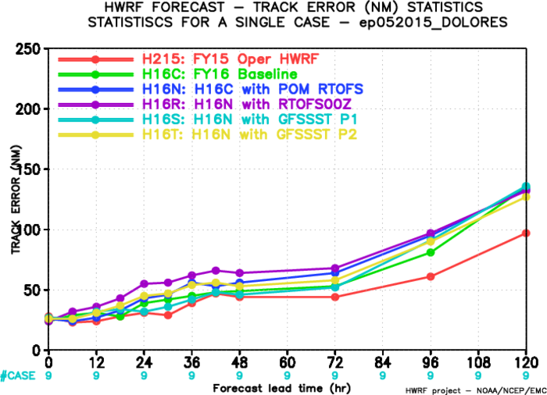
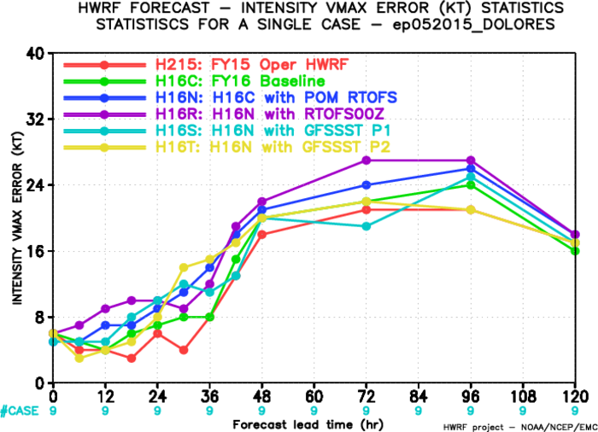
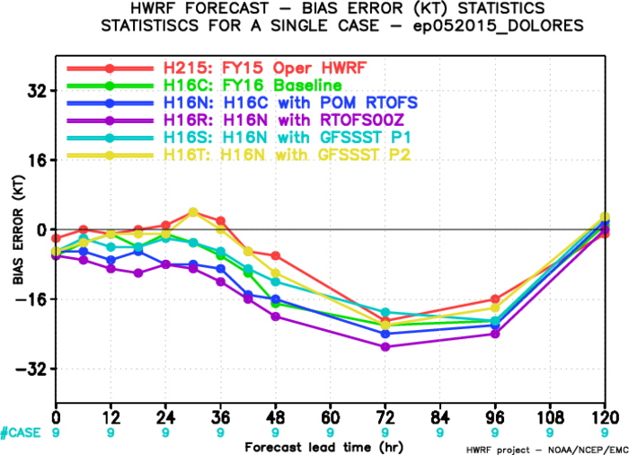

Slide 20
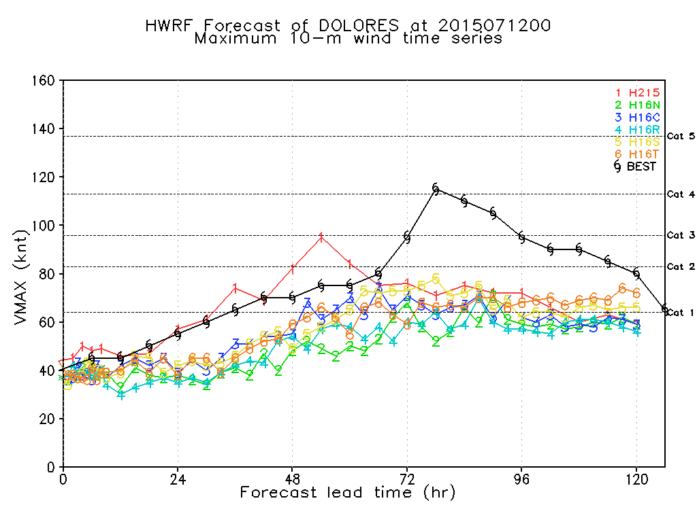
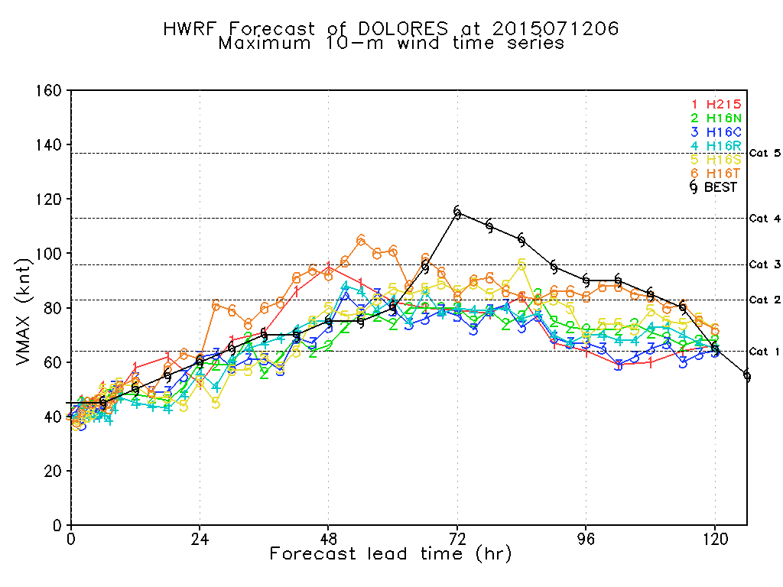
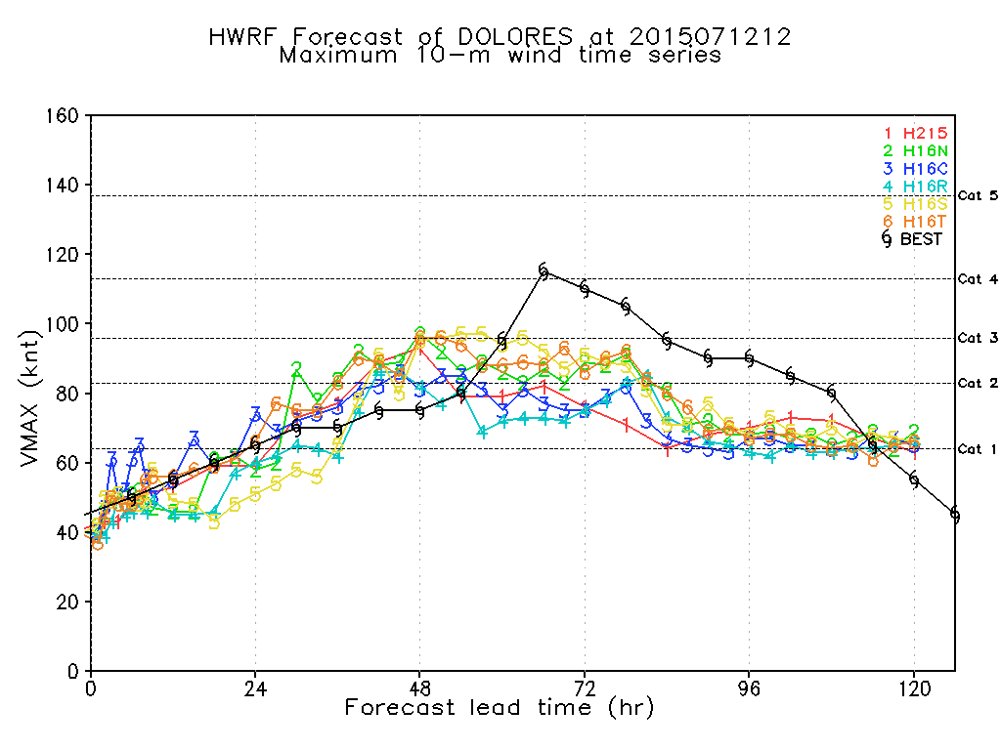
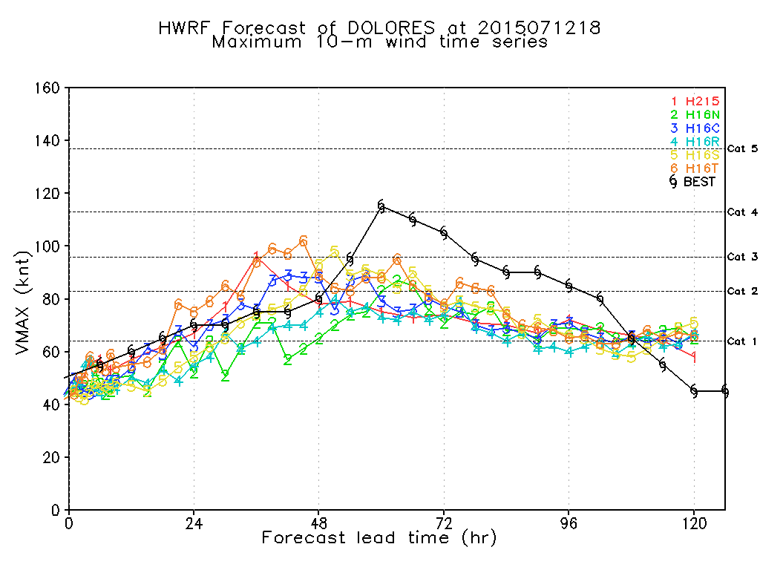

Slide 22
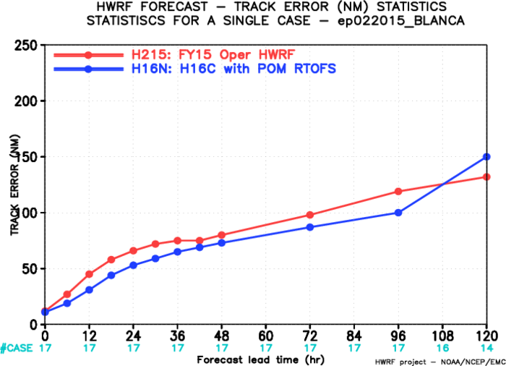
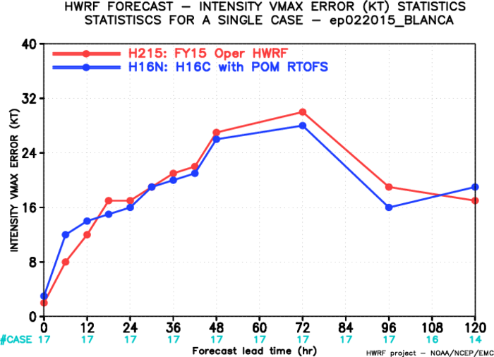
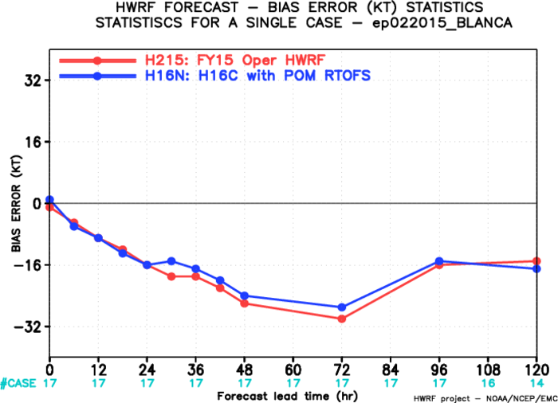
Blanca (02E2015)

Slide 23
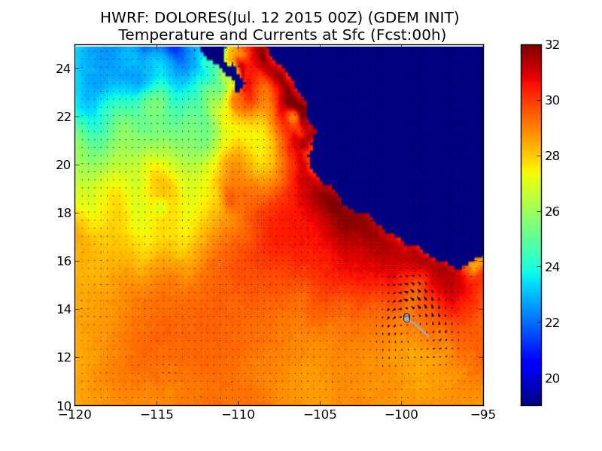
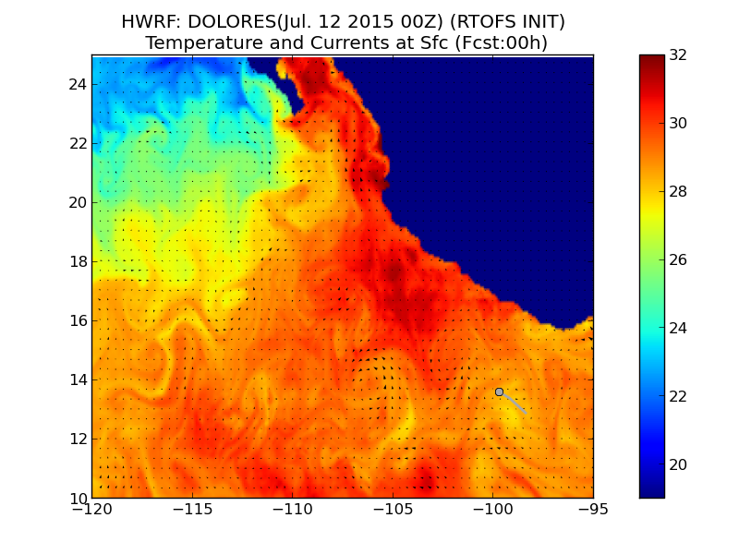
Dolores July 12, 00Z SST: Hour 0
GDEM
RTOFS

Slide 24
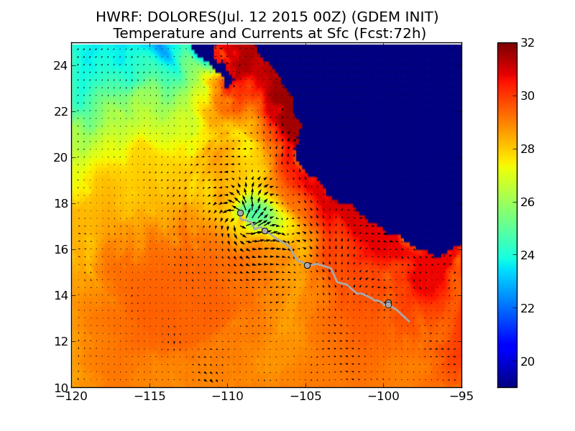
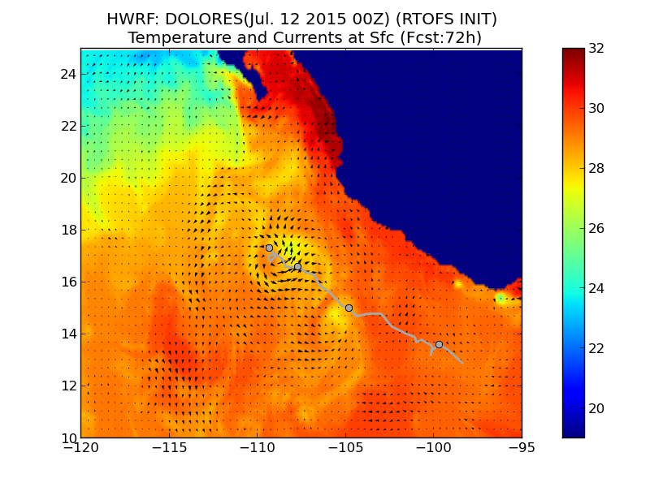
Dolores July 12, 00Z SST: Hour 72
GDEM
RTOFS

Slide 25
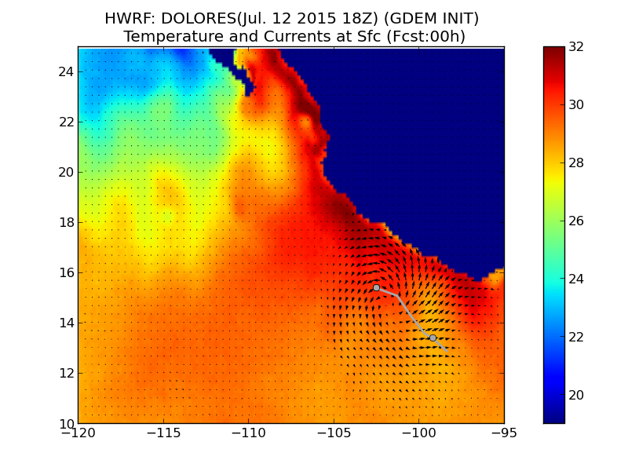
Dolores July 12, 18Z SST: Hour 0
GDEM
RTOFS

Slide 26
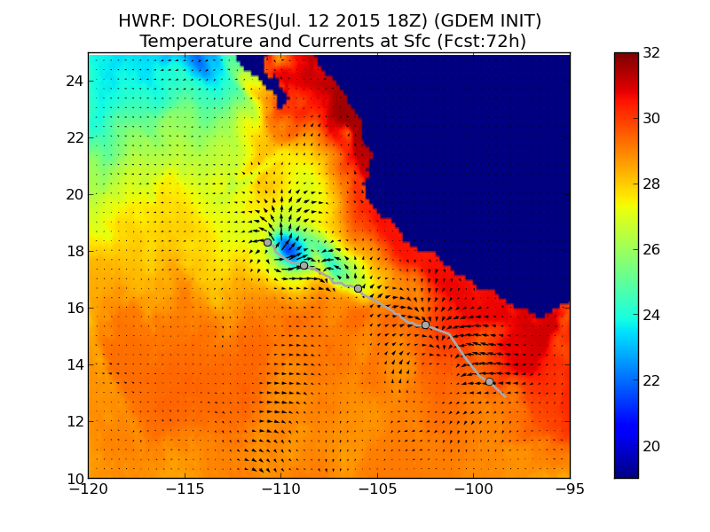
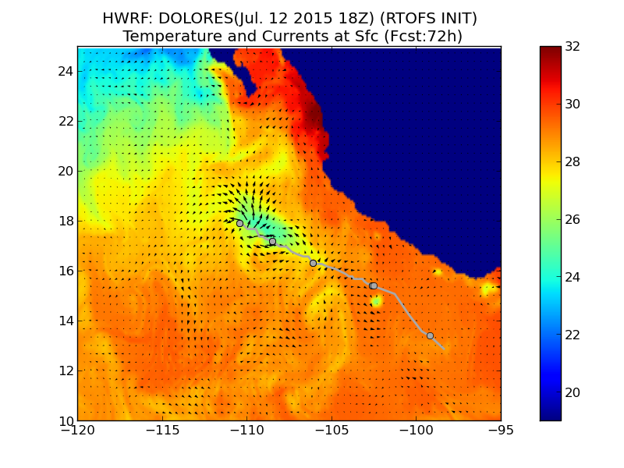
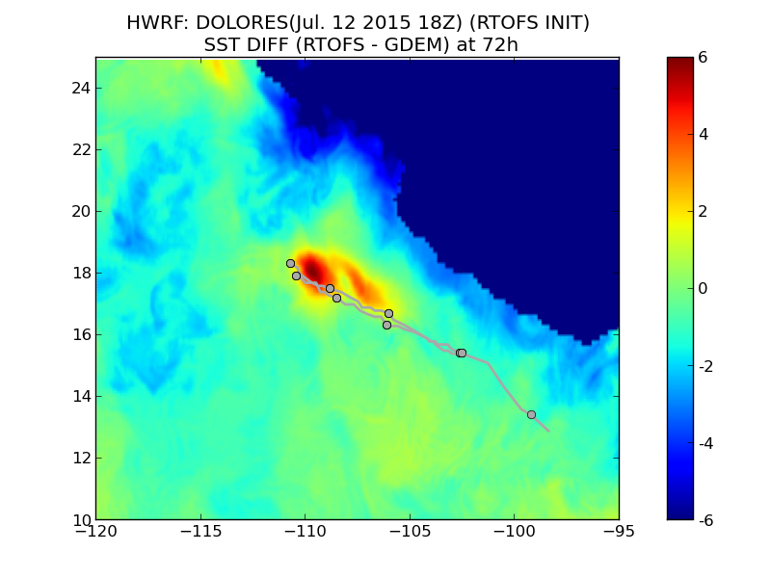
Dolores July 12, 18Z SST: Hour 72
GDEM
RTOFS
Diff

Slide 27
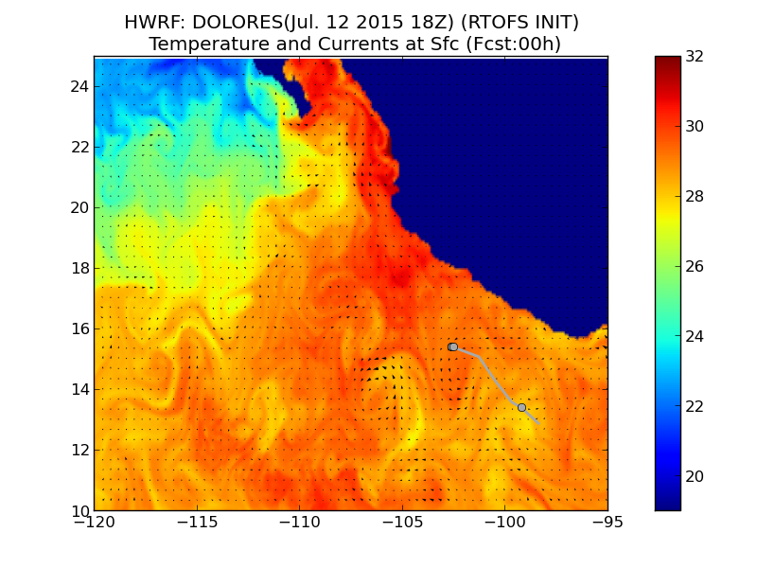
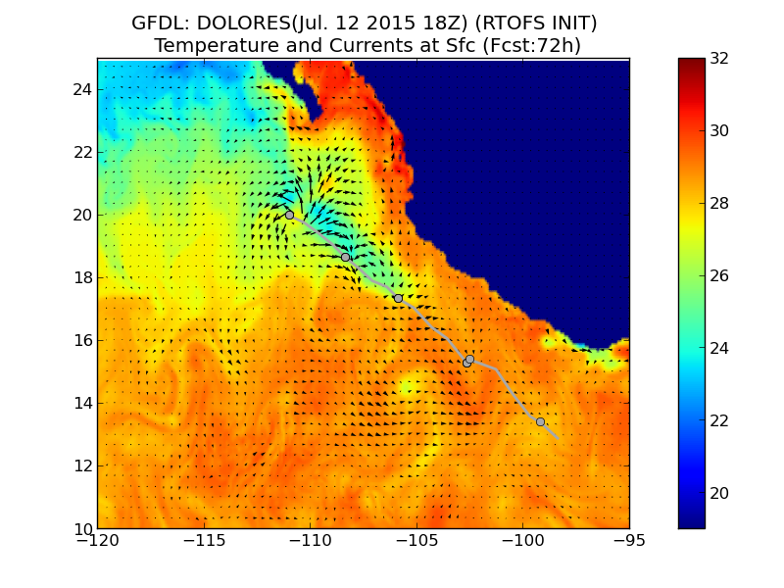
HWRF/GFDL Comparison: Dolores July 12, 18Z
Hour 0
GFDL
HWRF
Hour 72
GFDL
HWRF

