Slide 1
Meeting Agenda
HWRF FY16 baseline (H16C) update and combined physics upgrade;
GFDL model update;
HWRF RTOFS ocean initialization update, and implementation status update.
Other issues?

Slide 2
Planned/Finished Retrospective HWRF Runs using new GFS
Year | 2012 | 2013 | 2014 | 2015 | Sum
Storm ID | 18L | 03L-14L | 01L-09L | 03L-12L
Verifiable Samples | 30 | 178 | 160 | 210 | 578
Completed/Total for AL storms: 543/578
Year | 2013 | 2014 | 2015 | Sum
Storm ID | 04E-18E | 01E-21E | 04E-20E
Verifiable Samples | 254 | 450 | 238 | 942
Completed/Total for EP storms: 808/942
Red: completed

Slide 3
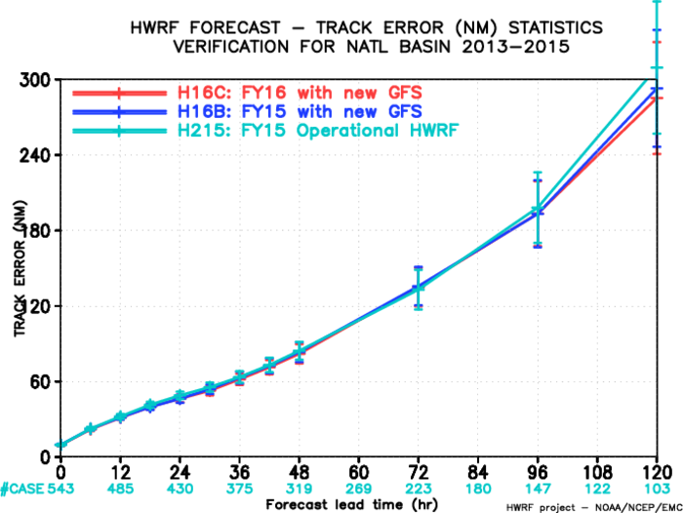
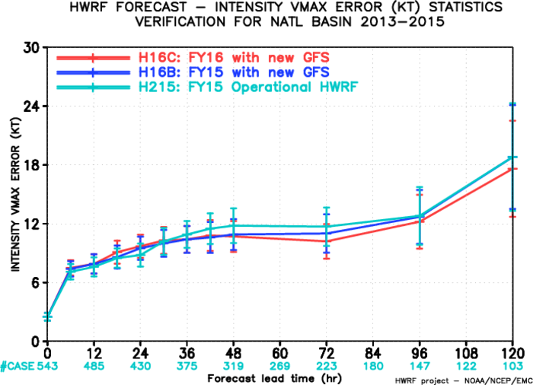
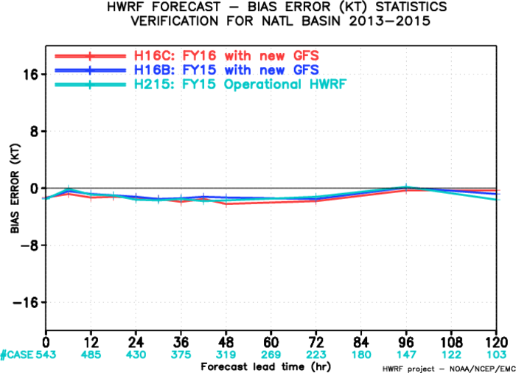
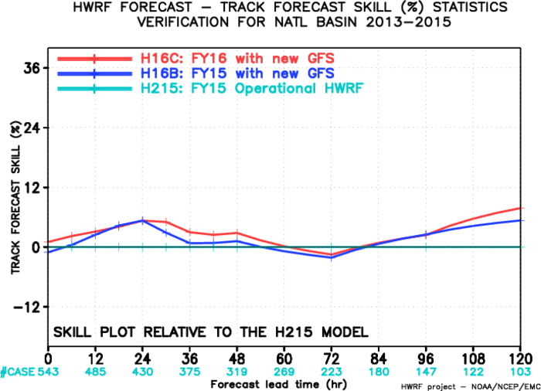
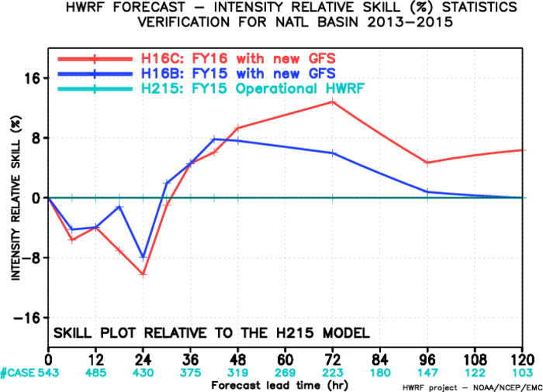
FY16 Baseline, AL

Slide 4
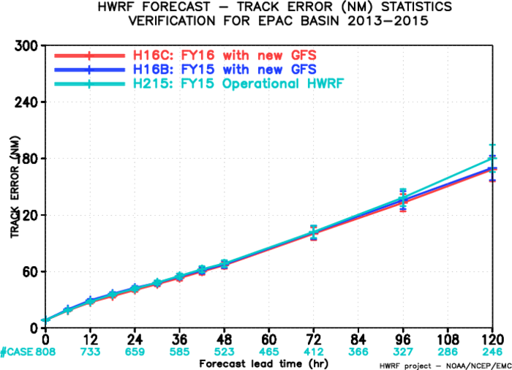
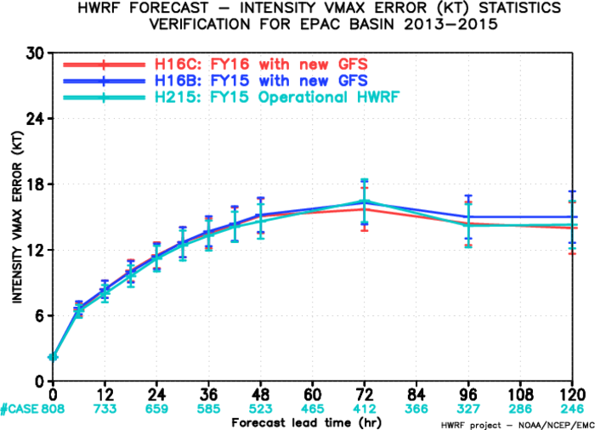
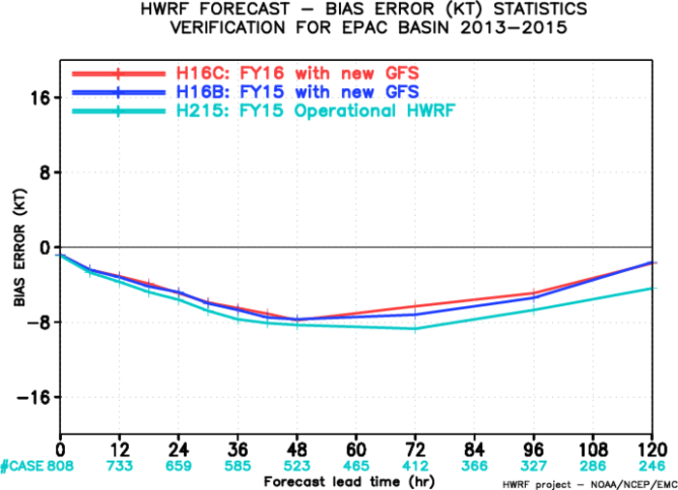
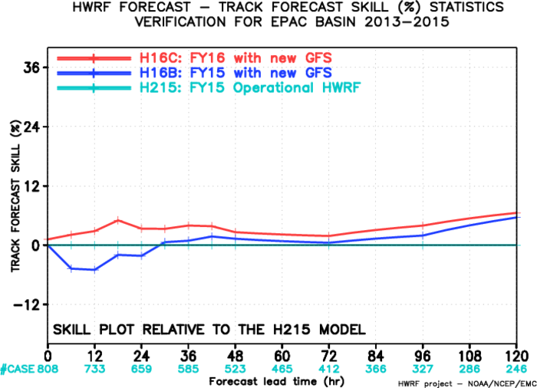
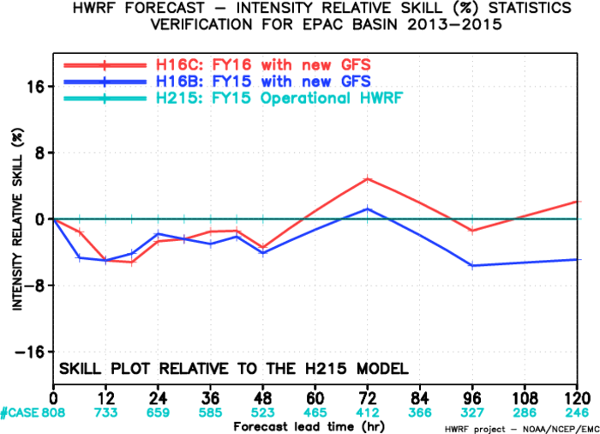
FY16 Baseline, EP

Slide 5
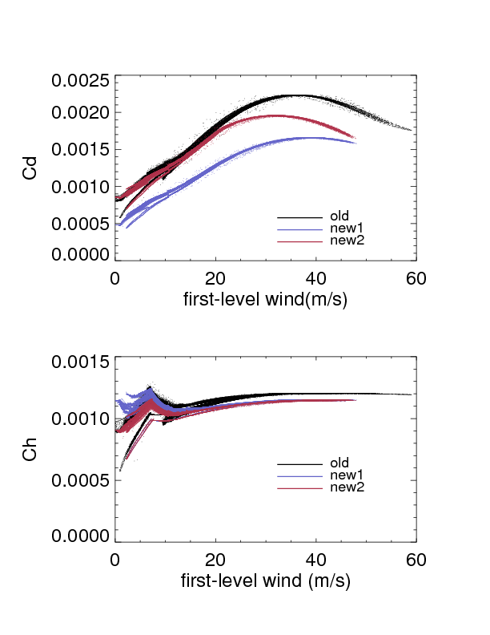
Cd and Ck from lowest model level

Slide 6
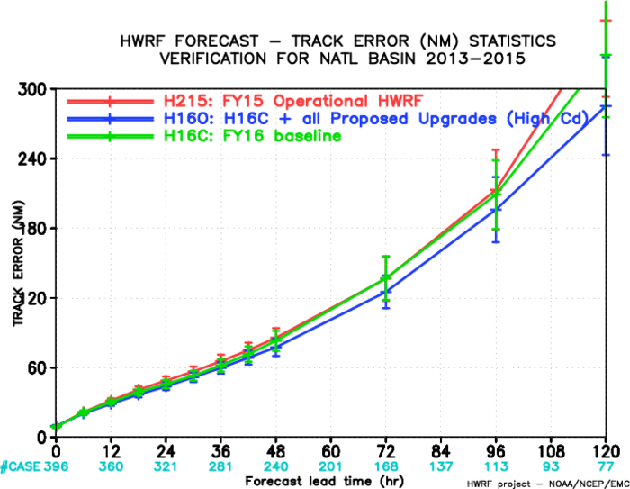
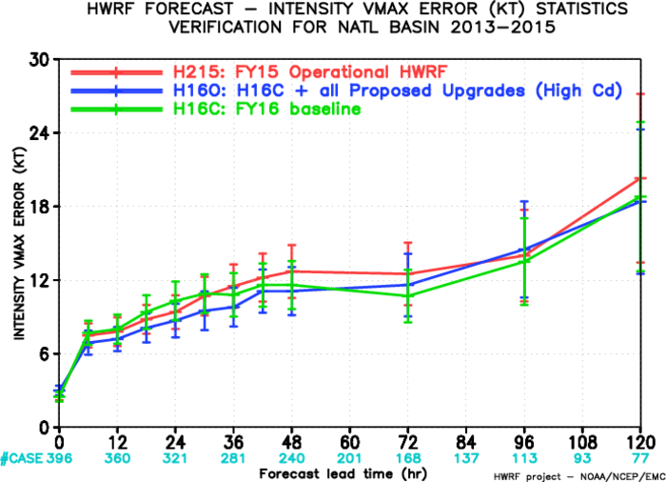
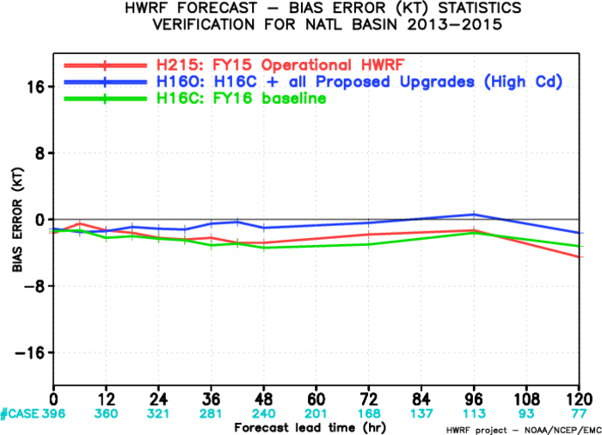
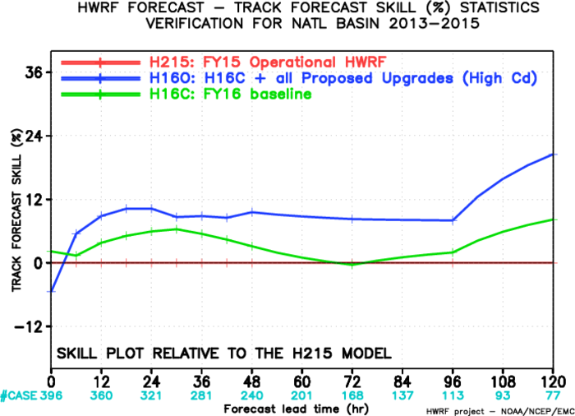
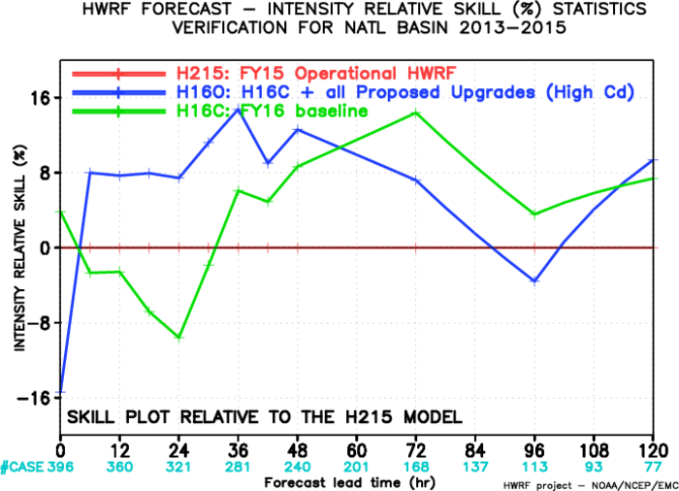
FY16 Physics Upgrade, AL

Slide 7
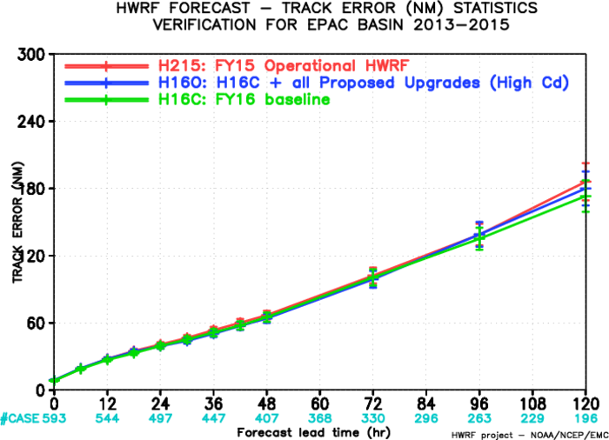
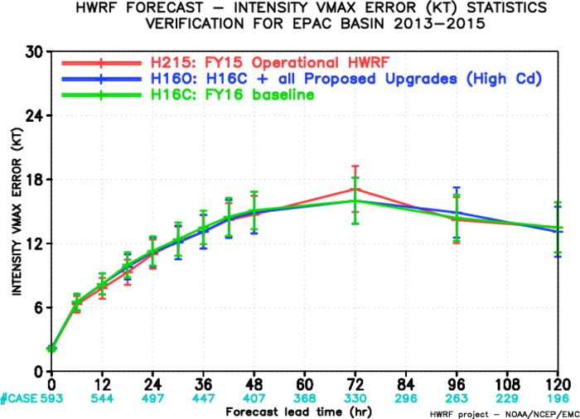
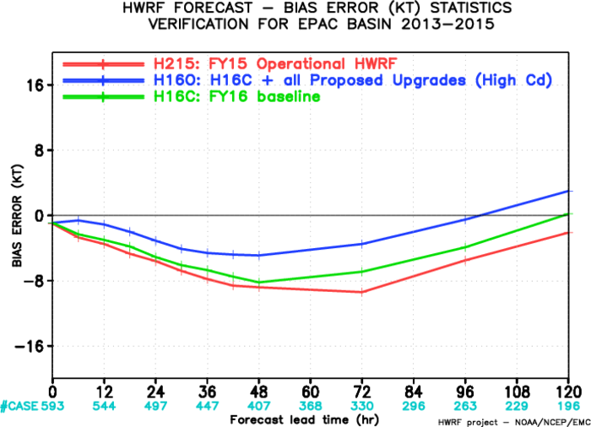
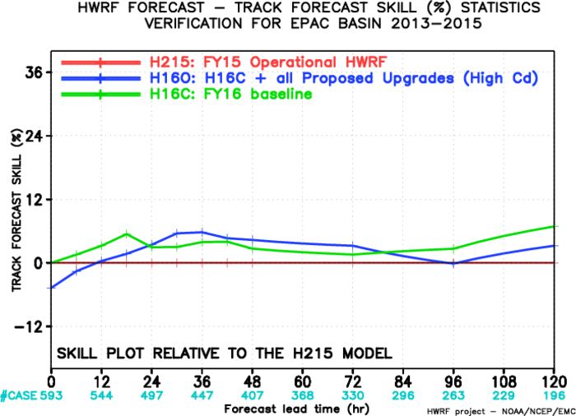
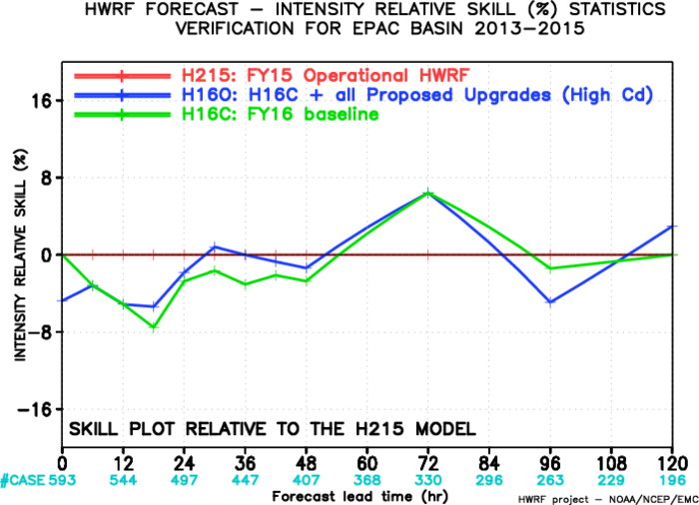
FY16 Physics Upgrade, EP

Slide 8
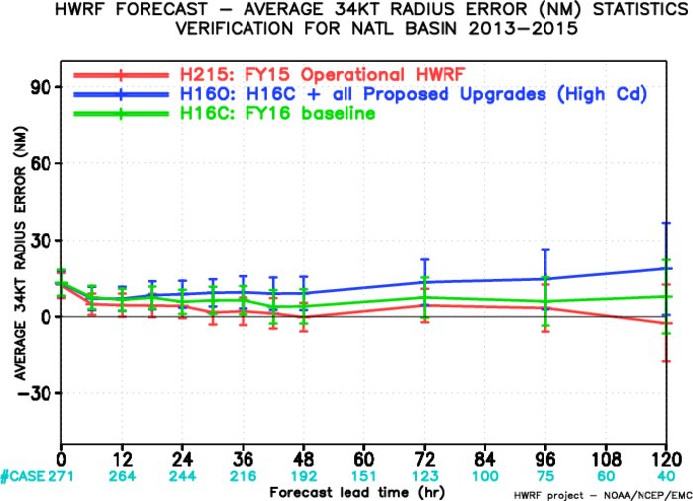
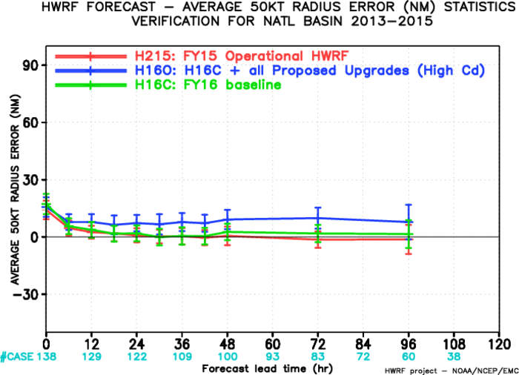
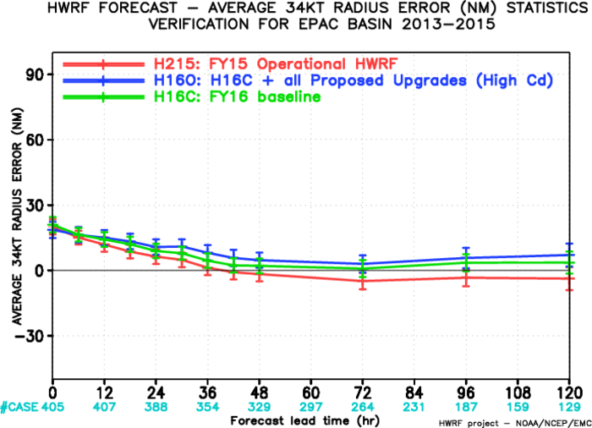
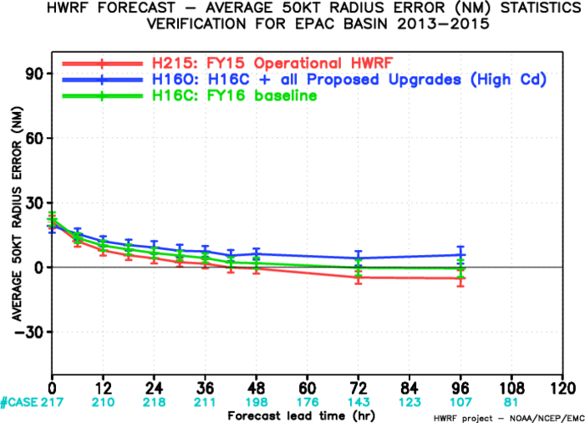
Storm Size verification
AL-34kt
AL-50kt
EP-34kt
EP-50kt

