Slide 1
Meeting Agenda
FY16 baseline (H16C) update;
Update on combined physics experiments;
Cd/Ch discussion;
Global RTOFVS ocean initialization impact on GFDL, and implementation status update.
Other issues?

Slide 2
Planned/Finished Retrospective HWRF Runs using new GFS
Year | 2012 | 2013 | 2014 | 2015 | Sum
Storm ID | 18L | 03L-14L | 01L-09L | 03L-12L
Verifiable Samples | 30 | 178 | 160 | 210 | 578
Completed/Total for AL storms: 461/578
Year | 2013 | 2014 | 2015 | Sum
Storm ID | 04E-18E | 01E-21E | 04E-20E
Verifiable Samples | 254 | 450 | 238 | 942
Completed/Total for EP storms: 739/942
Red: completed

Slide 3
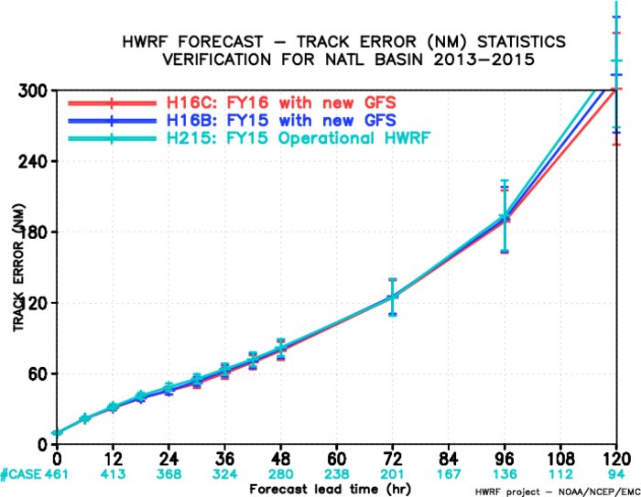
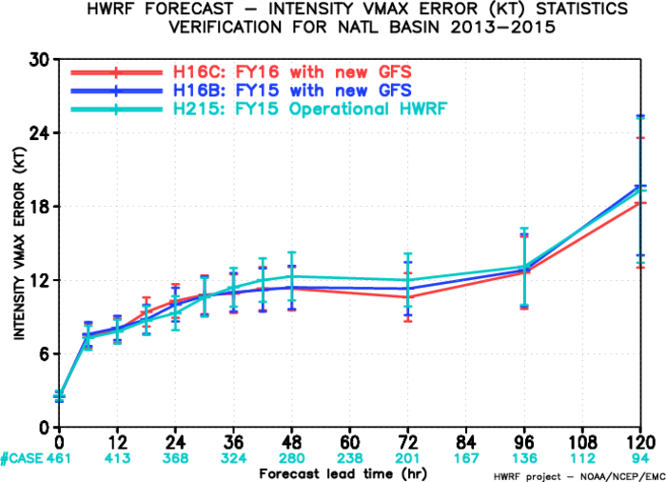
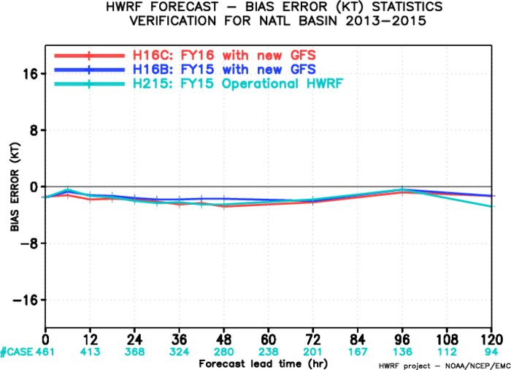
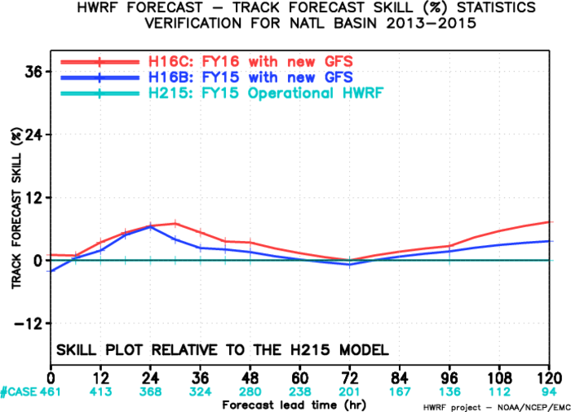
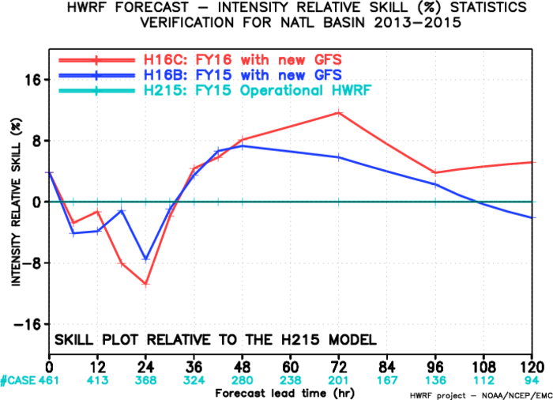
FY16 Baseline, AL

Slide 4
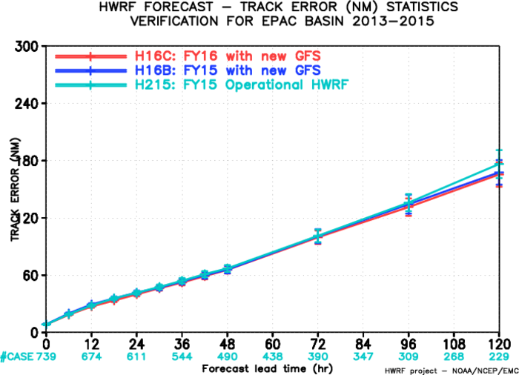
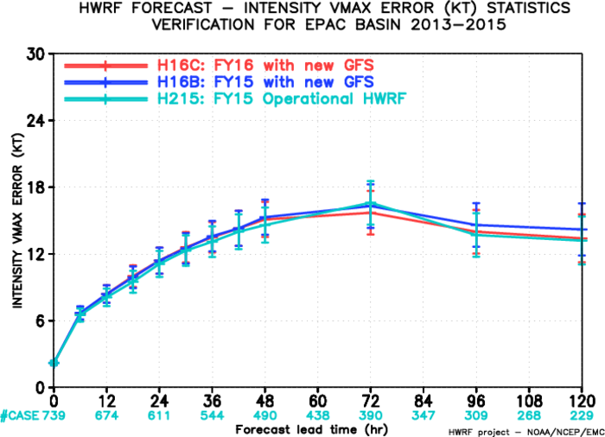
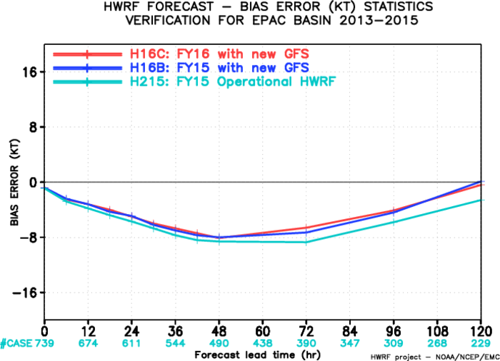
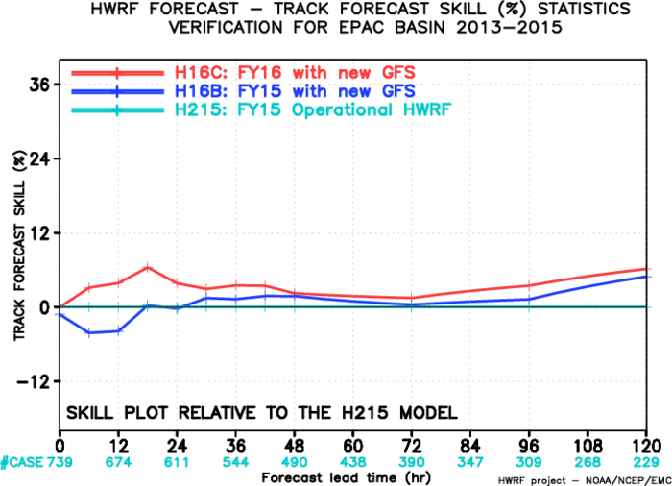
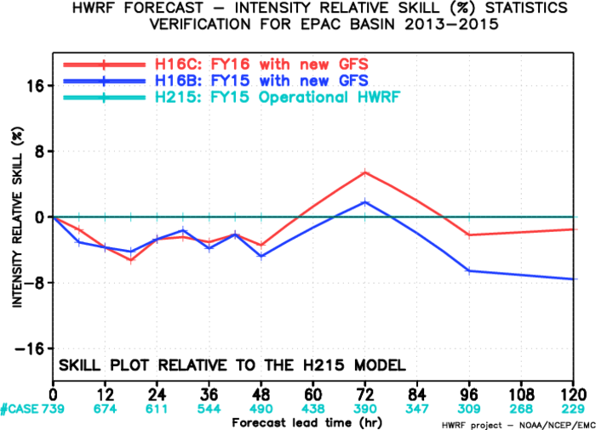
FY16 Baseline, EP

Slide 5
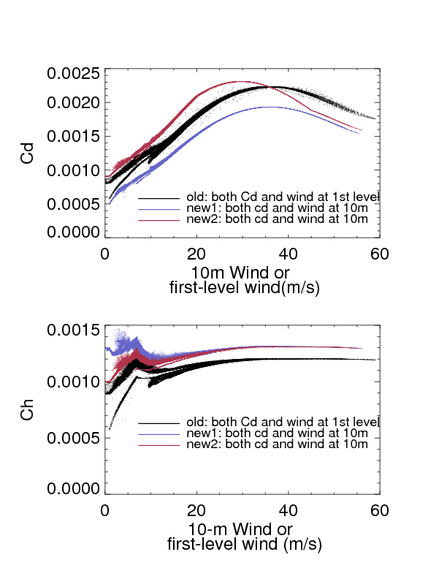
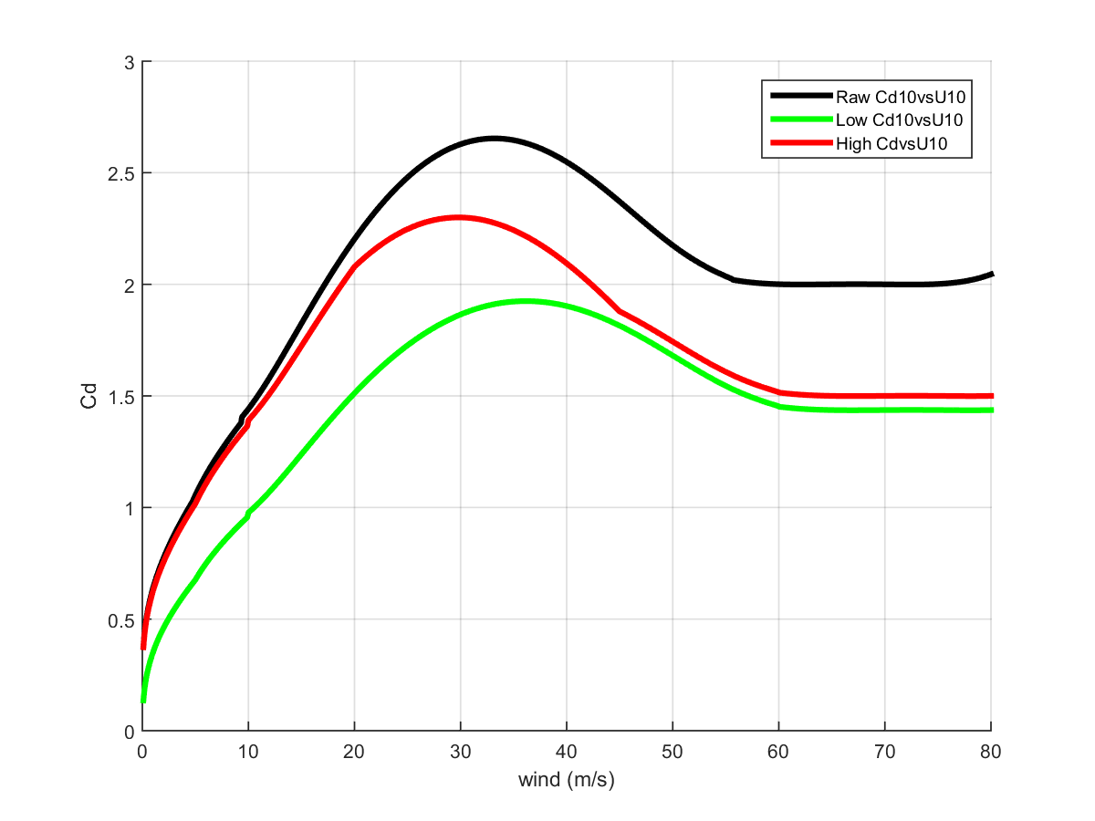
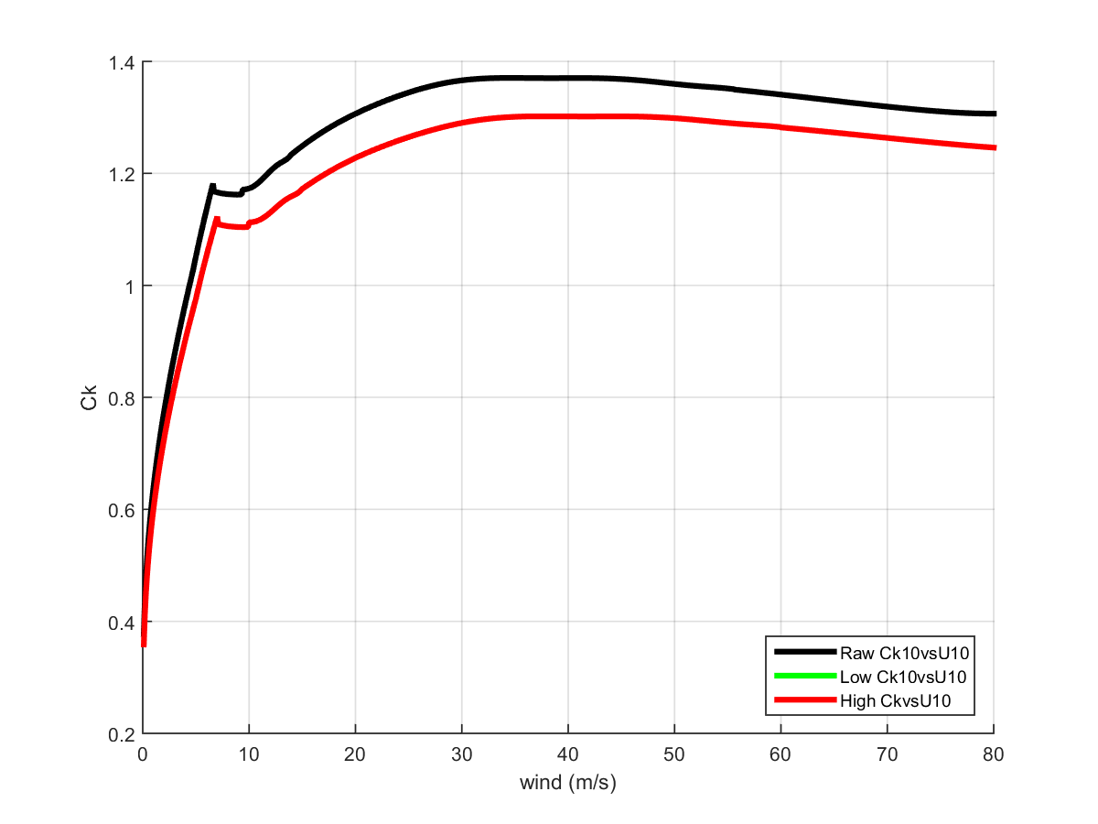
Cd and Ck
10m Wind speed
Ck is the same for both high Cd and low Cd experiments

Slide 6
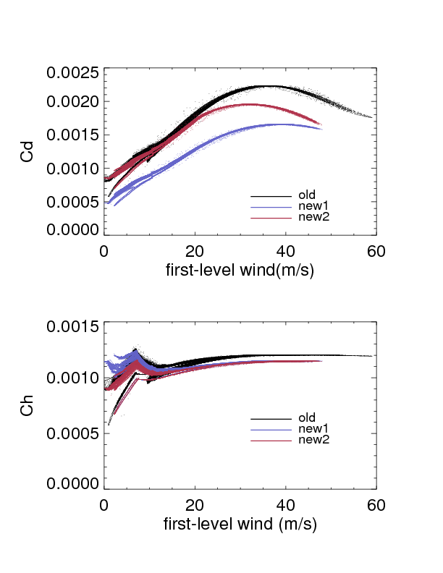
Cd and Ck from lowest model level

Slide 7
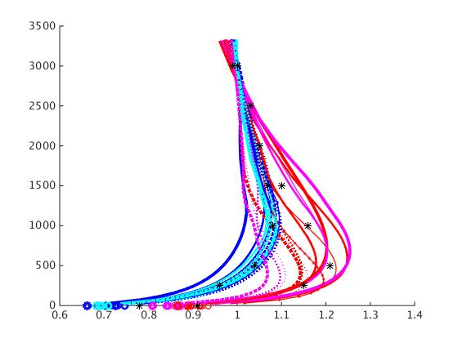
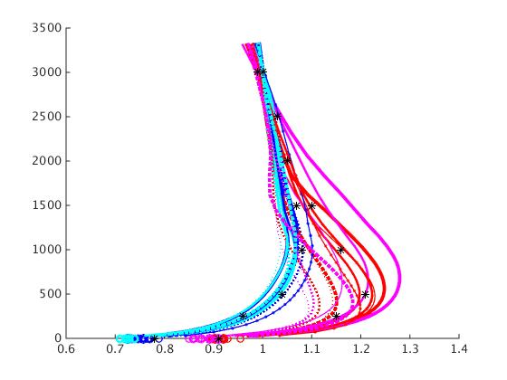
Wind Speed ratio between 3500m and 10m
Low Cd
High Cd

Slide 8
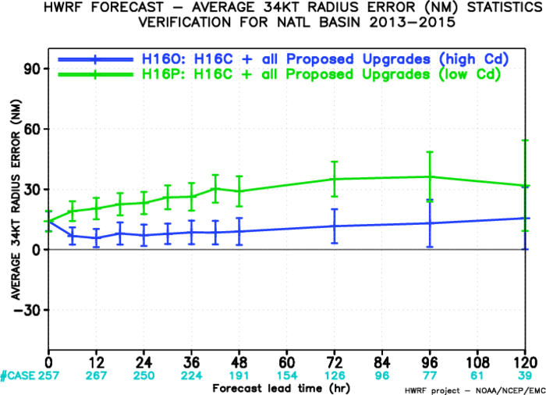
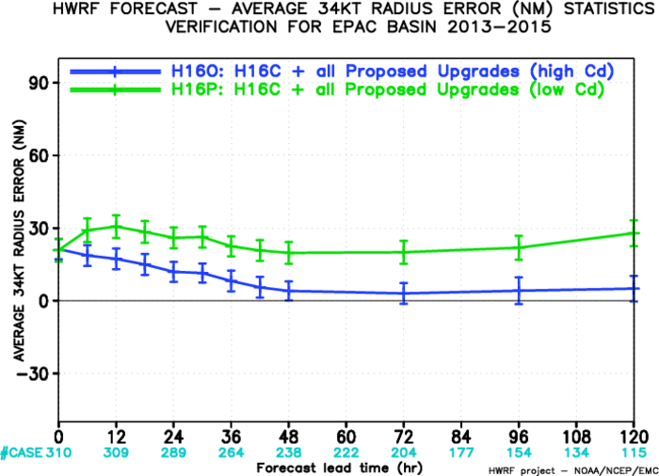
Storm Size verification
AL-34kt
EP-34kt

Slide 9
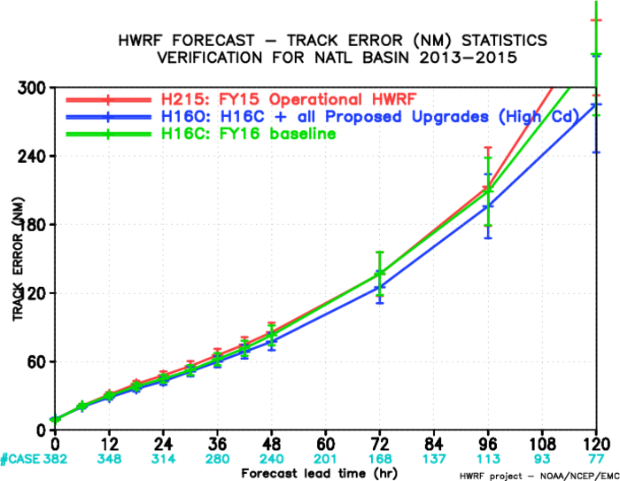
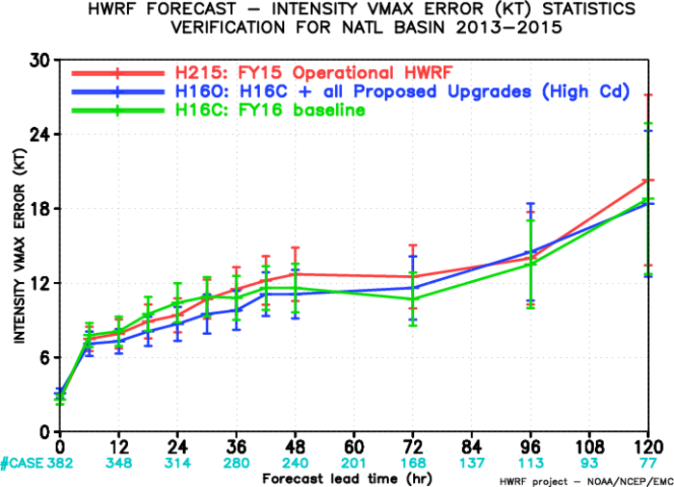
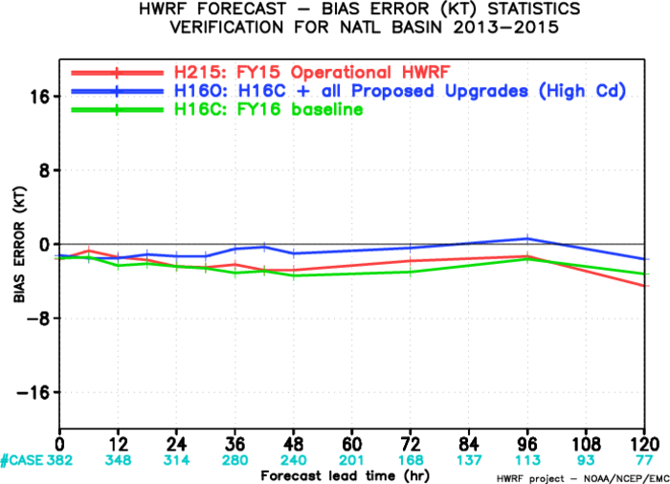
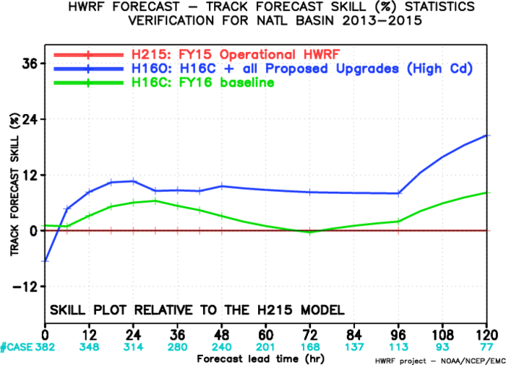
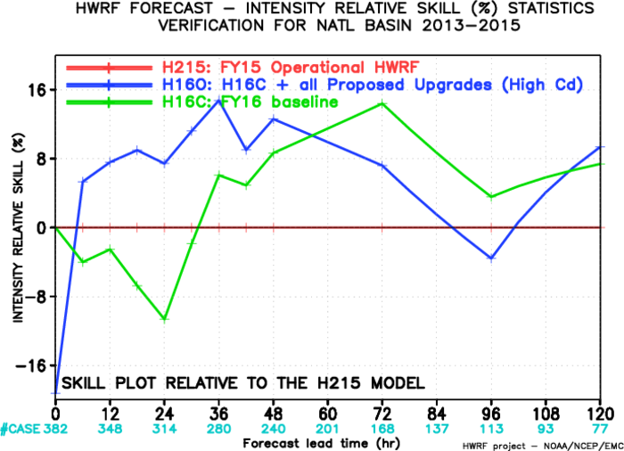
FY16 Physics Upgrade, AL

Slide 10
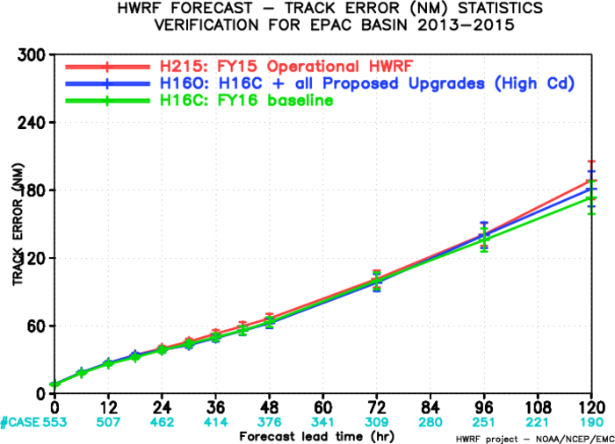
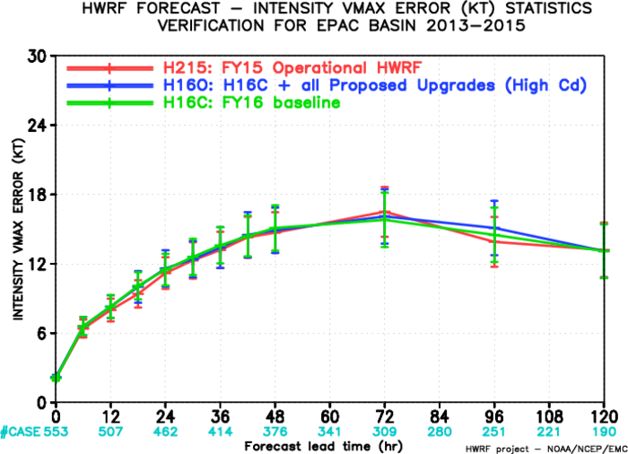
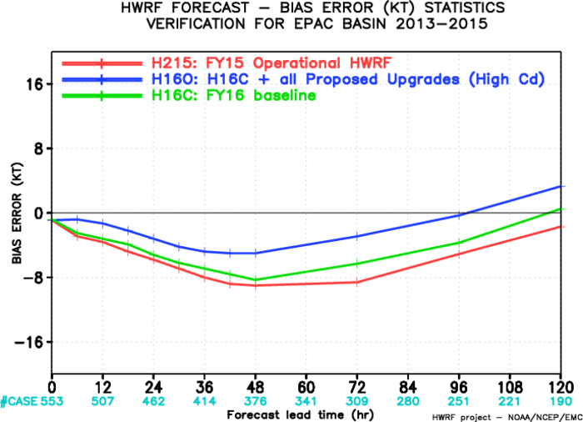
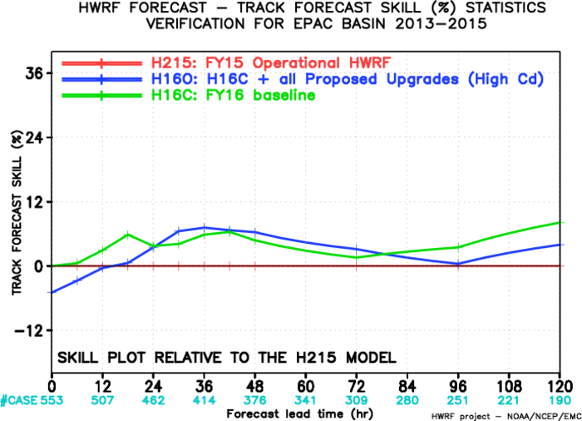
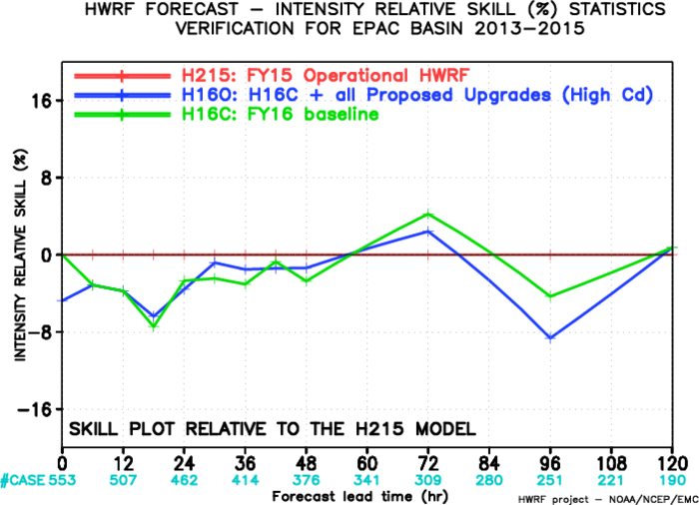
FY16 Physics Upgrade, EP

Slide 11
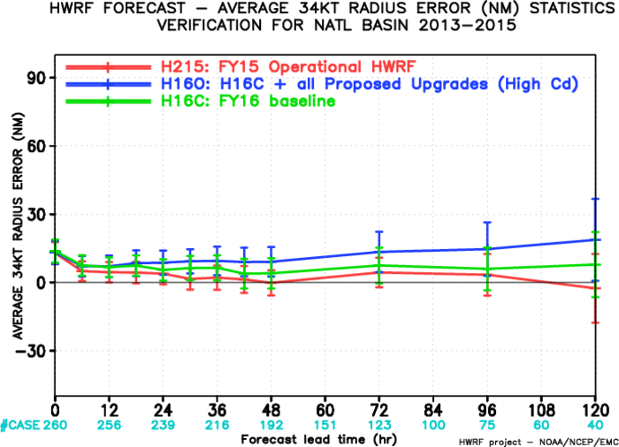
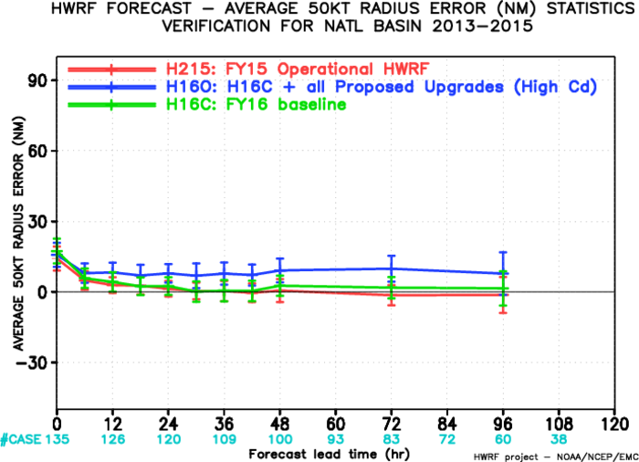
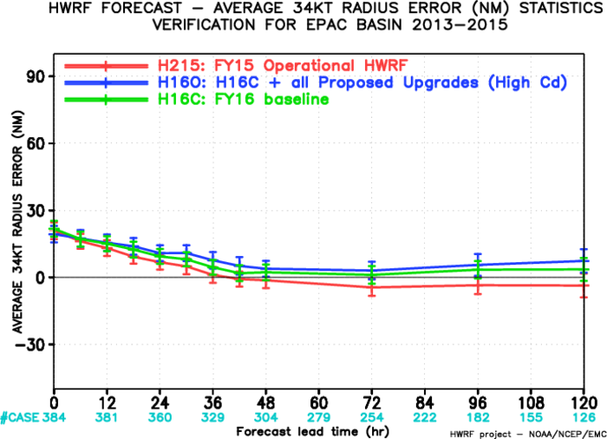
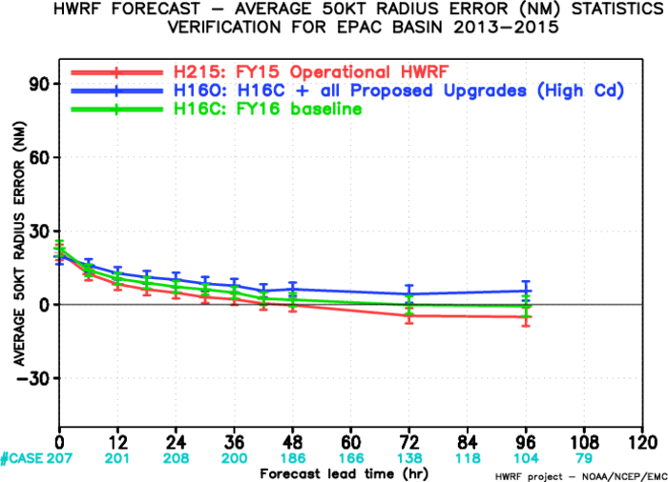
Storm Size verification
AL-34kt
AL-50kt
EP-34kt
EP-50kt

