Slide 1





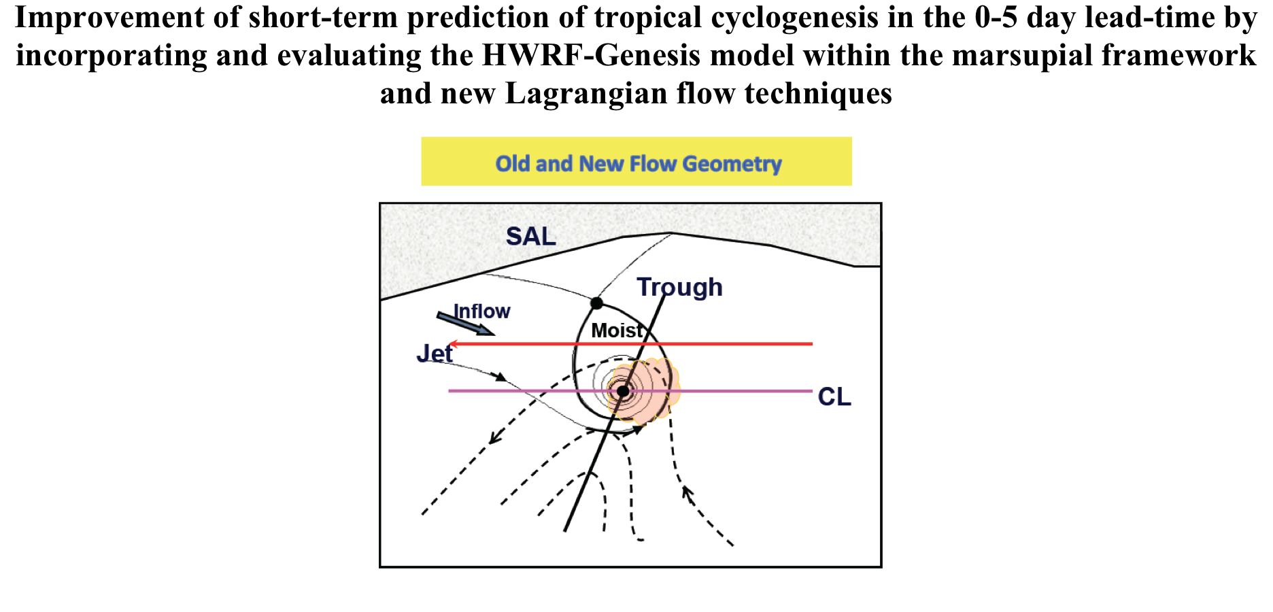
HFIP Telecon, 25 March 2015
Michael T. Montgomery
Mark Boothe
Blake Rutherford

Slide 2
Project Goals
Evaluate HWRF-Genesis performance by how it represents dynamical processes that lead to genesis. This is depicted by new Lagrangian analyses:
    Okubo-Weiss (OW) parameter
    OW integral along particle trajectories (Lagrangian OW)
    Advected equivalent potential temperature (q_{e})
    Objective radial profiles of all the above quantities
  These methods will be used to diagnose the formation and robustness of Lagrangian pouch boundaries.
HWRF-Genesis will be included in our multi-model ensemble to examine its value for improving real-time forecasts of cyclogenesis. Results will be determined by model performance of forecast accuracy of our Lagrangian quantities as well as track accuracy.
Notes:
Focus: Cyclogenesis performance

Slide 3
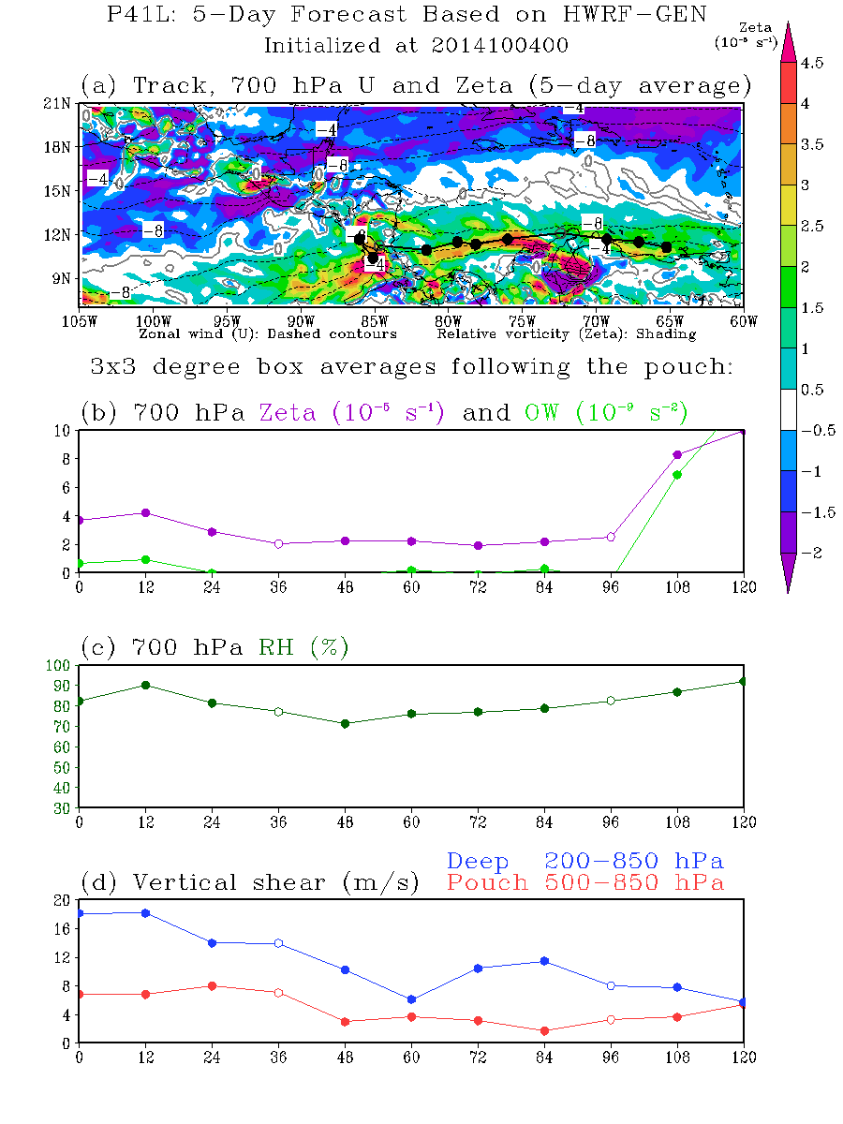

Okubo-Weiss parameter
OW ~ Relative vorticity - strain - shear
Frame-independent measure of the tendency for a rotational flow to be shape preserving
Operational 3x3 degree box averaged Okubo-Weiss
Operational 3x3 degree box averaged relative humidity
Notes:
Areas of high OW tend to be immune to horizontal shear deformation, which means that areas of positive OW may be protected from environmental influences

Slide 4
What does a developed TD+ look like in HWRF-Gen?
Operational 3x3 degree box averaged Okubo-Weiss
HWRF-Gen analysis OW for developed systems correlates well with NHC intensities, suggesting a threshold of 9x10⁻⁹ s⁻² for TD development
Analyses too intense?
9x10⁻⁹
s⁻²
25kt
No actual intensity values
60 24 11 15 15 14 11 Total: 150
30 August – 31 October 2014

Slide 5
Operational 3x3 degree box averaged Okubo-Weiss
Only 11 intense analyses
10 invests + 1 post-invest
Dry subtropical
5 large but dry subtropical
2 briefly convective
2 less than a day from TD
2 near the African coast
Dry subtropical
Dry subtropical
Prior to NHC TD designation:
21 h early
Brief convective flare
87 h early. African coast
Dry subtropical
9 h early
Brief convective flare
Dry subtropical
63 h early. African coast
9x10⁻⁹ s⁻²
60 24 11 15 15 14 Total: 139

Slide 6
Operational 3x3 degree box averaged relative humidity
HWRF-GEN Analysis RH (%) and NHC 2014
70%
HWRF-Gen analysis RH provides an additional tool to exclude the high-OW but dry systems.
HWRF-Gen developed systems
OW > 9x10⁻⁹ s⁻²
RH > 70%
Limitation #1: Values for only the one tracked level
Dry subtropical
60 24 11 15 15 14 11 Total: 150
30 August – 31 October 2014

Slide 7
Streamfunction Coordinate System
OW
Maxima of the OW field also occur at the maximal value of the streamfunction.
Limitation #2: OW can be noisy

Slide 8
Streamfunction Coordinate System
Lagrangian OW
Units: radians
Lagrangian Okubo-Weiss
Time integral (-36h to +36h) of sqrt(OW) along particle trajectories
+36h
Provides time-smoothing of OW and the promise of fewer false alarms
-36h
Values of the nondivergent streamfunction increase monotonically toward center.
The contours approximate the Lagrangian flow, and the contour number can be used as a flow-relative radius.
Averages along these contours give a radial profile of dynamic quantities.

Slide 9
Averages along streamfunction contours
High Lagrangian OW value near center
Pouch center
Edge of pouch
The averages of dynamic quantities are taken along streamfunction contours.
The Lagrangian OW average provides a significant smoothing that denoises the data set, and will allow us to draw more general conclusions about model performance.
Notes:
Recall that Lag-OW is also related to the square root of OW along particle trajectories

Slide 10
Proposed new Lagrangian depiction of developed tropical circulations
6.5 hours after first advisory for TS Gonzalo
1. Vertically aligned (<1º) throughout 850-500 hPa layer
2. High OW or Lagrangian OW (>3 rad.) near center throughout 850-500 hPa layer
3. Horizontal shear sheath within 3 degrees of center
Notes:
Allows for objective and automated assessment of potential circulations

Slide 11
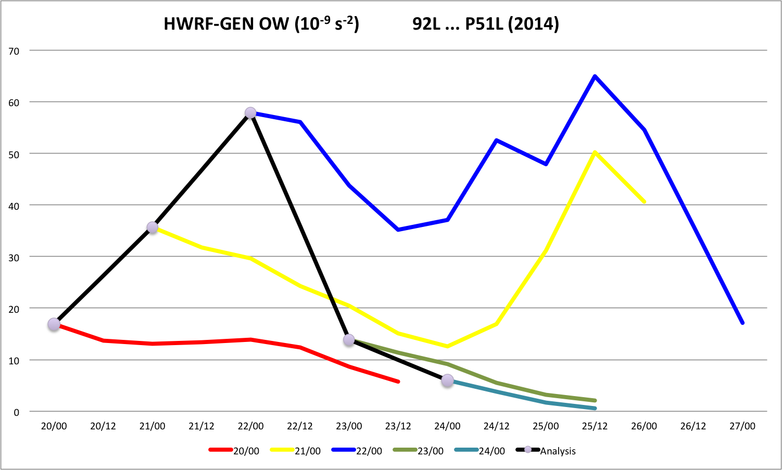
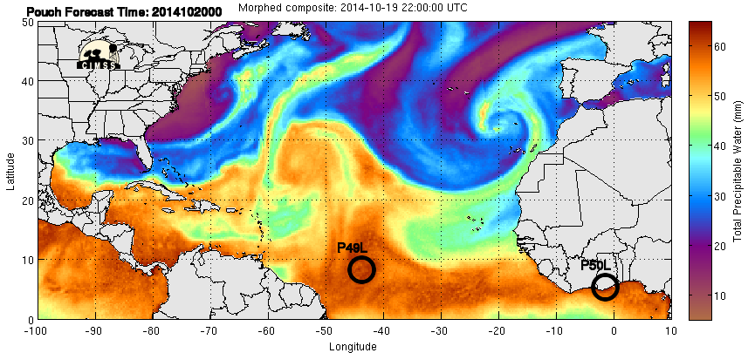
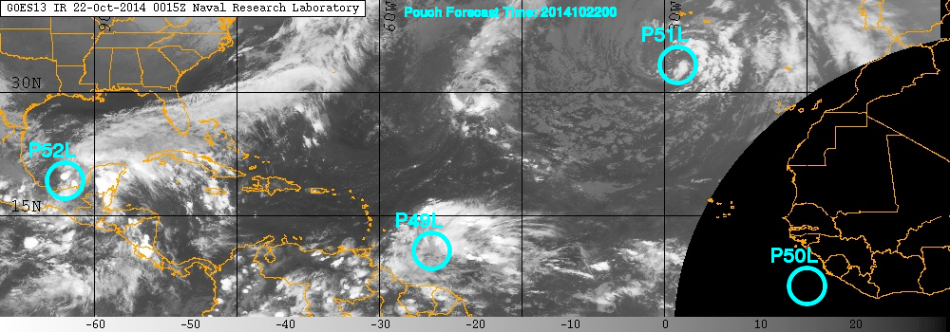
Large Subtropical System
Initiated as a pouch after NHC declared as Invest 92L
First two HWRF-GEN forecasts miss the early intensification, but the 2-3 day forecasts verify well
Once system reaches peak, HWRF-GEN forecast then remains too strong
P51
P51
P51
P51
Before first forecast (October 20)
Peak OW (October 22):
Invest 92L

Slide 12
AL92/P51L: New Lagrangian OW technique recognizes as a non-developed system
1. Vertically aligned (<1º) throughout 850-500 hPa layer YES
2. High OW or Lagrangian OW (>3 rad.) near center throughout 850-500 hPa layer PERHAPS
3. Horizontal shear sheath within 3 degrees of center NO

Slide 13
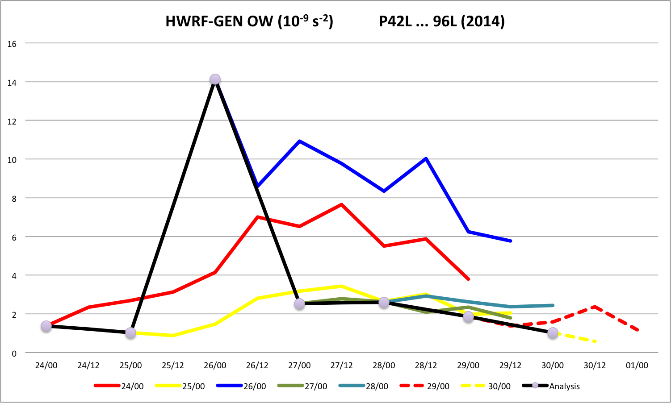
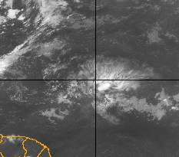
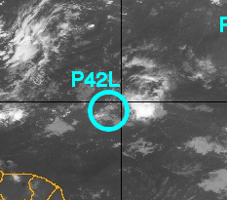
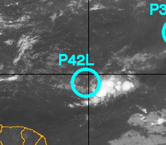
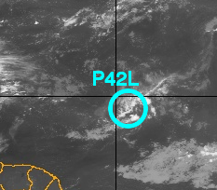
Brief Spike … 925-hPa Pouch
Low-level pouch crept eastward for a couple days
When convection flared on September 26, HWRF-GEN responded with increased analysis OW, which dropped along with the convection the following day
Forecasts missed the brief intensification
26 September
P42
First P42L assessment
P44
Convection gone
Invest 96L declared
Convection flaring
Sep 24
Sep 25
Sep 26
Sep 27

Slide 14
P42L: New Lagrangian OW technique recognizes as a non-developed system
Tracked down at 925 hPa
1. Vertically aligned (<1º) throughout 850-500 hPa layer NO
2. High OW or Lagrangian OW (>3 rad.) near center throughout 850-500 hPa layer NO
3. Horizontal shear sheath within 3 degrees of center NO

Slide 15
P29L (pre-Edouard): New Lagrangian OW technique recognizes as a non-developed system
63 hours before first advisory for TD06L
1. Vertically aligned (<1º) throughout 850-500 hPa layer NO
2. High OW or Lagrangian OW (>3 rad.) near center throughout 850-500 hPa layer NO
3. Horizontal shear sheath within 3 degrees of center NO

Slide 16
Operational 3x3 degree box averaged relative humidity
HWRF-GEN RH Error (%): Forecast RH vs. Analysis RH
2014
Too moist entire 120 hours
RH Error (%)
Sample Size
150 122 119 95 92 77 73 58 51 45 40
Forecast interval (h)

Slide 17
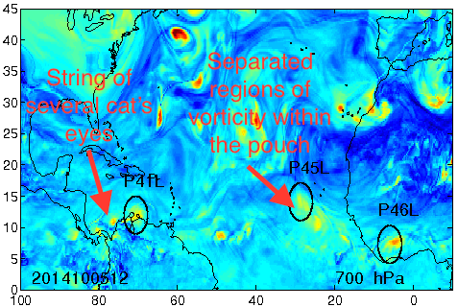
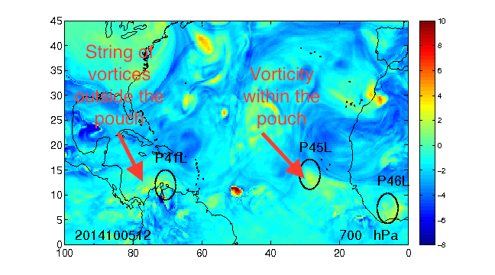
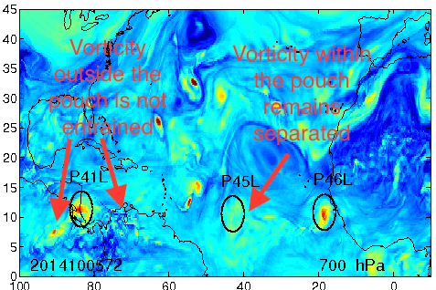
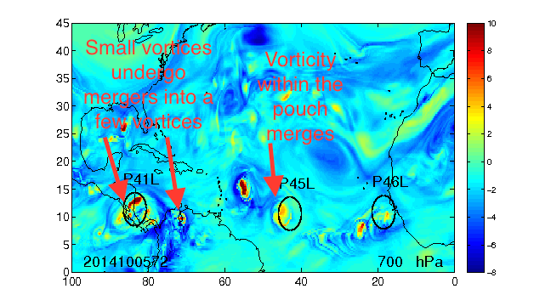
Small-scale Vortex Mergers
HWRF-GEN has a tendency to merge small vortices
ECMWF keeps them separated
00 UTC
5 October 2014
ECMWF
HWRF-GEN
12-h
Forecast
72-h
Forecast
Notes:
At 12 UTC, the ECMWF model develops a string of 4 cat’s eyes for P41L.
At the same time HWRF-Genesis has a string of vorticity without as much fine-scale vortical structure.
The ECMWF model has more well defined Lagrangian boundaries at the pouch scale. This could be a result of the spectral representation of velocity derivatives which are used to define the Lagrangian boundaries.
Over the next 60 hours, the ECMWF model does not have as many mergers, and most small vortices are not entrained.
HWRF-Genesis does merge the small vortices into a few larger vortices.
A similar story occurs WITHIN the pouch for P45L. Manifolds between small vortices act as barriers to merger in ECMWF while HWRF-Genesis tends to aggregate small vortices more frequently.
These difference in Lagrangian manifold structure imply a difference in vortex merger, and appears to be a common difference between the models. From this, we can say that HWRF-Genesis tends to show higher intensity as measured by an average of the OW parameter than ECMWF. Because ECMWF does not show as many mergers, the tracks are deflected as pouches pass by nearby vortices.
Due to the extreme sensitivity of flows near saddle points, we cannot make conclusions yet as to which model better represents the dynamical processes of genesis.
(Boothe: Blake plots the ECMWF position ellipses on all the models; hence, the seemingly “displaced” position of P45L by the 72-h forecast actually provides information that the HWRF-GEN forecast for P45L is faster westward than ECMWF in this case.)

Slide 18
2014 HWRF-GEN Forecast Characteristics
 | Overall Quality | Track | Intensity | Structure (Vert./Horiz.)
P23L Central Atlantic | Good, except one | Slow | Intense: Brief ITCZ excitation | Size OK. Too deep.
P26L/Dolly Yucatan | Three bad | Fast | Weak: Missed overland intensification | Good
P27L West Africa | Good, except one | Slow | Intense | Too large. Developed wrong portion.
P27L African exit | Three bad (improved with time) | Slow, south | Intense | Too large. Not zonally squeezed.
P28L Eastern Atlantic | Good, except one | Slow, south | Intense | Developed tiny ITCZ VHT
P29L/pre-Edouard African exit | Good, except one (African exit) | Slow, north | Intense | Large, deep
P41L Central America | Many good, then several bad | Slow | Intense over isthmus | Tilted (before isthmus)
P42L Central Atlantic | Missed brief spike | North | Briefly weak | Elongated
Notes:
Many good forecasts of “intensity” (3x3 degree box averaged OW)
When erroneous, HWRF-Gen forecast tends to be slow, intense, and large

Slide 19
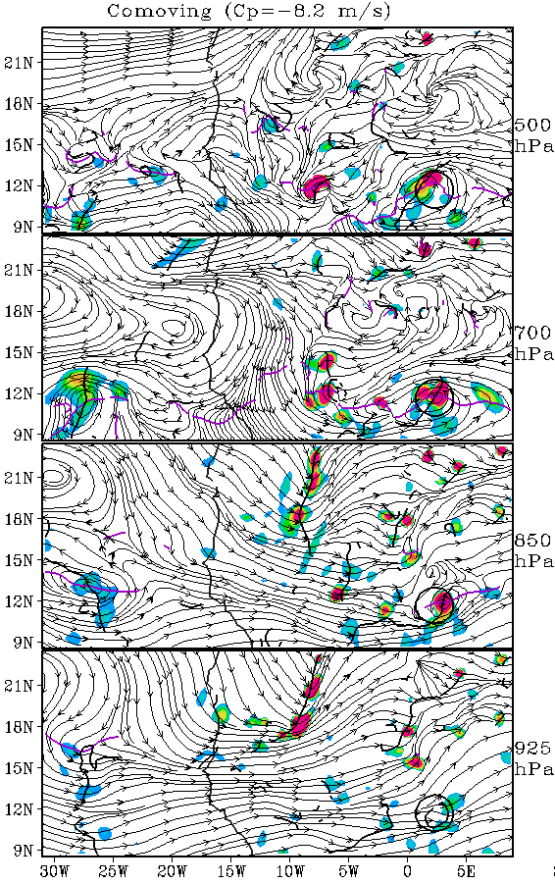
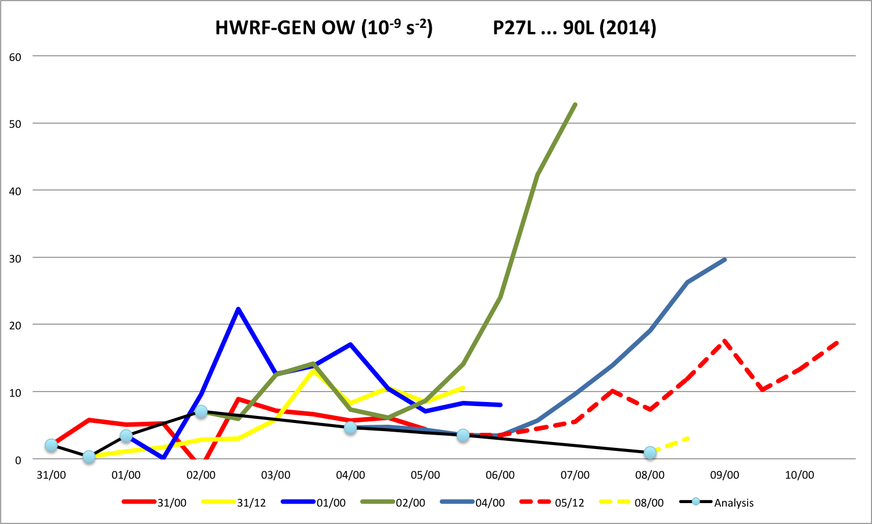
02/00Z
Forecast
00h
P27L … AL90
Excessive rapid intensification
00Z 2 September 2014 (green)
Post-48h rapid intensification
  Begins upon hitting the Atlantic
Relative humidity structure and value match well with verifying analyses
Verifying analyses indicate P27L was zonally squeezed, but forecast is:
  Large, circular system
  Slow
Operational 3x3 degree box averaged Okubo-Weiss forecasts
Tracked at 700 hPa.
These OW values are for 700 hPa.

Slide 20
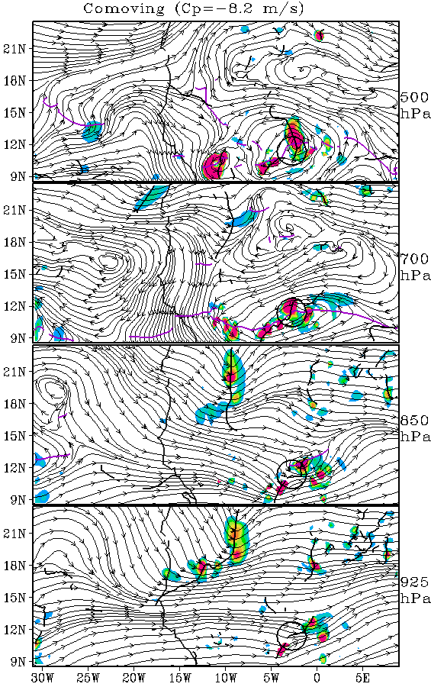
02/00Z
Forecast
12h
P27L … AL90
Excessive rapid intensification
00Z 2 September 2014 (green)
Post-48h rapid intensification
  Begins upon hitting the Atlantic
Relative humidity structure and value match well with verifying analyses
Verifying analyses indicate P27L was zonally squeezed, but forecast is:
  Large, circular system
  Slow
Operational 3x3 degree box averaged Okubo-Weiss forecasts
12h
Not much at 925 hPa

Slide 21
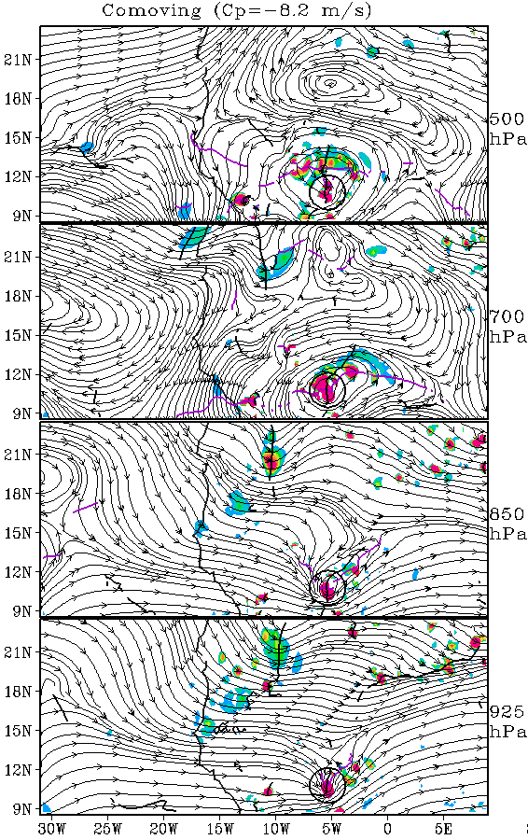
02/00Z
Forecast
24h
P27L … AL90
Excessive rapid intensification
00Z 2 September 2014 (green)
Post-48h rapid intensification
  Begins upon hitting the Atlantic
Relative humidity structure and value match well with verifying analyses
Verifying analyses indicate P27L was zonally squeezed, but forecast is:
  Large, circular system
  Slow
Operational 3x3 degree box averaged Okubo-Weiss forecasts
24h
Increasing OW

Slide 22
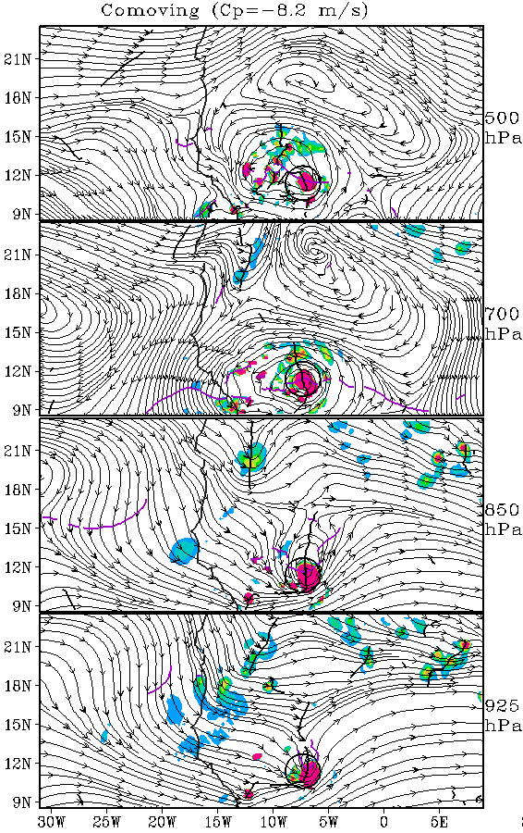
02/00Z
Forecast
36h
36h
Vertically aligned through 500 hPa
P27L … AL90
Excessive rapid intensification
00Z 2 September 2014 (green)
Post-48h rapid intensification
  Begins upon hitting the Atlantic
Relative humidity structure and value match well with verifying analyses
Verifying analyses indicate P27L was zonally squeezed, but forecast is:
  Large, circular system
  Slow
Operational 3x3 degree box averaged Okubo-Weiss forecasts

Slide 23
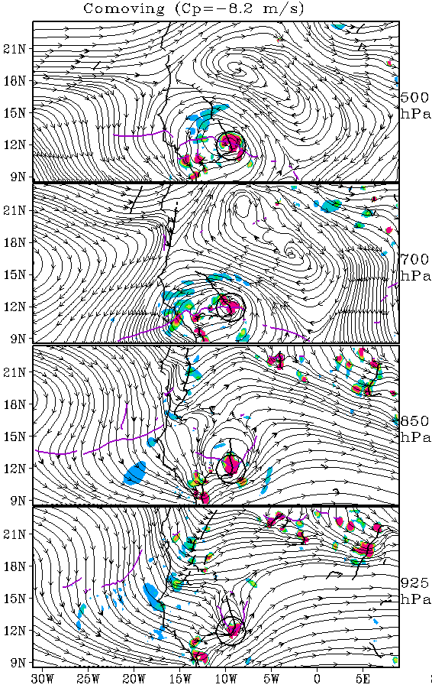
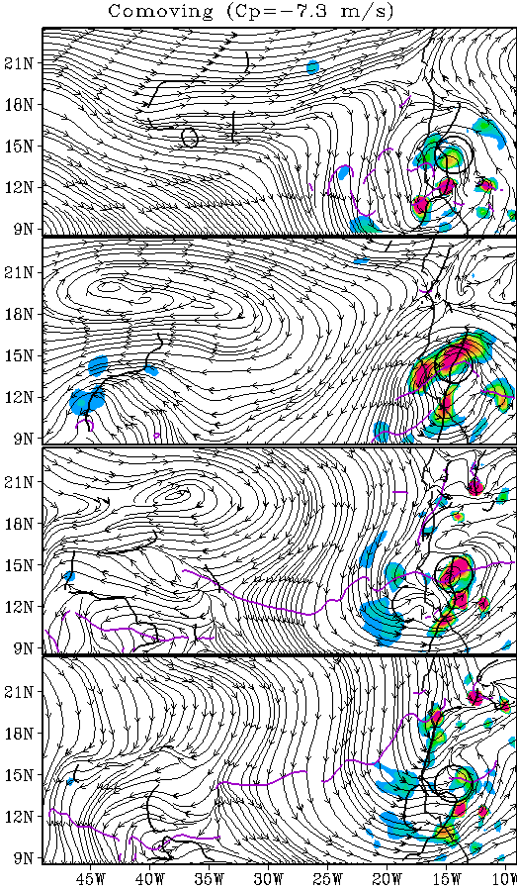
02/00Z
Forecast
48h
Analysis
Forecast slow and with OW more concentrated
48h
Forecast OW is actually slightly higher than in analysis

Slide 24
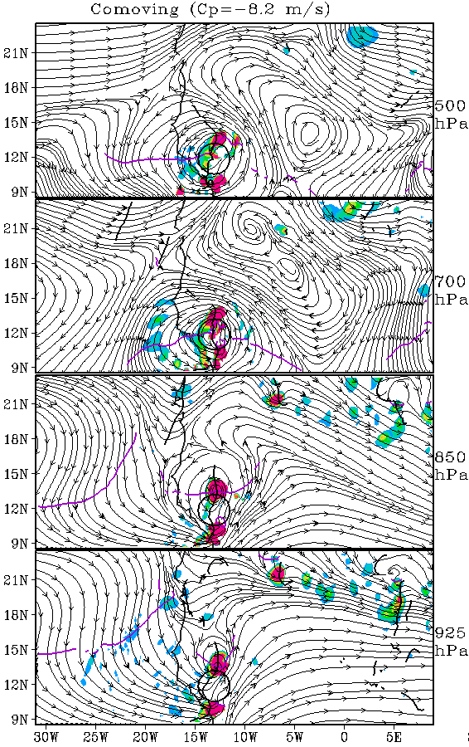
02/00Z
Forecast
60h
60h
OW dip: No longer vertically aligned
P27L … AL90
Excessive rapid intensification
00Z 2 September 2014 (green)
Post-48h rapid intensification
  Begins upon hitting the Atlantic
Relative humidity structure and value match well with verifying analyses
Verifying analyses indicate P27L was zonally squeezed, but forecast is:
  Large, circular system
  Slow
Operational 3x3 degree box averaged Okubo-Weiss forecasts

Slide 25
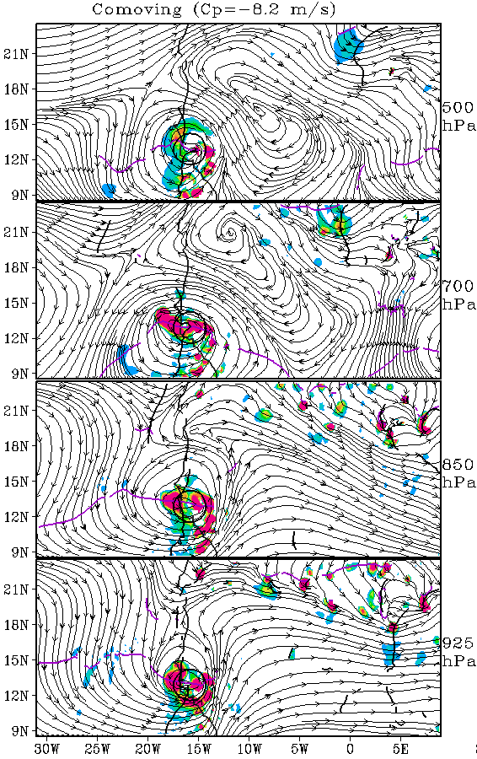
02/00Z
Forecast
72h
P27L … AL90
Excessive rapid intensification
00Z 2 September 2014 (green)
Post-48h rapid intensification
  Begins upon hitting the Atlantic
Relative humidity structure and value match well with verifying analyses
Verifying analyses indicate P27L was zonally squeezed, but forecast is:
  Large, circular system
  Slow
72h
Forecast OW starting to increase at coast

Slide 26
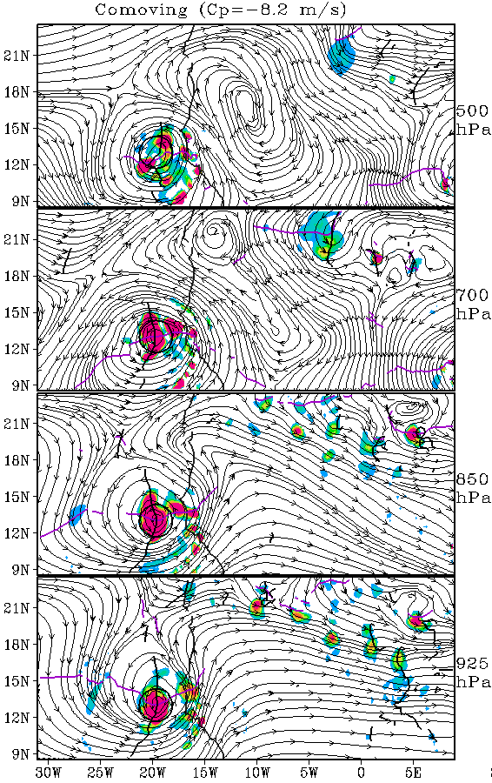
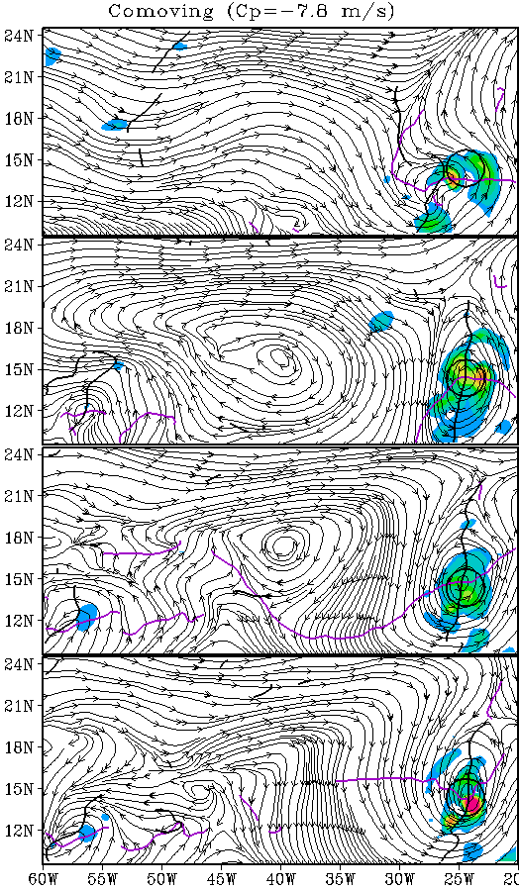
02/00Z
Forecast
84h
Analysis
OW increasing rapidly over water
Has actually been over water longer, but is weaker (and zonally squeezed)
84h
Forecast OW much too high
Slow: 13N, 20W
14N, 24W

Slide 27
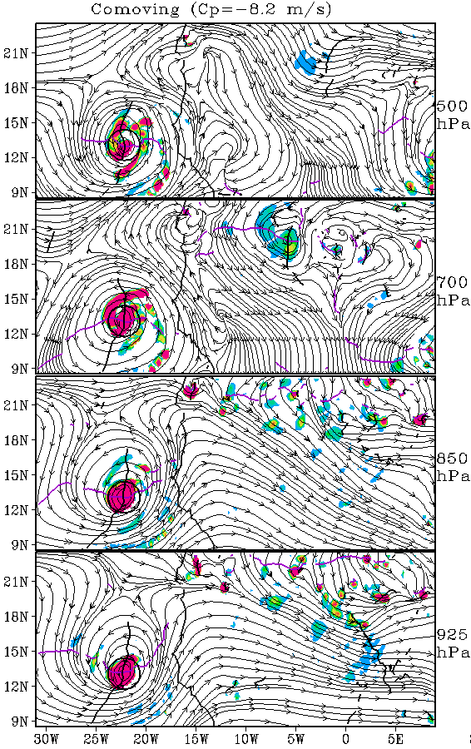
02/00Z
Forecast
96h
P27L … AL90
Excessive rapid intensification
00Z 2 September 2014 (green)
Post-48h rapid intensification
  Begins upon hitting the Atlantic
Relative humidity structure and value match well with verifying analyses
Verifying analyses indicate P27L was zonally squeezed, but forecast is:
  Large, circular system
  Slow
Operational 3x3 degree box averaged Okubo-Weiss forecasts

Slide 28
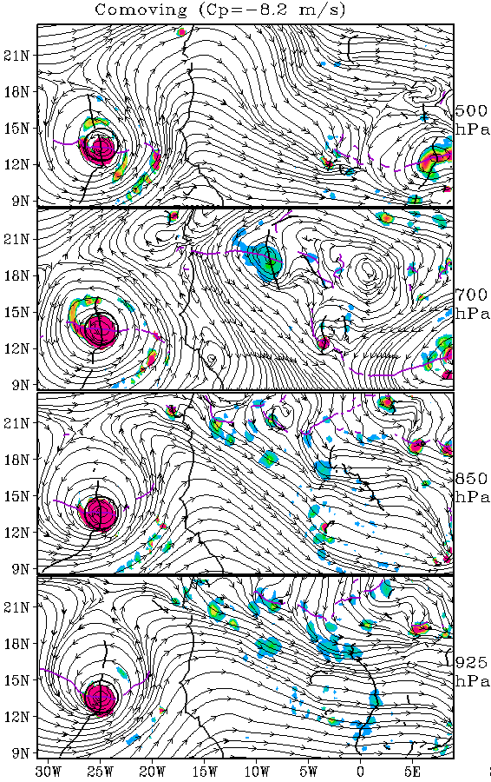
02/00Z
Forecast
108h
P27L … AL90
Excessive rapid intensification
00Z 2 September 2014 (green)
Post-48h rapid intensification
  Begins upon hitting the Atlantic
Relative humidity structure and value match well with verifying analyses
Verifying analyses indicate P27L was zonally squeezed, but forecast is:
  Large, circular system
  Slow
Operational 3x3 degree box averaged Okubo-Weiss forecasts

Slide 29
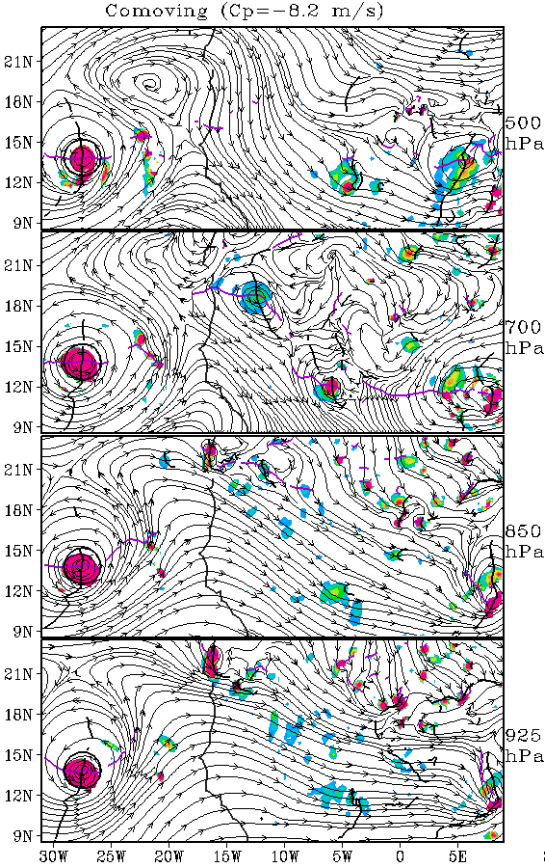
02/00Z
Forecast
120h
P27L … AL90
Excessive rapid intensification
00Z 2 September 2014 (green)
Post-48h rapid intensification
  Begins upon hitting the Atlantic
Relative humidity structure and value match well with verifying analyses
Verifying analyses indicate P27L was zonally squeezed, but forecast is:
  Large, circular system
  Slow
120h
Forecast continues to intensify
Operational 3x3 degree box averaged Okubo-Weiss forecasts

Slide 30
Development of P27L during September 2 forecast
HWRF-Genesis
Lagrangian OW
ECMWF
500 hPa
700 hPa
850 hPa
Both models over-develop P27L. The HWRF-Genesis model depicts greater Lagrangian OW in the lower troposphere, while the ECMWF model has higher values at 500 hPa.

Slide 31
Development of P27L during September 2 forecast
HWRF-Genesis
Lagrangian OW
ECMWF
500 hPa
700 hPa
850 hPa

Slide 32
Development of P27L during September 2 forecast
HWRF-Genesis
Lagrangian OW
ECMWF
500 hPa
700 hPa
850 hPa

Slide 33
Development of P27L during September 2 forecast
HWRF-Genesis
Lagrangian OW
ECMWF
500 hPa
700 hPa
850 hPa

Slide 34
Development of P27L during September 2 forecast
HWRF-Genesis
Lagrangian OW
ECMWF
500 hPa
700 hPa
850 hPa

Slide 35
Development of P27L during September 2 forecast
HWRF-Genesis
Lagrangian OW
ECMWF
500 hPa
700 hPa
850 hPa

Slide 36
Development of P27L during September 2 forecast
HWRF-Genesis
Lagrangian OW
ECMWF
500 hPa
700 hPa
850 hPa

Slide 37
Development of P27L during September 2 forecast
HWRF-Genesis
Lagrangian OW
ECMWF
500 hPa
700 hPa
850 hPa

Slide 38
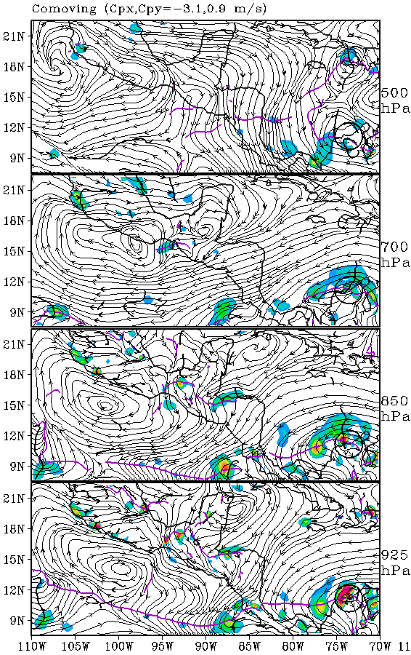
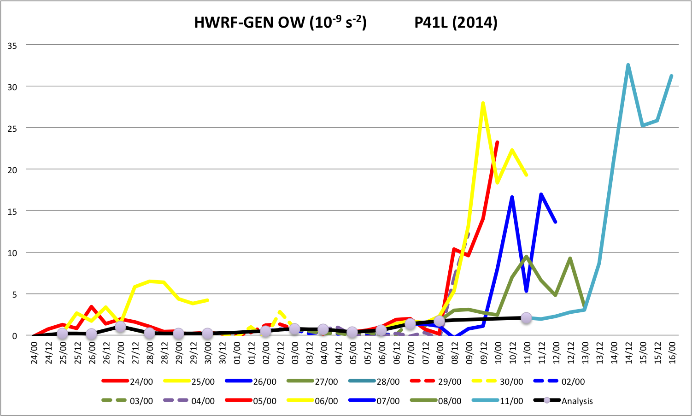
06/00Z
Forecast
00h
P41L
Third excessive intensification forecast
00Z 6 October 2014 (yellow)
First 24 h: Too strong and north
Next 24 h: A little too fast
Last 3 days: Intensifies over Central America and turns northward over land
Largest OW at 925 hPa

Slide 39
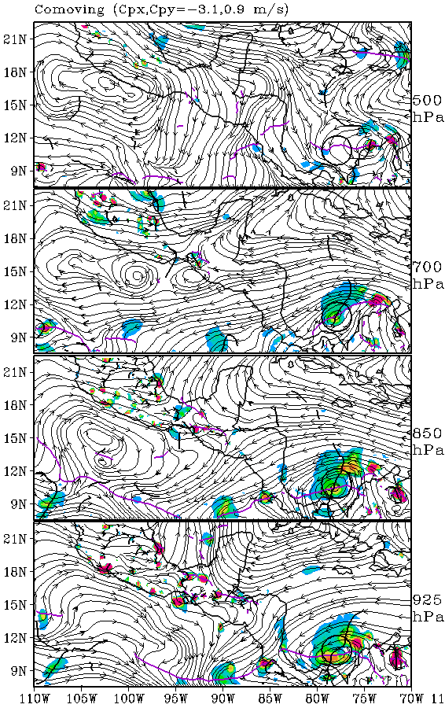
06/00Z
Forecast
12h
P41L
Third excessive intensification forecast
00Z 6 October 2014 (yellow)
First 24 h: Too strong and north
Next 24 h: A little too fast
Last 3 days: Intensifies over Central America and turns northward over land

Slide 40
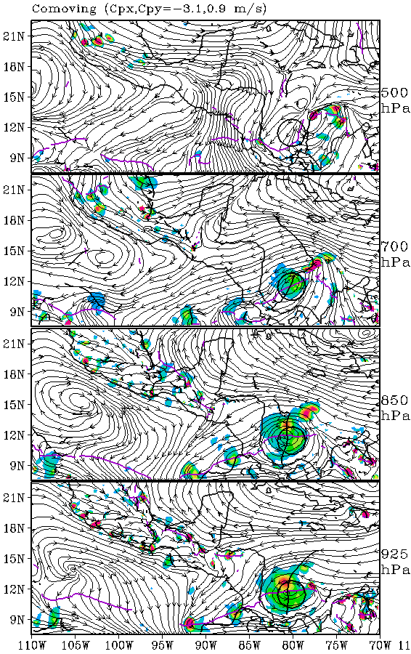
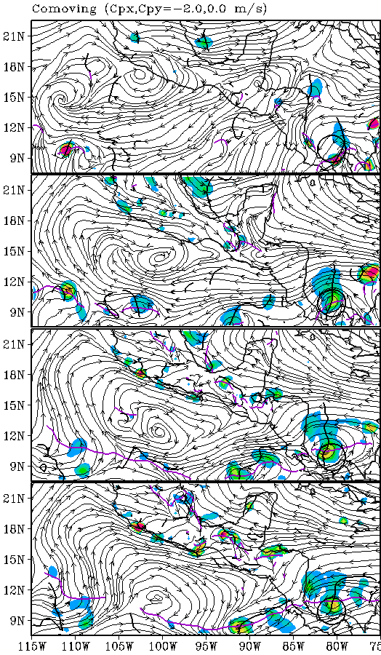
06/00Z
Forecast
24h

Slide 41
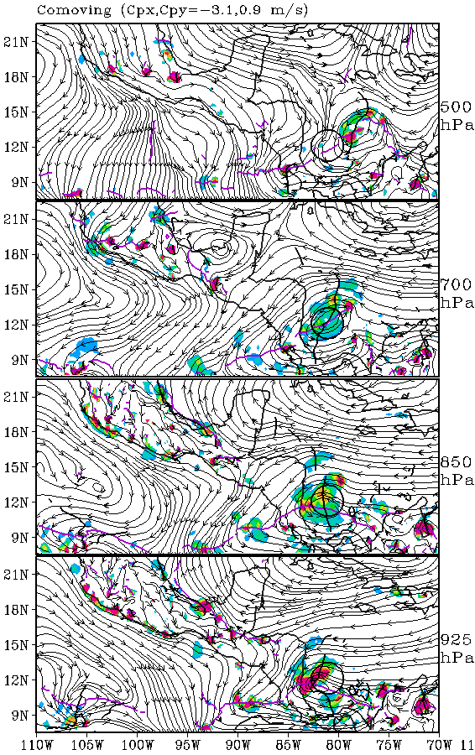
06/00Z
Forecast
36h
P41L
Third excessive intensification forecast
00Z 6 October 2014 (yellow)
First 24 h: Too strong and north
Next 24 h: A little too fast
Last 3 days: Intensifies over Central America and turns northward over land

Slide 42
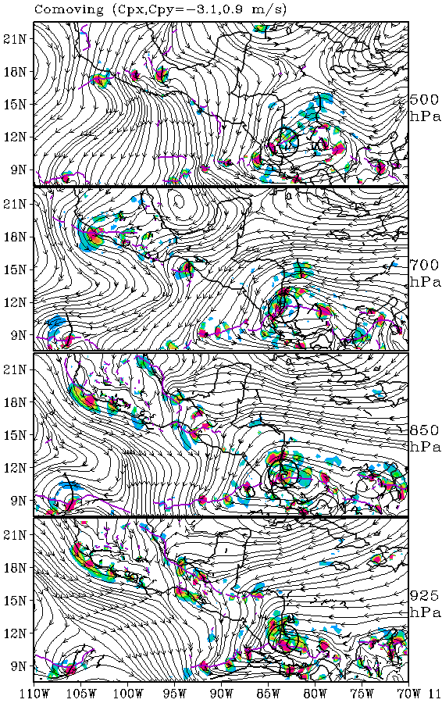
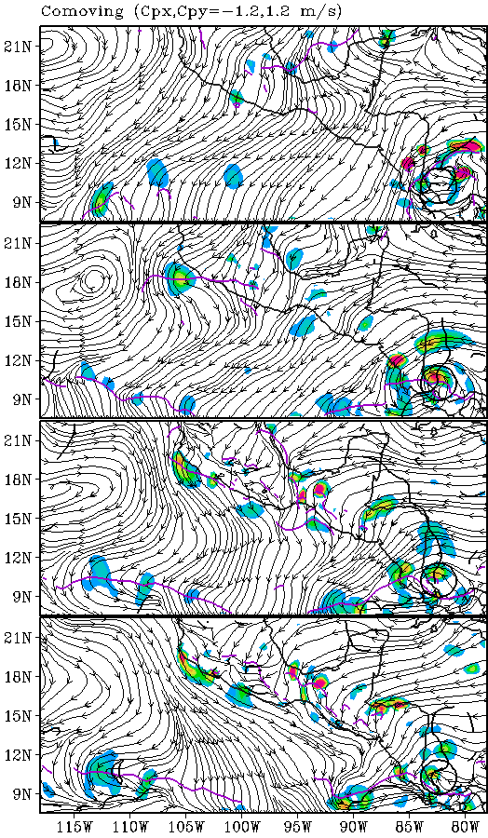
06/00Z
Forecast
48h

Slide 43
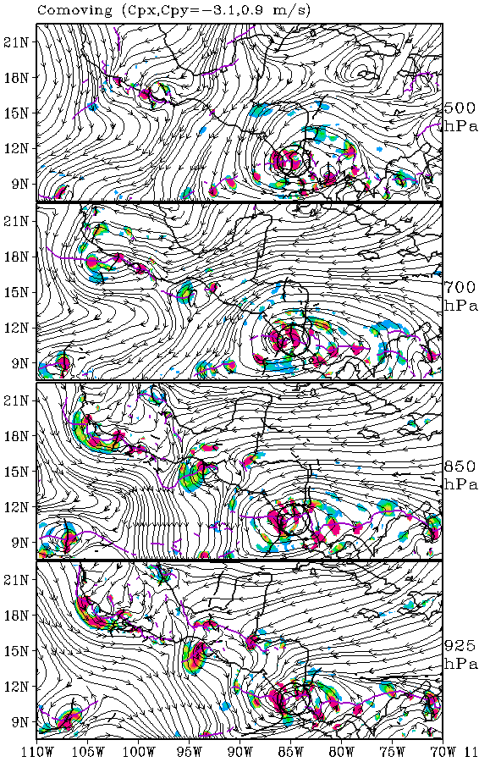
06/00Z
Forecast
60h
P41L
Third excessive intensification forecast
00Z 6 October 2014 (yellow)
First 24 h: Too strong and north
Next 24 h: A little too fast
Last 3 days: Intensifies over Central America and turns northward over land
OW spike begins. Eastern OW maxima in SW Caribbean appear.

Slide 44
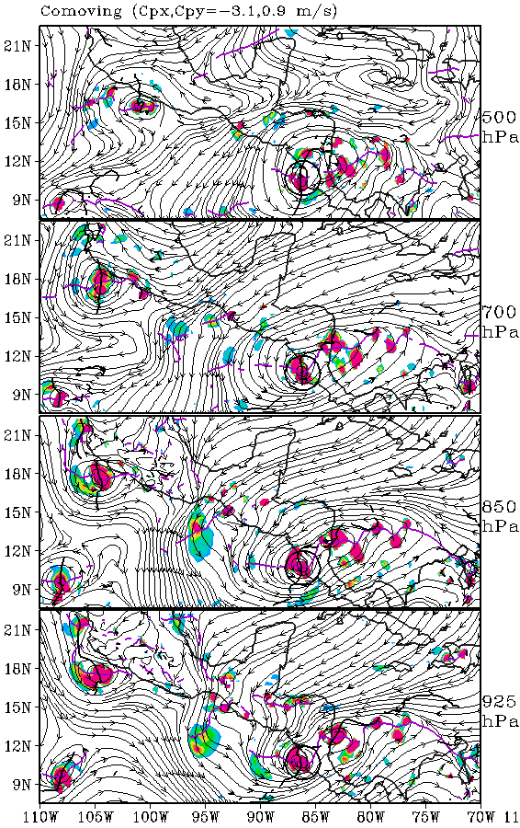
06/00Z
Forecast
72h
P41L
Third excessive intensification forecast
00Z 6 October 2014 (yellow)
First 24 h: Too strong and north
Next 24 h: A little too fast
Last 3 days: Intensifies over Central America and turns northward over land

Slide 45
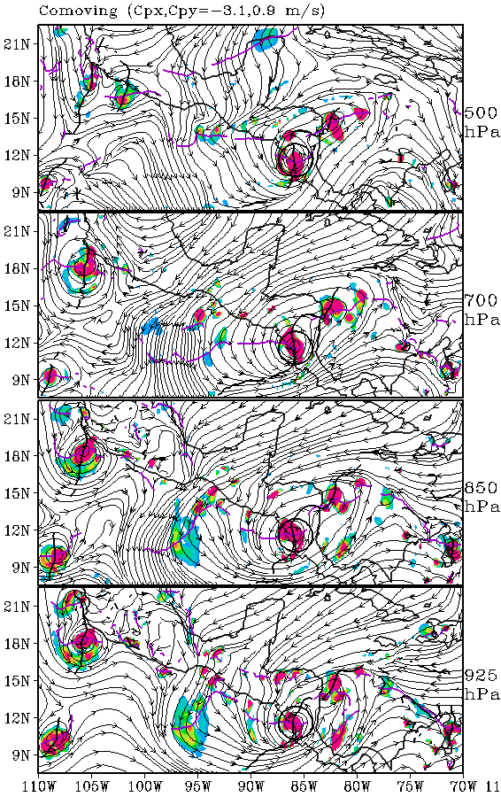
06/00Z
Forecast
84h
P41L
Third excessive intensification forecast
00Z 6 October 2014 (yellow)
First 24 h: Too strong and north
Next 24 h: A little too fast
Last 3 days: Intensifies over Central America and turns northward over land
Eastern OW maxima in SW Caribbean are smaller than P41L, so they rotate to NW and dissipate or are absorbed.

Slide 46
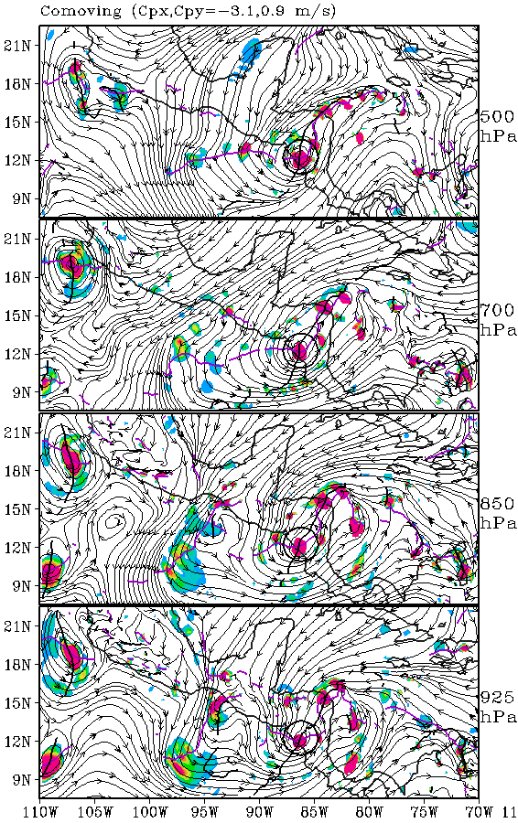
06/00Z
Forecast
96h
P41L
Third excessive intensification forecast
00Z 6 October 2014 (yellow)
First 24 h: Too strong and north
Next 24 h: A little too fast
Last 3 days: Intensifies over Central America and turns northward over land

Slide 47
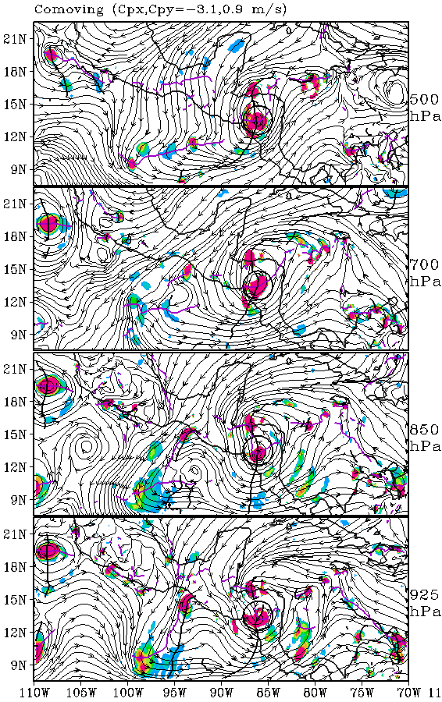
06/00Z
Forecast
108h
P41L
Third excessive intensification forecast
00Z 6 October 2014 (yellow)
First 24 h: Too strong and north
Next 24 h: A little too fast
Last 3 days: Intensifies over Central America and turns northward over land

Slide 48
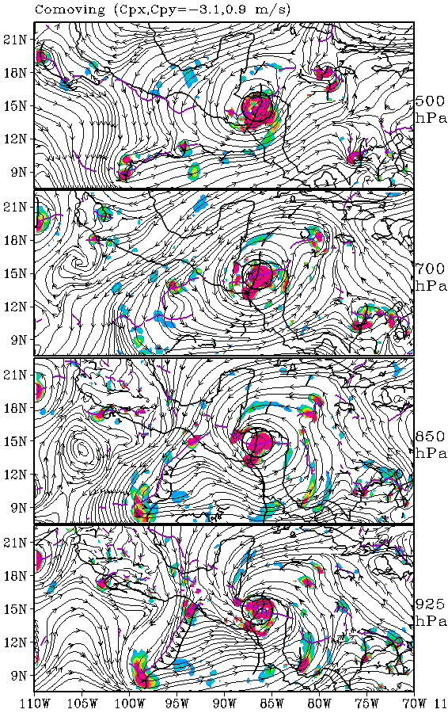
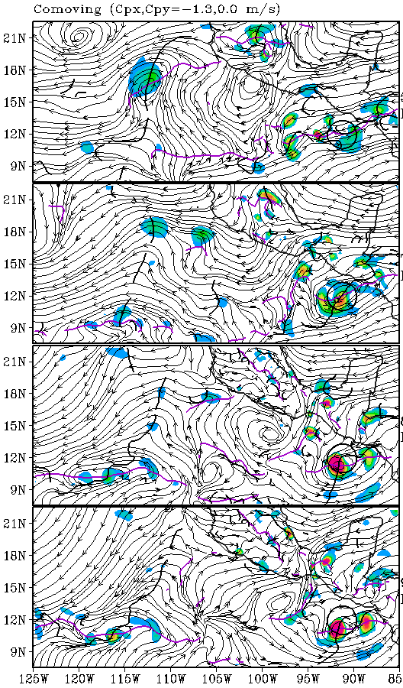
06/00Z
Forecast
120h
Westward into Eastpac

Slide 49
Conclusions: HWRF-Genesis Analyses
We have diagnosed the value of the HWRF-Genesis model to accurately depict cyclogenesis based on standard pouch products of analysis Okubo-Weiss and relative humidity quantities.
HWRF-Gen developed systems
OW > 9x10⁻⁹ s⁻²
RH > 70%
New Lagrangian OW field and radial profiles along the streamfunction contours provide a way for averaging the very noisy data sets so that the above results can be generalized over a large data set (in progress). Suggest formation threshold:
1. High OW or Lagrangian OW values (>3) near center throughout 850-500 hPa layer
2. Vertically aligned within 1 degree throughout 850-500 hPa layer
3. Horizontal shear sheath within 3 streamfunction contour (Negative Lag OW ring)

Slide 50
Conclusions: HWRF-Genesis Forecasts
HWRF-Genesis has a consistent forecast bias toward producing storms that are too strong in the OW field.
Merges small circulations
Common locations of excessive intensification
  West African coast
  Over Central America
A detailed comparison for P27L suggests that HWRF-Genesis depicts high Lagrangian OW values at early times at lower levels (while ECMWF has initially high Lagrangian OW values at 500 hPa).

Slide 51
Future Work
We have been assessing kinematic and dynamic processes via OW and Lagrangian OW.
We will soon examine:
  Thermodynamic (Advected q_{e})
  Vertical shear
  Ventilation index

