Slide 1


Evaluation of Proposed FY15 Upgrades for NCEP Operational HWRF
NATL/EPAC Storms, 2011-2014
HWRF Team @EMC, in collaboration with
NHC, DTC, GFDL, URI, UCLA, Purdue/NSF, HRD
Presented by
Vijay Tallapragada
HWRF Weekly Meeting, March 26, 2015
Notes:
1
1

Slide 2
Scope of FY15 HWRF Upgrades
System & Resolution Enhancements
  Replace current partial HWRF python based scripts with complete Python based scripts for a unified system
  GFS data Upgrades
  Increase the horizontal resolution of atmospheric model for all domains from 27/9/3 to 18/6/2 km.
Initialization/Data Assimilation Improvements
  Upgrade and improve HWRF vortex initialization scheme in response to both GFS and HWRF resolution increases
  Upgrade Data Assimilation System with hybrid HWRF-based EnKF and GSI system.
Physics Advancements
  Upgrade Micro-physics process (Ferrier-Aligo)
  Upgrade GFDL radiation to RRTMG scheme with partial cloudness
  Upgrade surface physics and PBL, momentum and enthalpy exchange coefficients(Cd/Ch)
  Upgrade current GFDL slab model to NOAH LSM.
First time in 2015….
  Self cycled HWRF ensembles based warm start for TDR DA
  Expand HWRF capabilities to all global (including WP/SH/IO) basins through 7-storm capability in operations to run year long

Slide 3


Q3FY15 Hurricane WRF V9.0.0
Project Status as of 03/06/2015
G
Project Information and Highlights
G
Scheduling
Lead: Vijay Tallapragada, EMC and Becky Cosgrove, NCO
Scope:
Replace current partial HWRF python based scripts with complete Python based scripts for a unified system.
Increase the horizontal resolution of atmospheric model for all domains from 27/9/3 to 18/6/2 km.
Upgrade and improve HWRF vortex initialization scheme in response to both GFS and HWRF resolution increases.
Upgrade Data Assimilation System with hybrid HWRF-based EnKF and GSI system.
Upgrade model physics to accommodate model resolution increase, including micro-physics process, radiation, surface physics and PBL.
Upgrade current GFDL slab model to NOAH LSM.
Upgrade ocean initialization for MPIPOM
Self cycled HWRF ensembles based warm start for TDR DA
Expand HWRF capabilities to all global (including WP/SH/IO) basins through 7-storm capability in operations to run year long
Expected Benefits:
Improved track & intensity forecast skill and additional model output for
downstream applications
Milestone (NCEP) | Date | Status
Initial coordination with SPA team | 1/31/2015 → 3/13/2015 | Complete
EMC testing complete/ EMC CCB approval | 3/31/15 →4/15/2015
Final Code Delivered to NCO | 3/28/2015 → 4/09 →4/16/2015
Technical Information Notice Issued | 3/17 → 4/29/2015
Initial Test Complete | 4/30 → 5/15 → 5/22/2015
Test with specific cases | 4/17 → 4/24 →4/30/2015
Testing Ends | 4/24 →5/04 → 5/11/2015
IT testing ends | 5/05 → 5/15/2015
Management Briefing | 5/09 → 5/25/2015
Operational Implementation | 5/25 → 5/26/2015
G
Issues/Risks
G
Finances
Issues:
Risks:
Mitigation:
Associated Costs:
Funding Sources: EMC Base: T2O 18 Man-months (3 FTE full time for 6 months). NCO Base: 2 man-months for implementation, 1 man-month annually for maintenance
Management Attention Required | Potential Management Attention Needed | On Target
R
Y
G
v1.0 09/14//07

Slide 4
HWRF Upgrade Plan for 2015 Implementation
Multi-season Pre-Implementation T&E
 | Model upgrades | Physics and DA upgrades |  |  |  | Combined
 | Baseline (H15B) | NOAH LSM (H15W) | Upgraded Ferrier (H15W) | RRTMG/ PBL/ Surface Physics (H15W) | Data Assimilation* (H15T) | H215
Descriptions | 1.Resolution increase: 18/6/2km w/ same domain size; 2. Python scripts 3. New GFS T1534 4. Init improvement, GFS vortex filter | NOAH LSM (w/ Ch cap over land) | Separate species, w/o advection | 1.Radiation 2.Variable α 3.Scale-aware partial cloudiness scheme | Hybrid GSI/HWRF-EPS based DA | Baseline + NOAH/LSM +newMP+RRTMG+ Surface Physics + PBL
Cases | Four-season 2011-2014 simulations in ATL/EPAC, cases (~2300) | Priority cases | Priority cases | Priority cases | Only TDR cases for 2011-2014 | Four 2011-2014 retrospectives ~2300 simulations in ATL/EPAC
Platforms | Jet | WCOSS | Jet | Jet/Zeus | Jet | Jet/WCOSS/Zeus
The plan is based on the assumption that 2015 operational HWRF system will have 3x computer resources as current system on WCOSS within HWRF operational time windows. We will be using only 2.5X for each storm
* DA experiment requires additional computer resources outside current operational time window.

Slide 5
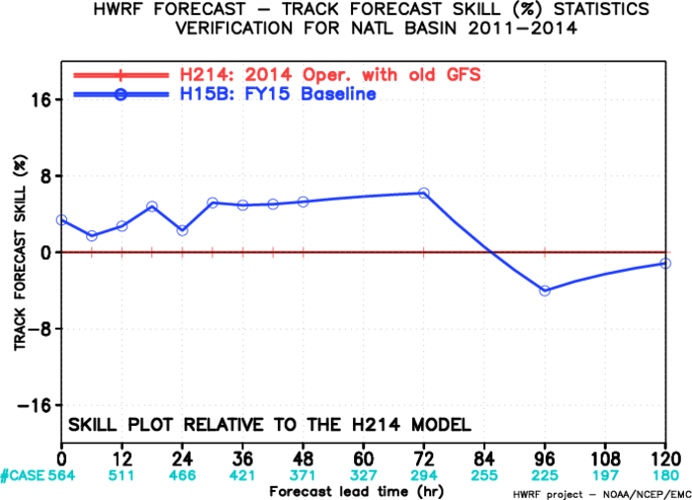
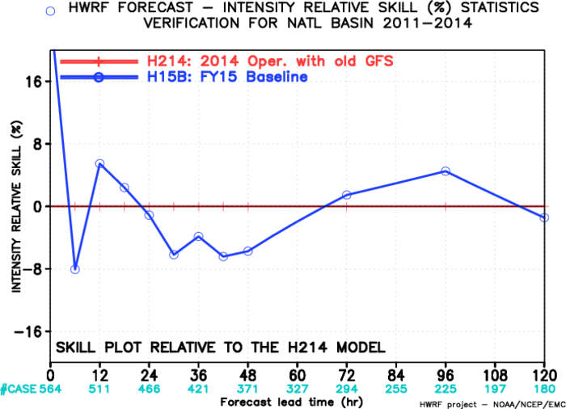
HWRF Infrastructure/Resolution Upgrades
The NMM core of the operational HWRF model upgraded to latest community version WRF V3.6.1.
The horizontal resolution increased from 27/9/3km to 18/6/2km, which allow the model to resolve more storm scale features and have better storm-large scale interactions.
Use high resolution GFS T1534 as IC/LBC
Fix a major bug in vortex initialization for tropical storms in Southern Hemisphere
Adjust the size of the filter domain in response to res. GFS res. increase
Add more smoothing if the radius of maximum wind speed is significantly smaller than observation
Remove the basin-dependence in vortex initialization

Slide 6
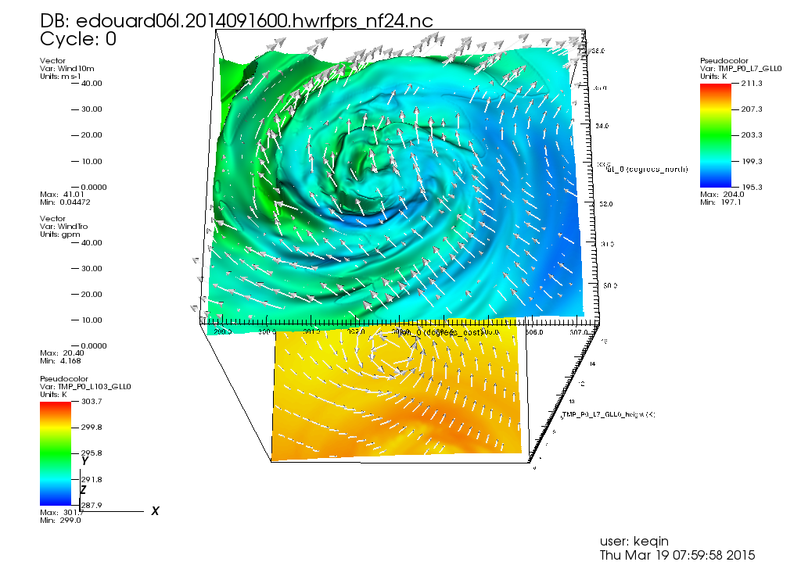
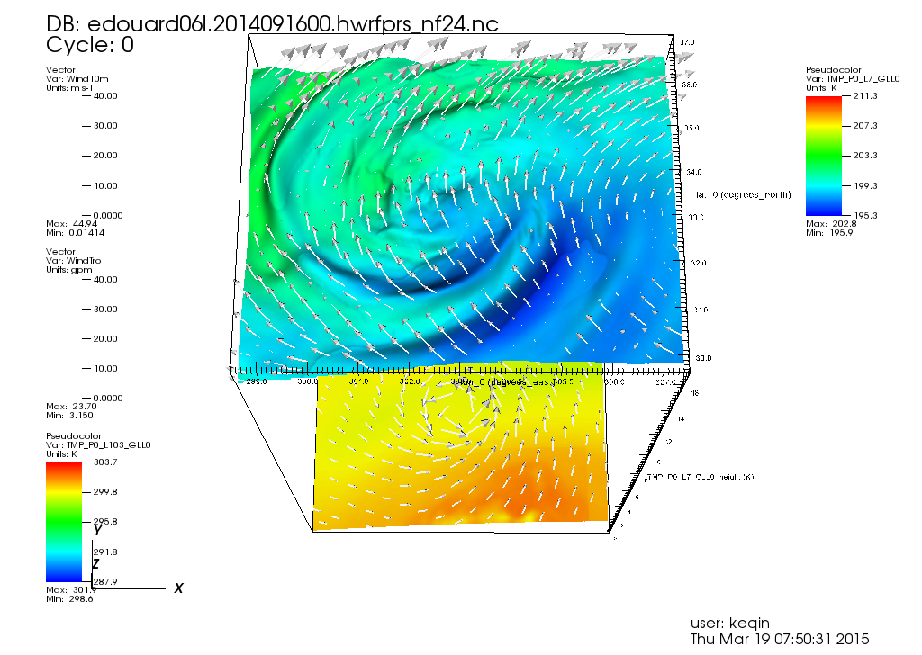
Resolution Impact on Storm Structure
Edouard, 06L 2014091600, at Day 1 Forecast
H215
H214
Detailed storm structure from high resolution model.

Slide 7
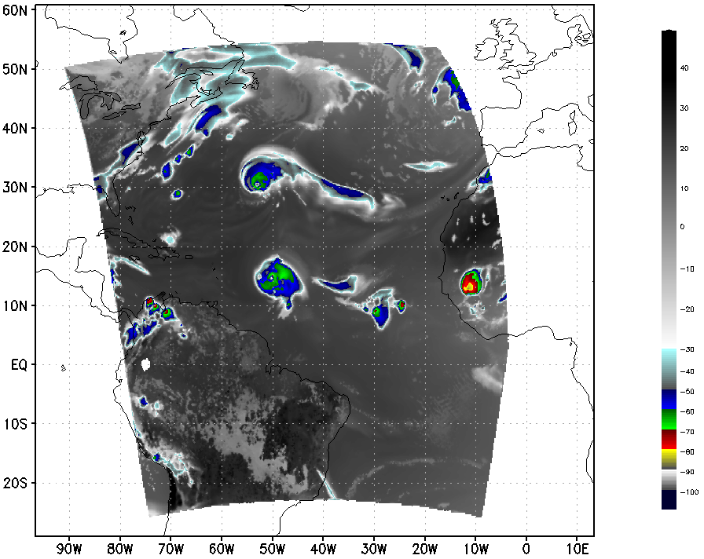
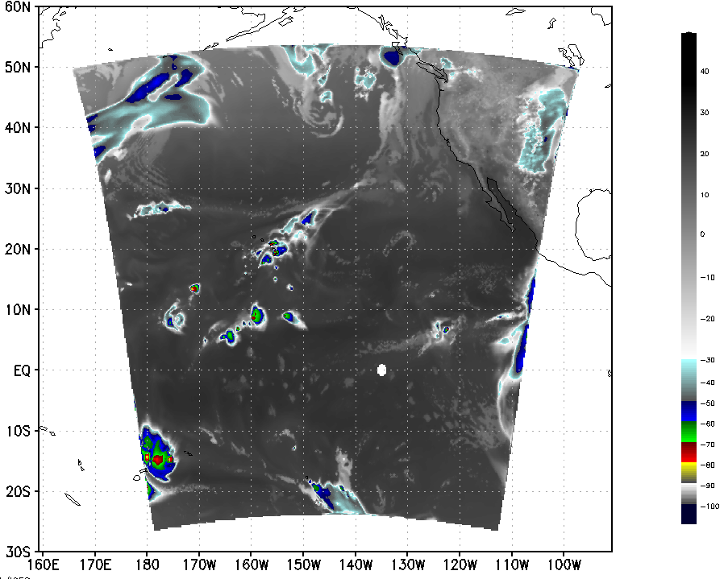
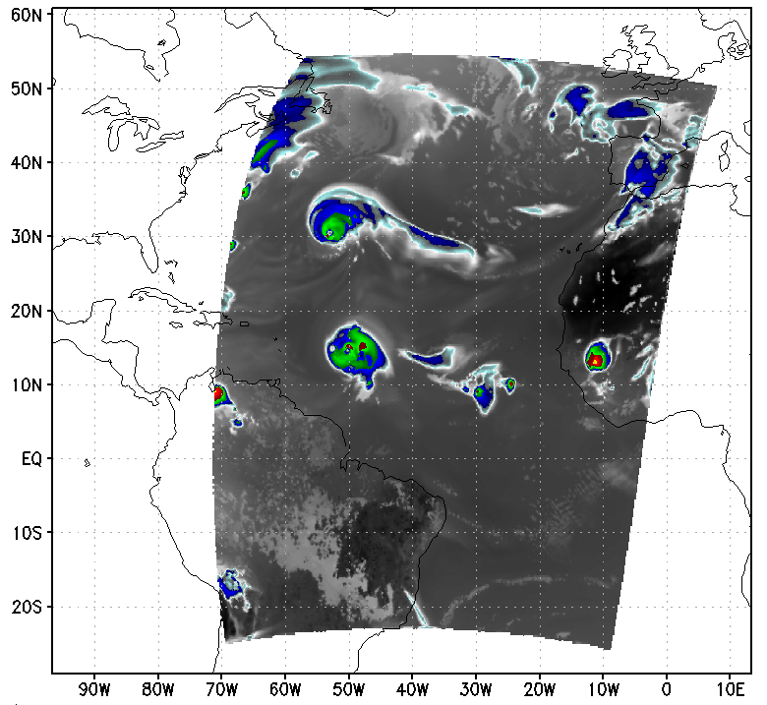
Product Upgrades for GOES/SEVIRI synthetic IR imagery
IR
IR
IR
HWRF GOES-15
HWRF SEVIRI/METEOSAT
HWRF GOES-13

Slide 8
Data Assimilation Upgrades (H15T)
DA Upgrades for non-TDR cases (included in H215)
  Upgrade to the latest EMC GSI v5.0.0, and will be further tuned to improve the initial analysis for all HWRF domains.
  use the 80-member global ensemble based one-way hybrid EnKF-3DVAR 6h forecast fields to calculate the covariance.
  Enlarged d2 (6km) and d3 (2km) analysis domains to address discontinuity in the initial condition between forecast domains;
  Run GSI on d2 analysis domain and add analysis increment to d3;
  No satellite DA on d3 analysis domain due to pronounced negative impact;
  Added the assimilation of tcvitals MSLP data along with dropsonde data.
DA Upgrades for TDR cases (H215 Final):
  run 40-member HWRF ensembles for 6h to provide more accurate, flow-dependent, vortex-dependent data assimilation covariance.
  Run GSI on both d2 and d3 analysis domains;
  Larger data assimilation domains

Slide 9
Upgraded Land Surface model
GFDL slab to NOAH LSM – NSF VSP Contributions
NOHA LSM provides realistic land surface physics, and predicts soil moisture, soil temperature, land surface skin temperature, land surface evaporation and sensible heat flux, and total runoff.
NOAH LSM significantly reduced the negative temperature bias
A major bug fix for NOAH LSM is introduced to prevent occasional model crash due to inconsistent stability dependent heat exchange coefficients over land (Subramaniam, NSF-NOAA VSP)
HWRF will include additional products for down-stream applications (e.g. storm surge, inland flooding)
Track errors for land-falling storms are improved based on preliminary tests
GFDL Slab
NOAH LSM

Slide 10
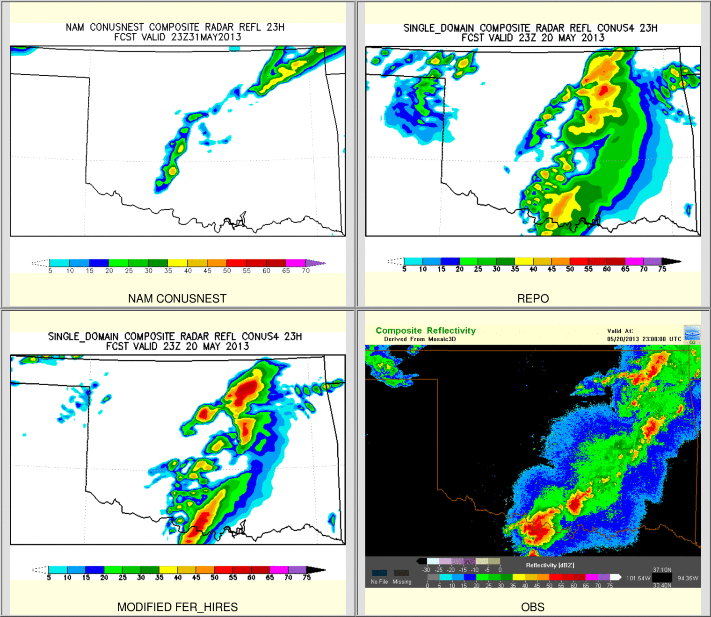
Upgraded Hi-Res Ferrier-Aligo Microphysics
New ice nucleation scheme to reduce no. concentration of small ice crystals
New, simpler closure for diagnosing small ice crystals and large, precipitating ice particles from ice mixing ratios
Slightly slower fall speeds of rimed ice
Increase the maximum (minimum) number concentration of small (large) ice in order to simulate better anvil cloud
Individual test showed positive impacts on structure and intensity forecasts
NAM Parallel
operation
With upgraded Ferrier
obs

Slide 11
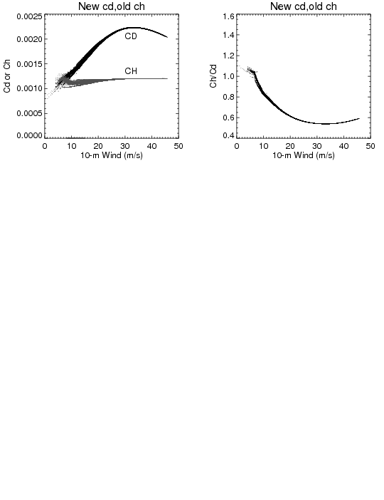
  Upgrade surface physics and PBL, momentum and enthalpy exchange coefficients(Cd/Ch) (H15U)
Cd/Ch change, suggested by URI, to better match observations values. The modified configuration provides improved intensity bias.
Increase of Ch at higher wind speeds (as implemented in GFDL) was causing model to become unstable and crash for stronger storms, suggestive of strong dependency of heat exchange coefficients at air-sea interface on model horizontal resolution

Slide 12
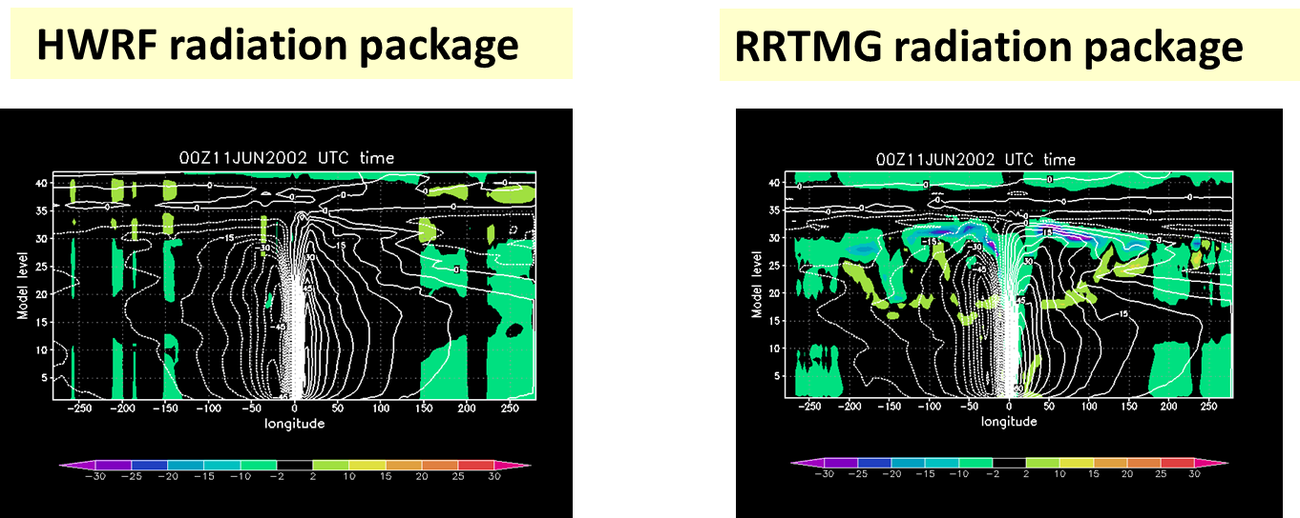
Upgraded SW/LW radiation schemes
(GFDL radiation to RRTMG)
GFDL radiation schemes have problems of proper representations of cloud-radiation interactions, especially net cloud top cooling and net cloud base warming.
Introduced much improved RRTMG radiation with parameterized sub-grid scale cloudiness and variable (wind-speed dependent) vertical mixing coefficient (following work done by Robert Fovell, UCLA; Greg Thompson, NCAR; Ligia Bernardet/Christina Holt,DTC).
Identified a problem in RRTMG related to O₃/CO₂ initialization. This problem is fixed in final H215 configuration
Cloud top cooling due to radiation

Slide 13
Code Optimization & Workflow Modifications
  Sped up 2015 HWRF from 160 minutes to 96 minutes
    Increase from 13 compute nodes to 22 (~2.5x increase w.r.t. WCOSS Phase 1 16 core nodes, to fit of new 24 core Phase 2 compute nodes).
    Change the task geometry so that WRF compute processors within one compute node are adjacent to one another in a 4x4 grid.
    Switch to the quilt_pnc implementation of WRF I/O servers. This gained us about 30-35 minutes of runtime.
    Turn off the logging from all WRF processors. This gained us about 8 minutes of runtime.
  End-to-end HWRF scripting system in Python for all global ocean basins
  Switch to 100% GRIB2 output from HWRF
  Further changes to the HWRF workflow to improve the timing and reliability of forecast delivery

Slide 14
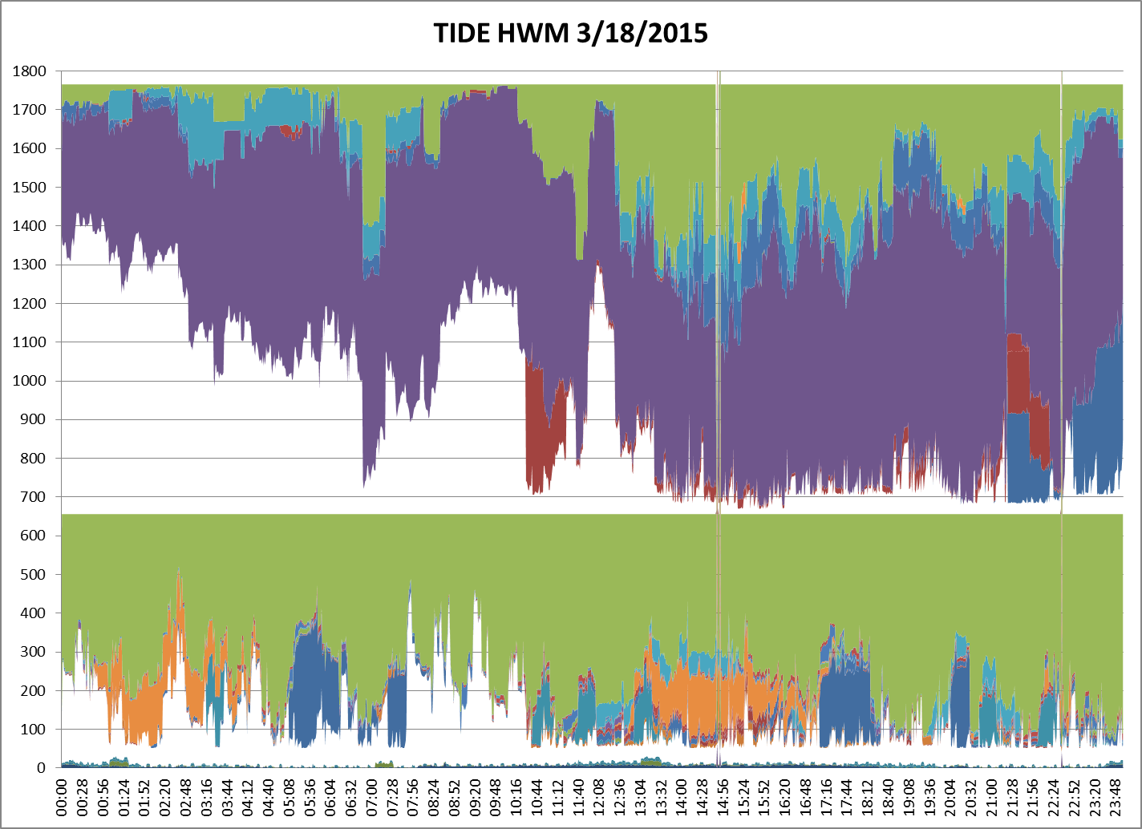
WCOSS Development Machine 03/18/2015
RTOFS
HWRF
NAM
GFS
CFSV2
GEFS
SREF

Slide 15
Acronyms
H15B: FY15 HWRF baseline, 18/6/2km resolution, L61, input: T1534L64 GFS (Spectral files for both IC and BC);
H214: 2014 version of operational HWRF, 27/9/3km resolution, L61, input: T574 L64 GFS (Spectral files for both IC and BC);
H15Z: H214 driven by New GFS (Control)
H215: H15B + All Physics upgrades;
H15T: Combined with H215, and tested for TDR storms for high-resolution ENSDA.

Slide 16
Verification for Atlantic Storms (2011-2014)

Slide 17
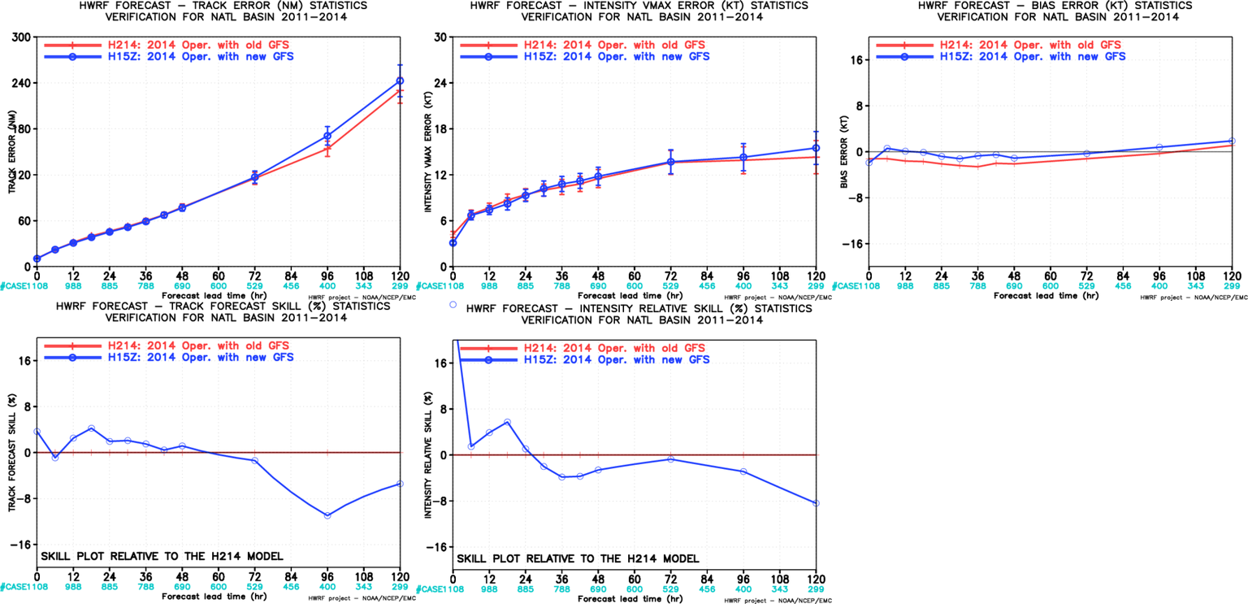
Impact of New GFS, NATL
New GFS degraded track/intensity forecasts at later hours

Slide 18
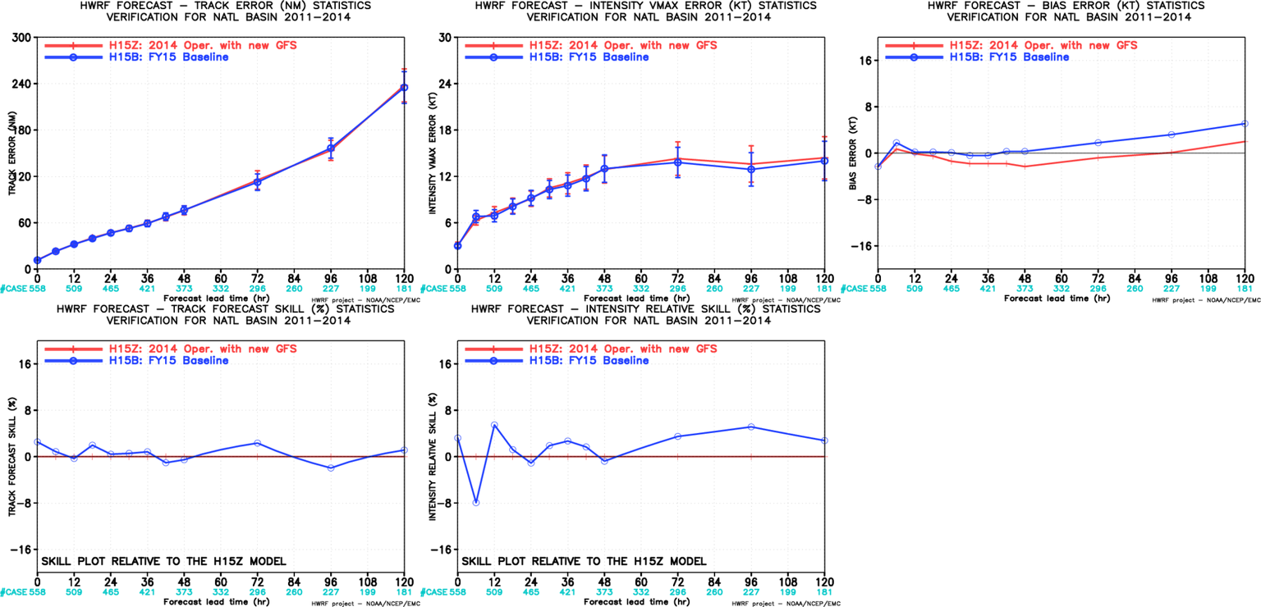
Impact of HWRF Resolution, NATL
Neutral track impact;
Neutral to positive intensity impact;
Relative large intensity bias;
Resolution upgrades and vortex initialization changes have offset the loss of skill due to new GFS

Slide 19
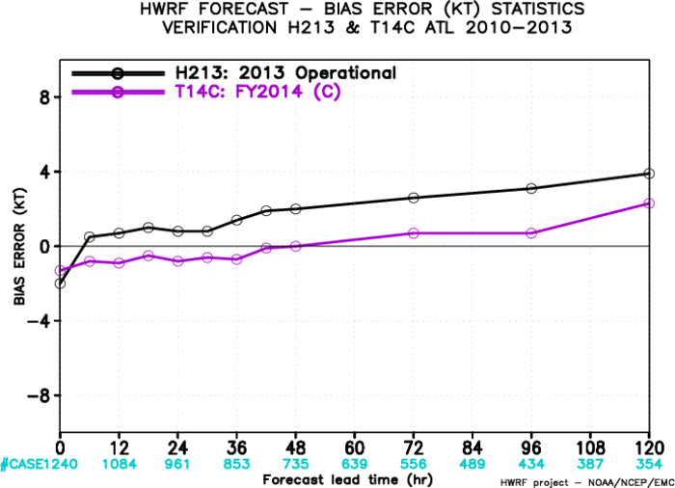
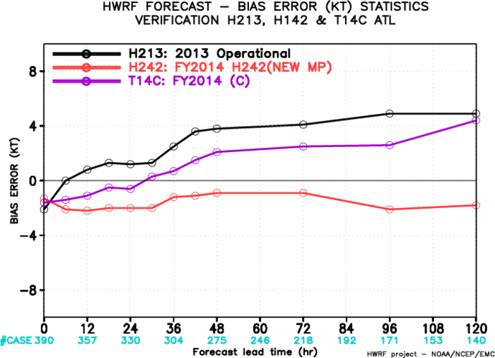
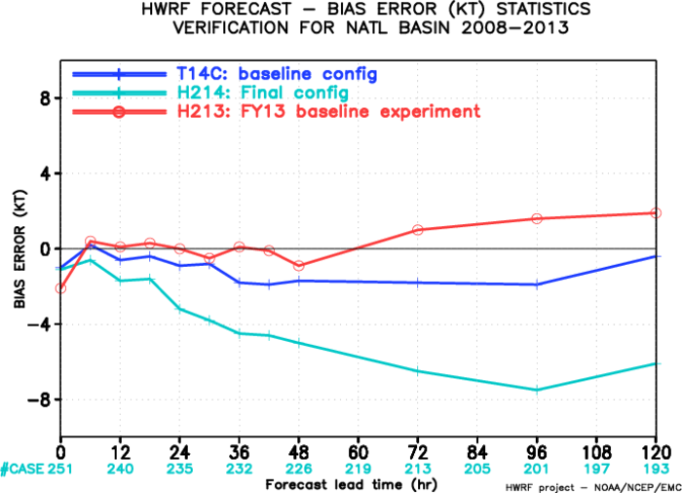
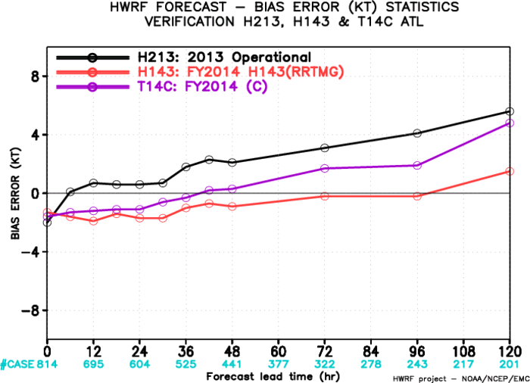
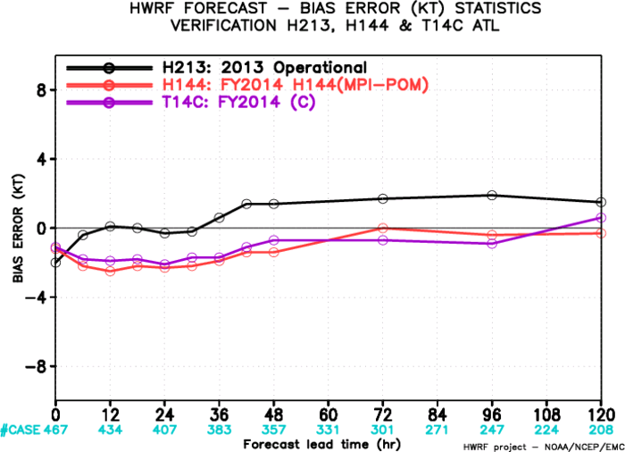
BIAS
T14C
Initial combination
H242
Control configuration
Microphysics upgrades
Combination
Infrastructure+MP+Radiation+Ocean
Radiation upgrades
Ocean upgrades

Slide 20
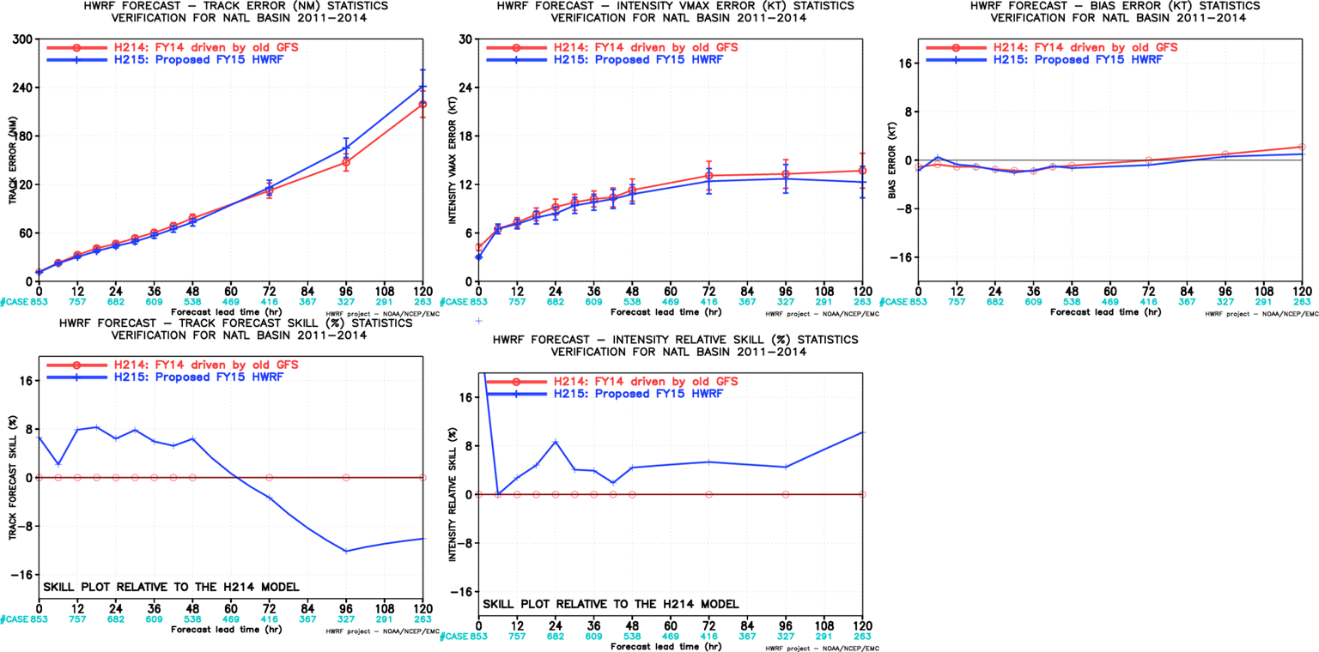
Impact of Physics, Resolution & New GFS, NATL(H215 vs H214)
New Cd, Current Ch, Modified PBL, Ferrier-Aligo MP, RRTMG, NOAH LSM
Positive track impact;
Positive intensity impact;
Similar intensity bias;
Physics enhancements were carefully evaluated based on resolution and initialization upgrades to address the negative impacts noted in H214 evaluation

Slide 21
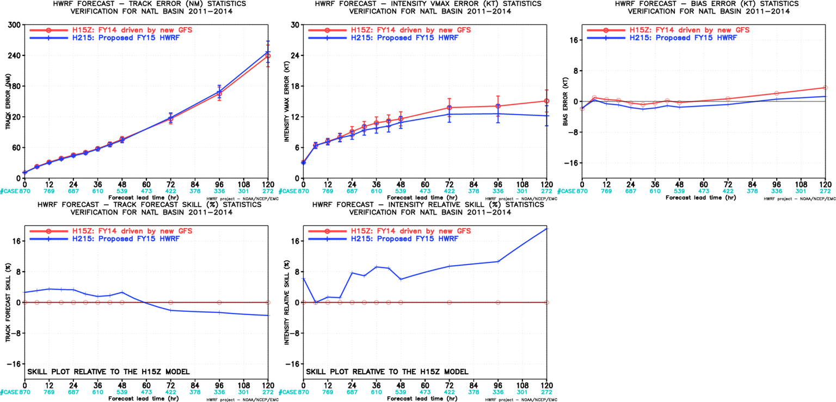
Impact of Physics & Resolution, NATL(H215 vs H15Z)
New Cd, Current Ch, Modified PBL, Ferrier-Aligo MP, RRTMG, NOAH LSM
Neutral track impact;
Positive intensity impact
Continued the trend of improvements in intensity forecasts;
Physics enhancements were carefully evaluated based on resolution and initialization upgrades to address the negative impacts noted in H214 evaluation

Slide 22
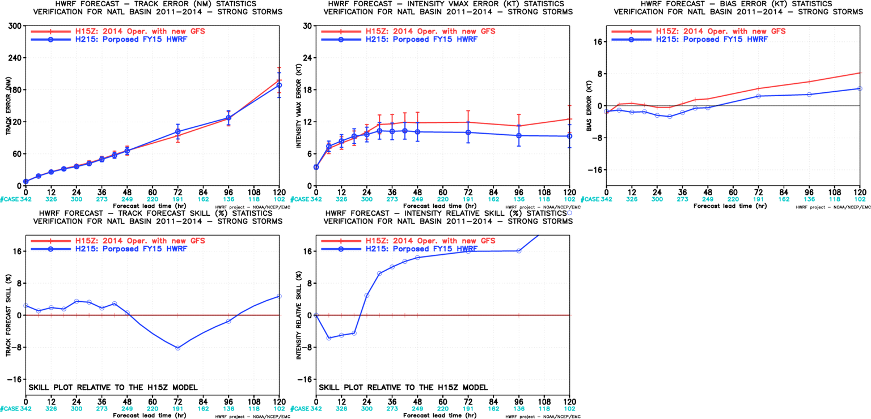
Initially Strong Storm verification, NATL
(H215 vs H15Z)
Improved track fcst at all time except for day3;
Improved intensity fcst at all times (>10% improvement beyond day2)

Slide 23
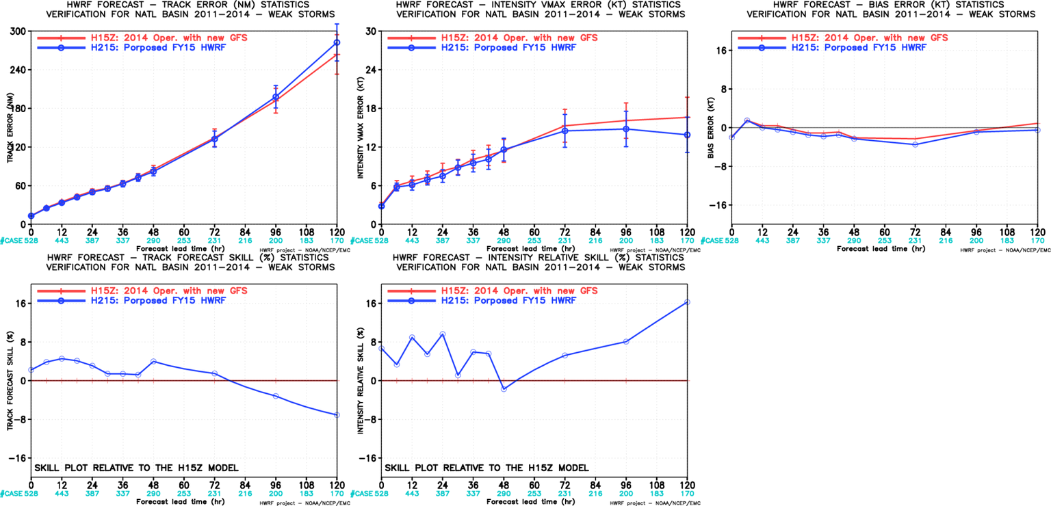
Initially Weaker Storm verification, NATL
(H215 vs H15Z)
Improved track fcst up to day 3
Improved intensity fcst at all times

Slide 24
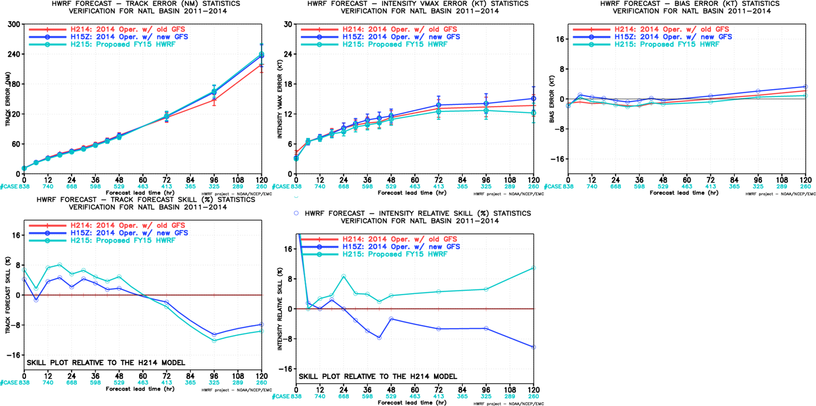
Homogenous Verification of H214/H15Z/H215, NATL
Confirmed that new GFS degraded HWRF track forecasts, FY15 implementation is able to partially recover the skill loss, also substantially improves the intensity forecasts.

Slide 25
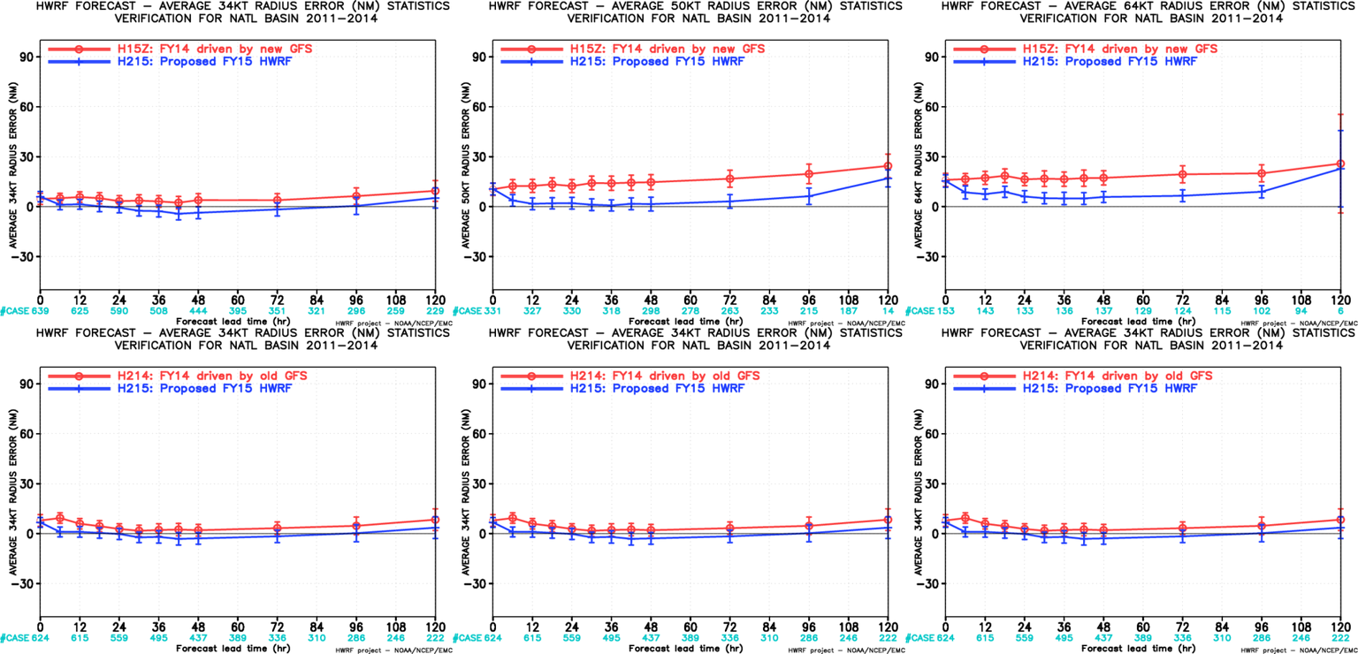
Storm Structure Verification for H215 vs H15Z/H214,NATL
Top: H215 vs H15Z, Bottom: H215 vs H214
AL-R34
AL-R50
AL-R65
AL-R34
AL-R50
AL-R65
Storm sizes are improved in H215 in all three radii for ATL storms.

Slide 26
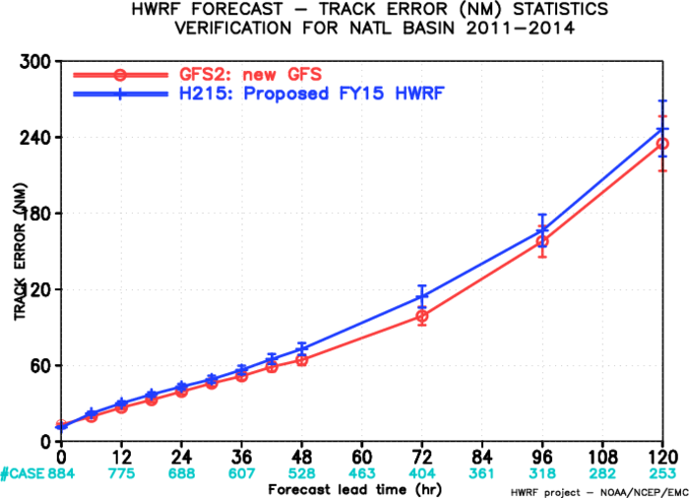
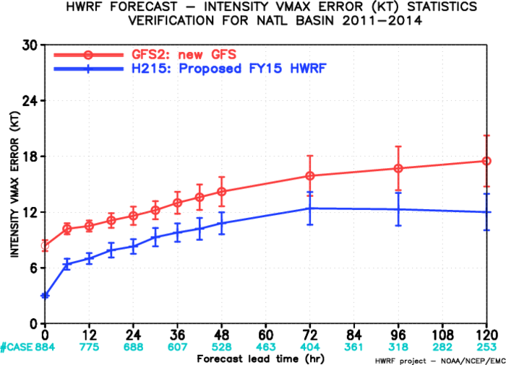
Verification Against new GFS, NATL

Slide 27
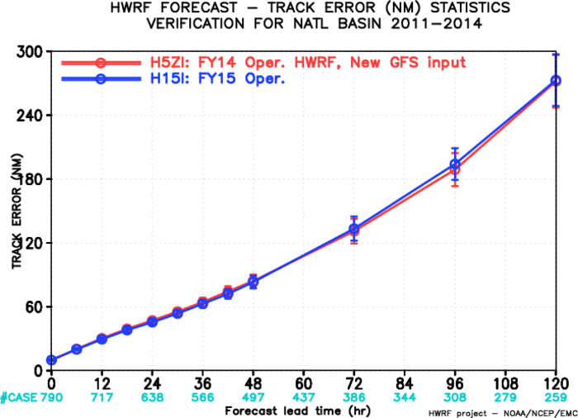
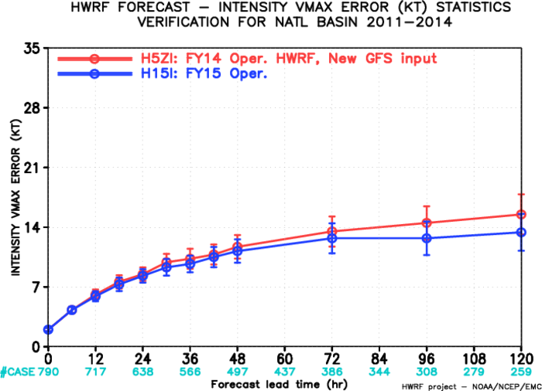
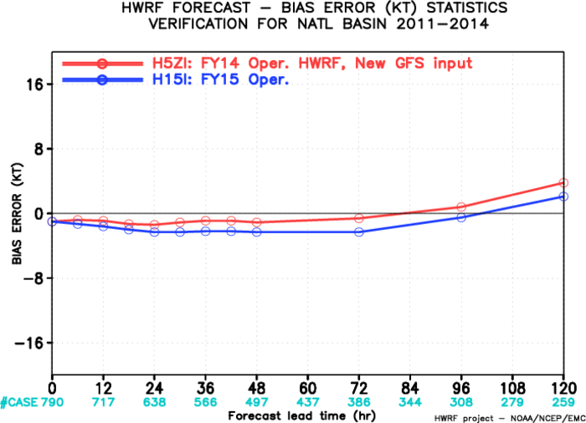
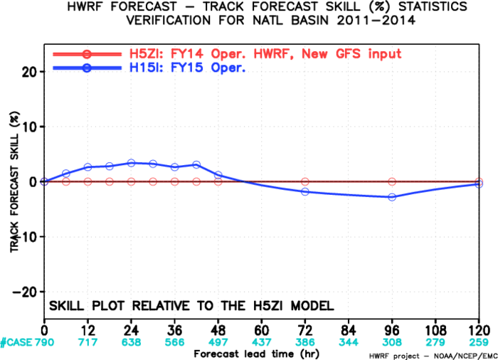
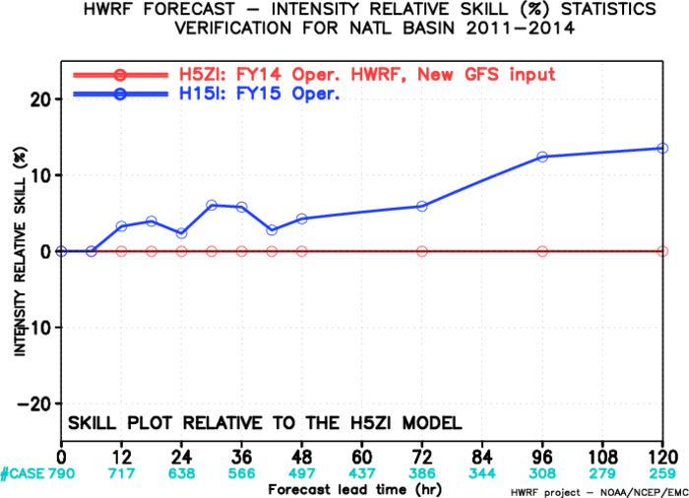
Early Model Verification: H215I vs H15ZI,NATL
Positive to neutral track impact;
Positive intensity impact at all forecast lead times
Continued the trend of improvements in intensity forecasts;

Slide 28
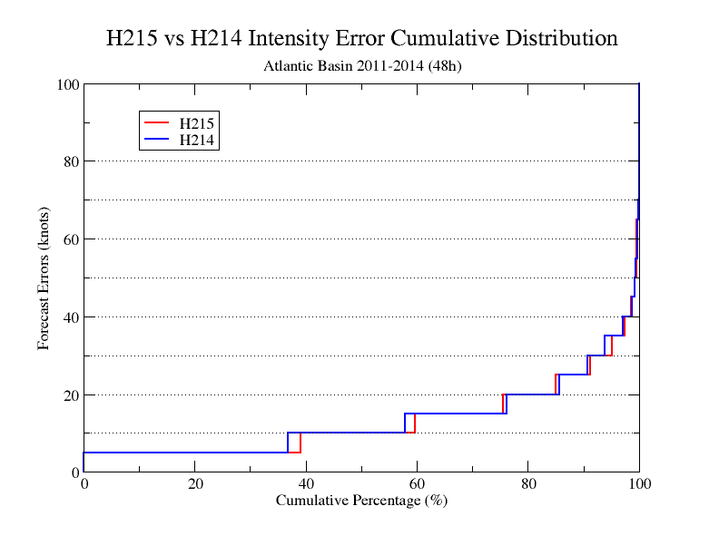
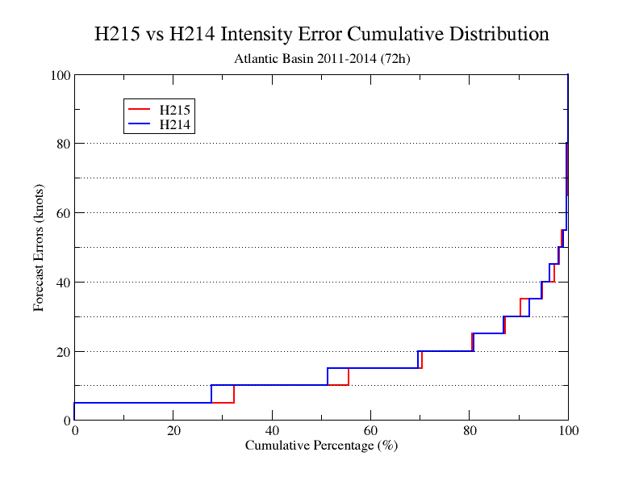
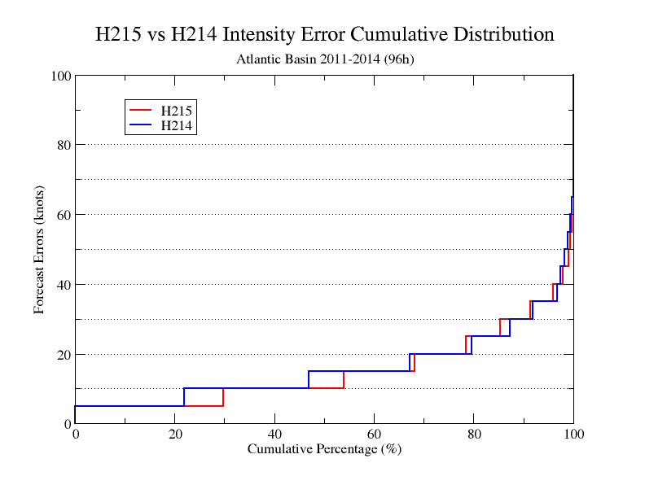
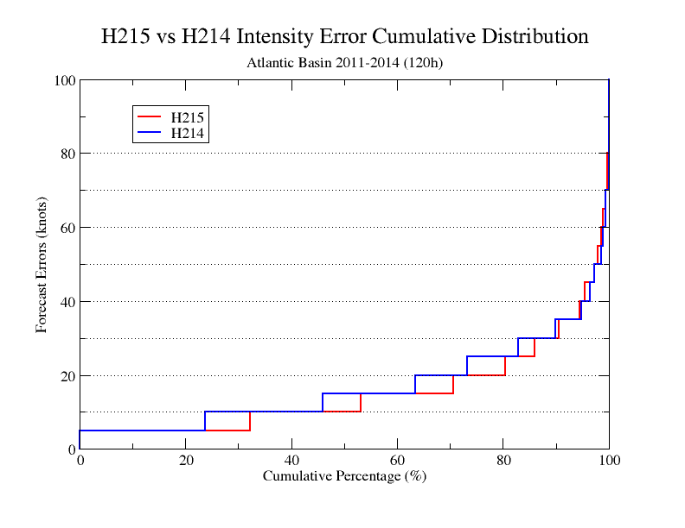
Improvement of Intensity Cumulative Distribution of H215,AL
Day 2
Day 3
Day 4
Day 5

Slide 29
Verification for East-Pacific Storms (2011-2014)

Slide 30
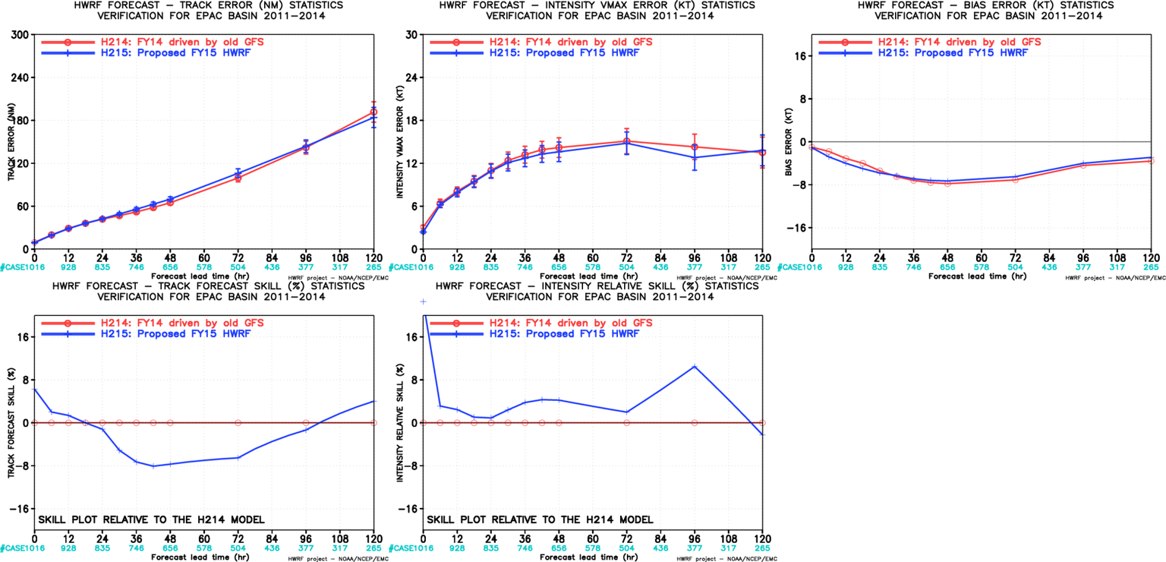
Impact of New GFS, EP
New GFS degraded track forecasts by about 8%
Some improvements in the intensity forecasts at later hours
Neutral intensity bias

Slide 31
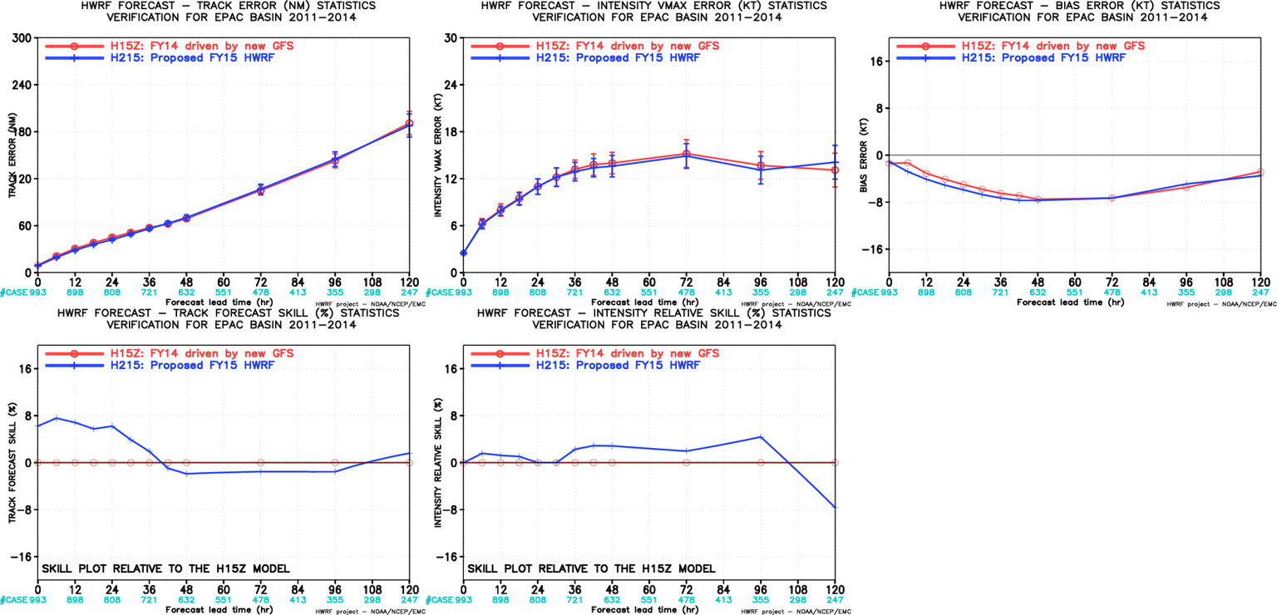
H215 vs H15Z,EP
2015 HWRF upgrades were able to recover the loss of track forecast skill due to new GFS, while still improving intensity forecasts

Slide 32
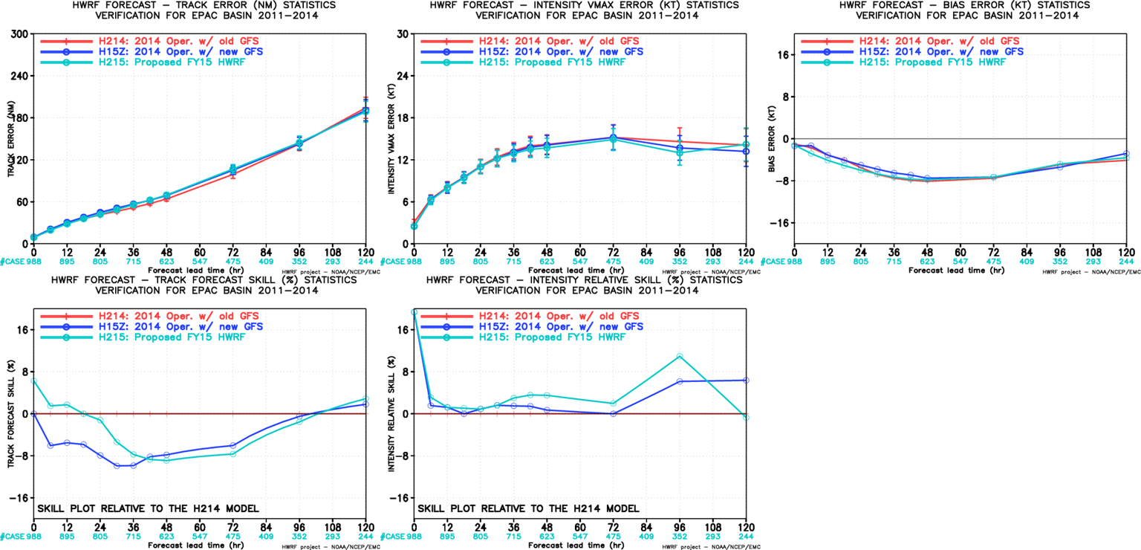
Homogenous Verification of H214/H15Z/H215,EP
2015 HWRF upgrades were able to recover the loss of track forecast skill due to new GFS, while still improving intensity forecasts

Slide 33
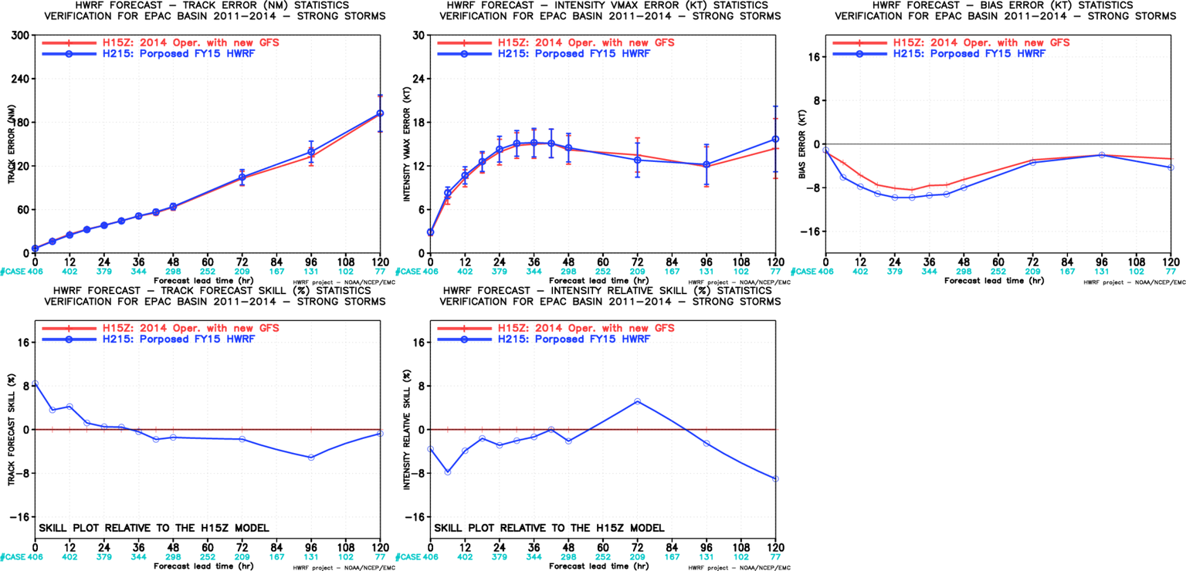
Initially Stronger Storm verification, EP
(H215 vs H15Z)
Neutral impact of 2015 HWRF upgrades for strong storms during the first three days, some degradation at day-5

Slide 34
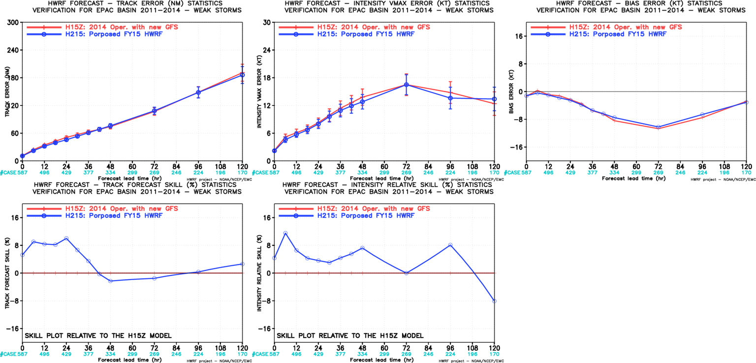
Initially Weaker Storm verification, EP
(H215 vs H15Z)
Track and intensity forecasts showed improvements for weaker storms in the Eastern Pacific

Slide 35
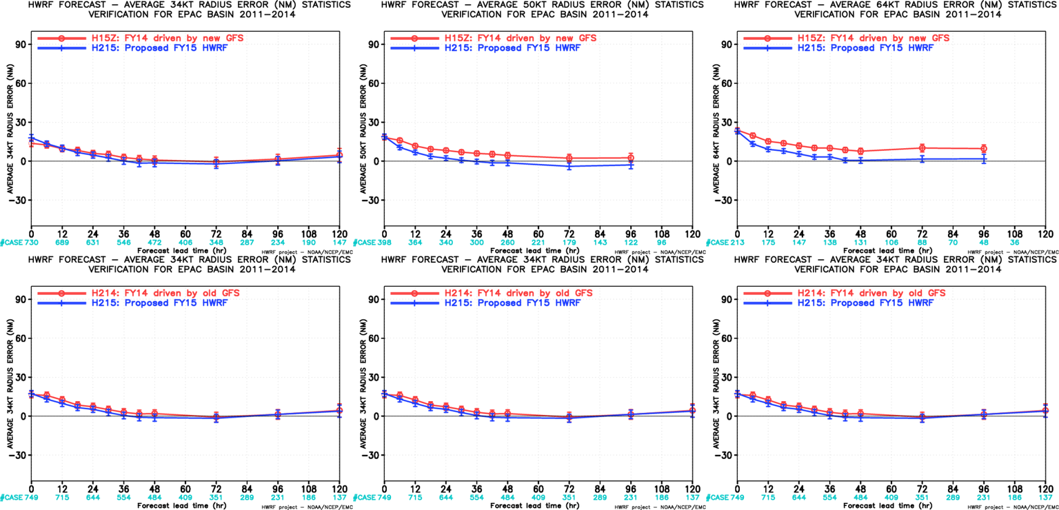
Storm Structure Verification for H215 vs H15Z/H214,EP
Top: H215 vs H15Z, Bottom: H215 vs H214
EP-R34
EP-R50
EP-R65
EP-R34
EP-R50
EP-R65
Storm sizes are improved in H215 in all three radii for EP storms.

Slide 36
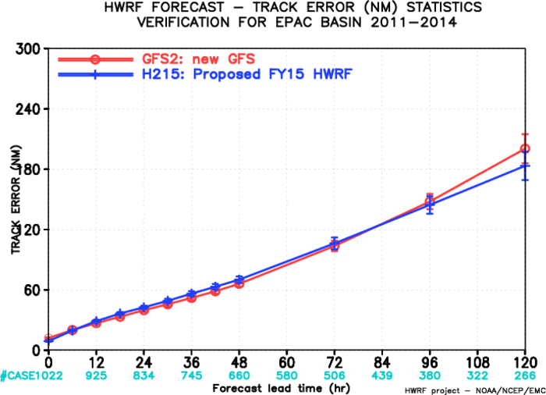
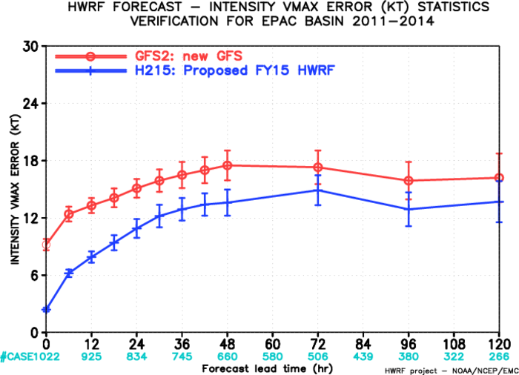
Verification Against new GFS, EP

Slide 37
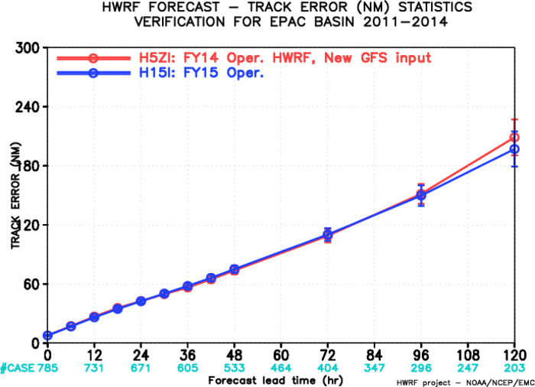
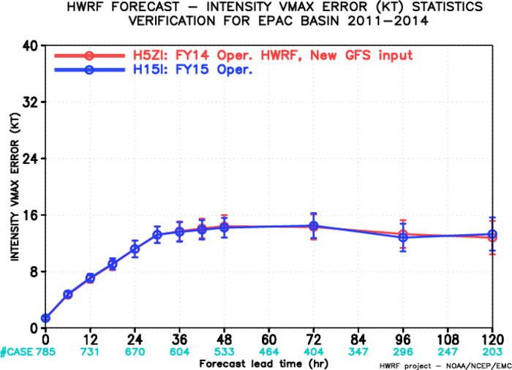
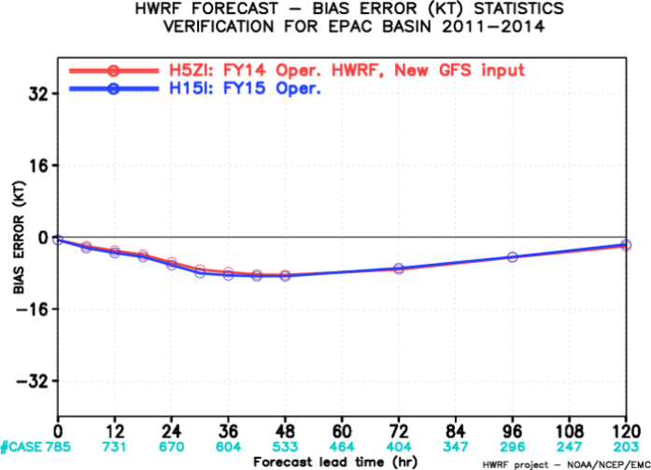
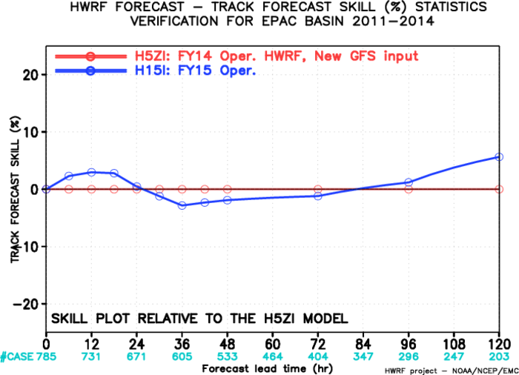
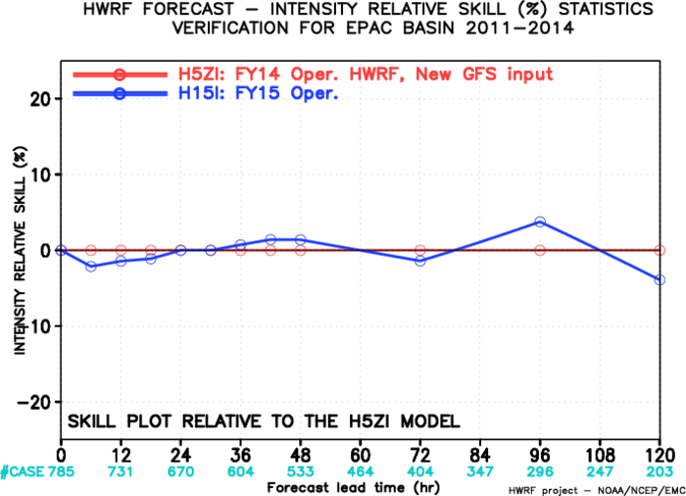
Early Model Verification: H215I vs H15ZI,EP

Slide 38
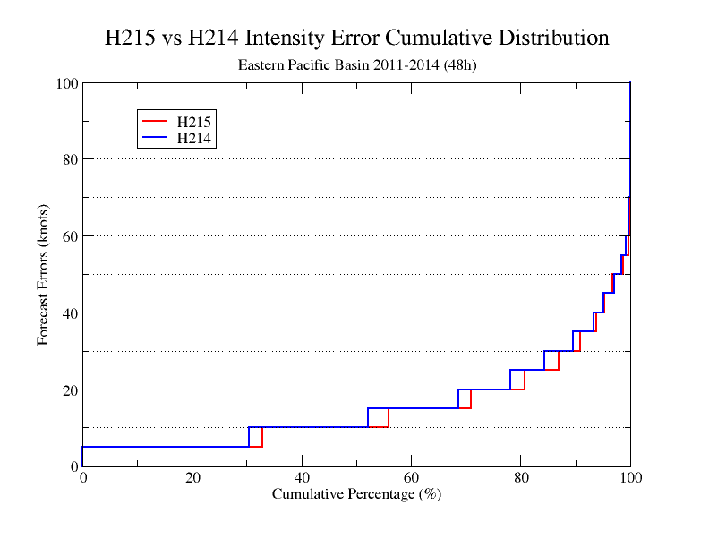
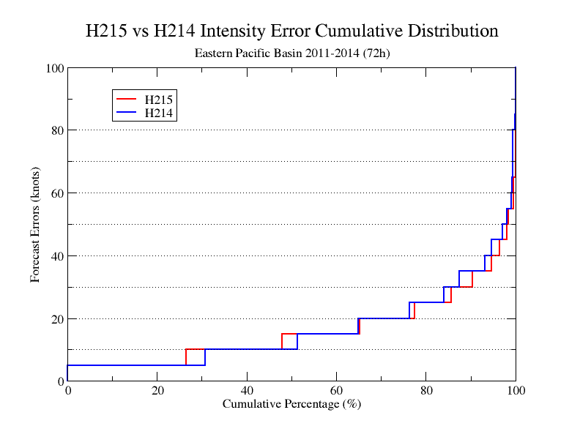


Improvement of Intensity Cumulative Distribution of H215,EP
Day 2
Day 3
Day 4
Day 5

Slide 39
Summary
Further enhancements suggested for 2015 operational HWRF include:
  Increase the horizontal resolution from 27/9/3 to 18/6/2 km.
  Upgrade and improve HWRF vortex initialization scheme
  Upgrade DA with hybrid HWRF-based EnKF and GSI system.
  Upgrade model physics to accommodate model resolution increase, including micro-physics process, radiation, surface physics, land surface and PBL.
H215 retrospective evaluation of 2011-2014 hurricane seasons (848/1110 cycles in NATL, 933/1204 in EP ) demonstrated improved track/intensity forecasts compared to both FY14 operational HWRF (H214) and FY14 driven by new GFS (H15Z), proposed for FY15 implementation;
Results from H215 for the Atlantic basin suggested additional 10-15% improvement possible from the newly upgraded model.
High-resolution ensemble based TDR DA paves way for the next generation vortex scale DA efforts supported by HFIP, while bringing immediate benefits in the operations.
Centralized HWRF Development Process for both research and operations with community involvement is critical for making further enhancements.

Slide 40

2015 HWRF: Continuing the trend of incremental but substantial improvements in ATL intensity forecasts

Slide 41
Next Steps
Retrospective T&E at EMC: March 23, 2015 --- Completed
Briefing to NHC: March 26, 2015 ----- Completed
NHC Evaluation and Recommendations: April 7, 2014 -- requested
Briefing to EMC and CCB: April 15, 2015
Submission of Codes to NCO: April 16, 2015
TIN for HWRF : April 29, 2015
NCO IT Testing and Code Freeze: May 15, 2015
Briefing to NCEP Director's Office: May 25, 2015
Implementation by NCO: May 29, 2015

Slide 42
Backup Slides
Evaluation of H215 for individual hurricane seasons
Per-storm evaluation of improvements/degradations for track and intensity forecasts at different lead times

Slide 43

Verification for each individual Year, NATL
(H215 vs H15Z)
2011
2012
2013
2014

Slide 44

Verification for each Individual year, EP
(H215 vs H15Z)
2011
2012
2013
2014

Slide 45
Individual Storm Track Forecast Improvement/Degradation, AL, Day 1
Negative: Improved
Positive: Degraded

Slide 46
Individual Storm Track forecast Improvement/Degradation, AL, Day 2
Negative: Improved
Positive: Degraded

Slide 47
Individual Storm Track forecast Improvement/Degradation, AL, Day 3
Negative: Improved
Positive: Degraded

Slide 48
Individual Storm Track forecast Improvement/Degradation, AL, Day 4
Negative: Improved
Positive: Degraded

Slide 49
Individual Storm Track forecast Improvement/Degradation, AL, Day 5
Negative: Improved
Positive: Degraded

Slide 50
Individual Storm Intensity Forecast Improvement/Degradation, AL, Day 1
Negative: Improved
Positive: Degraded

Slide 51
Individual Storm Intensity Forecast Improvement/Degradation, AL, Day 2
Negative: Improved
Positive: Degraded

Slide 52
Individual Storm Intensity Forecast Improvement/Degradation, AL, Day 3
Negative: Improved
Positive: Degraded

Slide 53
Individual Storm Intensity Forecast Improvement/Degradation, AL, Day 4
Negative: Improved
Positive: Degraded

Slide 54
Individual Storm Intensity Forecast Improvement/Degradation, AL, Day 5
Negative: Improved
Positive: Degraded

Slide 55
Individual Storm Track Forecast Improvement/Degradation, EP, Day 1
Negative: Improved
Positive: Degraded

Slide 56
Individual Storm Track Forecast Improvement/Degradation, EP, Day 2
Negative: Improved
Positive: Degraded

Slide 57
Individual Storm Track Forecast Improvement/Degradation, EP, Day 3
Negative: Improved
Positive: Degraded

Slide 58
Individual Storm Track Forecast Improvement/Degradation, EP, Day 4
Negative: Improved
Positive: Degraded

Slide 59
Individual Storm Track Forecast Improvement/Degradation, EP, Day 5
Negative: Improved
Positive: Degraded

Slide 60
Individual Storm Intensity Forecast Improvement/Degradation, EP, Day 1
Negative: Improved
Positive: Degraded

Slide 61
Individual Storm Intensity Forecast Improvement/Degradation, EP, Day 2
Negative: Improved
Positive: Degraded

Slide 62
Individual Storm Intensity Forecast Improvement/Degradation, EP, Day 3
Negative: Improved
Positive: Degraded

Slide 63
Individual Storm Intensity Forecast Improvement/Degradation, EP, Day 4
Negative: Improved
Positive: Degraded

Slide 64
Individual Storm Intensity Forecast Improvement/Degradation, EP, Day 5
Negative: Improved
Positive: Degraded

