Slide 1
FY15 HWRF Baseline/Physics Verification

Slide 2
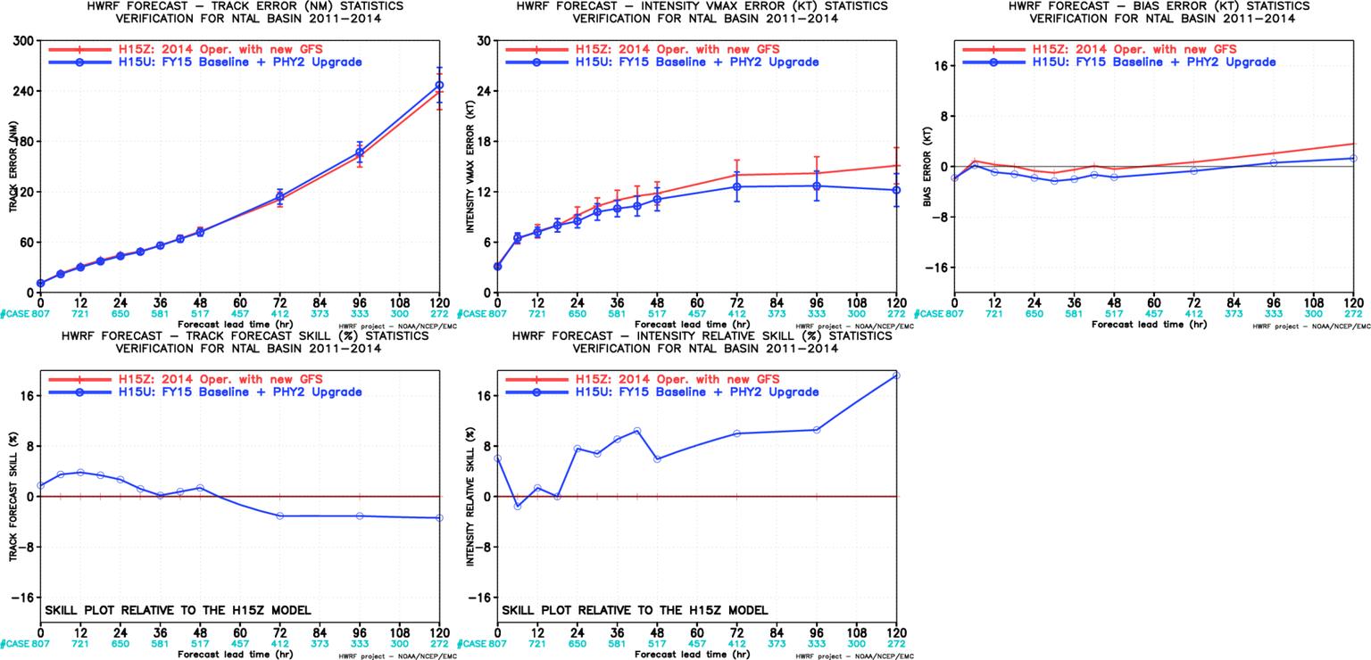
H15U vs H15Z, ATL
Neutral impact on track;
Positive impact on intensity and bias

Slide 3
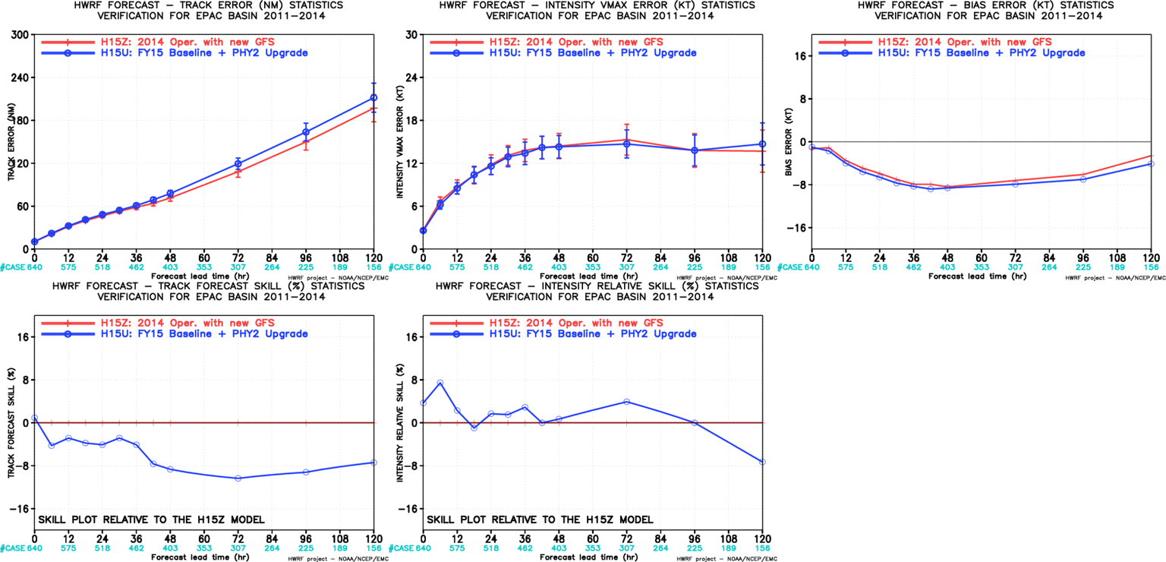
H15U vs H15Z, EP
Track neutral to little degraded,
Intensity improved except for day 5

Slide 4
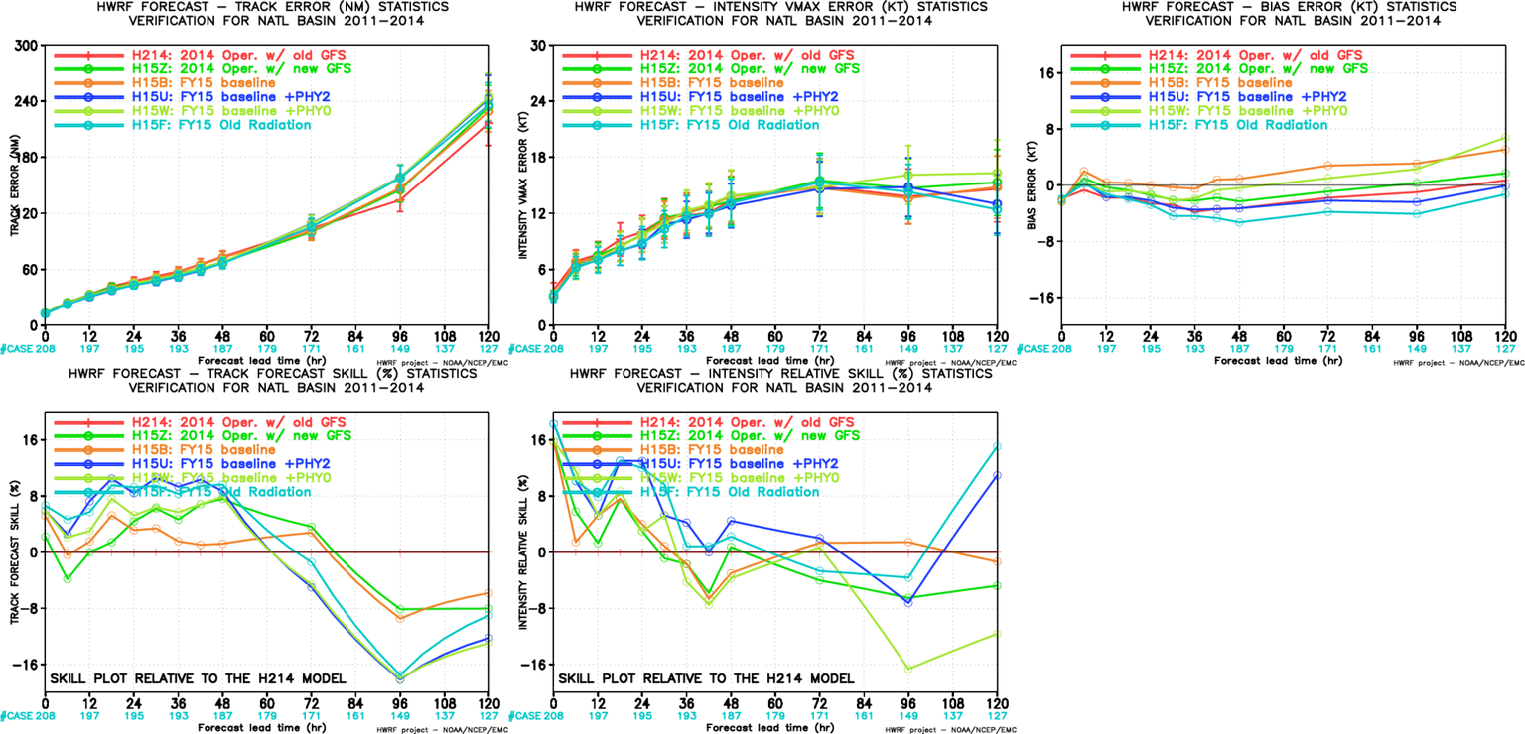
H15F(rollback Radiation) , ATL
Physics component rollback experiments:
RRTMG rollback;
MP rollback;
LSM rollback.
Rollback Rad. Has slightly positive impact on AL track forecasts.

Slide 5
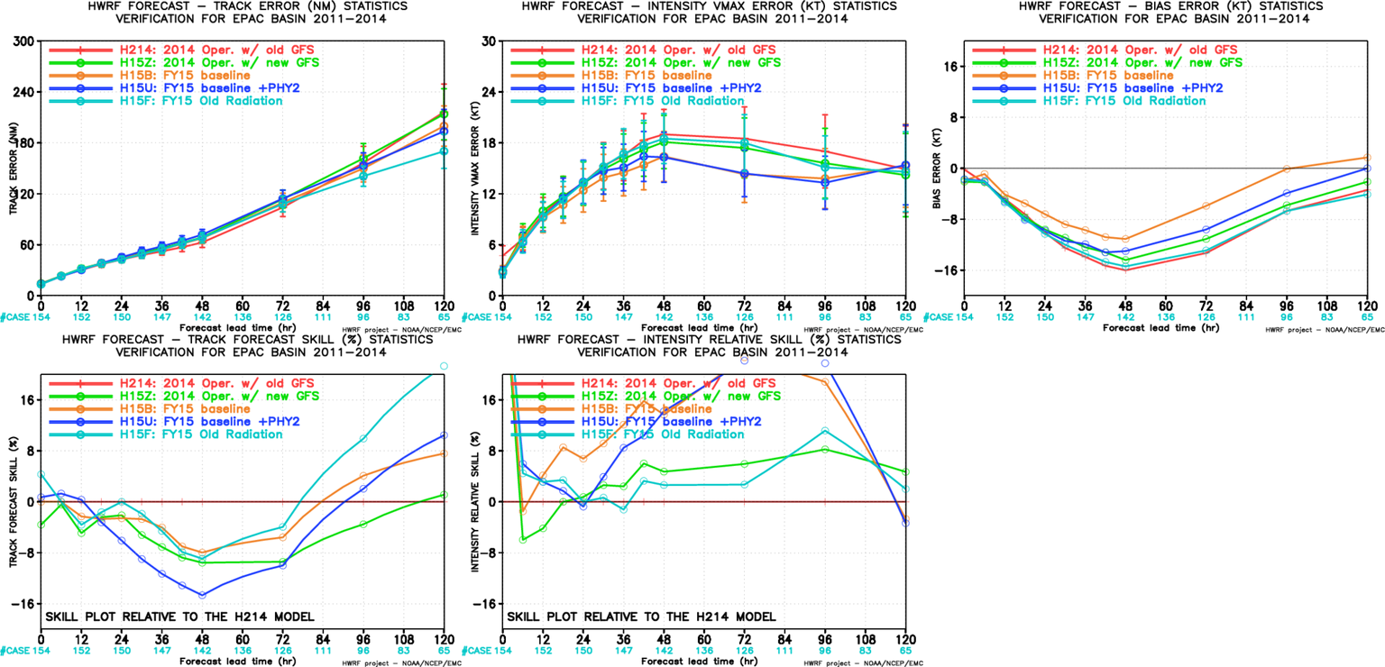
H15F(rollback Radiation) , EP
Physics component rollback experiments:
RRTMG rollback;
MP rollback;
LSM rollback.
RRTMG rollback has very positive impact on track forecasts.

