Slide 1
FY15 HWRF Baseline/Physics Verification

Slide 2
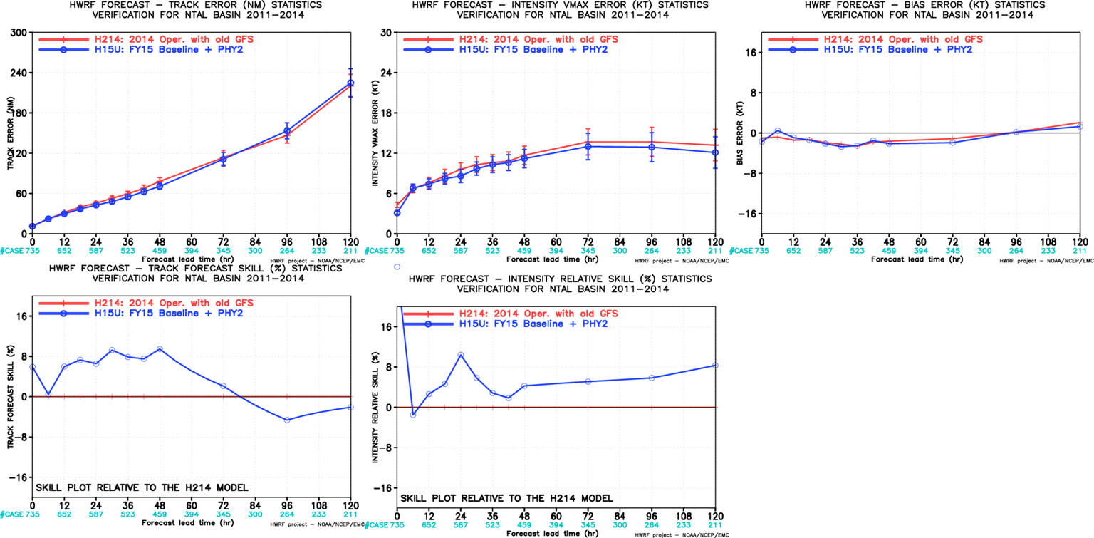
H15U vs H214, ATL
Some problematic storms are not included, but still have large sample size.

Slide 3
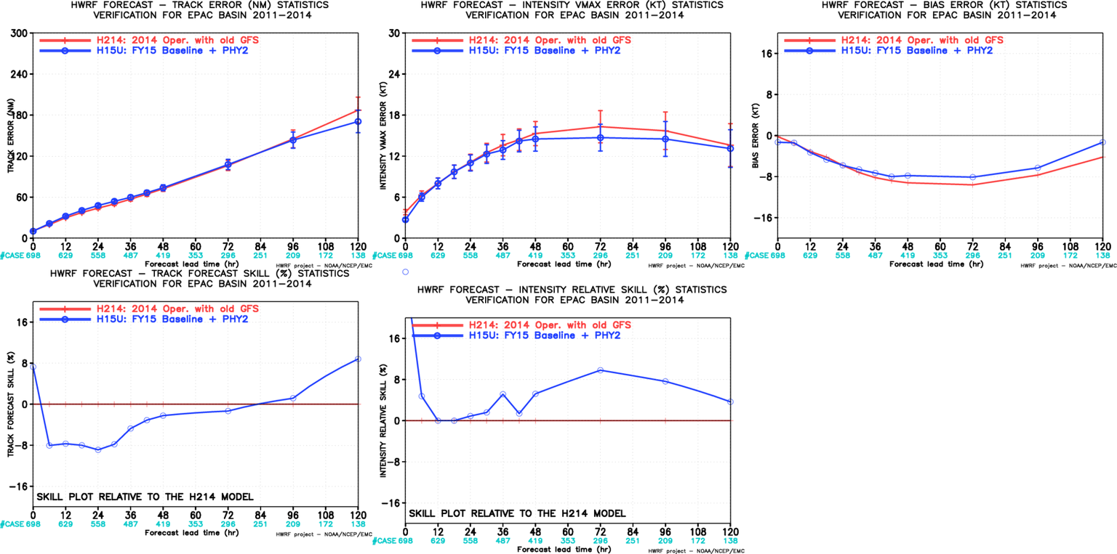
H15U vs H214, EP
Some problematic storms are not included, but still have large sample size.

Slide 4
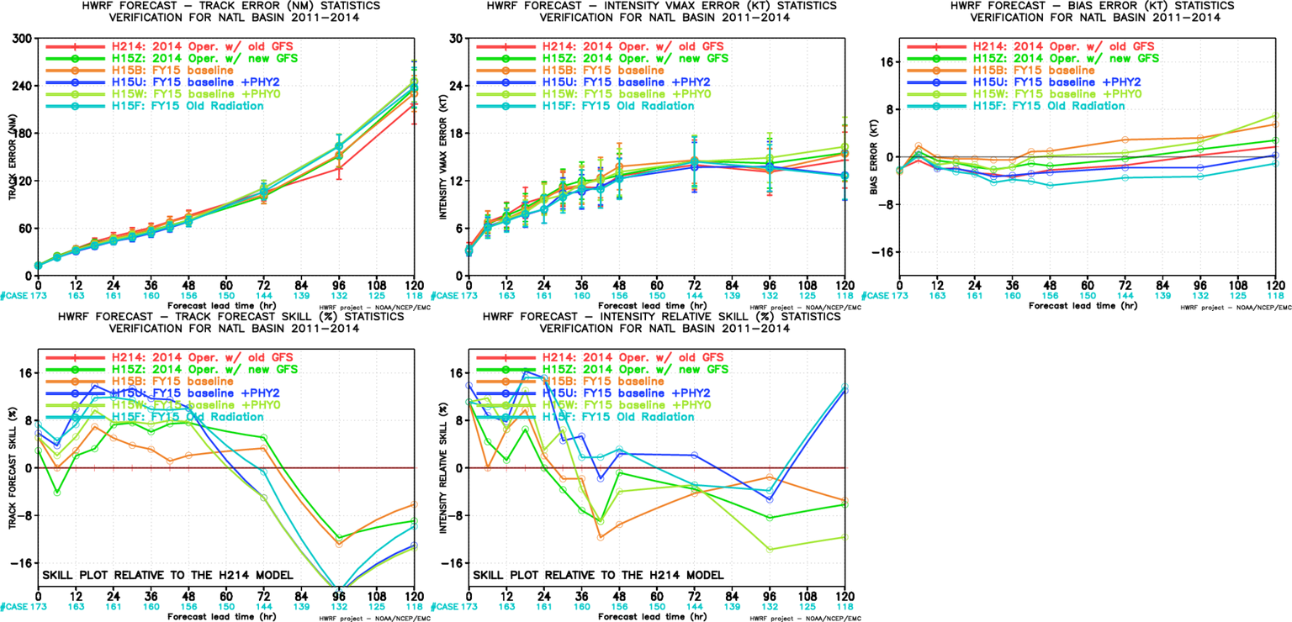
H15F(rollback Radiation) , ATL
Physics component rollback experiments:
RRTMG rollback;
MP rollback;
LSM rollback.

Slide 5
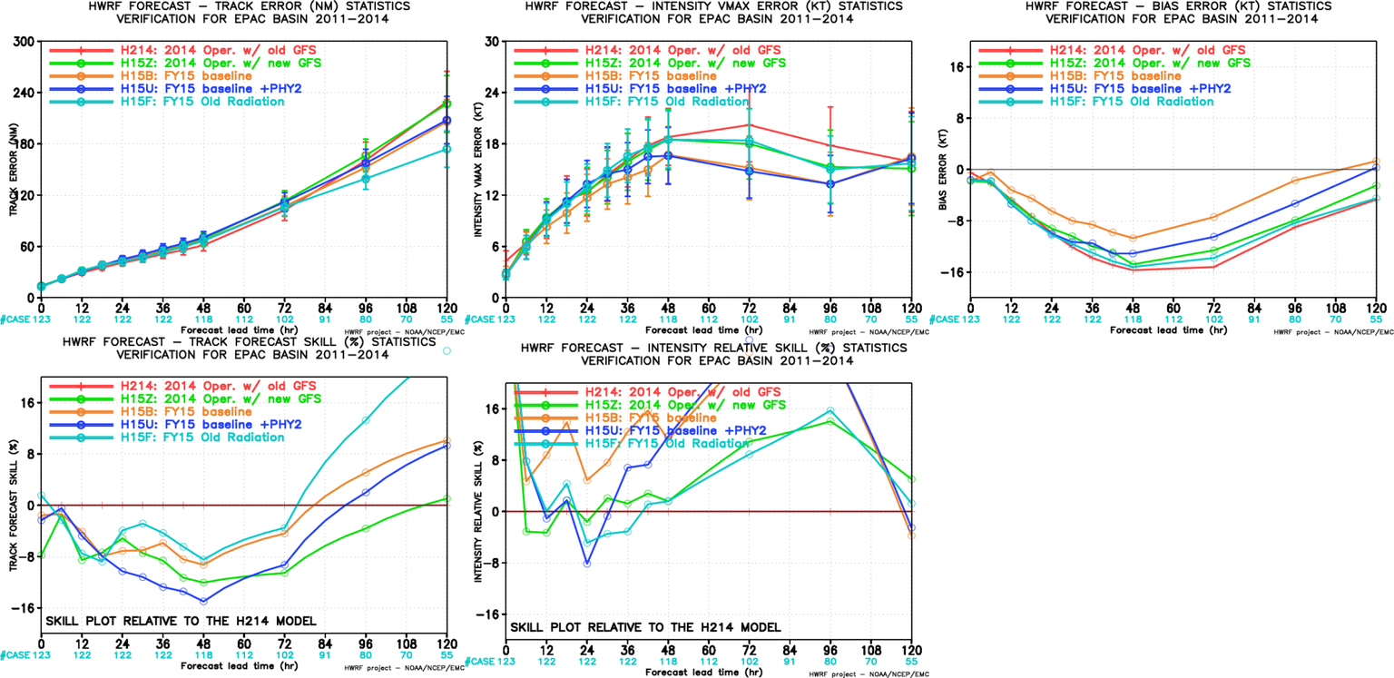
H15F(rollback Radiation) , EP
Physics component rollback experiments:
RRTMG rollback;
MP rollback;
LSM rollback.
RRTMG rollback has very positive impact on track forecasts.

