Slide 1
Investigate H15T forecast spin-down of Hilary 09E
Mingjing Tong

Slide 2
 | H15T | H15B/E
Data assimilation configuration | G02: 26°x26°, 0.045° G03: 13°x13°, 0.015° | G02: 20°x20°, 0.045° G03: 10°x10°, 0.045°
 | TDR available: DA on both G02 and G03. TDR not available: DA on G02 and interpolate analysis increment to D03 | DA on both G02 and G03
 | Both G02 and G03: all conventional and satellite observations as well as TDR data | G02: all observations G03: conventional and TDR data (no satellite observations)
 | Merge G03 analysis to G02, when DA on G03 is turned on | No merge between G02 and G03
Forecast | D02: 12°x12° | D02: 16°x16°

Slide 3
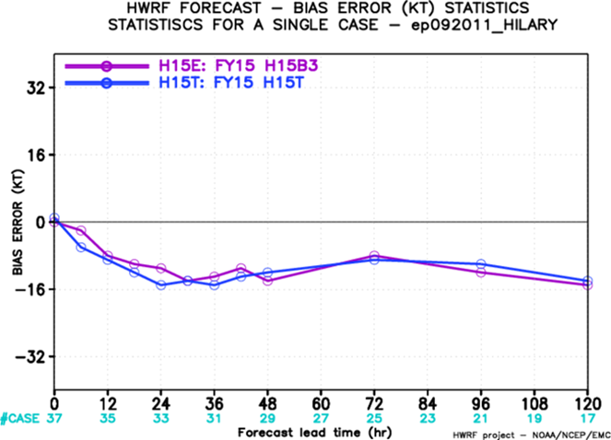
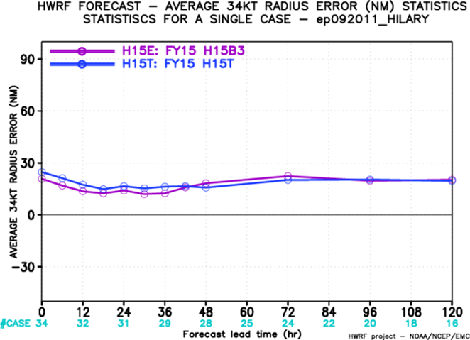

Slide 4
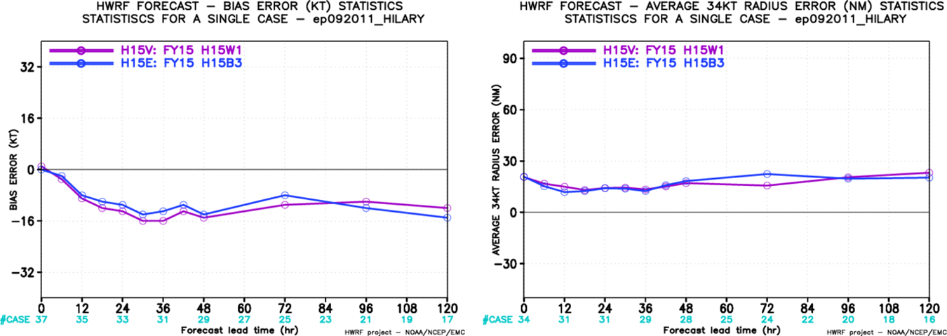

Slide 5
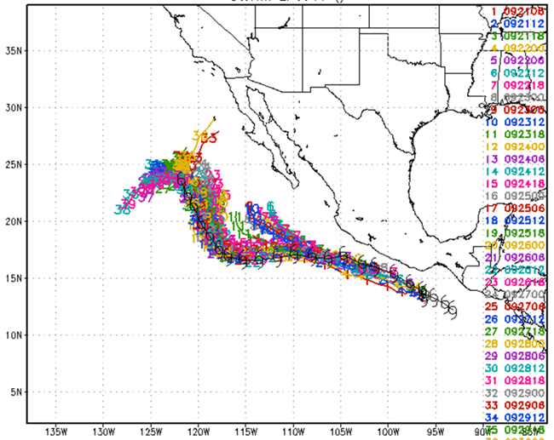
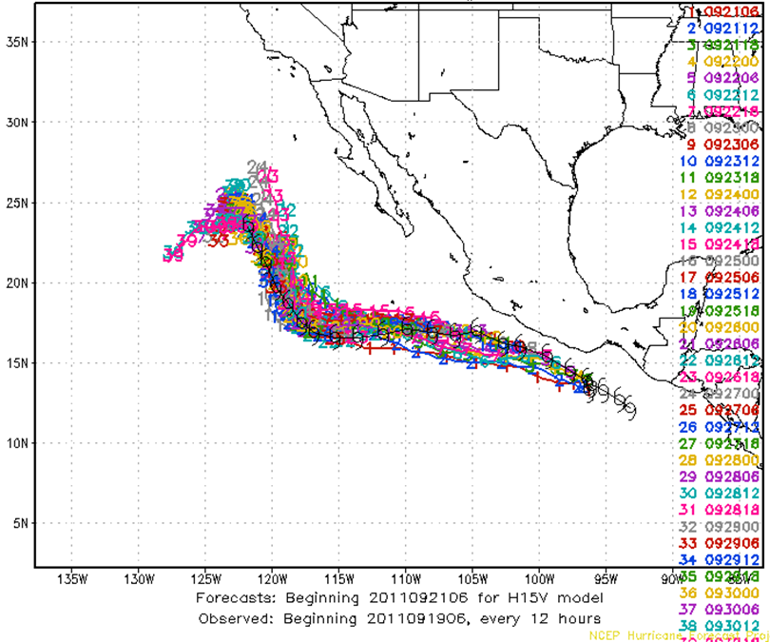
H15T
H15B/E
H15V

Slide 6
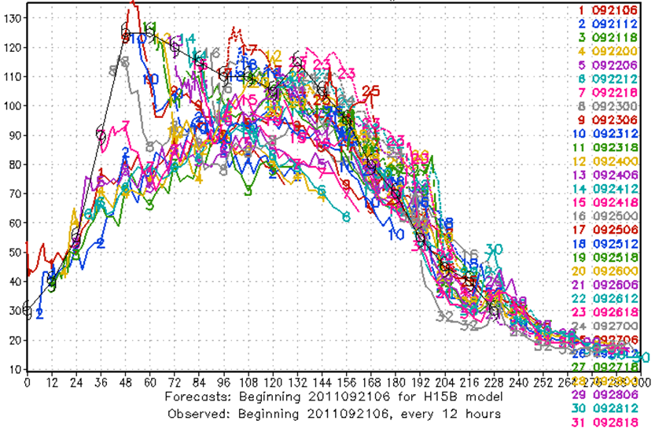
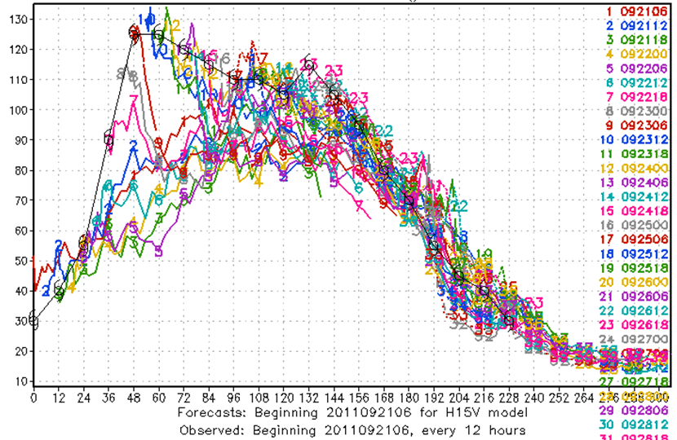
H15T
H15B/E
H15V

Slide 7
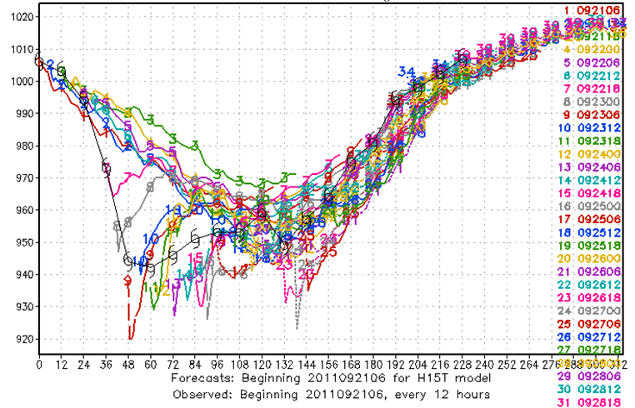
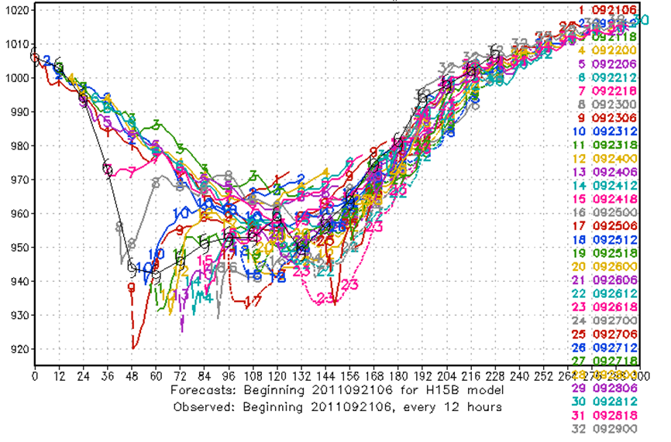
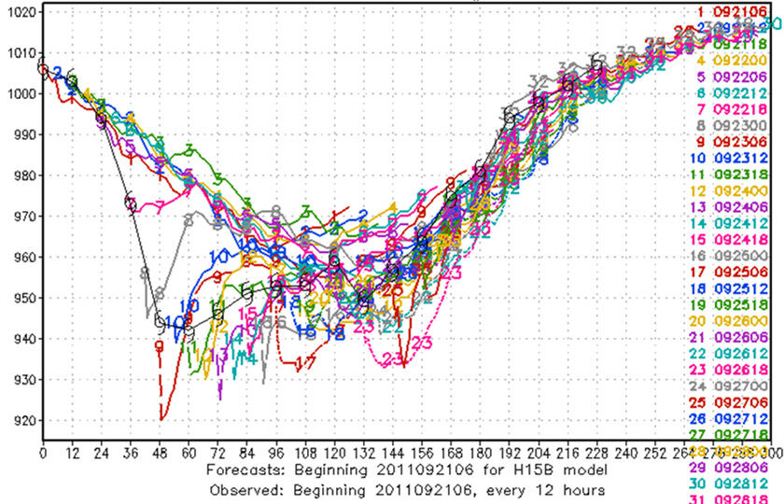
H15T
H15B/E
H15V

Slide 8
2011092300 H15T

Slide 9
2011092300 H15B/E

Slide 10
2011092300 H15T

Slide 11
2011092300 H15B/E

Slide 12
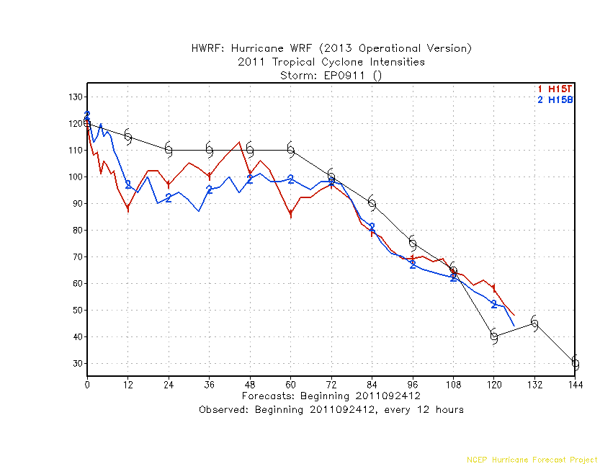
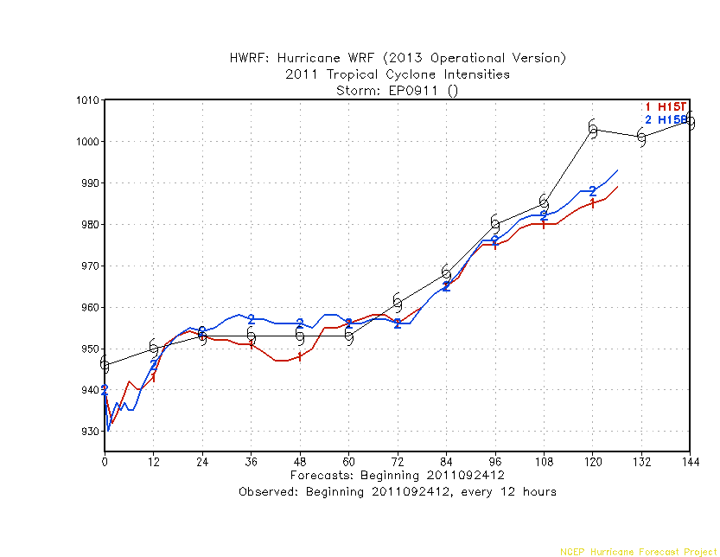

Slide 13
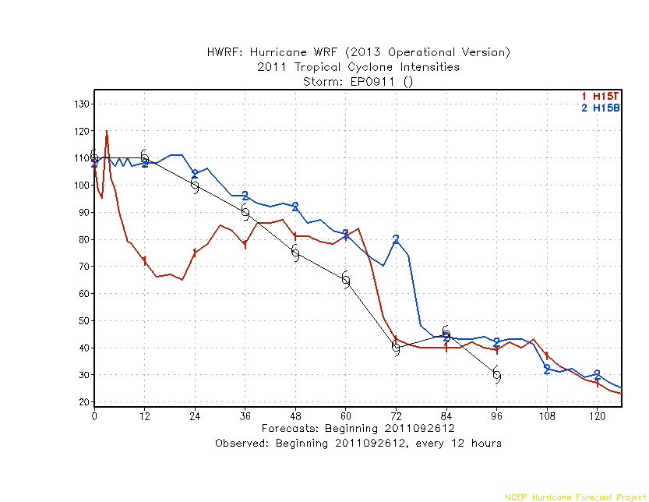
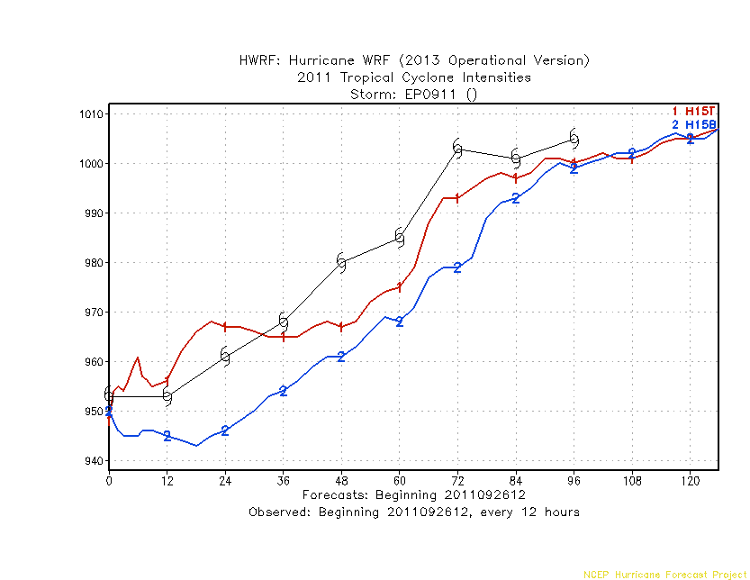

Slide 14
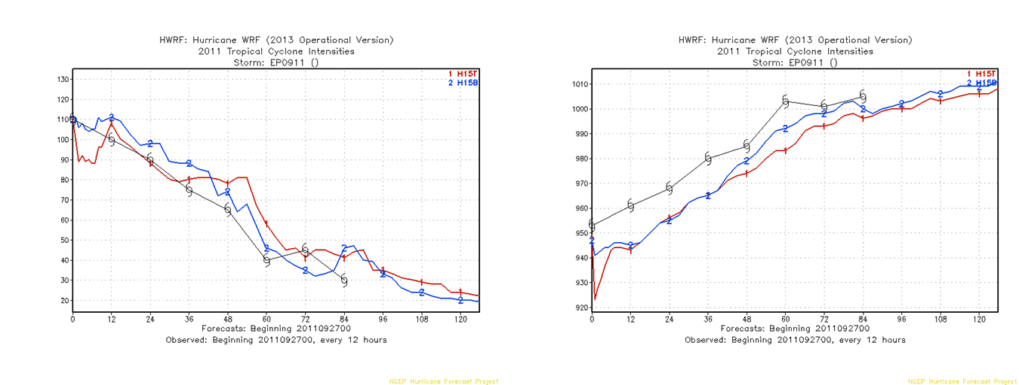

Slide 15
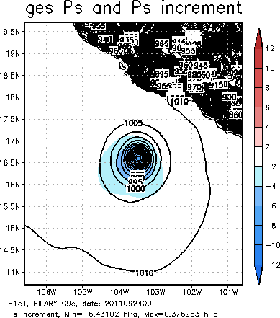
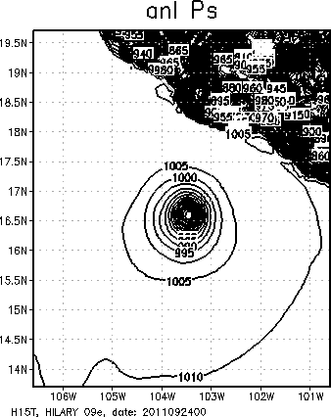
2011092400

Slide 16
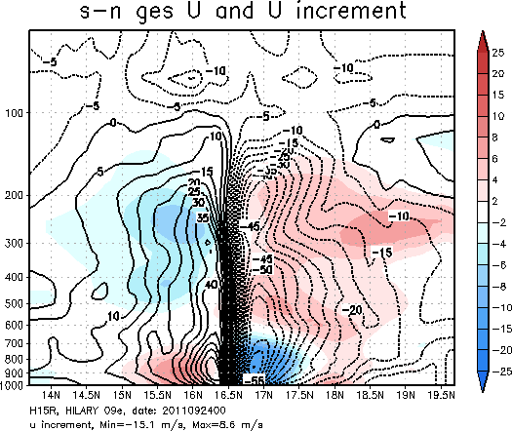
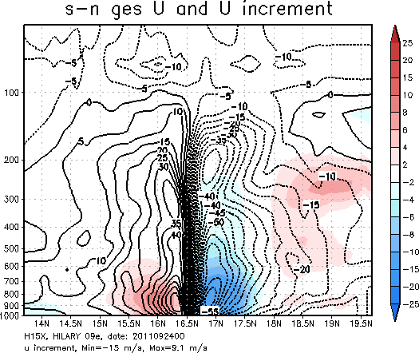
2011092400
H15T
fix sat DA
without sat wind
without sat DA

Slide 17
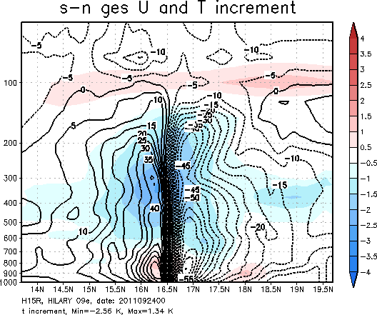
2011092400
H15T
fix sat DA
without sat wind
without sat DA

Slide 18
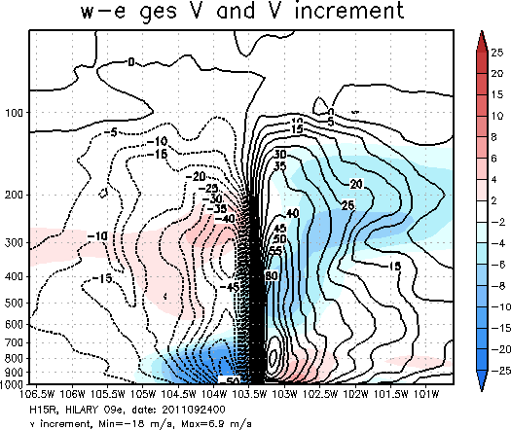
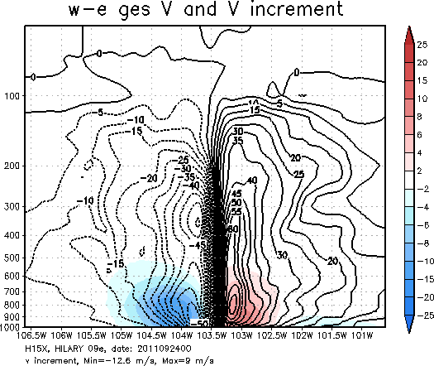
2011092400
H15T
fix sat DA
without sat wind
without sat DA

Slide 19
H15S: fixed errors in using enhanced bias correction
H15X: DA on both g02 and g03. No satellite DA on d03

Slide 20
H15S: fixed errors in using enhanced bias correction

Slide 21
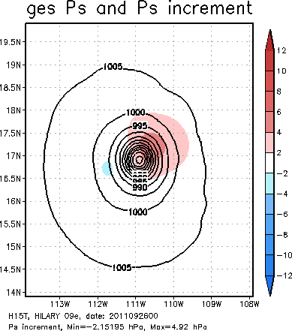
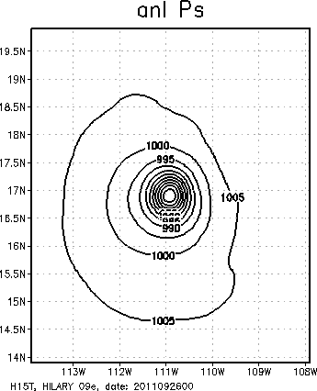
2011092600

Slide 22
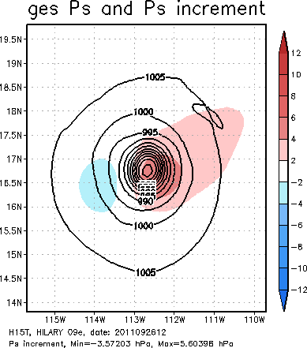
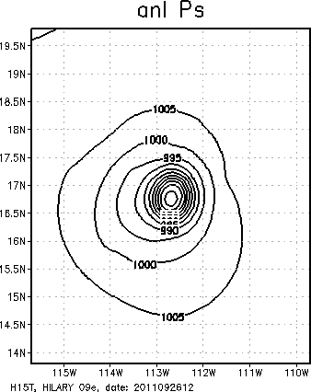
2011092612

Slide 23
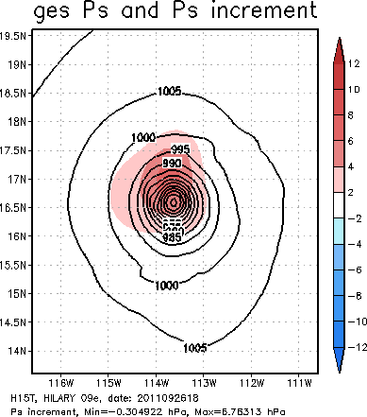
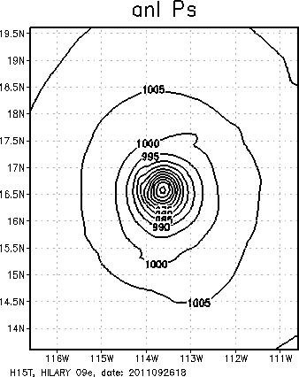
2011092618

Slide 24
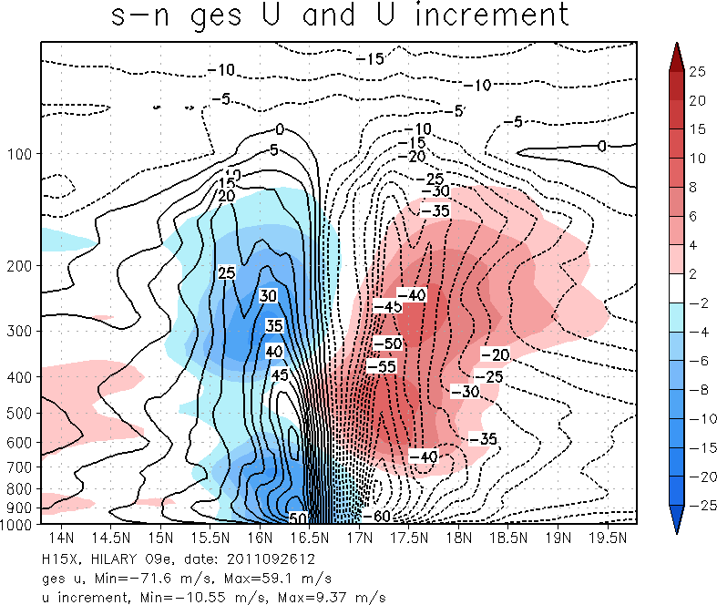
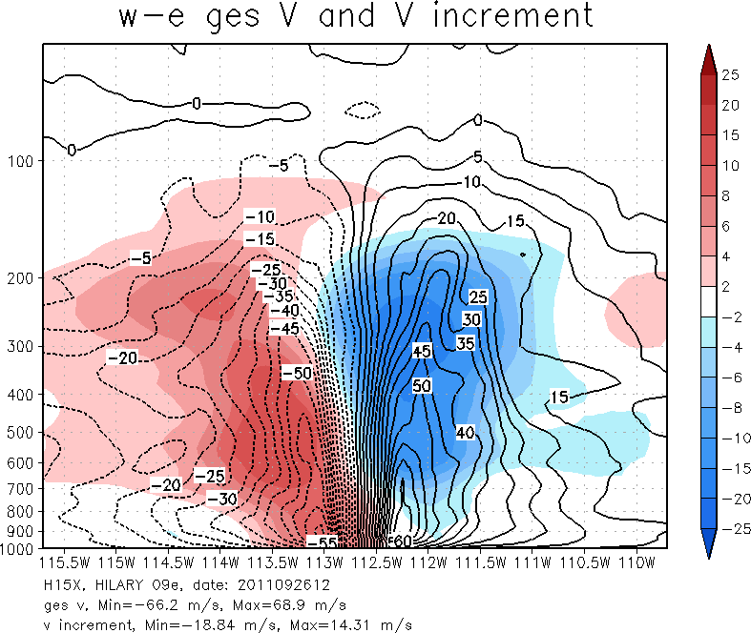
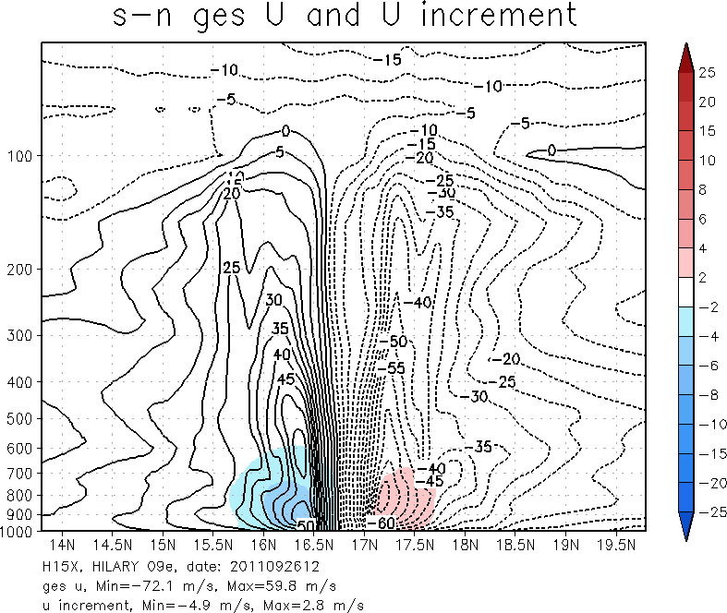
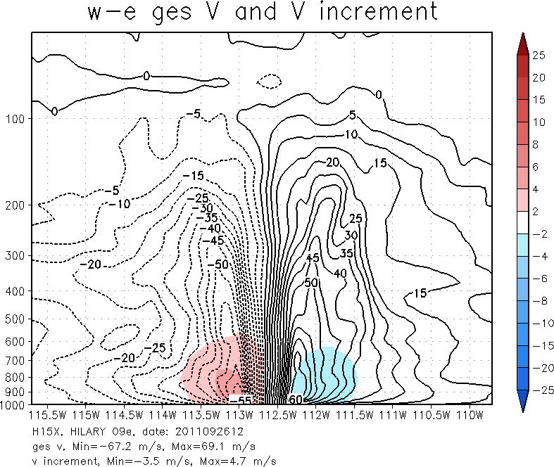
Analysis increment (vertical cross-section through storm center)
with sat data
w/o sat data
Notes:
The impact of satellite data is weakening the storm (in terms of hurricane circulation)

Slide 25
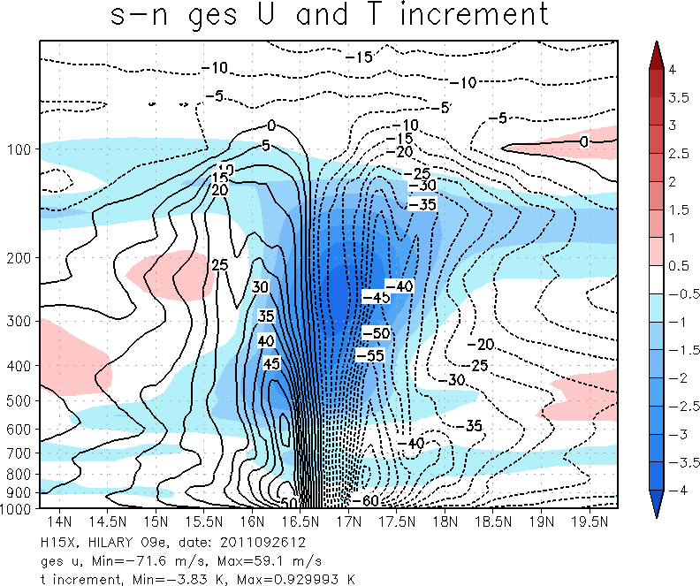
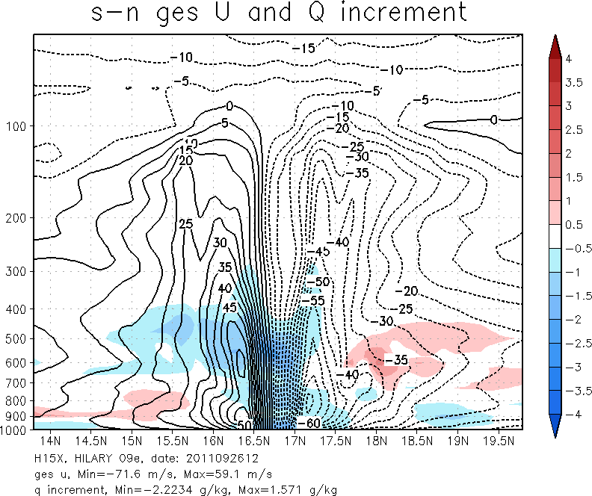
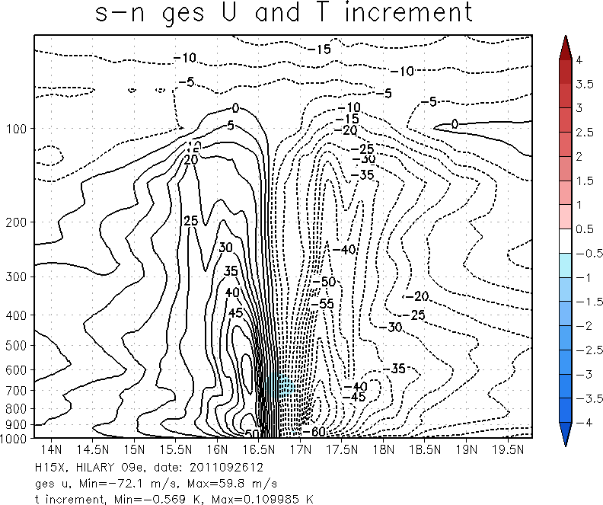
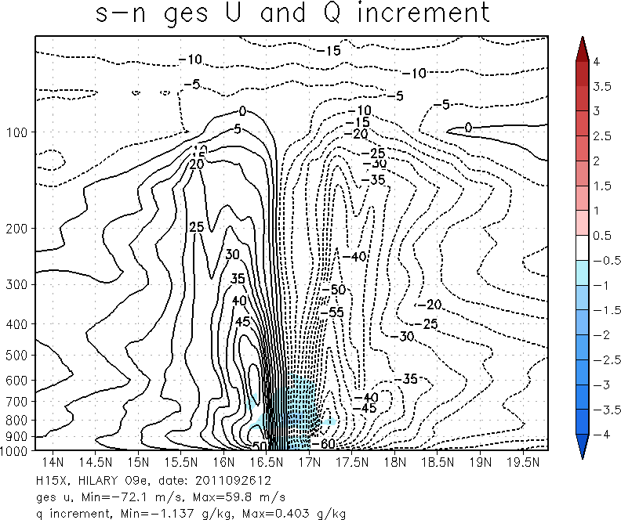
Analysis increment (vertical cross-section through storm center)
with sat data
w/o sat data
Notes:
The impact of satellite data is cooling the storm center in upper levels and make the storm center between 700 – 400 mb drier.

Slide 26
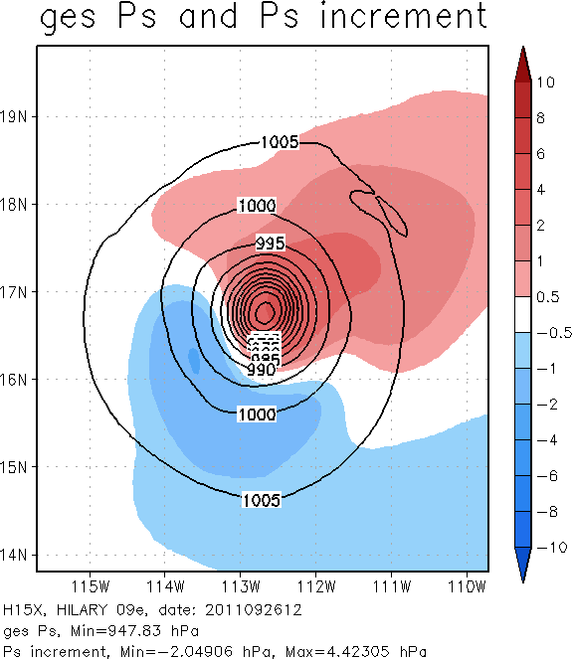
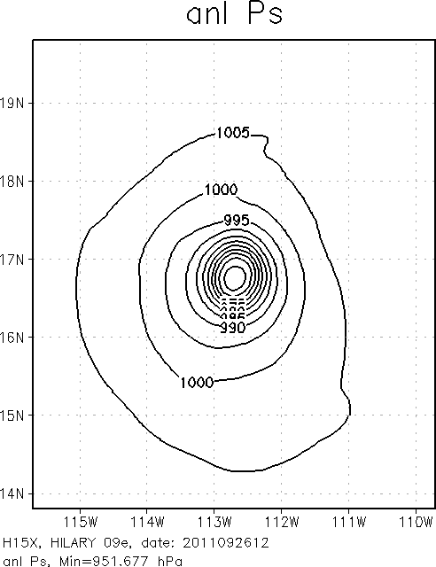
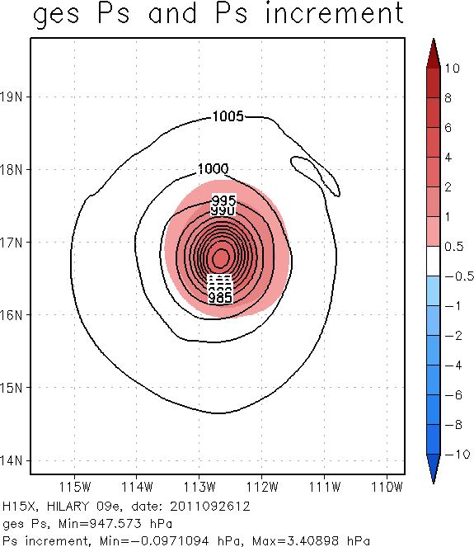
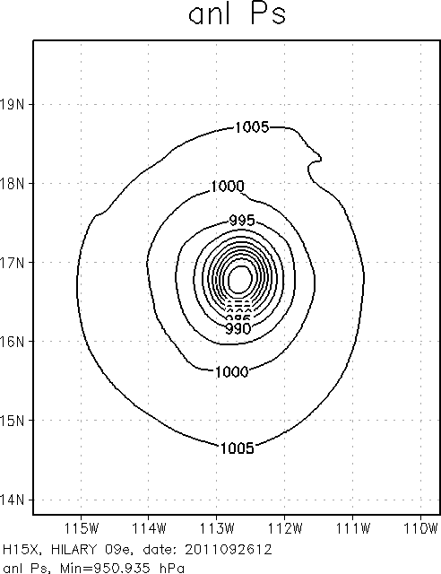
Analysis increment (vertical cross-section through storm center)
with sat data
w/o sat data
Notes:
Satellite data can change the surface pressure gradient in the northeast and southwest quadrants.

Slide 27
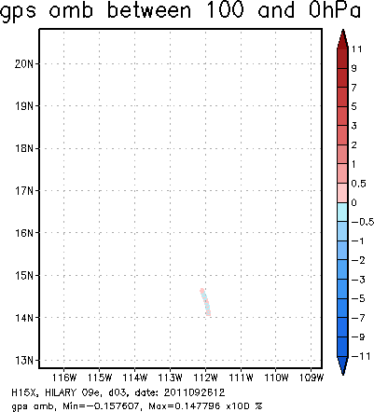
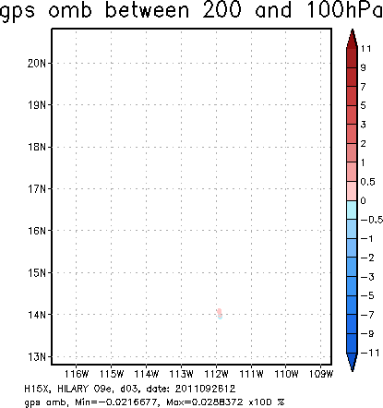
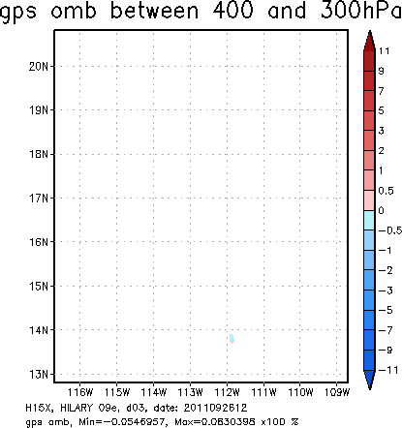
Notes:
Conventional data (o-b) that can be found in analysis domain. Besides the tcvial MSLP data, there is no conventional data near storm center, which is at the center of the plot domain.

Slide 28
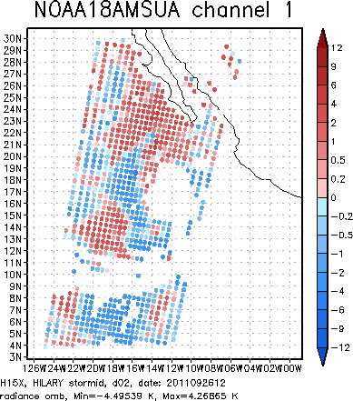
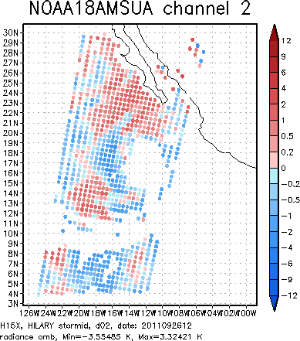
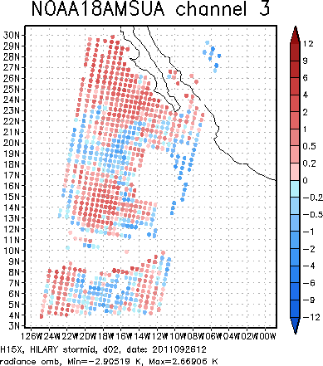
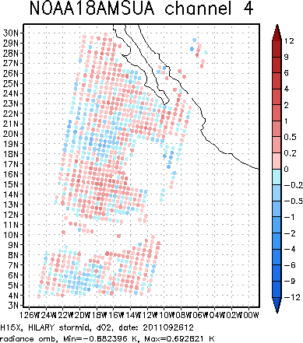
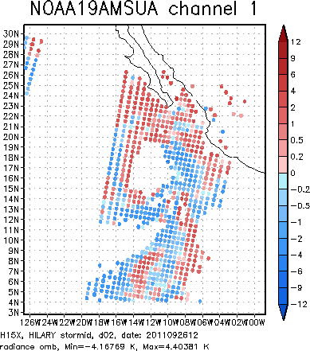
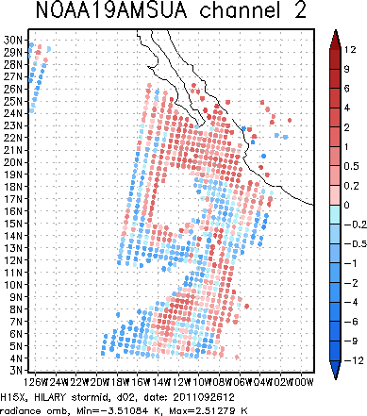
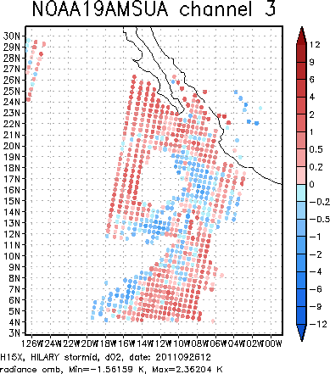

Slide 33
Notes:
O-B of AQUARIS assimilated in our analysis domain. The analysis domain is 23x23 degree at 7 km resolution.

Slide 34
Difference between GFS forecast vortex and HWRF forecast vortex (w relocation)

Slide 35
Impact of vortex initialization

Slide 36
Arthur 01L

