Slide 1
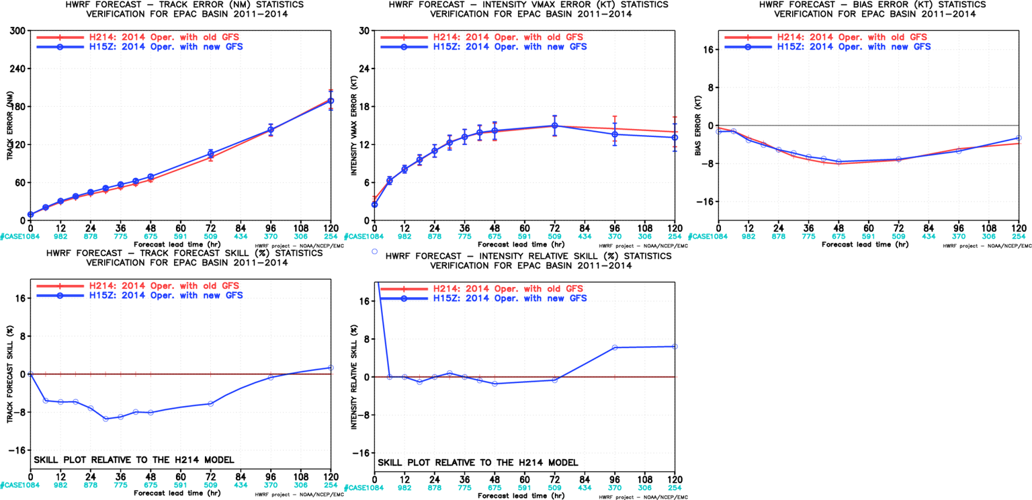
Impact of new GFS, EP
Track Forecast skill loss from GFS upgrade

Slide 2
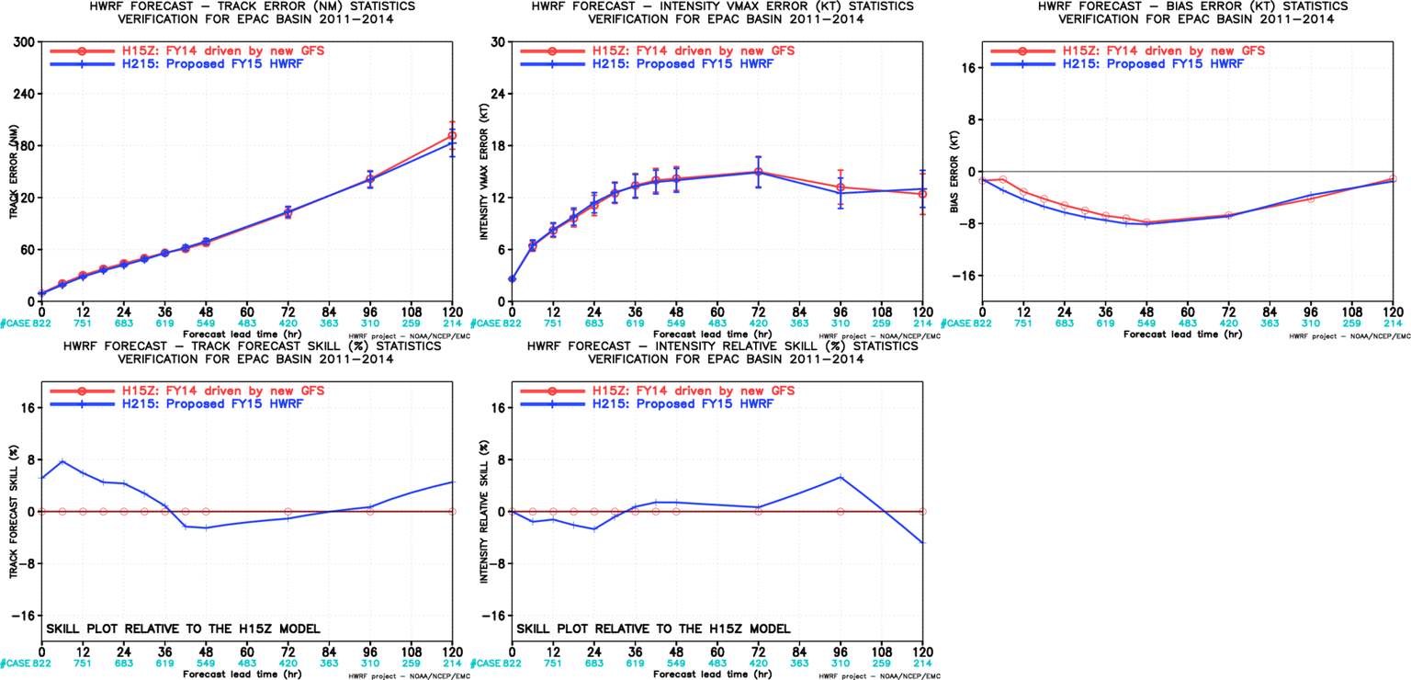
FY15 vs FY14, EP
Offset the skill loss from new GFS: neutral impact on track/intensity

Slide 3
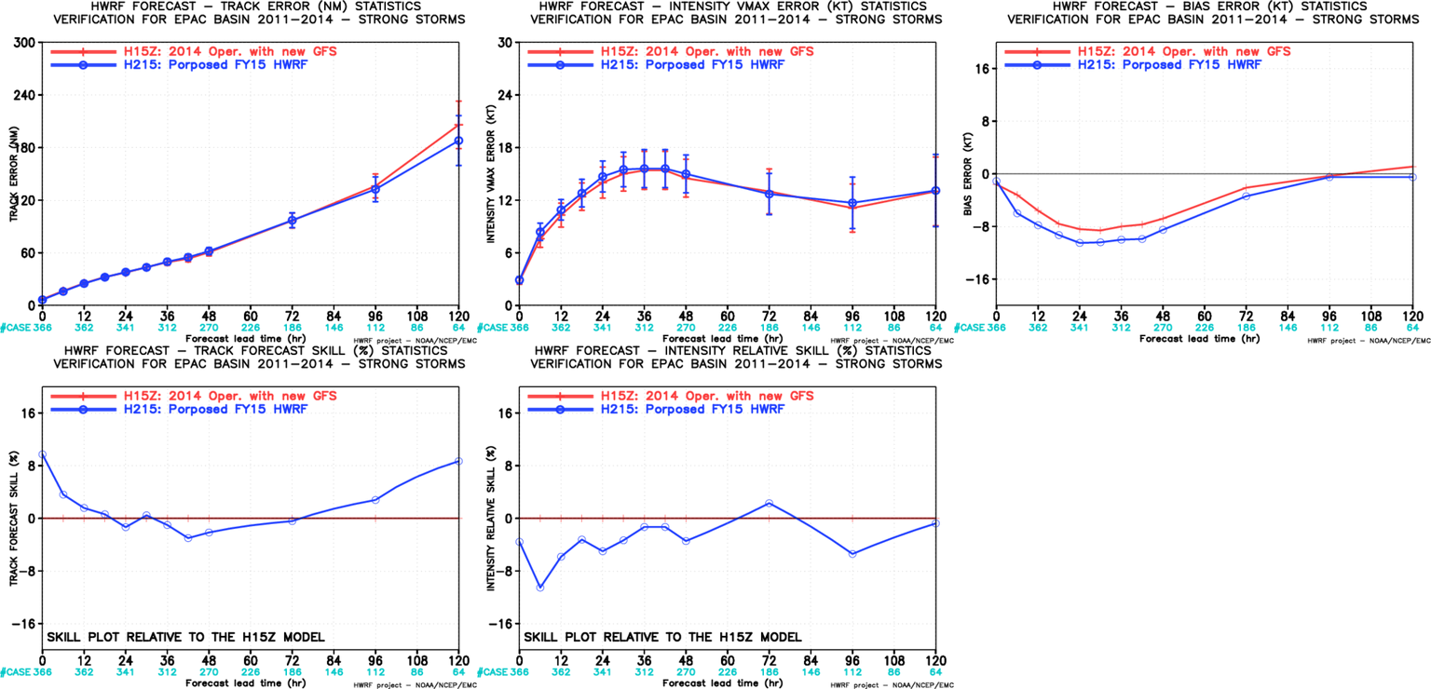
Initially Strong Storm Verification, EP

Slide 4
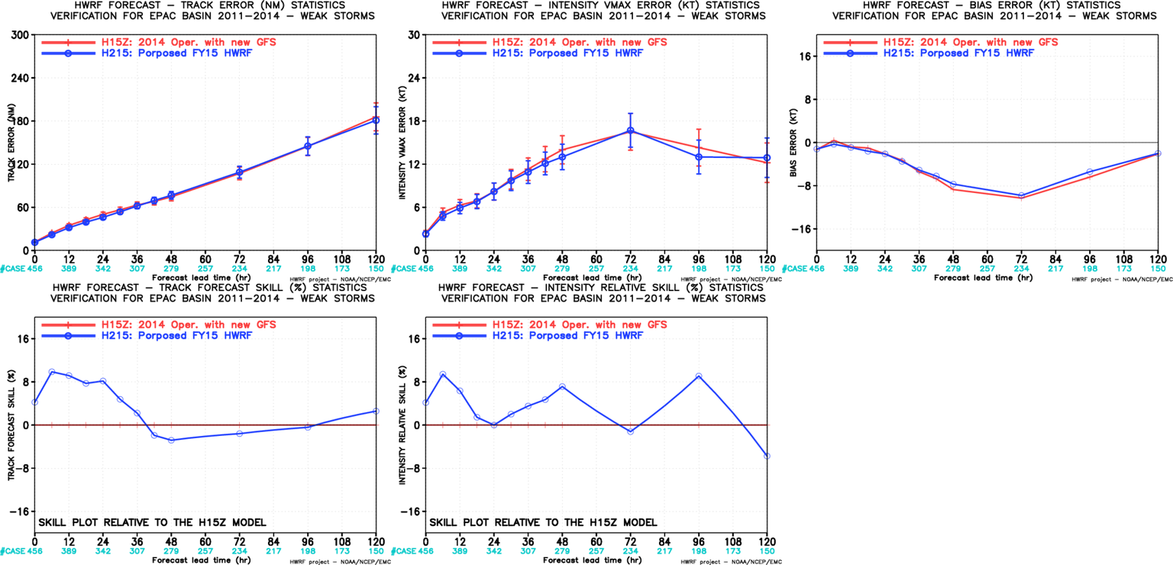
Initially Weak Storm Verification, EP
Improved weak storm intensity forecasts

Slide 5
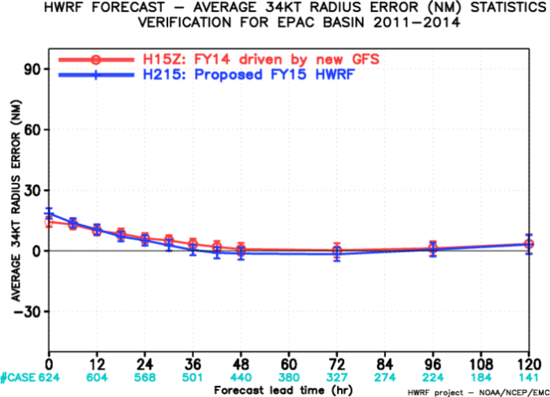
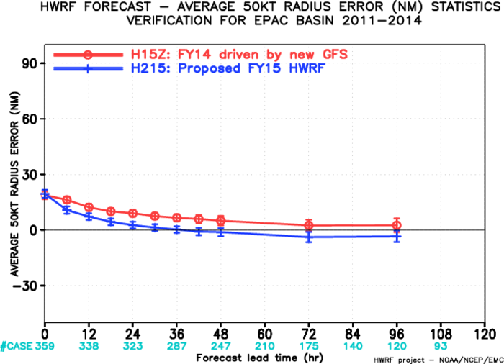
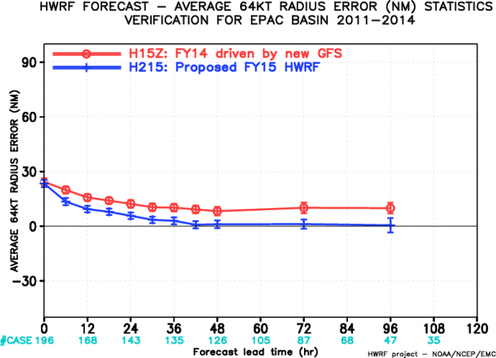
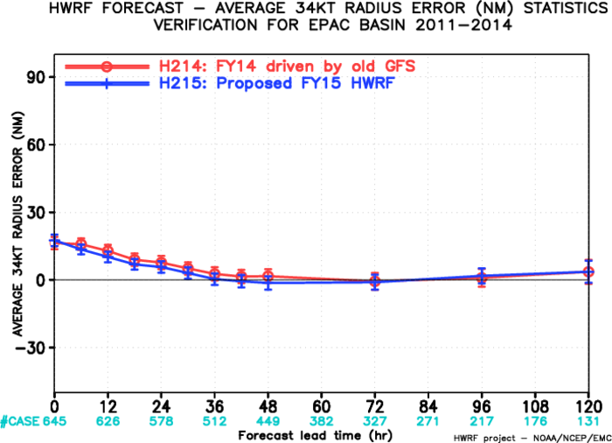
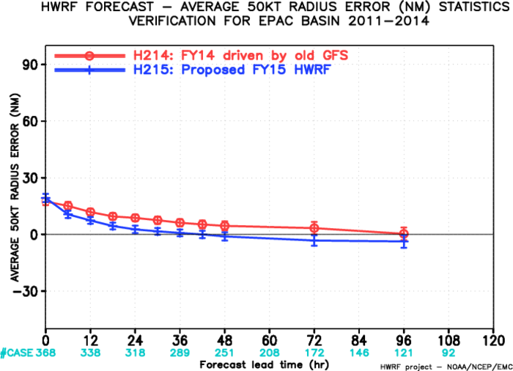
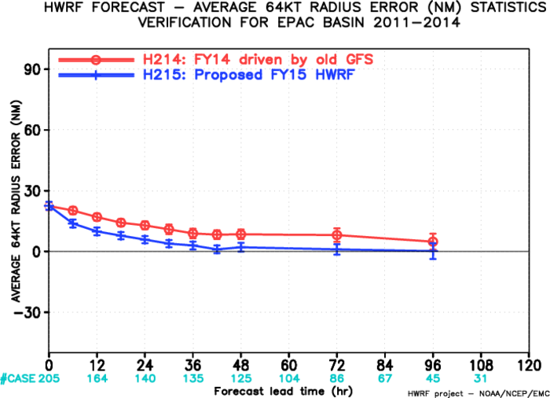
Storm Structure Verification, EP

