Slide 1
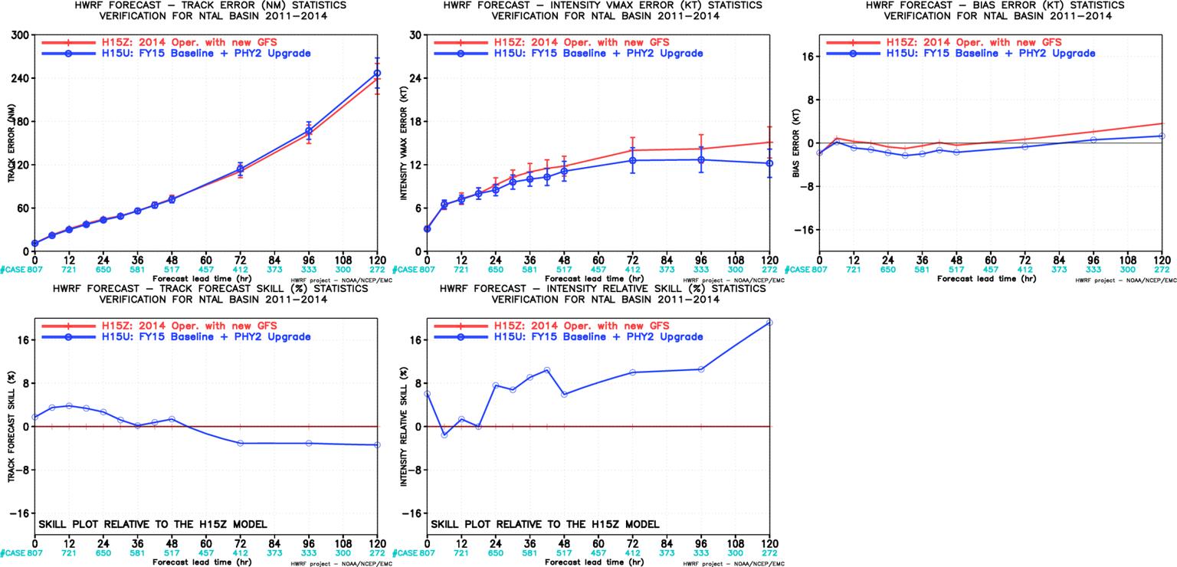
H15U vs H15Z, ATL

Slide 2
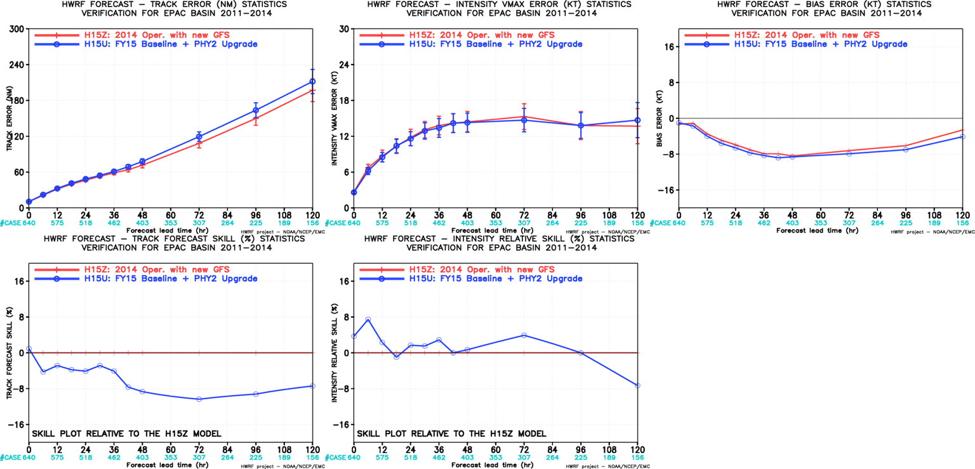
H15U vs H15Z, EP

Slide 3
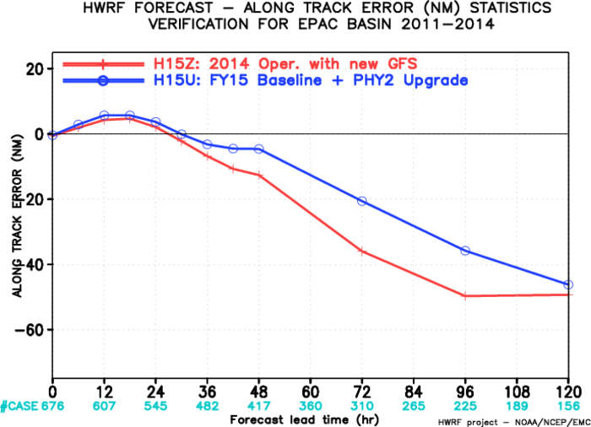
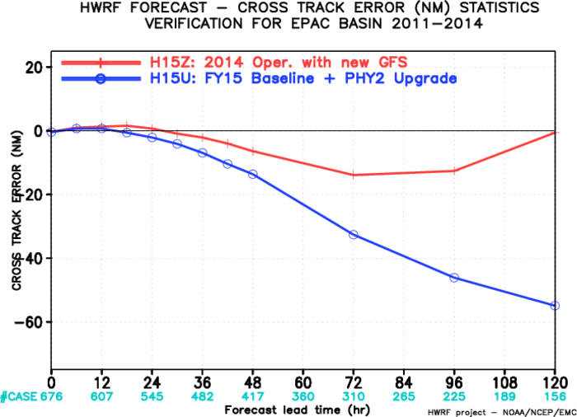
H15U vs H15Z, (along/Cross track), EP
Along track actually improved
Cross track degraded!

Slide 4
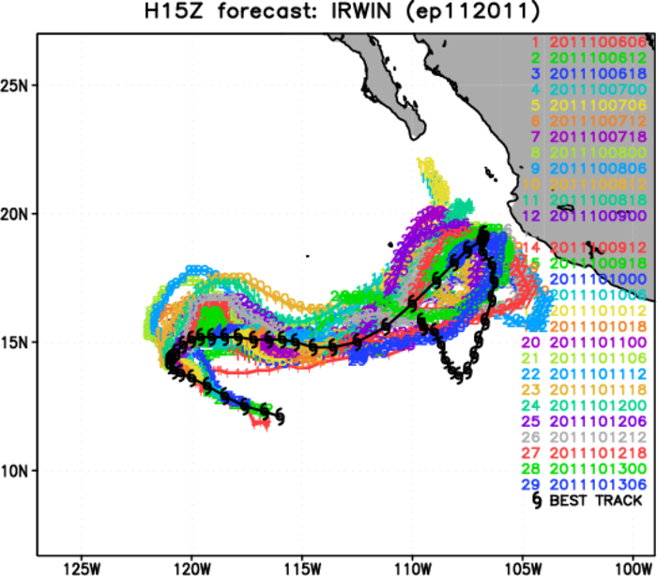
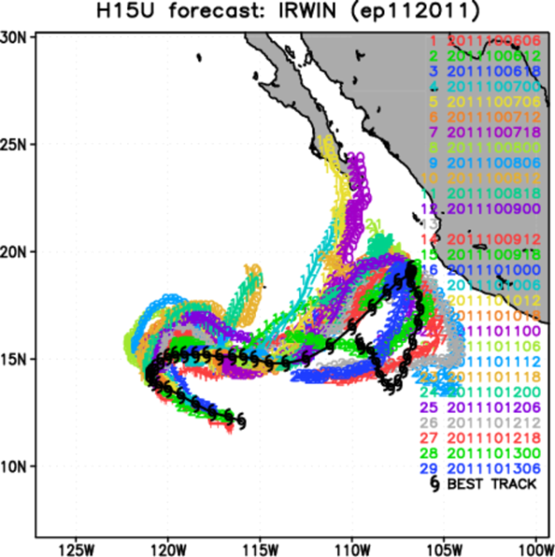
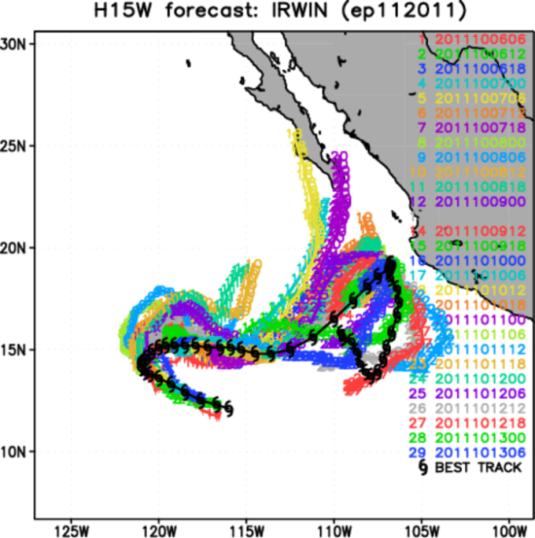

Slide 5
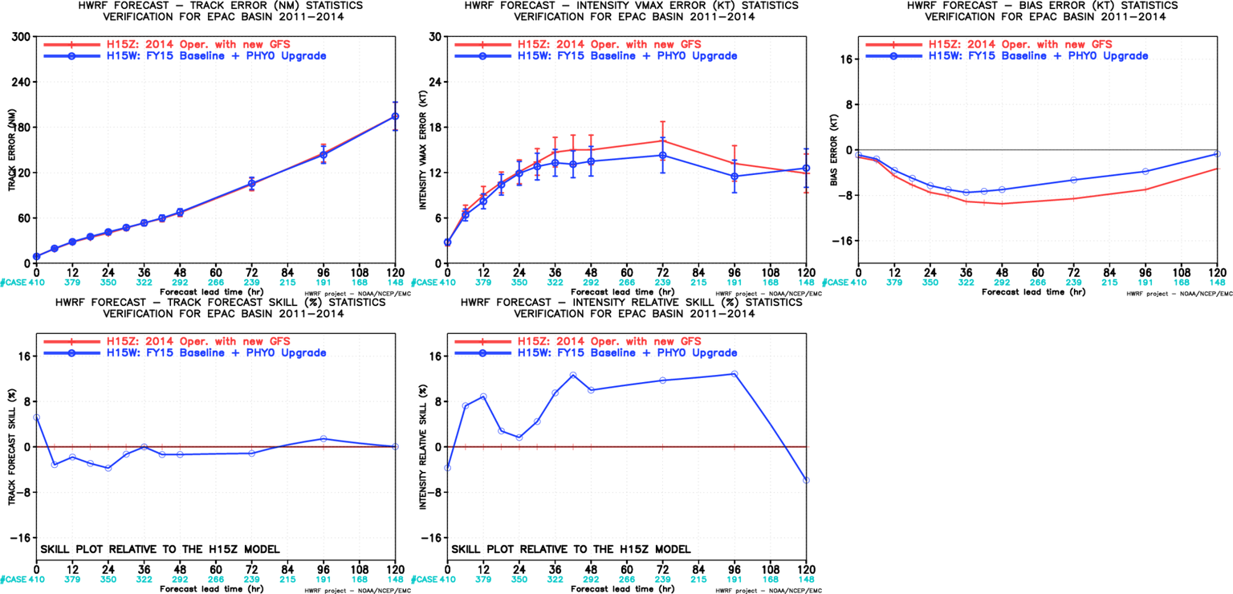
H15W vs H15Z, EP

Slide 6
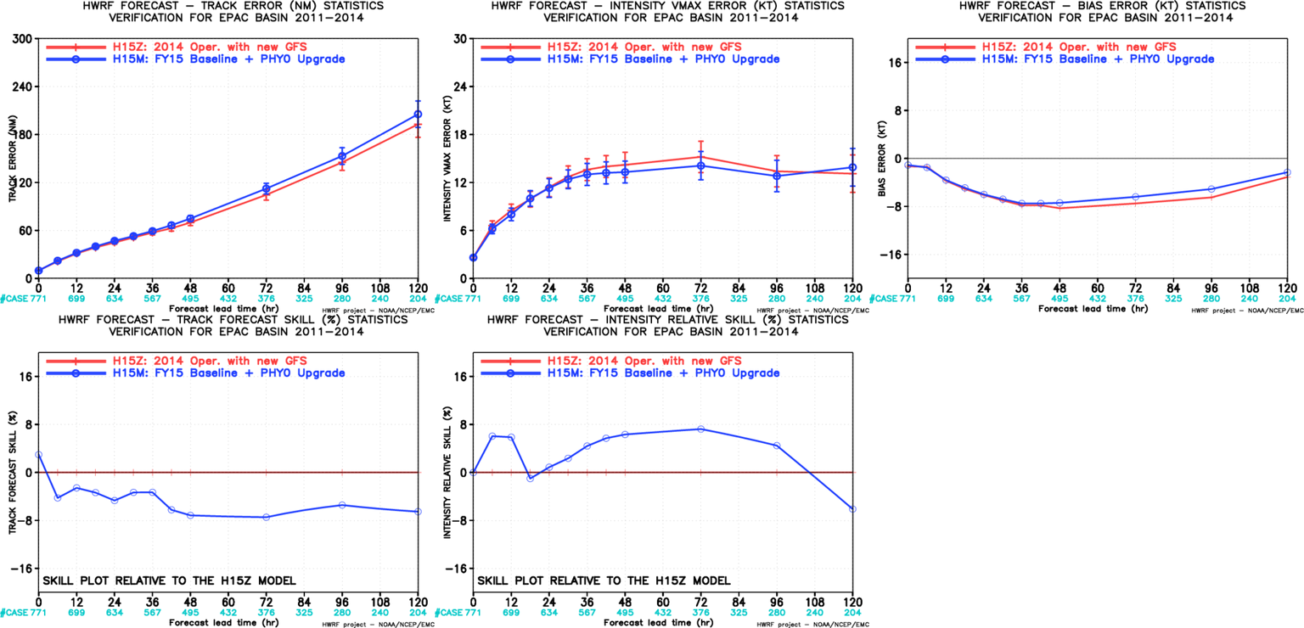
H15M vs H15Z, EP

Slide 7
Failures for WP storms
Current HWRF:
dt=45; dx=0.18
FY15 HWRF:
dt=38+4/7~38.57; dx=0.135
dx is reduced 25%, if dt is reduced at the rate, dt=33.75

