Slide 1


Evaluation of Proposed FY15 Upgrades for NCEP Operational HWRF
North Atlantic Basin; 2011-2014
HWRF Team @EMC. NHC, DTC, GFDL, URI, UCLA, Purdue/NSF, HRD
Presented by
Zhan Zhang
HWRF Weekly Meeting, March 19, 2015
Notes:
1
1

Slide 2
Potential FY15 HWRF Upgrades
System
  Replace current partial HWRF python based scripts with complete Python based scripts for a unified system
  GFS data Upgrades
  Increase the horizontal resolution of atmospheric model for all domains from 27/9/3 to 18/6/2 km.
Initialization/Data Assimilation
  Upgrade and improve HWRF vortex initialization scheme in response to both GFS and HWRF resolution increases
  Upgrade Data Assimilation System with hybrid HWRF-based EnKF and GSI system.
Physics
  Upgrade Micro-physics process (Ferrier-Aligo)
  Upgrade GFDL radiation to RRTMG scheme with partial cloudness
  Upgrade surface physics and PBL, momentum and enthalpy exchange coefficients(Cd/Ch)
  Upgrade current GFDL slab model to NOAH LSM.
Additions
  Self cycled HWRF ensembles based warm start for TDR DA
  Expand HWRF capabilities to all global (including WP/SH/IO) basins through 7-storm capability in operations to run year long

Slide 3
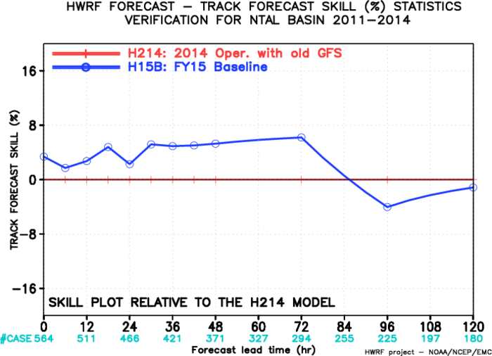
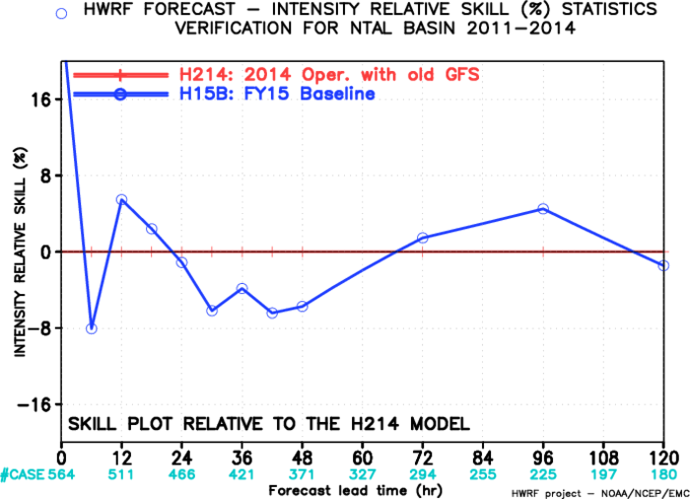
HWRF Infrastructure/Resolution Upgrades
The NMM core of the operational HWRF model upgraded to latest community version WRF V3.6.1.
The horizontal resolution increased from 27/9/3km to 18/6/2km, which allow the model to resolve more storm scale features and have better storm-large scale interactions.
Use high resolution GFS T1534 as IC/LBC
Fix a major bug in vortex initialization for tropical storms in Southern Hemisphere
Adjust the size of the filter domain in response to res. GFS res. increase
Add more smoothing if the radius of maximum wind speed is significantly smaller than observation
Remove the basin-dependence in vortex initialization

Slide 4
Code Optimization & Workflow Modifications
  Sped up 2015 HWRF from 160 minutes to 96 minutes
    Increase from 13 compute nodes to 22.
    Change the task geometry so that WRF compute processors within one compute node are adjacent to one another in a 4x4 grid.
    Switch to the quilt_pnc implementation of WRF I/O servers. This gained us about 30-35 minutes of runtime.
    Turn off the logging from all WRF processors. This gained us back about 8 minutes of runtime.
  End-to-end HWRF scripting system in Python for all global ocean basins
  Switch to 100% GRIB2 output from HWRF
  Further changes to the HWRF workflow to improve the timing and reliability of forecast delivery

Slide 5
Upgraded Land Surface model
GFDL slab to NOAH LSM – NSF VSP Contributions
NOHA LSM provides realistic land surface physics, and predicts soil moisture, soil temperature, land surface skin temperature, land surface evaporation and sensible heat flux, and total runoff.
NOAH LSM significantly reduced the negative temperature bias
A major bug fix for NOAH LSM is introduced to prevent occasional model crash due to inconsistent stability dependent heat exchange coefficients over land (Subramaniam, NSF-NOAA VSP)
HWRF will include additional products for down-stream applications (e.g. storm surge, inland flooding)
Track errors for land-falling storms are improved based on preliminary tests
GFDL Slab
NOAH LSM

Slide 6
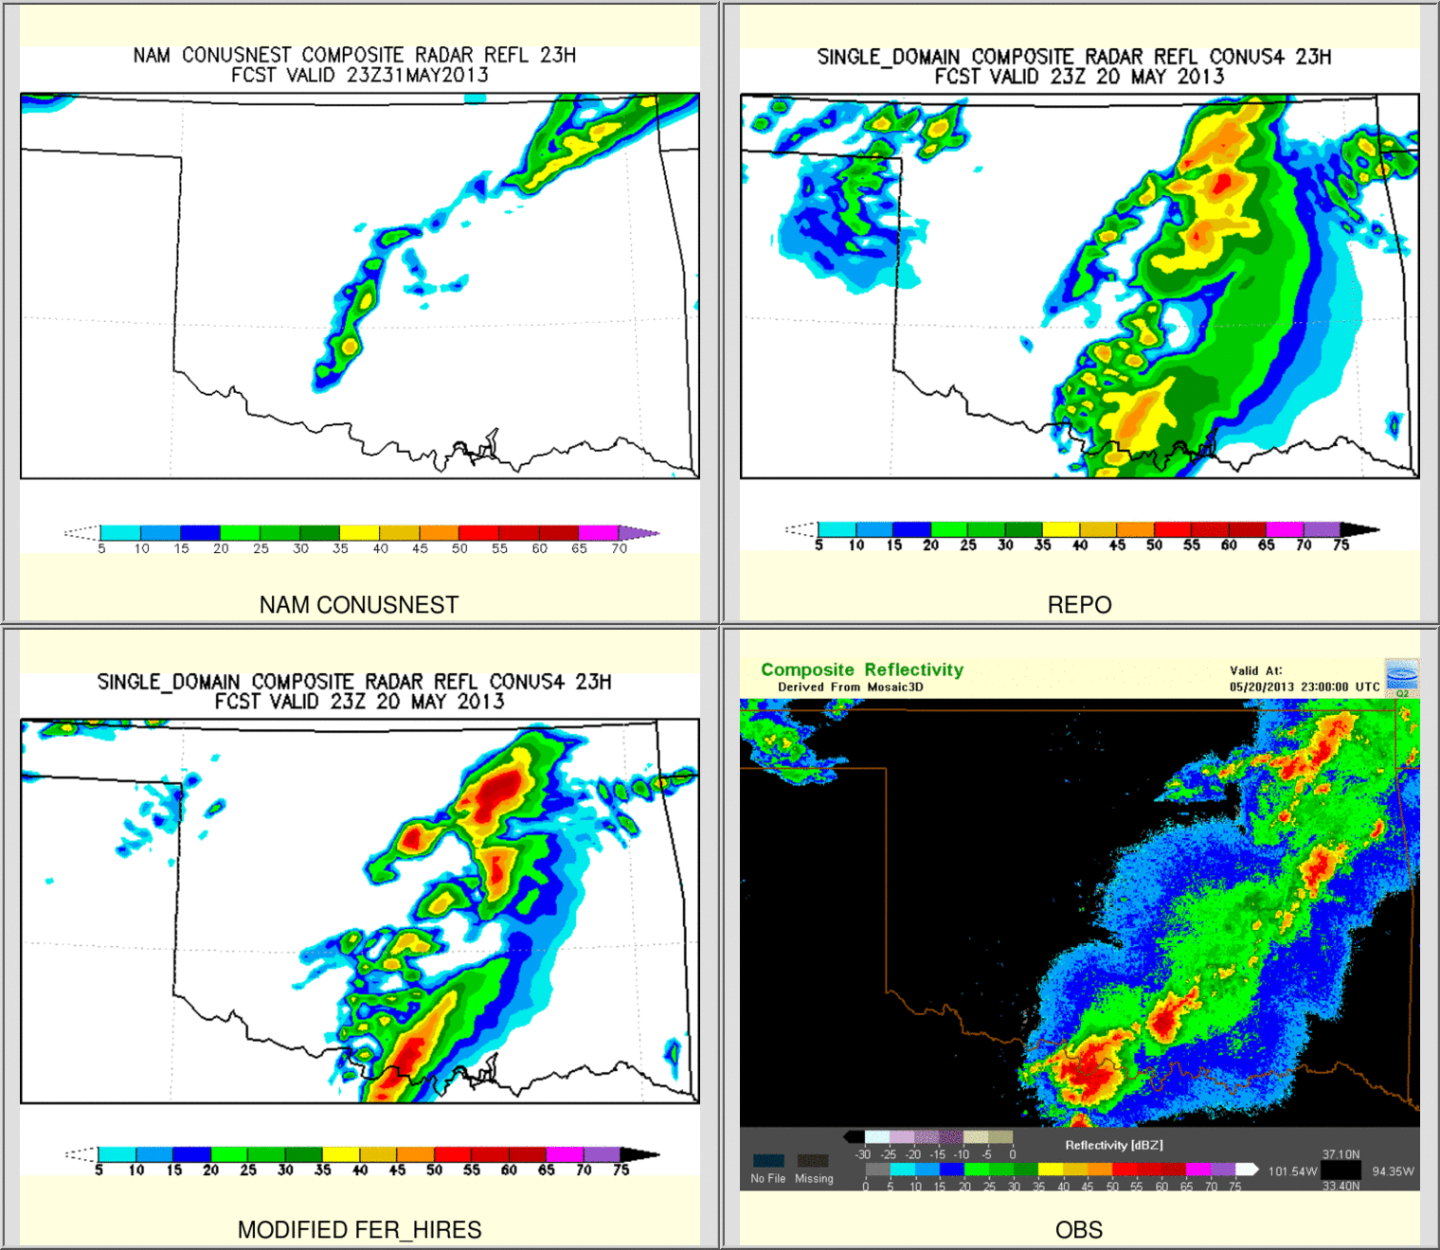
Upgraded Hi-Res Ferrier-Aligo Microphysics
New ice nucleation scheme to reduce no. concentration of small ice crystals
New, simpler closure for diagnosing small ice crystals and large, precipitating ice particles from ice mixing ratios
Slightly slower fall speeds of rimed ice
Increase the maximum (minimum) number concentration of small (large) ice in order to simulate better anvil cloud
Individual test showed positive impacts on structure and intensity forecasts
NAM Parallel
operation
With upgraded Ferrier
obs

Slide 7
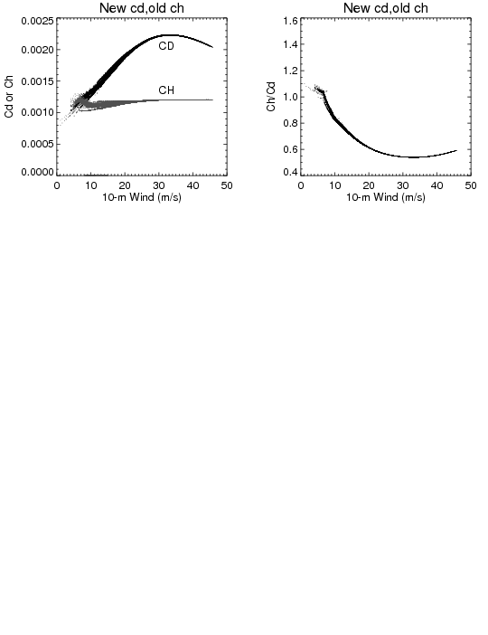
  Upgrade surface physics and PBL, momentum and enthalpy exchange coefficients(Cd/Ch) (H15U)
Cd/Ch change, suggested by URI, to better match observations values. The modified configuration provides improved intensity bias.
Increase of Ch at higher wind speeds (as implemented in GFDL) was causing model to become unstable and crash for stronger storms, suggestive of strong dependency of heat exchange coefficients at air-sea interface on model horizontal resolution

Slide 8
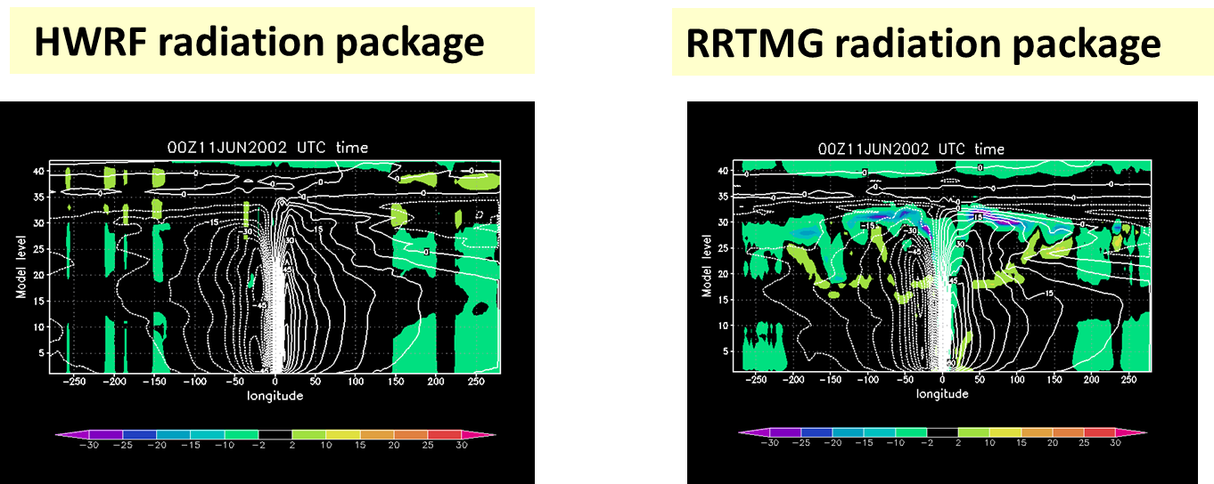
Upgraded SW/LW radiation schemes
(GFDL radiation to RRTMG)
GFDL radiation schemes have problems of proper representations of cloud-radiation interactions, especially net cloud top cooling and net cloud base warming.
Introduced much improved RRTMG radiation with parameterized sub-grid scale cloudiness and variable (wind-speed dependent) vertical mixing coefficient (following work done by Robert Fovell, UCLA; Greg Thompson, NCAR; Ligia Bernardet/Christina Holt,DTC).
Cloud top cooling due to radiation

Slide 9
Data Assimilation Upgrades (H15T)
DA Upgrades for non-TDR cases (already included in H15U)
  Upgrade to the latest EMC GSI v5.0.0, and will be further tuned to improve the initial analysis for all HWRF domains.
  use the 80-member global ensemble based one-way hybrid EnKF-3DVAR 6h forecast fields to calculate the covariance.
  Enlarged d2 (6km) and d3 (2km) analysis domains to address discontinuity in the initial condition between forecast domains;
  No satellite DA on d3 analysis domain due to pronounced negative impact;
  Added the assimilation of tcvitals MSLP data along with dropsonde data.
DA Upgrades for TDR cases (H15T+H15U=H215):
  run 40-member HWRF ensembles for 6h to provide more accurate, flow-dependent, vortex-dependent data assimilation covariance.
  Run GSI on both d2 and d3 analysis domains;
  Larger data assimilation domains

Slide 10
Acronyms
H15B: FY15 HWRF baseline, 18/6/2km resolution, L61, input: T1534L64 GFS (Spectral files for both IC and BC);
H214: 2014 version of operational HWRF, 27/9/3km resolution, L61, input: T574 L64 GFS (Spectral files for both IC and BC);
H15Z: H214 driven by New GFS (Control)
H15U: H15B + All Physics upgrades;
H15T: H15U + upgraded Data Assimilation procedure: Final H215.

Slide 11
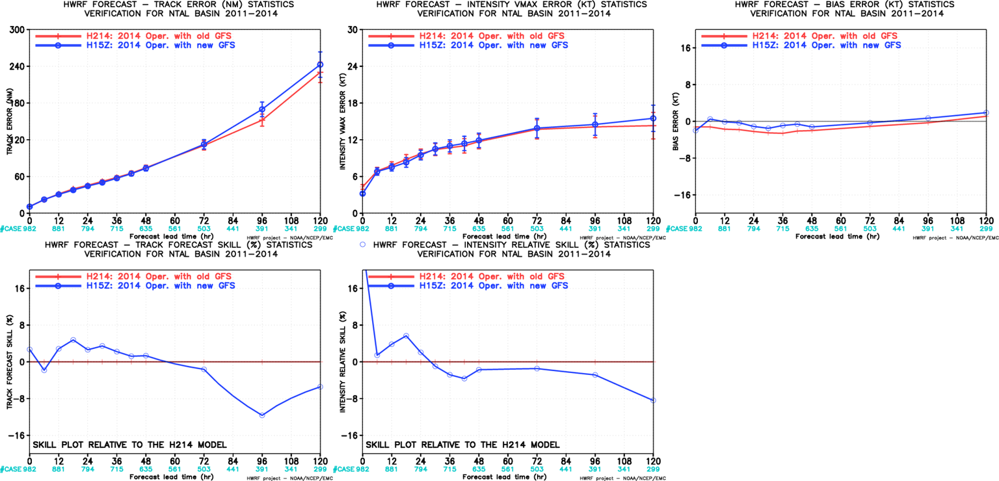
Impact of New GFS, AL
New GFS degraded track/intensity forecasts at later hours

Slide 12
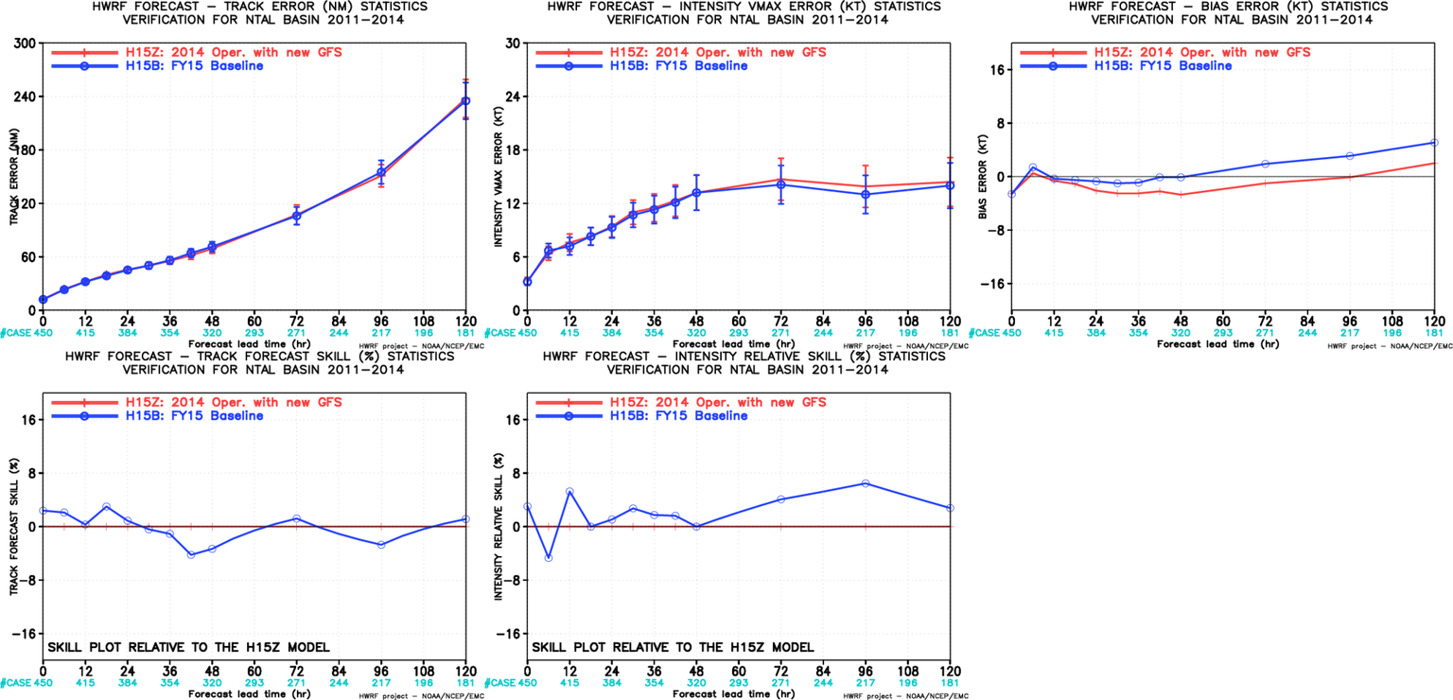
Impact of HWRF Resolution, AL
Neutral track impact;
Neutral to positive intensity impact;
Relative large intensity bias;
Resolution upgrades and vortex initialization changes have offset the loss of skill due to new GFS

Slide 13
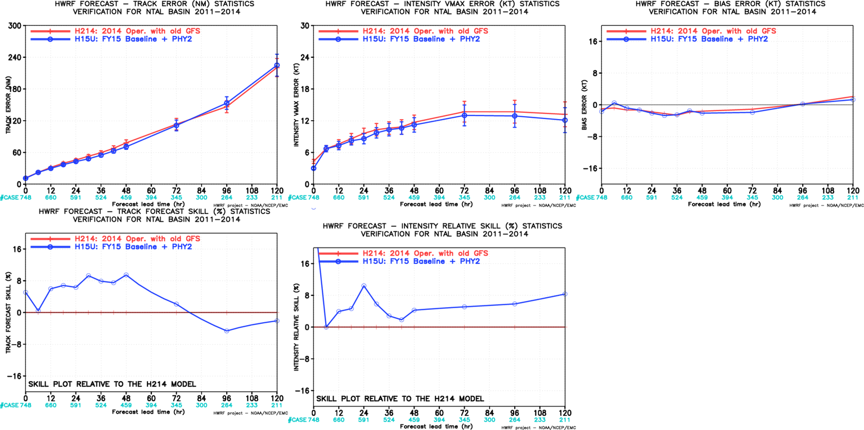
Impact of Physics Upgrades, AL(H15U vs H214)
New Cd, Current Ch, Modified PBL, Ferrier-Aligo MP, RRTMG, NOAH LSM
Positive track impact;
Positive intensity impact;
Similar intensity bias;
Identified a problem in RRTMG related to O₃/CO₂ initialization. This problem is fixed in final H215 configuration

Slide 14
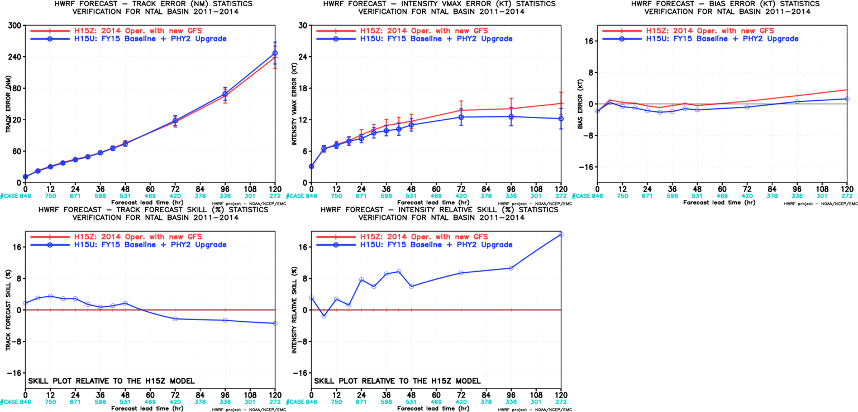
Impact of Physics Upgrades, AL(H15U vs H15Z)
New Cd, Current Ch, Modified PBL, Ferrier-Aligo MP, RRTMG, NOAH LSM
Neutral track impact;
Positive intensity impact;
Identified a problem in RRTMG related to O₃/CO₂ initialization. This problem is fixed in final H215 configuration

Slide 15
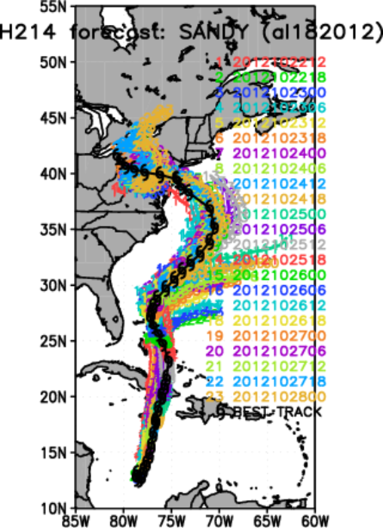
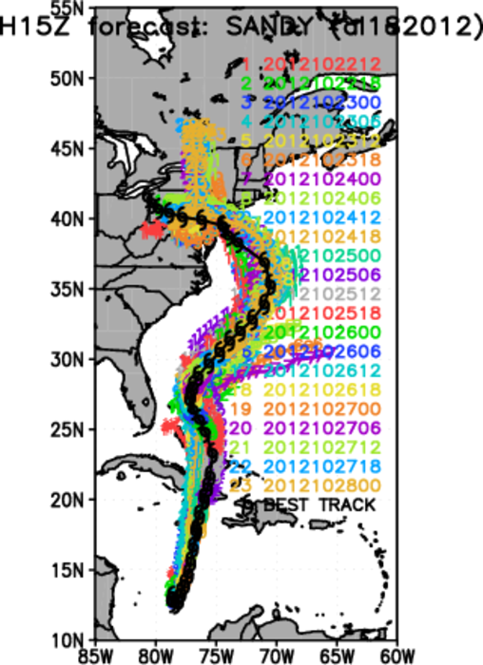
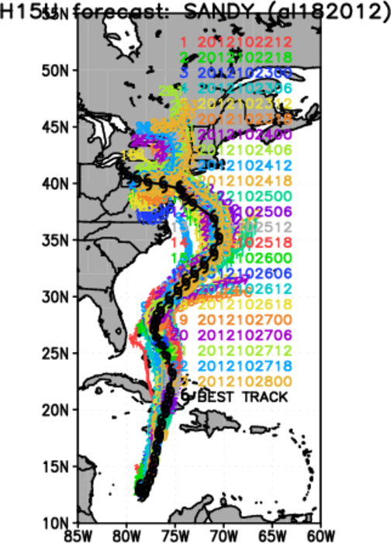
Composite Track plots for Sandy, 18L ,2012
H214
H15Z
H15U

Slide 16
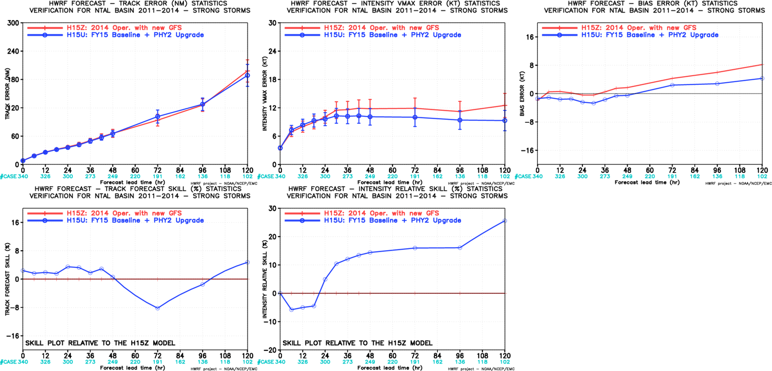
Initially Strong Storm verification, AL
(H15U vs H15Z)
Improved track fcst at all time except for day3;
Improved intensity fcst at all times (>10% improvement beyond day2)

Slide 17
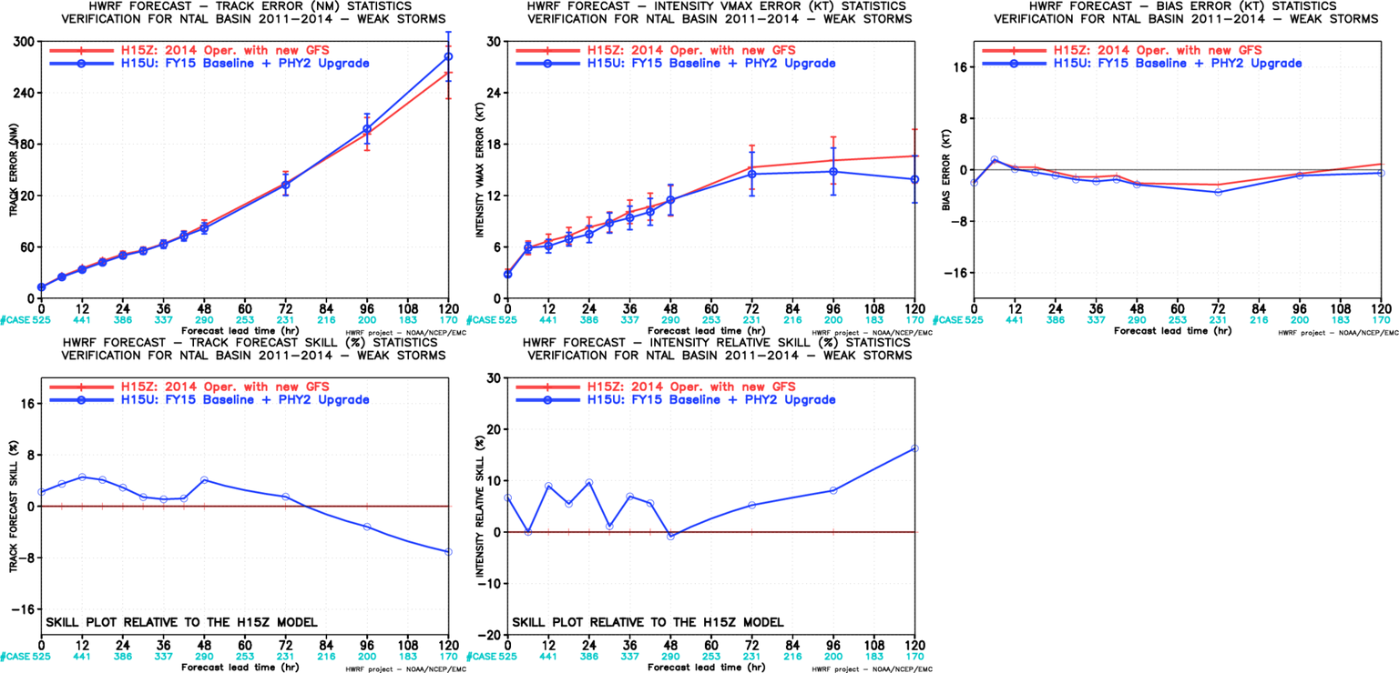
Initially Weaker Storm verification, AL
(H15U vs H15Z)
Improved track fcst up to day 3
Improved intensity fcst at all times

Slide 18
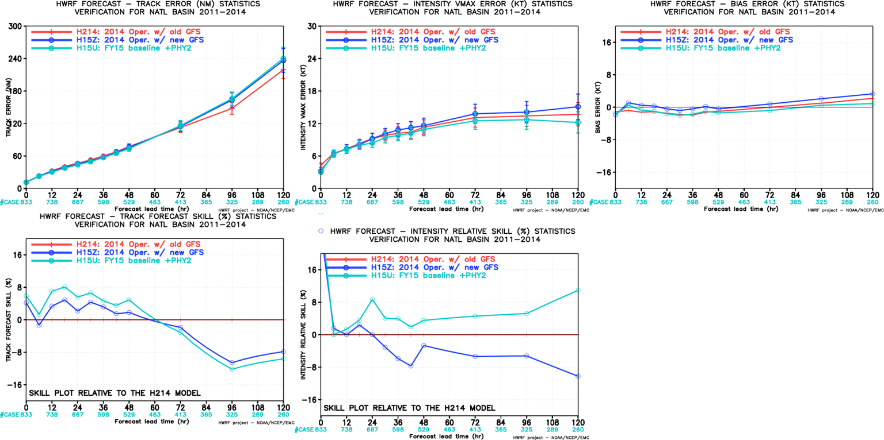
Homogenous Verification of H214/H15Z/H15U
Confirmed that new GFS degraded HWRF track forecasts, FY15 implementation is able to partially recover the skill loss, also improves the intensity forecasts.

Slide 19
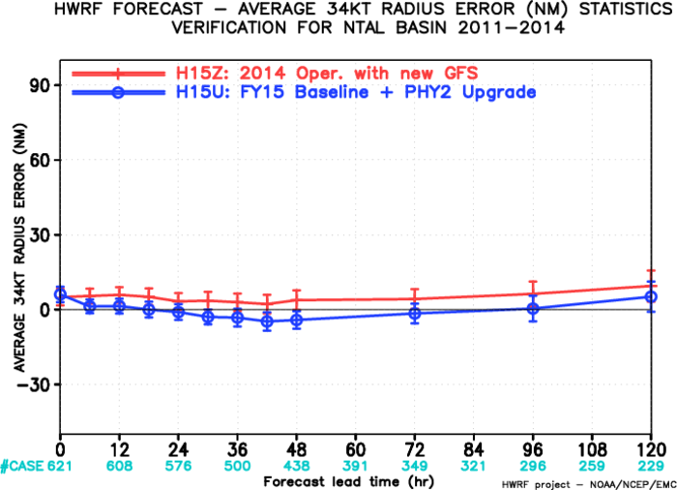
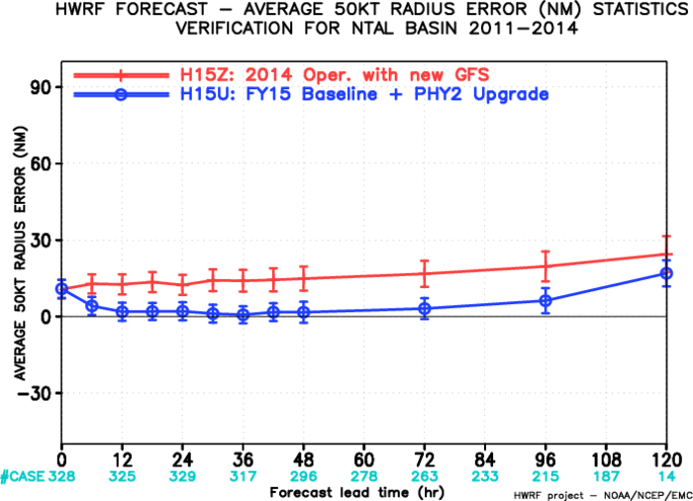
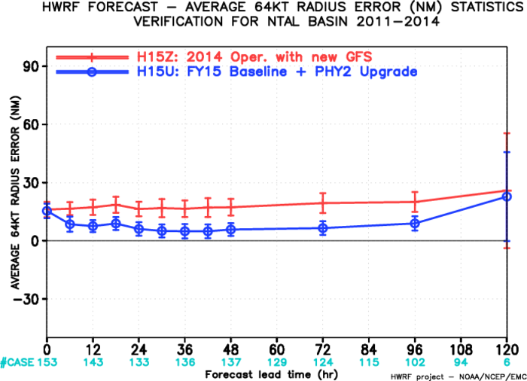
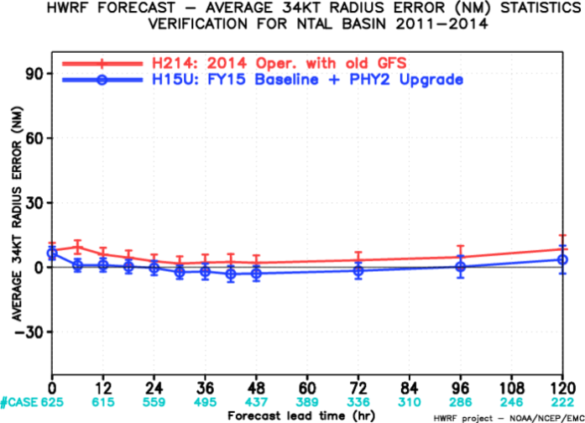
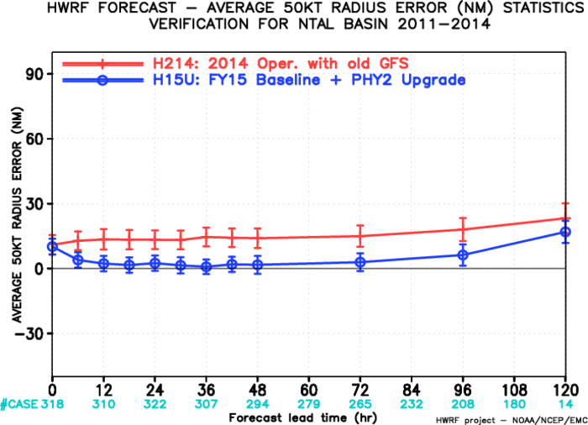
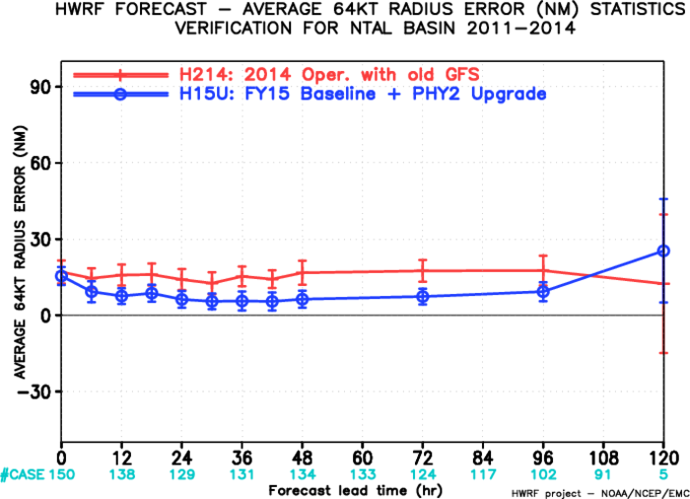
Storm Structure Verification for H15U vs H214
Top: H15U vs H15Z, Bottom: H15U vs H214
AL-R34
AL-R50
AL-R65
AL-R50
AL-R65
AL-R34
Storm sizes are improved in H15U in all three radii for ATL storms.

Slide 20
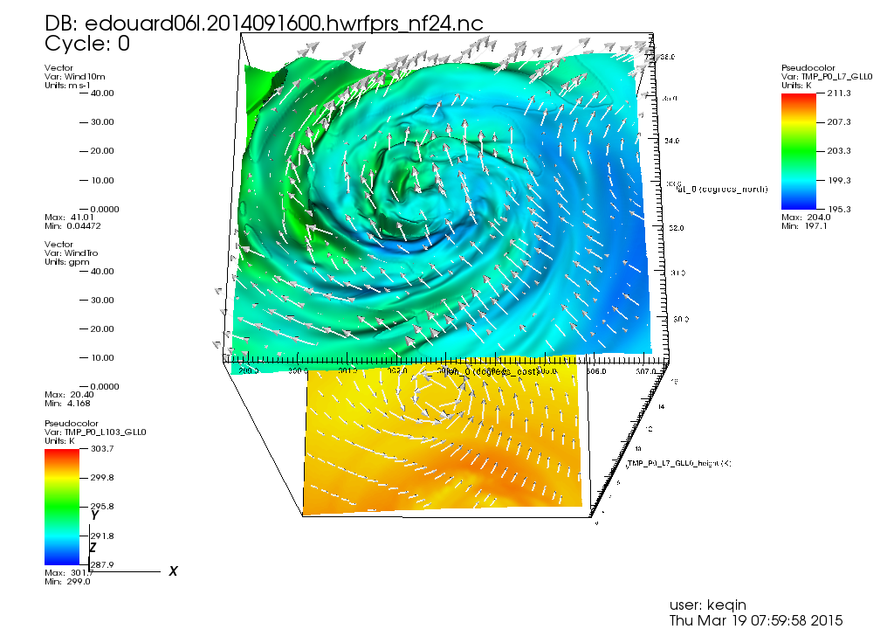
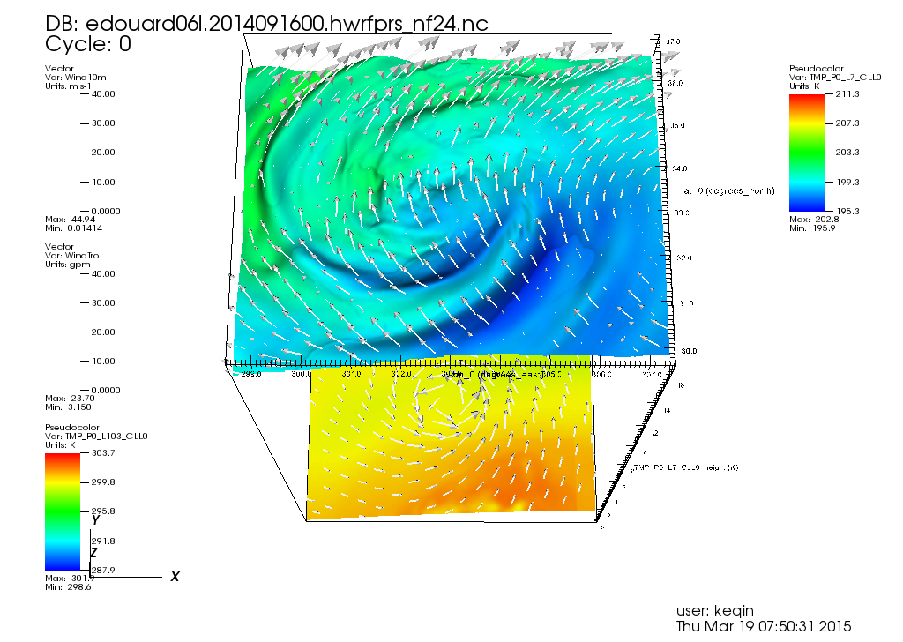
Resolution Impact on Storm Structure
Edouard, 06L 2014091600, at Day 1 Forecast
H15U
H214
Detailed storm structure from high resolution model.

Slide 21
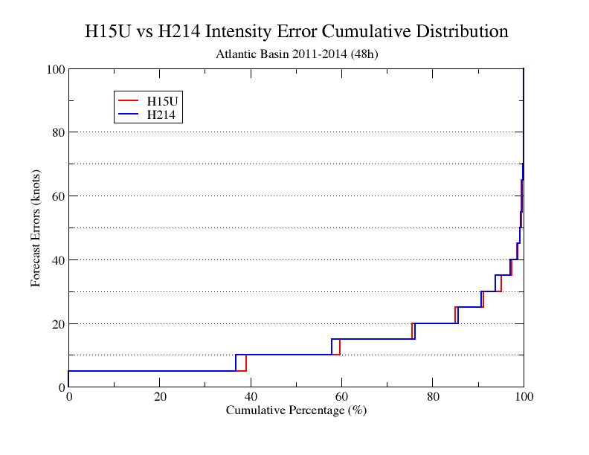
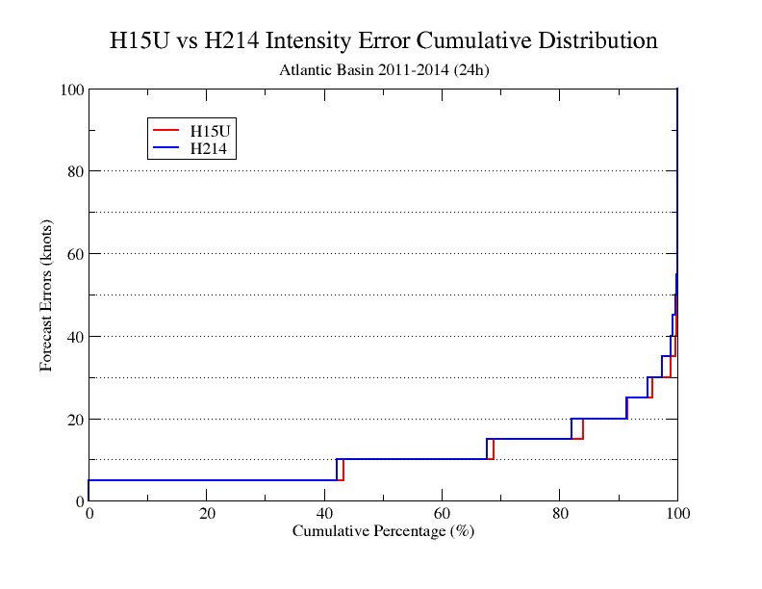
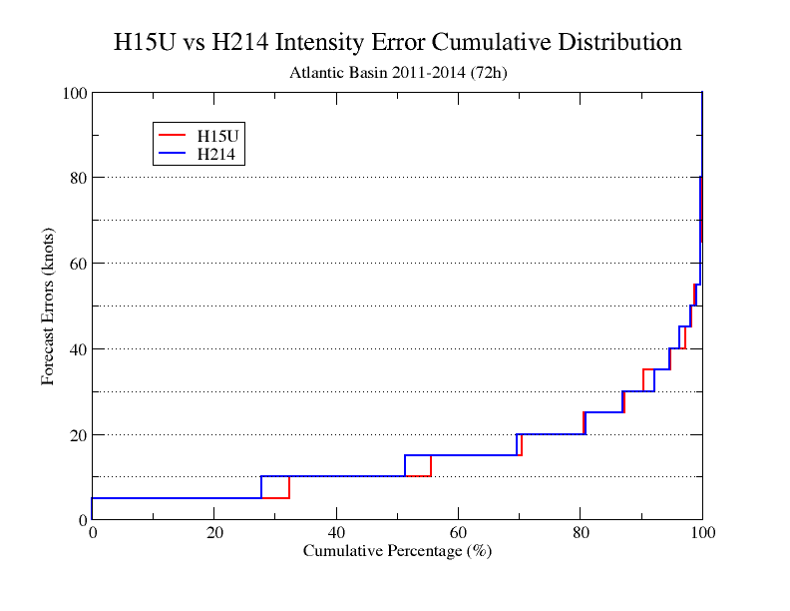
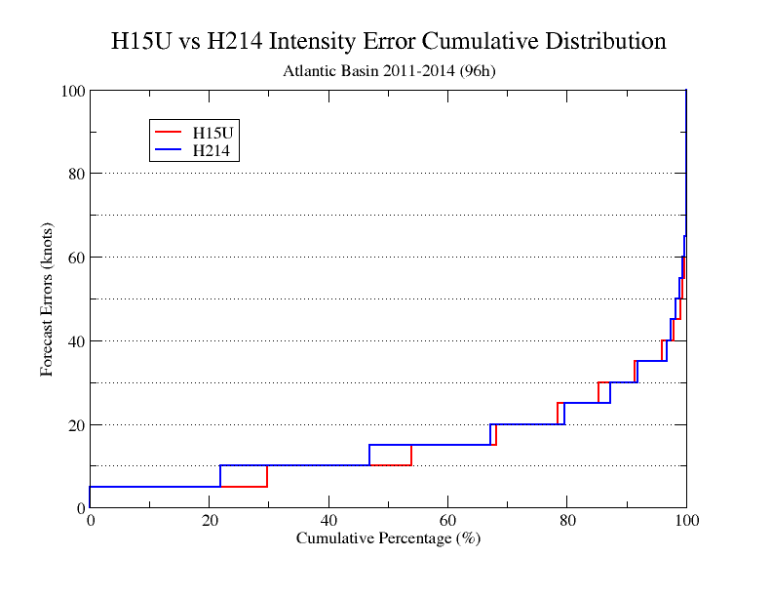
Improvement of Intensity Cumulative Distribution of H15U
Day 1
Day 2
Day 3
Day 4

Slide 22
Summary
H15U (with 848 verifiable cycles out of 1110 in AL) demonstrated improved track/intensity forecasts compared to both FY14 operational HWRF (H214) and FY14 driven by new GFS (H15Z), proposed for FY15 implementation;
Identified a problem with RRTMG scheme, will put a fix in H215; should have minimum impact on final results (based on large-scale diagnostics)
Combine DA upgrade (H15T) with the final physics upgrade version: H215;
EP storms are still being evaluated, will report results next week;
Evaluate H215 for other non-NWS basins, WP/IO/SH

Slide 23
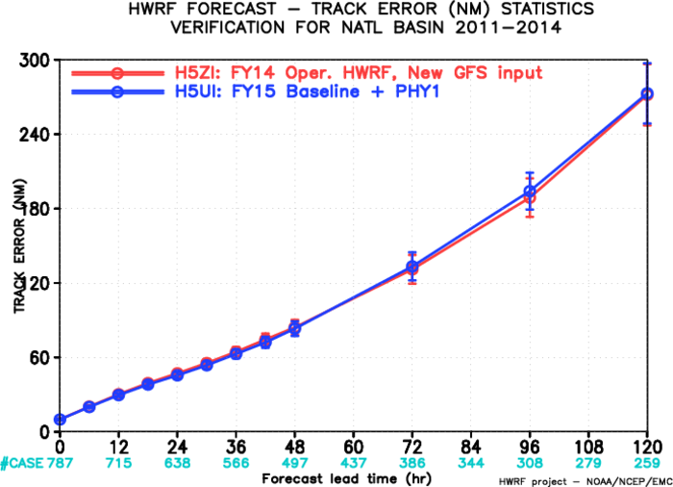
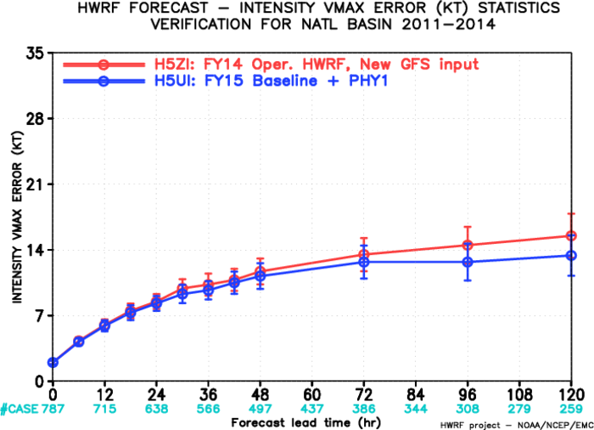
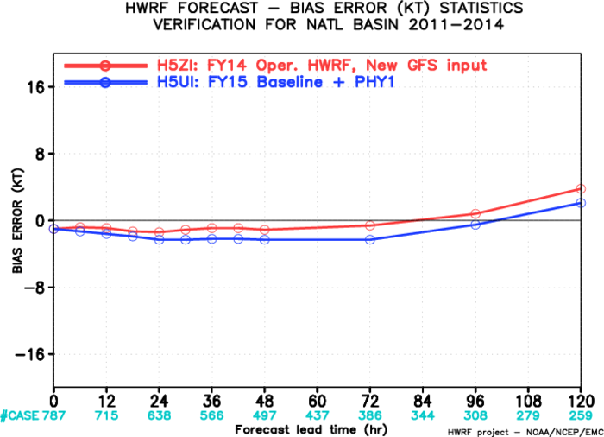
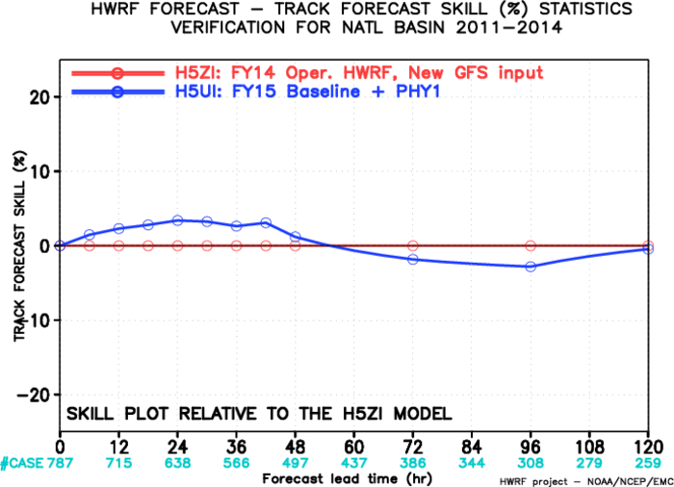
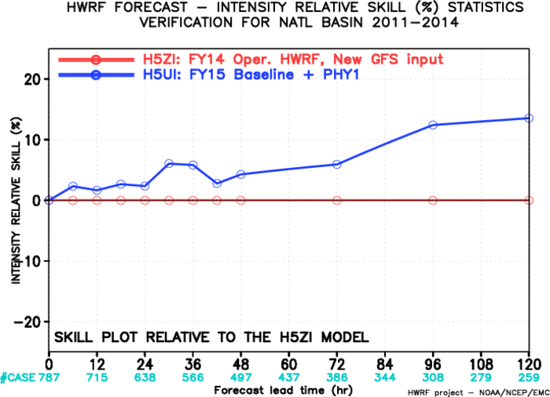
Early Model Verification: H15UI vs H15ZI

Slide 24
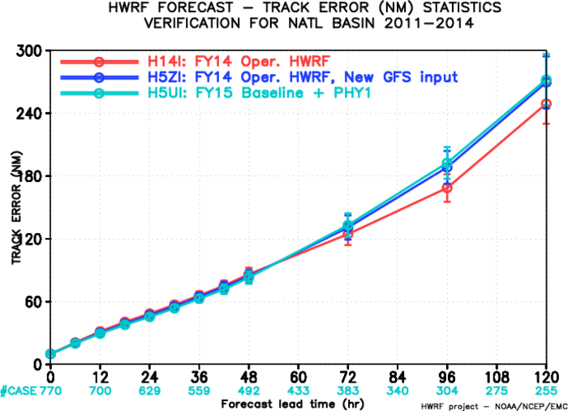
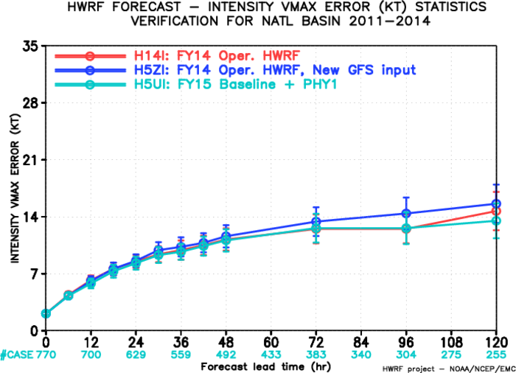
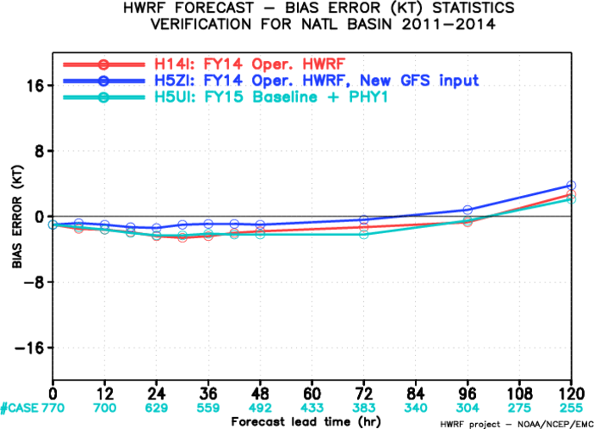
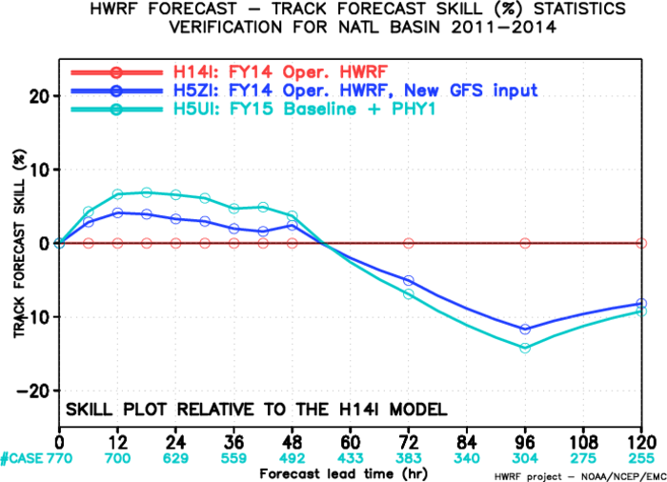
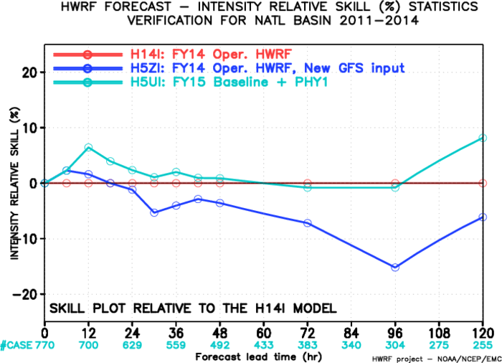
Early Model Verification: H15UI vs H15ZI

Slide 25
Individual Storm Track Forecast Improvement/Degradation, AL, Day 1
Negative: Improved
Positive: Degraded

Slide 26
Individual Storm Track forecast Improvement/Degradation, AL, Day 2
Negative: Improved
Positive: Degraded

Slide 27
Individual Storm Track forecast Improvement/Degradation, AL, Day 3
Negative: Improved
Positive: Degraded

Slide 28
Individual Storm Track forecast Improvement/Degradation, AL, Day 4
Negative: Improved
Positive: Degraded

Slide 29
Individual Storm Track forecast Improvement/Degradation, AL, Day 5
Negative: Improved
Positive: Degraded

Slide 30
Individual Storm Intensity Forecast Improvement/Degradation, AL, Day 1
Negative: Improved
Positive: Degraded

Slide 31
Individual Storm Intensity Forecast Improvement/Degradation, AL, Day 2
Negative: Improved
Positive: Degraded

Slide 32
Individual Storm Intensity Forecast Improvement/Degradation, AL, Day 3
Negative: Improved
Positive: Degraded

Slide 33
Individual Storm Intensity Forecast Improvement/Degradation, AL, Day 4
Negative: Improved
Positive: Degraded

Slide 34
Individual Storm Intensity Forecast Improvement/Degradation, AL, Day 5
Negative: Improved
Positive: Degraded

