Slide 1
HOPS vs H212
Composite Track plots

Slide 2
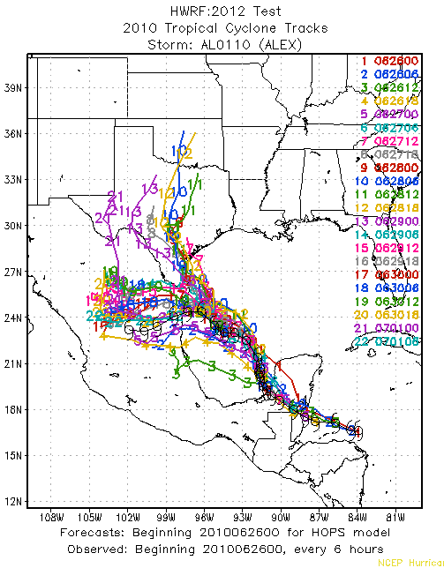
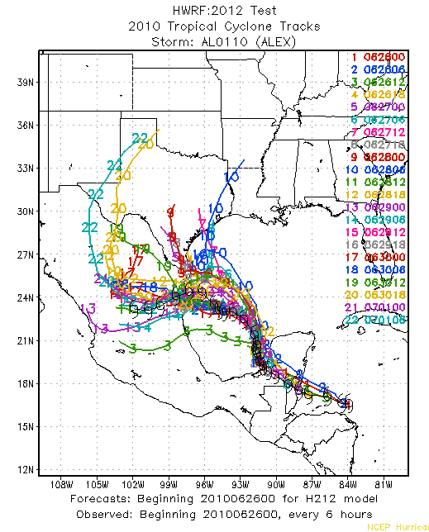
ALEX 01 2010
HOPS H212

Slide 3
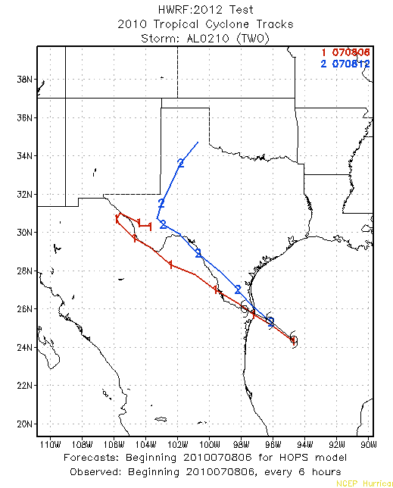
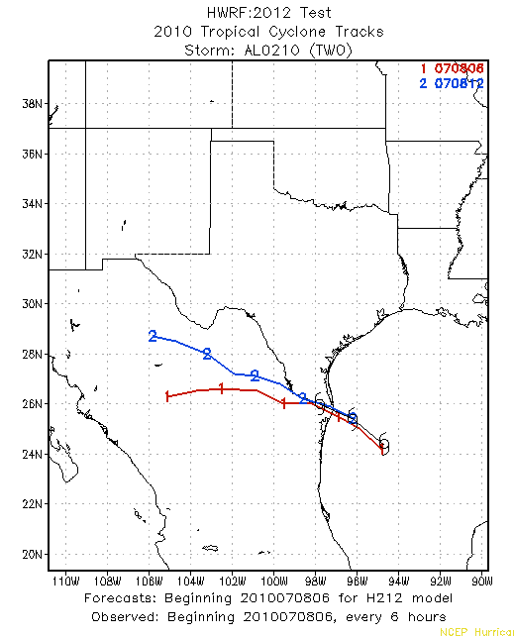
TWO 02 2010
HOPS H212

Slide 4
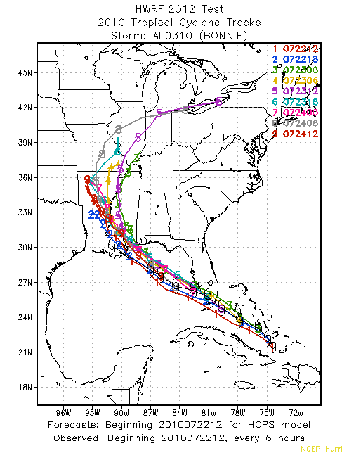
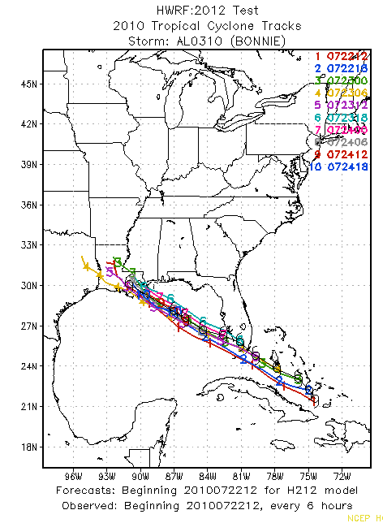
BONNIE 03 2010
HOPS H212

Slide 5
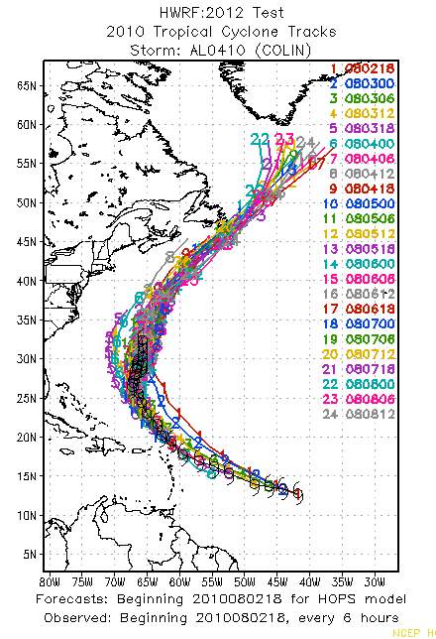
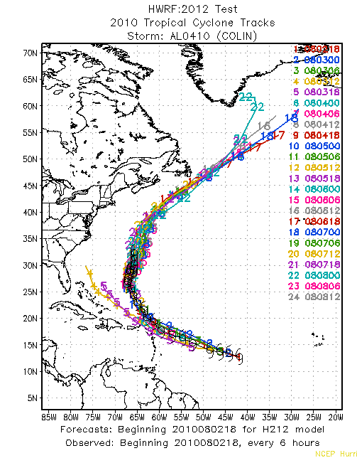
COLIN 04 2010
HOPS H212

Slide 6
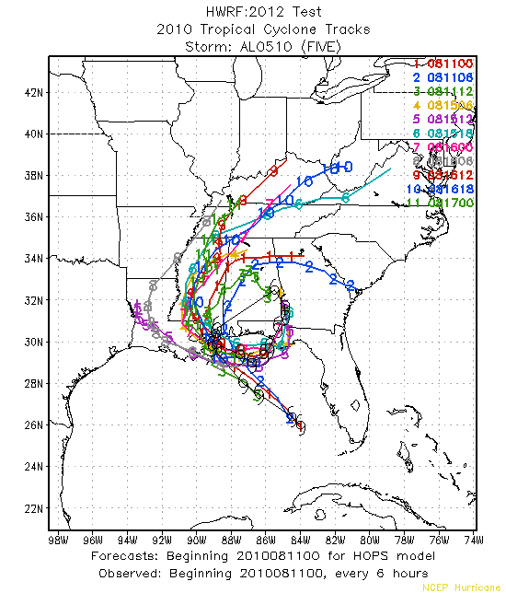
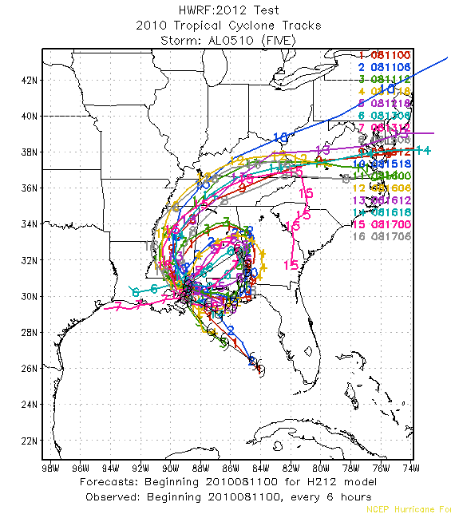
FIVE 05 2010
HOPS H212

Slide 7
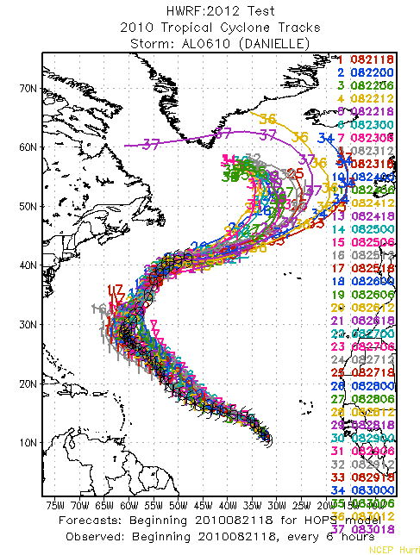
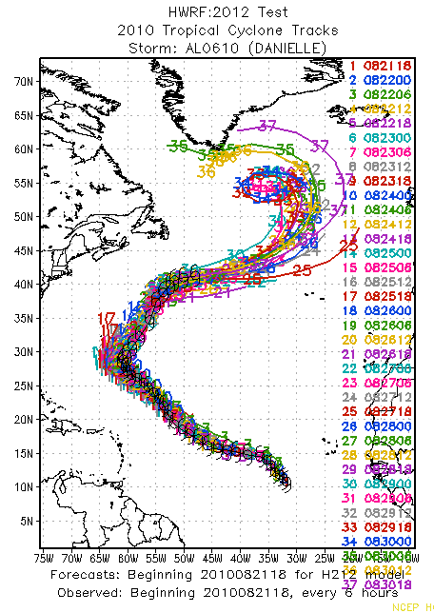
DANIELLE 06 2010
HOPS H212

Slide 8
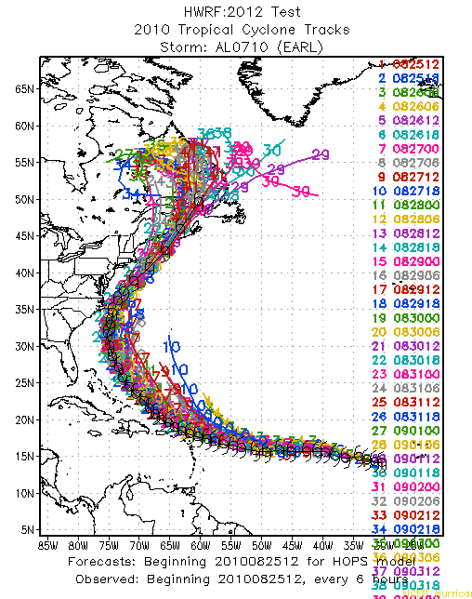
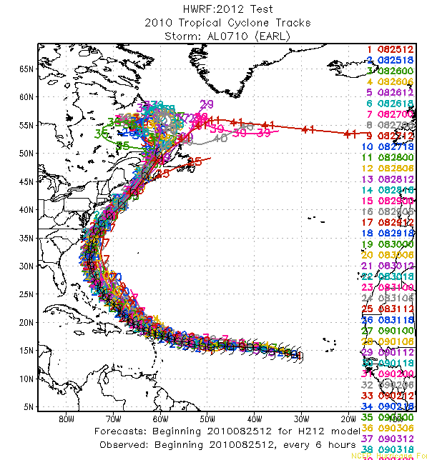
EARL 07 2010
HOPS H212

Slide 9
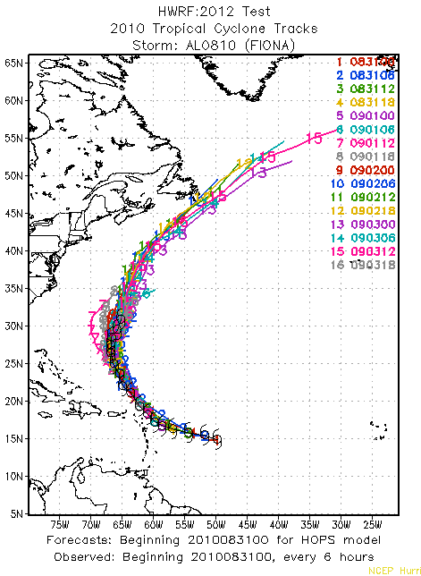
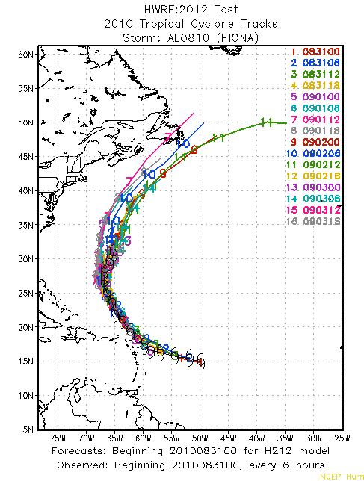
FIONA 08 2010
HOPS H212

Slide 10
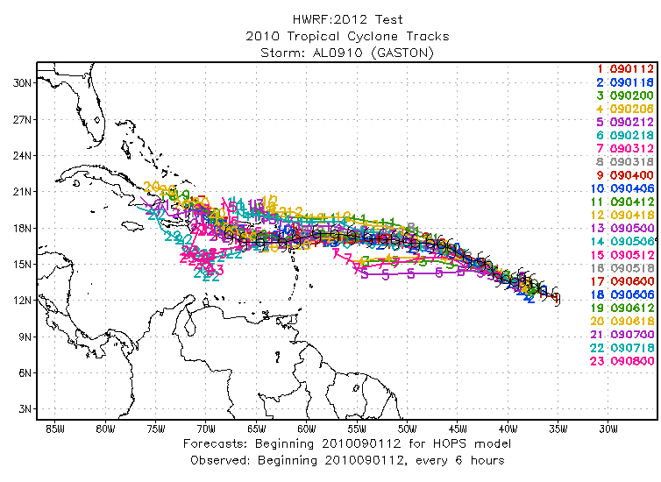
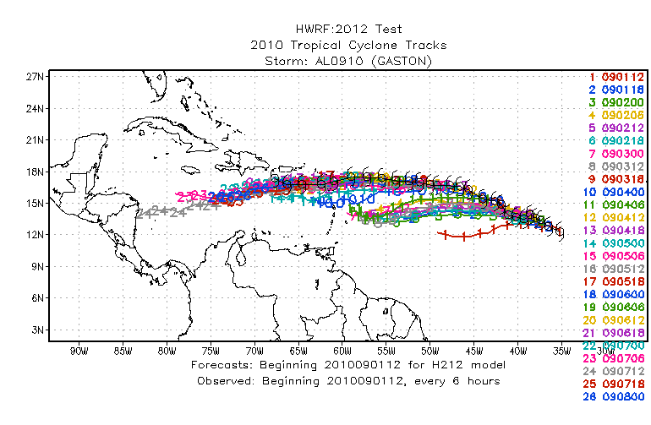
GASTON 09 2010
HOPS H212

Slide 11
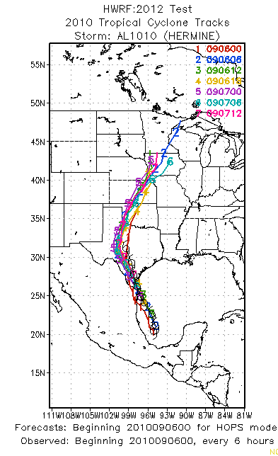
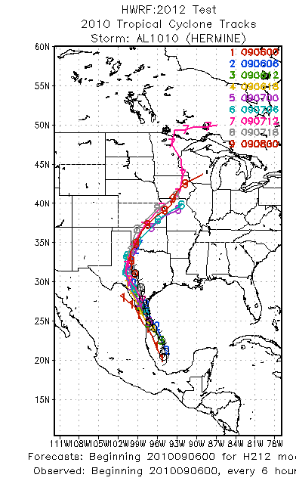
HERMINE 10 2010
HOPS H212

Slide 12
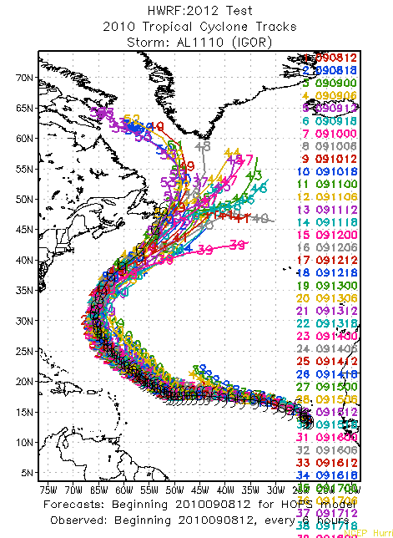
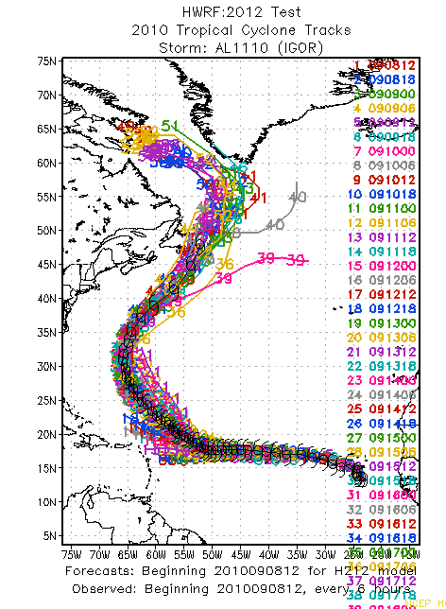
IGOR 11 2010
HOPS H212

Slide 13
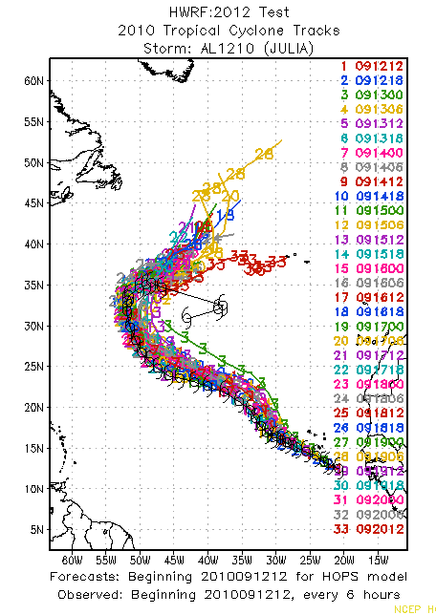
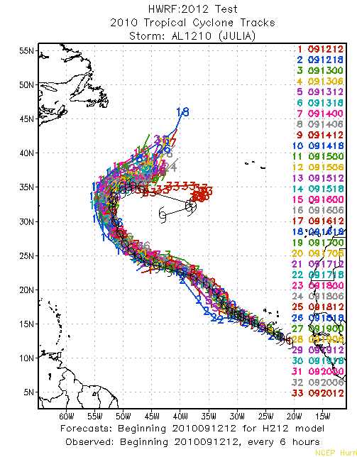
JULIA 12 2010
HOPS H212

Slide 14
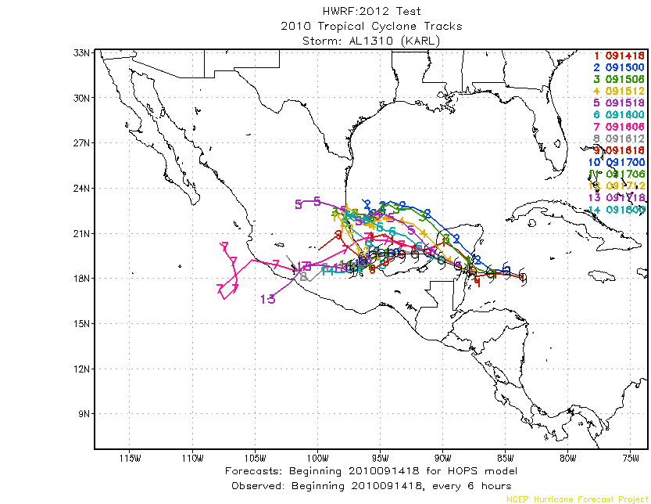
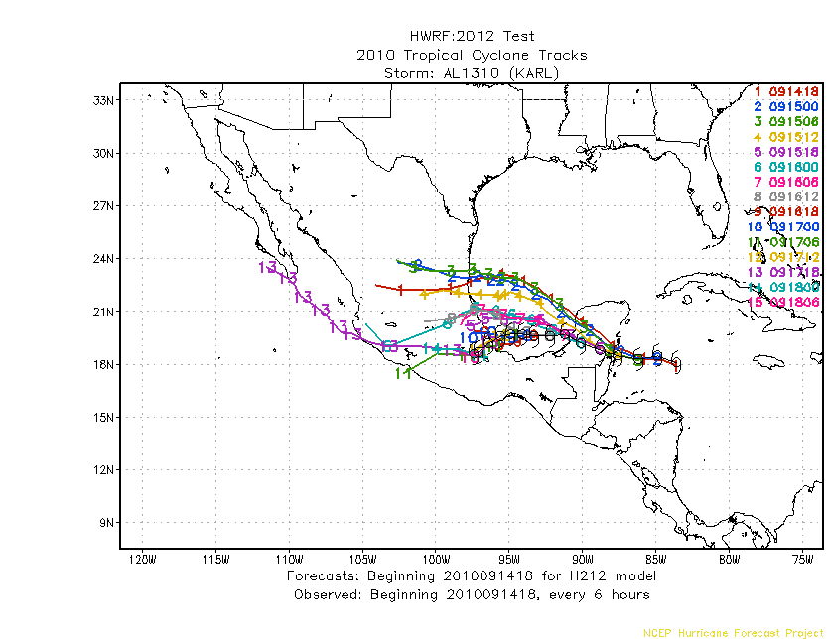
KARL 13 2010
HOPS H212

Slide 15
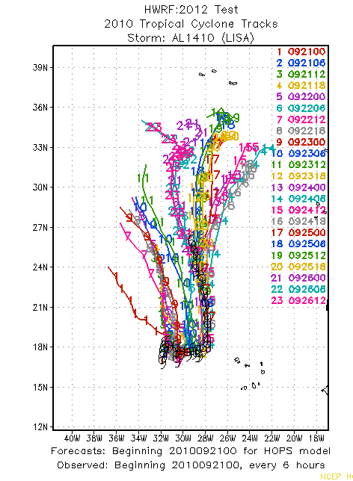
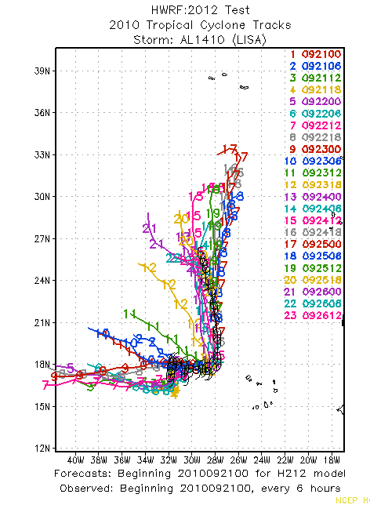
LISA 14 2010
HOPS H212

Slide 16
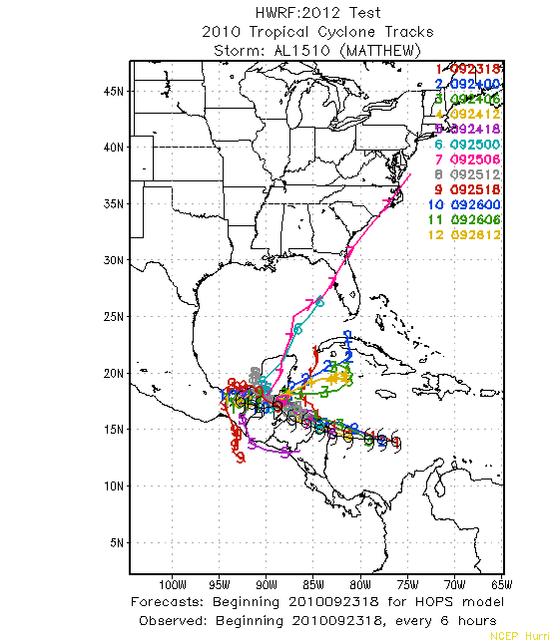
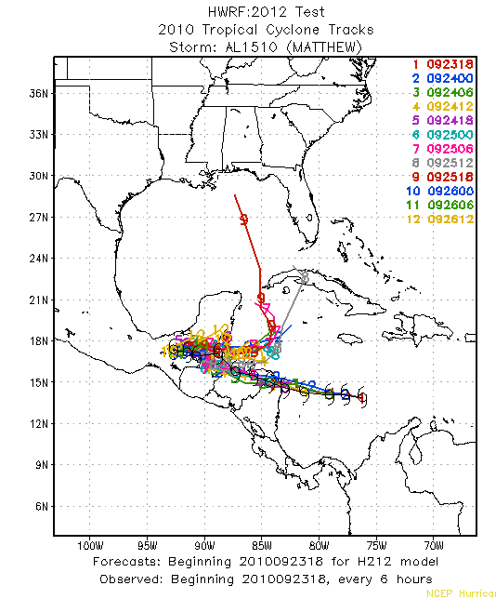
MATTHEW 15 2010
HOPS H212

Slide 17
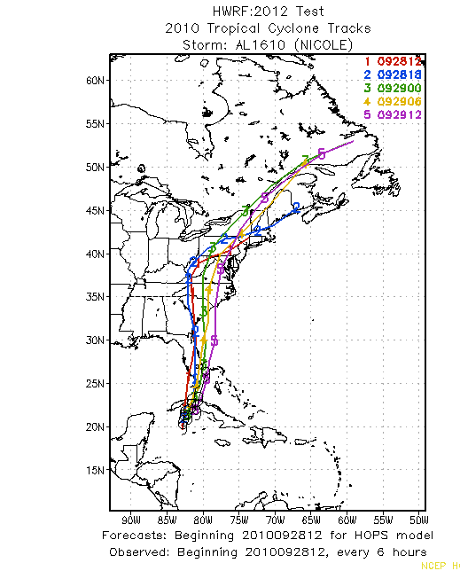
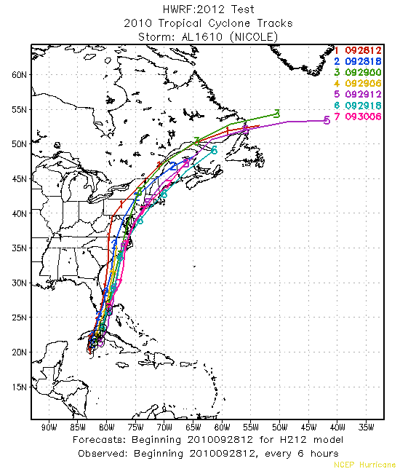
NICOLE 16 2010
HOPS H212

Slide 18
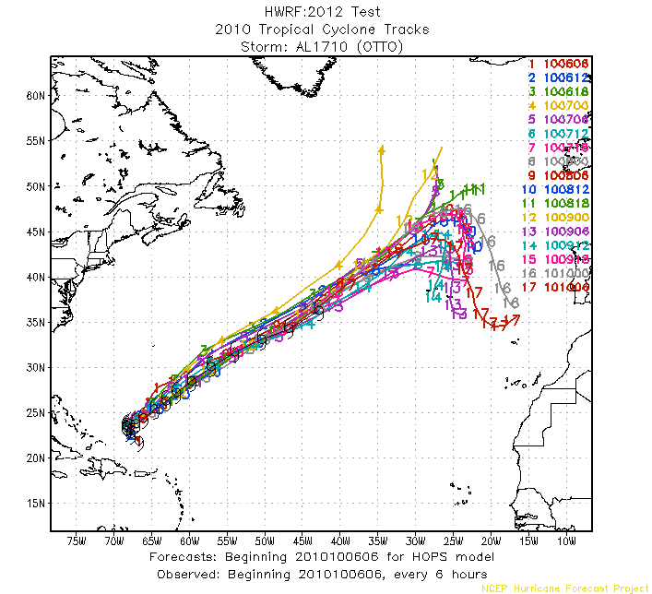
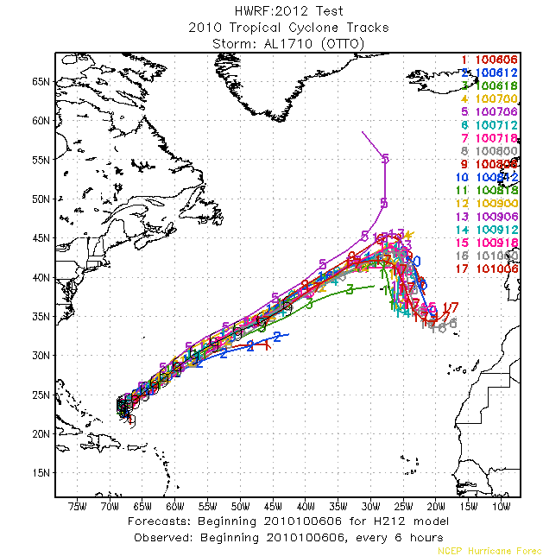
OTTO 17 2010
HOPS H212

Slide 19
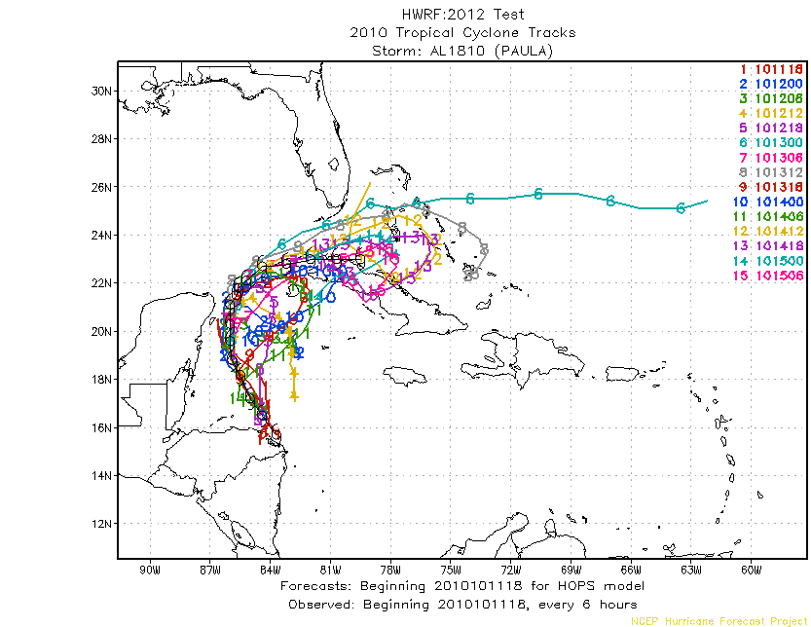
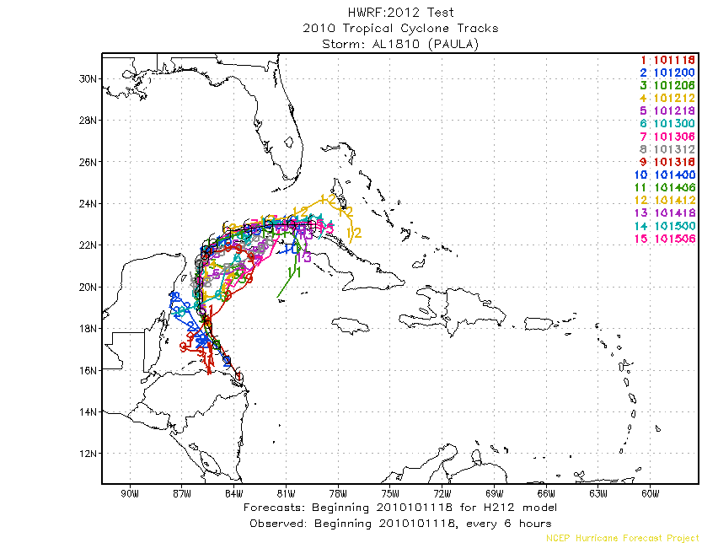
PAULA 18 2010
HOPS H212

Slide 20
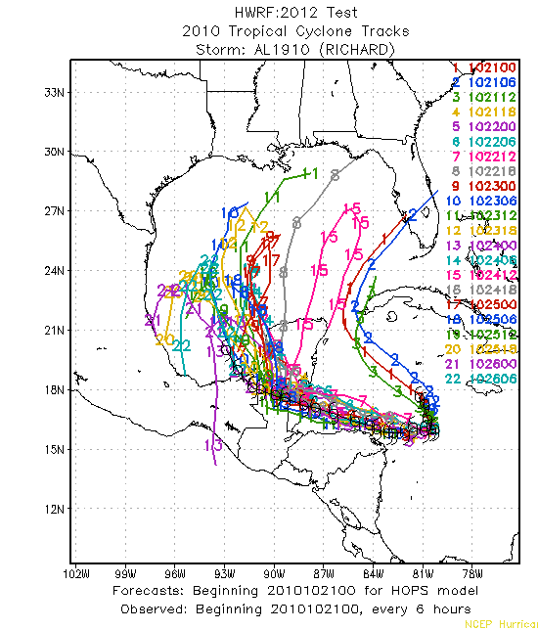
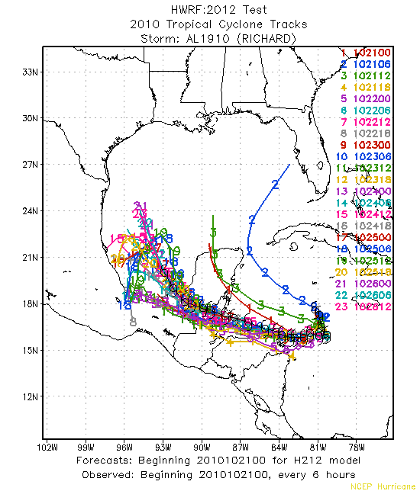
RICHARD 19 2010
HOPS H212

Slide 21
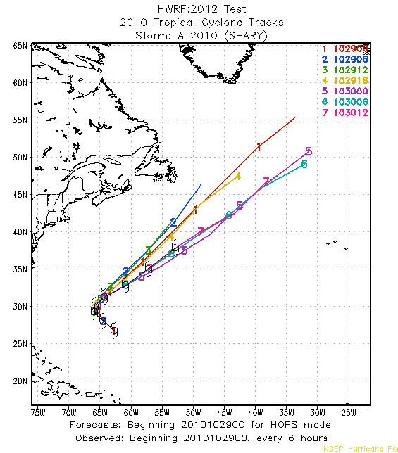
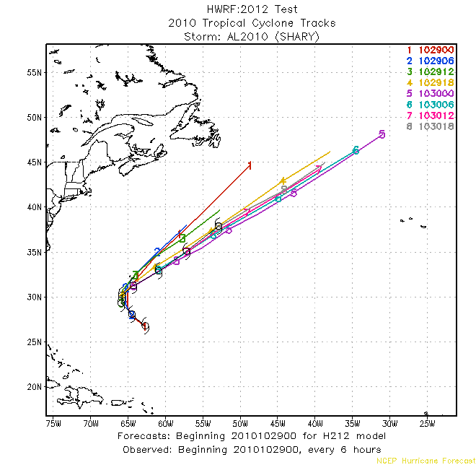
SHARY 20 2010
HOPS H212

Slide 22
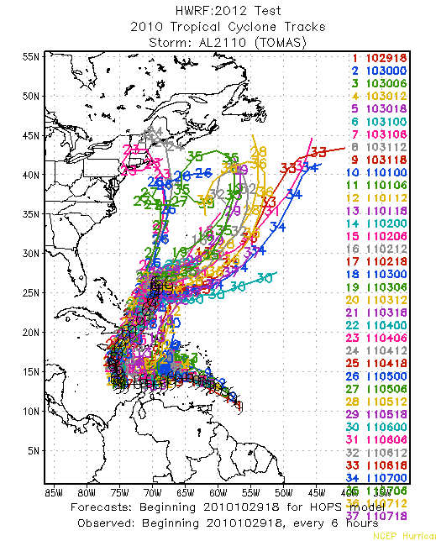
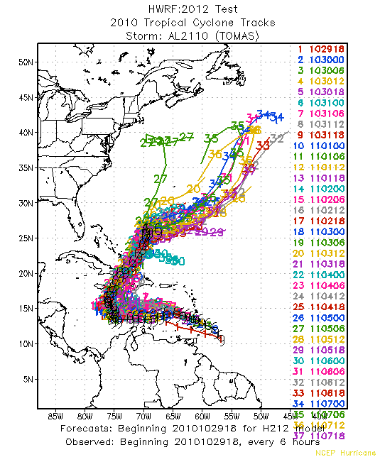
TOMAS 21 2010
HOPS H212

Slide 23
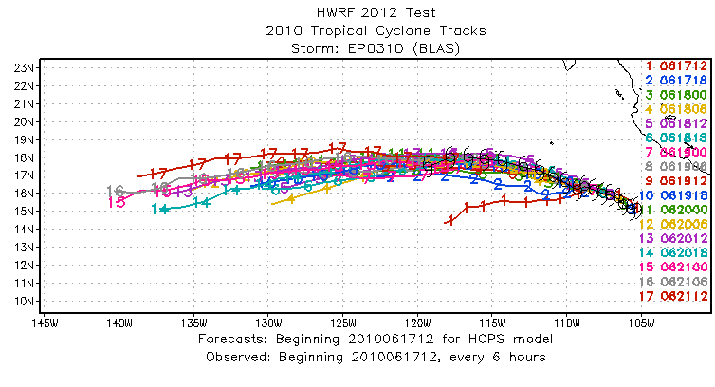
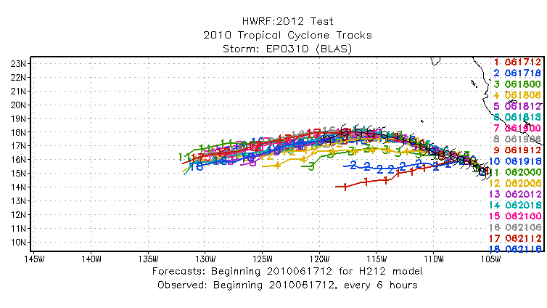
BLAS 03E 2010
HOPS H212

Slide 24
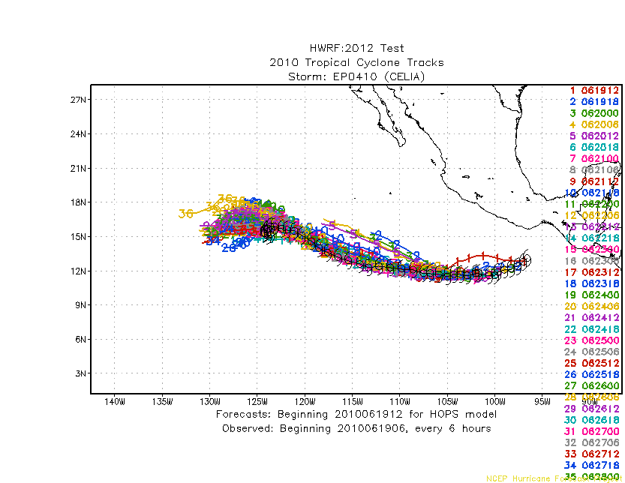
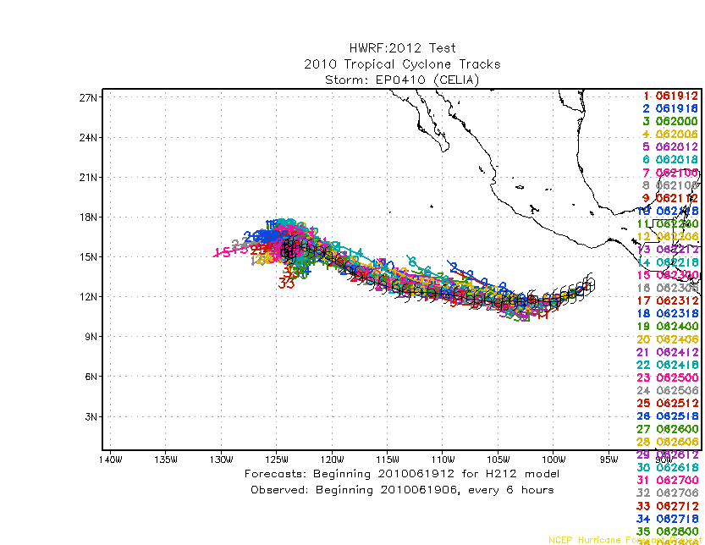
CELIA 04E 2010
HOPS H212

Slide 25
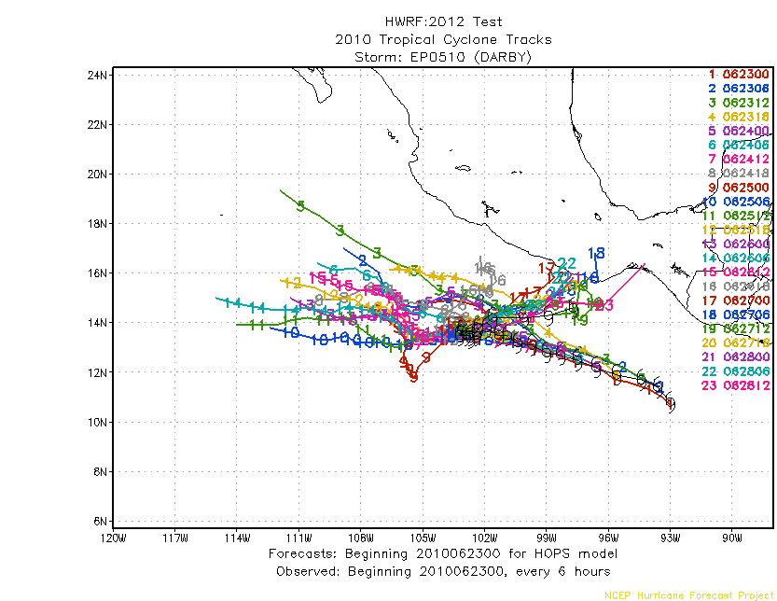
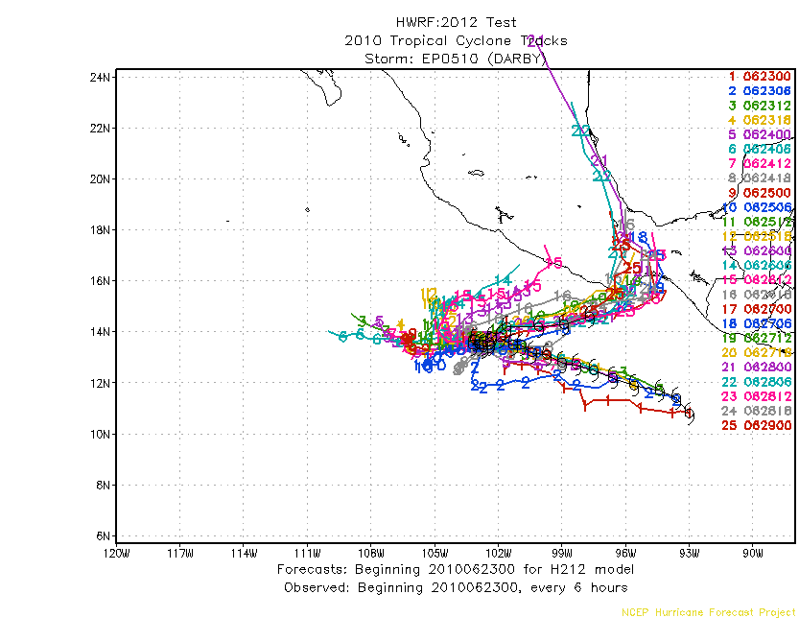
DARBY 05E 2010
HOPS H212

Slide 26
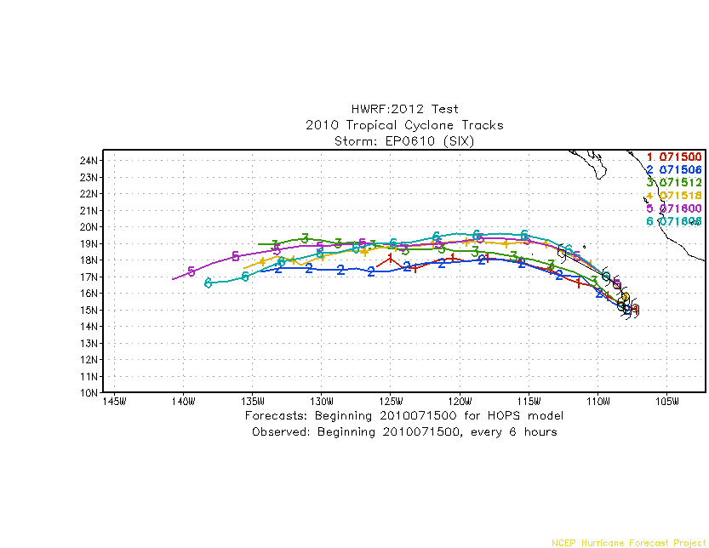
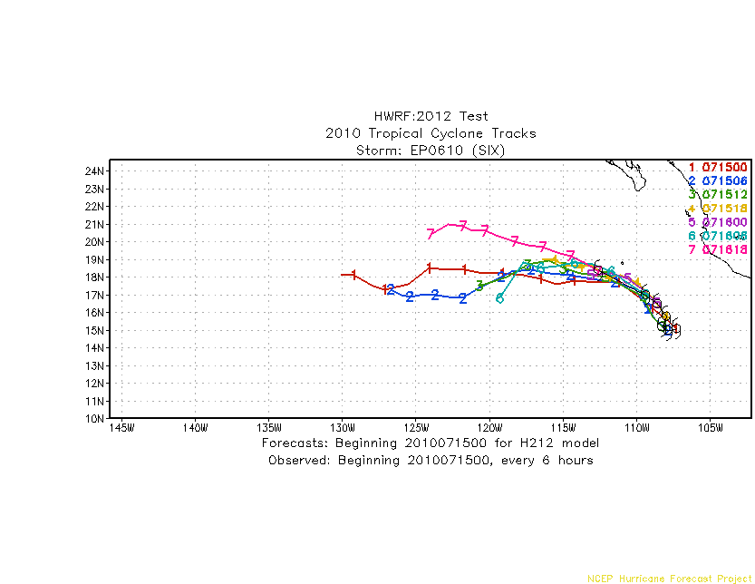
SIX 06E 2010
HOPS H212

Slide 27


ESTELLE 07E 2010
HOPS H212

Slide 28


EIGHT 08E 2010
HOPS H212

Slide 29


FRANK 09E 2010
HOPS H212

Slide 30


TEN 10E 2010
HOPS H212

Slide 31


ELEVEN 11E 2010
HOPS H212

Slide 32


GEORGETTE 12E 2010
HOPS H212

Slide 33


ARLENE 01L 2011
HOPS H212

Slide 34


BRET 02L 2011
HOPS H212

Slide 35


CINDY 03L 2011
HOPS H212

Slide 36


DON 04L 2011
HOPS H212

Slide 37


EMILY 05L 2011
HOPS H212

Slide 38


FRANKLIN 06L 2011
HOPS H212

Slide 39


GERT 07L 2011
HOPS H212

Slide 40


HARVEY 08L 2011
HOPS H212

Slide 41


IRENE 09L 2011
HOPS H212

Slide 42


TEN 10L 2011
HOPS H212

Slide 43


JOSE 11L 2011
HOPS H212

Slide 44


KATIA 12L 2011
HOPS H212

Slide 45


LEE 13L 2011
HOPS H212

Slide 46


MARIA 14L 2011
HOPS H212

Slide 47


NATE 15L 2011
HOPS H212

Slide 48


OPHELIA 16L 2011
HOPS H212

Slide 49


PHILIPPE 17L 2011
HOPS H212

Slide 50


RINA 18L 2011
HOPS H212

Slide 51


SEAN 19L 2011
HOPS H212

Slide 52


ADRIAN 01E 2011
HOPS H212

Slide 53


BEATRIZ 02E 2011
HOPS H212

Slide 54


CALVIN 03E 2011
HOPS H212

Slide 55


DORA 04E 2011
HOPS H212

Slide 56


EUGENE 05E 2011
HOPS H212

Slide 57


FERNANDA 06E 2011
HOPS H212

Slide 58


GREG 07E 2011
HOPS H212

Slide 59


EIGHT 08E 2011
HOPS H212

Slide 60


HILRARY 09E 2011
HOPS H212

Slide 61


JOVA 10E 2011
HOPS H212

Slide 62


IRWIN 11E 2011
HOPS H212

Slide 63


TWELVE 12E 2011
HOPS H212

Slide 64


KENNETH 13E 2011
HOPS H212

