Slide 1
Extending Operational HWRF Initialization to Triple-nest HWRF System
Qingfu Liu, Xuejin Zhang(HRD)
Samuel Trahan, Vijay Tallapragada
Young Kwon, Mingjing Tong
Zhan Zhang, Bill Lapenda
EMC/NCEP
Contributors: Kelvin Yeh,
Weiguo Wang, Chanh Kieu
In-Hyuk Kwon and Janna Oconnor
Thanks to: Steve Lord, Naomi Surgi, Bob Gall, Gopal and Frank Marks for their support during the development of the HWRF initialization system

Slide 2
OUTLINE
Philosophy in HWRF initialization design
Current HWRF initialization system
Test results using 3km HWRF model
Problems in current HWRF initialization and possible Future work

Slide 3
1. Philosophy in HWRF initialization design
➔ HWRF initialization has two steps
Step1: Create a better background fields
mini-vortex analysis in background fields
includes: storm relocation
storm size correction
storm intensity correction
Step2: Traditional data assimilation using GSI

Slide 4
The design of the original HWRF initialization satisfies the following requirements:
1). No bogus data
Reasons: a) bogus data may conflict with observation data
b) we will get the storm structure we specified
2) No conflict between the mini-vortex analysis and the traditional data assimilation
a) if we have no/few data in hurricane areas, we can use the results from mini-vortex analysis + GSI to give the final analysis, and the result can be used for storm track and intensity forecast
b) If we have more data (such as the airborne radar data), we can still use the results from mini-vortex analysis + GSI to further improve the vortex structure and the environment fields through GSI data assimilation

Slide 5
3) Model-consistent
Generally speaking, the differences are large between the model and the observation in hurricane area. We have two choices:
a) Small correction
pro: model-consistent
small adjustment in model forecast
con: bad vortex structure
➔ HWRF initialization can be considered as small correction (correction is large in a few cases):
Storm size correction is limited to 15%
wind speed correction < 10% (generally speaking)
Bad vortex structure is frequently criticized by research community. However, as physics improve, the vortex structure will become better, and eventually converge to observation (theoretically).

Slide 6
3) Model-consistent (continue)
b) Large correction
pro: good vortex structure
con: generally speaking, Not model-consistent
Large adjustment in model forecast
Once model forecast starts, the good vortex structure can be lost in several hours forecast time.
Case study: 2005 Wilma has an 8-km eyewall size at 140 knots wind. Model forecast gives 20km eyewall size in the background fields. If we produce a nice initial vortex with 8-km eyewall size in HWRF initial fields, the eyewall will collapse, and significant spin-down will occur in model forecast. The current HWRF model does not have the capability to maintain this kind of hurricane structure.

Slide 7
2. Current Operational HWRF initialization
Problem in the initialization when applied to regional model
The design of the HWRF initialization is better fitted to global model (need high resolution nests). When applied to regional model such as HWRF, large scale flow can drift after several cycles which may lead to very bad track forecast (tested in year 2007).
Modified HWRF initialization (currently used in operational HWRF)
we use the following combination as HWRF background fields:
Environment field from GFS analysis + Corrected HWRF vortex
Environment field from GFS analysis = GFS analysis – GFS vortex
Corrected HWRF vortex includes:
storm relocation
storm size correction
storm intensity correction

Slide 8
➔ Storm relocation and storm size correction
Storm relocation and storm size correction are done simultaneously in the code:
HLAT(i,j)=(HLAT(i,j)-CLAT_FCST)*fact(i,j)+CLAT_OBS
HLON(i,j)=(HLON(i,j)-CLON_FCST)*fact(i,j)+CLON_OBS
VLAT(i,j)=(VLAT(i,j)-CLAT_FCST)*fact(i,j)+CLAT_OBS
VLON(i,j)=(VLON(i,j)-CLON_FCST)*fact(i,j)+CLON_OBS
fact(i,j) is the compress/stretch factor
After storm size correction, we need to adjust the surface pressure, 3D temperature and the moisture field to maintain the model consistency of the vortex (detailed description can be found in DTC HWRF document).
➔ Storm Intensity correction:
If storm is stronger than observation, we multiply the HWRF vortex 3D wind field by a constant factor (no composite storm involved)
If storm is weaker than observation: we add a small fraction of the composite storm to match the observed storm intensity (wind speed)
After intensity correction, surface pressure, 3D temp and moisture fields need to be adjusted. I only show case 2) here.

Slide 9
Storm Intensity Correction (continue)
New initial 3D wind fields
And
where v_{obs} is the maximum 10m observed wind converted to the first model level, and m denotes the model grid where the wind speed reach its maximum

Slide 10
Storm Intensity Correction (continue)
Surface pressure adjustment after wind speed correction
Case 2): wind speed in background is weaker than obs.
And the pressure adjustment is
Where gradient wind stream function is defined as,

Slide 11
Storm Intensity Correction (continue)
Temperature adjustment
It can be shown that the temperature adjustment is proportional to the magnitude of the vortex temperature perturbation,
Water vapor adjustment
Assumption: relative humidity is unchanged before and after the temperature correction, we have
Where

Slide 12
3. Test results using 3km HWRF
➔ The results are from the final version of 2012
(Plots are from Young Kwon’s presentation)
HOPS: Operational HWRF
H212: 3km HWRF using upgraded HWRF model physics
Major changes in model physics:
1) add GFS shallow convection
2) PBL:
change critical Richardson number from 0.5 to 0.25
set alpha=0.5 from 1
Results:
There are significant improvements in hurricane track forecast in 3km HWRF. Intensity forecast is better compared to operational HWRF.
HWRF vortex is cycled. As model physics improved, the initial vortex structure also become better. The major improvements in the initial vortex are:
1) storm size significantly reduced, now close to observation
2) boundary layer height significantly reduced
3) Initial spin up/down problem also reduced

Slide 13
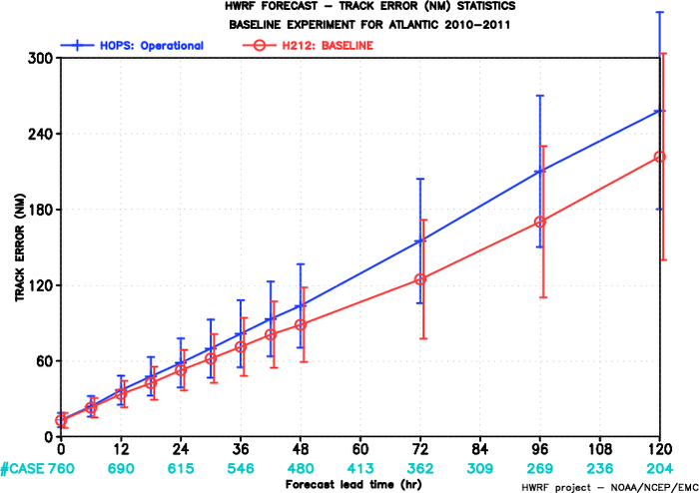
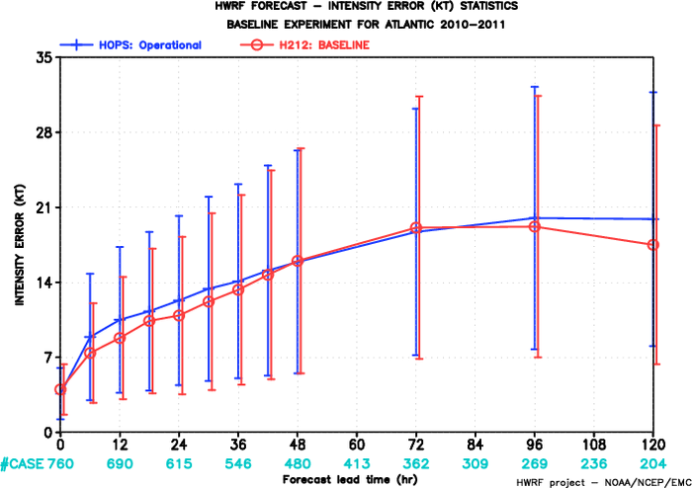
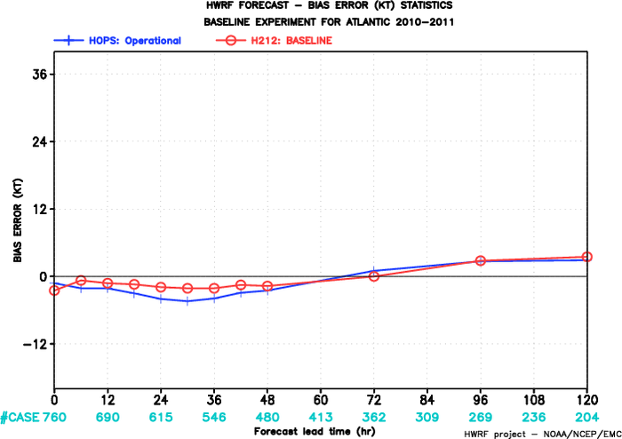
2010-2011 Atlantic Track Verification
Intensity errors
~20% improvement
~10% improvement
Track errors
Track FSP
HOPS: operational HWRF
H212: 2012 HWRF
Intensity Bias

Slide 14
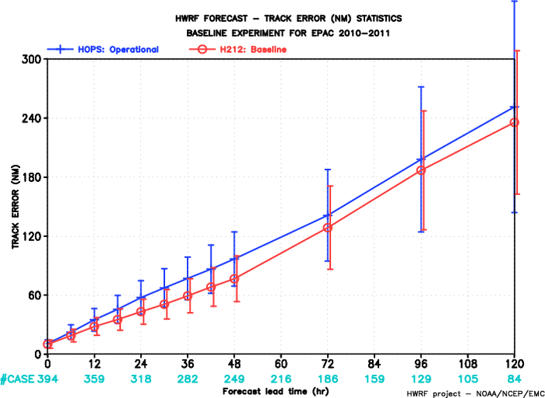
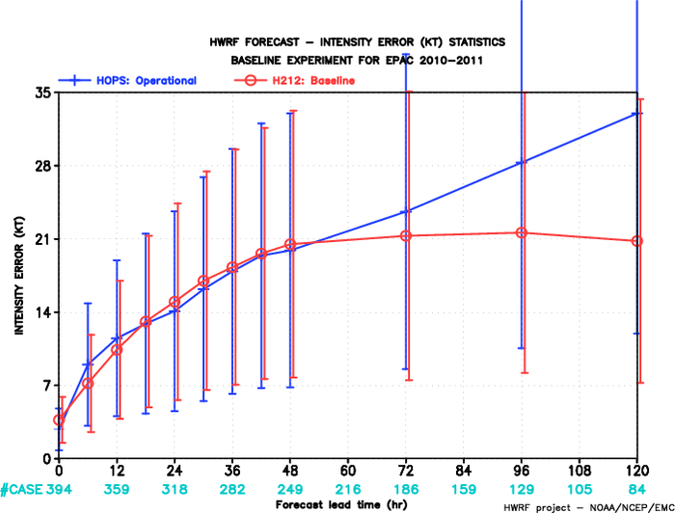
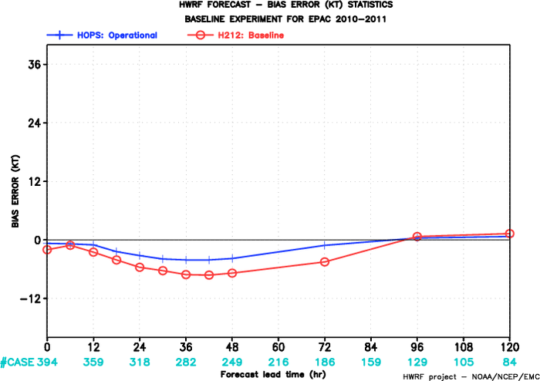
2010-2011 E-PAC
Track Verification
Intensity errors
~20% improvement
Track errors
~35% improvement
HOPS: operational HWRF
H212: 2012 HWRF
Intensity Bias

Slide 15
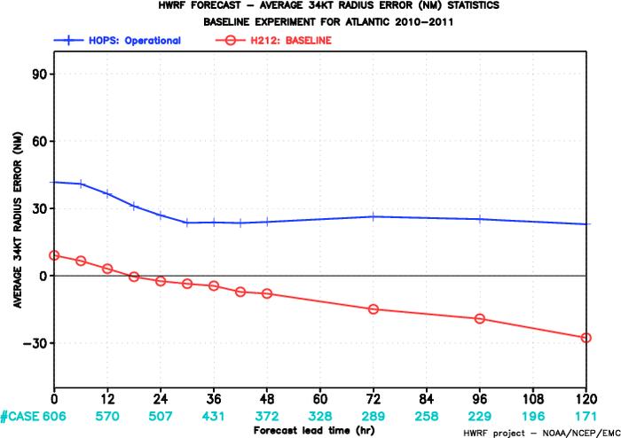
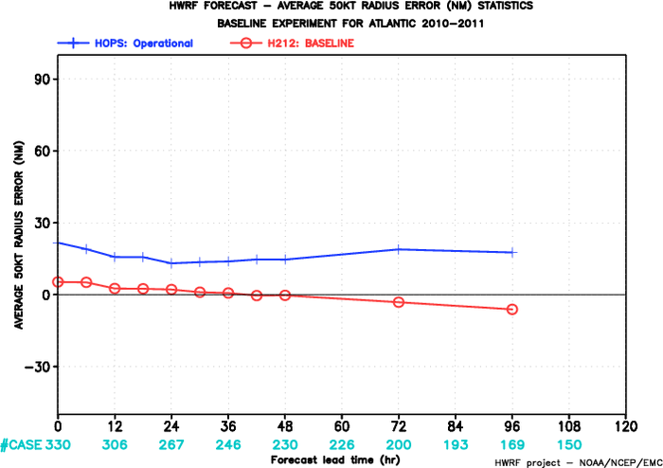
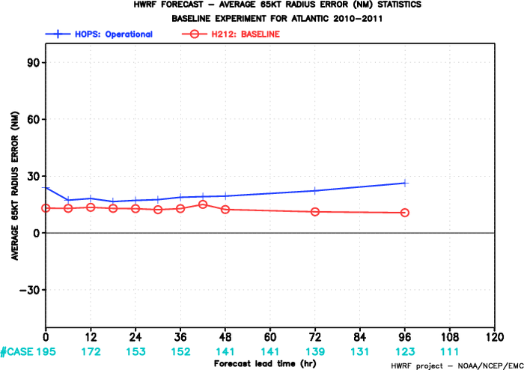
HOPS: operational HWRF
H212: 2012 HWRF
Mean 34-kt Radius Error
Mean 50-kt Radius Error
Mean 65-kt Radius Error
2010-2011 Atlantic
Radii Verification

Slide 16
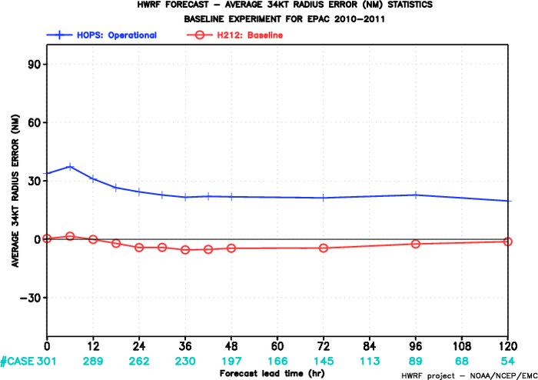
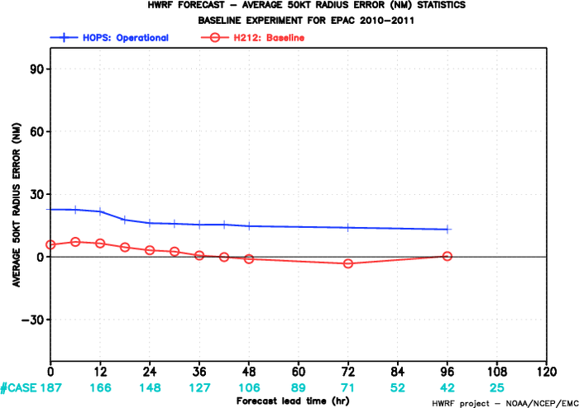
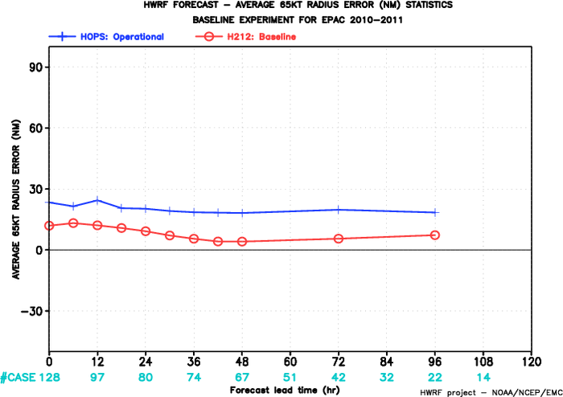
Mean 34-kt Radius Error
Mean 50-kt Radius Error
HOPS: operational HWRF
H212: 2012 HWRF
Mean 65-kt Radius Error
2010-2011 E-PAC
Radii Verification

Slide 17
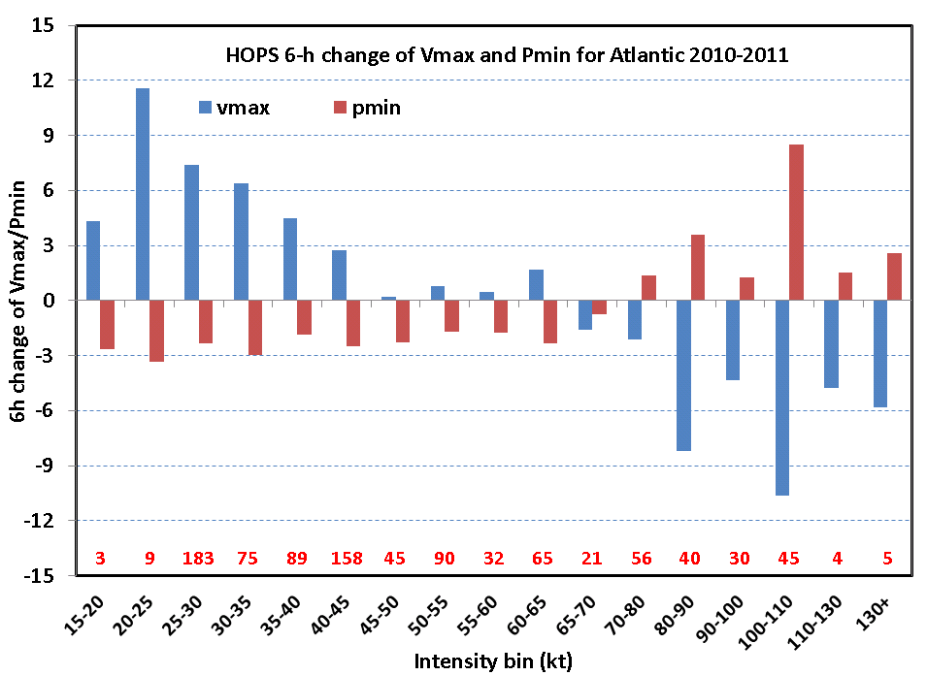
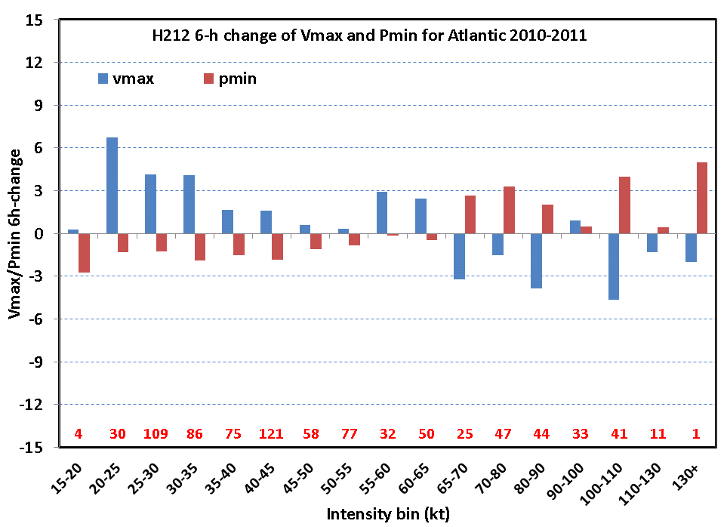
HOPS vs. H212 6-h change for 2010-11 ATL
HOPS (H211)
H212

Slide 18
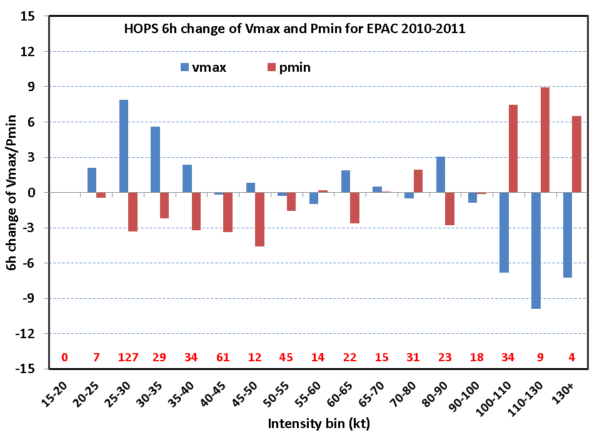
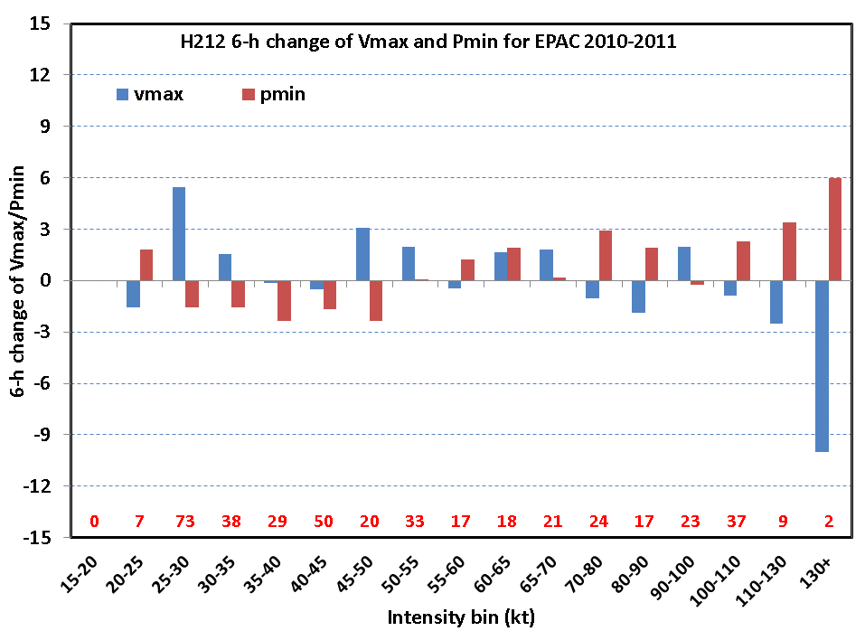
HOPS vs. H212 6-h change for 2010-11 EPAC
HOPS (H211)
H212

Slide 19
4. Problems in current HWRF initialization and the possible Future work
Surface pressure is not calculated based on the model-consistent formulation
Vortex replacement has uncertainties. Definition of the GFDL filter domain affects storm track and intensity forecasts.
(If mini-vortex analysis is done in HWRF background fields, the filter definition will have much less impact. Reason: what we removed during the vortex analysis will be added back later).
No upper level data
The initialization should become better if upper data is added in the future. Currently, there is no upper level control

