Slide 1


2016 HWRF V10.0.0 Implementation
Much improved operational forecast guidance for all global tropical cyclones
Avichal Mehra, Vijay Tallapragada
& the HWRF Team
Environmental Modeling Center,
NCEP/NOAA/NWS, NCWCP, College Park, MD 20740.
in collaboration with NHC, DTC, GFDL, URI, HRD, JTWC & NWS PR
Notes:
1
1

Slide 2
Scope of FY16 HWRF Upgrades
System & Resolution Enhancements
  T&E with new 2016 4D-Hybrid GDAS/GFS IC/BC
  Upgrade dynamic core from WRF3.6a to WRF3.7.1a (with bug fixes)
  Smaller time step (dt=30 s vs. 38 4/7 s)
  Increase the size of nested domains (details on next slide)
  More products: MAG and AWIPS2
Initialization/Data Assimilation Improvements
  GSI upgrades; new data sets for GSI (CrIS, SSMI/S, METOP-B changes)
  Turn on Data Assimilation for all storms in East Pacific and use of ROTFS initialization
Physics Advancements
  Implement new GFS PBL (2015 version)
  Upgrade to new scale-aware SAS convection scheme for all domains
  Update momentum and enthalpy exchange coefficients(Cd/Ch)
  Improved vertical wind profile in the surface and boundary layer
First time in 2016….
  Implementation on WCOSS Cray
  Ocean coupling for CPAC, WPAC and NIO (all NH basins)
  One-way coupling to wave model (Hurricane Wave Model)
  Use of dev-ecflow for accelerated T2O

Slide 3
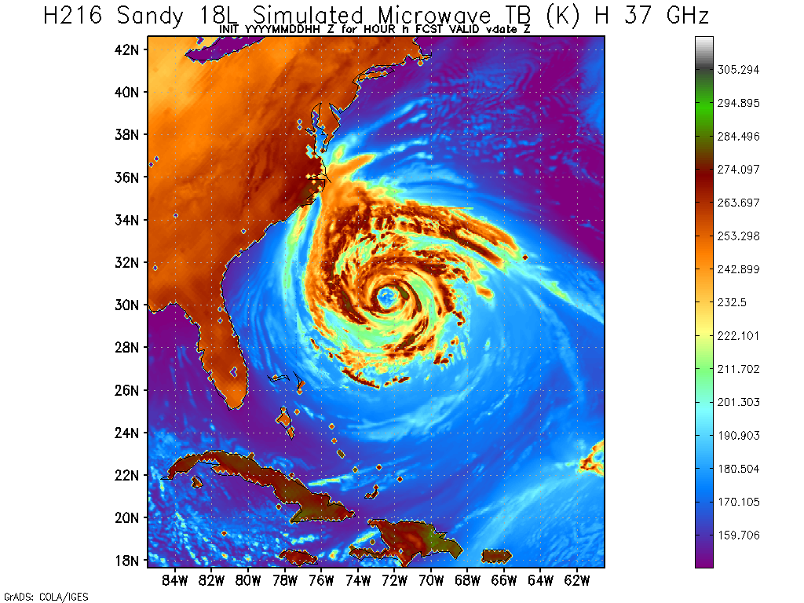
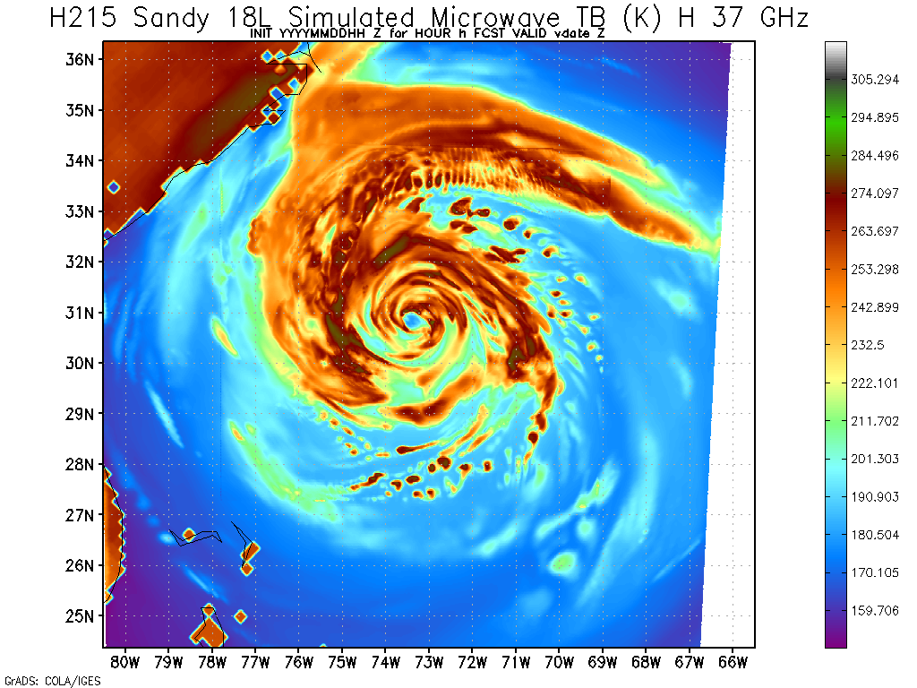
2016: Larger size nested domains and smaller timesteps
Domain Sizes/Time Steps
(Degrees/Sec) | 18 km | 6 km | 2 km
2015 HWRF | 75 x 75 38 4/7 | 12 x 12 12 6/7 | 6.5 x 7 4 2/7
2016 HWRF | 75 x 75 30 | 25 x 25 10 | 8.3 x8.3 3 1/3
NEW HWRF
6km Domain
OLD HWRF
6km Domain

Slide 4
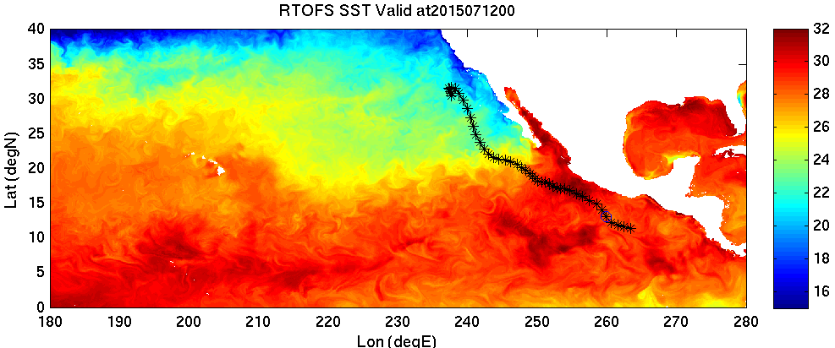
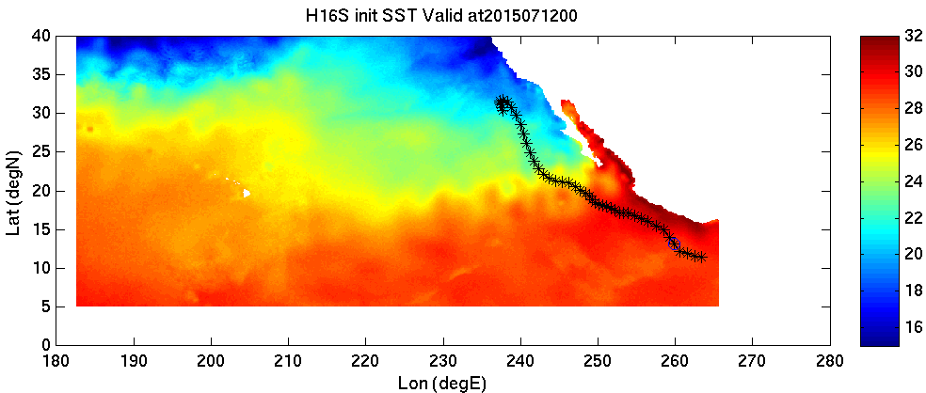
Difference between RTOFS and GFS SST for 2015071200Z
(Dolores)
For RTOFS first model level, ~0.5m depth
For MPIPOM first half-sigma model level, varying from ~0.1 to ~5 m depth

Slide 5
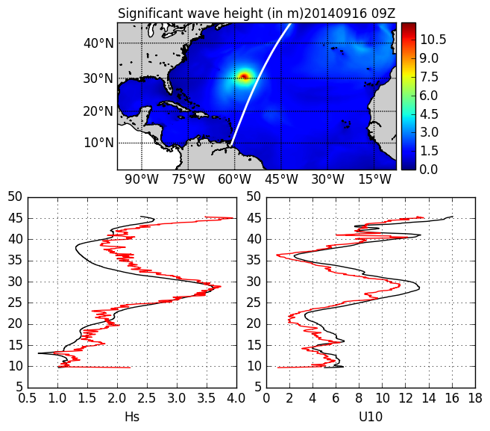
WAVEWATCH III results for Hurricane Eduardo (One way coupled)
Red – Jason2; Black -- WAVEWATCH

Slide 6
2016 Data Assimilation Upgrades (ATL and EPAC)
Turn off blending of vortex initialization and GSI analysis for weak storms (Vmax < 50 kts)
Turn on satellite DA on ghost d03
Satellite data usage changes:
  Adding assimilation of CrIS (JPSS), SSMIS, Metop-B AMSU-A, Metop-B MHS and IASI
  Change from assimilation to monitor: NOAA 19 AMSU-A Channel 7; NOAA 18 AMSU-B Channel 5, 8; NOAA 19 HIRS4; NOAA 19 MHS channel 3; GOES sounder; SEVIRI Meteosat-10
  Modified channels used for cloud detection: NOAA 15 AMSU-A; Metop-A AMSU-A; NOAA 18 AMSU-B; HIRS/3; HIRS/4; AQUA AMSU-A; ATMS; GOES sounder; IASI
Turn on VarQC in the second minimization loop

Slide 7
2016 Physics Upgrades
Module | Highlights | Improvements
Surface Layer | Use 10m wind to calculate cd/ch Update Cd, Ch for V >20m/s | Independent of z grid Better low level wind Closer to observations
PBL | Replace old GFS PBL with latest GFS-EDMF PBL Add observations based K adjustment Improve & remove discontinuity of K profile | Better representation of CBL/SBL Better low level winds Better simulation of storm intensification
Convection | Scale-aware deep/shallow convection scheme in all domains | Represent multi-scale convection
Horizontal diffusion | Reduce horizontal length scale ~ 2/3 of that in 3-km HWRF, (COAC values of 0.75, 1, 1.2 from 0.75, 3, 4 in H215) | Consistent with higher resolution
Microphysics 1 adv Ferrier_hires 2 Thompson MP | Advect individual hydrometers good Ice physics | Tech issue, next year tests not yet done

Slide 8
HWRF Upgrade Plan for 2016 Implementation
Multi-season Pre-Implementation T&E
 | Model upgrades | Physics and DA upgrades |  | Combined
 | Baseline (H16C) | Data Assimilation changes (H16S) | Physics changes (H16O) | H16O/H216
Description | 1. WRF-NMM V3.7.1a dynamic core with 1.a. retention of non-hydrostatic status during the nest movement; 1.b icloud=3 bugfix; 2. New GFS upgrade 3. Smaller time step | Hybrid GSI/HWRF EPS based DA | Assess impact of physics changes (Eddy Diffusivity Mass-Flux Scheme, scale aware SAS convection, update exchange coefficients, improved wind profile) | Baseline + DA changes + all physics changes + RTOFS initialization for EPAC + CPAC coupling + One-way coupling to Wave Model
Cases | Three-season 2013-2015 (and Hurricane Sandy) simulations in ATL/EPAC cases (~2000) | Only Aircraft DA cases for 2013-2015 | Priority cases (~500 cases in each basin) | Three-season 2013-2015 (and 2012 Hurricane Sandy) retrospectives ~5000 simulations in all TC basins
Platform | WCOSS/Jet/Theia | WCOSS/Jet/Theia | WCOSS/Jet/Theia | WCOSS Cray

Slide 9
Successful R2O in FY16 HWRF Upgrades
This upgrade is a result of multi-agency R2O efforts supported by HFIP.
  EMC: Key model physics upgrades, including GFS-EDMF PBL scheme, scale-aware convection scheme, eddy diffusivity K adjustment, computational efficiency, and pre-implementation T&E;
  HRD/AOML: Tuning surface drag and entropy coefficients based on observation values;
  DTC/NCAR: code management and repository, Thompson Microphysics experiment; icloud=3 bug fix;
  URI: RTOFS initialization for EP basin storms; ocean coupling for CP basin storms; one way wave coupling;
  GFDL: Knowledge sharing;
  NHC/CPHC/JTWC/NWS-PR: Diagnostics and evaluation of the HWRF pre-implementation tests and real-time guidance

Slide 10
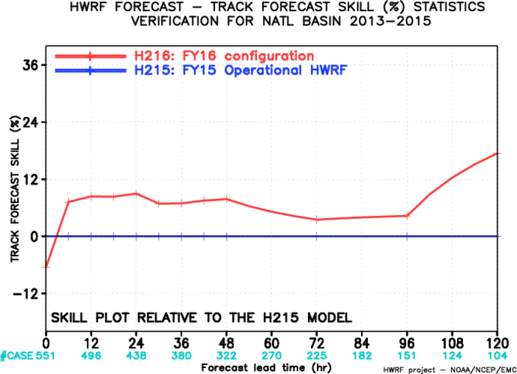
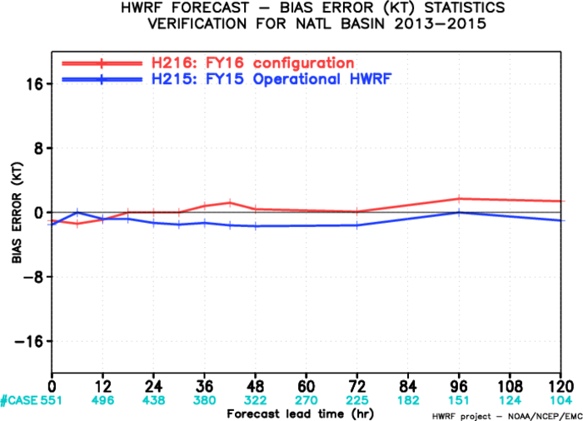
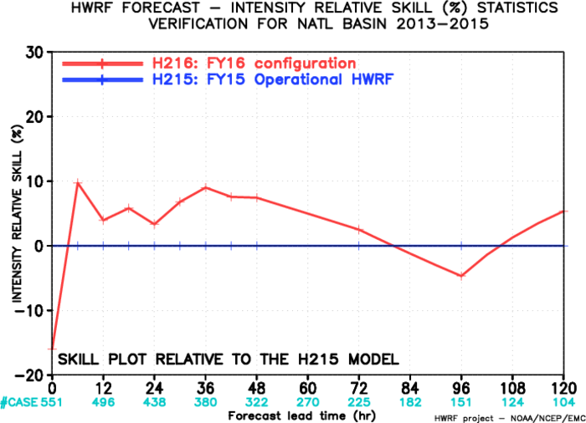
Evaluation of 2016 HWRF upgrades for NATL
(2012 Sandy, 2013-2015)
Track forecast results from H216 for the Atlantic basin suggested additional 10% improvement compared to H215.
Intensity forecast results from H216 for the Atlantic basin suggested additional 5-10% improvements compared to H215 for the first 3 days.
H216 also has a neutral to positive bias for intensity as compared to neutral to negative values for H215

Slide 11
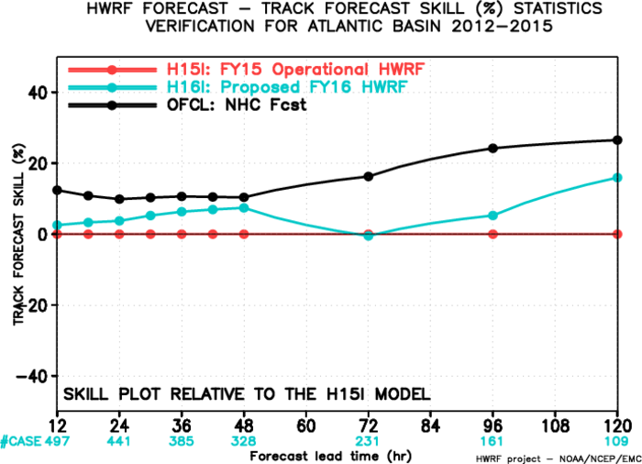
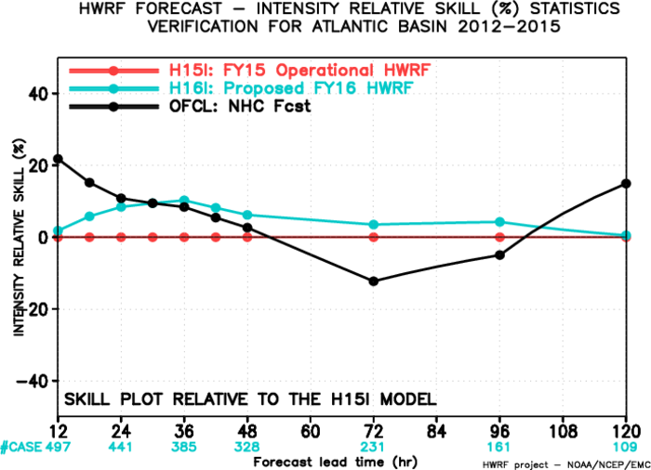
Evaluation of 2016 HWRF upgrades for NATL :
Interpolated Guidance (2012 Sandy, 2013-2015)
H216 shows improvements in both track and intensity as compared to H15I but still needs to catch-up to official tracks and intensity.

Slide 12
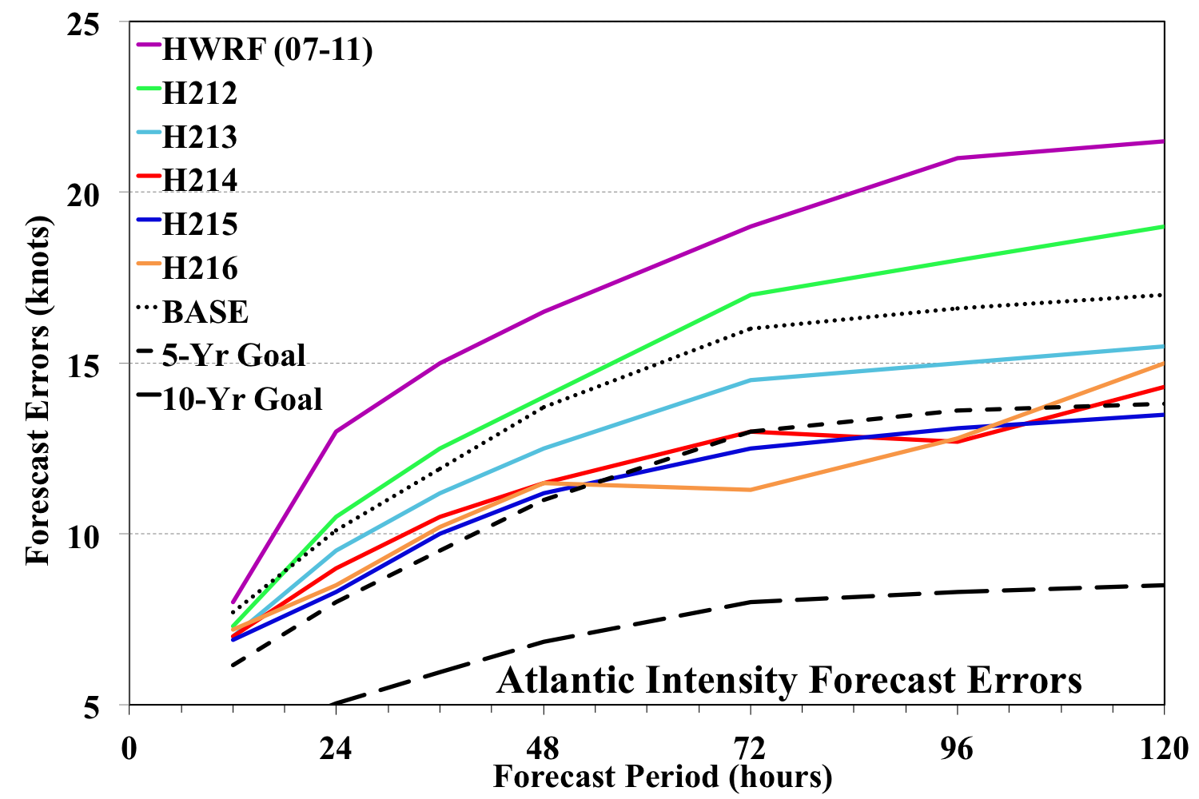
2016 HWRF: Continuing the trend of incremental but substantial improvements in NATL intensity forecasts
Rapid Progress in Hurricane Forecast Improvements
This marks 5th year in a row of demonstrating continuous improvements as measured through heterogeneous verification of multi-year retrospective runs.

Slide 13
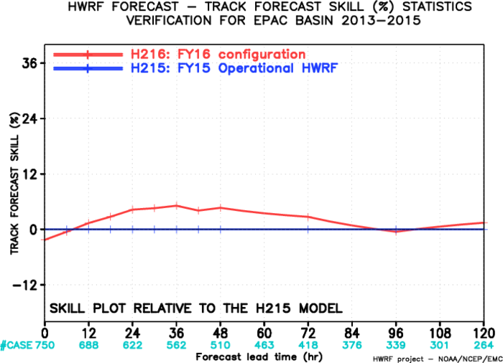
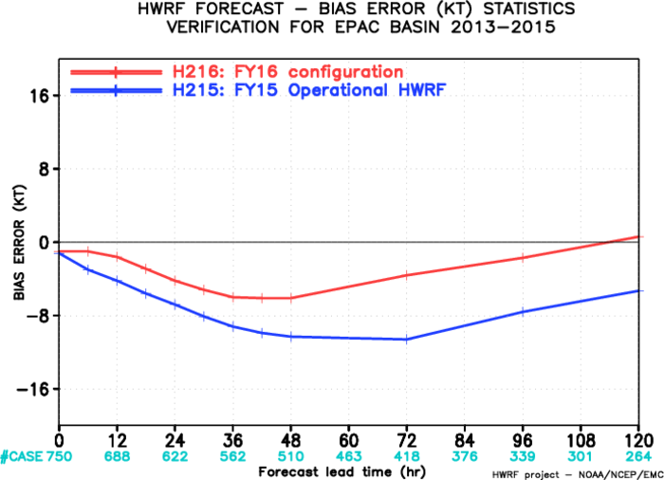
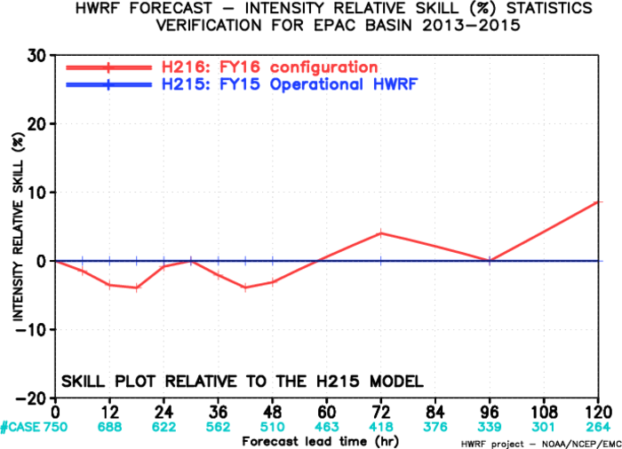
Evaluation of 2016 HWRF upgrades for EPAC
(2013-2015)
Compared to H215, H216 results indicate improved track skill of ~5% for the first 3 days.
Intensity skill is mostly neutral with some improvements seen at longer lead times.
H216 has much reduced intensity bias measures compared to H215.

Slide 14
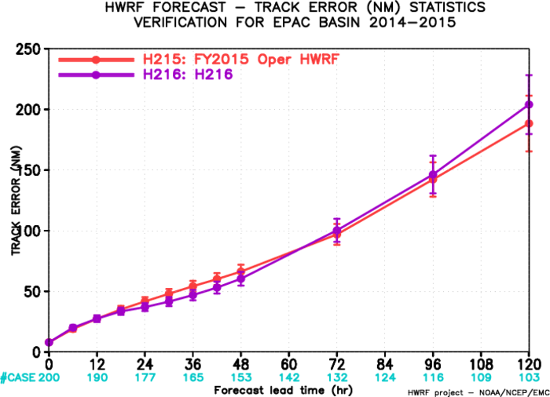
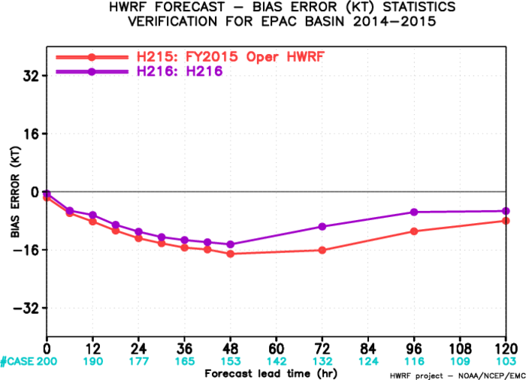
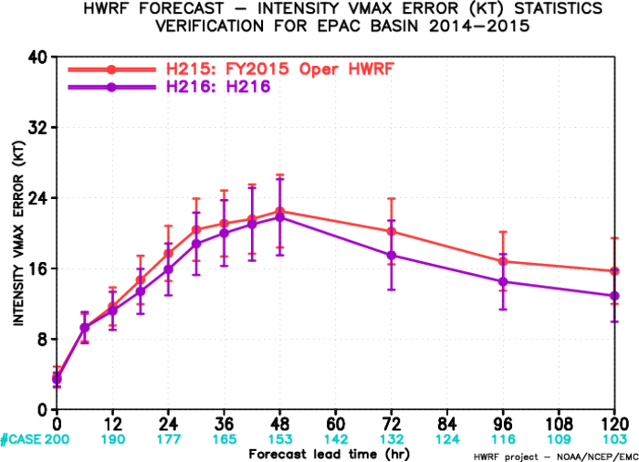
FY16: Impact of RTOFS Initialization and GSI on RI cases
For RI cases in EPAC, DA and RTOFS initialization of MPIPOM gave improved performance for intensity skill after the first few hours (both error and bias). Impact on track is neutral.
Results very similar to GFDL

Slide 15
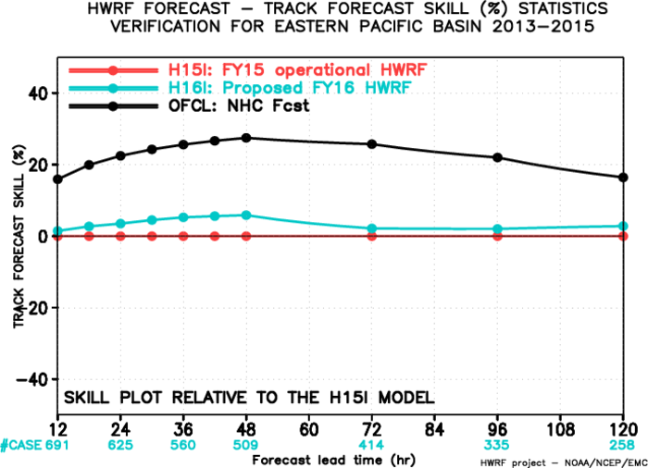
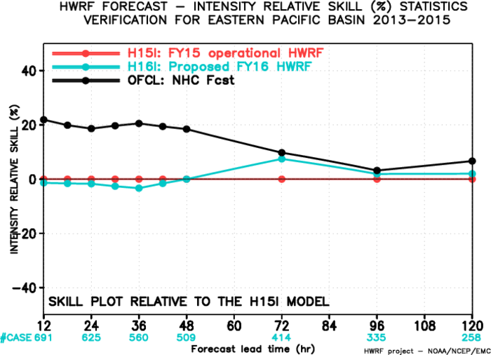
Evaluation of 2016 HWRF upgrades for EPAC:
Interpolated Guidance (2013-2015)
Track skill
Intensity skill
H16I exhibits improvements over H15I in track but is poor compared to official tracks. Intensity is neutral to positive after 48 hrs.

Slide 16
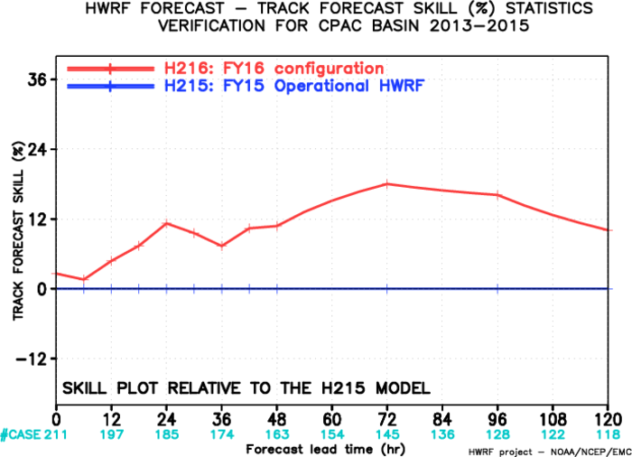
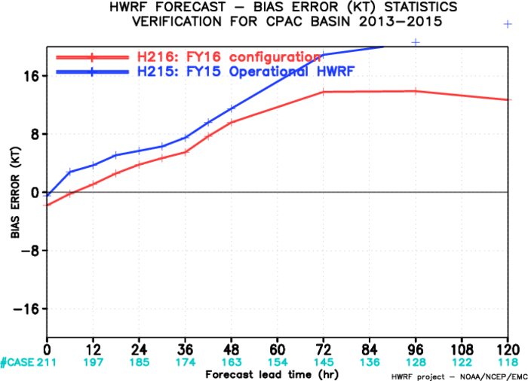
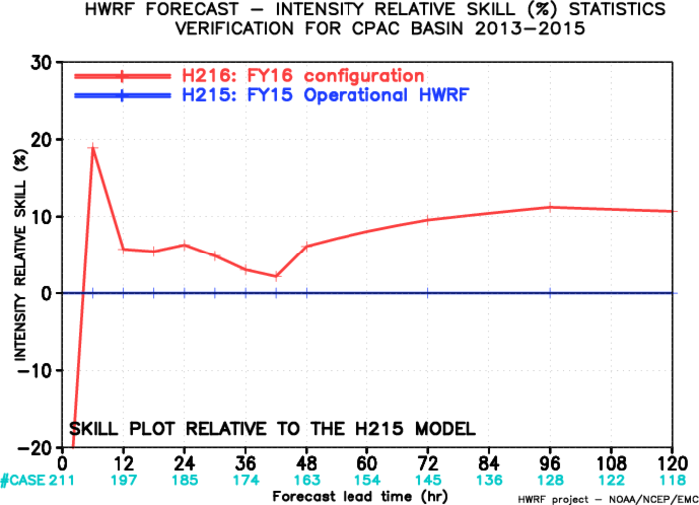
Evaluation of 2016 HWRF upgrades for CPAC (2015)
H216 shows significant improvements in both track and intensity performance especially after 2 days.
H216 also exhibits reduced positive intensity bias after 2 days.

Slide 17
Verification for JTWC Basins (WPAC & NIO)
(2015)

Slide 18
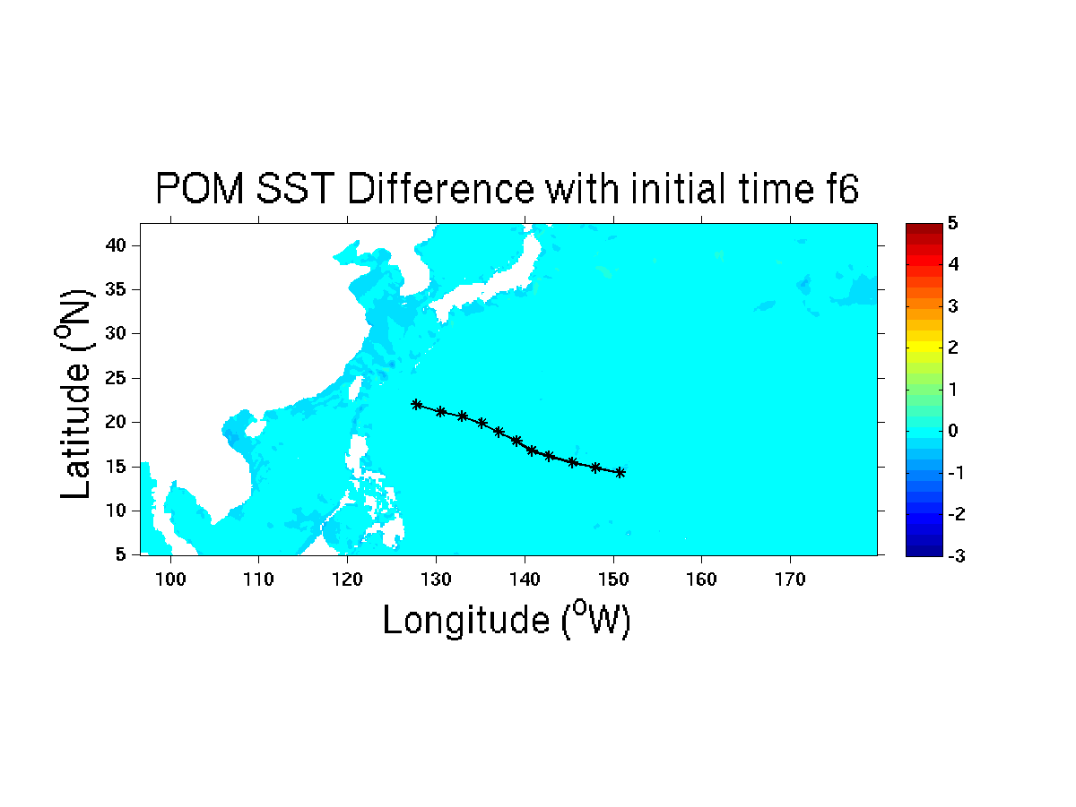
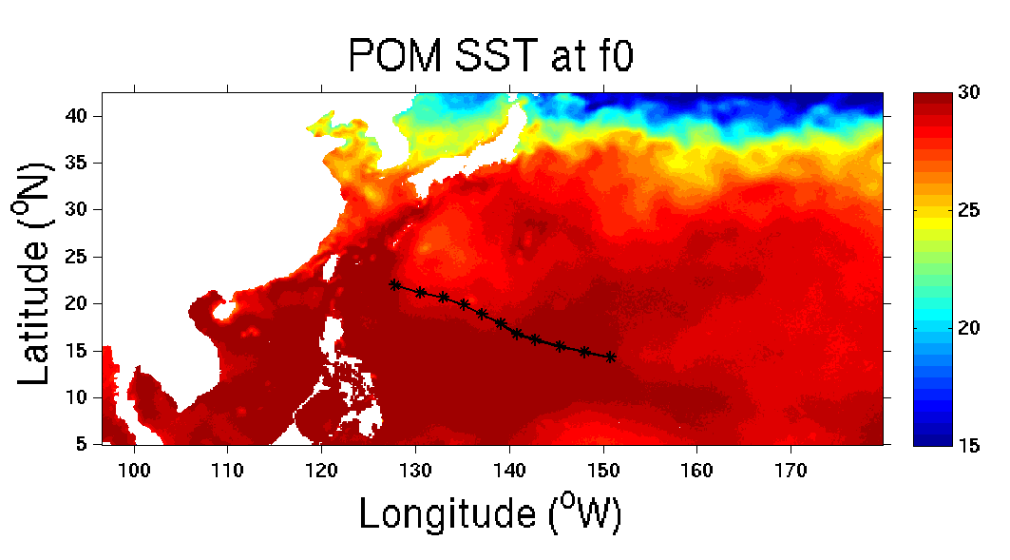
Impact of Ocean Coupling
Soudelor, 2015080112, 13W

Slide 19
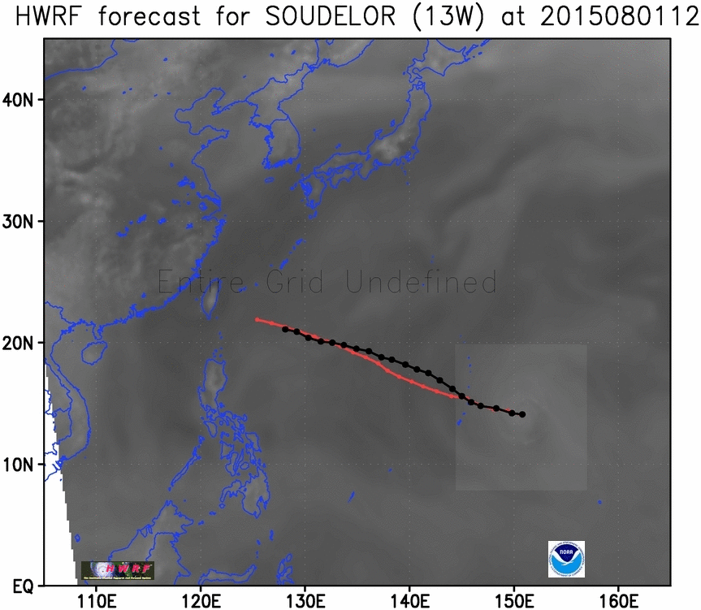
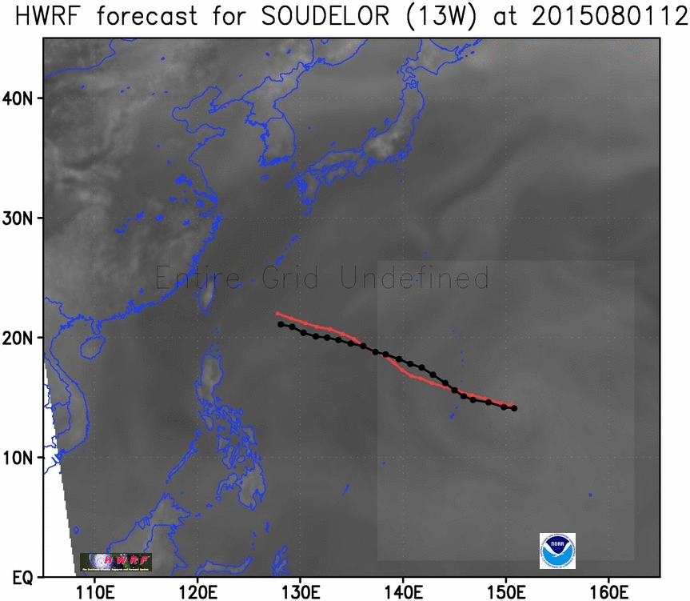
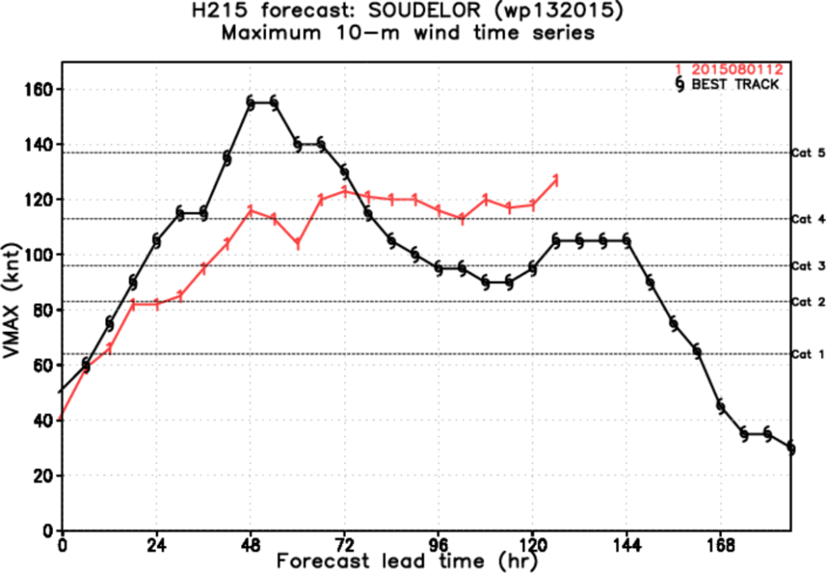
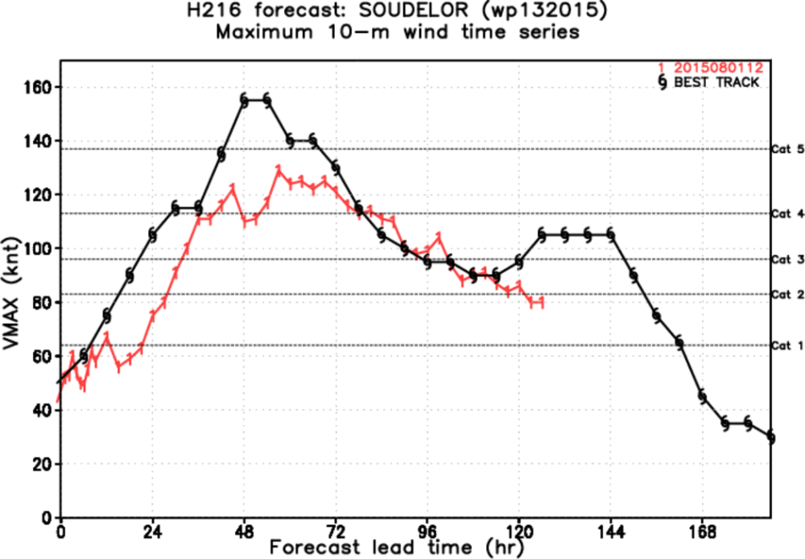
HWRF Model Radar Reflectivity
Soudelor, 2015080112, 13W
H215
H216

Slide 20

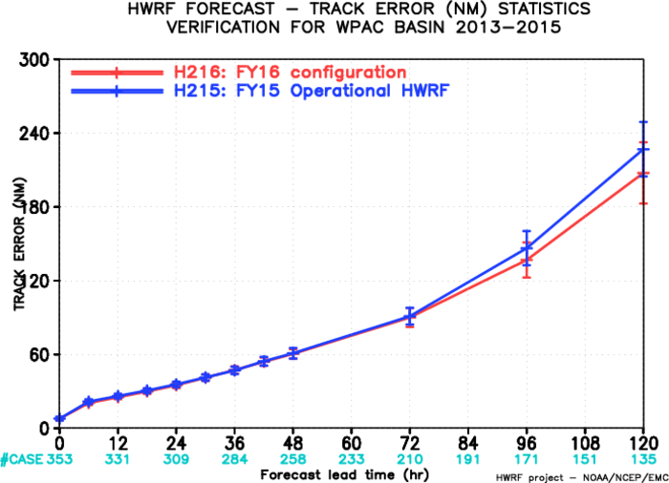
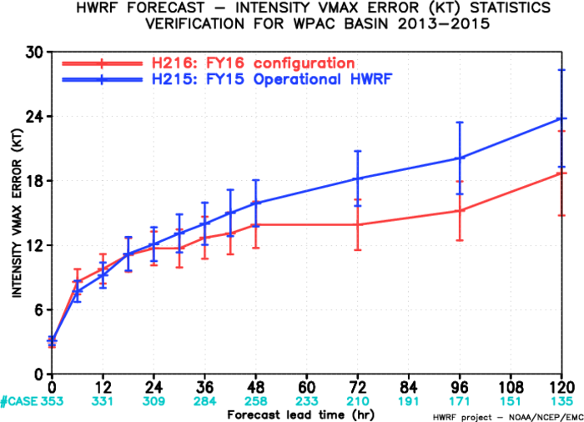
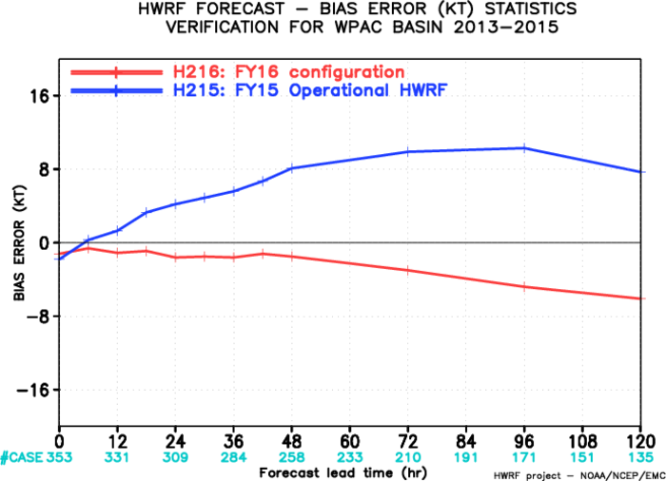
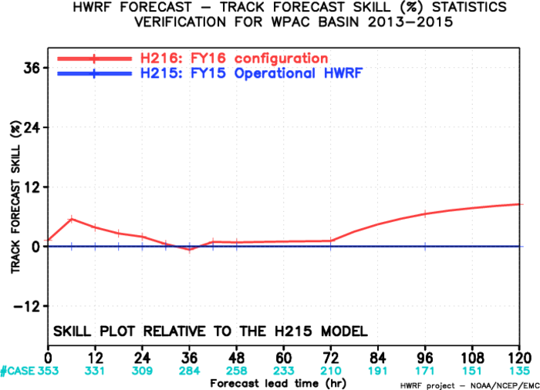
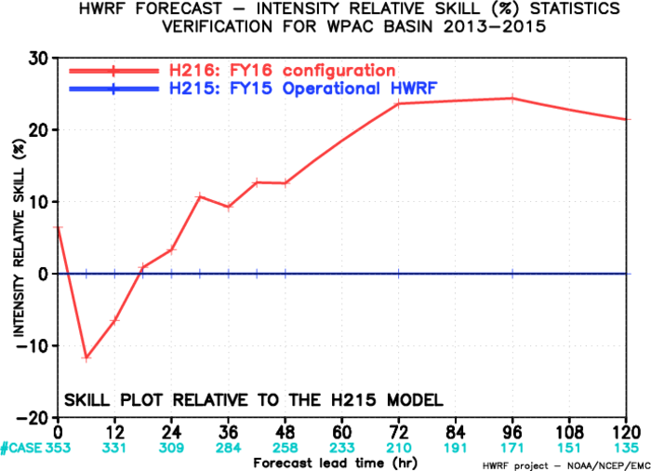
Evaluation of 2016 HWRF upgrades for WPAC
(2015)
AL-track- skill
Track improvement at all lead times
More than 20% intensity forecast improvement

Slide 21
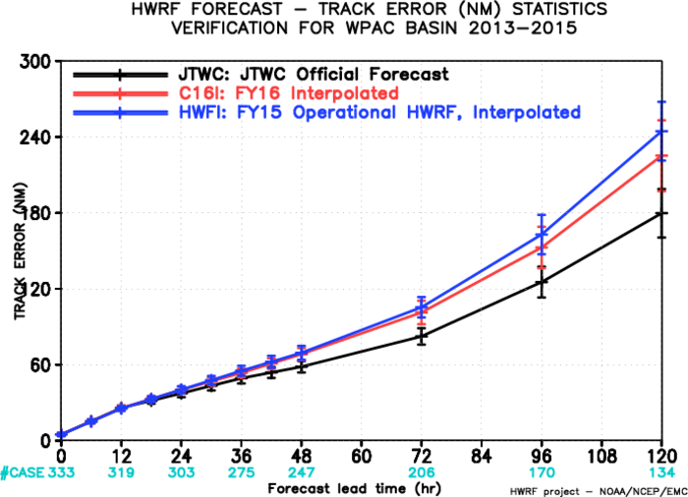
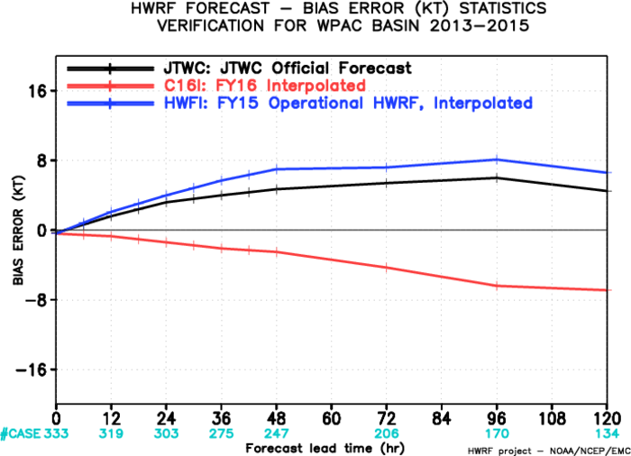
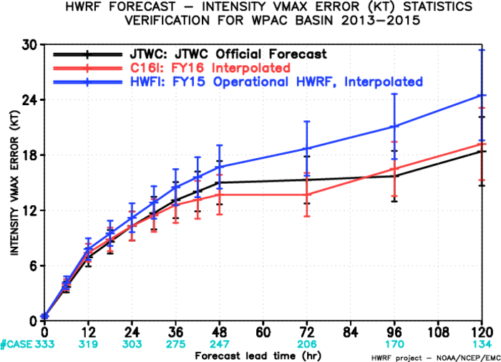
Evaluation of 2016 HWRF upgrades for WPAC:
Interpolated Guidance (2015)
AL-track- skill
H216 intensity forecasts are significantly improved, the intensity forecast errors are lower than JTWC official forecasts.

Slide 22
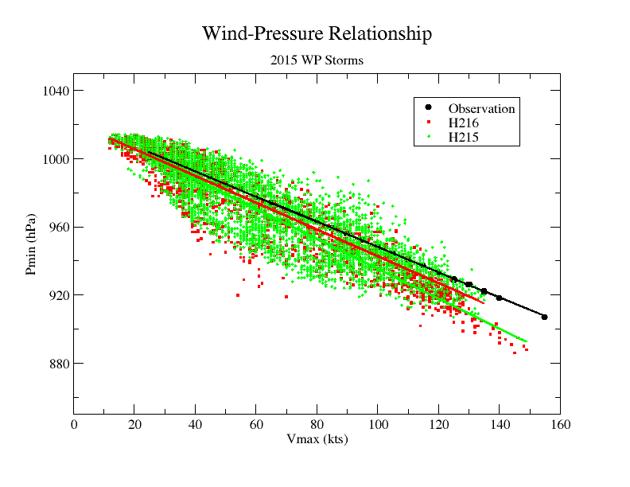
Improved pressure-wind relationship in H216, compared to H215
22

Slide 23
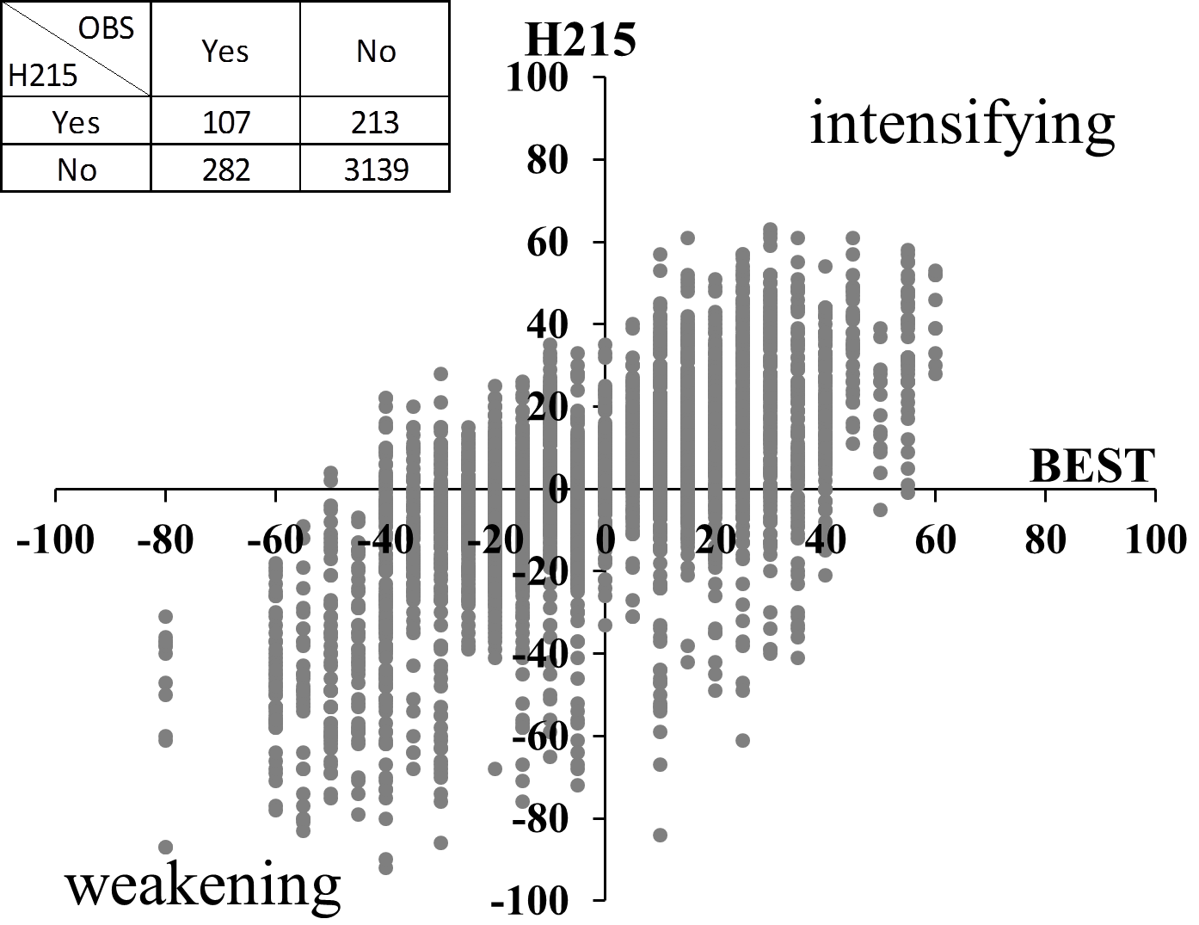
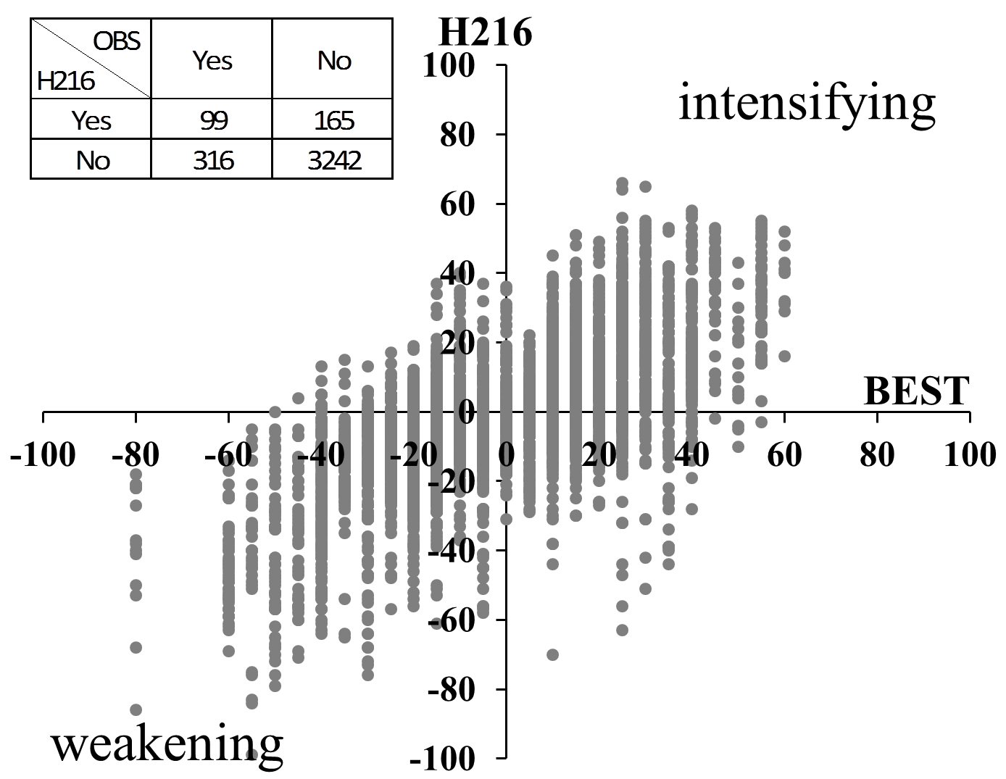
RI Probability of Detection
wp13-25, 2015
POD = 0.28 FAR = 0.67
POD = 0.24 FAR = 0.63

Slide 24
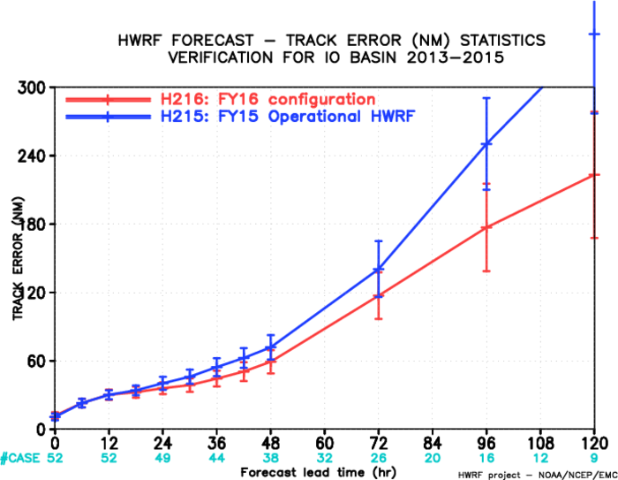
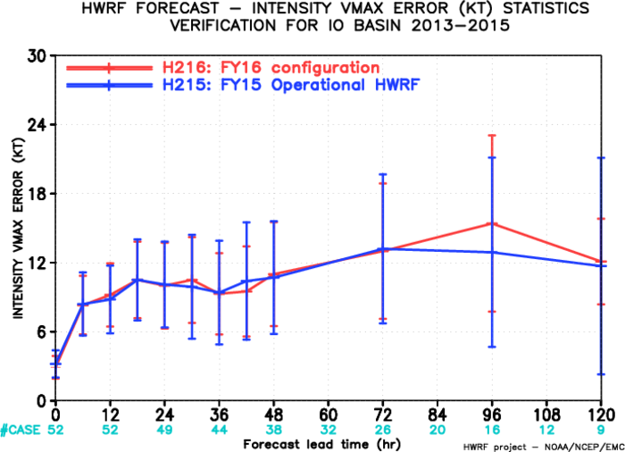
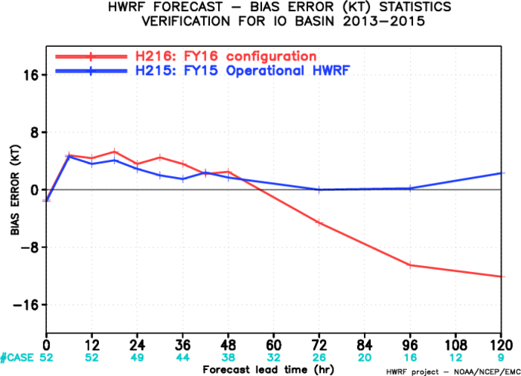
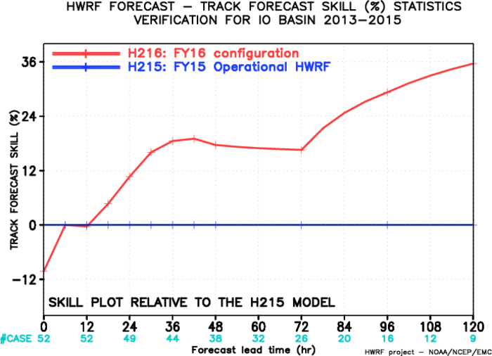
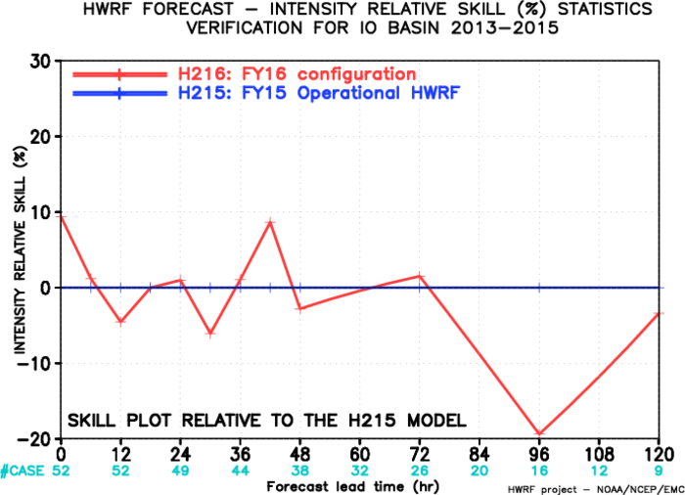
Evaluation of 2016 HWRF upgrades for NIO
(2015)

Slide 25
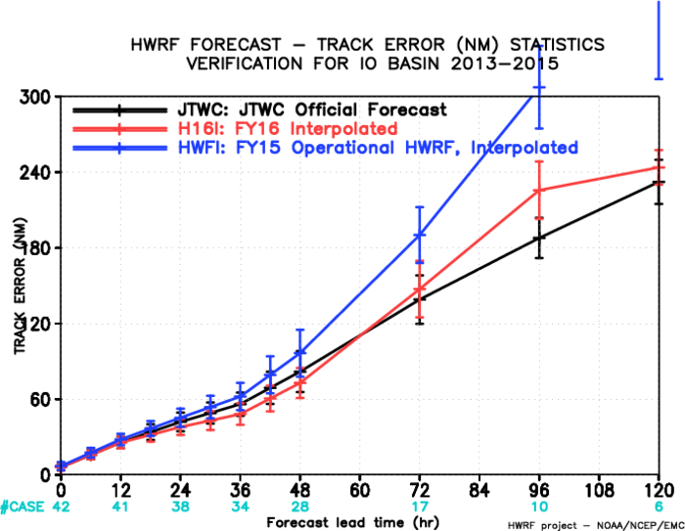
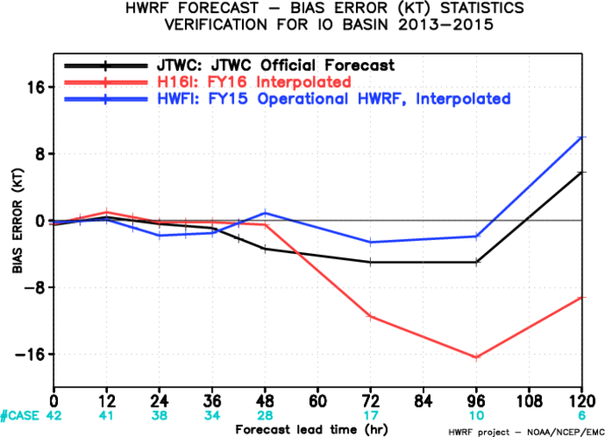
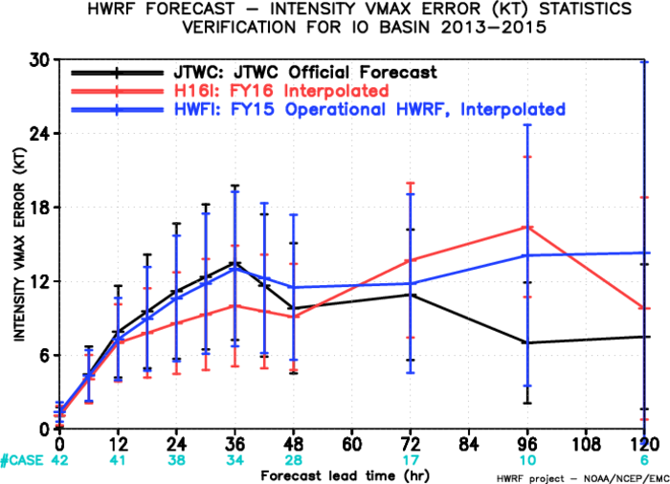
Evaluation of 2016 HWRF upgrades for NIO:
Interpolated Guidance (2015)
AL-track- skill
H216 track forecasts are better or comparable with JTWC official forecasts before day 3;
H216 intensity forecasts has lower forecast errors than JTWC official forecasts before day 2;
Negative intensity bias at later forecast hrs with limited sample size.

Slide 26
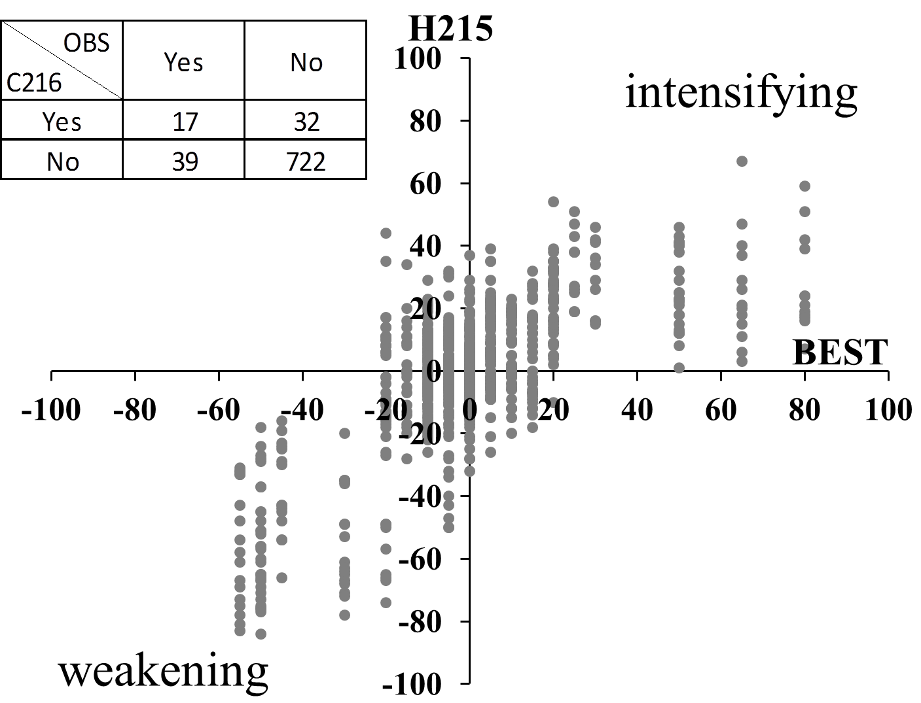
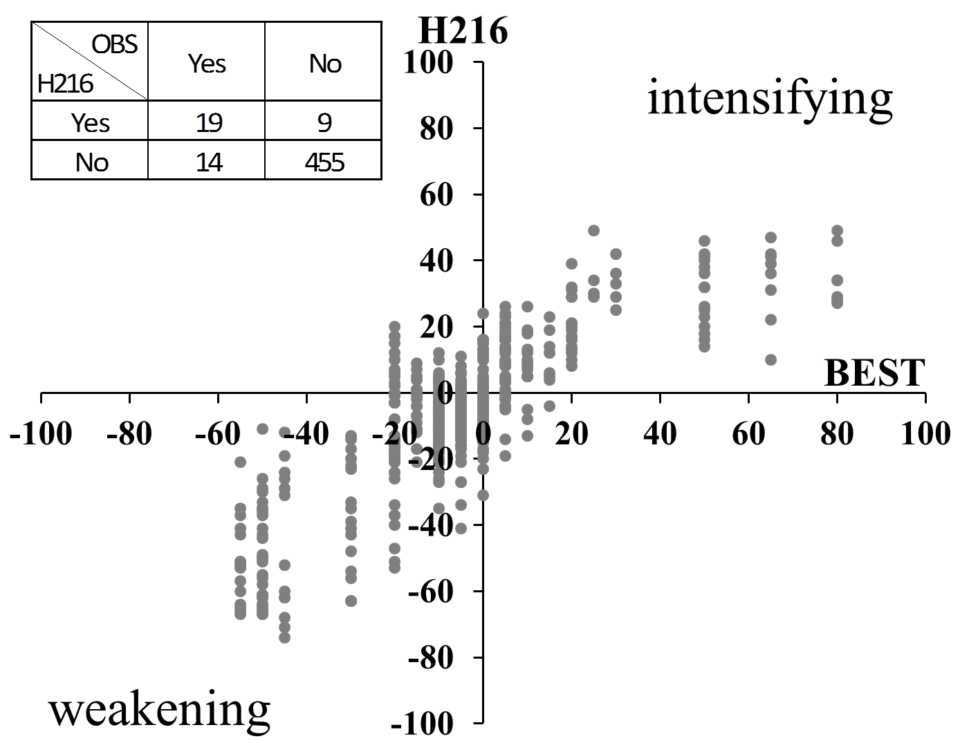
RI Probability of Detection
NIO, (02B,03A,04A) 2015/01B, 2016
POD = 0.3 FAR = 0.65
POD = 0.58 FAR = 0.32

Slide 27
Summary
Total H216 retrospective evaluation of 2012-2015 hurricane seasons (total 571 verifiable cycles in NATL, 888 in EPAC, 211 in CPAC, 353 in WPAC, 52 in NIO ) demonstrated improved track/intensity forecasts compared to FY15 operational HWRF (H215)
Results from H216 for the Atlantic basin and the Central Pacific suggested additional 5-10% improvement compared to H215.
Results from H216 for the Eastern Pacific basin suggested a modest (~5%) improvement in intensity forecasts is shown possible from 2015 operational HWRF. Use of DA and RTOFS for ocean initialization should help in RI cases.
Results from H216 for the West Pacific basin suggested additional 5-10% improvement for track forecasts, more than 20% improvement in intensity forecasts, compared to H215;
Results from H216 for the Northern Indian basin suggested average of ~23% improvement in track forecasts from 2015 operational HWRF, and neutral impact before 72h and degradation at day 4 and 5 in intensity forecasts with limited sample size.

Slide 28
Summary (cont.)
Evaluation metrics in the skill space confirmed the positive improvements from H215.
High-resolution ensemble based TDR DA paves way for the next generation vortex scale DA efforts supported by HFIP, while bringing immediate benefits in the operations.
Centralized HWRF Development Process for both research and operations with community involvement is critical for making further enhancements.
Use of ecflow in development environment accelerates the transition of model upgrades to operations
Seek more direct engagement of HFIP supported researchers for active participation in model evaluation, enhancements and future R2O.
Full credit to the entire HWRF team for another successful execution of pre-implementation T&E for implementing improved HWRF model in operations.

Slide 29
Operational HWRF Configurations: 2015 (top) vs. 2016 (bottom)
Basin | Ocean | Data Assim | Ensemble | Vertical | Model Top
NATL | 3D POM GDEM | Always | TDR Only | 61 level | 2 mbar
EPAC | 3D POM GDEM | TDR Only | TDR Only | 61 level | 2 mbar
CPAC | None | None | None | 61 level | 2 mbar
WPAC | None | None | None | 43 level | 50 mbar
NIO | None | None | None | 43 level | 50 mbar
SIO | None | None | None | 43 level | 50 mbar
SPAC | None | None | None | 43 level | 50 mbar
Basin | Ocean | Data Assim | Ensemble | Vertical | Model Top
NATL | 3D POM GDEM | Always* | TDR Only† | 61 level | 2 mbar
EPAC | 3D POM RTOFS | Always* | TDR Only† | 61 level | 2 mbar
CPAC | 3D POM GDEM | None | None | 61 level | 2 mbar
WPAC | 3D POM GDEM | None | None | 43 level | 50 mbar
NIO | 3D POM GDEM | None | None | 43 level | 50 mbar
SIO | None | None | None | 43 level | 50 mbar
SPAC | None | None | None | 43 level | 50 mbar
29

Slide 30
NHC Evaluation and Recommendations
The National Hurricane Center strongly endorses the implementation of new versions of the GFDL Hurricane Model and the HWRF model for 2016. Retrospective runs of these models for the 2013, 2014, and 2015 hurricane seasons mostly show improvements to track and intensity forecasts. For the HWRF, the improvements were as large as 7 percent for 1-5 day track forecasts in the Atlantic basin. We look forward to receiving this improved guidance for our operations, and would like to see these models implemented as early in this year's hurricane season as possible.
Dr. Richard J. Pasch
Senior Hurricane Specialist ,
National Hurricane Center

Slide 31
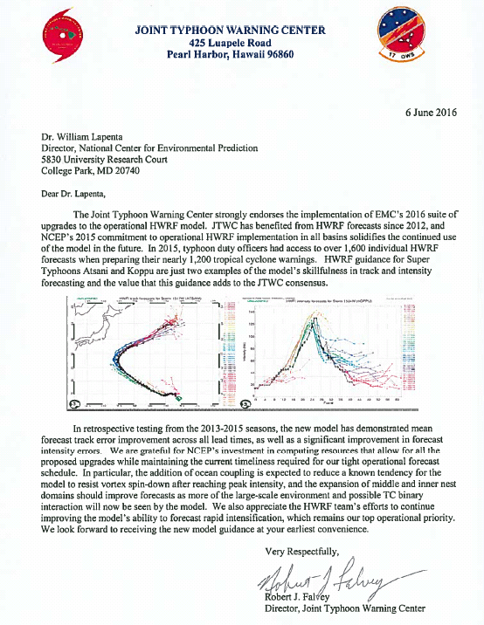
Feedback from JTWC and NWS Pacific Region
I would like to state emphatically that the Pacific Region strongly endorses the implementation of the HWRF upgrades. The HWRF has been the Go To model for TC in all basins within the PR.
Bill Ward
Environmental Scientific and Services Division Chief
National Weather Service
Pacific Region Headquarters

Slide 32
Feedback from EC-Joint Research Center and private users
“We appreciate the information that HWRF provides regarding the structure and the attributes of the Tropical Cyclones globally. It is our intention to use these results as forcing to hydrodynamic solvers in an effort to assess and validate against buoys/gauge measurements (where available). This is why the global nature of this analysis tool is of paramount importance. We are looking forward to any future improvements.”
GEORGE BREYIANNIS, PhD
Scientific / Technical Project Officer
“The HWRF provides details which are essential to an understanding of the impact of hurricanes in my research and that of others I am sure. As in all models, continuing improvements and upgrades to HWRF will enhance its benefits to science and the users such as emergency managers and government officials whose job it is to plan for public safety and to prevent loss of life. The three domains (D01, 18km horizontal resolution, D02, 6km, D03, 2km) provided great detail on the system.”
Austin L. Dooley, Ph.D
Dooley SeaWeather Analysis, Inc.

Slide 33
What it takes in operations to run 2016 HWRF
Resource requirements:
  FY16 HWRF H216: ~3x increased resources are needed for large nest domains, smaller time step, DA changes (atmosphere & ocean), wave coupling, and ocean coupling for additional basins, ~1512 cores or 63 nodes on Cray;
  Run maximum seven storms in all global basins simultaneously.
  No changes in delivery time (before t+6);
JHWRF_FORECAST (Coupled or Un-coupled) | 1512 cores (508 cores) 63 nodes (22 nodes) | ~95min (~95min) | T+4:19min (T+4:16) Forecast to finish by T+5:54

Slide 34
Next Steps
Retrospective T&E at EMC: May 6, 2016 --- Completed
Briefing to NHC: May 11, 2016 ----- Completed
NHC Evaluation and Recommendations: May 16, 2016 -- Completed
Briefing to EMC and CCB: May 18, 2016 --- Completed
Submission of Codes to NCO: May 20, 2016 --- Code Hand-Off, Submission of RFC form, release notes and flow diagrams.
Science briefing to NCEP Director’s Office: June 7, 2016 --- Completed
TIN for HWRF : June 9, 2016
NCO IT Testing and Code Freeze: ~June 30, 2016
IT briefing to NCEP Director's Office: ~July 5, 2016
Implementation by NCO: ~July 12, 2016

Slide 35


HWRF as a unique global tropical cyclone model
Operational Real-time forecast guidance for all global tropical cyclones in support of NHC, JTWC and other US interests across the Asia Pacific, North Indian Ocean and Southern Hemisphere ocean basins
Continue the community modeling approach for accelerated transition of research to operations
International partnerships for accelerated model development & research

Slide 36
Supplementary Material

Slide 37

2016 Physics Upgrades
Upgraded HWRF generates more physically sensible structure.

Slide 38

2016 Physics Upgrades
Surface-layer
Cd and Ch
Reduce Cd for wind > 20 m/s
Ch is reduced by 5%
More consistent with Observations-derived Cd, Ch.
Modify current Z0 ~ wind function; Use the standard 10m wind to compute Cd, Ch through Zo.

Slide 39


2016 Physics Upgrades
Latest version GFS PBL EDMF
HWRF2015
Counter-gradient method
to represent nonlocal flux
HWRF2016
Also, TKE-based dissipation heating
Local Eddy Mass Flux

Slide 40
2016 Physics Upgrades
Scale-aware SAS convection scheme
For cumulus convection, a scale-aware parameterization will be necessary for the grid sizes of 500m ~ 10 km where the strong updrafts are partially resolved.
Scale function
Based on Arakawa & Wu (2013):
σ_{u}: updraft area fraction (0~1.0)
original cloud base mass flux from AS quasi-equilibrium closure
updated cloud base mass flux with a finite σ_{u}

Slide 41

Physics Upgrades
K adjustment
Observations based
Constant (with z) adjustment, simply multiply K by a coefficient, discontinuous K, big impact on low-level wind.
Fix: height-dependent adjustment so that K is continuous.

Slide 42


Q4FY16 Hurricane WRF V10.0.0
Project Status as of 05/18/2016
G
Project Information and Highlights
G
Scheduling
Lead: Vijay Tallapragada, EMC and Steven Earle, NCO
Scope:
Smaller timestep needed to support extreme storms in AL/EP/CP.
Hybrid ENKF-3DVAR data assimilation for both ATL and EPAC storms
Further improvements to model physics: EDMF based GFS PBL, scale-aware convection, improved surface physics.
One-way coupling to Waves.
Daily updated RTOFS ocean conditions for EPAC instead of GDEM climatology.
Ocean coupling in CPAC.
Expected Benefits:
Improved track & intensity forecast skill
Improved products (including downstream applications and MAG).
Add AWIPS output.
Milestone (NCEP) | Date | Status
Initial coordination with SPA team | 1/29/2016
EMC testing complete/ EMC CCB approval | 5/18/2016
Final Code Delivered to NCO | 5/20/2016
Technical Information Notice Issued | 6/1/2016
Initial Test Complete
Test with specific cases
Testing Ends
IT testing ends
Management Briefing
Operational Implementation | July 2016
Issues/Risks
G
Issues: Complex T&E due to dependency on GFS and new RTOFS upstream requirement; porting and T&E on Cray
Expected Resource Requirements:
3x increase in forecast window due to larger inner domains, smaller timestep, wave coupling
ENSDA will require additional resources for P3 TDR storms in the Atlantic
Risks: Implementation dates are dependent on completion of T&E
Mitigation: Conduct T&E as soon as (or along with) GFS and RTOFS retrospective data are available. Use ecflow for accelerated T2O.
G
Finances
Associated Costs:
Funding Sources: EMC Base: T2O 18 Man-months (3 FTE full time for 6 months). NCO Base: 2 man-months for implementation, 1 man-month annually for maintenance
42
Management Attention Required | Potential Management Attention Needed | On Target
R
Y
G
v1.0 09/14//07
Notes:
42

Slide 43
2016 ATL Experiments
H215: 2015 version of operational HWRF, 18/6/2km resolution, L61, input: T1534 L64 GFS (spectral files for both IC and BC);
H16B: H215 driven by new GFS
H16C: Baseline (new GFS, new WRF-NMM V3.7.1a dynamic core, smaller time step, grib2 BCs)
H16S: H16C plus data assimilation upgrades
H16P: Impact of CD
H16O: H16S plus all physics upgrades – proposed H216
H16X: Additional levels (63) with damping at the top, new tracker, DA and RTOFS init for EP storms (rolled back to H16O; see next slide)

Slide 44
Differences between H16X and H16O
Atlantic:
Upgraded tracker; (rolled back)
Two more vertical levels (L61 vs L63); (rolled back)
East Pacific:
RTOFS ocean initialization for EP storms;
DA for all EP storms;
Upgraded tracker; (rolled back)
Two more vertical levels (L61 vs L63); (rolled back)
H16X with above changes is renamed as H216

Slide 45



FY16 Baseline Performance in AL
AL-track- skill
Compared to H215, H16C track forecasts showed improvements for the first 36 hrs, and again beyond 84 hrs.
Compared to H215, H16C intensity forecast indicated a degradation at 24h but significant improvements beyond hr 30.
Compared to H16B, H16C intensity forecasts indicated positive impacts beyond day 2. Track skill is neutral.

Slide 46




FY16 Baseline plus Data Assimilation Impacts
H16S: GSI data upgrades, Blending turned off for weaker storms
DAT4: Satellite DA for ghost d03 domain, VarQC turned on (final)
Impact: Much improved tracks with all DA upgrades, intensity is neutral

Slide 47

FY16: Impact of Physics Upgrades for AL
Two different settings for Cd were tested, the higher value of Cd resulted in improved storm size verifications, tracks and intensity are neutral

Slide 48
2016 EPAC Experiments
H215: 2015 version of operational HWRF, 18/6/2km resolution, L61, input: T1534 L64 GFS (Spectral files for both IC and BC);
H16B: H215 driven by new GFS
H16C: Baseline (new GFS, new WRF-NMM V3.7.1a dynamic core, smaller time step)
H16P: H16C plus physics changes
H16O: H16C+H16P
H16X: H16O+GSI+RTOFS init+63levs+New Tracker
H216: H16O+GSI+RTOFS Init

Slide 49



FY16 Baseline Performance in EP
AL-track- skill
H16C tracks are much improved over H215, but intensity impact is neutral
Intensity bias shows some improvements compared to H215 across all forecast lead times.

Slide 50

FY16: Impact of Physics Upgrades for EP
Two different settings for Cd were tested, the higher value of Cd resulted in improved storm size verifications, tracks and intensity are neutral (similar to AL results)

Slide 51



FY16: Impact of RTOFS Initialization on Blanca: Initial time Jun 3, 2015 00Z

Slide 52
2016 CPAC Experiments
H215: 2015 version of operational HWRF, 18/6/2km resolution, L61, input: T1534 L64 GFS (Spectral files for both IC and BC);
H216: All upgrades + coupling to MPIPOM (GDEM climatology) for CPAC

Slide 53
FY16 HWRF Computer Resource Requirement
JOBS | Computer Resources | Run Time | Starting Time
JHWRF_PRE_MASTER | 1 core/2GB (1 core/2GB) | <1min | T+3:20 (T+3:20, first GFS grib2 analysis available)
JHWRF_WAVE_INIT (new) | 1 node (24cores/2GB)
JHWRF_OCEAN_INIT | 24 cores (9 core) POM RTOFS init | ~12min (~22min)
JHWRF_INIT (Step 1) (WPS+PREP+REAL+ 3DVAR_ANALYSIS) | 96 cores (48 cores) | ~13min (several jobs combined) (~10min) | T+3:20 (GFS GRIB2 available) Run continuously until gfs 126h grib2 file is available
JHWRF_INIT (Step 2) (PREP+REAL+ 3DVAR_ANALYSIS) | 96 cores (48 cores ) | ~33min (several jobs combined) (~45min) | T+4:09 (one by one continuously until gfs 126h grib2 file is available)
JHWRF_INIT (GDAS) 3 GDAS jobs run simultaneously | 3 copies of 96 cores (48cores) | ~13min (~8min ) | T+3:24 (gdas 3,6,9h fcst available)
JHWRF_RELOCATE 3 relocate run simultaneously | 3 copies of 1 nodes (24 cores) | ~34min (~25min)
Red: Last year resource requirement; Green: Jobs submitted simultaneously.

Slide 54
FY16 HWRF Computer Resource Requirement
JOBS | Computer Resources | Run Time | Starting Time
JWHRF_NMM_GSI_D2 | 5 nodes (4 nodes) | ~14min (~18min) | Run parallel with GSI_D03
JWHRF_NMM_GSI_D3 | 10 nodes (8 nodes) | ~14min (~18min) | Run parallel with GSI_D02
JHWRF_MERGE | 1 node (1 node) | ~5min (~3min)
JHWRF_FORECAST (Coupled or Un-coupled) | 1512 cores (508 cores) 63 nodes (22 nodes) | ~95min (~95min) | T+4:19min (T+4:16) Forecast to finish by T+5:54
JHWRF_POST Run parallel with forecast job | 2 copies of 24 cores (24 cores) | ~100min (~100min) | We need to run 2 copies due to I/O speed variation
JHWRF_PRODUCTS tracker, swath and others | 2 nodes (1 node) | ~101min (~101min) | Run in parallel with forecast job ATCF Forecast delivered by T+6:00
JHWRF_OUTPUT Archiving hwrf output | 1 node (1 core) due wave coupling | ~9min (~9min)
JHWRF_GEMPAK | 1 cores (1 core) | ~2min (~2min) | T+6.09 (T+6:00)

Slide 55
Computer Resource Requirement for HWRF-ensemble Based Data Assimilation
HWRF V10.0.0, Q4FY16
J-job name | Job Description | Current Resource requirement (w/ T1534 GFS) | New Resource requirement
JHWRF_ENSEMBLE | HWRF Ensemble 6h forecast from Global EnKF analysis. 40-member 2-nest domain(18/6) | Each possible storm (for AL/EPAC basins) requires: 3 nodes each for 40 independent jobs for 30 min. 10 simultaneous ensemble runs will take 2 hrs to complete all 40 members | Can start at T+7:02 to be completed by T+9:30

Slide 56
Code Hand-Off and Release Notes
Release Notes (includes dependencies for ocean coupling); HWRF setup; triggering for HWRF ensembles
IT testing
Implementation instructions
Workflow diagram
SVN Tag for HWRFV10.0.0 (entire system):
https://svnemc.ncep.noaa.gov/projects/hwrf/branches/hwrf.v10.0.0

Slide 57
IT Testing
Test Objective | Comment
Missing GDAS EnKF members (total 80 mem) | if Nmissing >= 40, hybrid EnKF/GSI else conventional GSI
TDR (Tailed Doppler Radar) test | GSI will be done w/wo TDR for D03
Missing ICs from GDAS data | HWRF fails with proper error message
Missing BCs from GFS data | HWRF fails with proper error message
Missing previous cycle’s 6-hr forecast output | HWRF runs to completion in cold start mode
Zero length data files for GSI | Initialization and analysis runs to completion
Missing input data files for GSI | Initialization and analysis runs to completion
Missing loop current for ocean initialization | POM runs to completion using climatology
Failed ocean/wave initialization | HWRF runs in un-coupled mode
Tracker fails to identify initial storm location | Swath generator fails with proper error message
Test at least one storm in each basin | HWRF runs to completion
Cross dateline and Greenwich test | Make sure HWRF model and scripts properly handle the specially situations.
Bugzilla entries | Operational failure of 20160112 12/18Z

Slide 58
IT Testing
Two additional tests:
1.Processing of real-time TDR data: this test could not be done in retrospective mode due to real-time data requirement, and all tests were done using canned data assuming that the dumps are set correctly to handle initial processing of data tanks. -- resolved
2. Wave coupling: wave coupling is new in 2016, and the exception handling due to unforeseen failure of ocean initialization on atmosphere-wave coupling was not properly configured. -- resolved

Slide 59

Dev-ecFlow for accelerated transition to operations
For the first time, EMC and NCO worked together to get HWRF into dev-ecFlow.
This will lead to better EE, and reduce time for implementing model upgrades in operations

