Slide 1
Issues on start_domain_nmm.F (especially on fraction of MP)
Young Kwon, Eric Aligo, Zhan Zhang, Brad Ferrier, Sam Trahan, Vijay Tallapragada and all…

Slide 2
Contents
Nature of bugs
Role of allowed_to_read
Sam’s results on 27-9km
Experimental design
Results
Conclusion

Slide 3
There are three potential bugs found in start_domain_nmm.F related to the initialization of MP species (Thanks to Sam)
Initialization of fractional values whenever nest moves
- causes unrealistic melting of ice without absorption of latent from air, and they refreeze with add heat to air. So this bug fix causes the weakening of storms.
2. An argument of phy_init supposed to set allowed_to_read but hardwired to .TRUE.
If block added by Greg Thompson at the end of the program. Should be called only in the initial time?
* Need more careful evaluation of the effect of 2 and 3

Slide 4
The role of allowed_to_read in start_domain_nmm.F
start_domain_nmm.F is called from
1. mediation_integrate.F
2. mediation_nest_move.F
3. real_nmm.F
4. dfi.F
The programs relevant to HWRF nest motions are 1 and 2.
* mediation_integrate calls start_domain_nmm(SD) when the nest domain is initialized (t=0hr) and allowed_to_read = true
* mediation_nest_move calls SD whenever a nest moves and allowed_to_read = false at this time.
This indicates that allowed_to_read in SD is true only initial time but false all other times during integration – therefore, the variable shouldn’t be initialized when nest move should have in the if loop with allowed_to_read!!!

Slide 5
In SD of the current HWRF
If (.not. restart) then
grid%f_ice = 0.
grid%f_rimef = 1.
grid%f_rain = 0.
endif
There is no allowed_to_read in the if – loop.
Do we need to reinitialize the fractional values of MP whenever nest moves? -- NO!!!
Because resetting of f_ice to zero when nest move, we’ve seen the problems Sam showed from 3minutes interval f_ice animation. Because f_* values should not be re-initialized, allowed_to_read should be included in if statement. -- allowed_to_read is false except t=0hr

Slide 6
Other two possible bugs.
1) Arguments in phy_init and 2) Greg Thompson’s addition
argument in phy_init
In start_domain_nmm.F,
call phy_init (grid%id, config_flags, ……
……………………………….
,.TRUE., grid%moved, start_of_simulation….
………………………………………………)
In V2.0 the .TRUE. was set to allowed_to_read, but somehow it is hard-wired .TRUE. in V3.2. What’s the impact of changing .TRUE. from allowed_to_read?

Slide 7
Change the argument of “call phy_init” in start_domain_nmm.F from .true. to allowed_to_read
It seems that the change of argument of phy_init from .true. to allowed_to_read does not impact on the f_* zeroing out problem from Eric’s run.
The consequence of this change should be more carefully investigated. For reference, HWRF V2.0 has allowed_to_read in the argument instead of hard-wired true value. Therefore, in V2.0 this logical variable is set to .true. at the first time step but .false. all other time steps. On the contrary, HWRFV3.0 always has .true. in the argument in call phy_init.
After quick surveying, the flows of phys_init are following:
start_domain_nmm.F :: call phy_init (….. allowed_to_read ….)
module_physics_init.F :: there are all physics initialization routines here.
Such as, call ra_init, call bl_init, call mp_init, call cu_init and so on.
SUBROUTINE mp_init is also located in module_physics_init.F
Subroutine mp_init calls all init of possible mp schemes
In case of HWRF → call etanewinit_HWRF
Module_mp_HWRF.F :: etanewinit_HWRF is here
When allowed_to_read is true, this subroutine sets
1. F_ice_phys = 0.
F_rain_phys=0.
F_rimef_phys=1.
2. mpi broadcast many variables to all tiles
3. Read VENTR1, VENTR2, ACCPR, MASSI, and so on and broadcast them
4. And doing many others too. At this moment, I am not sure what the consequence of the changing the argument from .true. to allowed_to_read. We may need to read codes more carefully and do some sensitivity test. Especially, this change of argument may impact not only MP but also all other physics initializations too.

Slide 8
Greg’s addition
IF (.NOT. RESTART) THEN
DO K =
DO J =
DO I =
MOIST(.. , P_QV) = …
ENDDO
……………………………
………………. Mostly doing Recalculation of moist array ………………….
ENDIF

Slide 9
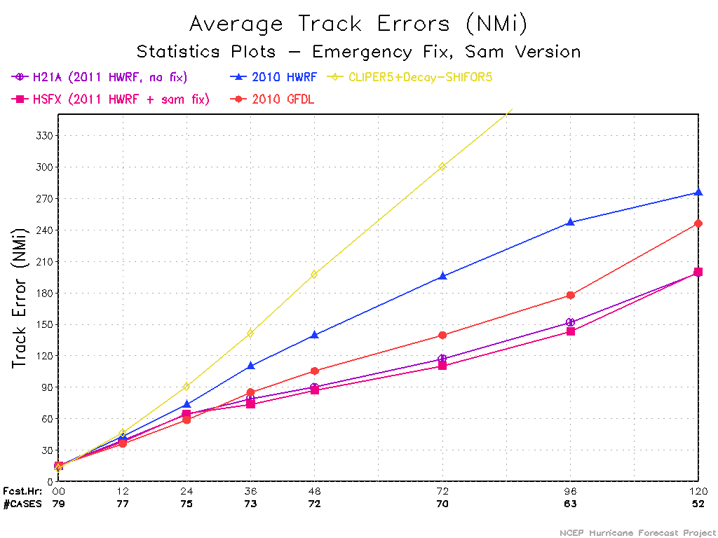
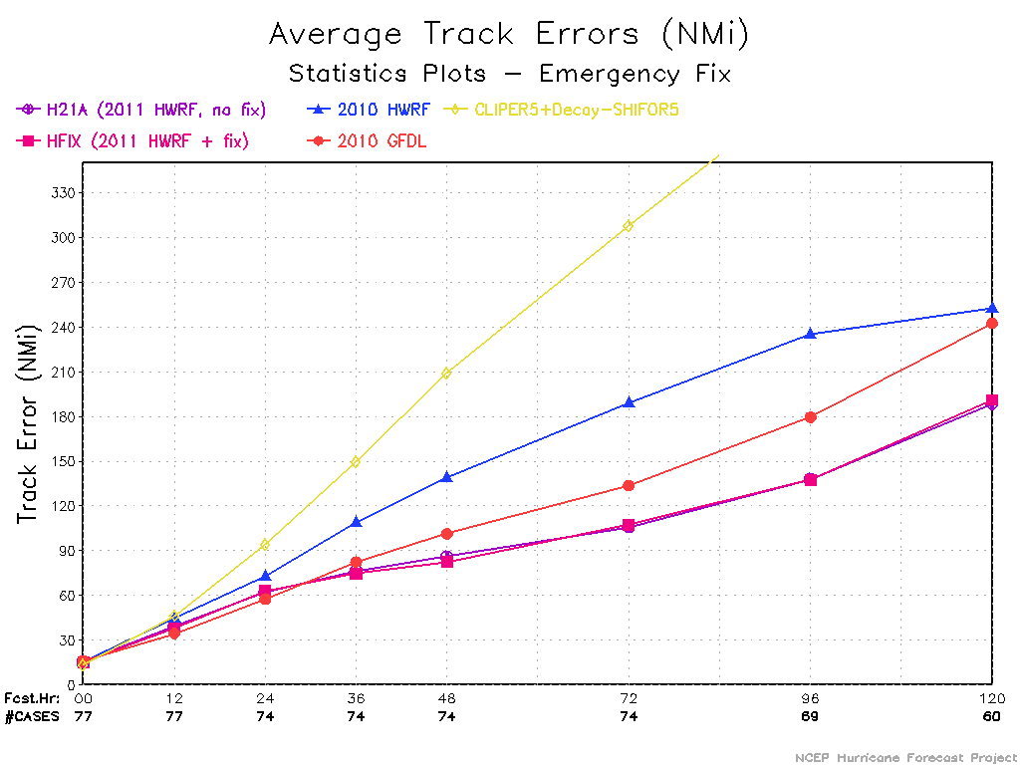
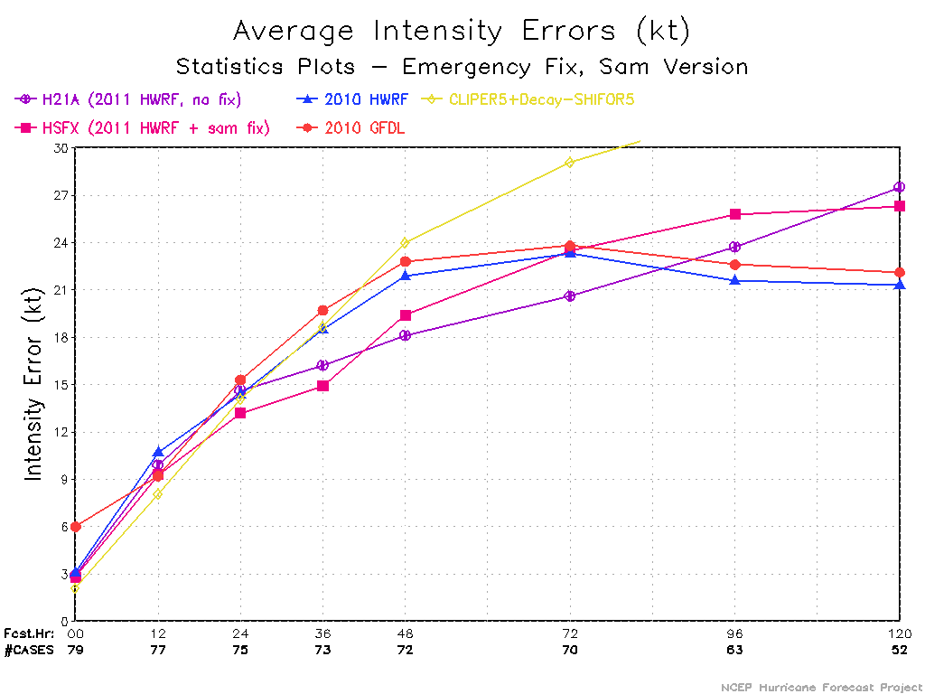
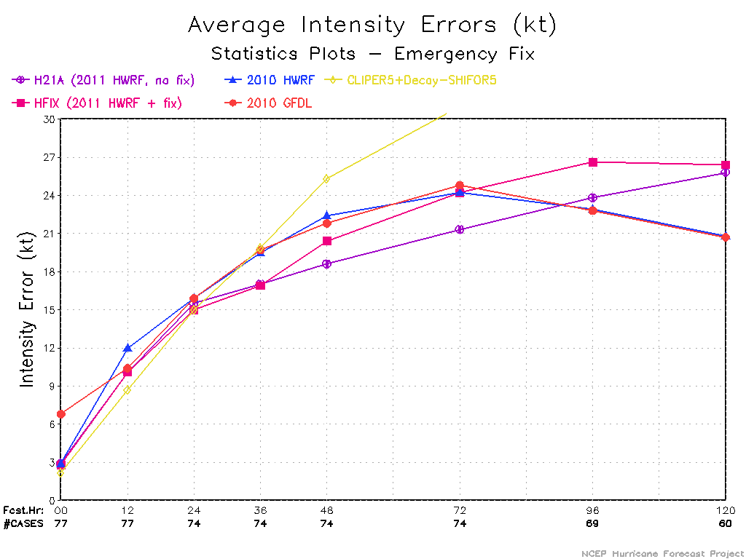
Change1 (“Sam’s fix”)
change1+2+3 (“Brad’s fix”)

Slide 10
Fay 2008081612
All exps used the exactly same initial and boundary condition
Experimental Designs
Experiments | Explanations
control | Original 2011 operational HWRF (27-9km)
change-1 (Sam fix) | add allowed_to_read in the if-loop of reinitializing f_*
change-2 | Change .true. to allowed_to_read in call phy_init
change-3 | Add allowed_to_read in Greg Thompson’s block
change 2+3 | combination of 2 and 3
change 1+3 | combination of 1 and 3
change 1+2 | Combination of 1 and 2
Change 1+2+3 (Brad fix) | combination of 1, 2 and 3
Change 1+2+3 Executable from Sam’s dir | Same as above but exe from Sam’s directory

Slide 11
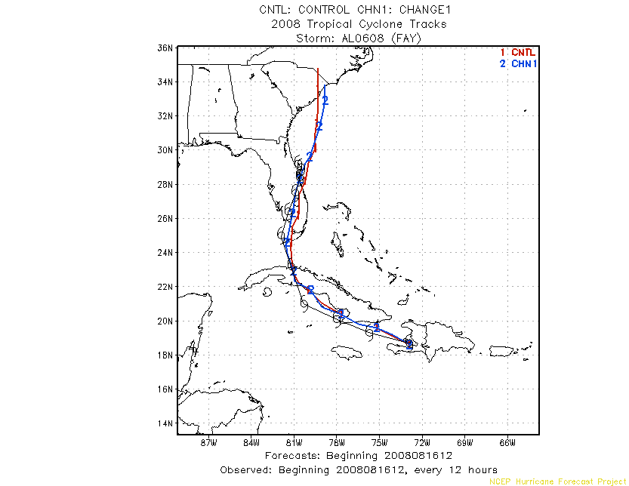

Slide 12
Experiments Results
1. The result (wrfout) from control is binary identical to that of change-3, which means that adding allowed_to_read in the Greg’s block does not change the answer of HWRF at all.
The result of control run is binary identical to that of change-2 and change2+3 except f_rimef at the lateral boundary areas of the nest domain. *physics values are not updated along the LB of nest.
According to the results from control, change-2, change-3 and change 2+3, we are pretty confident that change 2 (argument in phy_init) and change 3 (Greg’s addition) do not alter the solution of HWRF in 27-9km configuration. And this result is contradict to Sam’s results shown last week.

Slide 13
Experiments Results (contd.)
3. The results of control run is different from that of change-1 as Sams results.
4. The results of change-1 (Sam’s fix) are binary identical to those of change1+3, change2+3 and change1+2+3 (Brad fix).
Because we’ve seen that change-2, change-3 and the combination of two changes do not impact HWRF results, it is expected that the combination which include change-1 should be the same of change-1.
So, the question is why the simulation results from Sam’s fix and Brad fix shown last week are different? – answer will be from Eric’s run using Sam’s exe for all three changes combined.

Slide 14
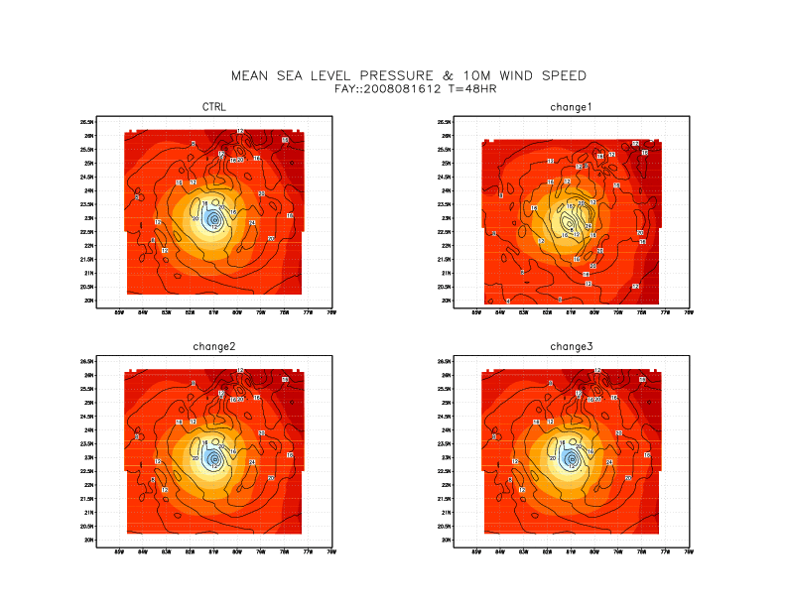

Slide 15
