Slide 1
Improving HMON simulation of TKE in hurricane
Weiguo Wang¹, Lin Zhu¹, Avichal Mehra², Vijay Tallapragada²
¹ IMSG @EMC/NCEP
² EMC/NCEP, College Park, MD

Slide 2
Outline
1. Motivation
2. Equation and parameterization
NCEP HMON Model setup
Results
5. Summary and future work

Slide 3
Motivation
Studies have shown that the widely-used eddy-diffusivity approach might fail to represent sub-grid scale (SGS) fluxes in some situations, particularly in convective conditions.
Parameterization in PBL has been extensively studied to represent turbulent fluxes in convective condition. Examples: counter-gradient approach, EDMF approach, ……
Above PBL, a simple K approach is usually used to represent SGS fluxes. This may have issues for convective areas, e.g., in convective clouds, hurricane eyewall areas, …
Some studies have proposed and tested new approaches to represent SGS fluxes in convective cloudy areas (e.g., Moeng, 2012,2014, Verrelle et al, 2017, ……)
Our work is to test how new SGS approach may affect hurricane forecast in NCEP operational hurricane models.

Slide 4
Equation and parameterization
For scalars, S,
Usually, K-closure is used to parameterize flux terms (above PBL)
$\overline{w^{′}s′}$= $−$K$\frac{∂S}{∂z}$
$\overline{w^{′}s′}$= C $∆^{2}\left(\frac{∂\overline{w}}{∂x}\frac{∂\overline{s}}{∂x}+\frac{∂\overline{w}}{∂y}\frac{∂\overline{s}}{∂y}\right)$
Relate SGS flux to horizontal gradients of mean vertical velocity and mixing ratio
Proposed by Moeng (2012,2014) , Verrelle et al. (2017) tested. Give better counter-gradient structure,….

Slide 5
TKE simulation is sensitive to production terms, particularly, thermal term in relatively coarse grid.
$\overline{w^{′}θ_{v}′}$=$A \overline{w^{′}θ_{l}′}$+B $\overline{w^{′}q_{np}′}$
Where θ_{l} for liquid potential temperature.
q_{np} for non-precipitating water mixing ratio
A, B coefficients.
Note, in our preliminary tests, new approach is applied only to heat flux in TKE/heat equation in convective areas (above PBL) .

Slide 6
HMON
Hurricanes in a Multi-scale Ocean coupled Non-hydrostatic model
One of NCEP operational hurricane forecast systems
- Dynamic core: NMMB
- Vortex initialization
- Moving nests
- Well-tuned Physics package
- Coupled to Ocean models (HYCOM)

Slide 7
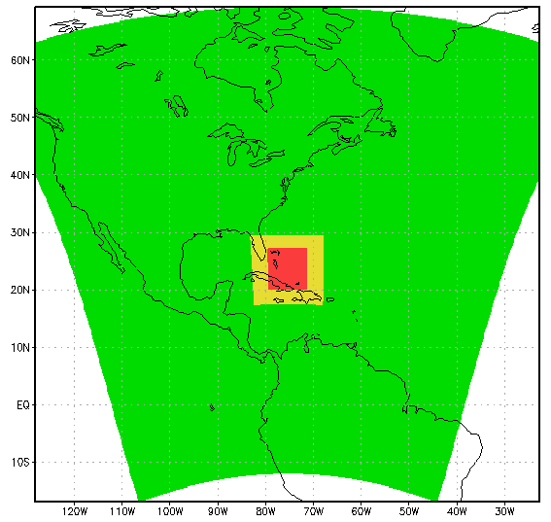
Idealized HMON configuration
No ocean, const SST
Zero background wind
42 levels
Three domains, two nests
D1: ~65 ̊ x 65 ̊
D2: ~ 12 ̊ x 12 ̊
D3: ~ 7 ̊x 7 ̊
6 km
2 km
18 km

Slide 8
Physics schemes
Scheme | Description
Land model | Noah land surface model
Surface layer | MYJ surface layer, with cd, ch matching obs.
PBL | MYJ PBL
Convection | D1 and D2: Simplified Arakawa-Schubert (SAS) scheme with modifications. D3 none
Microphysics | Ferrier-Aligo scheme for high resolution model
Radiation | RRTM, partial cloudiness

Slide 9
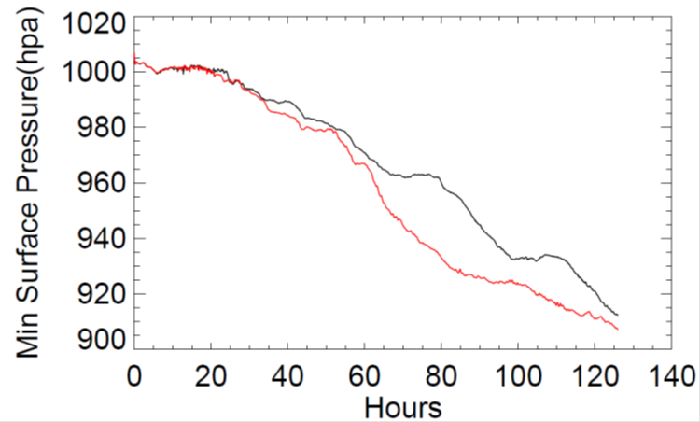
Two simulations
CONTROL:
default MYJ PBL
CONTROL-SGS :
default MYJPBL
+ SGS scheme for heat
- Max winds are close
- New run is more rapidly intensified.

Slide 10
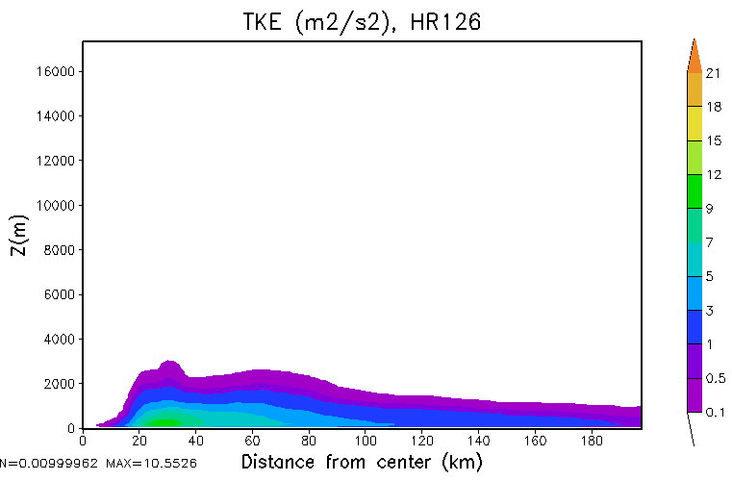
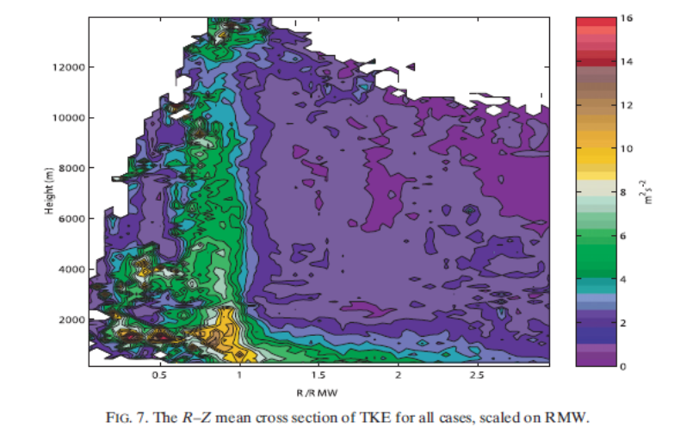
TKE
+ Using new SGS produces results much closer to OBS
+ Control run using K-closure underestimates TKE in eyewall area. Failed to simulate TKE buoyance production term in convective area
CONTROL
Radar-derived, Lorsolo et al. 2010
CONTROL-SGS

Slide 11
Tangential wind
CONTROL @84hr
CONTROL @126hr
CONTROL-SGS
CONTROL-SGS

Slide 12
Radial wind
CONTROL @84hr
CONTROL @126hr
CONTROL-SGS
CONTROL-SGS

Slide 13
Summary
1. A SGS scheme was applied to MYJ TKE PBL scheme
2. With the scheme,
The model can realistically simulate TKE
distribution in convective eyewall area.
TC is more rapidly developed.
3. Future Plan:
+ Make real-case simulations and further evaluate results
+ Introduce the scheme to NCEP hurricane models (HWRF/HMON)

