Slide 1








Preliminary Results of Differences in Rapid Intensification for Two Consecutive Cycles in HWRF for Hurricane Harvey (2017)
Lin Zhu¹ , Bin Liu¹, Qingfu Liu², Weiguo Wang¹, Zhan Zhang¹, Hua Leighton³, Avichal Mehra² and Vijay Tallapragada²
¹IMSG at EMC/NCEP/NOAA, College Park, MD
²EMC/NCEP/NOAA, College Park, MD
³ CIMAS of University of Miami at HRD/NOAA

Slide 2
Outline
Motivations
Model Configurations
Preliminary results
Summary and future work

Slide 3
Motivations
Rapid intensification behavior in operational NCEP models
remains inconsistent
exhibits large differences between consecutive cycles
needs improved performance
Notes:
RI forecast remains a challenge for operational hurricane models. The performance need to improve, it is difference cycle by cycle

Slide 4
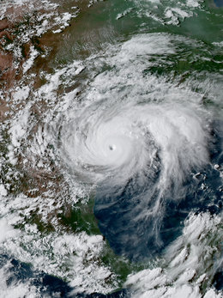
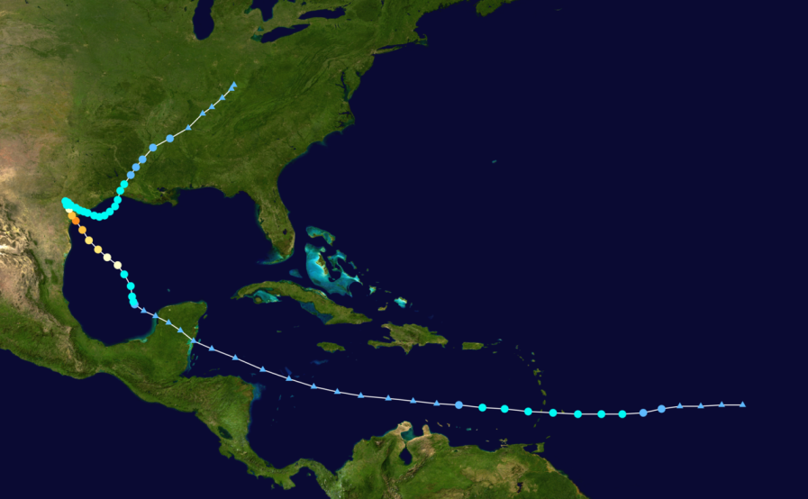
Hurricane Harvey 09L 2017
Primary features:
Caused catastrophic rainfall, which triggered historic flooding in Houston area
Underwent rapid intensification
Consecutive cycles in HWRF showed large differences

Slide 5
Model Configurations of FY2017 HWRF
FY2017 HWRF
Resolutions | 18/6/2 km with 75 levels
Microphysics | Ferrier-Aligo
Radiation scheme | RRTMG
Convection scheme | Scale-awared SAS
PBL scheme | EDMF GFS
Land Surface | Noah Land surface
Surface Layer | GFDL

Slide 6
Intensity (surface maximum wind)
RI-18hr
RI cycle
notRI cycle
RI onset
It is clear that the cycle initialized at 12Z (blue line) captured RI while the cycle initialized at 18Z (red line) did not.

Slide 7
Shear and SST
RI cycle
RI-18hr
notRI cycle
RI onset
RI cycle
RI-18hr
notRI cycle
There is no big difference in shear and SST between these two cycles.

Slide 8
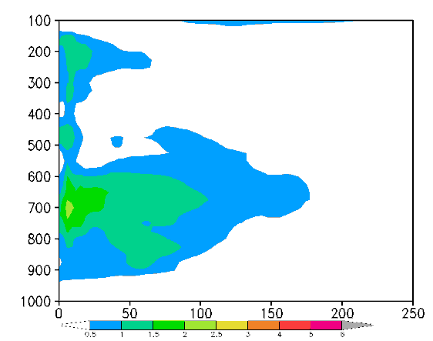
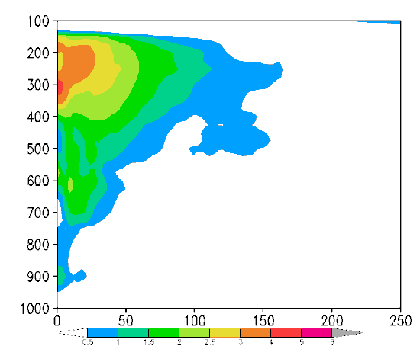
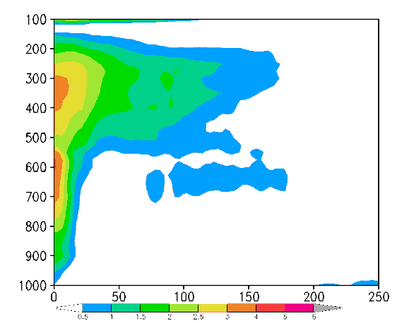
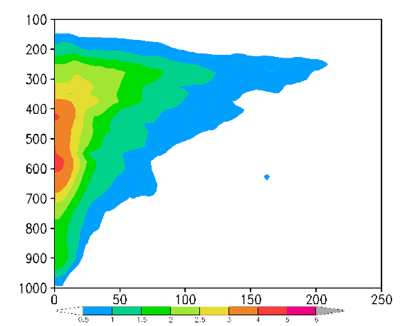
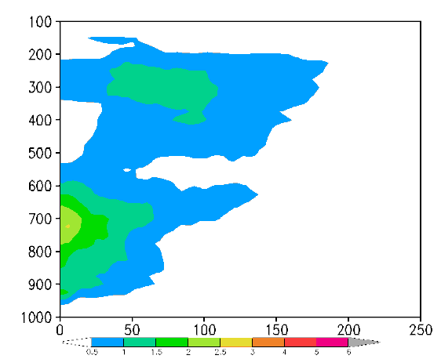
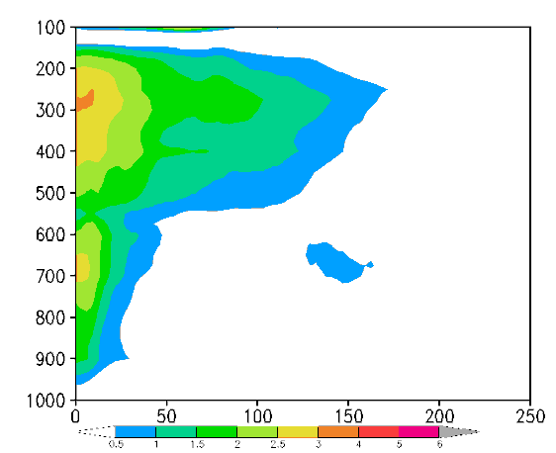
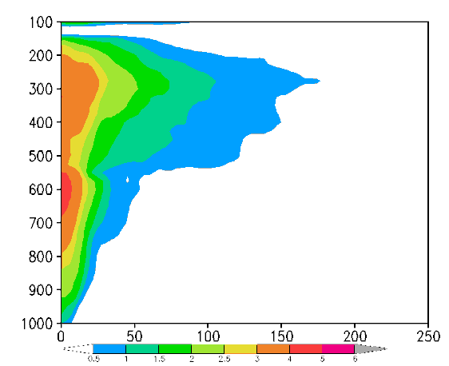
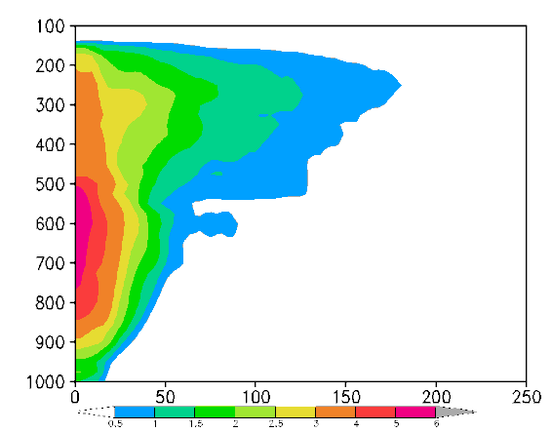
Temperature anomaly (shaded)
20170823 12Z notRI
RI-18h
RI-12h
RI-6h
RI
Pressure (hPa)
(km)
(km)
(km)
(km)
20170823 18Z RI
RI-18h
RI-12h
RI-6h
RI
Pressure (hPa)
(km)
(km)
(km)
(km)
The lower-level warm core in notRI cycle developed slower to merge with upper-level warm core than RI cycle;
The notRI cycle has a stronger upper-level warm core at 12h before RI.

Slide 9
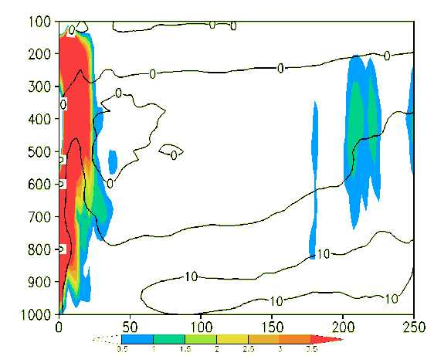
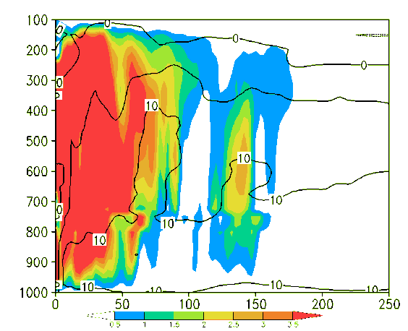
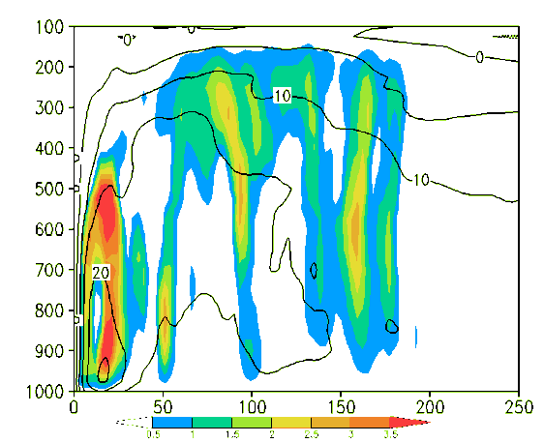
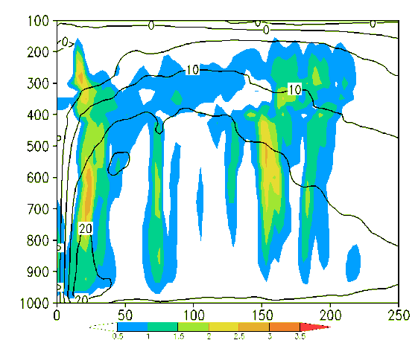
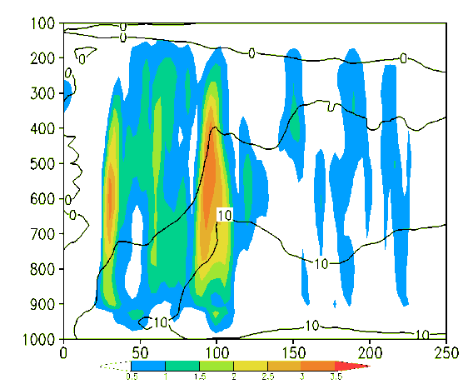
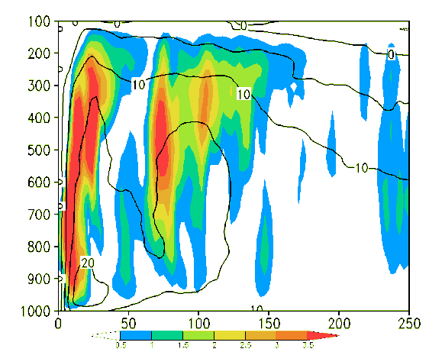
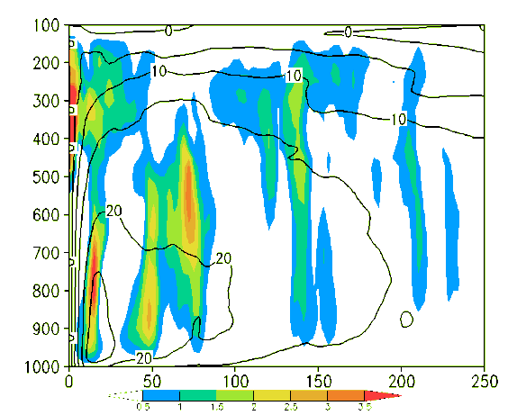
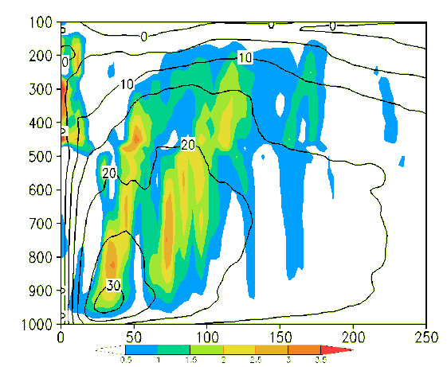
Vertical motion (shading) and tangential wind (contour)
20170823 12Z notRI
RI-18h
RI-12h
RI-6h
RI
Pressure (hPa)
(km)
(km)
(km)
(km)
20170823 18Z RI
RI-18h
RI-12h
RI-6h
RI
Pressure (hPa)
(km)
(km)
(km)
(km)
notRI cycle has very strong upward motion at 12h before RI;
RI cycle has more organized tangential wind structure at 6h before RI.

Slide 10
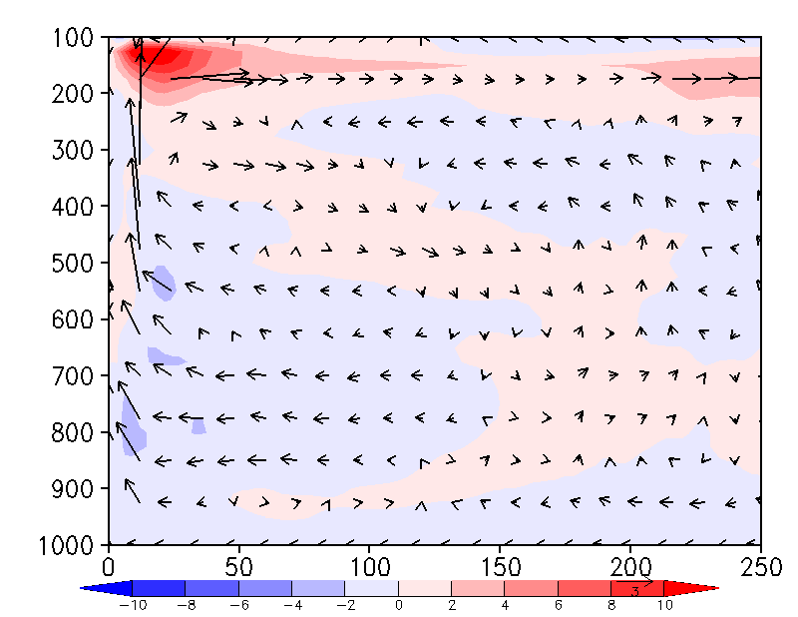
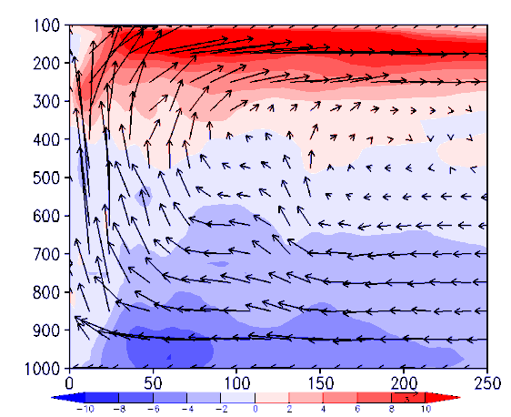
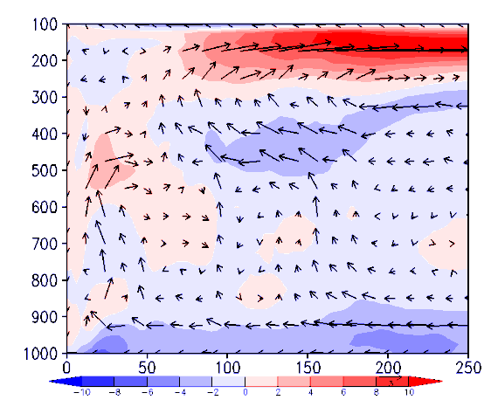
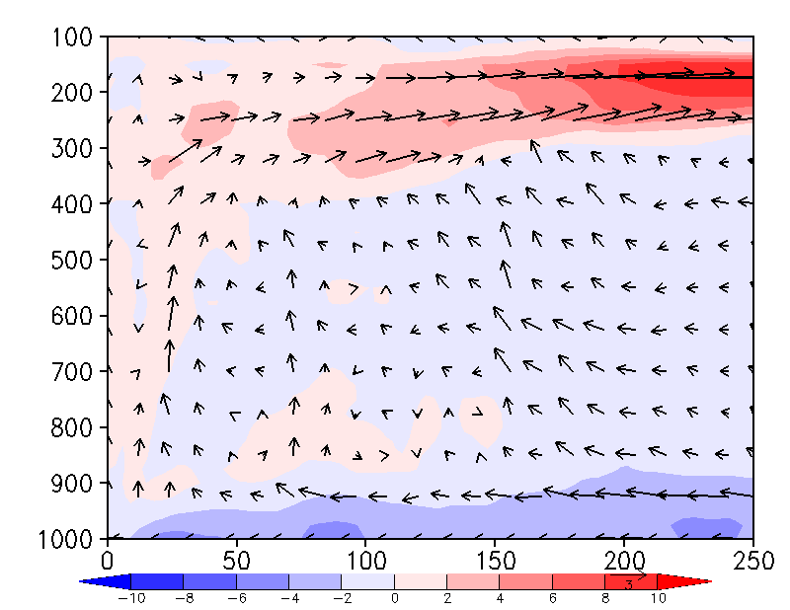
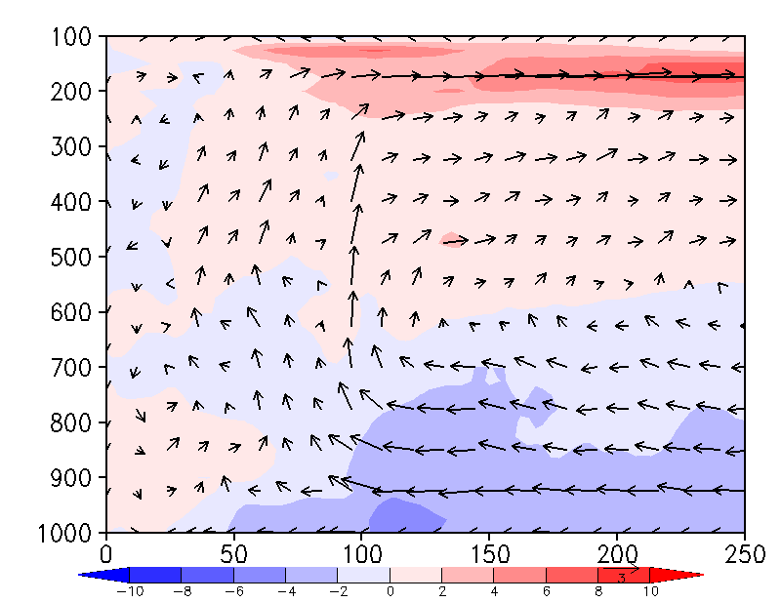
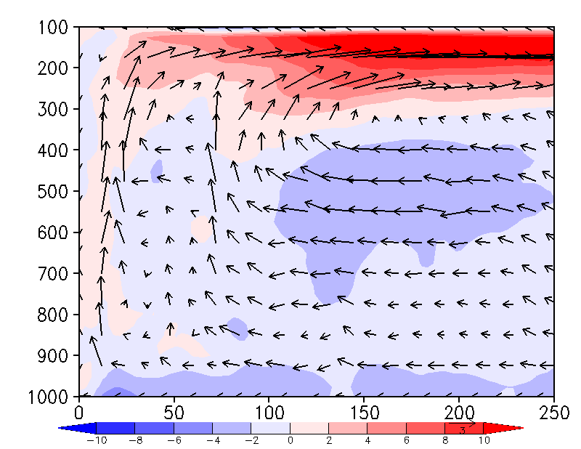
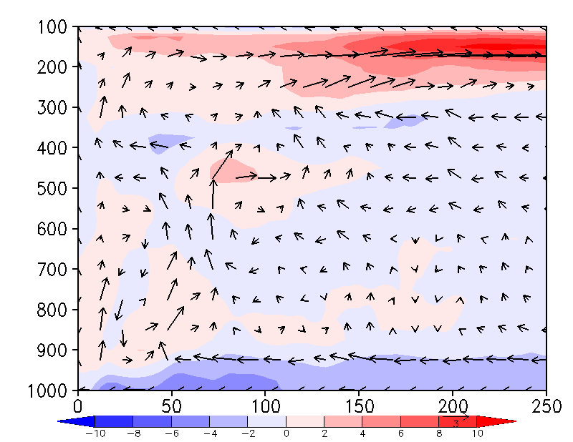
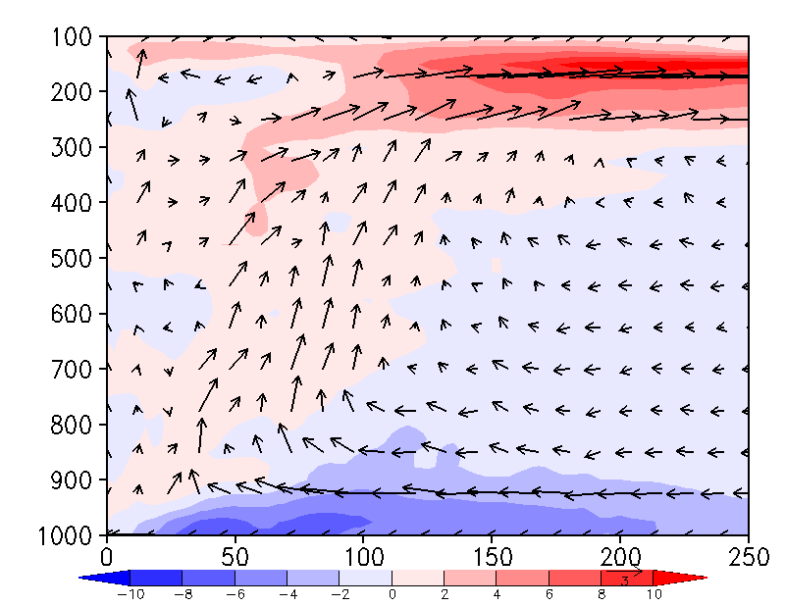
Secondary circulation
20170823 12Z notRI
RI-18h
RI-12h
RI-6h
RI
Pressure (hPa)
(km)
(km)
(km)
(km)
20170823 18Z RI
RI-18h
RI-12h
RI-6h
RI
Pressure (hPa)
(km)
(km)
(km)
(km)
Azimuthal averaged radial wind (shaded) and secondary circulation (vector).
There is stronger and deeper inflow at notRI cycle at 12h before RI

Slide 11
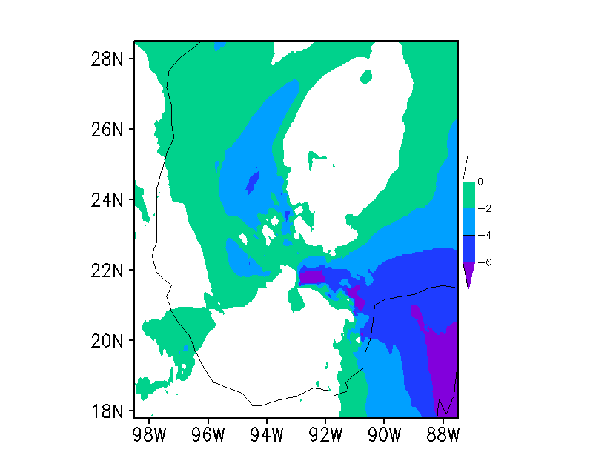
1000 – 600 hPa mean inflow at 12h before RI in notRI cycle
Downshear right quadrant contains the deeper inflow. (Reasor, P.D., R. Rogers, and S. Lorsolo, 2013: Environmental flow impacts on tropical cyclone structure diagnosed from airborne Doppler radar composite. MWR)

Slide 12
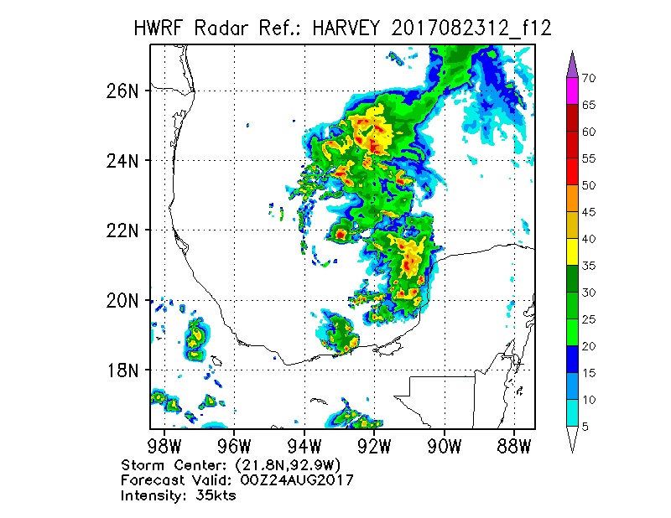
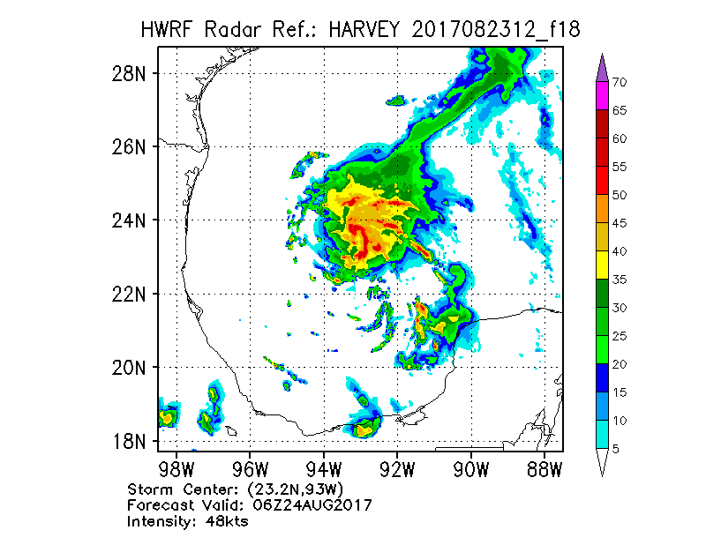
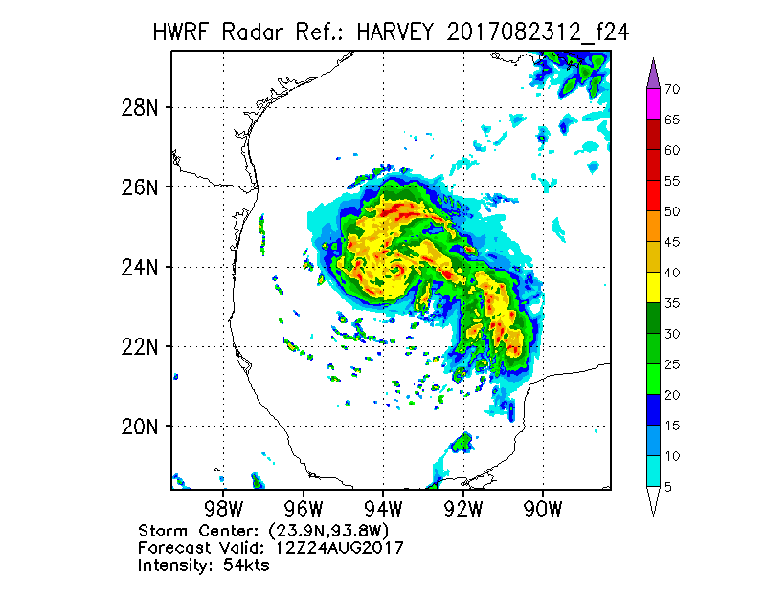
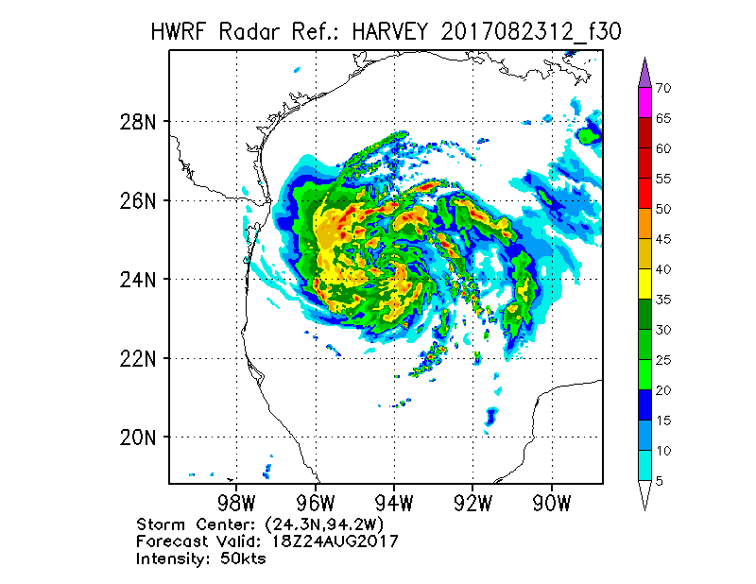
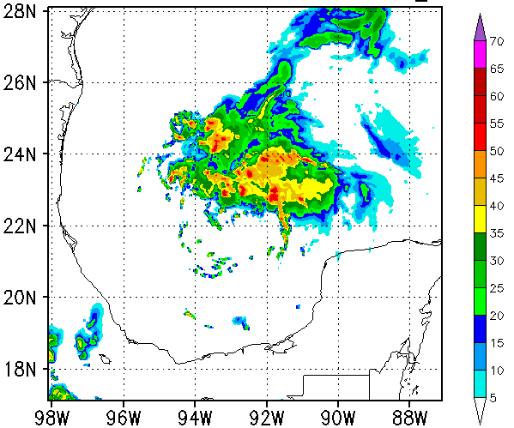
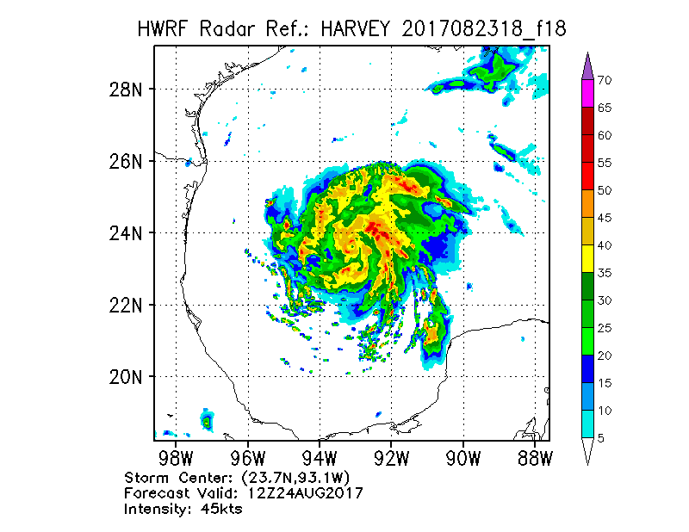
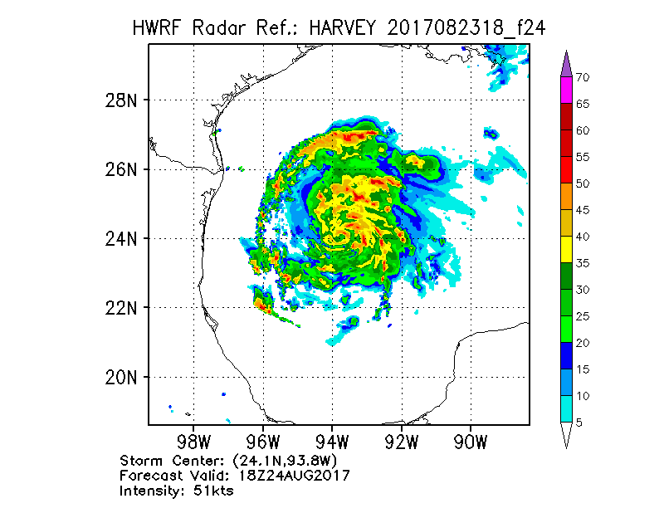
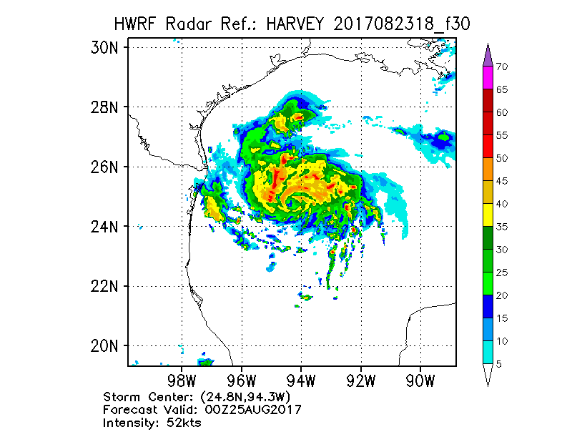
Composite radar reflectivity
20170823 12Z notRI
RI-18h
RI-12h
RI-6h
RI
RI-18h
20170823 18Z RI
RI-18h
RI-12h
RI-6h
RI
The convection moves cyclonically from downshear right to downshear, upshear left in both notRI and RI cycles;
There is a outer rainband in notRI cycle, which partially barrier the inflow. (Barnes, G. M., E. J. Zipser, D. Jorgensen, and F. Marks Jr., 1983: Mesoscale and convective structure of a hurricane rainband. JAS)

Slide 13
Summary
There are no big differences in shear and SST between notRI cycle and RI cycle;
Outer rainband in downshear right slows down the intensification in notRI cycle;
Future work
Rerun these two cycles with higher temporal resolution;
Diagnose the formation of outer rainband in the downshear right in notRI cycle;
Diagnose more cases for the relationship between rainband location and shear, and the storm movement.

