Slide 1



HWRF Activities at
CIRA Data Assimilation Group
Ting-Chi Wuª and Milija Zupanskiª
Collaborators: Louie Grassoª, Paula J. Brown^{b},
Chris Kummerow^{ab}, Karina Apodaca^{ac}, and Sid-Ahmed Boukabara^{d}
ªCooperative Institute for Research in the Atmosphere/Colorado State University
^{b}Department of Atmospheric Science/Colorado State University
^{c}NOAA/ESRL/GSD/GOSA
^{d}NOAA/Center for Satellite Applications and Research
July 13, 2017 @ NOAA/EMC/HWRF Weekly Meeting

Slide 2
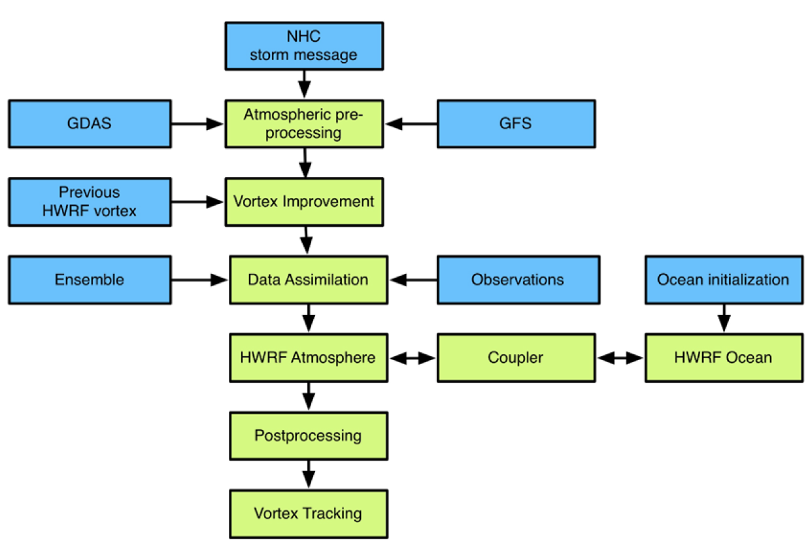

Hurricane WRF (HWRF) v3.7a System
v3.7a is functionally equivalent to
the 2015 operational version
or Vortex initialization / Vortex relocation
GSI: Gridpoint Statistical Interpolation
WRF NMM core
HWRF employs
the hybrid 3DEnVar GSI
20 % static + 80 % ensemble
background error covariance
HWRF Scientific Document
Tallapragada et al. (2015)

Slide 3
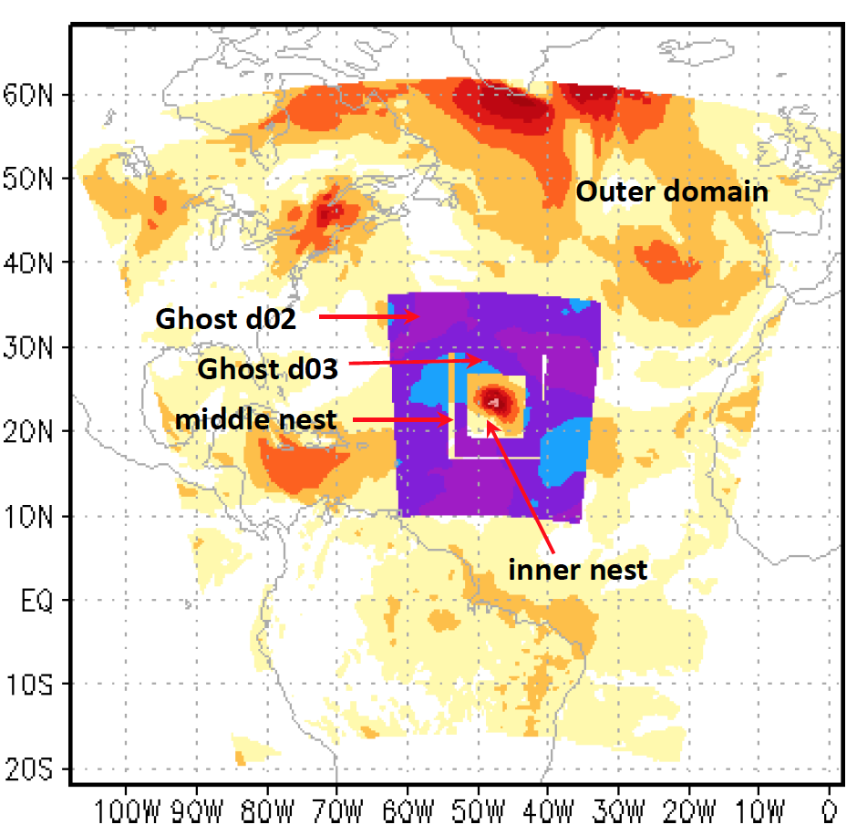
HWRF Configuration (v3.7a)
Domain (Δx) | Domain size | Data assimilation | Conv. observation assimilated | Satellite radiance assimilated
D01 (18 km) | 216 x 432 | Inherit from GDAS | - | -
ghost d02 (6km) | 166 x 336 | Hybrid 3DEnVar GSI | Yes | Clear sky only
ghost d03 (2km) | 250 x 500 | Hybrid 3DEnVar GSI | Yes | -
d01
d02
d03
60 vertical levels
Model top pressure = 2 mb
FGAT: -3 h, 0 h, +3 h
The Community Radiative Transfer Model
HWRF Scientific Document
Tallapragada et al. (2015)
To increase the utility of satellite observations in the core of hurricanes,
  we extends the HWRF-GSI capability to assimilate precipitation-affected data that includes microwave satellite retrievals and radiances.
  We also plan to extend the GSI lightning assimilation capability to HWRF.

Slide 4
1. Microwave Hydrometeor Retrievals
Hurricane GPROF

Slide 5
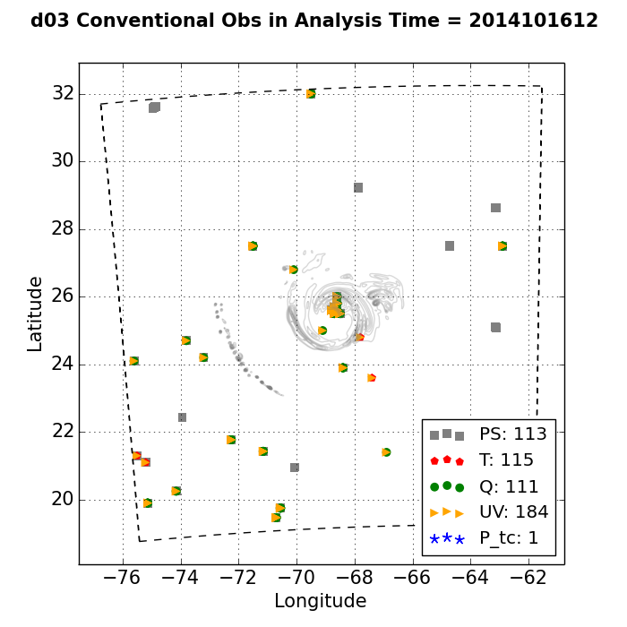
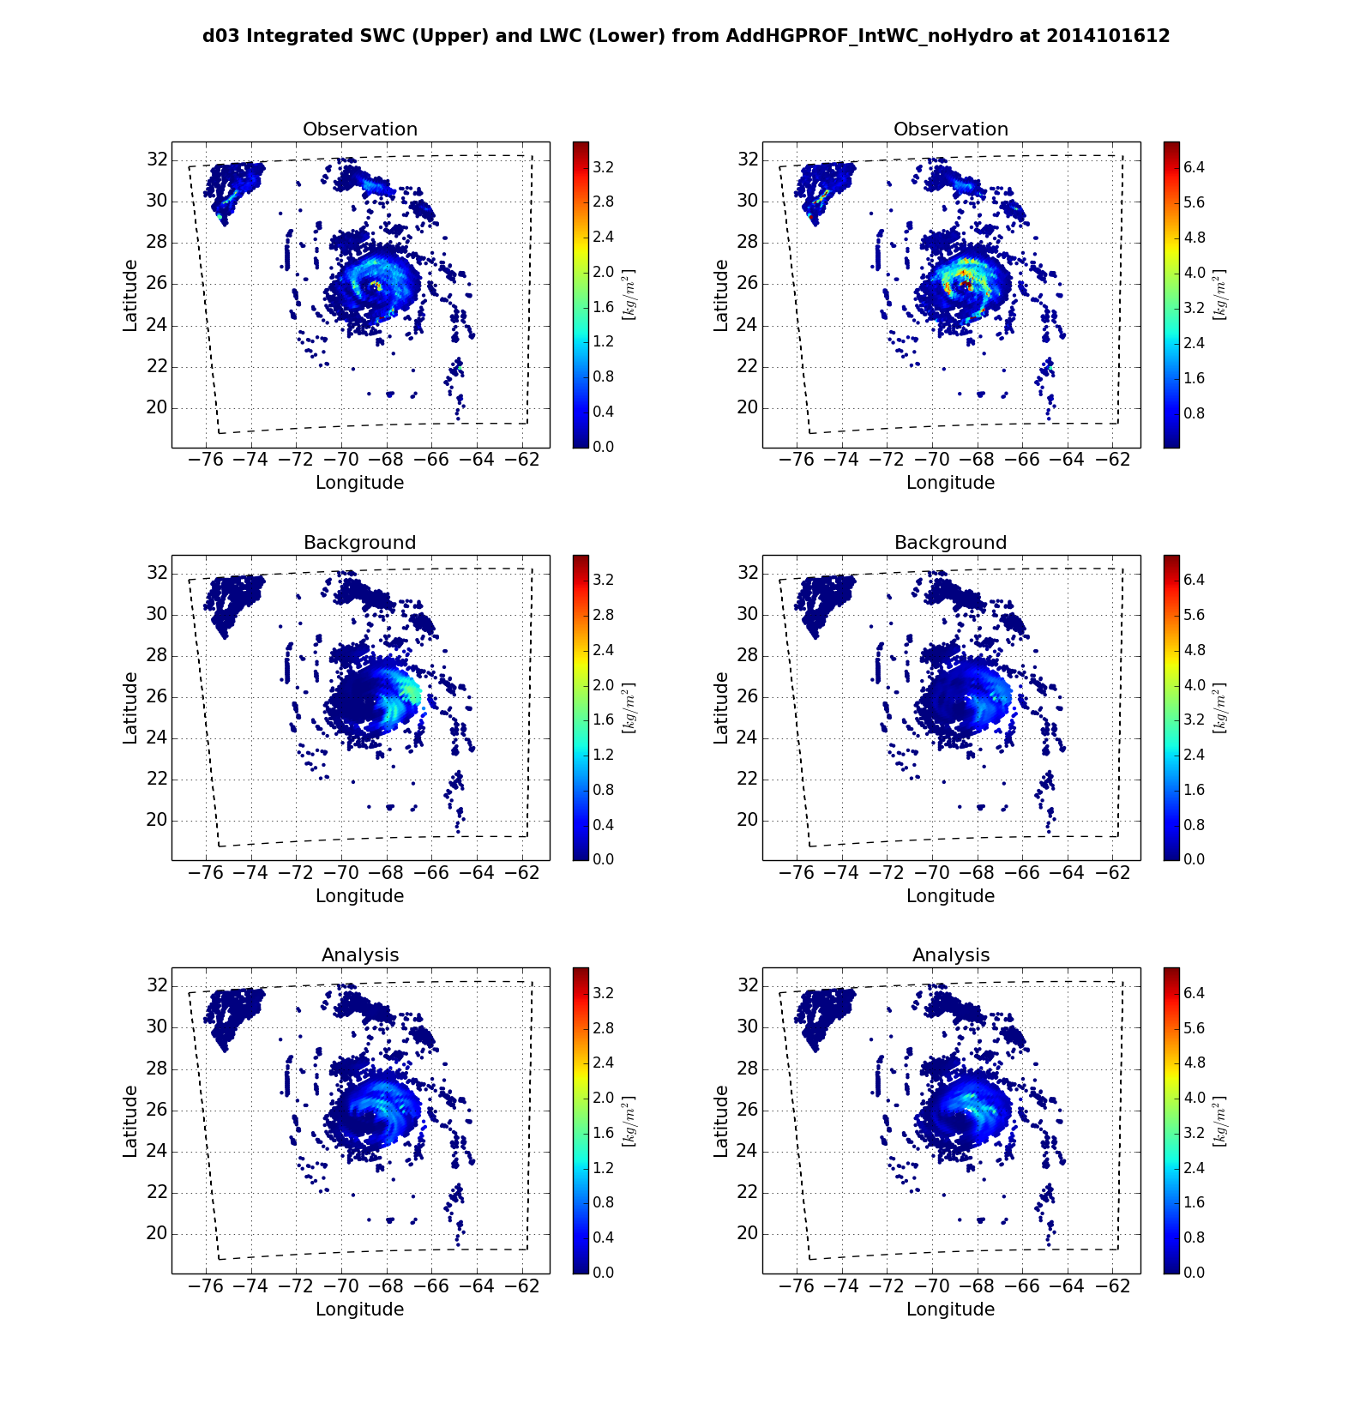
Hurricane GPROF
A hurricane-specific microwave retrieval that utilizes data from GMI/TMI and HURDAT2 info (Brown et al. 2016)
Provides retrieved instantaneous rain rates and hydrometeor profiles (cloud water, rain, mixed-phase, and ice)
Transformed into two vertically integrated quantities to be assimilated into HWRF:
  Integrated solid-water content (SWC) in kg m⁻²
  Integrated liquid-water content (LWC) in kg m⁻²
Conventional Obs
Integrated SWC
Integrated LWC
ghost d03
ghost d03
ghost d03

Slide 6
Observation Operators for HGPROF
  Use current set of control variables that includes T, P, and q and assume super-saturated water vapor will condense out:
  Add cloud condensate control/state variables:
Integrated SWC
Integrated LWC
Wu et al. (2016)
HWRF uses Ferrier-Aligo microphysics scheme, prognostic microphysical variable is total cloud condensate mass (aka CWM) instead of individual hydrometeor species.
Also need to address the partition of CWM
into individual hydrometeor
Wu and Zupanski (2017)

Slide 7
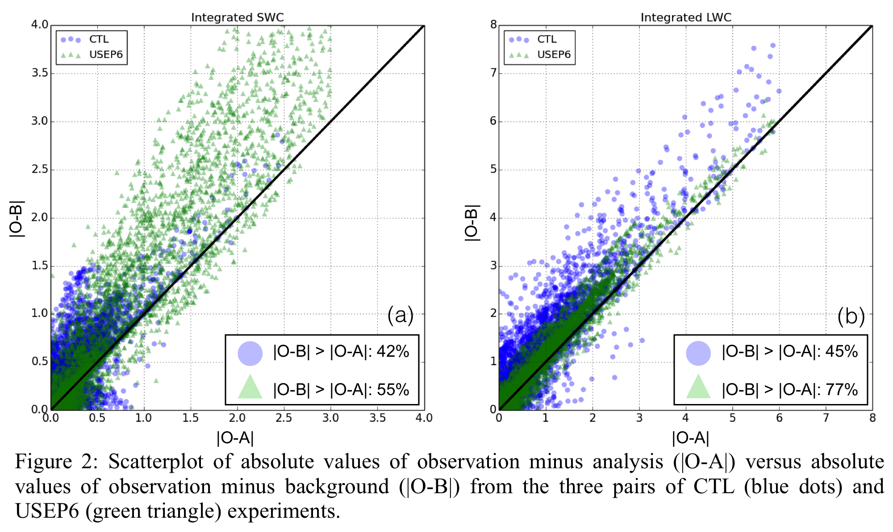
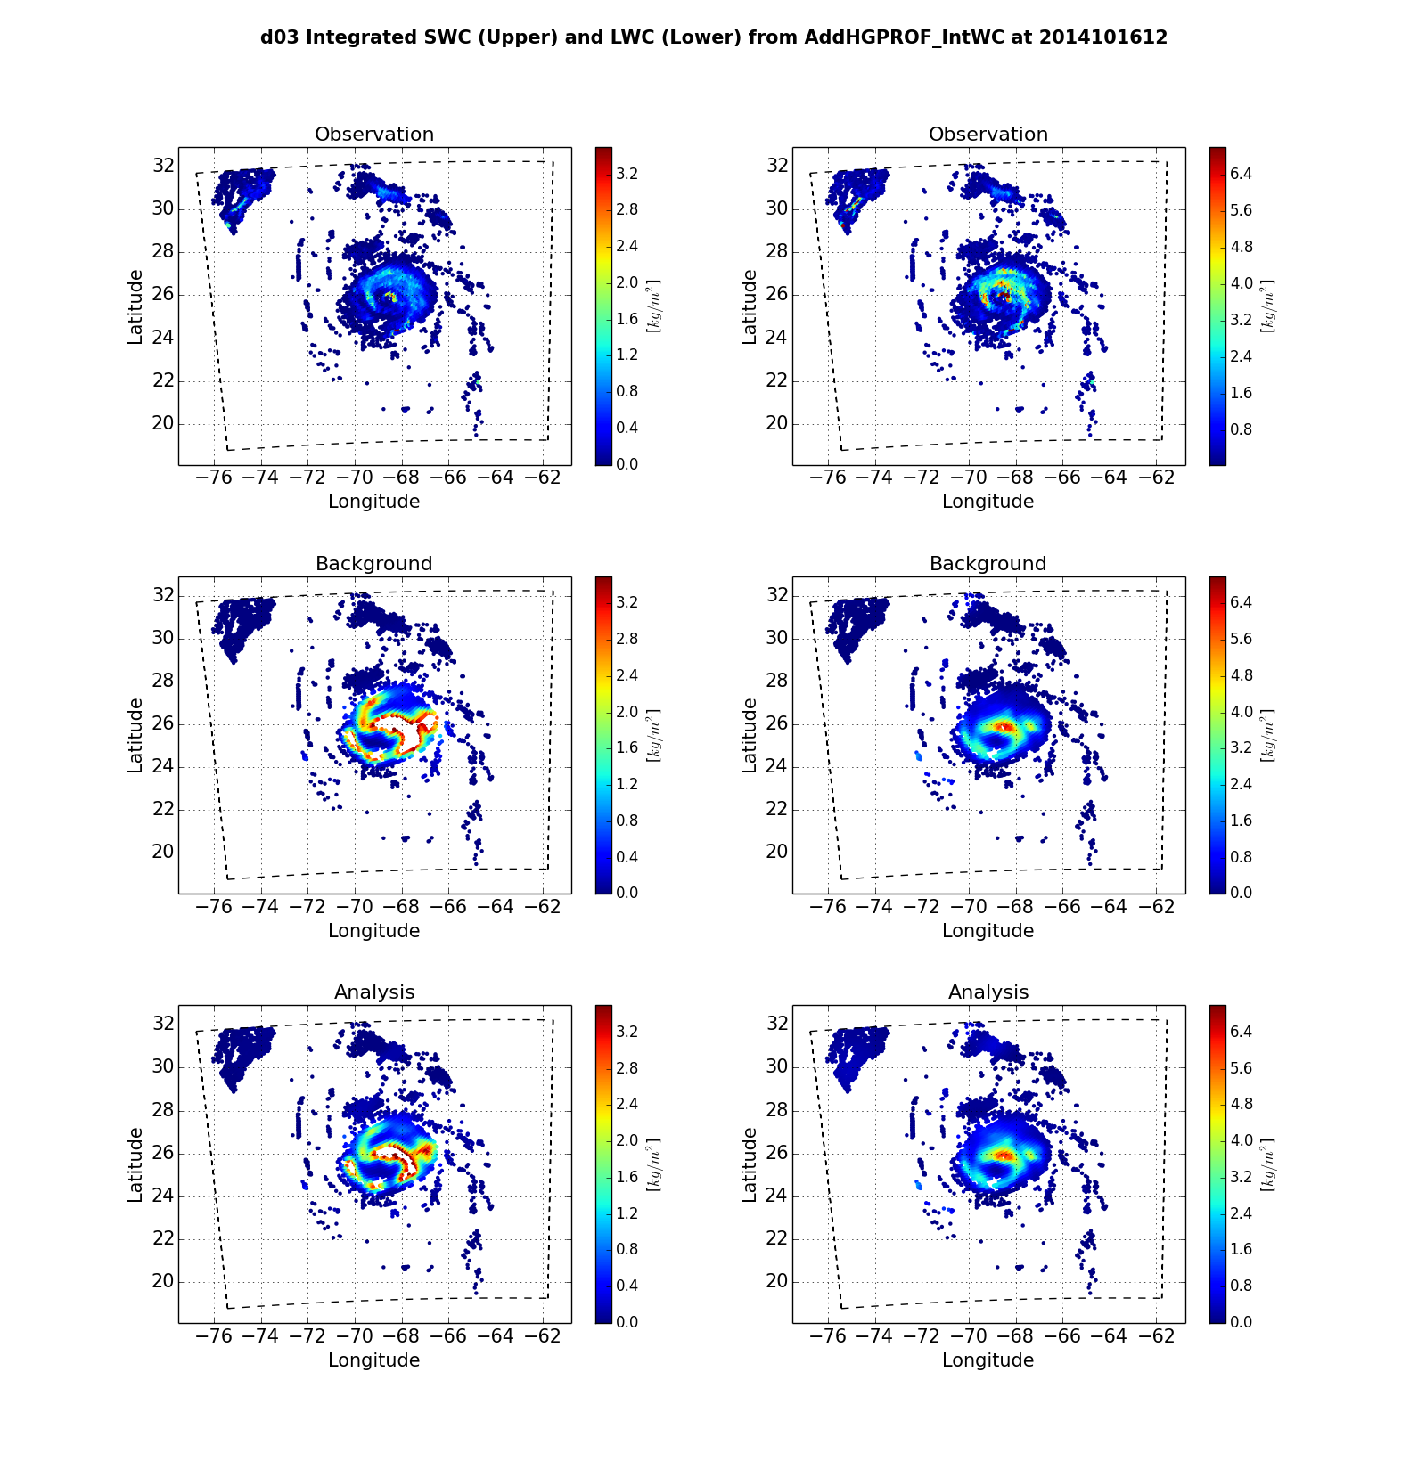
Case: Hurricane Gonzalo (2014)
Integrated LWC
at 2014/10/16 1200 UTC
ghost d03
Operator a): values of LWC are generally lower than observed ones
Operator b): background values of LWC are more comparable to observations

Slide 8
Case: Hurricane Gonzalo (2014)
Integrated SWC
at 2014/10/16 1200 UTC
ghost d03
Operator a): values of SWC are comparable to observed ones, but displaced to the east of Gonzalo
Operator b): In general, distribution of SWC is similar to observed ones, but their values are much larger

Slide 9
Analysis increments
Operator a) noHydro Operator b) Hydro

Slide 10
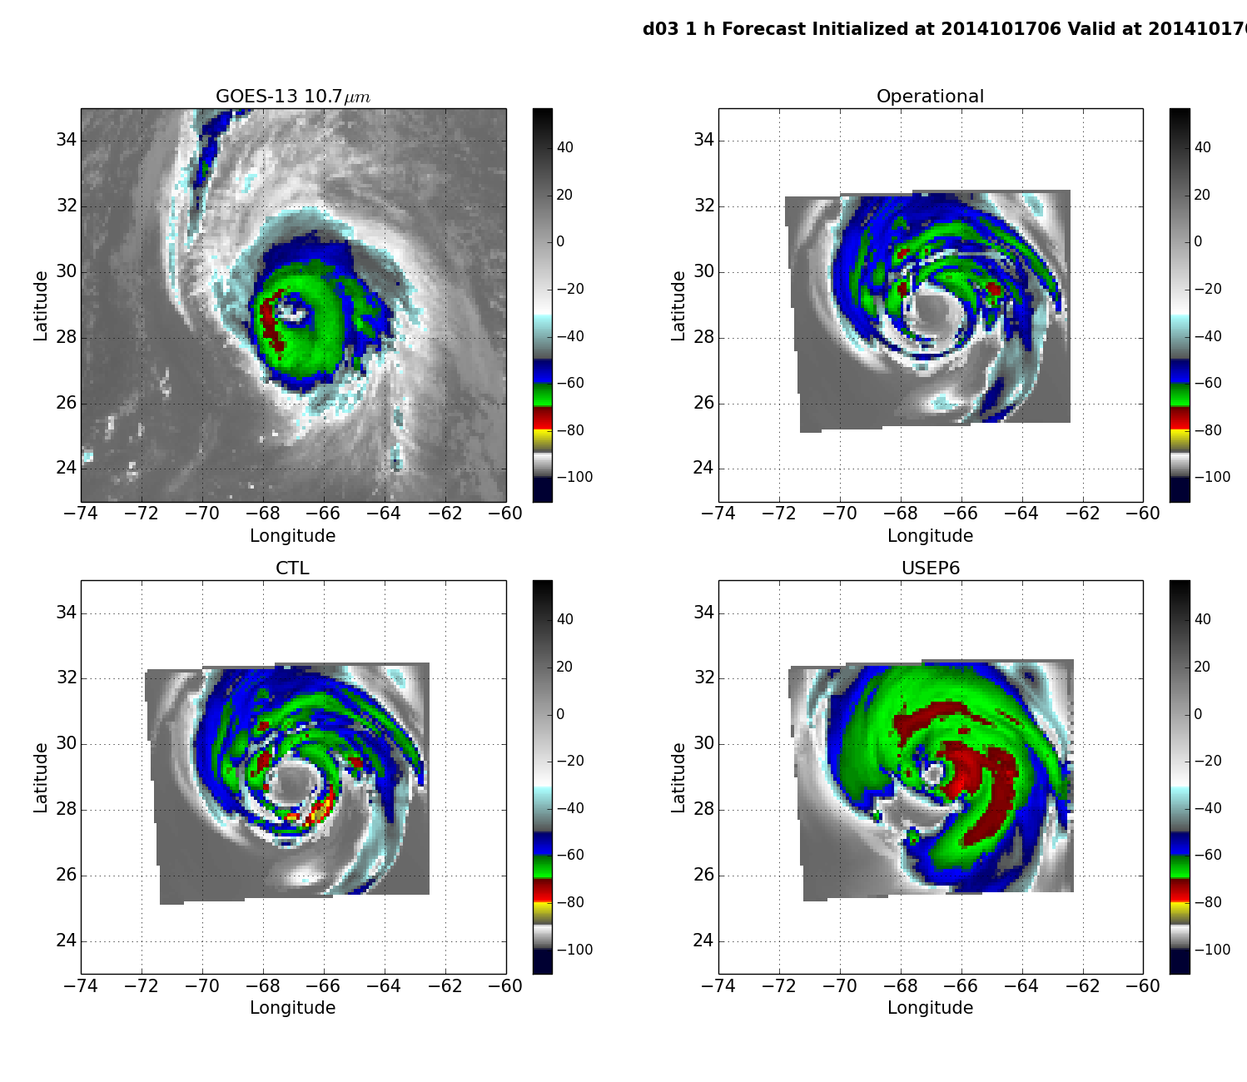
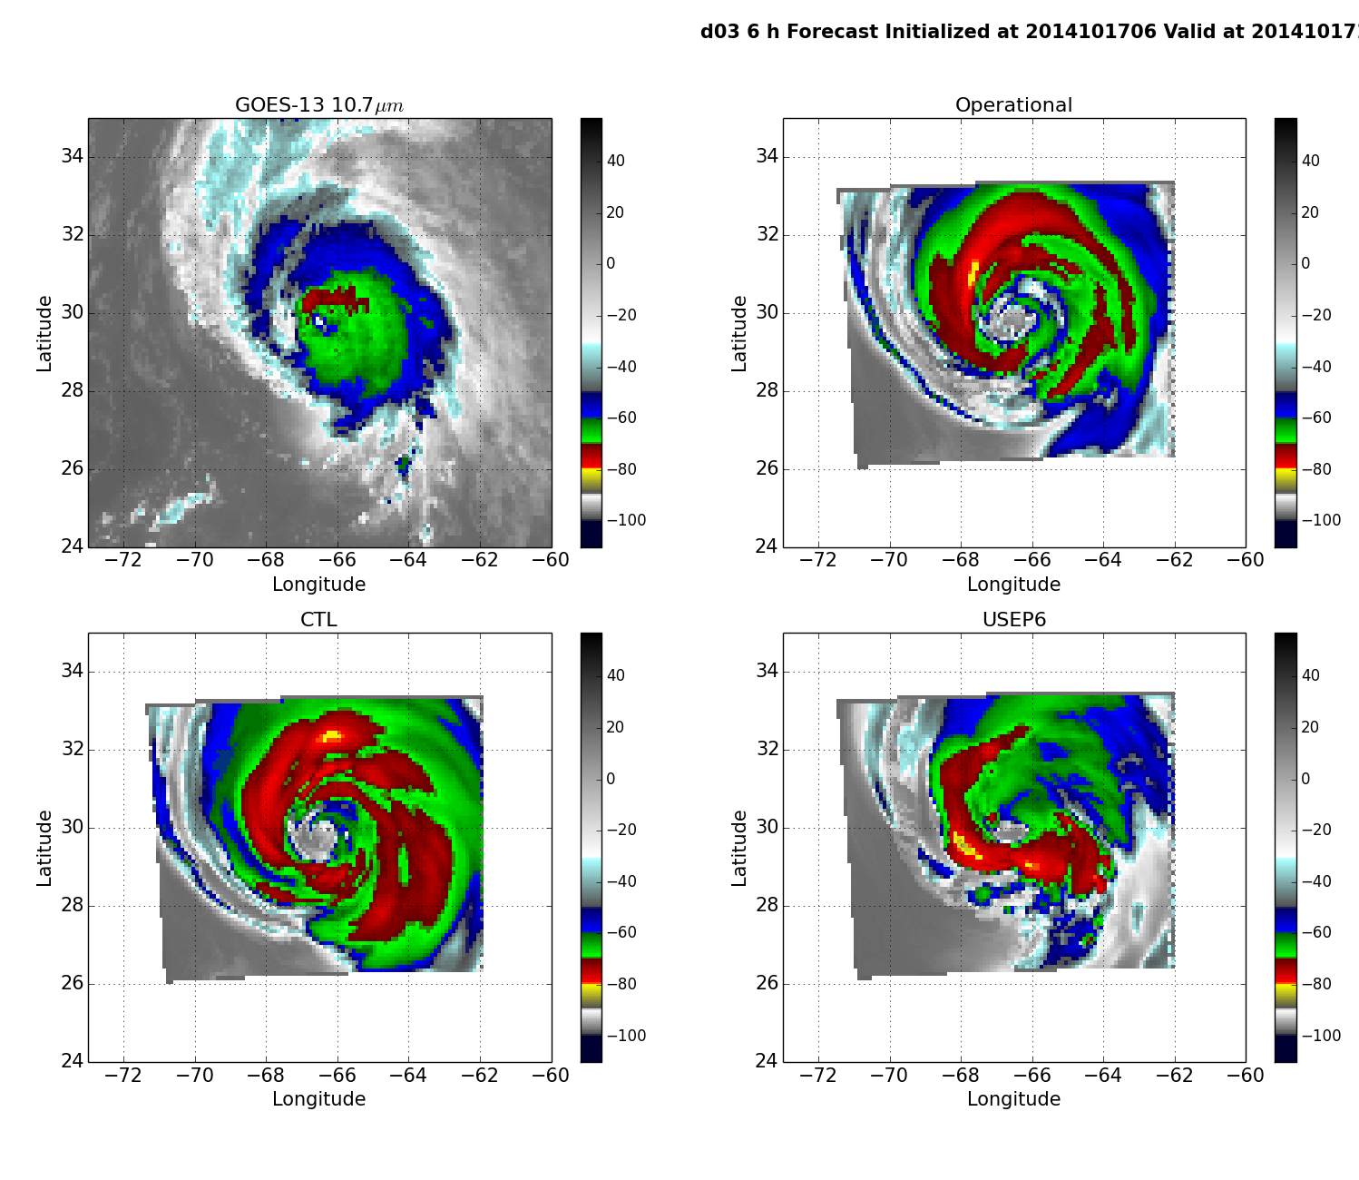
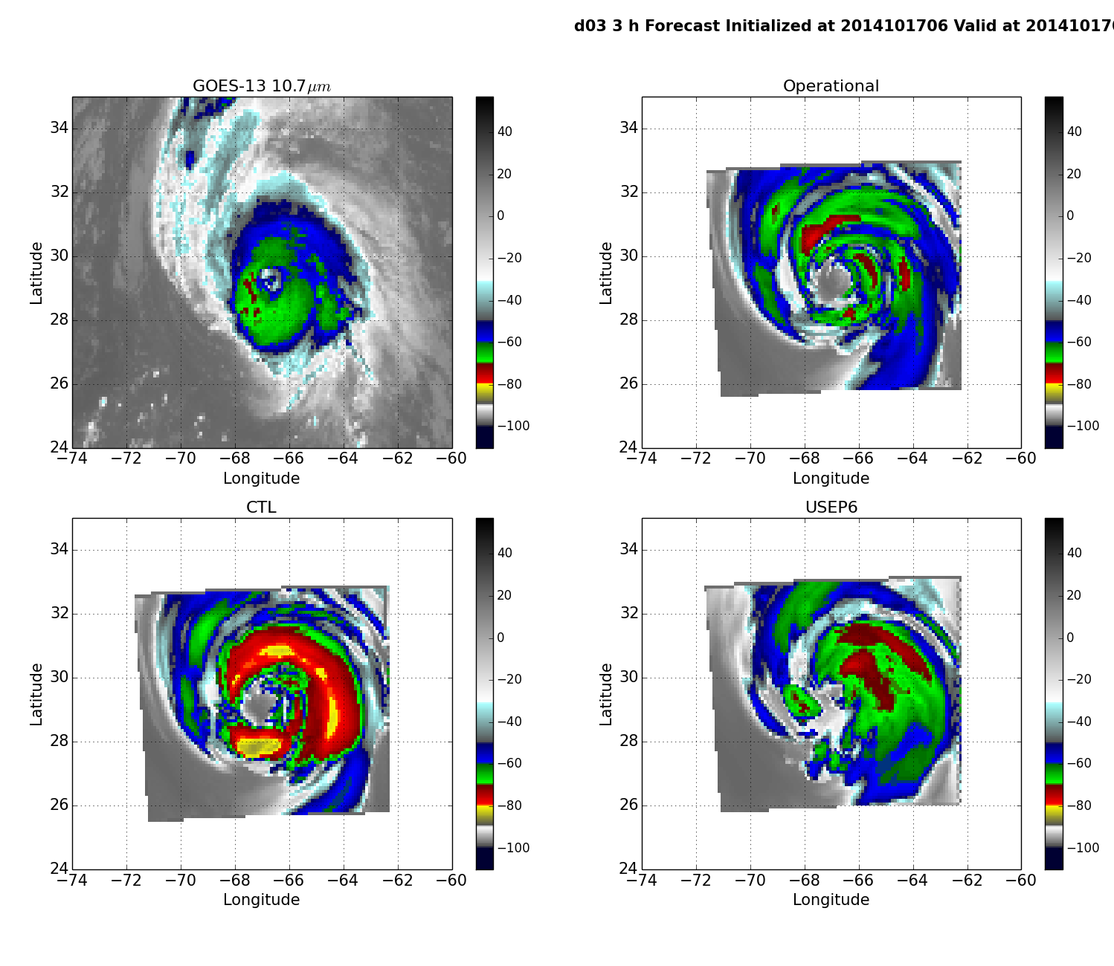
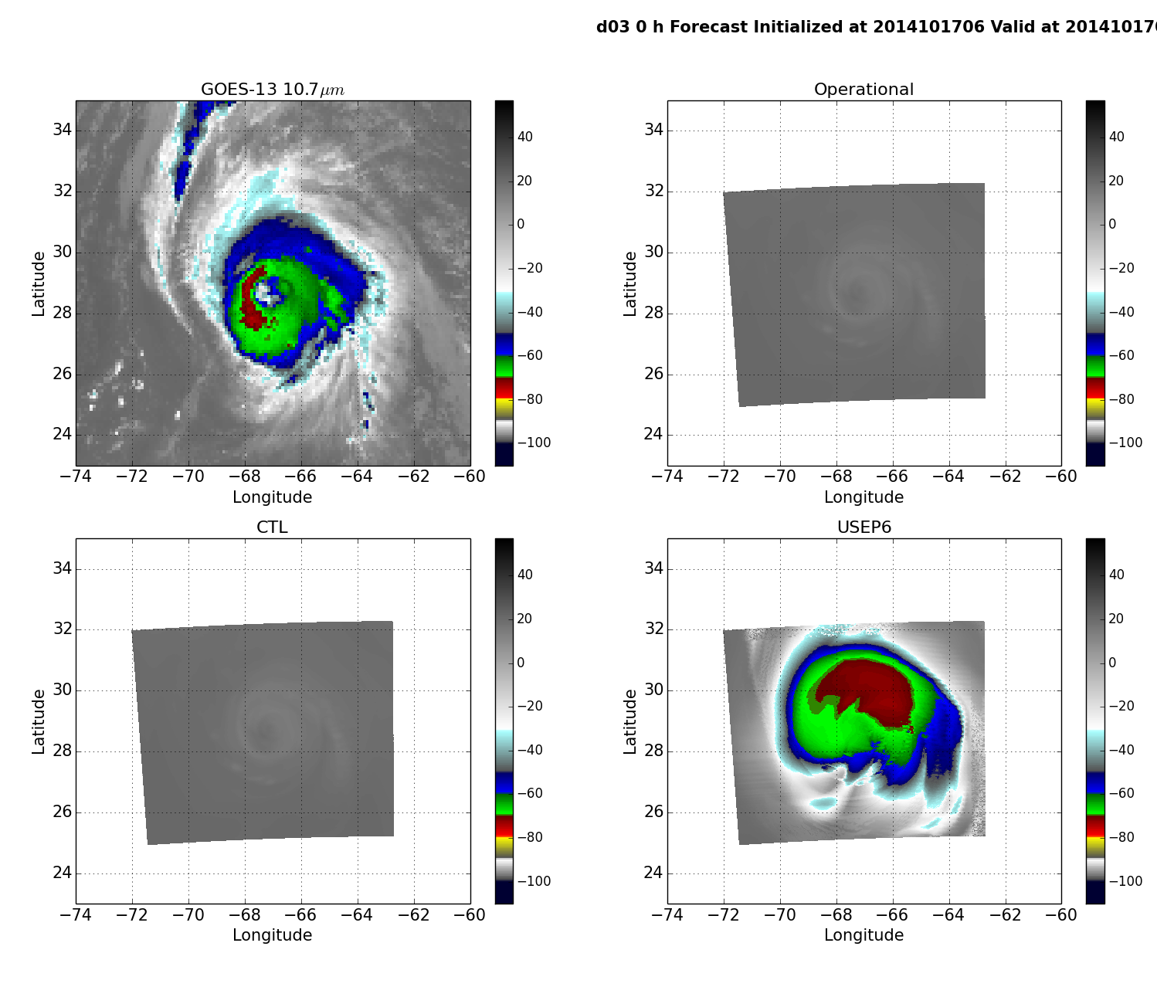
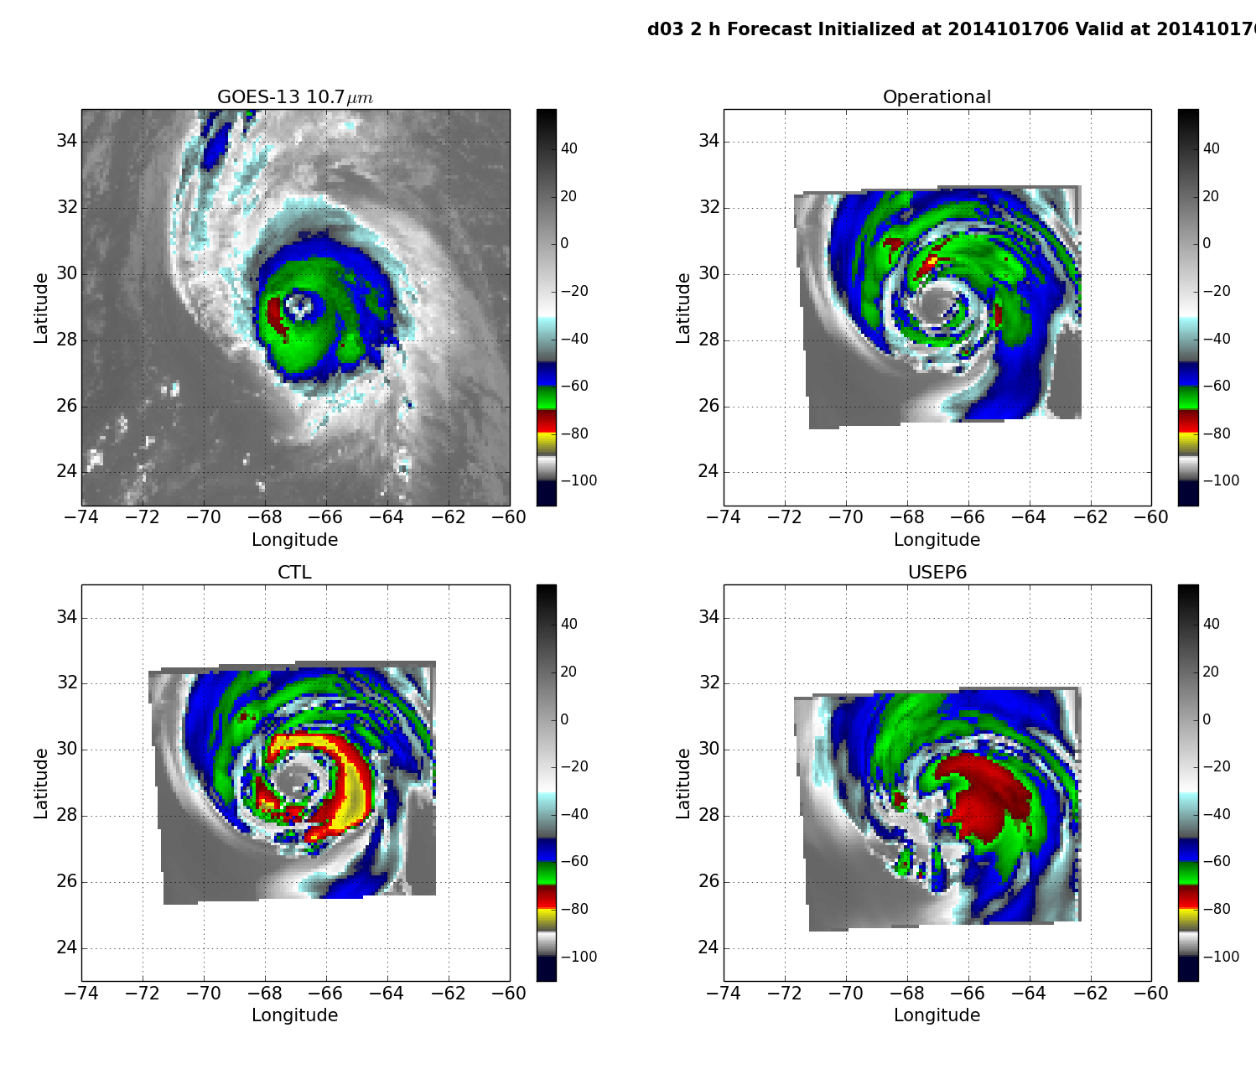
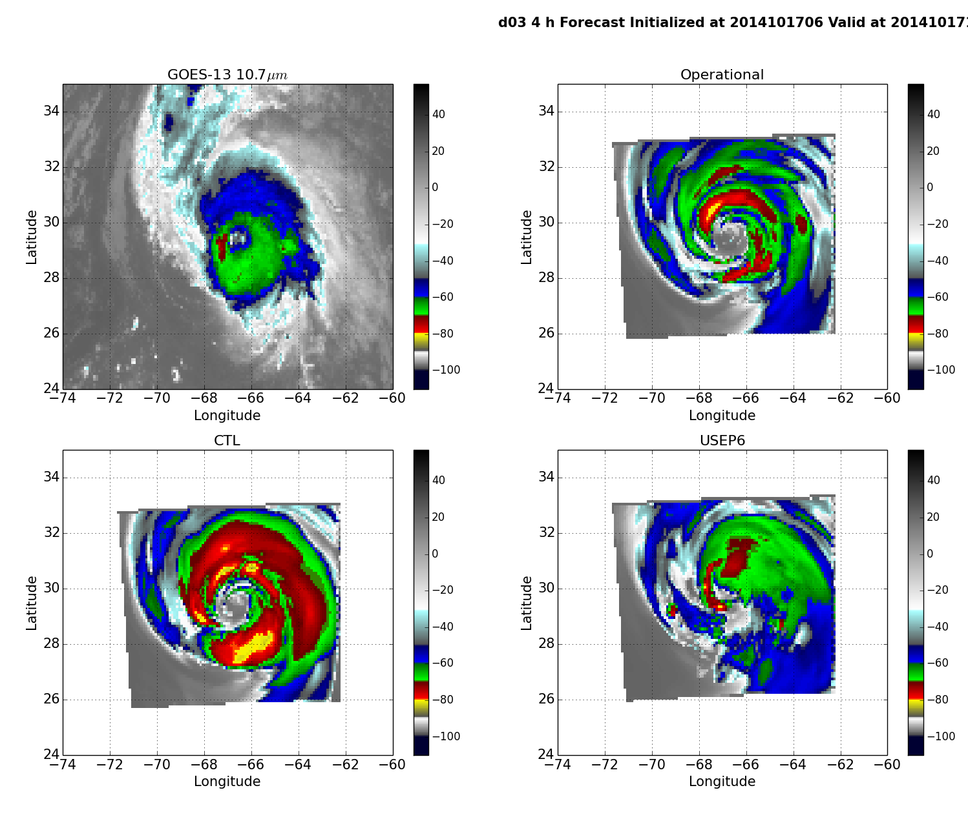
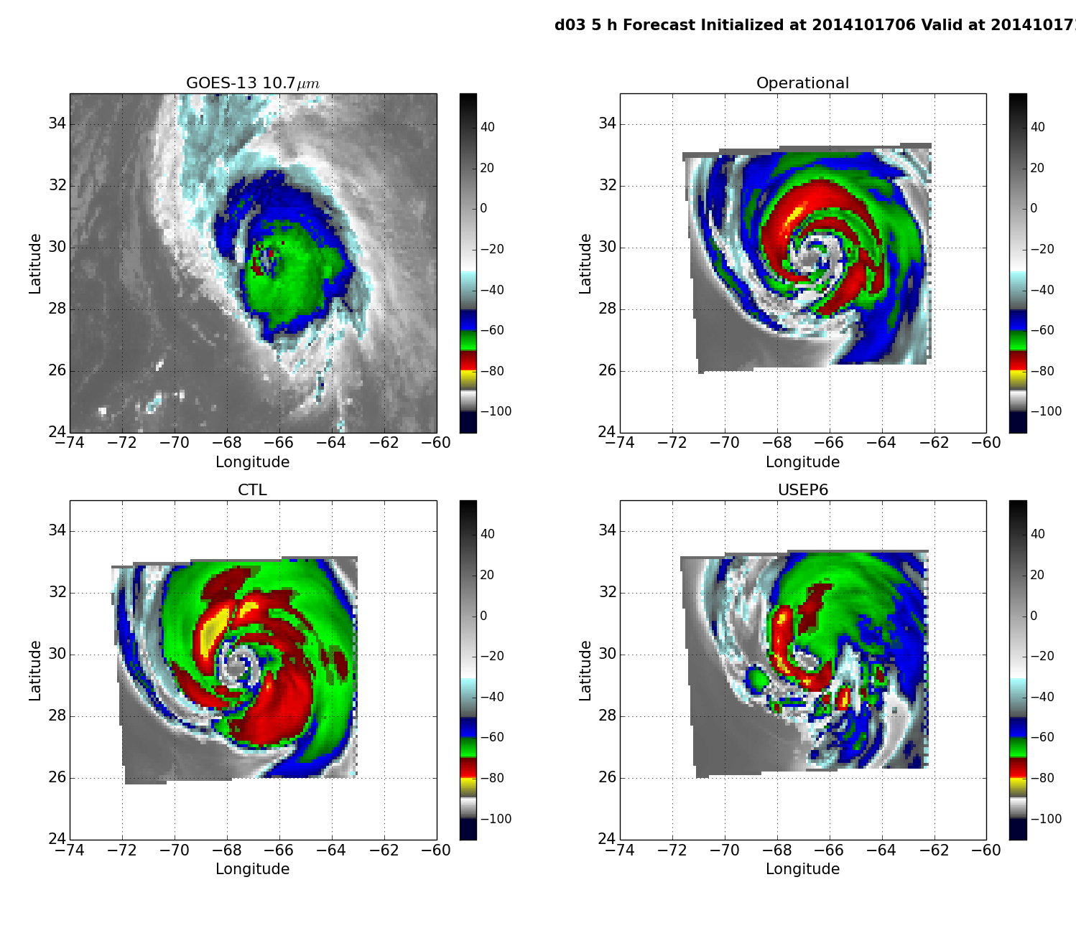
Compare w/ GOES-13 image at 10.7 μm
(Brightness Temperature in °C)
ghost d03
Operator a)
Operator b)
ghost d03
ghost d03

Slide 11
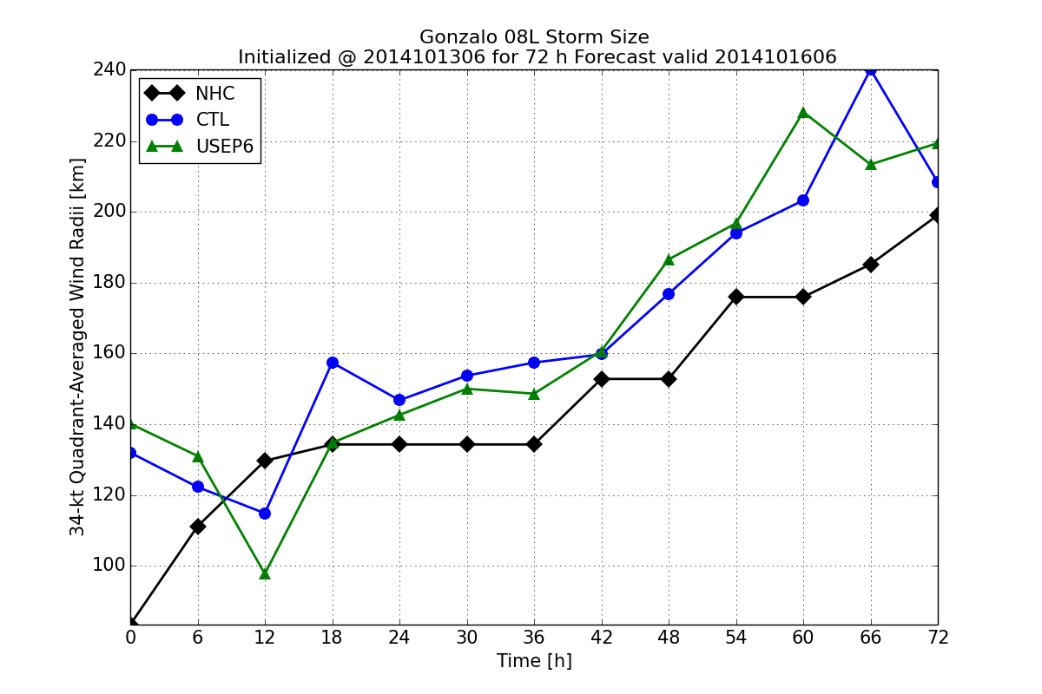
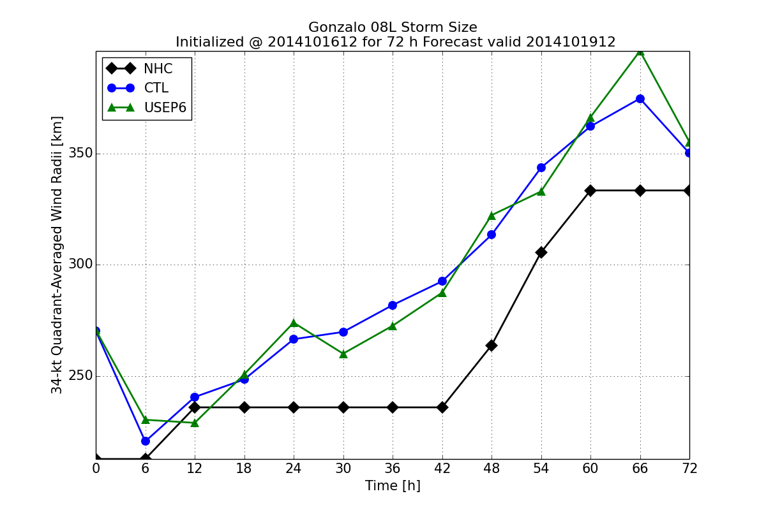
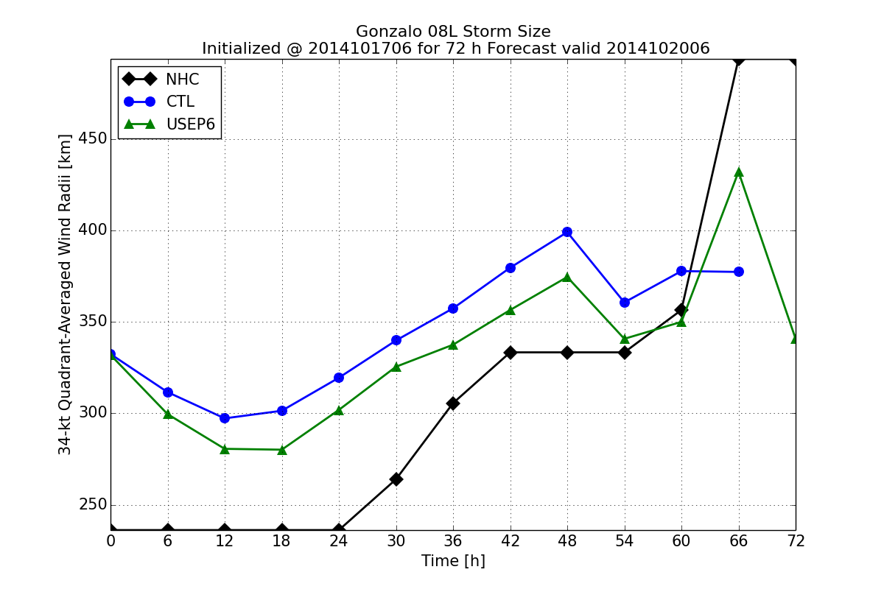
72-h HWRF Forecast
Operator a)
Operator b)
Track Error (km)
Intensity Error (hPa)
Size Error (km)
TS
HU
HU

Slide 12
Summary (1)
Fit to observation was improved with operator b)
While there was no obvious improvement in forecast track and size forecast, intensity forecast was found slightly improved when operator with cloud condensate update (operator b) is used
Although initial cloud condensate field (synthetic satellite image) was comparable to observations, there were too many cold clouds being produced during forecast
 | Pros | Cons
a) | Relatively easy to implement Code modifications are limited to GSI only Impact cloud environment | Create bias from using already saturated-then-condensed water vapor from background guess No cloud condensate update
b) | In addition to dynamical variables, cloud condensate variables are also updated (cloud environment + clouds) Align with GSI all-sky radiance assimilation efforts (see section 2) | Need to modify procedures in HWRF related to cloud condensate (e.g. vortex relocation, merge) in order to preserve cloud condensate fields for GSI Depends on cloud microphysics scheme used by HWRF

Slide 13
2. All-Sky ATMS Radiances

Slide 14
Preps for all-sky assimilation in HWRF
Inherit the GSI all-sky assimilation capability
  Developed for GFS by Zhu et al. (2016) via adding CWM as control variable and including ql and qi as state variables
  We extended to also include qr, qs, qg, and qh
  Currently uses GFS ensemble (non-native) to estimate ensemble background error covariance for HWRF
Total cloud condensate (CWM) partition
  An empirical formula based on Ferrier-Aligo microphysics scheme for partitioning CWM into ql, qi, qr, qs, qg, and qh with partition parameters (F_ICE, F_RAIN, and F_RIMEF) is available in GSI
  The tangent linear and adjoint parts of the partition are included in cost function minimization (Wu and Zupanski 2017)
Cloud Initialization
  Cloud condensate is currently not considered during the vortex initialization procedure, a step prior to GSI within HWRF, and the merge procedure
  We provided a simple approach by appending CWM and its partition parameters from the forecast of a previous HWRF cycle to the background guess

Slide 15
ATMS Ch 1: 23.8 GHz (Tb in Kelvin)
Hurricane Cristobal (2014) 1800 UTC, August 26
ghost d03
Ch 1 and 2 are sensitive to cloud liquid droplets and rain: ocean surface appears cold and condensate associated with hurricane ( ) appears warm (>240K)
Absolute innovation differences = |O-B|-|O-A|
Notes:
Ch 1-2: sensitive to cloud liquid droplets and rain
Ch 7-9: provides information about the warm core of hurricane
Ch 16: helps identify the location of the deepest convection through a scattering signal from precipitation-sized ice particles
Ch 17-20: water vapor channels make moisture sounding possible in clear-sky regions

Slide 16
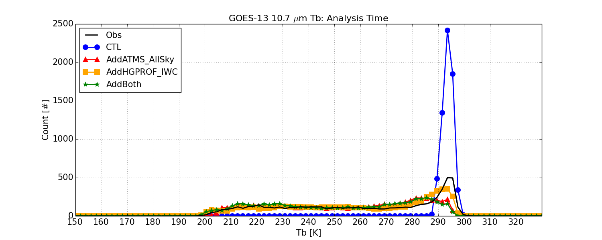
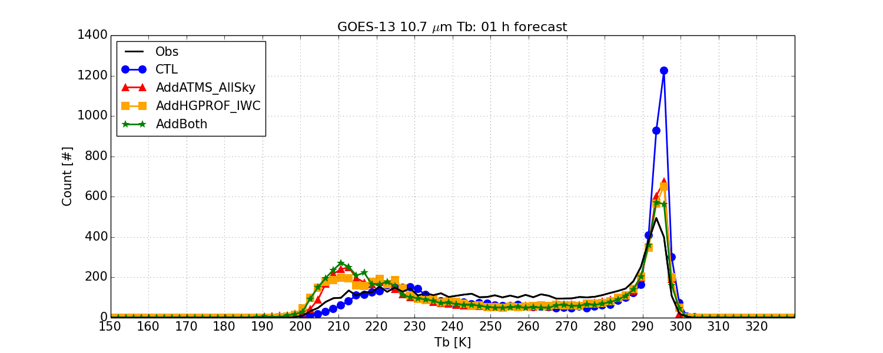
Compare w/ GOES-13 data
Histogram of Tb of observed GOES-13 10.7 μm image (black) and synthetic images (colored)
The distribution of brightness temperature at t = 0 is consistent with observation, except for CTL (blue) due to no cloud condensate.
Within the first hour of the forecasts, a discrepancy developed, where the brightness temperatures are around 210 K
Such discrepancy persists in the following (at least) 24 hours of forecast
Analysis: t = 0
Forecast: t = 1 h

Slide 17
Summary (1)+(2)
Extended GSI capability to assimilate cloud and precipitation-affected satellite observations into HWRF.
Both Hurricane GPROF hydrometeor retrievals and ATMS all-sky radiances were successfully assimilated into HWRF.
Although forecast results from all-sky assimilation measured in metrics including track, intensity, and sizes were mixed (not shown), initial cloud fields (synthetic satellite images) from assimilation were comparable to observation.
HWRF appears to produce too many clouds with cloud top temperature that is too cold compared to observations.
Currently, working on merging the extended capabilities to the HWRF and GSI repository through the DTC Visitor Program.

Slide 18
3. GLM Lightning observations
(in collaboration with Vijay, Avichal, and Mingjing)

Slide 19
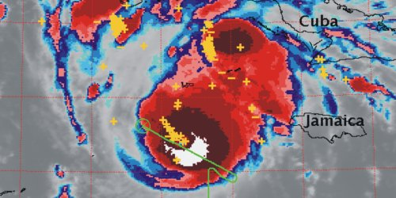
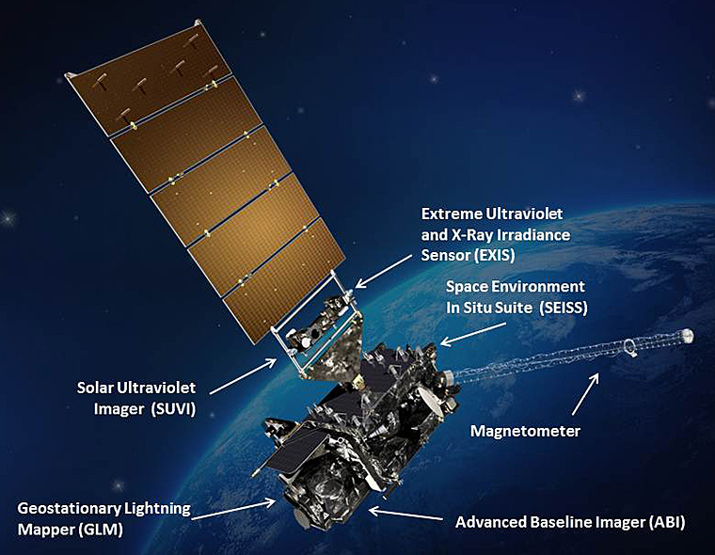
General Project Description
Data assimilation of GLM observations in HWRF/GSI system
The scientific focus of this project is to exploit unique capabilities of the GLM instrument to improve data assimilation with NOAA HWRF operational system
Courtesy of NASA: Hurricane Emily (2005)
: lightning strikes
We plan to achieve this by:
Adopting and optimizing the GLM lightning observation operator previously developed for NOAA GDAS and WRF-ARW systems
Incorporating the lightning observation operator in NOAA HWRF system

Slide 20
Lightning observations
Actual lightning measurements from GLM are lightning strikes
Lightning observation operators are often related to lightning flash rate (LFR)
Need to transform lightning strikes to LFR
First, we define a regular observation grid with gridspacing corresponding to the spatial resolution of GLM measurements (~8 km):
Black cross: central grid point at which LFR calculation is performed
Black dash line: defines the boundary of each grid point
Blue line: defines area that impacts the calculation at the central grid point
Circles: lightning strikes where blue circles denote strikes that impact the central point and red circles denote strikes that impact other grid points
v

Slide 21
Observation Operators for LFR
Regression between LFR and maximum vertical updraft (Barthe et al. 2010)
  impact the environment of clouds, but not clouds directly
Regression between LFR and forecast threat (McCaul et al. 2009)
  impact the environment of clouds and the clouds too
- empirical parameters
Implemented for WRF-NMM (Apodaca et al. 2014) and GDAS
- empirical parameters
- level at T = -15°C
Implemented for WRF-ARW; Will need to modify for HWRF (w & microphysics)

Slide 22
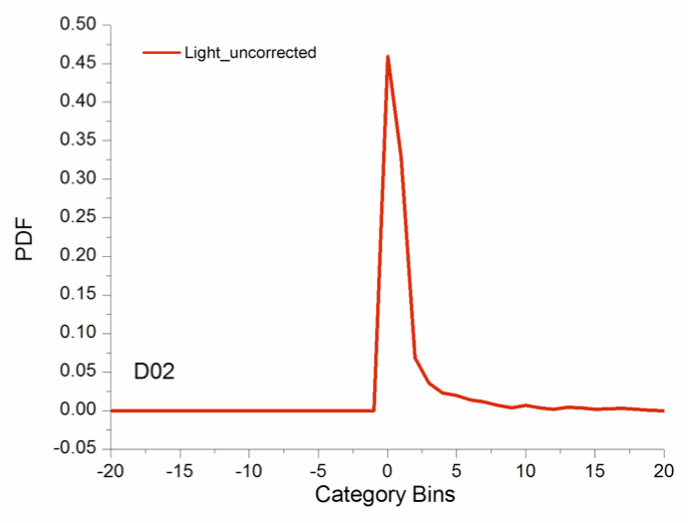
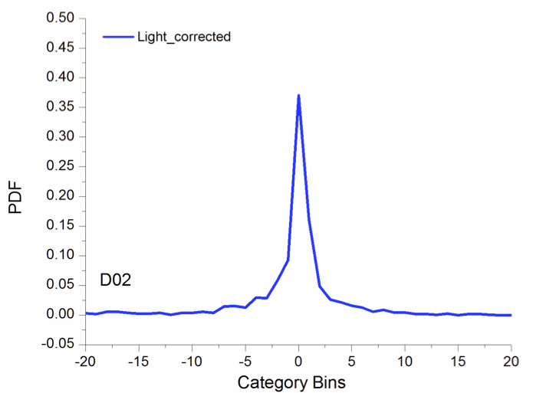
Correcting bias & parameter optimization
Since the aforementioned observation operators are based on empirical regressions, bias correction/parameter optimization are required
Assume multiplicative errors:
Minimize cost function to obtain optimal multiplicative parameter
- an adjustable multiplicative
correction parameters
Normalized innovation vector (O-B)
before
after
More details can be found in Apodaca et al. (2014)

Slide 23
Analysis Increments: proxy lightning obs
Lightning observations from World Wide Lightning Location Network (WWLLN) valid at 1200 UTC Aug 7, 2013 (used as proxy for GLM data before it is available)
@ 700 hPa
T
U
V
Q
All model variables are impacted, indicating an adjustment of storm environment, from assimilating lightning observations in GDAS (operator 1)

Slide 24
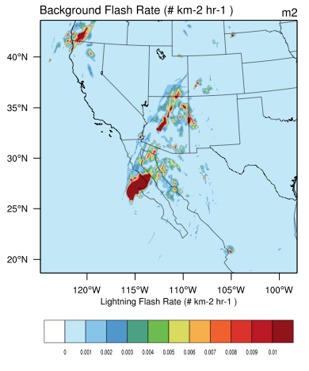
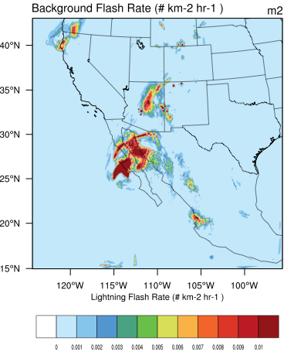
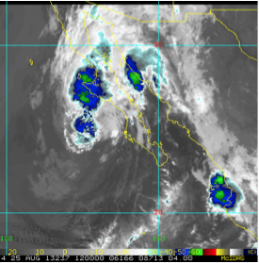
Impact on Forecast
Tropical Storm Ivo (2013)
CTL: GDAS, but no lightning
LIGHT: same as CTL, but with assimilation of lightning
GOES-15 IR
CTL
LIGHT
Improved representation of storm structure through more accurate location and intensity of lightning activity

Slide 25
Summary (3)
Milestones (Year 1)
Prepare for using GLM lightning data in GSI data assimilation
  Prepare the format of input lightning data for use in GSI (i.e., BUFR)
  Optimize the transformation from lightning strikes to LFR for HWRF
Examine and adjust the lightning observation operators for use in HWRF
  Investigate the applicability of the previously developed lightning observation operators to hurricanes
  Adjust lightning observation operators for hurricane applications
  Conduct HWRF experiments with the assimilation of GLM observations
Deliverables (Year 1)
Add cloud variables in HWRF initialization procedure
Algorithm for transforming lightning strikes to flash rates
GLM lightning observation operators optimized for HWRF
Notes:
Microphysics schemes, native HWRF ensemble, and cloud initialization

Slide 26
Thank you!
CIRA Data Assimilation Group http://da.cira.colostate.edu
References:
Apodaca, K., M. Zupanski, M. DeMaria, J. A. Knaff, and L. D. Grasso 2014: Development of a hybrid variational-ensemble data assimilation technique for observed lightning tested in a mesoscale model. Nonlin. Processes. Geophys, 21, 1027-1041. https://doi.org/10.5194/npg-21-1027-2014
Barthe, C., W. Deierling, and M. C. Barth, 2010: Estimation of total lightning from various storm parameters: A cloud-resolving model study. J. Geophys. Res. Atmos., 115, 1–17, https://doi:10.1029/2010JD014405
Brown P. J., Kummerow C. D., Randel D. L. 2016. Hurricane GPROF: an optimized ocean microwave rainfall retrieval for tropical cyclones. Journal of Atmospheric and Oceanic Technology 33: 1539–1556. https://doi.org/10.1175/JTECH-D-15-0234.1
McCaul, E. W., S. J. Goodman, K. M. LaCasse, and D. J. Cecil, 2009: Forecasting lightning threat using cloud-resolving model simulations. Weather Forecast., 24, 709–729, https://doi:10.1175/2008WAF2222152.1
Tallapragada V., Bernadet L., Biswas M. K., Ginis I., Kwon Y., Liu Q., Marchok T., Sheinin D., Thomas B., Tong M., Trahan S., Wang W., Yablonsky R., Zhang X. 2015. Hurricane Weather Research and Forecasting (HWRF) Model: 2015 scientific documentation, http://nldr.library.ucar.edu/collections/technotes/TECH-NOTE-000-000-000-893.pdf
Wu T.-C., Zupanski M., Grasso L. D., Brown P. J., Kummerow C. D., Knaff J. A. 2016. TheGSI capability to assimilate TRMM and GPM hydrometeor retrievals in HWRF. Quarterly Journal of the Royal Meteorological Society, 142: 2768–2787. https://doi.org/10.1002/qj.2867.
Wu T.-C., and Zupanski M. 2017. Assimilating GPM hydrometeor retrievals in HWRF: choice of observation operators. Atmospheric Science Letters, 18, 238–245. https://doi.org/10.1002/asl.748.
Zhu Y., Liu E., Mahajan R., Thomas C., Groff D., Van Delst P., Collard A., Kleist D., Treadon R., Derber J. C. 2016. All-sky microwave radiance assimilation in NCEP’s GSI analysis system. Monthly Weather Review, 144: 4709–4735. https://doi.org/10.1175/MWR-D-15-0445.1

Slide 27
Backup slides

Slide 28
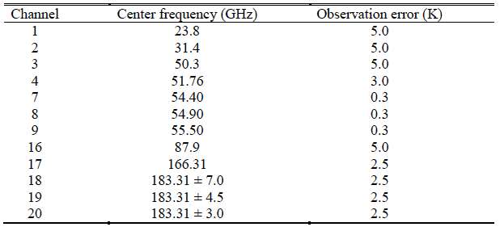
ATMS Channel Selection
clear-sky error for now
Ch 1-2: sensitive to cloud liquid droplets and rain
Ch 7-9: provides information about the warm core of hurricane
Ch 16: helps identify the location of the deepest convection through a scattering signal from precipitation-sized ice particles
Ch 17-20: water vapor channels make moisture sounding possible in clear-sky regions
Notes:
Ch 1-2: sensitive to cloud liquid droplets and rain
Ch 7-9: provides information about the warm core of hurricane
Ch 16: helps identify the location of the deepest convection through a scattering signal from precipitation-sized ice particles
Ch 17-20: water vapor channels make moisture sounding possible in clear-sky regions

