Slide 1


The Impacts of Numerical Schemes on Asymmetric Hurricane Intensification
Steve Guimond
Univ. of Maryland/NASA GSFC

Slide 2
Problem and Motivation
Hurricanes are complex, nonlinear natural systems
  Physical processes span several orders of magnitude
  Predictive capability for intensity is poor
  Interactions between numerics and physics, large errors
Notes:
Point out that track is largely a synoptic scale problem, we understand and can model it well. Intensity combines nonlinear interactions among all scales and this is poorly forecast.

Slide 3
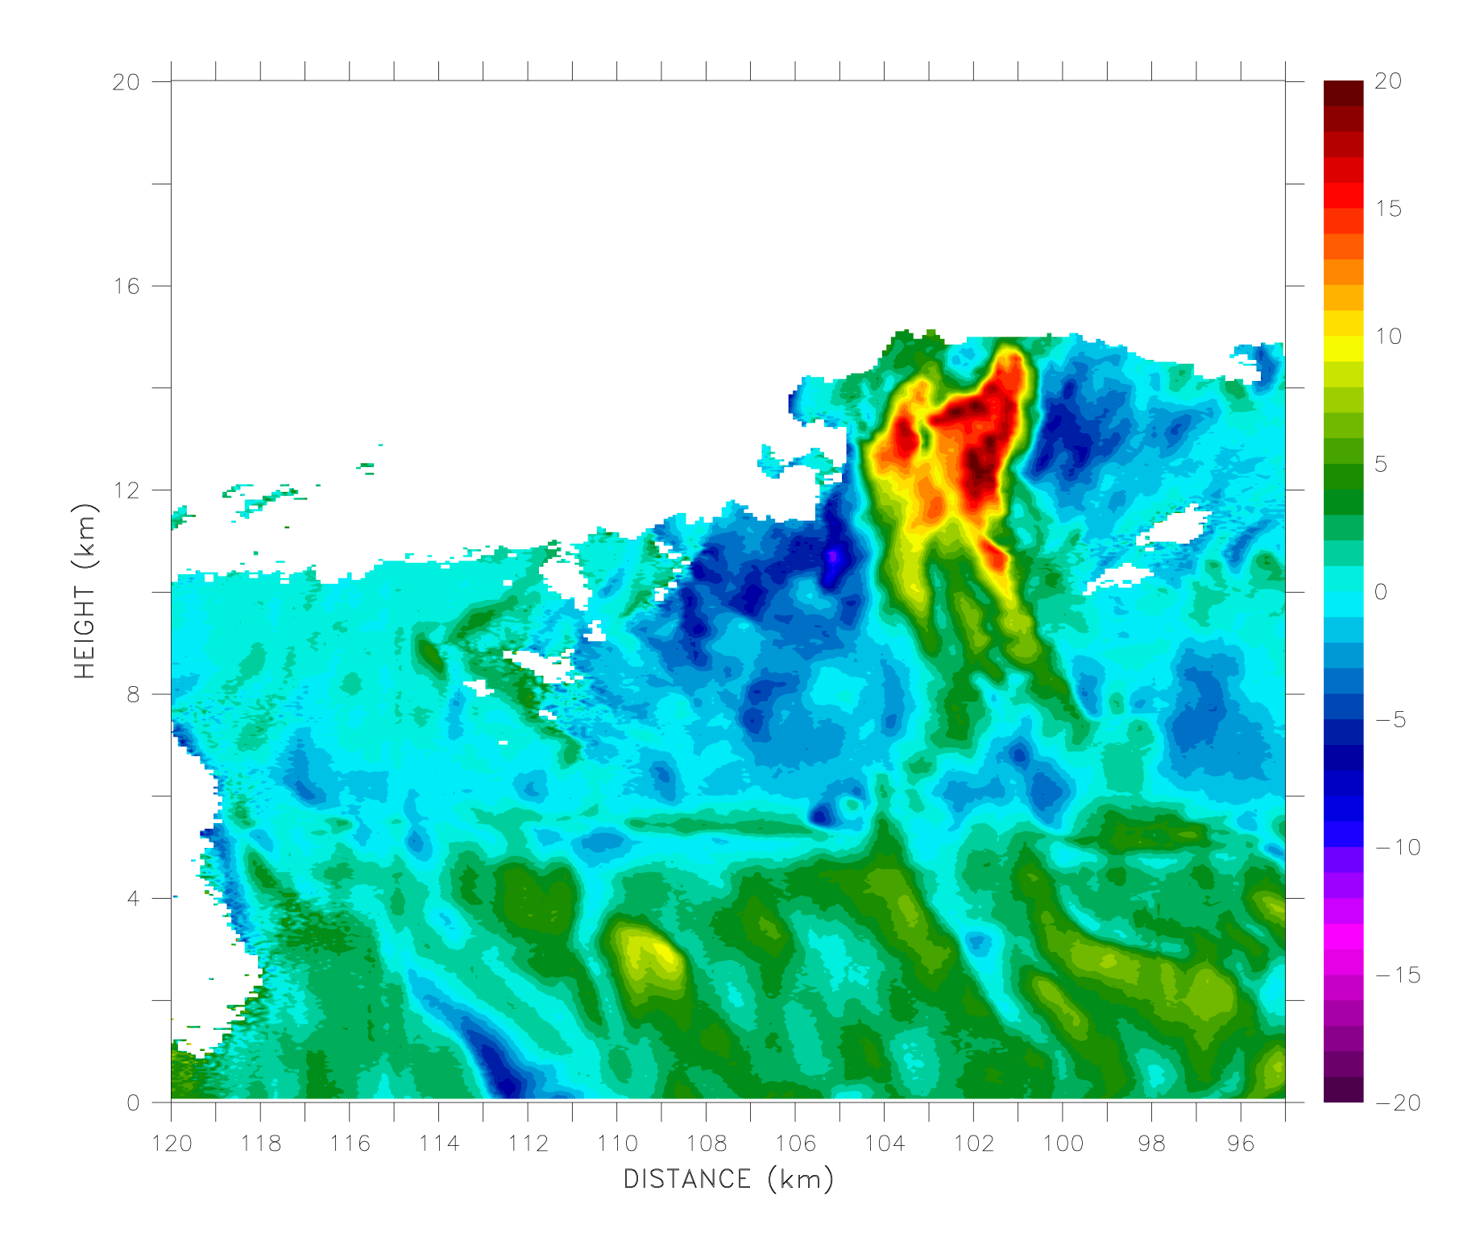
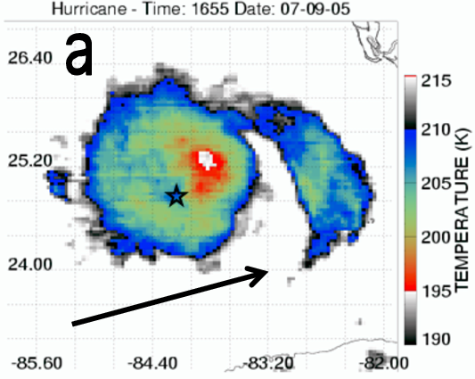
Drivers of Hurricane Intensity Change
Hurricane Dennis (2005)
EYE
    Guimond et al. 2010, J. Atmos. Sci.
Notes:
Asymmetric processes are found to be negligible because the developing vorticity anomalies extract energy from the vortex before returning energy to the vortex through the axisymmetrization process. Thus, the net effect of asymmetric heating is negligible. This is for the LINEAR case.

Slide 4
Hurricane Karl (2010) during NASA GRIP
Low wind shear ( ~ 5 m/s )
Warm SSTs
Notes:
Mention the time period covered by Global Hawk and P3. Mention the 2 h P3 coverage between black lines in wind plot.

Slide 5
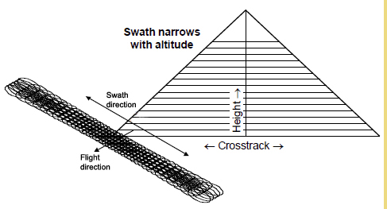
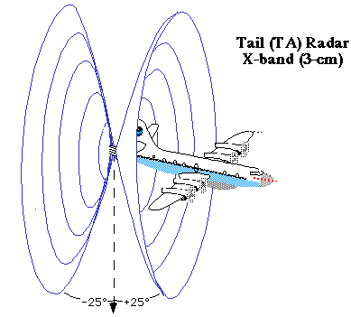
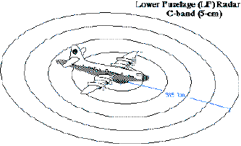
Hurricane Karl (2010) during NASA GRIP
HIWRAP
HAMSR
From JPL
600 – 700 m (along-track)
150 m (gate spacing)
1 km retrieval products
Sensitive to Temp & Precipitation
~ 2 km resolution, ~ 60 km swath width
NOAA P3 TA & LF Radars
X-band & C-band
large coverage area
2 km retrieval products
From NOAA

Slide 6
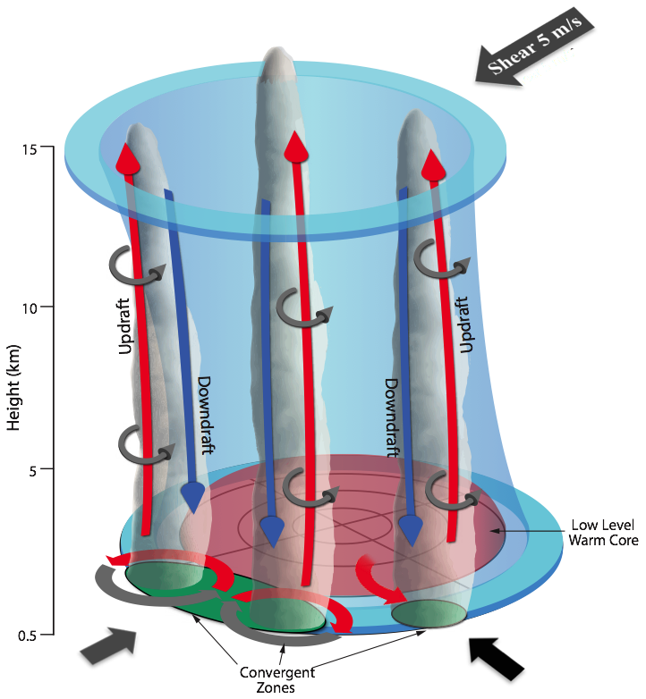
Organization of Stochastic Forcing
    Guimond et al. 2016, J. Atmos. Sci.
Notes:
Asymmetric processes are found to be negligible because the developing vorticity anomalies extract energy from the vortex before returning energy to the vortex through the axisymmetrization process. Thus, the net effect of asymmetric heating is negligible. This is for the LINEAR case.

Slide 7
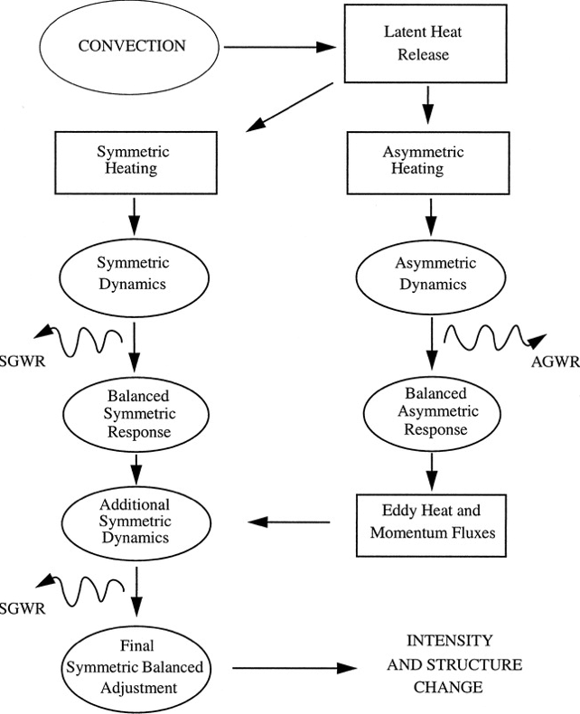
Dynamics of Hurricane Intensity Change
  Nolan and Montgomery (2002;NM02)
  Nolan and Grasso (2003;NG03)
  Nolan et al. (2007)
“Axisymmetrization”
Notes:
Asymmetric processes are found to be negligible because the developing vorticity anomalies extract energy from the vortex before returning energy to the vortex through the axisymmetrization process. Thus, the net effect of asymmetric heating is negligible. This is for the LINEAR case.

Slide 8
Dynamics of Hurricane Intensity Change
  Nolan and Montgomery (2002;NM02)
  Nolan and Grasso (2003;NG03)
  Nolan et al. (2007)
Dominates by 10²
Notes:
Asymmetric processes are found to be negligible because the developing vorticity anomalies extract energy from the vortex before returning energy to the vortex through the axisymmetrization process. Thus, the net effect of asymmetric heating is negligible. This is for the LINEAR case.

Slide 9
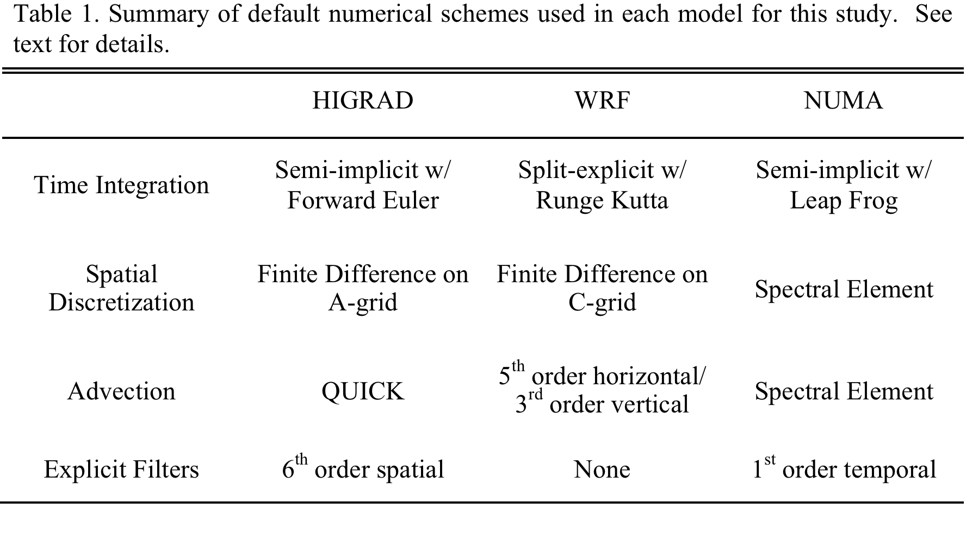
Dynamical Cores

Slide 10
Numerical Model Setup
      3D, compressible Euler equation set
      800 km² box, grid spacing of 2 km
        NUMA (5th order polynomials, 80 elem in x/y, 12 in z)
      60 vertical levels at ~ 333 m resolution
      WRF upper damping layer added to HIGRAD and NUMA
      Same Coriolis frequency (5.0 x 10⁻⁵ s⁻¹)
      No dissipation of momentum at lowest level
      Doubly Periodic BCs
      Turbulent diffusion – very simple
        Laplacian operator
        Eddy viscosity/diffusivity = 150 m²/s in x/y/z

Slide 11
Initial Conditions
WN3

Slide 12
20 K Perturbation Results
WN0
WN3

Slide 13
20 K WN3 Perturbation Results
HIGRAD
WRF
NUMA
LF2
NUMA
ARK2B
Notes:
Note: tried many perturbation amplitudes and wavenumber asymmetries in range of 1 K – 30 K and WN1 – WN5 and the results are generally robust. 20 K WN3 case is used here as a typical example.

Slide 14
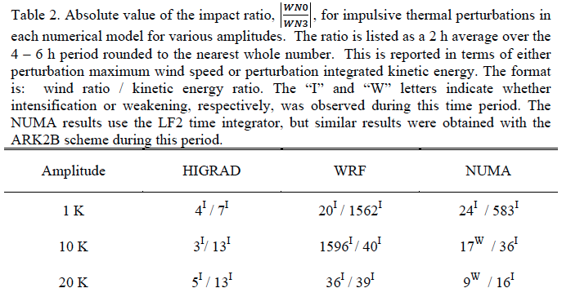
WN3 Perturbation Results

Slide 15
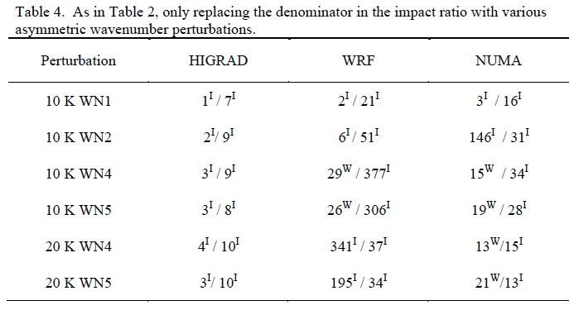
Testing other Asymmetries

Slide 16
Understanding Differences
Model configuration sensitivity tests
  Grid spacing, domains, boundary conditions, gravity wave absorption, initialization, perturbation magnitude and location, explicit diffusion, etc.
Angular and Radial Momentum Budgets
Model Solution Sensitivity Analysis
Spectral Kinetic Energy Budgets and Analysis

Slide 17
Spectral Dynamics
Compare kinetic energy (KE, per unit mass) spectra
  X-direction FFTs for velocity (perturbations)
  Average in y-direction and up to damping layer
  Decomposed into rotational and divergent modes
Compare spectral KE budgets (shown later)

Slide 18
Kinetic Energy Spectra: 20 K WN3
0.5 h
1 h
3 h
6 h
Notes:
Put slides showing evolution of KE Spectra in WRF with perturbation.

Slide 19
Kinetic Energy Spectra: 20 K WN3
HIGRAD
NUMA LF2
NUMA ARK2B
Notes:
Put slides showing evolution of KE Spectra in WRF with perturbation.

Slide 20
Spectral Kinetic Energy Budgets

Slide 21
Spectral Kinetic Energy Budgets
For 20K WN3 theta perturbation
upscale transfer
WRF
HIGRAD
NUMA ARK2B
NUMA LF2
Notes:
Storage tendency is negative because KE is decaying with time due largely to PGF. Remember: heating input is only initial condition. Peak differences between WRF/HIGRAD in storage term are ~ 6 units (~ 18 units for WRF and ~ 12 units for HIGRAD). This amounts to…6 / ((18 + 12)/2) = 40 %. Vortex intensity is different (HIGRAD more intense than WRF) because pressure fluctuations are different. WRF removes more energy due to pressure fluctuations, which makes HIGRAD stronger relative to WRF. Vortex intensifies from heating because there is transfer of energy upscale from the heating scale up to the vortex scale.

Slide 22
Spectral Kinetic Energy Budgets
WRF
HIGRAD
NUMA ARK2B
NUMA LF2

Slide 23
Summary
  Impulsive thermal asymmetries in vortex intensification…
    Important, largely positive impact in HIGRAD/NUMA.
    Negligible impact in WRF.
  Spectral dynamics
    WRF removes more kinetic energy than HIGRAD/NUMA due to pressure term (inertia-gravity wave activity).
    Energy moves upscale with time from nonlinear effects.
  Guimond, S., J. Reisner, S. Marras and F. Giraldo 2016: The impacts of dry dynamic cores on asymmetric hurricane intensification. J. Atmos. Sci., in review.

Slide 24
Implications
  WRF has more numerical dissipation than HIGRAD/NUMA for this problem.
  Indicates significant uncertainty in hurricane intensification understanding and potentially prediction.
  What about more realistic regime?
    Realistic heating, moisture, turbulence
  What about HWRF (NMM dynamic core)?
    Evaluate forecasts with spectral dynamics/scale interactions
      Use higher resolution/re-analysis/obs for truth
      Various physics packages and data assimilation

Slide 25
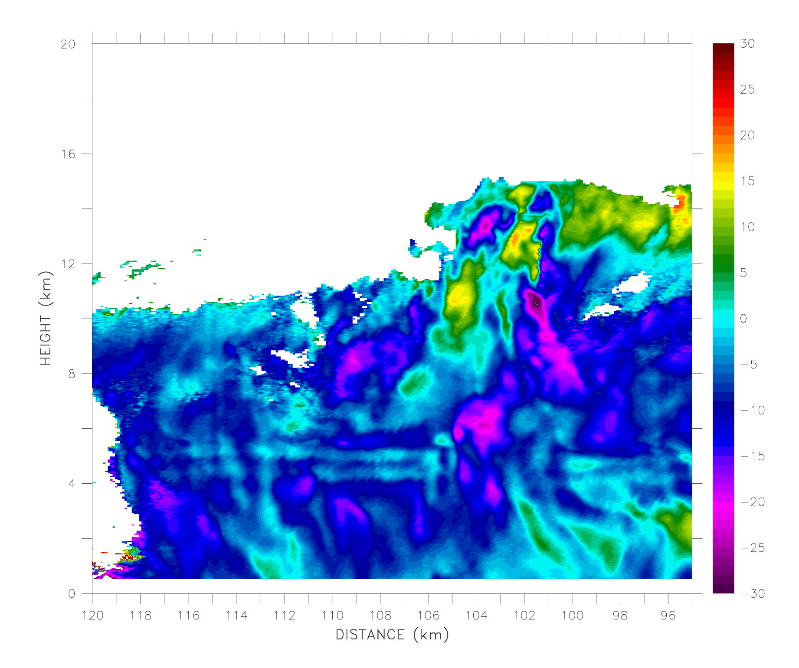
Ongoing Work: Impact of Asymmetric Mode in Turbulent, Observational Regime
EDOP Observations (Guimond et al. 2010)
100 m horizontal, 37.5 m vertical sampling
Turbulent Eddies
EYE

Slide 26
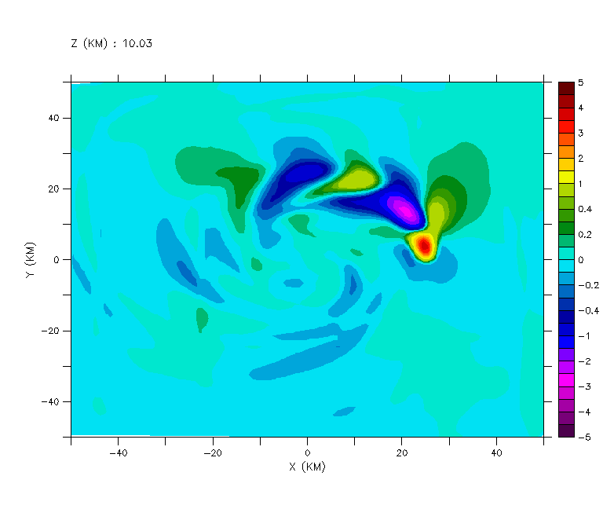
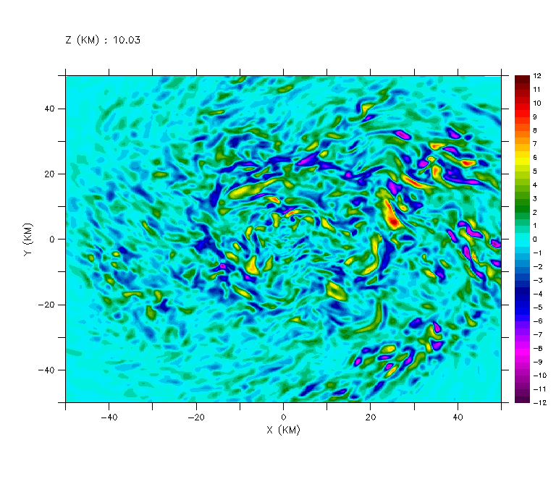
Ongoing Work: Impact of Asymmetric Mode in Turbulent, Observational Regime
Vertical velocity at 10 km height using EDOP heating pulse for (A) 1 km resolution and (B) 200 m resolution
A
B
Will LES runs produce -5/3 spectral slope and up-scaling effects? What is the role of symmetric/asymmetric processes in this regime?

Slide 27
Acknowledgements
I am grateful to Institute of Geophysics, Planetary Physics and Signatures (IGPPS) at LANL for support.
Jon Reisner for many discussions and support.
Simone Marras and Frank Giraldo for NUMA help.
Dave Nolan (Univ. Miami) for initial conditions and discussions.
Discussions with Michael Waite, Paul Reasor, George Bryan, Bill Skamarock and Mike Montgomery.
Three anonymous JAS reviewers.

Slide 28
Backup Slides

Slide 29
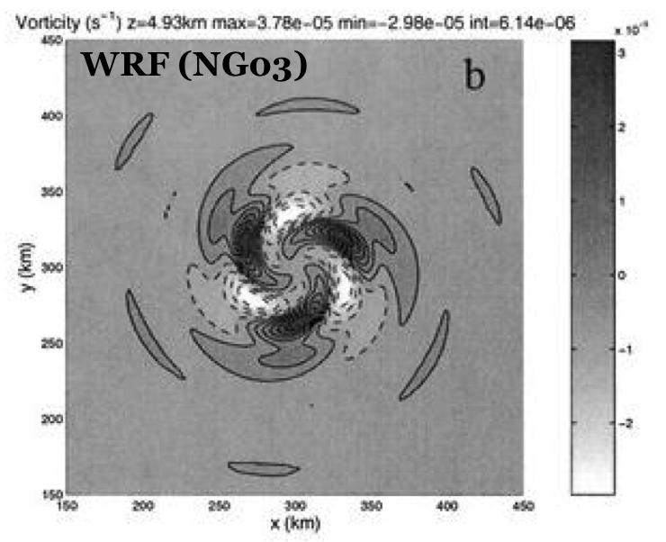
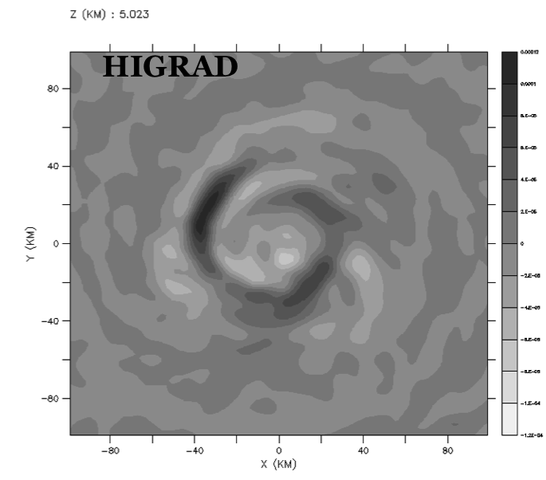
Vorticity: HIGRAD and WRF
K = 40 m² s⁻¹
K = 40 m² s⁻¹
Max = ~ 4 x 10⁻⁵ s⁻¹
Max = ~ 2 x 10⁻⁴ s⁻¹

Slide 30
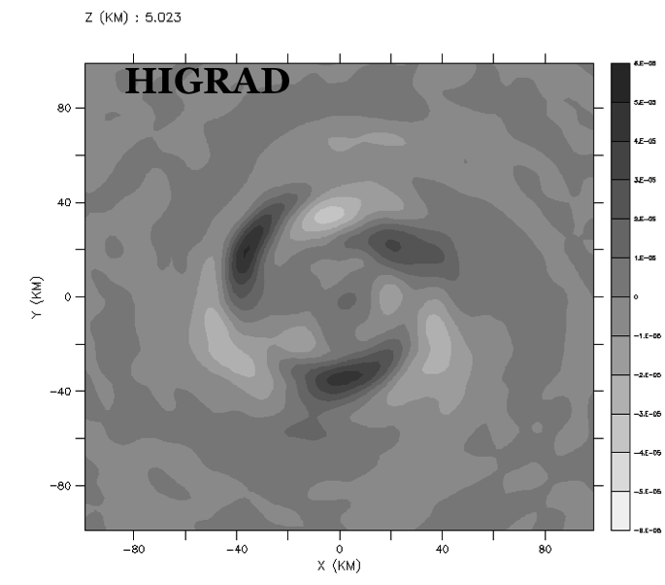
Vorticity: HIGRAD and WRF
K = 40 m² s⁻¹
K = 100 m² s⁻¹
Max = ~ 4 x 10⁻⁵ s⁻¹
Max = ~ 7 x 10⁻⁵ s⁻¹

Slide 31
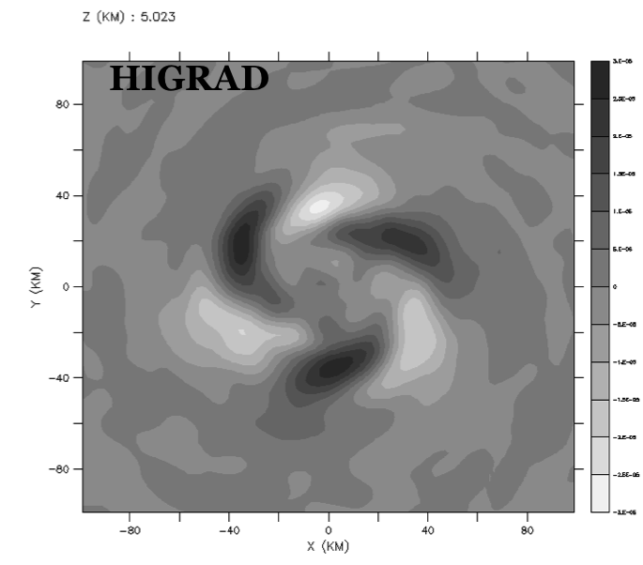
Vorticity: HIGRAD and WRF
K = 40 m² s⁻¹
K = 200 m² s⁻¹
Max = ~ 4 x 10⁻⁵ s⁻¹
Max = ~ 3 x 10⁻⁵ s⁻¹

Slide 32
Numerical Model
    HIGRAD (Reisner et al. 2005; Reisner and Jeffery 2009)
    Equation set…
    Discretization
      Temporal →semi-implicit (higher order an option)
      Space → finite volume on A-grid (non-staggered)
      No filters or damping added to numerics

Slide 33
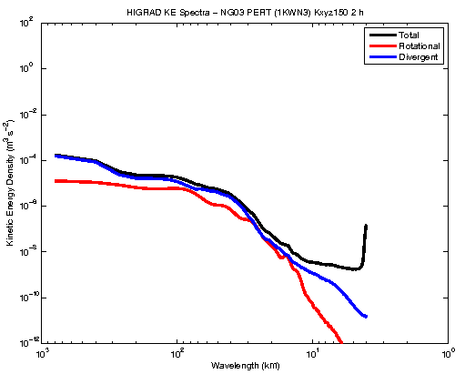
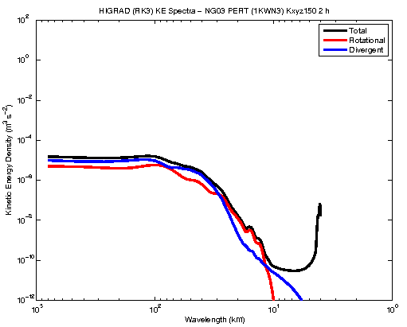
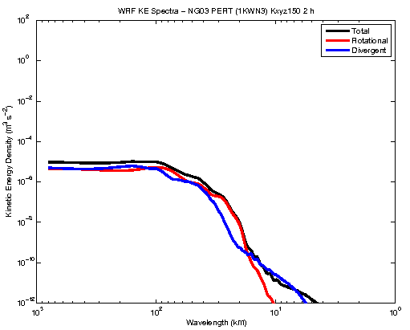
The Impact of Numerics: 2 hours
HIGRAD w/FCT, SI
HIGRAD no FCT, RK3
WRF 5th ADV, RK3
Very similar results to WRF using NO FCT and RK3 in HIGRAD

Slide 34
Which Results are Correct?
HIGRAD FCT results produce -5/3 spectrum and up-scaling of energy
HIGRAD NO FCT and WRF produce steep/damped energy spectrum
What is correct energy spectrum for this problem?
LES simulation using HIGRAD with NO FCT
    dx = 60 m, dt = 0.25 s, semi-implicit
    Slightly modified vortex/heating

Slide 35
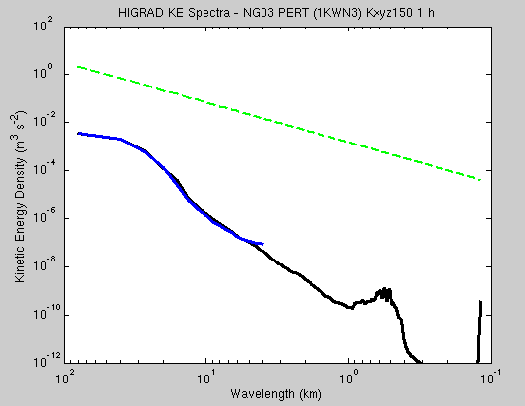
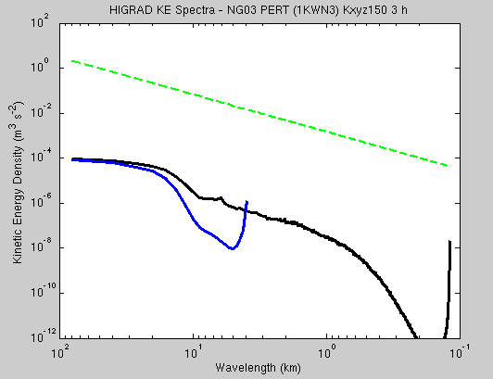
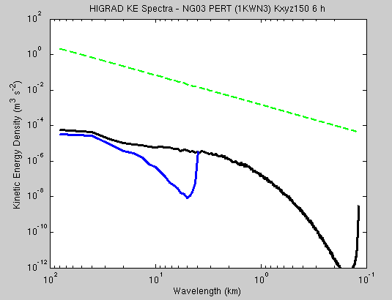
LES Results
1 h
3 h
6 h
Blue = 2 km
Black = 60 m

Slide 36
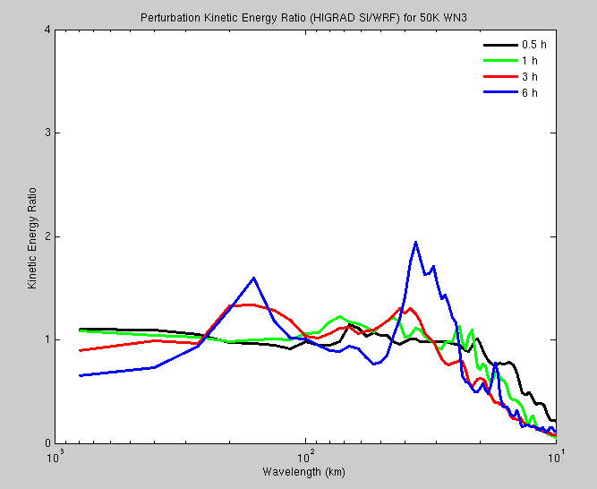
Kinetic Energy Evolution:
50K WN3 in HIGRAD/WRF/NUMA

Slide 37
Spectral Kinetic Energy Budgets
For 50K WN3 theta perturbation
Net removal of energy
HIGRAD WRF
Notes:
Storage tendency is negative because KE is decaying with time due largely to PGF. Remember: heating input is only initial condition. Peak differences between WRF/HIGRAD in storage term are ~ 12 units (~ 87 units for WRF and ~ 75 units for HIGRAD). This amounts to…12 / ((87 + 75)/2) = 15 %. 20K heating differences were ~ 40%. Vortex intensity is the same for both models here because pressure fluctuations are about the same. Vortex weakens from heating because there is a net removal of energy by advective nonlinearities at the scales of vortex.

